Slide 1





Homo vitro fragilior
Peter G. Wolynes
Rice University
AJL @ 80
University of Illinois at Urbana-Champaign
March 2018

Slide 2
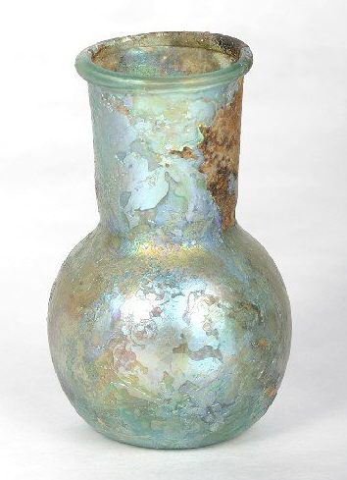
Nonne fragiLIOrES sumus, quam si vitrei essemus? vitrum enim etsi fragile est, tamen servatum diu durat: et invenis calices ab avis et pro avis, in quibus bibunt nepotes et pronepotes.
St. Augustine
Are we not frailer than if we were of glass? For even if glass is fragile, yet if cared for, it lasts a long time and you find grandsons and great-grandsons drinking out of the cups of their grandfathers and great-grandfathers.

Slide 3
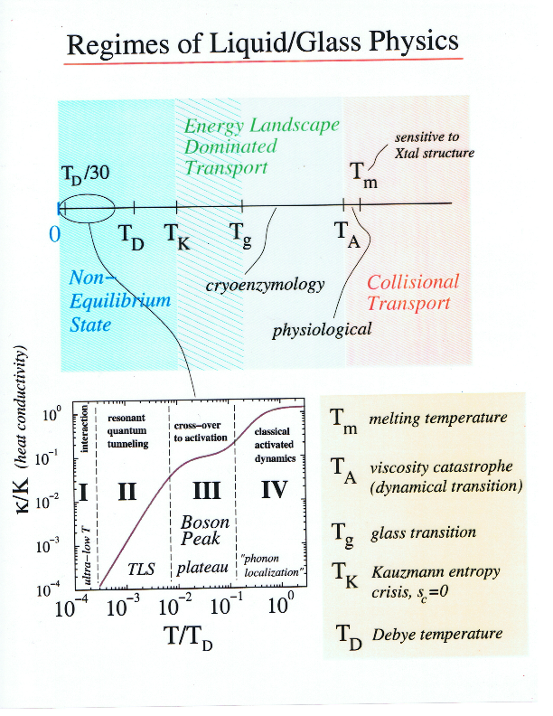

Slide 4
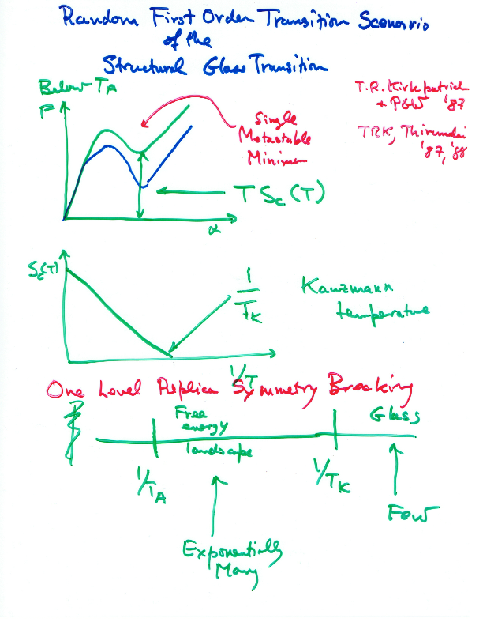

Slide 5
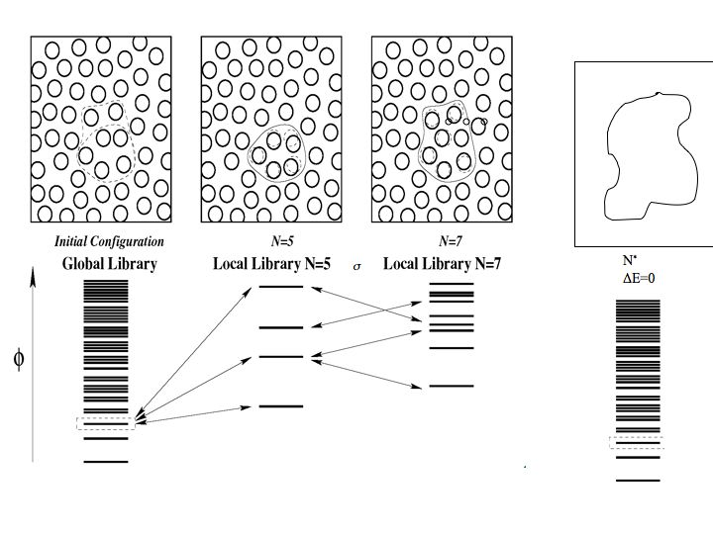
Crystallization vs. Glassy Dynamics
crystallite
N^{1/3}
critical nucleus size
F
large surface cost
N
F(N) = - Ts_{c}N + ΓN^{1/2}
F(N) = -Δƒ N + γ N^{2/3}
Notice no energy gap.
Γ²
(ΔE_{s} - TS_{c}),
Δ F‡ =
Free energy gap
4Ts_{c}
Crystal nucleation barrier depends on T_{F} - T
Glassy Barrier depends on Ts_{c} alone!

Slide 6
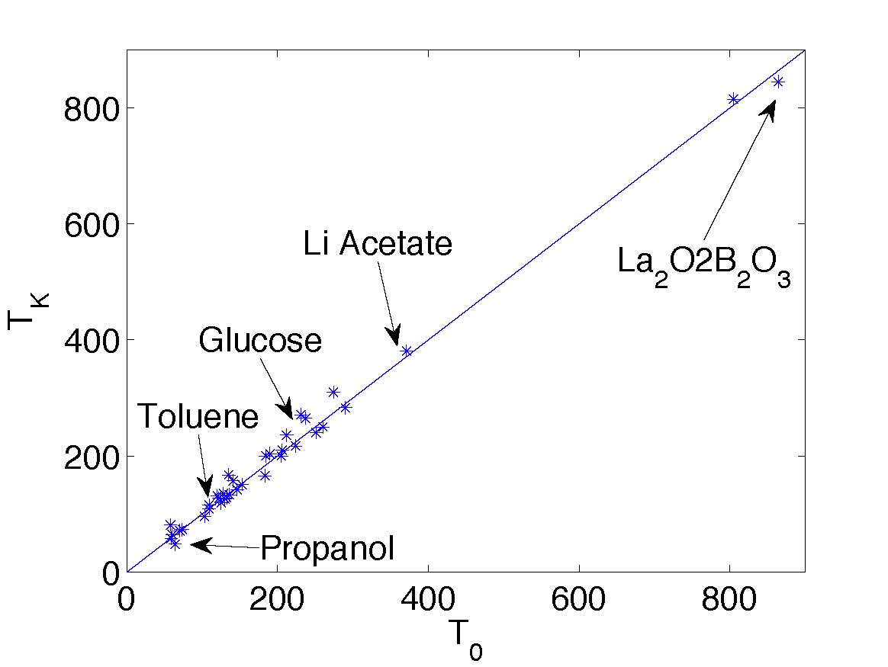
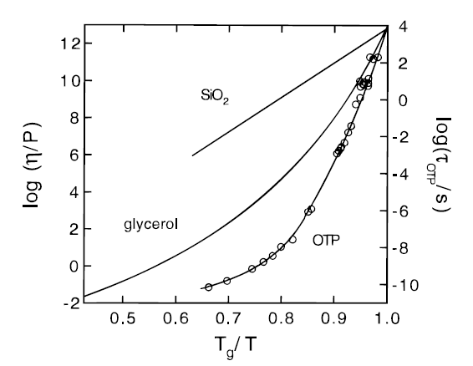
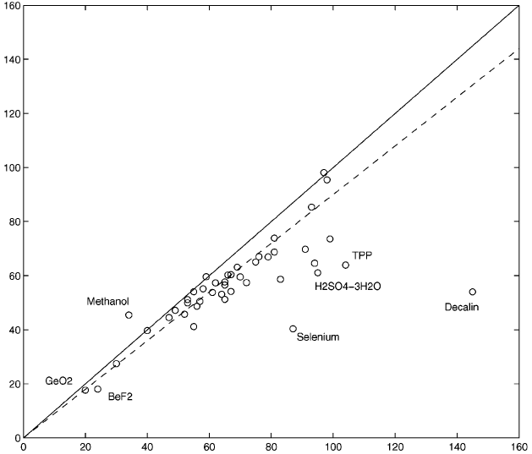
Glassy Dynamics from a Mosaic of Energy Landscapes
Super Arrhenius temperature dependence of rates
RFOT theory predicts fragility parameter, m
Temperature of Vanishing Entropy
Lubchenko and Wolynes, Annu. Rev. Phys. Chem. 2007, 85:235-66.
m from RFOT
Notice no data extrapolation or fitting needed for this comparison.
m from experiment

Slide 7
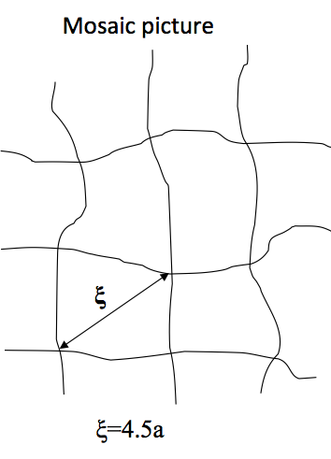
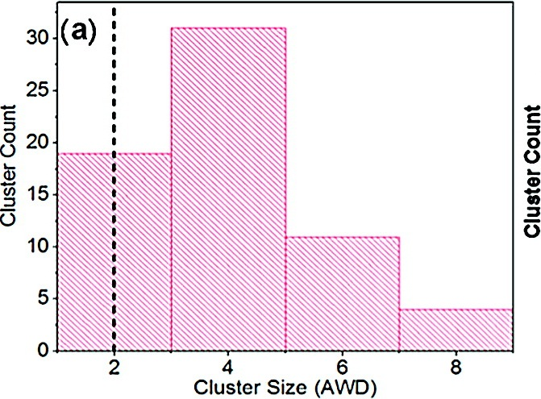
RFOT predictions of CPR size agree with experiment
Berthier et al. Science (2005) 310, 1797
Data from:
Bohmer et al. J. Chem. Phys. (1993) 99, 4201

Slide 8
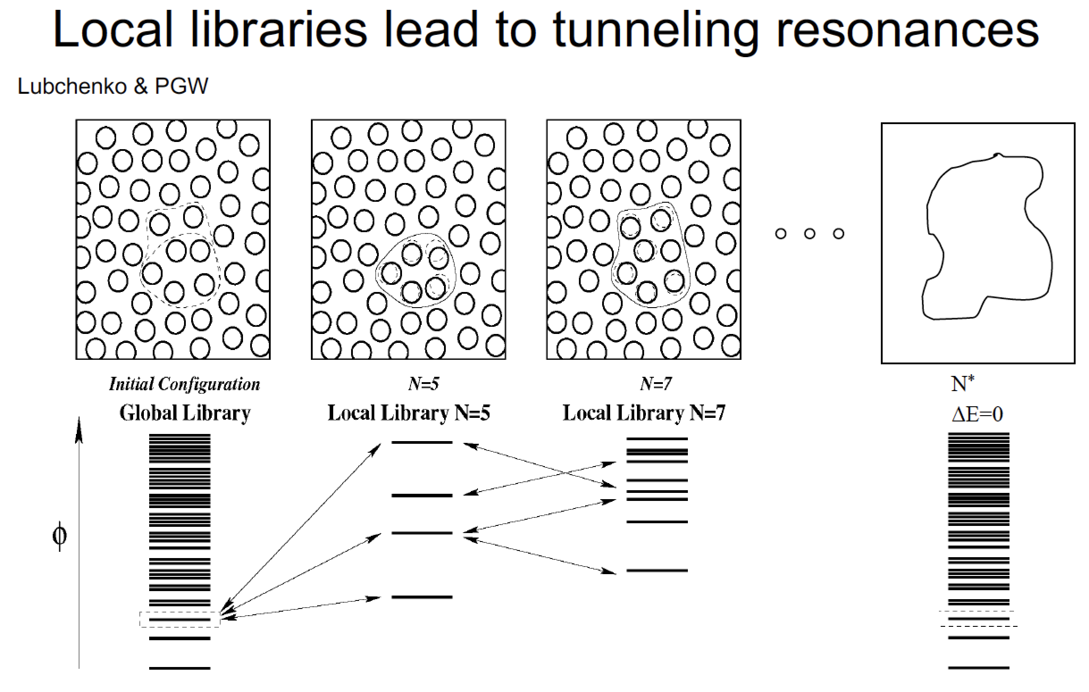
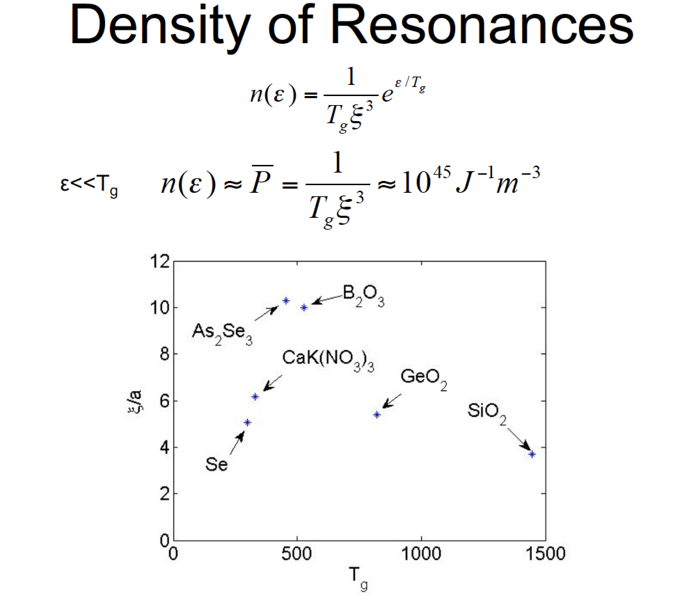

Slide 9
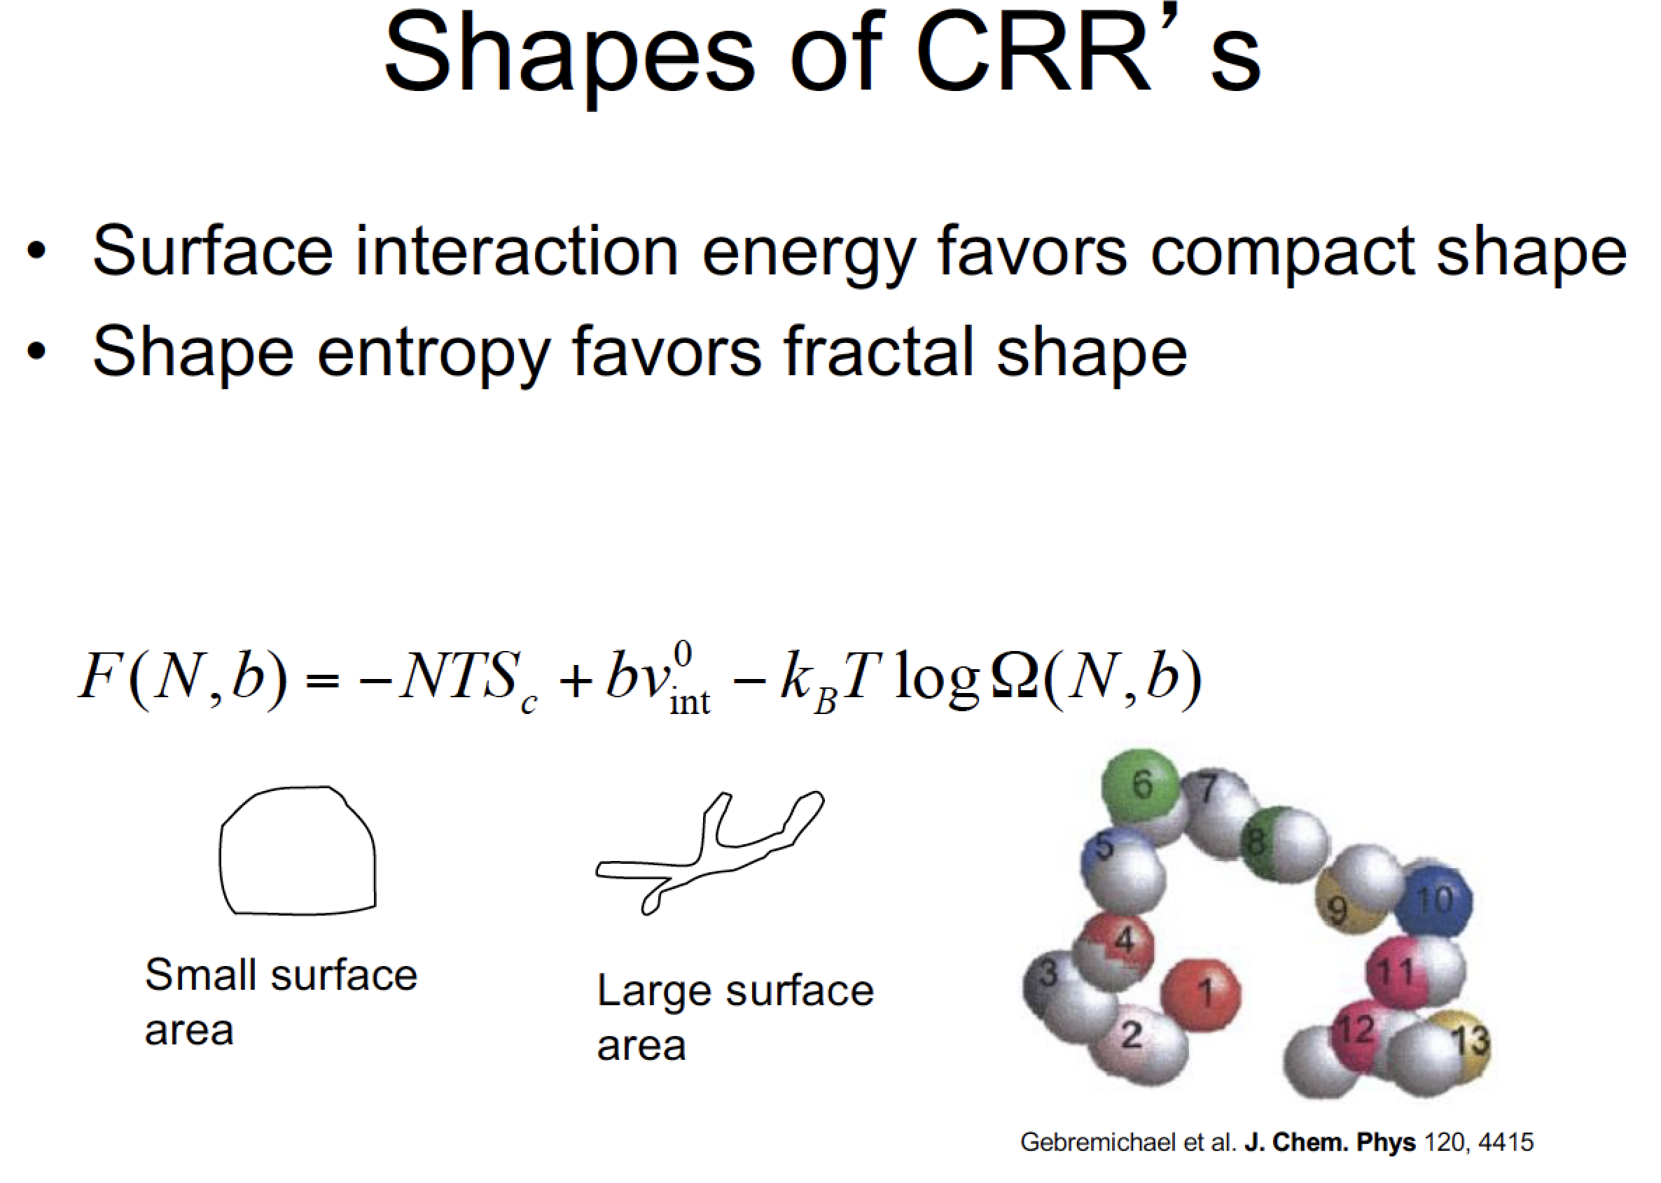
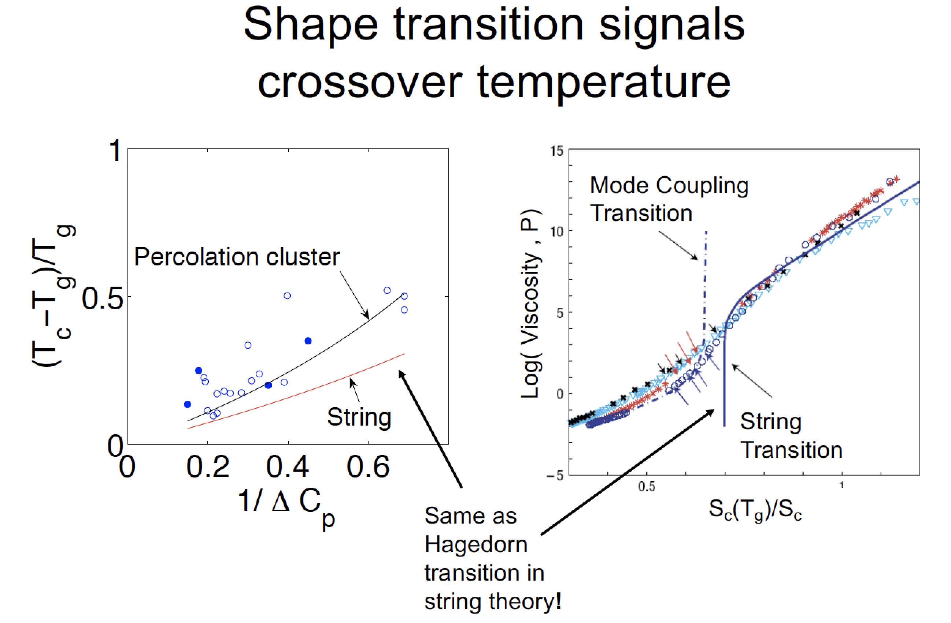

Slide 10

Prince Rupert’s Drop

Slide 11
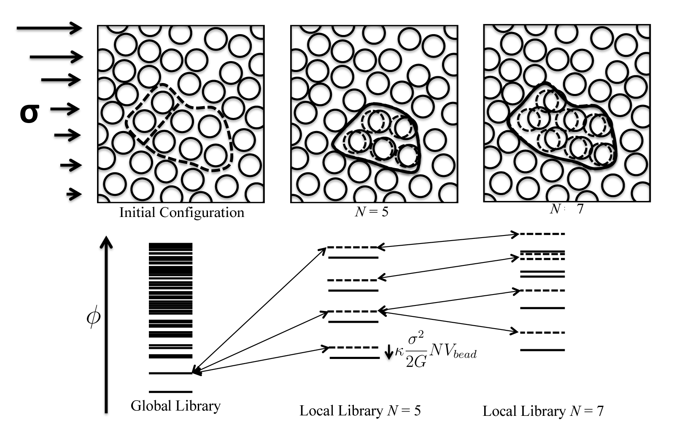
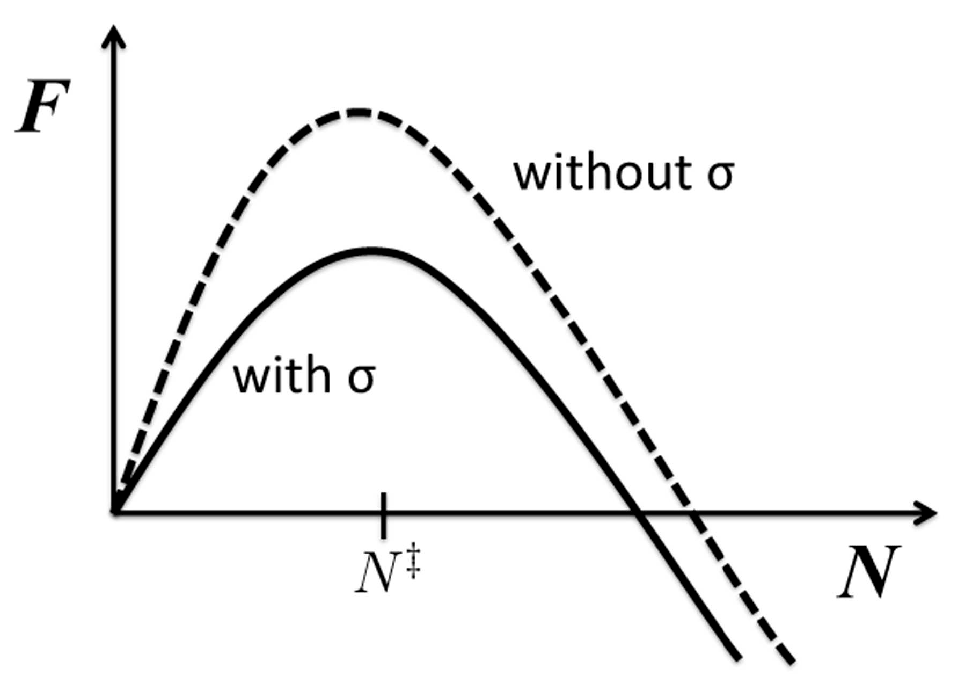
Stress shifts the landscape!
A. Wisitsorasak and PGW 2012

Slide 12
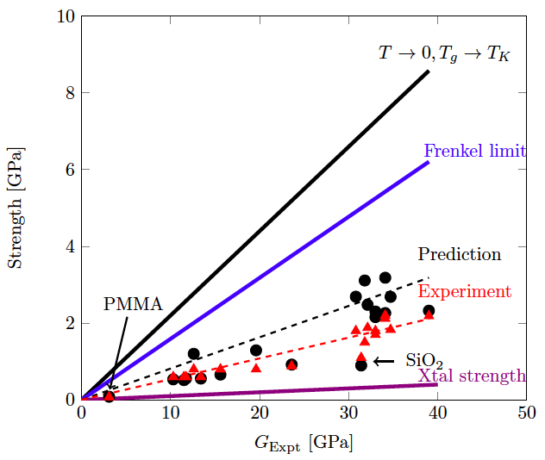
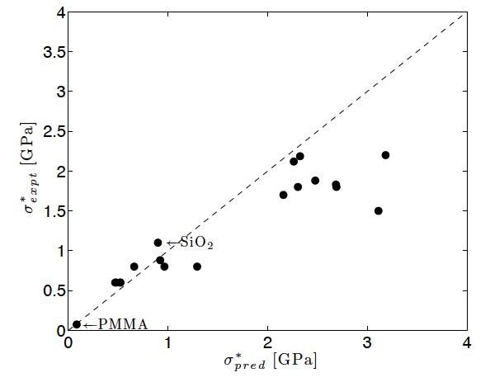
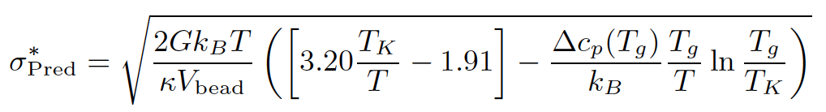
RFOT Theory Predicts Limiting Strength
of Glasses
A. Wisitsorasak and PGW 2012

Slide 13
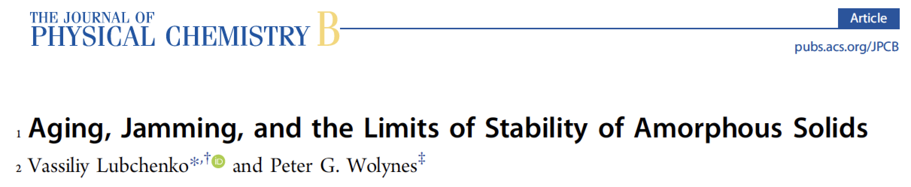
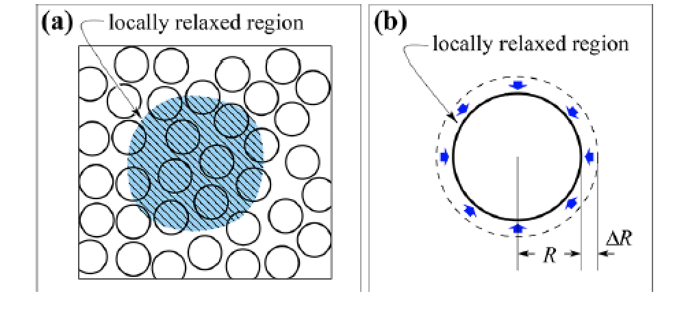
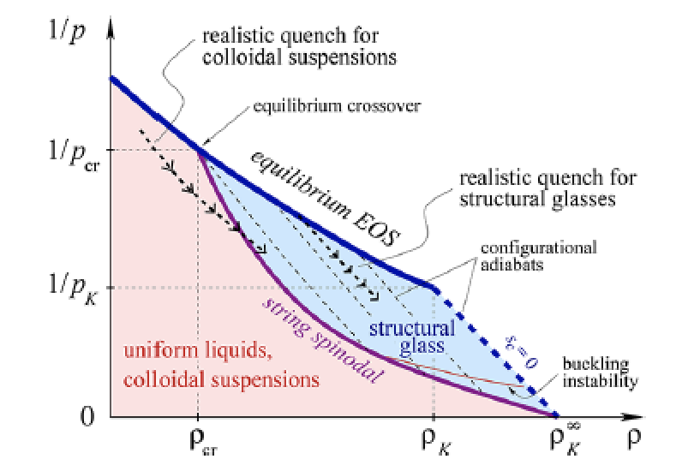
INSERT? . ..

Slide 14
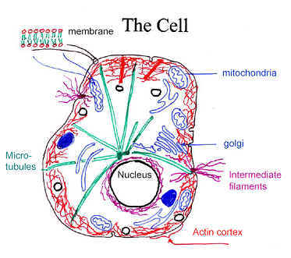
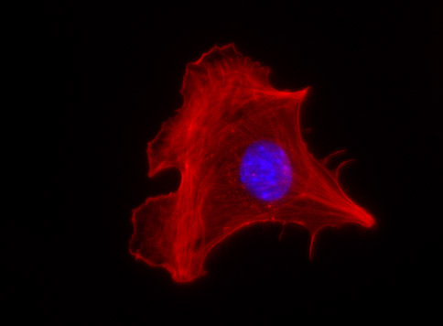
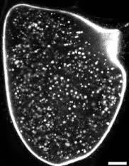
The Cell is a Marginally Stable Glass
Bulk
Filamentous network
Structure and shape
Remodeling
Polar filaments
track for molecular motors
directed motion
Cytoplasm
Cytoplasmic streaming
Crowded by organelles
W.M. Saxton

Slide 15


Slide 16
Backup Slides

Slide 17
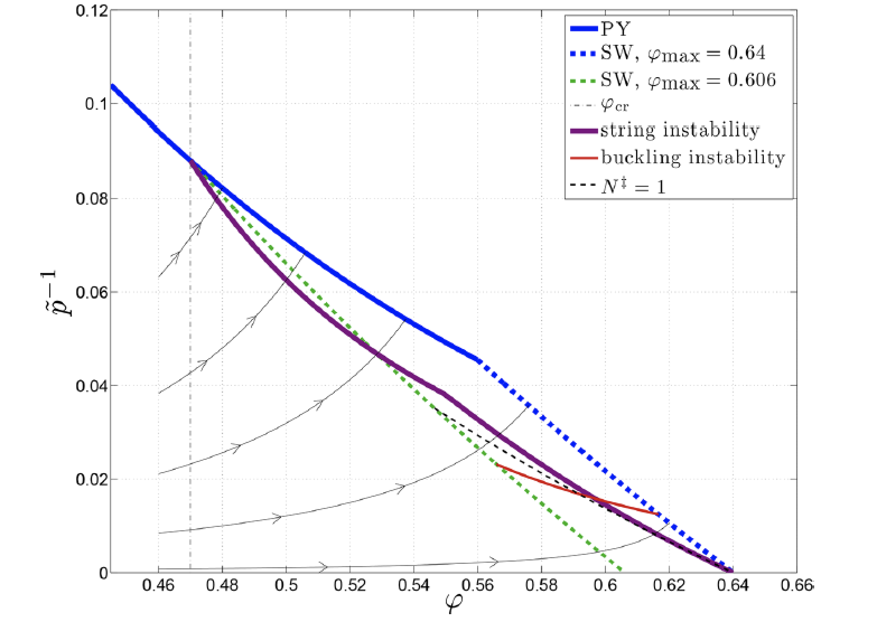

Slide 18
Confrontation of Classical RFOT Theory with Observation

Slide 19
Confrontation of Classical RFOT Theory with Observation
Mobility Transport 2008 ✓ rejuvenation front dynamics predicted
Secondary Relaxations 2009 ✓ a. nearly Arrhenius
✓ b. grow in amplitude as T_{c} is approached
Surface Glass Transitions 2008 ✓ halved activation energy
Crystallization Dynamics 2010 ✓ new mechanisms of crystal growth and nucleation near T_{g}

Slide 20
Some Relationships of RFOT Theory with Other Approaches
RFOT
Theory
(Microscopic) Mode
Coupling Theory
Leutheusser, Götze
Strings,
Bhattacharya,
Bagchi, PGW
Phenomenological Mode
Coupling Theory
Yes, but a higher order effect
Facilitation
Andersen, etc.
Frustrated Phase Transitions- icosahedratics, etc.
Nelson, Kivelson, etc.

Slide 21
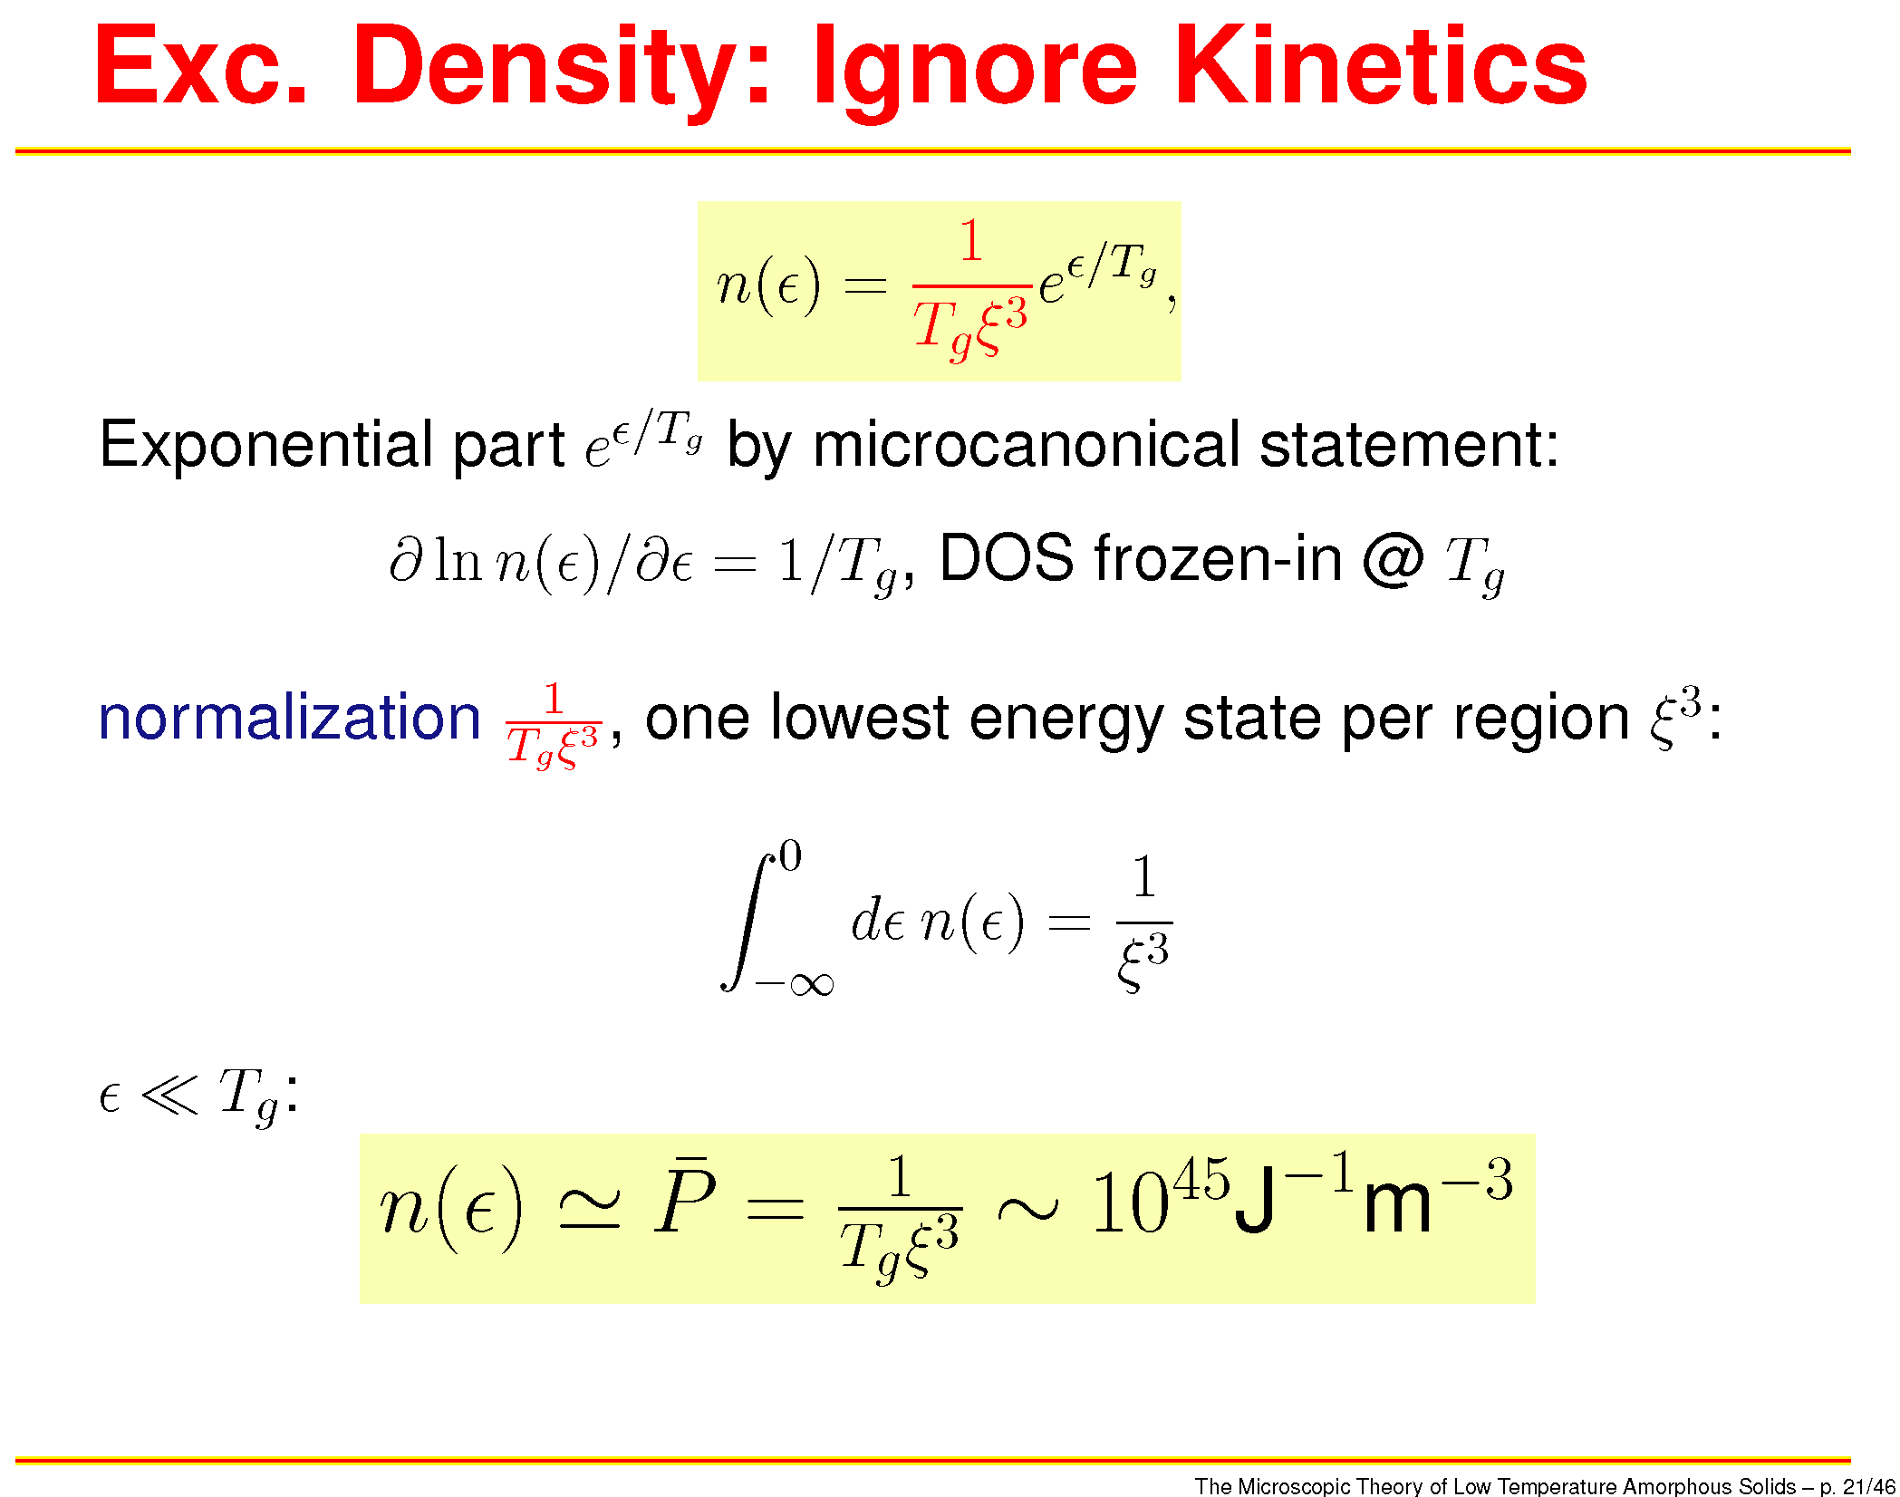
Density of Resonances

Slide 22
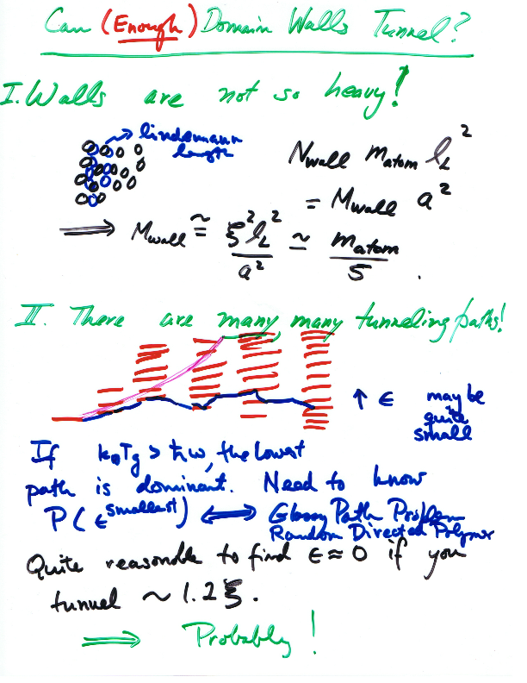

Slide 23
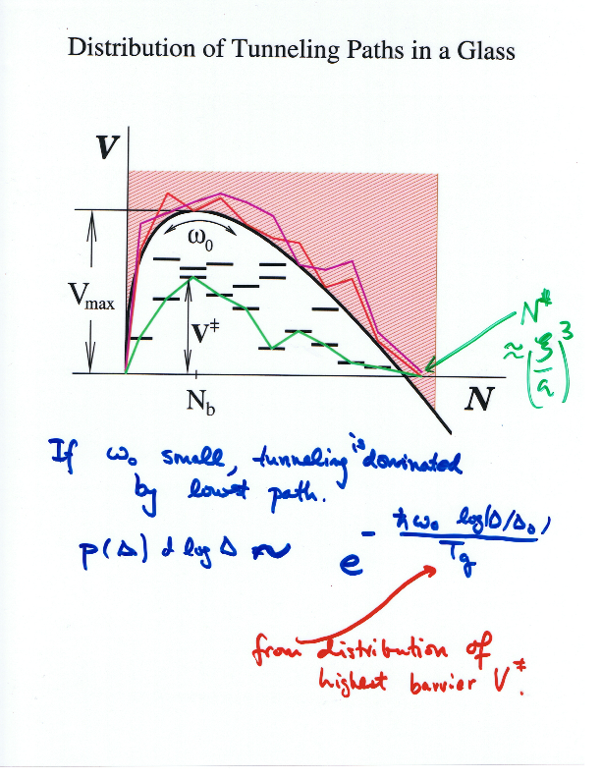

Slide 24
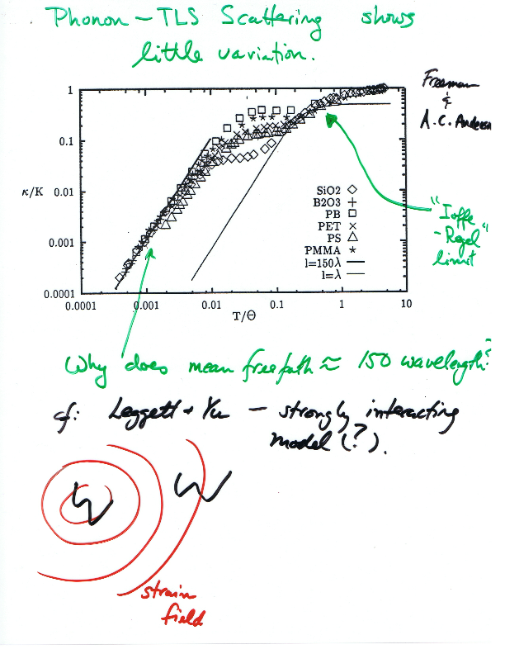

Slide 25
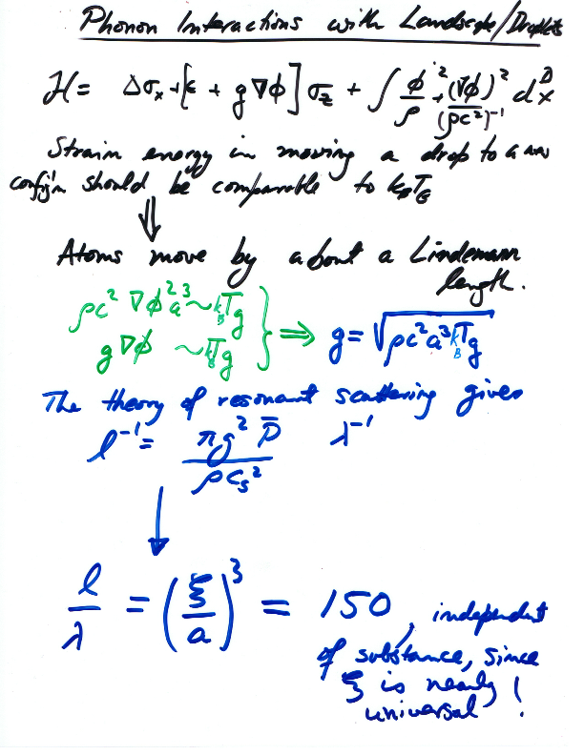

Slide 26
Stevenson and Wolynes, The Ultimate Fate of Supercooled Liquids (2010)
Crystallization and Glassy Dynamics
nanocrystallite
n_{ν} n_{α} n_{M}
Initial amorphous state
The crystal
n_{ν} n_{M} n_{α}
region size n

Slide 27
Crystallization and the Dynamical Mosaic
Low Temperature
High Temperature
ξ_{α} > ξ_{M}
ξ_{α} < ξ_{M}
ξ_{ν}
ξ_{M}
ξ_{α}
ξ_{M}
ξ_{α}
Percolative
Nanocrystallization
Classical
Turnbull Regime

Slide 28
New Mechanisms of Homogeneous Nucleation emerge near and deep below T_{g}
When critical crystal nucleus is bigger than dynamically correlated region, percolative nanocrystallization begins.
When nanocrystals percolate fully, complete decoupling of nucleation and growth from α relaxation!
Percolative Nanocrystallization
Turnbull
Stevenson and Wolynes, The Ultimate Fate of Supercooled Liquids (2010)

Slide 29
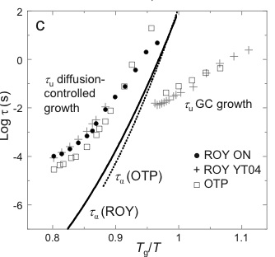
New Mechanisms of Crystal Growth emerge near T_{g}
3.5 orders of magnitude
4 orders of magnitude predicted change of crystal growth rate near T_{g}
Sun et al. J. Phys Chem B, Vol. 112, No. 18, 2008
Stevenson and Wolynes, The Ultimate Fate of Supercooled Liquids (2010)

Slide 30
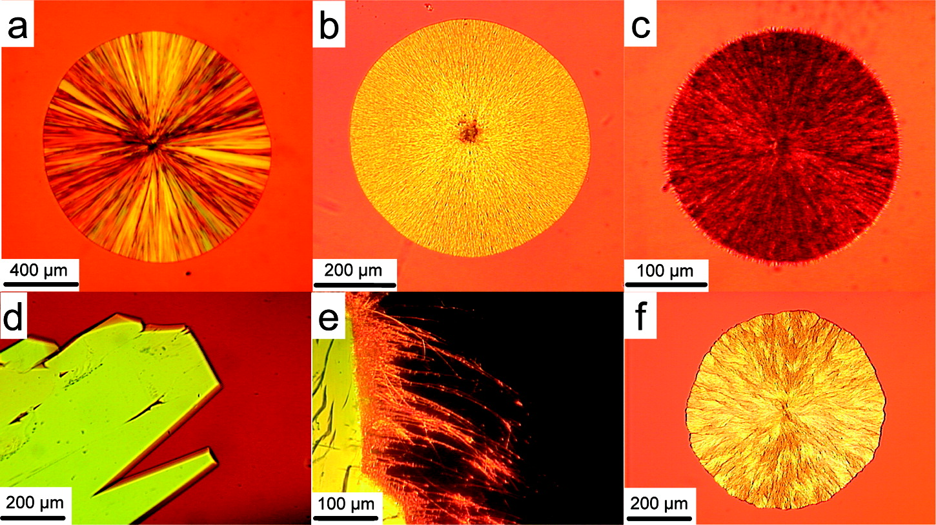
Sun et al. J. Phys Chem B, Vol. 112, No. 18, 2008
Spherulitic Crystallization near and below T_{g} in the Laboratory and the Field
Estimated Time of Formation:
50 years ~ 10²² picoseconds
~ 3m
Time of Formation:
5 hours ~ 10¹⁷ picoseconds
~ 3 m
Silver Cliff District, Colorado
Formed in Late Eocene to Early Oligocene
Smith et al. American Mineralogist, Vol. 86, 589-600, 2001

