Slide 1
Tony's Advocacy in Science Diplomacy and Human Rights: Impact & Global Guidance
Laura H Greene
National MagLab and FSU @LauraHGreene
AJL@80 31 Mar 2018 Urbana

Slide 2
Science Diplomacy
“Using the words and actions of science and communication between scientists to build a better world.”
Can effectively be applied towards Human Rights.
e.g., working across boarders and boundaries towards improving water resources, furthering agriculture, studying quantum materials,... AND increasing broad human communication and mutual understanding.
Note: Must be staunchly non-political

Slide 3
Tony Leading Science Diplomacy Since the 1970’s
Polish Winter Schools in Theoretical Physics:
The IXth in 1972, Karpacz
The XVIth in 1979, Karpacz
Organized by the Physics Department, University of Wroclaw
His lectures are published! Acta Universitatis Wratislaviensis

Slide 4
Some More of Tony’s Science Diplomacy
Teaching and research in many countries, e.g.,:
developing, such as Ghana
post developing, such as Singapore
Joined scientific groups to visit the FSU (Former Soviet Union) in 1986
More recently, spending ~ 1 month / year in China and Canada
And his trip to Iran with Warren & Paul in 2014...

Slide 6
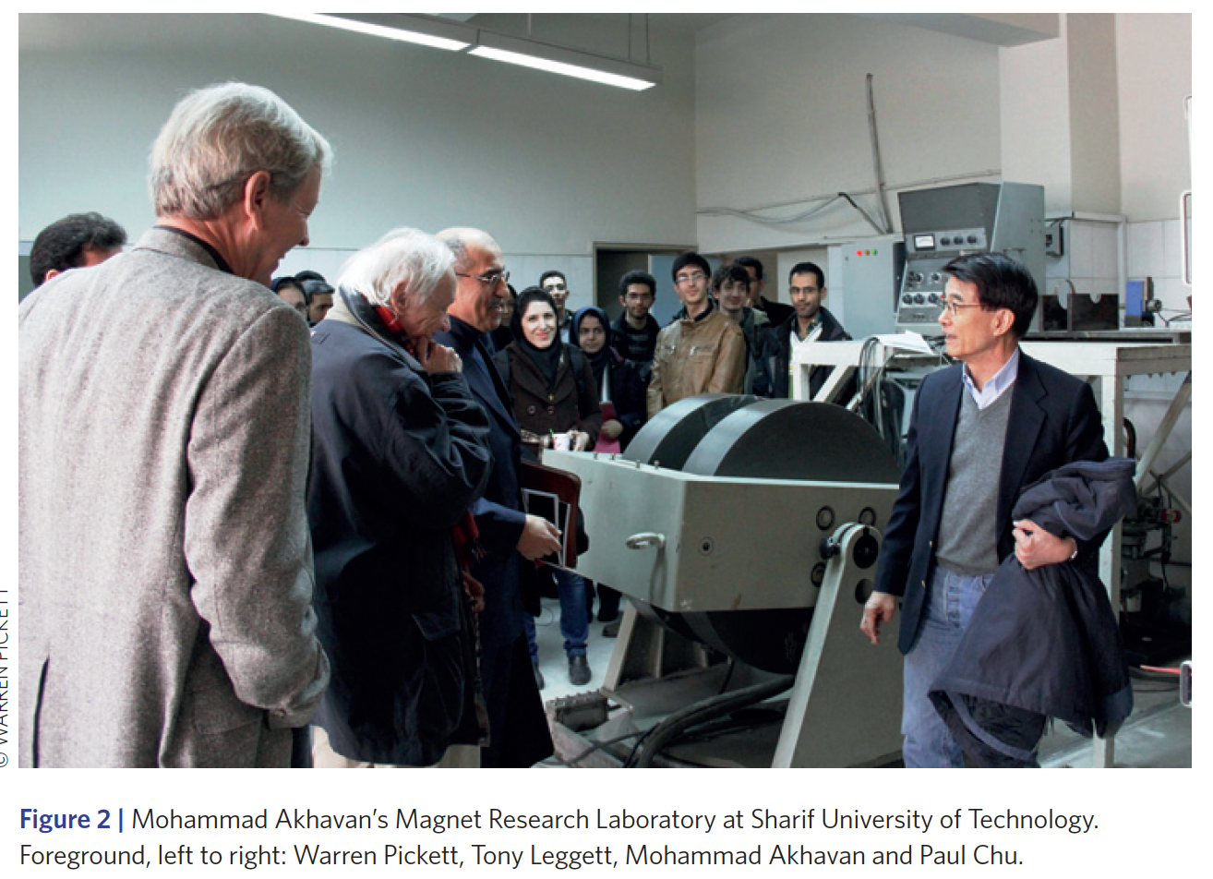
Nature Physics (2016)

Slide 7
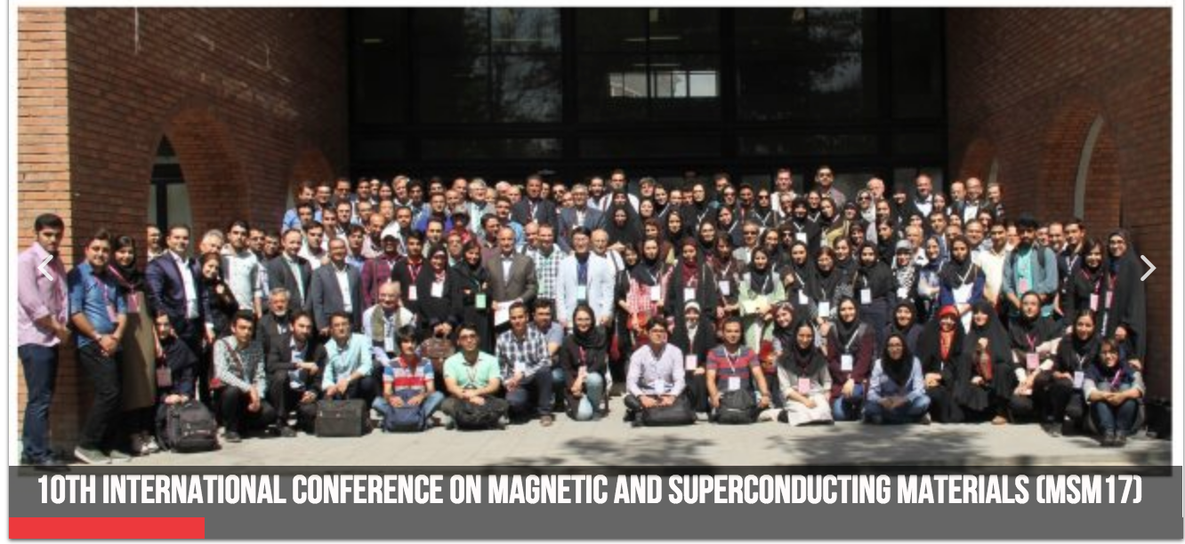
2017: A major setback in science diplomacy
From APS News, March 2018: “At the eleventh hour in September, the U.S. government blocked five scientists from four U.S. universities—ourselves and three of our colleagues—from traveling to Iran. We had been invited to attend and present scientific lectures at the 10th. International Conference on Magnetic and Superconducting Materials, MSM2017.” – Pickett & Greene
We were denied by the US Treasury Department under ITSR (Iranian Transactions and Sanctions Regulations)

Slide 8
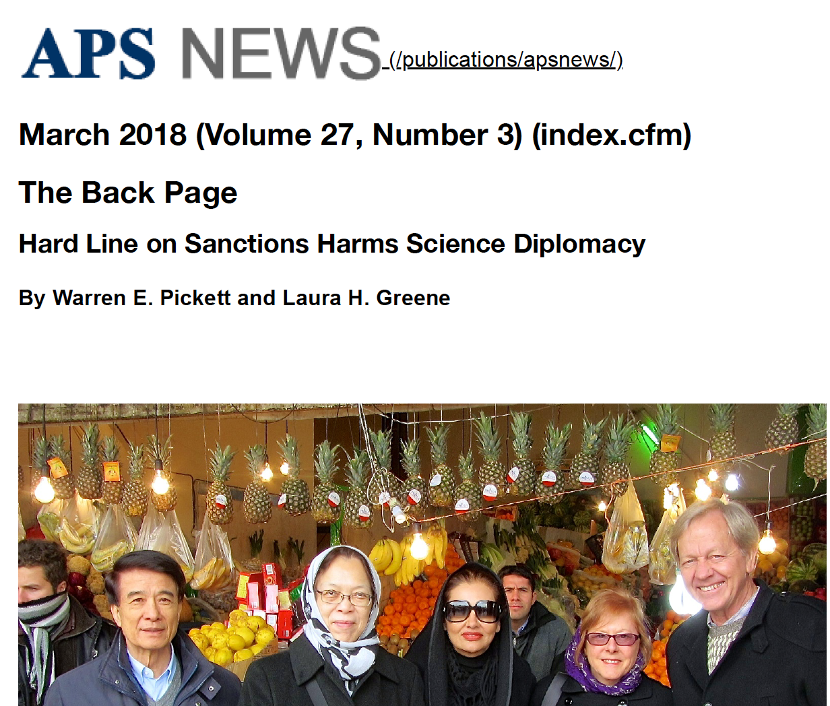
Paul and May Chu, Farzaneh Akhavan, Jill and Warren Pickett at a Tehran bazaar during their travels to Iran for a superconductivity conference.

Slide 9
Selected Students and PDs
Tony has always gone out of his way to work with students and post docs from developing countries
This is another, and important, form of Science Diplomacy, so..
I asked about that in a email and the next day he sent me this list...

Slide 11
Human Rights
Tony is a member of Committee on Human Rights (CHR) of the National Academies of Science, Engineering and Medicine (NASEM).
(This is bigger than you think.)
Examples from APS (‘cause that’s what I know best).
Impressive successes from The NASEM CHR

Slide 12
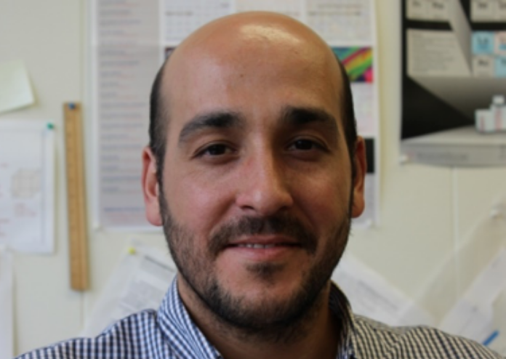
APS Case for a Turkish Scientist
Physicist Ali Basaran:
Arrested in July 2016 then released with no accusation or trial
Fired from Gebze Technical University
Banned from working at a scientific institution in Turkey. or from leaving Turkey
APS Action:
Feb. 2016: Letter from APS President to President Erdoğan (after coup, more general) The next week I went to Turkey for a conference
Sept. 2017: Letters from APS President to Turkish President & Rector of Gebze I’m going to Turkey in two weeks
Still monitoring...

Slide 13
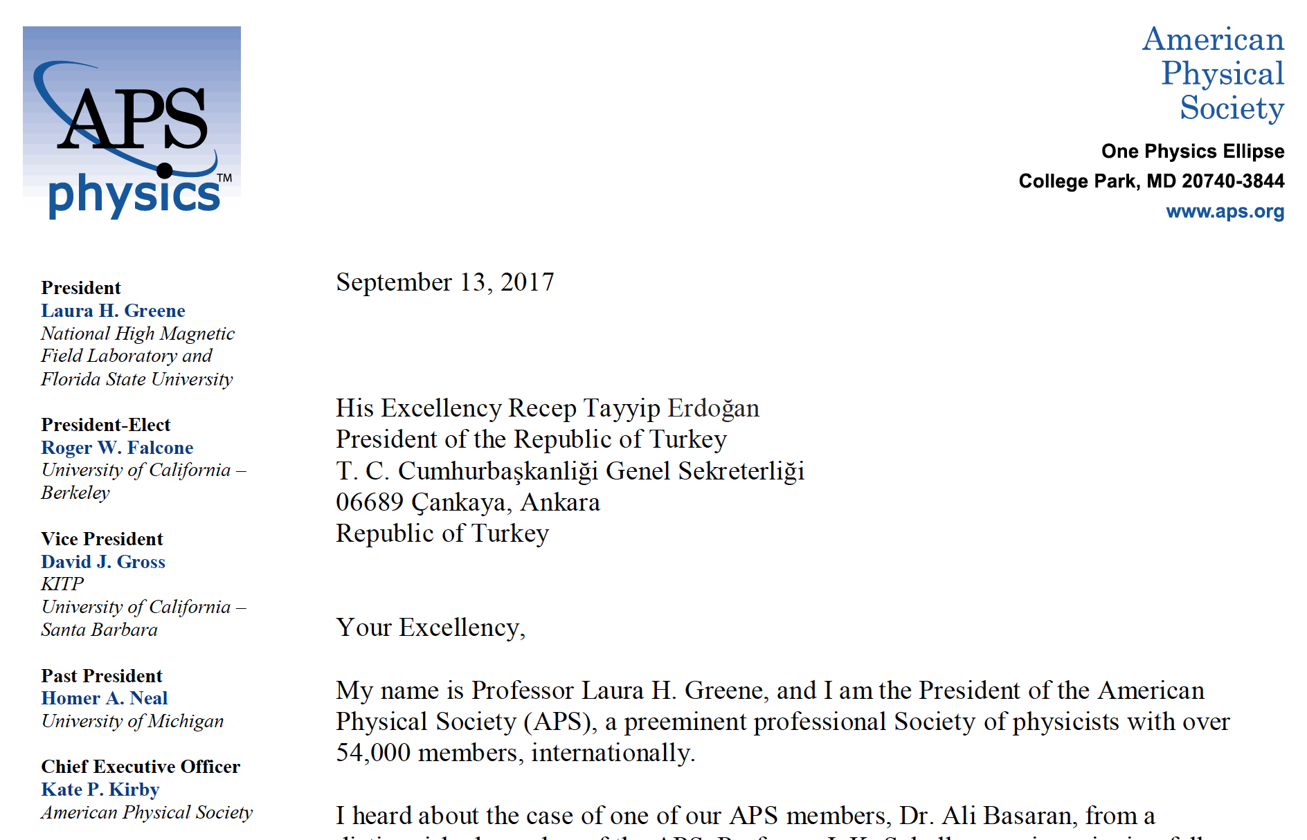

Slide 14
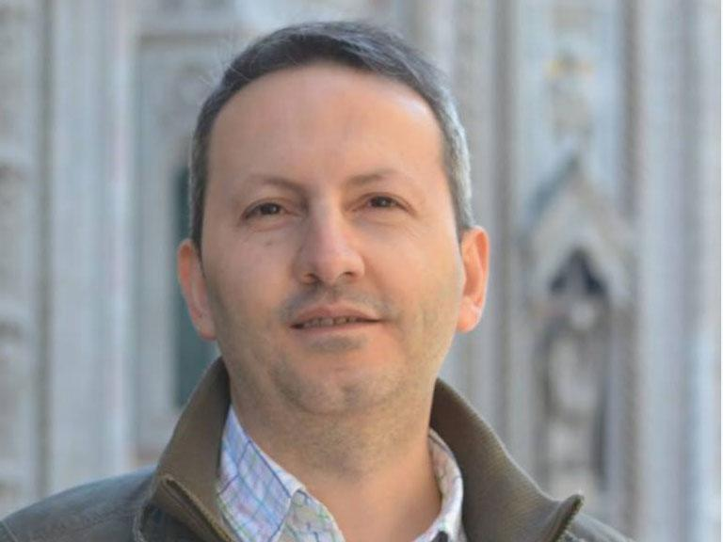
APS Case for an Iranian Scientist
Disaster Medicine Scientist Ahmadreza Djalali, Lives in Sweden
Apr. 2016: Arrested during academic visit to Iran, coerced espionage confession, sentenced to death
Nov. 2017: Letter from APS President to Iranian President asking that a review of this case be undertaken
Dec. 2017: COMBINED APS/AAAS letter to to Iranian President – standard AI type letter and Monitoring
Feb. 2017: Sweden grants him Citizenship
We continue to monitor...

Slide 15
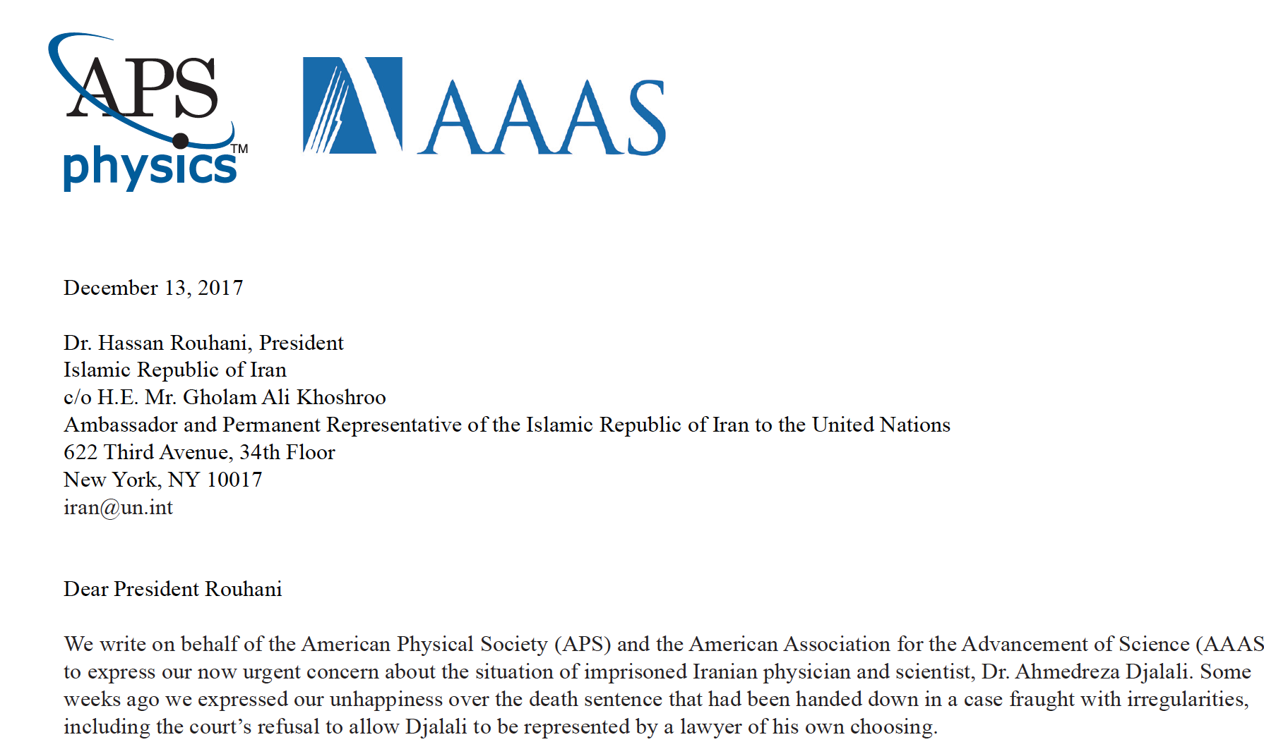

Slide 16
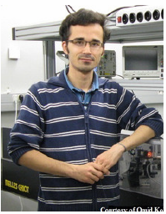
Iranian Student: One success story
Omid Kokabee, UT student arrested 2011:
2014 APS Andrei Sakharov Prize
2014 AAAS Scientific Freedom & Responsibility Award
OSA and IEEE awards
HUGE work from NASEM CHR
Letters more effective with weight of many societies
He is free now

Slide 17
Tony is More Effective
The Committee on Human Rights (CHR):
Next: a very few Release Articles, which are Real success stories!

Slide 20
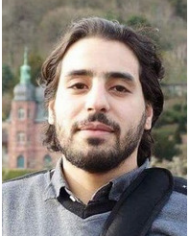
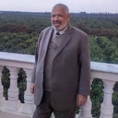
Egyptian medical doctor and computer engineer granted presidential pardons
On November 17, 2016, Egyptian vascular surgeon Dr. Ahmed Said and computer engineer Mostafa Ibrahim Mohamed Ahmed were granted presidential pardons, along with 80 other prisoners, after nearly one year in prison on charges related to their peaceful exercise of the rights to assembly and expression. They were released from al-Aqrab (Scorpion) Prison, where they had been held under harsh conditions of confinement, 24 hours after the pardon was announced.

Slide 21
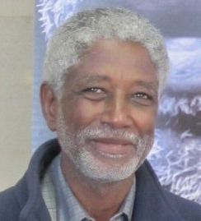
Imprisoned Sudanese engineer Dr. Mudawi Ibrahim Adam released following presidential pardon
August 31, 2017
Dr. Mudawi Ibrahim Adam is an engineer, a prominent human rights advocate, and founder of the Sudan Social Development Organization (SUDO), a nongovernmental organization that promotes human rights and development initiatives relating to water, sanitation, and health in Sudan. He has been recognized internationally for his human rights promotion and humanitarian efforts, but repeatedly jailed for this work in Sudan. After nearly nine months in detention on spurious national security-related charges, he was among several prisoners granted a pardon by Sudanese President Omar al-Bashir on August 29, 2017.
Tony had a PhD student from Sudan who returned and took up a teachiang position. He had challenges with the authorities, and sadly died of a lymphoma in 2006. (This case was of special interest to Tony.)

Slide 22
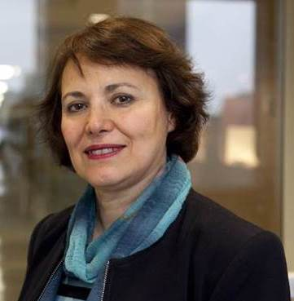
Iranian-Canadian Anthropologist Released from Prison: September 27, 2016
Iranian-Canadian anthropologist Homa Hoodfar, who had been in jail in Tehran since her arrest on June 6, 2016, left Iran yesterday. She is currently in Oman receiving medical treatment and will return home to Canada when she is strong enough to make the trip. Although charges were never presented to her lawyer, the Iranian press stated in late June that she had been charged with collaborating with a hostile government against national security and with propaganda against the state and quoted the prosecutor as saying she had been “dabbling in feminism.” Professor Hoodfar reportedly was found guilty before a court this weekend and sentenced to several years in prison.

Slide 23
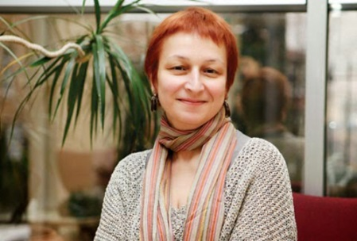
Detained Turkish Political Scientist Acquitted Feb 5, 2017
On January 31, 2018, Dr. İştar Gözaydın—a Turkish academic and human rights defender—was acquitted of membership in the Fethullah Gülen movement in her final hearing before the 27th High Criminal Court of Istanbul.
Dr. Gözaydın is an internationally respected Turkish scholar of political science and law and was Chair of the Department of Sociology at Gediz University, in Izmir Province, until her suspension on July 21, 2016. Her suspension occurred after she posted information on social media criticizing the proposed reinstatement of the death penalty in Turkey and mob violence

Slide 24
Kudos to CHR for their HUGE amount of hard work and SUCCESSES! and...

Slide 25
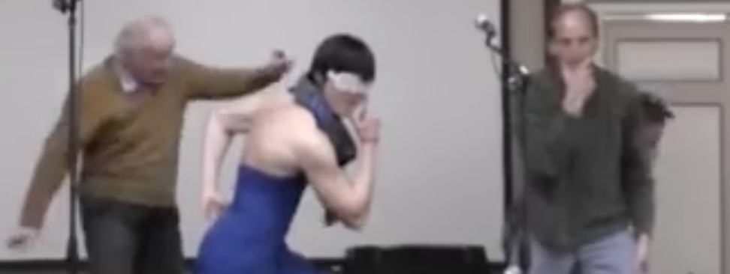
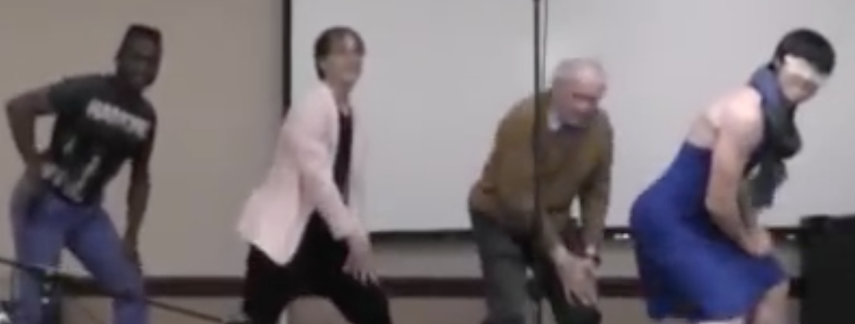
Gangnam Style!

Slide 26
Spare slide – did not use

Slide 27
CIFS Growing and One Future Plan...
2017 March Meeting: CIFS Chair and I met with Grad Students
To educate the next generation of scientists about human rights and build the “pipeline” of APS Members involved in defending the rights of scientists
Attended > 80 people
Young scientists raised their concerns, too
VISAS: Long history and on-going – need to do better!
NAS “Science & Security Coalition (SciSec)” (since 2004)
~ 25 scientific and higher ed orgs to address impact of visa and immigration policies on scientific mobility.
Last meeting: October 30, 2017

