Slide 1
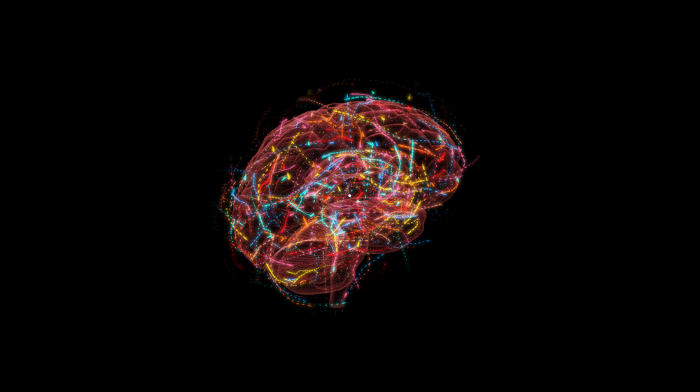
Are we quantum computers, or merely clever robots?
Tony Fest
March 30, 2018
Matthew PA Fisher

Slide 2
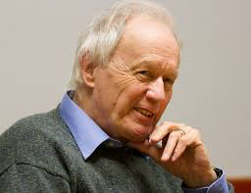
Happy Birthday Tony!!
Brilliant yet Modest

Slide 3
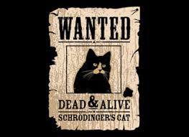
Happy Birthday Tony!!
Creative Independence

Slide 4
Are we quantum computers, or merely clever robots?

Slide 5
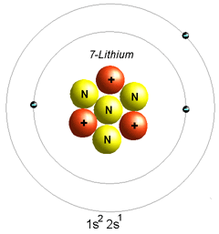
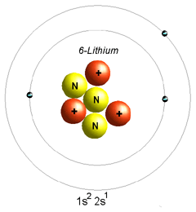
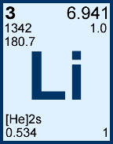
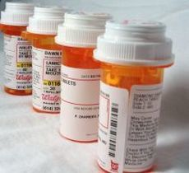
Lithium
An atom:
Lithium-7
3 protons, 4 neutrons
Lithium-6
3 protons, 3 neutrons
Two stable isotopes:
92% abundance
8% abundance
A drug: for bipolar-disorder since 1970
How does lithium work?
How do any psychiatric medications work???

Slide 6
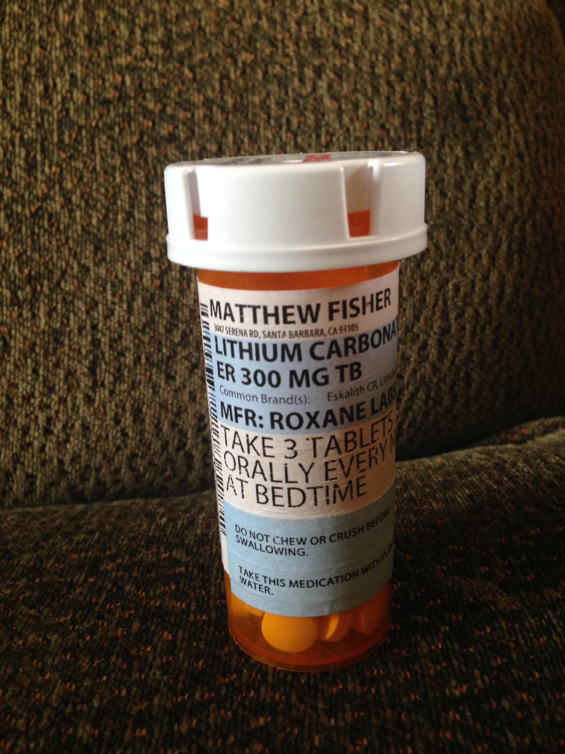
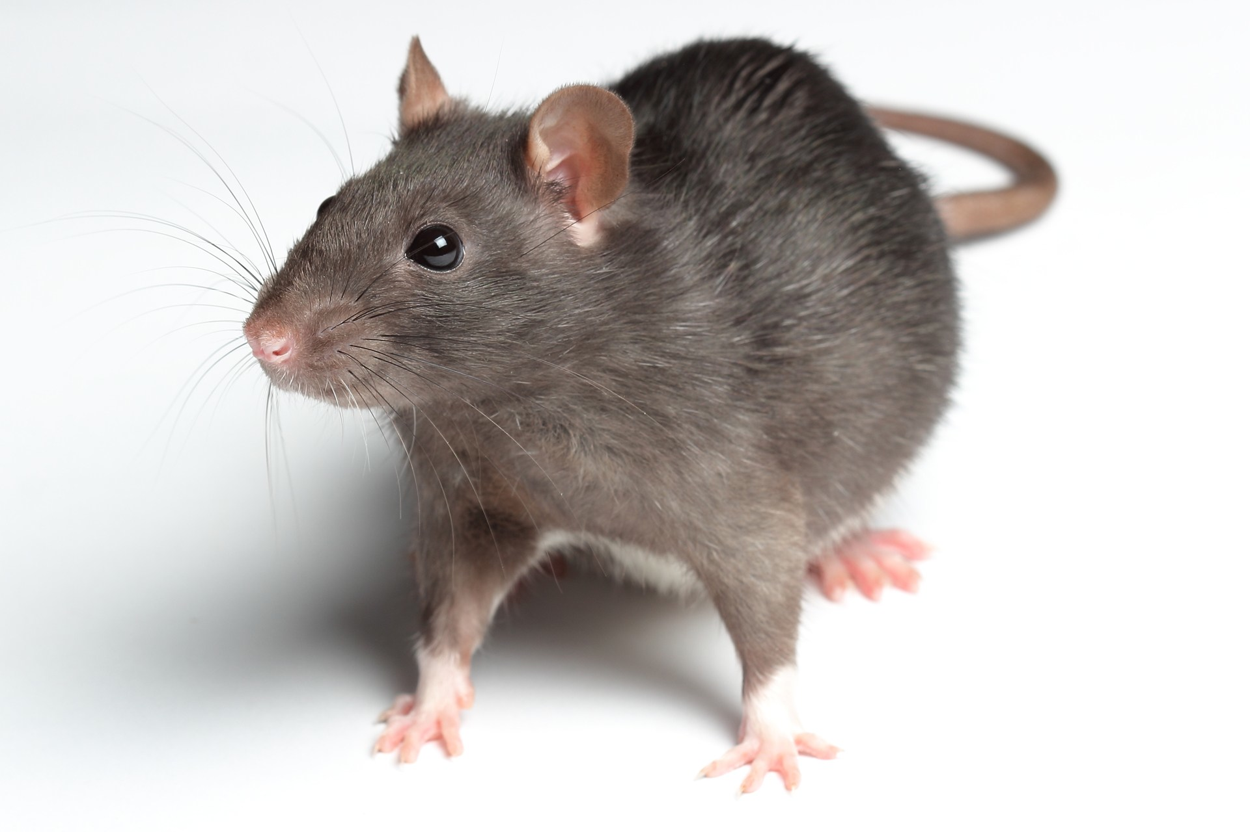
Feeding Lithium isotopes to rats
Pharmacy Lithium: Li-N
92% Li-7, 8% Li-6
Isotope “purify”: 95% Li-6 or 99% Li-7
Experiment: Feed Rats Lithium isotopes
Li-N, Li-7, Li-6, control
Any behavioral differences?
Experiment was tried
Sechzer et.al., Biol. Psych. (1986)

Slide 7
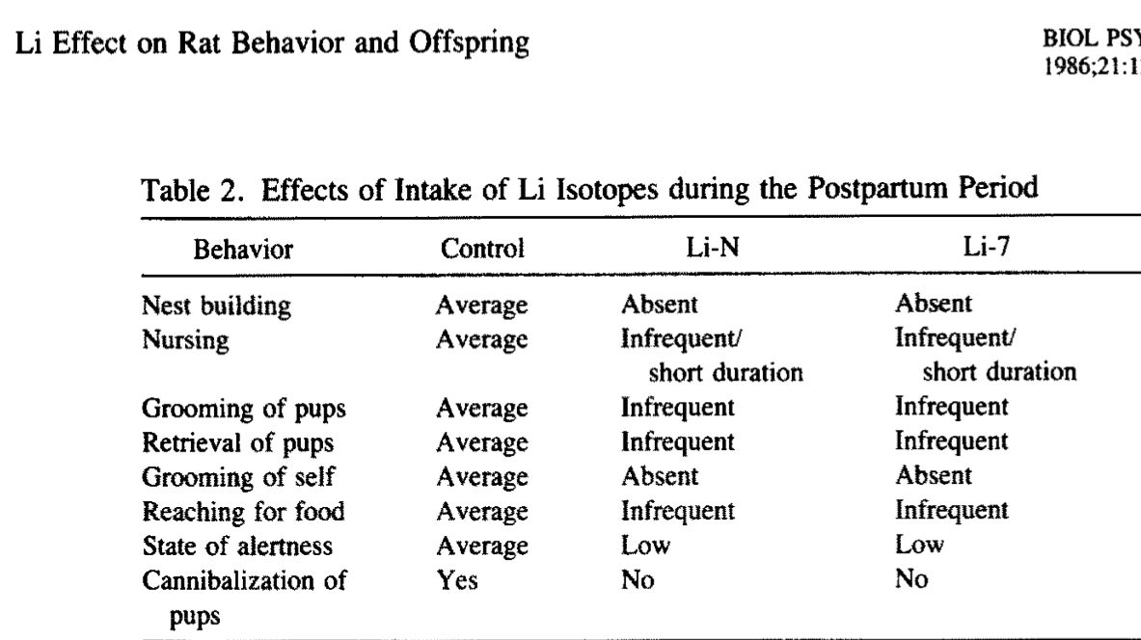

Slide 8
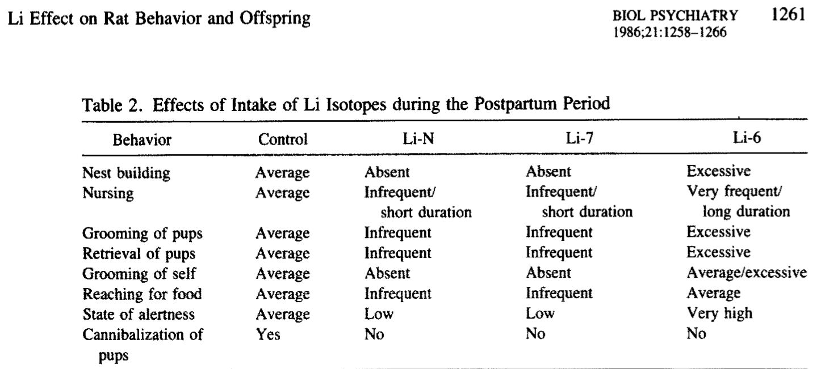
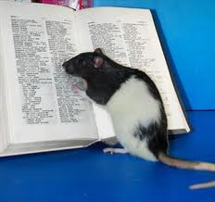
One less neutron makes all the difference!
And a neutron is quantum mechanical...

Slide 9
Quantum Processing in the Brain?
Are we Quantum Computers??

Slide 10
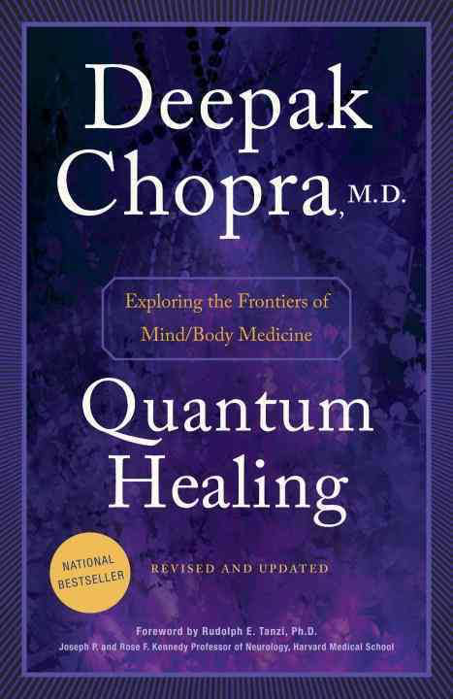
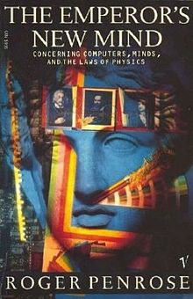
2 books from 1989: bad president...
Roger Penrose:
Classical physics inadequate to
explain consciousness
Brain harnassing quantum mechanics,
(operational in microtubules)
Richard Dawkins: Chopra uses
“quantum jargon as plausible
sounding hocus pocus”
Patricia Churchland: “Pixie dust in the
synapses is about as explanatorily powerful as
quantum coherence in the microtubules.”
The skeptics (also physicists) laughed and scoffed...

Slide 11
2 books from 1989: bad precedent...
Roger Penrose:
Classical physics inadequate to
explain consciousness
Brain harnassing quantum mechanics,
(operational in microtubules)
Richard Dawkins: Chopra uses
“quantum jargon as plausible
sounding hocus pocus
Patricia Churchland: “Pixie dust in the
synapses is about as explanatorily powerful as
quantum coherence in the microtubules.”
The skeptics (also physicists) laughed and scoffed...

Slide 12
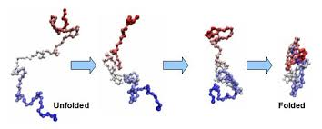
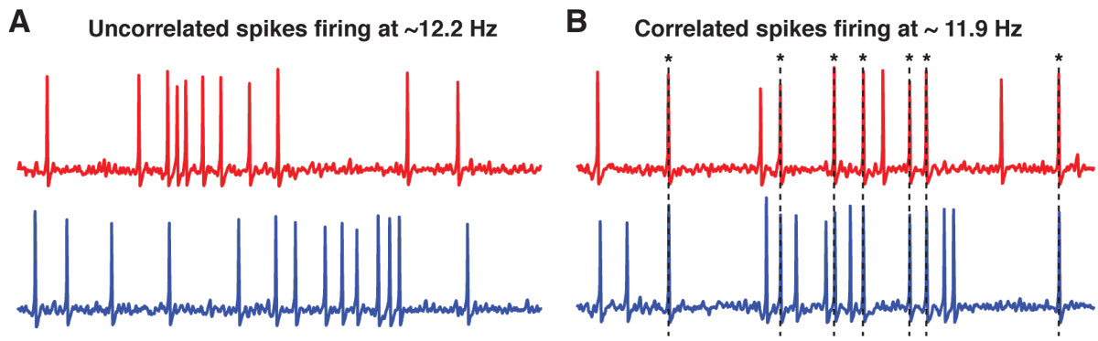
Why the skepticism?
Biological Processes are slow:
protein folding, rate
neuron spike-firing, frequency
Frequency gives “Quantum” crossover temperature T*
Quantum (cold)
Thermal (hot):
Ex:
Bio processes are thermal, not quantum
Body is too hot for Quantum effects

Slide 13
But, this assumes thermal equilibrium...
And Quantum computers are not in thermal equilibrium...
they require isolation...

Slide 14
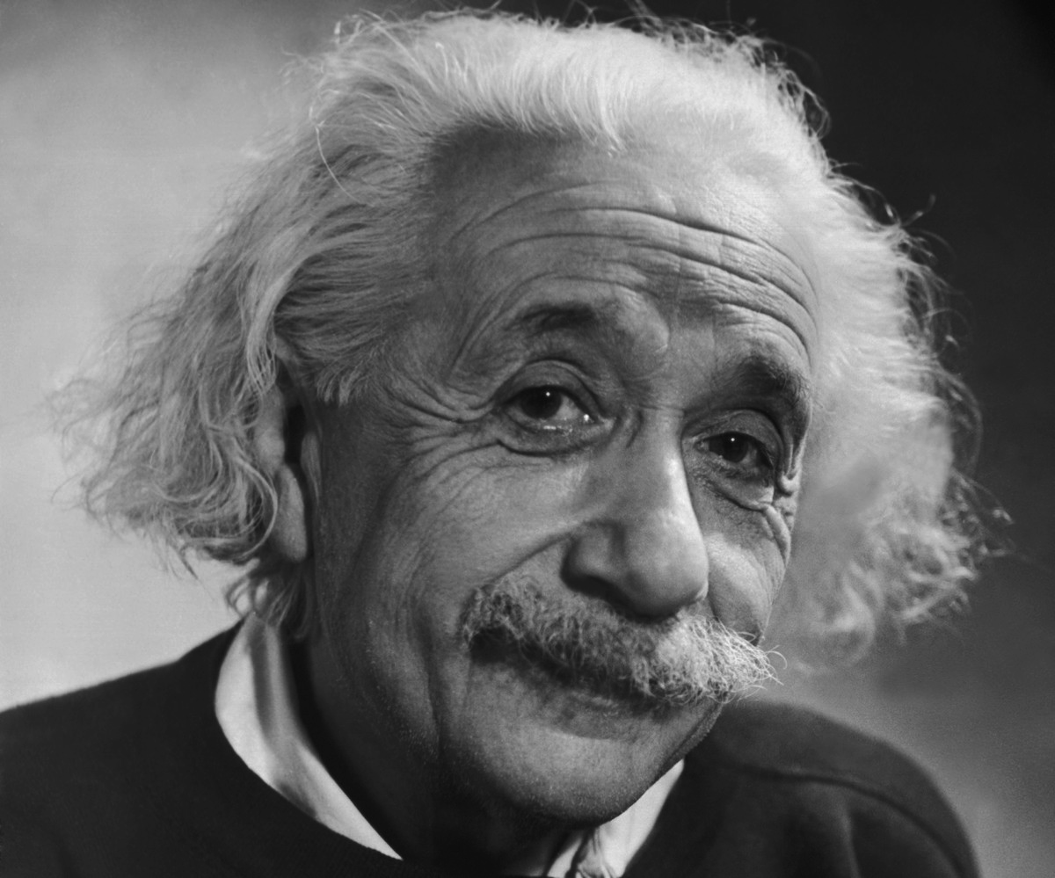
What is a Quantum Computer?
Classical bit (0,1) , replaced by quantum-spin,
(e.g. nuclear spin, electron spin, ...)
Quantum Computer: Many interacting Qubits
Key requirement: Non-local quantum entanglement
between Qubits (must be created and controlled)
Einstein called this:
Spooky action at a distance

Slide 15

Power of a Quantum Computer
Multiple Qubits can be entangled (non-locally)
Allows non-local storage, control and computation

Slide 16
Power of a Quantum Computer
Multiple Qubits can be entangled (non-locally)
Allows non-local storage, control and computation
Challenge: Quantum Computer entangles with “environment”
– unless isolated

Slide 17
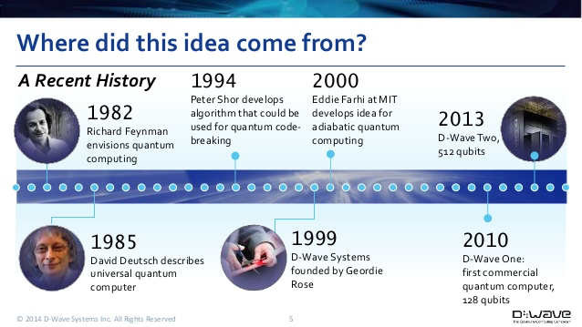
Path towards a Quantum Computer

Slide 18
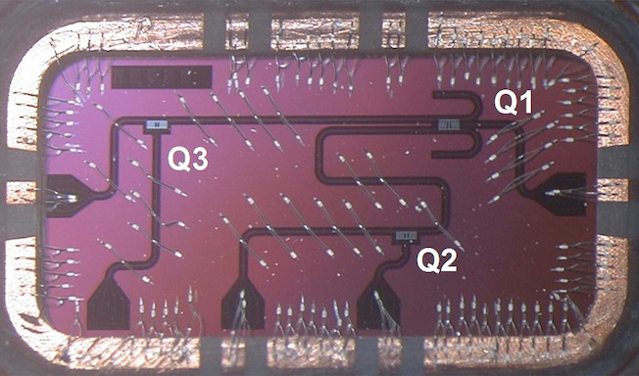
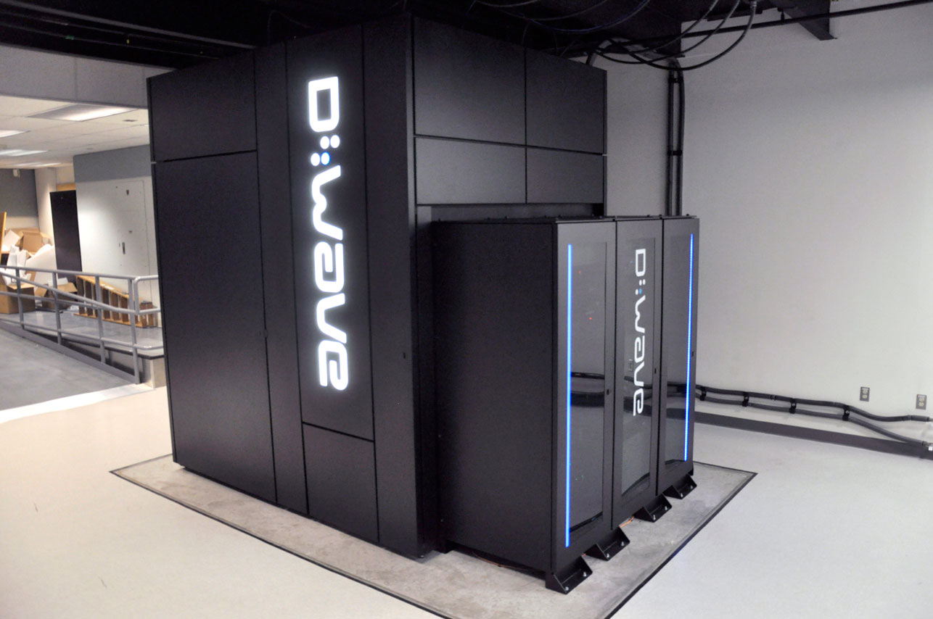
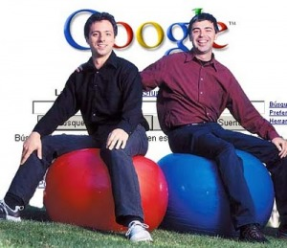

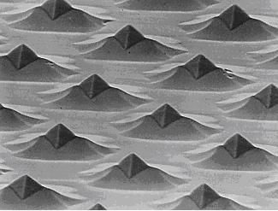
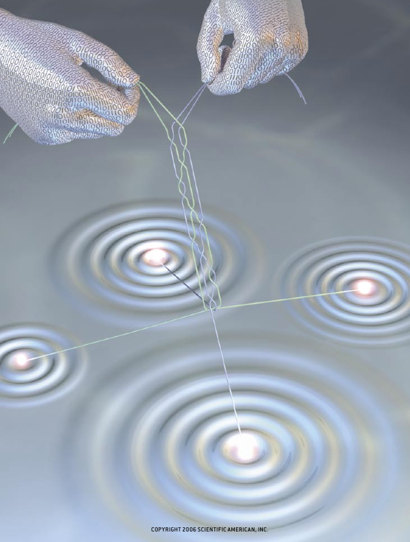
Isolation of Qubits is expensive!
Superconducting Qubits
Google
IBM, NEC
D-wave
Solid state Qubits
(diamond, quantum dots)
HP
Topological Qubits
(“Majorana Fermions”)
Microsoft

Slide 19
Isolation of Qubits is Expensive!!
Superconducting Qubits
Google
IBM, NEC
D-wave
Solid state Qubits
(diamond, quantum dots)
HP
Topological Qubits
(“Majorana Fermions”)
Microsoft
Apple?
Facebook??
Twitter???

Slide 20
Quantum processing requires isolated qubits
What is isolated from wet environment in biology?

Slide 21
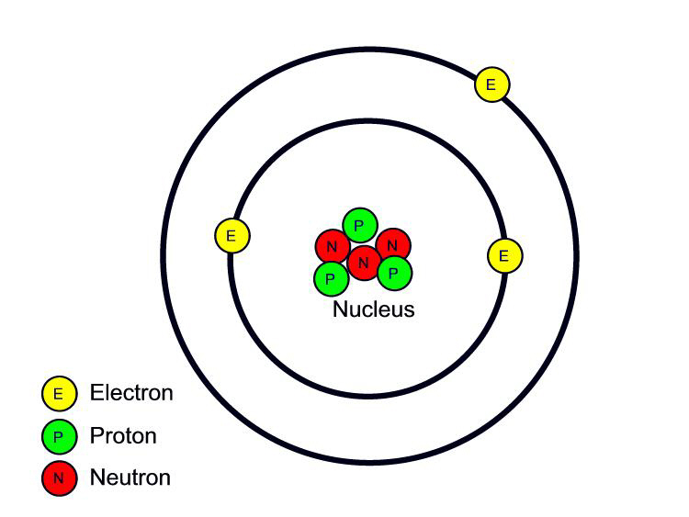
Quantum processing requires isolated qubits
What is isolated from wet environment in biology?
Nuclear spins!
Proton/neutron spin S=1/2
some atomic nuclei have spin

Slide 22
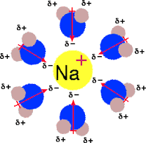
Quantum processing requires isolated qubits
What is isolated from wet environment in biology?
Nuclear spins!
Proton/neutron spin S=1/2
some atomic nuclei have spin
Solvated ions: nuclear spins entangle w/ H₂O, “decoherence” time

Slide 23
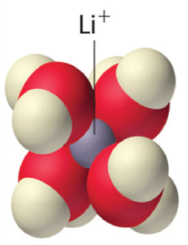
Quantum processing requires isolated qubits
What is isolated from wet environment in biology?
Nuclear spins!
Proton/neutron spin S=1/2
some atomic nuclei have spin
Solvated ions: nuclear spins entangle w/ H₂O, “decoherence” time

Slide 24
Quantum processing requires isolated qubits
What is isolated from wet environment in biology?
Nuclear spins!
Proton/neutron spin S=1/2
some atomic nuclei have spin
Solvated ions: nuclear spins entangle w/ H₂O, “decoherence” time
Li-6 nuclear spin is very isolated!

Slide 25
Quantum processing requires isolated qubits
What is isolated from wet environment in biology?
Nuclear spins!
Proton/neutron spin S=1/2
some atomic nuclei have spin
Solvated ions: nuclear spins entangle w/ H₂O, “decoherence” time
Li-6 rat...

Slide 26
Quantum processing requires isolated qubits
What is isolated from wet environment in biology?
Nuclear spins!
Proton/neutron spin S=1/2
some atomic nuclei have spin
Solvated ions: nuclear spins entangle w/ H₂O, “decoherence” time
Quantum processing w/ nuclear spins operative in the brain?

Slide 27
Nuclear-spin Quantum Processing in the Brain
Requires many (seemingly) unrealizable conditions;
Biological element w/ very isolated nuclear spin: A Neural Qubit
Mechanism for entangling pairs of nuclear spins
Mechanism for quantum processing qubits
Method for Quantum-biochemical transduction...
....
Can such conditions be fulfilled (in biology)?

Slide 28
Nuclear-spin Quantum Processing in the Brain
Requires many (seemingly) unrealizable conditions;
Biological element w/ very isolated nuclear spin: A Neural Qubit
Mechanism for entangling pairs of nuclear spins
Mechanism for quantum processing qubits
Method for Quantum-biochemical transduction...
....
Can such conditions be fulfilled (in biology)?
Approach: Reverse engineering

Slide 29
A Neural Qubit?
Common biological atom w/ long nuclear-spin entanglement time?
Atom with spin S=1/2
Bio-chemical elements: C H N O P S
Bio-electrical ions: Na K Ca Cl Mg

Slide 30
*The* Neural Qubit
Common biological atom w/ long nuclear-spin entanglement time?
Atom with spin S=1/2
Bio-chemical elements: C H N O P S
Bio-electrical ions: Na K Ca Cl Mg
Nuclear Spin S = 1/2
Phosphorus ³¹P nucleus: The only possible neural Qubit

Slide 31
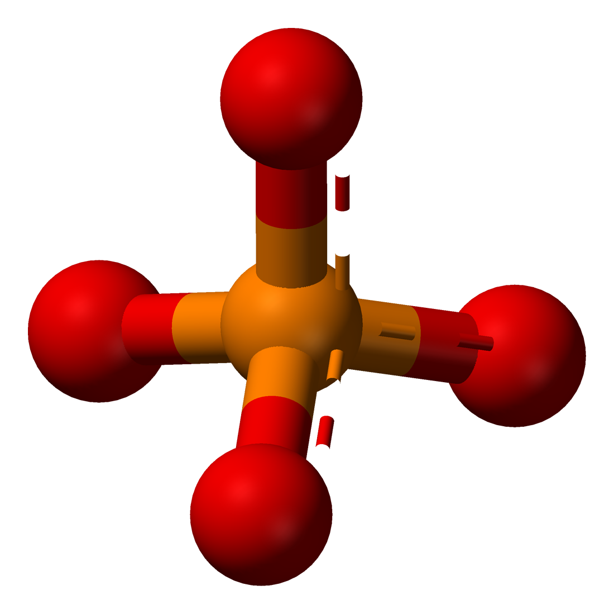
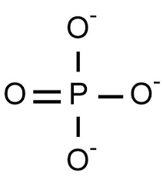
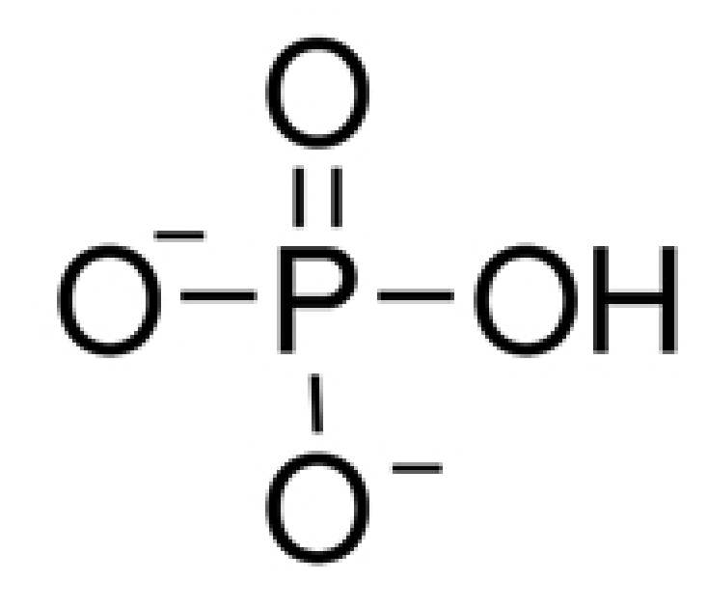
Where is Phosphorus?
Phosphate ion
³¹P decoherence time for
phosphate in water
H binds to phosphate,
³¹P and proton spins entangle
Can another ion out-compete H⁺ in binding to phosphate?

Slide 32
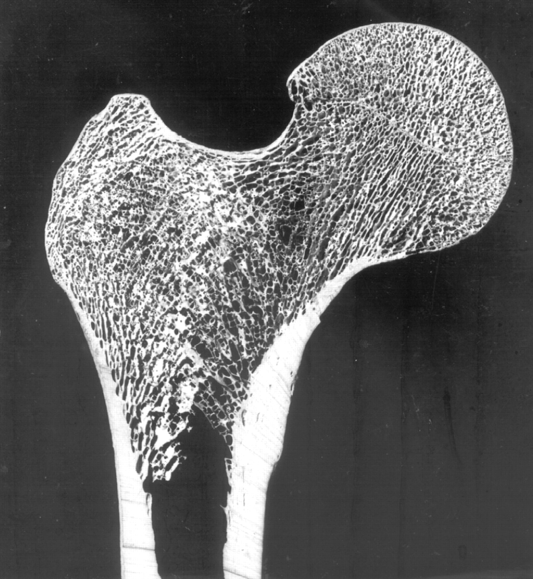
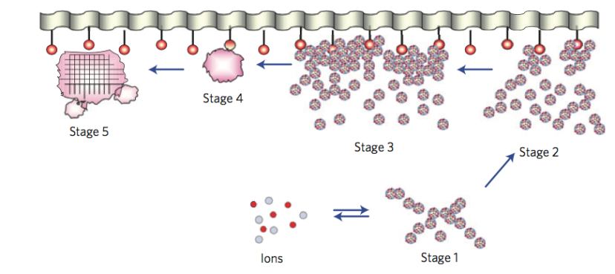
Yes! Calcium!
Hint: Bone is Calcium-Phosphate
“Posner Molecule”
(detected in 2010)
Bone “precursor”
~1 nanometer diameter
³¹P coherence times for Posner in H₂O:
Posner Molecule: Ideal for Quantum storage/processing

Slide 33
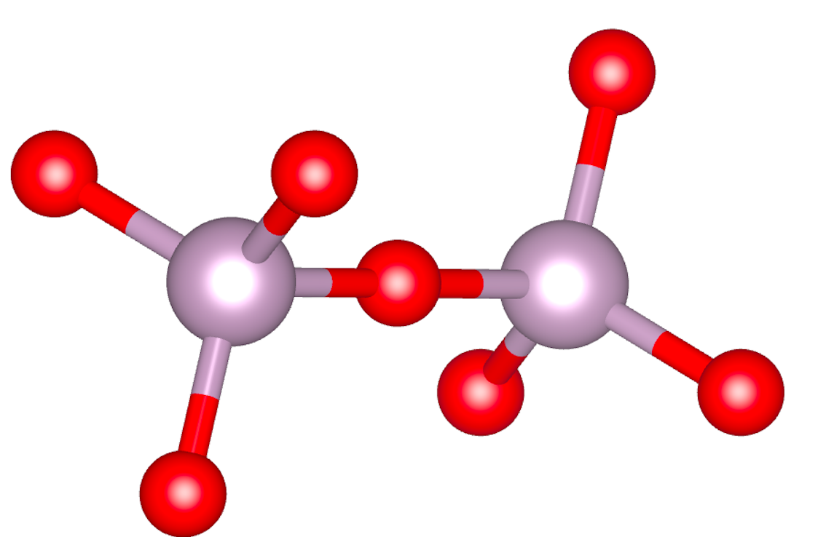
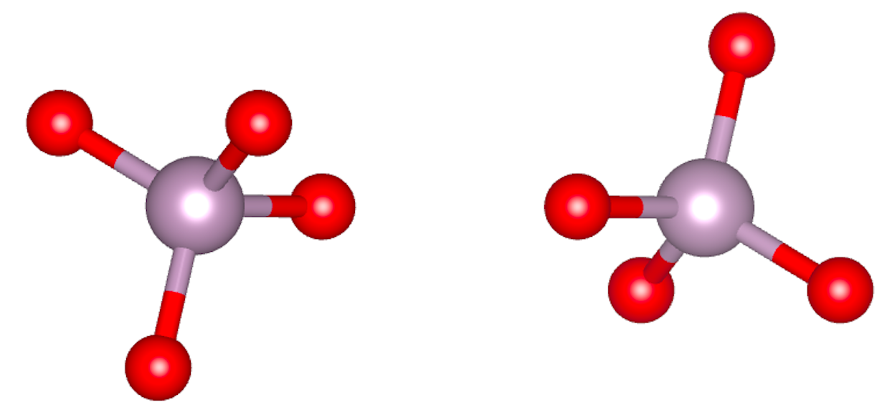
Quantum entangling ³¹P nuclear-spins?
PPi
Two ³¹P spins quantum entangled
Chemical reaction: PPi splits into pair of phosphates ions

Slide 34
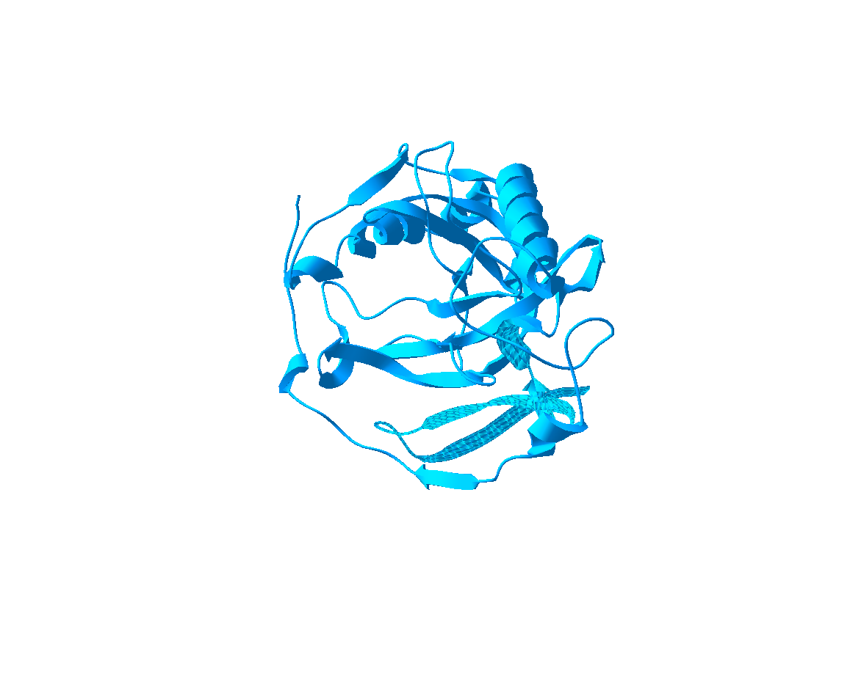
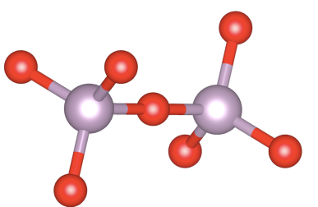
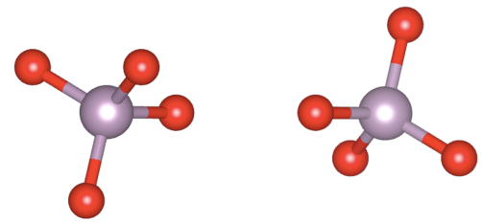

Creating non-local Quantum Entanglement
quantum
entangled
Released ³¹P pairs are quantum entangled

Slide 35
Quantum entangled showers

Slide 36
Quantum entangled showers
Throughout your brain?

Slide 37
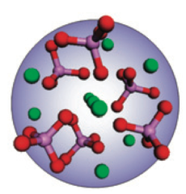
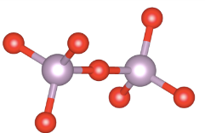


Quantum storage of entangled spins
Ca²⁺
PPA
entangled
³¹P pairs
Envelope ³¹P nuclear spins into Posner molecules
Creates inter-molecular nuclear spin entanglement

Slide 38
Quantum processing...
“Networks” of spin entangled Posner molecules:
Entanglementment influences, non-locally, pair binding:
a
a’
a’
a
?
b
b
b’
b’

Slide 39
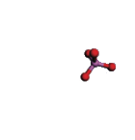
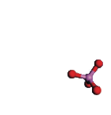
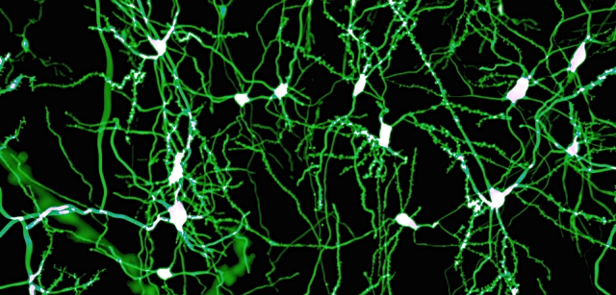
Quantum-biochemical transduction?
Pair-binding influences dissolution
of Posner molecules
Released calcium ions modulate
neural activity, creating a “quantum” network
that co-exists with the neural network

Slide 40
The Classical brain
Classical (“all”) Neuroscience

Slide 41
The Classical/Quantum brain...
Classical (“all”) Neuroscience
Quantum Neuroscience
Nuclear spins...

Slide 42
The brain as a quantum computer???
Classical (“all”) Neuroscience
Nuclear spins modulate chemical reaction rates
Quantum Neuroscience
Nuclear spins...
Chemical reactions
implement measurements on nuclear spins

Slide 43
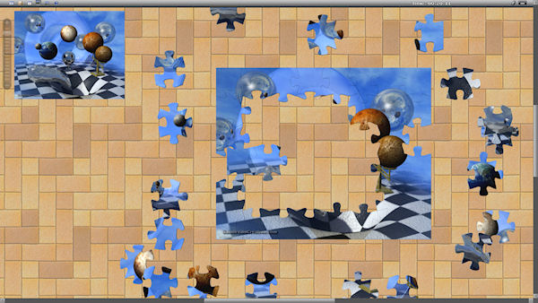
Story: partly-formed picture puzzle...

Slide 44

Story: partly-formed picture puzzle...
Experiments initiated to discern *precise* shapes of the
various pieces, and see if they start fitting together...

Slide 45
Are we quantum computers, or merely clever robots?

Slide 46
Path towards a Quantum Computer
Multipurpose quantum computer in 50 years?

Slide 47
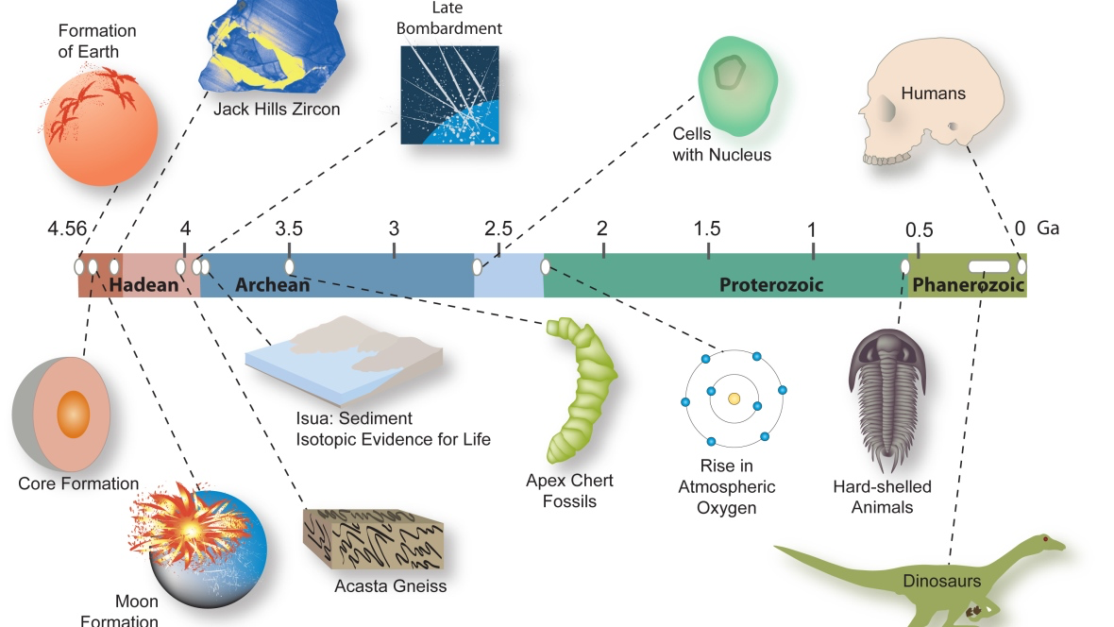
Longer path towards a Quantum Computer
3.5 Billions years to evolve (human) quantum engineers

Slide 48
How many years will it take for evolution to “design/build” a quantum computer??

Slide 49
How many years will it take for evolution to “design/build” a quantum computer??
3.5 Billion years + 50 years

Slide 50
How many years will it take for evolution to “design/build” a quantum computer??
3.5 Billion years + 50 years
Just 3.5 Billion years

Slide 51
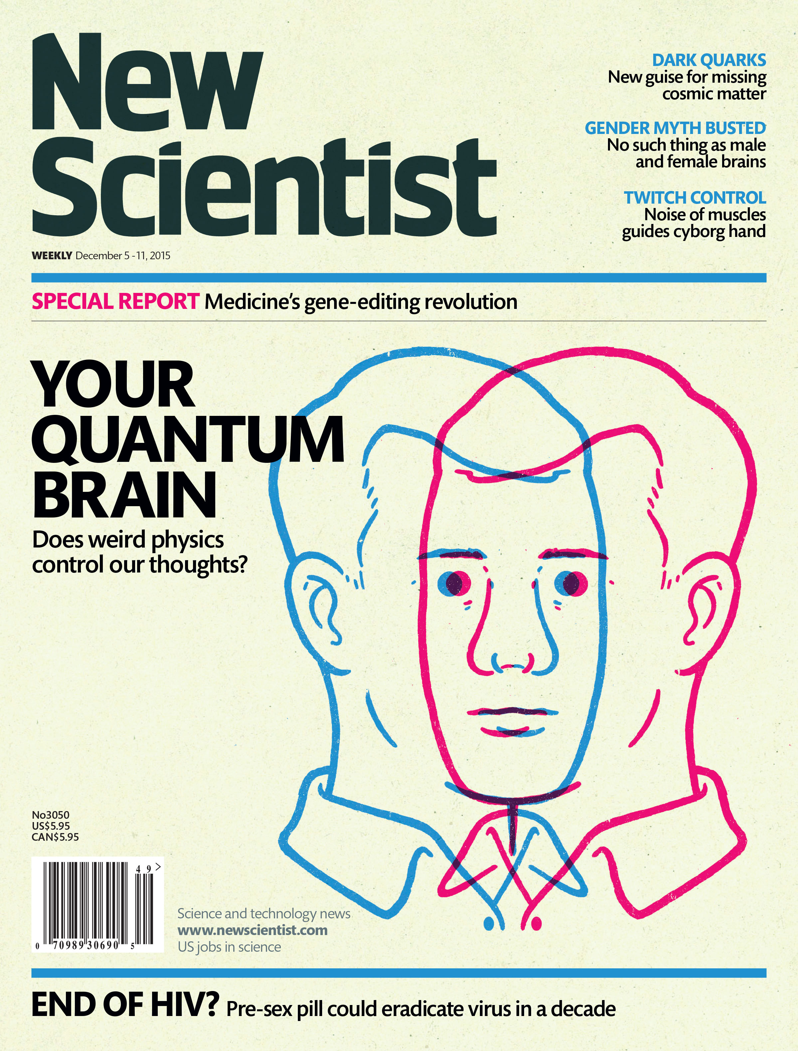
“I can calculate the motion of the heavenly bodies, but not the madness of men” – Isaac Newton

Slide 52
Happy Birthday Tony!!

Slide 53
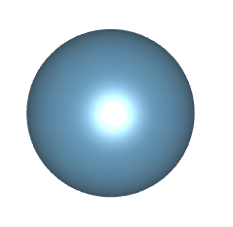
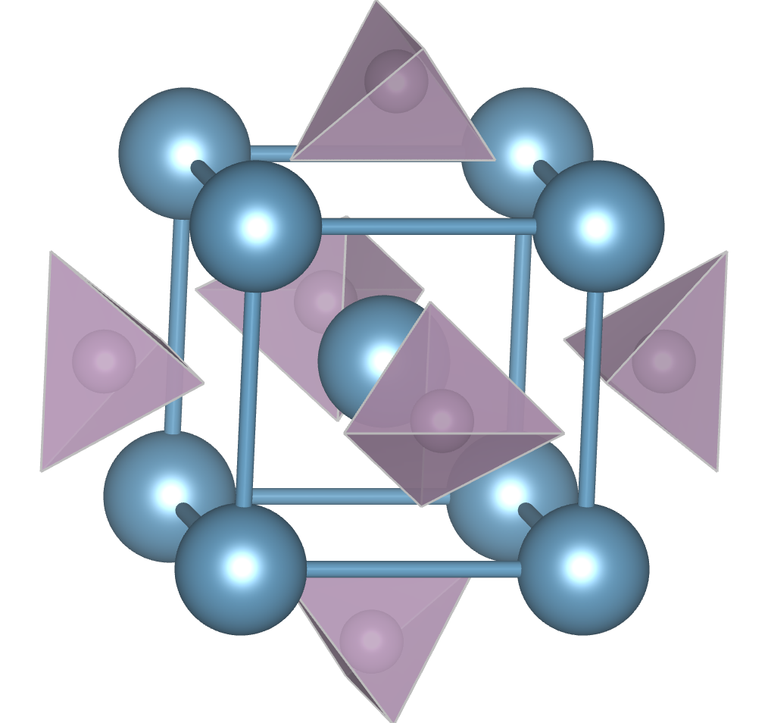
Trapping two Li⁺ ions inside Posner molecule?
Replace central Ca⁺⁺
w/ two Li⁺ ions

Slide 54
“I can calculate the motion of the heavenly bodies, but not the madness of men” – Isaac Newton
“Neurons that (quantum) entangle together, jingle-jangle⁽¹⁾ together” - MPAF

Slide 55
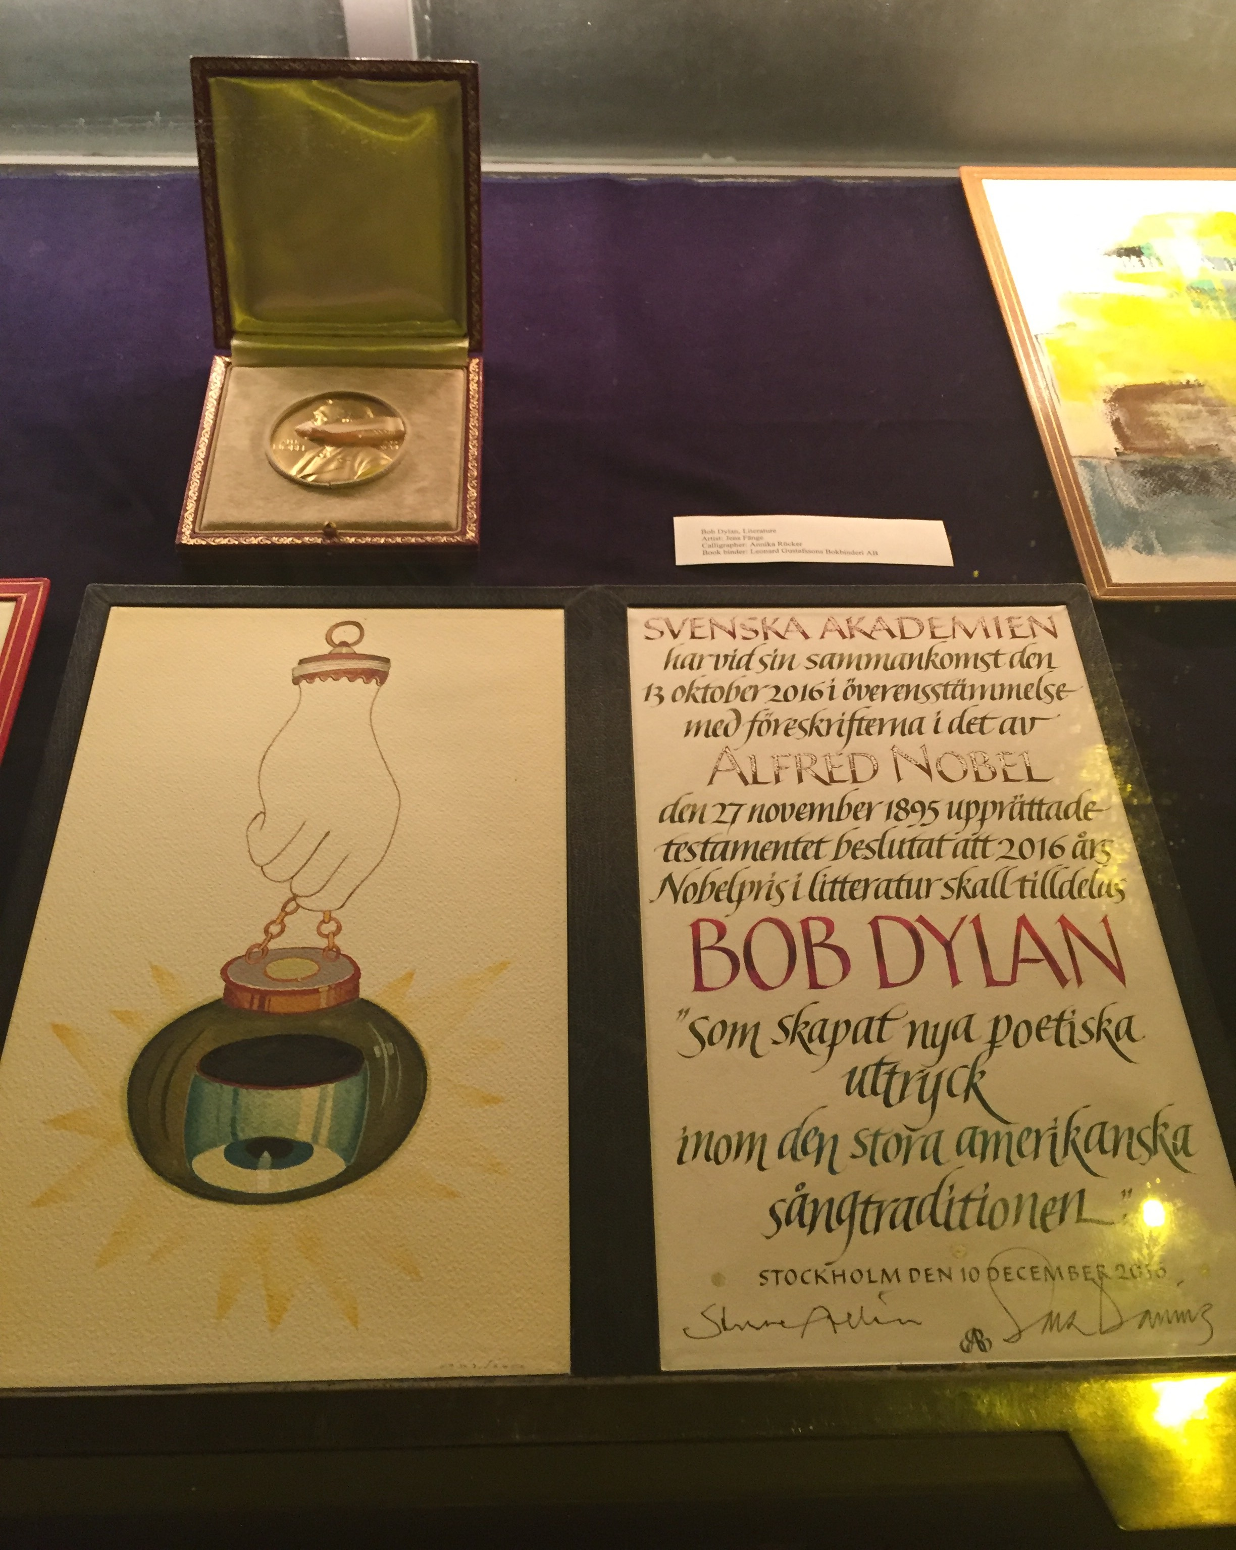
2016 Nobel Literature Laureate

Slide 56
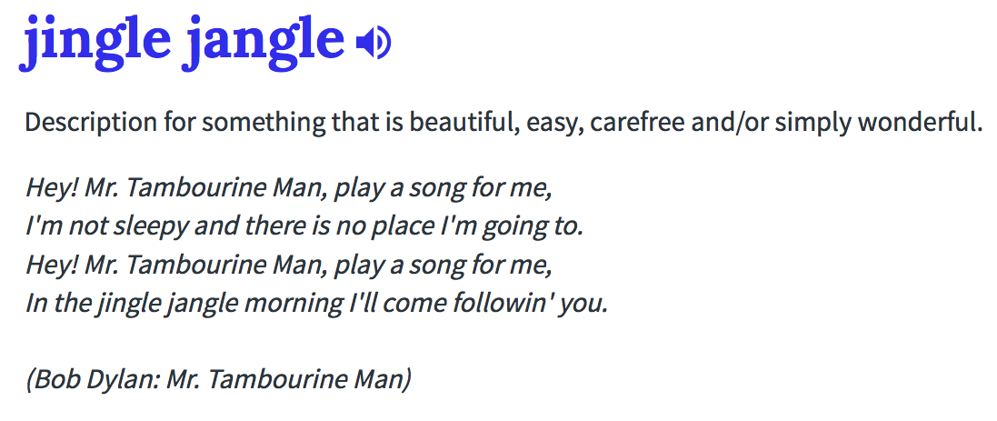
(1) Urban online Dictionary:

Slide 57
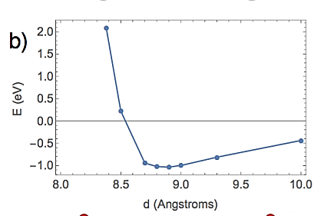
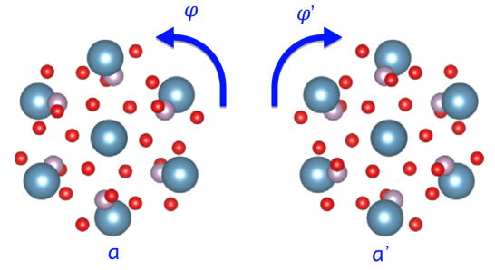

“Hide” entanglement in pseudospin
Posner molecule 3-fold symmetry axis – Pseudospin
Characterizes spin-states and dictates rotational angular momentum
Cannot construct non-rotating wf for non-zero pseudospin
Pseudospin selection rule:
Binding two Posner molecules implements “pseudospin-singlet” projection
φ_{a}
φ_{b}
Energy, E(d,Δφ)
d
a
b
distance, d (Å)
Michael Swift

Slide 58
Some physicists think consciousness is too mysterious to be understandable
“Biologists and perhaps physicists will understand much better how the brain works. But why something that we call consciousness goes with those working, I think that will remain mysterious. I have
a much easier time imagining how we understand the Big Bang than I have imagining how we can understand consciousness...”
E. Witten, IAS, 2016
Yet some think that QM can perhaps be ruled out...
“The general assumption has been that of course there is no quantum information processing that’s possible in the brain. He (Fisher) makes the case that there’s precisely one loophole. So the next step is to see if that loophole can be closed.”
T. Senthil, MIT, 2016

Slide 59

Posner molecules in vivo? Mitochondria
Location of ATP production
Form dynamic networks, fusing/fissioning, intra/inter cellular motion
Buffering, sequestering and releasing calcium into the cell (modulates cell signalling)
Harbor high concentrations of calcium-phosphate “sludge”, Ca:Pi in 3:2 ratio, cf Posners
Conjecture: Posner molecule formation/melting inside mitochondria, entangled non-locally in mitochondrial networks via fusion/fission

Slide 60

Mitochondrial Dynamics

Slide 61

Mitochondrial Dynamcis 2

Slide 62
Tony stories
I assume you can read Russian?
Head bobbing in skepticism (to one of my many wrong ideas)
Blazes his own trail
Calm and composed when his creativity is critiqued

Slide 63
Isolation of Qubits is Paramount!!
Superconducting Qubits
Solid state Qubits
(diamond, quantum dots)
Topological Qubits
(“Majorana Fermions”)

Slide 64


Goal: Synthesize a Quantum-Brain...
Generate spin entangled ³¹P

Slide 65


Goal: Synthesize a Quantum-Brain...
Generate spin entangled ³¹P
Ca²⁺ forms entangled Posners

Slide 66
Goal: Synthesize a Quantum-Brain...
Generate spin entangled ³¹P
Ca²⁺ forms entangled Posners
Add Ca²⁺ fluorescence molecules

Slide 67
Goal: Synthesize a Quantum-Brain...
Generate spin entangled ³¹P
Ca²⁺ forms entangled Posners
Add Ca²⁺ fluorescence molecules
Separate into separate samples

Slide 68

Goal: Synthesize a Quantum-Brain...
Generate spin entangled ³¹P
Ca²⁺ forms entangled Posners
Add Ca²⁺ fluorescence molecules
Separate into separate samples
Acidify: dissolve Posners, measure fluorescence

Slide 69
Goal: Synthesize a Quantum-Brain...
Generate spin entangled ³¹P
Ca²⁺ forms entangled Posners
Add Ca²⁺ fluorescence molecules
Separate into separate samples
Acidify: dissolve Posners, measure fluorescence
Look for cross-correlation of fluorescence
Cross-correlated fluorescence would provide direct evidence of quantum entanglement transducing a
(non-local) chemical response

Slide 70




Isolation of Qubits is Hard
Proposed Qubits
Superconducting
junctions
Nuclear spins
in solids/liquids
Electron/nuclear
spins in diamond
Trapped ions
Trapped atoms
Electron charges/spins in quantum dots

