Slide 1
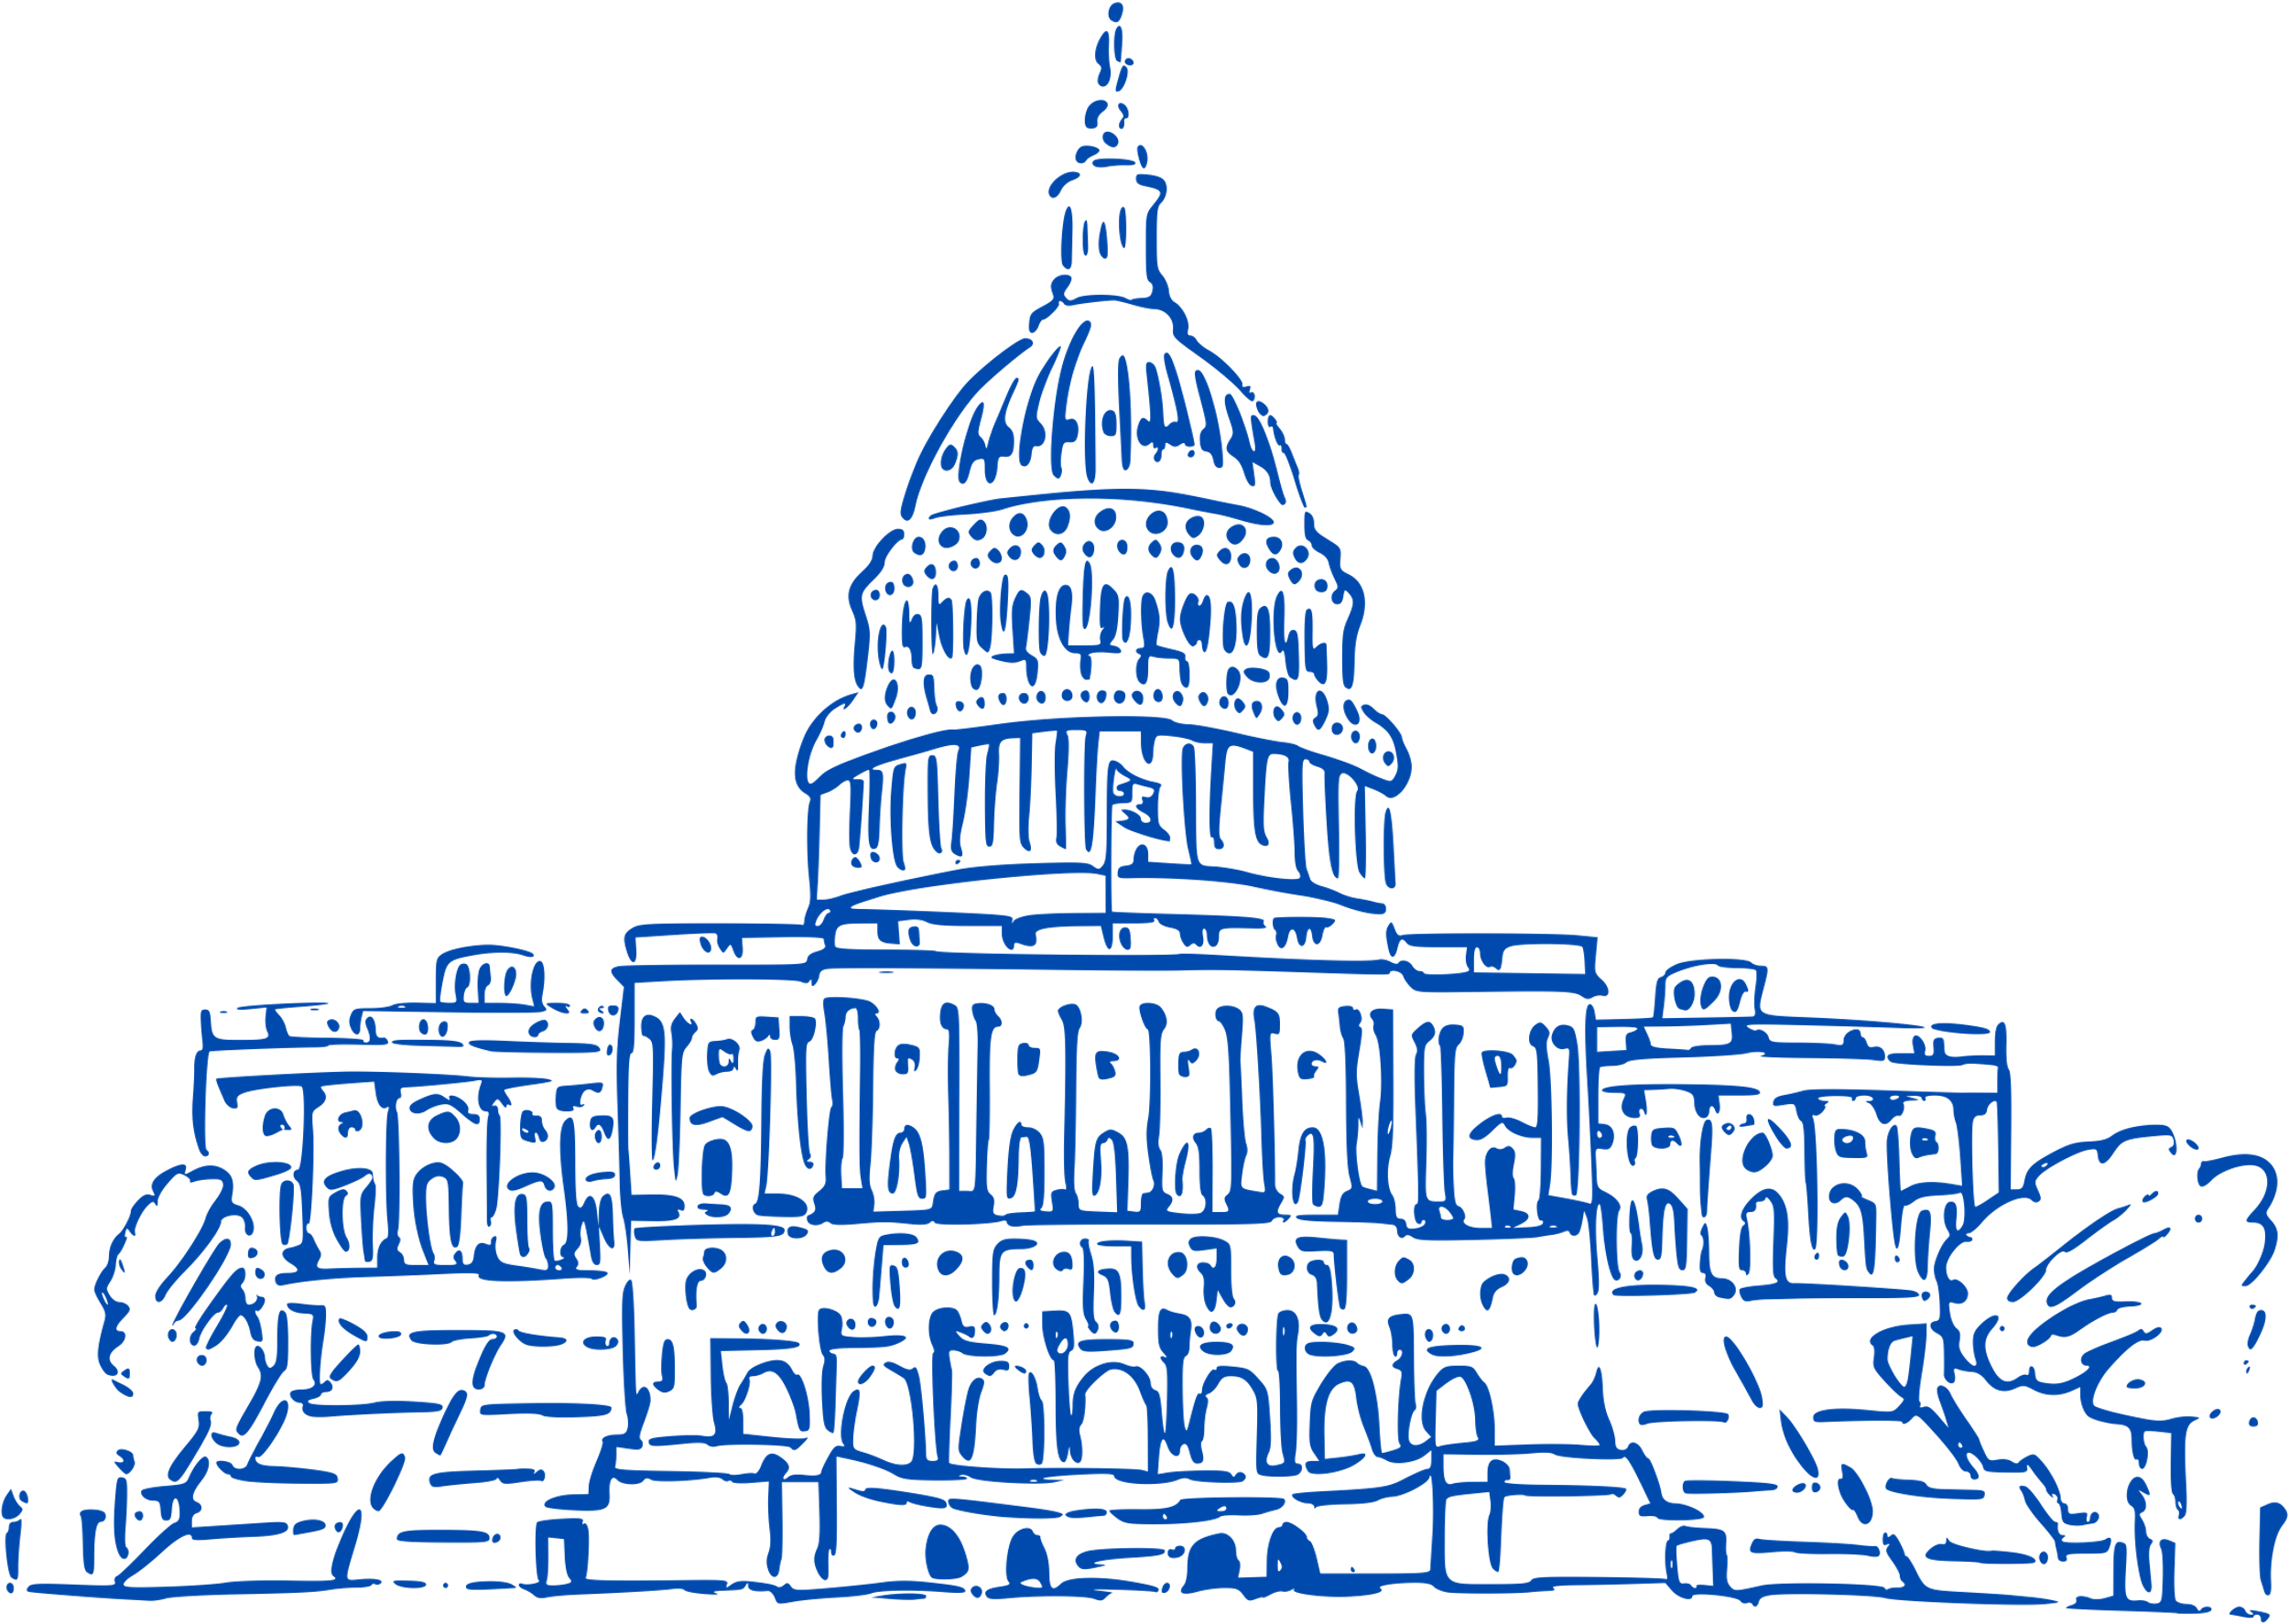







COLLEGE CONVENTION 2024
Critical Eyes, Deceptive Lies?:
Political Advertising and You
JANUARY 9, 2024
Dr. Michelle Nelson, Professor and Department Head, Department of Advertising
Kirby Cook, M.S., Doctoral Candidate, Institute of Communications Research
University of Illinois, Urbana-Champaign

Slide 2

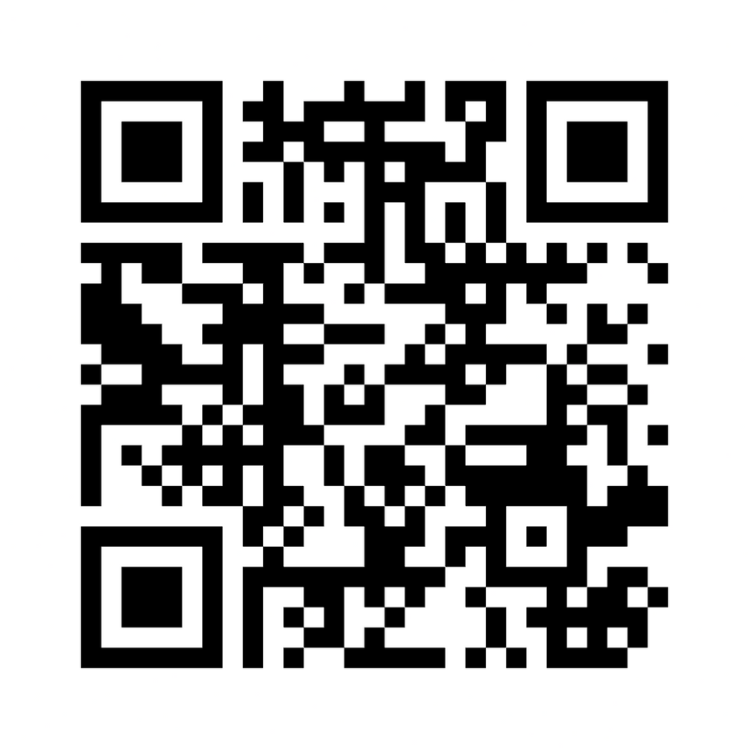
Join at menti.com | Use code 4302 7962
Notes:
https://www.mentimeter.com/app/presentation/alpi7boo5aqyhmq7rkc7htp3v37r93e7/cpeftyz8k49f/edit

Slide 3
How do we learn about political candidates?

Slide 4

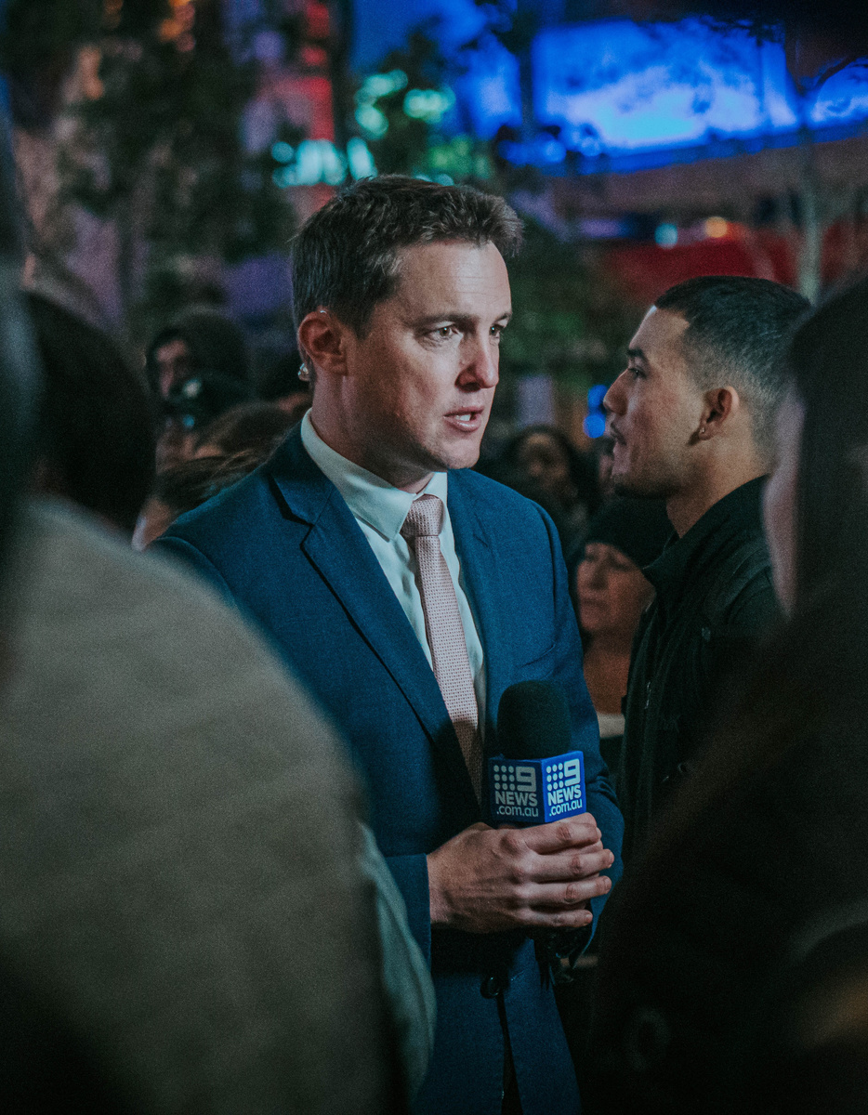

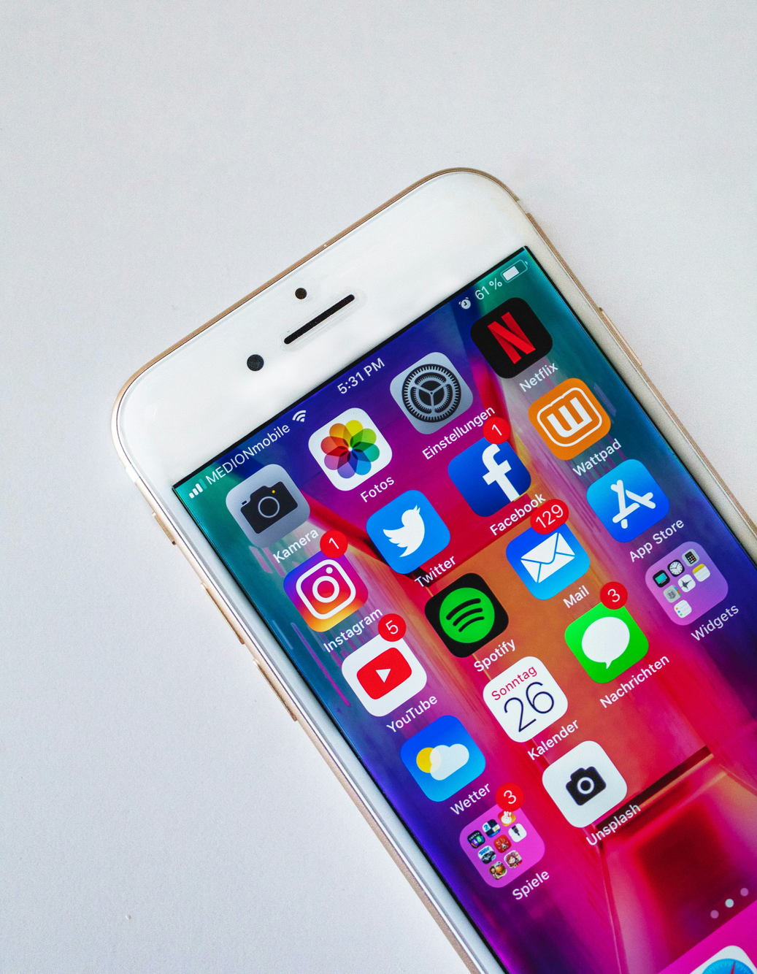
How do we learn about political candidates?
Advertising
News and debates
Other people
Social media

Slide 5
How do we learn about political candidates?
Advertising
News and debates
Other people
Social media

Slide 6
How do we learn about political candidates?
Advertising
News and debates
Other people
Social media

Slide 7
How do we learn about political candidates?
Advertising
News and debates
Other people
Social media

Slide 8
5 Objectives for Today
1
To understand the purpose of political ads in a democracy.

Slide 9
5 Objectives for Today
1
To understand the purpose of political ads in a democracy.
2
To explore the persuasion tactics used in political ads.

Slide 10
5 Objectives for Today
1
To understand the purpose of political ads in a democracy.
2
To explore the persuasion tactics used in political ads.
3
To examine the unique ways in which political advertising in the U.S. is funded and to identify funding sources of political ads.

Slide 11
5 Objectives for Today
1
To understand the purpose of political ads in a democracy.
2
To explore the persuasion tactics used in political ads.
3
To examine the unique ways in which political advertising in the U.S. is funded and to identify funding sources of political ads.
4
To understand how political advertising is regulated.

Slide 12
5 Objectives for Today
1
To understand the purpose of political ads in a democracy.
2
To explore the persuasion tactics used in political ads.
3
To examine the unique ways in which political advertising in the U.S. is funded and to identify funding sources of political ads.
4
To understand how political advertising is regulated.
5
To consider our own agency as voters in a democracy.

Slide 13


1
What is the purpose of political advertising?

Slide 14

1
What is the purpose of political advertising?
Rally
votes

Slide 15

1
What is the purpose of political advertising?
Rally
votes
Generate enthusiasm for candidate or issue

Slide 16

1
What is the purpose of political advertising?
Rally
votes
Generate enthusiasm for candidate or issue
(Re)define
candidate image

Slide 17

1
What is the purpose of political advertising?
Rally
votes
Generate enthusiasm for candidate or issue
(Re)define
candidate image
Provide
Information

Slide 18
Advertising
today
is very different than in the past.

Slide 19
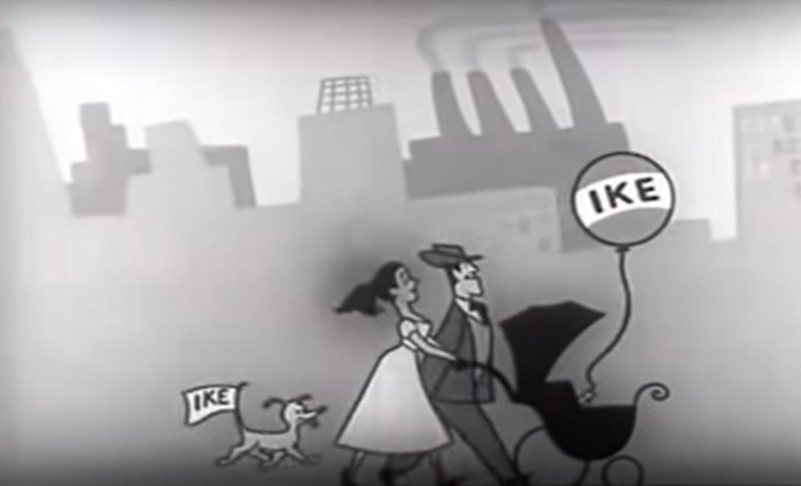
2
What are the persuasion tactics used in political ads?
Notes:
https://www.youtube.com/watch?v=Y9RAxAgksSE

Slide 20
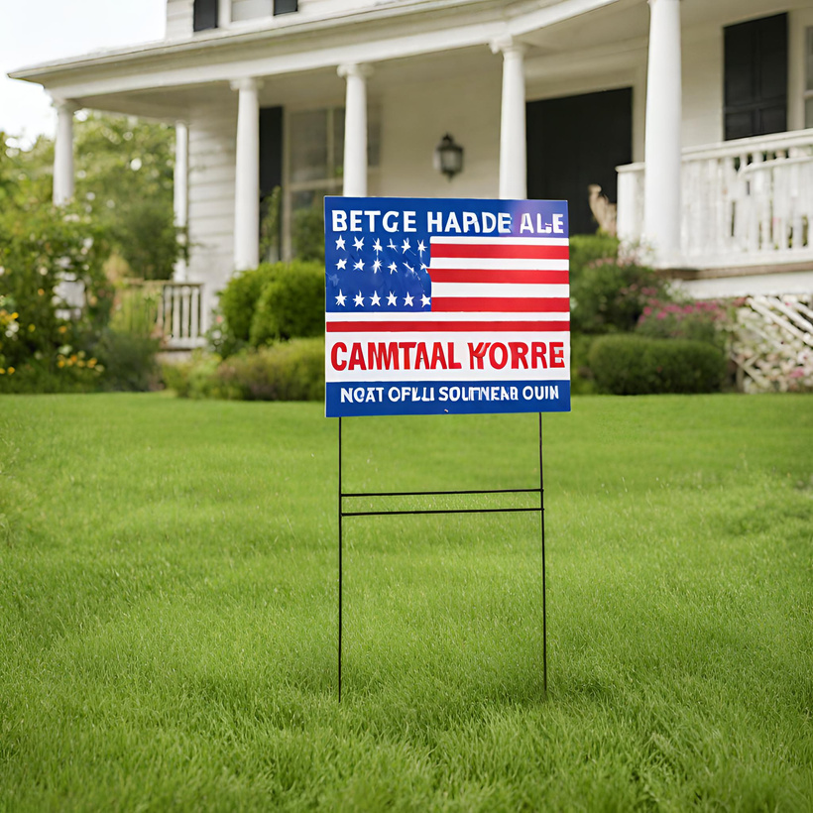
Advertising
today
ads
is very different than in the past.
It can be
difficult
VOTE for
Candidate
to tell what is advertising and what isn’t.

Slide 21

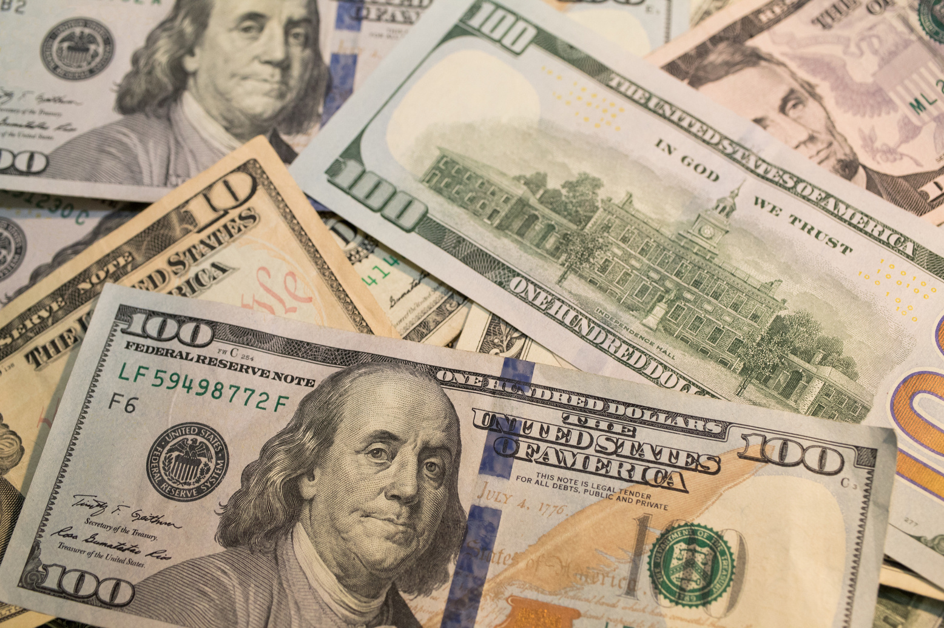
Advertising
today
is very different than in the past.
It can be
difficult
VOTE for
Candidate
to tell what is advertising and what isn’t.

Slide 22

Advertising
today
ads
AI, targeted + easy
digital distribution
is very different than in the past.
It can be
difficult
VOTE for
Candidate
to tell what is advertising and what isn’t.

Slide 23
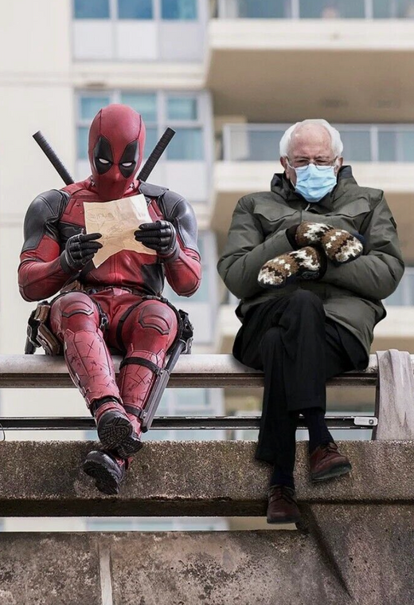
Advertising
today
ads
AI, targeted + easy
digital distribution
is very different than in the past.
It can be
difficult
VOTE for
Candidate
to tell what is advertising and what isn’t.

Slide 24
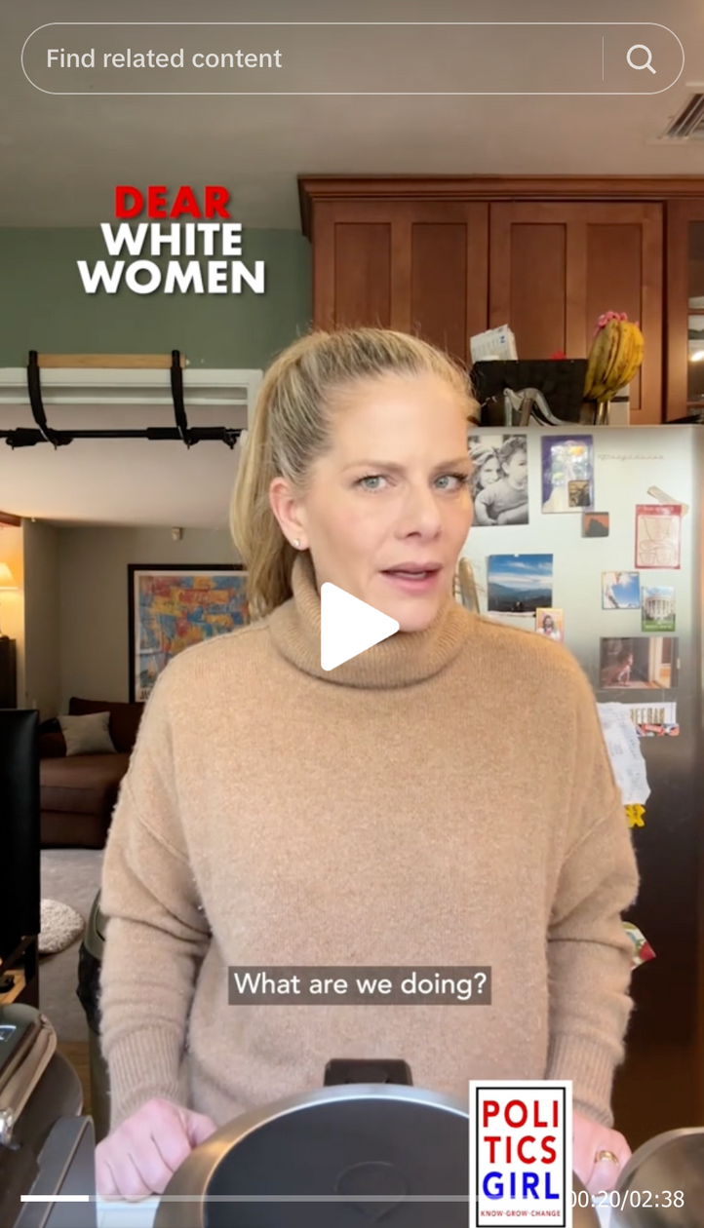
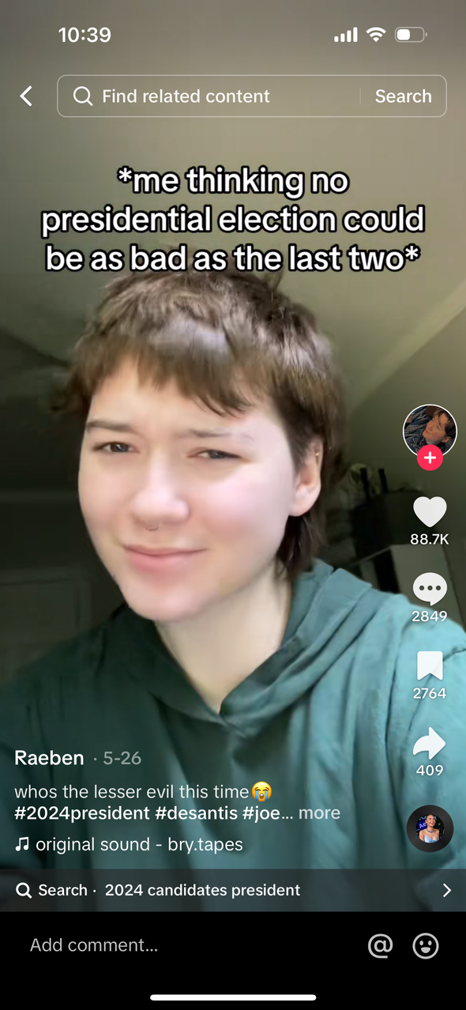
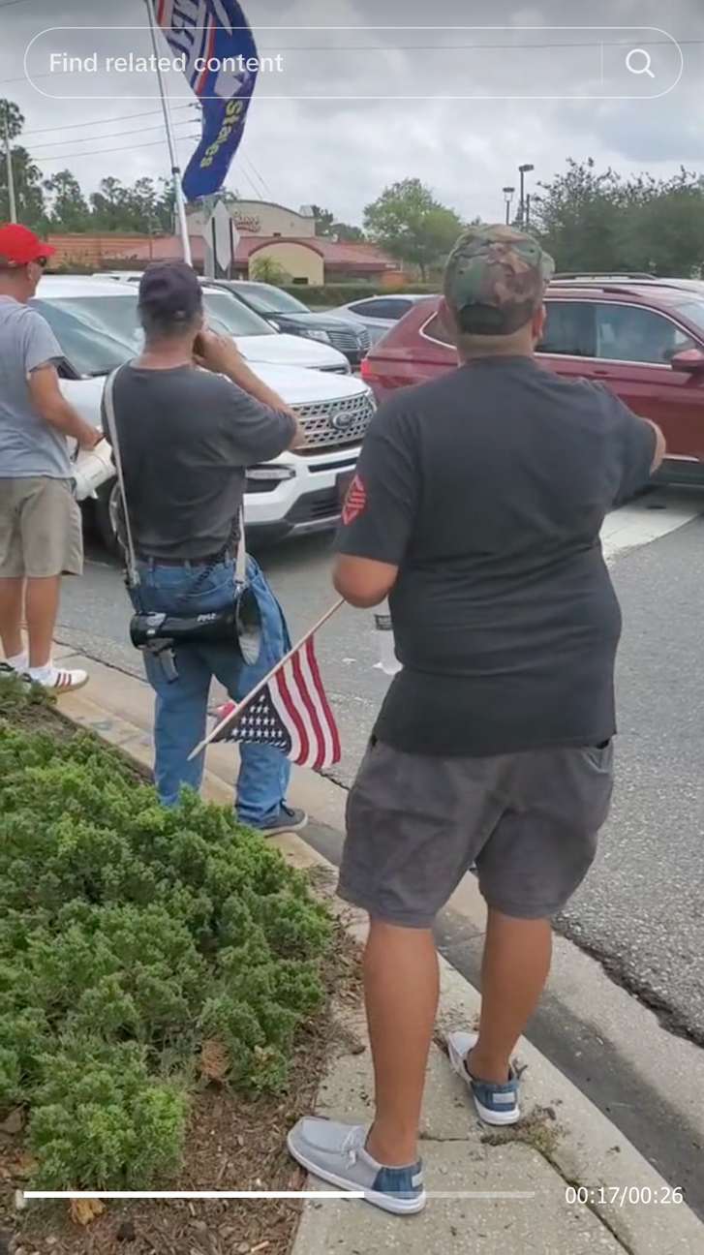

Slide 25
AI + Advertising
  can be used to generate realistic print, digital, or video ads.
  may or may not be labeled or tagged as AI.

Slide 26
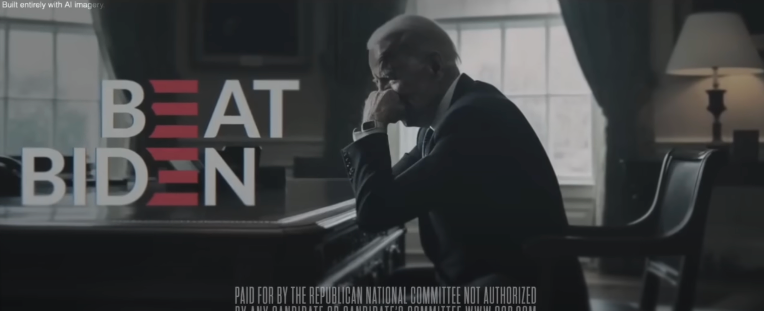
AI + Advertising
  can be used to generate realistic print, digital, or video ads.
  may or may not be labeled or tagged as AI.

Slide 27
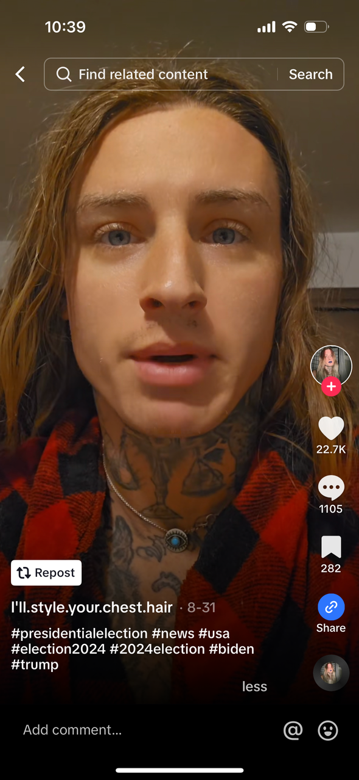
AI + Advertising
  can be used to generate realistic print, digital, or video ads.
  may or may not be labeled or tagged as AI.

Slide 28
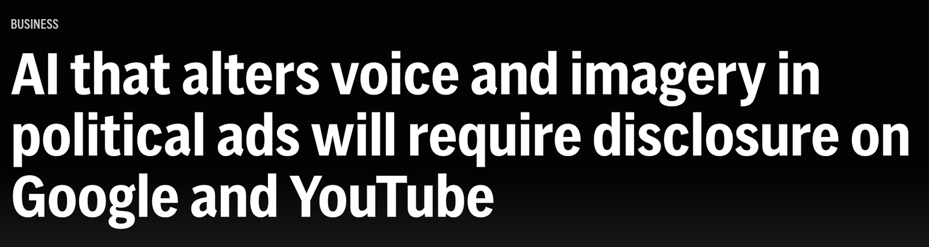

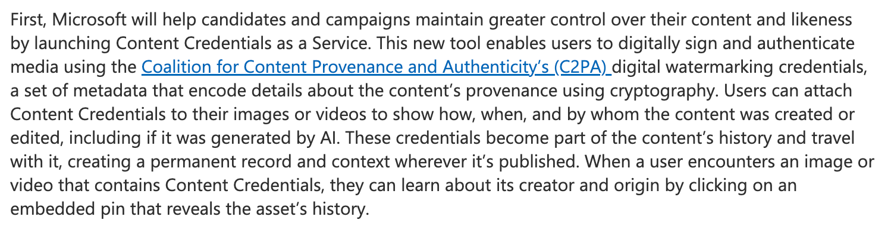


Slide 31





Stand by Your Ad
Provision of the Bipartisan Campaign Reform Act (McCain-Feingold Act) of 2002

Slide 32

Stand by Your Ad
Provision of the Bipartisan Campaign Reform Act (McCain-Feingold Act) of 2002
“I am [candidate’s name], a candidate for [position sought], and I approved this message.”

Slide 33
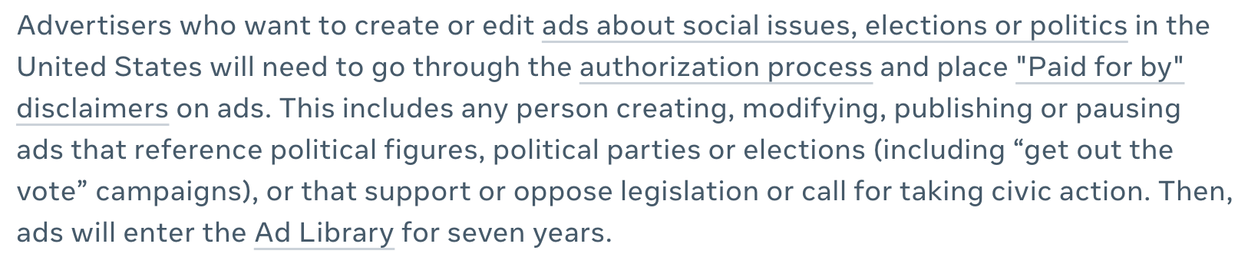
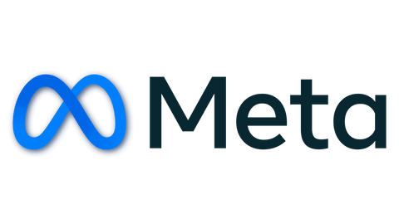
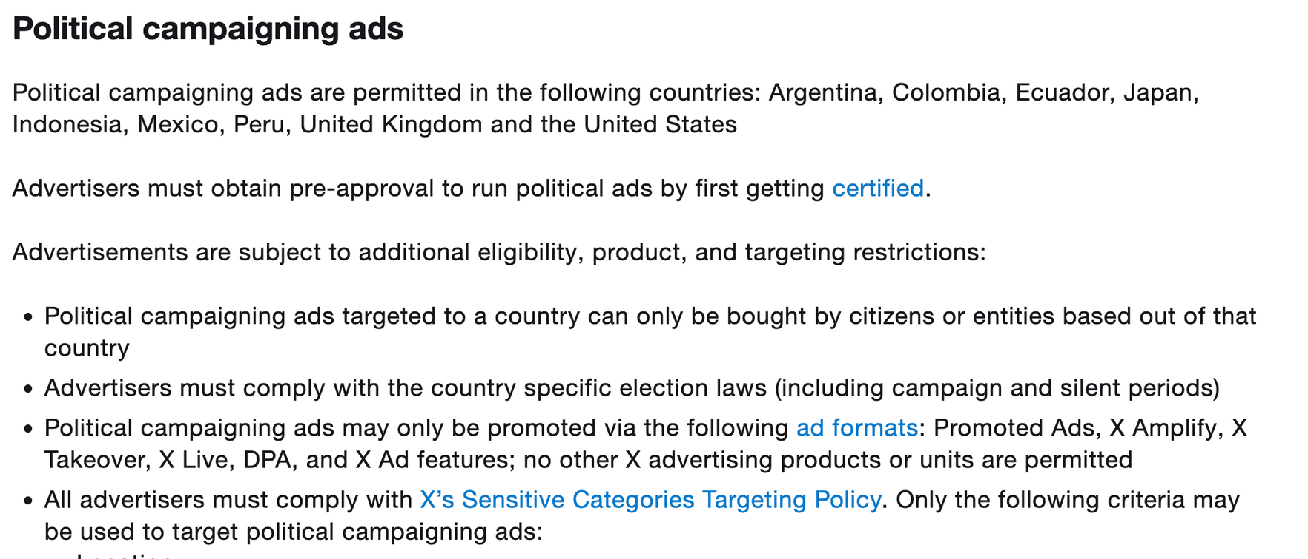


Slide 34
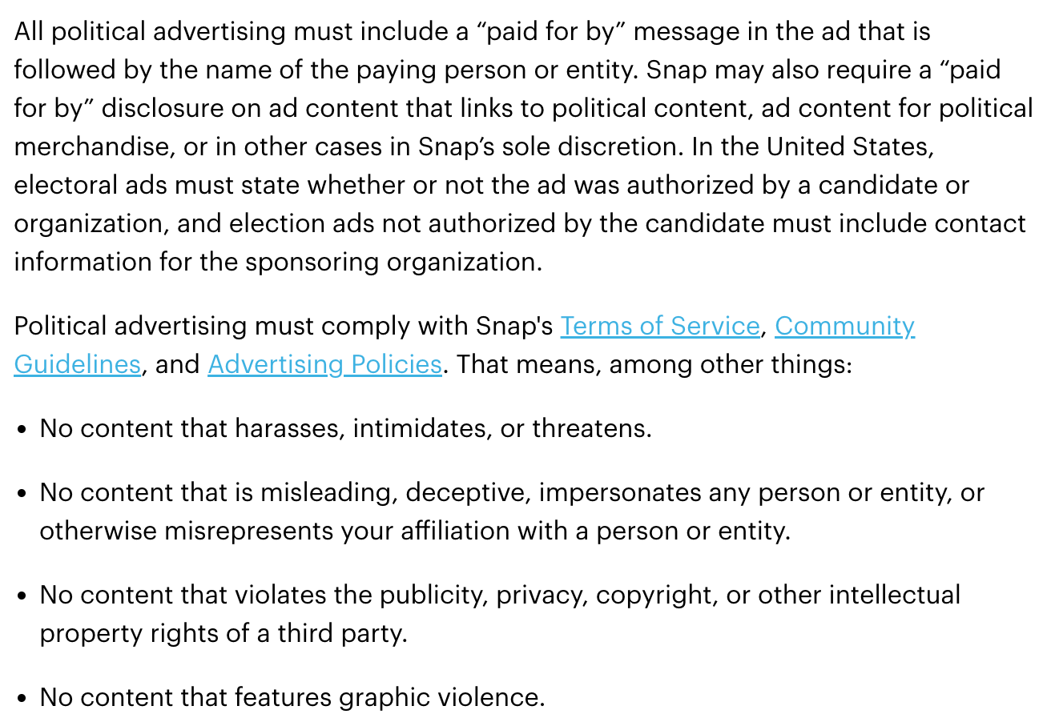


Slide 35

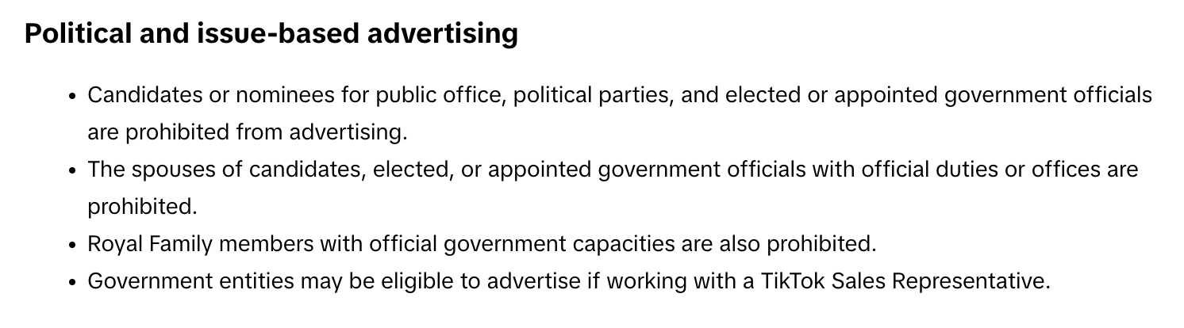

Slide 36
What can we learn from political advertising?

Slide 37


What can we learn from political advertising?
Candidate’s name

Slide 38

What can we learn from political advertising?
Candidate’s name
Candidate’s political party

Slide 39

What can we learn from political advertising?
Candidate’s name
Candidate’s political party
Prospective position/office

Slide 40

What can we learn from political advertising?
Candidate’s name
Candidate’s political party
Prospective position/office
Image/Personality

Slide 41

What can we learn from political advertising?
Candidate’s name
Candidate’s political party
Prospective position/office
Image/Personality
Values

Slide 42

What can we learn from political advertising?
Candidate’s name
Candidate’s political party
Prospective position/office
Image/Personality
Values
Stance on issues

Slide 43

What can we learn from political advertising?
Candidate’s name
Candidate’s political party
Prospective position/office
Image/Personality
Values
Stance on issues
Policies

Slide 44
2
What are the persuasion tactics used in political ads?

Slide 45

2
What are the persuasion tactics used in political ads?
Content
  Image ads
  Issue ads

Slide 46

2
What are the persuasion tactics used in political ads?
Content
Emotion
  Image ads
  Issue ads
  Enthusiasm
  Fear

Slide 47

2
What are the persuasion tactics used in political ads?
Content
Emotion
Tone
  Image ads
  Issue ads
  Enthusiasm
  Fear
  Positive
  Negative

Slide 48
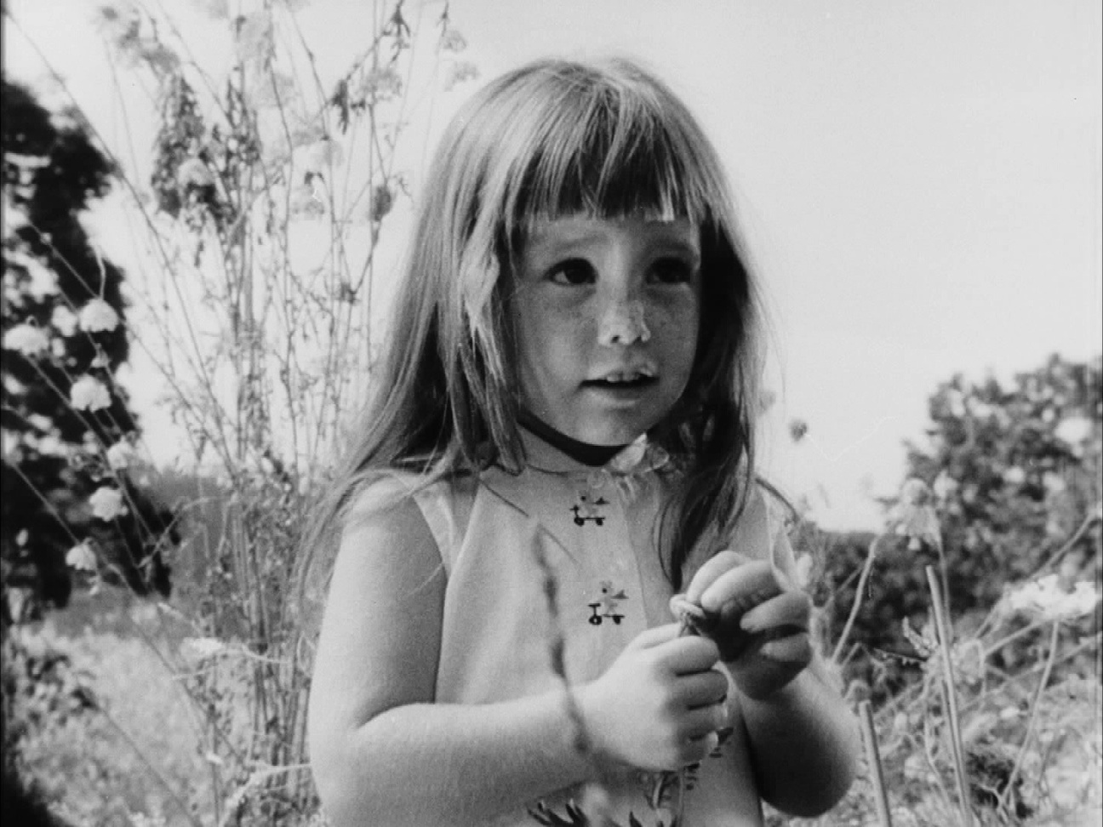
2
What are the persuasion tactics used in political ads?
Notes:
https://www.youtube.com/watch?v=dDTBnsqxZ3k

Slide 49
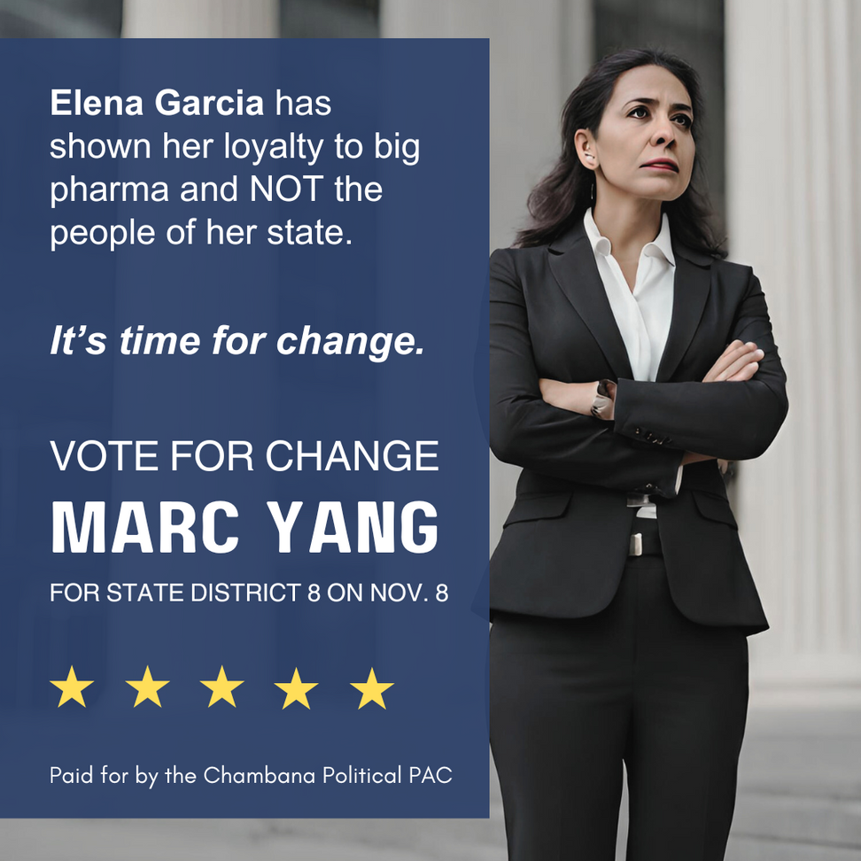

2
What are the persuasion tactics used in political ads?
DISCLAIMER: FICTITIOUS AD

Slide 50
2
What are the persuasion tactics used in political ads?
(1) Image: Naming and showing competitor
(2) Content: Making a negative claim
DISCLAIMER: FICTITIOUS AD

Slide 51
2
What are the persuasion tactics used in political ads?
(1) Image: Naming and showing competitor
(2) Content: Making a negative claim
(3) Tone: Signaling optimism
DISCLAIMER: FICTITIOUS AD

Slide 52
2
What are the persuasion tactics used in political ads?
(1) Image: Naming and showing competitor
(2) Content: Making a negative claim
(3) Tone: Signaling optimism
(4) Positive call to action: vote for change/Marc Yang
DISCLAIMER: FICTITIOUS AD

Slide 53
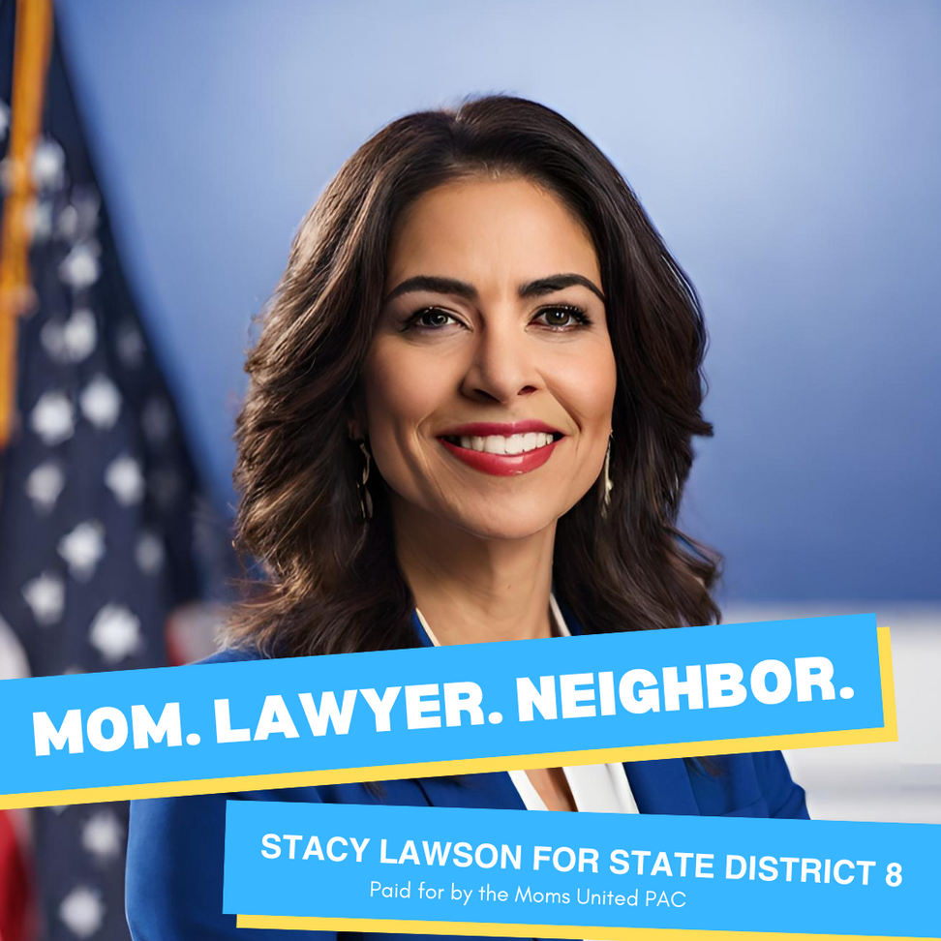
2
What are the persuasion tactics used in political ads?
DISCLAIMER: FICTITIOUS AD

Slide 54
2
What are the persuasion tactics used in political ads?
(1) Image: Naming and showing candidate
DISCLAIMER: FICTITIOUS AD

Slide 55
2
What are the persuasion tactics used in political ads?
(1) Image: Naming and showing candidate
(2) Content/Tone: Positive, qualified, relatable, patriotic
(3) Call to action: vote for Stacy Lawson
DISCLAIMER: FICTITIOUS AD

Slide 56
2
What are the persuasion tactics used in political ads?
(1) Image: Naming and showing candidate
(2) Content/Tone: Positive, qualified, relatable, patriotic
(3) Call to action: vote for Stacy Lawson
DISCLAIMER: FICTITIOUS AD

Slide 57


How is political advertising funded in the U.S. and how can voters identify the funding source?
3
6

Slide 58
How is political advertising funded in the U.S. and how can voters identify the funding source?
3
Who pays?
  Candidates
  Individuals
  Unions
  Corporations
  PACs, Super PACs
6

Slide 59
How is political advertising funded in the U.S. and how can voters identify the funding source?
3
Who pays?
What is a PAC?
  Candidates
  Individuals
  Unions
  Corporations*
  PACs, Super PACs
  Political Action Committee
    Organized to raise and spend money in order to elect and defeat candidates.
    PAC may represent businesses, groups, or ideological interests.
*Corporations can spend an unlimited amount of money (“Citizens United” Supreme Court case, 2010).
6

Slide 60

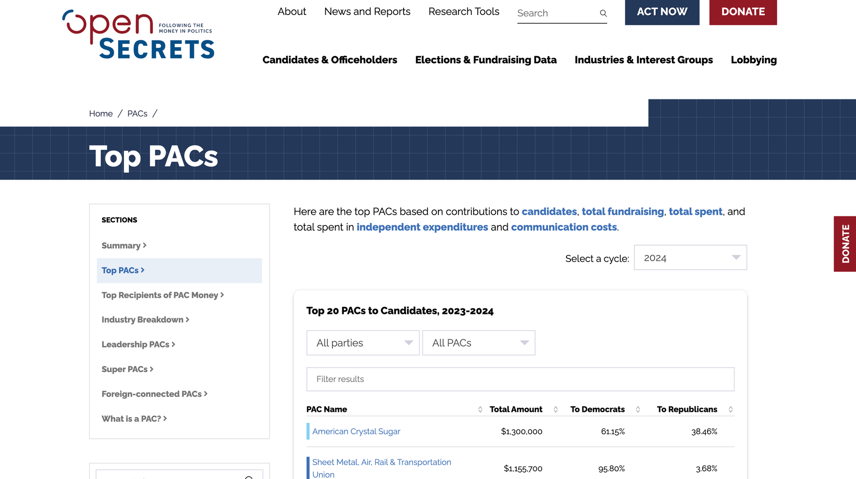


Slide 61

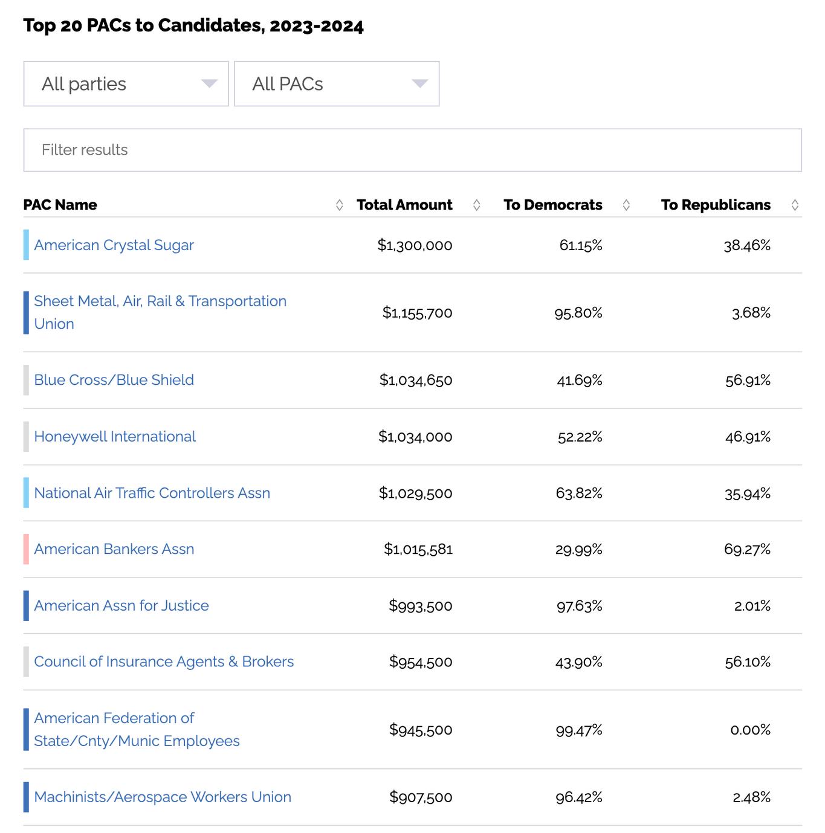

Slide 62
How is political advertising funded in the U.S. and how can voters identify the funding source?
3
DISCLAIMER: FICTITIOUS AD
6

Slide 63

How is political advertising funded in the U.S. and how can voters identify the funding source?
3
DISCLAIMER: FICTITIOUS AD
6

Slide 64
How is political advertising funded in the U.S. and how can voters identify the funding source?
3
DISCLAIMER: FICTITIOUS AD
6

Slide 65
How is political advertising funded in the U.S. and how can voters identify the funding source?
3
DISCLAIMER: FICTITIOUS AD
6

Slide 66
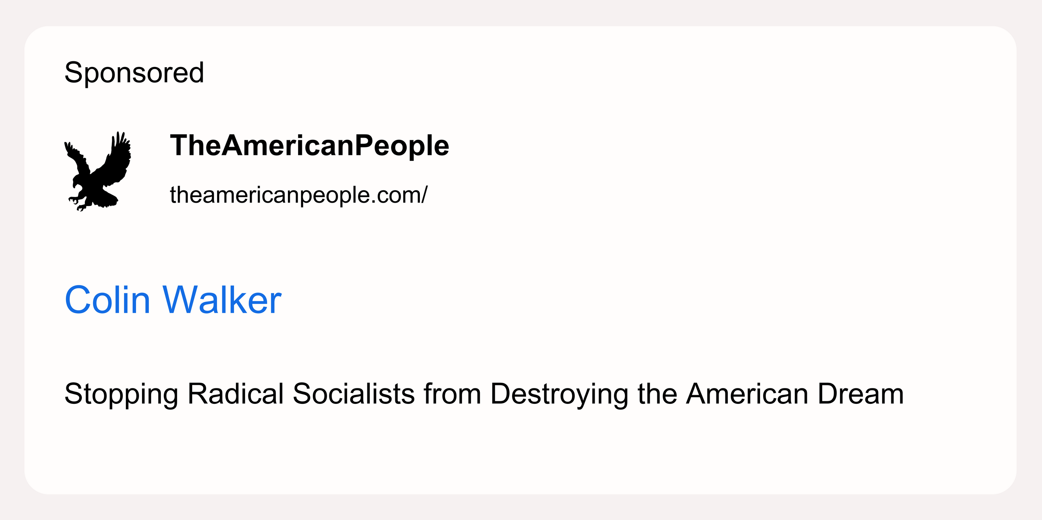
How is political advertising funded in the U.S. and how can voters identify the funding source?
3
DISCLAIMER: FICTITIOUS AD
6

Slide 67
How is political advertising funded in the U.S. and how can voters identify the funding source?
3
DISCLAIMER: FICTITIOUS AD
6

Slide 68
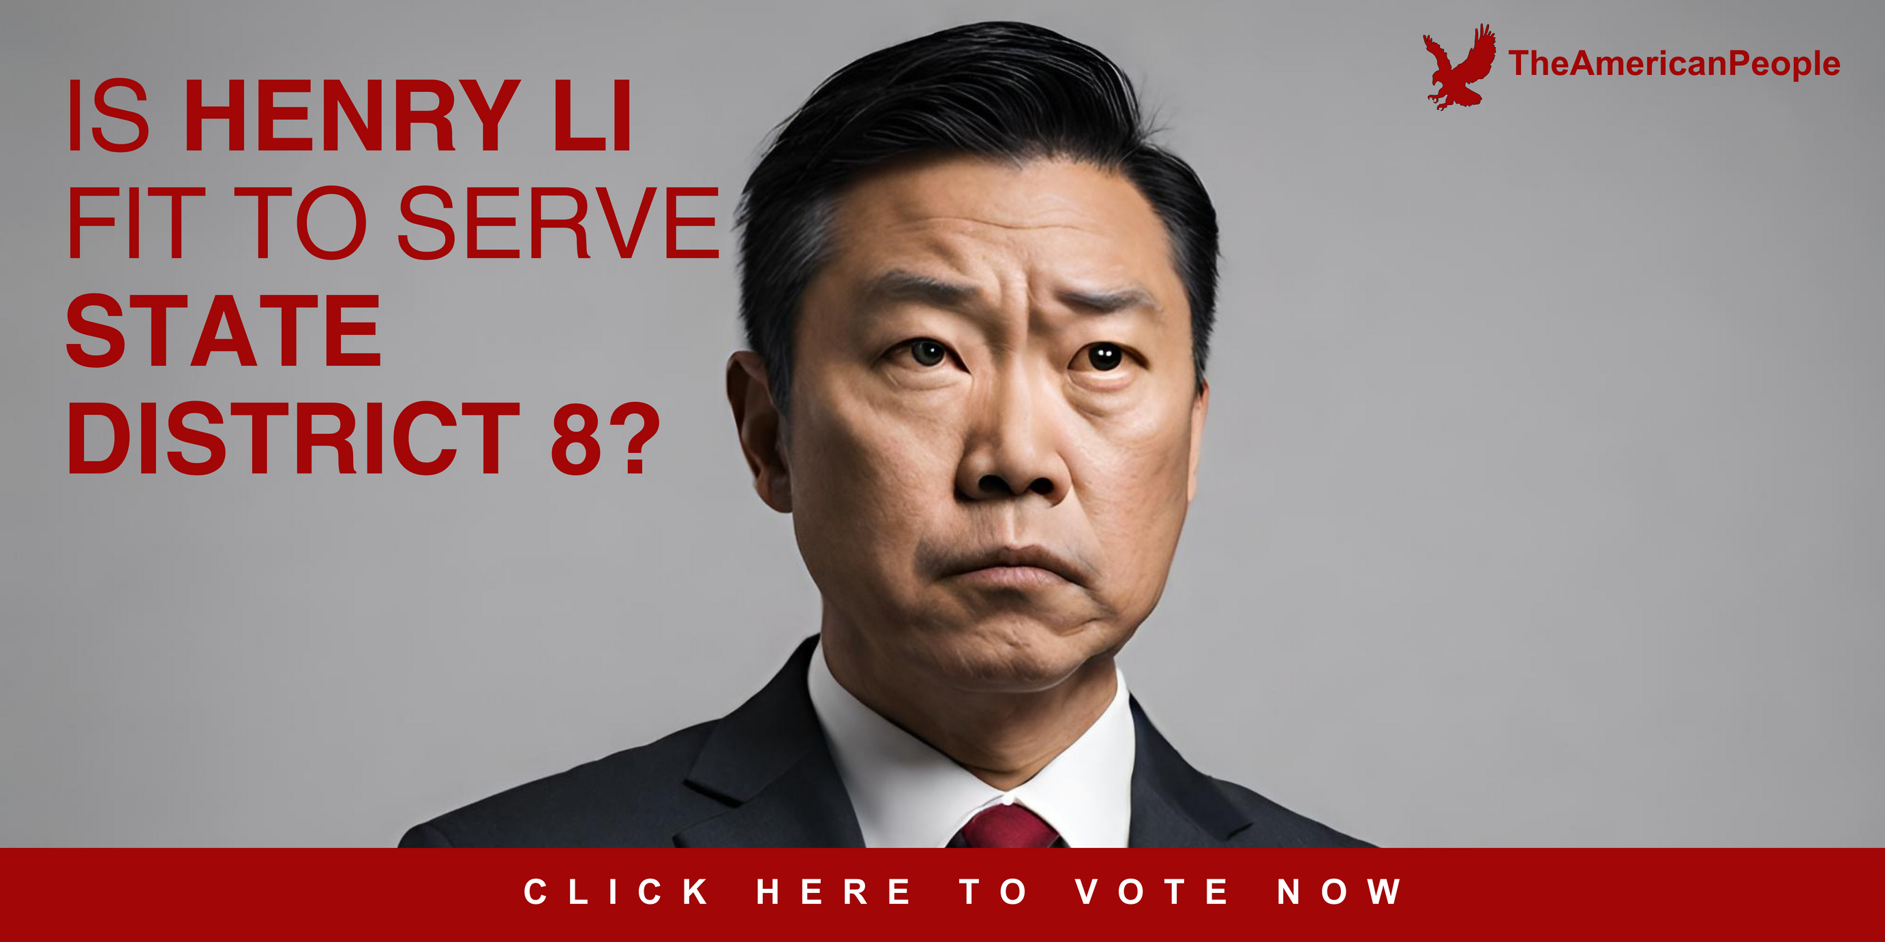
How is political advertising funded in the U.S. and how can voters identify the funding source?
3
DISCLAIMER: FICTITIOUS AD
6

Slide 69
How is political advertising funded in the U.S. and how can voters identify the funding source?
3
DISCLAIMER: FICTITIOUS AD
6

Slide 70
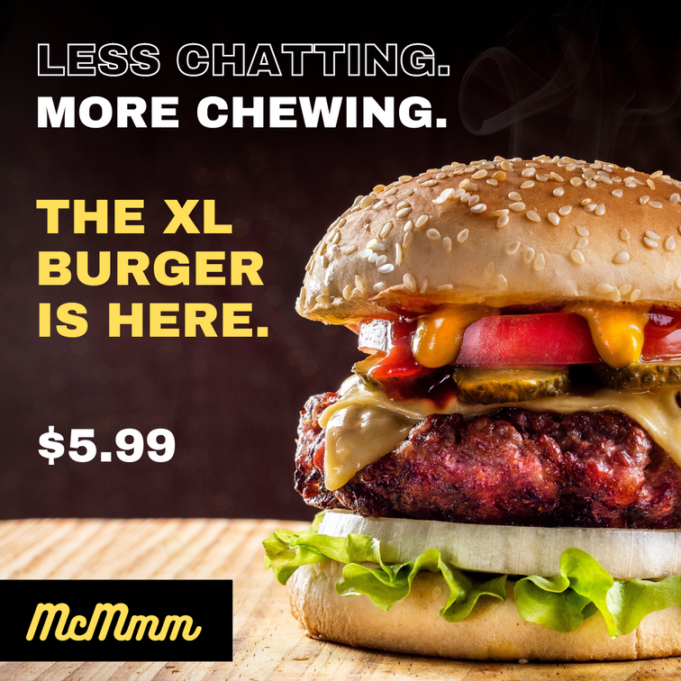
4
How is political advertising regulated in the U.S.?
COMMERCIAL ADVERTISING
6

Slide 71
4
How is political advertising regulated in the U.S.?
COMMERCIAL ADVERTISING
REGULATION
Federal Trade Commission
TRUTH IN ADVERTISING LAWS
6

Slide 72
4
How is political advertising regulated in the U.S.?
COMMERCIAL ADVERTISING
REGULATION
RESULT
Federal Trade Commission
TRUTH IN ADVERTISING LAWS
Truthful commercial ads
6

Slide 73
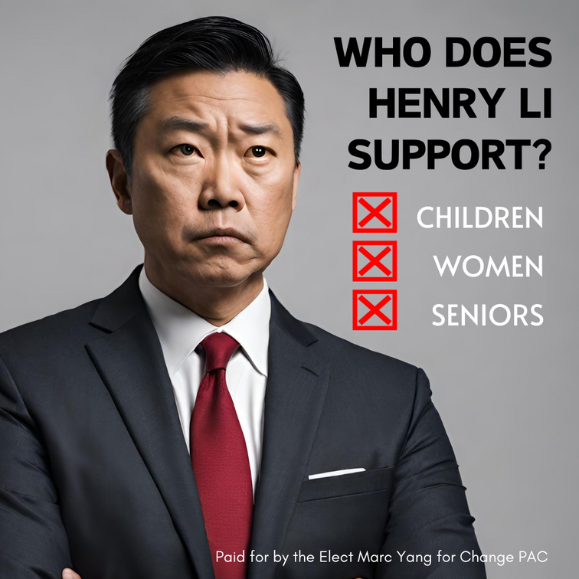
4
How is political advertising regulated in the U.S.?
COMMERCIAL ADVERTISING
REGULATION
RESULT
Federal Trade Commission
TRUTH IN ADVERTISING LAWS
Truthful commercial ads
POLITICAL ADVERTISING
6

Slide 74
4
How is political advertising regulated in the U.S.?
COMMERCIAL ADVERTISING
REGULATION
RESULT
Federal Trade Commission
TRUTH IN ADVERTISING LAWS
Truthful commercial ads
POLITICAL ADVERTISING
Federal Election Commission
public communication = freedom of speech
(1st amendment)
6

Slide 75
4
How is political advertising regulated in the U.S.?
COMMERCIAL ADVERTISING
REGULATION
RESULT
Federal Trade Commission
TRUTH IN ADVERTISING LAWS
Truthful commercial ads
POLITICAL ADVERTISING
Federal Election Commission
public communication = freedom of speech
(1st amendment)
Truthful (?)
political ads

Slide 76

No federal regulations requiring that the content of political advertising be truthful...

Slide 77


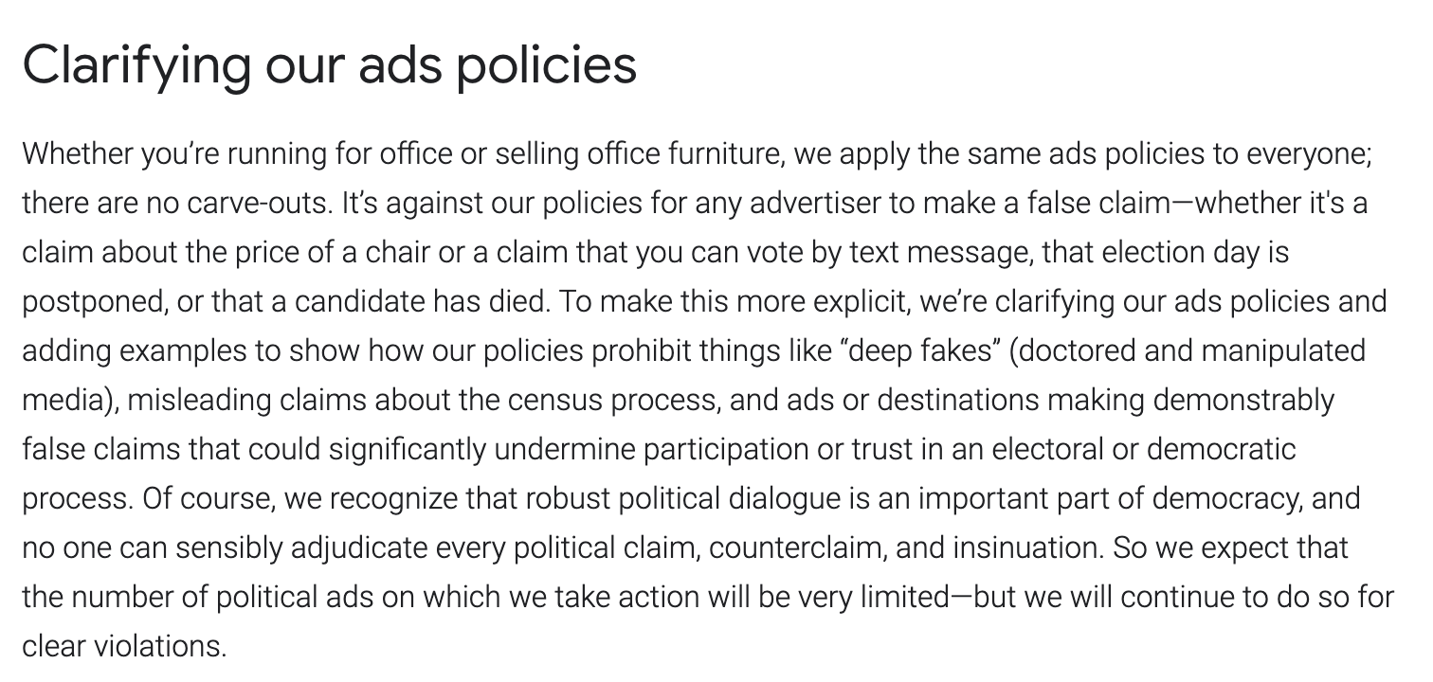

Slide 78
Most political ads do not outright lie but it’s important to note that ads can be misleading.

Slide 79
taking quotes out of context

Slide 80
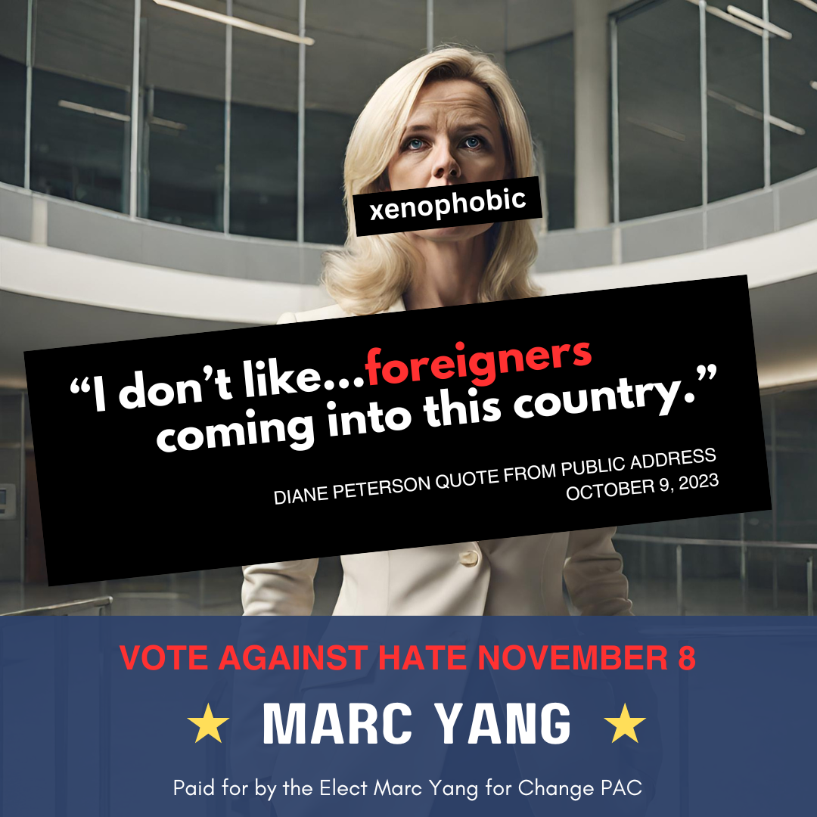
DISCLAIMER: FICTITIOUS AD

Slide 81
taking quotes out of context
altering or borrowing images

Slide 82
taking quotes out of context
altering or borrowing images
editing audio or video

Slide 83
taking quotes out of context
altering or borrowing images
editing audio or video
misleading information

Slide 84
taking quotes out of context
altering or borrowing images
editing audio or video
misleading information
leaving out information

Slide 85

KAHOOT
Notes:
https://create.kahoot.it/details/33d29670-76f6-439a-b82c-34b3ab9ab4d4

Slide 86
What do you do when you see political advertising?

Slide 87

What do you do when you see political advertising?
OUR RESEARCH
25 interviews
18 to 64 years old (eligible to vote)

Slide 88
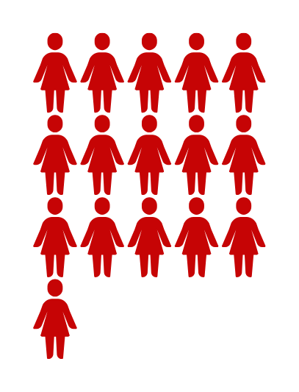


What do you do when you see political advertising?
OUR RESEARCH
16 females
8 males
1 non-binary individual
25 interviews
18 to 64 years old (eligible to vote)

Slide 89

What do you do when you see political advertising?
AVOID

Slide 90


What do you do when you see political advertising?
AVOID
ATTENTION
COPING RESPONSE

Slide 91
What do you do when you see political advertising?
Light attention
Sorting process
Counterarguing
AVOID
ATTENTION
COPING RESPONSE
Identifying the source
Searching for more information

Slide 92

5
How can we have agency as voters in a democracy?
!
You will encounter political messages in many places in the next 11 months.

Slide 93




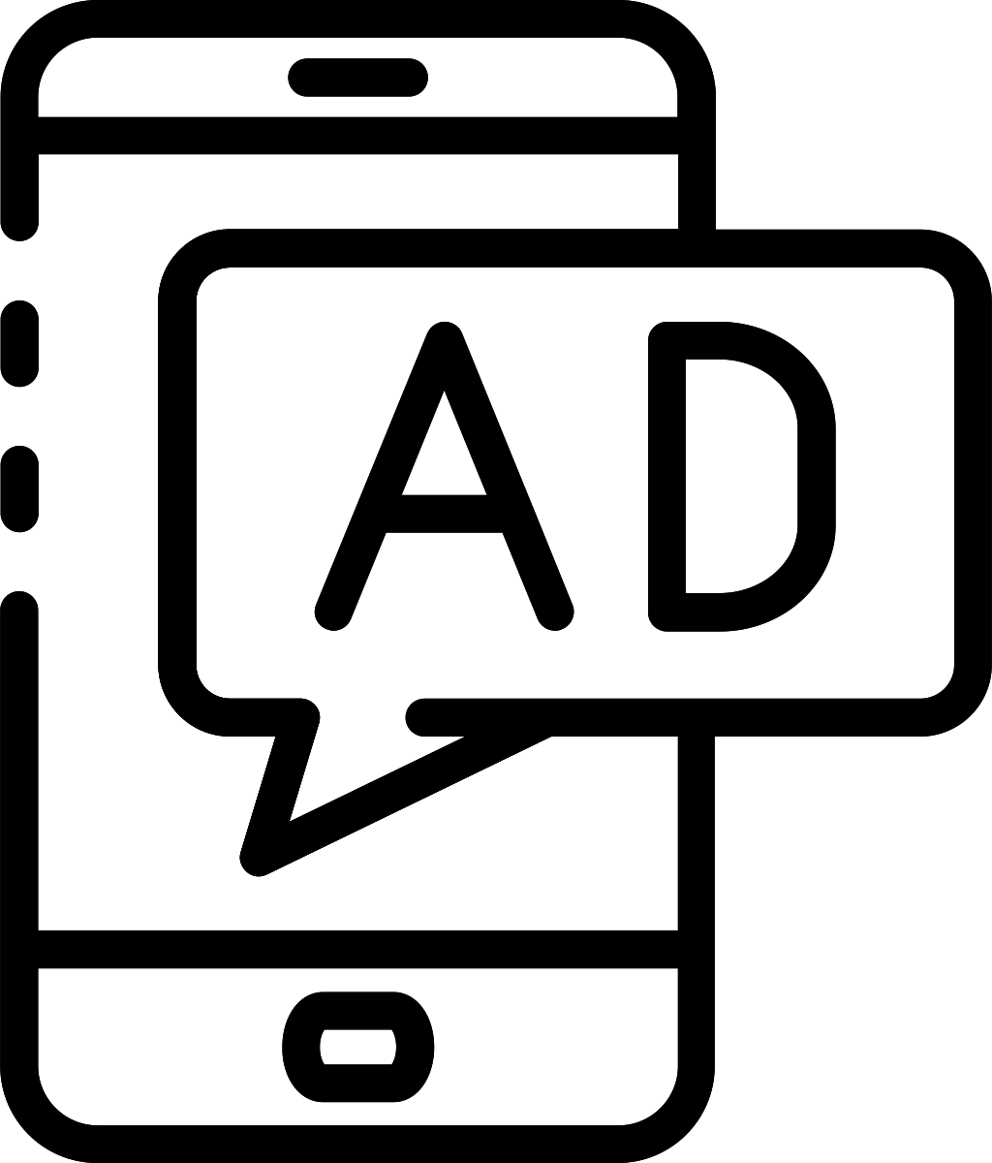


5
How can we have agency as voters in a democracy?

Slide 94

5
How can we have agency as voters in a democracy?
Be smart
Look for the source

Slide 95

5
How can we have agency as voters in a democracy?
Be smart
Consider
Look for the source
Image, Content, Tone? Intent?

Slide 96
5
How can we have agency as voters in a democracy?
Be smart
Consider
Remember
Look for the source
Image, Content, Tone? Intent?
Easy to spread unverified information

Slide 97
1
Political advertising CAN
provide valuable information...

Slide 98
1
2
Political advertising CAN
provide valuable information...
BUT be critical about what you see and look across a variety of sources to get your information.

Slide 99
1
2
3
Political advertising CAN
provide valuable information...
BUT be critical about what you see and look across a variety of sources to get your information.
Take the time to BE an informed voter and VOTE.

Slide 100

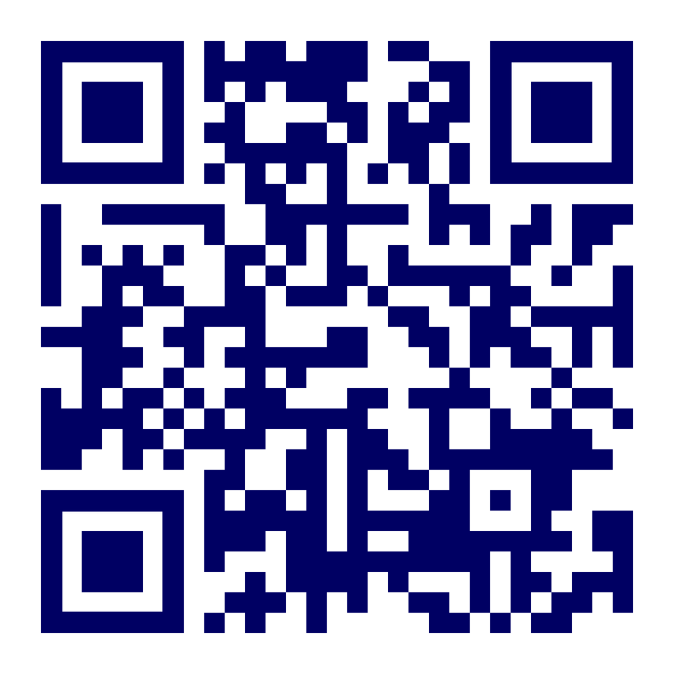

THANK YOU
Michelle Nelson
nelsonmr@illinois.edu
Kirby Cook
kmlcook@illinois.edu
Scan for voter
resources!

