Slide 1
Leading Through Crisis
Meredith Whipple Callahan Arif Virani

Slide 2
Agenda
Orient to the realities of the world today
Understand what is underlying leadership and organizational responses to these changes
Identify what’s missing and the bigger leadership invitation
Discuss our thoughts and reactions together

Slide 3
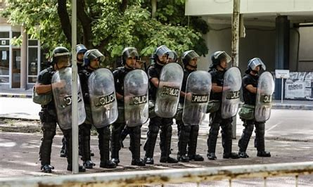
The world today

Slide 4
We are shifting from a VUCA to a FUCA world
V
F
olatile
undamental
U
ncertain
U
nravelling of
C
omplex
C
ollective
A
mbiguous
A
greements

Slide 5
What is your experience of the current moment?

Slide 7
“SoFi, the venture-backed finance company, and others have tasked black employees with deciding where corporate donations should go and attending company listening sessions about race.”
Source: The Washington Post, “Corporations Say They Support Black Lives Matter. Their Employees Doubt Them”
Notes:
Nuance - change in not only what you’re doing, but how you’re doing it

Slide 8
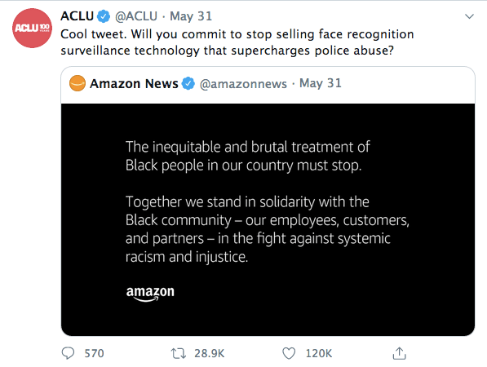

Slide 9
Leaders who get it wrong demonstrate one or more of the following failures modes:
Not taking time to learn from the wisdom of others
Failing to claim one’s own stake - individually and organizationally - in a situation
Remaining blind to the nuances of the situation
Missing the opportunity to meaningfully reaffirm values and purpose
Failing to shift the business itself to address the new reality (e.g., realigning products and services, as well as the business’s core way of operating)

Slide 10
The challenge is reflected in a disproportionate focus on ‘agile’ leadership
ag·ile
/ˈajəl/
Flexible, adaptable, and fast-moving, particularly in regards to decision making.
Sources: Forbes

Slide 11
As a leader, focusing on being agile above all else risks becoming superficial

Slide 12
An alternative approach
MOVE INTO ACTION
TRIAGE YOUR SITUATION
SLOW DOWN
LOOK OUTSIDE
START WITH HONESTY
LOOK INSIDE
GROUND INTO PURPOSE
Sources: Theory U: Leading From the Future as It Emerges, Otto Schramer

Slide 14
Questions for you to consider
As a business school student preparing for leadership roles:
Where are you learning how to listen with an open mind and an open heart?
What are your own core values?
Where are you practicing being honest, even when it’s hard?
In your own life today (as an individual, in your current teams):
Are you slowing down or speeding through?

Slide 16
About Meredith Whipple Callahan
Meredith Whipple Callahan brings two decades of experience as a strategy consultant and line executive to her work in leadership development. Deeply fluent in business, Meredith helps clients find clarity, meaning, and action. She has an unparalleled ability to integrate organizational realities with personal and interpersonal wisdom. Her clients appreciate her intelligence, direct approach, and dedication to truth.
Meredith’s distinguished business career began at Bain & Company where she worked on due diligence and strategy for technology, healthcare, and private equity companies. Thereafter, she worked at Bridgewater Associates, the world’s largest hedge fund, as a manager. As a leadership executive, Meredith designed, built, and managed global leadership programs as well as led succession planning and executive development functions. Today, Meredith’s work focuses on executive coaching and organizational development in service of: leadership teams (individually and collectively), succession planning, emerging leaders, diversity and inclusion, and culture change.
Meredith is a certified coach, experienced facilitator, published author, and international speaker. She is an Associate Certified Coach with specialized certifications in strengths-based leadership, emotional intelligence, and gratitude. Her publications include Indispensable: How to Succeed at Your First Job and Beyond (Inkshares, 2018) and The Intentional Life: Reflections from Conscious Living (Potrero Press, 2019). Meredith holds a Bachelor of Arts in Religious Studies from Yale University and a Master of Business Administration from Stanford Graduate School of Business. She has been featured on CNN, in the Chicago Tribune, and on numerous podcasts and local media outlets.
Meredith lives in San Diego with her wife, two young children, and dog. She is passionate about nature, yoga, ritual, cooking, and personal evolution. Additionally, Meredith is a certified celebrant and has studied spirituality extensively at Himalayan Institute.

Slide 17
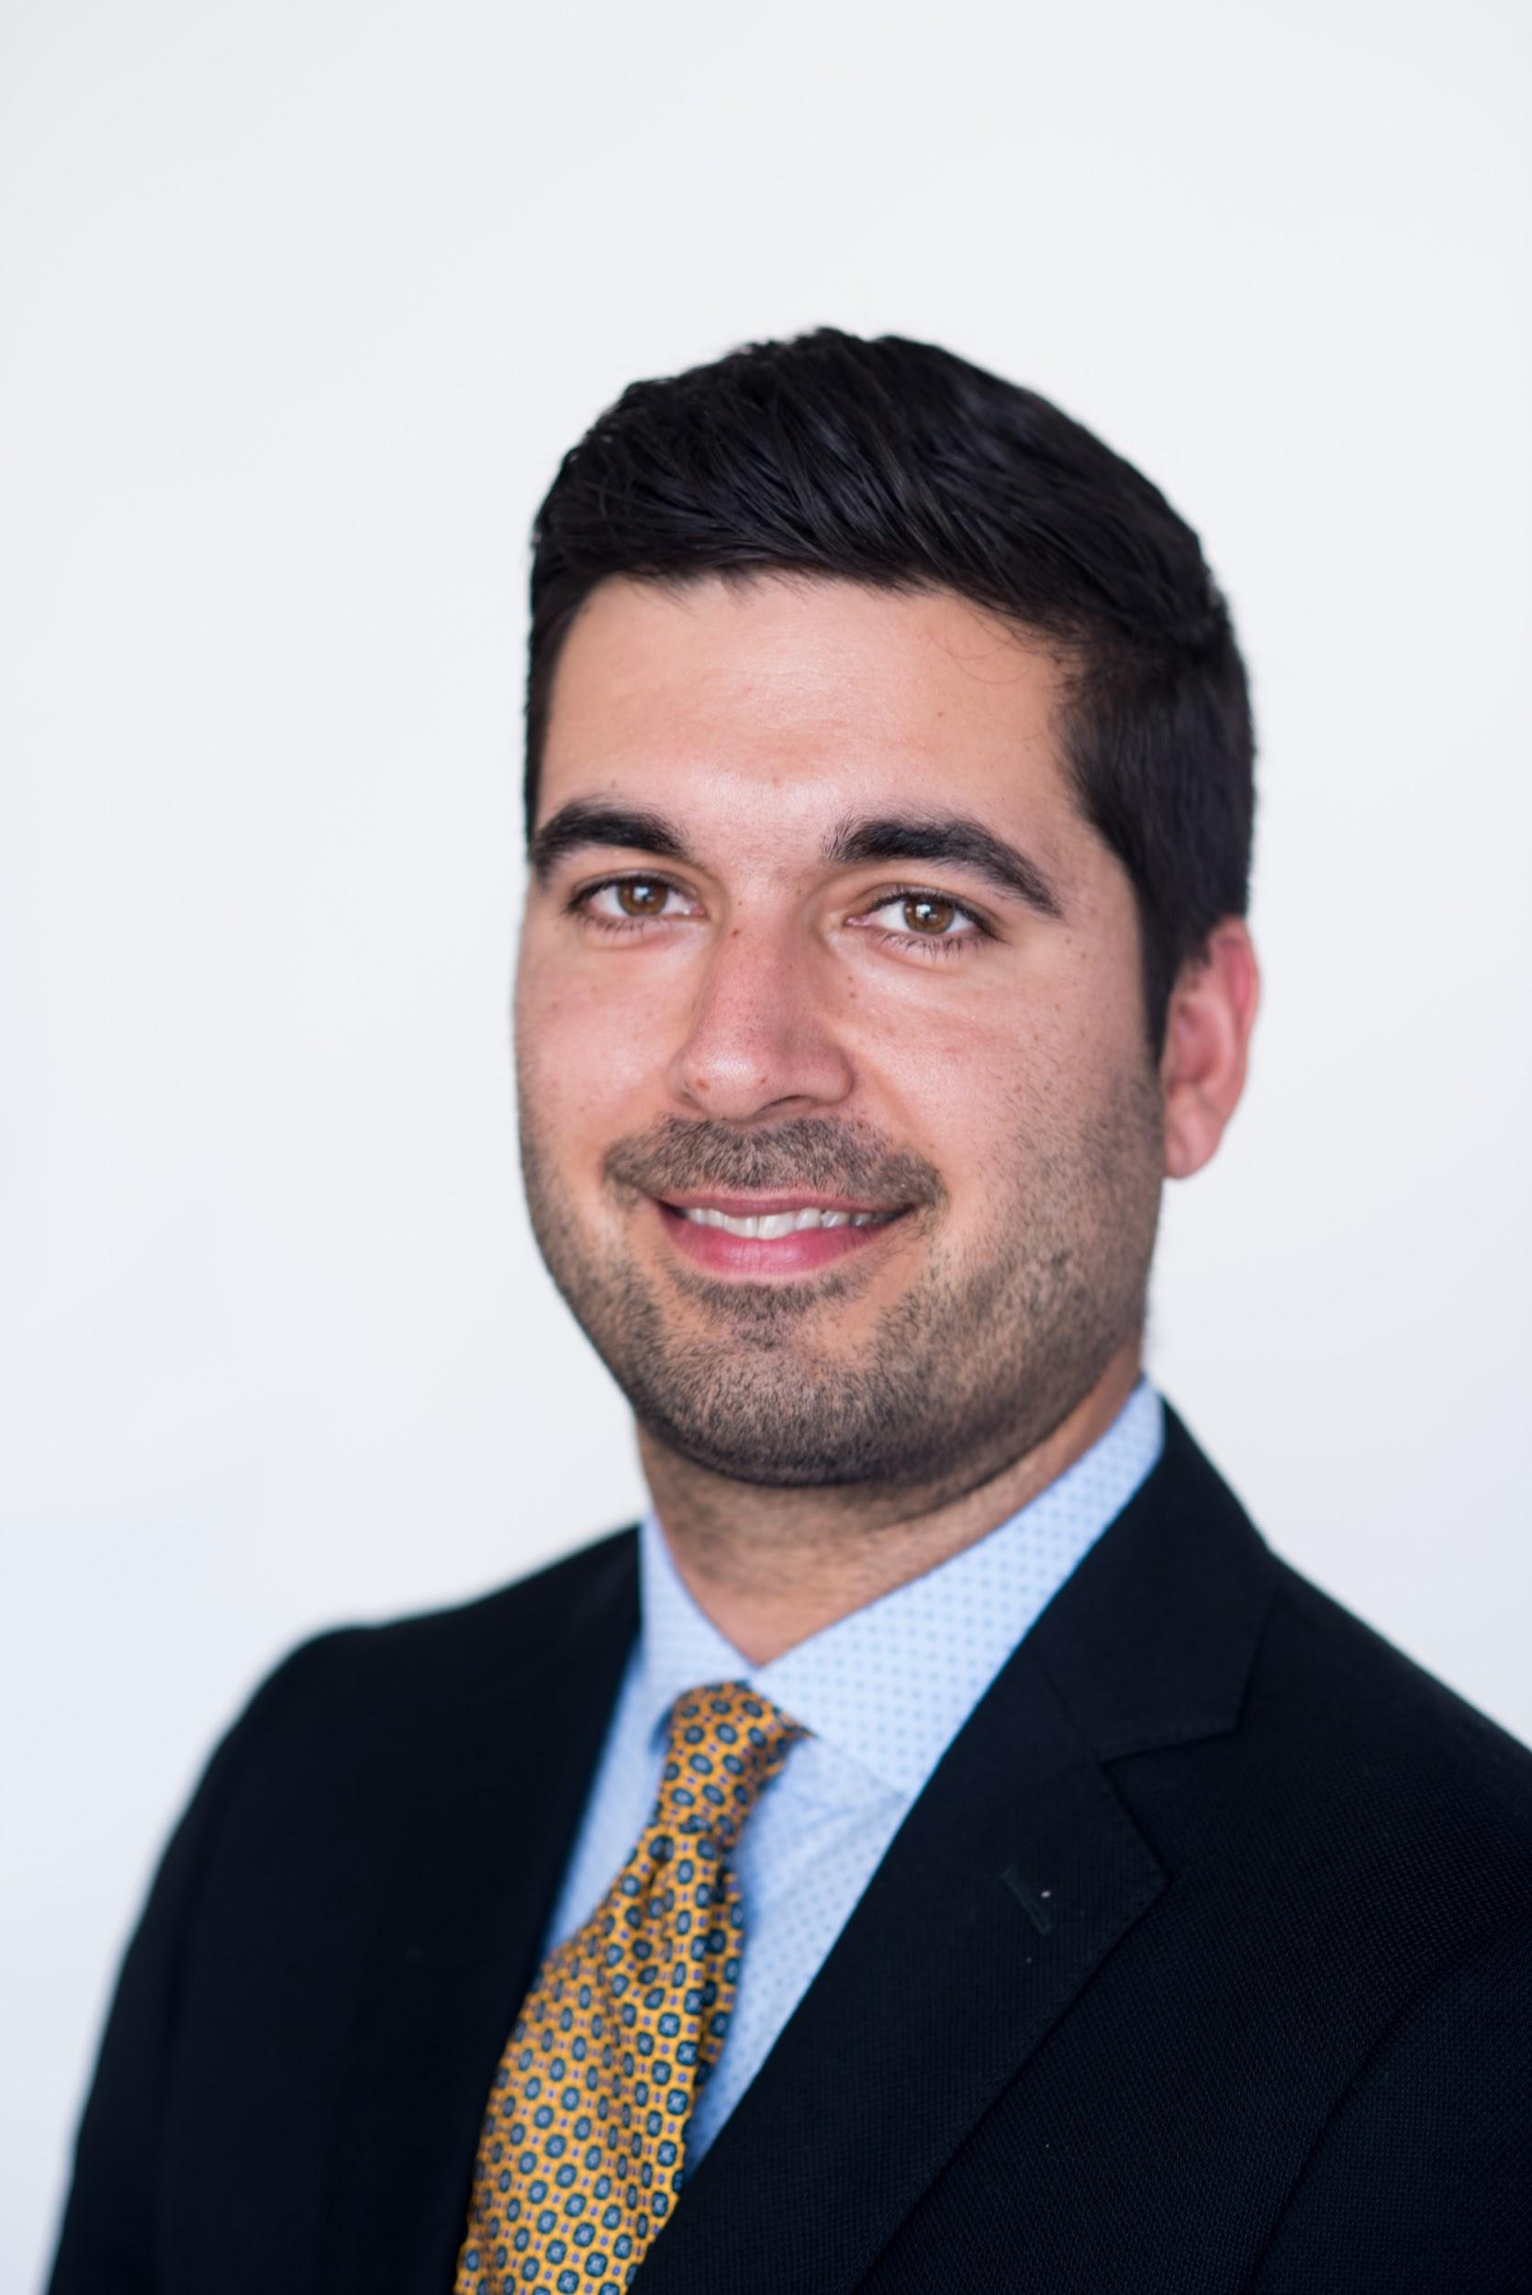
About Arif Virani
Arif Virani is a rising second-year MBA student at the McCombs School of Business at the University of Texas, Austin. He is a fellow at the McCombs Center for Leadership and Ethics, as well as a Longhorn Impact Fellow providing consulting services to organizations in the social impact space. He is also the co-president of the McCombs chapter of the Prison Entrepreneurship Program, a Texas-based non-profit that helps inmates integrate back into society.
This summer, Arif is working as an associate at makepath, an Austin-based spatial data science firm, with a focus on product and content marketing. Arif is also working collaboratively with Meredith Whipple Callahan, partner at Evolution, on perspectives on leadership in crisis.
Prior to attending McCombs, Arif was a middle school humanities teacher for 10 years in the Bay Area. He spent the previous five years working at The Menlo School in Atherton, CA, where, aside from his teaching responsibilities, he served as 6th Grade Team Lead, 7th and 8th grade Basketball coach, and Student Inclusiveness Committee chair on the school’s diversity committee. From 2017-19, he was also the school’s chapter lead of the National S.E.E.D. Project, a nationwide organization committed to improving equity and diversity in educational institutions.`
A Bay Area native, Arif currently lives in Austin with his wife, Caroline, and his dog, Rox. He loves playing and watching sports, cooking with lots of spice, crossword puzzles, hip-hop, blues, and soul, trivia, traveling, seeing live music (pre-Covid, unfortunately), losing himself in a good book or TV show, and exploring Austin.

Slide 18
Questions?
Please contact Meredith Whipple Callahan at: meredith@evolution.team

