Slide 1
Variant Interpretation
ACMG Guidelines part 1
Matheus Wilke, M.D., Ph.D.
Wilke.Matheus@mayo.edu

Slide 2
Objectives
Introduction to ACMG variant interpretation guidelines and updated recommendations.
Understand best-practices of pathogenicity evidence acquisition and integration for variant classification.
Discussion on the current limitations and the future of clinical variant interpretation.

Slide 3
Pretest questions:
1) When we classify a variant, we do it ONLY in the context of the case we are working on, we classify `if the variant is causing the disease in the patient`.
TRUE
FALSE
2) Retinoblastoma, the most malignant form of eye cancer, arises from a dominant pathogenic variant in one gene RB1, but only about 75% of people who carry this variant develop the disease. We are talking about:
Penetrance
Expressivity
3) A frequent variant (found in >5% in a population) will always be classified as `benign`
TRUE
FALSE

Slide 4
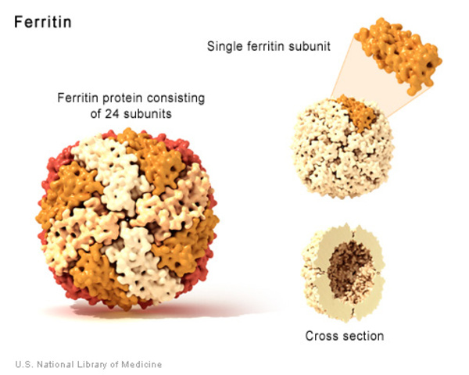
One quick story…
“ You have a pathogenic mutation in HFE which is responsible for autosomal dominant hemochromatosis”

Slide 5
One quick story…
“ You have a pathogenic mutation in HFE which is responsible for autosomal dominant hemochromatosis”
H63D is considered to be the “minor” variant, which seldom causes significant iron overload, even when it is present in compound heterozygosity with C282Y.
“RISK ALLELE”

Slide 6
One quick story…
“ You have a pathogenic mutation in HFE which is responsible for autosomal dominant hemochromatosis”
Wrong terminology
Wrong Inheritance pattern…
How can we all speak the same `language`?

Slide 7
Established a common framework and criteria for variant classification

Slide 8
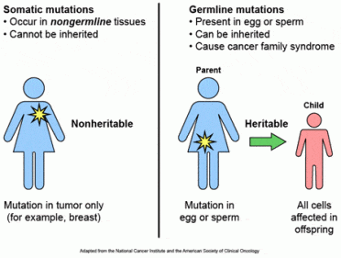
2015 ACMG Guidelines
PMID: 25741868
These recommendations primarily apply to genetic tests used in clinical laboratories including genotyping, single genes, panels, exomes and genomes.
It is not intended for the interpretation of somatic variation, pharmacogenomic variants, or variants in genes associated with multigenic non-Mendelian complex disorders.
https://positivebioscience.com/somatic-mutations-vs-germline-mutations/

Slide 9
2015 ACMG Guidelines
These recommendations primarily apply to genetic tests used in clinical laboratories including genotyping, single genes, panels, exomes and genomes.
It is not intended for the interpretation of somatic variation, pharmacogenomic variants, or variants in genes associated with multigenic non-Mendelian complex disorders.
Care must be taken when applying these rules to candidate genes (“genes of uncertain significance”, GUS)
This report recommends the use of specific standard terminology: ‘pathogenic’, ‘likely pathogenic’, ‘uncertain significance’, ‘likely benign’, and ‘benign’ to describe variants identified in Mendelian disorders.

Slide 10
2015 ACMG Guidelines
A variant which is proven to be deleterious to protein or gene function and is associated with a particular human disease phenotype.
A variant that does not appear to have a deleterious effect often associated with a “normal” human phenotype.

Slide 11
What is `Likely`? The rules proposed to classify sequence variants follows is a heuristic system for variant classification that is compatible with a formal, quantitative, Bayesian classifier.
B
LB
VUS
LP
P
<1%
10%
Probability of Pathogenicity
90%
99%

Slide 12
2015 ACMG Guidelines
Terminology
In the past…
Mutation
Polymorphism
Permanent change in the nucleotide sequence
Variant with a frequency above 1%.

Slide 13
2015 ACMG Guidelines
Terminology
Variant
Variant
Permanent change in the nucleotide sequence
Variant with a frequency above 1%.
the following modifiers: (1) pathogenic, (2) likely pathogenic, (3) uncertain significance, (4) likely benign, or (5) benign.

Slide 14
Use of ClinGen
2015 ACMG Guidelines
They anticipated “that those working in specific disease groups should continue to develop more focused guidance regarding the classification of variants in specific genes given that the applicability and weight assigned to certain criteria may vary by gene and disease” (Richards et al., 2015)

Slide 15
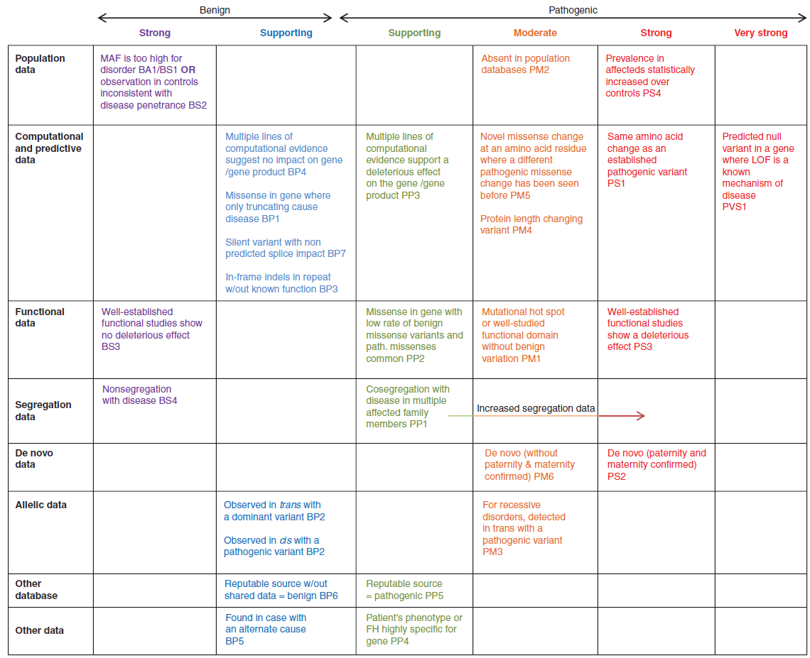
2015 ACMG Guidelines
The guideline defined 28 criteria, with codes that addressed types of variant evidence. Each evidence type or criterion code was assigned a direction, benign (B) or pathogenic (P), and a level of strength: stand‐alone (A), very strong (VS), strong (S), moderate (M), or supporting (P).

Slide 16
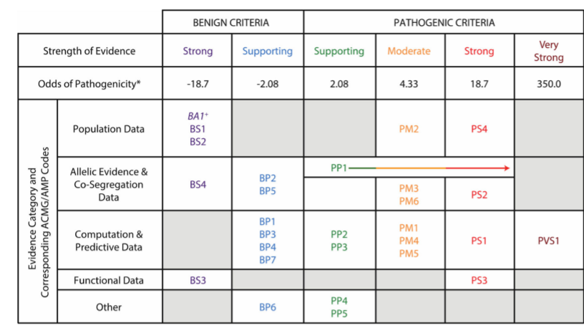
ACMG 2015 guidelines discrete criteria's have a strong quantitative correlation with the odds of pathogenicity of a variant.

Slide 17
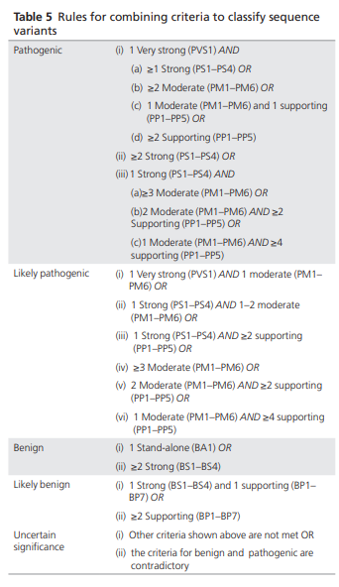
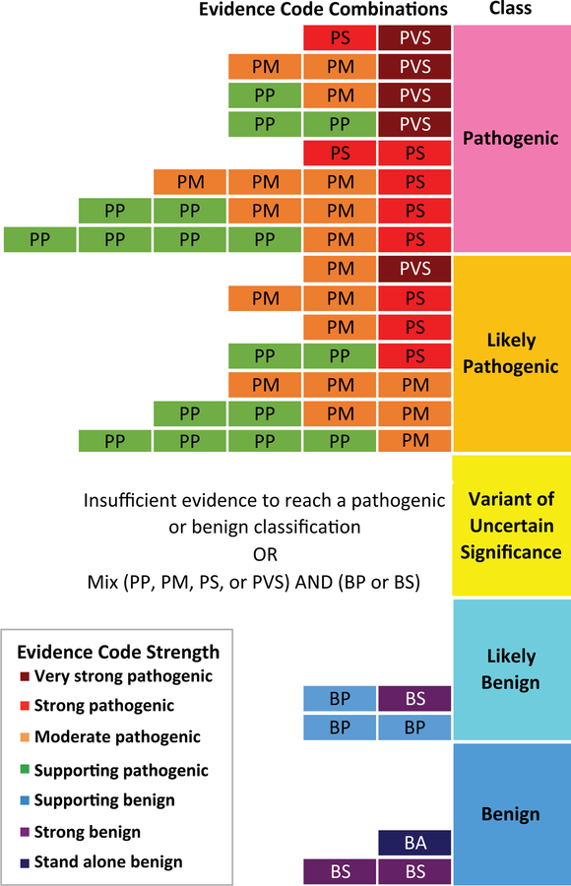
PMID: 25741868

Slide 18
PS4 + PM2 + PP1
= Likely Pathogenic
Pathogenic
Level of
Evidence:
Strong
PMID: 25741868

Slide 19
PS4 + PM2 + PP1
= Likely Pathogenic
Pathogenic
Level of
Evidence:
Strong
BP4
Benign
Level of
Evidence:
Supporting
PMID: 25741868

Slide 20
Conflicting evidence example:
PS4 + PM2 + BP2 + BP4
= Variant of Uncertain
Significance (VUS)
PMID: 25741868
1 strong
1 moderate
1 supporting
Criteria Nomenclature

Slide 21
PMID: 25741868

Slide 22
PMID: 25741868

Slide 23
1- Population Data

Slide 24
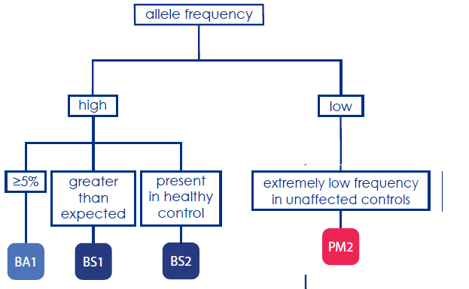
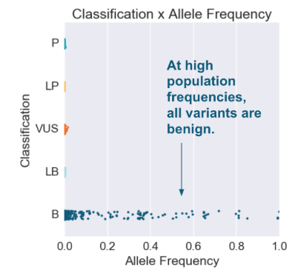
PMID: 25741868
The cutoffs of each of these criteria depends on many factors such as:
Prevalence of disease, age of onset, and penetrance
Richards CS et al. Gen Med. 2015;17:405-423
Notes:
Classification x allele frequency At high population frequencies all variants are benign

Slide 25
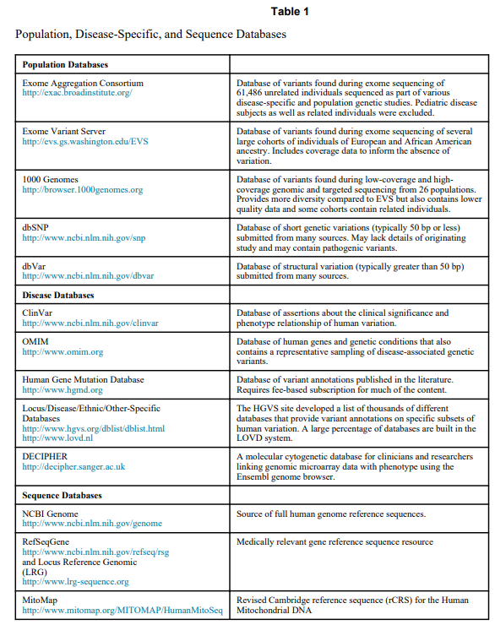
Examples of Databases
PMID: 25741868
Notes:
Table 1 Population, Disease-Specific, and Sequence Databases

Slide 26
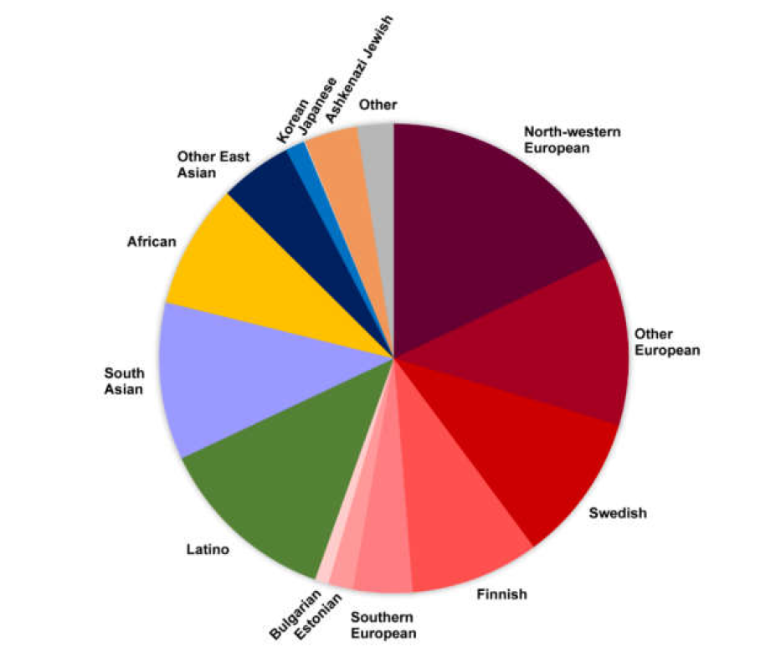
Examples of Databases
PMID: 25741868
https://doi.org/10.3390/genes10040275
Keep in mind if the database correctly assess the population of the proband !

Slide 27
Richards CS et al. Gen Med. 2015;17:405-423

Slide 28
Richards CS et al. Gen Med. 2015;17:405-423

Slide 29
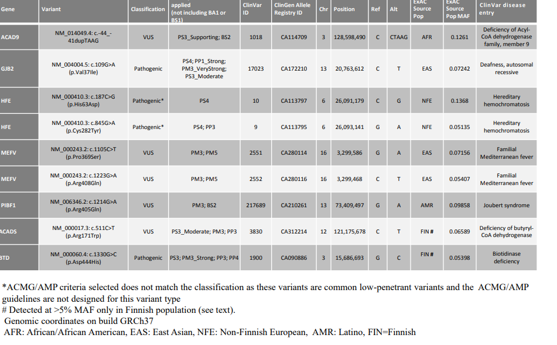
List of nine variants for which there was some evidence of pathogenicity even though the MAF was high for these variants!
https://clinicalgenome.org/site/assets/files/3460/ba1_exception_list_07_30_2018.pdf

Slide 30
What `greater than expected` means?
Richards CS et al. Gen Med. 2015;17:405-423

Slide 31
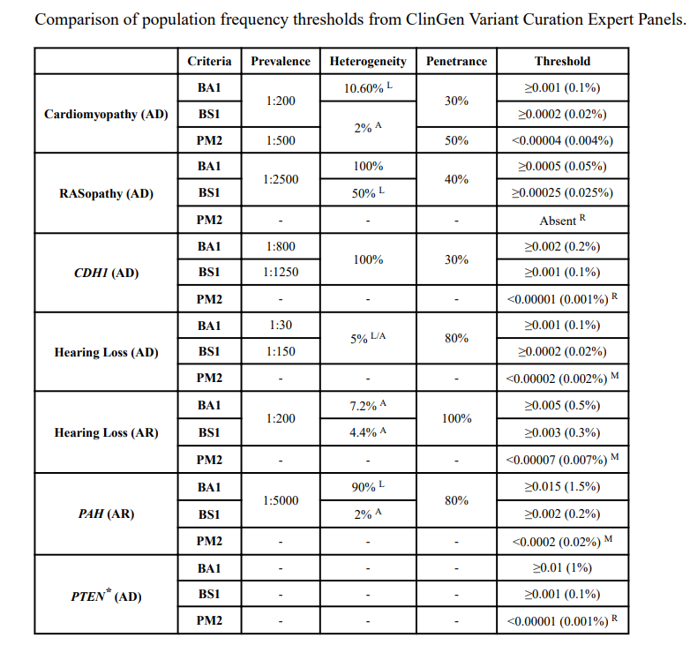
Different population frequency thresholds
PMID: 31479589
Notes:
Comparison of population frequency thresholds from Clingen variant Curation Expert Panels

Slide 32
Richards CS et al. Gen Med. 2015;17:405-423
Notes:
Observed in healthy adult individuals

Slide 33
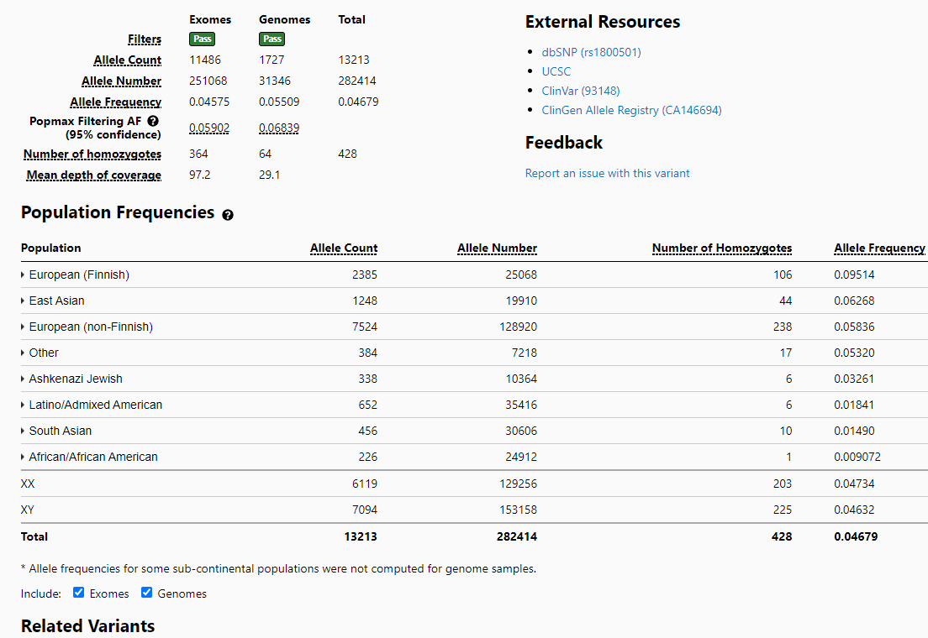
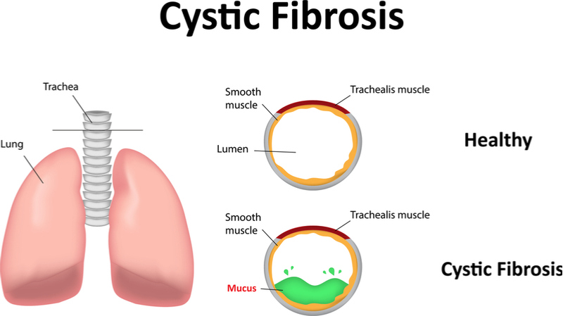
CFTR - c.-8G>C
https://medlineplus.gov/genetics/condition/cystic-fibrosis/
https://gnomad.broadinstitute.org/

Slide 34
CFTR - c.-8G>C
https://medlineplus.gov/genetics/condition/cystic-fibrosis/
Observed in healthy adult individuals
https://gnomad.broadinstitute.org/
https://www.fitnessforhealth.org/healthy-living-for-older-adults-tips-and-resources/

Slide 35
Richards CS et al. Gen Med. 2015;17:405-423
Notes:
Observed in healthy adult individuals

Slide 36
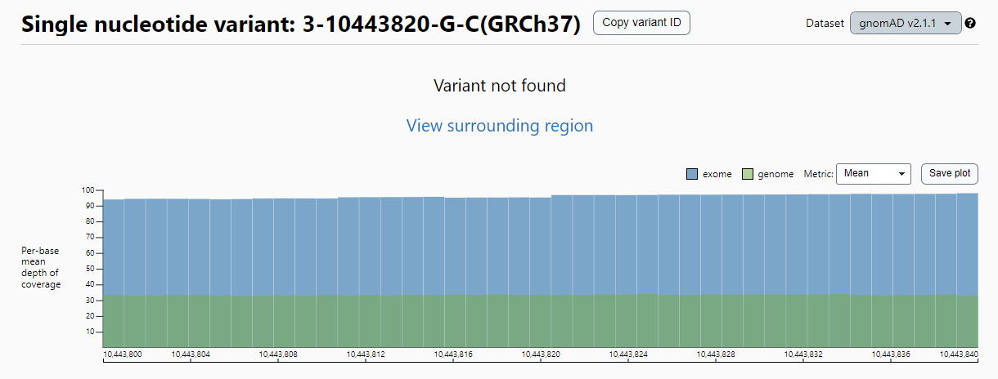
ATP2B2 HET c.610C>G
https://gnomad.broadinstitute.org/

Slide 37
ATP2B2 HET c.610C>G
https://gnomad.broadinstitute.org/
`M` as moderate level of evidence?

Slide 38
ATP2B2 HET c.610C>G
https://gnomad.broadinstitute.org/
`M` as moderate level of evidence?
Now PM2_Suppoting
https://clinicalgenome.org/working-groups/sequence-variant-interpretation/

Slide 39
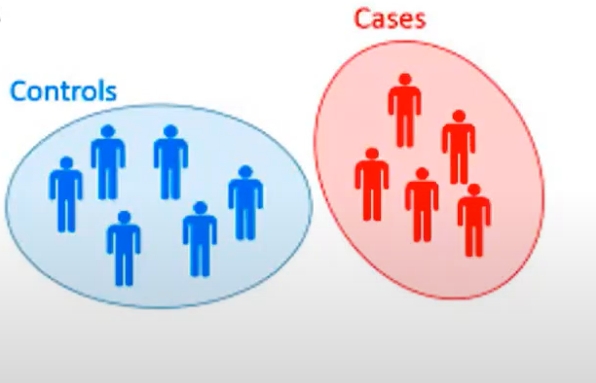
PS4
The prevalence of the variant is increased in affected individuals is significantly increased compared with the prevalence in controls.
Relative risk (RR) or odds ratio (OR) in a case-control study is >5.0, and the confidence interval around the estimate of relative risk or OR does not include 1.0.
What if some genetic diseases have a very low prevalence (1: 1,000,000)?
Richards CS et al. Gen Med. 2015;17:405-423
Notes:
Observed in healthy adult individuals

Slide 40
The prior observation of the variant in multiple unrelated patients with the same phenotype
Dr. Klee et al. 2015
Rory et al. 2022
This approach requires PM2 to be applicable → Absent in controls
Filippo et al. 2008
May be used as “moderate” or lower level of evidence.
Dr. Schimmenti et al. 2018
Richards CS et al. Gen Med. 2015;17:405-423
Notes:
Observed in healthy adult individuals

Slide 41
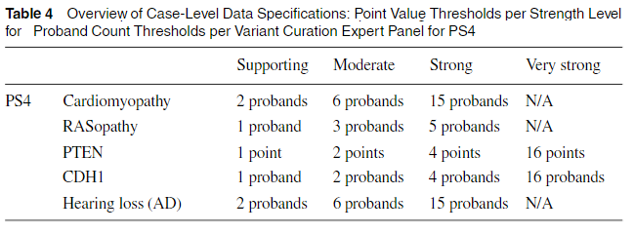
Examples of Case Prevalence or Previously Reported Cases (PS4) High Prevalence or Multiple Unrelated Patients Observed with Variant and Phenotype
.
Harrison et al., 2019 Curr Protoc Hum Genet. 2019 Sep; 103(1)
https://currentprotocols.onlinelibrary.wiley.com/doi/full/10.1002/cphg.93

Slide 42
1- Population Data
2- Computational and Predictive Data

Slide 43
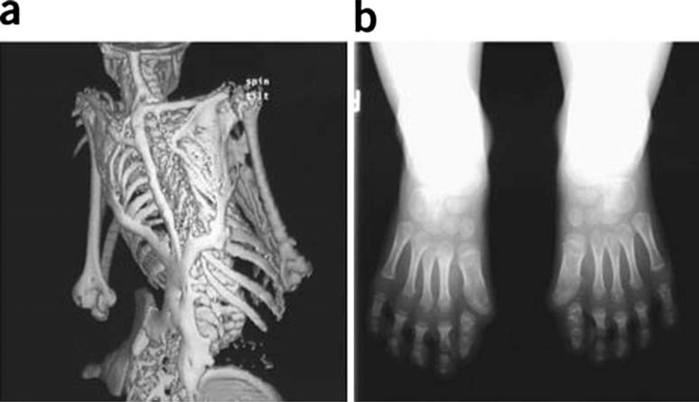
Before we continue…
Does it explain the phenotype?
Good phenotype overlap?
Does the type of mutation make sense for the gene/phenotype?
https://doi.org/10.1186/1750-1172-6-80
+ Variant in ACVR1

Slide 44
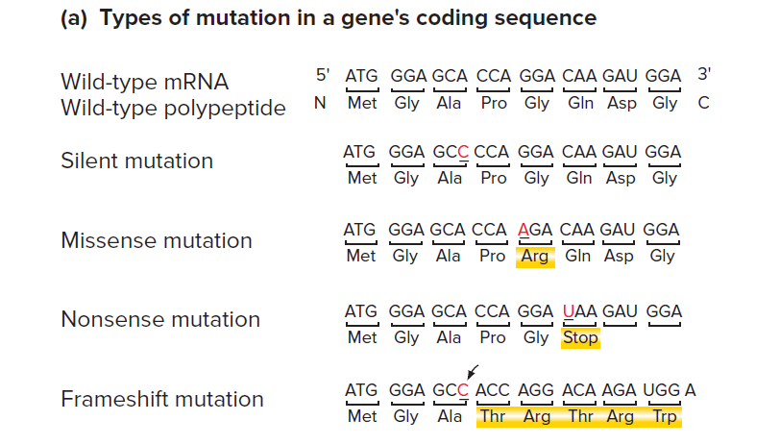
Does it explain the phenotype?
Good phenotype overlap?
Does the type of mutation make sense for the gene/phenotype?
DOI:10.1002/mma.4764
Notes:
(a) Types of mutation in a gene's coding sequence

Slide 45
Richards CS et al. Gen Med. 2015;17:405-423

Slide 46
Focus on the “Pathogenic criteria”
Richards CS et al. Gen Med. 2015;17:405-423

Slide 47
Loss of Function Criteria (PVS1) (only “very strong” level of evidence)
Null variant in a gene where loss of function (LoF) is a known mechanism of disease.

Slide 48
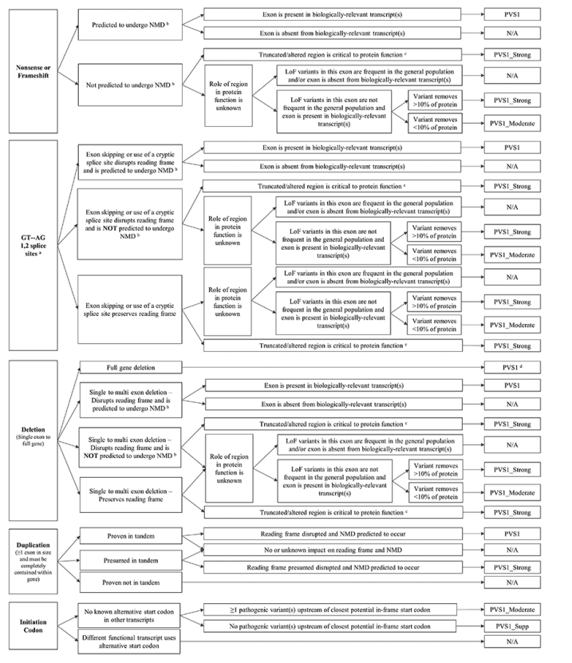
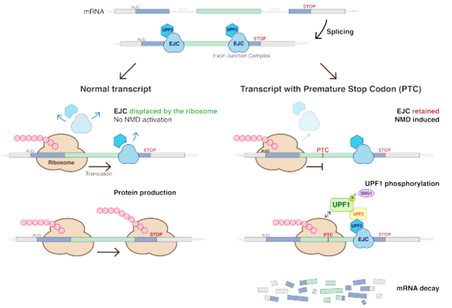
PVS1
https://www.clinicalgenome.org/site/assets/files/3677/clingen_variant-curation_sopv1.pdf
https://en.wikipedia.org/wiki/Nonsense-mediated_decay
If the termination codon is downstream of or within about 50 nucleotides of the final exon-junction complex then the transcript is translated normally.

Slide 49
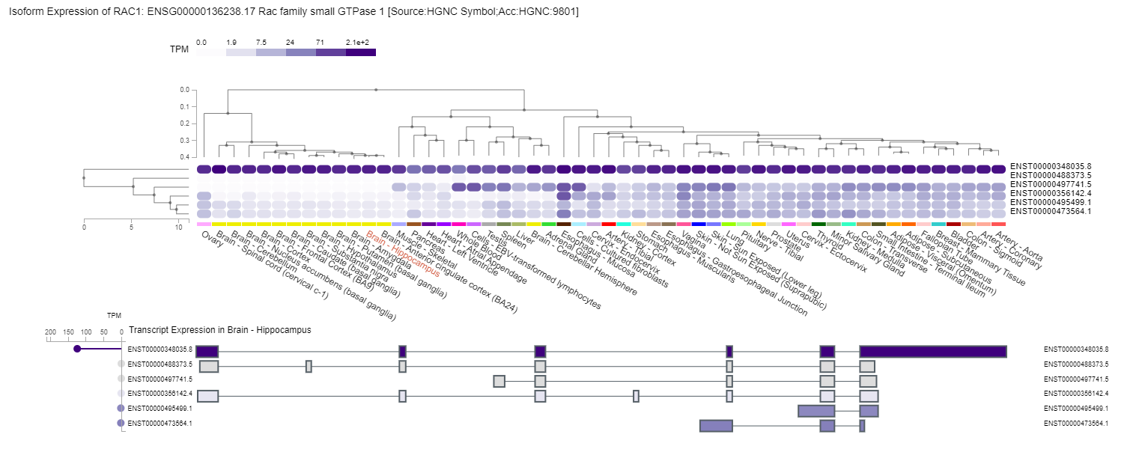
PVS1
https://www.clinicalgenome.org/site/assets/files/3677/clingen_variant-curation_sopv1.pdf
https://gtexportal.org/home/
What if I had a variant here?

Slide 50
PVS1
https://www.clinicalgenome.org/site/assets/files/3677/clingen_variant-curation_sopv1.pdf

Slide 51
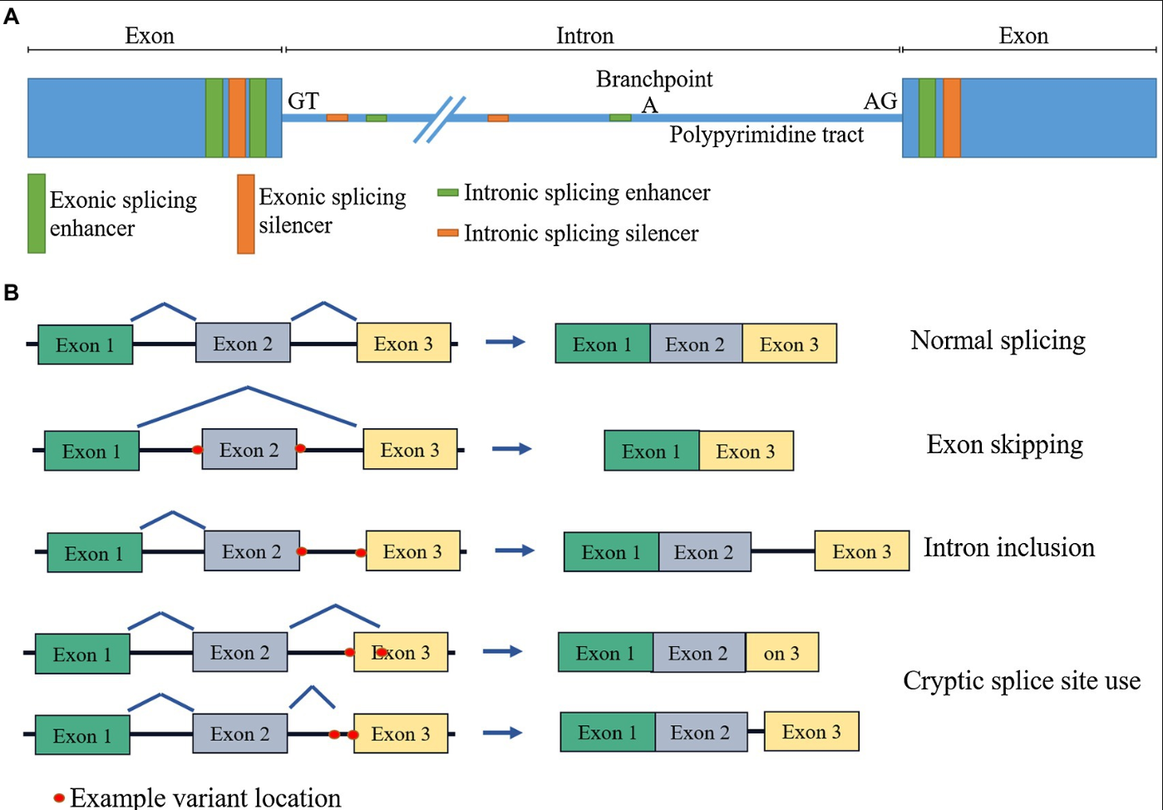
PVS1
https://www.clinicalgenome.org/site/assets/files/3677/clingen_variant-curation_sopv1.pdf
https://doi.org/10.3389/fgene.2021.689892

Slide 52
PVS1
https://www.clinicalgenome.org/site/assets/files/3677/clingen_variant-curation_sopv1.pdf
https://doi.org/10.3389/fgene.2021.689892

Slide 53
PVS1- How to investigate if LOF is a `known mechanism of disease`
https://www.clinicalgenome.org/site/assets/files/3677/clingen_variant-curation_sopv1.pdf
https://doi.org/10.3389/fgene.2021.689892

Slide 54
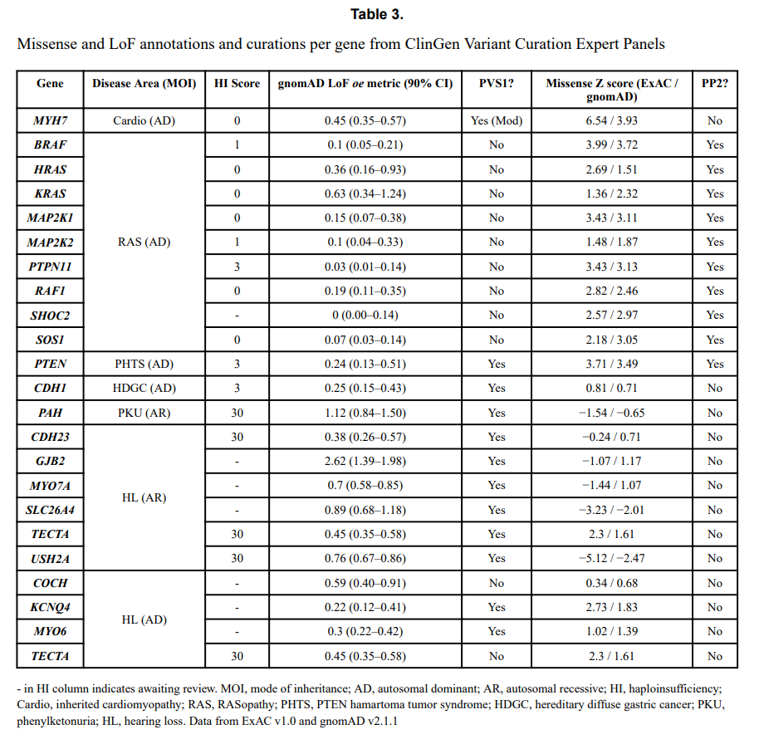
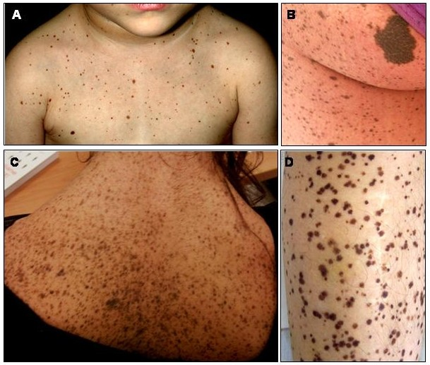
https://doi.org/10.1186/1750-1172-3-13
doi:10.1002/cphg.93
Notes:
Table 3. Missense and LO

Slide 55
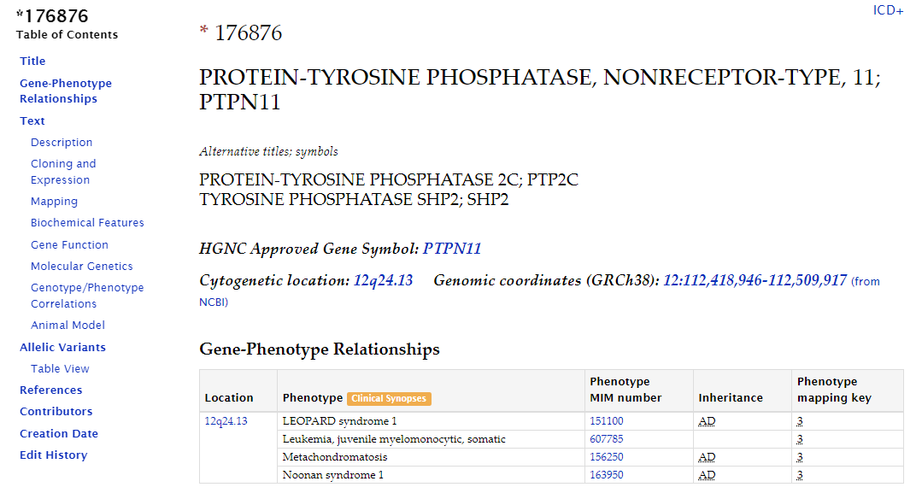
PVS1- How to investigate if LOF is a `known mechanism of disease`
https://www.omim.org/

Slide 56
OMIM - Online Mendelian Inheritance in Man®
https://www.omim.org/

Slide 57
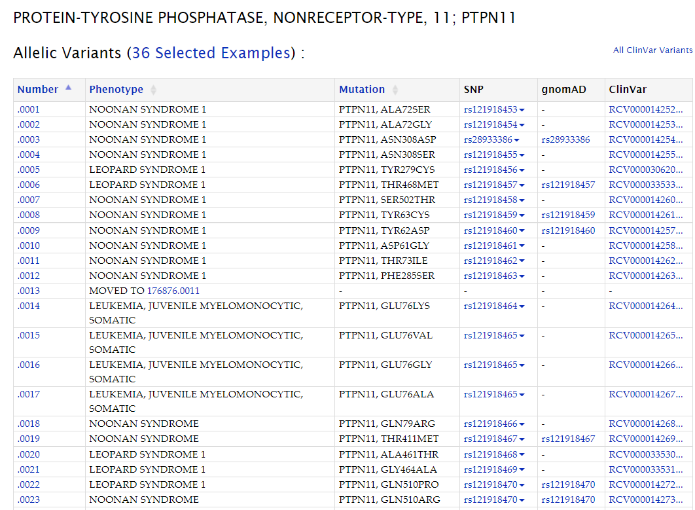
OMIM - Online Mendelian Inheritance in Man®
https://www.omim.org/
Most of the variants associated with the phenotype are Missense

Slide 58
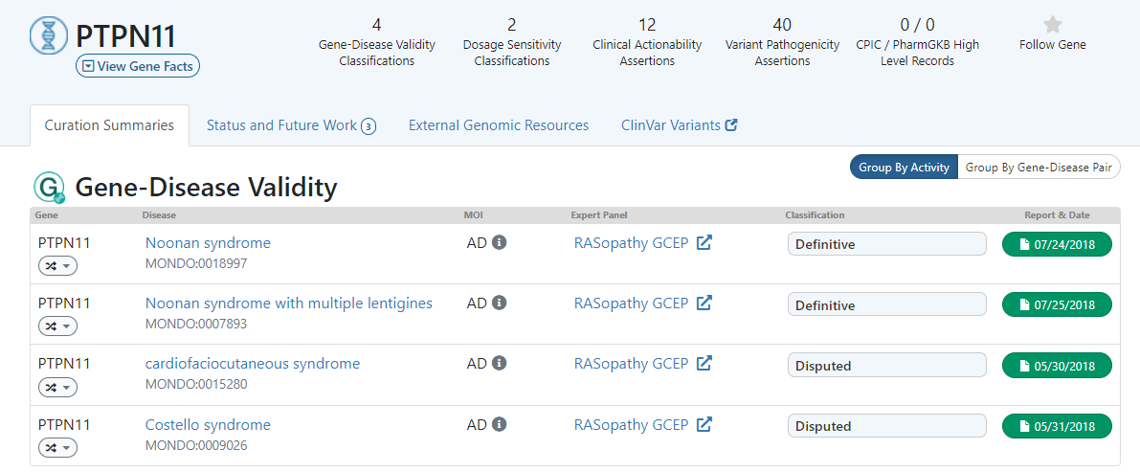
ClinGen
Noonan syndrome is believed to be caused by gain-of-function defects in PTPN11 (PMID:11992261), and LEOPARD syndrome is believed to be caused by dominant-negative mechanisms (PMID: 16358218). Evidence gathered for the haploinsufficiency rating for this gene is related to the metachondromatosis phenotype.

Slide 59
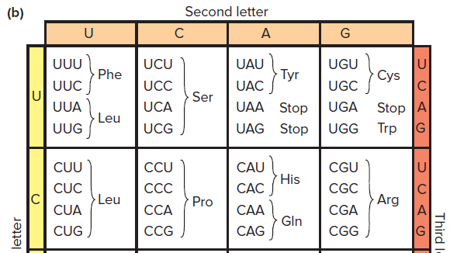
PS1
PMID: 25741868
https://rsscience.com/codon-chart/

Slide 60
PS1
PMID: 25741868
CUU → CUC
Both are Leucine
https://rsscience.com/codon-chart/

Slide 61
PMID: 25741868
PM5

Slide 62
PMID: 25741868
PM5
Leu257Pro - Pathogenic
CUU → CCU
https://rsscience.com/codon-chart/

Slide 63
PMID: 25741868
PM5
Leu257Pro - Pathogenic
CUU → CCU
Leu257His - ???
CUU → CAU
https://rsscience.com/codon-chart/

Slide 64
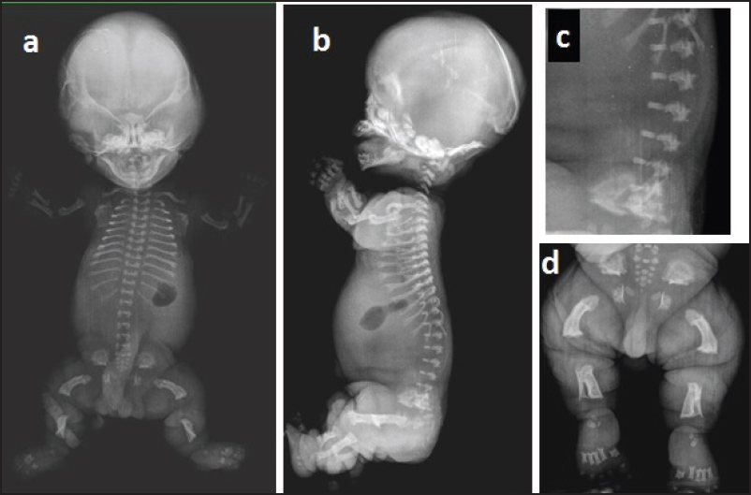
An interesting example… FGFR3
Lys650
Lys650Glu
Type II thanatophoric dysplasia
DOI: 10.4103/0974-5009.165584
Notes:
SADDAN is characterized by short-limb dwarfism (achondroplasia); profound developmental delay; and thick, dark, velvety skin.

Slide 65
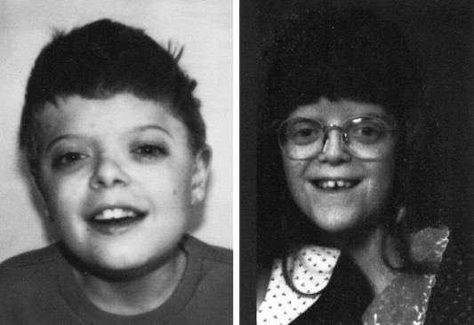
An interesting example… FGFR3
Lys650
Lys650Glu
Lys650Met
SADDAM
Type II thanatophoric dysplasia
https://www.sciencedirect.com/topics/agricultural-and-biological-sciences/fibroblast-growth-factor-receptor-3
DOI: 10.4103/0974-5009.165584
Notes:
SADDAN is characterized by short-limb dwarfism (achondroplasia); profound developmental delay; and thick, dark, velvety skin.

Slide 66
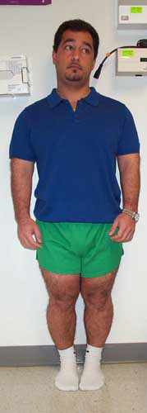
An interesting example… FGFR3
Lys650
Lys650Glu
Lys650Met
Lys650Asn
SADDAM
Hypochondroplasia
Type II thanatophoric dysplasia
DOI: 10.4103/0974-5009.165584
https://www.sciencedirect.com/topics/agricultural-and-biological-sciences/fibroblast-growth-factor-receptor-3
https://www.hss.edu/LLcase19.asp
Notes:
SADDAN is characterized by short-limb dwarfism (achondroplasia); profound developmental delay; and thick, dark, velvety skin.

Slide 67
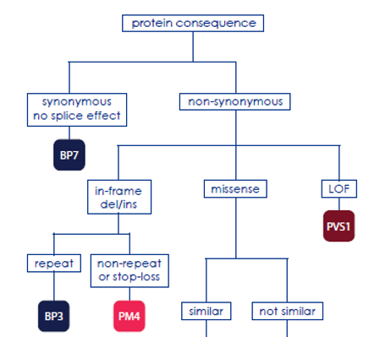
PM4
Protein length changes due to in-frame deletions/insertions in a non-repeat region or stop-loss variants.
To prevent double-counting of this evidence type, we recommend that PM4 should not be applied for any variant in which PVS1, at any strength level, is also applied.

Slide 68
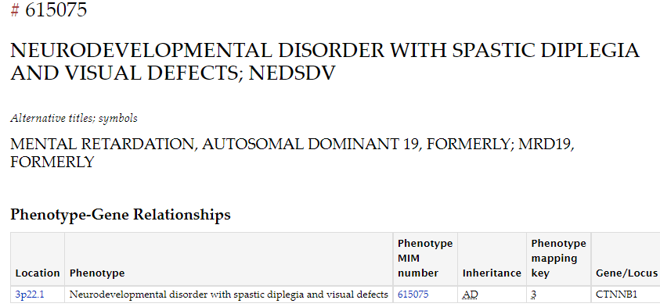
Example – CTNNB1 c.1021_1026del, p.(Ser341_Arg342del)
https://www.omim.org/

Slide 69
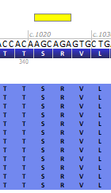
Example – CTNNB1 c.1021_1026del, p.(Ser341_Arg342del)
Images from Alamut software:
https://www.omim.org/

Slide 70
Example – CTNNB1 c.1021_1026del, p.(Ser341_Arg342del)
Images from Alamut software:
https://www.omim.org/
16 individuals from 15 families were found to have newly identified loss-of-function CTNNB1 mutations. Virtually all were de novo events.

Slide 71
PM4
Protein length changes due to in-frame deletions/insertions in a non-repeat region or stop-loss variants.
To prevent double-counting of this evidence type, we recommend that PM4 should not be applied for any variant in which PVS1, at any strength level, is also applied.

Slide 72
PP3

Slide 73
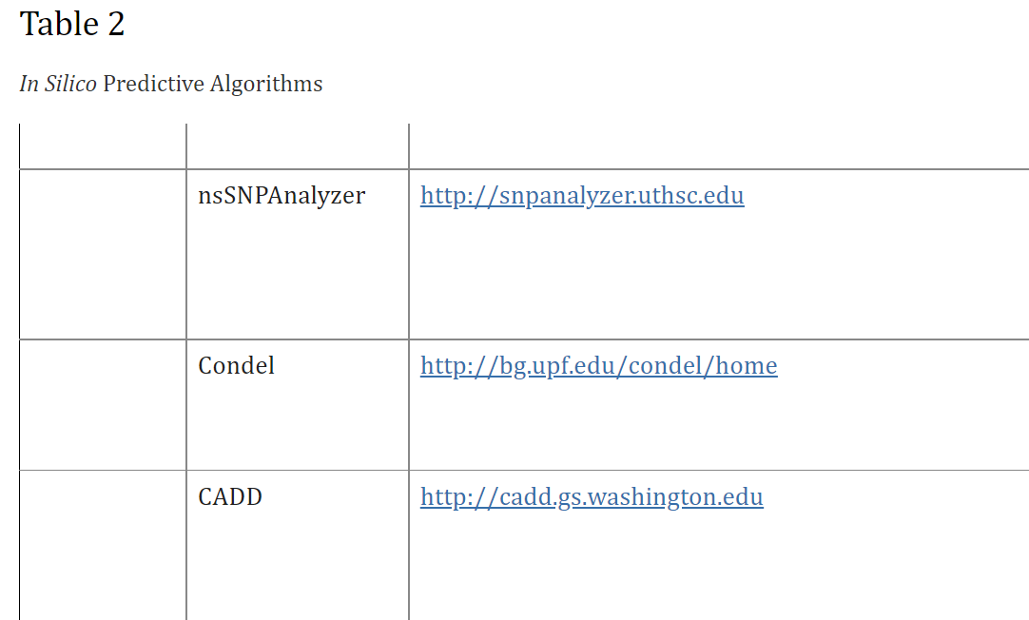
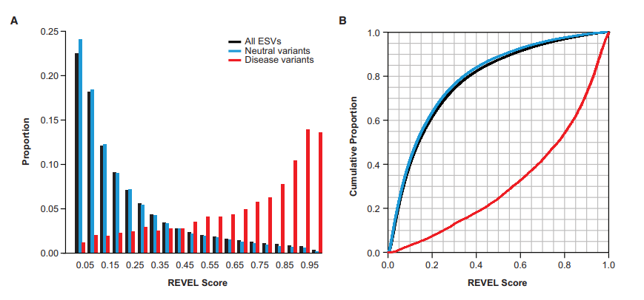
…Some of the In Silico tools mentioned
REVEL
Richards CS et al. Gen Med. 2015;17:405-423

Slide 74
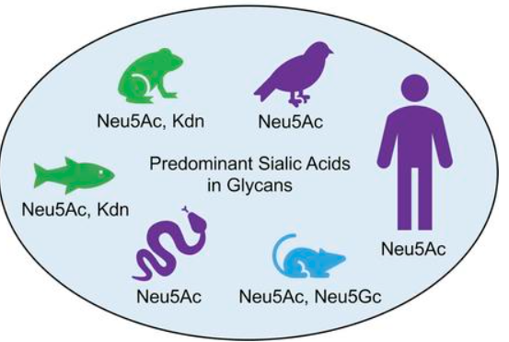
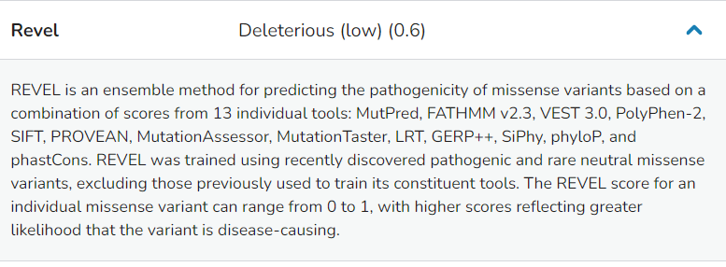
Example
phyloP scores measure evolutionary conservation at individual alignment sites. Interpretations of the scores are compared to the evolution that is expected under neutral drift.
https://www.jci.org/articles/view/137681
https://franklin.genoox.com/

Slide 75
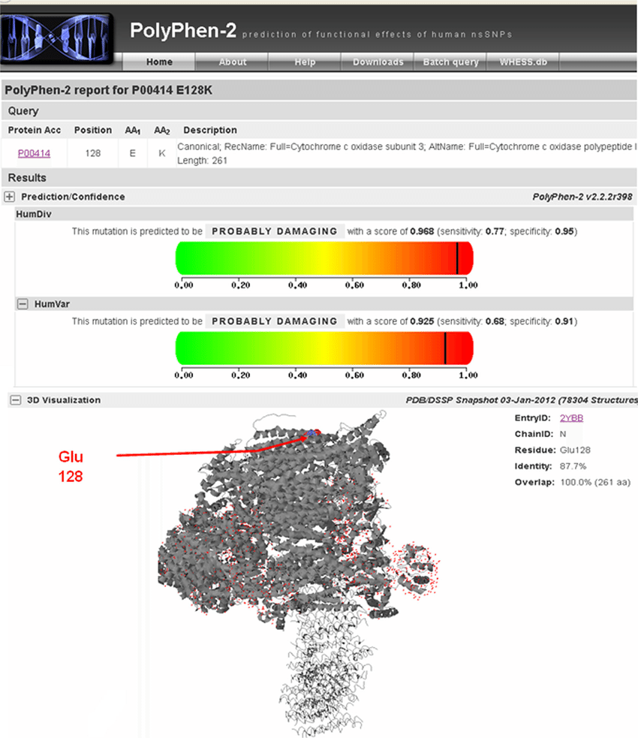
Example
Impact of amino acid allelic variants on protein structure/function can be reliably predicted via analysis of multiple sequence alignments and protein 3D-structures.
http://genetics.bwh.harvard.edu/pph2/
https://franklin.genoox.com/
Notes:
Mutation Taster

Slide 76
Scores are not deterministic of biological effect/deleteriousness, they are used as “supporting evidence”
PMID: 25741868
gDNA: Chr6(GRCh37):g.51720765A>G
cDNA: NM_138694.3(PKHD1):c.7837T>C
p.Trp2613Arg
Polyphen-2: Probably damaging
CADD: 29
M-CAP: Probably
PredictSNP2: Deleterious
Scores agree towards SNV being deleterious

Slide 77
1- Population Data
2- Computational and Predictive Data
3- Segregation Data

Slide 78
PMID: 25741868
PP1
Co-segregation with disease in multiple affected family members of a single family in a gene definitively known to cause the disease.
Note: May be used as stronger evidence with increasing segregation data.

Slide 79
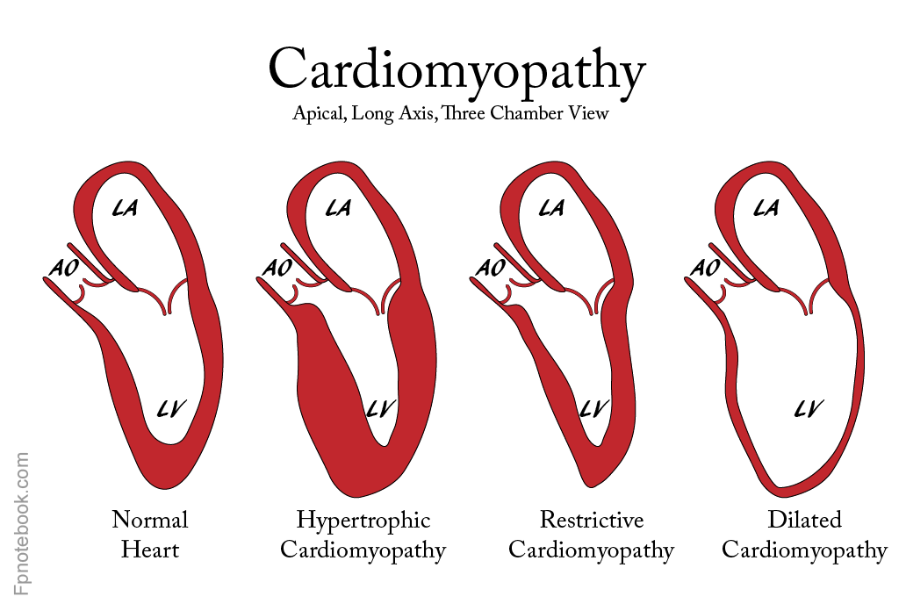
…Example of segregation
Restrictive cardiomyopathy; Variant of uncertain significance in FLNC
https://fpnotebook.com/CV/Myocardium/Crdmypthy.htm

Slide 80
…Example of segregation
Restrictive cardiomyopathy; Variant of uncertain significance in FLNC
https://fpnotebook.com/CV/Myocardium/Crdmypthy.htm

Slide 81
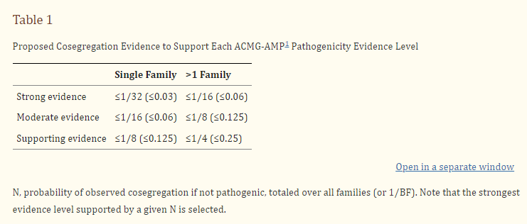
…Example of segregation
Restrictive cardiomyopathy; Variant of uncertain significance in FLNC
Under a dominant model, this probability is N = (1/2)^{m}, where m is the number of meioses of the variant of interest that are informative for cosegregation.
Watch out for different penetrance, expressivity and phenocopies!
Notes:
Consideration of cosegregation in pathogenicity classification of Genomic Variants

Slide 82
Publicly Available Calculators and Workflows
Publically available tools that will help add up your “points”
https://varsome.com/
http://wintervar.wglab.org/
http://www.medschool.umaryland.edu/Genetic_Variant_Interpretation_Tool1.html/
Several analysis software integrate guidelines into their workflow

Slide 83
Post-test questions:
1) When we classify a variant, we do it ONLY in the context of the case we are working on, we classify `if the variant is causing the disease in the patient`.
TRUE
FALSE
2) Retinoblastoma, the most malignant form of eye cancer,
arises from a dominant pathogenic variant in one gene RB1, but only
about 75% of people who carry this variant develop the disease. We are talking about:
Penetrance
Expressivity
3) A frequent variant (found in >5% in a population) will always be `benign`
TRUE
FALSE

Slide 84
Post-test questions:
1) When we classify a variant, we do it ONLY in the context of the case we are working on, we classify `if the variant is causing the disease in the patient`.
TRUE
FALSE
WE CLASSIFY THE VARIANT
2) Retinoblastoma, the most malignant form of eye cancer,
arises from a dominant pathogenic variant in one gene RB1, but only
about 75% of people who carry this variant develop the disease. We are talking about:
Penetrance
Expressivity
3) A frequent variant (found in >5% in a population) will always be `benign`
TRUE
FALSE

Slide 85
To be continued…

Slide 86
Questions?

Slide 87
Variant Interpretation Part 2
ACMG Guidelines
Wilke.Matheus@mayo.edu

Slide 88
Richards CS et al. Gen Med. 2015;17:405-423

Slide 89
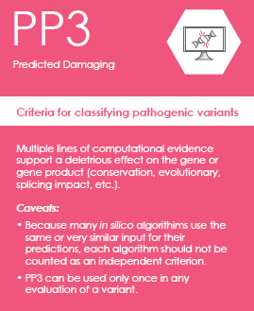
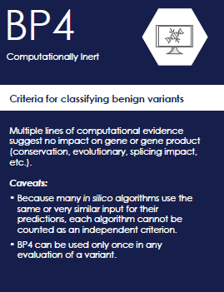
Impact Prediction: Computational or Knowledge-based
“In-Silico”
Tools
Richards CS et al. Gen Med. 2015;17:405-423

Slide 90
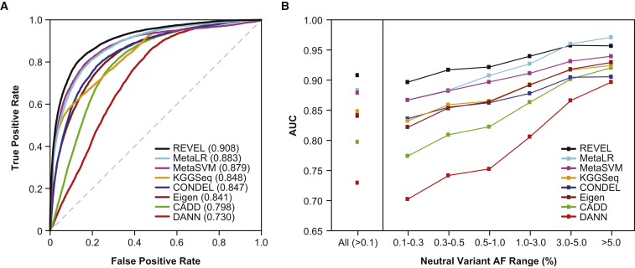
Impact Prediction: Computational or Knowledge-based
https://www.ncbi.nlm.nih.gov/pmc/articles/PMC5065685/

Slide 91
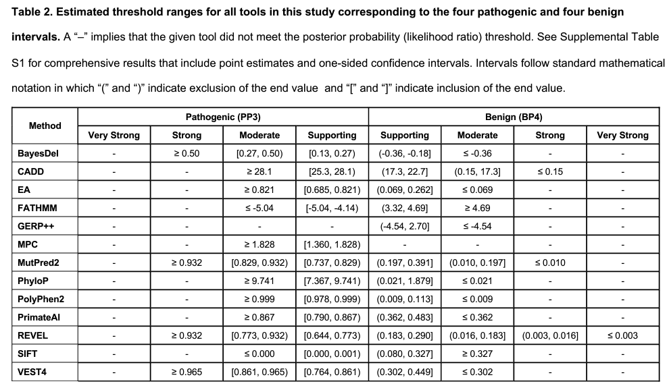
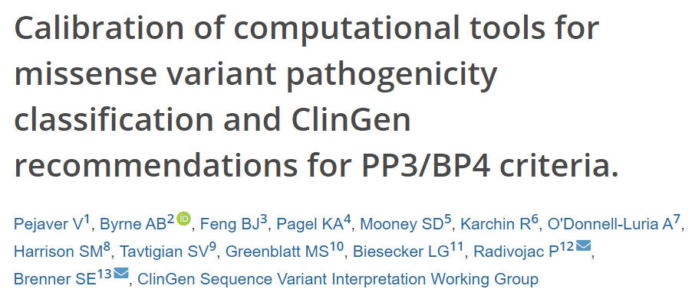
Impact Prediction: Computational or Knowledge-based
2022 new guidelines update. Will be implemented in the future
PMID: 36413997

Slide 92
Richards CS et al. Gen Med. 2015;17:405-423

Slide 93
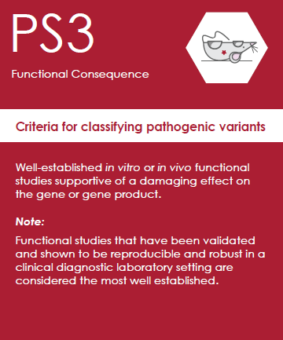
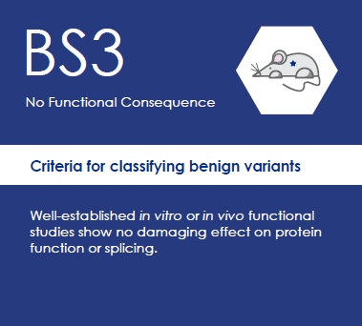
Functional Evidence:
What defines a “well established” functional study or assay?
How reliable? This is not simple.
Richards CS et al. Gen Med. 2015;17:405-423

Slide 94
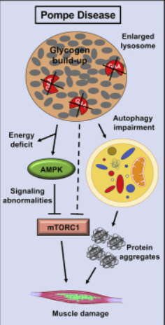
GAA example
From ClinGen Lysosomal Storage Disorders Variant Curation Expert Panel Specifications to the ACMG/AMP Variant Interpretation Guidelines Version 2
Notes:
acid alpha-glucosidase

Slide 95
Decision Tree to guide PS3/BS3 criterion
Brnich SE et al. Gen Med. 2019 Dec 31;12(1):3

Slide 96
PS3/BS4
Guidugli L. et al. Am J Hum Genet. 2018 Feb 1;102(2)

Slide 97
PS3/BS4
Familial hypercholesterolemia
Is a significant decrease in protein function sufficient to cause disease?
Overexpression: LDLR-GFP transiently expressed Complementation: siRNA-resistant LDLR-GFP LDLR disruptive-allele carriers have higher plasma LDL-cholesterol (LDL-C)
Thormaehlen A. et al.
PLoS Genet 2015 Feb 3;11(2)
Notes:
Figure 3. Cell-based functional profiling distinguishes disruptive from non-disruptive rare missense variants in the low-density lipoprotein receptor (LDLR) gene as identified through exome sequencing of 3,325 individuals.(A) Rare LDLR missense variants from exome sequencing of the ATVB cohort were individually introduced into LDLR’-GFP, transiently expressed in HeLa-cells, and the impact on cellular uptake of fluorescently-labeled LDL (DiI-LDL) was quantified for the indicated four parameters and GFP-expression. Shown are means from 3–4 independent experiments per variant relative to wild-type LDLR’-GFP. Phenotypes (red, reducing; blue, increasing) meeting statistical criteria (p<0.05; deviation >1) are framed in orange. Variants that significantly reduced LDL-uptake in ≥3 DiI-LDL parameters, including total LDL signal, were classified as “disruptive-missense” (for details, see Methods). OSD, O-linked sugars domain (exon15); TMD, transmembrane domain (exons16–17); CT, carboxy-terminus (exon18). (B) Comparison of mean total DiI-LDL signal intensities within endosome-like intracellular compartments (“total LDL signal”) between the overexpression setting (ΔLDLR’-GFP only) and a complementation setting (siRNA against endogenous LDLR together with ΔLDLR’-GFP) relative to wildtype LDLR’-GFP (wt, black circle) and GFP control (GFP, open circle). Variants classified as “non-disruptive” failed to reach significance in any parameter under neither experimental setting. (C) For 14 variants classified as disruptive-missense, impact upon overexpression on cellular levels of free cholesterol (FC) was determined. Shown are means±s.d. relative to wildtype LDLR’-GFP from 2–4 independent experiments. (D) Determination of subcellular localization of LDLR’-GFP disruptive-missense variants. Shown are maximal projections of confocal stacks of representative cells transiently transfected with indicated mutants. Bar graphs reflect ΔLDLR’-GFP levels on Western Blots (shown in S5 Fig.; means from 2 experiments) of endoplasmic reticulum (ER; 120kDa) relative to post-ER (160kDa) form of the LDLR protein relative to total wildtype LDLR as determined by ratiometric measurements. For each mutant, contribution of ER- relative to total LDLR’-GFP protein are indicated in percent.

Slide 98
Richards CS et al. Gen Med. 2015;17:405-423

Slide 99
“Functional” Impact Prediction:
Computational or Knowledge-based
https://www.genomenon.com/mastermind-variant-interpretation-cards-download/
Richards CS et al. Gen Med. 2015;17:405-423

Slide 100
“Functional” Impact Prediction:
Computational or Knowledge-based
Richards CS et al. Gen Med. 2015;17:405-423

Slide 101
“Functional” Impact Prediction:
Computational or Knowledge-based
Reference laboratories are very conservative in the use of this criteria because of its subjectivity
Richards CS et al. Gen Med. 2015;17:405-423

Slide 102
“Functional” Impact Prediction:
Computational or Knowledge-based
Gene-specific ClinGen expert panels
Recommendations for PM1 specified in guidelines if applicable
PMID: 30311380

Slide 103
Impact Prediction:
Computational or Knowledge-based
https://www.genomenon.com/mastermind-variant-interpretation-cards-download/

Slide 104
Impact Prediction:
Computational or Knowledge-based
Z-score “bigger” than 4 (Z > 3 in some literature)
Richards CS et al. Gen Med. 2015;17:405-423

Slide 105
Impact Prediction:
Computational or Knowledge-based
“Gene-wide” score
Richards CS et al. Gen Med. 2015;17:405-423
Notes:
pLi upper bound of the oe confidence interval < 0.35

Slide 106
Impact Prediction:
Computational or Knowledge-based
Gene-wide summary measures of constraint are prone to overstating and understating constraint within specific regions of protein-coding genes
Regional intolerance correlates with important functional domains

Slide 107
Impact Prediction:
Computational or Knowledge-based
Gene-wide summary measures of constraint are prone to overstating and understating constraint within specific regions of protein-coding genes
Intolerant domain
https://stuart.radboudumc.nl/metadome/dashboard

Slide 108
Case-specific data to consider

Slide 109
Case-Specific Evidence - Segregation Data
https://www.genomenon.com/mastermind-variant-interpretation-cards-download/
De novo (both maternity and paternity confirmed) in a patient with the disease and no family history.
Confirm parental status through validated test
Richards CS et al. Gen Med. 2015;17:405-423

Slide 110
PS2/PM6
parental confirmed
phenotype consistency
number of de novo observations
https://clinicalgenome.org/site/assets/files/3461/svi_proposal_for_de_novo_criteria_v1_1.pdf
https://clinicalgenome.org/site/assets/files/3461/svi_proposal_for_de_novo_criteria_v1_1.pdf

Slide 111
PS2/PM6
parental confirmed
phenotype consistency
number of de novo observations
https://clinicalgenome.org/site/assets/files/3461/svi_proposal_for_de_novo_criteria_v1_1.pdf
If a NIPBL variant was de novo in one patient with Cornelia de Lange syndrome, with confirmed parental relationships and de novo in two additional unrelated patients with Cornelia de Lange syndrome with unconfirmed parental relationships, then …

Slide 112
PS2/PM6
https://clinicalgenome.org/site/assets/files/3461/svi_proposal_for_de_novo_criteria_v1_1.pdf
parental confirmed
phenotype consistency
number of de novo observations
If a NIPBL variant was de novo in one patient with Cornelia de Lange syndrome, with confirmed parental relationships and de novo in two additional unrelated patients with Cornelia de Lange syndrome with unconfirmed parental relationships, then …
..Very Strong evidence level is applied (PS2_Very Strong) based on combined point value of 4 (Table 2).

Slide 113
PS2/PM6 – Additional considerations
A patient with early infantile epileptic encephalopathy and a de novo SIK1 variant with confirmed parental relationships is awarded 1 point (as the patient’s phenotype is consistent with the gene but not highly specific and the variant is de novo with confirmed parental relationships). If this patient is the only de novo occurrence for the variant, then a Moderate strength level (PS2_Moderate) is applied.
A patient with nonsyndromic intellectual disability and a de novo ASH1L variant is awarded 0.5 points (as the variant is de novo with confirmed parental relationships and patient’s phenotype is consistent with the gene but not highly specific and there is significant evidence of genetic heterogeneity). If this patient is the only de novo occurrence for the variant, then a Supporting strength level (PS2_Supporting) is applied.
A patient with developmental delay but no other features of Cornelia de Lange syndrome and a de novo NIPBL variant with unconfirmed parental relationships is awarded zero points as this phenotype is not consistent with the gene/disease association. If this patient was the only de novo occurrence for the variant, then no de novo criteria are applied.

Slide 114
Case-specific data to consider
Richards CS et al. Gen Med. 2015;17:405-423

Slide 115
Case-Specific Evidence – Allelic Data
https://www.genomenon.com/mastermind-variant-interpretation-cards-download/
For recessive disorders, detected in trans with a pathogenic variant.
Note:
This requires testing of parents (or offspring) to determine phase.
Observed in trans with a pathogenic variant for a fully penetrant dominant gene/disorder or observed in cis with a pathogenic variant in any inheritance pattern.
Richards CS et al. Gen Med. 2015;17:405-423

Slide 116
PM3/BP2
Patient presents with Familial Hypercholesterolemia (AD)
LDLR
p.Cys82Ter
p.Asp263Ala
Allele 1
Allele 2

Slide 117
PM3/BP2
Patient presents with Familial Hypercholesterolemia
LDLR
p.Cys82Ter
p.Asp263Ala
Allele 1
Allele 2
p.Cys82Ter
Allele 1
p.Asp263Ala
Allele 2

Slide 118
PM3/BP2
Patient presents with HoFH
LDLR
p.Cys82Ter
p.Asp263Ala
Allele 1
Allele 2
p.Cys82Ter
Allele 1
p.Asp263Ala
Allele 2
p.Cys82Ter
Allele 1
p.Asp263Ala
Allele 2

Slide 119
Case-specific data to consider
Richards CS et al. Gen Med. 2015;17:405-423

Slide 120
Case-Specific Evidence – Phenotype Specificity
https://my.clevelandclinic.org/health/diseases/24000-hurler-syndrome
Patient’s phenotype or family history is highly specific for a disease with a single genetic etiology.
enzyme α-L-iduronidase (IDUA)

Slide 121
Reputable sources
Richards CS et al. Gen Med. 2015;17:405-423

Slide 122
PP5/BP6
Who is reputable?
Expert panel curation takes precedence (if available)
https://my.clevelandclinic.org/health/diseases/24000-hurler-syndrome

Slide 123
Publicly Available Calculators and Workflows
Publically available tools that will help tally up your “points”
https://varsome.com/
http://wintervar.wglab.org/
http://www.medschool.umaryland.edu/Genetic_Variant_Interpretation_Tool1.html/
https://mobidetails.iurc.montp.inserm.fr/MD/
Several analysis software integrate guidelines into their workflow

Slide 124
Publicly Available Calculators and Workflows

Slide 125
The ACMG guidelines are not mandatory, or the only ones used
https://doi.org/10.1038/gim.2017.37

Slide 126
Warning! Germline and Somatic Classification and Catalogue Differences

Slide 127
Warning! Germline and Somatic Classification and Catalogue Differences
Categories:
Diagnostic
Prognostic
Therapeutic
Categories:
Pathogenic
Likely Pathogenic
VUS – Variant of Uncertain Significance
Likely Benign
Benign

Slide 128
Framework Summary for Variant Interpretation – 6 key questions
Allele Frequency?
What is the mechanism of disease?***
Known or predicted impact?
Do we have functional evidence? How reliable?
Phenotype overlaps with gene-disease association described?
Does it segregate with disease?

Slide 129
Questions?

Slide 131
VUS examples
Gene | Genomic position | Coding DNA | Variant | Inheritance
DDX41 | Chr5:176941942G>A | c.773C>T | p.Pro258Leu | Mother Neg (Healthy) Father Neg (Healthy)
Age: 71 y
Sex: Male
RFR: Pancytopenia
Family History: Negative
Gene | Genomic position | Coding DNA | Variant | Inheritance
RTEL1 | Chr20:622908596A>G | c.101A>G | p.Gln34Arg | Mother is Neg (Healthy) Father is Het (Affected)
Age: 62 y
Sex: Female
RFR: Idiopathic pulmonary fibrosis and short telomeres
Family History: Father and Brother are affected and carry the mutation.
Sister is affected and does not carry the mutation.
Cousin is unaffected and carries the variant

Slide 132
VUS examples
Gene | Genomic position | Coding DNA | Variant | Inheritance
DDX41 | Chr5:176941942G>A | c.773C>T | p.Pro258Leu | Mother Neg (Healthy) Father Neg (Healthy)
Age: 71 y
Sex: Male
RFR: Pancytopenia
Family History: Negative
Gene | Genomic position | Coding DNA | Variant | Inheritance
RTEL1 | Chr20:622908596A>G | c.101A>G | p.Gln34Arg | Mother is Neg (Healthy) Father is Het (Affected)
Age: 62 y
Sex: Female
RFR: Idiopathic pulmonary fibrosis and short telomeres
Family History: Father and Brother are affected and carry the mutation.
Sister is affected and does not carry the mutation.
Cousin is unaffected and carries the variant

