Slide 1
REGULATORY GENOMICS
Saurabh Sinha, Dept. of Computer Science & Carl R. Woese Institute of Genomic Biology, University of Illinois.

Slide 2
The importance of gene regulation

Slide 3
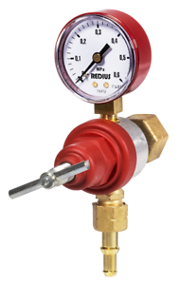
DNA, RNA, Proteins
Gene: a piece of DNA, has the “code” to make a protein
DNA: a long sequence of nucleotides (a,c,g,t)
GENE EXPRESSION
“Transcription”
mRNA: a physical “copy” of gene
CAN BE REGULATED
protein: molecule with important functions in cell
Image Credit: udaix/Shutterstock.com

Slide 4

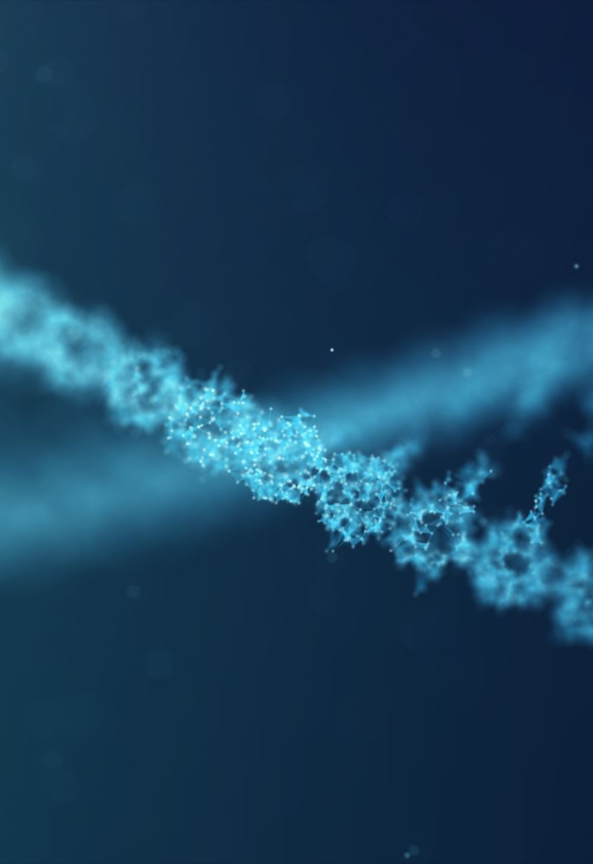

Gene regulation
Gene regulation is the process of turning genes on and off.
Gene regulation ensures that the appropriate genes are expressed in the right cells at the proper times.
Source:

Slide 5

Gene Regulation: fast and slow transcription
Machinery for transcribing gene
Gene
mRNA
Low gene expression
High gene expression

Slide 6
Transcription can be regulated by Proteins called Transcription Factors (TFs)
TF
GENE
BINDING
SITE
TCTAATTG
Humans have ~2000 TFs

Slide 7
Different cells may have different TFs
TF2 represses gene.
Low gene expression
TF1 activates gene.
High gene expression
TF2
TF1
TF2
TF1
TF2
TF1
TF2
TF1
Liver cell
Skin cell
Heart cell

Slide 8
Gene Regulation builds bodies
Source: http://www.bioinfo.org.cn/book/biochemistry/chapt27/bio9.htm

Slide 9
Different cells occasionally have different DNA
TF1 binds DNA and activates gene.
High gene expression
TF1 cannot binds DNA, does not activate gene.
Low gene expression
TF1
TF1
TCTAATTG
TCTGGTTG
mutation
Normal cell
Tumor cell

Slide 10
Gene Regulation is disrupted in cancer
Source: https://www.ck12.org/c/biology/gene-regulation-and-cancer/lesson/Gene-Regulation-and-Cancer-Advanced-BIO-ADV/

Slide 11
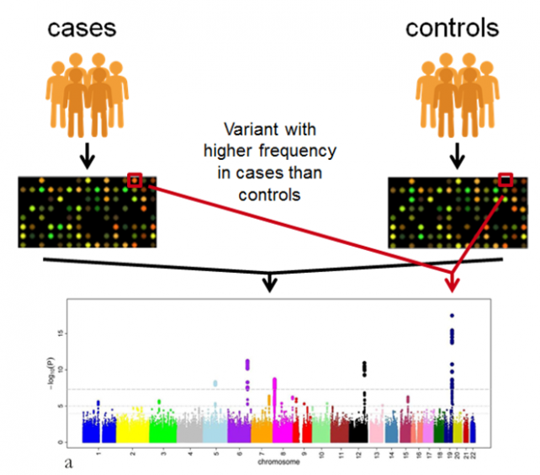
Most disease-related mutations are outside of genes
(impact gene regulation)
Source: https://www.ebi.ac.uk/training/online/courses/gwas-catalogue-exploring-snp-trait-associations/what-is-gwas-catalog/what-are-genome-wide-association-studies-gwas/

Slide 12
Gene Regulatory Networks:
TF-gene relationships
TF1 activates gene.
High gene expression
TF1
G1
TF1
G1
TF1
G1
TF1
TF1
Healthy sample
Tumor sample

Slide 13
Gene Regulatory Networks:
TF-gene relationships
TF1
“Gene Regulatory Network” (GRN)
G9
G8
G7
G6
G5
G4
G3
G2
G1
TF2

Slide 14
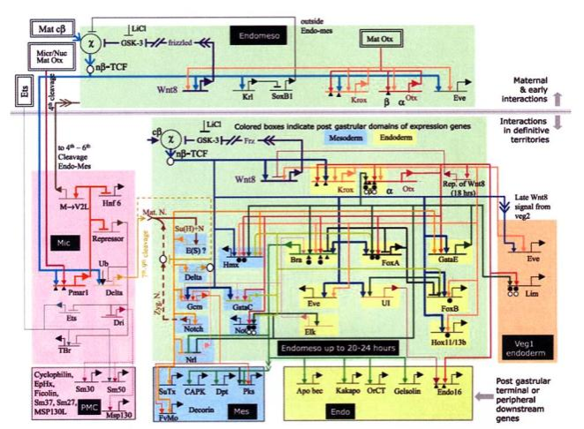

0, 6, 23, 11, 19, and 13
0, 6, 23, 11, 19, and 13
Genetic regulatory network controlling the development of the body plan of the sea urchin embryo. Davidson et al., Science, 295(5560):1669-1678

Slide 15
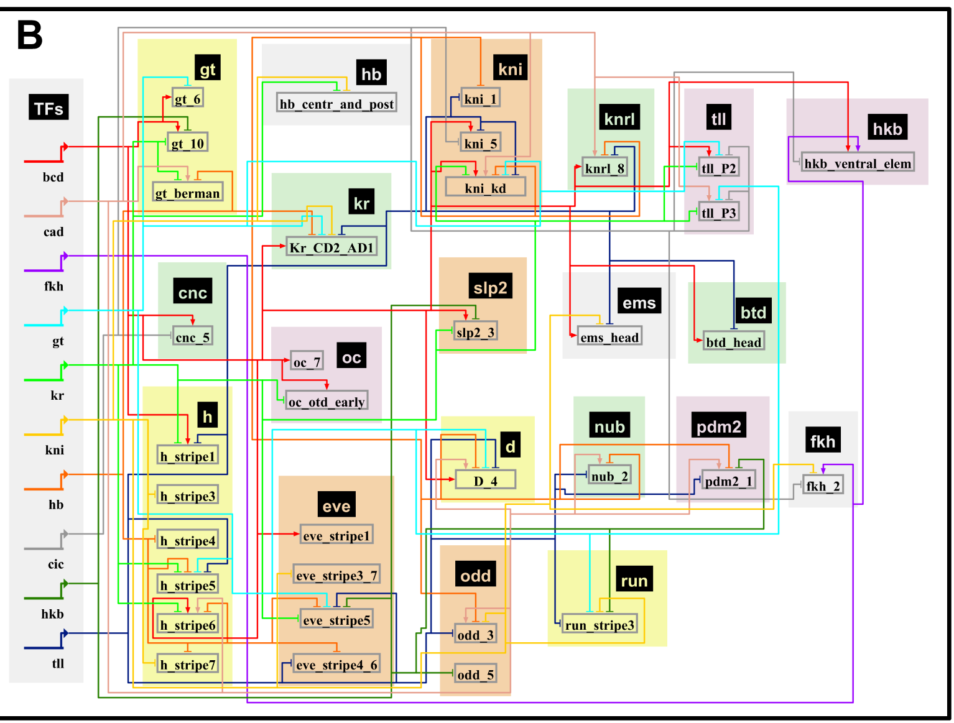

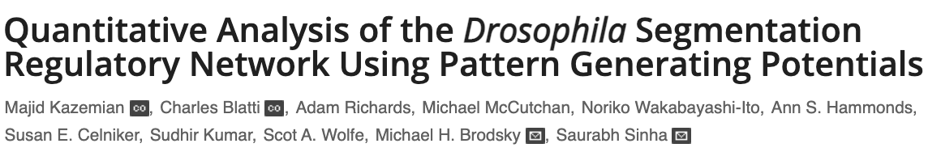
GRNs can be reconstructed computationally

Slide 16
Goal: discover the gene regulatory network
Sub-goal: discover the genes regulated by a transcription factor

Slide 17
Genome-wide assays
One experiment per cell type AND PER TF
... tells us which TF might regulate a gene of interest
Expensive !

Slide 18
Goal: discover the gene regulatory network
Sub-goal: discover the genes regulated by a transcription factor
… by DNA sequence analysis

Slide 19
The regulatory network is encoded in the DNA
TF1
TCTAATTG
It should be possible to predict where transcription factors bind, by reading the DNA sequence

Slide 20
Motifs and DNA sequence analysis

Slide 21
Finding TF targets
Step 1. Determine the binding specificity of a TF
Step 2. Find motif matches in DNA
Step 3. Designate nearby genes as TF targets

Slide 22
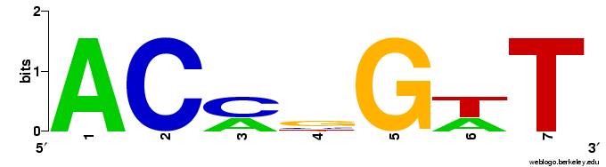
Step 1. Determine the binding specificity of a TF
ACCCGTT
ACCGGTT
ACAGGAT
ACCGGTT
ACATGAT
“MOTIF”
5 | 0 | 2 | 0 | 0 | 2 | 0 | A
0 | 5 | 3 | 1 | 0 | 0 | 0 | C
0 | 0 | 0 | 3 | 5 | 0 | 0 | G
0 | 0 | 0 | 1 | 0 | 3 | 5 | T

Slide 23
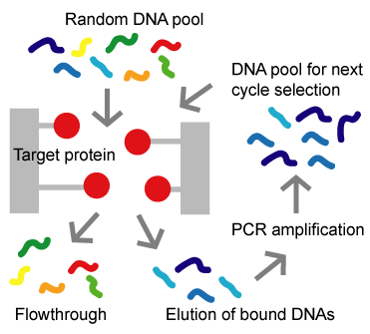
How?
SELEX
TAACCCGTTC
TAACCCGTTC
GTACCGGTTG
GTACCGGTTG
ACACAGGATT
ACACAGGATT
AACCGGTTA
AACCGGTTA
GGACATGAT
GGACATGAT
http://altair.sci.hokudai.ac.jp/g6/Projects/Selex-e.html

Slide 24
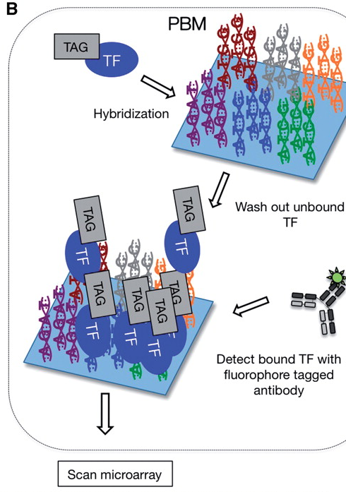
How?
Protein binding microarrays
TAACCCGTTC
TAACCCGTTC
GTACCGGTTG
GTACCGGTTG
ACACAGGATT
ACACAGGATT
AACCGGTTA
AACCGGTTA
GGACATGAT
GGACATGAT
http://bfg.oxfordjournals.org/content/9/5-6/362/F2.large.jpg

Slide 25
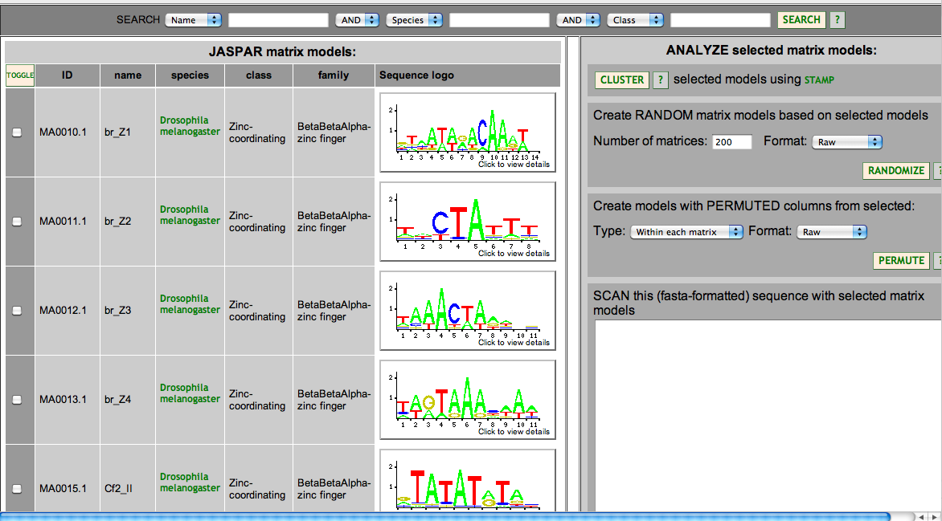
Motif Databases
JASPAR: http://jaspar.genereg.net/

Slide 26
Motif Databases
TRANSFAC
  Public version and License version
Cis-BP http://cisbp.ccbr.utoronto.ca/
  Experimentally determined as well as computationally inferred motifs
Hocomoco: http://hocomoco.autosome.ru/
  Human and mouse motifs
UniProbe: http://thebrain.bwh.harvard.edu/uniprobe/
  variety of organisms, mostly mouse and human
Fly Factor Survey: http://pgfe.umassmed.edu/TFDBS/
  Drosophila specific

Slide 27
Step 2. Finding motif matches in DNA
Basic idea:
To score a single site s for match to a motif W, we use
Motif:
Match:
ACCGGTT
Apprx. Match:
ACACGTT

Slide 28
What is Pr (s | W)?
5 | 0 | 2 | 0 | 0 | 2 | 0 | A
0 | 5 | 3 | 1 | 0 | 0 | 0 | C
0 | 0 | 0 | 3 | 5 | 0 | 0 | G
0 | 0 | 0 | 1 | 0 | 3 | 5 | T
1 | 0 | 0.4 | 0 | 0 | 0.4 | 0 | A
0 | 1 | 0.6 | 0.2 | 0 | 0 | 0 | C
0 | 0 | 0 | 0.6 | 1 | 0 | 0 | G
0 | 0 | 0 | 0.2 | 0 | 0.6 | 1 | T
Now, say s =ACCGGTT (consensus)
Pr(s|W) = 1 x 1 x 0.6 x 0.6 x 1 x 0.6 x 1 = 0.216.
Then, say s = ACACGTT (two mismatches from consensus)
Pr(s|W) = 1 x 1 x 0.4 x 0.2 x 1 x 0.6 x 1 = 0.048.

Slide 29
Scoring motif matches with “LLR”
Pr (s | W) is the key idea.
However, some statistical massaging is done on this.
Given a motif W, background nucleotide frequencies W_{b} and a site s,
LLR score of s =
Good scores > 0. Bad scores ≲ 0.

Slide 30
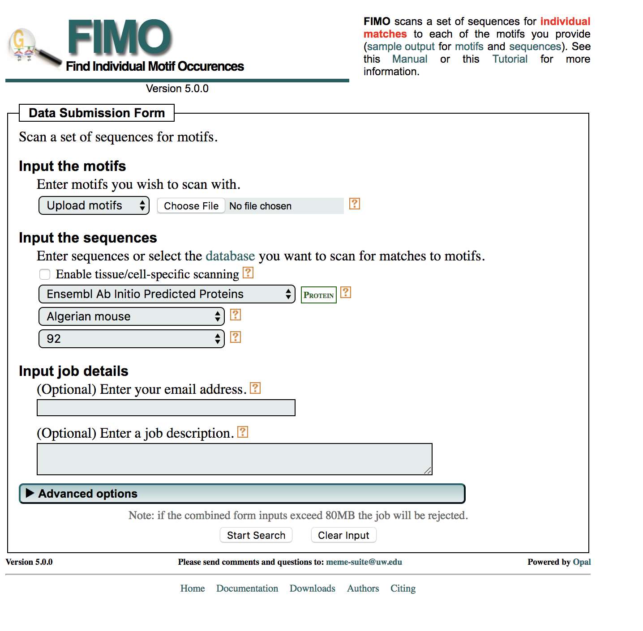
The FIMO program
https://meme-suite.org/meme/tools/fimo
Grant, Bailey, Noble; Bioinformatics 2011.
Takes motif W, background W_{b} and a sequence S.
Scans every site s in S, and computes its LLR score.
Uses sound statistics to deduce an appropriate (p-value) threshold on the LLR score. All sites above threshold are predicted as binding sites.

Slide 31
Finding TF targets
Step 1. Determine the binding specificity of a TF
Step 2. Find motif matches in DNA
Step 3. Designate nearby genes as TF targets

Slide 32
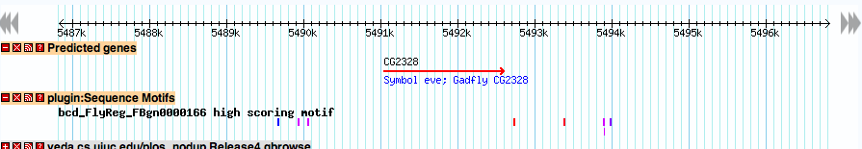

Step 3: Designating genes as targets
Predicted binding sites for motif of TF called “bcd”
Designate this gene as a target of the TF
Sub-goal: discover the genes regulated by a transcription factor … by DNA sequence analysis

Slide 33
Computational motif discovery

Slide 34
Why?
We assumed that we have experimental characterization of a transcription factor’s binding specificity (motif)
What if we don’t?
There’s a couple of options …

Slide 35
Option 1
Suppose a transcription factor (TF) regulates five different genes
Each of the five genes should have binding sites for TF in their promoter region
Gene 1
Gene 2
Gene 3
Gene 4
Gene 5
Binding sites for TF

Slide 36
Option 1
Now suppose we are given the promoter regions of the five genes G1, G2, … G5
Can we find the binding sites of TF, without knowing about them a priori ?
This is the computational motif finding problem
To find a motif that represents binding sites of an unknown TF

Slide 37
Option 2
Suppose we have ChIP-Seq data on binding locations of a transcription factor.
Collect sequences at the peaks
Computationally find the motif from these sequences
This is another version of the motif finding problem

Slide 38
Motif finding algorithms
Version 1: Given promoter regions of co-regulated genes, find the motif
Version 2: Given bound sequences (ChIP peaks) of a transcription factor, find the motif
Idea: Find a motif with many (surprisingly many) matches in the given sequences

Slide 39
Motif finding algorithms
Gibbs sampling (MCMC) : Lawrence et al. 1993
MEME (Expectation-Maximization) : Bailey & Elkan 94. (Very popular, visited in today’s lab.)
CONSENSUS (Greedy search) : Stormo lab.
Priority (Gibbs sampling, but allows for additional prior information to be incorporated): Hartemink lab.
Many many others …

Slide 40
Examining one such algorithm

Slide 41
The “CONSENSUS” algorithm
Final goal: Find a set of
“substrings” (sites), one in each input
sequence
Set of substrings define a motif.
Goal: This motif should have
high “information content”.
High information content means that the sites are identical or similar to each other

Slide 42
The “CONSENSUS” algorithm
Start with a substring in one
input sequence
Build the set of substrings
incrementally, adding one
substring at a time
The current set of substrings.

Slide 43
The “CONSENSUS” algorithm
Start with a substring in one
input sequence
Build the set of substrings
incrementally, adding one
substring at a time
The current set of substrings.
The current motif.

Slide 44
The “CONSENSUS” algorithm
Start with a substring in one
input sequence
Build the set of substrings
incrementally, adding one
substring at a time
?
?
?
?
The current set of substrings.
The current motif.
Consider every substring in the next sequence, try adding it to current motif and scoring resulting motif’s information content

Slide 45
The “CONSENSUS” algorithm
Start with a substring in one
input sequence
Build the set of substrings
incrementally, adding one
substring at a time
The current set of substrings.
The current motif.
Pick the best one ….

Slide 46
The “CONSENSUS” algorithm
Start with a substring in one
input sequence
Build the set of substrings
incrementally, adding one
substring at a time
The current set of substrings.
The current motif.
Pick the best one ….
… and repeat

Slide 47
Summary so far
To find genes regulated by a TF
  Determine its motif experimentally
  Scan genome for matches (e.g., with FIMO & the LLR score)
Motif can also be determined computationally
  From promoters of co-expressed genes
  From TF-bound sequences determined by ChIP assays
  MEME, CONSENSUS, etc.

Slide 48
Further reading
Introduction to theory of motif finding
  Moses & Sinha: http://www.moseslab.csb.utoronto.ca/Moses_Sinha_Bioinf_Tools_apps_2009.pdf
  Das & Dai: http://www.ncbi.nlm.nih.gov/pmc/articles/PMC2099490/pdf/1471-2105-8-S7-S21.pdf

Slide 49
Motif finding tools
MEME: http://meme-suite.org/
RSAT: http://rsat.sb-roscoff.fr/

Slide 50
Integrating sequence analysis and expression data

Slide 51
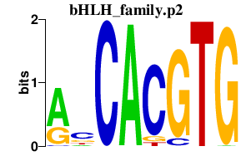
1. Predict regulatory targets of a TF
?
GENE
TF
Motif module: a set of genes predicted to be regulated by a TF (motif)

Slide 52
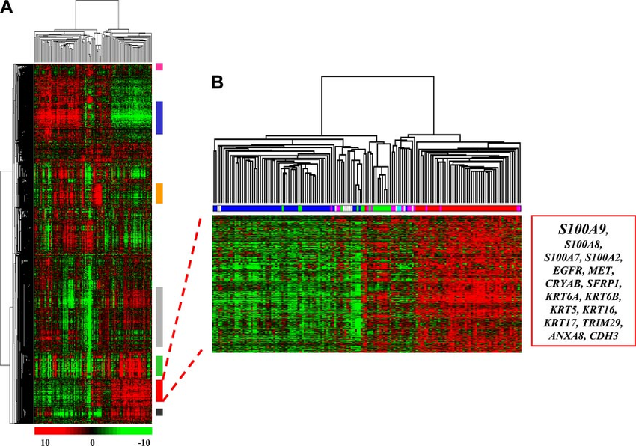
2. Identify dysregulated genes in phenotype of interest
Two “subtypes” of patients
Set of genes differentially expressed between the two subtypes of patients
Source: DOI:10.1074/mcp.M700487-MCP200

Slide 53
3. Combine motif analysis and gene expression data
All genes (N)
Genes regulated by TF
(m)
Genes differentially expressed between subtypes
(n)
Is the intersection (size “k”) significantly large, given N, m, n?
Use Hypergeometric test to obtain “p-value”

Slide 54
3. Combine motif analysis and gene expression data
All genes (N)
Genes regulated by TF
(m)
Genes differentially expressed between subtypes
(n)
Infer: TF may be determining cancer subtypes.
An “association” between motif and condition

Slide 55
Useful tools
GREAT: http://bejerano.stanford.edu/great/public/html/
  Input a set of genomic segments (e.g., ChIP peaks)
  Obtain what annotations enriched in nearby genes
  only for human, mouse and zebrafish
DAVID: https://david.ncifcrf.gov/
  Input a set of genes
  Obtain what annotations enriched in those genes
  Many different species

Slide 56
Epigenomics
Where do TFs bind?
Which genomic segments actively regulate gene expression?

Slide 57
Outline
Decorations on the genome
Experimental assays to profile the decorated genome
Insights from large scale epigenomics studies

Slide 58
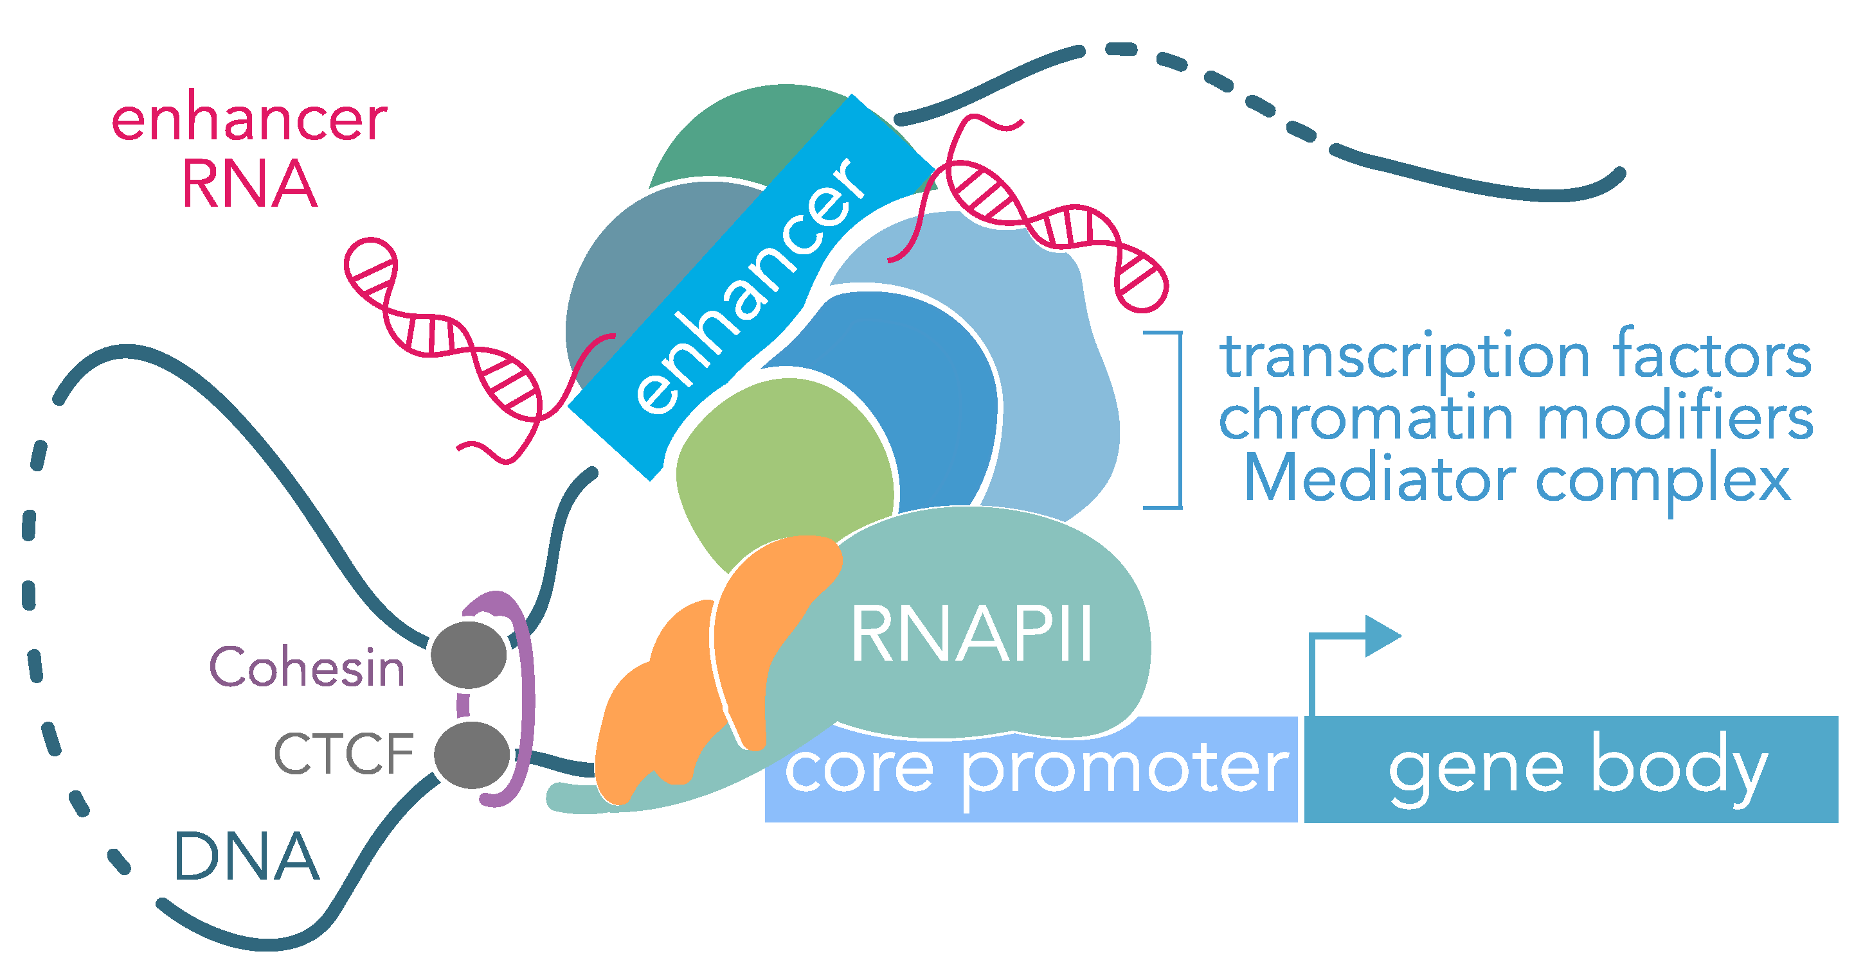
The regulatory genome
Source: Genomic Enhancers in Brain Health and Disease. Nancy V. N. Carullo and Jeremy J. Day. Genes 2019, 10(1), 43;

Slide 59
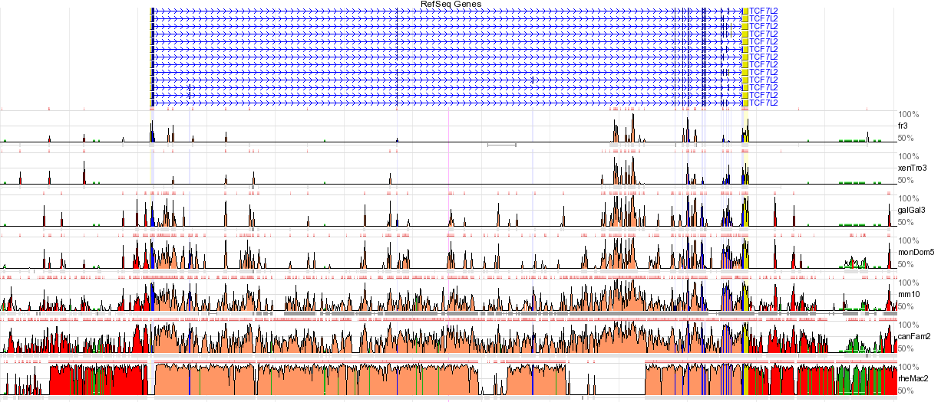
How to find enhancers?
Like finding needle in a haystack
Evolutionary conservation is sometimes used to identify enhancers
  but not all functional elements are conserved at the level that DNA sequence alignments can detect. So how do we find regulatory elements?
More important question is: which enhancers are active in a particular cell type?

Slide 60
Regulatory activity leaves its “mark” on the genome: epigenomics

Slide 61
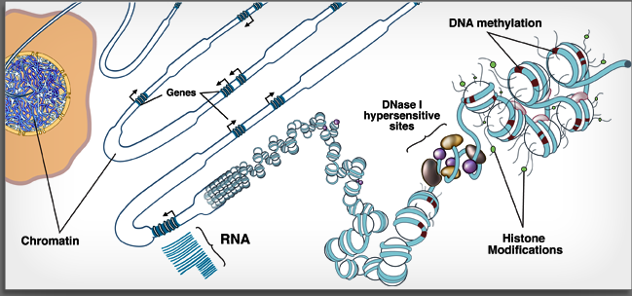
Eukaryotic genomes are complex 3D structures comprised of modified and unmodified DNA, RNA and many types of interacting proteins
Most DNA is wrapped around a “histone core”. Such wrapped-around DNA is relatively “inaccessible” to other molecules such as TFs. But there are “accessible regions” as well, can be detected as “Dnase I hypersensitive sites” (DHS)
TFs bind to their preferred sites (especially in accessible regions), or not
Histone proteins are ‘marked’ (like flags), or not
CpG dinucleotides in DNA are methylated, or not

Slide 62
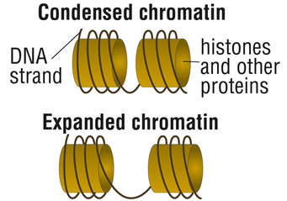
Epigenomic clues into regulatory activity
Look for accessible regions of DNA, that’s where active regulatory elements might lie
Also: specific histone modifications and DNA methylation mark regulatory activity
If you know a particular TF that is important for regulation, look for its binding sites
Not accessible
accessible

Slide 63
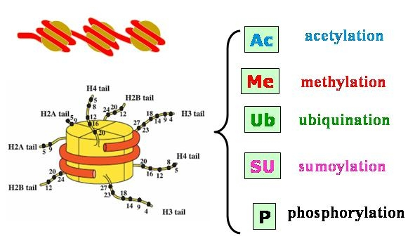
All four histones in the tetramer have “tails” that can be modified in various ways
The most consequential modifications, with respect to transcriptional activity, appear to involve methylation or acetylation of Lysines (K) in histone H3

Slide 64
Experimental assays

Slide 65
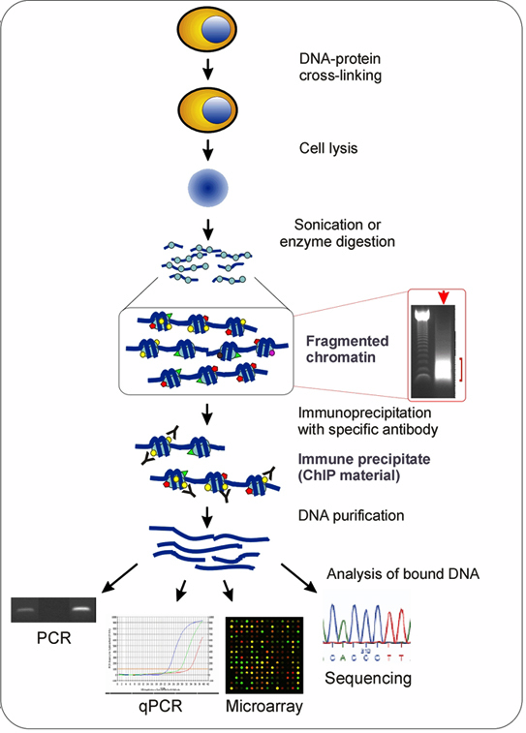
How to find TF binding sites?
Chromatin ImmunoPrecipitation (ChIP)
Antibody to a DNA binding protein is used to “fish out” DNA bound to the protein in a living cell
  DNA and protein are crosslinked in the cell using formaldehyde
  Crosslinked chromatin is sheared, usually by sonication, to yield short fragments of DNA+protein complexes
  Antibody to a TF or other binding protein used to fish out fragments containing that DNA binding protein
  DNA is then “released” and can be analyzed by sequencing
Creates a pool of sequences highly enriched in binding sites for a particular protein
Requires availability of excellent antibodies that can detect the protein in its in vivo context

Slide 66
ChIP computational issues
First step is to map reads: BOWTIE, Novalign, BWA or other
ChIP-seq reads surround but may not contain the DNA binding site
  Sequence is generated from the ends of randomly sheared fragments, which overlap at the protein binding site
Gives rise to two adjacent sets of read peaks
Programs like MACS and HOMER automatically subtract your control (genomic input) from sample reads to define a final set of peaks
Binding site
Seq reads
ChIP fragments

Slide 67
ChIP Analytical challenges
Genomic neighborhoods
  Shear efficiency is not really “random”
    Some genomic regions are fragile and sensitive
    Some regions are protected from shear or degradation
  Other artifacts
    Centromeres, polymorphic regions, repeats in general: most programs cannot manage sequence reads that are not mapped uniquely
ChIP-seq can be used to profile not only TF binding sites but also histone modifications. Data and peak characteristics are different depending on what is profiled.
  TFs are typically sharp peaks; chromatin marks are more diffuse

Slide 68
Analyzing ChIP data
User-friendly tools
  MACS:
    Zhang et al, Genome Biology 2008, Feng et al. 2012, Nat Procols PMID: 22936215 (Xiaole Liu lab);
    MACS1 is best for sharp peaks (TFs); will break diffuse peaks into smaller regions
    MACS2 is designed to allow broad- or sharp-peak detection
  HOMER (http://homer.salk.edu/homer)
    Can be easily tweaked for more sensitive peak detection
    Comes packaged wiith a rich set of peak annotation tools
    Tools for DNAse-seq, Hi-C, differential ChIP analysis and many more
  Both tools permit generation of “wiggle files” or similar that can be viewed in the UCSC browser
    Looking at your data is a very important step! Peak finders can miss peaks that you can easily see by eye!

Slide 69
ChIP analysis workflow
FASTQC -> BOWTIE -> Peak finder (MACS or HOMER)
This same workflow and tools can be used for a variety of assays
e.g., ATAC-seq, DNase seq, etc.
Downstream analysis:
Mapping peaks to nearby genes (and perhaps, differentially expressed genes)
Identifying enriched motifs
For your factor
For co-binding factors
Overlapping with other genome features
e.g., open chromatin, known binding sites, etc.

Slide 70
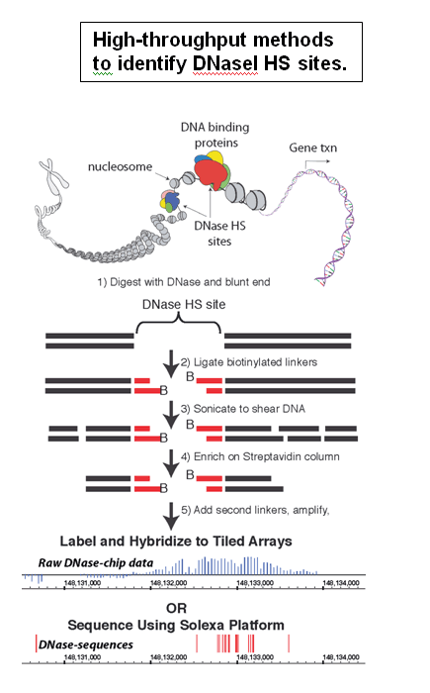
How to find accessible DNA?
The first approach:
Crawford et al., Genome Research 16:123, 2006 (Francis Collins’ laboratory)
Genome-wide identification of Dnase I Hypersensititive sites (DHS)
Later variants also based on DNase I treatment, but different protocol and different philosophy. See http://homer.ucsd.edu/homer/ngs/dnase/index.html
Many later methods: ChIP-exo, FAIRE, ATAC-seq etc. (see Furey et al., 2012 for older review)

Slide 71
An economical approach to open chromatin: ATAC-seq
Buenrostro et al., 2013, 2015
Uses Tn5 transposase and a Transposon modified to contain Illumina primers at each end
Transposon “jumps” preferentially (and randomly) into accessible chromatin
Because of the design the transposon breaks DNA where it jumps in, tagging the site with the primer
Two insertions close together yield fragments of the size amenable for Illumina sequencing
PCR amplification between primers is all you need to make a library
Since it skips library-making steps (ligation etc), can be done with small amounts of input chromatin – e.g. 50,000 vs 1,000,000 cells

Slide 72
DNA Methylation
Methyl (-CH3) group added to Cytosine (‘C’)
CpG (CG dinucleotide) is often methylated
Methylated CpG may hinder transcription factor binding to DNA at that site
Methylated CpG may recruit proteins that render local chromatin less accessible
Roughly speaking, DNA methylation is repressive for gene expression

Slide 73
CpG Methylation profiling
Bisulfite sequencing
Other methods:
DNA cleavage by methylation-sensitive restriction enzymes
Immunoprecipitation with methyl-binding protein

Slide 74
Insights from large scale epigenomics studies

Slide 75
Lessons from epigenomics assays
Massive deep-sequencing of multiple chromatin features in cell lines (ENCODE), primary cell types and tissues (Epigenetics Roadmap)
  Histone H3 modifications: highlight on H3K4me1, H3K4me3, H3K27Ac, H3K27me3.
  Other chromatin proteins: e.g. P300 (acetyltransferase)
H3K4me3 marks are enriched at active promoters
  H3K4me3 marks are largely the same in all cell lines, with a small fraction of marks being cell-specific
P300, and H3K4me1 without H3K4me3 is enriched at enhancers
  Most P300 peaks also contain H3K4me1
  P300, H3K4me1 marks are highly cell-type specific
  Most P300 marks are enhancers, but not all enhancers have P300
  Most enhancers have an H3K4me1 mark but, not all H3K4me1 marks are in enhancers
Other marks: H3K27Ac or H3K27me3
  Mutually exclusive marks for open (Ac) versus closed (Me3) chromatin regions
  H3K27Ac is perhaps the most general mark of open chromatin: promoters and enhancers
  H3K27Ac often found in combination with H3K4 me1/me3

Slide 76
Application 1: Chromatin “states”: an unbiased, systematic characterization
ChromHMM tool combines information from 38 different histone marks, Pol2 and CTCF profiles to identify different ‘states’
Other tools exist, e.g., ChromaSig, Segway
ChromHMM: automating chromatin-state discovery and characterization. Jason Ernst & Manolis Kellis. Nature Methods 9, 215–216 (2012) http://www.ncbi.nlm.nih.gov/pubmed/22373907

Slide 77
Application 2: DNA Methylation profiles in cancer and aging
DNA Methylation levels can be condition-dependent
  Aberrant methylation patterns in cancer (e.g., hypermethylation of tumor suppressors and hypomethylation of oncogenes)
  Progressive increase in global methylation levels with age. Also aging-correlated hypomethlation at some genes.

Slide 78
3D genome

Slide 79
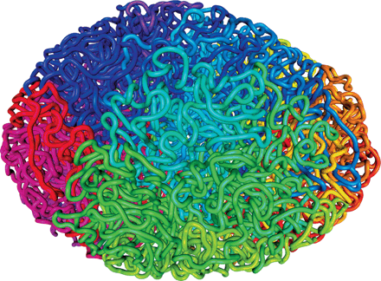
Source: DOI: 10.1126/science.347.6217.10

Slide 80
Probing 3-dimensional chromatin structure with conformation capture
from Wit and de Laat, 2012

Slide 81
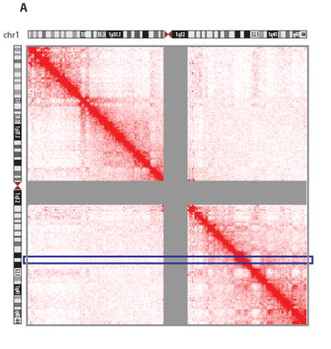
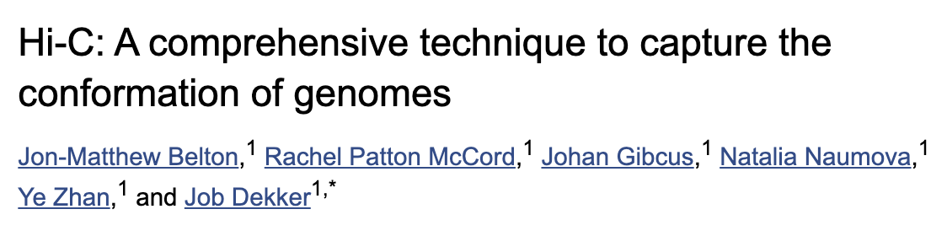
Hi-C “output”
heatmap of interactions between all 1 Mb bins along chr1 for GM06990 cells. The intensity of red color corresponds to the number of Hi-C interactions.

Slide 82
Requires analysis methods that are different from ChIP
Provides the essential “big picture” view, since it is otherwise impossible to predict long-range enhancer-enhancer or enhancer-promoter interactions
Sequenced fragments contain a bit of DNA from two distant regions
  Data need to be trimmed and mapped to allow non-contiguous sequences
Long-distant contacts are numerous, and each contact point is relatively rare: peaks are small and require deep sequencing
Hi C kits are now readily available and quite reliable, giving a whole-genome view of interactions
  Lots of interactions and lots of noise! Computational issues are tricky
  All 3D methods require deep sequencing and paired-end reads

Slide 83
Why is 3D information useful?
The issue is finding out “who is talking to whom?”
  Enhancers can be shared by multiple genes
  Alternative promoters for the same gene can have very different regulatory partners
  Position relative to the TSS is not a reliable indicator in large vertebrate genomes
  3D methods are necessary to tie enhancers and promoters (genes) together

Slide 84
Summary (epigenomics)
Transcription factor binding sites genome-wide
Histone modification profiles (different marks or combinations of marks can point to different classes of regulatory elements)
DNA accessibility profiles
CpG methylation profiles
Epigenomic profiles are informative about gene expression and regulatory mechanisms

Slide 85
Questions ?

