Slide 1
Confounding variable correction and outlier expression analysis
Eric Klee, PhD

Slide 2
Outline
Introduction to confounding variables in RNA data
Concepts of differential expression vs outlier detection
Software solutions overview and challenges
Machine learning-based correction of confounding variables
Outlier gene expression detection and utility in rare genetic disease studies
Notes:
https://colab.research.google.com/drive/1ntYCrVtKb5ejdOXpBC_NQVBzjFA46vqU?usp=sharing

Slide 3
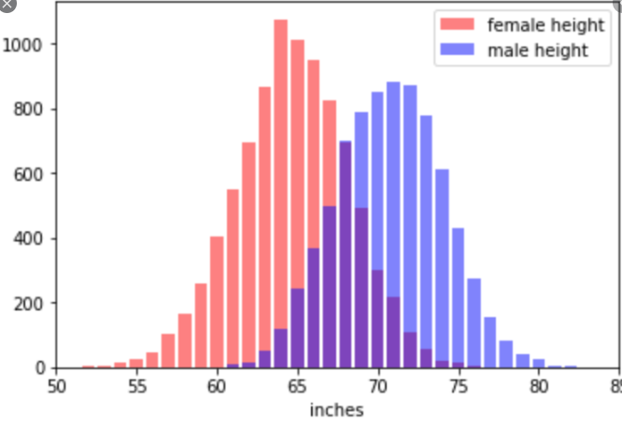
Confounding variables
We sample a population many times and find the following data
A 5’ tall man is unusually short, but if we did not factor in sex then we would not see 5’ tall adult as an outlier
A 5’ male peds patient not an outlier so age also confounder

Slide 4
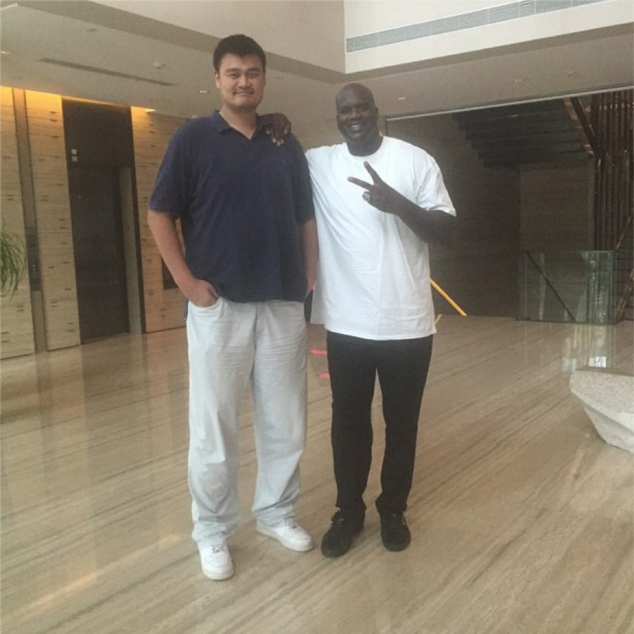
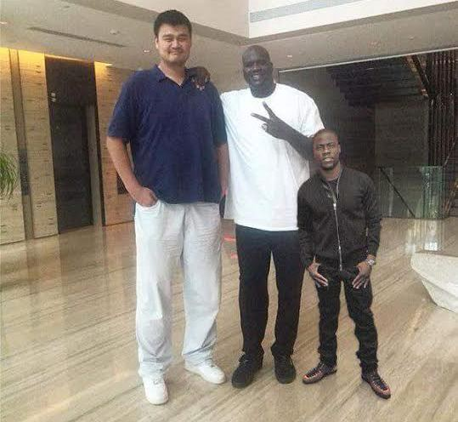

Slide 5
Yao Ming is a male with 90” height
Outlier detection has the goal of seeing this example and flagging it as an outlier or anomaly since it is unlikely within the population
There are many methods for quantitatively deciding what is “unlikely” but we will discuss the broad class of methods based on statistical hypothesis tests/p-values
Notes:
image from:
https://medium.com/@shirleyliu/histograms-from-scratch-482dba2a4e31

Slide 6
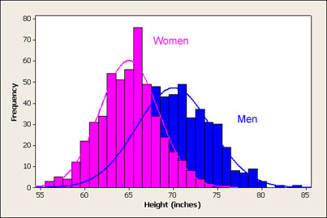
Statistical testing approach
First define a model, for example a separate bell curve for men and women
Collect “normal” data and fit models to the data
“normal” depends on scientific question; e.g., outlier in NBA versus general population
Calculate p-values
Conclude outlier when p-value
sufficiently small
Notes:
image from:
https://www.usablestats.com/lessons/normal

Slide 7
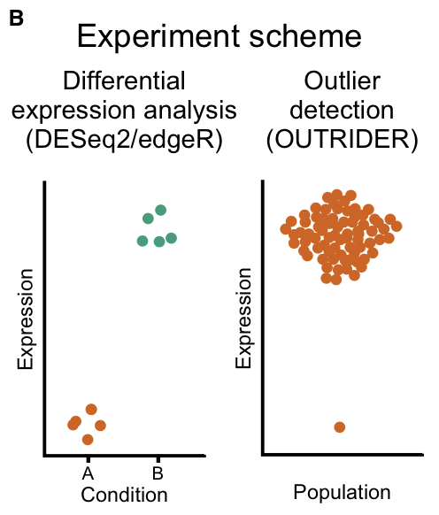
Traditional RNA-seq differential analysis
Rather than outlier detection, usually the statistical test is a group-wise comparison
Normal versus cancer expression
Lung versus brain expression
Requires “replicates” which don’t exist in rare/novel/undiagnosed disease
Not an individual-level prediction
This is more akin to determining that men are on average taller than women and the p-values are computed differently (e.g., t-test or linear models)

Slide 8
Closer look at the p-values
Null: Yao Ming’s 90 inch height was randomly selected from population of heights
Suppose we estimate from data the average male is 70 inches and the standard deviation is 4 inches
P-value for Yao Ming’s height asks: “what is the probability that someone 90 inches or taller is randomly selected from the population”
Here we can calculate this as: zscore = (90-70)/4 = 5 → p-value = 0.00001
Interpretation: it is highly unlikely that I randomly selected Yao Ming by chance from the population of heights
This is true. I specifically chose him due to his notoriously large height, and so outlier analysis has correctly identified an anomaly

Slide 9
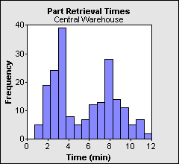
Not all distributions are Gaussian
The aforementioned procedure is general, but a good model should match the data generation process
Normal distribution is good for heights but not the below graph
Note in the case of heights the situation was actually similar if we didn’t account for sex
Height only looked Gaussian for each sex separately
Z-scores sometimes used instead of p-value; incorrect unless Gaussian
Notes:
Image from:
http://www.statit.com/support/quality_practice_tips/histograms.shtml

Slide 10
RNA-seq Expression
RNA extracted from the cells and sequenced
Each sequencing read can be mapped (not always uniquely) to a given transcript/gene
We extract counts of reads coming from each gene
Counts need context and are not useful in isolation
Long genes have more RNA-bases per transcript expressed
Samples sequenced to higher depths will have more total counts for technical and not biological reasons
Models for RNA counts need to account for both

Slide 11
Over-simplified view: just use TPM
Notes:
image source: statquest.com

Slide 12
First normalize by gene length
Notes:
image source: statquest.com

Slide 13
Now normalize by sequencing depth
Notes:
image source: statquest.com

Slide 14
Build model
Use a Gaussian distribution as before, but now using TPMs that are comparable across genes and samples
Most sophisticated RNA-seq analysis avoid this route and model the counts directly (often with negative binomial distribution) while accounting for gene length and sequencing depth but idea is similar
Once you model your “normal” cohort, just do outlier detection via p-values as before
Trick in rare disease is to use patients as “normal” cohort

Slide 15
Confounding variables revisited
Variables that are not of interest that affect your variable of interest
sex, age, smoking status, technical artifacts, cell admixture in whole blood, etc
If your “normal” population was mostly males and you measured an average female’s height you might incorrectly label them an outlier
One option is directly accounting for them as we did with sex in heights (e.g., PEER package)
Pros: intuitive model we control and interpret
Cons: requires much more data, and corresponding meta data (i.e., sex labels)

Slide 16
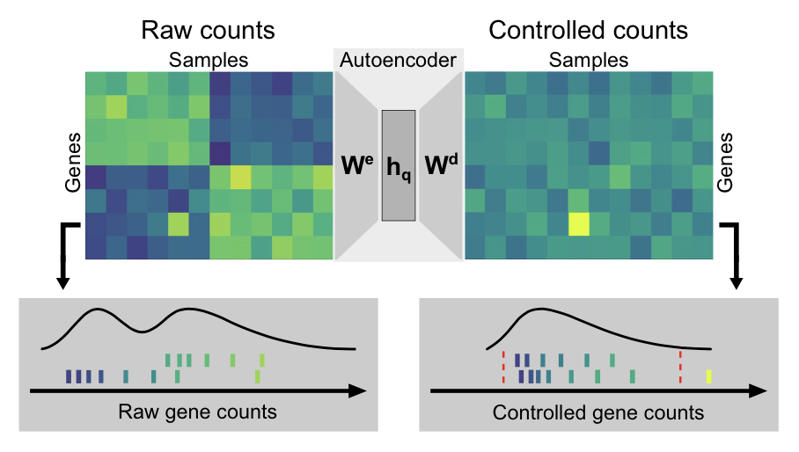
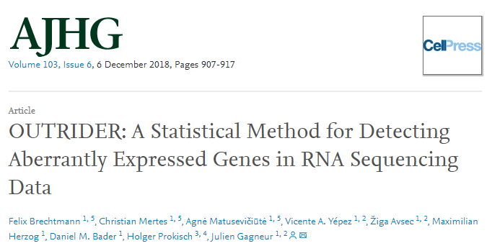
Autoencoder
“Black box” finds relationships between samples and corrects for them automatically
Pros: no meta data needed, less samples needed, accounts for hidden confounders
Cons: not easily interpretable output…need to “trust” the black-box

Slide 17
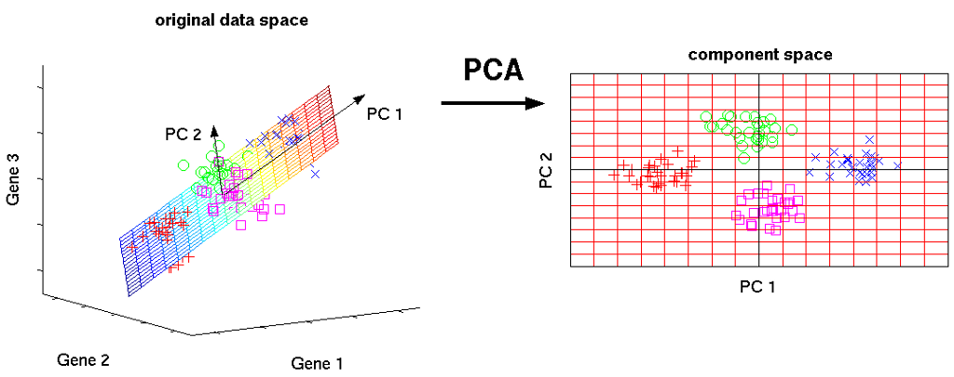
PCA (autoencoder initialization, W^{e}=W^{d})

Slide 18
Outlier Case study
9 year old male, non-consanguineous family
Mild global developmental delay
General Convulsive Intractable Epilepsy
Nevus sebaceous
Constipation due to colonic dysmotility
Outside diagnosis of mitochondrial disorder

Slide 19
Outlier-centric View

Slide 20
Outlier-centric View (top hit)
Notes:
Put boxes to make a story about relevant annotations

Slide 21
Variant-centric View
4/7

Slide 22
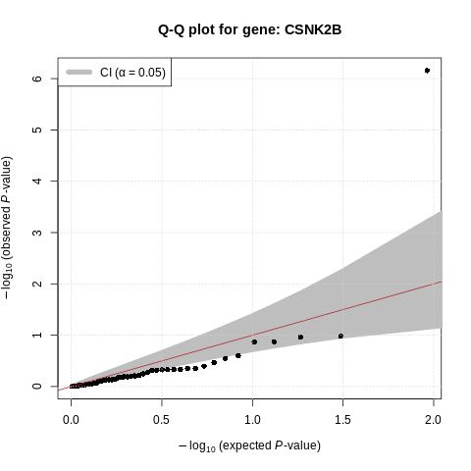
Case summary
OUTRIDER:
p-value = 1E-7
zScore = -5.4
l2fc = -0.69
Gene’s top CADD variant is case solving variant
Nonsense variant p.Glu61*, consistent with the near complete allelic loss of expression

Slide 23
Questions?
Slides curtesy of Garrett Jenkinson

Slide 24
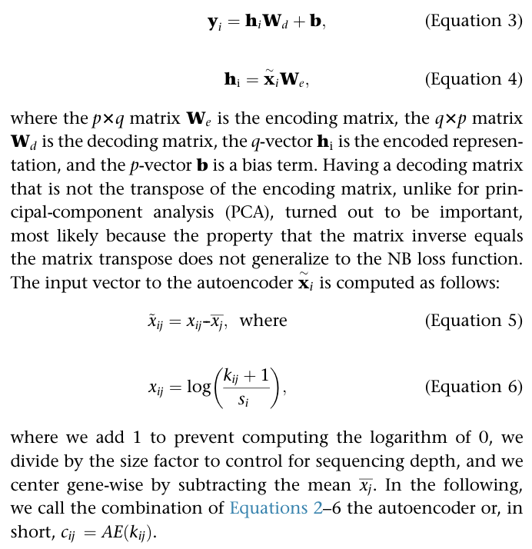
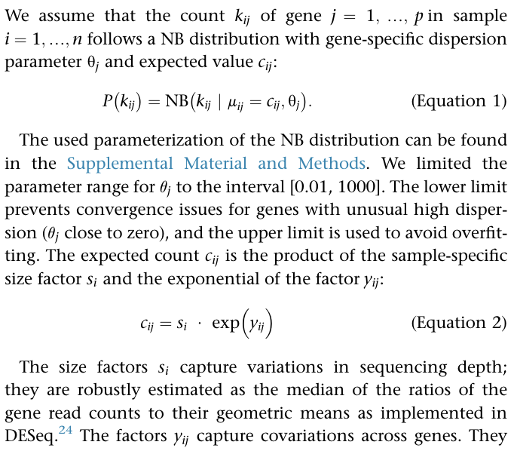
OUTRIDER

Slide 26
