Slide 1

Translational use of multifaceted RNA-Seq bioinformatics analysis in genetic disease investigation
Eric W. Klee, PhD
Director of Bioinformatics, Center for Individualized Medicine
Associate Professor of Biomedical Informatics

Slide 2
Outline
Discussing the role of RNA-sequencing in rare and undiagnosed disease
Unit consists of four lectures:
  Introduction to Rare and Undiagnosed Disease
  Expression Analysis for Outlier Observations
  Fusion analysis in RNA-sequencing data
  Splicing analysis
Lectures given by Gavin Oliver and Eric Klee

Slide 3
Introduction
What is rare genetic disease?
A common problem - when rare isn’t rare
Rare genetic disease diagnosis in the era of next-generation sequencing
The promise of RNA-Seq in improving rare genetic disease diagnosis

Slide 4
Rare Genetic Disease
In the United States, a rare disease is defined as a condition that affects fewer than 200,000 people in the US. This definition was created by Congress in the Orphan Drug Act of 1983. There may be as many as 7,000 rare diseases. rarediseases.info.nih.gov
The European Union defines a disease or condition as rare if it affects fewer than 1 in 2,000 (1) people within the general population. Currently, there are over 6,000 (2) known rare diseases. raredisease.org.uk
80% have a genetic component
Rare Genomics Institute

Slide 5

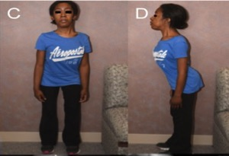
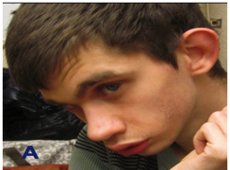
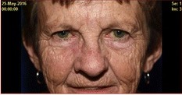
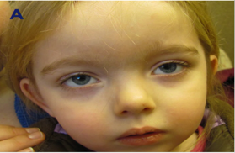
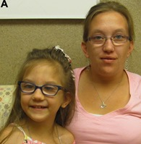
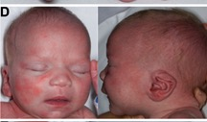
Faces of Rare Genetic Disease

Slide 6
A common problem - when rare isn’t rare
An estimated 300 million people worldwide are affected by a rare disease globalgenes.org
1 in 10 Americans have a rare disease raregenomics.org
6% to 8% of the population of the European Union is affected by a rare disease eurodis.org
rhondarowland.com
30% of patients with rare disease will not live to see their 5th birthday
Rare diseases are responsible for 35% of deaths in the first year of life
raregenomics.org

Slide 7
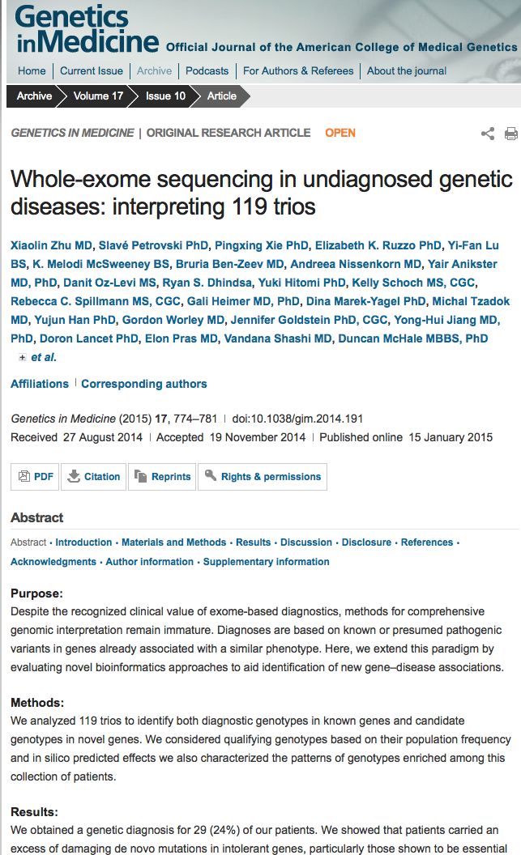
Proliferation of Exome Diagnostic Testing
“We analyzed 119 trios to…”
“We obtained a genetic diagnosis for 29 (24%)… ”
Clinical Exome Sequencing for Genetic Identification of Rare Mendelian Disorders - JAMA
“Results—Of the 814 cases, the overall molecular diagnosis rate was 26%”
Resolution of Disease Phenotypes Resulting from Multilocus Genomic Variation – NEJM
“A molecular diagnosis was rendered for 2076 of 7374 patients (28.2%)”

Slide 8

RNA Sequencing to Improve Diagnostic Rate
Expressed Fusions
Exon Skipping
Expression Changes
Notes:
Exponential growth in IM clinical consults and testing expecting to continue rapid trajectory

Slide 9
Case Examples
Patient #1: GNPTAB – cryptic splicing
Patient #2: ATM – expressed fusion
Patient #3: CASK – outlier expression
Patient #4: SGSH – allele-specific expression

Slide 10
Patient Example Case #1
Age: 9y female
Reason for Referral: Mild global developmental delay, brain MRI abnormal joint contractures, slightly distinctive facial features
Clinical Testing reported compound heterozygous variants in MEGF10, which upon further review did not seem a good fit.
Requested raw data from the testing provider and reanalyzed

Slide 11
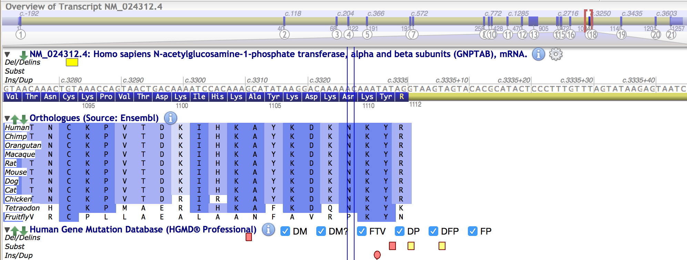
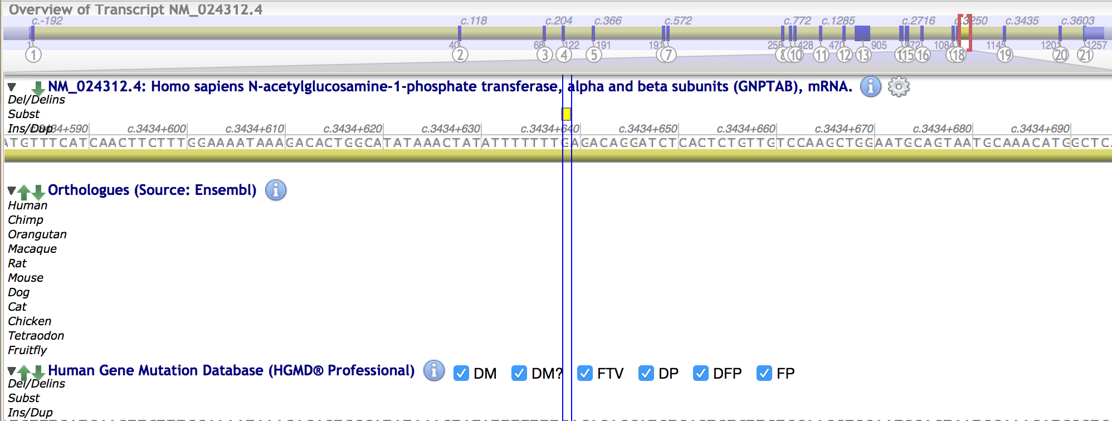
Candidate Splicing Variant Identified
A deep intronic variant was found in trans with a loss of function frame-shift variant.
If the intronic variant impacts gene splicing it may explain the patients phenotype

Slide 12
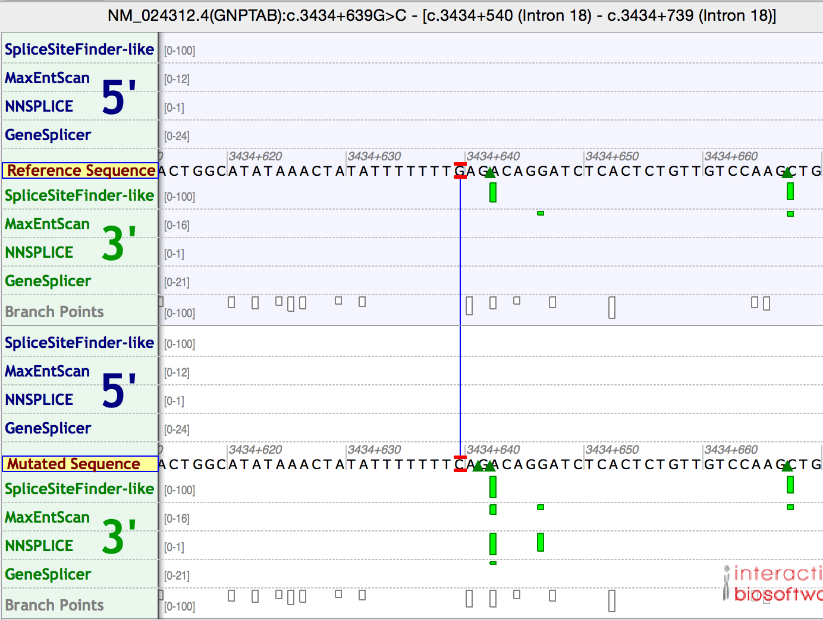
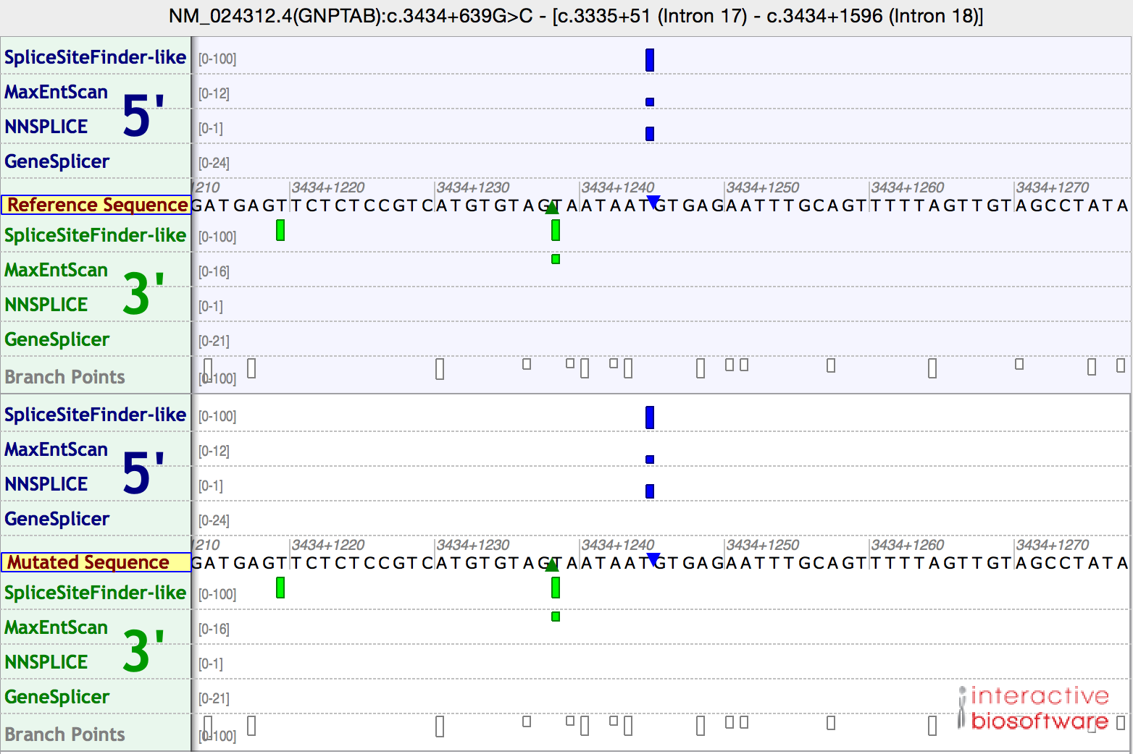
Splicing predictor identifies putative donor site
Patient variant creates spice acceptor
Cryptic splice donor
The intronic variant creates a predicted splice acceptor at c.3434+642 and there is a cryptic splice donor at 3434+1244

Slide 13
RNAseq confirms presence of a cryptic exon
GNPTAB TWO HET c.3281_3282delGT, p.C1094fs* – mother is het, father is neg c.3434+639G>C, p.?splice – de novo, parents are neg Disease: Mucolipidosis alpha/beta AR type II (MIM:252500) or III (MIM:252600)

Slide 14
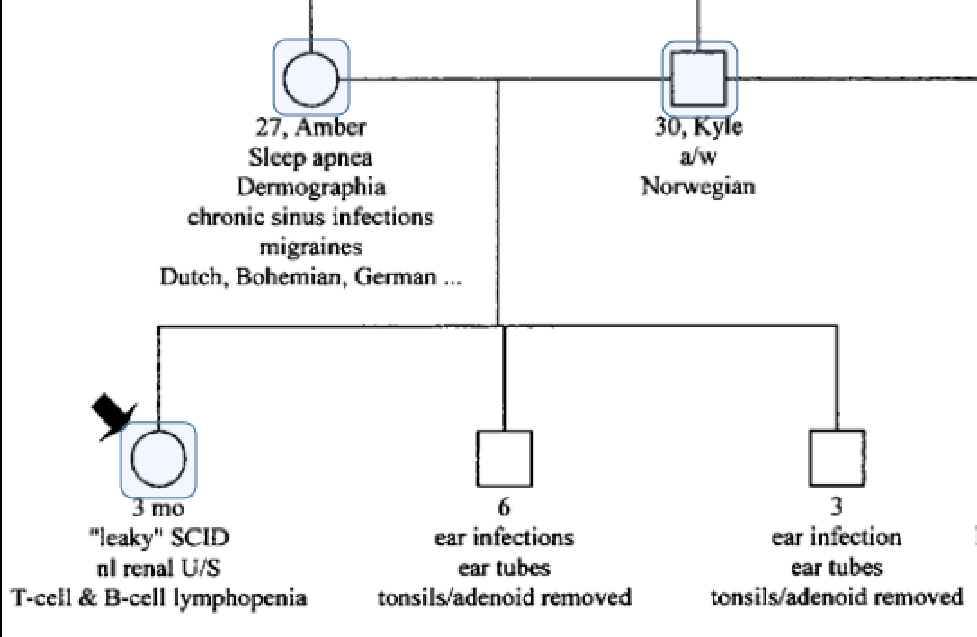
Patient Example Case #2
Single pathogenic variant in ATM (recessive condition) that would explain patient symptoms
Patient Symptoms:
Tested positive for SCID by newborn screening
Evidence of radiation sensitivity (partial)
B and T-cell lymphopenia (T-B-NK+)
TCR vbeta spectratyping is suggestive of polyclonal gaussian repertoire which is most likely suggestive of a combined immune deficiency
Thrombocytosis
Some ataxia-related phenotype potentially manifesting recently
Elevated AFP

Slide 15
Protein testing to evaluate diagnosis
Protein studies in proband and parents showed that the ATM protein was present in all three individuals, but non-functional in the proband
Patient protein present, but not functional
Notes:
Exponential growth in IM clinical consults and testing expecting to continue rapid trajectory

Slide 16
RNAseq identifies a gene fusion in ATM

Slide 17
Fusion caused by DNA inversion
Notes:
Exponential growth in IM clinical consults and testing expecting to continue rapid trajectory

Slide 18
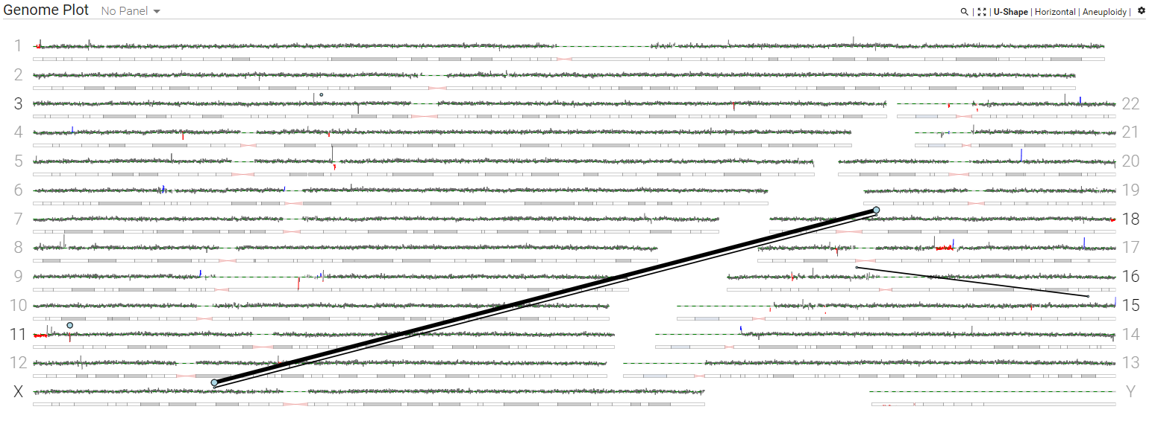
Mate-pair sequencing to investigate karyotype: t(X;18)(p11.2;q11.2)
Patient Example Case #3
Patient Symptoms:
12 month old female
GNAO1 related epileptic encephalopathy with cerebral and cerebellar atrophy
corpus callosum dysgenesis
left optic nerve hypoplasia
Micropthalmia
Cataract
cleft soft palate
ASD
dysmorphic facies
small size
microcephaly

Slide 19
Mate-pair characterizes t(X;18)(p11.2;q11.2)
Chr18:
Disrupts LOC105372028 (non-coding RNA); haploinsufficiency not known to result in any abnormal phenotypes
ChrX:
No gene was disrupted at the Xp11.4 breakpoint, however CASK is located ~173 kb distal
CASK deficiencies are a strong phenotypic fit for the patient’s symptoms

Slide 20
RNAseq Outlier Expression (CASK)
Epigenetic Profiling
Hypothesis: epigenetic gene repression on chromosome 18 near the breakpoint that has been put upstream of CASK in this patient from the t(X;18) that is now causing repression of CASK expression.
Evaluate: H3K9me, H3K27me, H3K4me and H2K9Ac (activating mark) to see if these features are present near the breakpoints in blood lineage cells of unaffected individuals.
ChIP-seq experiment on the patient’s blood sample to determine if there is a difference in the patient.
CASK:
p-value (unadjusted) = 4.08x10⁻⁸
p-value (adjusted) = 0.0003
Z-score = -5.61
Log₂(fold change) = -0.99
OUTRIDER: Brechtmann F, et al. Am J Hum Genet. 2018 Dec 6;103(6):907-917.
PMID: 30503520

Slide 21
Patient Example Case #4
Phenotype
Mucopolysaccharidosis type IIIA
Adult-onset hepatomegaly
Hypertrophic cardiomyopathy
Stroke (2014)
A. Fib
Non-dysmorphic
Mucopolysaccharidosis type III A (Sanfilippo syndrome type A; MPS IIIA) is characterized by psychomotor and speech delay, neurological regression, and behavioral disturbances.
Somatic changes are usually milder than other MPSs, and include mild coarsening, mild dysostosis multiplex, and contractures. About half of patients have hepatomegaly but splenomegaly is infrequent.
MPS IIIA is caused by biallelic pathogenic variants in SGSH resulting in a deficiency of sulfamidase, a lysosomal enzyme. The inability to degrade heparan sulfate leads to cellular accumulation of this glycosaminoglycan and increased excretion in urine.
There is only one report of a patient with sulfamidase deficiency, increased excretion of heparan sulfate, and late-onset cardiomiopathy without neurological phenotype. However, focused genetic analysis failed to identify variants in SGSH. (Van Hove et al, 2003)
Glycosaminoglycans in Cerebrospinal Fluid:
GAGs in the CSF are 50-100 times higher than controls in others MPS with neurological compromise

Slide 22
RNA Sequencing Reveals Allele-Specific Expression
ASE was noted initially in the blood, with a modest 65%-35% skew. Expression studies in a heart biopsy revealed complete skew 100%-0%.

Slide 23
Conclusions
Rare genetic disease can be individually rare, but collectively is quite common
NGS has transformed how rare genetic disease is tested, enabled considerably higher diagnostic rates and novel disease gene discovery
RNAseq can increase overall diagnostic yield in this patient population
RNAseq analysis is complex and involves looking at multiple event types

Slide 24
Questions

