Slide 1
Genomic Data Resources and Data Mining for Everyone
Krishna Rani Kalari Ph.D.
Associate Professor, Biomedical Informatics
College of Medicine, Mayo Clinic, Rochester, MN

Slide 2
Outline of my presentation
Background
Simple query tools for basic gene/variant search
UCSC, GWAS tools, and Knowledge Portals
Genotype-Tissue Expression queries
Cancer portals
TCGA, GDC, ICGC, cBioPortal, COSMIC, HTAN
Single-cell RNA
Proteomics
Trans-Omics for Precision Medicine (TOPMed)

Slide 3
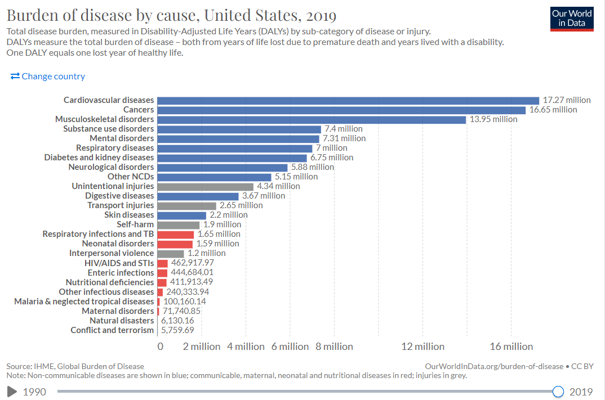
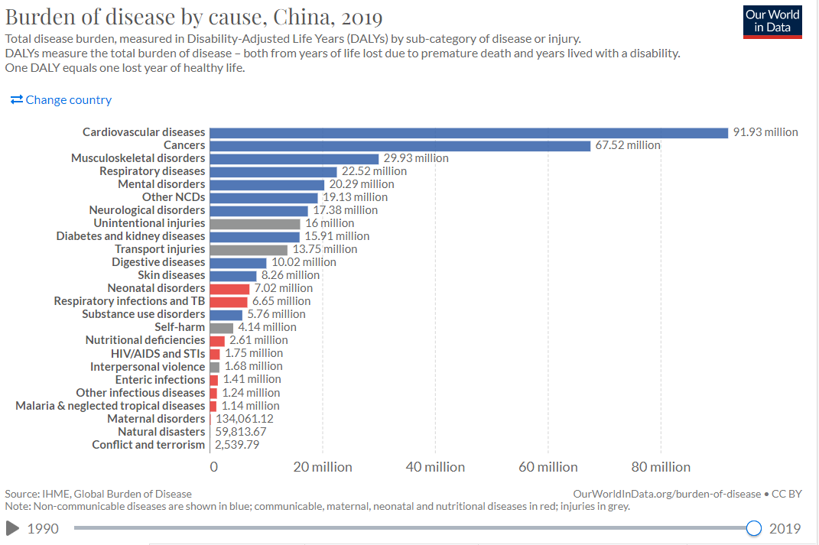
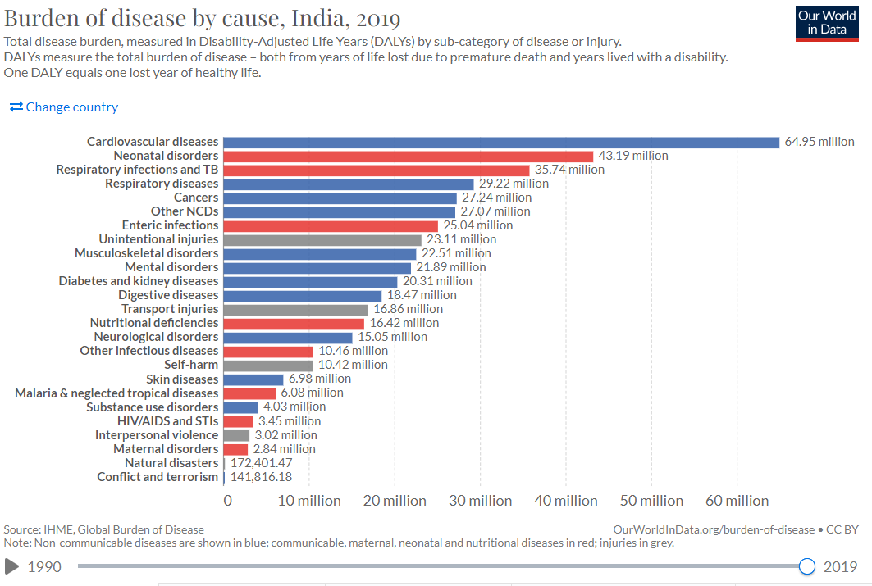

Slide 4
Make genomic data accessible
Interrogate the tsunami of data
Make genotype and phenotype data that is accessible for a relevant disease
Software platform or a user interface that provides access of genomics data to non-experts

Slide 5
UCSC Genome Browser

Slide 6
UCSC Genome Browser

Slide 7
Gene Cards

Slide 8
UCSC Genome Browser

Slide 9
UCSC Genome Browser

Slide 10
Drop-down controls to display various tracks
UCSC Genome Browser

Slide 11
GWAS Catalog

Slide 12
GWAS Catalog - ABCB1 associations

Slide 13
GWAS Catalog - 26 ABCB1 associations

Slide 14
Nature 2021 publication

Slide 15
Nature 2021 publication

Slide 16
GWAS – Catalog Alzheimer’s disease associations

Slide 17
Knowledge Portal Network

Slide 18
Genotype Tissue-Expression Project (GTEX)
Genome-wide association studies (GWAS)
Cases vs controls
~95% of SNPs located in non-coding regions
53 tissue sites

Slide 19
https://storage.googleapis.com/ashg-workshop-files/GTEx_ASHG_workshop_101817_final.pdf

Slide 20
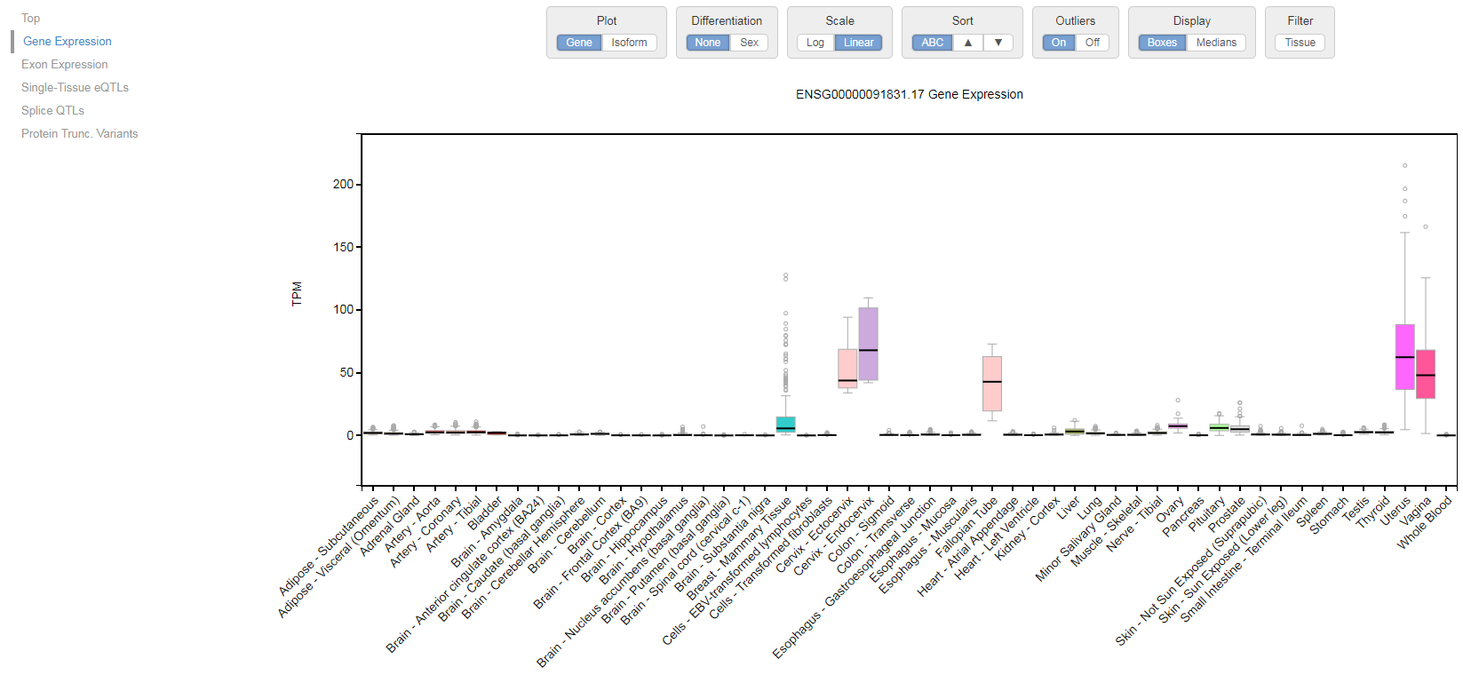
ESR1 query

Slide 21
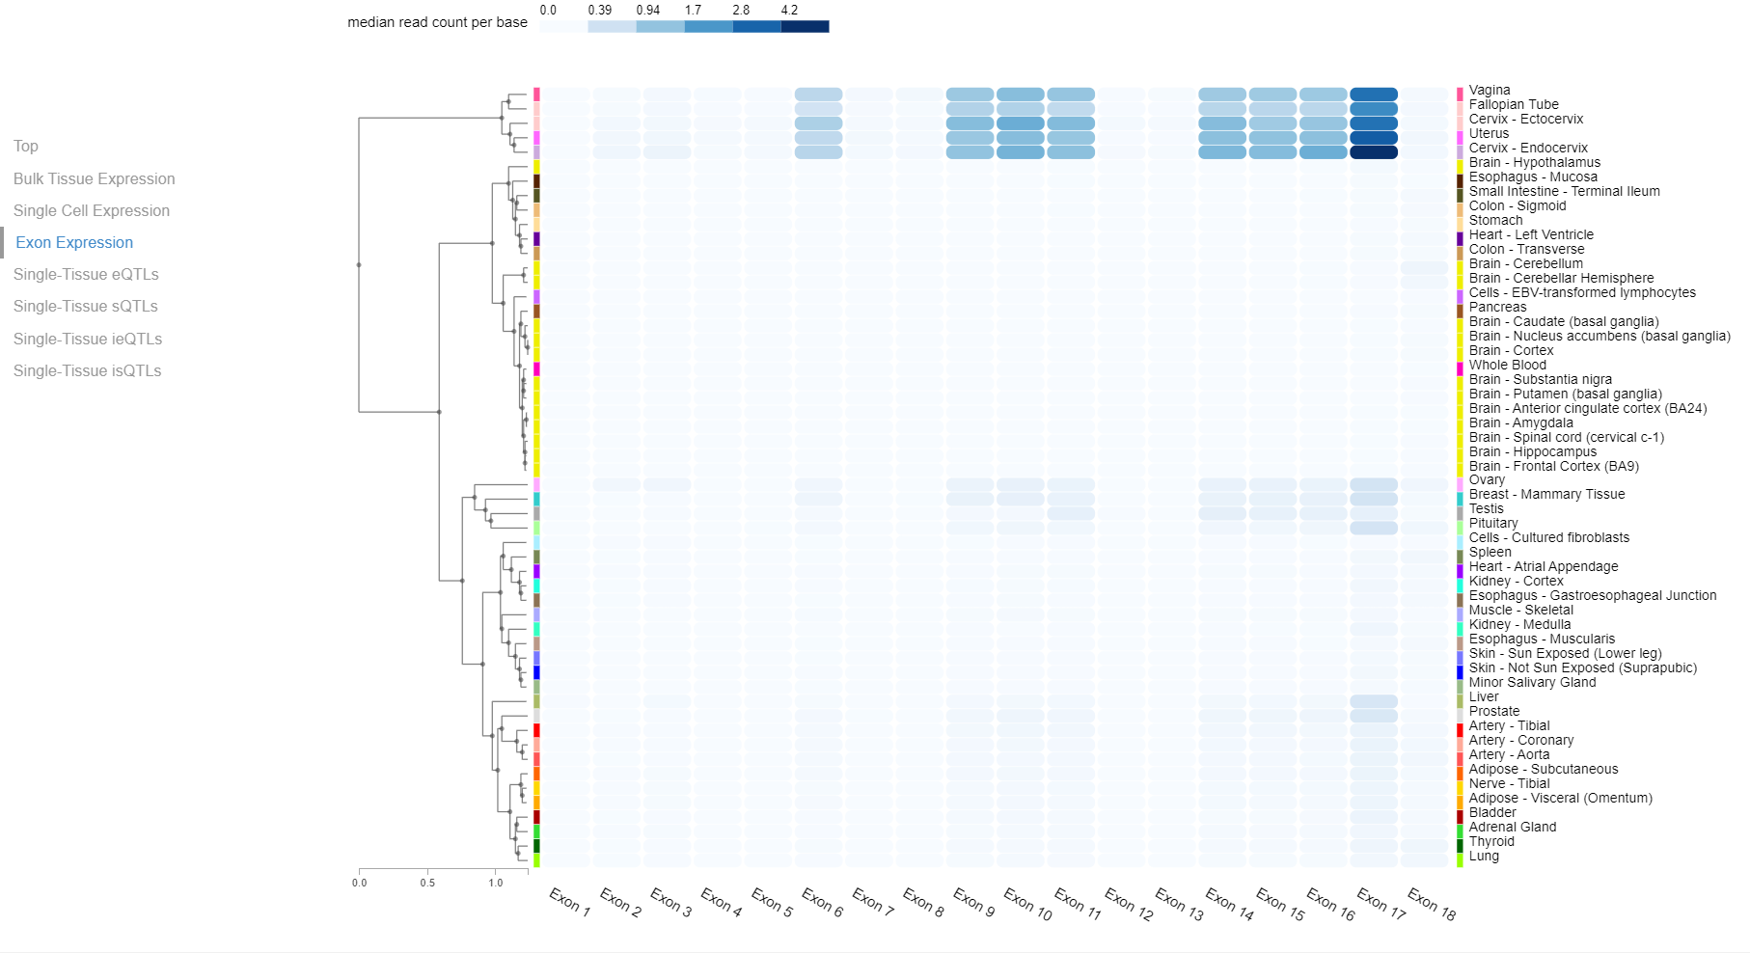
Exon expression

Slide 22
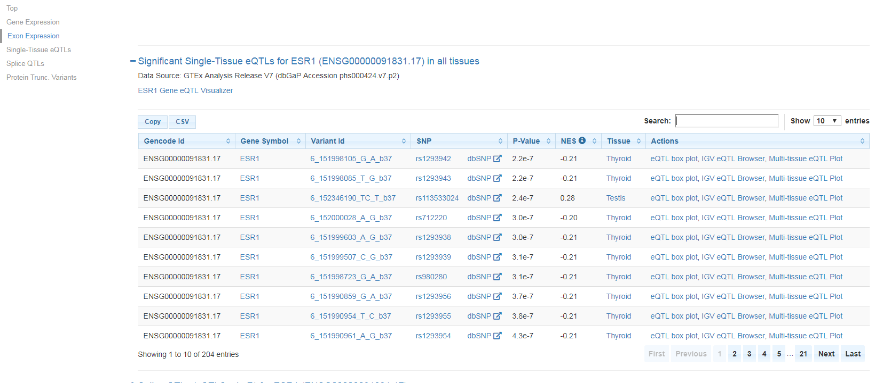
ESR1 - eQTLs

Slide 23
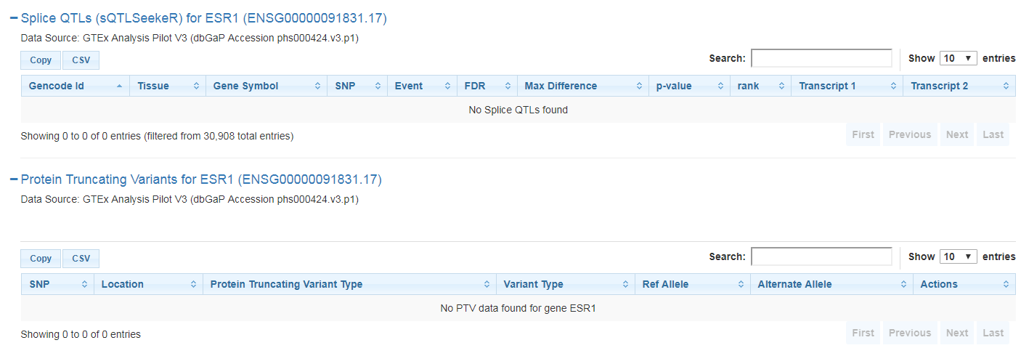
No splice QTLs and protein truncating variants found for ESR1

Slide 24
The Cancer Genome Atlas (TCGA)

Slide 25
The Cancer Genome Atlas (TCGA)
A comprehensive and coordinated effort to accelerate our understanding of the molecular basis of cancer through the application of genome analysis technologies, including large-scale genome sequencing.
Cancer.gov

Slide 26
The Cancer Genome Atlas (TCGA; https://cancergenome. nih.gov/)
Multi-omics data sets for > 33 cancer types
For more than 30000 individual tumor samples
RNA-Seq, DNA-Seq, miRNA-Seq, single-nucleotide variant (SNV), copy number variation (CNV), DNA methylation, and reverse phase protein array (RPPA) data
The biospecimens from TCGA are analyzed by mass spectrometry technique, and the cancer cohort proteomics data are available at Clinical Proteomic Tumor Analysis Consortium (CPTAC) (https://cptac-data-portal. georgetown.edu/cptacPublic/)

Slide 27
TCGA multiple data types
Reusing the slides from Kenna Shaw’s presentation

Slide 28
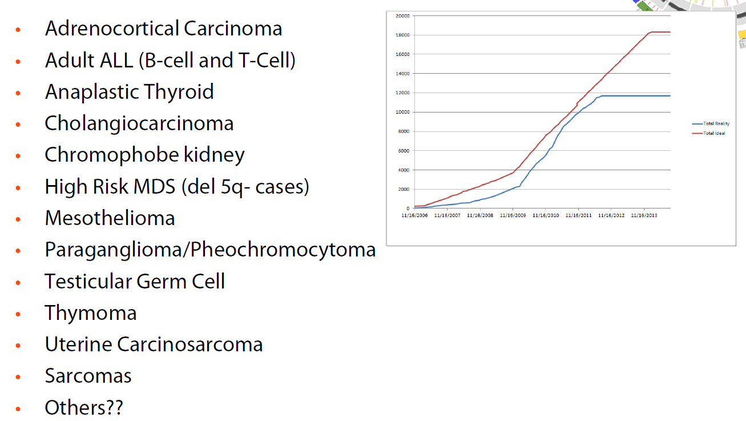
Rare tumors projects

Slide 29
Genomic Data Commons - GDC

Slide 30
Genomic Data Commons
A NCI repository for The Cancer Genome Atlas and Genomics data.
It consists of data from 72 projects
67 primary sites
>85K cases
>2.6 million mutations
827,518 files

Slide 31
Genomic data commons

Slide 32
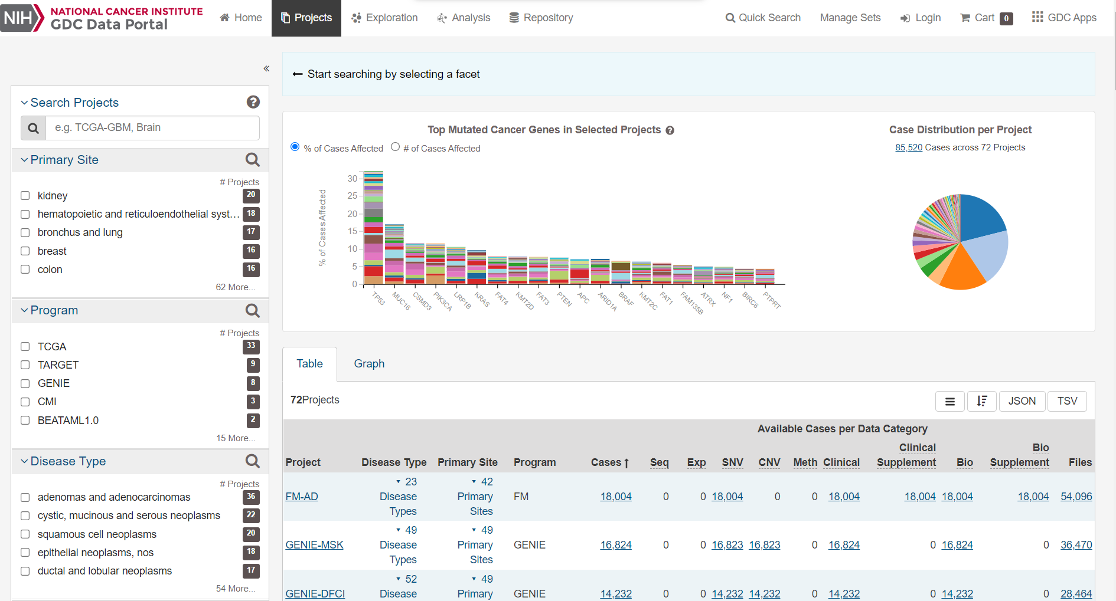
Projects

Slide 33
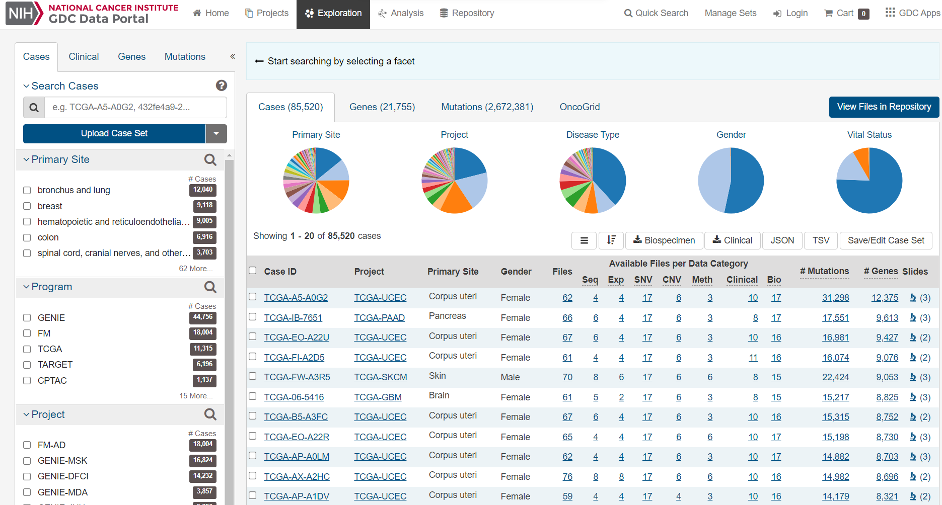
Exploration

Slide 34
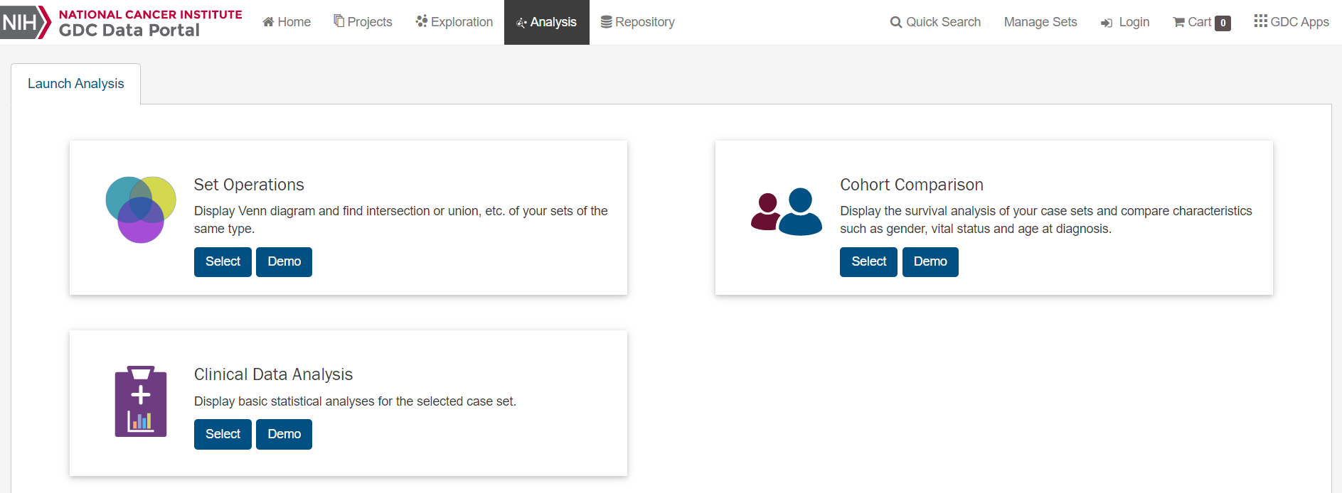
Analysis

Slide 35
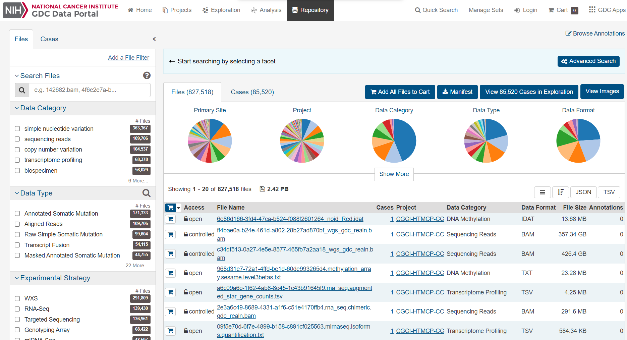
Repository

Slide 36
International Cancer Genomics Consortium (ICGC; https:// icgc.org/)
Large-scale generation of genome studies from 86 cancer projects in 22 primary cancer sites from 22,330 donors (RELEASE 28)
This project mainly contains mutation-related genomic alteration data (both germline and somatic) across cancer types from various ethnicities
The Pan-cancer analysis of whole genomes (PCAWG; https://dcc.icgc.org/pcawg) allows the exploration and analysis of more than 2800 whole genomes from ICGC

Slide 37
International Cancer Genome Consortium
Cancer Projects 86
Cancer Primary Sites 22
Patients with molecular data 22,330
Total Donors 24,289
Somatic mutations identified 81.7million

Slide 38
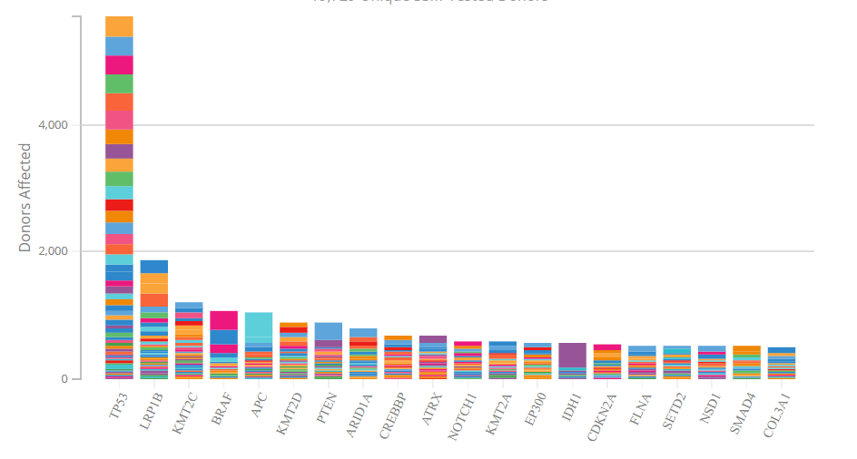
Top 20 mutated cancer genes with high functional impact somatic mutations
https://dcc.icgc.org/projects

Slide 39
Cancer Cell Line Encyclopedia (CCLE; (https://portals.broadinstitute.org/ccle)
Hosted by Broad institute is a compilation of gene expression, copy number, and sequencing data from 947 human cell lines and for 36 tumor types.
It also houses the pharmacological profiles of 24 anticancer drugs across the cancer cell lines.
https://depmap.org/portal/interactive/

Slide 40
COSMIC
“COSMIC, the Catalogue Of Somatic Mutations In Cancer, is the world's largest and most comprehensive resource for exploring the impact of somatic mutations in human cancer.”

Slide 41
Expert curated database

Slide 42
COSMIC

Slide 43
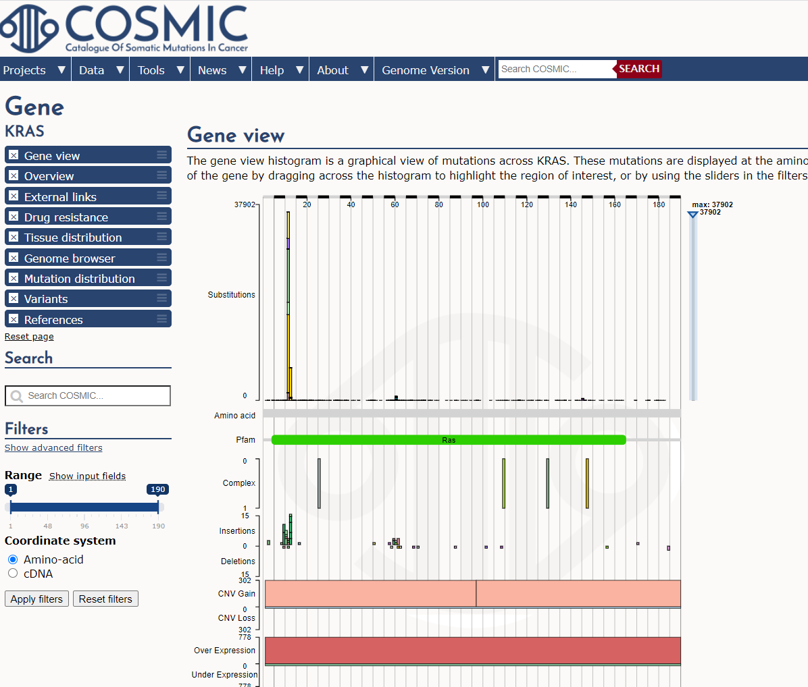

Slide 44
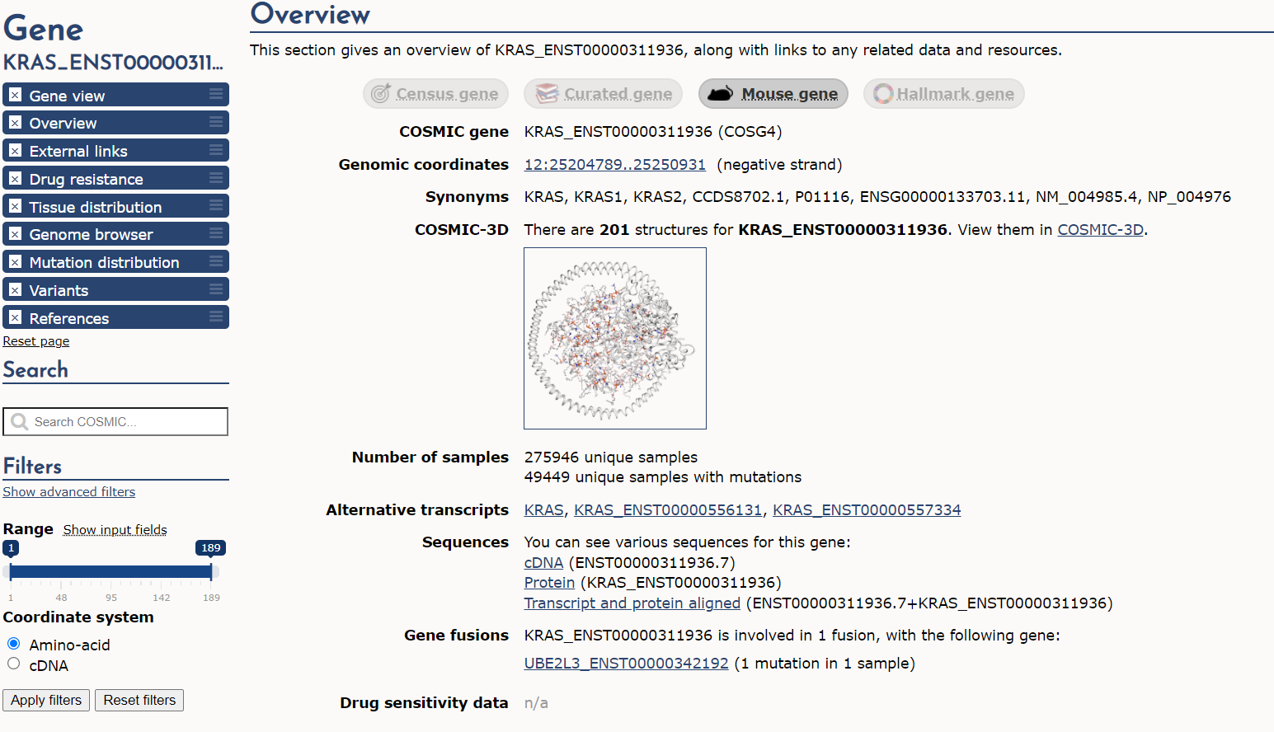

Slide 45
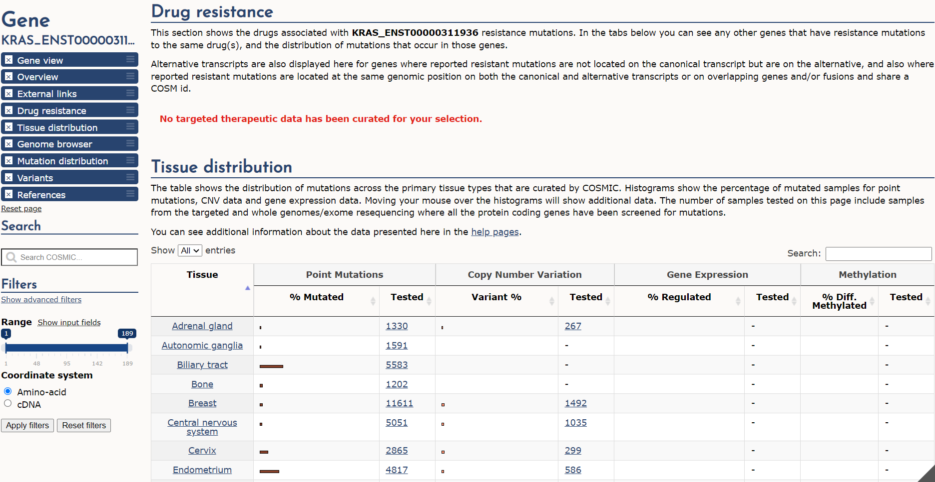
Drug Resistance and tissue distribution

Slide 46
Cell Lines Project

Slide 47
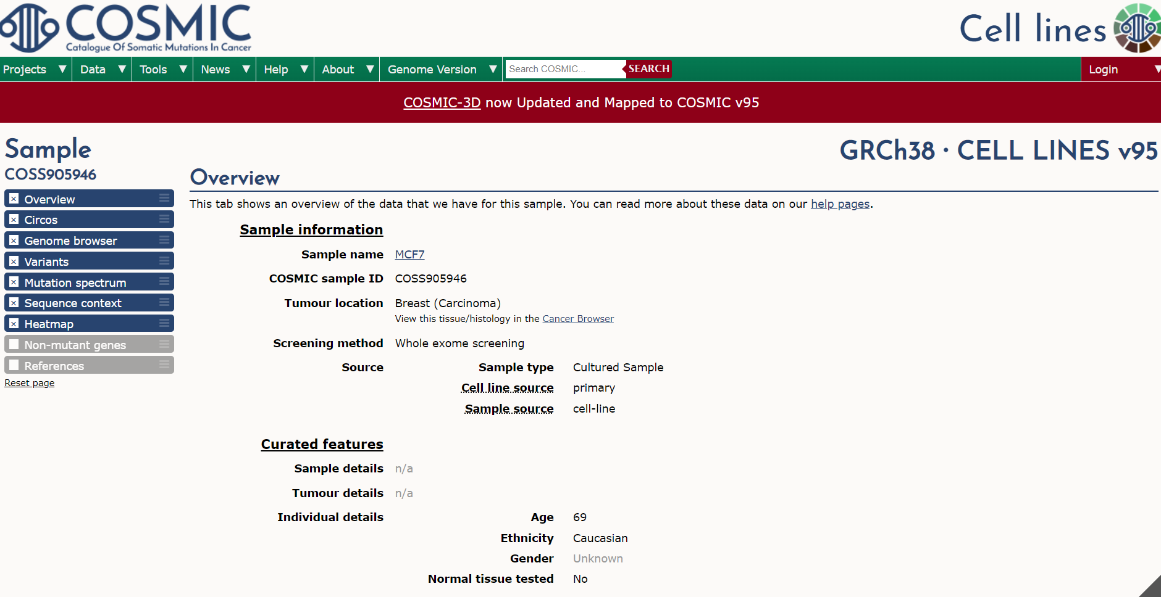
Cell lines project
Mutation profiles of over 1,000 cell lines used in cancer research (e.g.MCF7)

Slide 48
COSMIC-3D

Slide 49
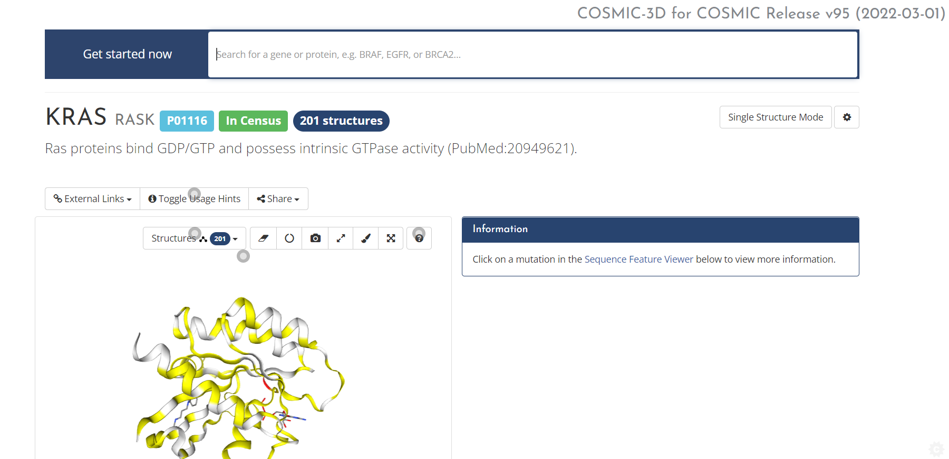
COSMIC-3D
A platform for understanding cancer mutations in the context of 3D protein structure.

Slide 50
COSMIC

Slide 51
Gene Tiers in Cancer Gene Census
Census tiers – 578 genes
Tier 1 – A gene must possess a documented activity relevant to cancer, along with evidence of mutations in cancer which change the activity of the gene product in a way that promotes oncogenic transformation.
Tier 2 - Consists of genes with strong indications of a role in cancer but with less extensive available evidence.

Slide 52
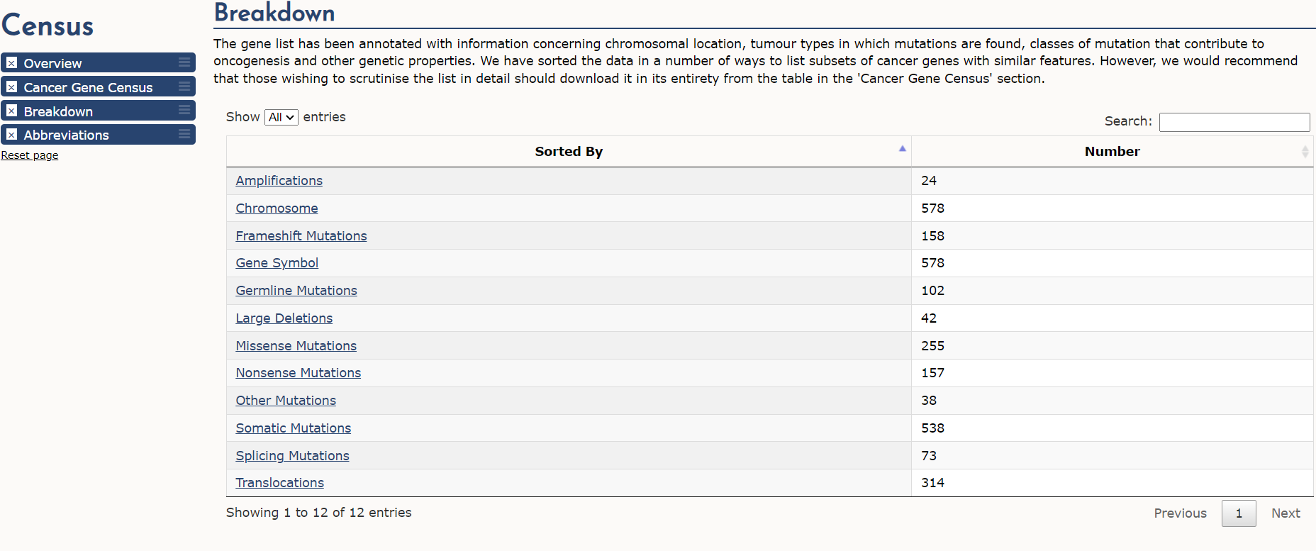
Breakdown of Genes/mutations

Slide 53
cBioPortal

Slide 54
TCGA - Somatic mutations in different cancer types
Lawrence MS et al., Nature 2013

Slide 55
Public cancer genomics data for mining
Cbioportal
Visualization of multi-omics data
Conduct simple analysis
Summary of mutations and other data types
Walkthrough simple queries
Glioma example
Breast cancer example
Pan-can analysis
Other examples
Barrowed few slides from cbioportal
http://www.cbioportal.org/index.do

Slide 56
Overview

Slide 57
Overview of Tabs in a Single Study Query
http://www.cbioportal.org/index.do

Slide 58
Glioma example

Slide 59
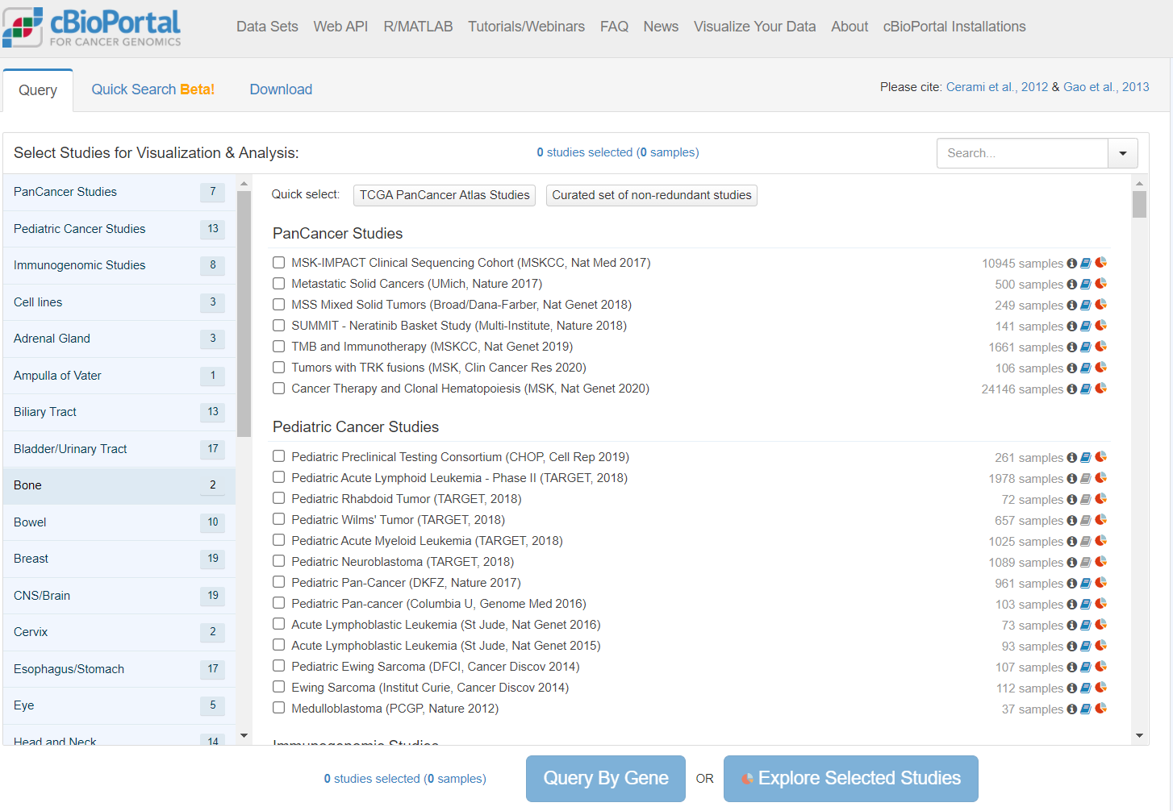
Query overview
Search studies
Browse available datasets and initiate queries
Download data
Click here for a drop-down menu with some common searches and examples of advanced search features
Number of studies for each organ system (click to filter)
List of all studies, organized by organ system
http://www.cbioportal.org/index.do

Slide 60
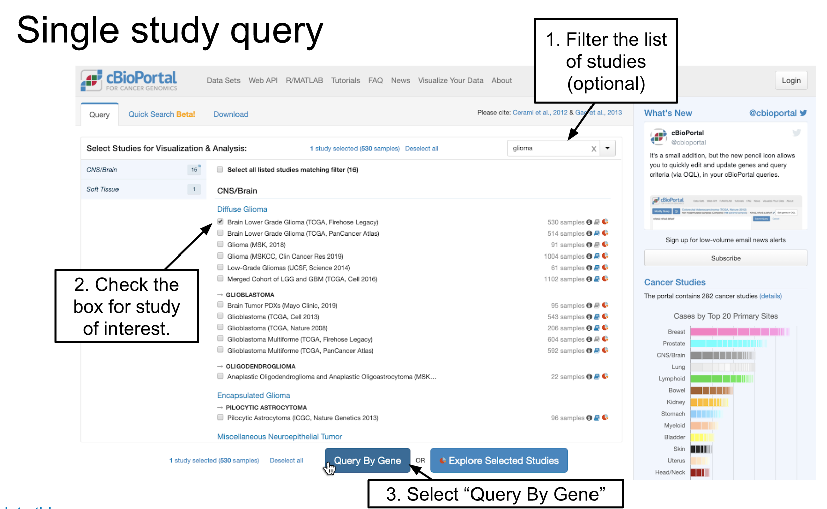

Slide 61
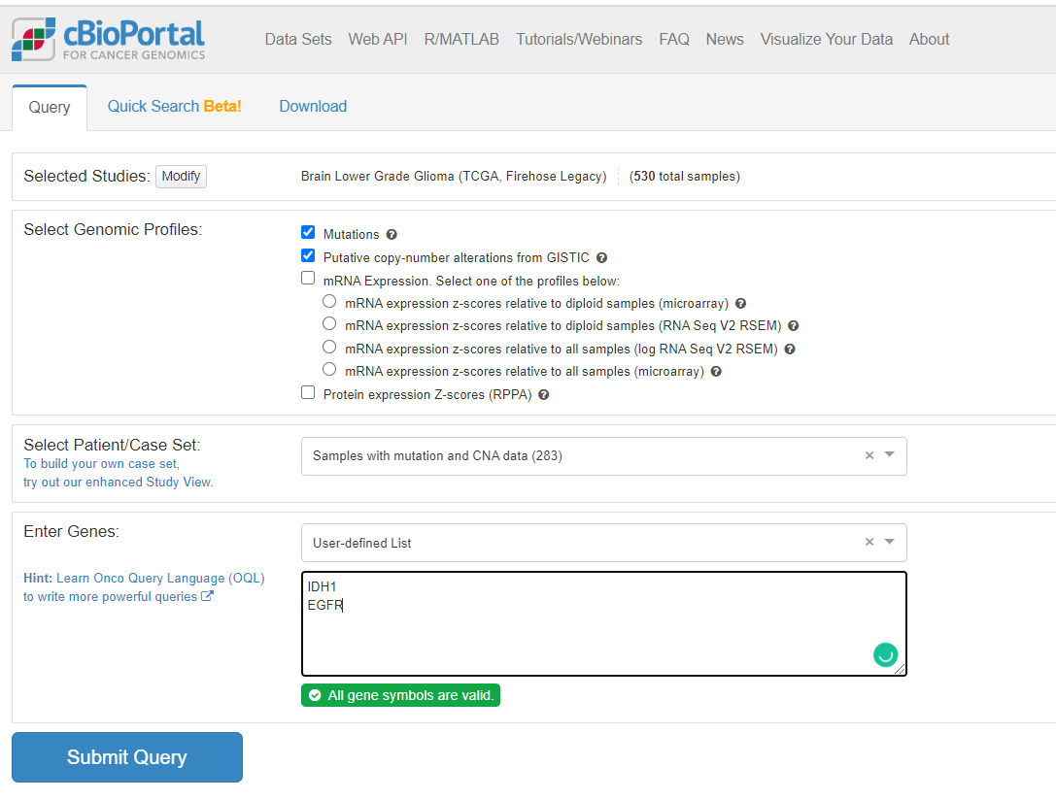

Slide 62
Glioma Query

Slide 63
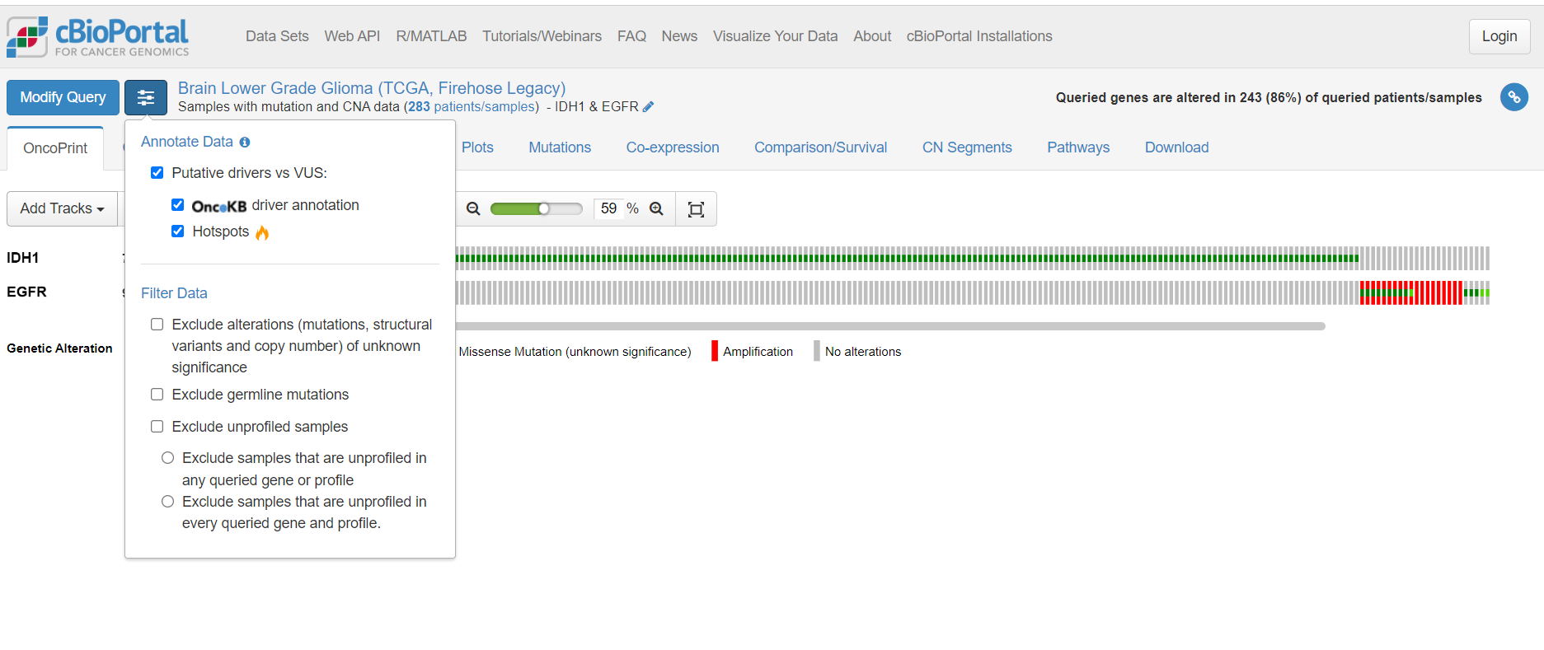
Annotations and Filtering

Slide 64
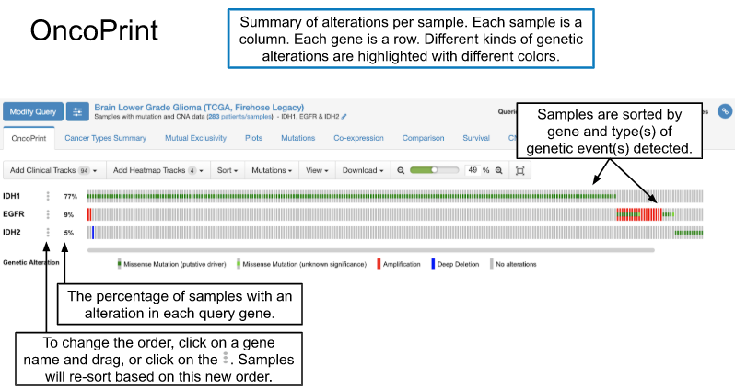

Slide 65
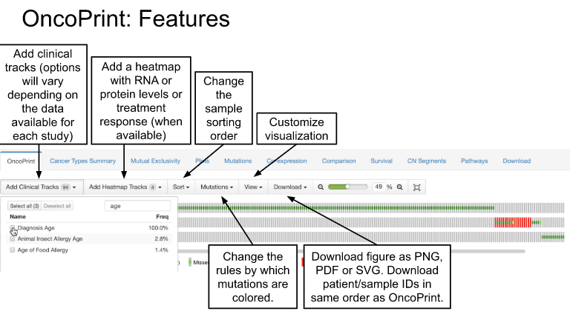

Slide 66
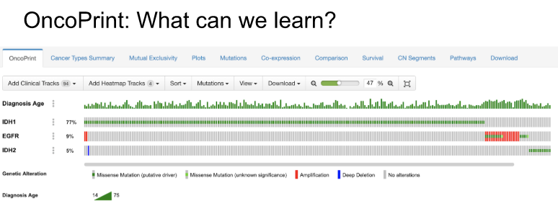
Mutually exclusive – alterations in one gene tend to not have alterations in other genes
Patients with alterations in EGFR tend to be older than patients with IDH1/2 alterations.

Slide 67
Mutual Exclusivity with Glioblastoma example
All pairwise combinations of query genes analyzed for mutual exclusivity or co-occurrence in the queried samples.
On the OncoPrint tab we could see visually that alterations in these three query genes tended to be mutually exclusive. Here we can address that same question with a statistical analysis.
Click on any column header to sort. Hover over the column names for more details about how values are calculated.
A positive value here suggests that alterations in these genes co-occur in the same samples, while a negative value suggests that alterations in these genes are mutually exclusive and occur in different samples.
p-Value comes from Fisher Exact Test. Note that this is an unadjusted p-value and may need to be corrected for multiple hypothesis testing.
log₂( )
odds of alteration in B given alteration in A
odds of alteration in B given lack of alteration in A
http://www.cbioportal.org/index.do

Slide 68
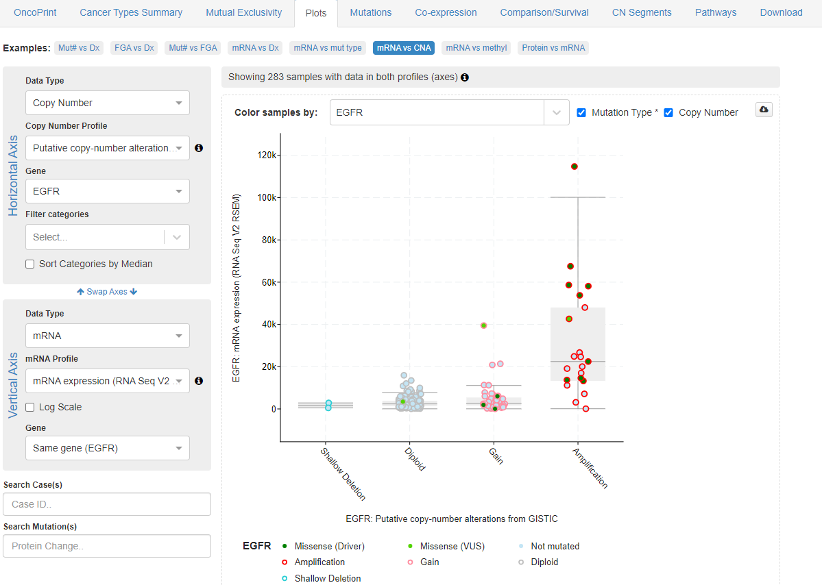
Plots
Depending on available data types for a given study, this tab allows for plots comparing copy number, gene expression, protein levels and DNA methylation of query genes, along with any available clinical attributes.
Choose genetic or clinical
Select a query gene
Each dot is a sample, color-coded by mutation status.
Select data type and processing
Swap horizontal & vertical axis
If checked, vertical axis will automatically show the same gene as horizontal axis.
http://www.cbioportal.org/index.do

Slide 69
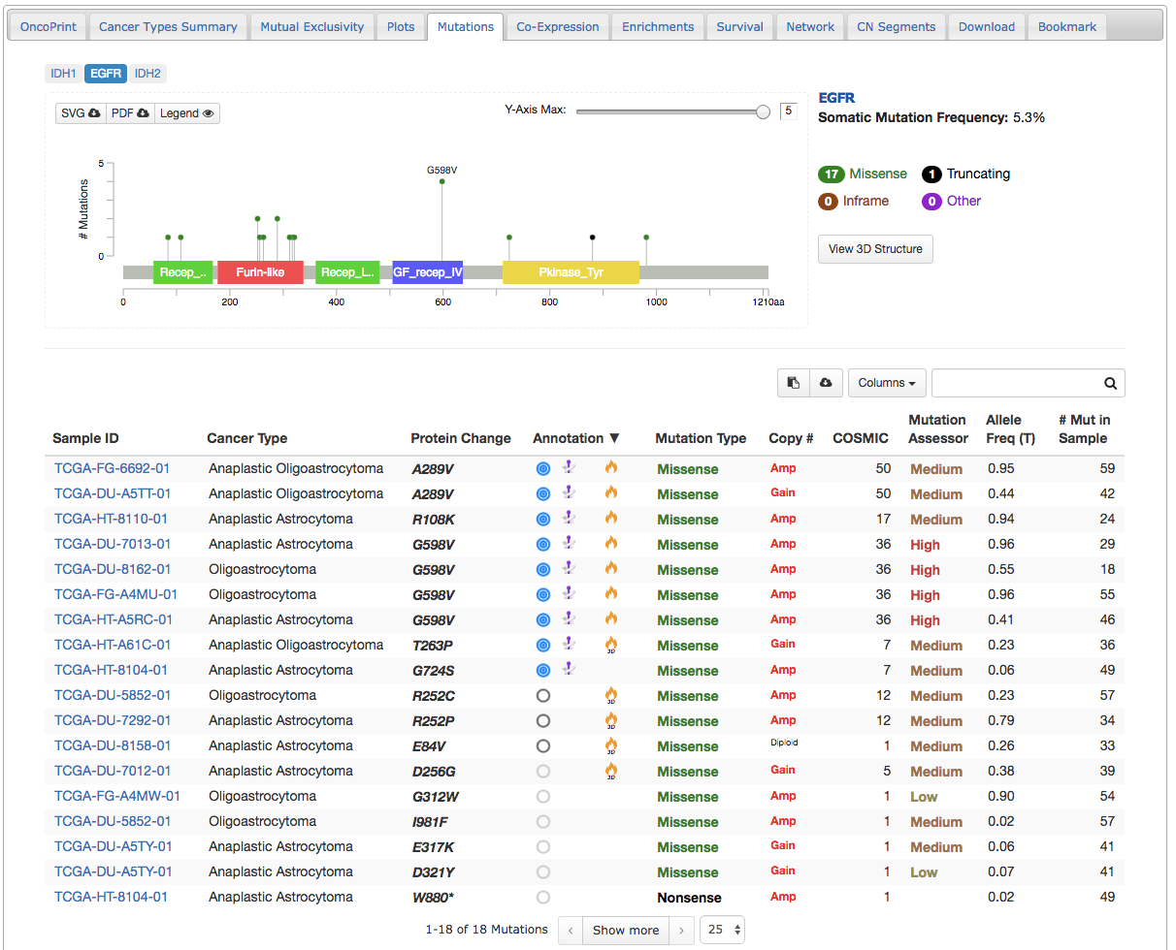
Mutations
Hotspots for EGFR mutation in glioma? Lolliplot shows G598V is the most common alteration. The Furin-like domain also appears to be frequently mutated.
http://www.cbioportal.org/index.do

Slide 70
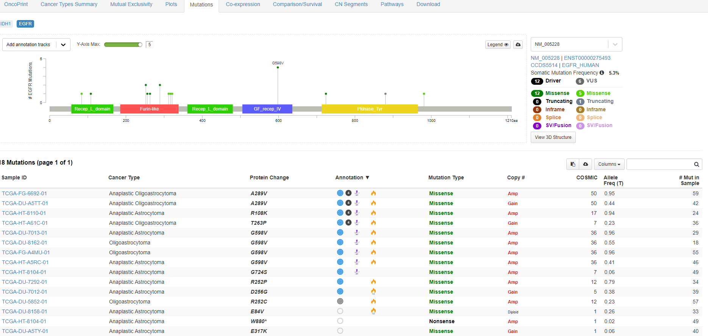
Mutations
Download figure as SVF or PDF
Adjust y-axis
Mutations are drawn as lollipops along the domain structure of the gene. The height of the lollipop reflects how many times that mutation was detected. This plot will update based on any filters applied to the table below. Hover over any lollipop for additional details.
http://www.cbioportal.org/index.do

Slide 71
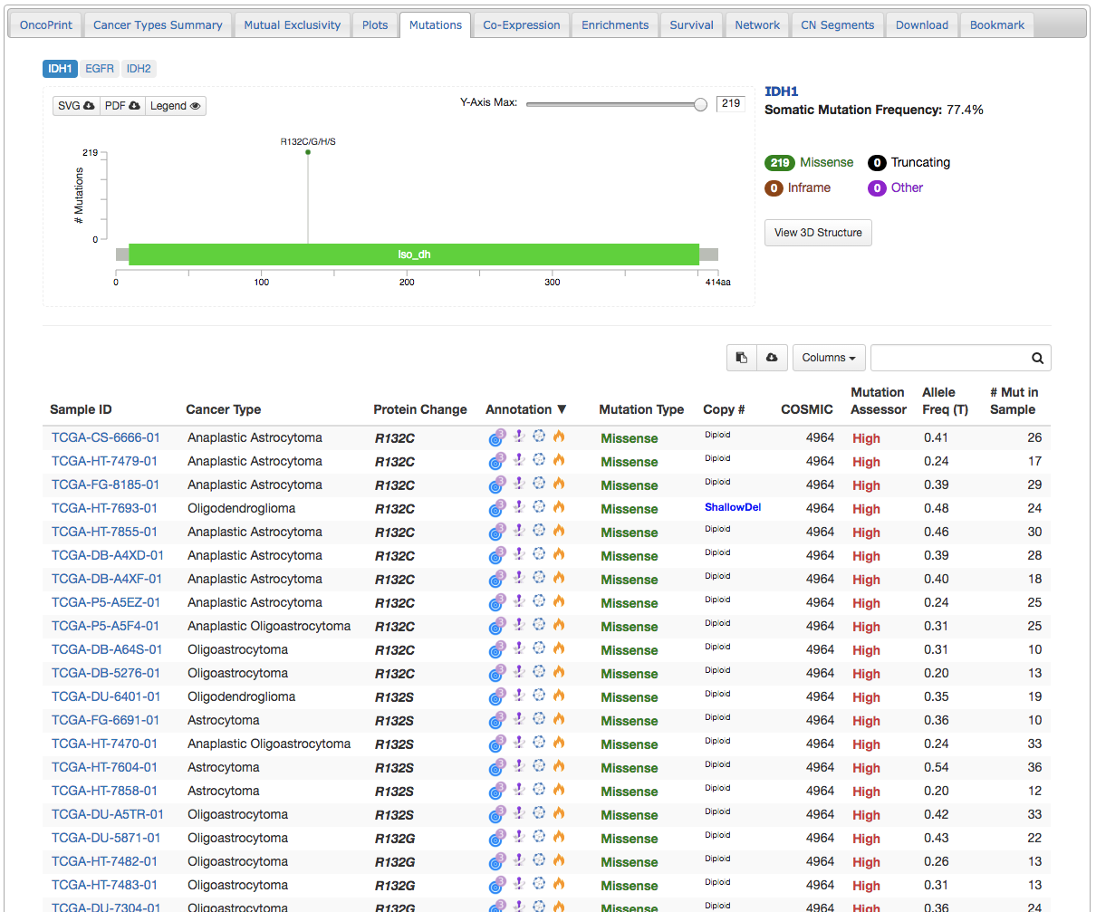
Mutations
http://www.cbioportal.org/index.do
This mutation is a recurrent hotspot based on a statistical analysis of mutation frequency.
You may also see this symbol which means the mutation is a recurrent hotspot based on a statistical analysis of 3D protein conformation.
This mutation is in OncoKB as a Level 3 variant. Hover over this symbol to see additional information, including that this is a known oncogenic mutation.
This mutation is annotated in CIViC. Hover over this symbol for additional information.
This mutation is in
My Cancer Genome.

Slide 72
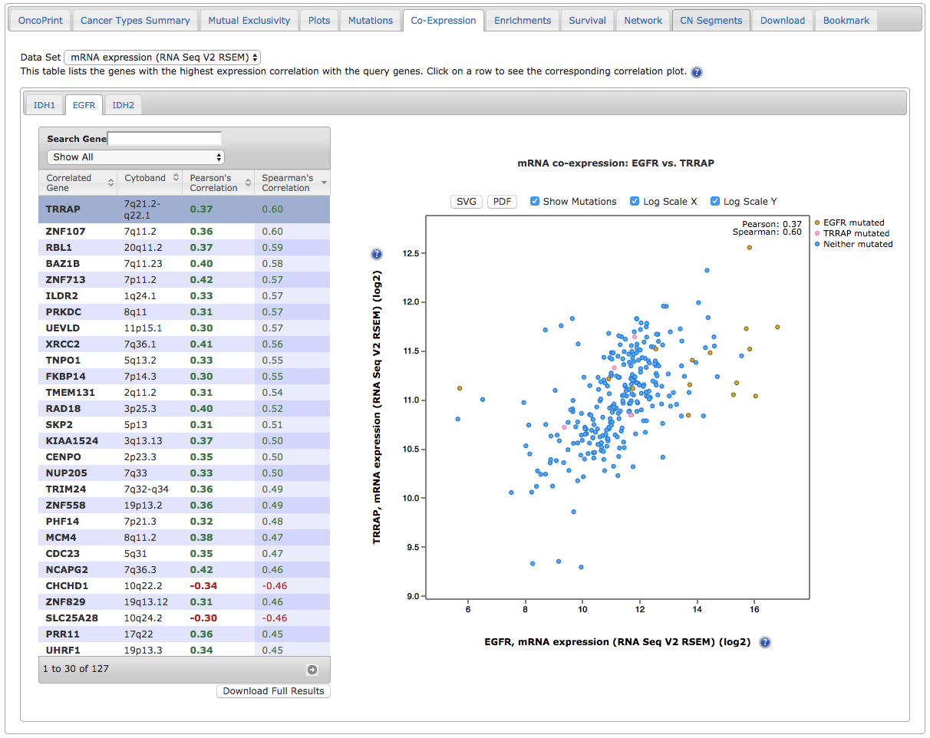
Co-Expression
Select from available data types
Compares mRNA/protein level expression of your query genes against all other genes. Only genes with Pearson and Spearman correlations >0.3 or <-0.3 are shown.
Each gene appears on a separate tab
Check boxes to color-code sample dots by mutation status or change x- or y-axis to log scale
Click on a gene name to see correlation plot
http://www.cbioportal.org/index.do

Slide 73
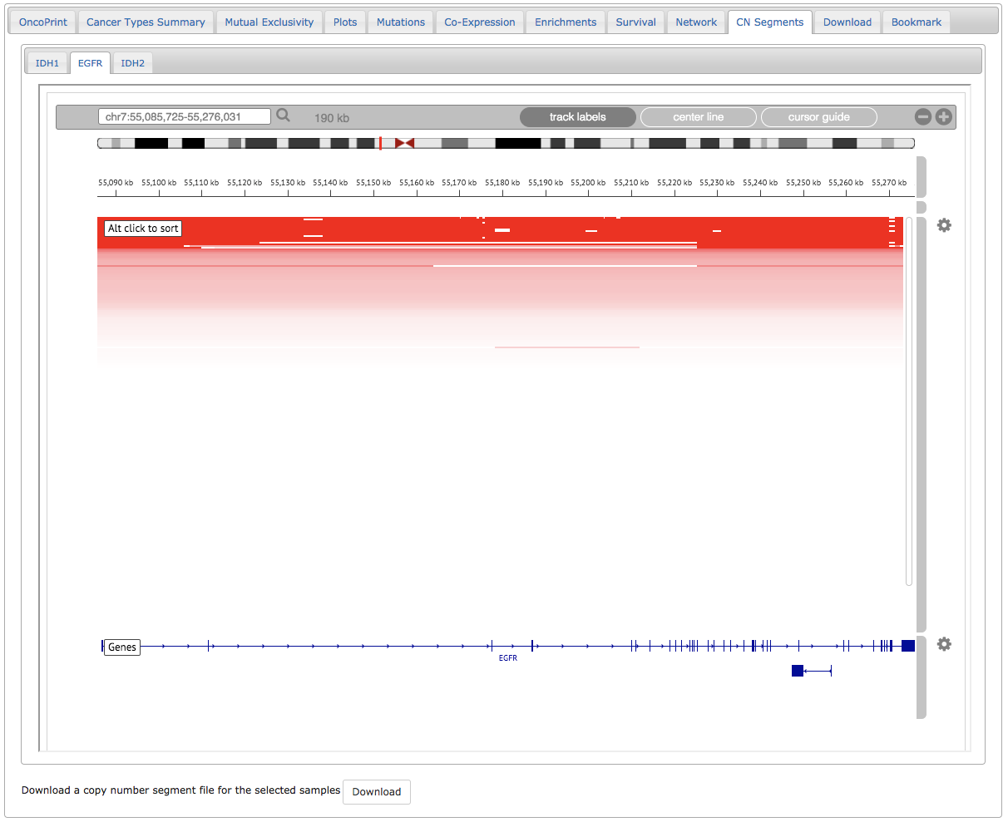
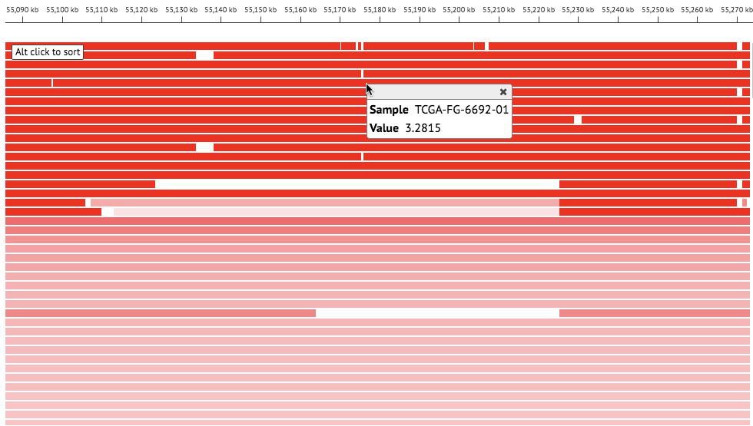
CN Segments
View copy number for each sample at each query gene via the Integrated Genomics Viewer (IGV).
Plots for each gene appear on a separate tab.
Click for track settings, including expanding the height of each sample (see below)
Each row is a single sample
Gene structures
Click on a read for sample ID and copy number value
Link to this page

Slide 74
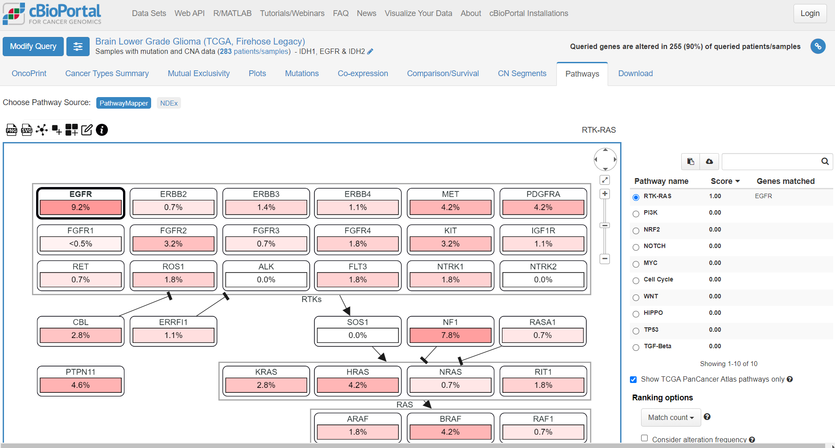

Slide 75
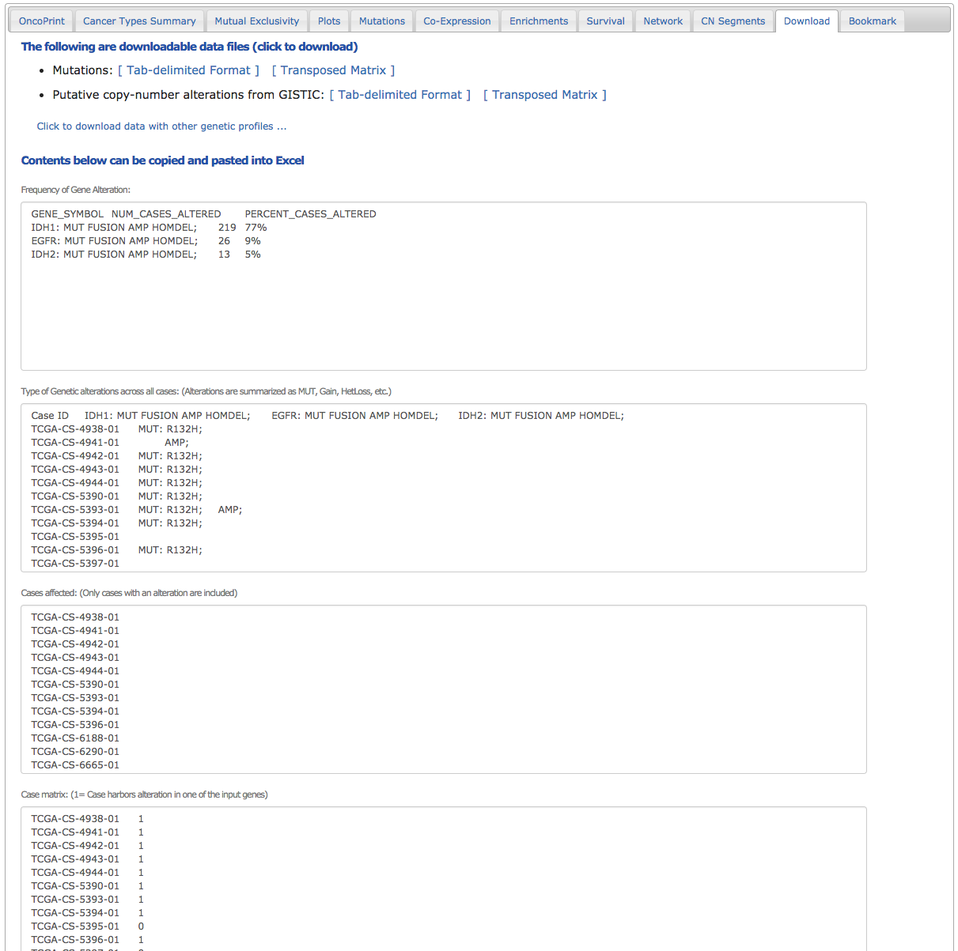
Download
Download data or copy lists of samples.
Download mutations and copy number
Frequency of gene alteration for each gene in the query
List of all samples with status of each query gene (blank = no alteration)
Advanced feature: use this list as a custom sample list to run a new query in only the subset of samples with a particular genetic alteration.
List of samples that have an alteration in one or more query genes
List of all samples with summary classification:
0 = no alteration in any query gene
1 = alteration in one or more query genes
Link to this page

Slide 76
Breast cancer example

Slide 77
CNV

Slide 78
mRNA overexpressed

Slide 79
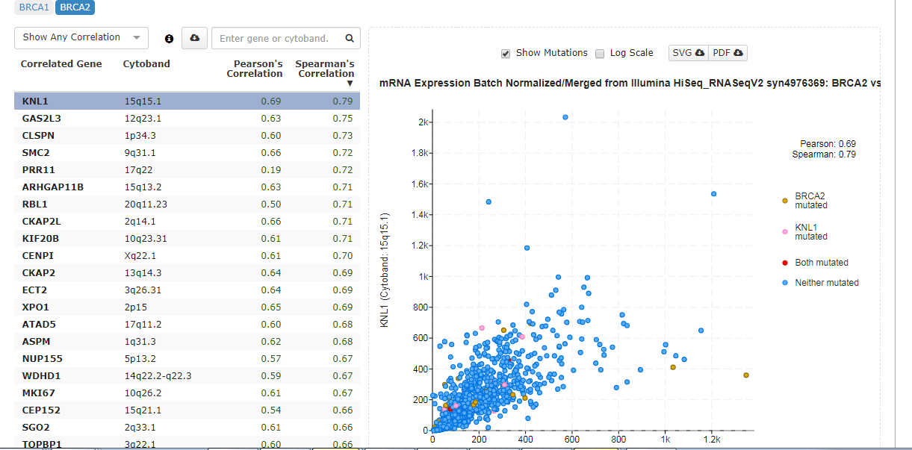
http://www.cbioportal.org/index.do

Slide 80
PAN-can example

Slide 81
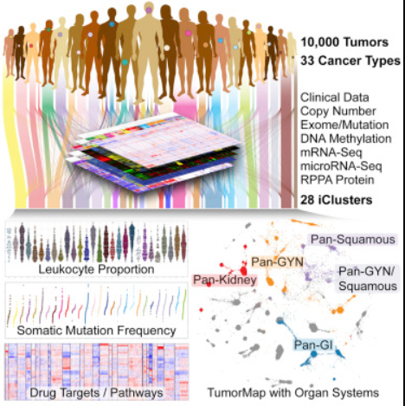
PAN-Can datasets and analyses
https://www.sciencedirect.com/science/article/pii/S0092867418303027
Notes:
Pan-cancer analysis aims to examine the similarities and differences among the datasets across cancers

Slide 82
PAN-Can datasets and analyses

Slide 83
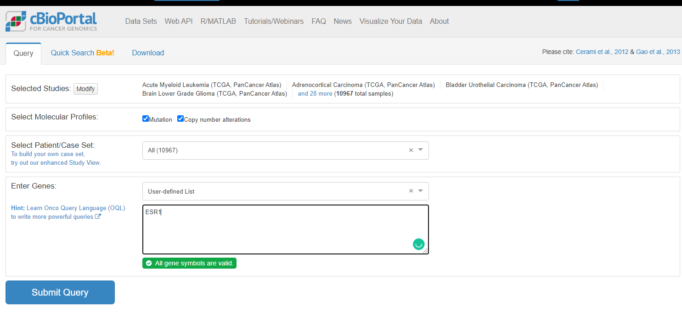
PAN-Can datasets and analyses – ESR1

Slide 84
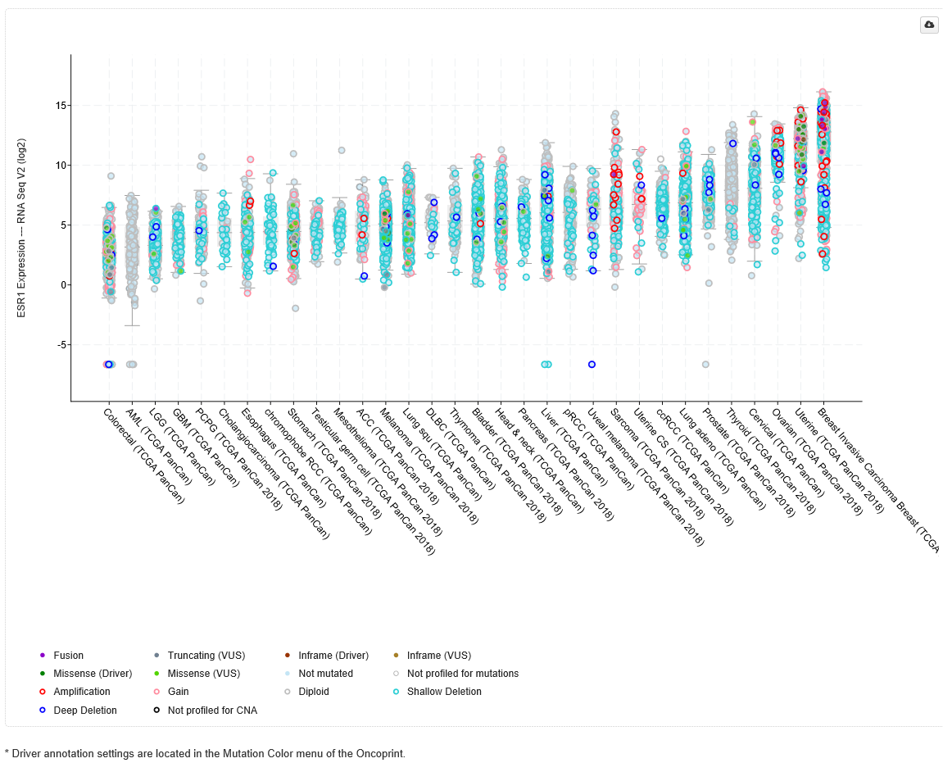
PAN-Can datasets and alterations – ESR1

Slide 85
Clustering example

Slide 86
Clustering example

Slide 87
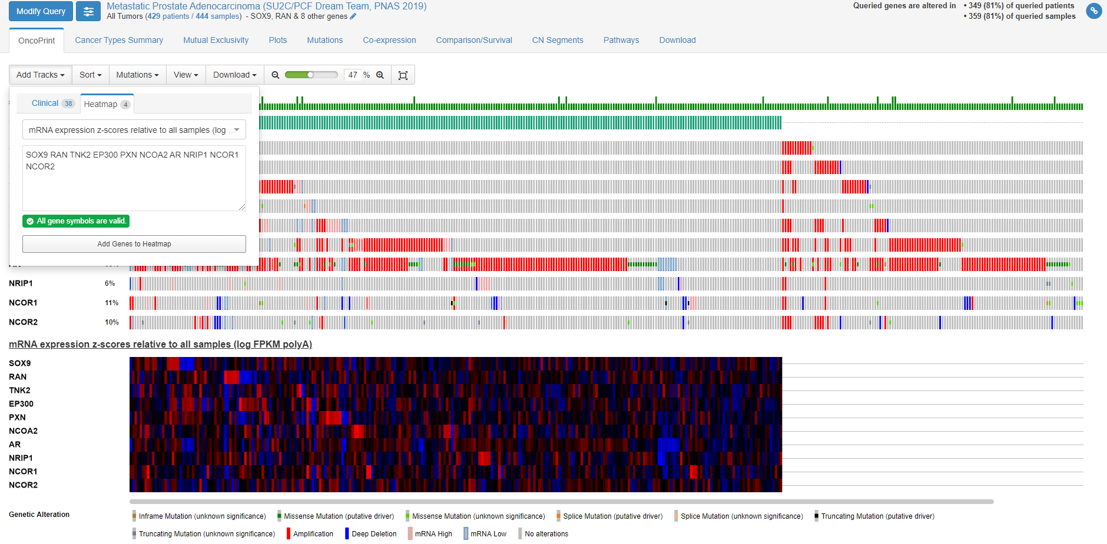
Clustering example

Slide 88
Long-noncoding RNA example

Slide 89
Long-noncoding RNA example

Slide 90
miRNA example

Slide 91
RNA and miRNA example

Slide 92
RNA and miRNA example

Slide 93
miRNA correlation with mRNA example

Slide 94
AACR Project GENIE
Clinical sequencing data from 19 cancer centers worldwide.
It consists of primary and metastatic tumor unlike TCGA where they only have primary and untreated tumors
For some samples, GENIE also consists of pre and post treatment.
Targeted gene panels (# of genes targeted varied across the cancer centers)
Majority of them have mutations and some have CNV

Slide 95
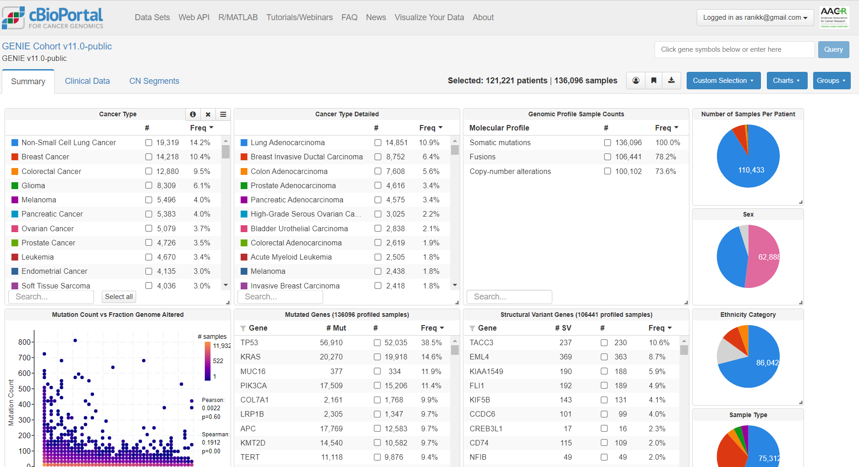
GENIE cbioportal
https://genie.cbioportal.org/
It consists of more 136 K samples (121K patients)

Slide 96
HTAN – Human Tumor Atlas Network
The Human Tumor Atlas Network (HTAN) is a National Cancer Institute (NCI)-funded Cancer MoonshotSM initiative to construct 3-dimensional atlases of the dynamic cellular, morphological, and molecular features of human cancers as they evolve from precancerous lesions to advanced disease.

Slide 97
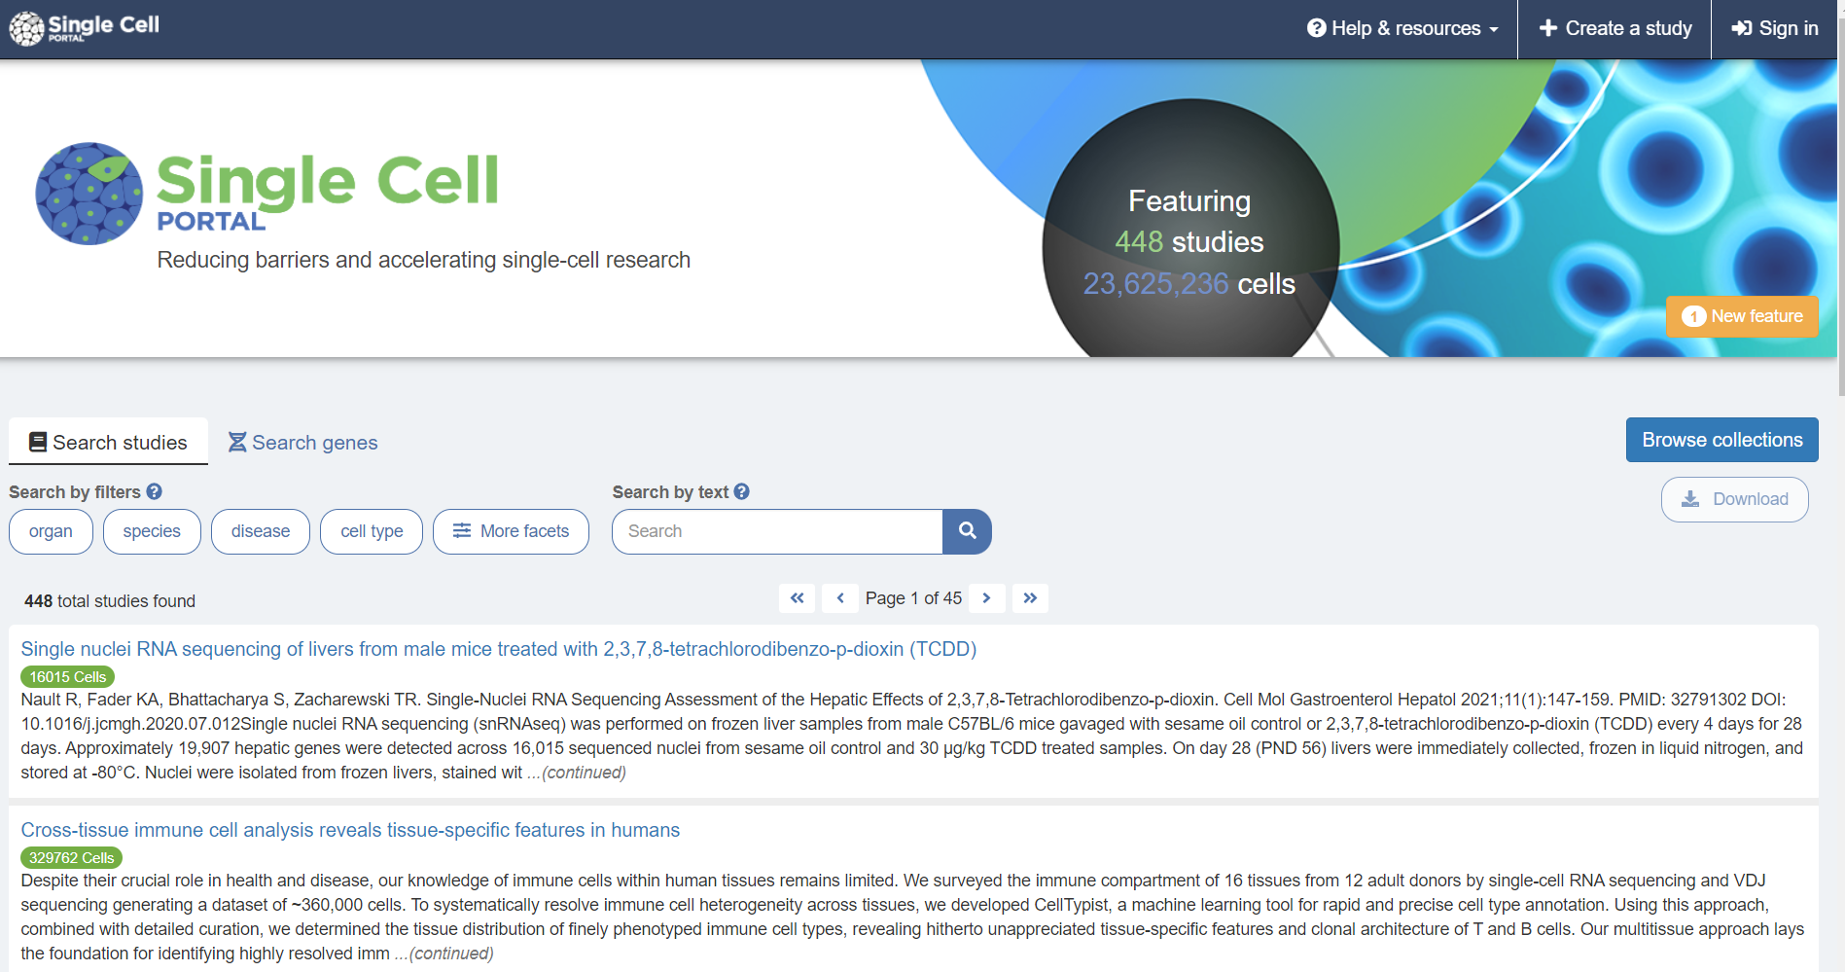
Single-cell Sequencing
Lots happening in this area.
Exciting area of research

Slide 98
Proteomics datasets
http://proteomecentral.proteomexchange.org/cgi/GetDataset

Slide 99
Trans Omics Precision MEDicine (TOPMed)
Large omics data resource to support discovery science and precision medicine.
Build a genomic database for more 20 or more diseases or conditions
170K Whole genome sequencing data, 32K RNA-Seq, 58K methylome, 16K metabolome and 3K proteome (75% of data released by dbGAP)

Slide 101
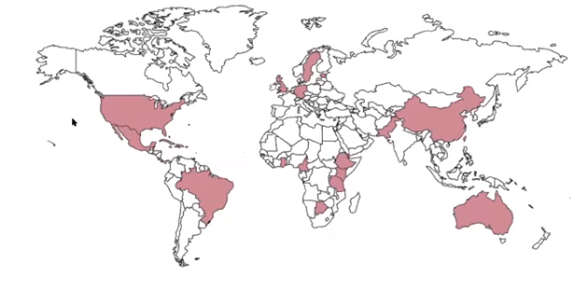
TOPMed

Slide 102
TOPMed

Slide 103
My Research

Slide 104
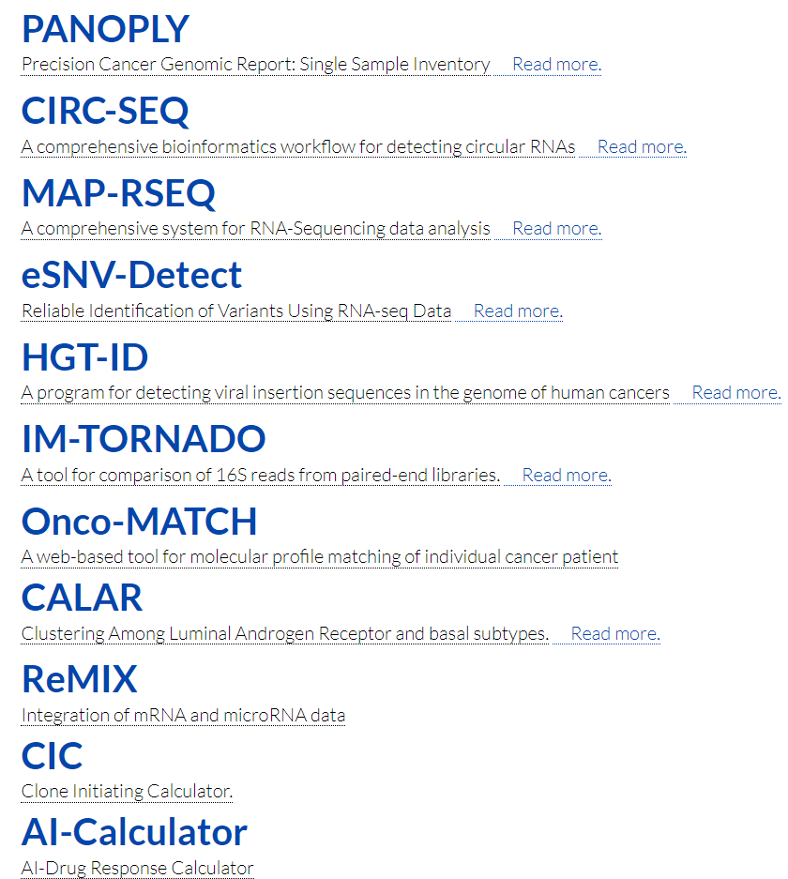
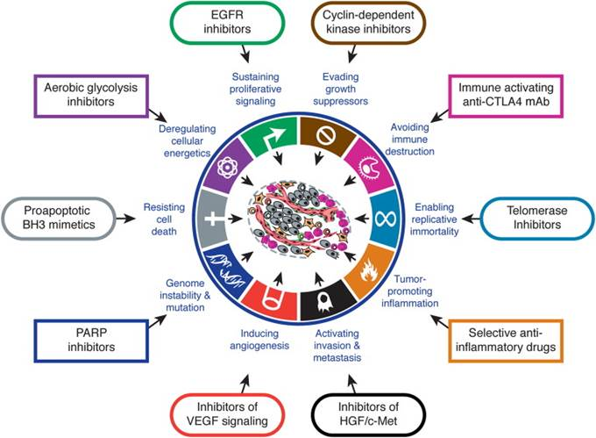
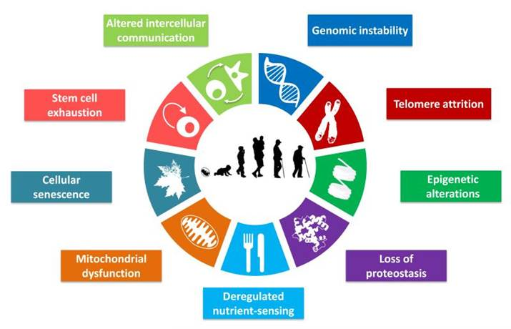
COMPUTATIONAL BIOLOGY METHODS
HALLMARKS OF CANCER
HALLMARKS OF AGING

Slide 105
Thank you all and email me if you have any questions at Kalari.Krishna@mayo.edu

