Slide 1
How I Learned to Stop Worrying and Love the Medical AI Hype
Garrett Jenkinson, PhD
Data Scientist, Assistant Professor of Biomedical Informatics
Division of Computational Biology
Department of Quantitative Health Sciences
Mayo Clinic
Notes:
Target time: 1hr 20min

Slide 2
Outline
AI/ML 101
Terminology
Successes and Excellent Reasons for Hype
Lessons Along the Way for ML in Medical Practice
Garbage in/Garbage Out
Use Prior Knowledge
Curse of Dimensionality
Data Leakage
Interpretability and Complex Decision Boundaries
Objective Function Misalignment, Class Imbalance
Association versus Causation
Use decision-theoretic thinking
Fairness and Calibration
Out of Distribution Predictions

Slide 3
Terminology
Artificial Intelligence
Machine Learning
Problem Solving By Search/Pathfinding/Logical Reasoning
Agent Perception/Planning/ Decision Making
Deep Learning
Supervised Learning
Unsupervised
Learning
Reinforcement Learning

Slide 4
Excellent Reasons For Hype
High profile super-human performance systems
IBM DeepBlue Chess, 1997
IBM Watson Jeopardy, 2011
Hinton, ImageNet Classification 2012-
AlphaGO, 2016
Poker, Pac-Man, Quake3, Dota2, StarCraft2, Atari, speech recognition, skin cancer detection, prostate cancer detection, diabetic retinopathy, machine translation
Self-driving cars, factory robots
Natural language processing, GPT3, codex
Notes:
Page 28 of AIMA 4th edition is citation for claims

Slide 5
AlphaFold achieves near experimental accuracy
AlphaFold 2
AlphaFold
Notes:
https://www.deepmind.com/blog/alphafold-a-solution-to-a-50-year-old-grand-challenge-in-biology

Slide 6
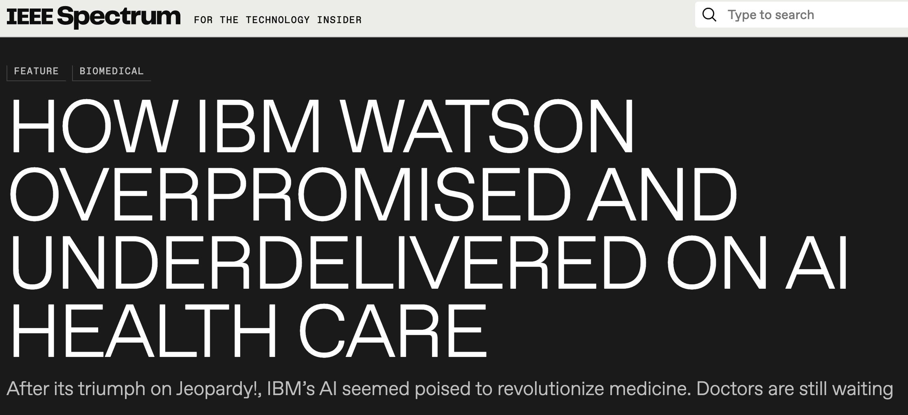
Care, diligence and acknowledgement of unique challenges are required
Notes:
Like harnessing the power of the atom, the technology is powerful but requires extra care

Slide 7
Probabilistic View of Supervised Learning
We have input features $x∈ℝd$ (numerical descriptions of examples)
$x \text{=}\text{ [185, 70]}$, representing weight/height
We have output labels $y∈ℝ$ (numerical outcomes, sometimes multidimensional as well)
$y$=0 or 1, representing diabetes diagnosis
$y$= A1c measurement
We seek a function $f(⋅)$such that $f(x)≃y$
Machine Learning/Deep Learning are tools to find this function
It is helpful to view this as coming from estimating $p(y|x)$ and then picking $y$

Slide 8
Example feature vectors $x$
a greyscale 256x256 image where each pixel takes value between 0 and 255, and d = 256 × 256 = 65,536
a color image with 256x256 pixels and r, g, b “channels” making 256x256x3 array of numbers between 0 and 255 and d = 256 × 256 × 3 = 196,608
a non-negative count vector of 10,000 genes measured by RNA-seq in blood with d=10,000
a vector of estimated probabilities in the range [0, 1] of methylation at d = 750,000 CpG sites in the genome

Slide 9
Example labels
Whether the patient is healthy (0) or has cancer (1)
Whether this DNA variant causes outlier expression (1) or not (0)
Whether this patient will have a severe reaction (1) or not to COVID (0)
The number of COVID patients entering the ER tomorrow
Variant pathogenicity {B, LB, VUS, LP, P}
Pixel position of LL and UR corners of bounding box around a tumor in a chest x-ray

Slide 10
Example functions
If weight/height > 3, predict diabetes (1), else predict no diabetes (0)
This is example of a decision tree (using an augmented/crossed feature)
Deep neural networks, random forests, logistic regression, KNN, SVM, etc, are all just algorithms to take training data in and produce concrete calculation representing $f(x)≃y$
Conceptually no different from above decision tree

Slide 11
Bayes Rule & Bayes Error
The Bayes Rule is the best function $f(⋅)$ possible which has performance of Bayes Error
“Best” means we need a loss function to evaluate if $f(x)≃y$ numerically
0/1 loss for classification
$\left(f\left(x\right)−y\right)2$ for regression
The Bayes rule for 0/1 loss in binary classes:
$$f\left(x\right)=\left\{\begin{aligned}1, \text{if} p\left(y=1 | x\right)>\frac{1}{2} \\ 0, \text{otherwise}\end{aligned}\right.$$

Slide 12
Lesson: Garbage in, Garbage Out
The Bayes Error tells us the best we can do predicting y from measurements x
If x is number of ChrY copies in each cell of fetus, Bayes Error for sexing fetus is near 0
p(y=1|x=0) $≃$ 0, p(y=1|x>0) $≃$ 1
If x is WGS of mother and father, Bayes error for sexing fetus is near 0.5
p(y=1|x) $≃$ 0.5 for all x
Human-level performance can be rough proxy in some cases for Bayes Error
If human case is hopeless, think hard first
Notes:
Notice a decision tree will be Bayes rule in first example. No amount of fancy methods will ever do better.

Slide 13
Lesson: Focus More on the Data
Often data cleaning, collection, representation will improve your performance much faster than overly focusing on ML algorithm/methods
AutoML tools like AutoGluon rapidly test and combine many cutting-edge tools
If AutoML fails catastrophically, perhaps Bayes Error is high or data integrity/representation is poor
If no opportunity to improve data, then focus on modeling assumptions and selecting best suited algorithms

Slide 14
We learn from limited examples
We have data pairs $\left(x_{n},y_{n}\right),n=1,…,N$
From these we need to estimate $p\left(y | x\right)$ or $f\left(x\right)$
If Bayes rule $f\left(x\right)$ is simple, we can use lower N
One male and one female example could train the Bayes classifier in sex pred from ChrY per cell count
If $x$ is all sensor measurements in car and $y$ is gas/brake pressure and steering angle, much larger N needed

Slide 15
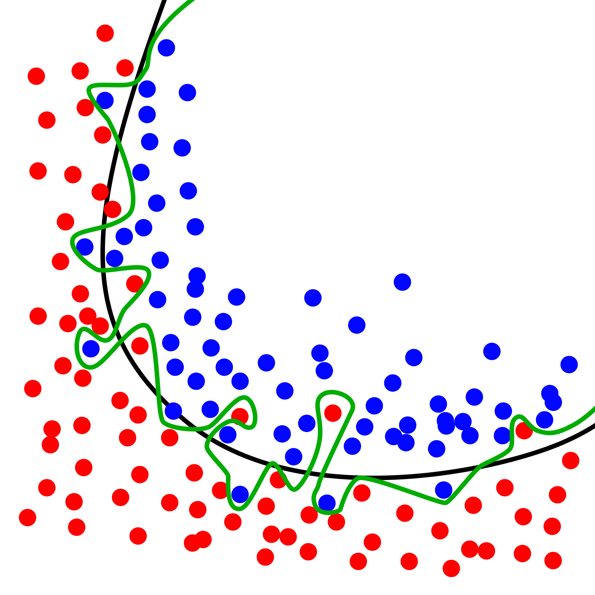
Overfitting
Complex decision boundaries fit “noise”
Higher error on unseen test data
https://en.wikipedia.org/wiki/Overfitting#/media/File:Overfitting.svg

Slide 16
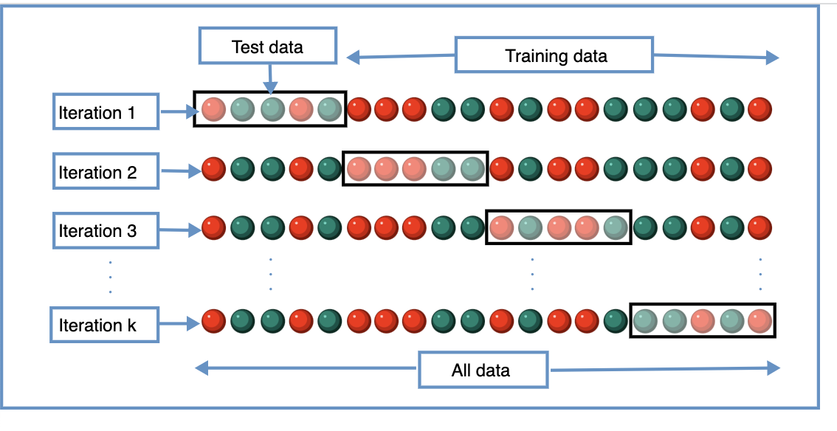
Cross-validation
https://upload.wikimedia.org/wikipedia/commons/b/b5/K-fold_cross_validation_EN.svg

Slide 17
Lesson: Regularization/Occam’s Razor
Simple answers require less evidence/data
Complicated answers require greater evidence
L1&L2 penalties/Dropout/Shrinkage/Bayesian methods can help
Cross-validation commonly used to evaluate over-fitting and tune regularization hyperparams/priors
Data Augmentation (e.g., jittering bootstrap, image manipulation, language rearrangements) can add robustness to common but irrelevant differences

Slide 18
Why “Deep” Learning
Each layer is its own ensemble of learners
Intuitively layers extract features, then combine them in increasingly sophisticated ways
Greater abstraction deeper in network
Layer2 Layer3 Layer4 Layer5 Layer6
Figure from Olah, et al., "Feature Visualization", Distill, 2017.
Notes:
https://distill.pub/2017/feature-visualization/
Diagrams and text are licensed under Creative Commons Attribution CC-BY 4.0 with the source available on GitHub, unless noted otherwise. The figures that have been reused from other sources don’t fall under this license and can be recognized by a note in their caption: “Figure from …”.

Slide 19
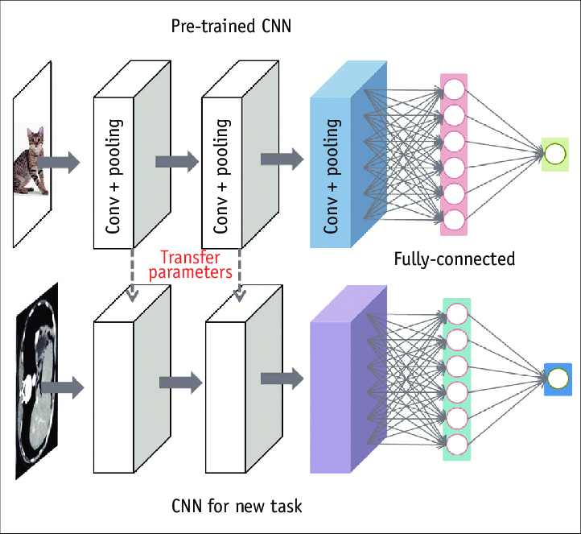
https://doi.org/10.3348/kjr.2019.0312
Notes:
This is an Open Access article distributed under the terms of the Creative Commons Attribution Non-Commercial License (http://creativecommons.org/licenses/by-nc/4.0/) which permits unrestricted non-commercial use, distribution, and reproduction in any medium, provided the original work is properly cited.

Slide 20
Lesson: Use prior knowledge
Transfer learning
Great for NLP or images where huge datasets available for pretraining
Don’t train a huge CNN from scratch with 100’s of medical images
Don’t train a huge transformer from scratch in 10K clinical notes
Bayesian methods can be even more rigorous when good prior data is available, e.g., in lab tests

Slide 21
Curse of dimensionality
Volume of d-dimensional box grows exponentially
Observing 10-point grid requires 10^{d} observations, e.g. to fit $p\left(y | x\right)$ over all $x$
High-dimensions not intuitive
Volume almost entirely on outer-shell/veneer
You are an extremist, in high enough dim
Data not uniform in feature space
Lives on low-dimensional “manifold”
Most randomly generated images look like TV fuzz, not kittens

Slide 22
Lesson: Model complexity/dim and lack of interpretability can hide overfitting
+ 0.005 x =
“Poodle” “nematode” “tennis ball”
72% confidence 4% confidence 98% confidence
Interpretability a thorny subject
Use “simple” models where possible
Understand risks of black boxes, SHAP/etc not global explainer
Notes:
Photos copyright: Garrett Jenkinson
https://arxiv.org/abs/1412.6572

Slide 23
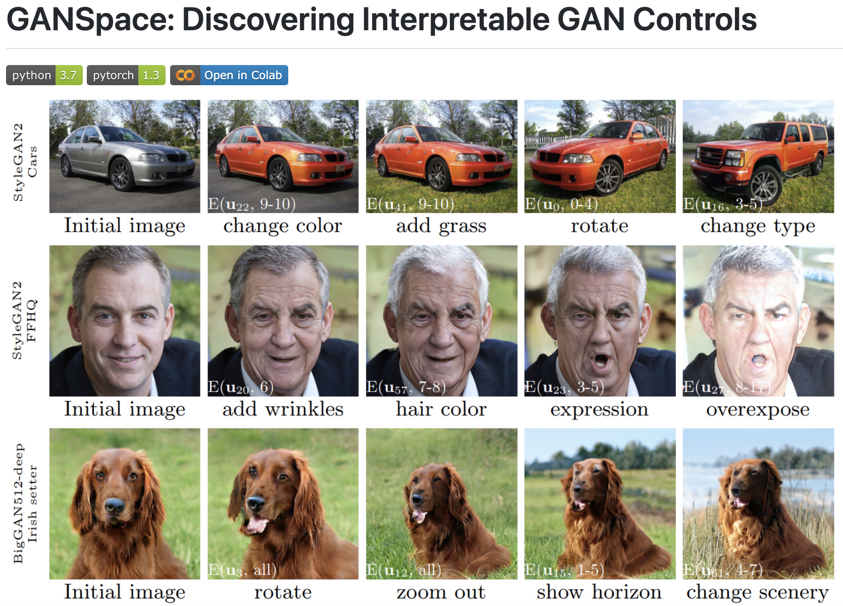
Lesson: Learning the manifold is powerful
Notes:
https://github.com/harskish/ganspace/blob/master/LICENSE

Slide 24
Data Leakage
We mentioned cross-validation, but generally we also want hold out test set
Evaluates generalization performance
Data leakage refers to information from a test or validation set entering the model fitting procedure
If $f(x)$ was developed with any knowledge from test set, the evaluation is optimistic/corrupted

Slide 25
Examples of data leakage
You plotted/inspected all your data before model building/fitting
You scaled your features before you did the data split
You produced a “Table 1” prior to model building
You did PCA/umap/etc for dimensionality reduction or manifold learning using all data
You collected some data, worked with it, collected more and re-split randomly
Your DNA variant impacts same codon but you split by DNA base position

Slide 26
Lesson: Take ML study design seriously
Very first step of ML project is designing your train, validation, test splits up front
Stratified split your test set off and zip the data
Only unzip when FINAL model selected and tuned
You get 1 shot only. Cannot go back and tweak/tune hyperparams, try another model, etc
Using cross-validation in non-test set data costs computations but can be very effective for model selection and hyper parameter tuning

Slide 27
Model training and evaluation require objectives
ML does not know what you want, only the loss function you provide it to minimize
The training loss function is not the only metric you should look at
Think of ML as a cursed monkey paw that grants wishes in easiest and often worst way possible
“I wish to be richest person on earth”
ML: “Done. I have killed all other people”
Objective function misalignment is the core of sci-fi AI gone wrong, but is very real problem

Slide 28
Lesson: Beware of misalignment
Made up example: train a model for maximal accuracy in Sickle Cell Disease
Take last 50k patients seen in Midwest clinic and train model with some lab measures
Model gets 99.9% accuracy!
Always says no SCD because only 50 patients had illness and labs mostly imputed/uninformative
Add extensive EHR data, use AUROC and recall to evaluate to ensure catching of cases
Get 0.97 AUROC, .96 recall with logistic regression
 | Not Black or African American | Black or African American
No SCD | 49,000 | 1,000
Has SCD | 2 | 48
Notes:
library(pROC)
df <- data.frame(x=c(rep(0,49000),rep(1,1000),rep(0,2),rep(1,48)),y=c(rep(0,49000),rep(0,1000),rep(1,2),rep(1,48)))
fit <- glm(formula = y ~ x, data = df,family="binomial")
df$predicted <- predict(fit, df, type="response")
auc(df$y,df$predicted)
table(df$x,df$predicted)

Slide 29
Label/feature leakage is prominent form of misalignment
Pathology slides labeled pathogenic with high accuracy, precision, recall, AUROC
ML learned that pathologist put arrows pointing to malignant features and just looks for arrows
Radiology DICOM (images and metadata/demographics) and it diagnoses case/control accurately
Metadata contains information related to case versus control and was not stripped from dataset
CNN knows race from chest xray…last slide revisited
Notes:
https://arxiv.org/pdf/2107.10356

Slide 30
Lesson: Do an error analysis
Generate a confusion matrix
Randomly examine ~dozens of cases from each quadrant TP, FP, FN, TP
Assume the algorithm is a cheater, and try to find out how it cheated
Use local explanation and/or counterfactual algorithms to try to understand why each case landed in their quadrant of the confusion matrix
Truth\Prediction | Class 0 | Class1
Class 0 | # TN | # FP
Class 1 | # FN | # TP

Slide 31
Causality is hard
Most ML systems will be doing associational predictions and not causal ones
This can lead to cheating as discussed before (camels are on sand, cows on grass)
This can lead to poor decision making based on model outputs
COVID-19 mortality model has NPV 99.8% and PPV 70%, how to use?
NPV is high, triage and send them home!
This is causal inference assertion. NPV that high only when getting full clinical support. Not same as if removing support

Slide 32
Lesson: use causal judgements with care
Increasing literature around causal ML algorithms
All observational causal inference is based on assumptions that may not hold
Where possible use ML models (even “causal” ones) in way that would be safe under associational interpretations
In COVID-19 model, consider alert system that only adds oversight/care and does not remove it

Slide 33
Levels of difficulty/data requirements increase as outputs become complex
Roughly, in increasing orders of “difficulty”:
Binary classification
Multiple ordinal classes (think: low, medium, high)
Multiple categorical classes (think: lung, liver, spleen)
Univariate regression (think: A1c levels)
Multivariate regression (think: transcriptome expression levels)
Univariate functional/density estimation
Multivariate functional/density estimation

Slide 34
Taking a step back and see big picture
Easy to get caught up in building a great ML tool, but think about how it fits into process
Example: “We built sophisticated regression to determine amount of contamination in sample”
How will lab use? Probably only a few choices such as: pass sample, or fail sample and re-analyze.
Would binary classification make more sense?
Will it be automated or human-in-the-loop?
What are practical costs/benefits of deciding to pass versus fail? How to tune algorithm?

Slide 35
Decision theoretic framework
Choice among actions $a∈𝒜$ from an action space, e.g.:
$𝒜$ = {“re-sequence”, “proceed with current data”}
$𝒜$ = {“give chemo”, “do surgery/radiation”, “wait and see”}
(Unknown) state of nature: $θ∈Θ$
$Θ$ = {“sample contaminated”, “sample uncontaminated”}
$Θ$ = {“aggressive tumor”, “benign tumor”}
Loss/utility function- $l\left(a,θ\right)≥0$

Slide 36
Decision Theory, Continued
Decision procedure/rule from features to actions: $f\left(x\right)∈𝒜$
Risk function $R\left(θ,f\right)=E_{θ} l(θ,f\left(x\right))$
Good rules $f(⋅)$ will minimize the risk function
Need to quantify your loss table (hard!), and combine with confusion matrix (easy!) to assess operating points/decision rules:
Loss Table. a = cols $θ$ = rows | Use current data | Re-sequence samples
No contamination | 0 | $ to resequence + $-value of delayed results
Contamination | $-value of potential medical error from contamination | $ to resequence + $-value of delayed results

Slide 37
Lesson: use decision theoretic thinking
Often you will not be able to “pin down” a loss
Still a valuable exercise to get stakeholders thinking about overall process
Thinking about an “action space” can help frame ML task (e.g., regression vs classification)
Loss/cost differential of FP versus FN
Often highly imbalanced in medicine, need to consider because operating point on ROC or precision/recall curves usually will not be at FP=FN
If human-in-loop, action can be “flag for manual review”…may not have automated positive actions

Slide 38
Lesson: Use Model Calibration or Fairness Modifications to Complex Models
When a complex model predicts class probabilities they are often uncalibrated
The probability is not accurate except in selecting class with highest probability
Often probabilities will all be very near 0 or 1, making models appear “over confident”
If used in human-in-loop decision support context, important to calibrate a model after training it
“Fairness measures” are at odds with a well-calibrated model so one may need to choose between them [Pleiss et al 2017]
Notes:
http://papers.neurips.cc/paper/7151-on-fairness-and-calibration.pdf

Slide 39
Production data may look different from training (and testing!) data
“Out of distribution” refers to systematic changes to $p(x)$ or $p(y|x)$ in the real setting
$p(x)$ would change if demographics at deployed hospital different than hospital model trained at
$p(y|x)$ could change if, e.g., a new variant made COVID more lethal, perhaps in specific cohort, as compared to time of training data
Out of distribution detection might label individual $x$ as outliers from training data, which could warn about model uncertainty
Be especially careful with synthetic/augmented data

Slide 40
Lesson: Quantify Uncertainty and Monitor Models Deployed
If you train a neural network with dropout for regularization (a good idea!) you should use “Monte Carlo Dropout”
Easy to implement (~1 line of code), increased accuracy, built in uncertainty estimates
Otherwise consider more sophisticated Bayesian method or other tools that can let you know when they are unsure
Monitor live models for “drift” (e.g., increased calling of positive class compared to train set)

Slide 41
Review and Bringing It All Together
Garbage in/Garbage Out
Use Prior Knowledge
Curse of Dimensionality
Data Leakage
Interpretability and Complex Decision Boundaries
Objective Function Misalignment, Class Imbalance
Association versus Causation
Use decision-theoretic thinking
Fairness and Calibration
Out of Distribution Predictions

Slide 42
Questions?

