Slide 1

RNA Sequencing Analyses
Jessica Holmes
Research & Instructional Specialist,
High Performance Computing in Biology
June 21, 2023

Slide 2
Today’s Topics
Transcriptomics
Traditional RNA-Seq Methods
  Sequencing & experimental considerations
  Gene counting
  Statistics
Single Cell RNA-Seq Methods
  Sequencing
  UMI counting & statistics
Where to find help

Slide 3
Today’s Topics
Transcriptomics
Traditional RNA-Seq Methods
  Sequencing & experimental considerations
  Gene counting
  Statistics
Single Cell RNA-Seq Methods
  Sequencing
  UMI counting & statistics
Where to find help

Slide 4
Transcriptome
Includes all transcripts expressed in a sample at a given time point
Unlike the genome, it is actively changing all the time
Which transcripts are present depends on:
  Environment
  Developmental stage
  Tissue type
  And more!
FancyTapis / Getty Images

Slide 5
What can we do with RNA sequences?
Differential Gene Expression
  Quantitative evaluation
  Comparison of transcript levels, usually between different groups
  Vast majority of RNA-Seq is for DGE
Transcriptome Assembly
  Build new or improved profile of transcribed regions (“gene models”) of the genome
  Can then be used for DGE
Metatranscriptomics
  Transcriptome analysis of a community of different species (e.g., gut bacteria, hot springs, soil)
  Gain insights on the functioning and activity rather than just who is present
Content adapted from Radhika Khetani

Slide 6
Biological Question
Microarrays
Experimental design
RNA-Seq
Label samples
Prepare libraries
Extract RNA
Hybridize arrays
Sequence samples
Image QC
Sequencing QC
Expression data
Sample QC
Sequence reads
Data preprocessing
Align reads
Read counts
Statistical analysis
Data mining
…..
Venn diagrams
Heatmaps
Annotation
Enrichment testing
Biological interpretation
Slide contributed by Jenny Drnevich

Slide 7
Today’s Topics
Transcriptomics
Traditional RNA-Seq Methods
  Sequencing & experimental considerations
  Gene counting
  Statistics
Single Cell RNA-Seq Methods
  Sequencing
  UMI counting & statistics
Where to find help

Slide 8
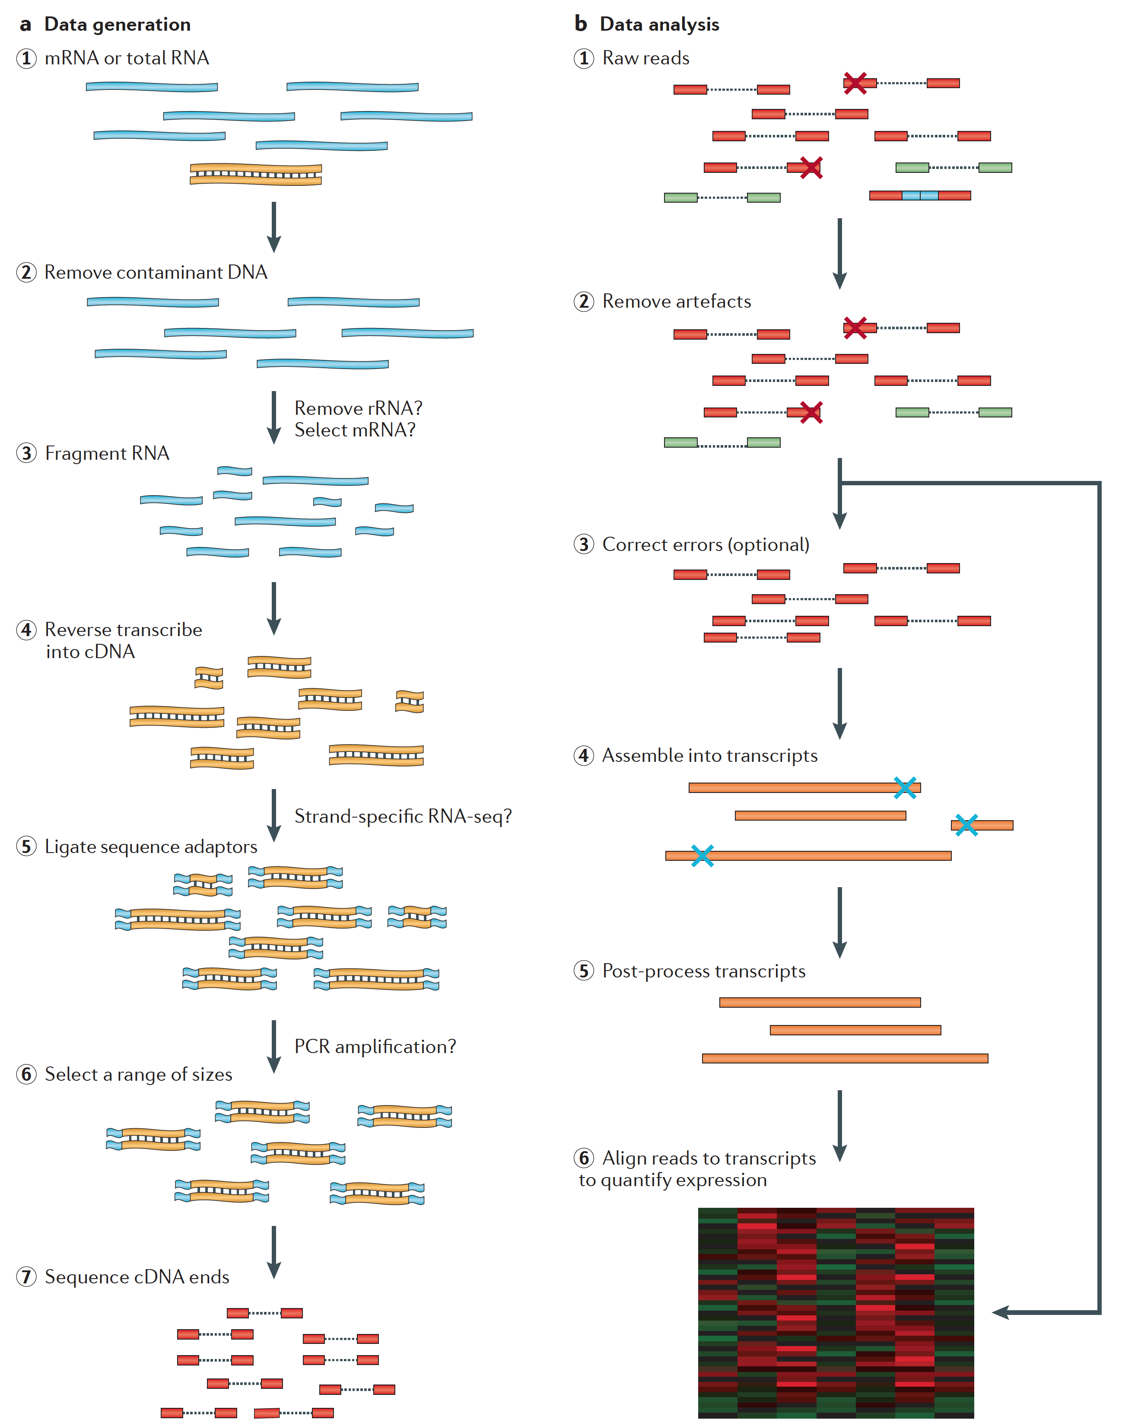
From RNA -> sequence data
Martin J.A. and Wang Z., Nat. Rev. Genet. (2011) 12:671–682

Slide 9
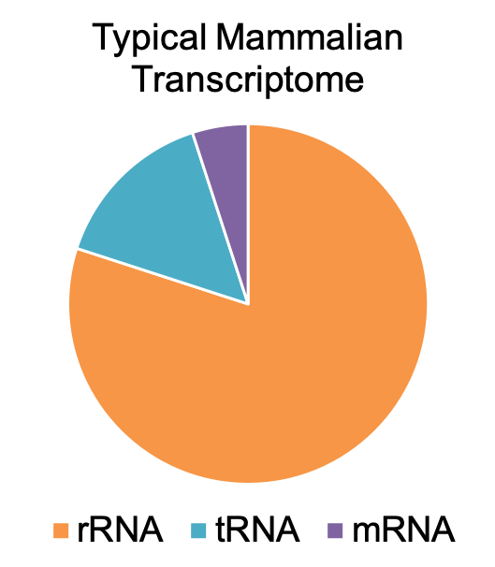
Removal of rRNA is almost always recommended
Removal Methods:
  poly-A selection (eukaryotes only)
  ribosomal depletion
  Size selection

Slide 10
From RNA -> sequence data
Martin J.A. and Wang Z., Nat. Rev. Genet. (2011) 12:671–682

Slide 11
From RNA -> sequence data
Martin J.A. and Wang Z., Nat. Rev. Genet. (2011) 12:671–682

Slide 12
How do we sequence DNA?
1st generation: Sanger method (1987)
2nd generation (“next generation”; 2005):
454 - pyrosequencing
SOLiD – sequencing by ligation
Illumina – sequencing by synthesis
Ion Torrent – ion semiconductor
Pac Bio – Single Molecule Real-Time sequencing, 1000 bp
3rd generation (2015)
Pac Bio – SMRT, Sequel system, 20,000 bp
Nanopore – ion current detection
10X Genomics – novel library prep for Illumina
Slide contributed by Jenny Drnevich, HPCBio

Slide 13
Illumina – “short read” sequencing
300bp reads at lower throughput
100-150bp reads at highest throughput
Many different types of sequencers for various applications.
Can also “flip” a longer DNA strand and sequence from the other end to get paired-end reads
Accuracy: 99.99% Biases: yes
Most common platform for transcriptome sequencing
New NovaSeqX may be able to perform whole transcriptome sequencing!
100nt
Single-read
……………..
Paired-end
……………..
100nt
Content adapted from Radhika Khetani
Notes:
Bias against extreme GC-content (low or high). Favors GC-balanced regions: https://academic.oup.com/dnaresearch/article/26/5/391/5541856. This can be especially detrimental to metatranscriptomics where extreme GC content species may get ignored.

Slide 14
Considerations for...
Differential Gene Expression
Keep biological replicates separate
Poly-A enrichment is generally recommended
  Unless you’re interested in non-coding RNA!
Remove ribosomal RNA (rRNA)
Usually single-end (SE) is enough
  Paired-end (PE) may be recommended for more complex genomes
Paired-end reads
Read1
ATGTTCCATAAGC…
Read2
CCGTAATGGCATG…
Single-end read
Read1
ATGTTCCATAAGC…

Slide 15
Considerations for...
Transcriptome Assembly
Collect RNA from many various sources for a robust transcriptome
  These can be pooled before or after sequencing (but before assembly)
Poly-A enrichment is optional depending on your focus
Remove ribosomal RNA (rRNA)
Paired-end (PE) is recommended. The more sequence, the better.
  Even better if you use long-read technology in addition

Slide 16
Experimental Design Issues
(or Why you need to think about how you will analyze the data before you do the experiment)
Poorly designed experiments (especially with confounding factors) can lead to lower power to detect differences, ambiguous results, or even a waste of time and money!
What to consider:
  How many factors do you have?
  How many levels per factor?
  How many independent replicates should you do? (3 minimum, 5 is better, and put 5 more in the -70 if you can)
The more complex the experiment, the more difficult the statistical analysis will be.
Slide courtesy of Jenny Drnevich, HPCBio

Slide 17
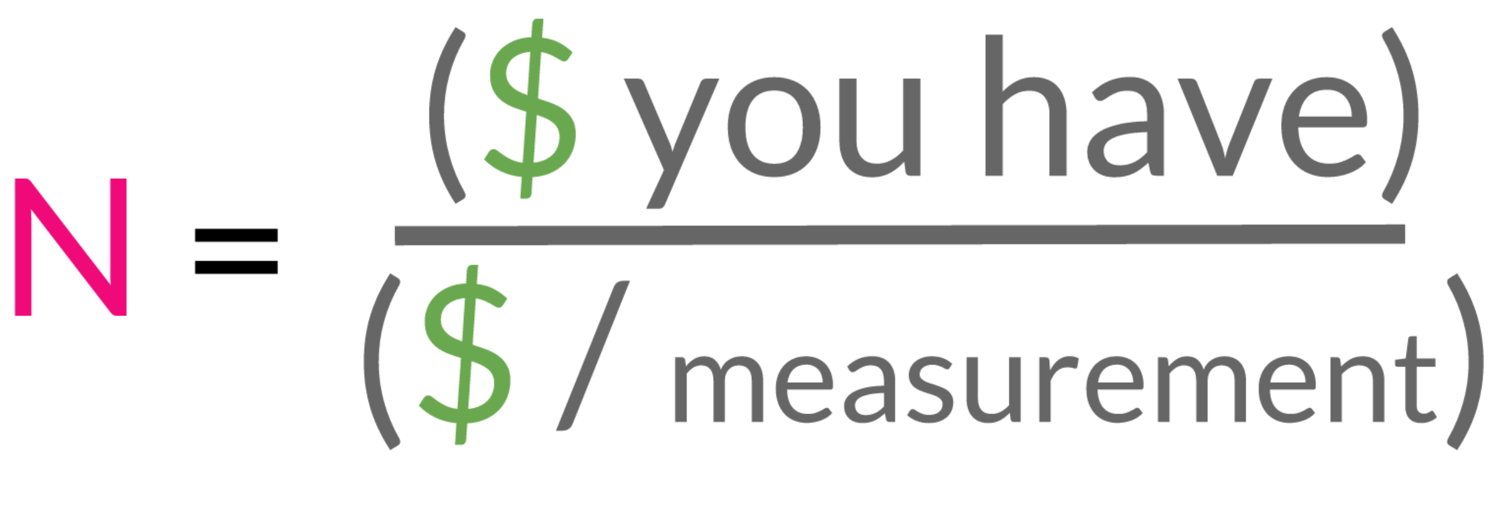
How many independent biological replicates (N)?
A power analysis is recommended: https://pubmed.ncbi.nlm.nih.gov/36830591/
Realistically, the most-used formula is:
Inspiration and graphic from Jeff Leek's Statistics for Genomic Data Science course on Coursera.org
https://docs.google.com/presentation/d/1tOuTVvnIpNm_QaEpaFBvD04z2y06sFqFWBqwO6GfJes/edit#slide=id.gc69a1ad99_0_46
Edited from original slide, courtesy of Jenny Drnevich (HPCBio)

Slide 18
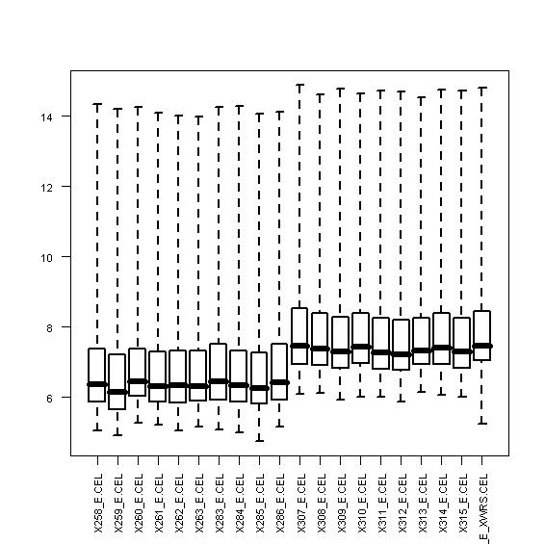
Beware of confounding factors!
(aka batch effects)
In good experimental design, you compare two groups that only differ in one factor.
Batch effect can occur when subsets of the replicates are handled separately at any stage of the process; handling group becomes in effect another factor. Avoid processing all or most of one factor level together if you can’t do all the samples at once.
If batch effects are spread evenly over factor levels, they can be accounted for statistically
Slide courtesy of Jenny Drnevich, HPCBio

Slide 19




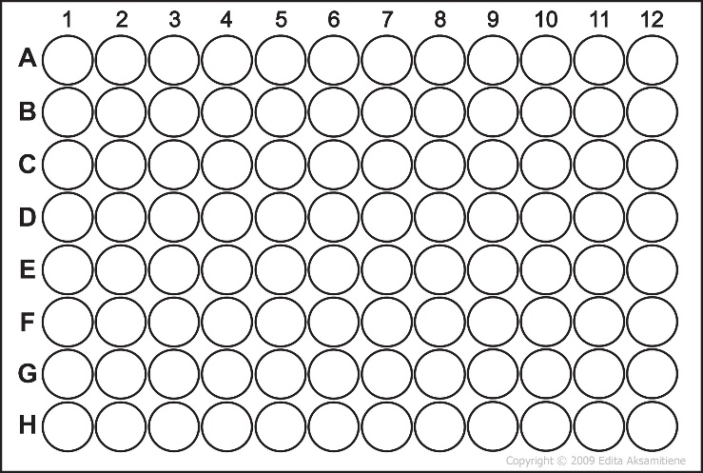
Beware of systematic biases!
Avoid systematic biases in the arrangement of replicates
  Don’t do all of one factor level first (circadian rhythms, experimenter experience, time-on-ice effects)
  Don’t send samples to a sequencing center in order
Have one rep in each row and each column!
http://www.clker.com/clipart-eppendorf-tube-closed.html
http://www.cellsignet.com/media/templ.html
Slide courtesy of Jenny Drnevich, HPCBio

Slide 20
A word on technical replication…
Technical replication is seen by many statisticians as a waste of time and resources because they do not substantially increase your power to detect differences... biological replicates do!
If you cannot increase the number of biological replicates but want to get extra certainty for the samples you do have, then you could do technical replicates if you have the $$ to spend.
Slide courtesy of Jenny Drnevich, HPCBio

Slide 21
Today’s Topics
Transcriptomics
Traditional RNA-Seq Methods
  Sequencing & experimental considerations
  Gene counting
  Statistics
Single Cell RNA-Seq Methods
  Sequencing
  UMI counting & statistics
Where to find help

Slide 22
Gene Counting Steps
1. Download data
2. Quality control steps
2. Align reads to a reference genome with splice aware software (unless bacterial)
3a. Use a gene counting software to obtain the number of read counts per known gene.
3b. Alternatively, use a transcript counting software like Salmon
Notes:
Differential gene expression

Slide 23
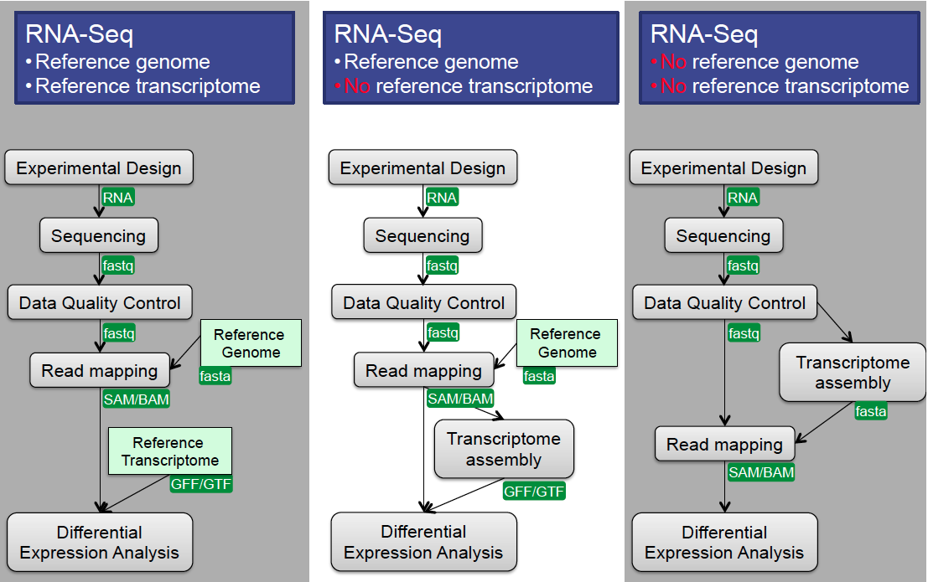
Differential Gene Expression Workflows
Slide courtesy of Radhika Khetani

Slide 24
Differential Gene Expression Workflows
Slide courtesy of Radhika Khetani

Slide 25
Differential Gene Expression Workflows
Slide courtesy of Radhika Khetani

Slide 26

1. Download sequence data
It depends on the center, but common methods include:
  Globus which allows you to transfer from one endpoint to another using their webpage
  Download data to a computer and upload to destination using an SFTP client
      Cyberduck, WinSCP…
  Utilize linux commands such as to perform the same steps
    scp, rsync, wget, curl …

Slide 27
2. So how can we check the quality of our raw sequences?
Software called FASTQC
  Name is a play on FASTQ format and QC (Quality Control)
  Checks quality by several metrics, and creates a visual report

Slide 28
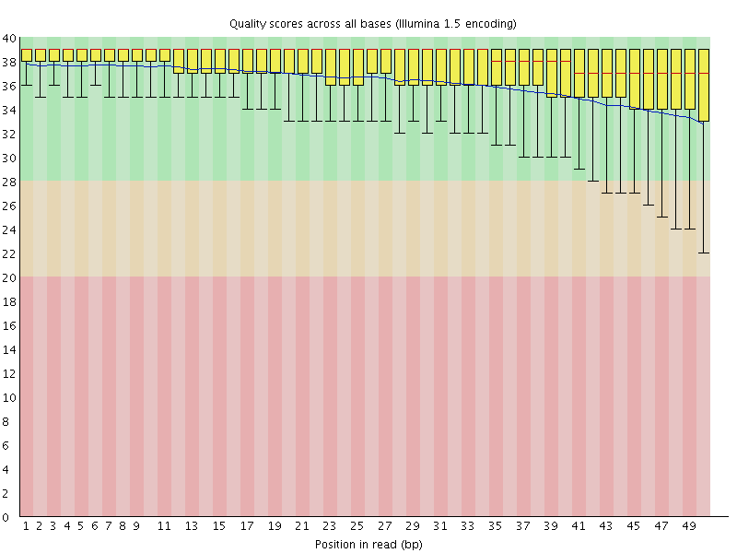
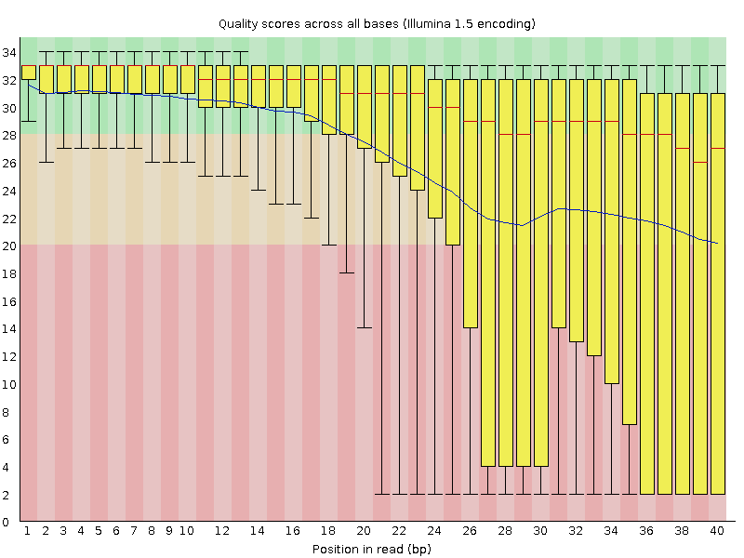
FASTQC: Quality Scores
Good quality!
Poor quality!

Slide 29
FASTQC cont...
Additional metrics
  Presence of, and abundance of contaminating sequences
  Average read length
  GC content
  And more!
Assumes that your data is:
  WGS (i.e. evenish sampling of the whole genome)
  Derived from DNA
  Derived from one species
So keep this in mind when interpreting results

Slide 30

2. What do I do when FastQC calls my data poor?
  Poor quality at the ends can be remedied
  Left-over adapter sequences in the reads can be removed
    Always trim adapters as a matter of routine
  We need to amend these issues so we get the best possible alignment
  After trimming, it is best to rerun the data through FastQC to check the resulting data

Slide 31
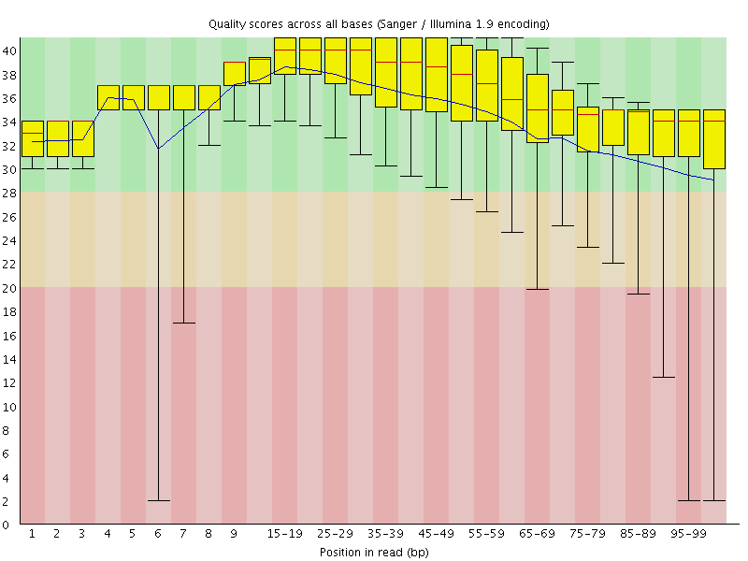
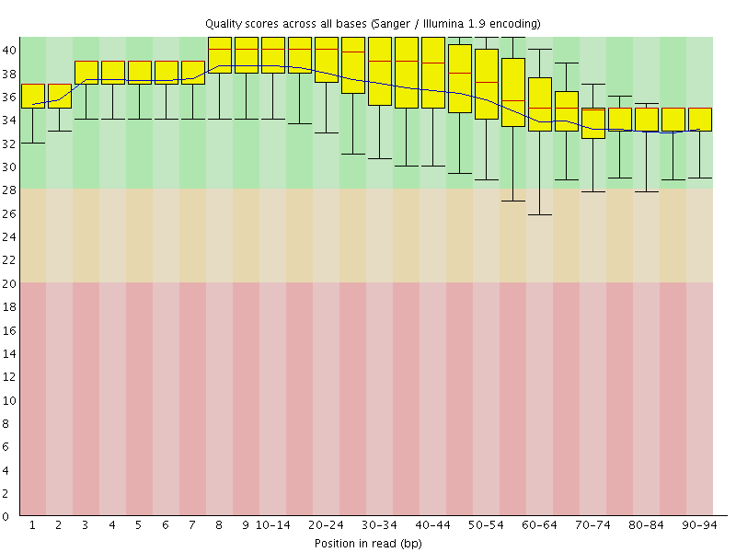
Quality Before & After
Before quality trimming
After quality trimming

Slide 32
3a. Traditional Gene Counting:
Sequence Alignment
We need to align the sequence data to our genome of interest
  If aligning RNASeq data to the genome, almost always pick a splice-aware aligner
Genome
Alignment
Reads
Gene
Versus
Genome
Splice-Aware
Alignment
Reads
Gene

Slide 33
3a. Traditional Gene Counting:
Sequence Alignment
Software choices:
Splice-aware aligners: recommended for most applications
  STAR, HiSat2, Novoalign (not free), MapSplice2, GSNAP, …
Non-splice aware aligners: ideal for bacterial genomes
  BWA, Novoalign (not free), Bowtie2, HiSat2
Software inputs:
Trimmed sequences in FASTQ format
Complete reference genome FASTA (or transcriptome)
Reference annotation file in GTF or GFF3 format (not required for non-splice aware aligners)

Slide 34
3a. Traditional Gene Counting:
Sequence Alignment
Other considerations when performing alignment:
  How does it deal with reads that map to multiple locations? Will that be compatible with downstream software?
  How does it deal with paired-end versus single-end data? Are there extra parameters that need to be added?
  How many mismatches will it allow between the genome and the reads?
  What assumptions does it make about my genome, and can I change these assumptions, if needed?

Slide 35
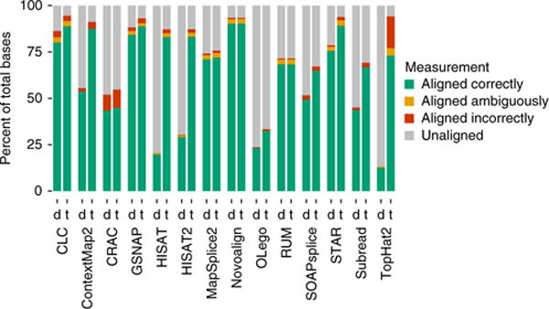
Always check the default settings of any software you use!!!
Performed on simulated human dataset with high complexity (0.03 substitution, 0.005 indel, 0.02 error)
Baruzzo et. al, 2017, doi: 10.1038/nmeth.4106

Slide 36
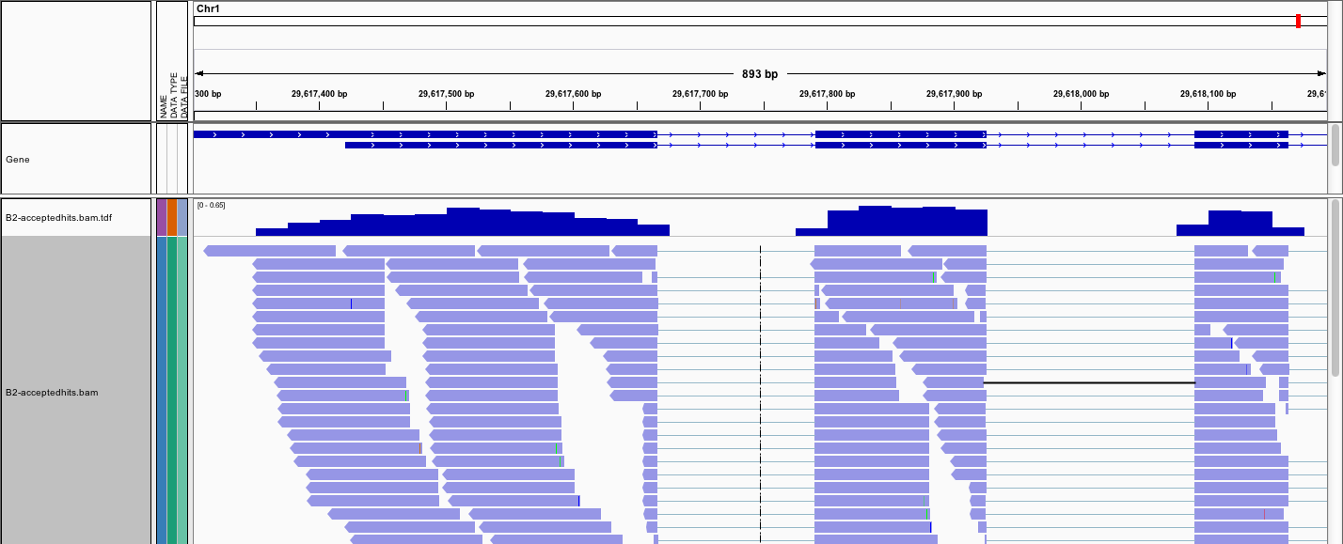
Optional: Alignment Visualization
IGV is the visualization tool used for this snapshot
Notes:
Differential gene expression

Slide 37
3a. Traditional Gene Counting:
# of sequences in genes
When selecting software consider whether you want to obtain:
raw read counts or normalized read counts
Gene counting software:
Software inputs: alignment file (e.g. SAM, BAM or CRAM files) and annotation file (e.g. GTF, GFF3)
feature-counts & htseq return raw read counts
    Required for R packages like DESeq, limma & EdgeR
StringTie returns FPKM or TPM normalized counts for each gene
  Required for R package Ballgown
RSEM returns TPM normalized counts

Slide 38
Problems with traditional gene counting software
Multi-mapping reads not used, leading to underestimation of gene abundances, particularly for genes with more shared sequence
A small percentage of genes may not ever be quantifiable using this method.
Genes that change relative isoform usage can have erroneous results due to changes in isoform length

Slide 39
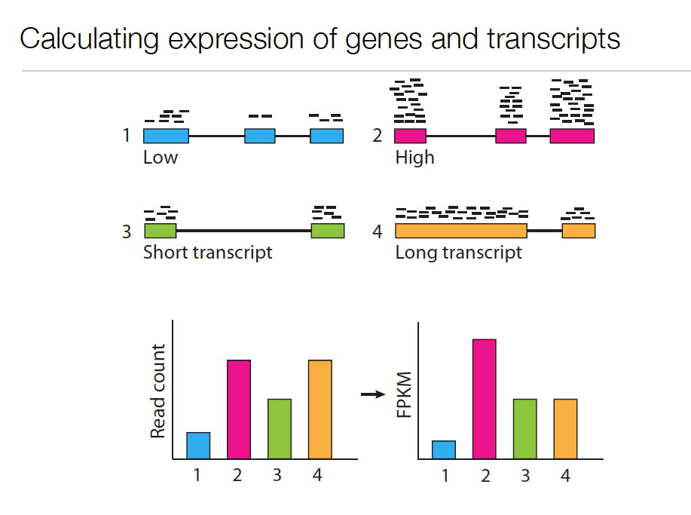
Expression Value
Slide courtesy of Cole Trapnell

Slide 40
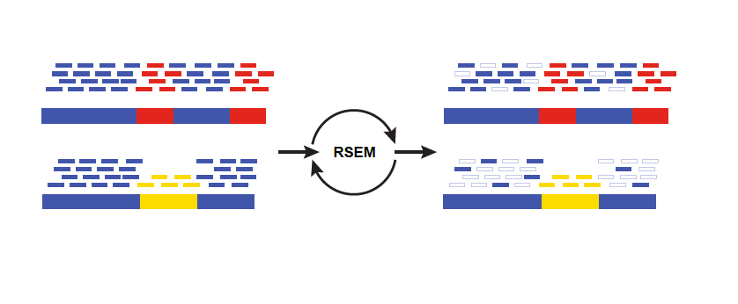
3b. Gene quantification
Solution: Expectation Maximization algorithms
Isoform A
EM
Isoform B
Blue = multiply-mapped reads
Red, Yellow = uniquely-mapped reads
Use Expectation Maximization (EM) to ﬁnd the most likely assignment of reads to transcripts.
Performed by:
StringTie
RSEM
eXpress
Salmon/kallisto
slide from Brian Haas; title modified

Slide 41
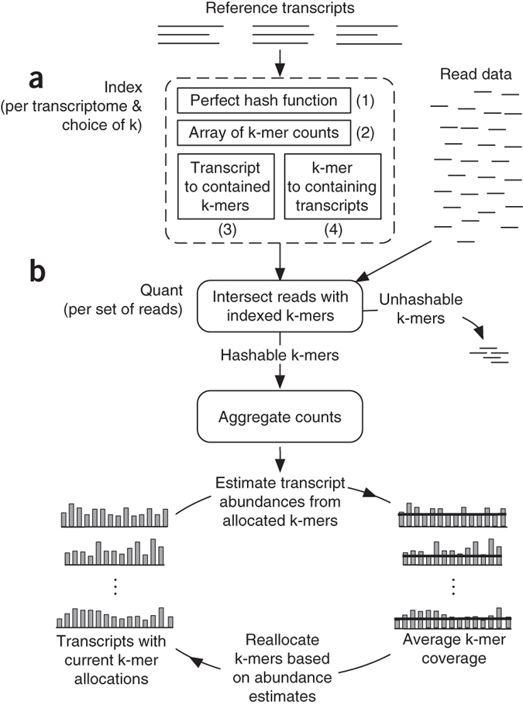
Modern transcript counting programs
Salmon (Patro et al. 2017)
  Estimates transcript coverage by k-mer counting approach
  Cannot find new splice junctions/isoforms
  Fast: 3-5 min!
Kallisto (Bray et al. 2016)
  Also utilizes de Bruijn graphs
  less than 5 min on laptop computer!
“Gene quantification”
  Both software are more accurate when transcript-counts are grouped to the gene-level
Slide courtesy of Jenny Drnevich

Slide 42
When to use either method
Traditional Gene Counting (1st workflow) | Gene Quantification (2nd workflow)
Reads with retained introns still counted (e.g. cancer and rapidly developing tissues) | Genome duplications present
Need to find novel transcripts/splice junctions | Lots of gene families present
Want to visualize alignments on genome | When ever you have a large percentage (>15%) of multi-mapped reads

Slide 43
Today’s Topics
Transcriptomics
Traditional RNA-Seq Methods
  Sequencing & experimental considerations
  Gene counting
  Statistics
Single Cell RNA-Seq Methods
  Sequencing
  UMI counting & statistics
Where to find help

Slide 44
DGE Statistical Analyses
  The first step is proper normalization of the data
    Often the statistical package you use will have a normalization method that it prefers and uses exclusively (e.g. Voom, FPKM, TMM (used by EdgeR))
  Is your experiment a pairwise comparison?
    Ballgown, EdgeR, DESeq
  Is it a more complex design?
    EdgeR, DESeq, limma, other R/Bioconductor packages
Slide courtesy of Rhadika Khetani, text edited

Slide 45
Statistical Results
A list of significantly differentially expressed genes
Venn Diagrams
Heatmaps
WGCNA
Advanced annotation
... and more!

Slide 46
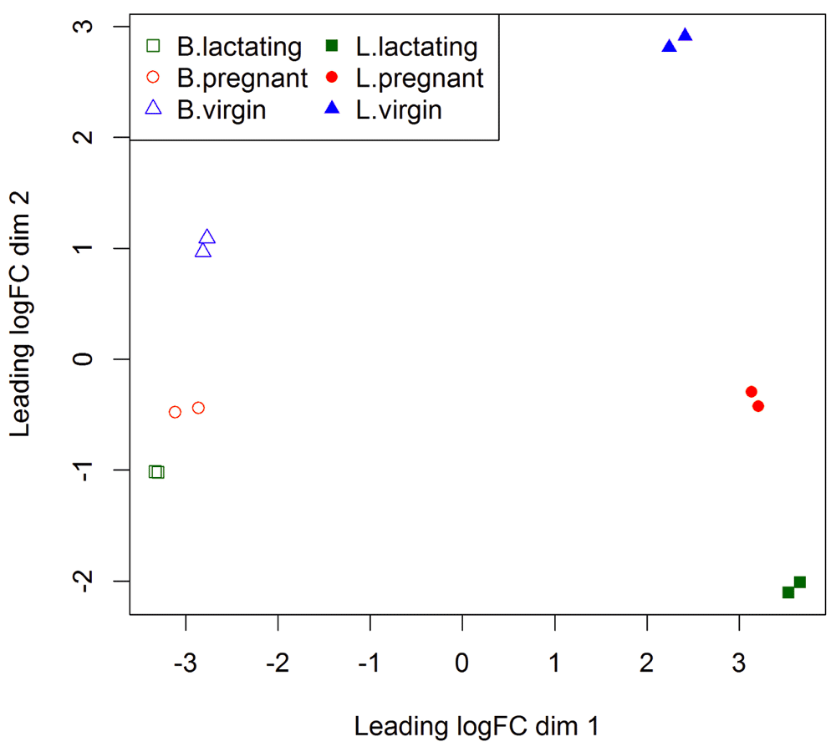
EdgeR: MDS Plot
https://f1000research.com/articles/5-1438 (doi: 10.12688/f1000research.8987.2)
Slide courtesy of Jenny Drnevich
Notes:
Figure 1. The MDS plot of the data set.
Samples are separated by the cell type in the first dimension, and by the mouse status in the second dimension.
Chen Y, Lun ATL and Smyth GK. From reads to genes to pathways: differential expression analysis of RNA-Seq experiments using Rsubread and the edgeR quasi-likelihood pipeline [version 2]. F1000Research 2016, 5:1438 (doi: 10.12688/f1000research.8987.2)
Depicts differences in samples. Samples that group together are more similar in their expression profiles. the distance between samples can be interpreted as the leading log-fold change between the samples for the genes that best distinguish that pair of samples.
B = basal cells; L = Luminal cells

Slide 47
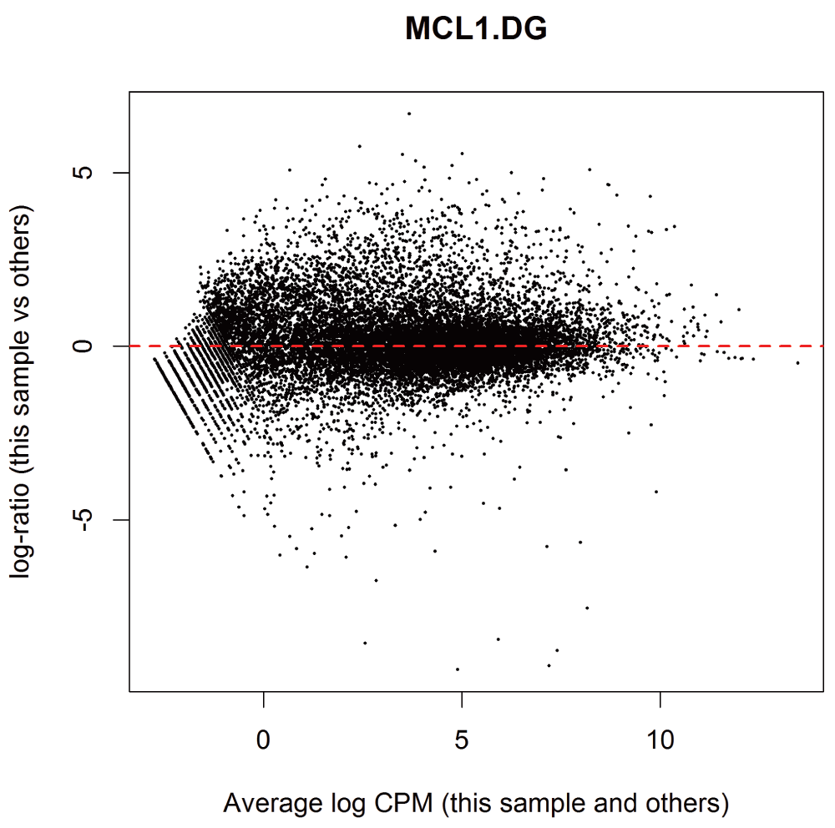
EdgeR: MD Plot
https://f1000research.com/articles/5-1438 (doi: 10.12688/f1000research.8987.2)
Slide courtesy of Jenny Drnevich
Notes:
Figure 2. MD plot of log2-expression in sample 1 versus the average log2-expression across all other samples.
Each point represents a gene, and the red line indicates a log-ratio of zero. The majority of points cluster around the red line.
Chen Y, Lun ATL and Smyth GK. From reads to genes to pathways: differential expression analysis of RNA-Seq experiments using Rsubread and the edgeR quasi-likelihood pipeline [version 2]. F1000Research 2016, 5:1438 (doi: 10.12688/f1000research.8987.2)
MD plots assess the performance of TMM normalization. It plots the library size adjusted log fold change between 2 libraries against the average log expression across the libraries. In other words, the difference between two libraries against the mean of those two libraries. The genes should be centered at a line of zero log fold change.

Slide 48
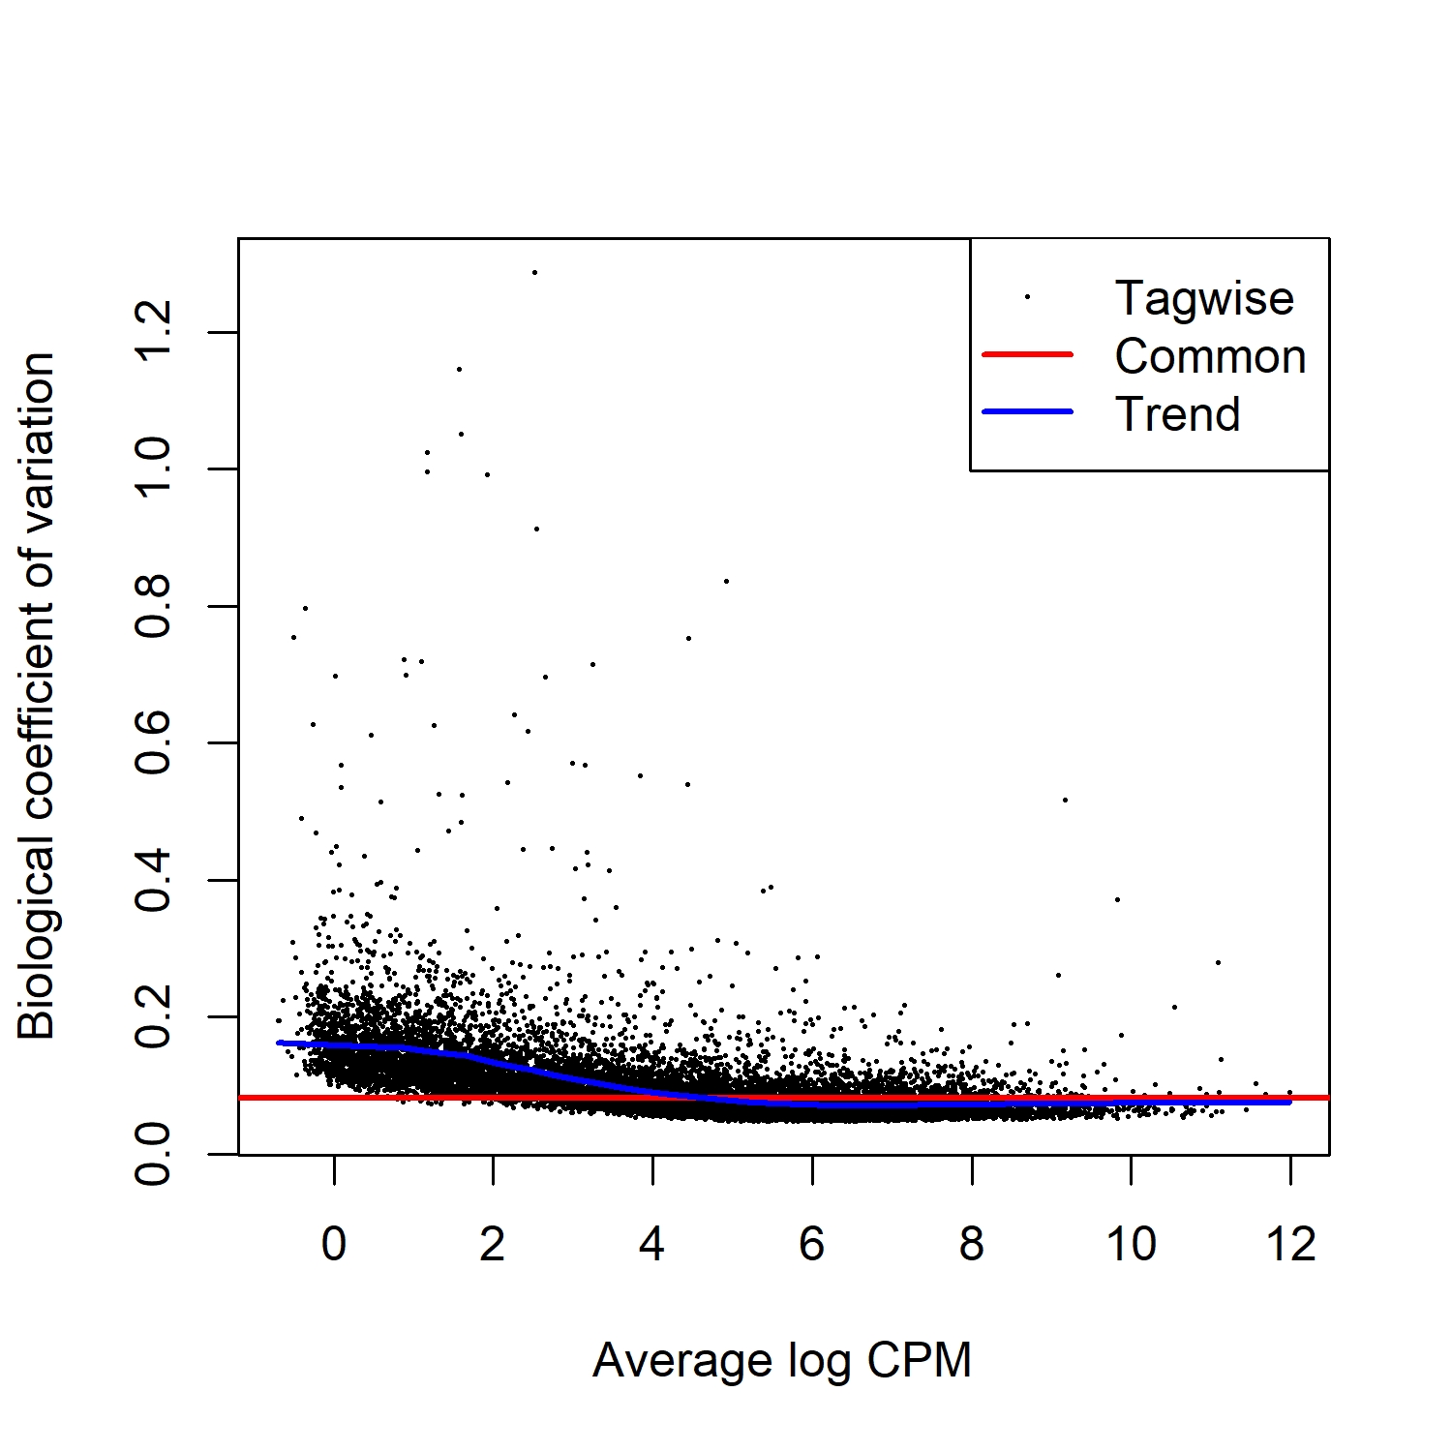
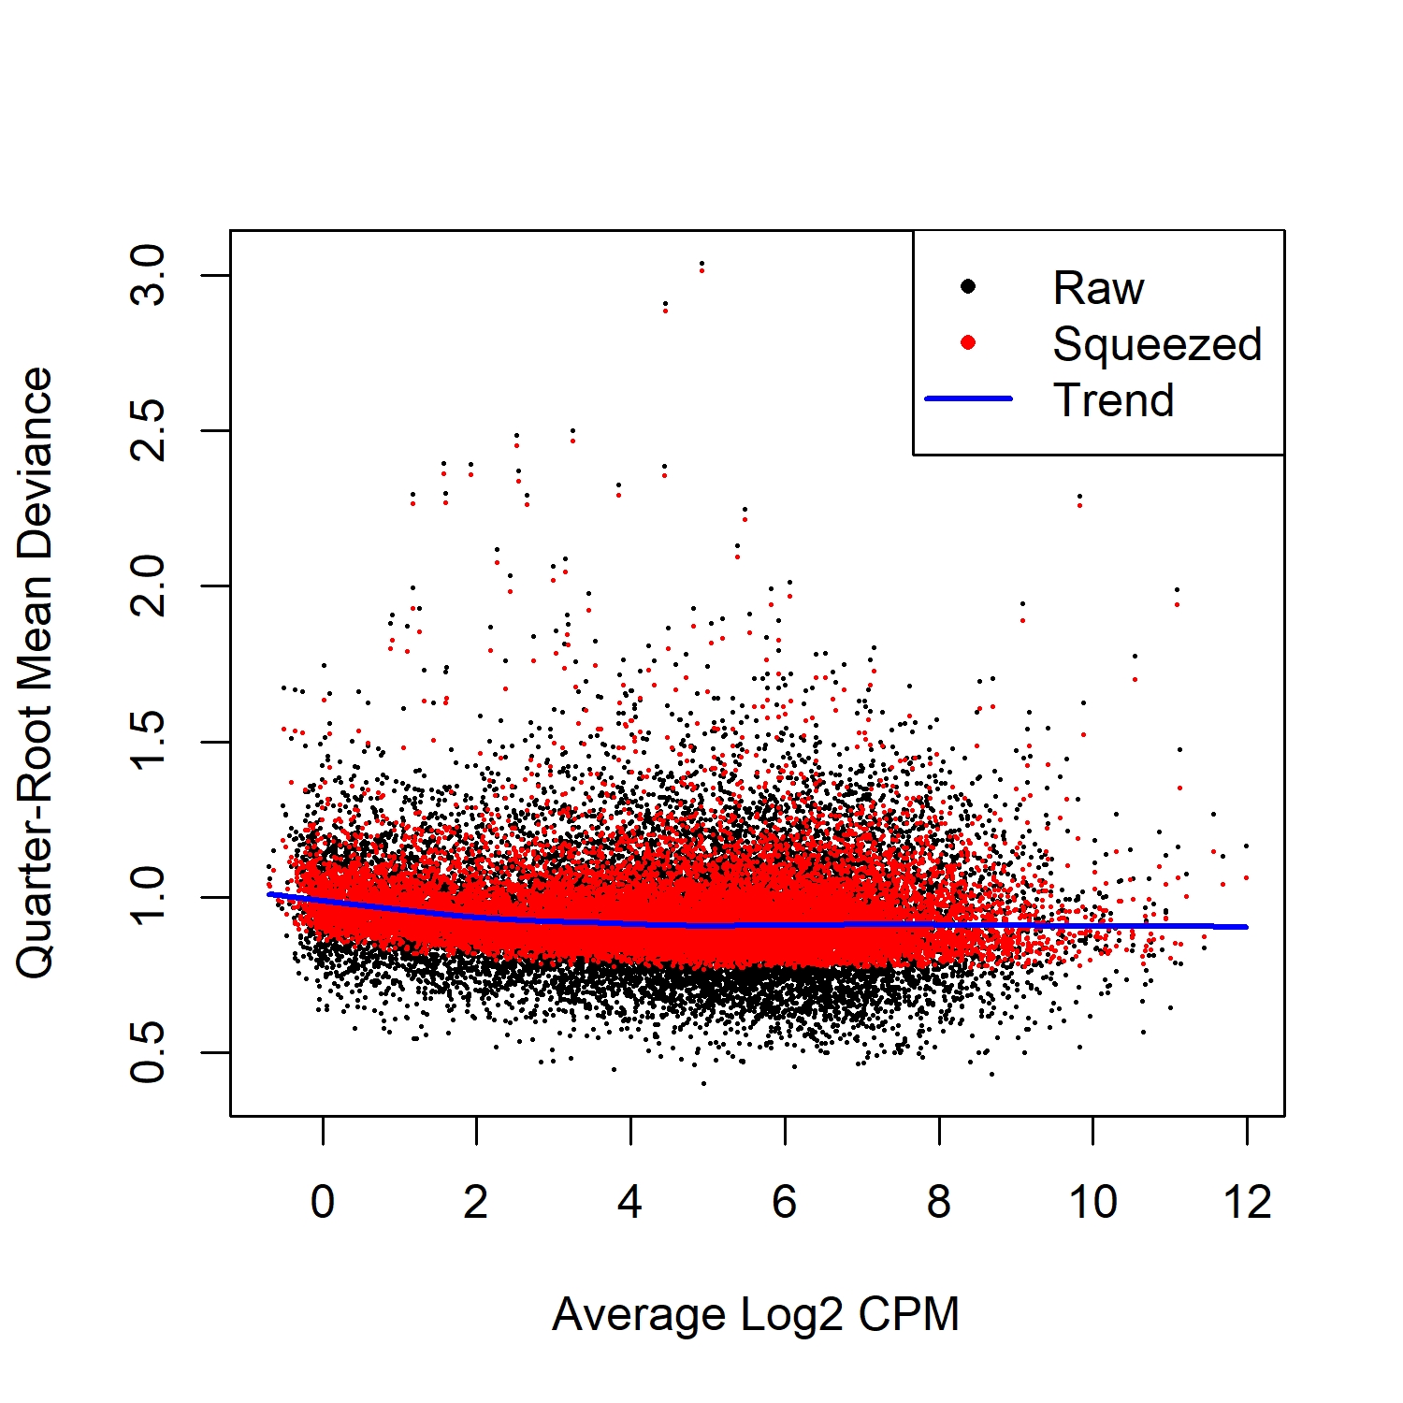
EdgeR Results: Dispersion Estimation
BCV Plot
QL Plot
https://f1000research.com/articles/5-1438
Slide courtesy of Jenny Drnevich
Notes:
The dispersion parameter of the negative binomial (NB) distribution accounts for variability between biological replicates. So another way of describing variance between replicates. EdgeR describes dispersion for each individual gene (Tagwise) as well as global dispersion averaged over all genes (common) and trended dispersion where it is predicted from gene abundance.
In BCV plot the y axis is the square root of this dispersion against the average expression. It’s normal for dispersion to be higher with low count genes. The average value differs depending on the genome. For mice it centers around 0.05 - 0.2, while human tends to be > 0.3.
The NB model can be extended with QL (Quasi-Likelihood) methods to account for variability from both biological and technical replicates. Raw = estimates of variation before empirical Bayes moderation. Trended & squeezed are after EB moderation.
QL
# Note extremely low dispersions have been squeezed upwards a lot, but the
# extremely high dispersions have only been squeezed downwards a little bit.

Slide 49
What does HPCBio use?
Quality Check - FASTQC
Trimming - Trimmomatic
Splice-aware alignment - STAR
Bacterial alignment - BWA or Novoalign
Counting reads per gene - featureCounts
Counting reads per isoform - Salmon* Can also group these counts by gene for even more accuracy
DGE Analysis - edgeR or limma
Alignment visualization - IGV
De novo transcriptome assembly – Trinity
Reference-based transcriptome assembly – StringTie

Slide 50
Still not sure?
Recent RNA-Seq software comparison articles:
Corchete, L.A., Rojas, E.A., Alonso-López, D. et al. Systematic comparison and assessment of RNA-seq procedures for gene expression quantitative analysis. Sci Rep 10, 19737 (2020). https://doi.org/10.1038/s41598-020-76881-x
Schaarschmidt, S., Fischer, A., Zuther, E., & Hincha, D. K. (2020). Evaluation of Seven Different RNA-Seq Alignment Tools Based on Experimental Data from the Model Plant Arabidopsis thaliana. International journal of molecular sciences, 21(5), 1720. https://doi.org/10.3390/ijms21051720
Zhang, C., Zhang, B., Lin, LL. et al. Evaluation and comparison of computational tools for RNA-seq isoform quantification. BMC Genomics 18, 583 (2017). https://doi.org/10.1186/s12864-017-4002-1

Slide 51
Today’s Topics
Transcriptomics
Traditional RNA-Seq Methods
  Sequencing & experimental considerations
  Gene counting
  Statistics
Single Cell RNA-Seq Methods
  Sequencing
  UMI counting & statistics
Where to find help

Slide 52
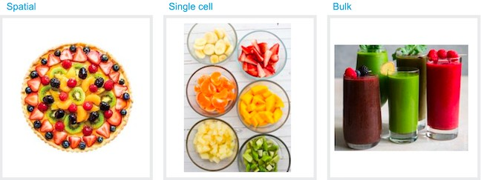



10x Genomics RNA Applications:
RNA-Seq:
“Bulk” Gene Expression profiling
10x Single Cell Transcriptomics (Single Cell RNA-Seq):
3’ Gene Expression profiling at single cell resolution 10x Spatial Gene Expression (Visium):
3’ Gene Expression profiling with morphological content (1-10 cell resolution)
Slide courtesy of Chris Wright

Slide 53
Why Single Cell RNASeq?
Comparison of individual cell transcriptomes within a population of cells
Analysis of cell heterogeneity/rare cell populations (average vs individual)
Embryonic tissue / tumors
Examining cell populations consisting of mostly unique cells (TCR, neurons)
Transcriptome Atlas
Slide courtesy of Chris Wright

Slide 54
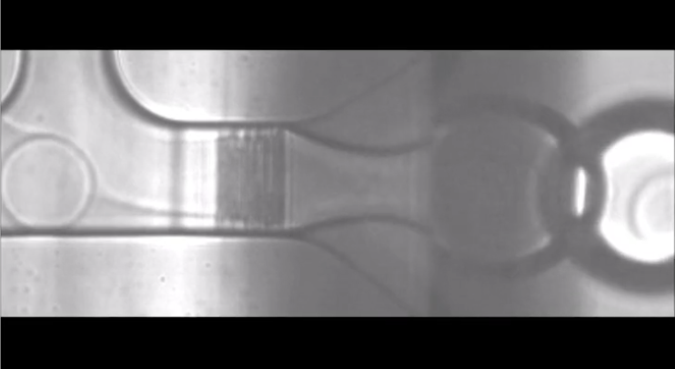
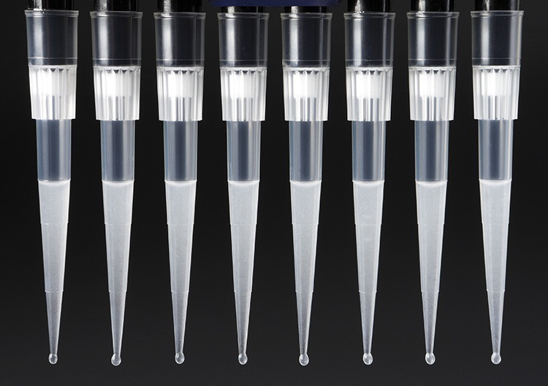
10x Single Cell Construction:
GEM Generation: Gel Beads in Emulsion
10x Chip: Add Gel Beads + Master Mix/Cells + Oil.
Mixing occurs on Chromium X.
90-99% of GEMS do not contain a cell.
Slide courtesy of Chris Wright

Slide 55
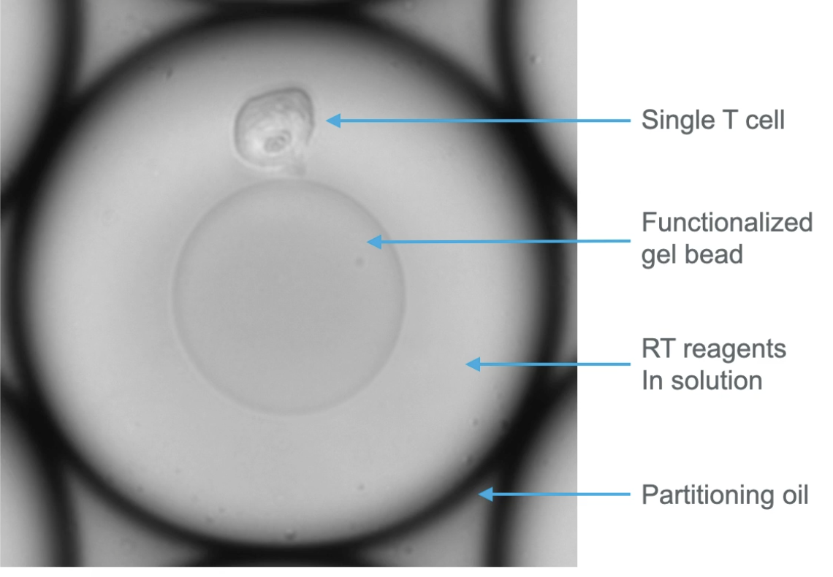
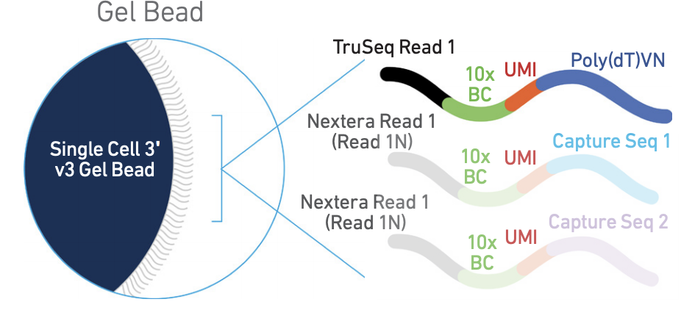
10x Single Cell Construction:
GEM Generation and Barcoding
10x Barcode: One for each cell captured (~3.5M 16bp)
UMI: Unique Molecular Identifier (12bp N’s)
Slide courtesy of Chris Wright

Slide 56
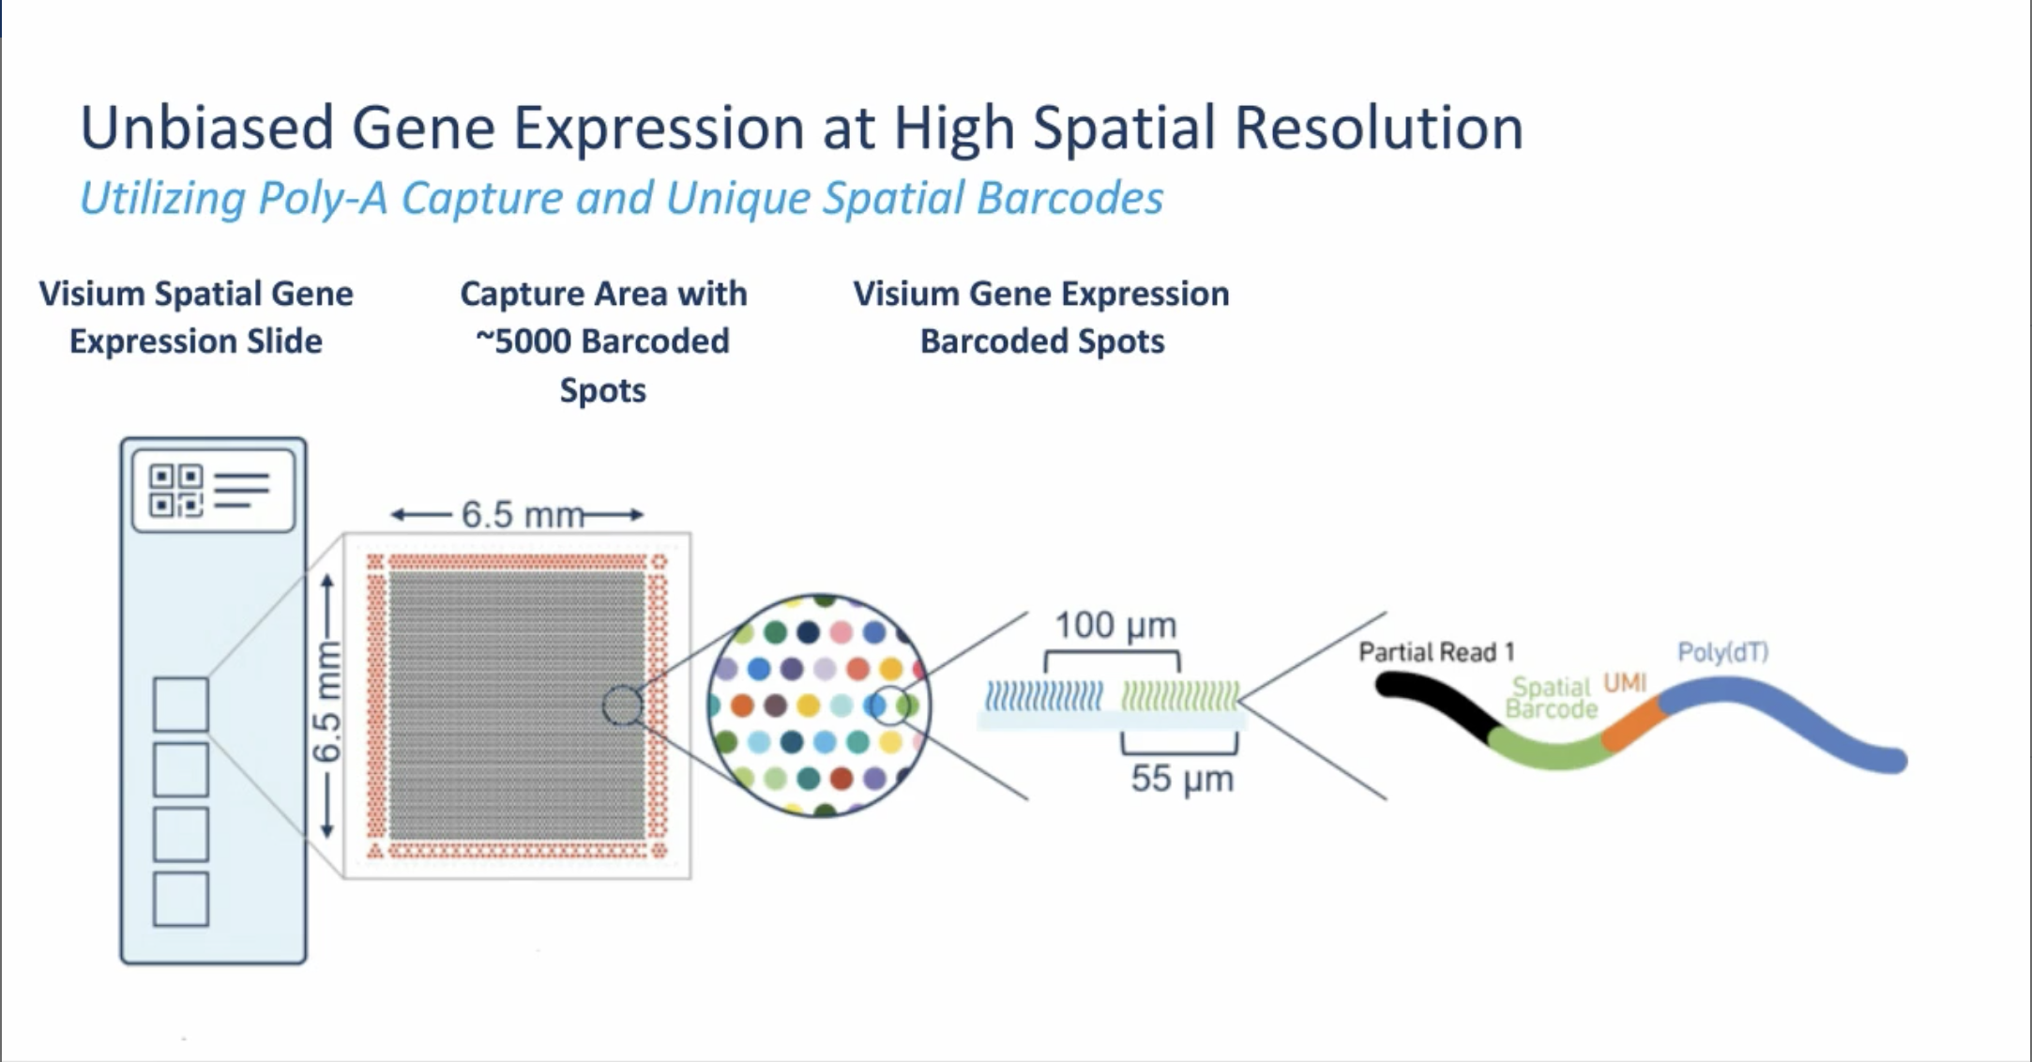
10x Visium Spatial Transcriptomics:
Slide courtesy of Chris Wright

Slide 57
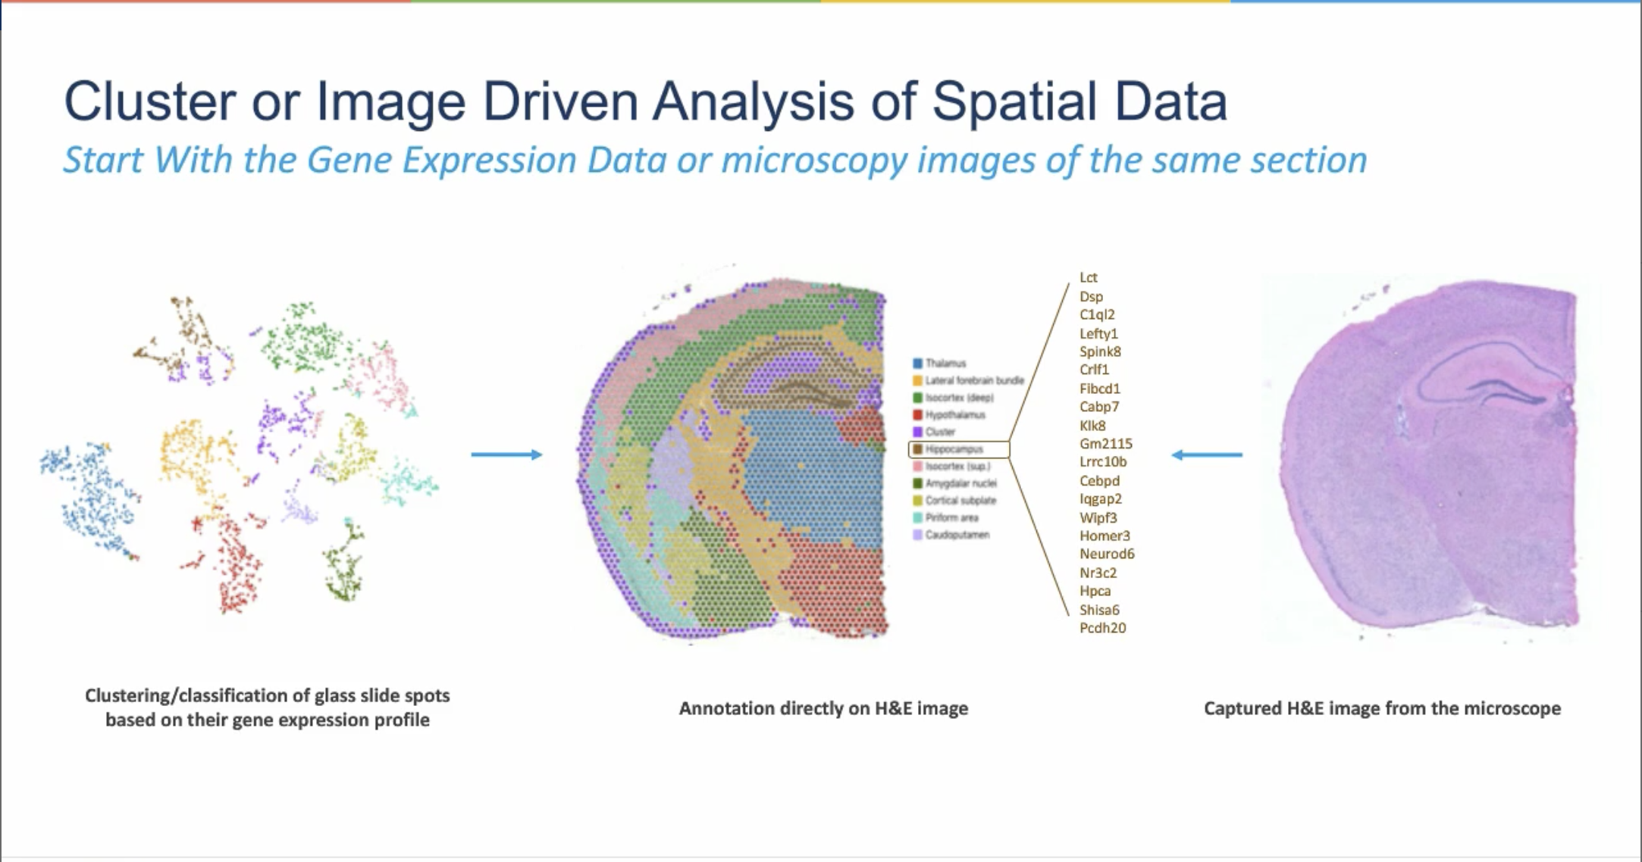
10x Visium Spatial Transcriptomics:
Slide courtesy of Chris Wright

Slide 58
Today’s Topics
Transcriptomics
Traditional RNA-Seq Methods
  Sequencing & experimental considerations
  Gene counting
  Statistics
Single Cell RNA-Seq Methods
  Sequencing
  UMI counting & statistics
Where to find help

Slide 59
UMI counting?
UMI = Unique Molecular Identifier
A UMI barcode is assigned to each transcript, in addition to a cell barcode (for differentiating single cells)
We can use Cell Ranger to run differential gene expression analysis & create a visualization file
  cellranger mkfastq
    Demultiplexes samples (run by sequencing center)
  cellranger count
    Run separately for each sample
  cellranger aggr
    Puts > 1 sample in same .cloupe file
    Only normalization is sub-sampling
  cellranger reanalyze
    Used to modify parameters of previous run

Slide 60
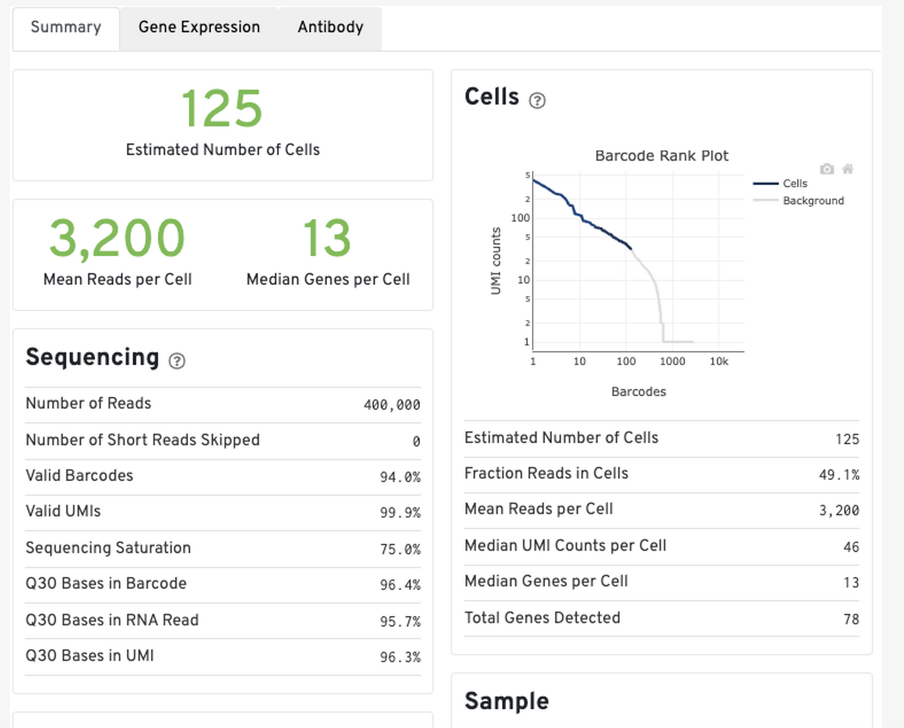
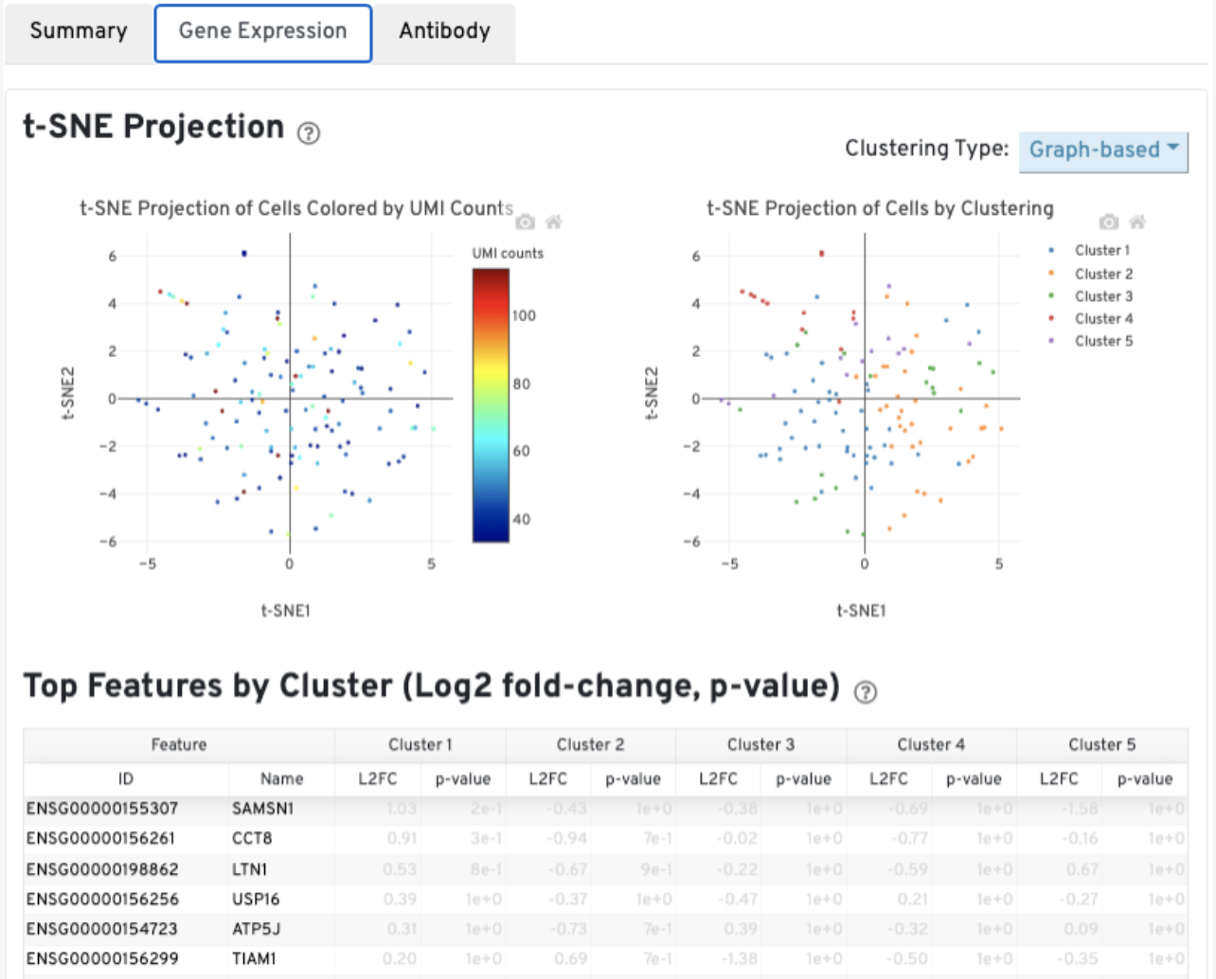
What does Cell Ranger give us?
Cell Ranger produces:
  web_summary.html file
  .cloupe file for visualization (next slides)
10X Genomics: https://support.10xgenomics.com/single-cell-gene-expression/software/pipelines/latest/output/summary

Slide 61
Loupe Browser
After UMI counting and clustering, you can import this data into Loupe Browser
10X Genomics: https://support.10xgenomics.com/single-cell-gene-expression/software/visualization/latest/what-is-loupe-cell-browser

Slide 62
Loupe Browser
You can also refine your clusters and assign cell types (manually)
10X Genomics: https://www.10xgenomics.com/products/loupe-browser

Slide 63
Cell Ranger Limitations
Excluding called cells based on other QC metrics (%MT) not easy
  Manual selection/output in Loupe
  Need to run cellranger reanalyze to remove cells/genes
Only a sub-optimal normalization method available
Loupe Browser Limitations
Limited tracking of steps performed (reproducible?) but you can save what you have done
Manual annotation of cell types
No trajectory analysis
Output plots not publication-quality
Not a substitute for a rigorous statistical analysis
Slide courtesy of Jenny Drnevich

Slide 64
Secondary analyses recommended using R
Filter genes
Filter cells
Select variable genes
Run PCA
  Run clustering
  Run t-SNE
  Run UMAP
Find marker genes per cluster
Annotate cell types
Differential analysis between cell types and/or within a cell type between samples
Slide courtesy of Jenny Drnevich

Slide 65
Recommended R Packages
HPCBio prefers to use Seurat
Cell annotation can be done by many programs
Other popular R packages, especially for trajectory analysis:
  Monocle is an R package for clustering, trajectory analysis, and differential expression
  Scanpy is a Python tool for clustering, trajectory inference, and differential expression
And more!
  Link to a list of Bioconductor packages for working with single cell data
  Link to a list of Bioconductor workflows for working with single cell data
  Link to a list of Bioconductor single cell data packages

Slide 66
Today’s Topics
Transcriptomics
Traditional RNA-Seq Methods
  Sequencing & experimental considerations
  Gene counting
  Statistics
Single Cell RNA-Seq Methods
  Sequencing
  UMI counting & statistics
Where to find help

Slide 67
How do I learn more about these steps?
Your lab will briefly go through some steps of a traditional RNA-Seq dataset: alignment, gene-counting, DGE analysis, and alignment visualization
We do offer a longer and very detailed workshop on these methods
  Spring semester: Bulk RNA-Seq workshop
  Fall semester: 10X single cell RNA-Seq workshop
Check http://hpcbio.illinois.edu/hpcbio-workshops at the beginning of the year for updates

Slide 68
Documentation and Support
Online resources for RNA-Seq analysis questions
Software manuals
  Most tools also have a dedicated lists/forums and/or github pages
Biostar (Bioinformatics explained) - http://www.biostars.org/
SEQanswers (the next generation sequencing community) - http://seqanswers.com/
Notes:
Thanks

Slide 69
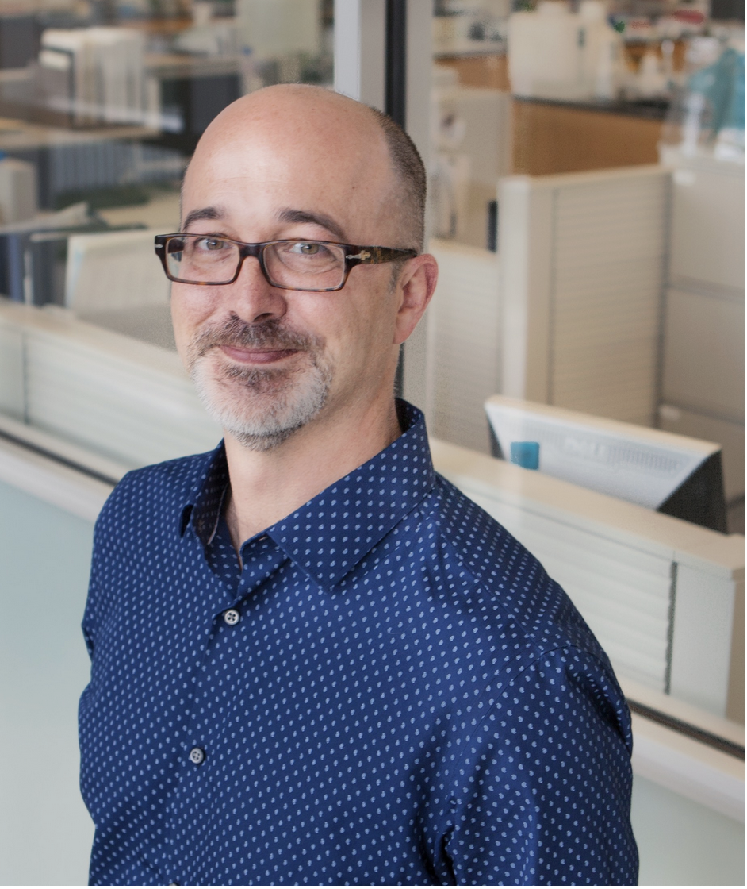
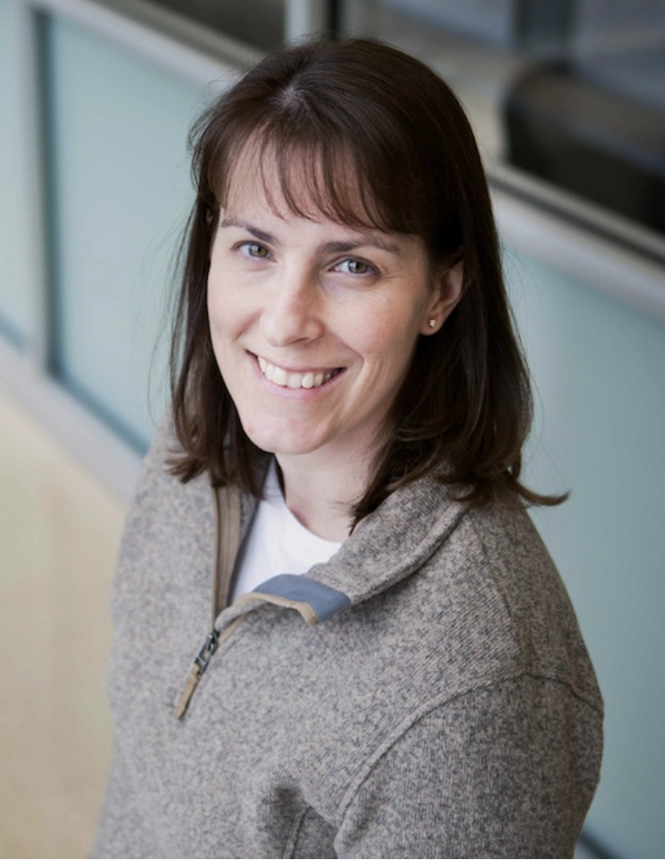
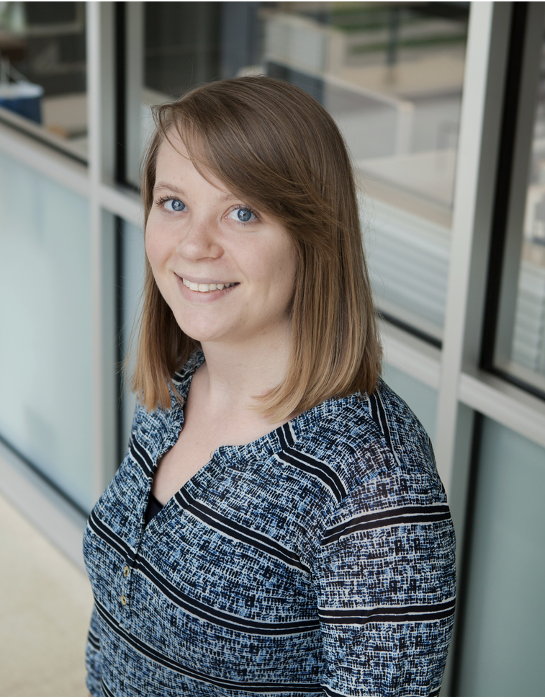
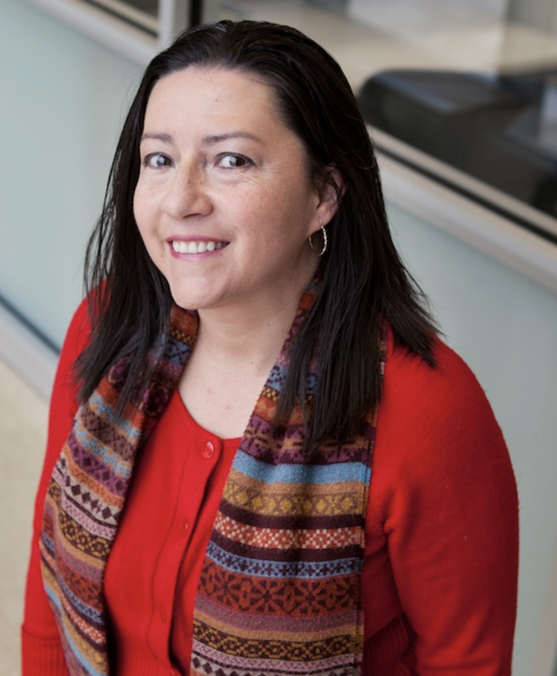
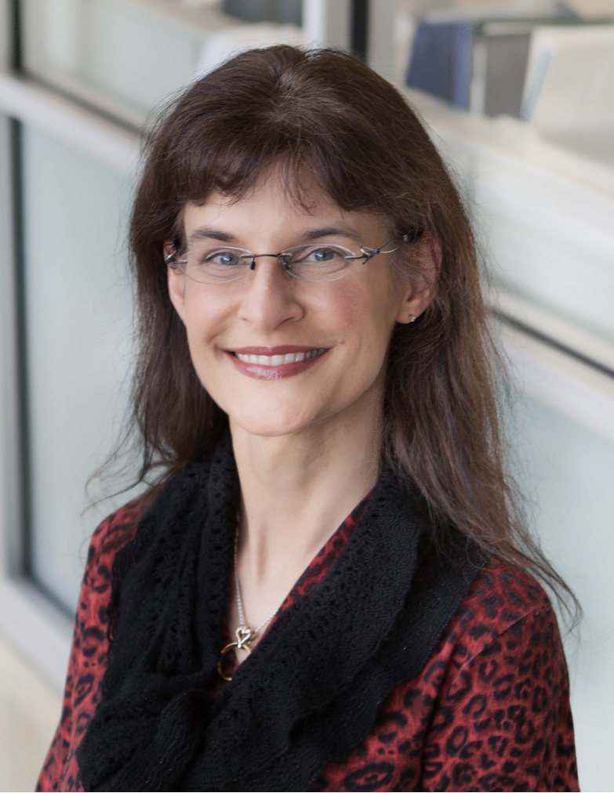
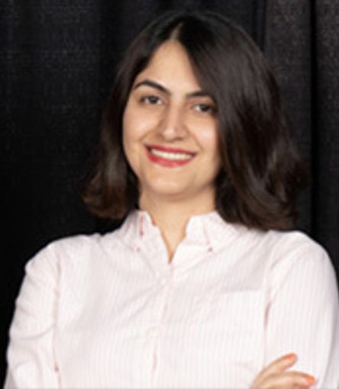
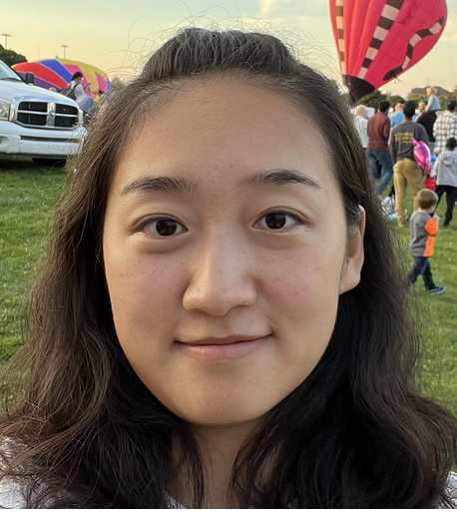
HPCBio Bioinformatics Consulting
Contact us at:
Help desk - hpcbio@biotech.illinois.edu
Training questions - hpcbio-training@biotech.illinois.edu
HPCBio website - http://hpcbio.illinois.edu/
My email - jholmes5@illinois.edu
Notes:
Thanks

Slide 70
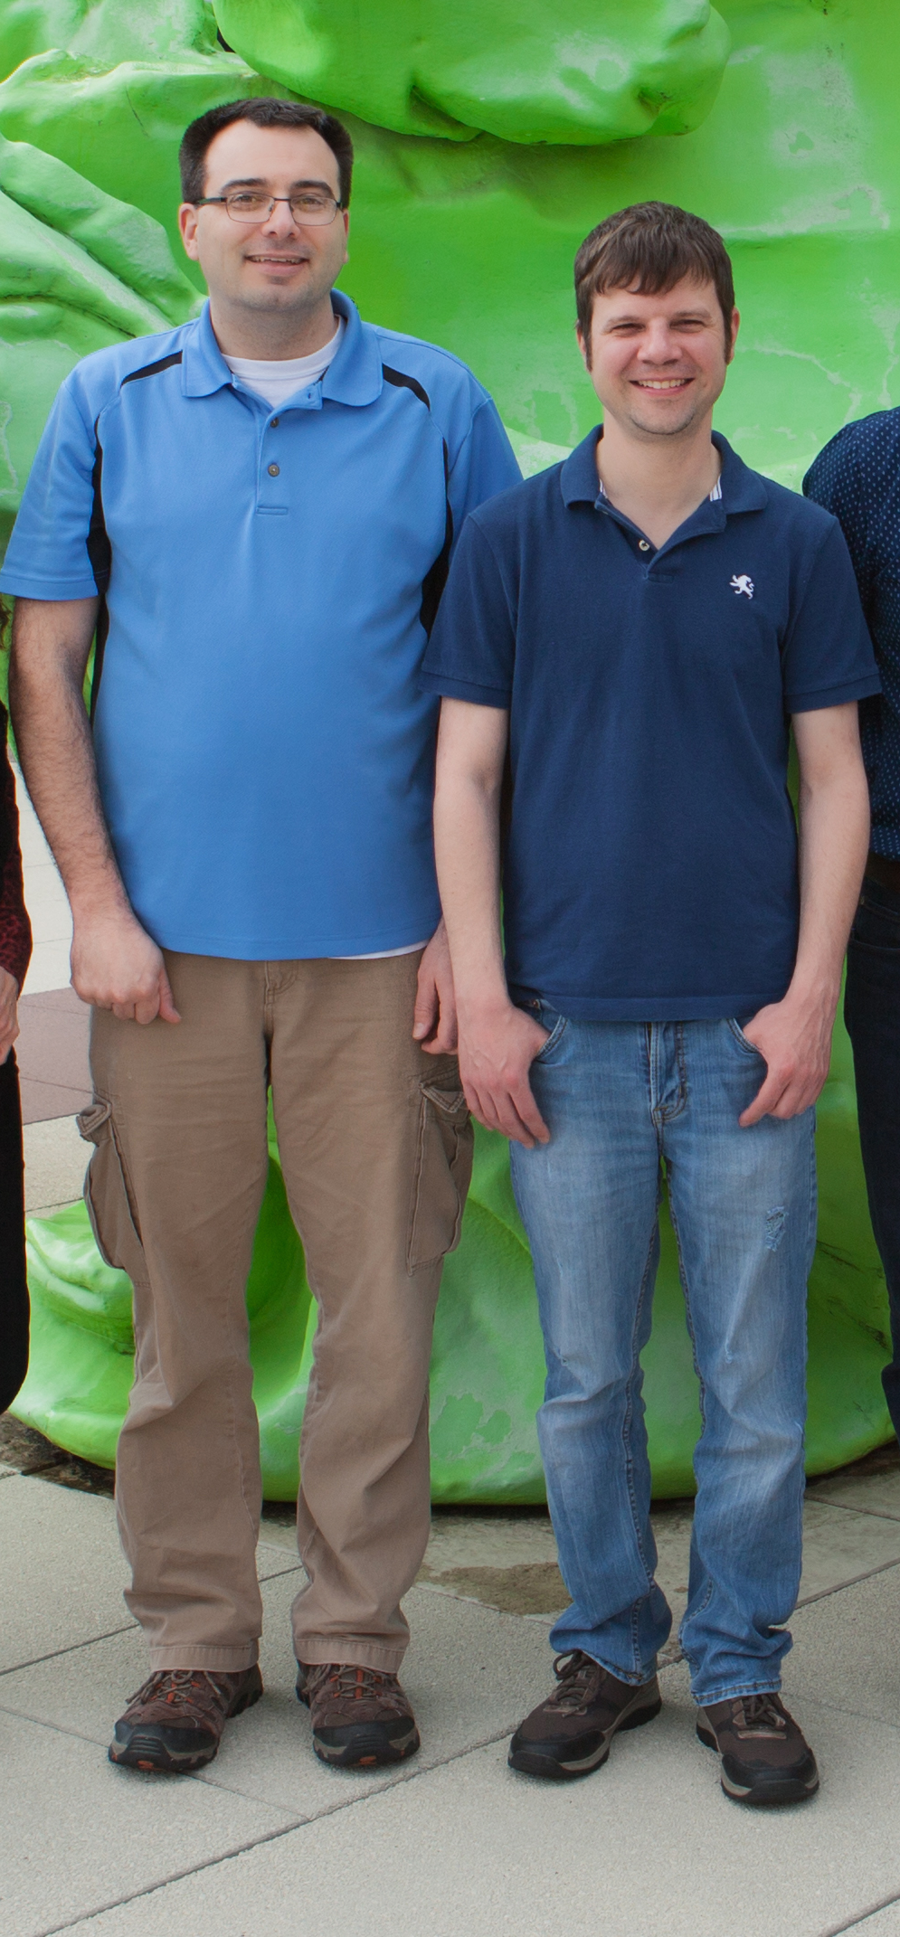
CNRG (Computer Network Resource Group)
Need help using Biocluster or need new software installed on it?
Contact CNRG at:
Help desk - help@igb.illinois.edu
CNRG website - https://help.igb.illinois.edu/
Notes:
Thanks

Slide 71
DNA Services Laboratory
  Director: Alvaro Hernandez Associate Director: Chris Wright
  aghernan@Illinois.edu clwright@Illinois.edu
  329 ERML 334 ERML
  217-244-3480 217-333-4372
  www.biotech.Illinois.edu/htdna

Slide 72
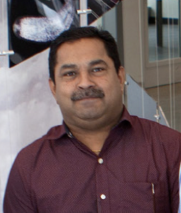
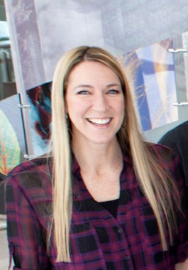
New CMtO Core lab in CBC:
Cytometry and Microscopy to Omics (CMtO)
  Led by Mayandi Sivaguru (Shiv), PhD., with specialist Kate Jaansen*
  Your existing CBC Flow Cytometry Core, plus:
    Assist with single cell / nuclei test counts (BigFoot cell sorter; K2)
    New BSL2 Cryostat and microtome for Visium workflow
    Custom configured Zeiss LSM980 microscopy system
Enables end-to-end CBC support, from CMtO to DNA Services
to HPCBio, for 10x Visium and single cell workflows!
https://biotech.illinois.edu/cmto

Slide 73
Thank you!

Slide 74
HPCBio workshop presentations are licensed under a Creative Commons Attribution-ShareAlike 4.0 International License.
This is a human-readable summary of (and not a substitute for) the license. Disclaimer.
You are free to:
Share — copy and redistribute the material in any medium or format
Adapt — remix, transform, and build upon the material
The licensor cannot revoke these freedoms as long as you follow the license terms.
Under the following terms:
Attribution — You must give appropriate credit, provide a link to the license, and indicate if changes were made. You may do so in any reasonable manner, but not in any way that suggests the licensor endorses you or your use.
ShareAlike — If you remix, transform, or build upon the material, you must distribute your contributions under the same license as the original.
No additional restrictions — You may not apply legal terms or technological measures that legally restrict others from doing anything the license permits.
Notices:
You do not have to comply with the license for elements of the material in the public domain or where your use is permitted by an applicable exception or limitation.
No warranties are given. The license may not give you all of the permissions necessary for your intended use. For example, other rights such as publicity, privacy, or moral rights may limit how you use the material.

