Slide 1
Knowledge-guided Algorithms in Systems Biology
KnowEnG BD2K Center
Slides by Charles Blatti and Amin Emad

Slide 2
Summary
Our goal in this lab is to use several pipelines of the KnowEnG platform to analyze ‘omic’ data sets and phenotypic spreadsheets
We will often try both network-guided and standard modes of operation for the pipelines (if applicable)
Other network-guided and systems biology analysis tools will also be introduced

Slide 3
More Specifically
The structure of this lab is laid out around 3 example datasets
It is focused on topics, methods, and types of networks from lecture
It uses browser-based analysis platforms
Data Sets | Somatic Mutations from Pan-Cancer | Drug Response in Cancer Cell Lines | ER+ Status in Breast Cancer
Topics | Sample Clustering | Gene Prioritization | Gene Expression Signatures, Gene Set Characterization
Methods | Network Based Stratification | ProGENI | GeneMANIA, DRaWR,
Networks | Integrated | Protein-Protein Interactions | Pathways, Integrated
Platforms | KnowEnG | KnowEnG | iLINCS, GeneMANIA, KnowEnG
3

Slide 4
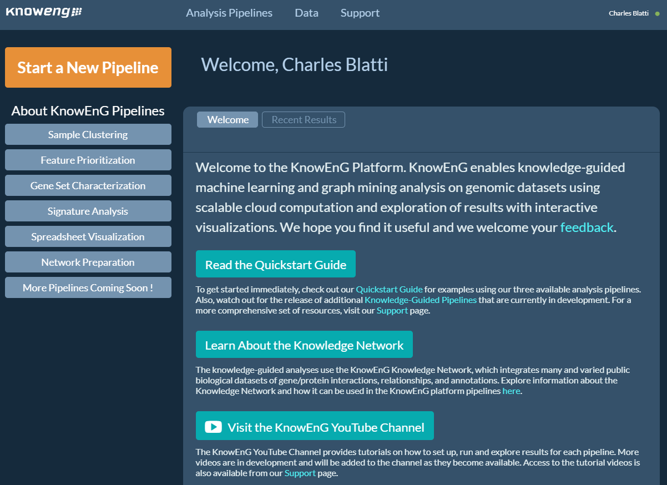
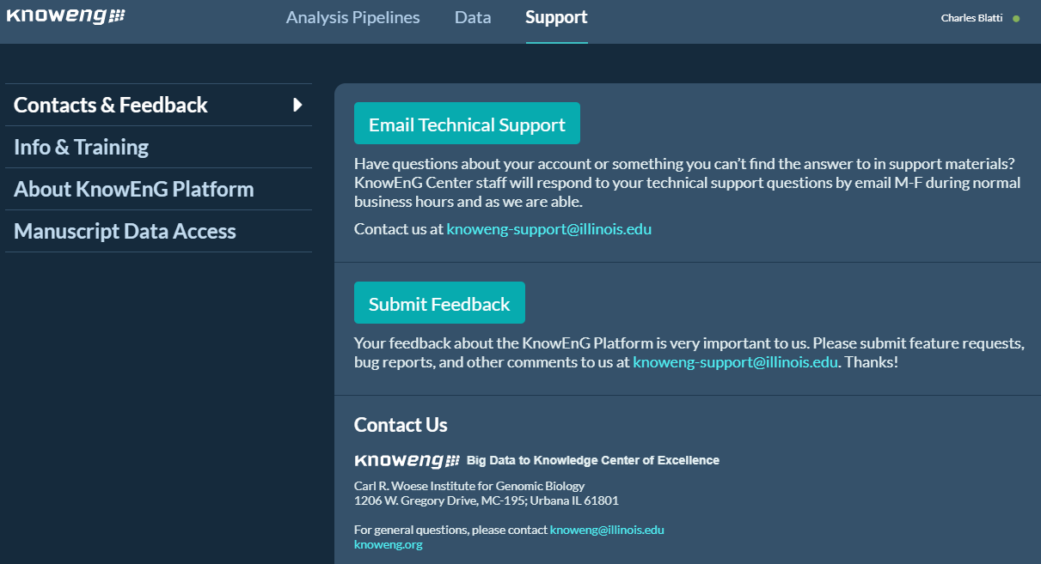
Some Notes on the KnowEnG Platform
The home page has links to many resources
The “Support” tab at the top has even more resources
Scalable platform using AWS cloud, but requires some waiting
Right before launch, carefully match Job summaries to slide stills to avoid errors

Slide 5
STEP 0A: Start the VM
Follow instructions for starting VM. (This is the Remote Desktop software.)
The instructions are different for UIUC and Mayo participants.
Find the instructions for this on the course website under Lab Set-up:
https://publish.illinois.edu/compgenomicscourse/2023-schedule/

Slide 6
Step 0: Local Files
For viewing and manipulating the files needed for this laboratory exercise, the path on the VM will be denoted as the following:
[course_directory]
We will use the files found in: [course_directory]\07_Signatures_and_Characterization -and- [course_directory]\08_Clustering_and_Prioritization
[course_directory]= Desktop\VM

Slide 7
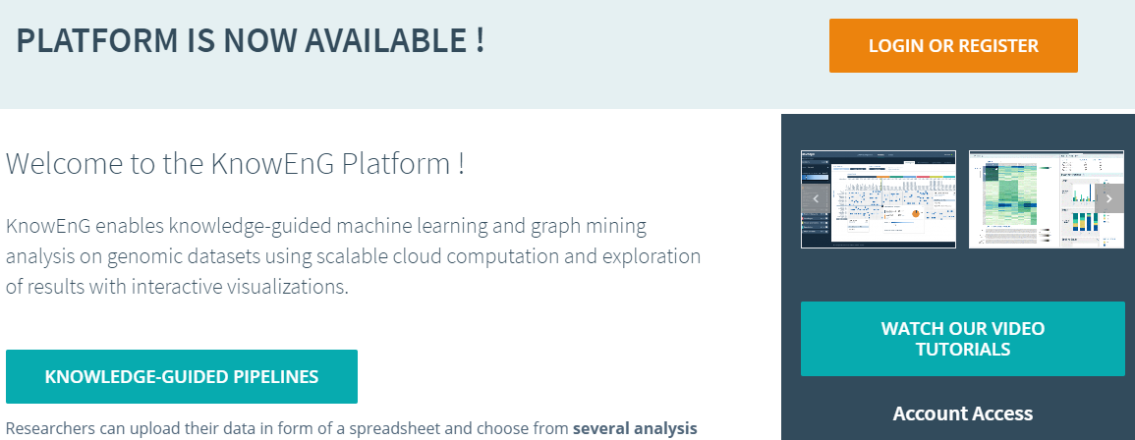
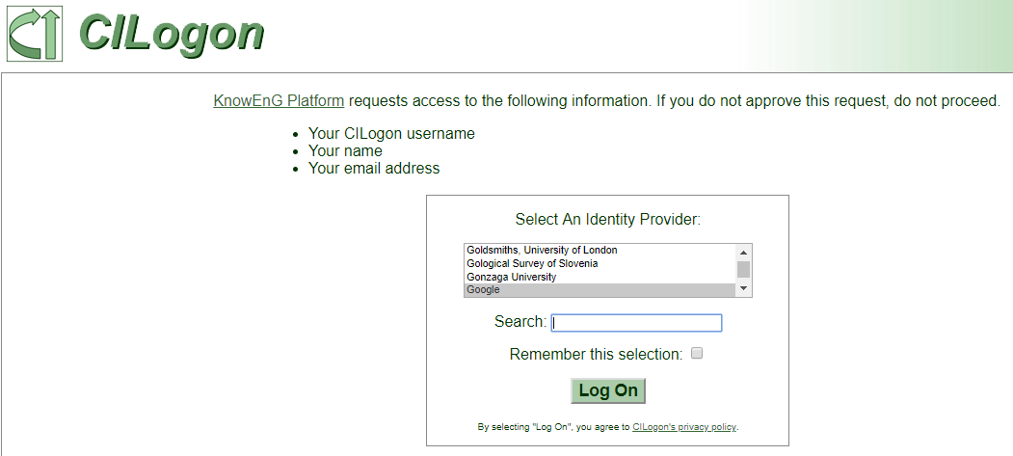
STEP 1: Sign Into KnowEnG Platform
Go to the KnowEnG Platform: https://knoweng.org/analyze/
Click “Login or Register”
Login with CILogon - Login service using your other existing accounts
Search for identity provider: Urbana, Mayo, Google, GitHub

Slide 8
Finding Cancer Subtypes with Knowledge Guided Clustering
In this exercise, we will use a subset of somatic mutation data samples from the Cancer Genome Atlas (TCGA) and cluster them into different cancer subtypes.

Slide 9
STEP 2: Sample Clustering
We will use KnowEnG’s clustering pipeline to perform both network-guided as well as standard clustering of samples
The network-guided clustering implemented in KnowEnG is inspired by the network-based stratification approach:
We will use some of the samples from the TCGA pancan12 dataset

Slide 10
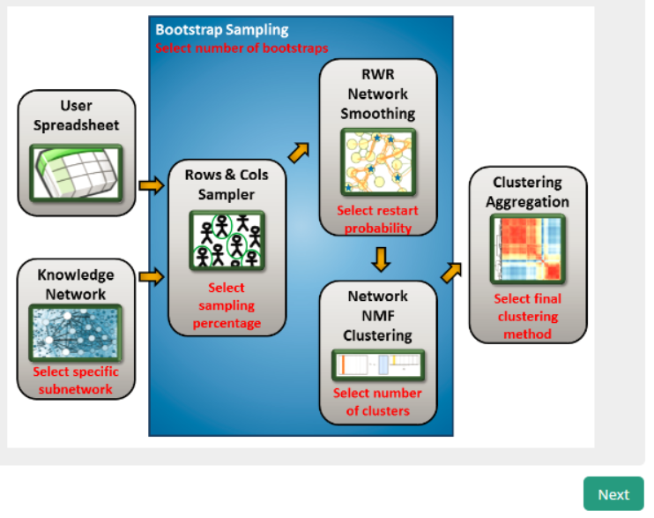
STEP 2: Sample Clustering
Overview of KnowEnG’s Network-based Stratification for Samples:

Slide 11
STEP 2: Sample Clustering
Find the files in this slide under [course_directory]/08_Clustering_and_Prioritization
Dataset characteristics:
Name | Description
Demo2_Mutation_pancan12_30 | A matrix of (gene x samples) containing the somatic mutation status of ~15k protein coding genes in 360 tumor samples from 12 cancer types.
Demo2_Clinical_pancan12_30 | A matrix of (samples x clinical phenotypes) including primary disease, PANCAN consensus cluster, survival years, etc.

Slide 12
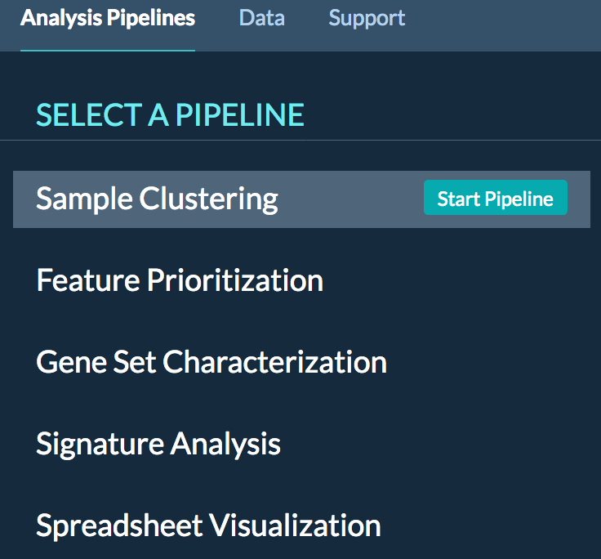
STEP 2A: Sample Clustering (standard)
Select the pipeline:
Once logged into the KnowEnG Platform
Select “Analysis Pipelines” at the top of the page
Select “Sample Clustering” and Click on “Start Pipeline”

Slide 13
STEP 2A: Sample Clustering (standard)
Find the files for this under [course_directory]/08_Clustering_and_Prioritization
Upload the data:
Click on “Upload New Data”
Click “BROWSE” and find the files to upload:
- Demo2_Clinical_pancan12_30
- Demo2_Mutation_pancan12_30.tsv

Slide 14
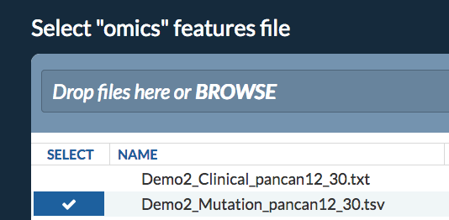
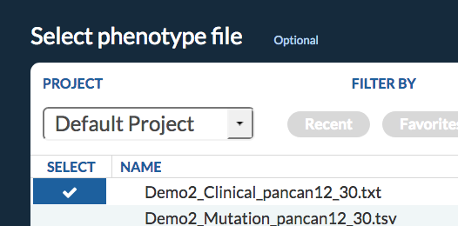
STEP 2A: Sample Clustering (standard)
Configure the pipeline:
For the “omics” file select:
Demo2_Mutation_pancan12_30.tsv
Click “Next” at the bottom right corner
For the “phenotype” file select:
Demo2_Clinical_pancan12_30.txt
Click “Next” at the bottom right corner

Slide 15
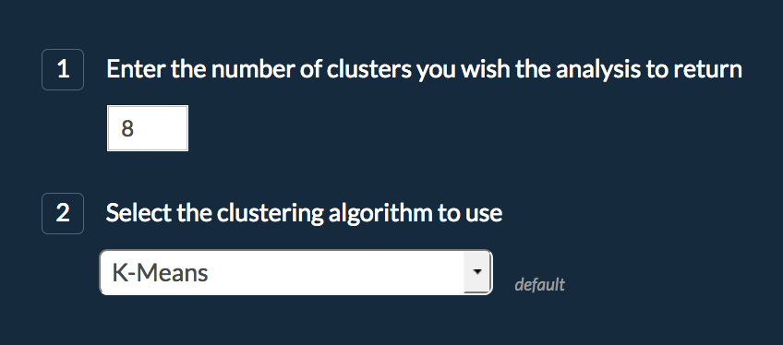
STEP 2A: Sample Clustering (standard)
Select “No” in response to using the knowledge network:
This allows us to perform standard clustering on the data
Click on "Next" at the bottom right corner
Choose 8 as number of clusters
This is what was found as optimal in the TCGA paper
We will use the default “K-Means” clustering algorithm
Click on “Next” at the bottom right corner

Slide 16
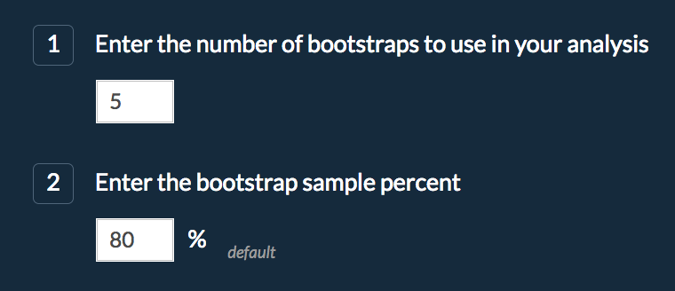
STEP 2A: Sample Clustering (standard)
Select “Yes” in response to using bootstrap sampling:
This allows us to obtain a more robust final clustering
Choose 5 as number of bootstraps.
This is unusually low for the purposes of quicker completion
We will use the default 80% rate to sample the data in each bootstrap
Click on “Next” at the bottom right corner

Slide 17
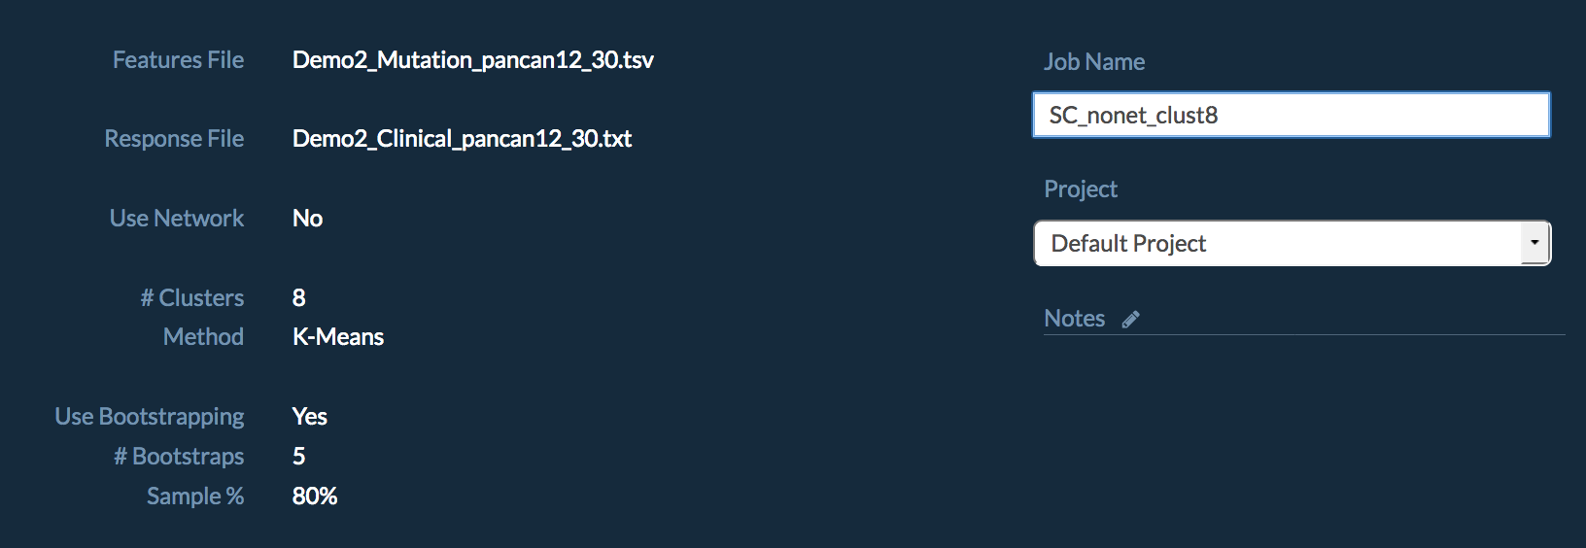
STEP 2A: Sample Clustering (standard)
Review the summary of the job and change the default “Job Name” to easily recognize later
Submit the job
The job will run for several minutes, so we will return to the results after launching the next job

Slide 18
STEP 2B: Sample Clustering (network-guided)
Now we are going to repeat the analysis using a knowledge network to provide richer information about the similarity between the sparse mutation samples. Nearly all steps will be the same as before.
Select the pipeline:
Select “Analysis Pipelines” at the top of the page on the same webpage
Select “Sample Clustering” and Click on “Start Pipeline”

Slide 19
STEP 2B: Sample Clustering (network-guided)
Configure the pipeline:
For the “omics” file select:
Demo2_Mutation_pancan12_30.tsv
Click “Next” at the bottom right corner
For the “phenotype” file select:
Demo2_Clinical_pancan12_30
Click “Next” at the bottom right corner

Slide 20
STEP 2B: Sample Clustering (network-guided)
This is different from the previous run.
Select “Yes” in response to using the knowledge network:
This allows us to perform network-guided clustering
Keep the species as “Human”
Select “HumanNet Integrated Network” as the network
This is a network that creates scores pairwise interactions of gene by combining many different types of gene relationships
Keep network smoothing at 50% and click Next:
This controls how much importance is put on network connections instead of the somatic mutations

Slide 21
STEP 2B: Sample Clustering (network-guided)
Choose 8 as number of clusters and click Next
Select “Yes” in response to using bootstrap sampling:
Choose 5 as number of bootstraps
We will use the default 80% rate to sample the data in each bootstrap
Click "Next"

Slide 22
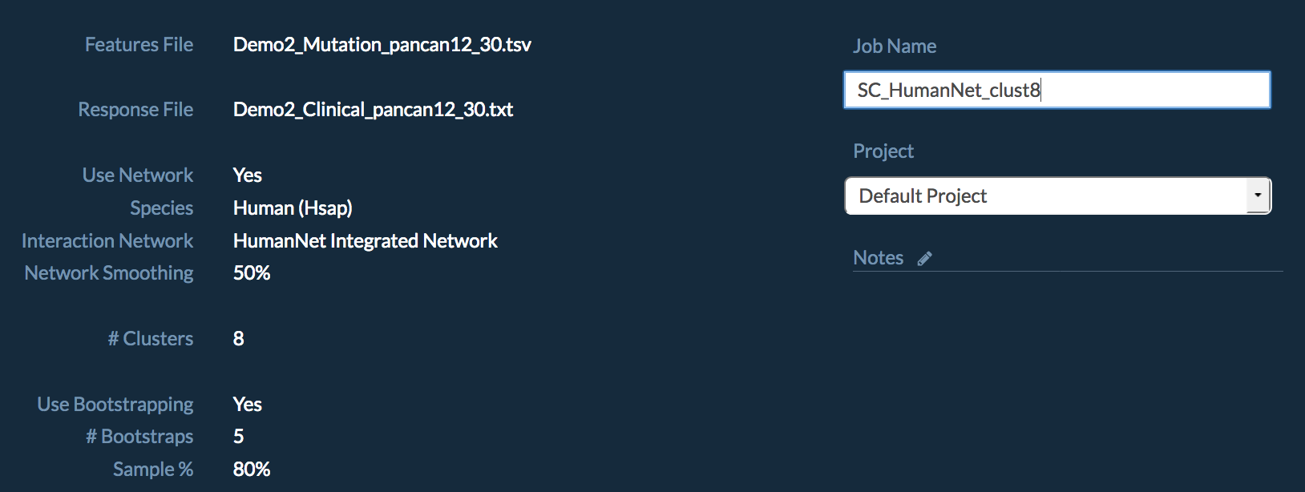
STEP 2B: Sample Clustering (network-guided)
Review the summary of the job and change the default “Job Name” to easily recognize later
Press Submit Job

Slide 23
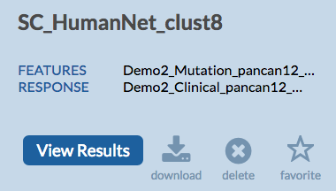
STEP 2C: Standard Clustering Results
Go to the “Data” page:
Select “SC_nonet_clust8” (or other name you chose for the first run)
Select “View Results” at the top right corner
The option to view results will not be available if
The job is still running:
There was an error:
If there’s an error, try repeating the launch steps

Slide 24
STEP 2C: Standard Clustering Results
Visualization shows the cluster sizes and the match of the samples to the cluster (silhouette_score)
Heatmap shows genes x samples – significantly correlated mutations

Slide 25
STEP 2C: Standard Clustering Results
Heatmap also shows samples x samples co-occurrence
The color of each cell indicates how frequently a pair of patients fell within the same cluster across all samplings

Slide 26
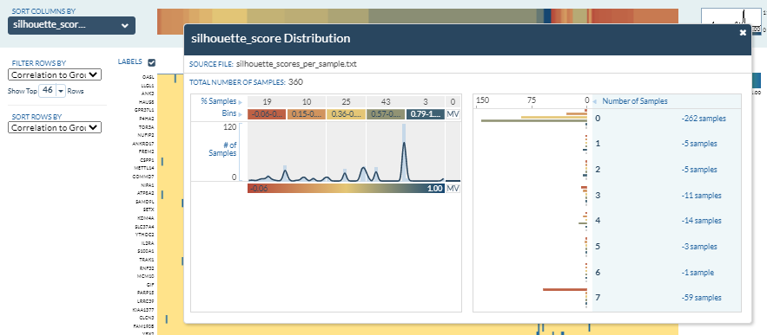
STEP 2C: Standard Clustering Results
Click on the silhouette_score Distribution colorbar.
The Number of Samples per cluster show high degree of clustering bias. 262 of the 360 samples are in Cluster 0
Close the Distribution panel with the ‘X’ in the top corner

Slide 27
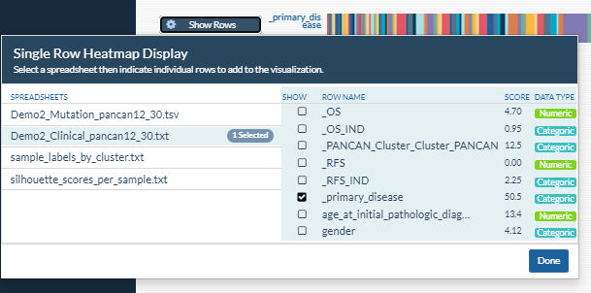
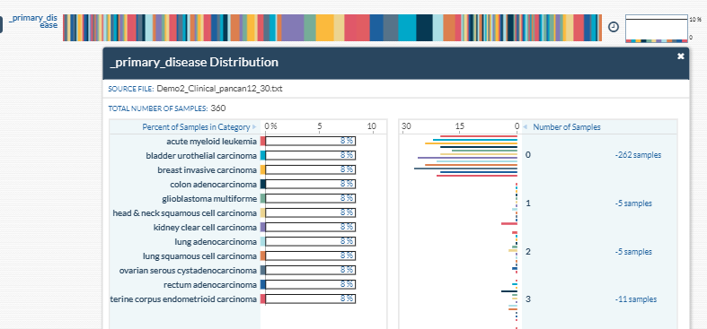
STEP 2C: Standard Clustering Results
You can add a phenotype to compare to the clustering at the very bottom of the page
click “Show Rows”,
the name of the clinical file, “Demo2_Clinical_pancan12_30.txt”,
and select an interesting phenotype, like the “_primary_disease” type,
and click “Done”
This color bar shows the original primary tumor (_primary_disease) types. Click on the colorbar to show which cancer types are present in which clusters

Slide 28
STEP 2D: Network Clustering Results
Go to the “Data” page:
Select “SC_HumanNet_clust8” (or any other name you chose)
Select “View Results” at the top right corner

Slide 29
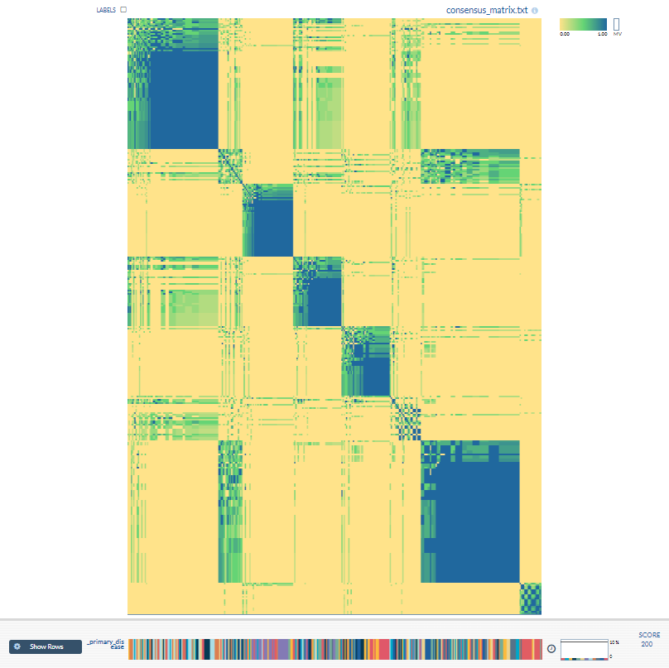
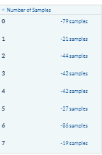
STEP 2D: Network Clustering Results
As you can see from the sample distribution and the co-occurrence matrix, the network-guided approach provided a more balanced clustering

Slide 30
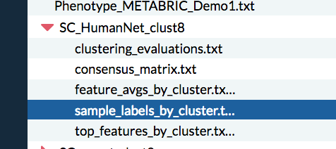
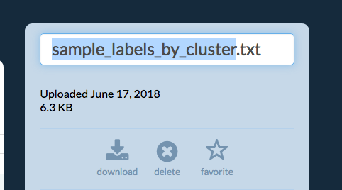
STEP 2E: Compare in Spreadsheet Visualizer
To Prepare the Files:
Go to the “Data” page
Click on triangle by “SC_HumanNet_clust8” (or any other name you chose)
Select “sample_labels_by_cluster.txt” results file of the network run
Click on the name at the right top corner to edit and add “_HumanNet” to the end
Repeat the same for the file in “SC_nonet_clust8” and add “_nonet” to the end

Slide 31
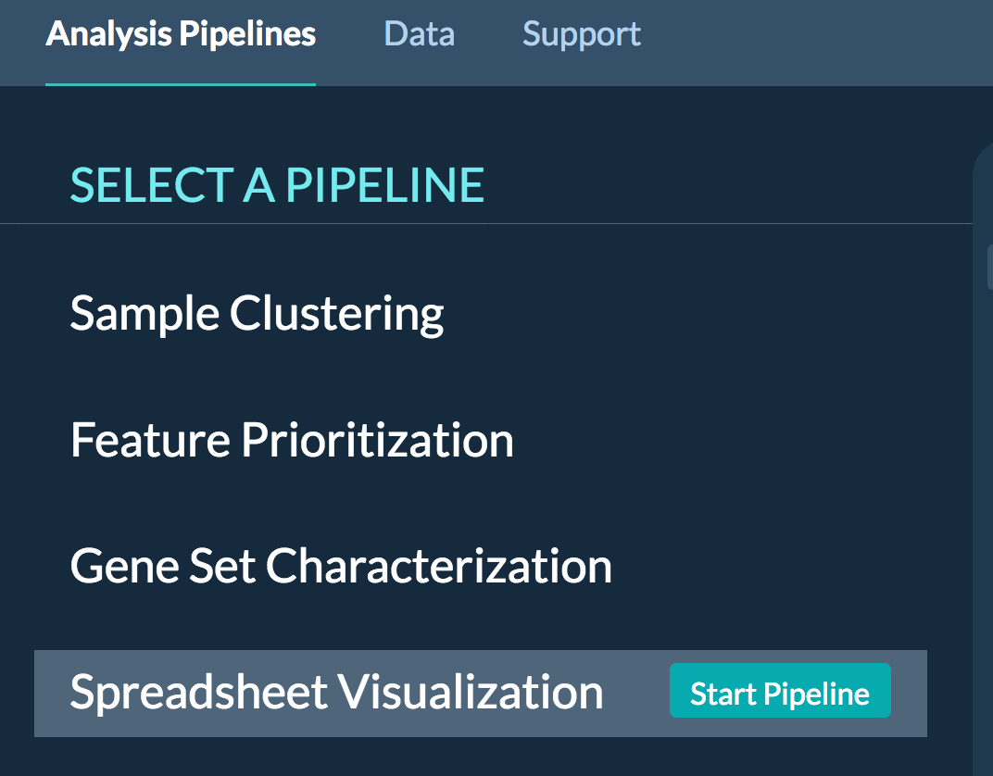
STEP 2E: Compare in Spreadsheet Visualizer
Let’s compare the two runs in KnowEnG’s Spreadsheet Visualization Tool
Select “Analysis Pipelines”
Select “Spreadsheet Visualization” and Click on “Start Pipeline”

Slide 32
STEP 2E: Compare in Spreadsheet Visualizer
Select these four files to evaluate simultaneously and press Next:
Check the summary and change the job name if you like. Press Submit Job.

Slide 33
STEP 2E: Compare in Spreadsheet Visualizer
The results:
Select “Go to Data Page”
Select the job you just ran
Then “View Results”

Slide 34
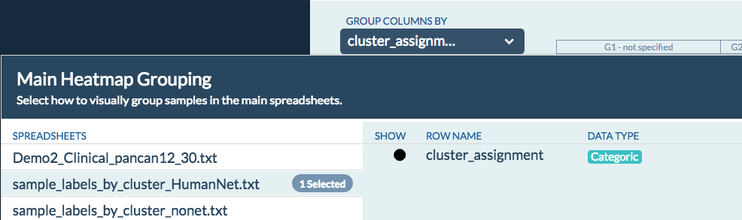
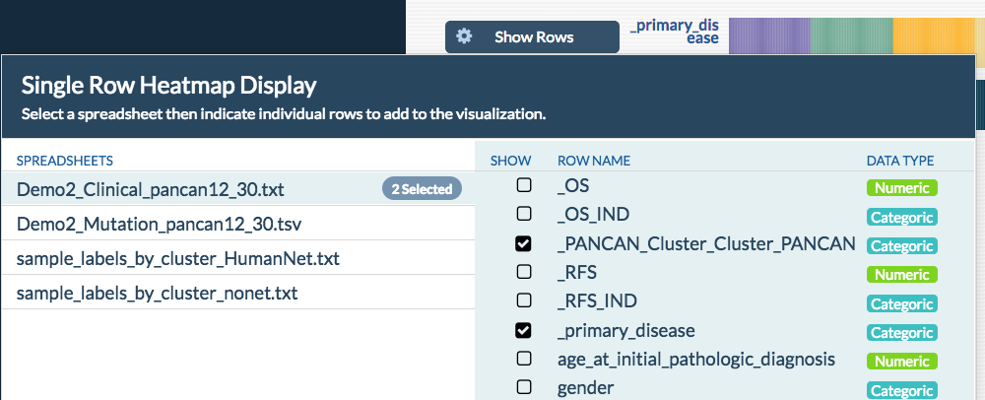
STEP 2E: Compare in Spreadsheet Visualizer
In the “Group Columns By” drop down click the “sample_labels_by_cluster_HumanNet.txt” network-guided clustering results file; then select “cluster_assignment”
Click "Done"
By clicking on “Show Rows” at the very bottom of the page add the colorbars
“_primary_disease” and “_PANCAN_Cluster_Cluster_PANCAN” from “Demo2_Clinical_pancan12_30.txt” clinical data
and “cluster_assignment” from the “sample_labels_by_cluster_noNet.txt” standard clustering results file
Click "Done"

Slide 35
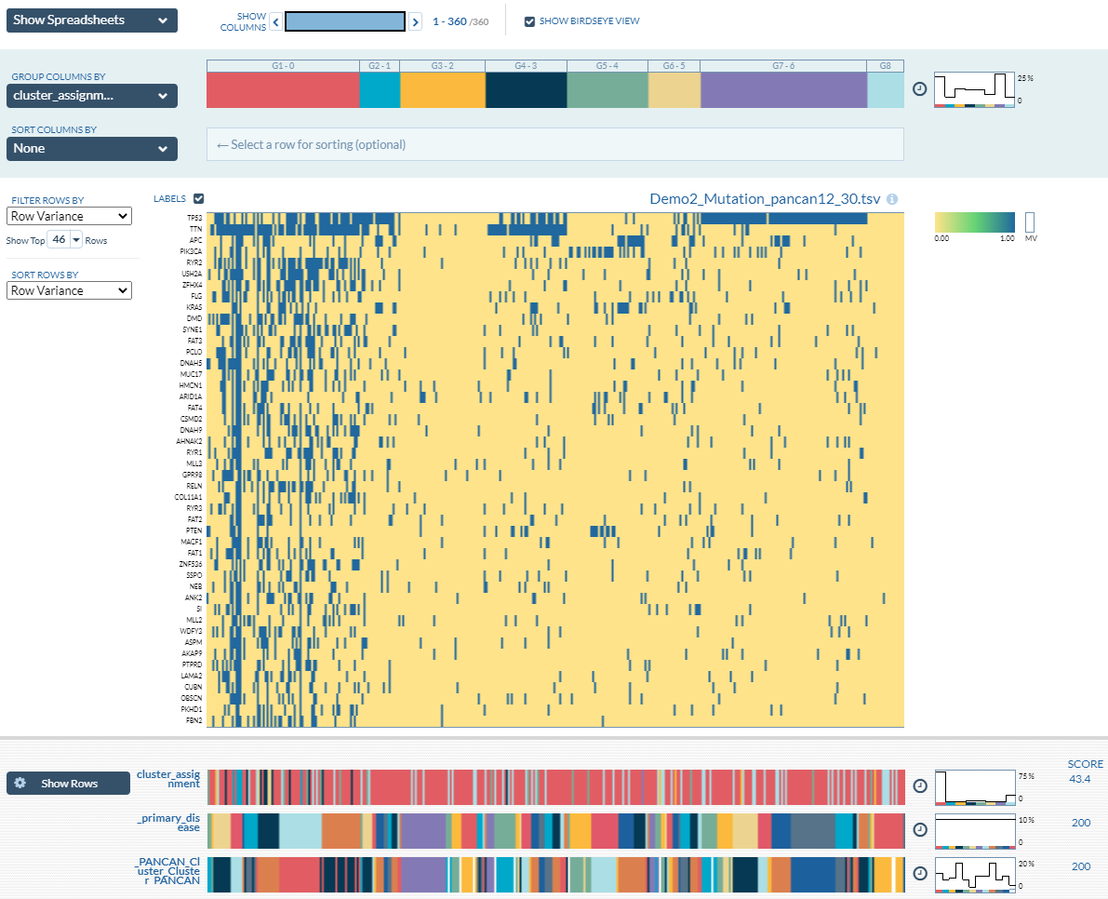
STEP 2E: Compare in Spreadsheet Visualizer
You can use this tool to explore top genes, draw Kaplan Meier curves, etc.

Slide 36
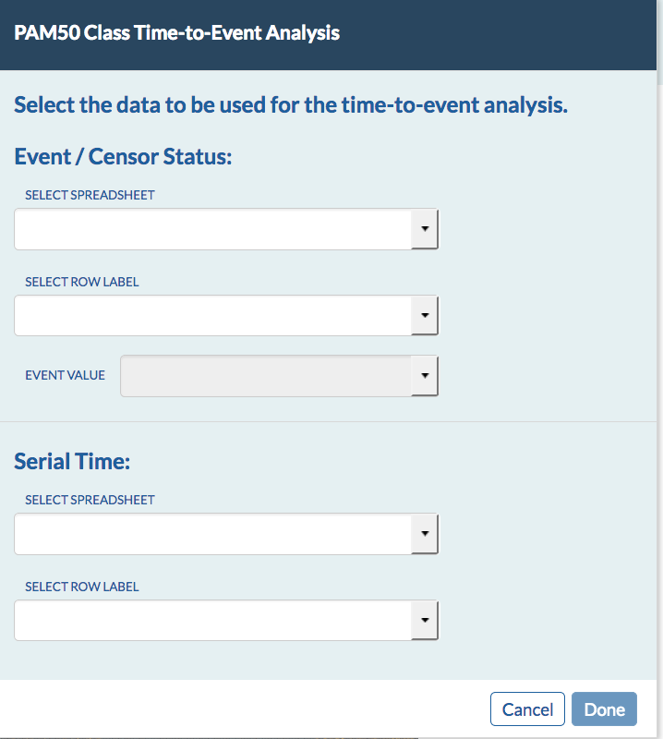
STEP 2E: Compare in Spreadsheet Visualizer
Click on the clock sign to perform Kaplan Meier survival analysis using the selected network-guided cancer subtypes
Use this table to configure Kaplan Meier analysis by selecting the events and time to events

Slide 37
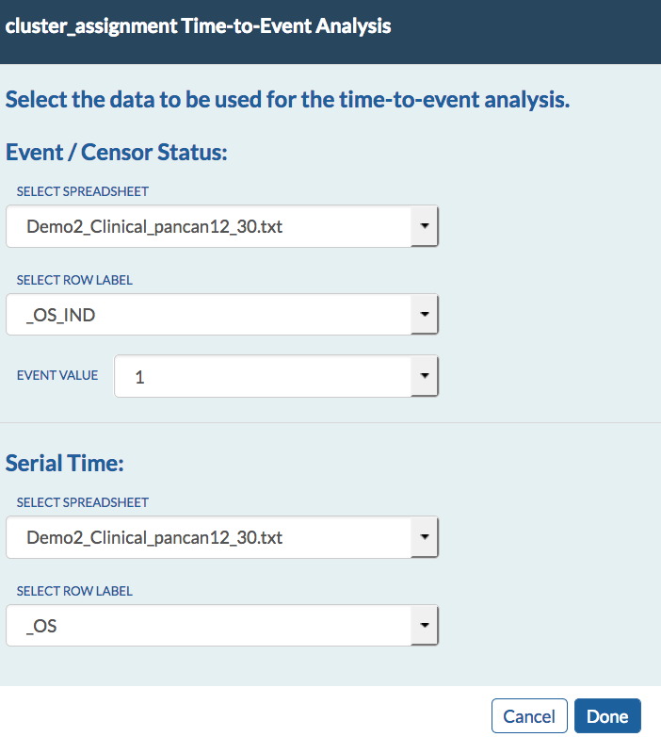
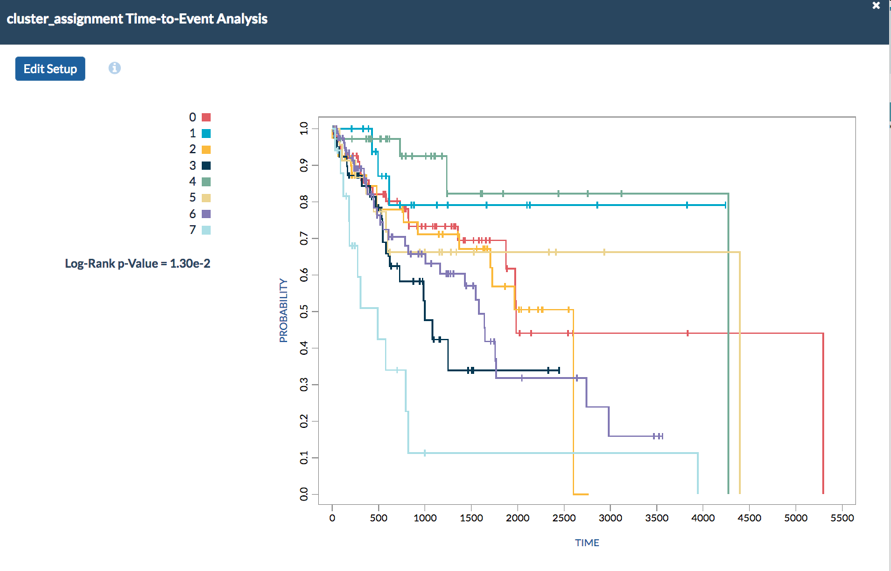
STEP 2E: Compare in Spreadsheet Visualizer
Select the parameters below and press Done to see Kaplan Meier curves of clusters identified using HumanNet network

Slide 38
Finding Genes Correlated with Drug Response
In this exercise, we will use cell line gene expression data and cytotoxicity experiments with knowledge-guided methods to find genes that may predict drug response.

Slide 39
STEP 3: Feature (Gene) Prioritization
We will use KnowEnG’s gene prioritization pipeline to perform network-guided feature (gene) prioritization
The network-guided gene prioritization implemented in KnowEnG is a method called ProGENI:
We will use samples from the Cancer Cell Line Encyclopedia (CCLE)

Slide 40
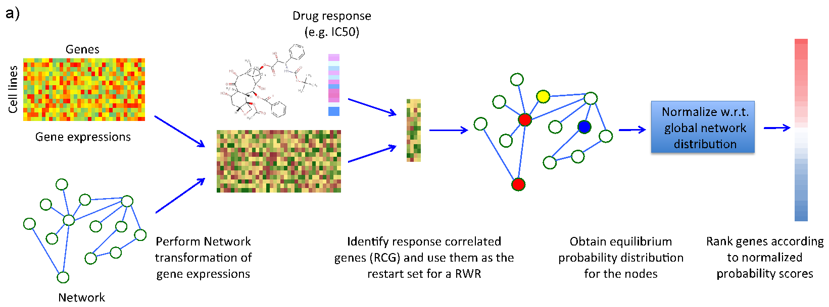
STEP 3: Gene Prioritization
Outline of ProGENI:

Slide 41
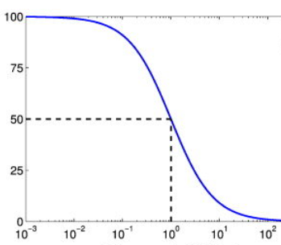
STEP 3: Gene Prioritization
Find the files in this slide under [course_directory]/08_Clustering_and_Prioritization
Dataset characteristics:
Name | Description
demo_FP.genomic | A matrix of (gene x samples) containing the expression of ~17k genes in ~500 cell lines. The expression profiles are normalized in advance.
demo_FP.phenotypic | A matrix of (samples x drugs) containing IC50 values for 24 cytotoxic treatments.
Inhibition
Concentration

Slide 42
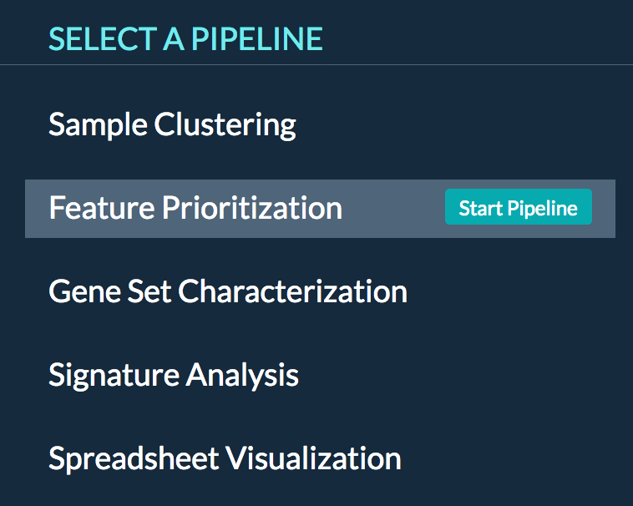
STEP 3A: Gene Prioritization (network-guided)
Select the pipeline:
Select “Analysis Pipelines” at the top of the page
Select “Feature Prioritization” and Click on “Start Pipeline”

Slide 43
STEP 3A: Gene Prioritization (network-guided)
Configure the pipeline:
For the “omics” file select “Use Demo Data”
Click “Next” at the bottom right corner
For the “response” file select “Use Demo Data”
Click “Next” at the bottom right corner

Slide 44
STEP 3A: Gene Prioritization (network-guided)
Select “Yes” in response to using the knowledge network:
This allows us to perform network-guided prioritization (ProGENI)
Keep the species as “Human”
Select “STRING Experimental PPI” as the network
This network connects genes by the physical protein-protein interactions between their corresponding proteins
Keep network smoothing at 50%:
This controls how much importance is put on network connections instead of the correlation with drug response
Click “Next”

Slide 45
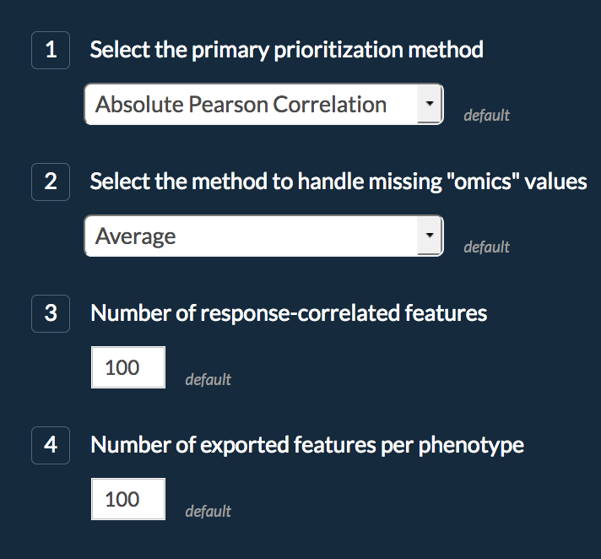
STEP 3A: Gene Prioritization (network-guided)
Keep the default parameters on this page
Choose “No” for bootstrapping
Used for continuous-valued response
Size of RCG set

Slide 46
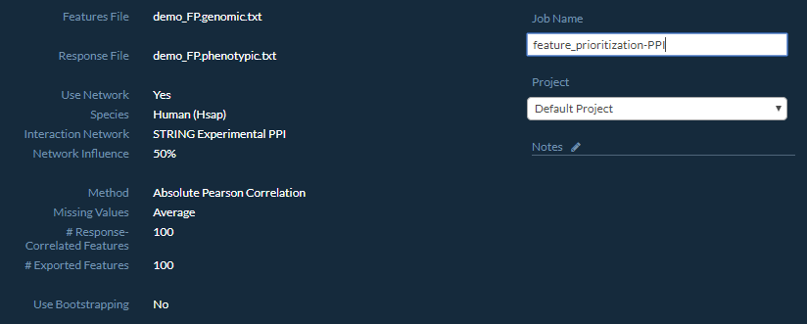
STEP 3A: Gene Prioritization (network-guided)
Review the summary of the job and change its name if you like
Submit the job

Slide 47
STEP 3A: Gene Prioritization (network-guided)
Note: If you ever want to view your data or results outside of the KnowEnG system, just go to the Data page, click on the file or run, and select “download” on the far right panel.
Reminder: The option to view results will not be available if
The job is still running:
There was an error:
If there’s an error, repeat the launch steps and check your job summary matches exactly
This job takes about five minutes, so you are welcome to skip ahead and start Step 4 on slide 55 and come back later to finish Step 3

Slide 48
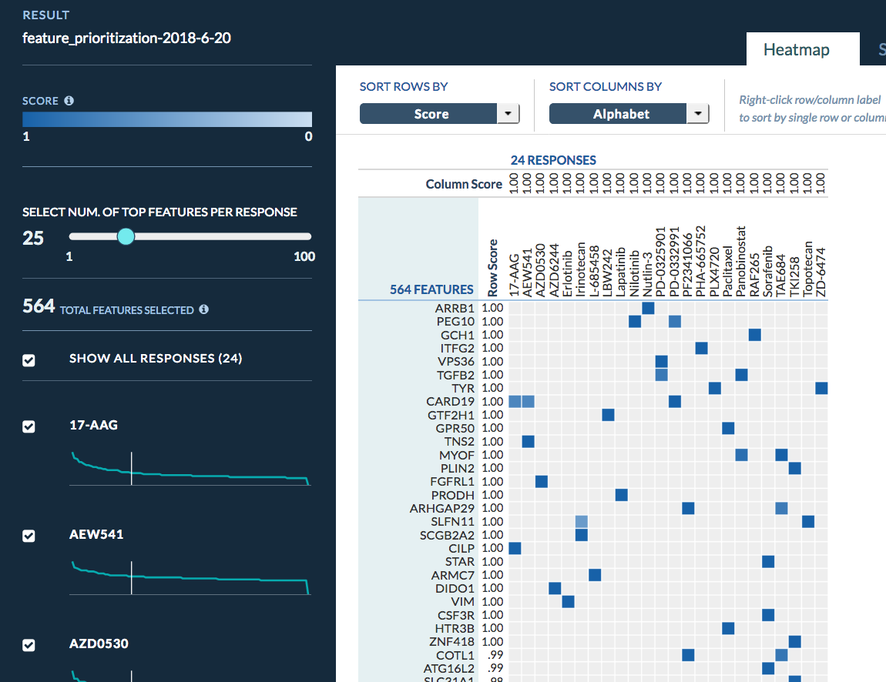
STEP 3A: Gene Prioritization (network-guided)
Go to the Data page
Select “View Results” when the job is done
Heatmap shows the top gene rows identified for each drug column

Slide 49
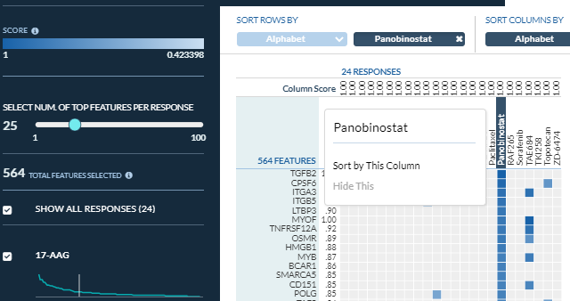
STEP 3A: Gene Prioritization (network-guided)
You can “right-click” on a drug column name to sort rows and see its top genes
You can also sort columns by a gene to see drugs for which the gene was among the top list
Panobinostat (HDAC inhibitor) prevents chromatin formation which is tied to the transforming growth factor beta signaling pathway (TGFβ2 is top result).

Slide 50
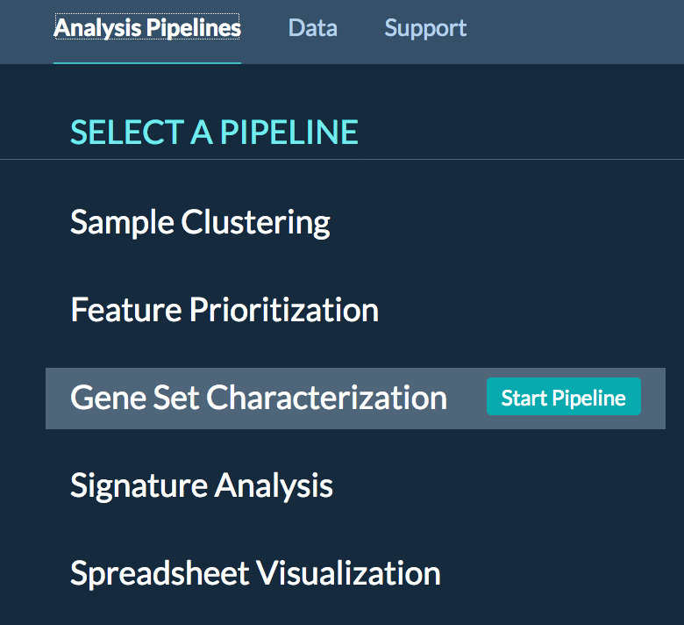
STEP 3B: Gene Prioritization (network-guided)
Let’s see the enrichment of the top genes in different Gene Ontology (GO) terms
Go to “Analysis Pipelines” page
Select “Gene Set Characterization” pipeline

Slide 51
STEP 3B: Gene Prioritization (network-guided)
Select the green triangle by the gene prioritization job you ran
Select “top_features_per_phenotype_matrix” which contains the ProGENI top gene lists for each of the 24 drugs
Press Next

Slide 52
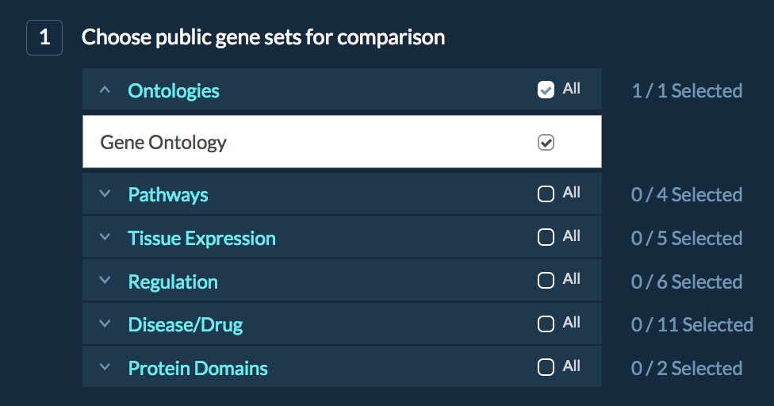
STEP 3B: Gene Prioritization (network-guided)
For gene sets, select your gene sets of interest (e.g. GO) and press Next
Say “No” to using the knowledge network (we will do that later) and press Next. Then press Submit Job.
This job should take about one minute.

Slide 53
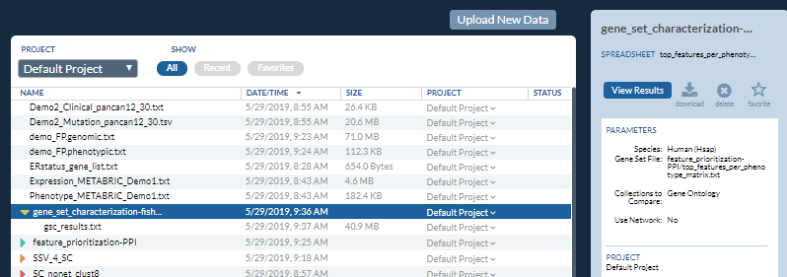
STEP 3B: Gene Prioritization (network-guided)
The Gene Ontology enrichment results:
Select “Go to Data Page”
Select the job you just ran
Then “View Results”

Slide 54
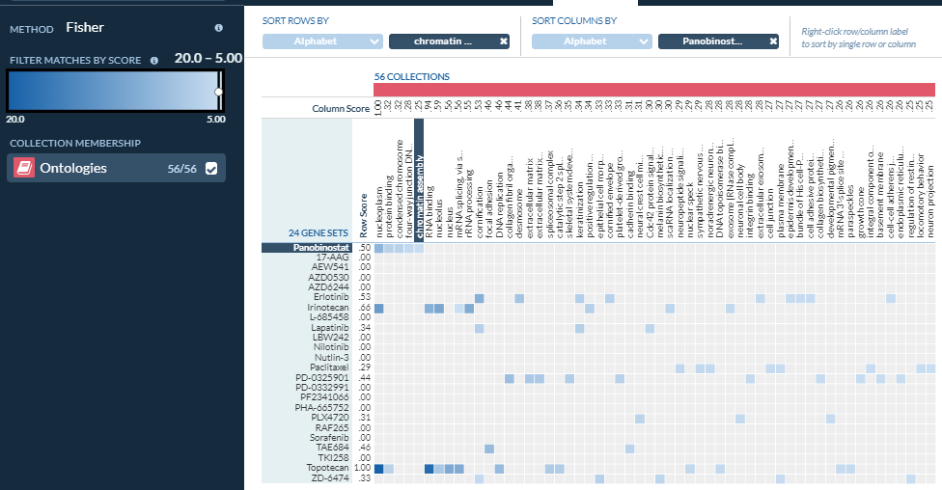
STEP 3B: Gene Prioritization (network-guided)
This page shows the enriched GO gene sets for each drug to gene list
You can change the filter (scores represent –log10 (p-value) of enrichment) to see fewer or more enriched gene sets
The network-guided genes whose expression correlated with the response to Panobinostat are enriched with terms related to chromatin assembly

Slide 55
Creating a Novel Gene Expression Signature
In this exercise, we will use the integrative iLINCS data portal to extract gene expression data from TCGA Breast Invasive Carcinoma (BRCA) samples and build a gene signature based on the estrogen receptor status.

Slide 56
Step 4: Perturbagen and Disease Datasets
Open your web browser and go to the iLINCS data portal: http://www.ilincs.org/ilincs/
This portal, curated by the LINCS Data Coordination and Integration Center, contains transcriptomic and proteomic datasets from the many LINCS affiliated projects, including the LINCS L1000 assay. It also contains several other large public datasets of perturbations to cell lines and samples of disease.
We will define a custom gene signature from TCGA data and see how it can be used in various network related analyses.

Slide 57
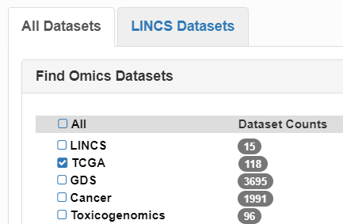
Step 4A: Select Breast Cancer Dataset
Click on “Datasets” in the header
In the “All Datasets” tab, for Choose Dataset, select only the TCGA datasets
Scroll down and enter “919” on the Description box to find “919 mRNA-seq breast invasive carcinoma (BRCA) samples from TCGA project” by Collins, et al. Click “Analyze”.

Slide 58
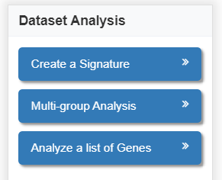
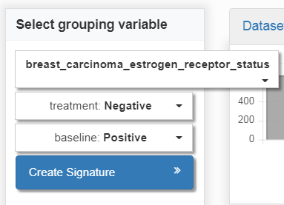
Step 4B: Creating a Novel Gene Signature
Click on “Create a Signature”
In “Select grouping variable” dropdown select “breast_carcinoma_estrogen_receptor_status”
In “Select treatment group” dropdown select “Negative”
In “Select baseline group” dropdown select “Positive”
Finally, click on “Create Signature” button

Slide 59
Step 4B: Our ER Status Gene Signature
When the signature is calculated, a quick summary of the number of samples from each group is presented in the “Signature Info” tab
Next, we will look more closely at the genes involved in our signature.

Slide 60
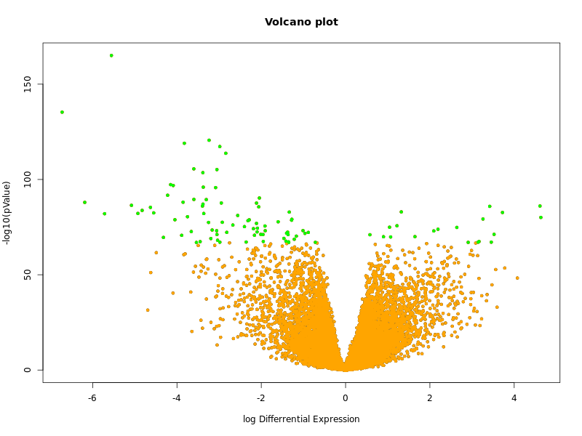
Step 4C: Examining Gene Expression of our Signature
To get statistics about how the signature is defined, we will select “Modify the list of selected genes” on the left
We are presented with a volcano plot for the log fold change (x-axis) and differential expression significance (y-axis) of each gene.
The green genes are the ones included in the gene expression signature.
They have a log Differential Expression of at least +/- 0.6 and significance p-value less than 10^-60.

Slide 61
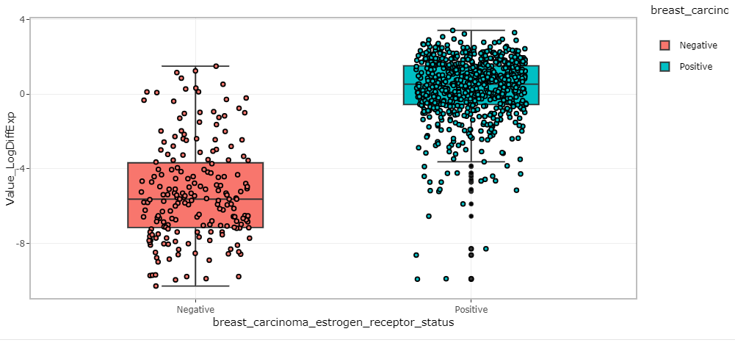
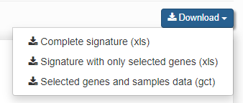
Step 4C: Examining Gene Expression of our Signature
Click the “Signature Data” tab and “Show selected genes” to see the list of selected signature genes
Note that ESR1, estrogen receptor 1, is the most significantly differentially expressed gene, which is consistent with the immunohistochemical staining assay result that defined the positive and negative groups. Click on the plot icon on the right to see ESR1’s measured gene expression values.
Because of the number of samples (868) is high, the differential expression p-values are very significant for these top signature genes
You can click the “Download ” button on the top right of the website and save “Signature with only selected genes” table as an Excel file if you want to save the details of the 100 selected genes. We will use part of this file later.

Slide 62
Discovering Pathways Related to Our Gene Signature
In this section, we will consider some of the characterization resources that are available for gene signatures and gene sets.

Slide 63
Step 5: Standard Gene Set Enrichment
Back in iLINCS, the “Analysis Results” tab which contains many different methods for analyzing our novel ER status gene signature.
Two of the tools listed are links to Enrichr and DAVID.
Both tools use standard statistical enrichment tests to examine the overlap of the 100 genes of our ER status gene signature with Gene Ontology term annotations, pathways, and other gene sets.
These tools output the results in slightly different ways, so you may want to explore them in your own time.

Slide 64
Step 5B: GeneMANIA
Return to the analysis result by clicking on “Differential Expression Signature” in the tool bar at the top
The last linked tool we will explore today from iLINCS is GeneMANIA.
GeneMANIA is a network-based guilt-by-association algorithm that finds the network neighbors of an input gene set from a heterogeneous collection of interaction networks
Go to https://genemania.org/

Slide 65
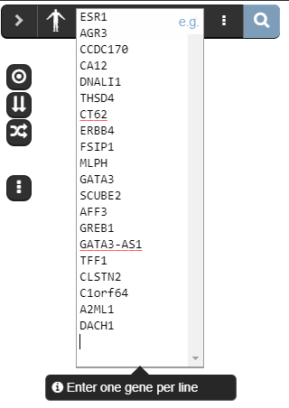
Step 5B: GeneMANIA
We are going to enter the top 20 differentially expressed genes from our ER status gene signature. We will use GeneMANIA to return 20 additional network neighbor genes (not necessarily differentially expressed themselves)
Then we will look at functional enrichment of this combined set of 40 genes.
Find, open in a editor, and copy the contents of the file: [course_directory]/07_Signatures_and_Characterization/ERstatus_top20.txt
This is the top 20 differentially expressed genes of our ER status signature extracted from the “Name_GeneSymbol” column in the Excel download
Paste this list into the text box at the top left corner of the main page. Make sure to delete any previous list in the text box.

Slide 66
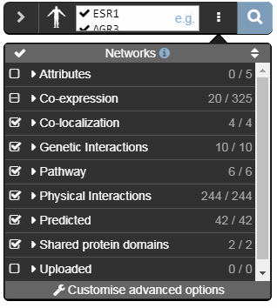
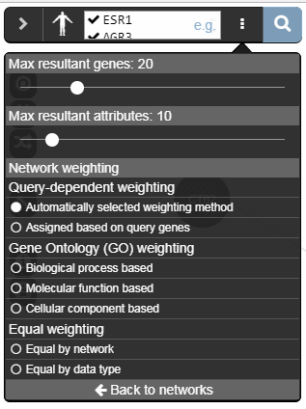
Step 5B: GeneMANIA
Click on the stacked-dots options button next to where you pasted the list
This first list shows all the possible networks that GeneMANIA will consider combining for the analysis of our twenty genes
Select “Customise advanced options”
This menu shows that we are going to find at most 20 neighbors using the automatic network weighting scheme, which is based on our 20 query genes
Click the search magnifying glass.

Slide 67
Step 5B: GeneMANIA
The resulting network contains our 20 input genes (striped) and our 20 predicted network neighbors (solids). The size of the network neighbors indicates its final guilt-by-association value on the composite affinity network.
You may choose between three arrangements of the graph. The stacked arrangement may be easiest for understanding the nodes. You can hover over any node to highlight its neighbors.
For example,
NCOA7 is also known as Estrogen Nuclear Receptor Coactivator 1 NCOA3 is associated with Estrogen-Receptor Positive Breast Cancer
Both are connected to ESR1 (and other top 20 genes) through pathways edges and neither are in our original 100 differentially expressed gene signature

Slide 68
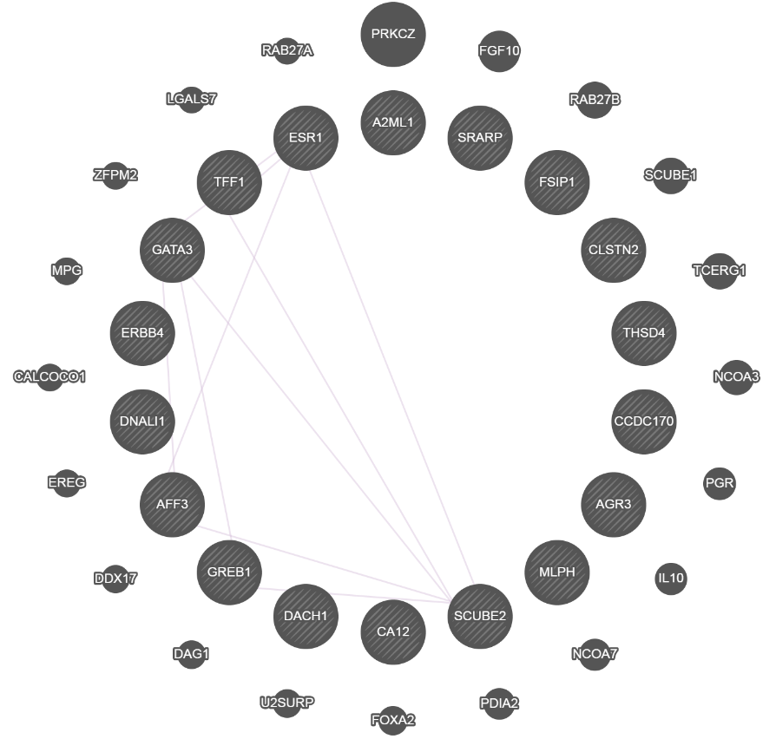
Step 5B: GeneMANIA
On the right side (hidden unless you click on the button with 3 horizontal bars) is the selected interaction networks that were relevant to the 20 input genes, sorted by type and by weight. You can toggle the networks to display any set of edges.
The highest weighted co-expression network is from breast tumors and relates the top 20 genes to each other fairly well, but does not connect them to the predicted 20.

Slide 69
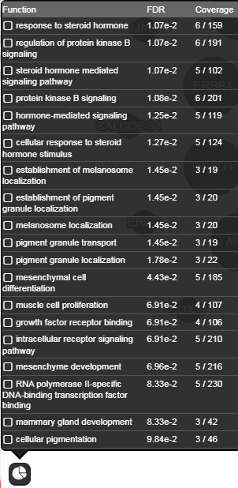
Step 5B: GeneMANIA
Finally, we can perform the standard enrichment tests incorporating our predicted neighbors into our gene set.
Click on the pie chart in the bottom left corner
We see most of the results relating to hormone and steroid signaling pathways and receptors.

Slide 70
Attention!
For this last section (Slides 71-84), please only continue on if you:
Have at least 20 min before we end for the day
Feel confident working with KnowEnG on your own
If not, please stop here.
-AND​-

Slide 71
Gene Set Characterization Using Discriminative Random Walks
In this final exercise, we will find terms related to the 100 top differentially expressed genes of our ER status signature using the DRaWR method that incorporates the functional annotation terms directly in the network-based algorithm.

Slide 72
Step 6: Login Into KnowEnG Platform
Return to KnowEnG Platform: https://platform.knoweng.org/static/#/home
If necessary,
Login with CILogon - Login service through other accounts
Search: Urbana, Mayo, Google, GitHub

Slide 73
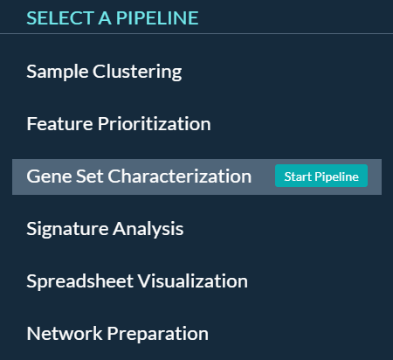
STEP 6A: Gene Set Characterization
Select the pipeline:
Select “Analysis Pipelines” at the top of the page
Select “Gene Set Characterization” and Click on “Start Pipeline”

Slide 74
Step 6A: Upload Data
Find the file in this slide under [course_directory]/07_Signatures_and_Characterization/
Leave the default species “Human”
Find, open in a text editor, and copy the contents of the file [course_directory]/07_Signatures_and_Characterization/ERstatus_top100.txt
This is the top 100 differentially expressed genes of our ER status gene signature extracted from the Name_GeneSymbol column of our earlier Excel download
Click on the “Upload New Data” tab
Select the “Paste a Gene List” button.
Give your gene list a name, e.g. “ERstatus_gene_list”
Paste the file contents into the gene list text box. Click “Done”
Click “Select” next to the name of your pasted list and you should see a checkmark
Click “Next”

Slide 75
Step 6A: Configure Algorithm Parameters
We will choose to use a subset of 4 gene set collections available in the knowledge network
Ontologies: Gene Ontology (default)
Pathways: Enrichr Pathway Membership (must add)
Pathways: Reactome Pathways Curated (must add)
Tissue Expression: GEO Expression Set (must add)
(unclick Protein Domains: PFam Protein Domains)
Click “Next”

Slide 76
Step 6A: Configure Network Parameters
Click “Yes” for question about using the Knowledge Network
The Knowledge Network we will use is an integrated network from the HumanNet project (“HumanNet Integrated Network”)
Network size information can be found here
The amount of network smoothing controls how much importance is put on network connections instead of the original 100 genes. We will use the default of 50%
Click “Next”

Slide 77
Step 6A: Reminder about DRaWR Algorithm
Squares are the Gene Ontology and pathway terms we selected
Query Genes are our 100 ER status signature genes
Gray edges are the HumanNet Integrated Network
We are asking the algorithm to find property squares that a random walker who is forced to restart often at the query genes will visit unusually frequently

Slide 78
Step 6A: Launch DRaWR Job
Change job name to “gene_set_characterization-DRaWR-HN”
Verify all the parameters are correct.
Click “Submit Job”
While this is running (roughly two minutes), we are going to launch the standard fisher exact enrichment tests with the same data sets.
Click “Start New Pipeline”

Slide 79
Step 6B: Launch Standard Enrichment Tests
Hover over Gene Set Characterization under Analysis Pipelines and click “Start Pipeline”
Click “Select” next to the name of your pasted list and you should see a checkmark. Click “Next”
Select same 4 collections:
Ontologies: Gene Ontology (default)
Pathways: Enrichr Pathway Membership (must add)
Pathways: Reactome Pathways Curated (must add)
Tissue Expression: GEO Expression Set (must add)
(unclick Protein Domains: PFam Protein Domains)
Click “Next”
Click “No” for question about using the Knowledge Network. Click “Next”
Change job name to “gene_set_characterization-fisher”
Verify all the parameters are correct.
Click “Submit Job”

Slide 80
Step 6C: View DRaWR Results
Click the “Go to Data Page” button
You can check the status of your jobs here. Gray arrows mean that your job is currently queued or running. A red icon means something went wrong.
Otherwise, when your job is successfully finished, you should be able to click the green arrow and see the primary result files.
Click on the DRaWR job “gene_set_characterization-DRaWR-HN”
Then click on the “View Results” button

Slide 81
Step 6C: View DRaWR Results
Slide the filter slider all the way to the right.
The DRaWR method picks up many GEO Expression gene sets that relate to ESR1 and estrogen and estradiol.
DRaWR also ranks highly a number of pathway and Gene Ontology terms related to extracellular space, which is known to have many molecules effected by estrogens and related to ER expression

Slide 82
Step 6C: View Fisher Results
Click the “Data” link at the top of the page
Click on the DRaWR job “gene_set_characterization-fisher”
Then click on the “View Results” button
Slide the filter slider all the way to the right.
The Fisher method finds the same GEO Expression gene sets that relate to ESR1 and estrogen and estradiol, as well as some additional estradiol ones that DRaWR missed. It also detects many more less obviously related GEO gene sets.
The standard enrichment method does not detect any highly significant enrichments with pathways or Gene Ontology terms.
Since it is missing here the extracellular space terms detected by DRaWR are strongly connected to the signature genes, but mostly through their HumanNet network neighbors and not direct connections.

Slide 83
Main Lab Take Home Message
Whether it is
Sample Clustering
Gene Prioritization
Gene Set Characterization
Omics data can be analyzed
in the context of a pathway, interaction, or other affinity network
to provide complementary insights to standard approaches

Slide 84
List of Other KnowEnG Resources
Other Pipelines:
Network Preparation for uploading your custom network to the platform for analysis
Signature Analysis for mapping samples to signatures by correlation of omics profiles
Tutorials:
Quickstarts: https://knoweng.org/quick-start/
YouTube: https://www.youtube.com/channel/UCjyIIolCaZIGtZC20XLBOyg
Resources:
Data Preparation Guide: https://github.com/KnowEnG/quickstart-demos/blob/master/pipeline_readmes/README-DataPrep.md
Knowledge Network Contents:
Summary: https://knoweng.org/kn-data-references/
Download: https://github.com/KnowEnG/KN_Fetcher/blob/master/Contents.md
Research:
Knowledge-guided analysis of omics Data (KnowEnG cloud platform paper): https://journals.plos.org/plosbiology/article?id=10.1371/journal.pbio.3000583
TCGA Analysis Walkthrough: https://github.com/KnowEnG/quickstart-demos/tree/master/publication_data/blatti_et_al_2019
Source Code:
Docker Images: https://hub.docker.com/u/knowengdev/
GitHub Repos: https://knoweng.github.io/
Other Cloud Platforms:
https://cgc.sbgenomics.com/public/apps#q?search=knoweng
Contact Us with Questions and Feedback: knoweng-support@illinois.edu

