Slide 1
Knowledge-guided Algorithms in Systems Biology
Charles Blatti
Research Scientist
National Center for Supercomputing Applications
University of Illinois Urbana-Champaign
Computational Genomics Course
Some Slides By Amin Emad
Assistant Professor at McGill University
http://www.ece.mcgill.ca/~aemad2/
Notes:
In collaboration with Mayo Clinic.

Slide 2
Plan for this Lecture
Topic: Methods for analyzing omics datasets while integrating prior knowledge
Systems Biology and Knowledge Networks
Sample Clustering
Gene Prioritization
Gene Set Characterization
Emphasis: tools that take advantage of prior knowledge networks (KnowEnG)
Goal: understand basic concepts and aware of approaches and resources

Slide 3
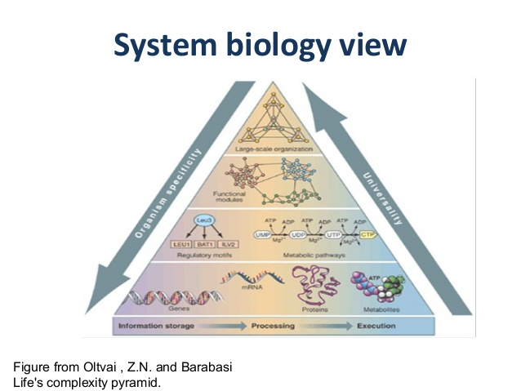
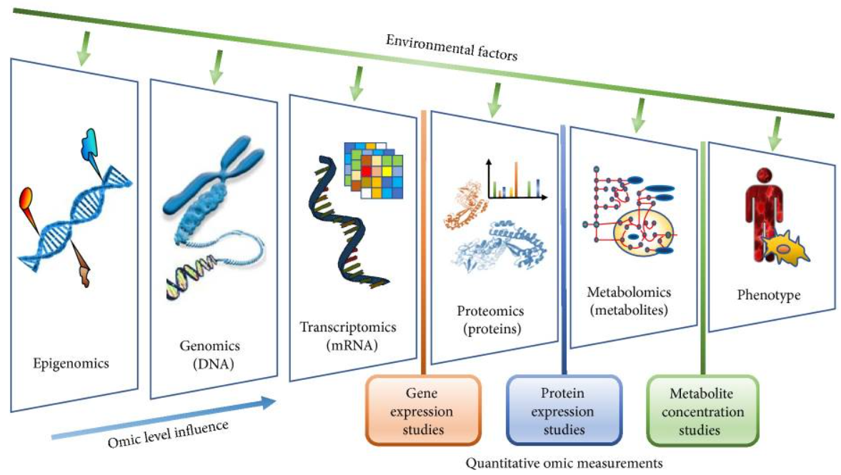
Systems Biology
Systems biology is the computational and mathematical modeling of complex biological systems.
Studies the interactions between the components of biological systems such as genes, proteins, metabolites, etc. (i.e. biological networks), and how these interactions give rise to the function and behavior of that system (phenotype)
Figure from Angione, C. Human Systems Biology and Metabolic Modelling: A Review-From Disease Metabolism to Precision Medicine. Biomed Res Int 2019.
Notes:
modules and biomarkers and association rules
Models for prediction, simulation, and hypthesis testing
interactions between components of a system
modules and modeling
system properties, mechanisms
relation to personalized medicine

Slide 4
Statistical and Machine Learning Methods
Applied to heterogeneous ‘omics and phenotype data and prior knowledge
Unsupervised Learning
Supervised Learning
No training example exists and the goal is to learn structure in the data
Training examples are provided with desired inputs and outputs to help learning the desired rule
Clustering
(subtyping)
Classification
(resistance group)
Regression
(survival time)
Dimensionality Reduction
(data visualization)
Supervised Feature Selection
(biomarkers)

Slide 5
Some Example Applications
Clustering
(subtyping)
Identifying the subtypes of a disease
Identifying genes associated with a disease
Predicting whether a patient is sensitive or resistant to a drug
Predicting the survival probability of a cancer patient
etc.
Supervised Feature Selection
(biomarkers)
Classification
(resistance group)
Regression
(survival time)

Slide 6
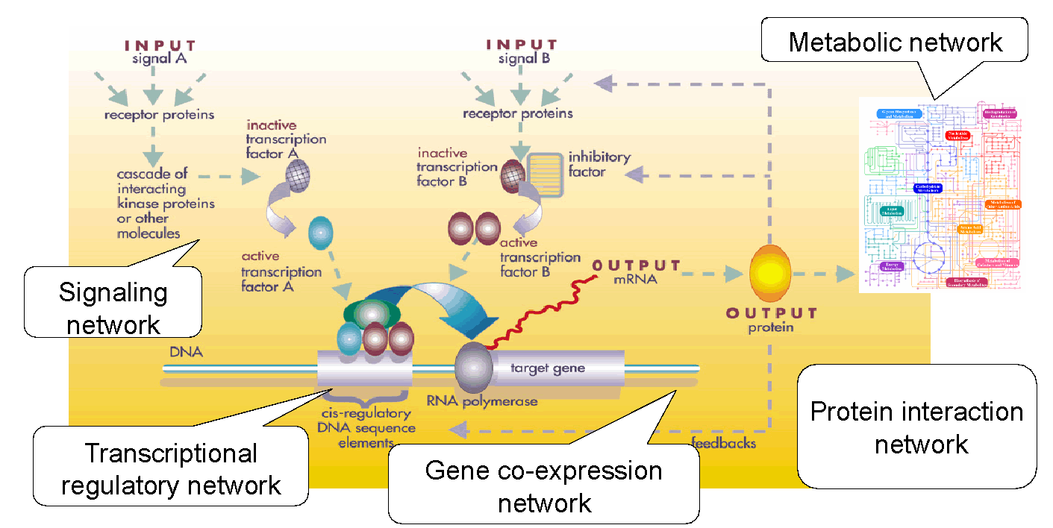
Prior Knowledge as Biological Networks
Existing prior knowledge in literature captures known interactions within and across different levels of the biological systems
Knowledge Network - a graphical representation of the interactions of the components of a biological systems
Figure from https://commons.wikimedia.org/wiki/File:Gene_Regulatory_Network.jpg

Slide 7
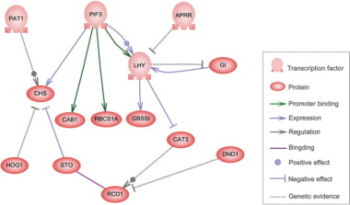
Directed Biological Networks
Gene regulatory networks
Nodes represent genes, proteins, etc.
Edges show regulatory relationships between the nodes
The network shows which entities (e.g. transcription factors) regulate the expression of each gene
Edges can have meaningful weights
Figure from Song, et al. "Comparative transcriptional profiling and preliminary study on heterosis mechanism of super-hybrid rice." Molecular plant 3.6 (2010).

Slide 8
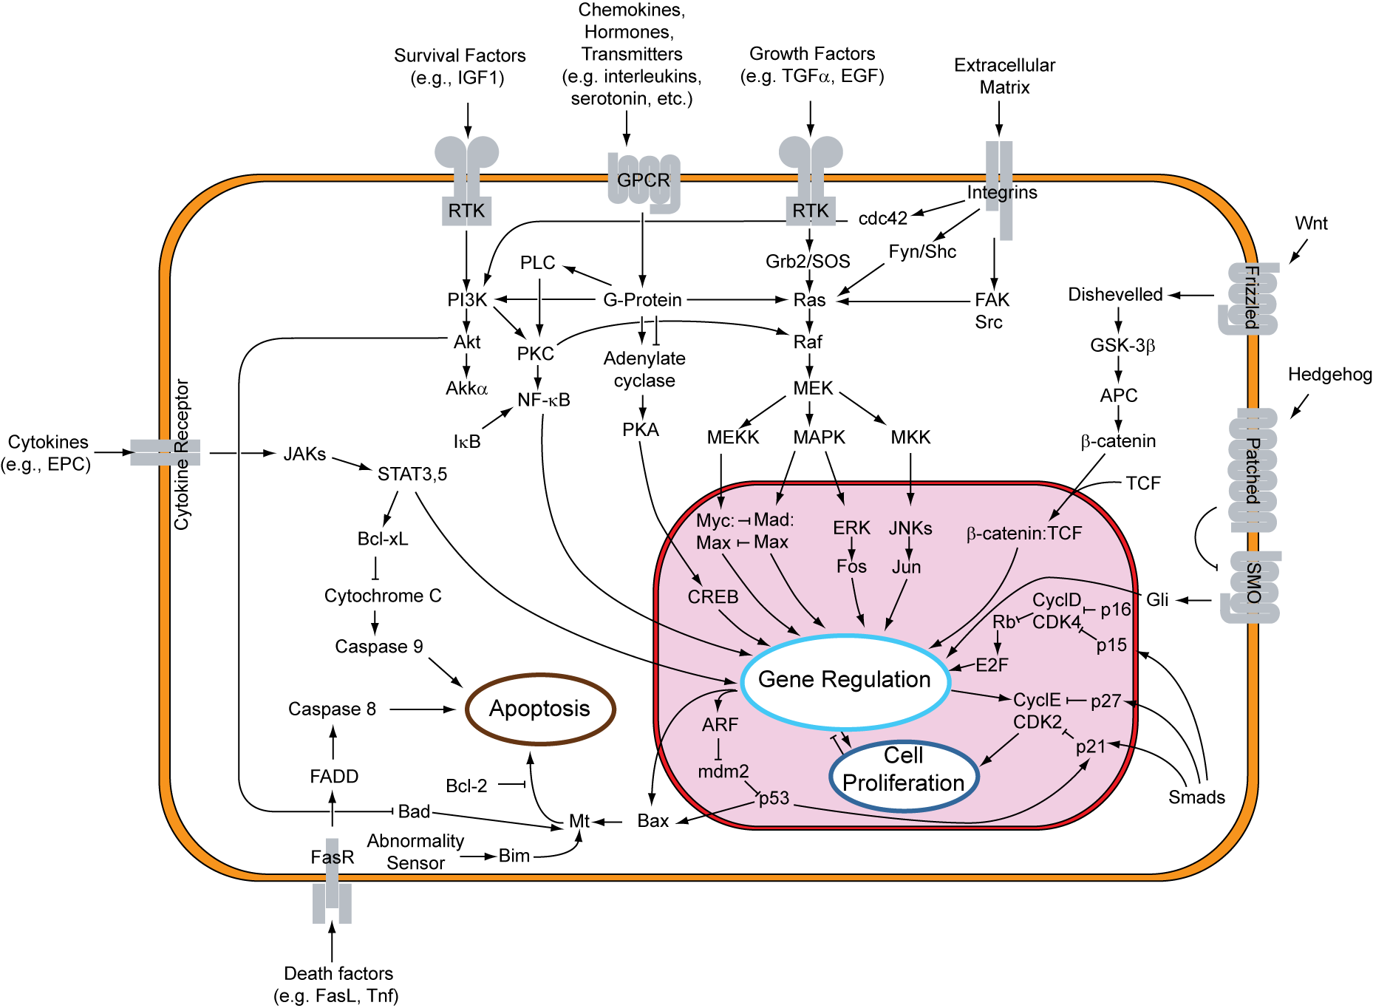
Directed Biological Networks
Signaling Networks
Represents communications within and between cells
Responsible for receiving, transmitting and processing information
The network is a graphical representation of the interactions of the components of a biological systems
Signal Transduction Pathway
https://commons.wikimedia.org/wiki/File:Signal_transduction_pathways.svg

Slide 9
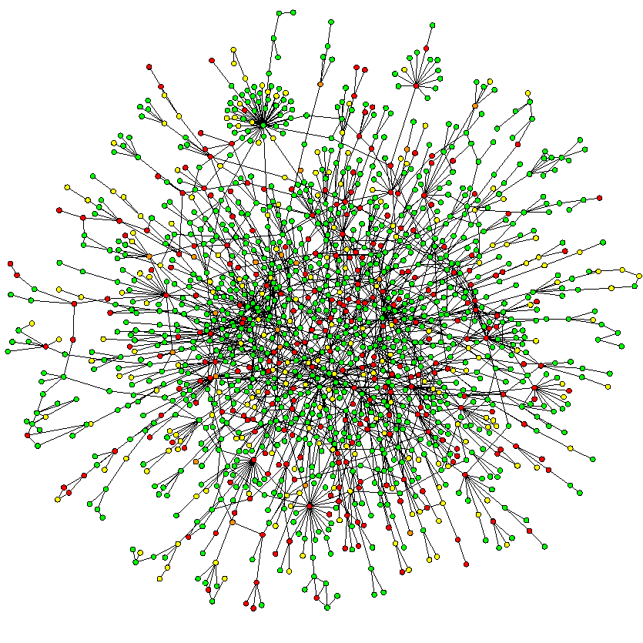
Experimental Networks
Protein-protein interaction networks
Nodes represent proteins
Edges show interactions between proteins
Interactions usually refer to different levels of physical contact and proximity of protein molecules
Figure from Jeong, Hawoong, et al. "Lethality and centrality in protein networks." Nature 411.6833 (2001).

Slide 10
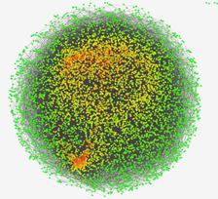
Experimental Networks
Gene co-expression networks
Nodes represent genes
An edge exists between two genes that are highly co-expressed across different samples
Figure from https://commons.wikimedia.org/wiki/File:Gene_co-expression_network_with_7221_genes_for_18_gastric_cancer_patients.png
gene 2
gene 2
gene 2
gene 1
gene 1
gene 1
Figure from https://www.freecodecamp.org/news/how-machines-make-predictions-finding-correlations-in-complex-data-dfd9f0d87889/

Slide 11
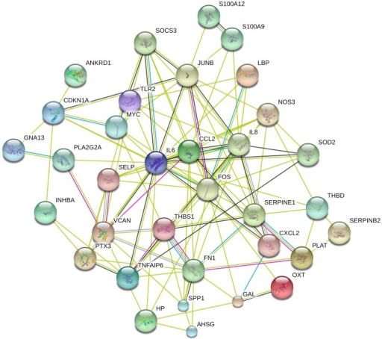
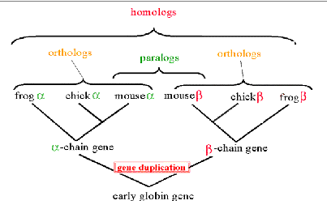
Computational Networks
Evolutionary Conservation networks
Nodes represent gene DNA or protein amino acid sequences
Edges represent the similarity between the pair of sequences, the more similarly the more recently the nodes share an evolutionary history
https://www.ncbi.nlm.nih.gov/books/NBK1762/pdf/Bookshelf_NBK1762.pdf
Text Mining networks
Nodes represent gene entities
Edges represent the frequency names, aliases, and synonyms for a pair of genes co-occur in literature abstracts
Figure from Yahaya, et al. "Gene expression changes associated with the airway wall response to injury." PloS one 8.4 (2013).

Slide 12
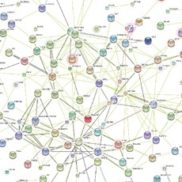
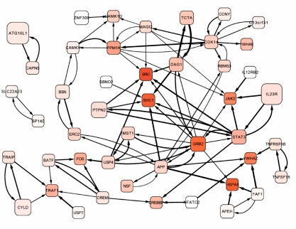
Computational Networks
Integrated networks
Nodes represent gene or proteins
Edges represent the weighted combination of normalized edge weights from many different types of network edges based on some predetermined criteria

Slide 13
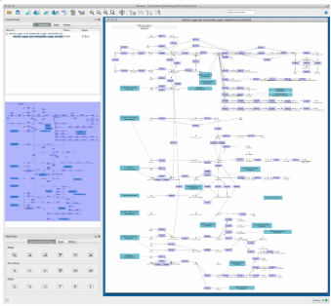
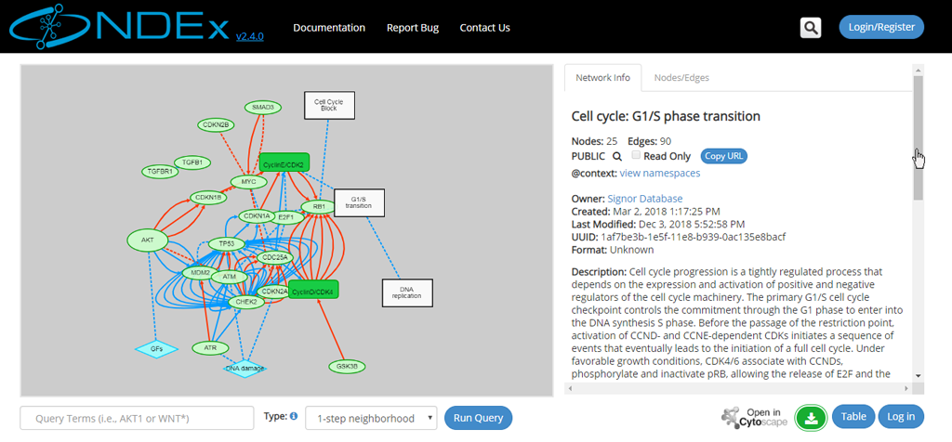
Visualizing / Sharing Biological Networks
https://home.ndexbio.org/quick-start/
https://cytoscape.org/release_notes_3_2_1.html

Slide 14
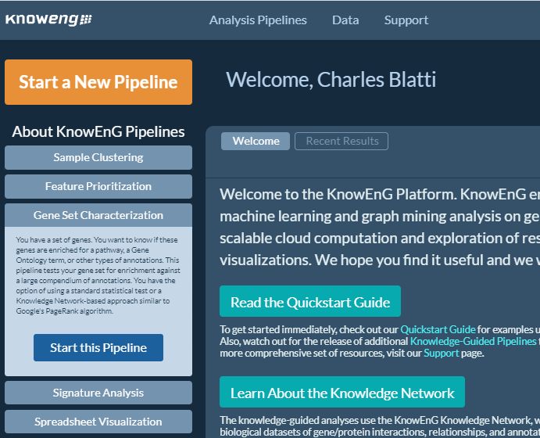
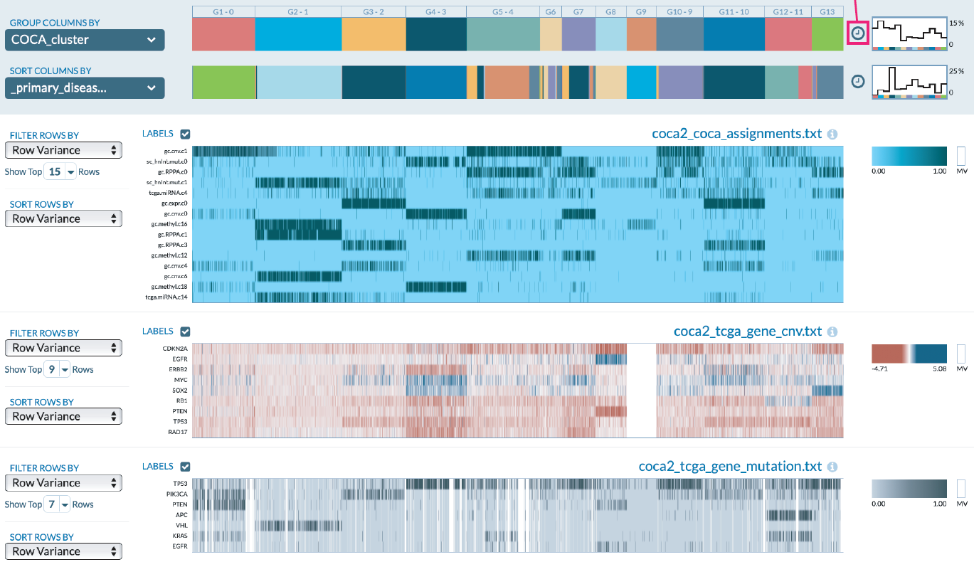
KnowEnG: Platform for Network-guided Analysis
https://knoweng.org/analyze/

Slide 15
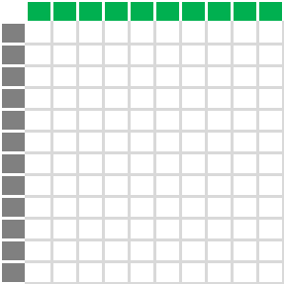
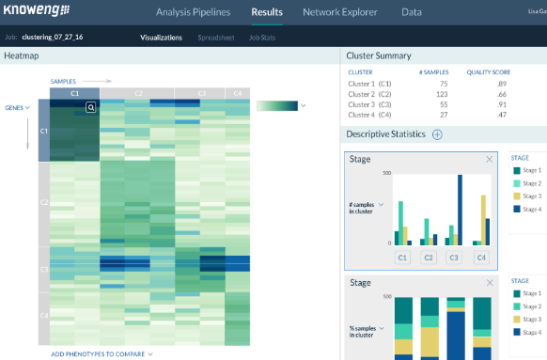
KnowEnG: Knowledge Engine for Genomics
‘omics Data Analysis Pipelines
Using Prior Knowledge
In a Scalable Cloud Platform
Samples
RNA-seq,
Somatic Mutations, etc..
Genes
Physical interactions,
co-expression, pathways, biological processes,
text mining, etc.

Slide 16
KnowEnG Pipelines and User Interface
Sample Clustering
What are the separate transcriptomic subtypes of patients and how do they relate to outcome?
Feature(Gene) Prioritization
What genes are differentially expressed with respect to viral shedding
Gene Set Characterization
What pathways do these differentially expressed genes relate to?
Signature Analysis
Given a new patient, what subtype does their profile most resemble?
Spreadsheet Visualization
Given multiple omics and clinical datasets on patient samples, what features relate to selected phenotypes?

Slide 17
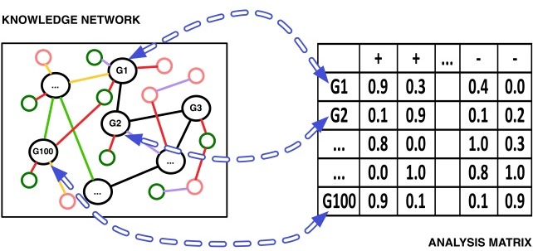
Analysis Pipelines Using Prior Knowledge
Knowledge Network (KN): heterogeneous graph whose nodes and edges encodes major public data sets as a network represented by genes/proteins, their properties, and relationships
Omics data: a spreadsheet (rows = genes or proteins) to be analyzed
Graph Mining
Machine learning
SPREADSHEET
Knowledge network + user spreadsheet

Slide 18
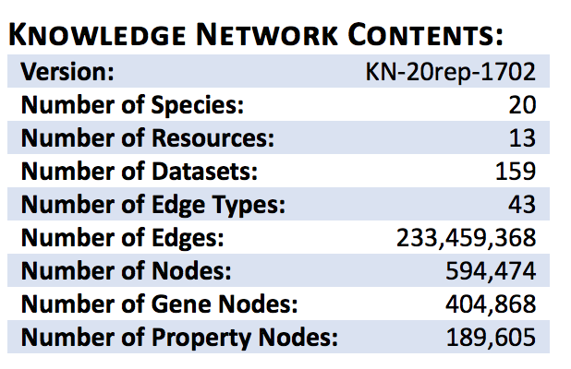
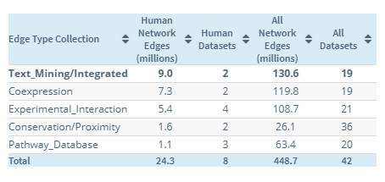
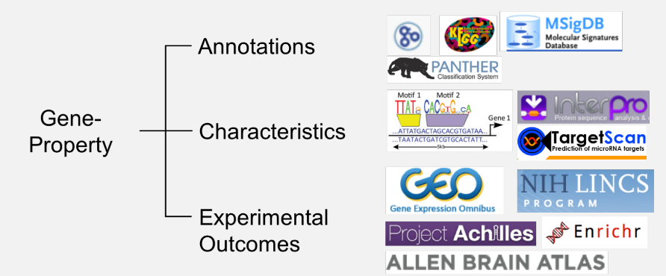
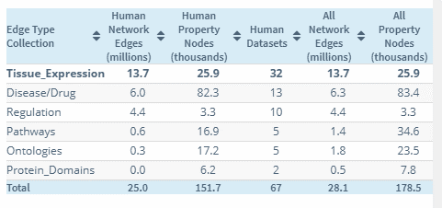
KnowEnG Prior Knowledge Networks
https://github.com/KnowEnG/KN_Fetcher/blob/master/Contents.md

Slide 19
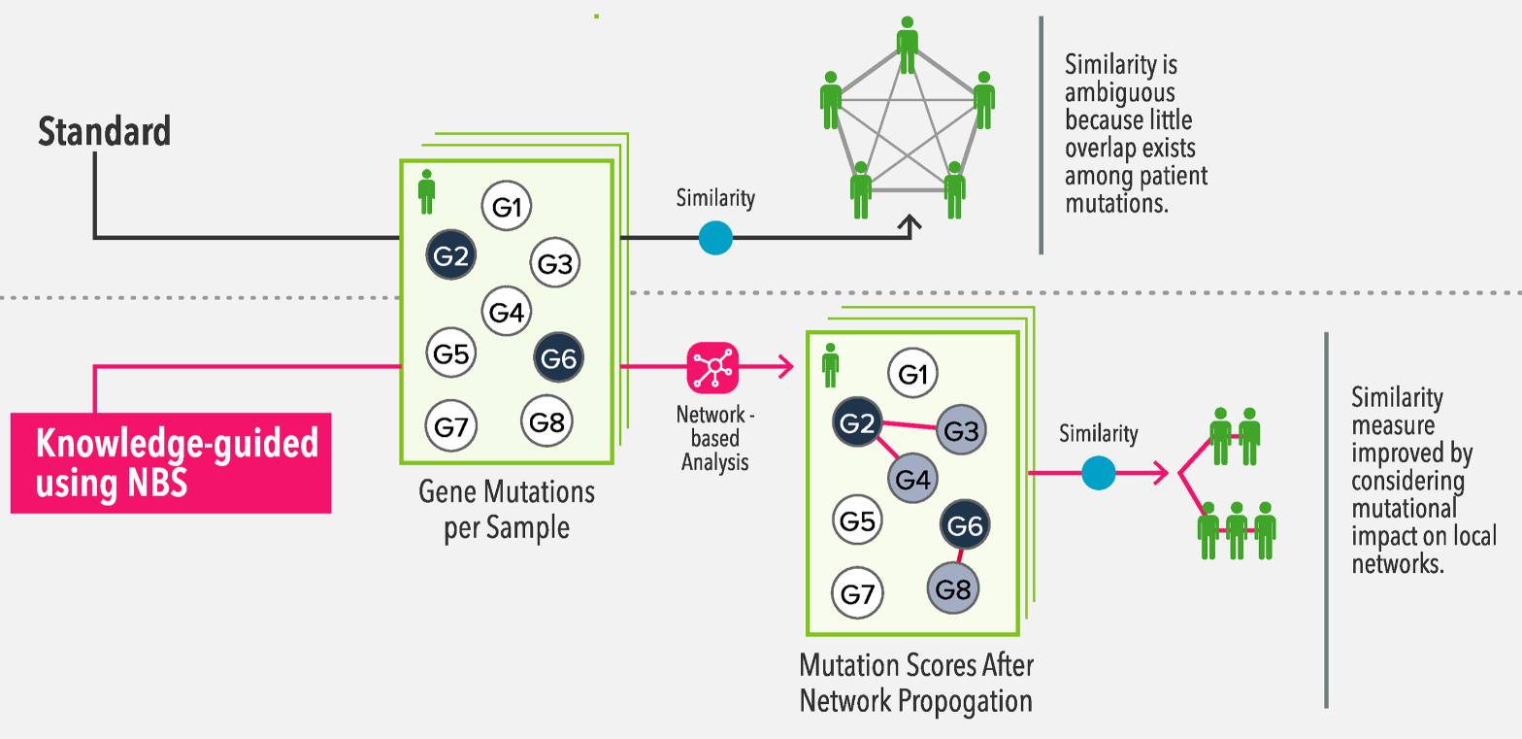
Network-guided Sample Clustering

Slide 20
Network-Guided Sample Clustering
Goal:
Stratification (clustering) of tumor samples based on somatic mutation profiles
Main Issue:
The mutation data is very sparse and most conventional clustering techniques fail to identify reasonable patterns
Although two tumors may not share the same somatic mutations, they may affect the same pathways and interaction networks

Slide 21
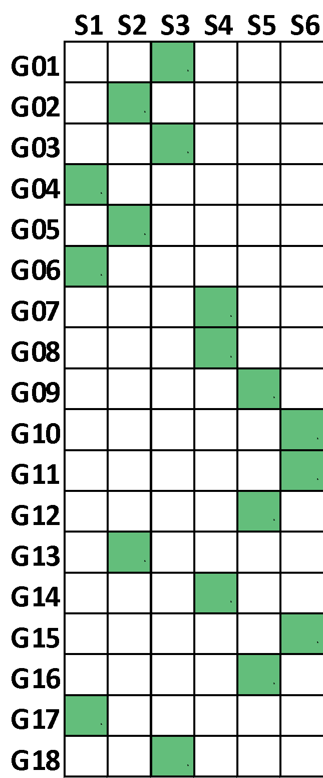
Knowledge-Guided Sample Clustering
Problem: Data sparsity in gene-level somatic mutation data
Toy Example
Due to the sparsity of the data, all samples are at equal distance of each other

Slide 22
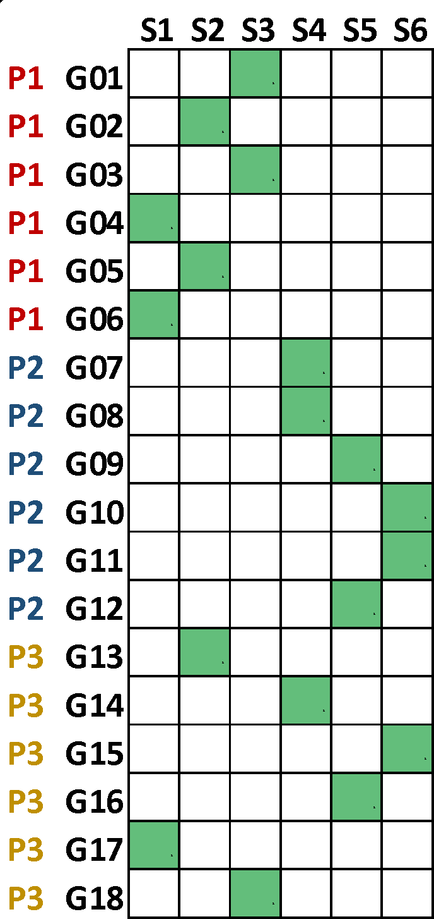
Knowledge-Guided Sample Clustering
Problem: Data sparsity in gene-level somatic mutation data
Toy Example
Due to the sparsity of the data, all samples are at equal distance of each other
Pathway information clarifies the similarity among some samples

Slide 23
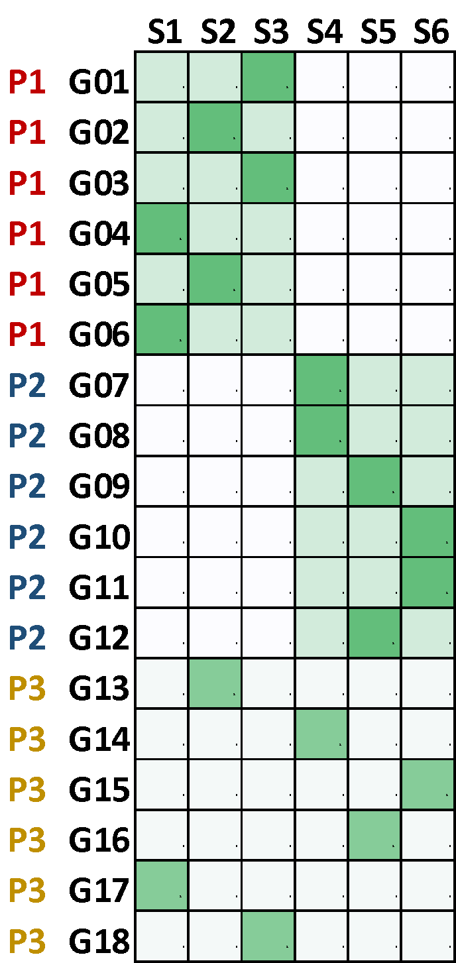
Knowledge-Guided Sample Clustering
Problem: Data sparsity in gene-level somatic mutation data
Toy Example
Due to the sparsity of the data, all samples are at equal distance of each other
Pathway information clarifies the similarity among some samples
Conventional clustering methods can then identify clusters based on network-smoothed features

Slide 24
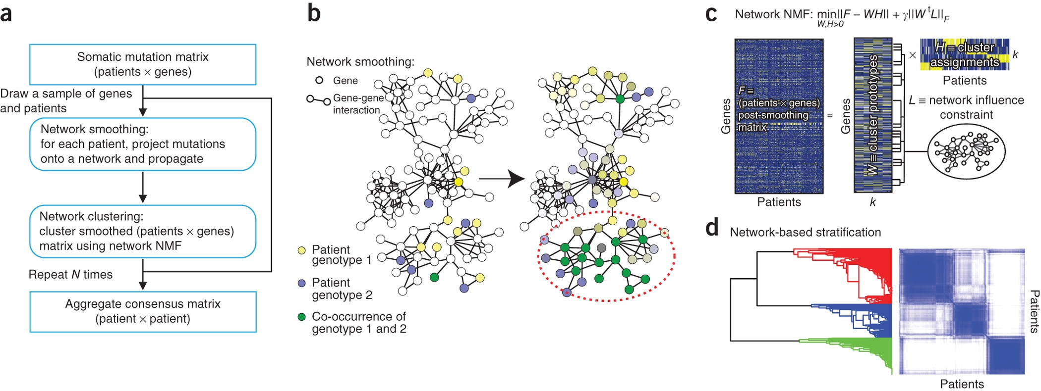
Network-based Stratification (NBS)
Network Smoothing – Random Walk with Restart
Patient Sampling for Robust Clustering

Slide 25
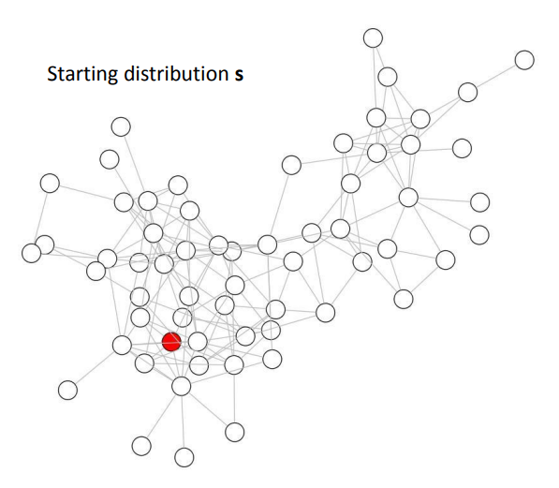
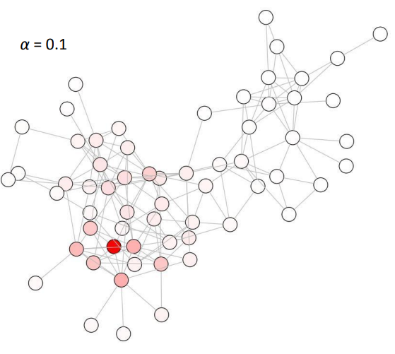
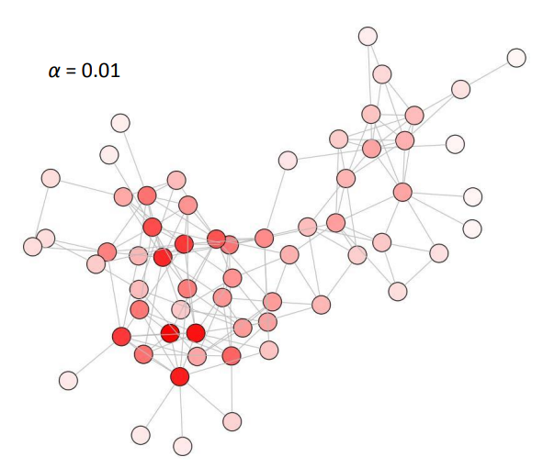
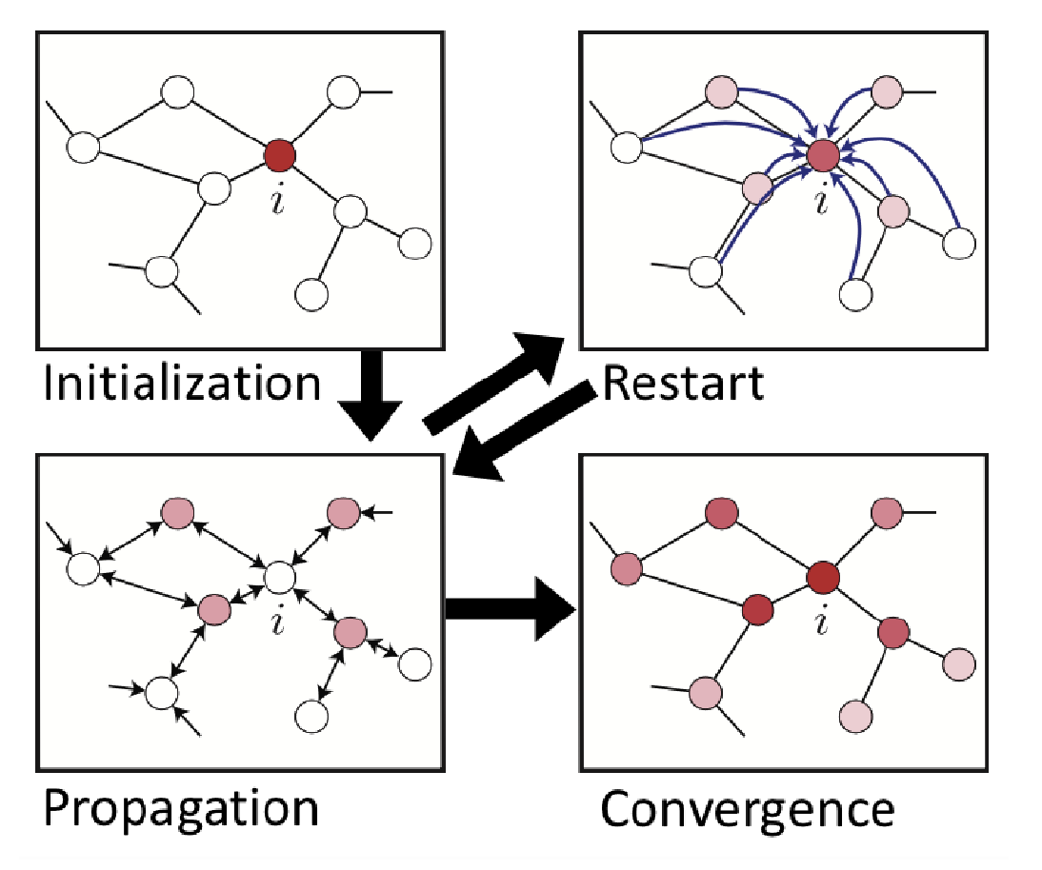
Random Walk With Restart Algorithm
Fast, scalable guilt-by-association method
Same ideas as personalized PageRank
Intuition
Walker at a node either
With probability 1-r, follows an outgoing edge
With restart probability r, returns to node in restart set
Converges to long run “stationary” distribution of the walker over the nodes
Final node ranking based on distribution incorporates
Connectedness of node in network
Proximity of node to restart set
Initialization
Propagation
Restart Jump with r
Edge Follow with 1-r
Convergence
https://cseweb.ucsd.edu/~atsiatas/pr_diffusion_slides.pdf

Slide 26
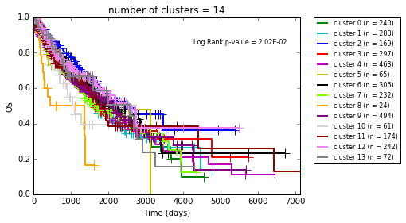
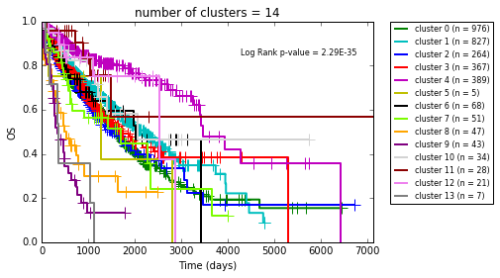
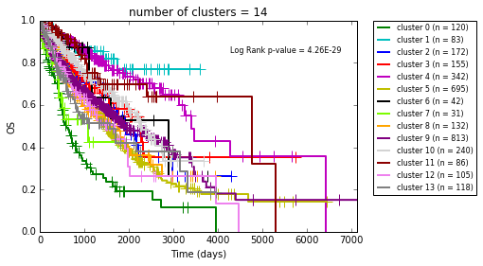
NBS Sample Clustering with KnowEnG
3276 tumor samples from TCGA from 12 cancer projects with sparse non-synonymous somatic mutation
Perform standard and network-guided Sample Clustering in platform
Knowledge-guided clusters significantly relate to survival outcome
Much better than standard methods that do not incorporate prior knowledge
In line with specialized method developed in TCGA paper that would be very difficult to reproduce
Notes:
https://journals.plos.org/plosbiology/article?id=10.1371/journal.pbio.3000583

Slide 27
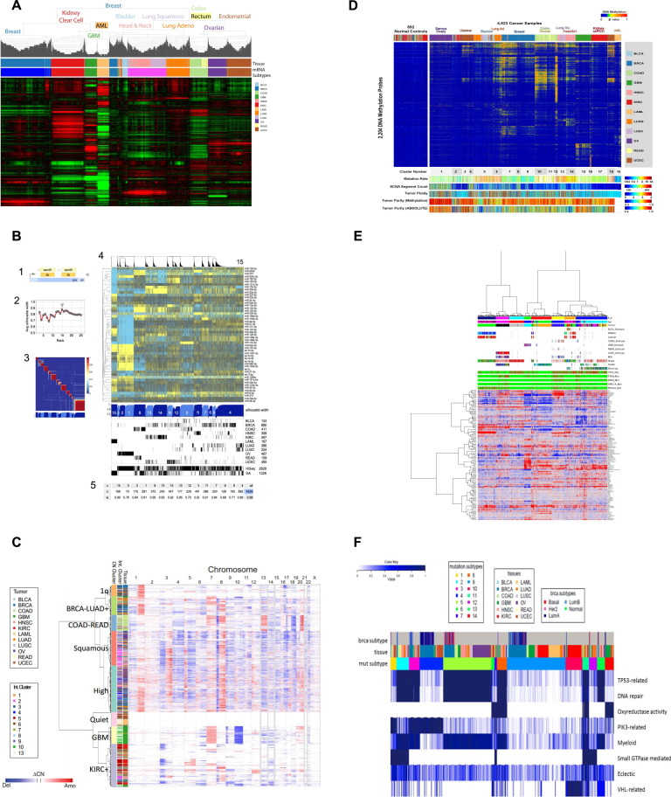
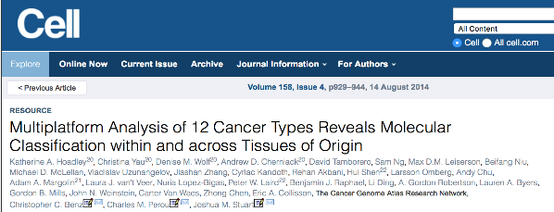
Integrating Experimental Assays for Stratification
Data from each experimental assay is subjected to sample clustering to find cancer subtypes per assay
Mutation data required specialized knowledge guided methods (panel F)
mRNA
DNA Methyl
miRNA
Protein RPPA
Copy Number
Mutations
Notes:
https://www.ncbi.nlm.nih.gov/pmc/articles/PMC4152462/

Slide 28
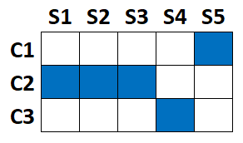
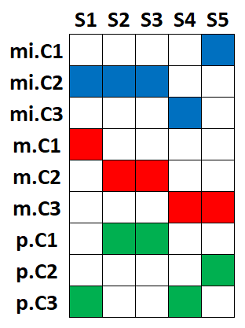
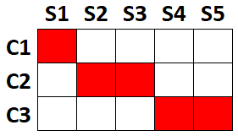
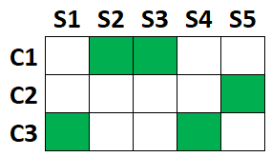
Cluster-Of-Cluster-Assignments (COCA)
Merge cluster assignments x samples matrices
Cluster the samples in the multi-omics matrix
Cluster Samples
miRNA
mRNA
Protein

Slide 29
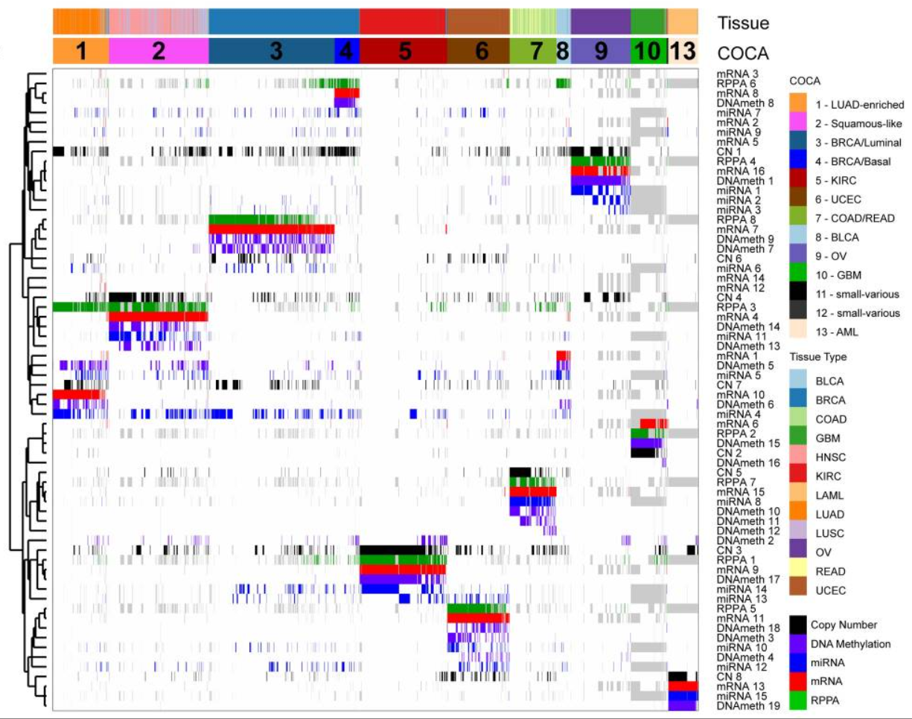
13 Cancer Subtypes from 6 Assays
Strong relationship between subtypes & disease
Interesting relations between clusters of different data types
Figure from Hoadley, et al. "Multiplatform analysis of 12 cancer types reveals molecular classification within and across tissues of origin." Cell 158.4 (2014).

Slide 30
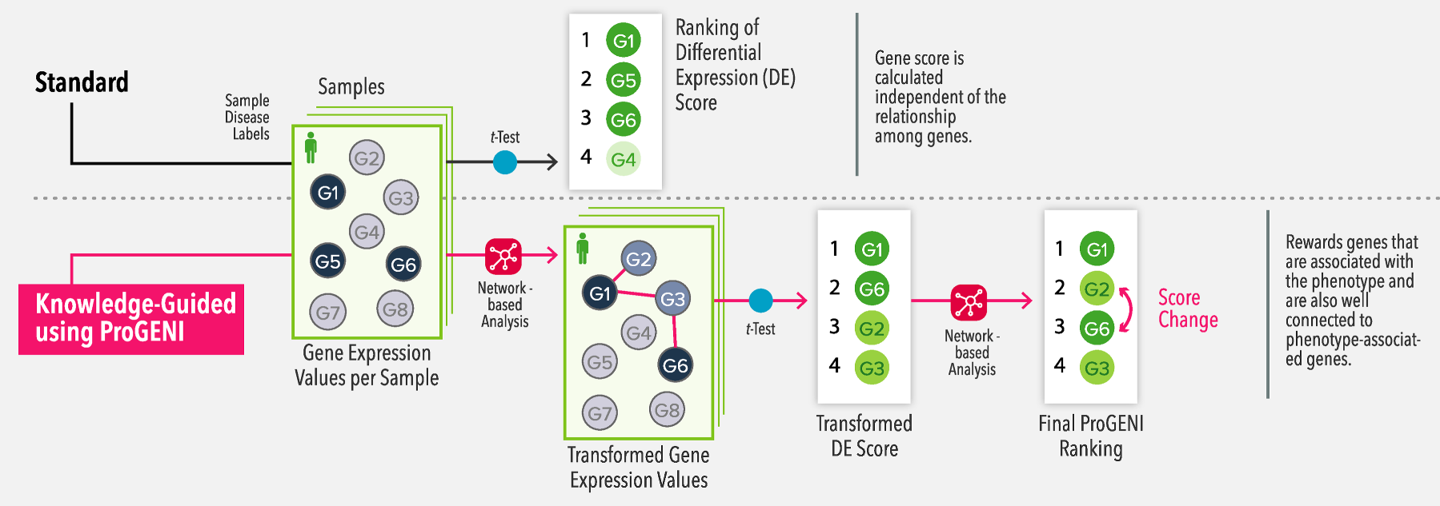
Network-Guided Gene Prioritization

Slide 31
Characterizing Cancer Subtypes
Find top related mutations and copy number alterations
Compare each subtype vs `all others`
KnowEnG calls this `Gene Prioritization`
Figure from Hoadley, et al. "Multiplatform analysis of 12 cancer types reveals molecular classification within and across tissues of origin." Cell 158.4 (2014).

Slide 32
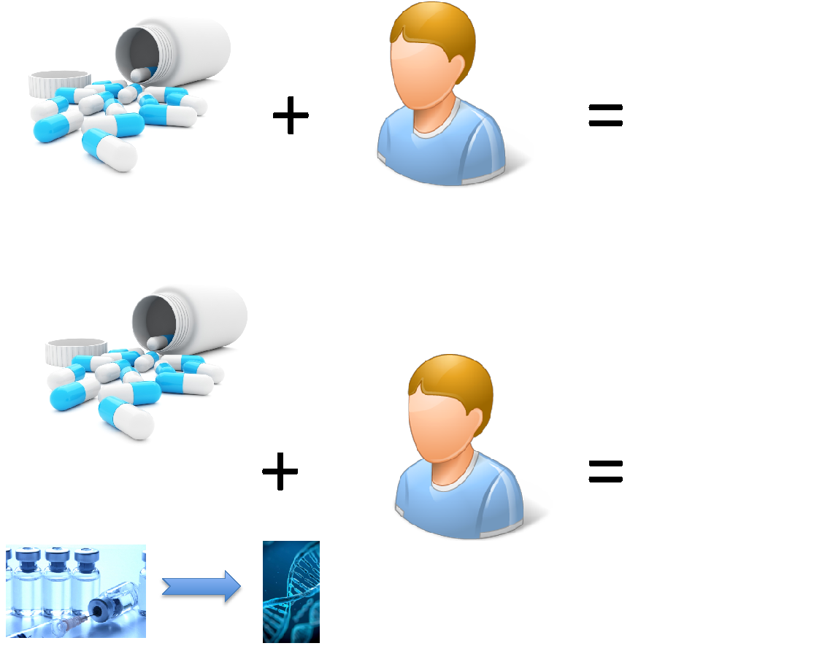
Towards Network-Guided Gene Prioritization
Drug Sensitivity Example
Goal:
Identifying genes whose basal mRNA expression determines the drug sensitivity in different samples (supervised feature selection)
Motivations:
Overcoming drug resistance
Revealing drug mechanism of action
Identifying novel drug targets
Predicting drug sensitivity of individuals
Notes:
In this project, the goal was to identify genes whose mRNA expression can explain the variation of response to cancer drugs across different samples. This is a very important problem, because if we can identify a small set of such genes, they can be targeted to overcome drug resistance.

Slide 33
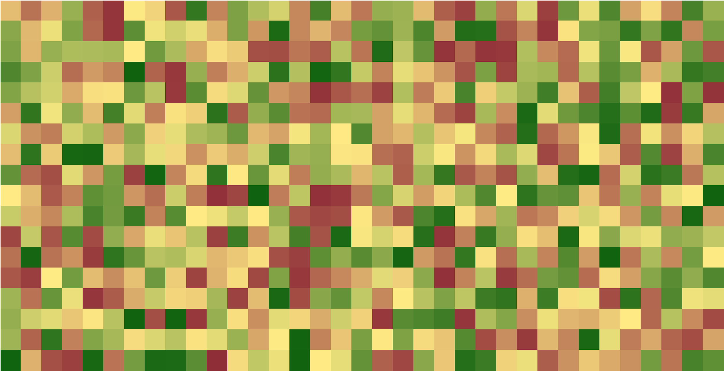
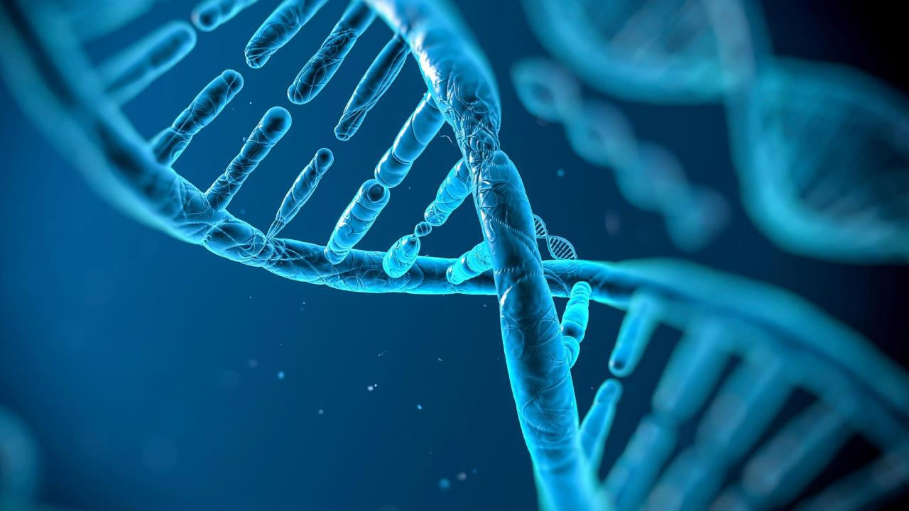
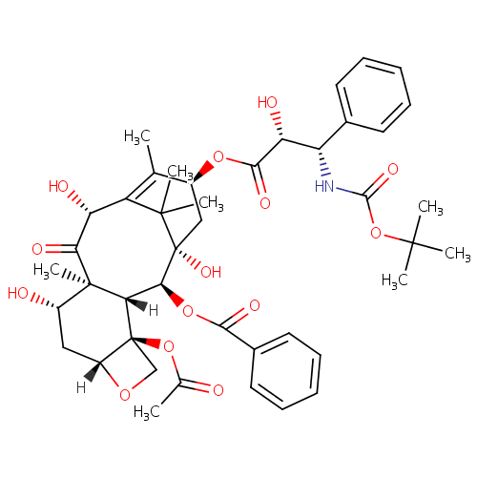
Standard Gene Prioritization
Examples of current methods:
Score each gene based on the correlation of its expression with drug response
genes
response
samples
Notes:
There are various techniques for gene prioritization in the literature.

Slide 34
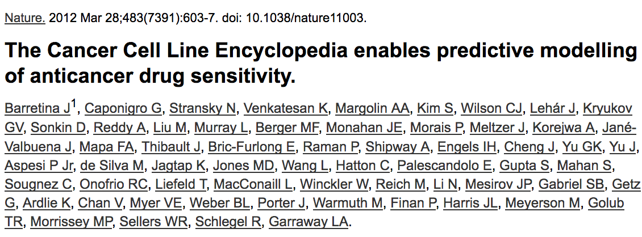
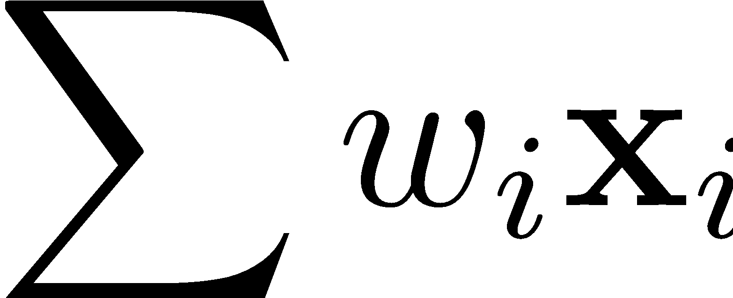
Standard Gene Prioritization
Examples of current methods:
Score each gene based on the correlation of its expression with drug response
Use multivariable regression algorithms such as Elastic Net to relate multiple genes’ expression values to drug response
genes
response
samples

Slide 35
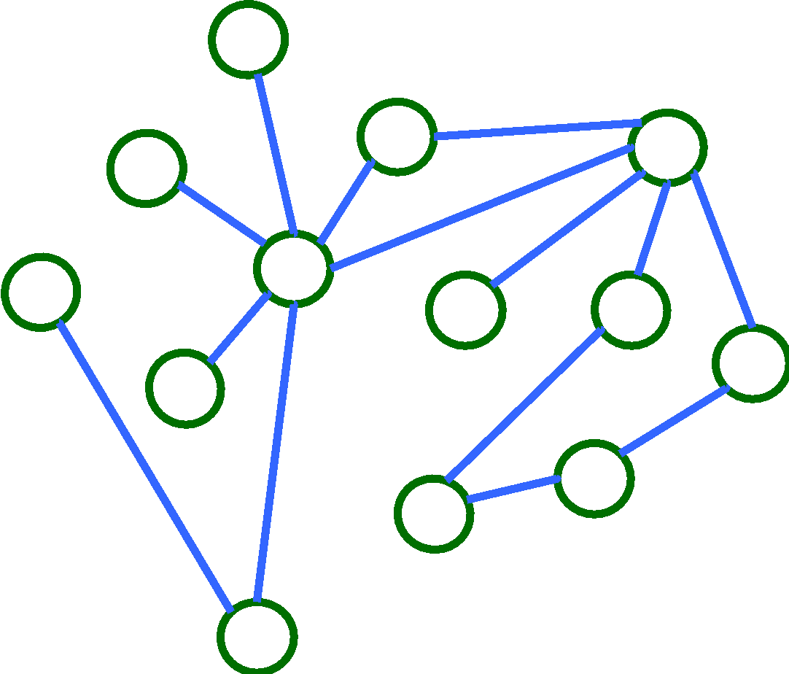
Augmenting Gene Prioritization
Examples of current methods:
Score each gene based on the correlation of its expression with drug response
Use multivariable regression algorithms such as Elastic Net to relate multiple genes’ expression values to drug response
Shortcoming:
These methods do not incorporate prior information about the interaction of the genes

Slide 36
Network-Guided Gene Prioritization
Hypothesis:
Since genes and proteins involved in drug MoA are functionally related, prior knowledge in the form of gene interaction network (e.g. PPI) can improve accuracy of the prioritization task
genes
response
samples

Slide 37
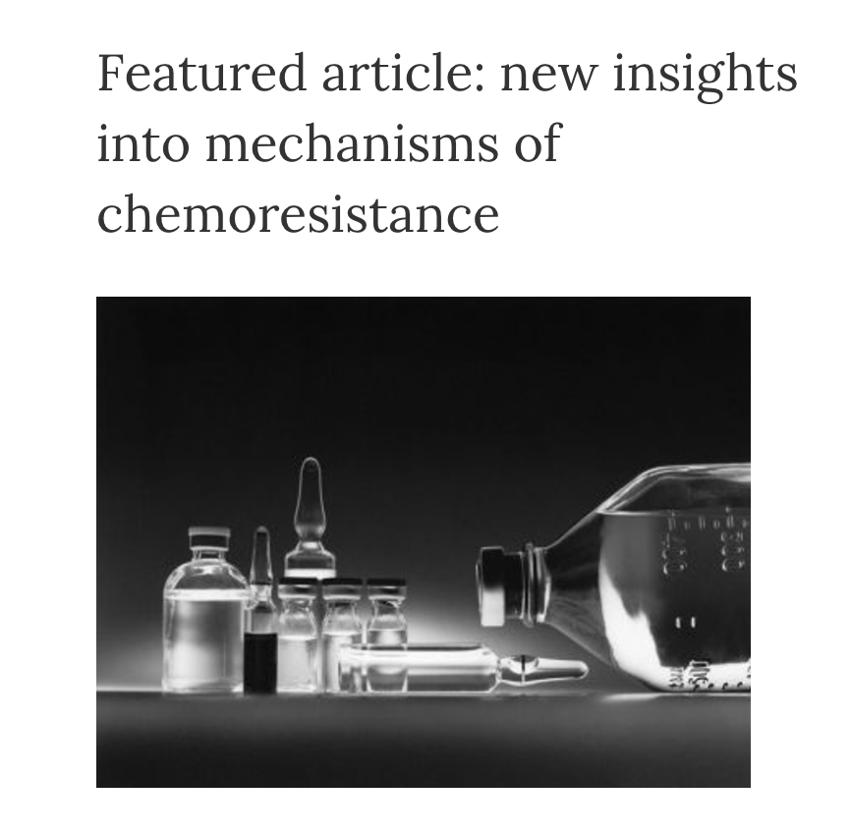
ProGENI
ProGENI: Network-guided gene prioritization
An algorithm that incorporates gene network information to improve prioritization accuracy
Notes:
https://photostockeditor.com/image/chemotherapy-drugs-12084

Slide 38
ProGENI Method
Step 1: Generate new features representing expression of each gene and the activity level of their neighbors weighted proportional to their relevance
Notes:
ProGENI includes several steps. In the first step, it performs a network-transformation on the gene expression matrix. For each gene, a random walk with restart is used to score the relevance of all the gene sin the network with respect to the gene of interest, while considering both local and global topology of the network. These scores are used to combine the expression of the gene with expression of other genes, weighted based on their relevance. The intuition behind this step is that the new values assigned to each gene represents the expression of the gene as well as the activity level of the genes that are relevant to it in the network.

Slide 39
ProGENI Method
Step 1: Generate new features representing expression of each gene and the activity level of their neighbors weighted proportional to their relevance
Figure from Rosvall and Bergstrom. "Maps of random walks on complex networks reveal community structure." Proceedings of the national academy of sciences 105.4 (2008).
Notes:
ProGENI includes several steps. In the first step, it performs a network-transformation on the gene expression matrix. For each gene, a random walk with restart is used to score the relevance of all the gene sin the network with respect to the gene of interest, while considering both local and global topology of the network. These scores are used to combine the expression of the gene with expression of other genes, weighted based on their relevance. The intuition behind this step is that the new values assigned to each gene represents the expression of the gene as well as the activity level of the genes that are relevant to it in the network.

Slide 40
ProGENI Method
Step 1: Generate new features representing expression of each gene and the activity level of their neighbors weighted proportional to their relevance
Step 2: Find genes most correlated with drug response (RCG set)
Notes:
In the next step, we identify a small set of genes whose transformed expression is most correlated with the drug response.

Slide 41
ProGENI Method
Step 1: Generate new features representing expression of each gene and the activity level of their neighbors weighted proportional to their relevance
Step 2: Find genes most correlated with drug response (RCG set)
Step 3: Score genes based on their relevance to the RCG set
Notes:
The response correlated genes are used as a restart set for another RWR, where the probability of restart is proportional to their correlation coefficient. This RWR scores all the genes in the network.

Slide 42
ProGENI Method
Step 1: Generate new features representing expression of each gene and the activity level of their neighbors weighted proportional to their relevance
Step 2: Find genes most correlated with drug response (RCG set)
Step 3: Score genes based on their relevance to the RCG set
Step 4: Remove network bias by normalizing scores w.r.t. scores corresponding to global network topology
Notes:
Finally, these scores are normalized with respect to scores that reflect the global topology of the network to remove the network bias.
Rank by (query-baseline)

Slide 43
ProGENI Analysis Datasets
Human lymphoblastoid cell lines (LCL)
Gene expression (~17K genes of ~300 cell lines)
Drug response of 24 cytotoxic treatments
Publicly available dataset from GDSC
Gene expression (~13K genes of ~600 cell lines from 13 tissues)
Drug response of 139 cytotoxic treatments
Publicly available prior knowledge
Network of gene interactions (PPI and genetic interactions) from STRING (~1.5M edges, ~15.5K nodes)
Notes:
Genomics of Drug Sensitivity in Cancer
https://www.cancerrxgene.org/
https://string-db.org/

Slide 44
Validation Using Drug Response Prediction
Genes ranked highly using a good prioritization method are good predictors of drug sensitivity
Notes:
We performed two major validations. The first one is a computational validation and the idea behind it is that if a prioritization method is accurate, the top genes identified by it should be good predictors of drug response. To compare ProGENI with other methods, we used a cross-validation framework where the top 500 genes identified based on the training set is used to train a support vector regression algorithm with RBF kernel to predict the drug response on the test set.

Slide 45
Validation Using Drug Response Prediction
LCL Dataset | Pearson | Elastic Net
Num. Drugs (out of 24) ProGENI > Baseline | 14 | 20
FDR (Wilcoxon signed-rank test) | 6.5 E-3 | 9.6 E-5
GDSC Dataset | Pearson | Elastic Net
Num. Drugs (out of 139) ProGENI > Baseline | 66 | 110
FDR (Wilcoxon signed-rank test) | 9.1 E-4 | 4.0 E-21
Notes:
These tables show the comparison of ProGENI with two of the baseline methods. The tables compare the performance of methods based on prediction accuracy of all the drugs. In all cases, ProGENI significantly outperforms the baselines. The scatter plots at the bottom shows the performance of ProGENI vs. EN for 5 drugs. Points above the diagonal line shows that PrOGENI outperforms the EN. The accuracy is measured using SPCI where random guess gets a value of 0.5 and perfect prediction is 1.

Slide 46
Functional Validation
We validated role of 33 (out of 45) genes (73%) for three drugs.
Notes:
The second validation was based on biological experiments. So I identified 15 genes using ProGENI for 3 drugs widely used in treating various types of cancer. Then we mined the literature for direct evidence of the role of gene in changing the sensitivity to the drug through biological experiments such as gene knockdown. For the genes that were not studied before, my Mayo clinic collaborators performed siRNA knockdown experiments, silencing the gene of interest and measuring the change in the drug response, discovering novel genes that can be targeted to overcome drug resistance. Overall, out of the 45 identified genes, 33 of them turned out to be true positives a success rate of 73% which is very high for this type of problem.
Doxorubicin network
Progeni green
Standard red
Higly connected neighbors

Slide 47
Gene Expression Signatures

Slide 48
Gene Expression Signatures
Massive Transcriptomic Profiling Projects
TCGA and ICGC
GTEX and CCLE
LINCS
Definitions
Projects produce expression vectors for samples (e.g. gene expression levels)
Scoring the difference in expression between samples of two (or more) conditions produces differential expression vectors
Signature (of a biological state):
Gene Set – differentially, characteristically expressed genes in that state relative to some reference (control or population)
Differential Expression Vector – the differential expression scores for the subset of genes in the same comparison
genes
samples
Figure from Greenough, et al. "A gene expression signature that correlates with CD8+ T cell expansion in acute EBV infection." The Journal of Immunology 195.9 (2015).
Notes:
The Cancer Genome Atlas Program
Genotype-Tissue Expression
International Cancer Genome Consortium
Cancer Cell Line Encyclopedia
Library of Integrated Network-Based Cellular Signatures (LINCS)

Slide 49
Gene Expression Signatures
Example Comparisons
Mutated vs Wild-Type
Metastatic vs Primary
Tumor vs Normal
Perturbagens
Drug Treatment vs Placebo
Environmental Stimuli vs Control
Gene Signatures provide a uniquely characteristic pattern of gene expression that is tied to its studied biological or medical phenomenon
Enable researchers to relate samples and other phenomenon by finding the similarity to the gene signatures
Focus understanding on underlying mechanism for phenomenon to a subset of gene behaviors
genes
samples

Slide 50
Public Resources for Gene Signatures
There are many public resources for acquiring gene expression signatures
Extracting signatures yourself
Libraries of Curated Signatures
Lab will use signatures from the Library of Integrated Network-Based Cellular Signatures (LINCS)
Notes:
https://maayanlab.cloud/g2e/
https://www.ncbi.nlm.nih.gov/geo/geo2r/
https://maayanlab.cloud/gen3va/
https://www.gsea-msigdb.org/gsea/msigdb/
https://lincsproject.org/

Slide 51
The LINCS DataCube of Signatures
Gathering a data cube of gene signatures
Using many different:
Cell Types
Dozens of cell lines
Induced pluripotent stem cells
Primary Cells
Perturbagens
Small molecules / Drugs
CRISPR overexpression and
shRNA knockdown
Microenvironments
Ligands
Experimental Assays
Gene expression: microarray, RNA-seq, L1000
Protein expression: RPPA, P100 mass spectrometry
Morphological and Proliferation: biochemical and imaging assays
Notes:
https://commonfund.nih.gov/lincs/programhighlights

Slide 52
Signature Similarity Analysis
Given a query signature and a library of reference signatures, how do you find the similar signatures?
Types of Similarity Comparisons
Gene Set & Differential Expression Vector
Differential Expression Vector & Differential Expression Vector
Gene Set & Gene Set

Slide 53
Standard Similarity Measures
When both signatures are represented as differential expression vectors:
In one analysis, they did not observe a large performance difference between the possible measures

Slide 54
Gene Set Enrichment Analysis
When sample signature is vector and library signature is gene set
GSEA - http://software.broadinstitute.org/gsea/index.jsp
Modification of the Kolmogorov-Smirnov Statistic
Calculate the enrichment score (ES) that represents the amount the genes in the gene set are over-represented in the top or the bottom of the signature vector
Estimate statistical significance of the ES by permuting the mappings between the data
Adjust for multiple hypothesis testing when analyzing a large number of gene sets

Slide 55
Gene Set Association Tests
For use when both signatures are gene sets
Also known as Gene Set Characterization
One-sided exact Fisher / Hypergeometric distribution tests
Covered by Saurabh this morning
Available through tools like:
DAVID - https://david.ncifcrf.gov/
Enrichr - http://amp.pharm.mssm.edu/Enrichr/
Metascape - http://metascape.org/gp/index.html
Standard Enrichment Test
User GS
KnownGS
Universe of Genes

Slide 56
Network-Guided Gene Set Characterization

Slide 57
Idea for a Network-based Method
Use guilt-by-association principles to find out which annotations are well connected to the query genes in a heterogeneous network.
These well connected annotations should be specific to the query genes, and not simply hub nodes in the network.
Developed Discriminative Random Walks with Restart (DRaWR)

Slide 58
Value of Network-Guided Analysis
Take advantage of gene neighbors
Incorporate dependencies from separate knowledge in analysis
User Set
Apoptosis Genes
Genes That Bind To Apoptosis Genes
Notes:
High level
Blue user set might have very little overlap with genes of red Gene Ontology term
But if we considered the gene that physically bind to the GO genes as well, the overlap may be significant
Network analysis can capture this association through extension
Statistics of enrichment assume every gene is independent
However, we have knowledge of global coexpression patterns between gene
Network analyses can incorporate these dependencies rather than ignoring them

Slide 59
Value of Network-Guided Analysis
Extension to poorly annotated domains
Integrating multiple data types
Embryonic Brain Development
Human
Fish
Notes:
Missing annotations in human might be more complete in a well studied modeled organism
For example, embryonic development is studied in transparent fish
Network analysis lets us leverage those more complete annotations
We might have many different types of data about the same entities
Network analysis gives us a framework for integrating this complimentary information

Slide 60
Network-based DRaWR Method
DRaWR – using random walks on a network
Construct a heterogeneous network of interest
Heterogeneous
Edge Types
type_A
type_B
type_C
Notes:
Brings us to the main method I want to talk about today, DRaWR
Published earlier this year
Uses the ideas of random walk on network that google uses to sort web search results
Basic steps – set up network
Genes from one or more species
Gene-gene interactions
Properties from one or more sources
Connect to genes
Heterogeneous with three different edge types

Slide 61
Network Methods for GSC
DRaWR – using random walks on a network
Construct a network of interest
Find stationary distribution on network
Notes:
Idea: If you allowed a walker to follow the edges in the graph for infinite time
Calculate the probability she would be at any node
Nodes with a lot of edges in and out should have a high probability
Remote edges with few connections should have a low probability
This stationary distribution tells us something about the network structure

Slide 62
Network Methods for GSC
DRaWR – using random walks on a network
Construct a network of interest
Find stationary distribution on network
Find gene set specific distribution
Return annotation nodes that are especially related to the query
Notes:
Now given a users gene set, change things up slightly,
Repeat the process, but force the walker to restart at the genes of interested every few steps
She will never get too far from that restart set of genes
Now the long term probability of the walker to be at any node capture both the graph structure and its proximity to the gene set
We compare that first baseline walk with this new query specific walk and return the property nodes that are unusually related to the gene set of interest
Questions about the method?

Slide 63
Social Aggression Study Application
Idea: Evolutionary “toolkits” – genes and modules with lineage-specific variations but deep conservation of function
Questions: Are there toolkits that underlie social behaviors
Such as aggressive response to territorial intrusions?
Study: gather brain transcriptomic responses to social challenge from three social species – honey bees, mice, and stickleback fish
With and without exposure to intraspecies intruder
From different brain regions and/or durations after event
Results: sets of differentially expressed genes across three species
Notes:
Since publication, used DRaWR in two applications

Slide 64
Failure of Standard Approach
Would like to find Gene Ontology annotations that:
Relate to DE gene sets of all three species
However, Gene Ontology annotation quality varies greatly in three species
Or relate to DE genes sets of the Mouse
However, the corresponding sets from the other species might have greatly different function
Solution:
Integrate Orthology and Gene Ontology information in a three species network
Find Gene Ontology terms that are strongly connected to the DE gene sets of all three species simultaneously
Statistical
Enrichment Test
Notes:
Since publication, used DRaWR in two applications

Slide 65
Findings with DRaWR
Annotations of two (red and green) conserved Gene Modules
Specific results for red module
Notes:
Many GO terms that receive better ranking when DRaWR considers DEG sets from all three species simultaneously
Top terms related to activity and perception, synaptic transmission, movement
Histamine is neurotransmitter
Inositol_trisphosphate – signaling, induction of plasticity in cells of cerebellum
GO terms with conserved, but individually weak signals in three species using DRaWR

Slide 66
Gene Ranking / Function Prediction
Given:
Novel gene set(s) generated by a genomic researcher
Task:
Rank genes for the strength of their relationship to the user’s gene set(s)…
… in order to assess the coherence of the genes in the experimental gene set or identify putative related genes
Figure from Arzt, et al. "Pipa: custom integration of protein interactions and pathways." GI-Jahrestagung. 2011.

Slide 67
GeneMANIA Approach
GeneMANIA stands for
Multiple Association Network Integration Algorithm
Main Idea
Given a gene set with a known functions
And several gene-gene interaction affinity networks
Find genes that relate to the functional set through the edges of the given networks
Approach
Find out how well each network predicts the membership of the given set
A linear regression-based algorithm that calculates a single composite functional association network from multiple data sources
Do label propagation guilt-by-association algorithm on the composite functional association network

Slide 68
GeneMANIA Performance
Participated in grand challenge for this function prediction task on Mouse genes
Did extraordinary well in the competition and has improve method since then
Has easy to use webserver for running functional prediction with small genesets

Slide 69
In this Lecture and the Lab
Biological Knowledge Networks
KnowEnG Platform
Network-Guided Sample Clustering
Network Based Stratification, COCA
Network-Guided Gene Prioritization
ProGENI
Gene Signatures and Similarity Methods
LINCS, GSEA, Enrichr, DAVID
Network-based Gene Set Characterization
DRaWR
Network-based Function Prediction
GeneMANIA

Slide 70
Thank you, Any Questions?
Reproduced by permission of Pierre de Meyts in Ebrahim. "Metabolomics, nutrition and why epidemiology matters." (2016).

Slide 72
KnowEnG Resources
Also Check Out:
Network Preparation for uploading your custom network to the platform for analysis
Signature Analysis for mapping samples to signatures by correlation of omics profiles
Tutorials:
Quickstarts: https://knoweng.org/quick-start/
YouTube: https://www.youtube.com/channel/UCjyIIolCaZIGtZC20XLBOyg
Resources:
Data Preparation Guide: https://github.com/KnowEnG/quickstart-demos/blob/master/pipeline_readmes/README-DataPrep.md
Knowledge Network Contents:
Summary: https://knoweng.org/kn-data-references/
Download: https://github.com/KnowEnG/KN_Fetcher/blob/master/Contents.md
Research
Knowledge-guided analysis of omics Data (KnowEng cloud platform paper): https://journals.plos.org/plosbiology/article?id=10.1371/journal.pbio.3000583
TCGA Analysis Walkthrough: https://github.com/KnowEnG/quickstart-demos/tree/master/publication_data/blatti_et_al_2019
Source Code:
Docker Images: https://hub.docker.com/u/knowengdev/
Github Repos: https://knoweng.github.io/
Other Cloud Platforms
https://cgc.sbgenomics.com/public/apps#q?search=knoweng
Contact Us with Questions and Feedback: knoweng-support@illinois.edu

Slide 73
Using A Permanent KnowEnG Account
For permanent account:
Go to https://knoweng.org/analyze/ Click on “Create an account”
Follow the instructions

Slide 74
Regression algorithms
Lasso: learns a linear model from the training data using only a few features (sparse linear model)
Elastic Net: learns a linear model from the training data by linearly combining ridge and Lasso regression regularization terms (a generalization of both Lasso and ridge regression)

Slide 75
Regression algorithms
Kernel-SVR:
Linear SVR learns a linear model such that it has at most ε-deviation from the response values and is as flat as possible
(Smola and Schölkopf, 1998)
Kernel-SVR generalizes the idea to nonlinear models by mapping the features to a high-dimensional kernel space

Slide 76
Other Network Based Characterization Methods
SPIA Idea:
Combine with standard enrichment p-value that asks about the significance of the number of perturbed genes in the pathway
Perturbagen p-value, which asks if the amount of total accumulated perturbation after one network propagation step is significant when considering the value it takes with random controls
SANTA Idea:
Quantify the Network Density of Gene Set by Shortest Path Length criteria
Notes:
Since publication, used DRaWR in two applications

Slide 77
Incorporating Meta-Paths
DRaWR random walks on heterogeneous networks make no consideration / memory of the edge types they have followed
Explore if similarity in a gene set can best be described by particular types of meta-paths amongst its genes.
Paths from G1 -> G2:
type_A
type_A - type_B
type_C- type_C
type_B - type_C (x2)
meta-path:
a path defined by sequence of edges types between two nodes
Notes:
Very good, but…
Meta-path concept pioneer by Professor Han’s group
Instead of finding the right combination of networks, what is the particular connections in that network that capture the similarity of the set

Slide 78
Ranking Genes for Disease
Initial Study:
53 MSigDB DE gene sets from separate cancer studies
Question:
If we hide a subset of genes disrupted by the development of cancer, what types of networks are best suited to recover them?
Evaluation:
Partition 75% of DE genes for training, 25% for testing
Use DRaWR on KnowNet subnetworks and training data to rank genes
Report average AUCs of ranking using test genes as truth
Notes:
Second Application,

Slide 79
Networks Under Consideration
Gene-Gene Edge Types
H: Homology
CoEx: Co-Expression
TM: Text Mining
Exp: Experimental Interaction
Gene-Property Edge Types
PD: Protein Domains
GO: Gene Ontology
Number of Species
Human: only
2sp: Human and Mouse
Specificity of the edges
Specific: high confidence edges
Loose: all edges of that types
Combinations of Edge Types
1ty: One primary type
2ty: Primary type + homology
Many: 3+ edge types

Slide 80
Best Networks
Gene Ontology annotations and Text Mining relations are the best edge types for recovering cancer set DE genes
Networks with all edges (Loose) are better at recovering gene than networks with only high confidence edges
Protein Domain annotations are poor predictors for cancer DE genes, but great for embryonic development
Notes:
High level observations about what are the best networks for relating cancer gene sets

