Slide 1
Variant Calling
Chris Fields, HPCBio
Mayo-Illinois Computational Genomics Workshop, June 8, 2023
Notes:
We going to discuss the process of variant calling for the Mayo Computation Genomics workshop.

Slide 2
Overview
Variant calling
Use cases
Variants vs. errors
Experimental design (GATK focus)
Small variant (SNV/Small Indel) analysis
  GATK Pipeline
  Formats encountered within

Slide 3
Variant Calling
As the name implies, we’re looking for differences (variations) between:
  Common reference – reference genome (for human: hg38, GRCh38)
  Sample(s) – one or more comparative samples, each sample from one individual
Start with raw sequence data (FASTQ format)
End with a file listing off differences, recording the variants
Additional information added downstream:
  Filters (quality of the calls)
  Functional annotation

Slide 4
Variations
Difference between 2 individuals : about 1 every 1000 bp
  ~ 2.7 million differences for the human genome
Small (<50 bp)
  SNV – single nucleotide (`SNPs`)
  Small insertions or deletions (‘Indels’)
Large (structural variations)
  Indels > 50 bp
  Copy Number Variations
  Inversions
  Translocations
  Chromosomal fusions

Slide 5
Variations
Mainly focus on diploid organisms, but this can be polyploid
  Human:
    22 pairs of autosomal chromosomes
      One from mother, one from father
    2 sex chromosomes (female XX, male XY)
      One from mother, one from father (where Y comes from for male offspring)
    Mitochondrial genome (generally maternally inherited)
      100-10,000 copies per cell
Variation can be in
  One chromosome (heterozygous, or ‘het’)
  All chromosomes (homozygous, or ‘hom’)

Slide 6
Use cases

Slide 7
Use cases
Medicine
  Hereditary or genetic diseases, genetic predisposition to disease
  Cancer biology - Normal (germline) vs. tumor (somatic) analyses, driver mutations
  Heteroplasmy
Biotechnology
  Detection of genomic modifications (CRISPR/Cas9)
Population genetics
  GWAS

Slide 8
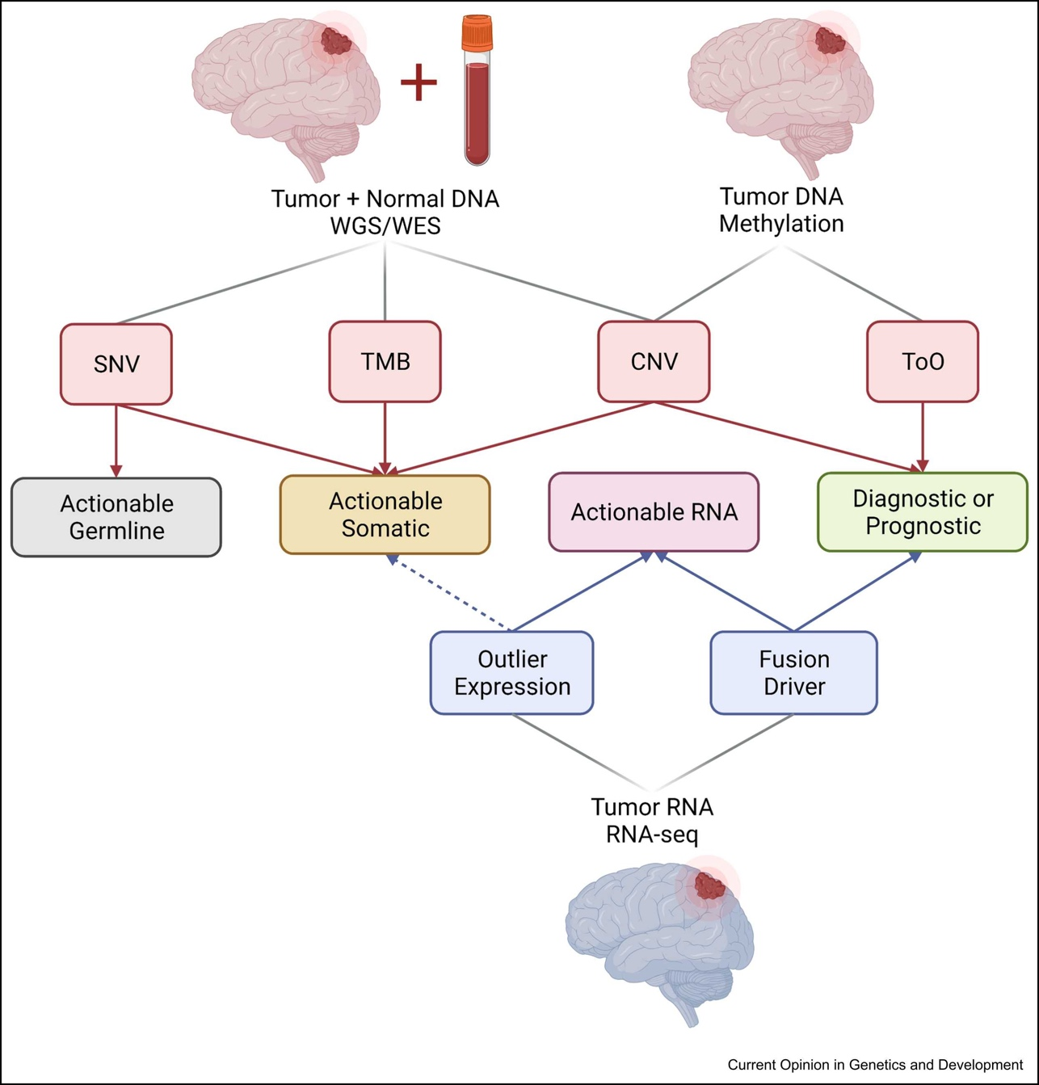
Cancer
Biology
Germline vs somatic variants
Structural variants
May combine with other types of genomic data (RNA, methylation, etc)
Miller, Mardis, Curr. Op. in Gen. & Dev, v75, Aug. 2022

Slide 9

Population genetics
1000 Genomes Project
Human Pangenome Project
2011
2023
IGSR: The International Genome Sample Resource
HPRC
Nature Special Issue

Slide 10
Variants vs. Errors
Must distinguish between actual variation (real change) and errors (artifacts) introduced into the analysis
Errors can creep in on various levels:
  PCR artifacts (amplification of errors)
  Sequencing (errors in base calling)
  Alignment (misalignment, mis-gapped alignments)
  Variant calling (low depth of coverage, few samples)
  Genotyping (poor annotation)
Try to control for these when possible to reduce false positives w/o incurring (worse) false negatives

Slide 11
How do sequencing errors occur?

Slide 12
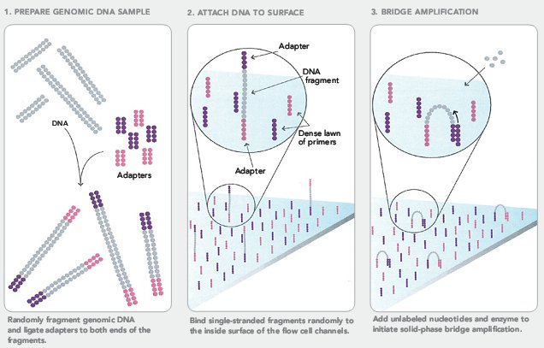
Illumina Sequencing
Video!
Illumina
Notes:
With Illumina data, DNA is sheared to less than 1000bp, and adapters are added to the ends (note two different adapters)
The DNA is denatured to single-strand, and flowed though the flow cell binding to a comp primer.
Bridge amplification increases the copy number of the DNA at their location

Slide 13
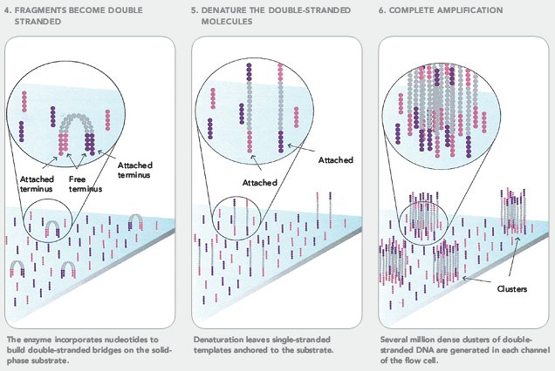
Illumina Sequencing
Illumina
Notes:
Once bridge amplification completes, there will be clusters of molecules on the flow cell

Slide 14
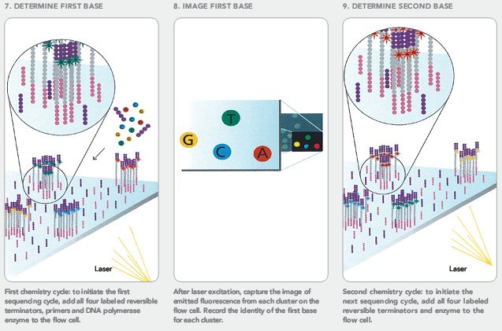
Illumina Sequencing
Illumina
Notes:
The DNA in the clusters is made ss and synchronized so they all originate from one of the adapters.
The first reaction adds the primer complementary to the adapter, then labeled nucleotides that are reversible terminators. The first base is imaged across the chip by recording emitted fluorescence from exciting the labeled nucleotides
The next phase reverses the terminator on the added nucleotide and adds the next labeled base. The imaging is then repeated again.

Slide 15
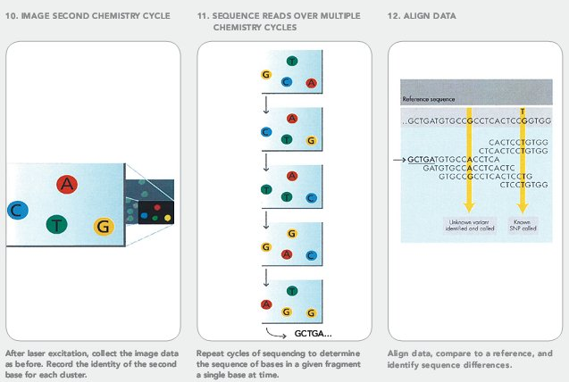
Illumina Sequencing
Illumina
Notes:
Base calls are accumulated into a sequence read based on the position on the chip (the example is GCTGA in the same position).
Reads can then be used in downstream analyses, for example, aligning the reads to a reference genome

Slide 16
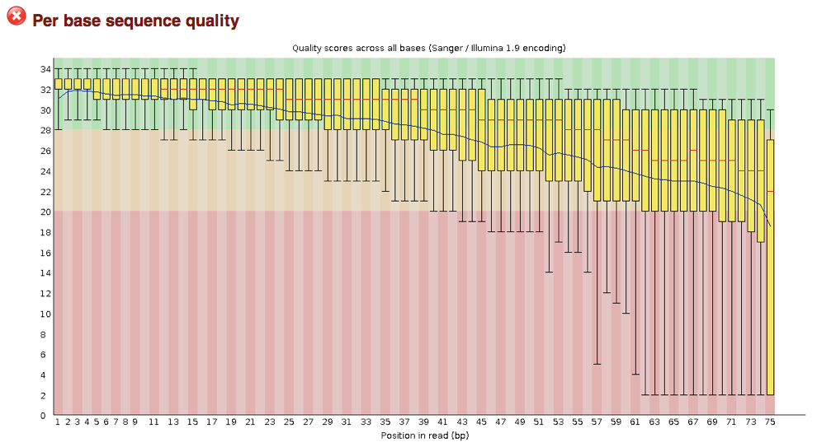
Check sequence data!
FASTQC
Notes:
This is an output from a commonly used tool in the field, called FASTQC. Notice the base quality drop off as the bases are added (red zone is poorer quality calls). This is almost always due to phasing issues from the sequencing reaction. The above example is from ~2010 or so, when reads were only 75nt long and with an earlier chemistry. Now it’s pretty common to get highly accurate calls out to 150-250nt.

Slide 17
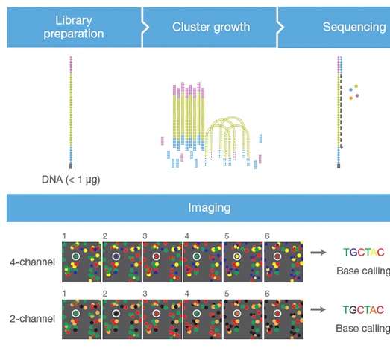
Illumina Sequencing – Two color
Illumina link
Video
Notes:
Illumina switched to a more efficient two-color base calling technique with the NovaSeq and NextSeq platforms.
Red = C, Green = T, Red + Green (orange) = A, no color (?!?) = G
This works pretty well, but if you have super short fragments (shorter than seq read and adapters), the sequencer will gladly call the base a ‘G’ with high confidence. Keep this in mind when looking at data later, as some library types will have this artifact and may require trimming

Slide 18
Sequence quality
Different technologies have different errors, error rates
  Illumina – substitution errors (0.1%)
  PacBio and Oxford Nanopore – (10-15%) Indels, primarily around homopolymer track errors
Represented as a quality score (Phred scale)
Probability of incorrect base call (e) | Base call accuracy | log10(e) | Phred Quality Score -10log10(e)
1 in 10 (0.1) | 90% | -1 | 10
1 in 100 (0.01) | 99% | -2 | 20
1 in 1000 (0.001) | 99.90% | -3 | 30
1 in 10000 (0.0001) | 99.99% | -4 | 40
1 in 100000 (0.00001) | ~100.00% | -5 | 50

Slide 19
Formats: FASTQ – ‘sequence with quality’
@HWI-ST1155:109:D0L23ACXX:5:1101:2247:1985 1:N:0:GCCAAT
NTTCCTTTGACAAATATTAAAATTAAGAATCAAATATGGTAGTGTATGCCAAGACCTAGTCTGAGTCAGTAGGAT
+
#1=DDFFFHHHHHJJJJJJIJJJIJJIJIJJJJJJJIJI?FHFHEIJEIIIEGFFHHGIGHIJEIFGIJHGDIII
Three general types (Sanger, Illumina, Solexa) Sanger by far most common
May be raw data (straight from sequencer) or processed (trimmed for various reasons)
Can hold 100’s of millions of records per sample
Files can be very large (10’s to 100’s of GB) apiece
Wikipedia

Slide 20
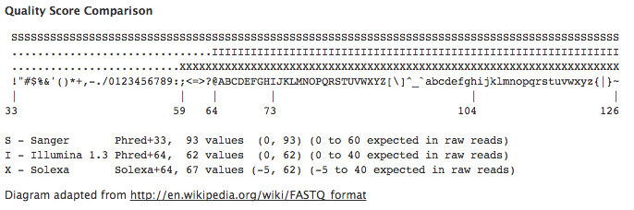
Formats: FASTQ – ‘sequence with quality’
@HWI-ST1155:109:D0L23ACXX:5:1101:2247:1985 1:N:0:GCCAAT
NTTCCTTTGACAAATATTAAAATTAAGAATCAAATATGGTAGTGTATGCCAAGACCTAGTCTGAGTCAGTAGGAT
+
#1=DDFFFHHHHHJJJJJJIJJJIJJIJIJJJJJJJIJI?FHFHEIJEIIIEGFFHHGIGHIJEIFGIJHGDIII
Very low Phred score, less than 10 (35 - 33 = 2)
Wikipedia

Slide 21
Formats: FASTQ – ‘sequence with quality’
@HWI-ST1155:109:D0L23ACXX:5:1101:2247:1985 1:N:0:GCCAAT
NTTCCTTTGACAAATATTAAAATTAAGAATCAAATATGGTAGTGTATGCCAAGACCTAGTCTGAGTCAGTAGGAT
+
#1=DDFFFHHHHHJJJJJJIJJJIJJIJIJJJJJJJIJI?FHFHEIJEIIIEGFFHHGIGHIJEIFGIJHGDIII
Low Phred score, < 20 (49– 33 = 16)
Wikipedia

Slide 22
Formats: FASTQ – ‘sequence with quality’
@HWI-ST1155:109:D0L23ACXX:5:1101:2247:1985 1:N:0:GCCAAT
NTTCCTTTGACAAATATTAAAATTAAGAATCAAATATGGTAGTGTATGCCAAGACCTAGTCTGAGTCAGTAGGAT
+
#1=DDFFFHHHHHJJJJJJIJJJIJJIJIJJJJJJJIJI?FHFHEIJEIIIEGFFHHGIGHIJEIFGIJHGDIII
High quality reads, Phred score >= 30 (63 – 33 = 30)
Wikipedia

Slide 23
Binned quality scores
Modern Illumina sequencers may have a subset of quality scores instead of full range
Saves space when compressing files (only ~4-5 ASCII symbols to represent quality vs 40+)
@A00835:592:HVGNMDRX2:1:2101:6994:1016 1:N:0:TCTAGTCC+GATTACCG
CGTCTATCATACGATGATTTAGATTATGATTCAAACTACATTTCTCTTTT
+
F,:FFFFFF:FF:FFFFFF::FF:FFF:FFFFFF:,:FFFFFFFFF,F,F
# - Q2
, - Q11
: - Q25
F - Q37
HPCBio data

Slide 24
Basic Experimental Design

Slide 25
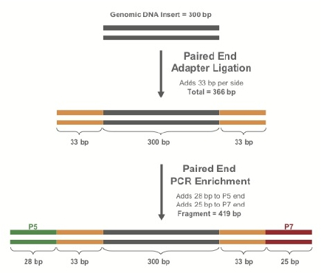
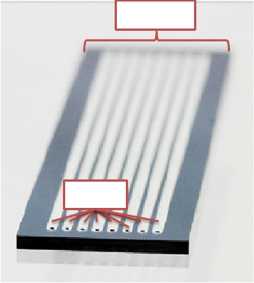
Terminology
Lane – Physical sequencing lane
Library – Unit of DNA prep pooled together
Sample – Single individual
Cohort – Collection of samples analyzed together
This information is useful for read groups
flowcell
lane
GATK Workshop
Notes:
All the information here (along with the sequencing platform) is useful for tracking information using read groups

Slide 26
Terminology
WGS vs Exome Capture
  Whole genome sequencing – everything
    High cost if per sample is deep sequence (>25-30x)
    Can run multisample low coverage samples
  Exome capture – targeted sequencing (1-5% of genome)
    Deeper coverage of transcribed regions
    Miss other important non-coding regions (promoters, introns, enhancers, small RNA, etc)
Notes:
In general, the approach you want to take is entirely dictated on budget and number of samples, though the cost of sequencing in 2023 is pretty cheap compared.
A whole human genome sample can be sequenced for $100-200 if run with many other samples at the same time.
However, if you want to run 1000’s of samples and only care about gene regions, you may want to switch to a targeted technology

Slide 27
GATK Workshop
Notes:
Do you need sensitivity? Higher sequence depth is needed, but may need to limit number of samples

Slide 28
Data requirements per sample |  |  | Variant detection among multiple samples
Target bases | 3 Gb |  | Variants found per sample | ~4-5M
Coverage | Avg. 30x |  | Percent of variation in genome | >99%
# sequenced bases | 100 Gb |  | Pr{singleton discovery} | >99%
# per lane (HiSeq 4000) | ~1 |  | Pr{common allele discovery} | >99%
# per lane (NovaSeq, S4) | ~8-9
GATK Workshop
NovaSeq 6000 = 750-850 Gb/lane (2x150nt, S4 lane)

Slide 29
Data requirements per sample |  |  | Variant detection among multiple samples
Target bases | 3 Gb |  | Variants found per sample | ~3M
Coverage | Avg. 5x |  | Percent of variation in genome | ~90%
# sequenced bases | 15 Gb |  | Pr{singleton discovery} | < 50%
# per lane (HiSeq 4000) | ~6 |  | Pr{common allele discovery} | ~99%
# per lane (NovaSeq, S4) | ~50
GATK Workshop
NovaSeq 6000 = 750-850 Gb/lane (2x150nt, S4 lane)

Slide 30
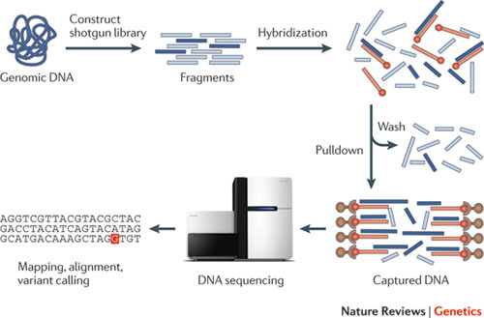
Targeted approach - Exome Capture
GATK Workshop

Slide 31
Targeted!
Based on Illumina ‘DNA Prep with Enrichment’ panel
Data requirements per sample |  |  | Variant detection among multiple samples
Target bases | 45-60 Mb |  | Variants found per sample | ~25-45k
Coverage | >90% 20x* |  | Percent of variation in genome | 0.005
# sequenced bases | 4 Gb |  | Pr{singleton discovery} | ~95%
# per lane (HiSeq 4000) | 20 |  | Pr{common allele discovery} | ~95%
# per lane (NovaSeq, S4) | ~384*
GATK Workshop
NovaSeq 6000 = 750-850 Gb/lane (2x150nt, S4 lane)

Slide 32
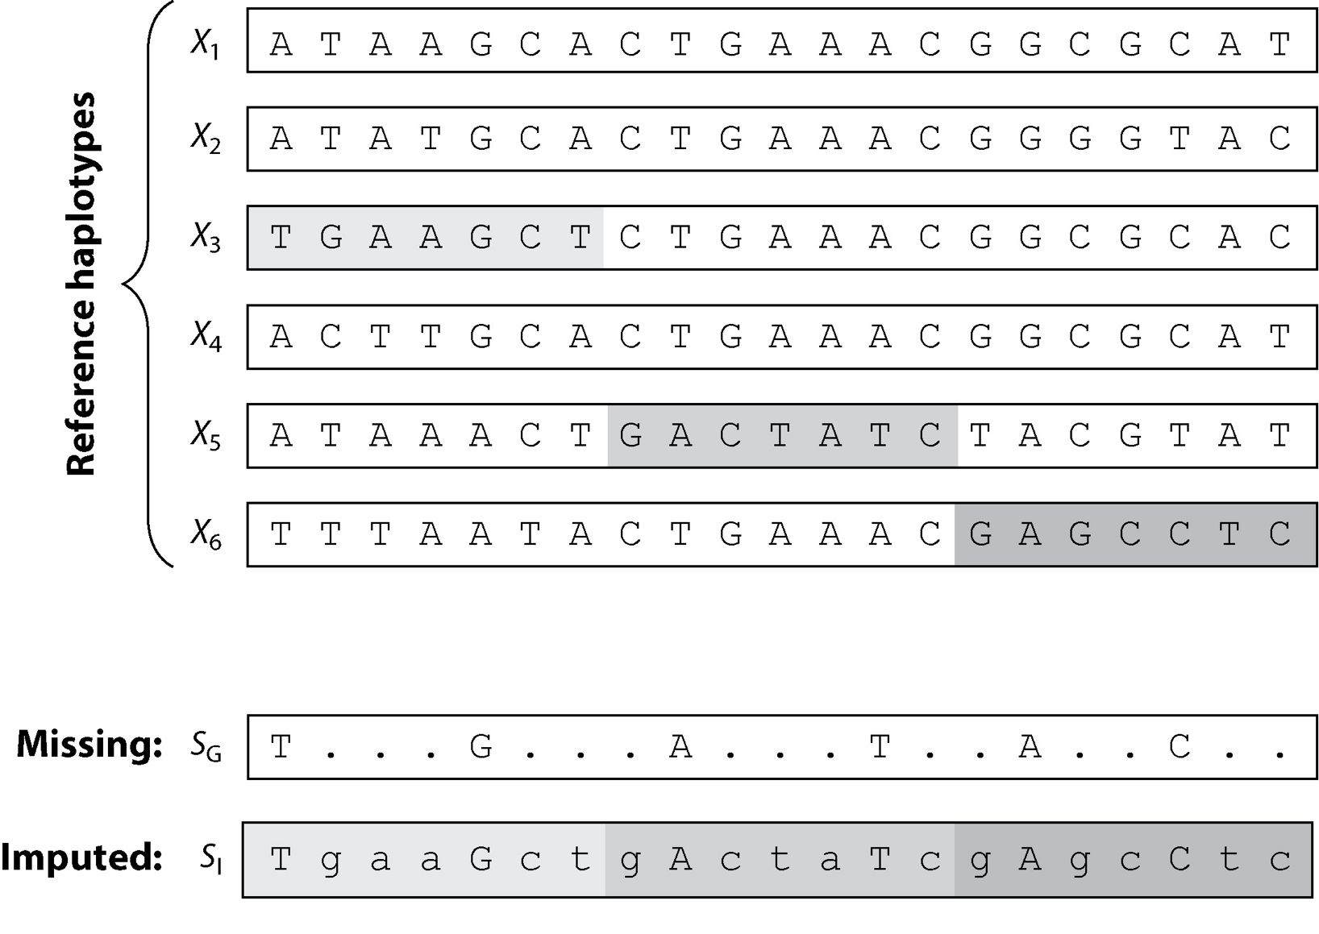
Imputation
You can use services which impute (infer) additional genotypes
Use known haplotypes from ‘gold standard’ (trusted) sources
  1000 genomes
  HapMap
Very common step in GWAS studies to deal with missing information (arrays)
Can impute variants with low pass sequencing (less than 5x coverage)
Das S, et al. Annu Rev. Genom. Hum. Genet. 19:73-96
Notes:
Note that imputation is completely based on depth of sequence data and the quality of the panel (known haplotypes and variants)
From the paper: Figure 2 An illustration of genotype imputation, showing the process of imputation for a study haplotype (S_{G}) genotyped at 6 markers using a reference panel of sequenced haplotypes at 21 markers. The alleles in S_{G} are used to match short segments from the reference panel. For example, in the first genomic segment, the alleles T and G imply that the corresponding segment might have been copied from haplotype X3. In the second segment, the alleles A and T imply that haplotype X5 might have been copied. Proceeding similarly, the study haplotype can be represented as a mosaic of DNA segments from haplotypes X3, X5, and X6. Consequently, the missing sites can be imputed to obtain the final imputed haplotype, SI.

Slide 33
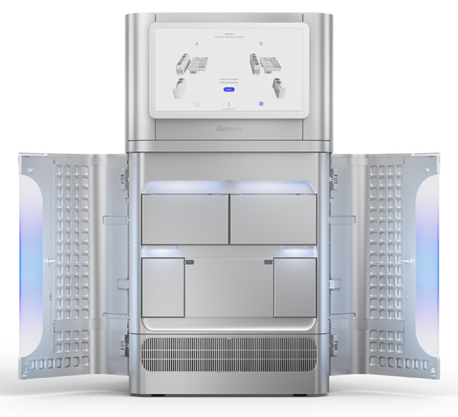
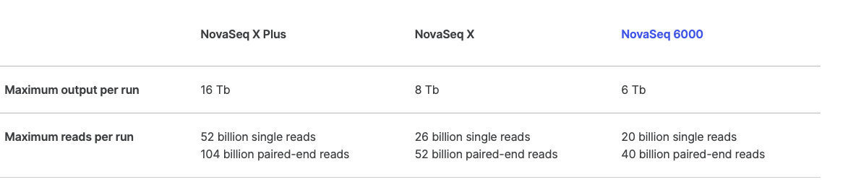
NovaSeq X
Will have secondary analyses built in
(using on-board/cloud DRAGEN Bio-IT).
This includes human variant calling
Illumina NovaSeq X
Notes:
A word about Illumina’s upcoming updates. Their new sequencer can generate way more data than before, and faster.

Slide 34
General variant calling pipelines
Common pattern:
  Align reads
  Optimize alignment
  Call variants
  Filter called variants
  Annotate

Slide 35
Tool/Workflow examples
Examples (standard variant calling)
  Genome Analysis Toolkit (GATK)
  samtools mpileup
  VarScan2
  freeBayes
  Commercial
    Illumina DRAGEN – GATK using FPGA (see the NovaSeq X slide!!!)
    Sentieon – accelerated CPU
    Parabricks – GPU-based

Slide 36
Tool/Workflow examples

Slide 37
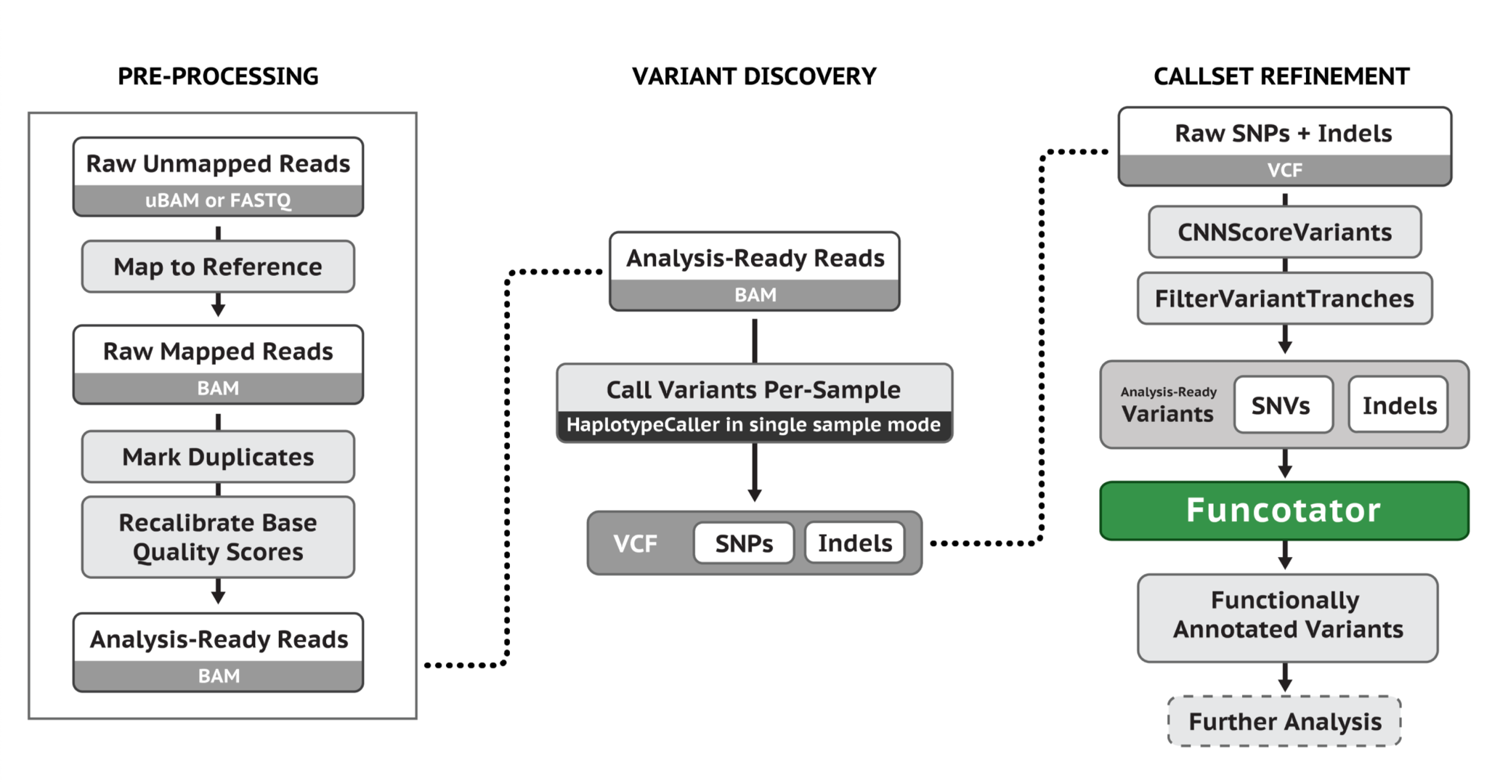
GATK – Single Sample Germline Calls
GATK Germline Calling

Slide 38
GATK – Somatic Calls (Tumor)
GATK Somatic Callling

Slide 39
GATK – RNA-Seq
GATK RNA-Seq

Slide 40
Standard GATK Workflow
aka ‘GATK Best Practices’

Slide 41
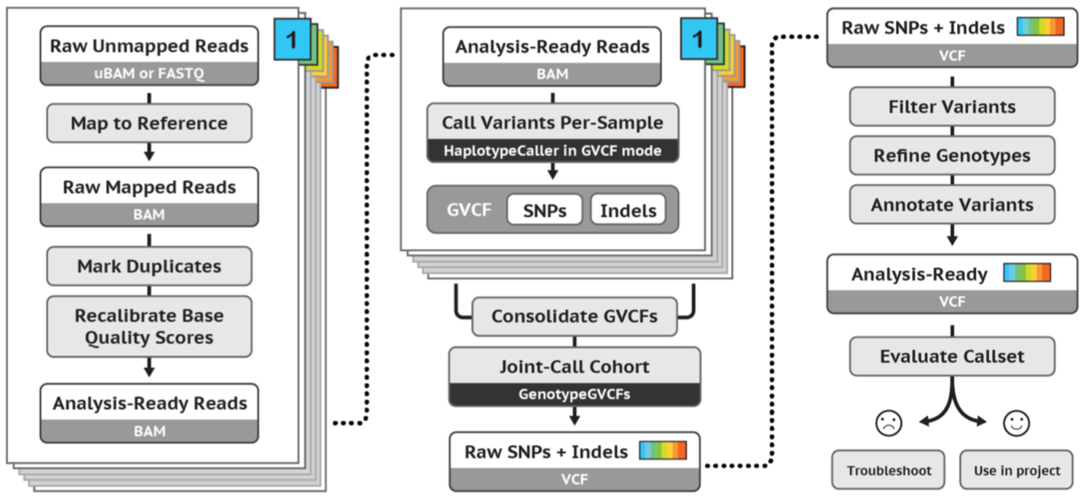
GATK Pipeline – Germline Calls
GATK Best Practices

Slide 42
Phase I : NGS Data Processing
GATK Best Practices

Slide 43
Read groups
Information about the samples and how they were run
  ID – Simple unique identifier each read belongs to
  LB – Library
  SM – Sample name
  PL – Sequencing platform (Illumina, PacBio, etc)
  PU – Platform unit barcode or identifier (flow cell, lane, or similar unit information)
  PI – Insert size (fragment size) for library (optional)
  CN – Sequencing center name (optional)
  DS – Description (optional)
  DT – Run date (optional)
  PM – Platform model (optional)
  PG – Program group (optional)
GATK

Slide 44
Phase I
NGS Data Processing
  Alignment of raw reads
  Duplicate marking
  Base quality recalibration
  Local realignment no longer required

Slide 45
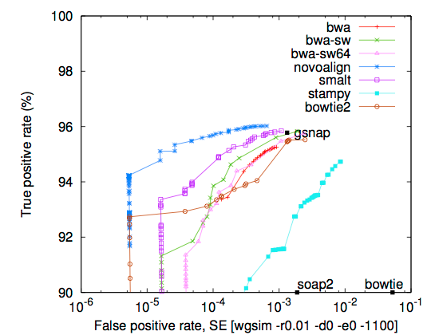
Phase I : Alignment of raw reads
Accuracy
  Sensitivity – maps reads accurately, allowing for errors or variation
  Specificity – maps to the correct region
Unique vs. multi-mapped reads
  Should we retain reads mapping to repetitive regions?
  May depend on the application
BWA MEM is currently recommended
Minimap2 is also good, esp for long reads
You can add read groups at this stage!!!
Heng Li’s aligner assessment

Slide 46
aka MAPQ
GATK Workshop
Notes:
Read alignment is a notoriously hard problem, especially when aligning millions to billions of reads.
Need some method for evaluating accuracy
MAPQ indicates confidence that alignment is mapped accurately, based on Phred scale
(MAPQ of 30 for example indicates that prob alignment is erroneous is 1/1000)

Slide 47
Alignment output : SAM/BAM
SAM – Sequence Alignment/Map format; BAM – BGZF compressed (binary) SAM output
  Stores alignment information
  Specification: http://samtools.sourceforge.net/SAM1.pdf
  Contains FASTQ reads, quality information, meta data, alignment information, etc.
  May be unsorted, or sorted by sequence name or genome coordinates
  Sorted BAM may be accompanied by an index file (.bai) (only if coord-sorted)
    Relatively simple format makes it easy to extract specific features, e.g. genomic locations
    Makes the alignment information easily accessible to downstream applications (large genome file not necessary)
Files are typically very large: 10-100’s of GB

Slide 48
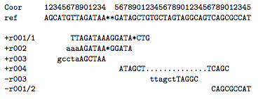
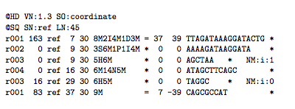
Alignment output : SAM/BAM
Alignment
SAM format

Slide 49
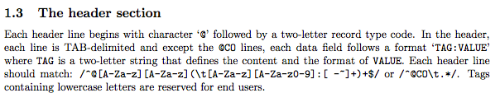
Alignment output : SAM/BAM
SAM format

Slide 50
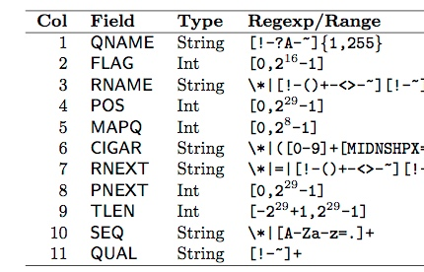
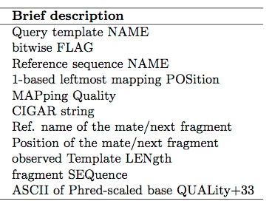
SAM format

Slide 51
SAM format

Slide 52
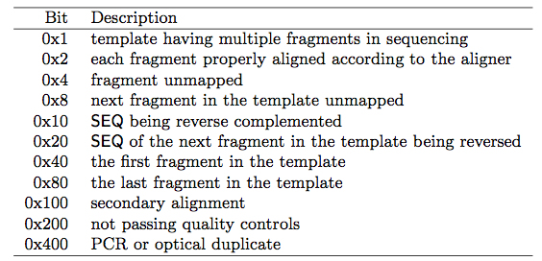
Bit Flags
Hex 0x80 0x40 0x20 0x10 0x8 0x4 0x2 0x1
Bit 128 64 32 16 8 4 2 1
r001 1 1 1 1 = 163

Slide 53
SAM format

Slide 54
SAM format

Slide 55
SAM format

Slide 56
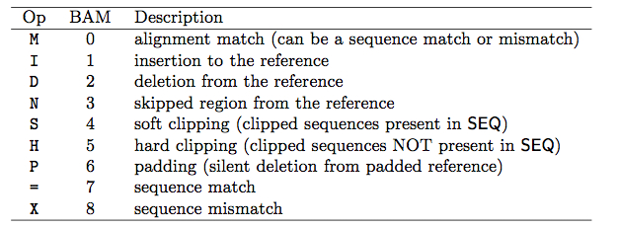
CIGAR

Slide 57
SAM format

Slide 58
SAM format

Slide 59
SAM format

Slide 60
SAM format

Slide 61
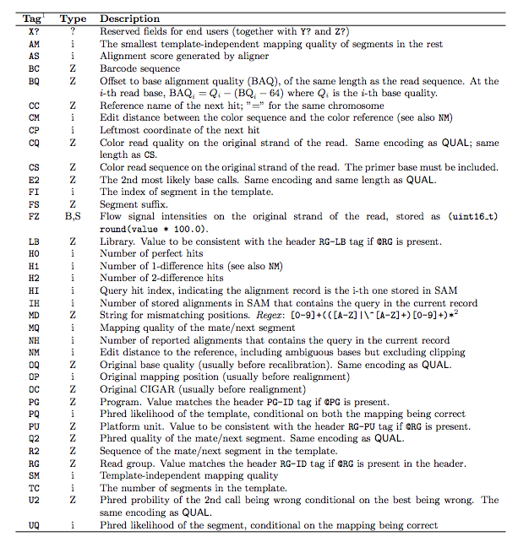
Alignment output : SAM/BAM
Too many to go over!!!

Slide 62
Alignment output : SAM/BAM
Tools
  samtools
  Picard
Mining information from a properly formatted BAM file:
  Reads in a region (good for RNA-Seq, ChIP-Seq)
  Quality of alignments
  Coverage
  …and of course, differences (variants)

Slide 63
Phase I : Duplicate Marking
GATK Workshop

Slide 64
Phase I : Duplicate Marking
GATK Workshop

Slide 65
Phase I : Sorting, Read Groups
GATK Workshop

Slide 66
Phase I : Local Realignment
No longer needed (if you use HaplotypeCaller)
Realign around indels
Common misalignment problem
Can cause problems with base quality recalibration, variant calls

Slide 68
Phase I : Base Quality Score Recalibration
Quality scores from sequencers are biased and somewhat inaccurate
Quality scores are critical for all downstream analysis
Biases are a major contributor to bad variant calls
Caveat:
  In practice, requires having a known set of variants (dbSNP)
BQSR (GATK Link)

Slide 69
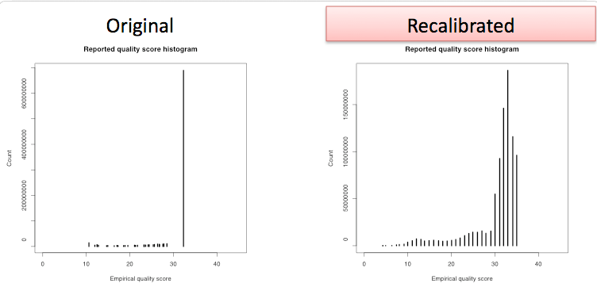
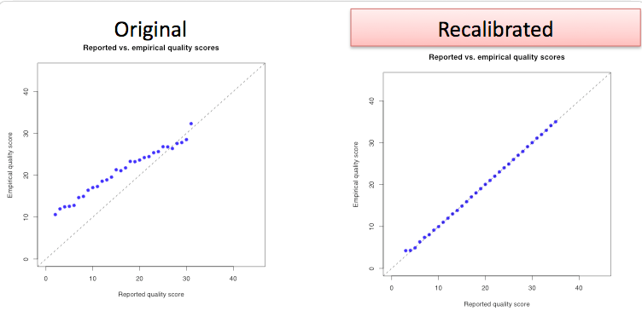
Also works for binned quality scores (NovaSeq)

Slide 70
Phase II : Variant Discovery/Genotyping
GATK Best Practices

Slide 71
Phase II : Variant Calling
This is where we actually call the variants
Prior steps leading up to this help remove potential causes of variant calling errors
I’ll be covering the current recommended caller, the HaplotypeCaller. I have a slide on the legacy UnifiedGenotyper (not included in GATK v4) included in this talk as well.

Slide 72
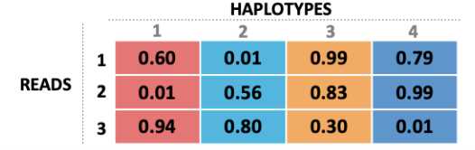
Phase II : Variant Calling
HaplotypeCaller
Assembly-based approach
  Define active regions (evidence for variation)
  Re-assemble active region, align against reference
    Get a list of possible haplotypes
    No need for local realignment
  Determine likelihoods based on reads compared to haplotypes
  Find most likely genotype at each site, emit as a call
HaplotypeCaller in a nutshell
(Broad Institute)

Slide 73
Phase II : Variant Calling
UnifiedGenotyper
In general, uses a probabilistic method, e.g. Bayesian model
  Determine the possible SNP and indel alleles
  Only “good bases” are included:
    Those satisfying minimum base quality, mapping read quality, pair mapping quality, etc.
  Compute, for each sample, for each genotype, likelihoods of data given genotypes
  Compute the allele frequency distribution to determine most likely allele count; emit a variant call if determined
  If we are going to emit a variant, assign a genotype to each sample
Note this assumes alignment is correct, so should perform local realignment
No longer recommended nor supported (not in GATK v4!)

Slide 74
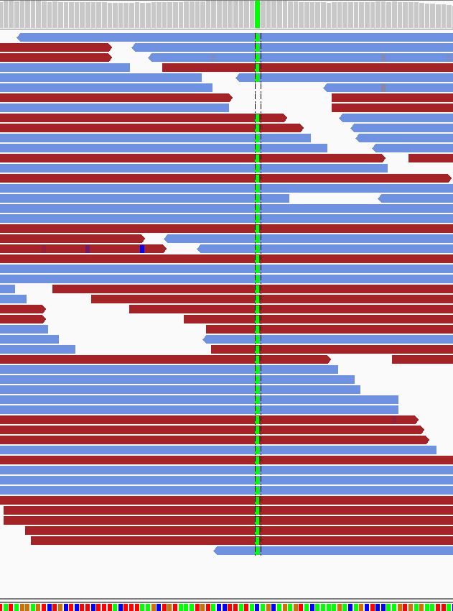
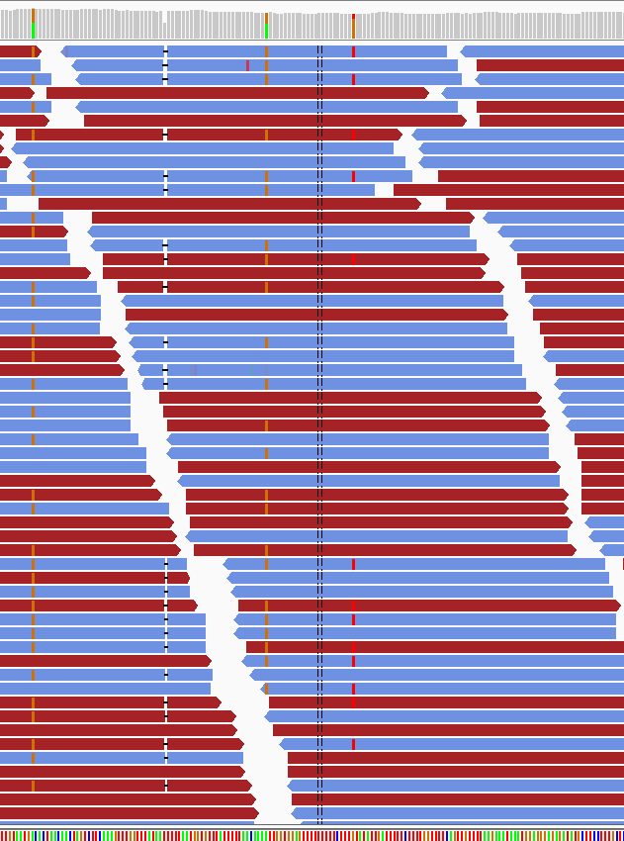
Het
REF: 50%
ALT: 50%
??
REF: 77%
ALT: 23%
Hom
REF: 0%
ALT: 100%

Slide 75
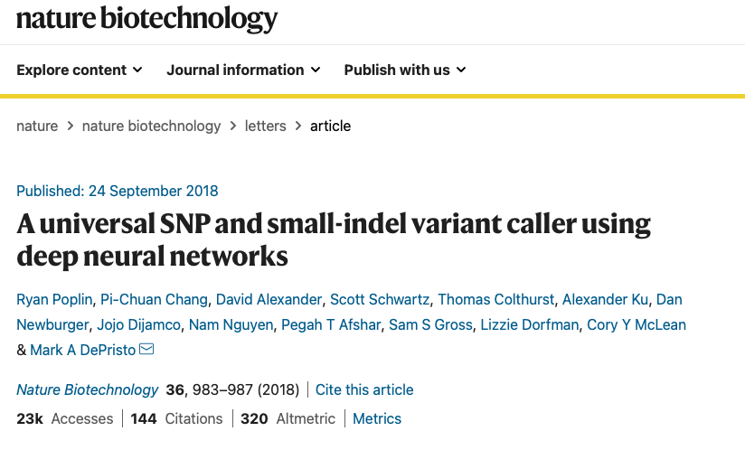
DeepVariant
‘Deep learning’ based variant calling tool
NOT PART OF GATK
Considered more accurate than HC
https://github.com/google/deepvariant

Slide 76
Output?

Slide 77
Variant calling output: VCF
Col | Field | Description
1 | CHROM | Chromosome name
2 | POS | 1-based position. For an indel, this is the position preceding the indel.
3 | ID | Variant identifier. Usually the dbSNP rsID.
4 | REF | Reference sequence at POS involved in the variant. For a SNP, it is a single base.
5 | ALT | Comma delimited list of alternative seuqence(s).
6 | QUAL | Phred-scaled probability of all samples being homozygous reference.
7 | FILTER | Semicolon delimited list of filters that the variant fails to pass.
8 | INFO | Semicolon delimited list of variant information.
9 | FORMAT | Colon delimited list of the format of individual genotypes in the following fields.
10+ | Sample(s) | Individual genotype information defined by FORMAT.
VCF (Variant Call Format)
Like SAM/BAM, also has a versioned specification
  From the 1000 Genomes Project
  http://www.1000genomes.org/wiki/Analysis/Variant%20Call%20Format/vcf-variant-call-format-version-41
Structure (2 parts):
  Header (metadata)
  Variant calls (one or more samples)
Variant calls have multiple fields (right)

Slide 78
Formats: VCF
##fileformat=VCFv4.1
##fileDate=20090805
##source=myImputationProgramV3.1
##reference=file:///seq/references/1000GenomesPilot-NCBI36.fasta
##contig=<ID=20,length=62435964,assembly=B36,md5=f126cdf8a6e0c7f379d618ff66beb2da,species="Homo sapiens",taxonomy=x>
##phasing=partial
##INFO=<ID=NS,Number=1,Type=Integer,Description="Number of Samples With Data">
##INFO=<ID=DP,Number=1,Type=Integer,Description="Total Depth">
##INFO=<ID=AF,Number=A,Type=Float,Description="Allele Frequency">
##INFO=<ID=AA,Number=1,Type=String,Description="Ancestral Allele">
##INFO=<ID=DB,Number=0,Type=Flag,Description="dbSNP membership, build 129">
##INFO=<ID=H2,Number=0,Type=Flag,Description="HapMap2 membership">
##FILTER=<ID=q10,Description="Quality below 10">
##FILTER=<ID=s50,Description="Less than 50% of samples have data">
##FORMAT=<ID=GT,Number=1,Type=String,Description="Genotype">
##FORMAT=<ID=GQ,Number=1,Type=Integer,Description="Genotype Quality">
##FORMAT=<ID=DP,Number=1,Type=Integer,Description="Read Depth">
##FORMAT=<ID=HQ,Number=2,Type=Integer,Description="Haplotype Quality">
#CHROM POS ID REF ALT QUAL FILTER INFO FORMAT NA00001 NA00002 NA00003
20 14370 rs6054257 G A 29 PASS NS=3;DP=14;AF=0.5;DB;H2 GT:GQ:DP:HQ 0|0:48:1:51,51 1|0:48:8:51,51 1/1:43:5:.,.
20 17330 . T A 3 q10 NS=3;DP=11;AF=0.017 GT:GQ:DP:HQ 0|0:49:3:58,50 0|1:3:5:65,3 0/0:41:3
20 1110696 rs6040355 A G,T 67 PASS NS=2;DP=10;AF=0.333,0.667;AA=T;DB GT:GQ:DP:HQ 1|2:21:6:23,27 2|1:2:0:18,2 2/2:35:4
20 1230237 . T . 47 PASS NS=3;DP=13;AA=T GT:GQ:DP:HQ 0|0:54:7:56,60 0|0:48:4:51,51 0/0:61:2
20 1234567 microsat1 GTC G,GTCT 50 PASS NS=3;DP=9;AA=G GT:GQ:DP 0/1:35:4 0/2:17:2 1/1:40:3

Slide 79
Formats: VCF - Header
##fileformat=VCFv4.1
##fileDate=20090805
##source=myImputationProgramV3.1
##reference=file:///seq/references/1000GenomesPilot-NCBI36.fasta
##contig=<ID=20,length=62435964,assembly=B36,md5=f126cdf8a6e0c7f379d618ff66beb2da,species="Homo sapiens",taxonomy=x>
##phasing=partial
##INFO=<ID=NS,Number=1,Type=Integer,Description="Number of Samples With Data">
##INFO=<ID=DP,Number=1,Type=Integer,Description="Total Depth">
##INFO=<ID=AF,Number=A,Type=Float,Description="Allele Frequency">
##INFO=<ID=AA,Number=1,Type=String,Description="Ancestral Allele">
##INFO=<ID=DB,Number=0,Type=Flag,Description="dbSNP membership, build 129">
##INFO=<ID=H2,Number=0,Type=Flag,Description="HapMap2 membership">
##FILTER=<ID=q10,Description="Quality below 10">
##FILTER=<ID=s50,Description="Less than 50% of samples have data">
##FORMAT=<ID=GT,Number=1,Type=String,Description="Genotype">
##FORMAT=<ID=GQ,Number=1,Type=Integer,Description="Genotype Quality">
##FORMAT=<ID=DP,Number=1,Type=Integer,Description="Read Depth">
##FORMAT=<ID=HQ,Number=2,Type=Integer,Description="Haplotype Quality">
#CHROM POS ID REF ALT QUAL FILTER INFO FORMAT NA00001 NA00002 NA00003
20 14370 rs6054257 G A 29 PASS NS=3;DP=14;AF=0.5;DB;H2 GT:GQ:DP:HQ 0|0:48:1:51,51 1|0:48:8:51,51 1/1:43:5:.,.
20 17330 . T A 3 q10 NS=3;DP=11;AF=0.017 GT:GQ:DP:HQ 0|0:49:3:58,50 0|1:3:5:65,3 0/0:41:3
20 1110696 rs6040355 A G,T 67 PASS NS=2;DP=10;AF=0.333,0.667;AA=T;DB GT:GQ:DP:HQ 1|2:21:6:23,27 2|1:2:0:18,2 2/2:35:4
20 1230237 . T . 47 PASS NS=3;DP=13;AA=T GT:GQ:DP:HQ 0|0:54:7:56,60 0|0:48:4:51,51 0/0:61:2
20 1234567 microsat1 GTC G,GTCT 50 PASS NS=3;DP=9;AA=G GT:GQ:DP 0/1:35:4 0/2:17:2 1/1:40:3

Slide 80
Formats: VCF – Variant calls
##fileformat=VCFv4.1
##fileDate=20090805
##source=myImputationProgramV3.1
##reference=file:///seq/references/1000GenomesPilot-NCBI36.fasta
##contig=<ID=20,length=62435964,assembly=B36,md5=f126cdf8a6e0c7f379d618ff66beb2da,species="Homo sapiens",taxonomy=x>
##phasing=partial
##INFO=<ID=NS,Number=1,Type=Integer,Description="Number of Samples With Data">
##INFO=<ID=DP,Number=1,Type=Integer,Description="Total Depth">
##INFO=<ID=AF,Number=A,Type=Float,Description="Allele Frequency">
##INFO=<ID=AA,Number=1,Type=String,Description="Ancestral Allele">
##INFO=<ID=DB,Number=0,Type=Flag,Description="dbSNP membership, build 129">
##INFO=<ID=H2,Number=0,Type=Flag,Description="HapMap2 membership">
##FILTER=<ID=q10,Description="Quality below 10">
##FILTER=<ID=s50,Description="Less than 50% of samples have data">
##FORMAT=<ID=GT,Number=1,Type=String,Description="Genotype">
##FORMAT=<ID=GQ,Number=1,Type=Integer,Description="Genotype Quality">
##FORMAT=<ID=DP,Number=1,Type=Integer,Description="Read Depth">
##FORMAT=<ID=HQ,Number=2,Type=Integer,Description="Haplotype Quality">
#CHROM POS ID REF ALT QUAL FILTER INFO FORMAT NA00001 NA00002 NA00003
20 14370 rs6054257 G A 29 PASS NS=3;DP=14;AF=0.5;DB;H2 GT:GQ:DP:HQ 0|0:48:1:51,51 1|0:48:8:51,51 1/1:43:5:.,.
20 17330 . T A 3 q10 NS=3;DP=11;AF=0.017 GT:GQ:DP:HQ 0|0:49:3:58,50 0|1:3:5:65,3 0/0:41:3
20 1110696 rs6040355 A G,T 67 PASS NS=2;DP=10;AF=0.333,0.667;AA=T;DB GT:GQ:DP:HQ 1|2:21:6:23,27 2|1:2:0:18,2 2/2:35:4
20 1230237 . T . 47 PASS NS=3;DP=13;AA=T GT:GQ:DP:HQ 0|0:54:7:56,60 0|0:48:4:51,51 0/0:61:2
20 1234567 microsat1 GTC G,GTCT 50 PASS NS=3;DP=9;AA=G GT:GQ:DP 0/1:35:4 0/2:17:2 1/1:40:3

Slide 81
Formats: VCF – Chromosome and position
##fileformat=VCFv4.1
##fileDate=20090805
##source=myImputationProgramV3.1
##reference=file:///seq/references/1000GenomesPilot-NCBI36.fasta
##contig=<ID=20,length=62435964,assembly=B36,md5=f126cdf8a6e0c7f379d618ff66beb2da,species="Homo sapiens",taxonomy=x>
##phasing=partial
##INFO=<ID=NS,Number=1,Type=Integer,Description="Number of Samples With Data">
##INFO=<ID=DP,Number=1,Type=Integer,Description="Total Depth">
##INFO=<ID=AF,Number=A,Type=Float,Description="Allele Frequency">
##INFO=<ID=AA,Number=1,Type=String,Description="Ancestral Allele">
##INFO=<ID=DB,Number=0,Type=Flag,Description="dbSNP membership, build 129">
##INFO=<ID=H2,Number=0,Type=Flag,Description="HapMap2 membership">
##FILTER=<ID=q10,Description="Quality below 10">
##FILTER=<ID=s50,Description="Less than 50% of samples have data">
##FORMAT=<ID=GT,Number=1,Type=String,Description="Genotype">
##FORMAT=<ID=GQ,Number=1,Type=Integer,Description="Genotype Quality">
##FORMAT=<ID=DP,Number=1,Type=Integer,Description="Read Depth">
##FORMAT=<ID=HQ,Number=2,Type=Integer,Description="Haplotype Quality">
#CHROM POS ID REF ALT QUAL FILTER INFO FORMAT NA00001 NA00002 NA00003
20 14370 rs6054257 G A 29 PASS NS=3;DP=14;AF=0.5;DB;H2 GT:GQ:DP:HQ 0|0:48:1:51,51 1|0:48:8:51,51 1/1:43:5:.,.
20 17330 . T A 3 q10 NS=3;DP=11;AF=0.017 GT:GQ:DP:HQ 0|0:49:3:58,50 0|1:3:5:65,3 0/0:41:3
20 1110696 rs6040355 A G,T 67 PASS NS=2;DP=10;AF=0.333,0.667;AA=T;DB GT:GQ:DP:HQ 1|2:21:6:23,27 2|1:2:0:18,2 2/2:35:4
20 1230237 . T . 47 PASS NS=3;DP=13;AA=T GT:GQ:DP:HQ 0|0:54:7:56,60 0|0:48:4:51,51 0/0:61:2
20 1234567 microsat1 GTC G,GTCT 50 PASS NS=3;DP=9;AA=G GT:GQ:DP 0/1:35:4 0/2:17:2 1/1:40:3

Slide 82
Formats: VCF - ID
##fileformat=VCFv4.1
##fileDate=20090805
##source=myImputationProgramV3.1
##reference=file:///seq/references/1000GenomesPilot-NCBI36.fasta
##contig=<ID=20,length=62435964,assembly=B36,md5=f126cdf8a6e0c7f379d618ff66beb2da,species="Homo sapiens",taxonomy=x>
##phasing=partial
##INFO=<ID=NS,Number=1,Type=Integer,Description="Number of Samples With Data">
##INFO=<ID=DP,Number=1,Type=Integer,Description="Total Depth">
##INFO=<ID=AF,Number=A,Type=Float,Description="Allele Frequency">
##INFO=<ID=AA,Number=1,Type=String,Description="Ancestral Allele">
##INFO=<ID=DB,Number=0,Type=Flag,Description="dbSNP membership, build 129">
##INFO=<ID=H2,Number=0,Type=Flag,Description="HapMap2 membership">
##FILTER=<ID=q10,Description="Quality below 10">
##FILTER=<ID=s50,Description="Less than 50% of samples have data">
##FORMAT=<ID=GT,Number=1,Type=String,Description="Genotype">
##FORMAT=<ID=GQ,Number=1,Type=Integer,Description="Genotype Quality">
##FORMAT=<ID=DP,Number=1,Type=Integer,Description="Read Depth">
##FORMAT=<ID=HQ,Number=2,Type=Integer,Description="Haplotype Quality">
#CHROM POS ID REF ALT QUAL FILTER INFO FORMAT NA00001 NA00002 NA00003
20 14370 rs6054257 G A 29 PASS NS=3;DP=14;AF=0.5;DB;H2 GT:GQ:DP:HQ 0|0:48:1:51,51 1|0:48:8:51,51 1/1:43:5:.,.
20 17330 . T A 3 q10 NS=3;DP=11;AF=0.017 GT:GQ:DP:HQ 0|0:49:3:58,50 0|1:3:5:65,3 0/0:41:3
20 1110696 rs6040355 A G,T 67 PASS NS=2;DP=10;AF=0.333,0.667;AA=T;DB GT:GQ:DP:HQ 1|2:21:6:23,27 2|1:2:0:18,2 2/2:35:4
20 1230237 . T . 47 PASS NS=3;DP=13;AA=T GT:GQ:DP:HQ 0|0:54:7:56,60 0|0:48:4:51,51 0/0:61:2
20 1234567 microsat1 GTC G,GTCT 50 PASS NS=3;DP=9;AA=G GT:GQ:DP 0/1:35:4 0/2:17:2 1/1:40:3

Slide 83
Formats: VCF – Reference and alternate alleles
##fileformat=VCFv4.1
##fileDate=20090805
##source=myImputationProgramV3.1
##reference=file:///seq/references/1000GenomesPilot-NCBI36.fasta
##contig=<ID=20,length=62435964,assembly=B36,md5=f126cdf8a6e0c7f379d618ff66beb2da,species="Homo sapiens",taxonomy=x>
##phasing=partial
##INFO=<ID=NS,Number=1,Type=Integer,Description="Number of Samples With Data">
##INFO=<ID=DP,Number=1,Type=Integer,Description="Total Depth">
##INFO=<ID=AF,Number=A,Type=Float,Description="Allele Frequency">
##INFO=<ID=AA,Number=1,Type=String,Description="Ancestral Allele">
##INFO=<ID=DB,Number=0,Type=Flag,Description="dbSNP membership, build 129">
##INFO=<ID=H2,Number=0,Type=Flag,Description="HapMap2 membership">
##FILTER=<ID=q10,Description="Quality below 10">
##FILTER=<ID=s50,Description="Less than 50% of samples have data">
##FORMAT=<ID=GT,Number=1,Type=String,Description="Genotype">
##FORMAT=<ID=GQ,Number=1,Type=Integer,Description="Genotype Quality">
##FORMAT=<ID=DP,Number=1,Type=Integer,Description="Read Depth">
##FORMAT=<ID=HQ,Number=2,Type=Integer,Description="Haplotype Quality">
#CHROM POS ID REF ALT QUAL FILTER INFO FORMAT NA00001 NA00002 NA00003
20 14370 rs6054257 G A 29 PASS NS=3;DP=14;AF=0.5;DB;H2 GT:GQ:DP:HQ 0|0:48:1:51,51 1|0:48:8:51,51 1/1:43:5:.,.
20 17330 . T A 3 q10 NS=3;DP=11;AF=0.017 GT:GQ:DP:HQ 0|0:49:3:58,50 0|1:3:5:65,3 0/0:41:3
20 1110696 rs6040355 A G,T 67 PASS NS=2;DP=10;AF=0.333,0.667;AA=T;DB GT:GQ:DP:HQ 1|2:21:6:23,27 2|1:2:0:18,2 2/2:35:4
20 1230237 . T . 47 PASS NS=3;DP=13;AA=T GT:GQ:DP:HQ 0|0:54:7:56,60 0|0:48:4:51,51 0/0:61:2
20 1234567 microsat1 GTC G,GTCT 50 PASS NS=3;DP=9;AA=G GT:GQ:DP 0/1:35:4 0/2:17:2 1/1:40:3

Slide 84
Formats: VCF – Variant quality
##fileformat=VCFv4.1
##fileDate=20090805
##source=myImputationProgramV3.1
##reference=file:///seq/references/1000GenomesPilot-NCBI36.fasta
##contig=<ID=20,length=62435964,assembly=B36,md5=f126cdf8a6e0c7f379d618ff66beb2da,species="Homo sapiens",taxonomy=x>
##phasing=partial
##INFO=<ID=NS,Number=1,Type=Integer,Description="Number of Samples With Data">
##INFO=<ID=DP,Number=1,Type=Integer,Description="Total Depth">
##INFO=<ID=AF,Number=A,Type=Float,Description="Allele Frequency">
##INFO=<ID=AA,Number=1,Type=String,Description="Ancestral Allele">
##INFO=<ID=DB,Number=0,Type=Flag,Description="dbSNP membership, build 129">
##INFO=<ID=H2,Number=0,Type=Flag,Description="HapMap2 membership">
##FILTER=<ID=q10,Description="Quality below 10">
##FILTER=<ID=s50,Description="Less than 50% of samples have data">
##FORMAT=<ID=GT,Number=1,Type=String,Description="Genotype">
##FORMAT=<ID=GQ,Number=1,Type=Integer,Description="Genotype Quality">
##FORMAT=<ID=DP,Number=1,Type=Integer,Description="Read Depth">
##FORMAT=<ID=HQ,Number=2,Type=Integer,Description="Haplotype Quality">
#CHROM POS ID REF ALT QUAL FILTER INFO FORMAT NA00001 NA00002 NA00003
20 14370 rs6054257 G A 29 PASS NS=3;DP=14;AF=0.5;DB;H2 GT:GQ:DP:HQ 0|0:48:1:51,51 1|0:48:8:51,51 1/1:43:5:.,.
20 17330 . T A 3 q10 NS=3;DP=11;AF=0.017 GT:GQ:DP:HQ 0|0:49:3:58,50 0|1:3:5:65,3 0/0:41:3
20 1110696 rs6040355 A G,T 67 PASS NS=2;DP=10;AF=0.333,0.667;AA=T;DB GT:GQ:DP:HQ 1|2:21:6:23,27 2|1:2:0:18,2 2/2:35:4
20 1230237 . T . 47 PASS NS=3;DP=13;AA=T GT:GQ:DP:HQ 0|0:54:7:56,60 0|0:48:4:51,51 0/0:61:2
20 1234567 microsat1 GTC G,GTCT 50 PASS NS=3;DP=9;AA=G GT:GQ:DP 0/1:35:4 0/2:17:2 1/1:40:3

Slide 85
Formats: VCF – Filter
##fileformat=VCFv4.1
##fileDate=20090805
##source=myImputationProgramV3.1
##reference=file:///seq/references/1000GenomesPilot-NCBI36.fasta
##contig=<ID=20,length=62435964,assembly=B36,md5=f126cdf8a6e0c7f379d618ff66beb2da,species="Homo sapiens",taxonomy=x>
##phasing=partial
##INFO=<ID=NS,Number=1,Type=Integer,Description="Number of Samples With Data">
##INFO=<ID=DP,Number=1,Type=Integer,Description="Total Depth">
##INFO=<ID=AF,Number=A,Type=Float,Description="Allele Frequency">
##INFO=<ID=AA,Number=1,Type=String,Description="Ancestral Allele">
##INFO=<ID=DB,Number=0,Type=Flag,Description="dbSNP membership, build 129">
##INFO=<ID=H2,Number=0,Type=Flag,Description="HapMap2 membership">
##FILTER=<ID=q10,Description="Quality below 10">
##FILTER=<ID=s50,Description="Less than 50% of samples have data">
##FORMAT=<ID=GT,Number=1,Type=String,Description="Genotype">
##FORMAT=<ID=GQ,Number=1,Type=Integer,Description="Genotype Quality">
##FORMAT=<ID=DP,Number=1,Type=Integer,Description="Read Depth">
##FORMAT=<ID=HQ,Number=2,Type=Integer,Description="Haplotype Quality">
#CHROM POS ID REF ALT QUAL FILTER INFO FORMAT NA00001 NA00002 NA00003
20 14370 rs6054257 G A 29 PASS NS=3;DP=14;AF=0.5;DB;H2 GT:GQ:DP:HQ 0|0:48:1:51,51 1|0:48:8:51,51 1/1:43:5:.,.
20 17330 . T A 3 q10 NS=3;DP=11;AF=0.017 GT:GQ:DP:HQ 0|0:49:3:58,50 0|1:3:5:65,3 0/0:41:3
20 1110696 rs6040355 A G,T 67 PASS NS=2;DP=10;AF=0.333,0.667;AA=T;DB GT:GQ:DP:HQ 1|2:21:6:23,27 2|1:2:0:18,2 2/2:35:4
20 1230237 . T . 47 PASS NS=3;DP=13;AA=T GT:GQ:DP:HQ 0|0:54:7:56,60 0|0:48:4:51,51 0/0:61:2
20 1234567 microsat1 GTC G,GTCT 50 PASS NS=3;DP=9;AA=G GT:GQ:DP 0/1:35:4 0/2:17:2 1/1:40:3

Slide 86
Formats: VCF – Variant information (across samples)
##fileformat=VCFv4.1
##fileDate=20090805
##source=myImputationProgramV3.1
##reference=file:///seq/references/1000GenomesPilot-NCBI36.fasta
##contig=<ID=20,length=62435964,assembly=B36,md5=f126cdf8a6e0c7f379d618ff66beb2da,species="Homo sapiens",taxonomy=x>
##phasing=partial
##INFO=<ID=NS,Number=1,Type=Integer,Description="Number of Samples With Data">
##INFO=<ID=DP,Number=1,Type=Integer,Description="Total Depth">
##INFO=<ID=AF,Number=A,Type=Float,Description="Allele Frequency">
##INFO=<ID=AA,Number=1,Type=String,Description="Ancestral Allele">
##INFO=<ID=DB,Number=0,Type=Flag,Description="dbSNP membership, build 129">
##INFO=<ID=H2,Number=0,Type=Flag,Description="HapMap2 membership">
##FILTER=<ID=q10,Description="Quality below 10">
##FILTER=<ID=s50,Description="Less than 50% of samples have data">
##FORMAT=<ID=GT,Number=1,Type=String,Description="Genotype">
##FORMAT=<ID=GQ,Number=1,Type=Integer,Description="Genotype Quality">
##FORMAT=<ID=DP,Number=1,Type=Integer,Description="Read Depth">
##FORMAT=<ID=HQ,Number=2,Type=Integer,Description="Haplotype Quality">
#CHROM POS ID REF ALT QUAL FILTER INFO FORMAT NA00001 NA00002 NA00003
20 14370 rs6054257 G A 29 PASS NS=3;DP=14;AF=0.5;DB;H2 GT:GQ:DP:HQ 0|0:48:1:51,51 1|0:48:8:51,51 1/1:43:5:.,.
20 17330 . T A 3 q10 NS=3;DP=11;AF=0.017 GT:GQ:DP:HQ 0|0:49:3:58,50 0|1:3:5:65,3 0/0:41:3
20 1110696 rs6040355 A G,T 67 PASS NS=2;DP=10;AF=0.333,0.667;AA=T;DB GT:GQ:DP:HQ 1|2:21:6:23,27 2|1:2:0:18,2 2/2:35:4
20 1230237 . T . 47 PASS NS=3;DP=13;AA=T GT:GQ:DP:HQ 0|0:54:7:56,60 0|0:48:4:51,51 0/0:61:2
20 1234567 microsat1 GTC G,GTCT 50 PASS NS=3;DP=9;AA=G GT:GQ:DP 0/1:35:4 0/2:17:2 1/1:40:3

Slide 87
Formats: VCF - Per-sample format information
##fileformat=VCFv4.1
##fileDate=20090805
##source=myImputationProgramV3.1
##reference=file:///seq/references/1000GenomesPilot-NCBI36.fasta
##contig=<ID=20,length=62435964,assembly=B36,md5=f126cdf8a6e0c7f379d618ff66beb2da,species="Homo sapiens",taxonomy=x>
##phasing=partial
##INFO=<ID=NS,Number=1,Type=Integer,Description="Number of Samples With Data">
##INFO=<ID=DP,Number=1,Type=Integer,Description="Total Depth">
##INFO=<ID=AF,Number=A,Type=Float,Description="Allele Frequency">
##INFO=<ID=AA,Number=1,Type=String,Description="Ancestral Allele">
##INFO=<ID=DB,Number=0,Type=Flag,Description="dbSNP membership, build 129">
##INFO=<ID=H2,Number=0,Type=Flag,Description="HapMap2 membership">
##FILTER=<ID=q10,Description="Quality below 10">
##FILTER=<ID=s50,Description="Less than 50% of samples have data">
##FORMAT=<ID=GT,Number=1,Type=String,Description="Genotype">
##FORMAT=<ID=GQ,Number=1,Type=Integer,Description="Genotype Quality">
##FORMAT=<ID=DP,Number=1,Type=Integer,Description="Read Depth">
##FORMAT=<ID=HQ,Number=2,Type=Integer,Description="Haplotype Quality">
#CHROM POS ID REF ALT QUAL FILTER INFO FORMAT NA00001 NA00002 NA00003
20 14370 rs6054257 G A 29 PASS NS=3;DP=14;AF=0.5;DB;H2 GT:GQ:DP:HQ 0|0:48:1:51,51 1|0:48:8:51,51 1/1:43:5:.,.
20 17330 . T A 3 q10 NS=3;DP=11;AF=0.017 GT:GQ:DP:HQ 0|0:49:3:58,50 0|1:3:5:65,3 0/0:41:3
20 1110696 rs6040355 A G,T 67 PASS NS=2;DP=10;AF=0.333,0.667;AA=T;DB GT:GQ:DP:HQ 1|2:21:6:23,27 2|1:2:0:18,2 2/2:35:4
20 1230237 . T . 47 PASS NS=3;DP=13;AA=T GT:GQ:DP:HQ 0|0:54:7:56,60 0|0:48:4:51,51 0/0:61:2
20 1234567 microsat1 GTC G,GTCT 50 PASS NS=3;DP=9;AA=G GT:GQ:DP 0/1:35:4 0/2:17:2 1/1:40:3

Slide 88
Formats: VCF – Formats - Variant per-sample information
##fileformat=VCFv4.1
##fileDate=20090805
##source=myImputationProgramV3.1
##reference=file:///seq/references/1000GenomesPilot-NCBI36.fasta
##contig=<ID=20,length=62435964,assembly=B36,md5=f126cdf8a6e0c7f379d618ff66beb2da,species="Homo sapiens",taxonomy=x>
##phasing=partial
##INFO=<ID=NS,Number=1,Type=Integer,Description="Number of Samples With Data">
##INFO=<ID=DP,Number=1,Type=Integer,Description="Total Depth">
##INFO=<ID=AF,Number=A,Type=Float,Description="Allele Frequency">
##INFO=<ID=AA,Number=1,Type=String,Description="Ancestral Allele">
##INFO=<ID=DB,Number=0,Type=Flag,Description="dbSNP membership, build 129">
##INFO=<ID=H2,Number=0,Type=Flag,Description="HapMap2 membership">
##FILTER=<ID=q10,Description="Quality below 10">
##FILTER=<ID=s50,Description="Less than 50% of samples have data">
##FORMAT=<ID=GT,Number=1,Type=String,Description="Genotype">
##FORMAT=<ID=GQ,Number=1,Type=Integer,Description="Genotype Quality">
##FORMAT=<ID=DP,Number=1,Type=Integer,Description="Read Depth">
##FORMAT=<ID=HQ,Number=2,Type=Integer,Description="Haplotype Quality">
#CHROM POS ID REF ALT QUAL FILTER INFO FORMAT NA00001 NA00002 NA00003
20 14370 rs6054257 G A 29 PASS NS=3;DP=14;AF=0.5;DB;H2 GT:GQ:DP:HQ 0|0:48:1:51,51 1|0:48:8:51,51 1/1:43:5:.,.
20 17330 . T A 3 q10 NS=3;DP=11;AF=0.017 GT:GQ:DP:HQ 0|0:49:3:58,50 0|1:3:5:65,3 0/0:41:3
20 1110696 rs6040355 A G,T 67 PASS NS=2;DP=10;AF=0.333,0.667;AA=T;DB GT:GQ:DP:HQ 1|2:21:6:23,27 2|1:2:0:18,2 2/2:35:4
20 1230237 . T . 47 PASS NS=3;DP=13;AA=T GT:GQ:DP:HQ 0|0:54:7:56,60 0|0:48:4:51,51 0/0:61:2
20 1234567 microsat1 GTC G,GTCT 50 PASS NS=3;DP=9;AA=G GT:GQ:DP 0/1:35:4 0/2:17:2 1/1:40:3
Samples

Slide 89
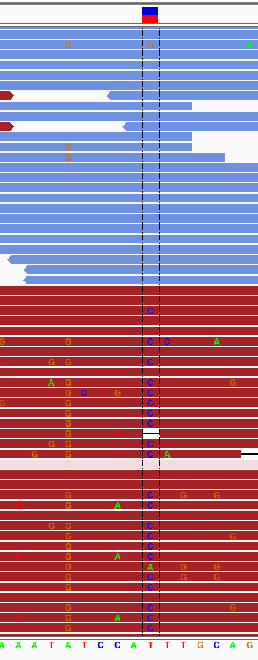
Annotations
Additional data included for variants that help assess quality of the call
Complete list link (GATK)
Can include measures/scores for:
  Quality of variant call (QD)
  Total or allele-specific read depth
  Read base quality metrics
  Strand bias (FS) – at right
  Base quality (QD)
  Consanguinity (InbreedingCoefficient)
  Tumor/normal somatic calling information (TLOD, NLOD)
Strand Bias

Slide 90
GVCF
Genomic VCF
A VCF file that contains a record for every site (regardless if there is a variant or not)
Highly recommended for multi-sample calling
GATK GVCF

Slide 91
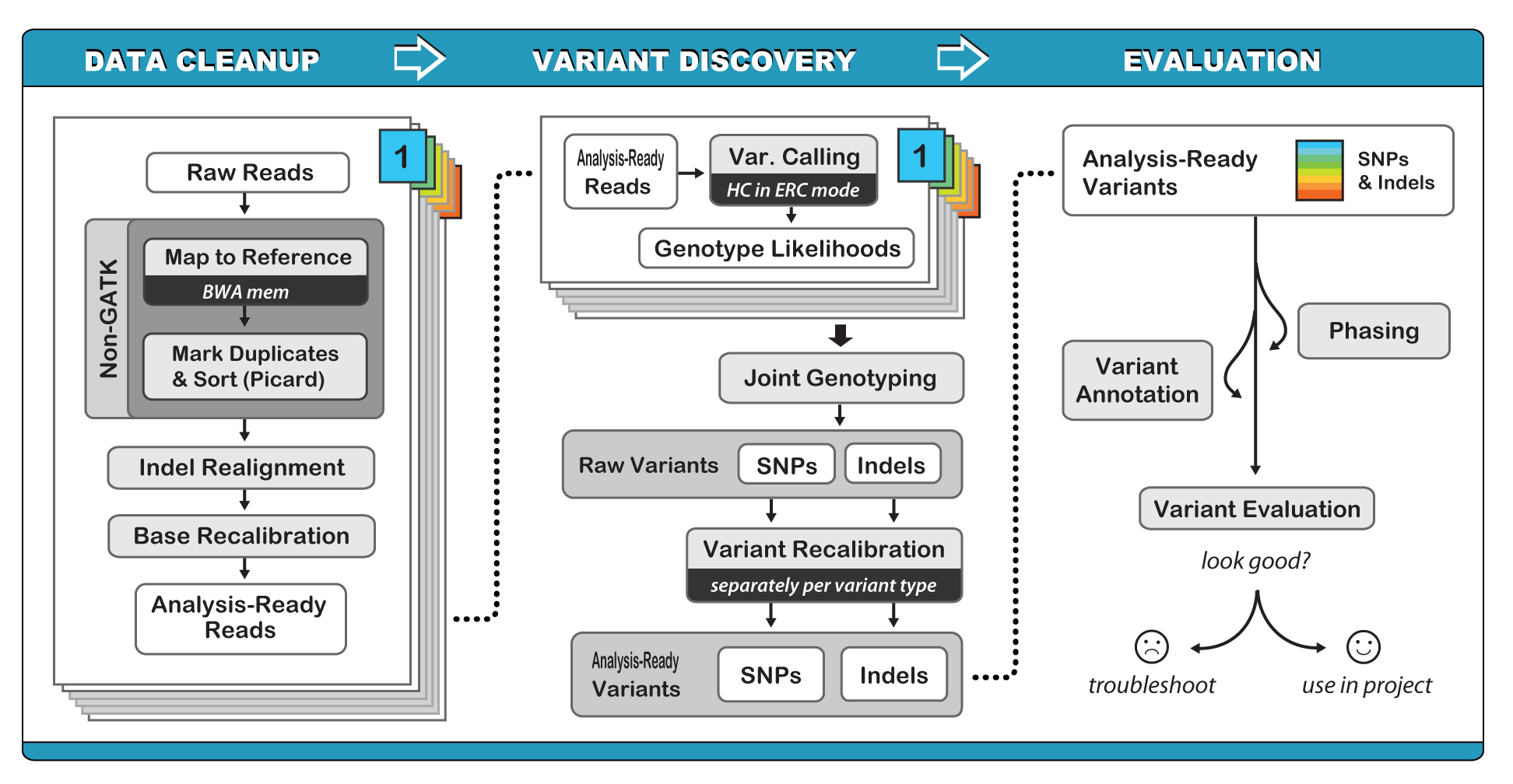
Calling variants on cohorts of samples
Perform joint genotyping calls on cohort
Can rerun as needed if more samples added to cohort
Used for ExAC cohort (92K exomes)
Link!

Slide 92
Phase III : Integrative Analysis
GATK Best Practices

Slide 93
Phase III : Filtering
Two basic methods:
  Hard filtering
  Variant quality score recalibration (VQSR)

Slide 94
Phase III : Hard Filtering
Reducing false positives by e.g. requiring
  Sufficient Depth
  Variant to be in >30% reads
  High quality
  Strand balance
  Etc etc etc
Very high dimensional search space
  … so, very subjective!
Strand Bias

Slide 95
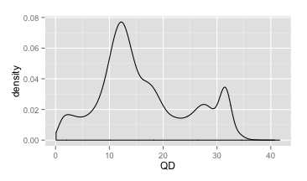
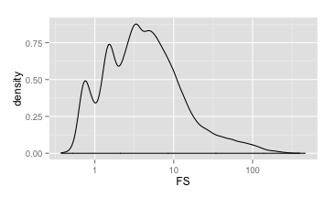
Phase III : Hard Filtering
Great overview here
Some starting points here
Visualize distribution of annotation value, pick cutoff
Most informative annotations:
  QD – normalized quality
  FS – strand bias
  SOR - strand bias
  MQ – mapping qual of reads
  MQRankSum - mapping qual of reads
  ReadPosRankSum - position of alleles in read

Slide 96
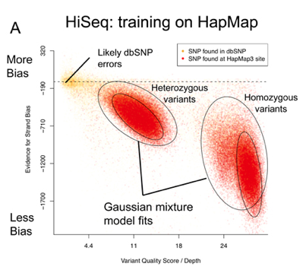
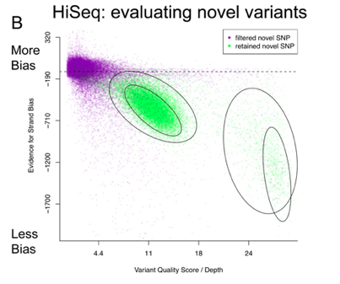
Phase III : Variant Quality Score Recalibration (VQSR)
Considered GATK ‘best practice’
Train on trusted variants (e.g. HapMap)
Require the new variants to live in the same hyperspace
Potential problems:
  Over-fitting
  Biasing to features of known SNPs
FS
QD

Slide 97
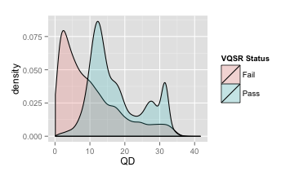
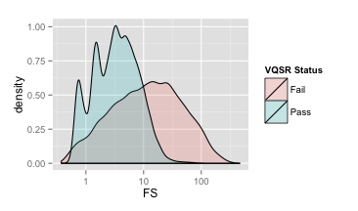
Phase III : Variant Quality Score Recalibration (VQSR)
Hard Filtering
VQSR
Considered GATK ‘best practice’
Train on trusted variants (e.g. HapMap)
Require the new variants to live in the same hyperspace
Potential problems:
  Over-fitting
  Biasing to features of known SNPs

Slide 98
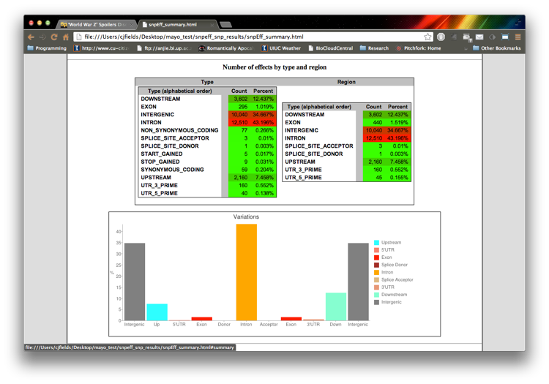
Phase III : Functional Annotation
Are these mutations in important regions?
  Genes? UTR?
  Are they changing the coding sequence?
Would these changes have an affect?
Tools:
    SnpEff/SnpSift
    Annovar
HPCBio Data

Slide 99
The end of the (pipe)line
GATK Best Practices

Slide 100
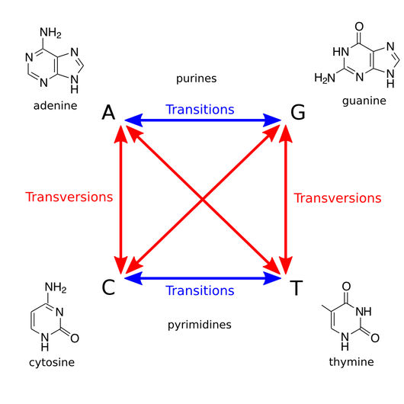
Follow-up Quality Control
Transition/Transversion ratio (T_{i}/T_{v})
  bcftools can help here
Concordance with known variants: dbSNP, HapMap, 1000genomes
Lower than expected – possibly includes more false positives
Higher that expected – indicates potential bias
Condition | Expected T_{i}/T_{v}
random | 0.5
whole genome | 2.1
exome | 3.0-3.3
Rosalind

Slide 101


Acknowledgments
Many figures/slides come from:
  GATK Workshop slides: https://qcb.ucla.edu/collaboratory/resources/gatk-workshop-slide-sets-march-2016/

