Slide 1
Genome Assembly
Chris Fields, HPCBio
Mayo-Illinois Computational Genomics Workshop June 20, 2023

Slide 2
Overview
  Sequencing technologies (2023)
  Steps in a standard genome assembly
  Assembly quality assessment
  Planning an assembly project
  Genome graphs
  Genome annotation

Slide 3
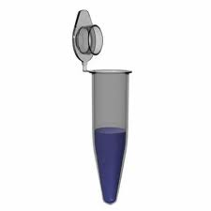
Ideal World!
iSequencer™
Human DNA
Sample
I have this joke slide (thx to Torsten Seemann) on all my past talks…
AGTCTAGGATTCGCTACAGATTCAGGCTCTGAAGCTAGATCGCTATGCTATGATCTAGATCTCGAGATTCGTATAAGTCTAGGATTCGCTATAGATTCAGGCTCTGATATAT
46 complete, haplotype-resolved, chromosome sequences
T. Seemann
Notes:
This is a somewhat jokey slide I have in past talks, but it’s now almost prescient in what can now be done depending on the technology

Slide 4
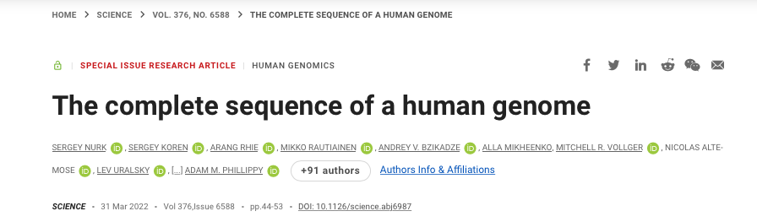
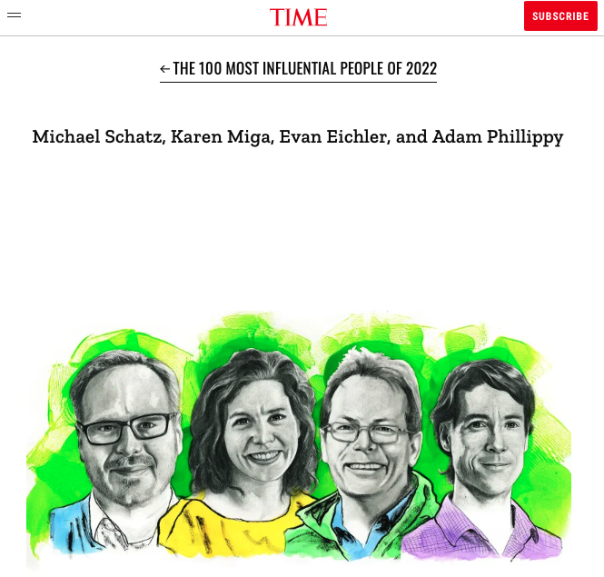
Ideal World!
We may not be too far from this now.
Science,
March 2022
Time, May 2022
Notes:
The original telomer-to-telomere (T2T) paper covers the assembly of CHM13
Pseudohaploid cell line.
Haploid assembly

Slide 5


Ideal World!
Announced 2018,
started early 2022
Nature,
May 2023
Earth Biogenome Project
Pangenomics
EBP website
HPRC Nature issue
Notes:
Earth Biogenome Project – ambitious effort from Harris Lewin and Gene Robinson, now in progress with 1000’s of high-quality genomes spanning the Tree of Life coming, and possibly 10k’s more planned.
Human Pangenome Project – 47 new high-quality human assemblies (including centromeric and more problematic regions)

Slide 6
Current Sequencing Technologies

Slide 7
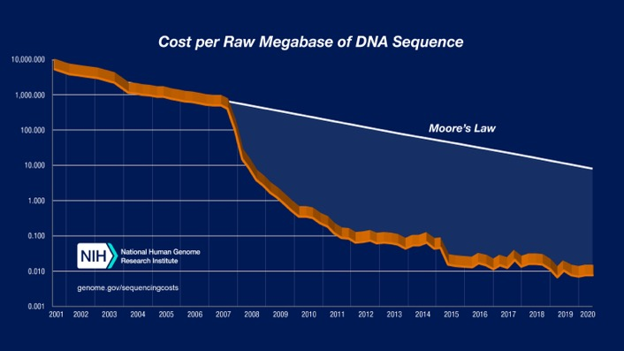
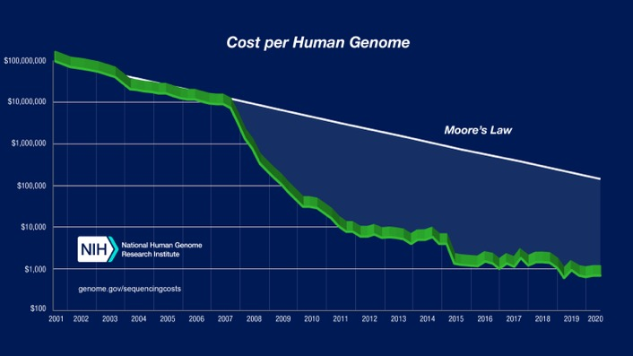
Illumina
Millions to billions of short but highly accurate reads (>99.9%)
Can be paired-end (sequence ends of fragments)
Advantages
  Highly accurate (~99.9%)
  Relatively even coverage of the genome
  Well-vetted technology
  Most cost-effective, as low as $10 per billion bases
  (Generally) robust to sample issues
Disadvantages
  Requires high depth for many applications (50x + for assembly)
  Sequence length (100-150nt reads) problematic for repeats
  Maximum fragment length (<800bp) is an issue
https://www.genome.gov/about-genomics/fact-sheets/DNA-Sequencing-Costs-Data

Slide 8
‘Long reads’
Oxford Nanopore (ONT)
Pacific Biosciences (PacBio)
MinION
Pacific Biosciences
Oxford Nanopore

Slide 9
Oxford Nanopore
Alberto Magi et al, Briefings in Bioinformatics, Volume 19, Issue 6, November 2018

Slide 10
Oxford Nanopore
~2016
2017
Total bases: 5,014,576,373 (5Gb) Number of reads: 150,604
N50: 63,747
Mean: 33,296.44
Accuracy: 80-85%
N. Loman, ASM Microbe 2017
http://lab.loman.net/2017/03/09/ultrareads-for-nanopore/

Slide 11

Oxford Nanopore
2017
E. coli: genome assembly in 8 reads
Read | Length | Ref start | Ref end | Time (m)
1 | 876991 | 4398844 | 634183 | 32.48
2 | 696402 | 470003 | 1166405 | 25.79
3 | 799047 | 1137438 | 1936485 | 29.59
4 | 642071 | 1759431 | 2401502 | 23.78
5 | 826662 | 2106227 | 2932889 | 30.61
6 | 883962 | 2699626 | 3583588 | 32.73
7 | 825191 | 3285196 | 4110387 | 30.56
8 | 463341 | 3995967 | 4459308 | 17.16
miniasm
N50 4Mb
Time: 1.5s (1 CPU)
1x coverage!
N. Loman, ASM Microbe 2017
http://lab.loman.net/2017/03/09/ultrareads-for-nanopore/

Slide 12
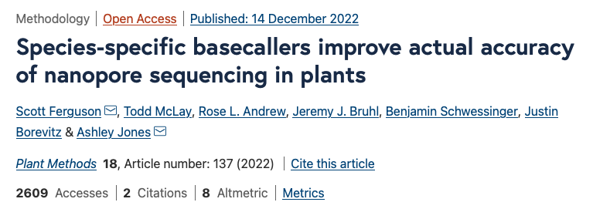
Oxford Nanopore
2021 – New flow cells (R10), kits
Oxford Nanopore

Slide 13
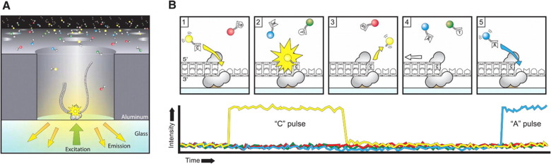
Pacific Biosciences
Rhoads and Au, Genomics, Proteomics & Bioinformatics, 13(5), Oct 2015

Slide 14
PacBio Continuous Long Read Sequencing
(aka PacBio CLR)
Optimized for length
25-50kb long reads
90% accuracy
Yields of ~125Gb+ per SMRT cell
Need ~50-90x coverage
Needs error correction, polishing
1-2 SMRT cells per human sample
Pacific Biosciences

Slide 15
PacBio Circular Consensus Sequencing
(aka PacBio HiFi)
Optimized for accuracy
10-15kb long reads
99% accuracy
Yields of ~25Gb per SMRT cell
Need ~25-50x coverage
No error correction/polishing required
~2-3 SMRT cells per human sample
Pacific Biosciences

Slide 16
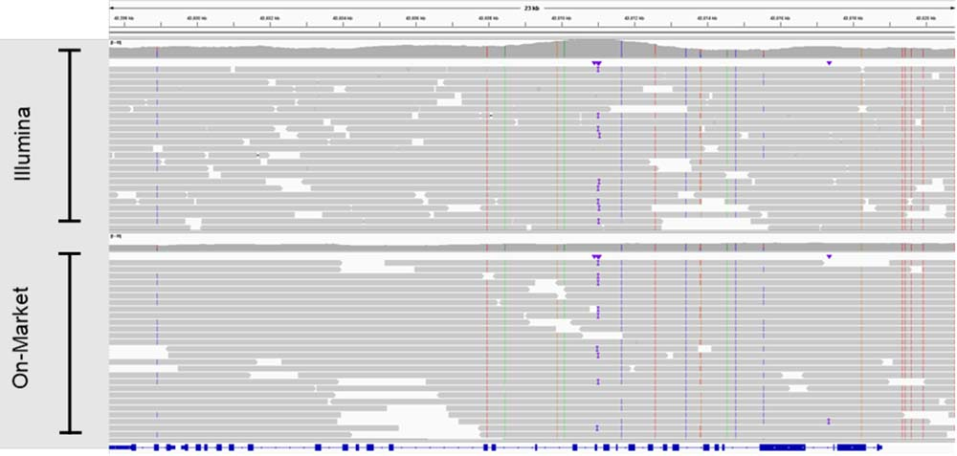
Illumina Complete Long Reads
Announced early 2022: ”… we are developing a novel, high performance long read assay, code named 'Infinity' that will accelerate access to the remaining ~5% of genic regions that are challenging to map”
  Contiguous reads up to 10 kb (N50 5-7kb)
  ~10x the throughput compared to traditional long read technologies
  90% less DNA input compared to current Long Read methods
  Fully automatable workflow
Human-only (currently)
Requires Illumina BaseSpace
Illumina Infinity announcement

Slide 17
‘Long Reads’
Advantages
  Reads can be very long (1kb – 100kb)
  Relatively even coverage of the genome
  PacBio HiFi, ONT using latest release - Highly accurate (99%)
  PacBio HiFi, ONT - DNA modifications (RNA mods for ONT)
  ONT - real-time sequencing, portable, direct RNA
Disadvantages
  Expensive compared to Illumina short reads
  Need very high quality, high MW DNA samples
  Least expensive options are error-prone
  Depending on technology, can have systematic errors (homopolymer issues), but getting better

Slide 18
Genome assembly steps

Slide 19
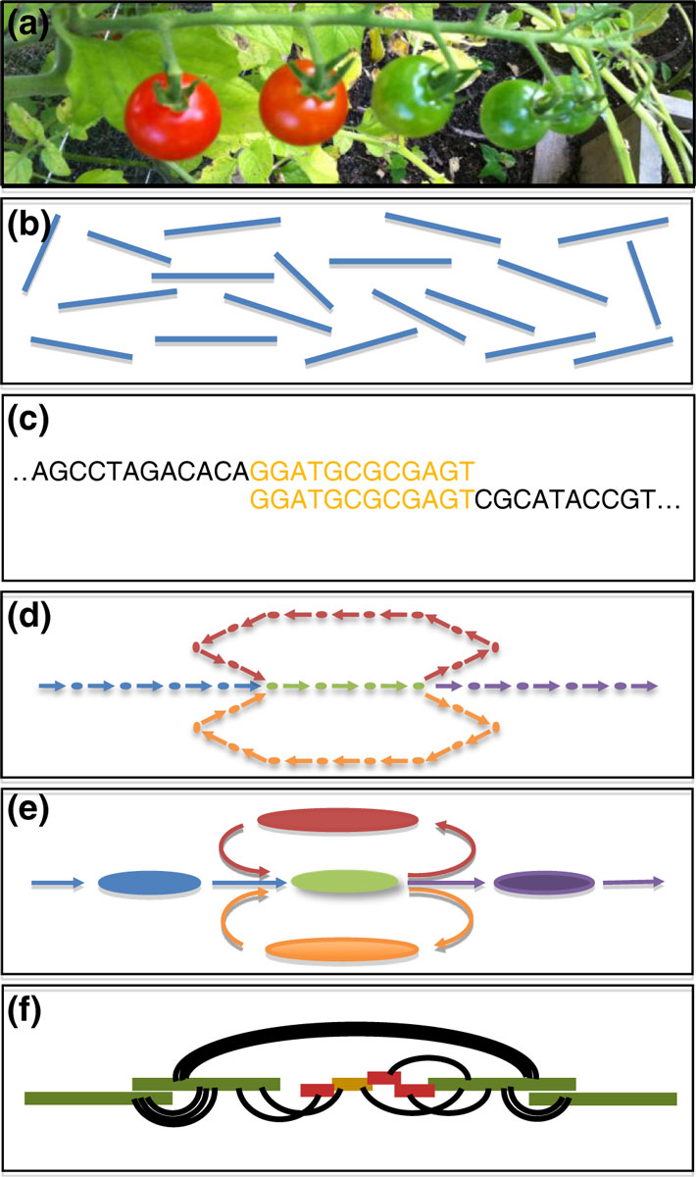
Collect DNA – samples are fragmented and sequenced.
Sequence - many millions/billions of (possibly short) unordered DNA fragments from random positions in the genome.
Compare – how do sequence fragments connect with one another
Graph – capture relationships in a large assembly graph
Simplify- The assembly graph is refined to correct errors and simplify
Scaffold – Use long reads, mates, markers, other long-range information to order/orient assembly (contigs) into large scaffolds
Clean – resolve artifacts, remove contaminants, check gene completeness, contiguity, etc
Annotate – Add features to the genome. Don’t forget RNA if you want to predict genes, preferably from a broad range of tissues/conditions
Schatz et al. Genome Biology 2012 13:243

Slide 20
Let’s Do a Genome Assembly!
  Sequence a sample, and have the computer do the rest?
  How do you find overlaps between sequences (when you have millions to billions of them)?
    You compare them all (overlapping pieces)
    You find shorter perfectly overlapping segments
      Faster but has a lot of assumptions!!!
  How do you store all this information?
  How long does it take?

Slide 21
The way it used to be… aka ‘the short read days’
  You spent your entire grant on getting sequence data and buy a monster multi-core high-memory server
  You assemble your genome with your favorite genome assembly tool
  You waited a week to a month and you now have results!
  Wait, why do I have a million scaffolds? And why is my server on fire?!?
Biology

Slide 23
Steps
  Basic DNA sequence cleanup and evaluation (pre-assembly)
  Contig building
  Scaffolding
  Post-assembly processing and analyses

Slide 24
Basic cleanup and evaluation
  Is the DNA sequence high quality?
  Does it need to be trimmed?
  Evaluate libraries for read ‘coverage’
  Any additional sequence preparation steps

Slide 25
DNA Quality (FASTQC)
Illumina Data
Bad,
need to
Trim heavily
Good!
https://www.bioinformatics.babraham.ac.uk/projects/fastqc/

Slide 26
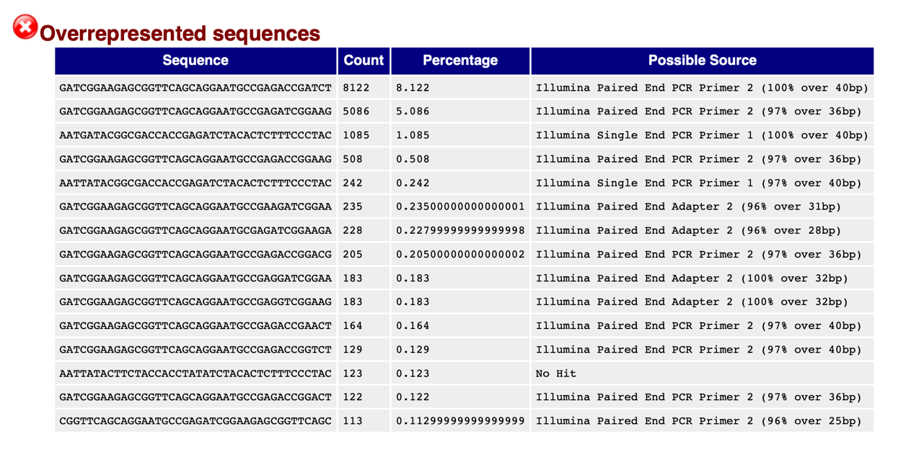
Adapters
https://www.bioinformatics.babraham.ac.uk/projects/fastqc/

Slide 27
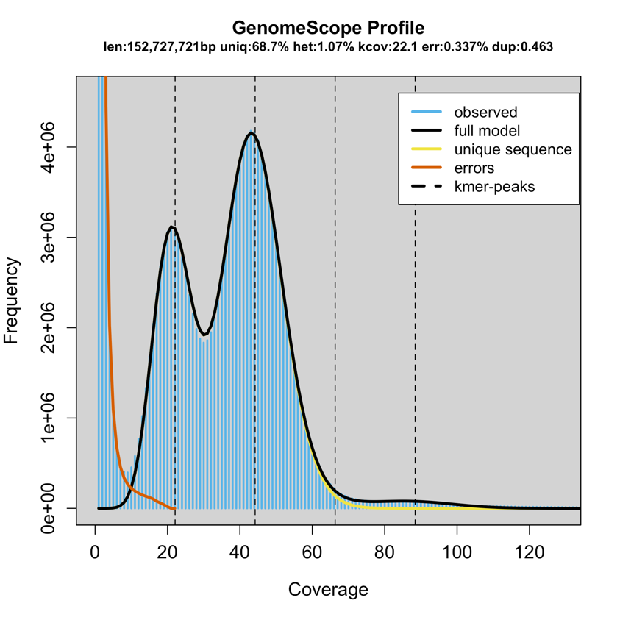
Coverage
Arabidopsis F1 cross
Requires highly accurate reads
  Illumina
  PacBio HiFi
Kmer read distribution
Genomescope
Rannallo T, Jaron K, Schatz M, Nature Comm, 1432(2020)

Slide 28
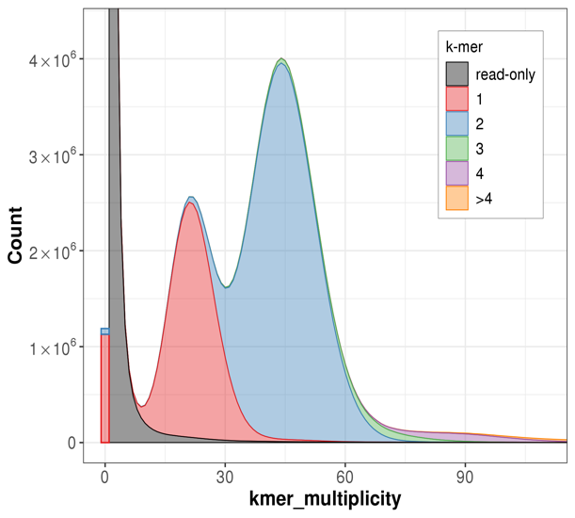
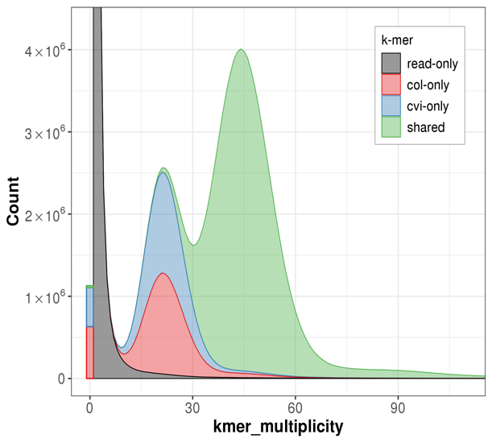
Coverage
Arabidopsis trio-binning assembly
Requires highly accurate reads
  Illumina
  PacBio HiFi
Kmer read distribution
Merqury
Rhie, Walenz, Koren, Phillipy, Genome Biology (2020)

Slide 29
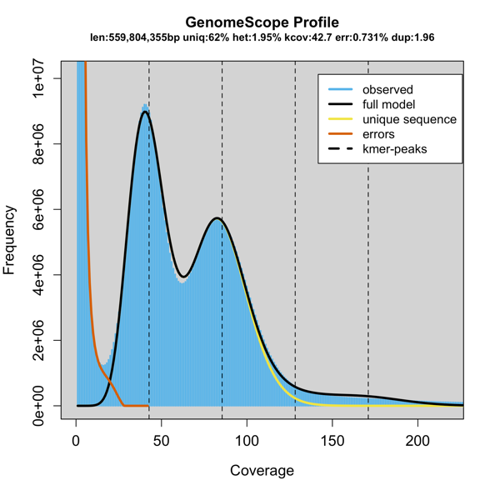
Other pre-assembly steps
Depending on the assembler and technology you use, you may want to:
  Assess reads for contaminants
  Join paired-end reads into longer reads
  Error correction of reads (e.g. fix sequencing errors)

Slide 30
Starting the assembly

Slide 31
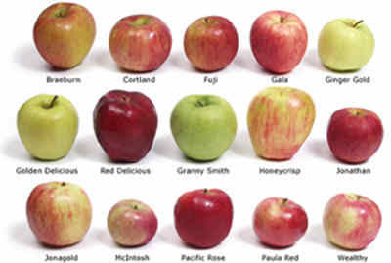
Contig building
Greedy assembly
Seed and extend
Overlap graph
de Bruijn graphs
String graphs
..etc etc
… all essentially doing similar things,
but taking different ‘shortcuts’ based on
needs
T. Seemann

Slide 32
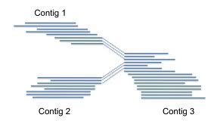
Contigs
Contiguous, unambiguous
stretches of assembled DNA sequence
Contigs ends correspond to
  Real ends (for linear DNA molecules)
  Dead ends (missing sequence)
  Decision points (forks in the road)
T. Seemann

Slide 33
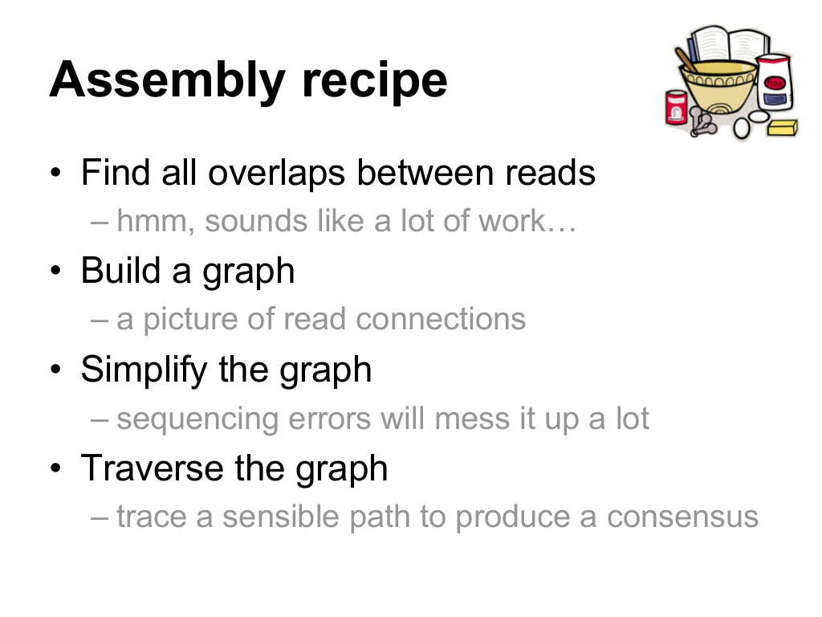
T. Seemann

Slide 34
Graph
Review: A structure where objects are related to one another somehow
Nodes/Vertices = objects (sequence)
Edges = relationship (overlap)
Compeau et al, Nature Biotech, 29(11), 2011; https://en.wikipedia.org/wiki/Graph_(discrete_mathematics)

Slide 35
Simple?
https://github.com/rrwick/Bandage/wiki/Effect-of-kmer-size

Slide 36
Erm…
http://armbrustlab.ocean.washington.edu/seastar

Slide 37
In essence…
  For each unconnected graph:
  Find a path which visits each node once
    This is referred to as a Hamiltonian path/cycle
  Form consensus sequences from paths
    use all the overlap alignments
    each of these collapsed paths is a contig
HPCBio data

Slide 38
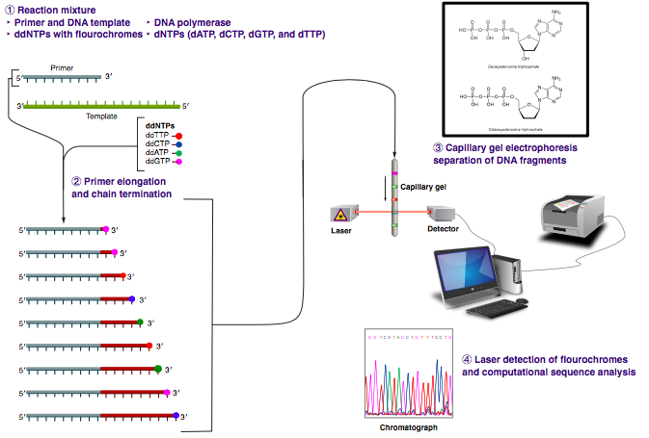
Overlap Layout Consensus
Assembly
Used for longer read data
Sanger
Newer variants for PacBio and Oxford Nanopore
By Estevezj - Own work, CC BY-SA 3.0,
https://commons.wikimedia.org/w/index.php?curid=23264166

Slide 39
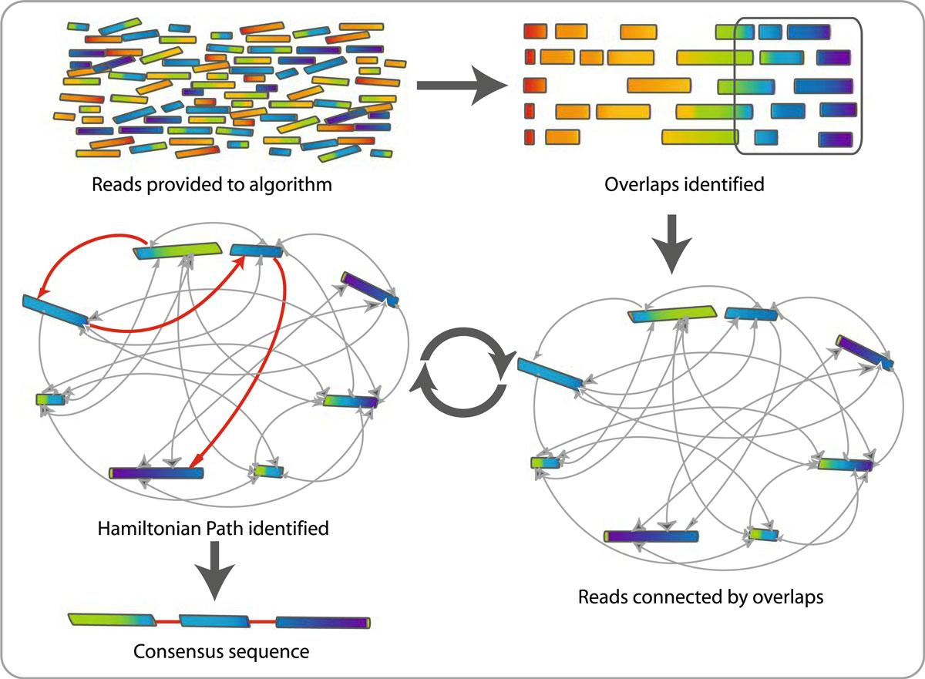
  For each unconnected
  graph, at least one per
  replicon in original
  sample
  Find a path which
  visits each node once
  Form consensus
  Sequences from
  paths
Contig
M. Schatz, Feb 2015 Course, JHU

Slide 40
OLC assembly steps
Calculate overlays
  Can use BLAST-like methods, but finding common strings (k-mers) more efficient
Assemble layout graph, try to simplify graph and remove nodes (reads) – find Hamiltonian path
Generate consensus from the alignments between reads (overlays)

Slide 41
Some OLC-based assemblers
Canu – is a fork of the Celera Assembler designed for high-noise single-molecule sequencing (PacBio, Oxford Nanopore)
HiCanu – PacBio HiFi assembler
Newbler, a.k.a. GS de novo Assembler - designed for 454 sequences, but works with Sanger reads
Hifiasm – a hybrid diploid assembler

Slide 42
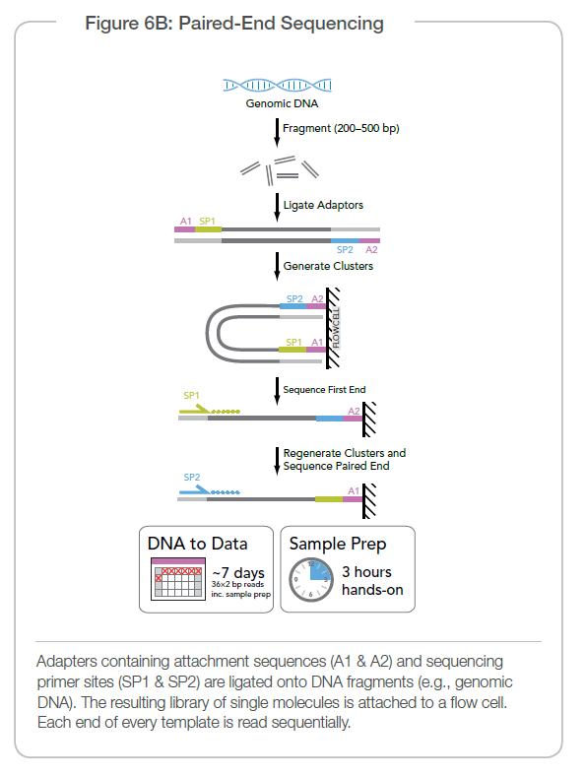
De Bruijn graph assemblers
Developed to deal with high-throughput highly accurate short-read data
Uses shotgun data (generally paired-end fragments of 300-500nt)
Illumina

Slide 43
M. Schatz, Feb 2015 Course, JHU

Slide 44
M. Schatz, Feb 2015 Course, JHU

Slide 45
M. Schatz, Feb 2015 Course, JHU

Slide 46
M. Schatz, Feb 2015 Course, JHU

Slide 47
M. Schatz, Feb 2015 Course, JHU

Slide 48
M. Schatz, Feb 2015 Course, JHU

Slide 49
De Bruijn graphs - concept
M. Schatz, Feb 2015 Course, JHU

Slide 50
Scaffolding
  Now, you have a huge pile of contigs but you want to make them larger. How?
  Add context!
  Link together contigs using other genomic information
    Infer contigs position on the genome relative to one another

Slide 51
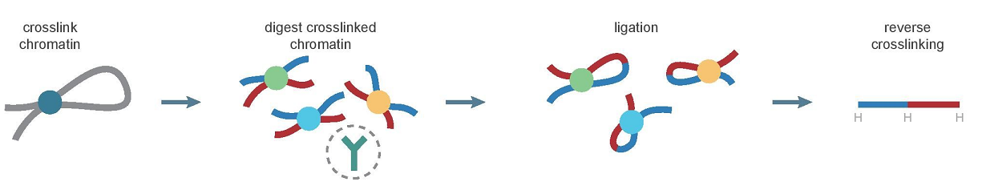
Linking Contigs via DNA Seq
HiC (Chromosome Conformation Capture)
Wikipedia
PacBio/ONT long-reads
10-100 kb+
Illumina sequencing
Paired-end reads
<500bp fragment
Mate pair reads
>5kb fragment
>50kb fragments
Linked reads

Slide 52
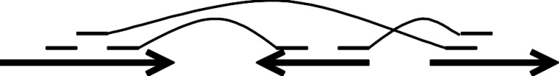
Contigs to scaffolds
Mate-pair read
Paired-end read
Contigs
Scaffold
Gap
Gap
T. Seemann

Slide 53
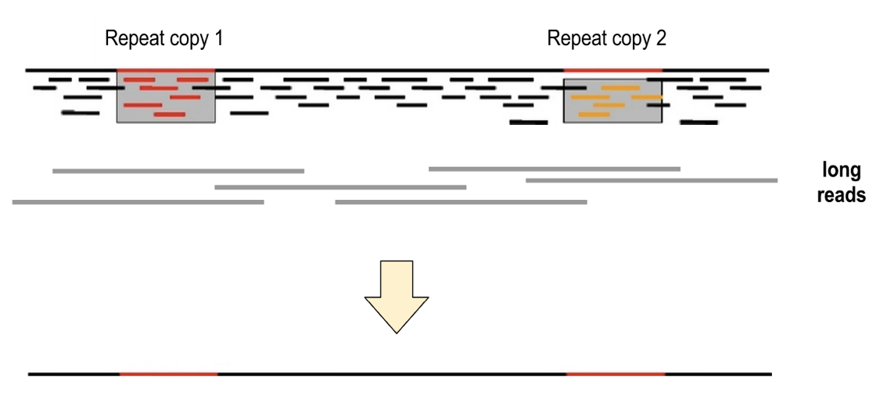
Long reads
T. Seemann

Slide 54
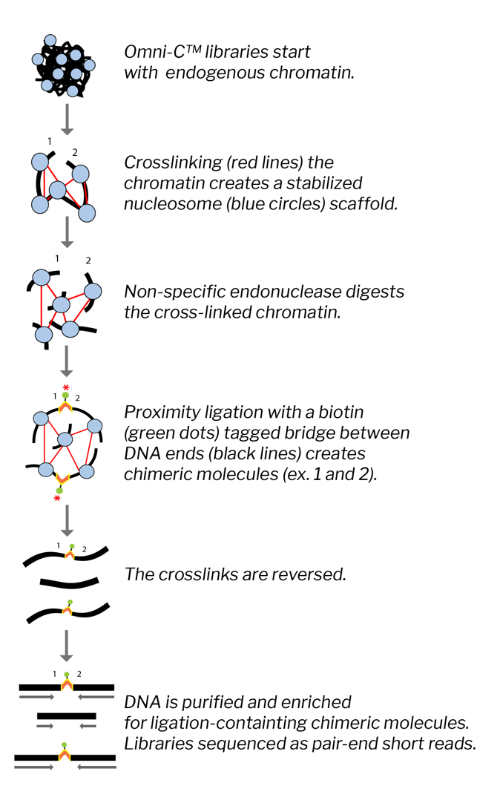
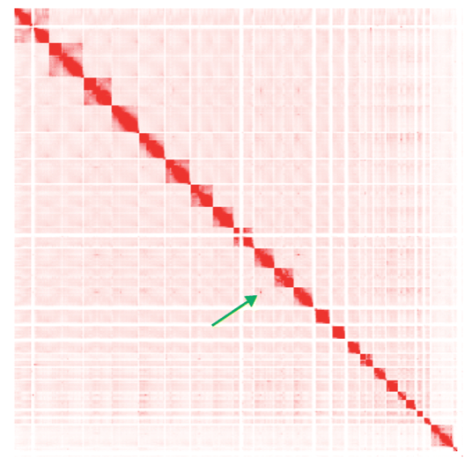
HiC
Chromosome Conformation Technology
Wikipedia
Dovetail Genomics

Slide 55
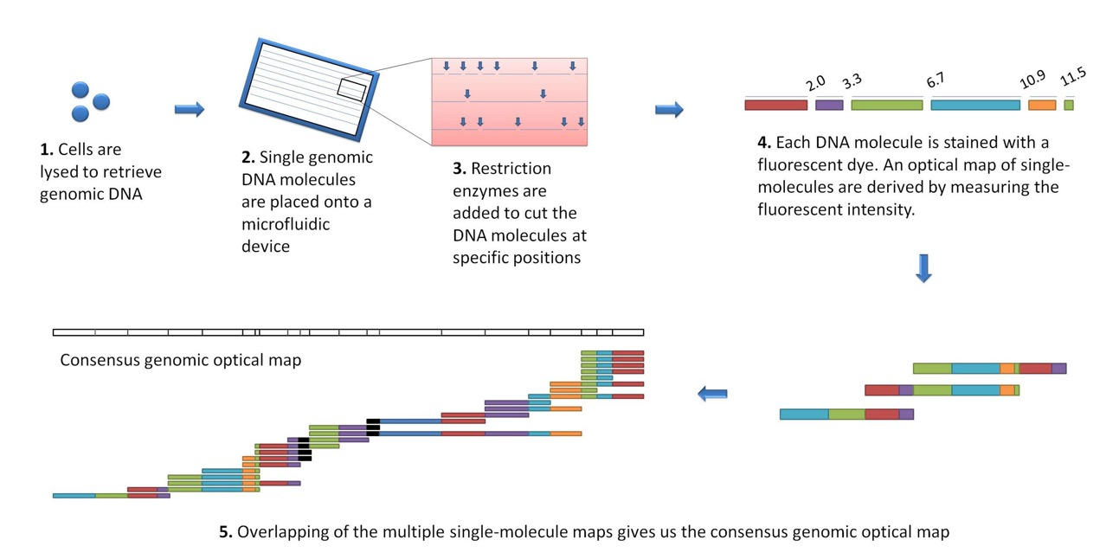
Optical Mapping
Using high resolution single-molecule restriction mapping combined with fluorescent dyes and fluorescence microscopy to produce a genomic map

Slide 56
Starting a new assembly project

Slide 57
Planning a genome sequencing project?
  BUDGET!!!
  Technological costs
  Computational costs
  Person costs (time)!
  Biology!
  Size: how large and/or complex is my genome?
  Ploidy: number of sets of chromosomes of the genome?
  Multinucleated: can cells have more than one nucleus?
  Repetitive: How much of the genome is repetitive? Repeat size distribution?
  Heterozygosity: Is my genome highly heterozygous? Inbred (homozygous)?
  Public data: Is a good quality genome of a related species available?

Slide 58
  How do you start (2023)?
Short reads (billions of reads)
  Sequencing costs - $$
  Compute costs - $$$$$$$$
  Results – fragmented, requires significant ‘cleanup’
Long error-prone reads
  Sequencing costs - $$$$
  Compute costs - $$$$$
  Results –better quality, but requires polishing, can’t easily phase
Long accurate reads
  Sequencing costs - $$$$$$
  Compute costs - $$$
  Results – best (partly) phased diploid assembly***
*** - doesn’t help much if you have higher ploidy! (though this will likely change)

Slide 59

How large is my genome?
The size and complexity of the genome can be estimated from the ploidy of the organism and the DNA content per cell
This will affect:
  How many reads will be required to attain sufficient coverage (typically 10x to 100x, depending on read length)
  What sequencing technology to use (short vs. long reads)
  What computational resources will be needed (generally amount of memory needed and length of time resources will be used)
Oyster (GenomeScope)

Slide 60
Genome size/complexity
By Abizar at English Wikipedia, CC BY-SA 3.0, https://commons.wikimedia.org/w/index.php?curid=19537795

Slide 61
Genome size/complexity
Genic content vs genome size
Bacterial – very compact (mostly protein or non-coding RNA)
Eukaryotes – highly variable, but more spread out
By Estevezj - Own work, CC BY-SA 3.0
https://commons.wikimedia.org/w/index.php?curid=23704739

Slide 62
Heterozygosity
Heterozygous – Locus-specific; diploid organism has two different alleles at the same locus.
Heterozygosity is a metric used to denote the probability an individual will be heterozygous at a given allele.
Higher heterozygosity == more diverse == harder to assemble
Unfortunately, assemblies are represented (for now) as haploid. So this is a major problem!
Oyster: http://qb.cshl.edu/genomescope/genomescope2.0/

Slide 63
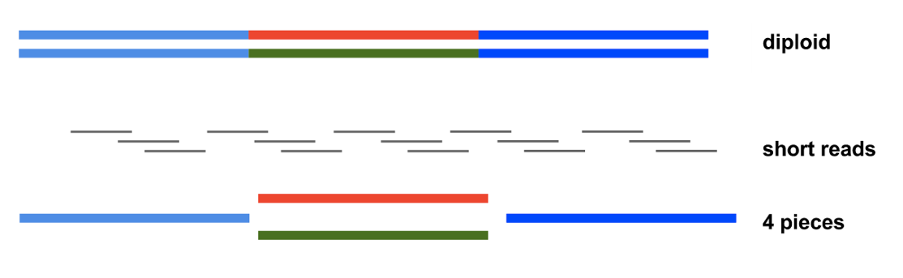
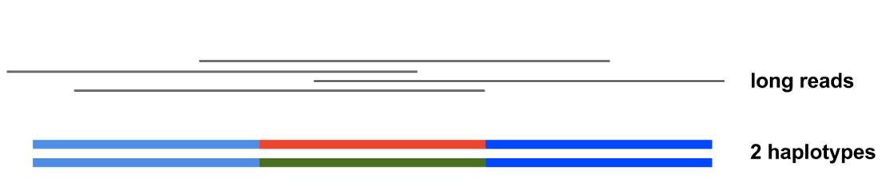
Heterozygosity
Short reads - initial assembly has mix of homozygous and heterozygous regions
Long reads – can get partial to fully phased diploid assemblies
  May need multiple technologies to do this
Unphased haploid assembly
Haplotypes are separate contigs (haplotigs)
Phased diploid assembly
T. Seemann

Slide 64
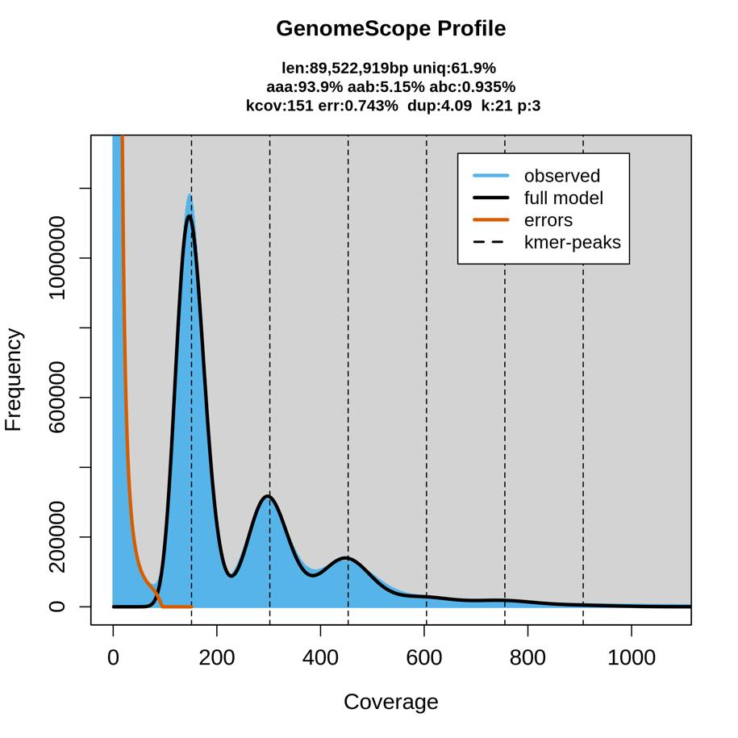
Ploidy
Number of sets of chromosomes in a cell (N)
  Bacteria – 1N
  Vertebrates – 2N (human, mouse, rat)
  Amphibians – 2N to 12N
  Plants – 2N to ??? (wheat is 6N)
Root knot nematode (GenomeScope)

Slide 65
Repetitive sequences
Most common source of assembly errors
If sequencing technology produces reads > repeat size, impact is much smaller
Most common solution: generate reads or mate pairs with spacing > largest known repeat
Root knot nematode (GenomeScope)

Slide 66
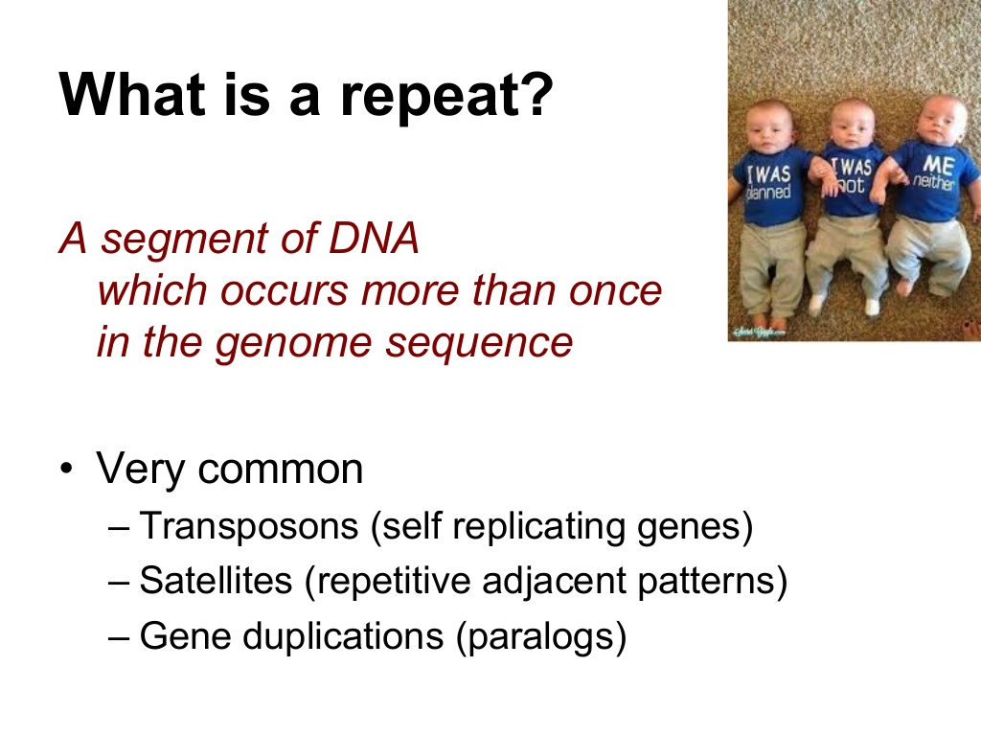
T. Seemann

Slide 67
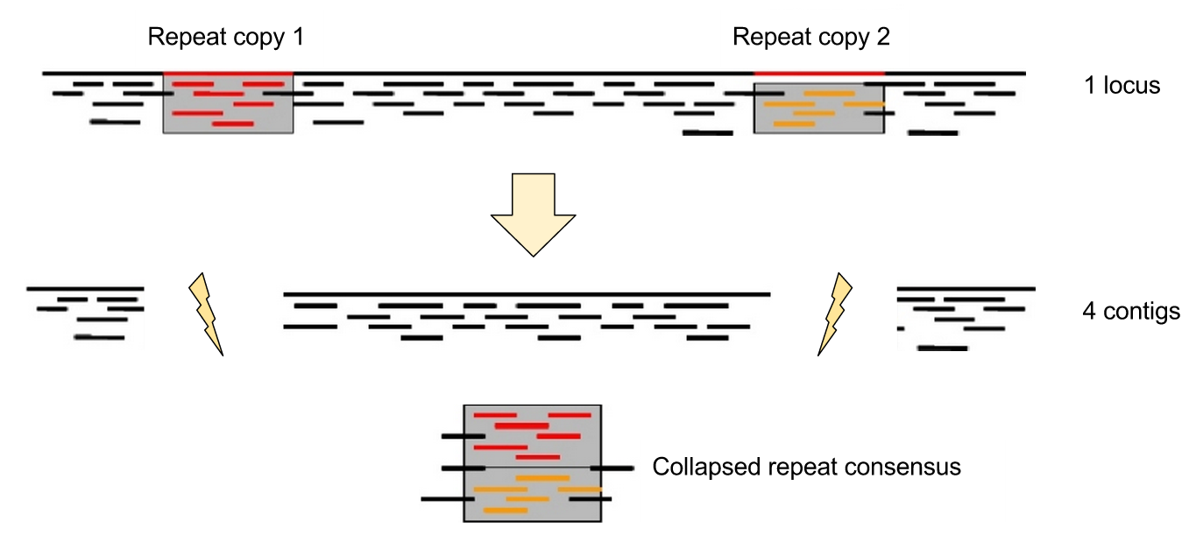
Assembling repeats
T. Seemann

Slide 68
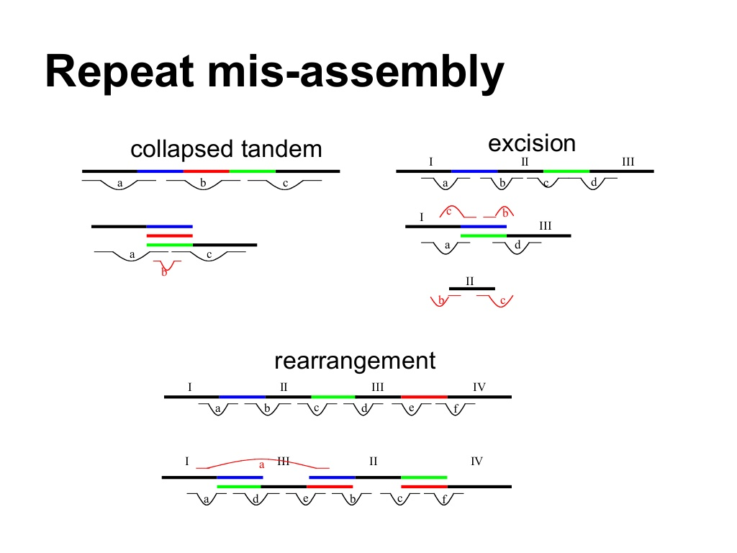
T. Seemann

Slide 69
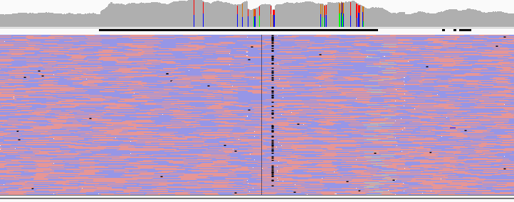
HPCBio data

Slide 70
Long reads
T. Seemann

Slide 71
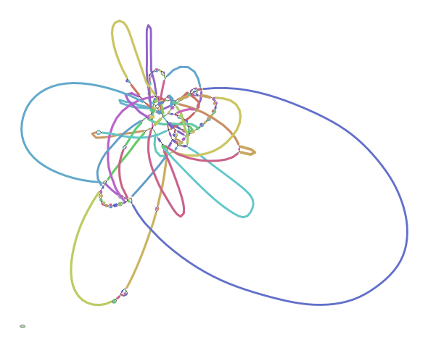
HPCBio data

Slide 72
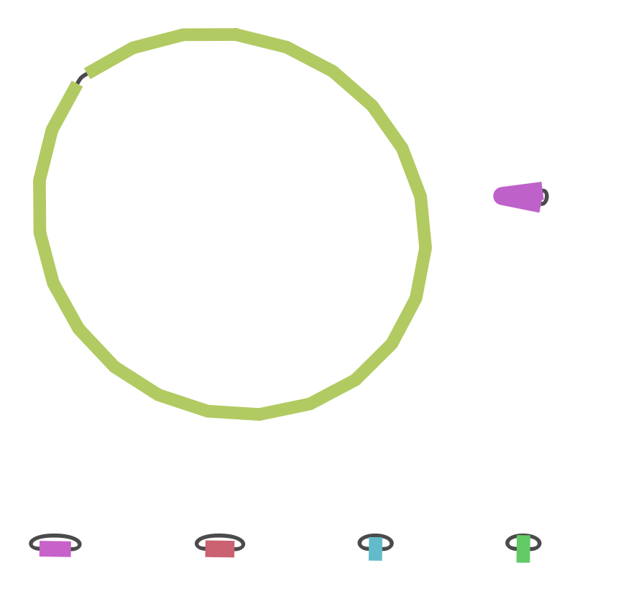
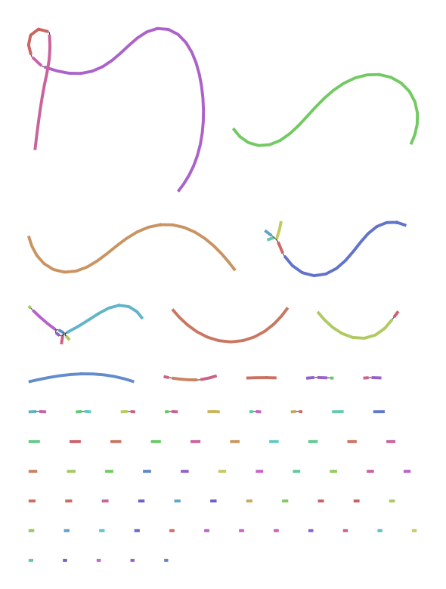
HPCBio data

Slide 73
Genome(s) from related species
Preferably of good quality, with large reliable scaffolds
Help verifying the completeness of the assembly
Can themselves be improved in some cases
Help guiding the assembly of the target species
  But to be used with caution – can cause errors when genome architecture is different!
  Large-scale genomic rearrangement in particular is a problem

Slide 74
Typical sequencing strategies
Small genomes (bacteria, fungal)
  If you can can get HMW DNA!
    PacBio HiFi
    Oxford Nanopore sequences at 40-50x coverage, 'polish’ with hybrid correction (using Illumina data) and assembly using Unicycler, Canu, Flye
      This may be changing with newer flow cells (R10.4.1 + ’kit14’, as of May 2022)
  2 x 300bp overlapping paired-end reads from Illumina MiSeq works okay but will get fragments
Larger genomes
  If you can afford it and can get HMW DNA
    PacBio HiFi
    HiC for scaffolding
    ONT (ultralong prep)

Slide 75
Additional useful data
RNA-Seq (transcripts)
  Assembled transcripts from genes, which can be used to order scaffolds
  Require their own independent assembly
  Needed for annotation!
Fosmid libraries
  End sequencing adds long-range contiguity information
  Pooled fosmids (~5000) can often be assembled more efficiently
Genetic or physical maps
  Location of alleles or physical markers in reference to one another
  May be hard to produce (years to decades, $$$$)

Slide 76
T2T strategy
But we are not too far from this!
Science,
March 2022
Human assemblies
HMW DNA preps
50x PacBio HiFi reads or higher
15-30x Oxford ultralong reads (>100kb)
This is also in flux!
$$$$$$$$$$
Time, May 2022

Slide 77
Assembly strategies and algorithms
For long reads (>500 nt), Overlap/Layout/Consensus (OLC) algorithms work best.
  Examples: hifiasm (PacBio HiFi only), Canu, Redbean, Flye, Shasta
  Hifiasm is generally recommended for PacBio HiFi data
For short reads, De Bruijn graph-based assemblers are most widely used
  Examples: MEGAHIT, SPAdes
Key points:
  There is no simple solution, best to try different assemblers and strategies
  Use simple metrics to gauge quality of assembly
  The field is rapidly evolving, like the sequencing technology
NEXT YEAR THIS PRESENTATION WILL CHANGE AGAIN!

Slide 78
Assessing your assembly

Slide 79
How good is my assembly?
How much total sequence is in the assembly relative to estimated genome size?
How many pieces, and what is their size distribution?
Are the contigs assembled correctly?
Are the scaffolds connected in the right order / orientation?
How were the repeats handled?
Are all the genes I expected in the assembly?

Slide 80
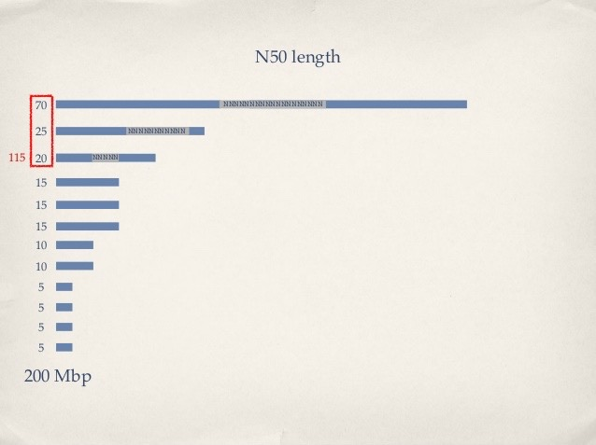
N50: the most common measure of assembly quality
N50 = length of the shortest contig in a set making up 50% of the total assembly length (Larger is better)
NG50 = length of the shortest contig in a set making up 50% of the estimated genome size
NG50 is generally better

Slide 81
Comparative analysis
Compare against
  A close reference genome
  Results from another assembler
  Self-comparison
  Versions of the same assembly
Whole genome alignment
  MUMmer
  Lastz
Generates an alignment and a dot plot

Slide 82
Dot Plot
How can we visualize whole genome alignments?
With an alignment dot plot
  N x M matrix
    Let i = position in genome A
    Let j = position in genome B
    Fill cell (i,j) if A_{i} shows similarity to B_{j}
T
G
C
A
A C C T
– A perfect alignment between A and B would completely fill the positive diagonal
From M. Schatz and A. Phillipy : Alignment and Assembly Lecture

Slide 83
B
Translocation
Inversion
Insertion
A
B
A
http://mummer.sourceforge.net/manual/AlignmentTypes.pdf
From M. Schatz and A. Phillipy : Alignment and Assembly Lecture

Slide 84
Assembly
Reference

Slide 85
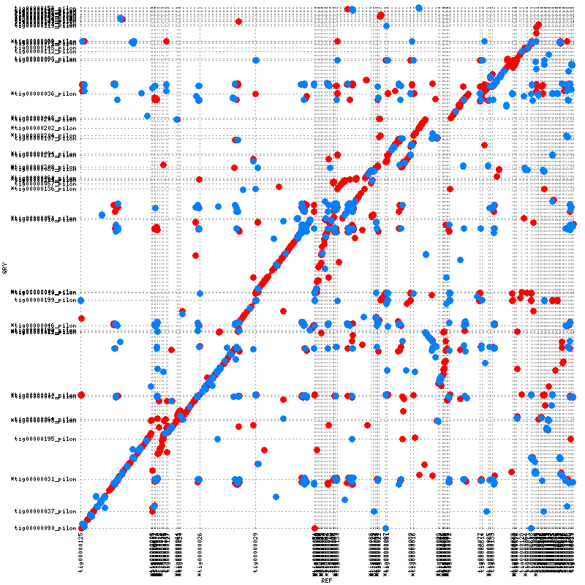
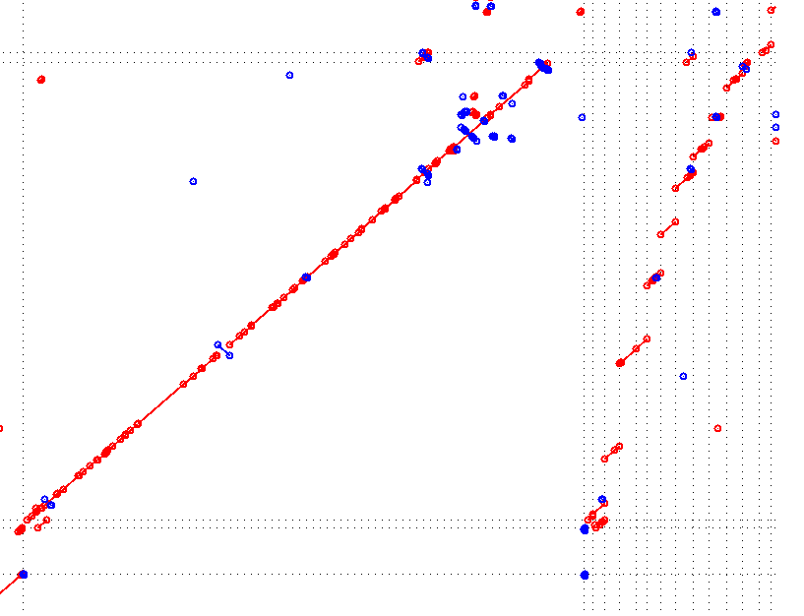

Slide 86
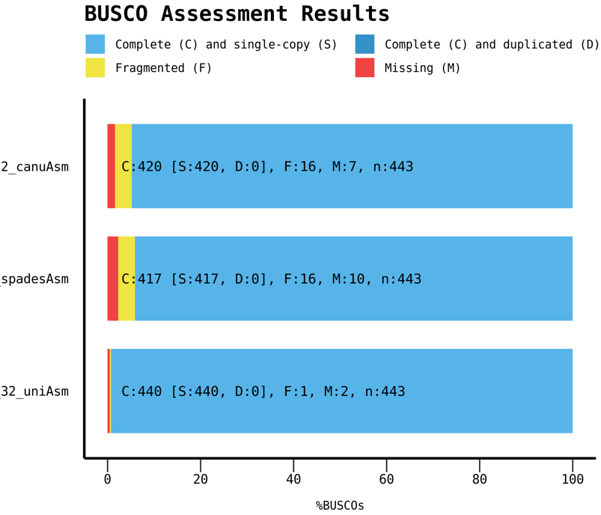
BUSCO: conserved gene sets
BUSCO: From Evgeny Zdobnov’s group,
University of Geneva
Coverage is indicative of quality
and completeness of assembly
HPCBio data

Slide 87
QUAST
QUality ASsessment Tool
  Small (bacterial, fungal) and large (eukaryotic) genomes
  Metagenomes
  Icarus for contig alignment visualization
Can compare multiple assemblies against one another
Compare against a known (or close) reference
Optional: Predict genes or include annotations (checks for odd issues like frameshifts)
Generates a summary HTML report

Slide 88
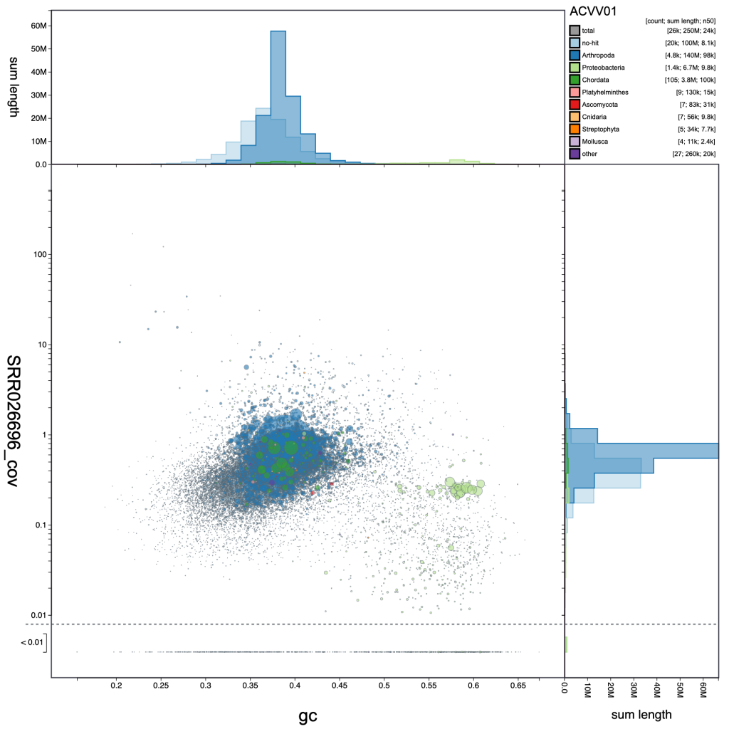
Blob plots
Analyses checking for contaminants, endosymbionts, etc.
Interactive version: BlobToolKit

Slide 89
Genome graphs

Slide 90
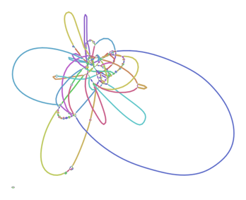
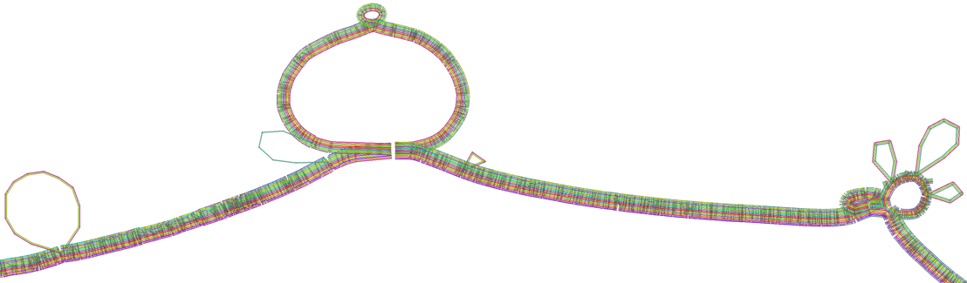
Assembly, variant, and pangenome graphs
With the release of the latest human genome reference, there is more pressure to represent more data with a genome.
Current representations are mainly haploid (one copy)
Assembly graphs can retain haplotype information or raw assembly connectivity
Variant graphs can be generated from a reference genome and a variant file from other samples
Pangenome graphs capture information across populations of samples from the same species
Novak et al, bioRxiv: https://doi.org/10.1101/101378
10x Genomics

Slide 91
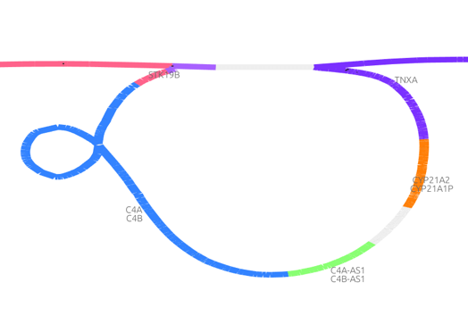
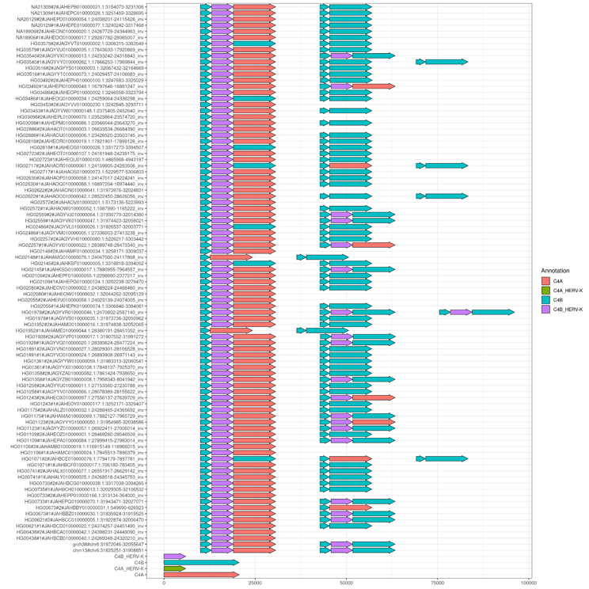
Pangenome graphs
New tools are available and actively being developed to generate and compare multiple high quality genome assemblies
Structural variants, including complex regions
Population genomics
Pangenome graph of the C4 locus with 90 haplotypes (44 diploid de novo assemblies plus the GRCh38 and CHM13 reference genomes).
Andrea Guarracino, MemPanG23 workshop/conference, May 2023
HPRC Main Paper
Acrocentric chromosomes

Slide 92
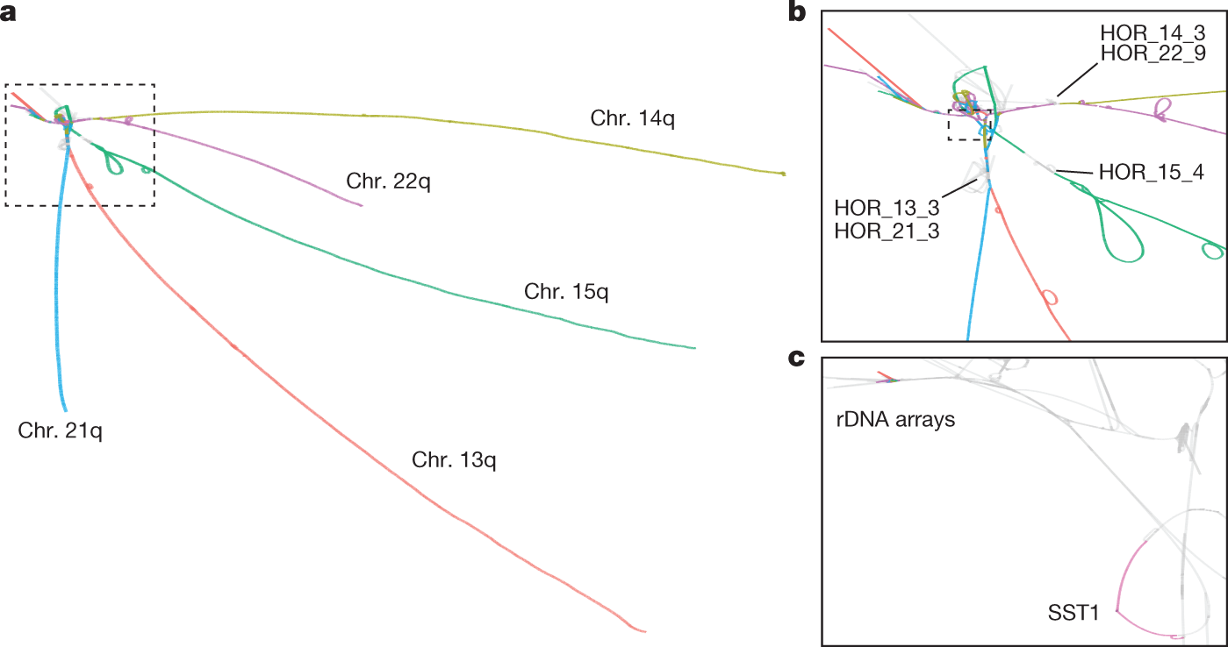
Pangenome graphs
New tools are available and actively being developed to generate and compare multiple high quality genome assemblies
Structural variants, including complex regions
Population genomics
HPRC Main Paper
Acrocentric chromosomes

Slide 93
Acknowledgements
Materials from this slide deck include figures and slides from many publications, Web pages and presentations by:
  Carver Biotechnology Center (HPCBio, DNA Sequencing Core)
  M. Schatz, A. Phillipy, T. Seemann, S. Salzberg, K. Bradnam, D. Zerbino, M. Pop, G. Sutton, Nick Loman, Carson Holt, Ryan Wick.
  I highly recommend Ben Langmead’s teaching materials; he has a ton fabulous (and much more in-depth) notes on his lab page: http://www.langmead-lab.org/teaching-materials/
  Thank you!

