Slide 1
Polymorphism and Variant Analysis Lab
Alexander E. Lipka
PowerPoint by Casey Hanson
Edited by Gio Madrigal & Roberto Cucalón Tamayo

Slide 2
Exercise
In this exercise, we will do the following:.
Gain familiarity with the software PLINK
Run a Quality Control (QC) analysis on genotype data of 90 individuals of two ethnic groups (Han Chinese and Japanese) genotyped for ~230,000 SNPs.
Use our QC data to perform a genome-wide association test (GWAS) across two phenotypes: case and control. We will compare the results of our GWAS with and without multiple hypothesis correction.

Slide 3
Start the VM
Follow instructions for starting VM (This is the Remote Desktop software).
The instructions are different for UIUC and Mayo participants.
Find the instructions for this on the course website under Lab set-up:
https://publish.illinois.edu/compgenomicscourse/2023-schedule/

Slide 4
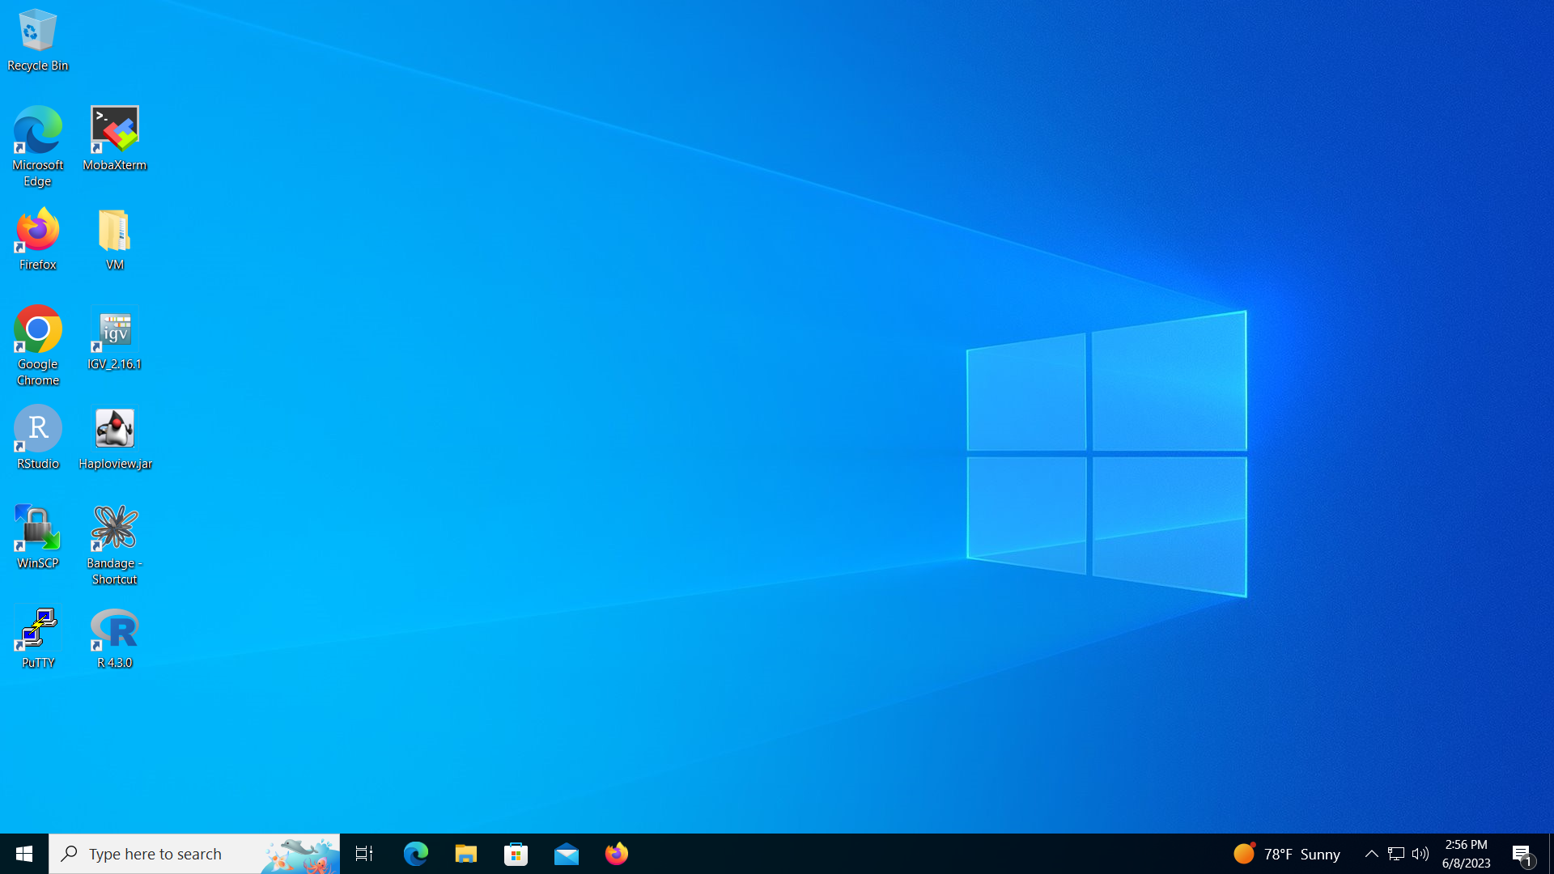
Step 0: Open MobaXterm from VM

Slide 5
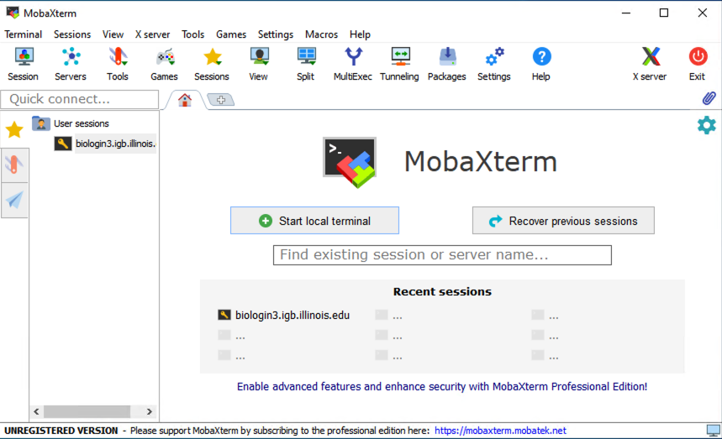
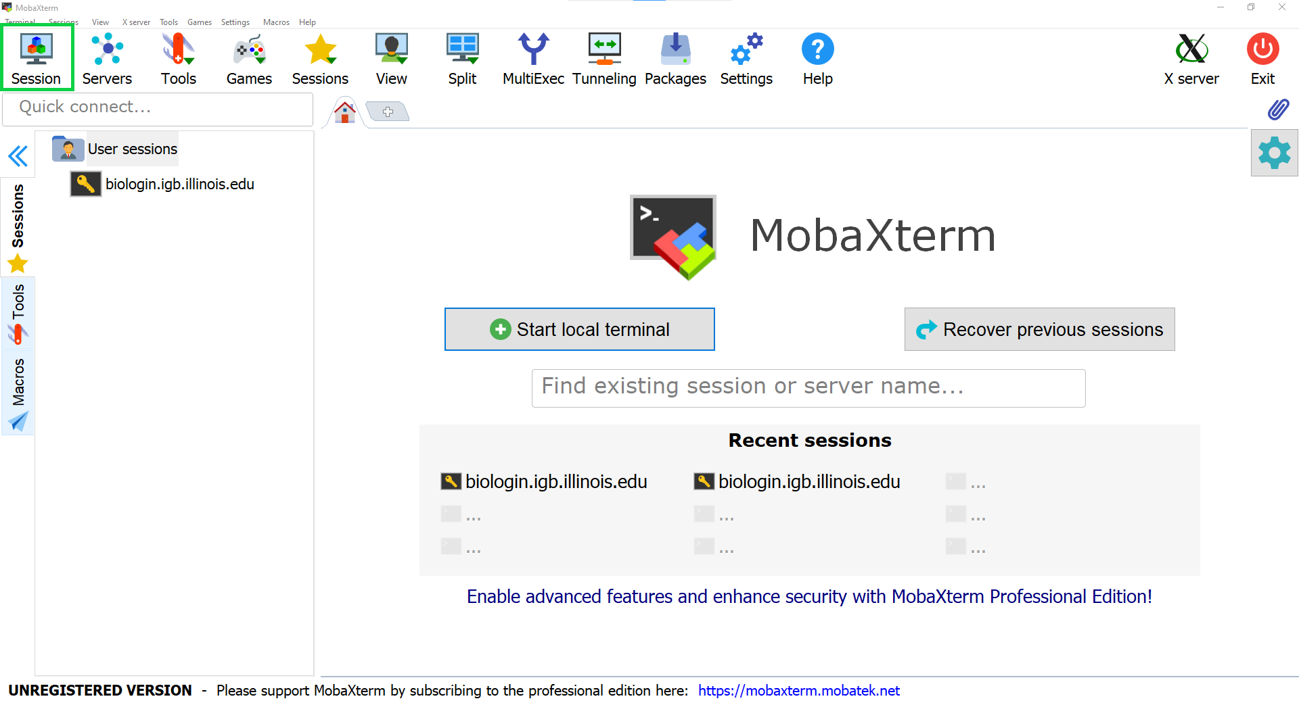
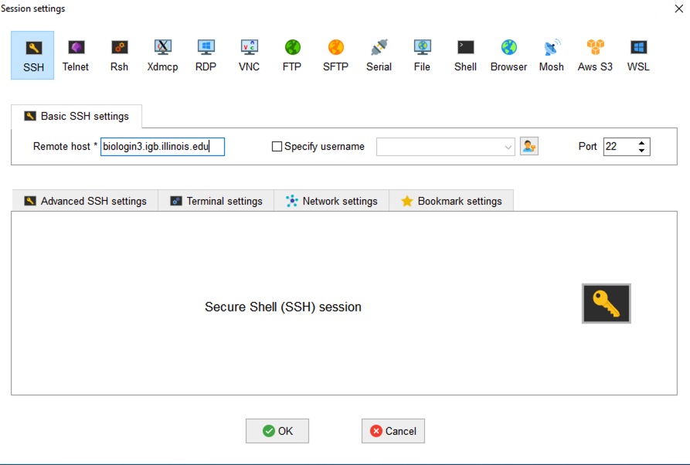
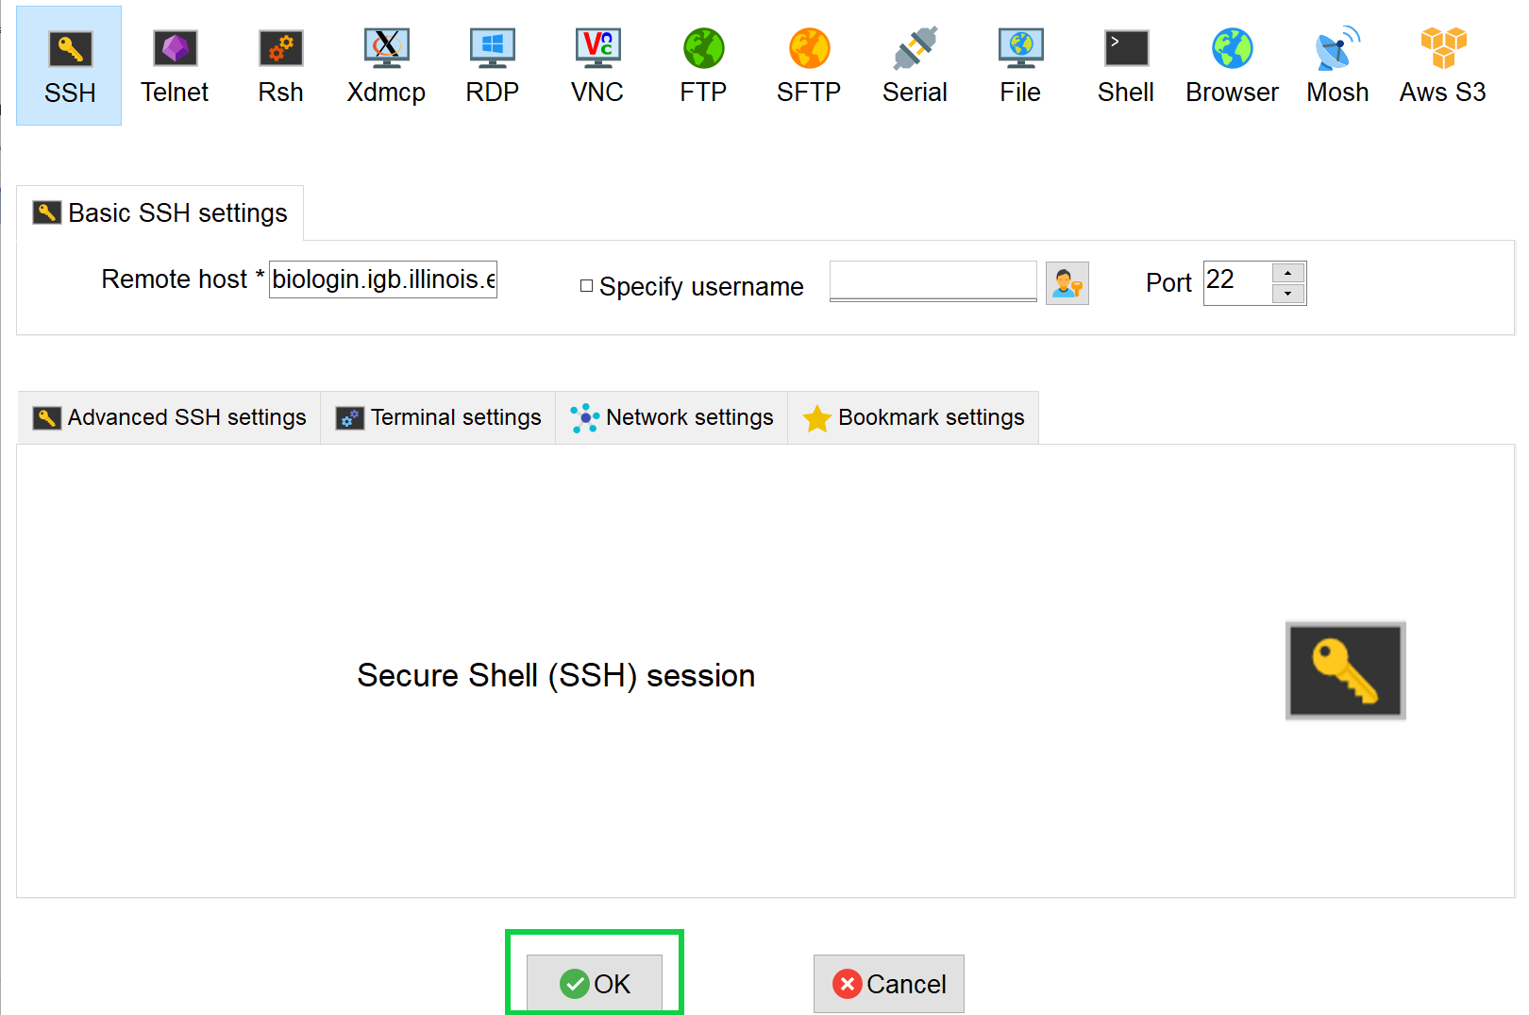
Step 0A: Accessing the IGB Biocluster for First Time
Open MobaXterm from the VM
In a new session, select SSH and type the following host name:
biologin3.igb.illinois.edu
Click OK

Slide 6
Step 0A: Accessing the IGB Biocluster
Enter login credentials assigned to you.
Example username: Class01
You will not see any characters on screen when typing in password. Just type it.

Slide 7
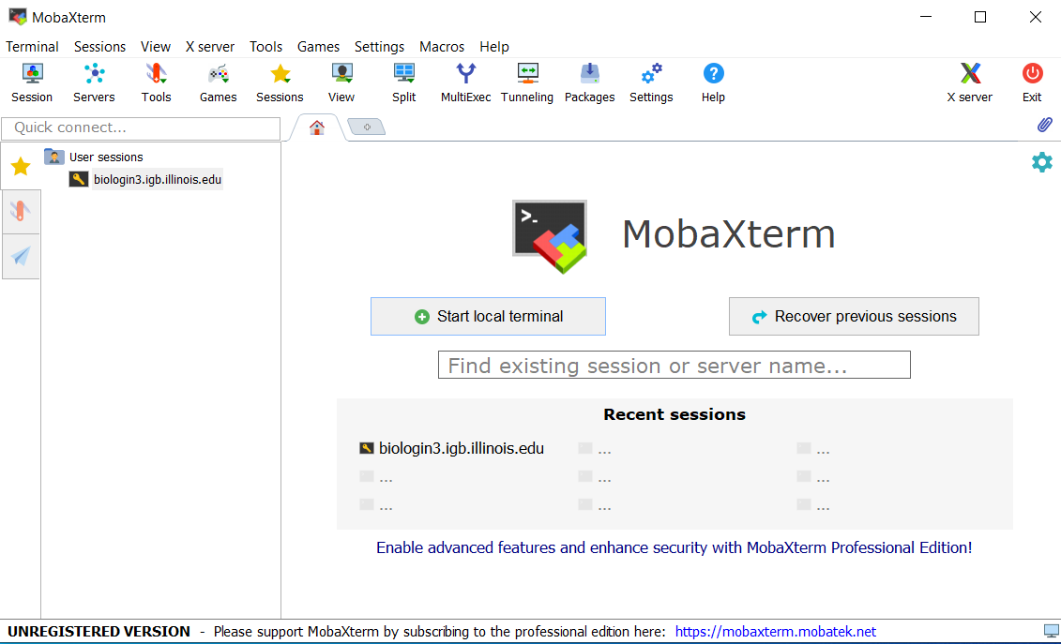
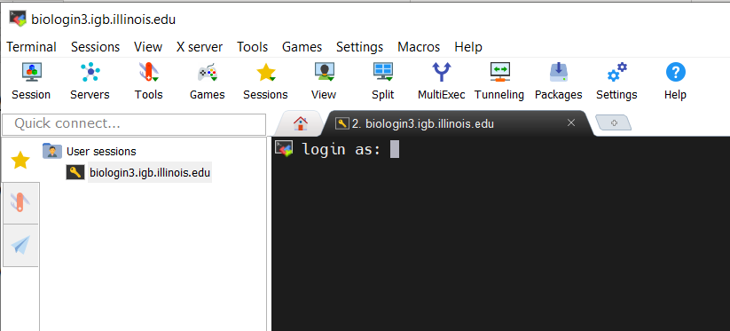
Step 0A: Accessing the IGB Biocluster
If you have done this before, just double-click on the session you created once and type username and password.

Slide 8
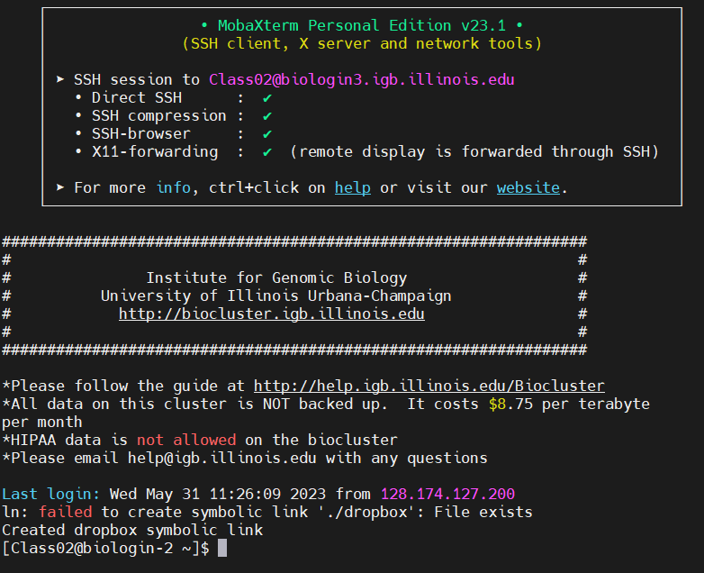

Slide 9
The PED File Format
The PED File Format specifies for each individual their genotype for each SNP and their phenotype.
Family ID is either CH (Chinese) or JP (Japanese)
Paternal and Maternal IDs of 0 indicate missing.
Sex is either Male=1, Female=2, Other=Unknown
Phenotype is either 0 = missing, 1 = affected, 2 = unaffected.
Genotype 0 is used for missing genotype
Family ID | Individual ID | Paternal ID | Maternal ID | Sex | Phenotype | Genotype…
CH18526 | NA18526 | 0 | 0 | 2 | 1 | A A 0 G ..

Slide 10
The MAP File Format
The MAP File Format specifies the location of each SNP.
Note: Morgans (M) are a special kind of genetic distance derived from chromosomal recombination studies. Morgans can be used to reconstruct chromosomal maps.
chr | SNP ID | cM | Base Pair Position
8 | rs17121574 | 12.8 | 12799052

Slide 11
Working with PLINK
In this exercise, we will analyze our data using PLINK on the command line
Additionally, we will perform a format conversion to speed up our QC analysis.
Finally, we will validate our conversion and see what individuals and SNPs would be filtered out with default filters for QC analysis.

Slide 12
Step 1A: Load plink
$ srun -p classroom -c 2 --mem 8000 --pty bash
# Open interactive session on biocluster with 2 cpus and 8G memory.
$ module load plink/1.07 # Load plink version 1.07 to the environment

Slide 13
Step 1B: Setting up the Directory
Copy and submit the prep_directory.sh job script to create a project directory with the input files.
# move to home directory
$ cd ~/
# copy prep_directory.sh to current directory
$ cp /home/classroom/mayo/2020/09_Variant_Analysis/prep_directory.sh ./
# submit job script
$ sbatch prep_directory.sh

Slide 14
Step 1C: Dataset Characteristics
Copy and submit the prep_directory.sh job script to create a project directory with the input files.
# move to project directory
$ cd ~/09_Variant_Analysis
# list out directory contents
$ ls
# gwas.map gwas.ped pop.cov
filename | meaning
gwas1.ped | Genotype data for 228,694 SNPS on 90 people.
gwas1.map | Map file for the snps in gwas1.ped.
pop.cov | Population membership of the 90 people. (1 = Han Chinese, 2 = Japanese)

Slide 15
Step 2A: Creating a bed file
Type in the following command to call the PLINK software to create a bed file
$ plink --file gwas1 --make-bed --out gwas2 --noweb
# --file → INPUT name
# --make-bed → operation to perform
# --out → OUTPUT name
# --noweb → tell plink not to connect to the internet

Slide 16
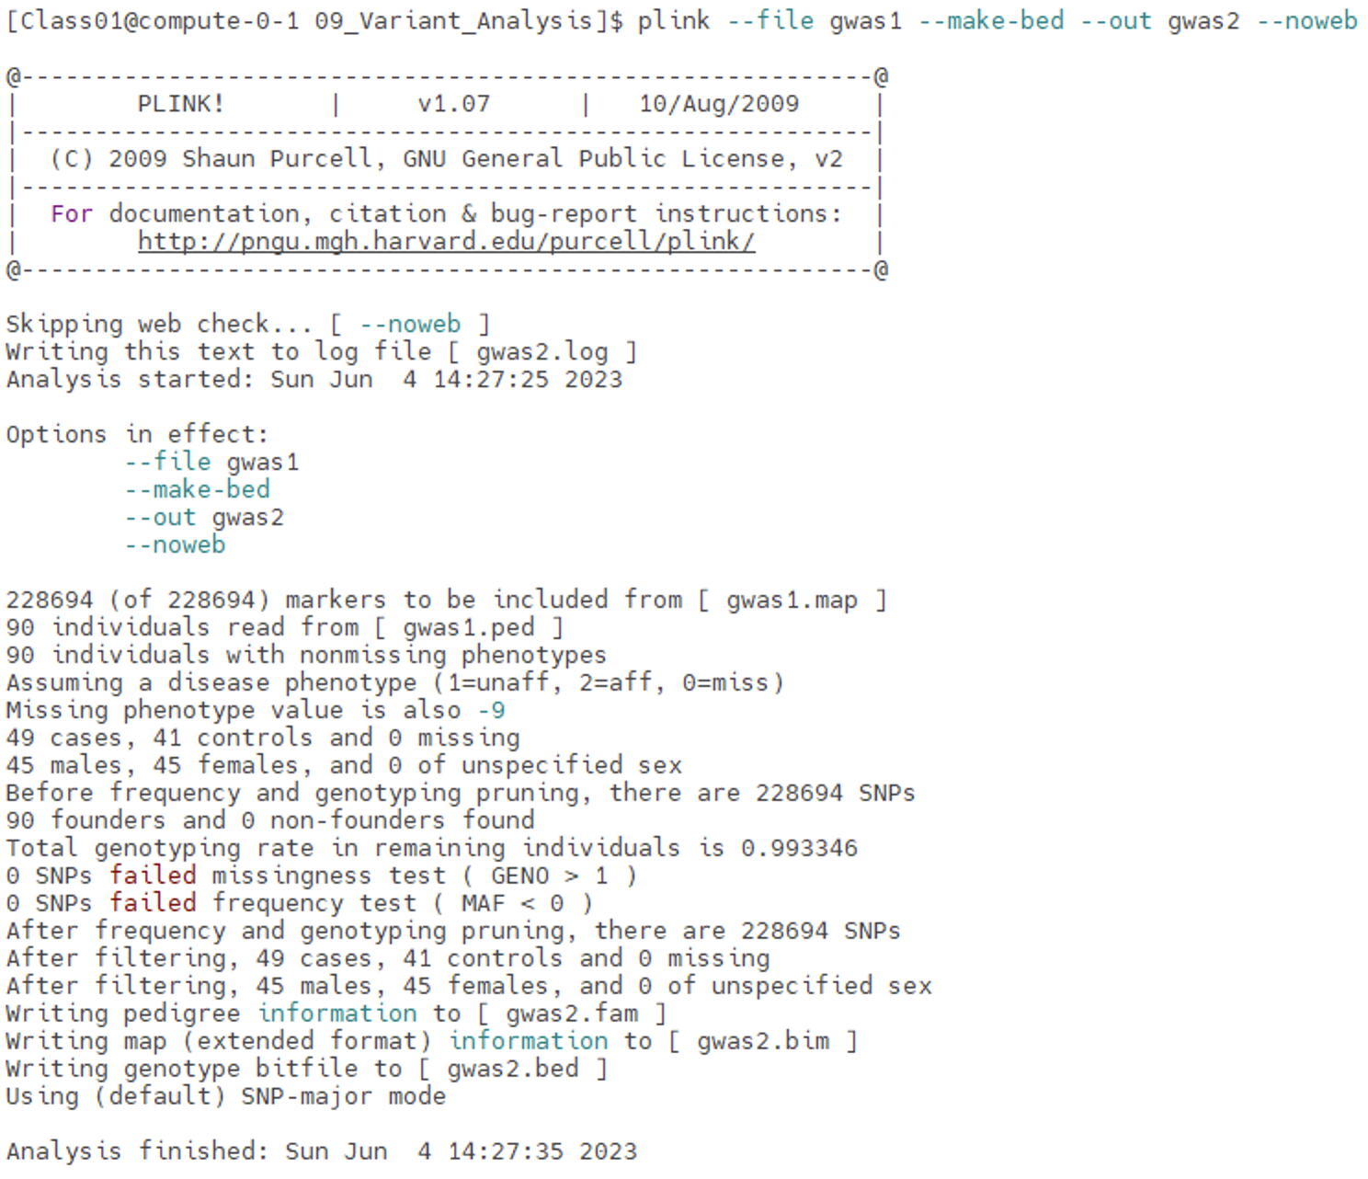
Step 2A: Creating a bed file
Your screen should look similar to this

Slide 17
Step 2B: Creating a bed file
Verify in your 09_Variant_Analysis folder that the gwas2 files were created
$ ls –lth
# -l will list out files in long format to get more information
# -t will list files in order by time (most recent files at the top of the list)
# -h will make the list human readable (e.g., 1.6K instead of 1620 for file size)

Slide 18
Step 3A: Validating the Conversion
Type in the following command to call the PLINK software to validate your initial output
$ plink --maf 0.01 --geno 0.05 --mind 0.05 --bfile gwas2 --out validate --noweb
# --maf → minor allele frequency to 0.01 (1%)
# --geno → Maximum SNP Missingness rate to 0.05 (5%)
# --mind → Maximum individual missingness rate to 0.05 (5%)
# --bfile → binary file name
# --out → output name
# --noweb → tell plink not to connect to the internet

Slide 19
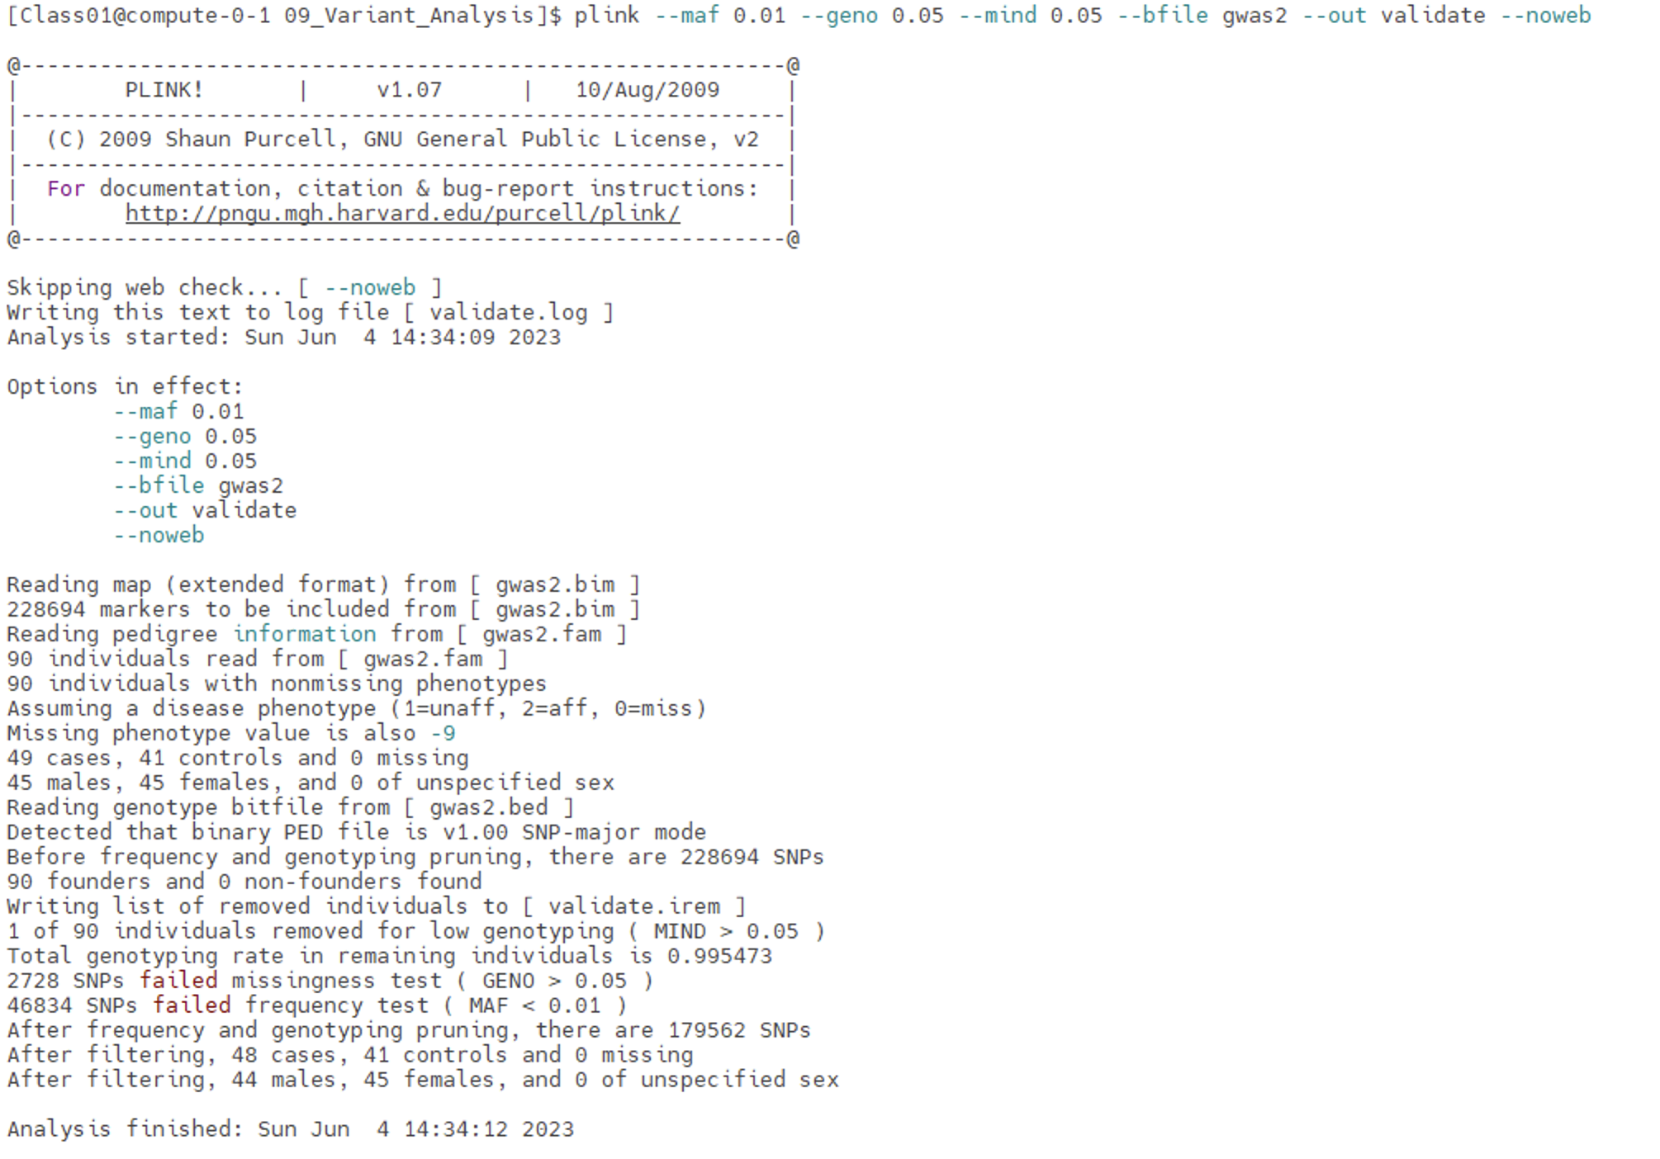
Step 3A: Validating the Conversion
Your screen should look similar to this

Slide 20
Step 3B: Validating the Conversion
Verify in your 09_Variant_Analysis folder that the validate files were created
$ ls –lth

Slide 21
Step 3C: Viewing Validation
46834 out of ~ 230,000 SNPs were removed because the failed the MAF.
2728 SNPS were removed because they were not genotyped in enough individuals (minimum, 95%).
1 of 90 individuals removed for low genotyping ( MIND > 0.05 )

Slide 22
Step 3D: Validating the Conversion
The validate.irem file is small enough to print to the console, so we can use cat to view it
The family id is JA19012 (Japanese) and the individual ID is NA19012. This individual was removed because of low genotyping quality.
$ cat validate.irem
# JA19012 NA19012

Slide 23
Quality Control Analysis
In this exercise, we will perform Quality Control Analysis (QC) to filter our data according to a set of criteria.

Slide 24
Quality Control Filters
The validation tool will impose the following criteria on our data.
filter | meaning | threshold
Minor Allele Frequency (MAF) | The proportion of the minor allele to the major allele of a SNP in the population must exceed this threshold for the SNP to be included in the analysis | 1%
Individual Genotyping rate | The number of SNPs probed for an individual must exceed this threshold for the person to be analyzed. | 95%
SNP genotyping rate | The SNP must be probed for at least this many individuals. | 95%

Slide 25
Step 4A: Quality Control Analysis
Type in the following command to call the PLINK software to perform the Quality Control (QC) analysis
$ plink --maf 0.01 --geno 0.05 --mind 0.05 --bfile gwas2 --make-bed --out gwas3 --noweb
# --maf → minor allele frequency to 0.01 (1%)
# --geno → Maximum SNP Missingness rate to 0.05 (5%)
# --mind → Maximum individual missingness rate to 0.05 (5%)
# --bfile → binary file name
# --make-bed → operation to perform
# --out → output name
# --noweb → tell plink not to connect to the internet

Slide 26
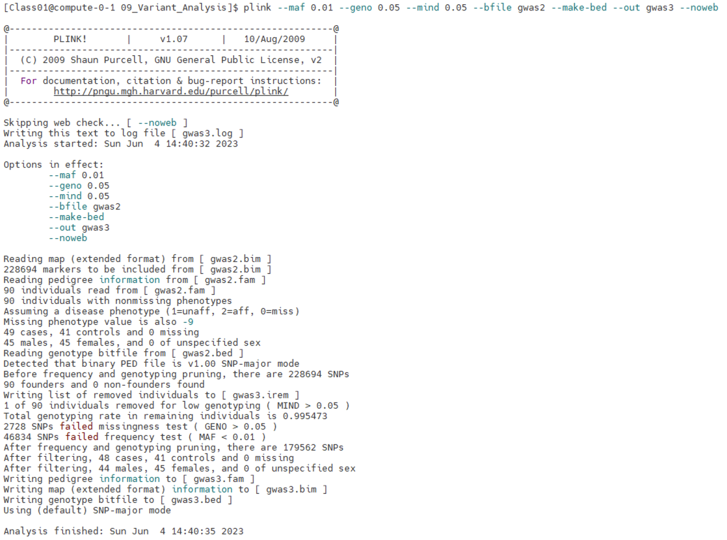
Step 4A: Quality Control Analysis
Your screen should look similar to this

Slide 27
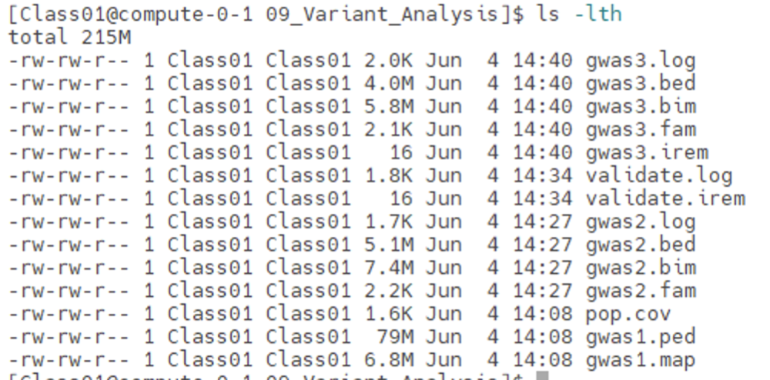
Step 4B: Quality Control Analysis
Verify in your 09_Variant_Analysis folder that the gwas3 files were created
$ ls –lth

Slide 28
Genome-Wide Association Test (GWAS)
In this exercise, we will perform a GWAS on our filtered data across two phenotypes: a case study and control. We will then compare the results between unadjusted p-values and multiple hypothesis corrected p-values.

Slide 29
Step 5A: GWAS
Type in the following command to call the PLINK software to test for associations and adjust for multiple testing
$ plink --bfile gwas3 --assoc --adjust --out assoc1 --noweb
# --bfile → binary file name
# --assoc → operation to perform, here association testing)
# --adjust → operation to perform, here adjust p-values due to multiple testing
# --out → output name
# --noweb → tell plink not to connect to the internet

Slide 30
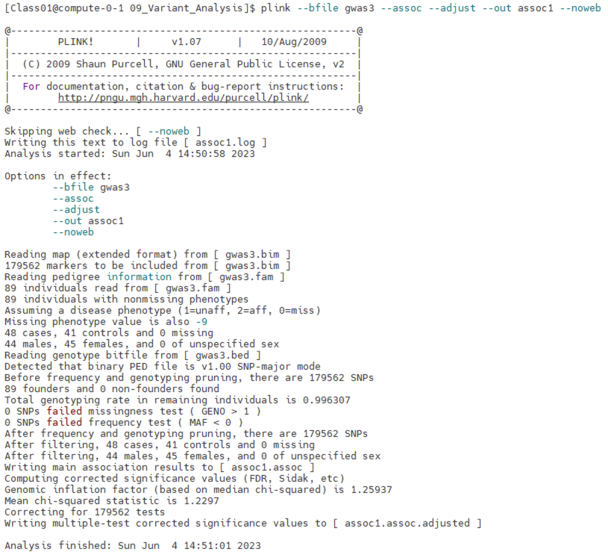
Step 5A: GWAS
Your screen should look similar to this

Slide 31
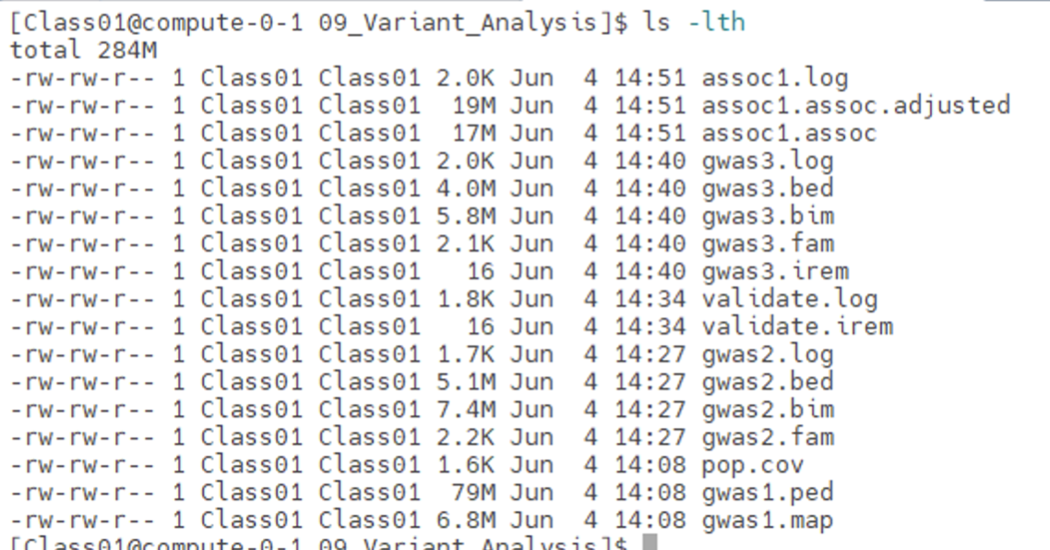
Step 5B: GWAS
Verify in your 09_Variant_Analysis folder that the assoc1 files were created
$ ls –lth

Slide 32
Step 6: GWAS Without Multiple Hypothesis Correction
The SNP p-values from our GWAS with no multiple hypothesis correction are located in the 9th column of assoc1.assoc.
Overall, 13,294 SNPs survive at p-value of 0.05 WITHOUT Multiple Hypothesis Correction
Here we will use the UNIX tool awk to count the number of lines/rows where the 9th column is equal or less than 0.05. At the end of the file, we then print our variable count, which was automatically created for us
$ awk '$9 <= 0.05 {count+=1} END {print count}' assoc1.assoc
# 13294

Slide 33
Step 6: GWAS Without Multiple Hypothesis Correction
The top few SNPs are shown below after using redirecting the result of sort by using the "|" character to the head command
$ sort -g -k9,9 assoc1.assoc | head
# -g tells the sort command to sort using generic numeric sorting
# -k tells the sort command to set the 9th column as the key column to sort on
# head will print the first 10 lines by default
Notes:
Add Excel to Desktop

Slide 34
Step 7: GWAS With Multiple Hypothesis Correction
The SNP p values from our GWAS with multiple hypothesis correction are located in the 9th column of assoc1.assoc.adjusted.
We will use awk to print every line ($0) where the p-value is less than or equal to 0.1
Overall, only 4 SNPS!!! show a FDR Correction of less than 0.1
$ awk '$9 <= 0.1 {print $0}' assoc1.assoc.adjusted

Slide 35
Step 8: GWAS Without Multiple Hypothesis Correction
Exit MobaXterm by either of the following:
Close the window
Type exit in the command line twice and then press <return>
$ exit # first to exit from compute node
$ exit # again to exit from login node
<RETURN>

Slide 36
Visualization
In this exercise, we will generate a Manhattan Plot of our association results using Haploview from the Broad Institute.

Slide 37
Step 9A: Configuring Haploview
Open Haploview from VM.
Click PLINK Format

Slide 38
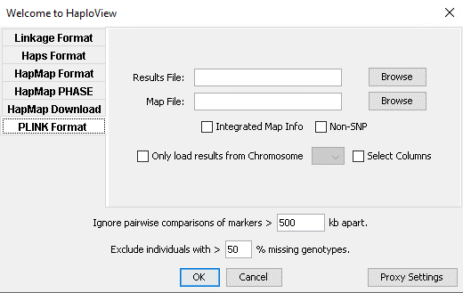
Step 9B: Configuring Haploview
Click on Browse next to Results File:

Slide 39
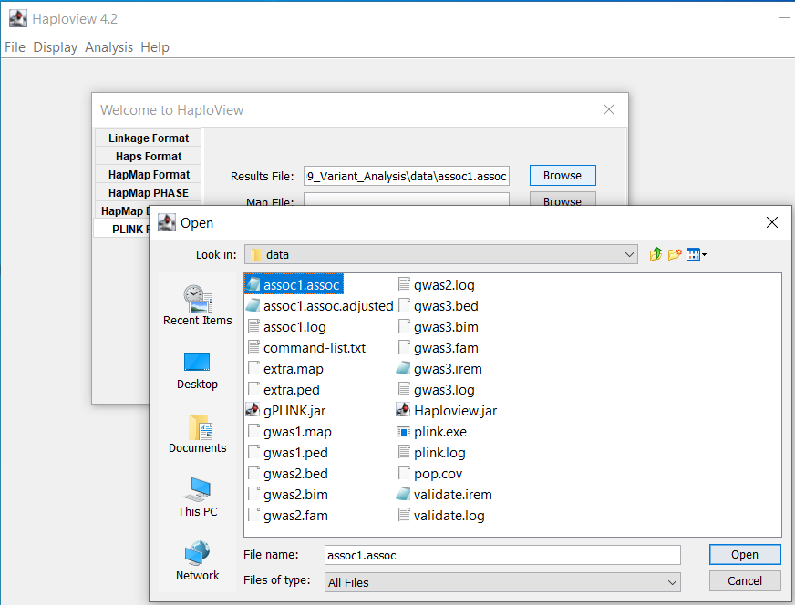
Step 9C: Configuring Haploview
Navigate to the directory PLINK saved the file assoc1.assoc. It should be saved in the data sub folder in the 09_Variant_Analysis folder
Select assoc1.assoc and click Open.

Slide 40
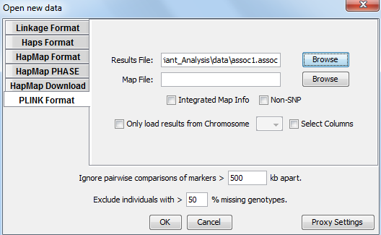
Step 9D: Configuring Haploview
Click on Browse next to Map File:

Slide 41
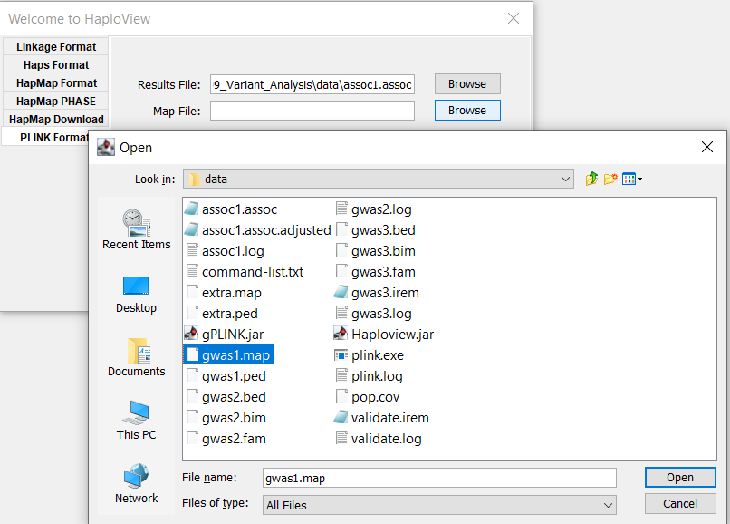
Step 9E: Configuring Haploview
Navigate to the data directory containing gwas1.map
Select gwas1.map and click Open.

Slide 42
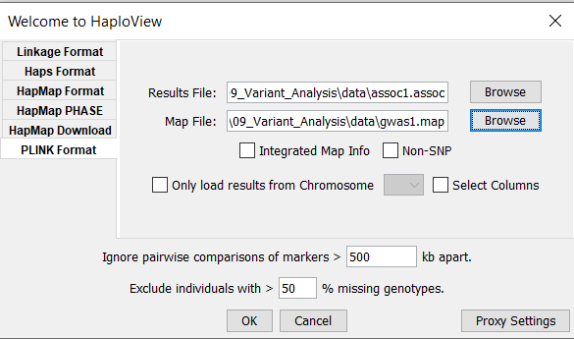
Step 9F: Configuring Haploview
Click on OK.

Slide 43
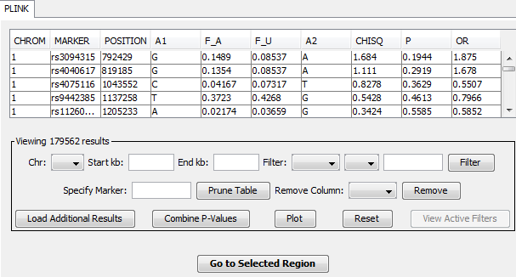
Step 9G: Configuring Haploview
Your asssoc1 should be shown in Haploview in tabular format.
To create a Manhattan Plot, click Plot

Slide 44
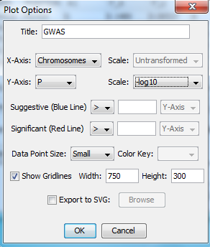
Step 9H: Configuring Haploview
Select Chromosomes for X-Axis
Select P for Y-Axis
Select –log10 for Y-Axis Scale
Click OK

Slide 45
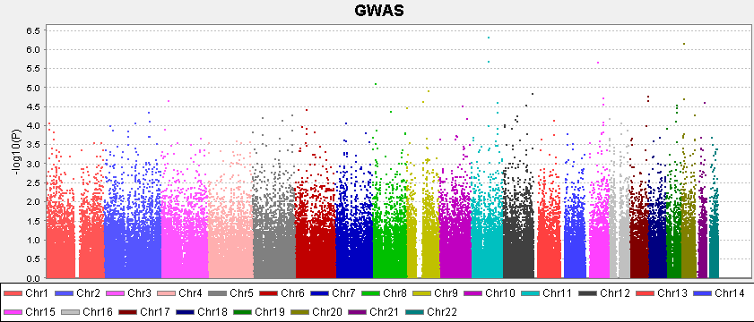
Step 10: Manhattan Plot
Haploview then should generate the following Manhattan Plot

