Slide 1
Variant Calling Workshop
Chris Fields
PowerPoint by Casey Hanson
Edited by Gio Madrigal & Roberto Cucalón Tamayo

Slide 2
Introduction
In this lab, we will do the following:
Perform variant calling analysis on the IGB biocluster.
Visualize our results on the desktop using the Integrative Genomics Viewer (IGV) tool.

Slide 3
Start the VM
Follow instructions for starting VM (This is the Remote Desktop software).
The instructions are different for UIUC and Mayo participants.
Find the instructions for this on the course website under Lab Set-up:
https://publish.illinois.edu/compgenomicscourse/2023-schedule/

Slide 4
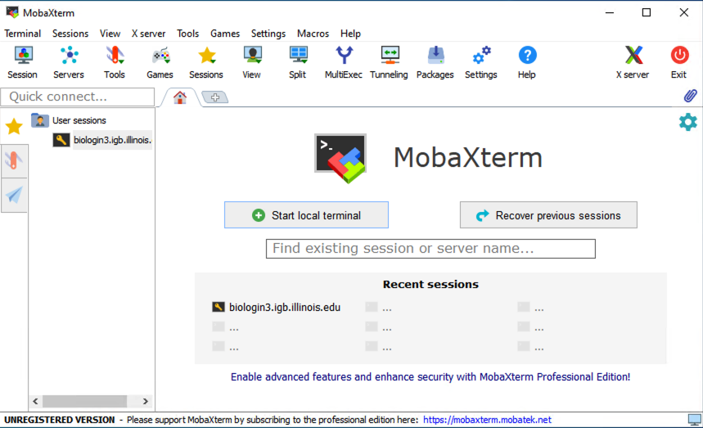
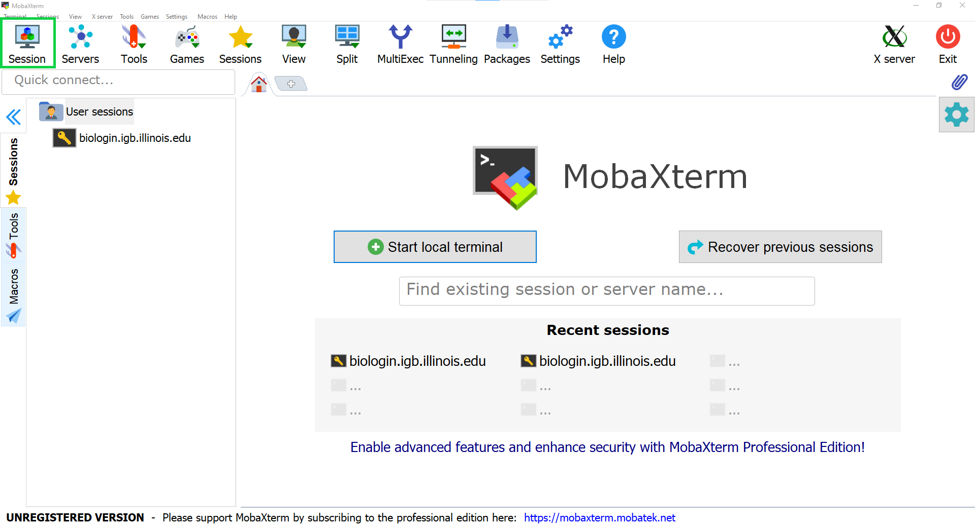
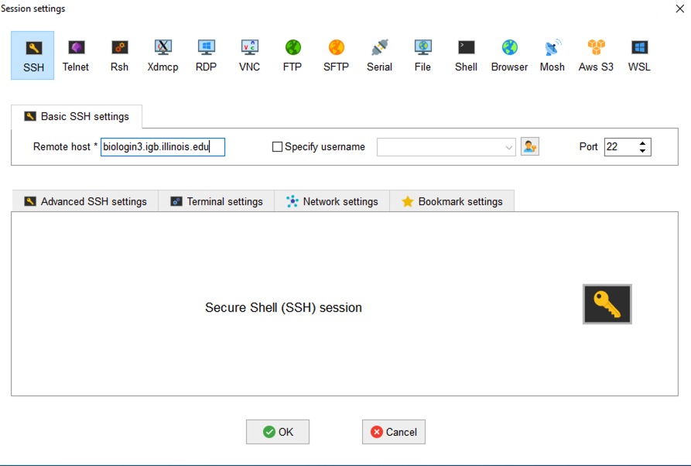
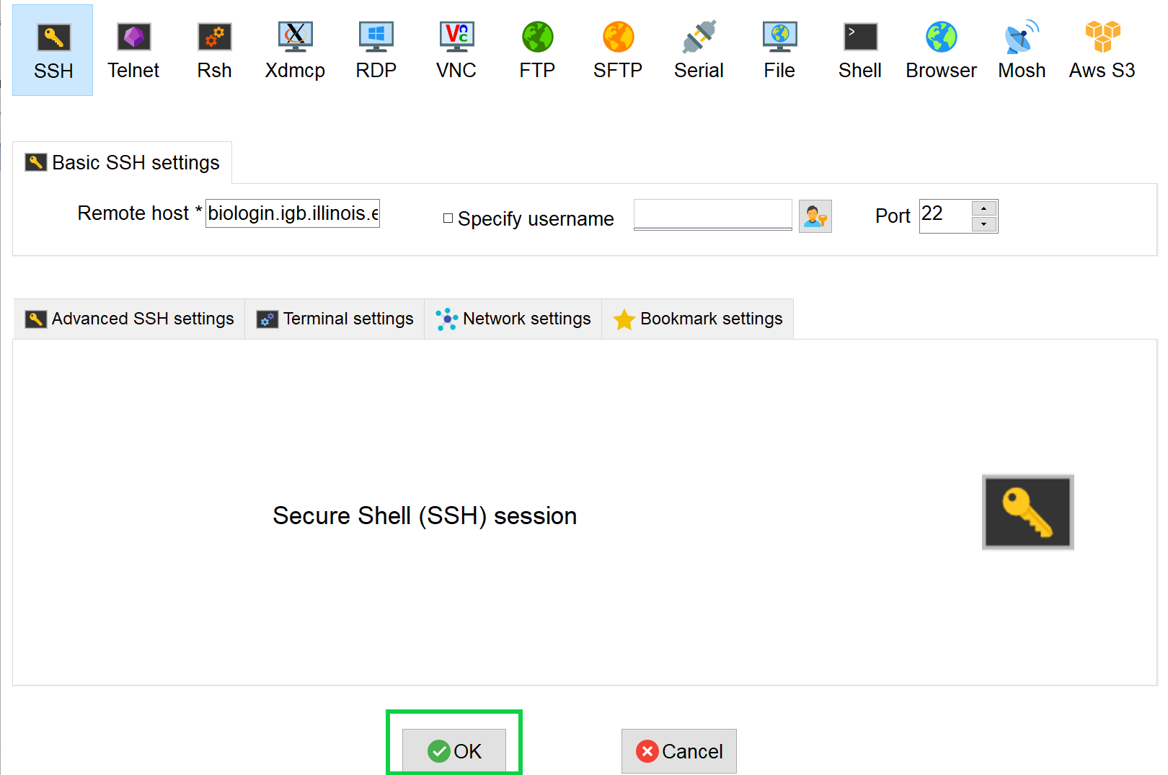
Step 0A: Accessing the IGB Biocluster for First Time
Open MobaXterm from the VM
In a new session, select SSH and type the following host name:
biologin3.igb.illinois.edu
Click OK

Slide 5
Step 0A: Accessing the IGB Biocluster
Enter login credentials assigned to you.
Example username: Class01
You will not see any characters on screen when typing in password. Just type it.

Slide 6
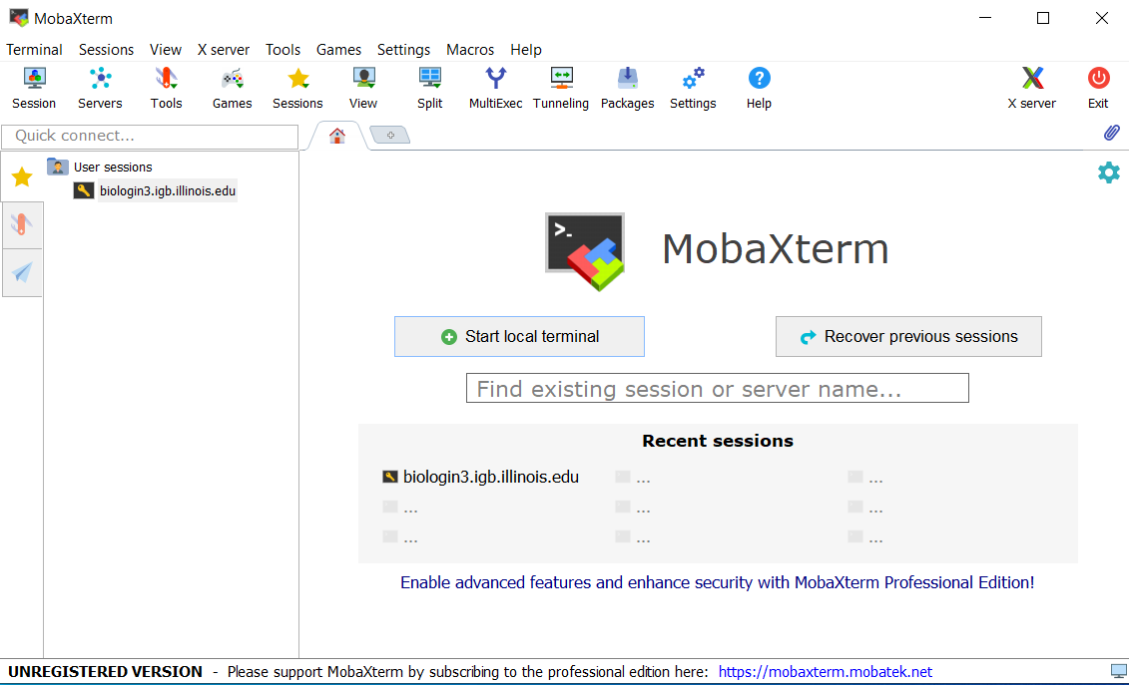
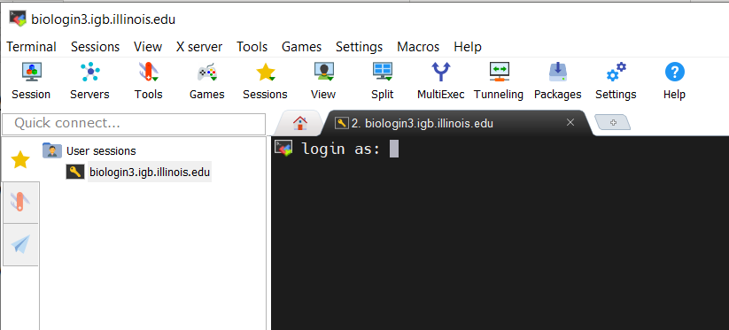
Step 0A: Accessing the IGB Biocluster
If you have done this before, just double-click on the session you created once and type username and password.

Slide 7
Step 0B: Lab Setup
The lab is located in the following directory:
/home/classroom/mayo/2020/03_Variant_Calling/
This directory contains the data and results from the finished version of the lab (i.e. the version of the lab after the tutorial). Consult it if you are unsure about your runs. You don’t have write permissions to the lab directory.
In the next slide, you will create a working directory of this lab in your home directory for your output to be stored. You will copy the necessary shell files (.sh) files from the data directory to your working directory.
Note ~ is a symbol in Unix paths referring to your home directory.
Note: In this lab, we will NOT login to a node on the biocluster. Instead, we will submit jobs to the biocluster.

Slide 8
Step 0C: Lab Setup
Copied Files
annotate_snpeff.sh
call_variants_ug.sh
hard_filtering.sh
post_annotate.sh
Create a working directory called ~/03_Variant_Calling in your home directory.
Copy all shell files (.sh) from the following path to your working directory.
$ mkdir ~/03_Variant_Calling
# Make working directory in your home directory
$ cd ~/03_Variant_Calling
# Change directory to your working directory.
$ cp /home/classroom/hpcbio/mayo_workshop/2019/Mayo-Variant-Calling/*.sh .
# Copy shell files to your working directory.

Slide 9
Variant Calling Setup
In this exercise, we will use data from the 1000 Genomes project (EXOME, 60x coverage) to call variants, in particular single nucleotide polymorphisms.
The initial part of the GATK pipeline (alignment, local realignment, base quality score recalibration) has been done, and the BAM file has been reduced for a portion of human chromosome 20. This is the data we will be working with in this exercise.

Slide 10
Step 1A: Running a Variant Calling Job
In this step, we will start a variant calling job using the sbatch command.
Additionally, we will gather statistics about our job using the squeue command.
$ sbatch call_variants_ug.sh
# This will execute call_variants_ug.sh on the biocluster.
$ squeue –u $USER
# Get statistics on your submitted job

Slide 11
Step 1B: Output of Variant Calling Job
Periodically, call squeue to see if your job has finished.
You should have 4 files when it has completed.
Discussion
- What did we just do?
We ran the GATK UnifiedGenotyper to call variants.
Look at the file structure.
Files
raw_indels.vcf
raw_indels.vcf.idx
raw_snps.vcf
raw_snps.vcf.idx

Slide 12
Step 1C: SNP and Indel Counting
In this step, we will count the # of SNPS and Indels identified in the raw_snps.vcf and raw_indels.vcf files.
We will use grep, which is a text matching program.
$ grep -c -v '^#' raw_snps.vcf # Get the number of SNPs.
# -v Tells grep to show all lines not beginning with # in raw_snps.vcf.
# -c Tells grep to return the total number of returned lines.
# Output should be approx. 14400.
$ grep -c -v '^#' raw_indels.vcf # Get the number of indels.
# Output should be approx. 1069.

Slide 13
Step 1D: SNP and Indel Counting in dbSNP
In this step, we will count the number of SNPs and Indels in dbSNP.
dbSNP SNPs and Indels have the rs# identifier where # is a number.
Example: rs1000
$ grep -c 'rs[0-9]*' raw_snps.vcf # Get the number of dbSNP SNPs.
# Return all lines in raw_snps.vcf containing rs followed by a number.
# -c Tells grep to return the total number of returned lines.
# Output should be approx. 12650.
$ grep -c 'rs[0-9]*' raw_indels.vcf # Get the number of dbSNP indels.
# Output should be approx. 958.

Slide 14
Step 2A: Hard Filtering Variant Calls
We need to filter these variant calls in some way.
In general, we would filter on quality scores. However, since we have a very small set of variants, we will use hard filtering.
$ sbatch hard_filtering.sh
# Execute hard_filtering.sh on the biocluster.
$ squeue –u $USER
Output Files
hard_filtered_snps.vcf
hard_filtered_indels.vcf
Periodically, call squeue to see if your job has finished.

Slide 15
Step 2A: Hard Filtering Variant Calls
**Do not need to run this code**
gatk -T VariantFiltration \
-R $REFERENCE \
--variant $SNP_VCF_FILE \
--clusterSize 3 \ # 3 SNPs within
--clusterWindowSize 10 \ # 10nt window
--filterExpression "QD < 2.0" \ # Condition
--filterName "QDFilter" \ # Label
--filterExpression "MQ < 40.0" \
--filterName "MQFilter" \
--filterExpression "FS > 60.0" \
--filterName "FSFilter" \
--filterExpression "HaplotypeScore > 13.0" \
--filterName "HaplotypeScoreFilter" \
--filterExpression "MQRankSum < -12.5" \
--filterName "MQRankSumFilter" \
--filterExpression "ReadPosRankSum < -8.0" \
--filterName "ReadPosRankSumFilter" \
-o $SNP_VCF_FILE_OUT
Hard filtering steps use specific cutoffs with annotations for filtering data, labeling them according to any filters that a variant doesn’t pass.
In the lecture we discuss ways to look at samples and assess a cutoff
Here we use example cutoffs recommended by GATK group

Slide 16
Step 2B: Hard Filtering Variants Calls
In this step, we will count the # of filtered SNPs and Indels.
$ grep -c 'PASS' hard_filtered_snps.vcf # Count # of passes
# Output 8554.
$ grep -c 'PASS' hard_filtered_indels.vcf # Count # of PASSES
# Output 1069
Discussion
Did we lose any variants?
How many PASSED the filter?
What is the difference in the filtered and raw input?
Why are these approximate (why do results slightly differ)? UnifiedGenotyper is non-deterministic when using multi-threading (timing)
Notes:
I got 8552 for the first one (Saba)

Slide 17
Step 2B: Hard Filtering Variants Calls
Some of the filters are as following:
QD: variant confidence/ quality by depth, QD < 2
MQ: RMS mapping quality, MQ < 40
FS: Phred-scaled p-value, FS > 60.0
- What is the difference in the filtered and raw input?
In the filtered input the “FORMAT” column has information on whether the SNP has passed all the filters (“PASS”) or has failed any of them.

Slide 18
Step 3A: Annotating Variants With SnpEff
With our filtered variants, we now need to annotate them with SnpEff.
SnpEff adds information about where variants are in relation to specific genes.
Periodically, call squeue to see if your job has finished.
$ sbatch annotate_snpeff.sh
# This will execute snpeff.sh on the biocluster.
$ squeue –u $USER
Output Files
hard_filtered_snps_annotated.vcf
hard_filtered_indels_annotated.vcf

Slide 19
Step 3B: Annotating Variants With SnpEff
The IDs for the human assembly version we use are from Ensemble. The Ensemble format is ENSGXXXXXXXXXXX.
Example: FOXA2’s Ensemble ID is ENSG00000125798.
In this step, we would like to see if there are any variants of FOXA2.
$ grep -c 'ENSG00000125798' hard_filtered_snps_annotated.vcf
# Get the number of SNPS in FOXA2, ENSG00000125798.
# Output should be 3.
$ grep -c 'ENSG00000125798' hard_filtered_indels_annotated.vcf
# Get the number of Indels in FOXA2, ENSG00000125798.
# Output should be 0.

Slide 20
Step 4: GATK Variant Annotator
SnpEff adds a lot of information to the VCF.
GATK Variant Annotator helps remove a lot of the extraneous information.
$ sbatch post_annotate.sh
# This will execute post_annotate.sh on the biocluster.
$ squeue -u $USER
Output Files
hard_filtered_snps_final.vcf
hard_filtered_indels_final.vcf

Slide 21
Exit MobaXterm by either closing the window or typing ‘exit’ in the command prompt.

Slide 22
Visualization of Results
In this exercise, we will visualize the results of the previous exercise using the Integrated Genomics Viewer (IGV).
We are going to do visualization on VM.

Slide 23
Step 0: Local Files
For viewing and manipulating the files needed for this laboratory exercise, the path on the VM will be denoted as the following:
[course_directory]
We will use the files found in:
[course_directory]\03_Variant_Calling\results
[course_directory]= Desktop\VM

Slide 24
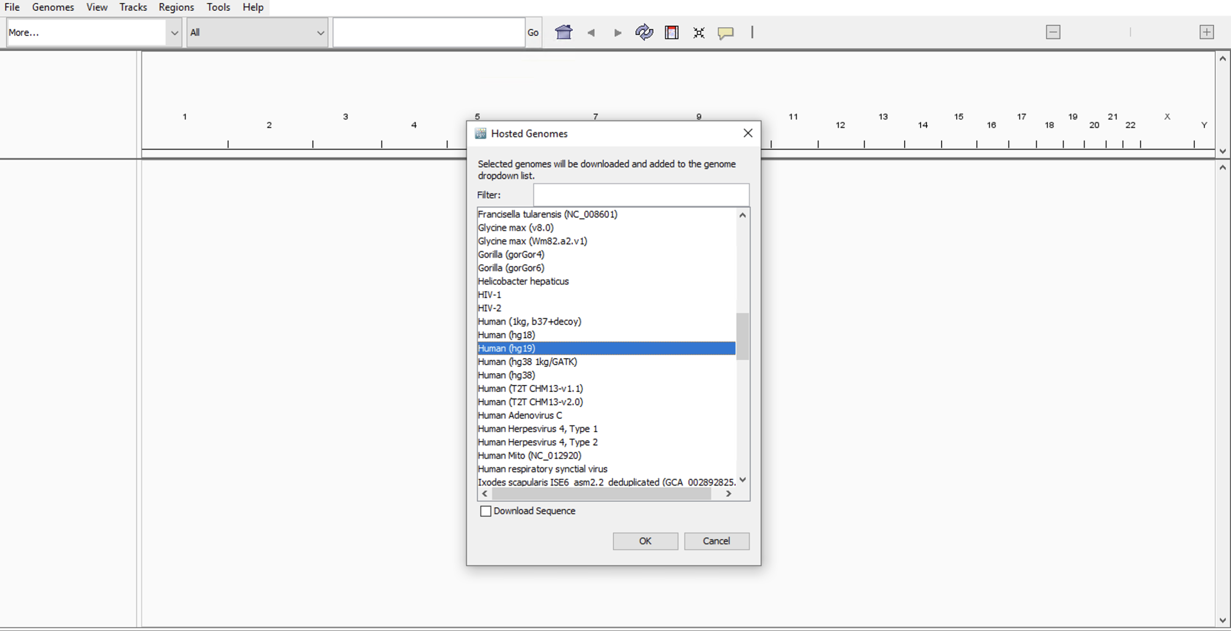
Step 5A: Visualization With IGV
Switch the genome to Human (hg19), which can be found by selecting More... under the genome selection panel

Slide 25
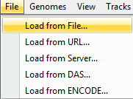
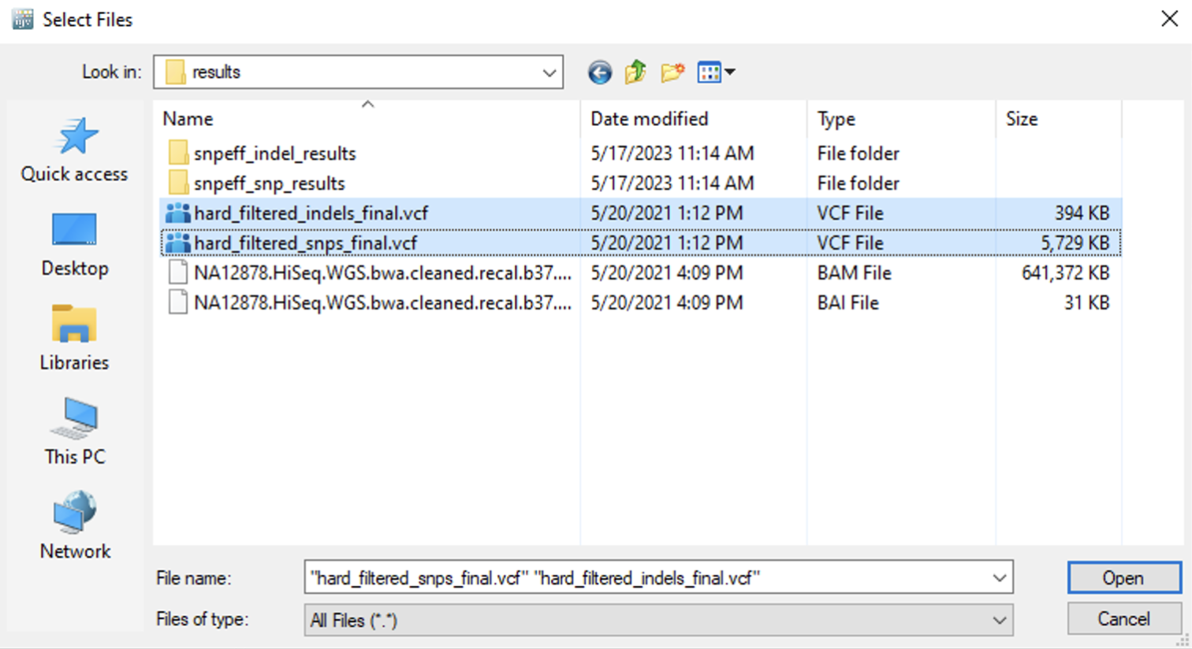
Step 5B: Loading VCF Files
On the menu bar, click File
Click Load from File…
Navigate to: [course_directory]/03_Variant_Calling/results
Hold the Ctrl key down.
Click both vcf files.
Click Open.

Slide 26
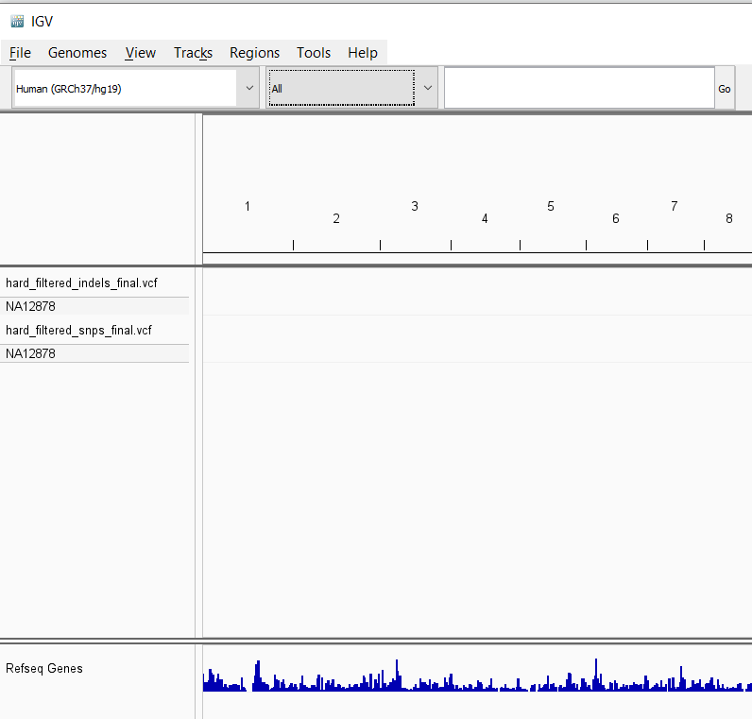
Step 5C: Loading VCF Files
You should see a windows similar to below:

Slide 27
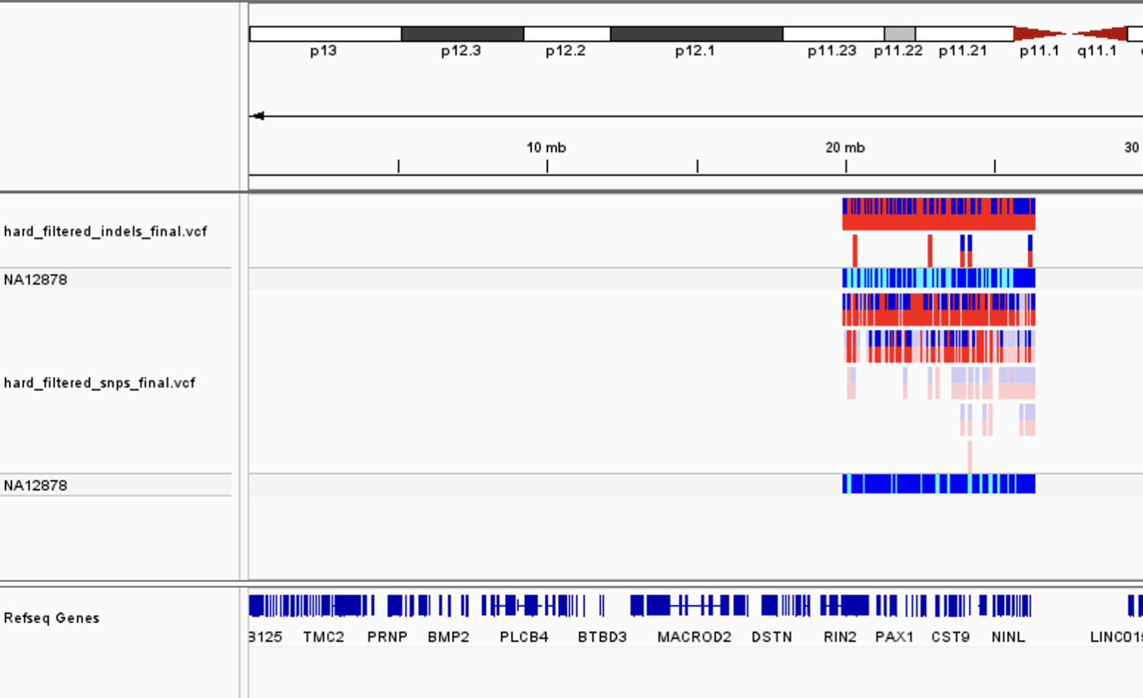
Step 5D: Navigate to Chromosome 20
In the search box, type chr20.
Press Enter or click Go.
You should see a track similar to the screenshot on the right.

Slide 28
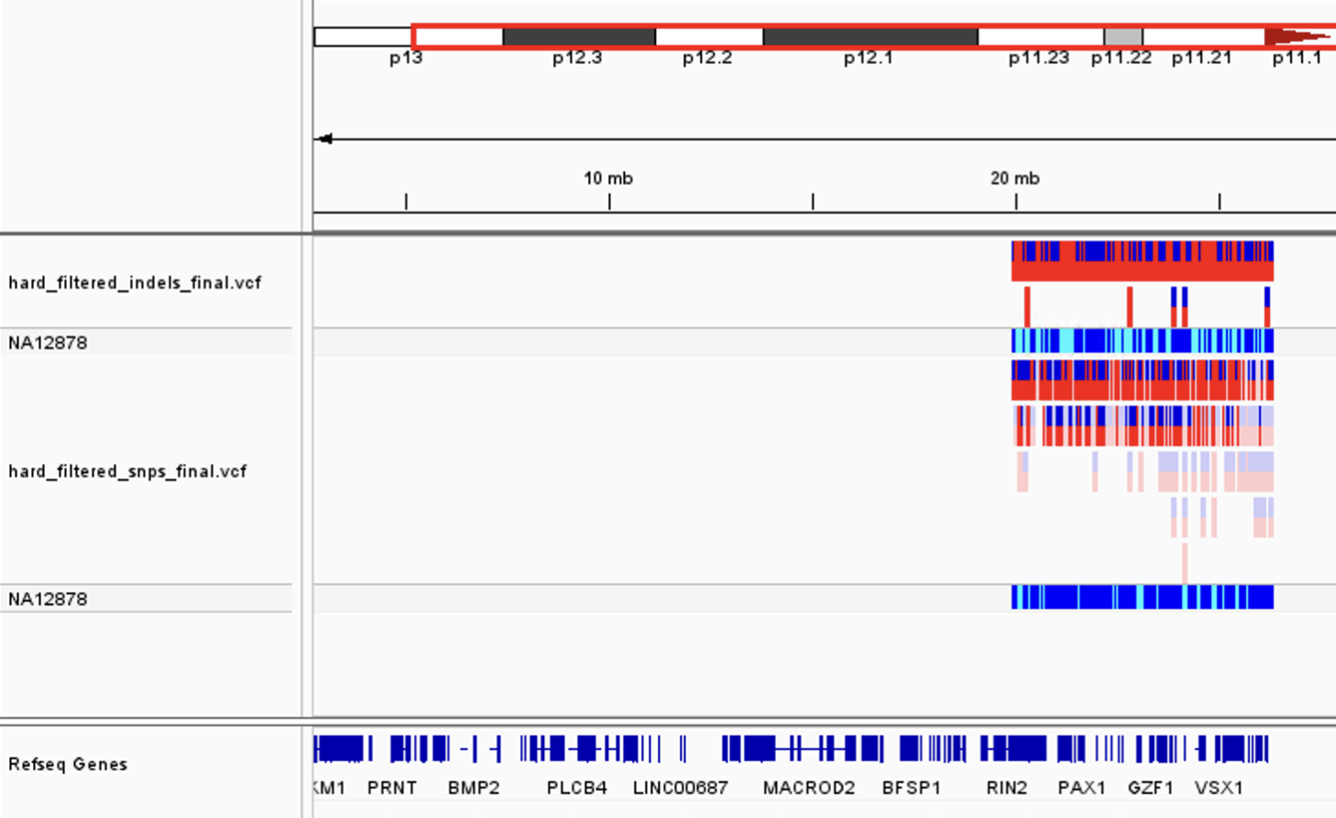
Step 5E: Navigate to Chromosome 20
Click and drag from around the 20 mb mark to about the 27 mb mark.

Slide 29
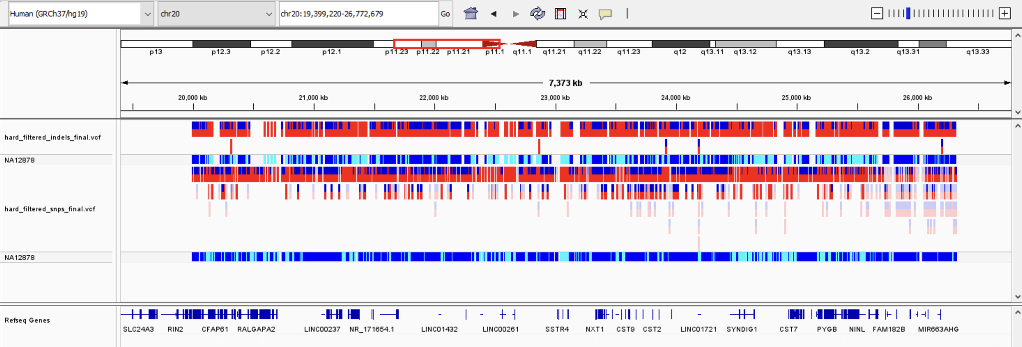
Step 5F: Navigate to Chromosome 20
The result should look similar to the screenshot below:

Slide 30
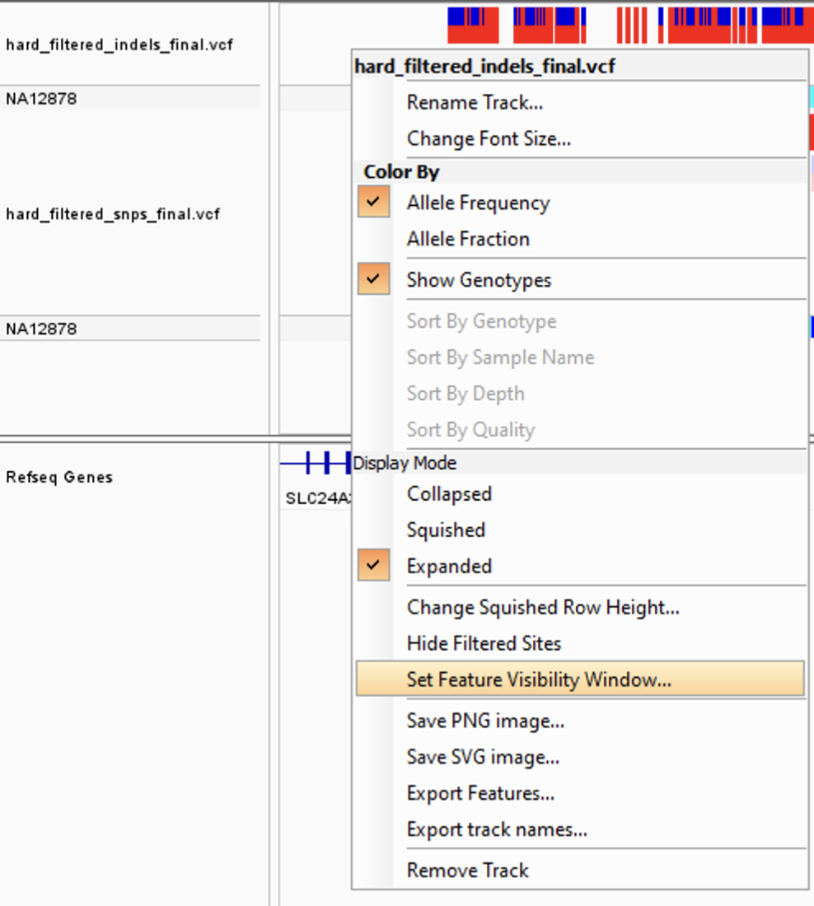
Step 5G: Setting Feature Visibility Window
Do this for each VCF track:
Right Click and Select Set Feature Visibility Window
Enter 10000 (which is 10 Mb).
Click OK.

Slide 31
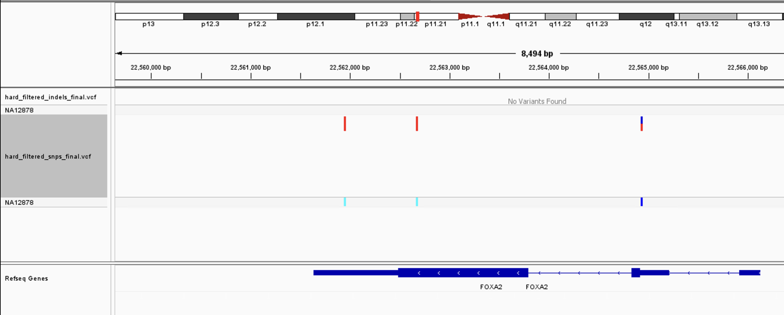
Step 5H: Viewing FOXA2 Polymorphisms
In the search box, type FOXA2 and press Enter.
You should see something like the window below:

Slide 32
Checkpoint: FOXA2 Polymorphisms
How many SNPs are here?
How many Indels are here?
How many SNPs are heterozygotes?

Slide 33
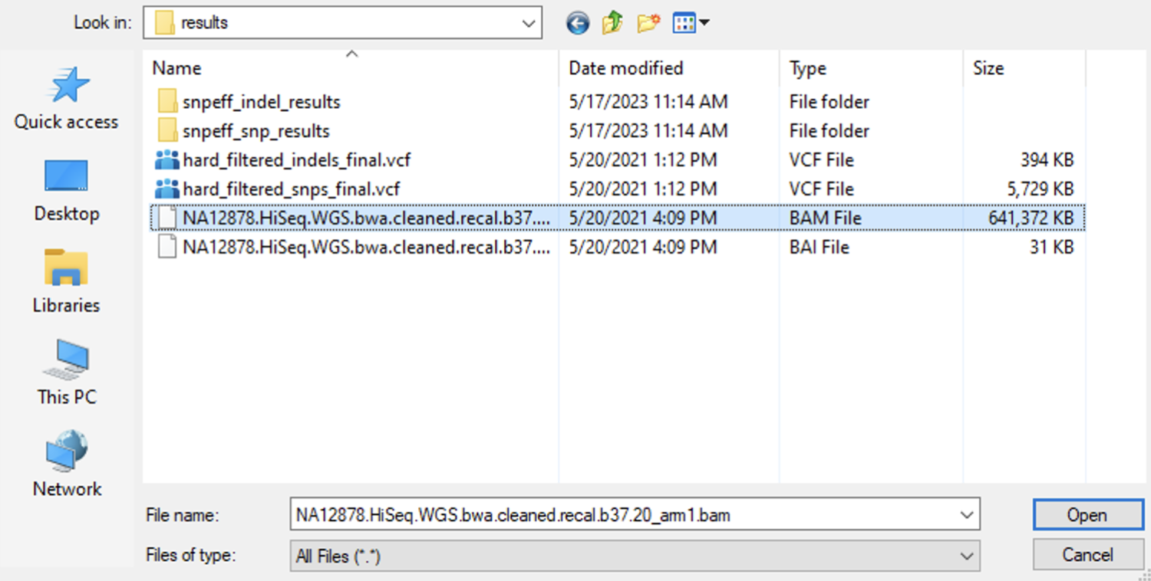
Step 6A: Loading a BAM File
On the menu bar, click File
Click Load from File…
Navigate to: [course_directory]/03_Variant_Calling/results
Click the bam file.
Click Open.

Slide 34
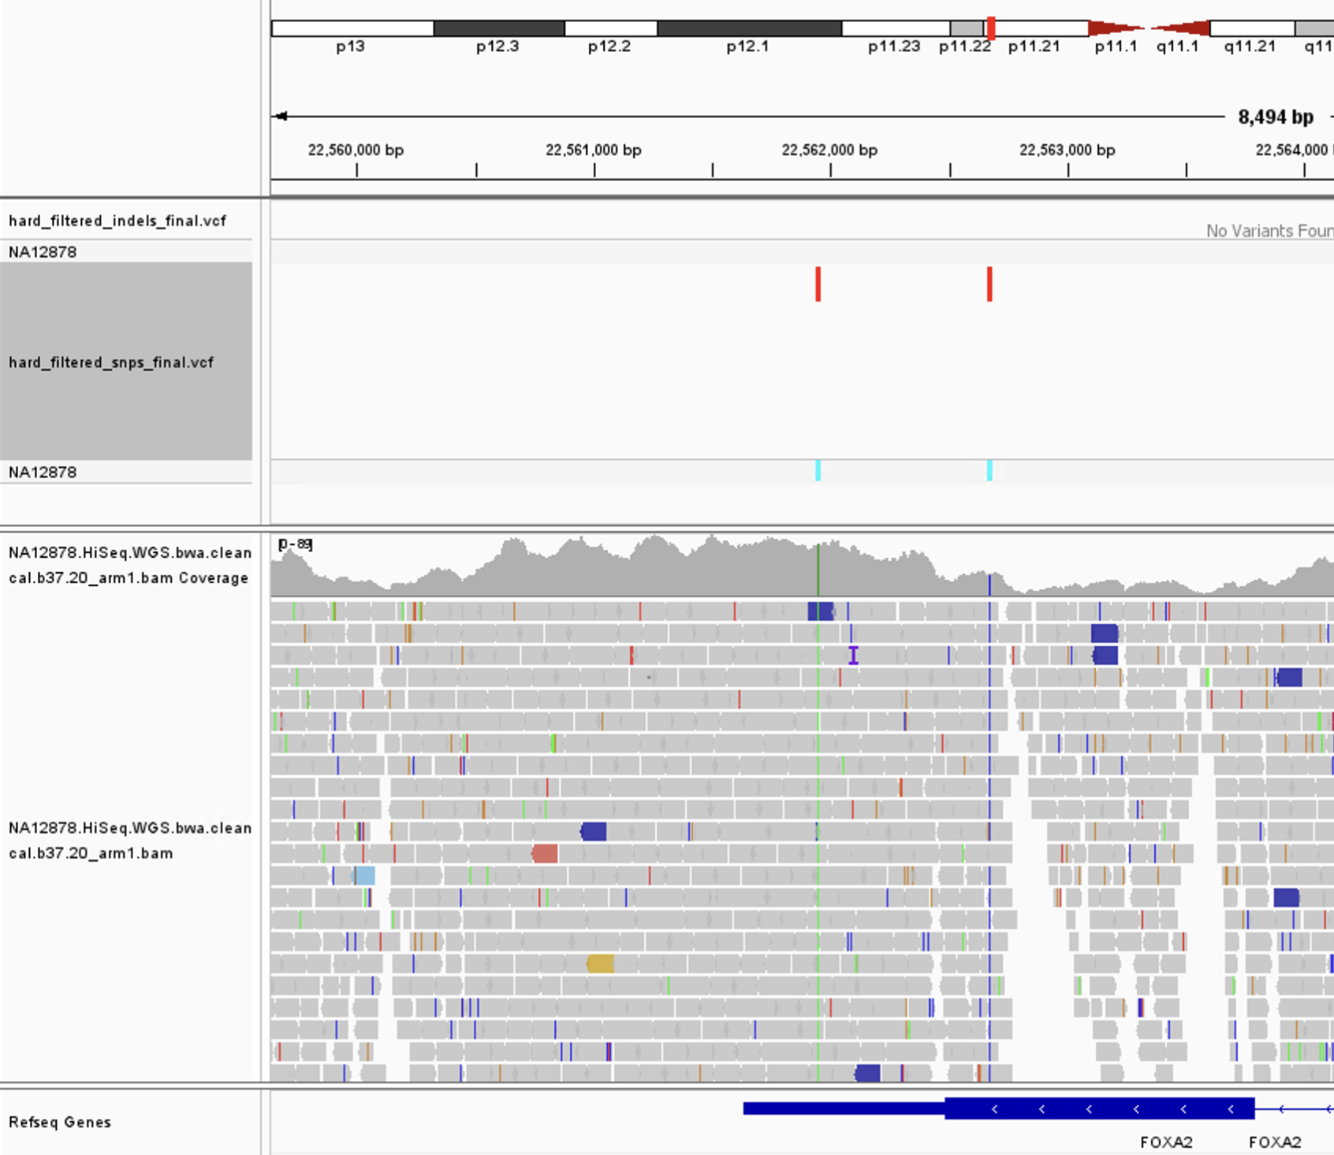
Step 6B: Loading BAM File
You should see a window with a new track similar to the one below:

Slide 35
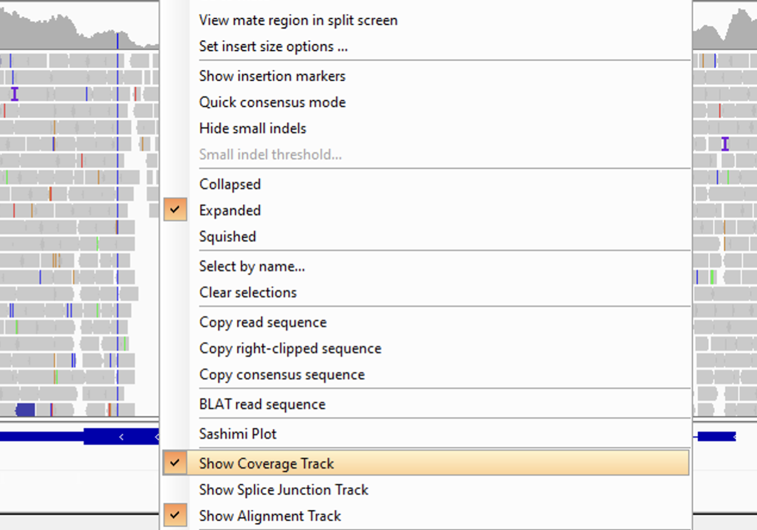
Step 6C: Show Coverage Track
Note: If you don't see a summary track like below :
Right Click on the BAM track.
Click Show Coverage Track.

Slide 36
Step 6D: Color Alignments by Read
Right Click on the BAM track.
Click Color Alignment by and then Read Strand

Slide 37
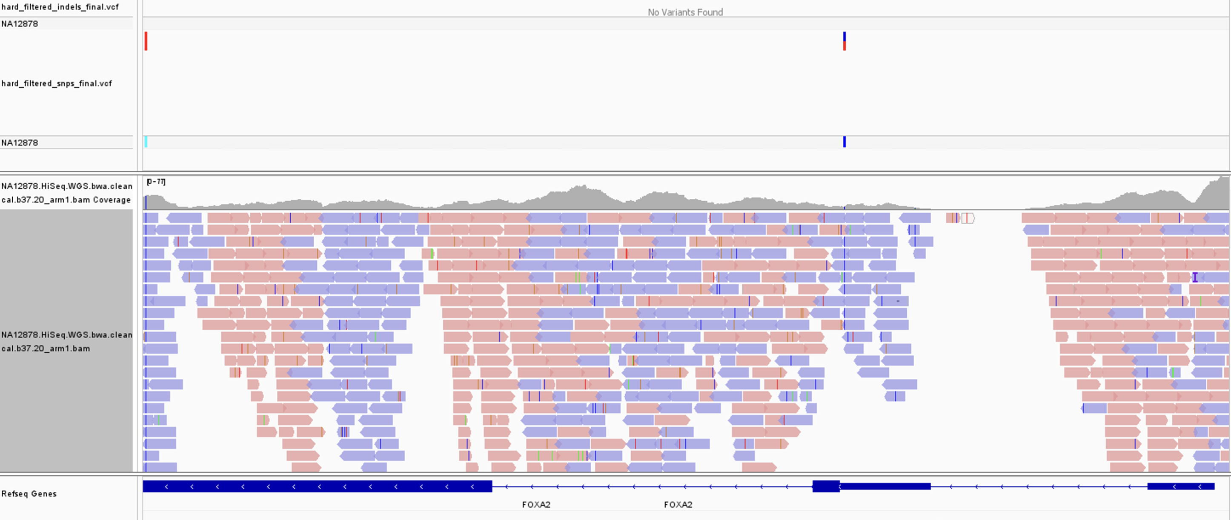
Step 6E: FOXA2 Read GAP Question
What is happening in the highlighted portion?

Slide 38
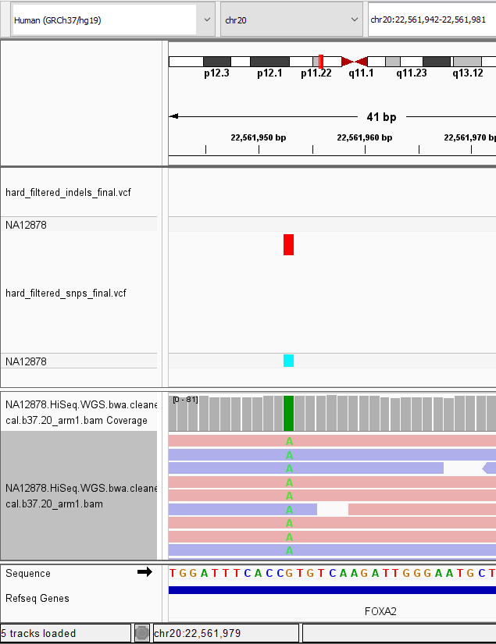
Step 6F: Viewing SNP Calls
Zoom In (double click) on SNPs to see the base pair calls on each read.

Slide 39
Step 7: SnpEff Results
SnpEff gives a nice summary HTML file.
Navigate to the results directory for this lab:
[course_directory]\03_Variant_Calling\results
Open snpEff_summary.html in each of the following sub directories:
1. snpeff_snp_results
2. snpeff_indel_results
Browse each of the HTML files and note the results of the following slides:

Slide 40
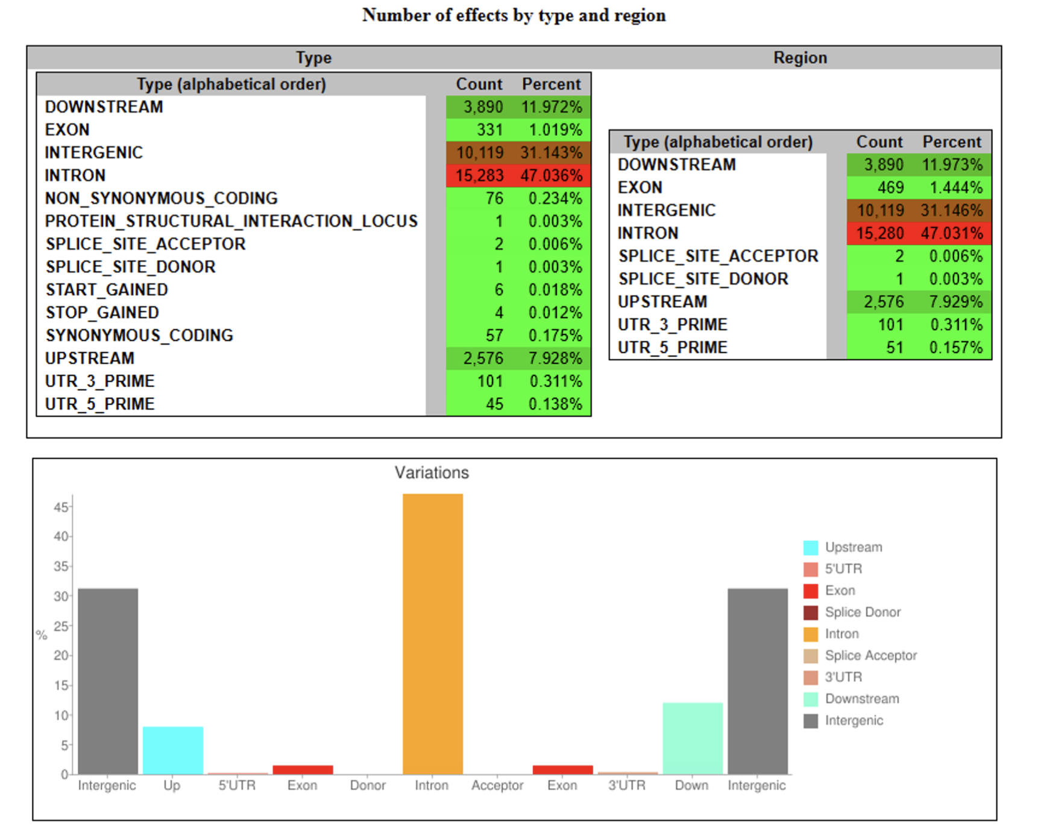
Step 7B: SNPEff Summary of SNPS

Slide 41
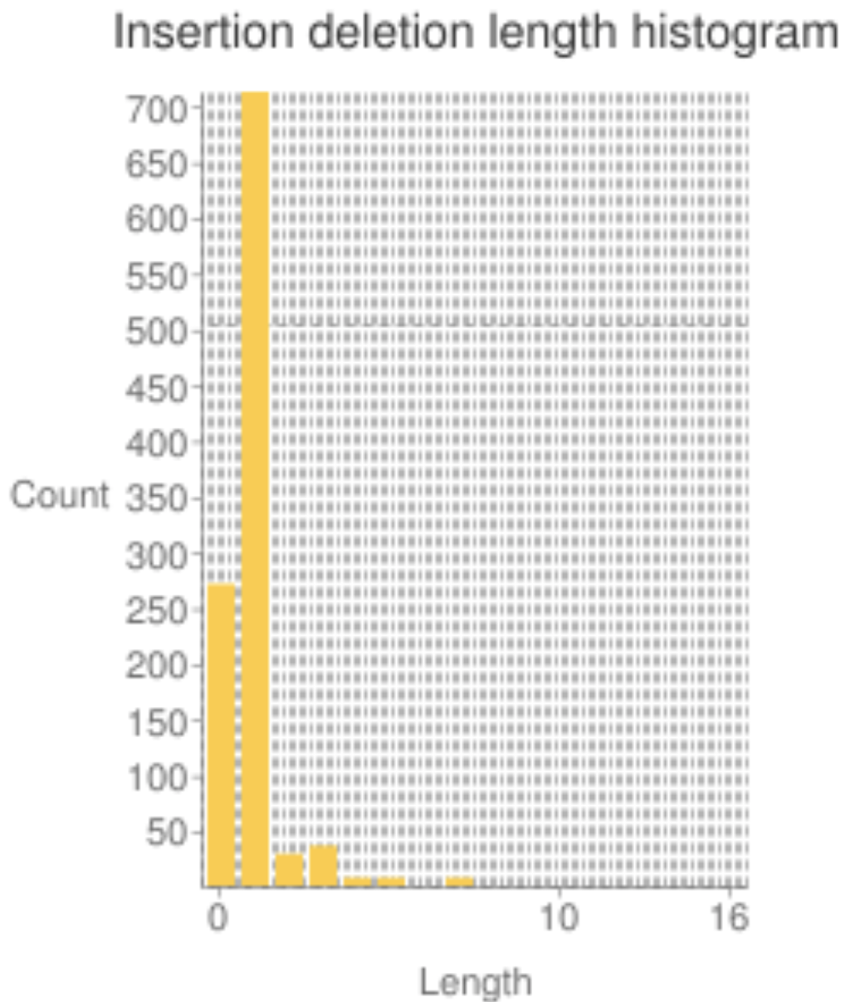
Step 7C: SNPEff Summary of Indel Lengths
The summary of snpeff indels shows the following distribution of indel lengths:

