Slide 1
Bacterial Genome Assembly
Chris Fields
PowerPoint by Saba Ghaffari
Edited by Gio Madrigal & Roberto Cucalón Tamayo

Slide 2
Introduction
Exercise
Perform a bacterial genome assembly using PacBio HiFi data.
Evaluation and comparison of different datasets and parameters.
View the best assembly in Bandage.

Slide 3
Premise
We have sequenced the genomic DNA of a bacterial species that we are very interested in. Using other methods, we have determined that its genome size is approximately 1.7 Mbp.
We chose to use Pacific Biosciences HiFi technology for performing this analysis because our genome of interest is relatively small and PacBio HiFi gives us both long reads (700bp-20kbp) that are 99% accurate.

Slide 4
Dataset Characteristics
Dataset # | FQ Name | File Size
1 | dataset1.fastq.gz | 144 MB
2 | dataset2.fastq.gz | 36 MB
3 | dataset3.fastq.gz | 18 MB
4 | dataset4.fastq.gz | 7.1 MB
The assembler can read compressed files, so the FASTQ* files are compressed to save disk space. We will see what the data look like in a bit.
* FASTQ -> “FASTQ format is a text-based format for storing both a biological sequence (usually nucleotide sequence) and its corresponding quality scores. Both the sequence letters and quality scores are encoded with a single ASCII character for brevity”. Excerpted from http://en.wikipedia.org/wiki/Fastq

Slide 5
Start the VM
Follow instructions for starting VM (This is the Remote Desktop software).
The instructions are different for UIUC and Mayo participants.
Find the instructions for this on the course website under Lab set-up:
https://publish.illinois.edu/compgenomicscourse/2023-schedule/

Slide 6
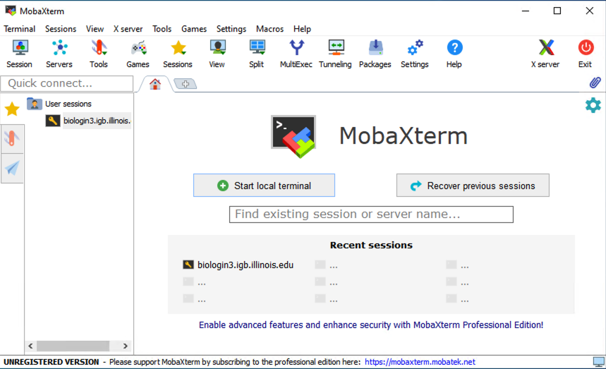
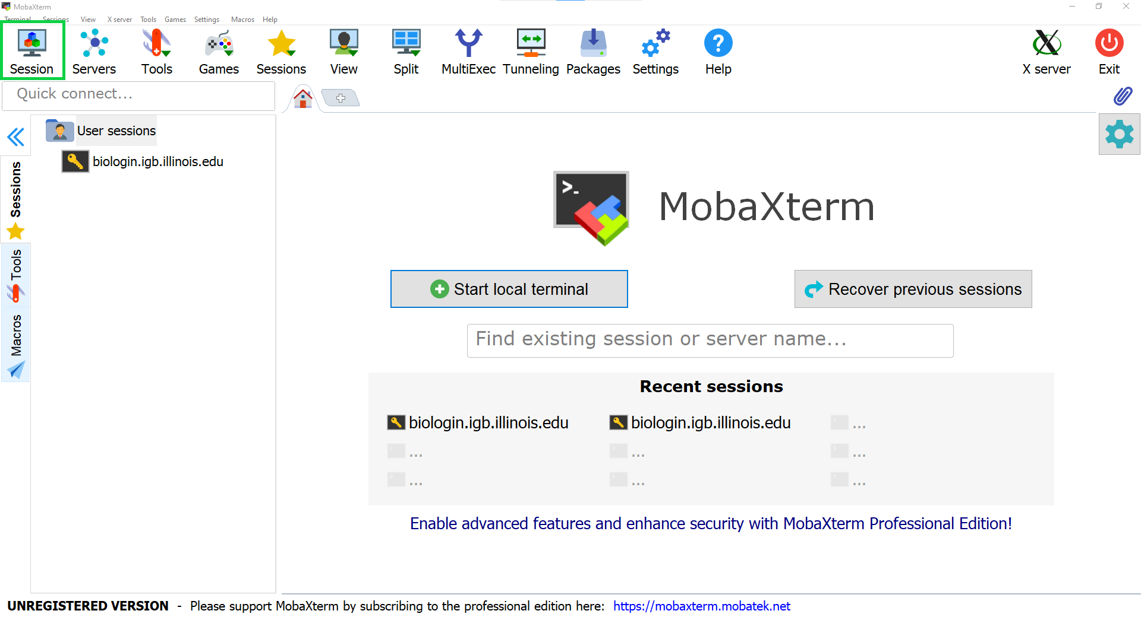
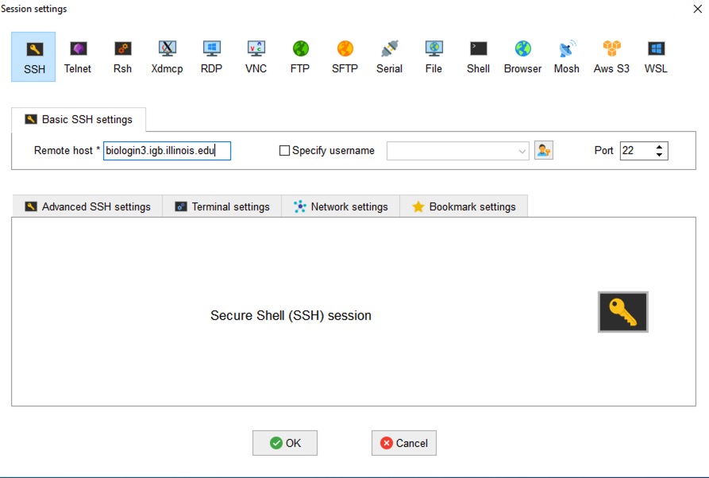
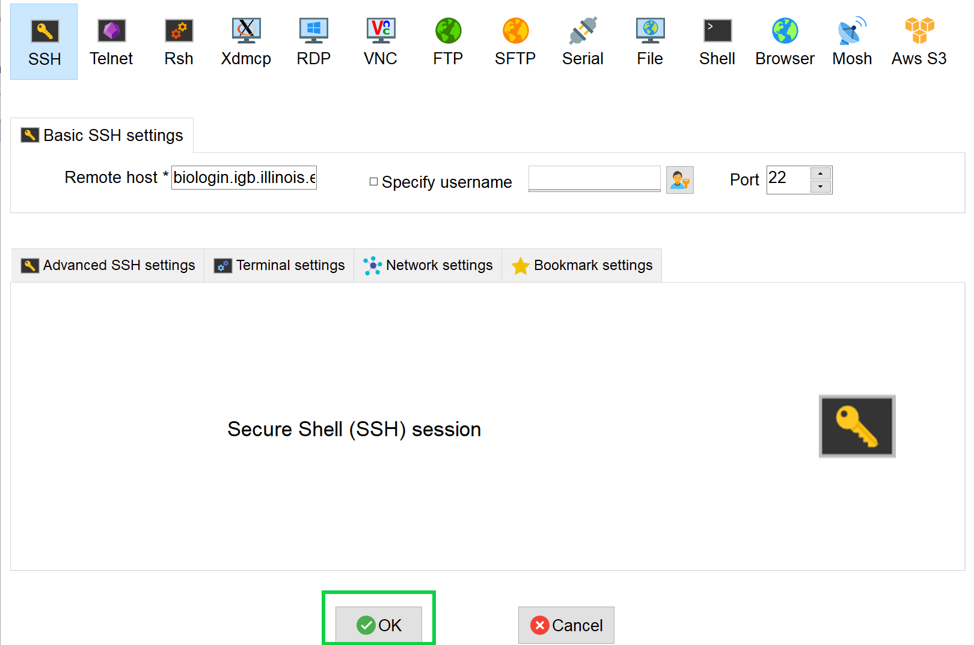
Step 0A: Accessing the IGB Biocluster for First Time
Open MobaXterm on the VM
In a new session, select SSH and type the following host name:
biologin3.igb.illinois.edu
Click OK

Slide 7
Step 0A: Accessing the IGB Biocluster
Enter login credentials assigned to you.
Example username: Class01
You will not see any characters on screen when typing in password. Just type it.

Slide 8
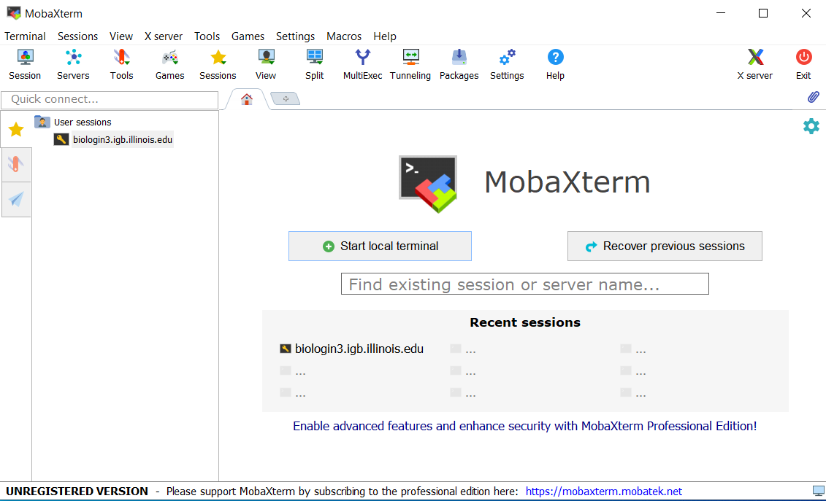
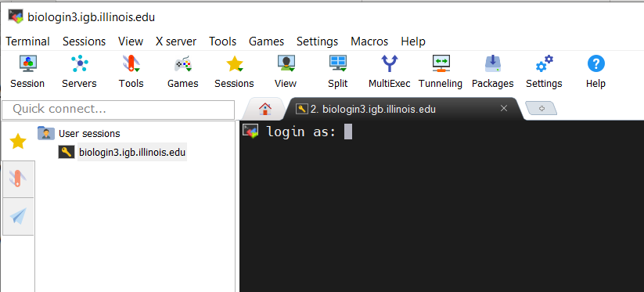
Step 0A: Accessing the IGB Biocluster
If you have done this before, just double-click on the session you created once and type username and password.

Slide 9
Step 0B: Lab Setup
The lab is located in the following directory:
/home/classroom/hpcbio/mayo_workshop/02_Genome_Assembly
This directory contains the initial data and the finished version of the lab (i.e. the version of the lab after the tutorial). Consult it if you are unsure about your runs.
You don’t have write permissions to the lab directory. Create a working directory of this lab in your home directory for your output to be stored. Note ~ is a symbol in Unix path referring to your home directory.
Copy the following script to your local directory line by line and run it. You do not need to copy the $ symbol.
This will set up everything for you to run. Then change into the directory just created.
$ mkdir ~/02_Genome_Assembly
$ cp /home/classroom/hpcbio/mayo_workshop/02_Genome_Assembly/src/setup.sh ~
$ bash setup.sh
$ cd ~/02_Genome_Assembly

Slide 10
Assembly
We will be using the hifiasm assembler, which is a very fast assembler developed for highly accurate long reads such as PacBio HiFi.

Slide 11
Step 1: Get sequence statistics
We know the size of the files, but we don’t know how many reads there are, what the maximum and minimum length is, total bases, and so forth. This would be good to know, since we want to make sure we have adequate coverage for an assembly.
Once you are logged into the biocluster with your classroom account, type the following commands.
$ sbatch run-fastq-stats.slurm.sh
$ squeue -u $USER
The first command (‘sbatch’) submits a job script (in this case, run-fastq-stats.slurm.sh) to the cluster for running.
The second command will check the status of the job; it should be very fast so this may show nothing if the job is already finished.

Slide 12
Step 1: Get sequence statistics
What’s in the job script?
#!/bin/bash
#SBATCH -n 1
#SBATCH --mem=4000
#SBATCH -p classroom
#SBATCH -J fastq-stats
### Load Modules
module load seqkit/0.12.1
### Run app on file
seqkit stats dataset*.fastq.gz > stats.txt
Tells the cluster ‘job manager’ what resources you want (1 core, 4GB memory, run on the ‘classroom’ nodes, and name the job ‘fastq-stats’
Load the software. We are using a tool called ‘seqkit’ to generate some basic stats on the sequence data
Run the tool on all the files (‘dataset*.fastq.gz’) and redirect the output (‘>’) to a text file

Slide 13
Step 1: Get sequence statistics
You can use the Linux ‘cat’ or ‘less’ command to get a peek at the ‘stats.txt’ file. Run the next command.
$ cat stats.txt
file format type num_seqs sum_len min_len avg_len max_len
dataset1.fastq.gz FASTQ DNA 7,286 75,079,593 793 10,304.6 28,055
dataset2.fastq.gz FASTQ DNA 3,611 37,452,304 793 10,371.7 27,426
dataset3.fastq.gz FASTQ DNA 1,800 18,723,557 793 10,402 27,426
dataset4.fastq.gz FASTQ DNA 724 7,471,070 1,010 10,319.2 25,180
Note the sum length for each file; the expected size of our genome is supposed to be 1.7 Mbp So, what is the expected sequence coverage for each?
(Hint: 1.7Mbp is 1,700,000 bases)

Slide 14
Step 2A: Run Assembly 1
For this 1st assembly we use dataset1.fastq.gz (144MB). Once you are logged into the biocluster with your classroom account, type the following command:
$ sbatch run-assembly1.slurm.sh
$ squeue –u $USER
Again, the first command (‘sbatch’) submits a job script (in this case, run-fastq-stats.slurm.sh) to the cluster for running. The second command will check the status of the job (this may be a bit slower, say a couple of minutes, depending on the computer load at the time). While this is running, let’s look at the script.

Slide 15
Step 2A: Run Assembly 1
This script is a little more complex, we are running several steps. Note the comments!
You can type ‘less run-assembly1.slurm.sh’ to see the text in your script (hit ‘q’ to exit).
#!/bin/bash
#SBATCH -n 4
#SBATCH --mem=8000
#SBATCH -p classroom
#SBATCH -J hifiasm
### Load Modules
module load hifiasm/0.5-IGB-gcc-8.2.0
# Step 1: make working directory
mkdir dataset1
# Step 2: run assembly
hifiasm -o dataset1/full.asm -f 0 -t $SLURM_NPROCS -a 3 dataset1.fastq.gz 2> dataset1/full.log
Tells the cluster ‘job manager’ what resources you want (4 cores, 8GB memory (memory listed in MB), run on the ‘classroom’ nodes, and name the job ‘hifiasm’
Load the software. We are using ‘hifiasm’ to assemble the data.

Slide 16
Step 2B: Run Assemblies 2, 3 & 4
For this 2nd run, we will assemble both dataset2.fastq.gz and dataset3.fastq.gz. The coverage for this are lower (dataset1 is ~44x, dataset2 is ~22x, dataset3 is ~11x, and dataset4 is ~4x).
For the last assembly (dataset4) we are really pushing the boundaries for adequate coverage for this tool (preferably above 25x).
$ sbatch run-assembly234.slurm.sh
$ squeue –u $USER
This may take about 2 minutes, or may finish quicker than that. We can look over the script again while this is running.

Slide 17
Step 2B: Run Assemblies 2, 3 & 4
This script is a little more complex, we are running several steps. Note the comments!
You can type ‘less run-assembly234.slurm.sh’ to see the text in your script (hit ‘q’ to exit).
#!/bin/bash
#SBATCH -n 4
#SBATCH --mem=8000
#SBATCH -p classroom
#SBATCH -J hifiasm
### Load Modules
module load hifiasm/0.5-IGB-gcc-8.2.0
# Step 1: make working directories (yes you can do more than one)
mkdir dataset2 dataset3 dataset4
# Step 2: run assemblies
hifiasm -o dataset2/half.asm -f 0 -t $SLURM_NPROCS -a 3 dataset2.fastq.gz 2> dataset2/half.log
hifiasm -o dataset3/quarter.asm -f 0 -t $SLURM_NPROCS -a 3 dataset3.fastq.gz 2> dataset3/quarter.log
hifiasm -o dataset4/tenth.asm -f 0 -t $SLURM_NPROCS -a 3 dataset4.fastq.gz 2> dataset4/tenth.log
Tells the cluster ‘job manager’ what resources you want (4 cores, 8GB memory, run on the ‘classroom’ nodes, and name the job ‘hifiasm’
Load the software. We are using ‘hifiasm’ to assemble the data.

Slide 18
Step 3: Convert formats
This is a really common task: you have format ’X’ and need format ‘Y’. In this case, hifiasm assemblies are in a reference graph format called GFA. We will look at one of these in a bit, but it is pretty complex.
We want a simpler file that represents the final assembly in FASTA format. We need this to gather assembly stats.
$ sbatch run-conversion.slurm.sh

Slide 19
Step 3: Convert formats
Want to convert all files. This script will run all of them.
#!/bin/bash
#SBATCH -n 1
#SBATCH --mem=2000
#SBATCH -p classroom
#SBATCH -J GFA-to-FASTA
### Load Modules
module load gfatools/0.4-IGB-gcc-4.9.4
# Convert GFA (reference graph) into FASTA (one at a time)
gfatools gfa2fa dataset1/full.asm.p_ctg.gfa > dataset1/full.asm.p_ctg.fasta
gfatools gfa2fa dataset2/half.asm.p_ctg.gfa > dataset2/half.asm.p_ctg.fasta
gfatools gfa2fa dataset3/quarter.asm.p_ctg.gfa > dataset3/quarter.asm.p_ctg.fasta
gfatools gfa2fa dataset4/tenth.asm.p_ctg.gfa > dataset4/tenth.asm.p_ctg.fasta
Tells the cluster ‘job manager’ what resources you want (1 core, 2GB memory, run on the ‘classroom’ nodes, and name the job ‘GFA-to-FASTA’
Load the software. We are using ’gfatools’ to convert formats

Slide 20
Step 3: Convert formats
Then type the below to list the files.
$ ls -l dataset*/*.fasta
-rw-rw-r-- 1 cjfields cjfields 1691621 May 23 2020 dataset1/full.asm.p_ctg.fasta
-rw-rw-r-- 1 cjfields cjfields 1673187 May 23 2020 dataset2/half.asm.p_ctg.fasta
-rw-rw-r-- 1 cjfields cjfields 1461613 May 23 2020 dataset3/quarter.asm.p_ctg.fasta
-rw-rw-r-- 1 cjfields cjfields 1370488 May 23 2020 dataset4/tenth.asm.p_ctg.fasta

Slide 21
Results:
The following instructions guide you to the location of the results. As the needed output for the rest of the lab is provided in the VM, you could skip this slide.
You can find the results of all previous runs in folders dataset1, dataset2, dataset3, and dataset4:
~/02_Genome_Assembly
You can go to each folder by typing the following command:
cd ~/02_Genome_Assembly/[Folder-Name]
To see the files in the each of these directories, type “ls” command.
Make sure that you return to your previous working directory for the rest of the lab by typing
cd ~/02_Genome_Assembly
The description of the results is provided in the next slide.

Slide 22
HiFiAsm Output: Legend
Once everything is finished you will have numerous files. Key ones are highlighted below:
File | Meaning
prefix.p_ctg.gfa | Primary assembly (a haploid representation). GFA format
prefix.p_ctg.fasta | Primary assembly (a haploid representation). FASTA format
prefix.a_ctg.gfa | Alternate assembly contig graph (alleles not in primary assembly). GFA format
prefix.r_utg.gfa | Raw unitig graph. GFA format. Keeps all haplotype information, including somatic mutations and recurrent sequencing errors.

Slide 23
Assembly Evaluation
What metrics do we use to evaluate the assembly?

Slide 24
Assembly Evaluation: Skeleton
 | dataset1 | dataset2 | dataset3 | dataset4
Genome Size (Mb)
N50 (Mb)
Number of contigs
Longest contig (Mb)
Shortest contig (bp)
Mean contig size (Kb)
GC content
Definition of N50:
“Given a set of contigs, each with its own length, the N50 length is defined as the shortest sequence length at 50% of the genome. It can be thought of as the point of half of the mass of the distribution. For example, 9 contigs with the lengths 2,3,4,5,6,7,8,9,and 10, their sum is 54, half of the sum is 27. 50% of this assembly would be 10 + 9 + 8 = 27 (half the length of the sequence). Thus the N50 = 8”. Excerpted from https://en.wikipedia.org/wiki/N50,_L50,_and_related_statistics#N50

Slide 25
Step 4A: Evaluate Assembly 1
We will evaluate the results of the 1st assembly (dataset 1) using a perl script: assemblathon_stats.pl
# Use a perl script to determine the various metrics for Assembly 1
$ perl assemblathon_stats.pl ~/02_Genome_Assembly/dataset1/full.asm.p_ctg.fasta

Slide 26
Step 4B: Output of Assembly 1 Evaluation (top)
Number of scaffolds 1
Total size of scaffolds 1663877
Longest scaffold 1663877
Shortest scaffold 1663877
Number of scaffolds > 1K nt 1 100.0%
Number of scaffolds > 10K nt 1 100.0%
Number of scaffolds > 100K nt 1 100.0%
Number of scaffolds > 1M nt 1 100.0%
Number of scaffolds > 10M nt 0 0.0%
Mean scaffold size 1663877
Median scaffold size 1663877
N50 scaffold length 1663877
L50 scaffold count 1
scaffold %A 30.50
scaffold %C 19.49
scaffold %G 19.68
scaffold %T 30.34
scaffold %N 0.00
scaffold %non-ACGTN 0.00
Number of scaffold non-ACGTN nt 0
Percentage of assembly in scaffolded contigs 0.0%
Percentage of assembly in unscaffolded contigs 100.0%
Average number of contigs per scaffold 1.0
Average length of break (>25 Ns) between contigs in scaffold 0

Slide 27
Step 5: Evaluate Assemblies 2, 3 and 4
We will evaluate the results of the stringent assembly using a perl script: assemblathon_stats.pl
# Use a perl script to determine the various metrics for Assembly 2-4
perl assemblathon_stats.pl ~/02_Genome_Assembly/dataset2/half.asm.p_ctg.fasta
perl assemblathon_stats.pl ~/02_Genome_Assembly/dataset3/quarter.asm.p_ctg.fasta
perl assemblathon_stats.pl ~/02_Genome_Assembly/dataset4/tenth.asm.p_ctg.fasta

Slide 28
Step 6: Compare Assembly Statistics
 | dataset1 | dataset2 | dataset3 | dataset4
Genome Size (Mb) | 1.663877 | 1.645745 | 1.437603 | 1.347800
N50 (Mb) | 1.663877 | 1.645745 | 0.799713 | 0.105349
Number of contigs | 1 | 1 | 4 | 18
Longest contig (bp) | 1,663.877 | 1,645,745 | 799,713 | 325,120
Shortest contig (bp) | 1,663,877 | 1,645,745 | 14,705 | 17,658
Mean contig size (bp) | 1,663,877 | 1,645,745 | 359,401 | 74,878
GC content | 39.17 | 39.19 | 39.03 | 39.17
Genome size is ~1.7 Mb; two of these assemblies are close. The genome coverage (the number of times each base is covered by a read) for dataset1 is about 44x, dataset2 is 22x, dataset3 is 11x and dataset4 is 4x. The lower the coverage the fewer bases recovered and more fragmented the genome.
Also note how many contigs each has; datasets 1 & 2 have fully assembled chromosomes!

Slide 29
Exit MobaXterm, by either closing the window or typing ‘exit’ in the command prompt.

Slide 30
Assembly Visualization
Use Bandage to visualize the assembly graph.
We are going to do visualization on VM

Slide 31
Step 0: Local Files
For viewing and manipulating the files needed for this laboratory exercise, the path on the VM will be denoted as the following:
[course_directory]
We will use the files found in:
[course_directory]\02_Genome_Assembly\results
[course_directory]= Desktop\VM

Slide 32
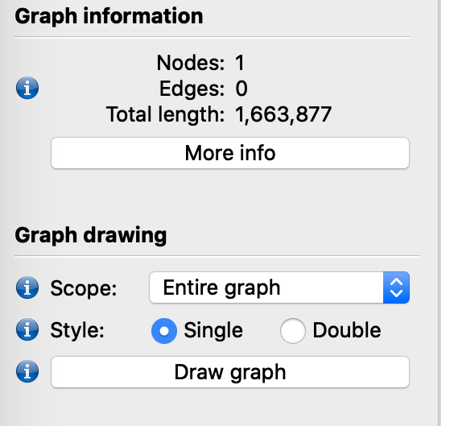
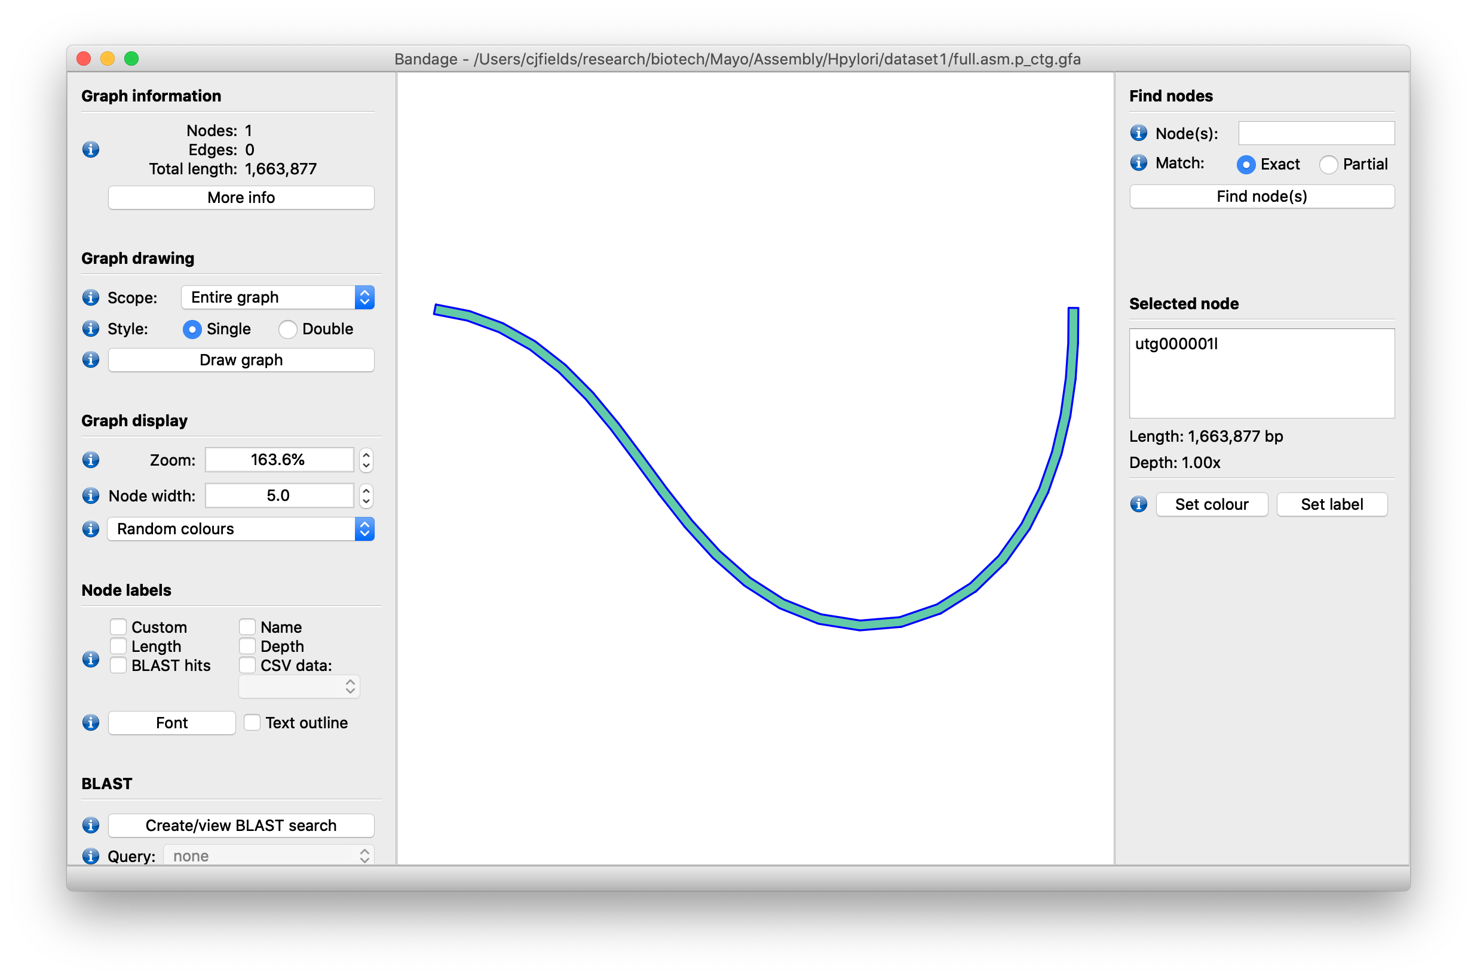
Step 1: Assembly Visualization
Open Bandage shortcut on Desktop
Under File, go to Load Graph and open the full.asm.p_ctg.gfa file in the results directory:
[course_directory]\02_Genome_Assembly\results\dataset1\
Click on the ‘Draw Graph’ button on left panel. Select the single node.
https://rrwick.github.io/Bandage/

Slide 33
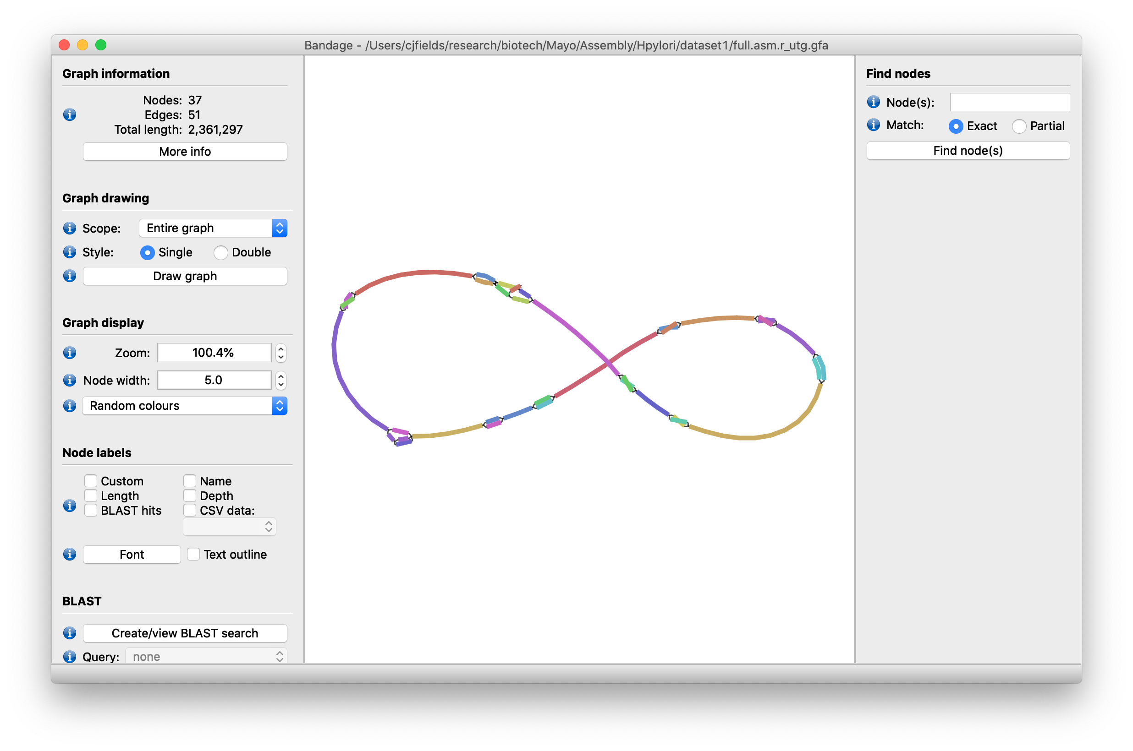
Step 1: Assembly Visualization
Kind of boring…
Now load in the raw data from file full.asm.r_utg.gfa (which also contains sequence bubbles likely due to errors).
https://rrwick.github.io/Bandage/

Slide 34
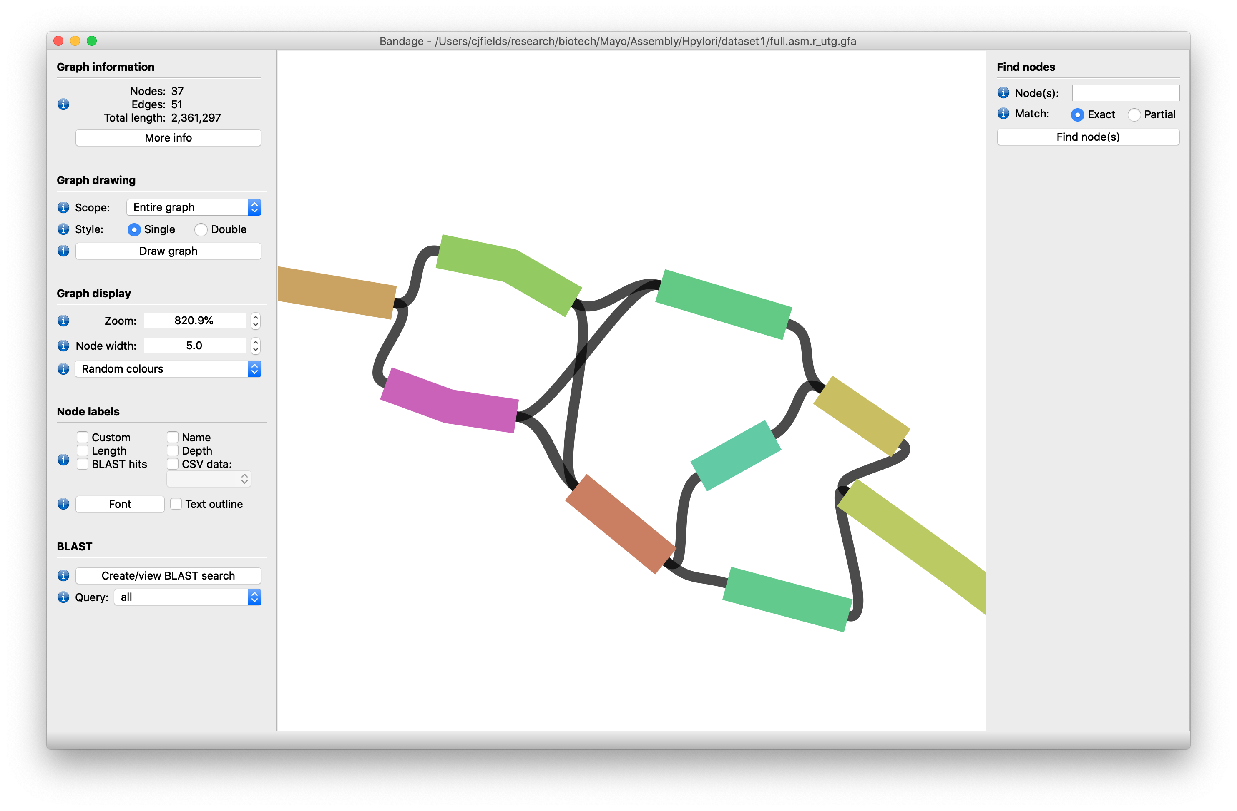
Step 1: Assembly Visualization
Zoom in using the Zoom option under Graph display:
https://rrwick.github.io/Bandage/

Slide 35
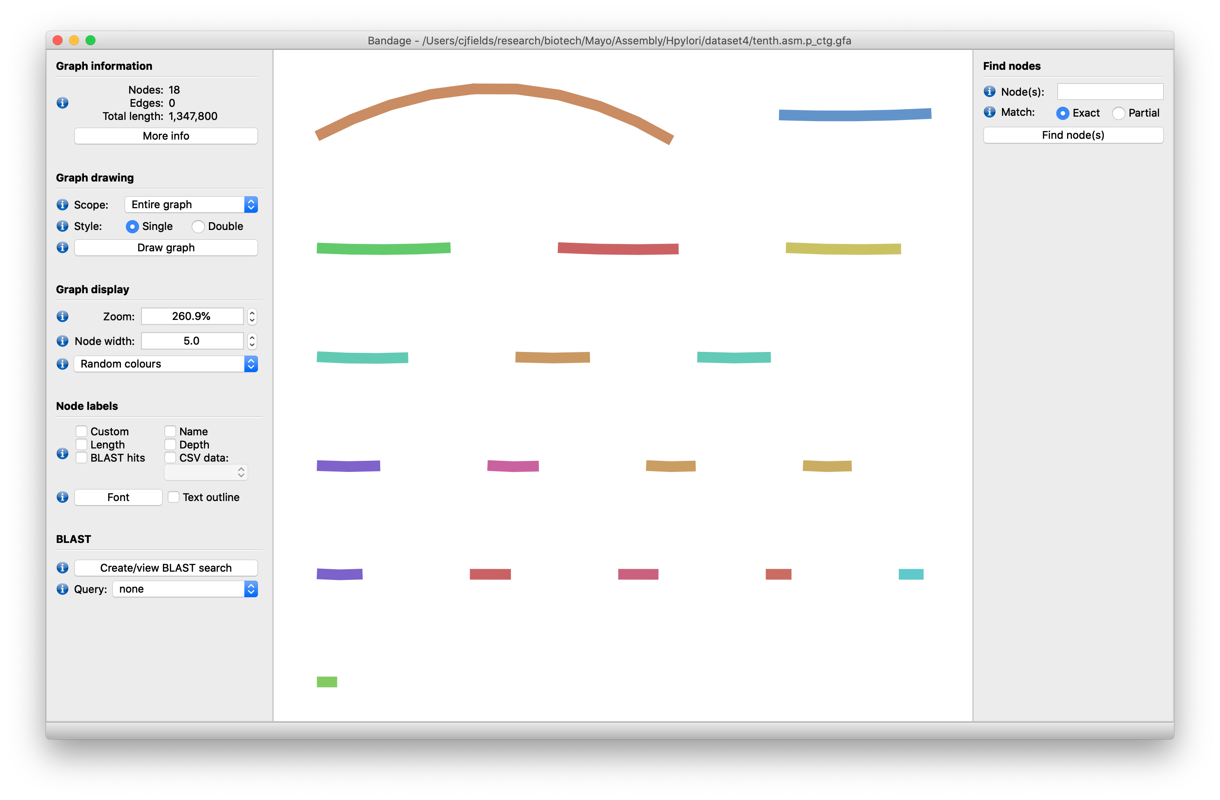
Step 1: Assembly Visualization
Now load in the primary data tenth.asm.p_ctg.gfa from dataset4 (the fragmented example)
[course_directory]\02_Genome_Assembly\results\dataset4\
https://rrwick.github.io/Bandage/

