Slide 1
Linux
Saba Ghaffari
Edited by: Gio Madrigal & Roberto Cucalón Tamayo

Slide 2
Linux commands
Using ClustalW to align two sequences

Slide 3
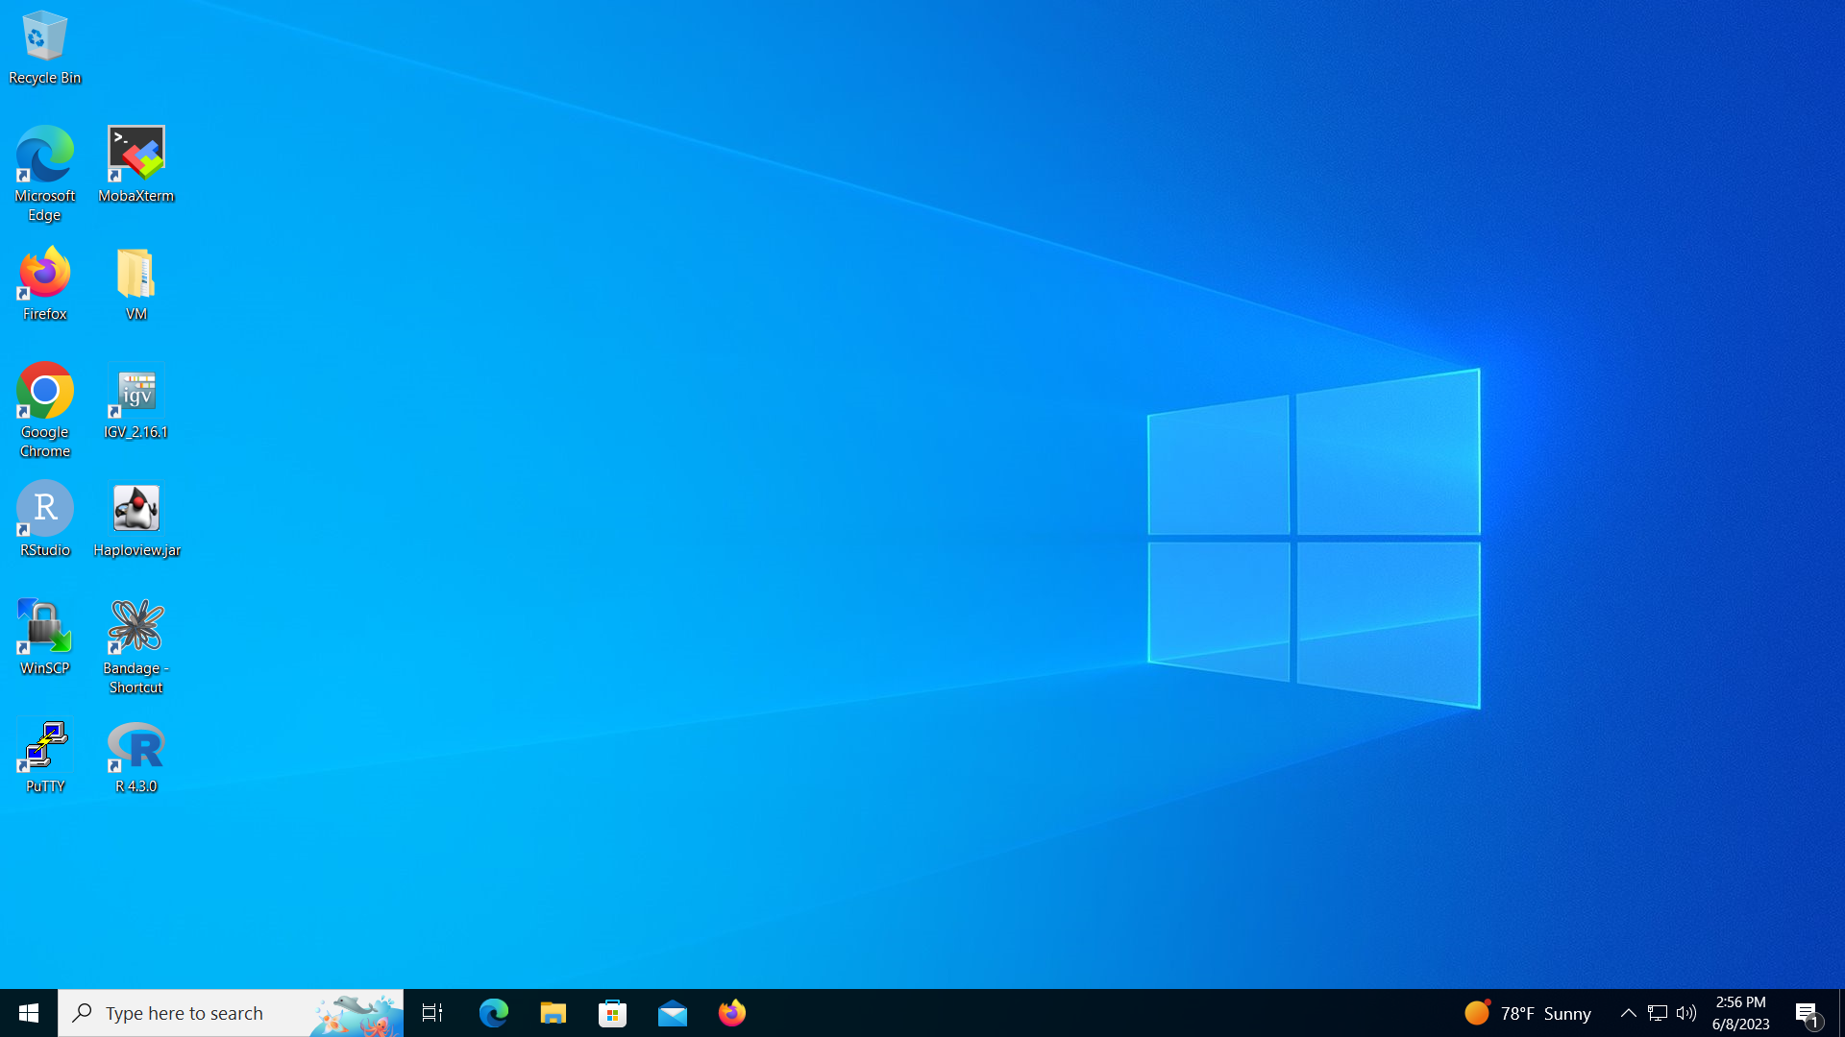
Step 0: Open MobaXterm from VM

Slide 4
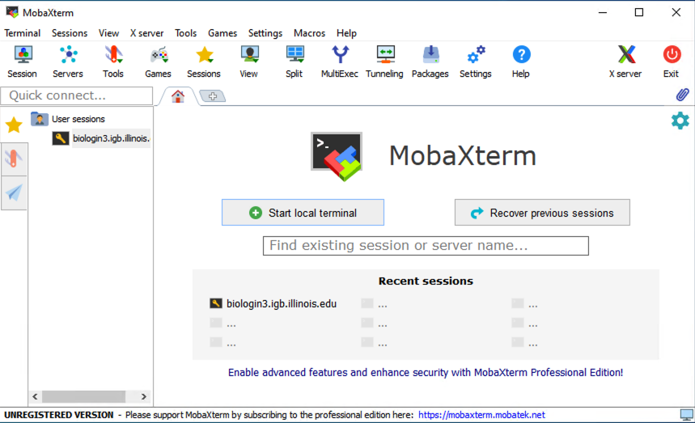
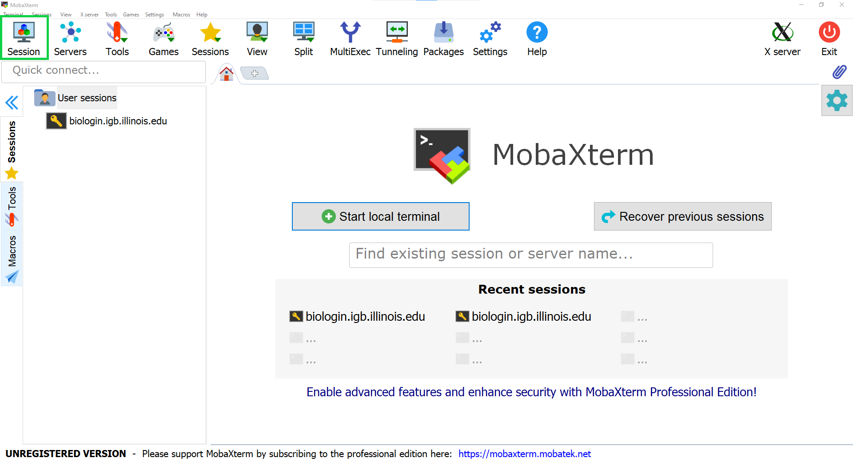
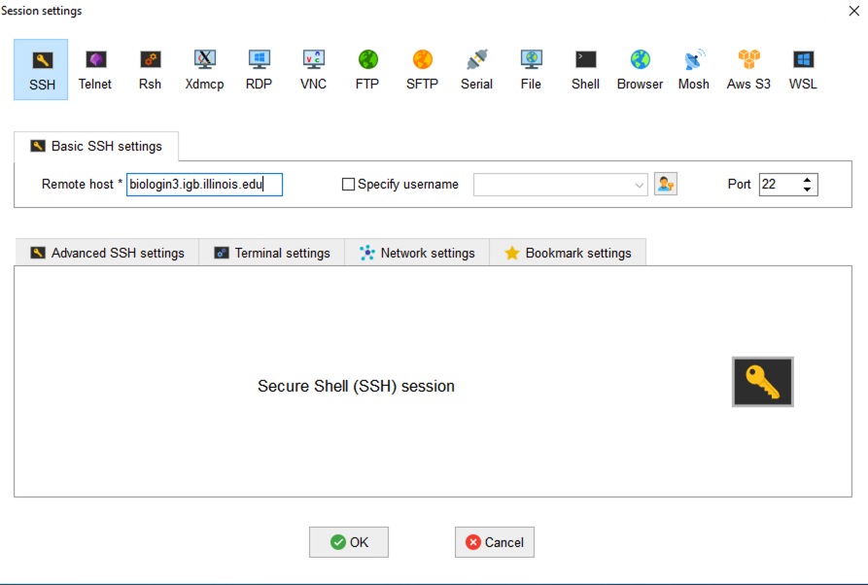
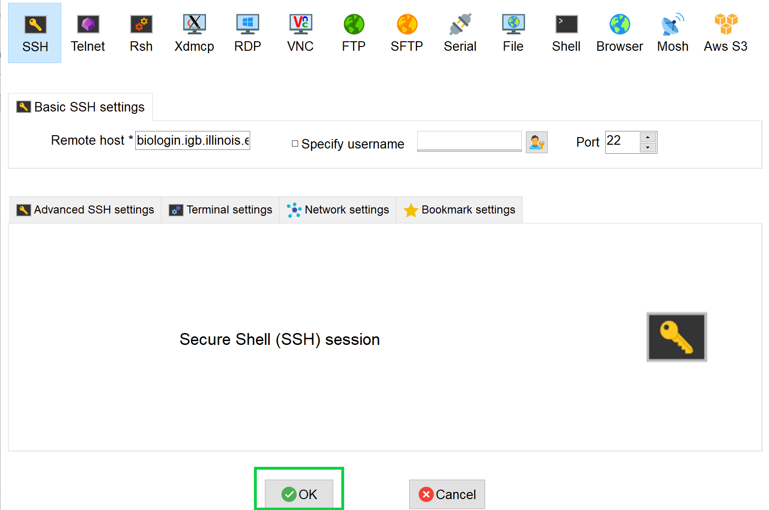
Step 0A: Accessing the IGB Biocluster for First Time
Open MobaXterm from the VM
In a new session, select SSH and type the following host name:
biologin3.igb.illinois.edu
Click OK

Slide 5
Step 0A: Accessing the IGB Biocluster
Enter login credentials assigned to you.
Example username: Class01
You will not see any characters on screen when typing in password. Just type it.

Slide 6
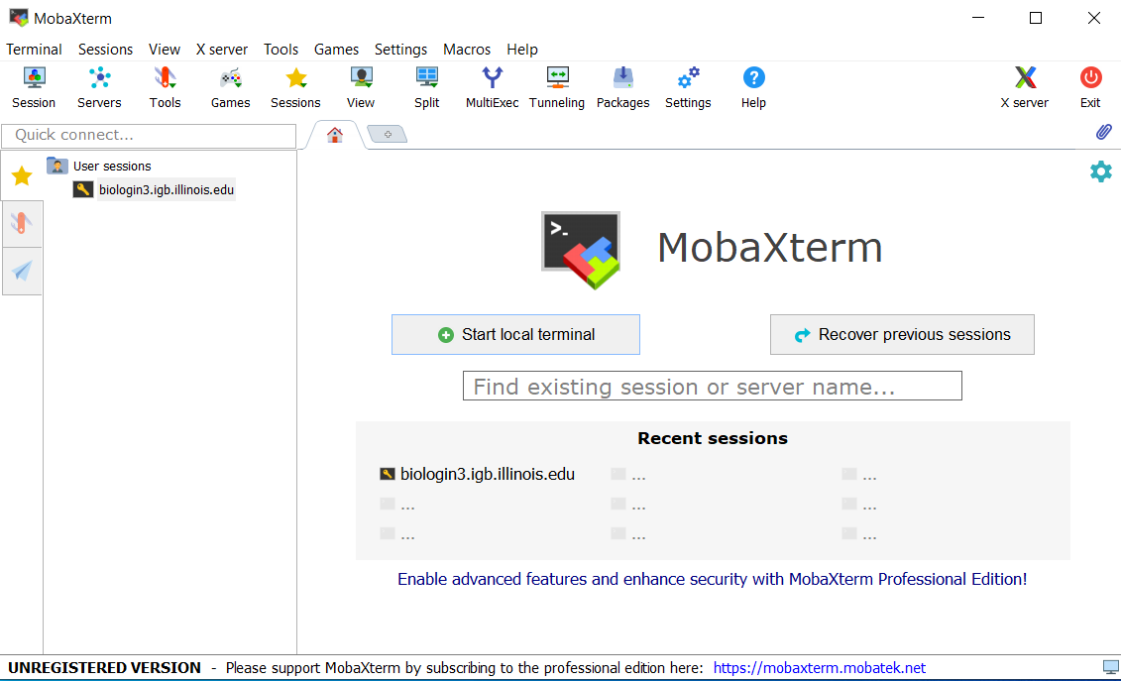
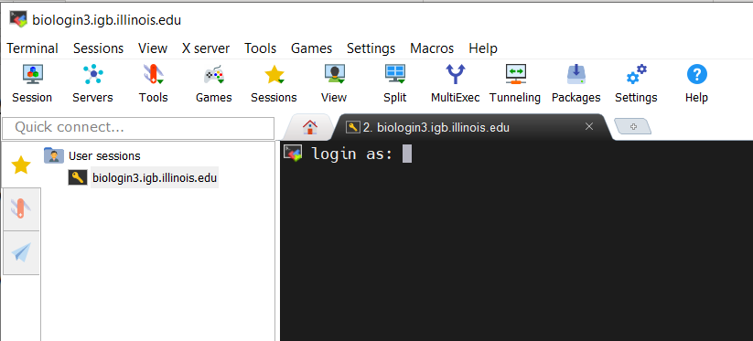
Step 0A: Accessing the IGB Biocluster
If you have done this before, just double-click on the session you created once and type username and password.

Slide 7
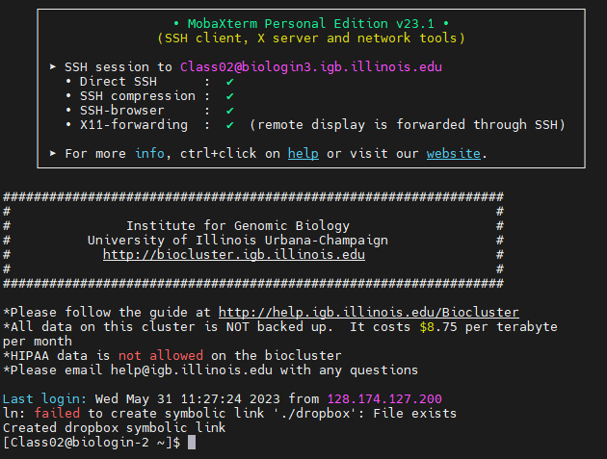

Slide 8
Step 1B: Listing files and directories (ls)
$ ls
# listing files in your current directory. When you first login, your directory is your home directory.
$ = command prompt
# = notes

Slide 9
Step 1C: Making Directories (mkdir)
$ mkdir ~/01_Linux
# create a subdirectory in your home directory. The tilde ~ character refers to your home directory.
$ ls
# to see the directory you just created.

Slide 10
Step 1D: Changing directory (cd)
The lab is located in the following directory:
/home/classroom/mayo/2020/01_Linux
$ cd /home/classroom/mayo/2020/01_Linux
# tip: use “tab” for auto-completion for path
$ ls
# to see the contents. You should see seqs.fa
Step 1E: Print working directory (pwd)
$ pwd
# to see the full pathname. You should see
“/home/classroom/mayo/2020/01_Linux”

Slide 11
Step 1F: Copying files (cp)
Copy seqs.fa from the data directory to your working directory.
$ cp /home/classroom/mayo/2020/01_Linux/seqs.fa ~/01_Linux/
# tip: use “tab” for auto-completion for path
$ cd ~/01_Linux/
Step 1G: Displaying the contents of a file on the screen (cat)
$ cat seqs.fa
# you should see two sequences on your screen
>seq1
GATCGAGCGATCGTGCAGC
GCAGAATGCGCGCTAG
>seq2
GGTAGGGTAAATTGCCTAC
CGTCGATCGAGTA

Slide 12
Commands Summary
Command | Meaning
ls | list files and directories
mkdir directory | make a directory
cd directory | change to named directory
cd ~ | change to home directory
cd .. | change to parent directory
pwd | display the path of the current directory
cp file1 file2 | cp file1 and call it file2
cat file | display the contents of a file

Slide 13
Useful tips
Command | Meaning
tab | auto-complete path
⬆ | retrieve previous commands

Slide 14
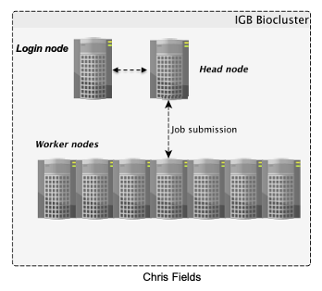
Accessing the IGB Biocluster
Step 1H: Run sequence alignment program

Slide 15
Step 1H: Run sequence alignment program
$ srun -p classroom -c 2 --mem 8000 --pty bash
# Open interactive session on biocluster with 2 cpus and 8G memory.
$ module load ClustalW2 # Load sequence aligner into the shell environment.
$ module list #See loaded tools
$ clustalw2 -INFILE=seqs.fa # Run the clustalW sequence aligner.

Slide 16
Step 1H: Run sequence alignment program
You will see this on your screen, when the program is done.
CLUSTAL 2.1 Multiple Sequence Alignments
Sequence format is Pearson
Sequence 1: seq1 35 bp
Sequence 2: seq2 32 bp
Start of Pairwise alignments
Aligning...
Sequences (1:2) Aligned. Score: 21
Guide tree file created: [seqs.dnd]
There are 1 groups
Start of Multiple Alignment
Aligning...
Group 1: Delayed
Alignment Score 47
CLUSTAL-Alignment file created [seqs.aln]

Slide 17
Step 1H: Run sequence alignment program
The alignment result is in seqs.aln. Use cat command to see the result.
$ cat seqs.aln
# You should see the following on your screen.
CLUSTAL 2.1 multiple sequence alignment
seq1 GATCGAGCGA-TCGTGCAGCGCAGAATGCGCGCTAG
seq2 GGTAGGGTAAATTGCCTACCGTCGATCGAGTA----
* * * * * * * * ** ** * *

Slide 18
Exit MobaXterm by either of the following:
Close the window
Type ‘exit’ in the command prompt twice and then press <return>.
$ exit # first to exit interactive session
$ exit # again to exit the login node
<return>

