Slide 1
Tips to Prepare for FY25 Year-End
Regina Harden, Anne Larimore, Aaron Rund, David Andersen, and Danielle Stoner
University Accounting and Financial Reporting (UAFR)

Slide 2
Agenda
Year-End Webpage/ Year-End Document
Year-End Fact Sheet Webpage
Fund Type Reminders
Payroll/ Labor Redistribution Webpage
GASB 87 and 96 Materiality Changes

Slide 3
Tips to Prepare for FY25 Year-End
Review UAFR’s Year-End Procedures webpage:

Slide 4
Tips to Prepare for FY25 Year-End
Review UAFR’s FY25 Closing & FY26 Opening Procedures document:

Slide 5
Tips to Prepare for FY25 Year-End
Critical Dates & Reminders for FY25 Year-End Closing
Post transactions (journal vouchers and/or Finance Feeder Front-End files) early to allow time for corrections and/or required approval queues reviews
Period 12 (July 1st through July 11th at 5pm) everyone has the ability to post to FY25 & FY26
Double check your dates to make sure you are properly recording your transaction to either FY25 or FY26
Preliminary Statements will be available on July 7th for transaction posted through July 5th
Period 12 Statements will be available on July 14th

Slide 6
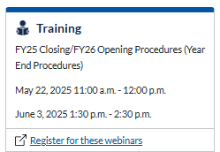
Tips to Prepare for FY25 Year-End
Register for one of UAFR’s Year-End Webinars found on the Year-End Procedures webpage, as shown below:

Slide 7
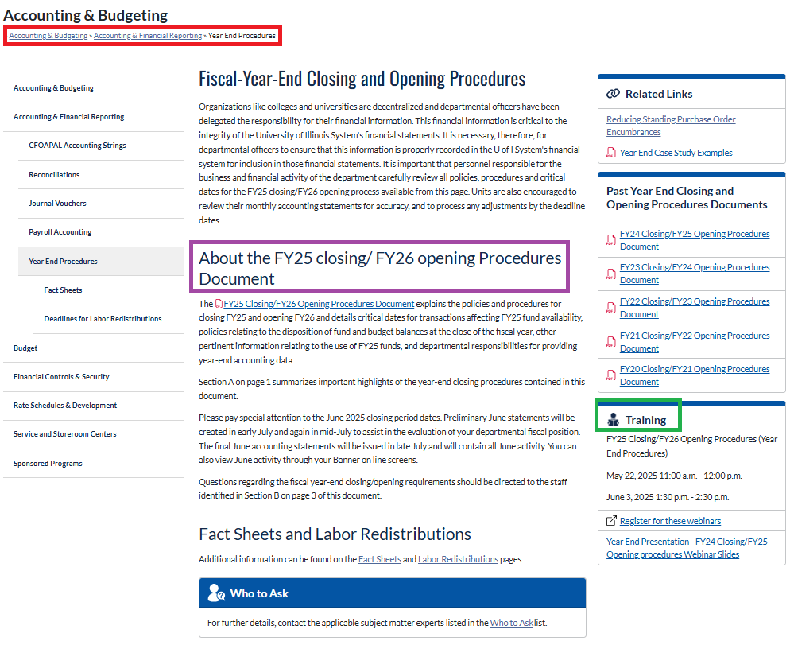
Tips to Prepare for FY25 Year-End

Slide 8
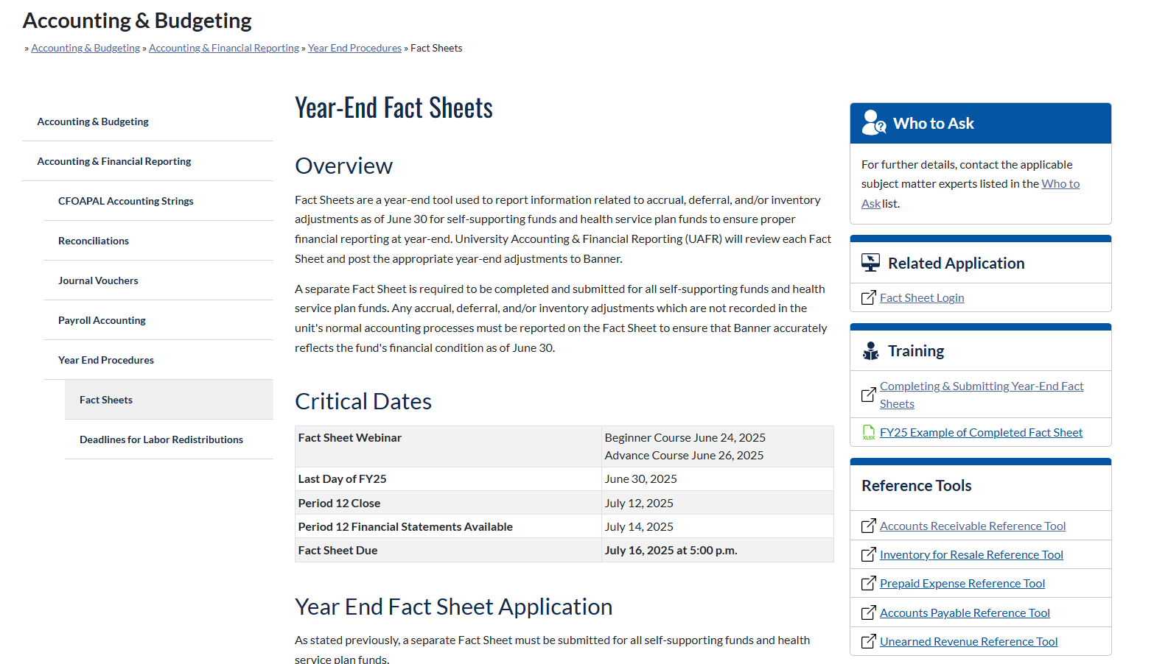
Tips for Prepare for FY25 Year-End
Review the Year-End Fact Sheets webpage:

Slide 9
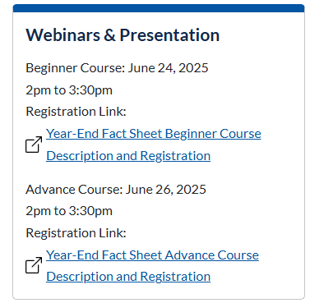
Tips for Prepare for FY25 Year-End
Register for the Beginner (6/24) and/or the Advanced (6/26) Fact Sheet Webinar, as shown in the lower right-hand corner of the Fact Sheets webpage:

Slide 10
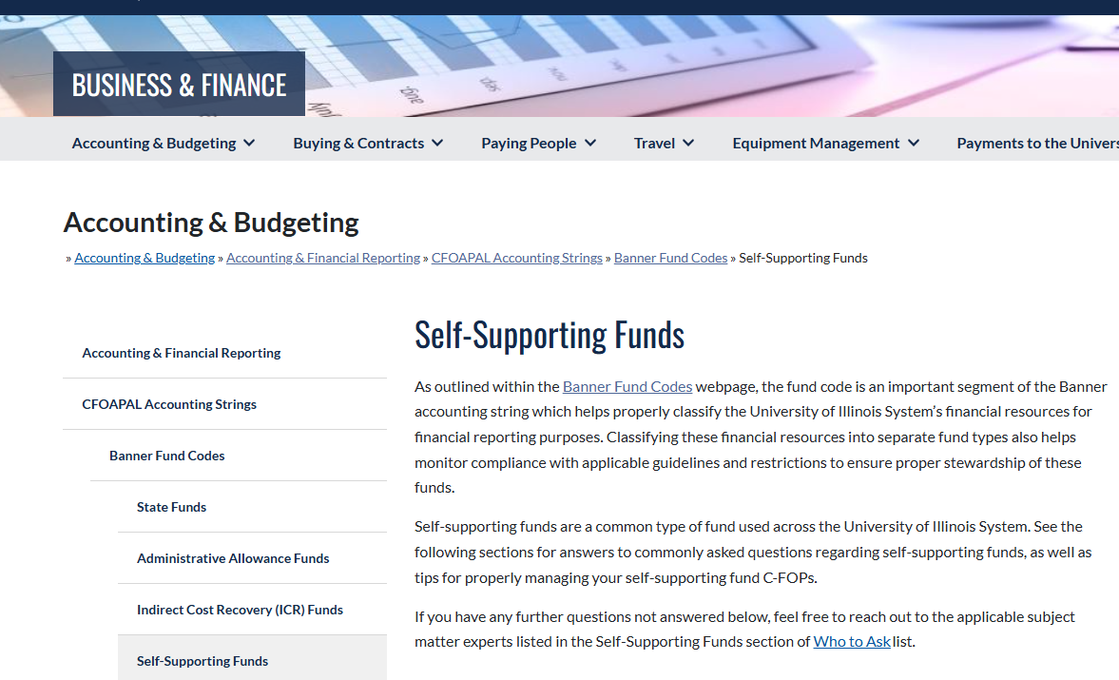
Tips for Prepare for FY25 Year-End
Self-Supporting Fund Webpage
22.4 Inventory for Resale
Section 13.7 Non-Monetary Exchange

Slide 11
Tips to Prepare for FY25 Year-End
Submit requests to terminate any self-supporting funds (or any other FOP segments) which are no longer needed as soon as possible to give yourself less to worry about at year-end.
All terminations will cease for FY25 is Friday, June 13th.
Make sure any funding transfers are handled via the appropriate channels
Verify the transfer is allowable per donor intent when transferring between gift funds.
Do not process budget or funding transfers for state or ICR funds via JVs on expense account codes. Use the proper budget transfer approval process instead.

Slide 12
Tips to Prepare for FY25 Year-End
Use the correct state fund code in July and August
State fund codes 100025 and 100026 will both be open during periods 01 & 02 of FY26, so be careful to ensure the proper fund code is used on your transactions.
Reconcile your state fund activity often during July and August to ensure your expenses are posting to the correct state fund.
Reminders
Use 100025 state fund for goods or services which were received or contracted for on or before June 30th.
Use 100026 state fund for goods or services which were received or contracted for on or after July 1st.
Once August business closes, the 100025 state fund will be terminated and no further corrections or adjustments involving that fund will be allowed.
Notes:
Don’t wait until September to reconcile and look at 100025 transactions.

Slide 13
Tips to Prepare for FY25 Year-End
Different Accrual Pay Events this year
BW 13 (BW998) – 6/8/25 to 6/21/25 service paid July 2nd
MN 7 (MN999) – 6/16/25 to 7/15/25 service paid July 16th
BW 14 (BW999) – 6/22/25 to 7/6/25 service paid July 16th
State fund timing for various employees
For all jobs EXCEPT 9/12 positions (AA, AB, BC, or BD eclass codes) the FY26 state fund should be on their job record as of 7/1/2025.
9/12 positions move to the FY26 state fund as of 6/16/2025

Slide 14
Tips to Prepare for FY25 Year-End
9/12 Positions | Non-9/12 Positions
AA, AB, BC, or BD eclass | All other eclass designations
Service (work) dates 8/16/2024-5/15/2025 | Full time appointments work year round
12 months pay: 2024 MN9 through 2025 MN8 | Paid either biweekly or monthly
Accrued Outside the Payroll System due to timing | Automatic Accruals on BW998-999, MN999
Redistribute MN7 using July posting dates | Use Guidelines on Year-End Deadlines webpage
FY26 State fund as of 6/16/2025 effective date* | FY26 State fund as of 7/1/2025 effective date*
*Most jobs will be updated in the system through the Mass Change process as of 6/15/2025. Positions will be updated as of 6/27/2025. Some positions may not automatically update and HR will need to process manual job distribution changes

Slide 15
Tips to Prepare for FY25 Year-End
Posting of payroll July 7th to July 11th
MN 7 calc Tuesday July 8th
BW 14 calc Wednesday July 9th
Adjustment calc Thursday July 10th – 5PM deadline to post labor redistributions in FY24
Labor redistributions processed after 5PM Monday July 7th will not show in banner until Friday July 11th which is after the deadline to redistribute.
Payroll Suspense – If you encounter banner fund 300011 when processing PZAREDS labor redistributions do not redistribute those line items. Those rows indicate funds “frozen” on terminated funds that cannot be redistributed.
Ex. (100024 State fund expense cannot be moved as of 9/1/24 and must remain on that fund).

Slide 16
Tips to Prepare for FY25 Year-End
Review the Year-End Deadlines for Labor Redistributions webpage:
Access the new Labor Redistributions (Detailed) Knowledgebase

Slide 17
Tips to Prepare for FY25 Year-End
As of 7/1/2025, the materiality threshold for the following agreements change:
GASB 87 Leases:
OLD THRESHOLD: $5,000 Contract Total
NEW THRESHOLD: $50,000 Contract Total
GASB 96 SBITAs (subscription-based IT arrangements):
OLD THRESHOLD: $25,000 Contract Total
NEW THRESHOLD: $100,000 Contract Total

Slide 18
Tips to Prepare for FY25 Year-End
This will change the account code for these agreements if all other criteria are met EXCEPT materiality.
GASB 87 Leases:
OLD ACCOUNT CODE: 157*-158* account range
NEW ACCOUNT CODE: 143* account range
GASB 96 SBITAs:
OLD ACCOUNT CODE: 153809
NEW ACCOUNT CODE: 1538* account range
Account code descriptions in the search tool will show this update as of 7/1/2025.
Direct any questions on this change to: Danielle Stoner, UAFR (dstoner@uillinois.edu).

Slide 19
Tips to Prepare for FY25 Year-End
Questions?
For further details, contact the applicable subject matter experts listed in the Who to Ask section of the Business & Finance website.

