Slide 1
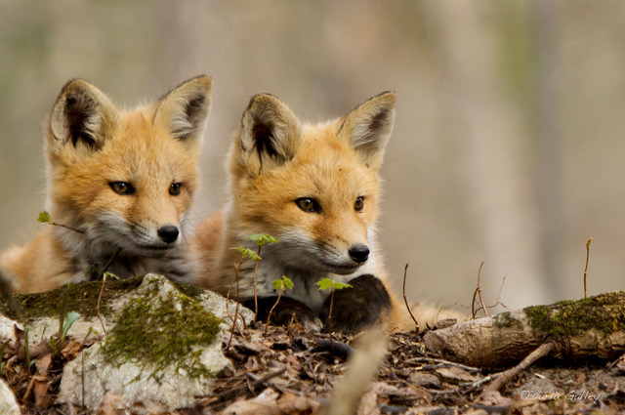
Keck Infrared Transient Survey (KITS) a NASA Key Strategic Mission Support program
Kaew Samaporn Tinyanont (NARIT), Ryan Foley (PI, UCSC), Kirsty Taggart, Kyle Davis, Dave Coulter, Majo Bustamante-Rosell, Phil Macias, César Rojas-Bravo (UCSC), Natalie LeBaron, Rafaella Margutti, Ryan Chornock, Wynn Jacobson-Galan (Berkeley), Matt Grayling, Kaisey Mandel (Cambridge), Lluís Galbany (ICE-CSIC), Melissa Shahbandeh, Justin Pierel, Ori Fox, Armin Rest, Matt Siebert, Jacob Jencson, Qinan Wang (STScI/JHU), Charlie Kilpatrick (Northwestern), Conor Larison, Yssavo Camacho-Neves, Lindsey Kwok, Saurabh Jha (Rutgers), Jennifer Andrews, David Jones (Gemini), Jeonghee Rho (SETI), Jeniveve Pearson, Griffin Hosseinzadeh, Dave Sand (Steward), Alex Gagliano, Gautham Narayan, Decker French (UIUC), Andy Howell, Giacomo Terreran (LCO), and many more.

Slide 2
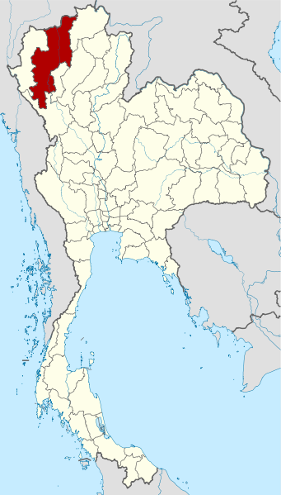
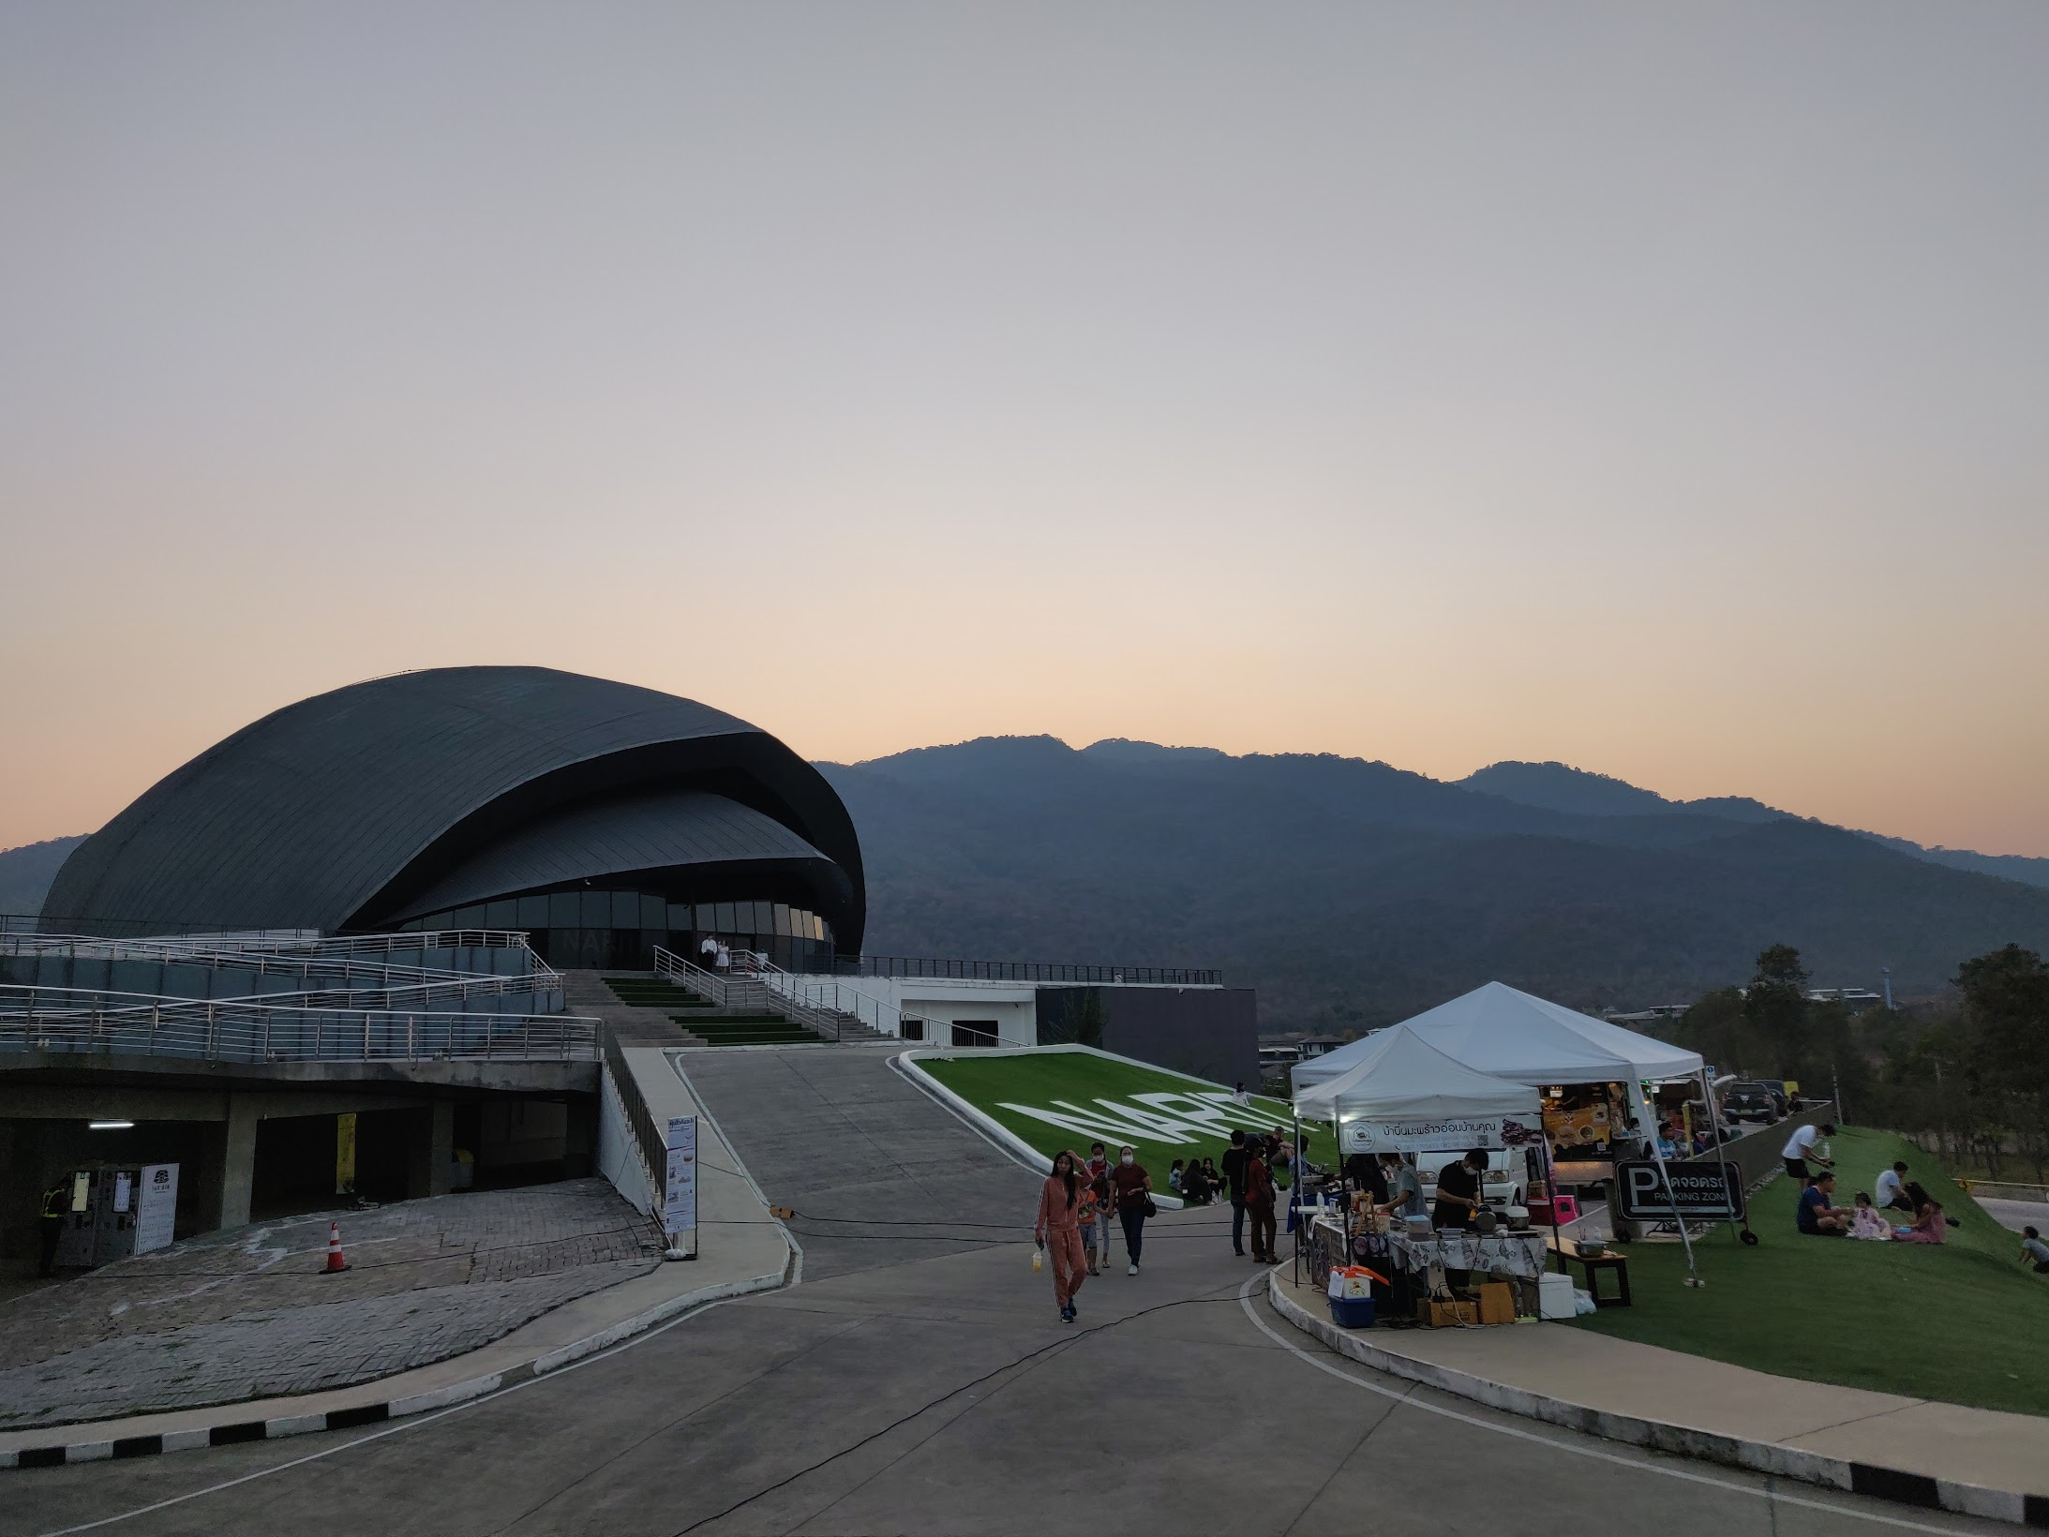
Chiang Mai
เชียงใหม่
Wikipedia

Slide 3
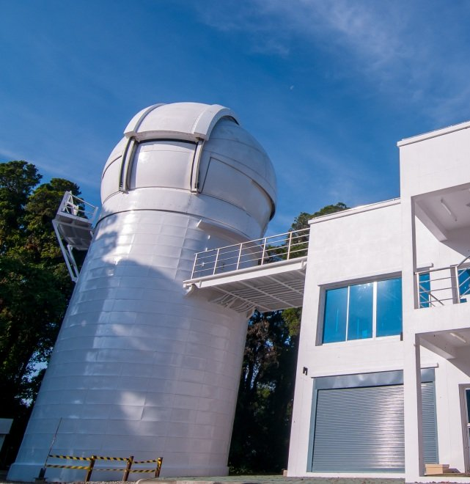
2.4-m Thai National Observatory
Planewave 0.7m + Andor IKON
High-speed photometer

Slide 4
Key science in the near infrared
NIR spectral template of SNe Ia for cosmology with Roman
CCSNe spectral template to interprete JWST surrendipitous observations of high-redshift, Pop III explosions
Perform a complete IR census of all transient classes
Measuring helium in SESNe using strong uncontaminated lines in the NIR
Probing carbon monoxide and dust formation in CCSNe

Slide 5
Supplementing Carnegie SN Project II
The bulk of NIR spectra from CSP II (Hsaio+ 2019) got published recently:
SNe II, Davis+ 2019
SESNe, Shahbandeh+ 2022
SNe Ia, Lu+ 2023
KITS observes contemporary SNe with faster public data releases, so the community can incorporate NIR spectra into paper they are working on
The sample is from all-sky surveys, less selection bias
Larger telescope, covering fainter objects and at early/late phases

Slide 6
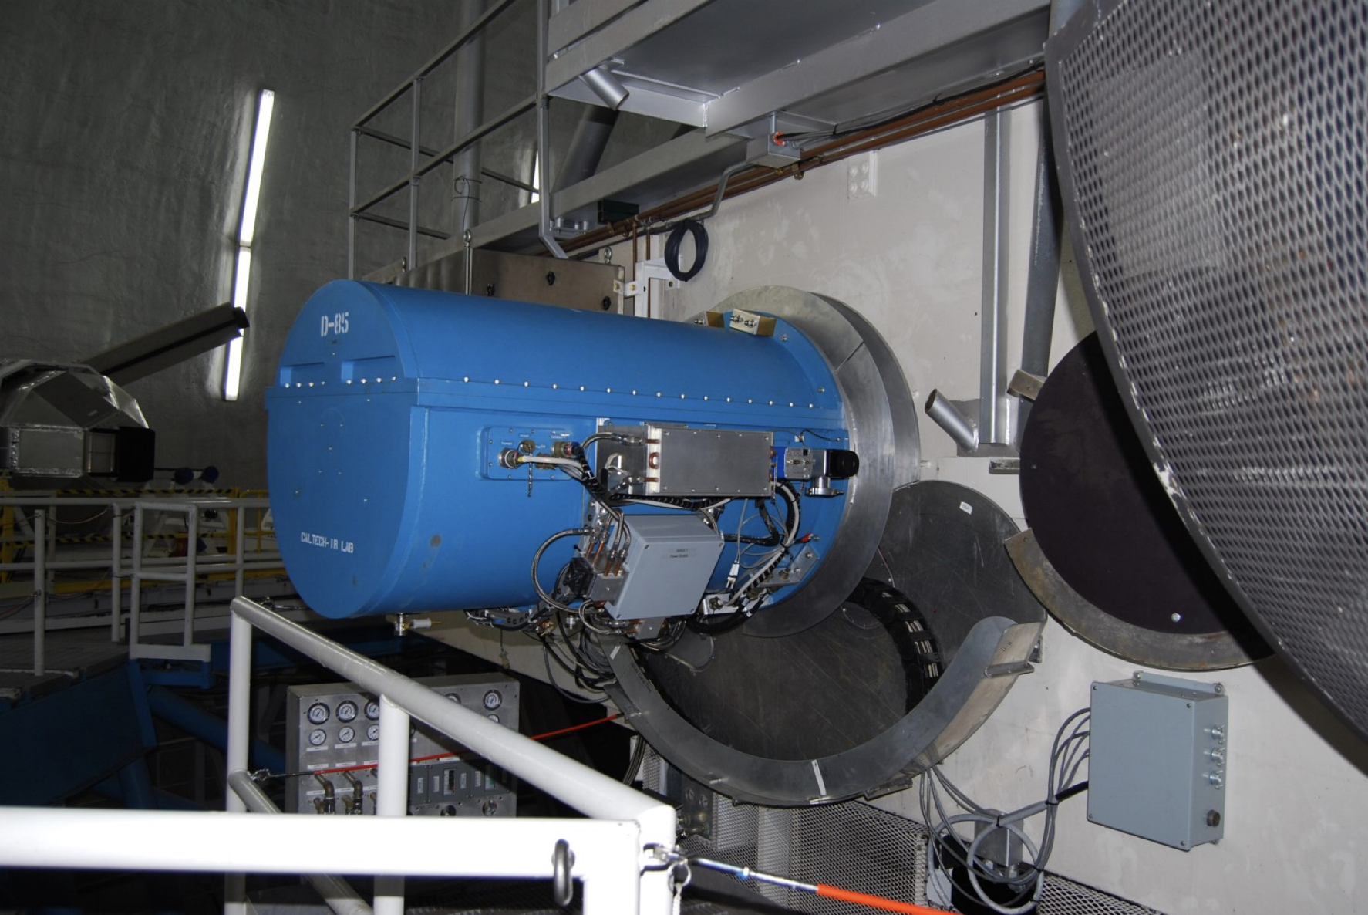
Near-InfraRed Echellette Spectrometer (NIRES)
TripleSpec design
Spectral coverage 0.94 - 2.45 µm with 1.85 - 1.88 µm gap
Resolving power R ~ 2700
Fixed 0.55’’ slit, no moving parts
2.1’x 2.1’ slit viewing camera
Off-axis optical guider

Slide 7
Survey Strategy
We use YSE-PZ (Coulter+ 2023) to manage the survey.
Volume limited sample: everything with z < 0.01
Flux limited sample: r < 17 mag
NIR photometric coverage still poor, due to the lack of publicly available imager on a 3-5 meter class telescope
Ia survey targeting objects with extreme light curve parameters and observations at phases with poor NIR coverage
ToO to observe young SNe and SNe at critical phases

Slide 8
Supplemental data
Spectroscopy for brighter objects with IRTF/SpeX
NIR photometry for faint objects with Gemini/NIRI and F2
Usual optical photometry from public surveys, including the Young Supernova Experiment
Optical spectroscopy from UCSC and other teams

Slide 9
Data reduction with pypeit
pypeit fully supports NIRES
Minimal user interaction, improve repeatability
Python-based, no need for an IDL license
Spectral extraction comparable to spextool
Telluric correction still lacking compared with xtellcor, working with the pypeit development team to improve.
Nifty helper scripts to run flux calibrations, coaddion, and telluric fitting

Slide 10
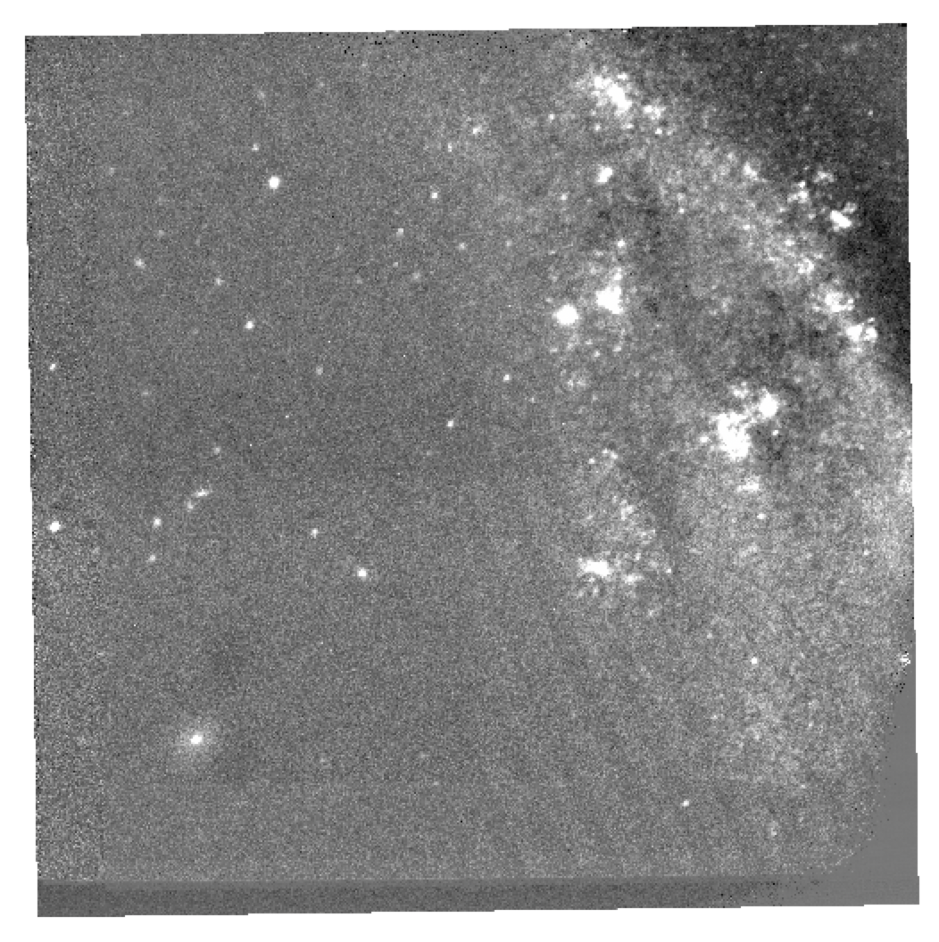
Slit viewing camera data reduction
2.1’x2.1’ slit viewing camera with a fixed K’ filter
Reduction effort led by Matt Grayling
Automatic reduction script to field flatten and stack images
Photometric calibration is still manual
Photometry will be included in future release
SN 2023dbc

Slide 11
Observed sample to date
33 half nights with 5 weathered out from 2022A-2023A
4 ToO (SNe II 2022jzc 2022mji, Ic-pec 2022oqm, Ia 2022hrs 2022aaiq, 2022zut)
1.5 nights left
217 NIRES spectra of 113 unique SNe reduced
103 spectra of 49 objects to be included in DR1 of 2022A observations

Slide 12
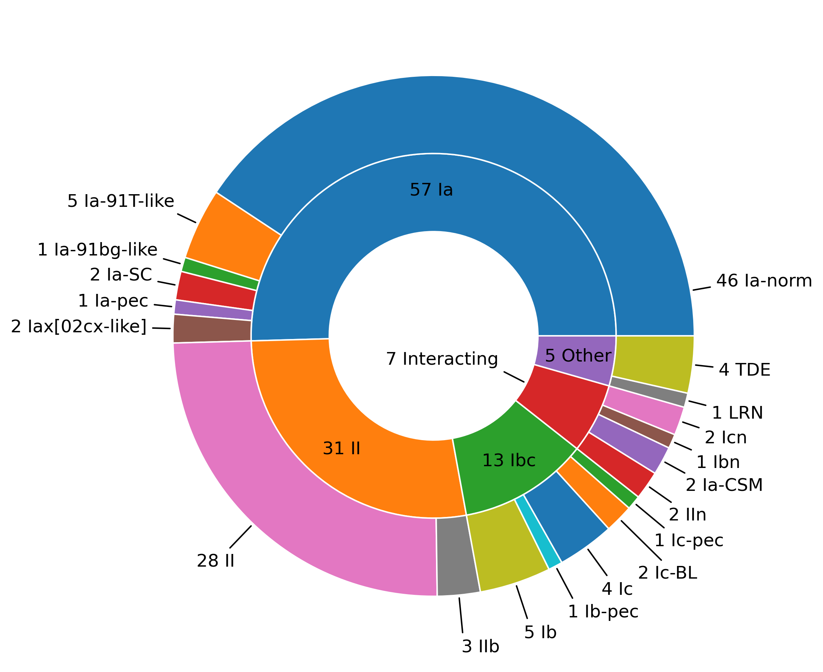
113 unique SNe observed

Slide 13
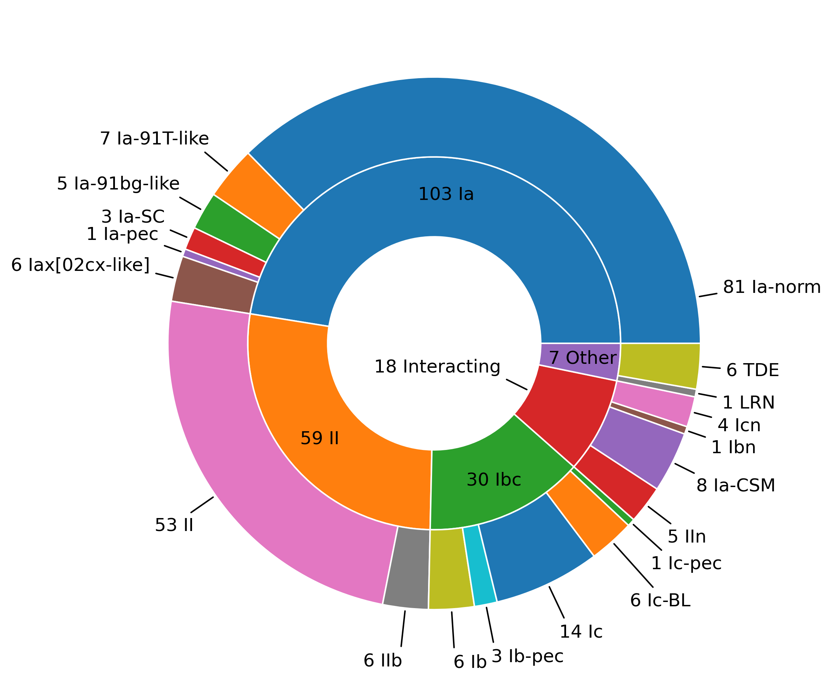
217 unique spectra to date

Slide 14
Observations per supernova
29

Slide 15
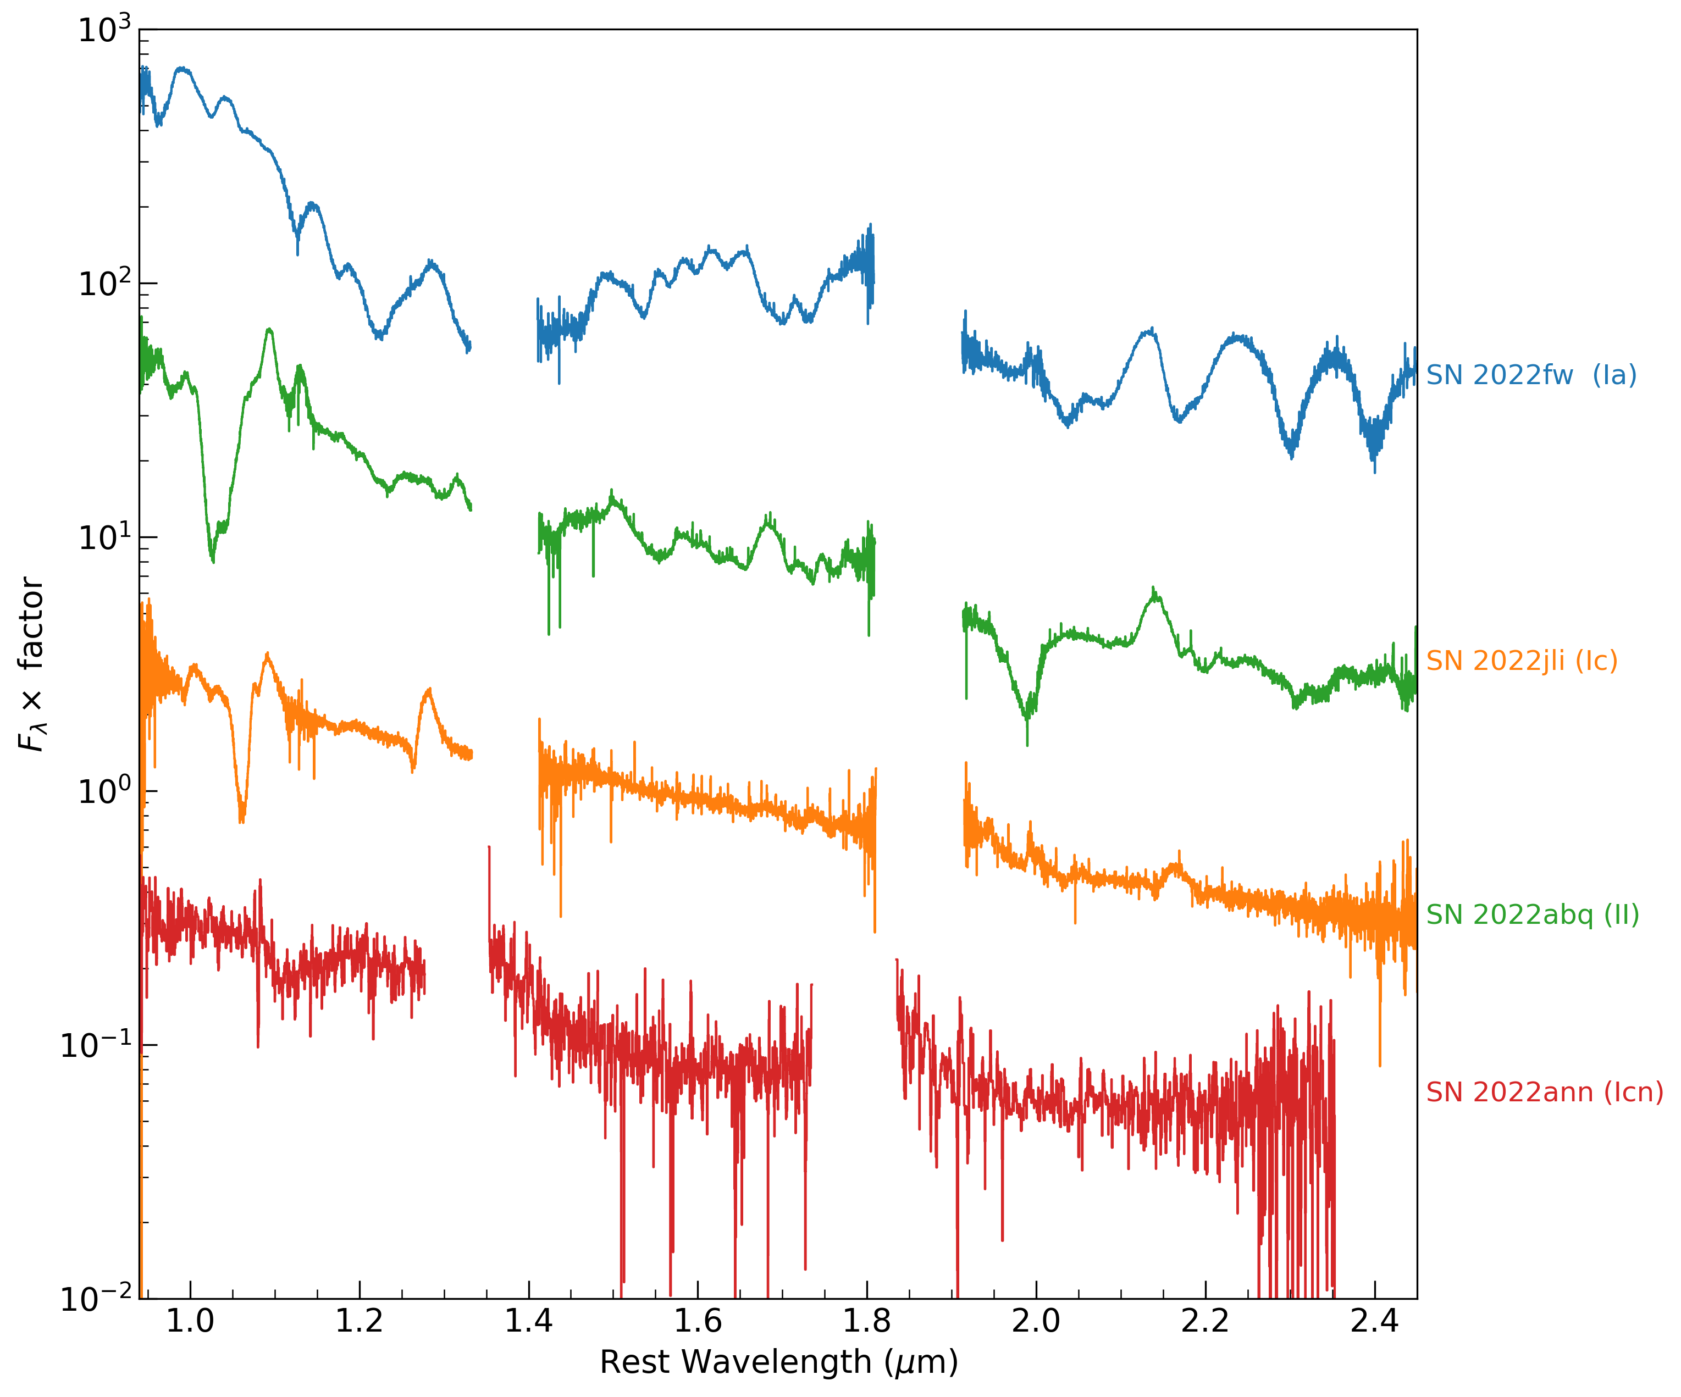
Sample Data

Slide 16
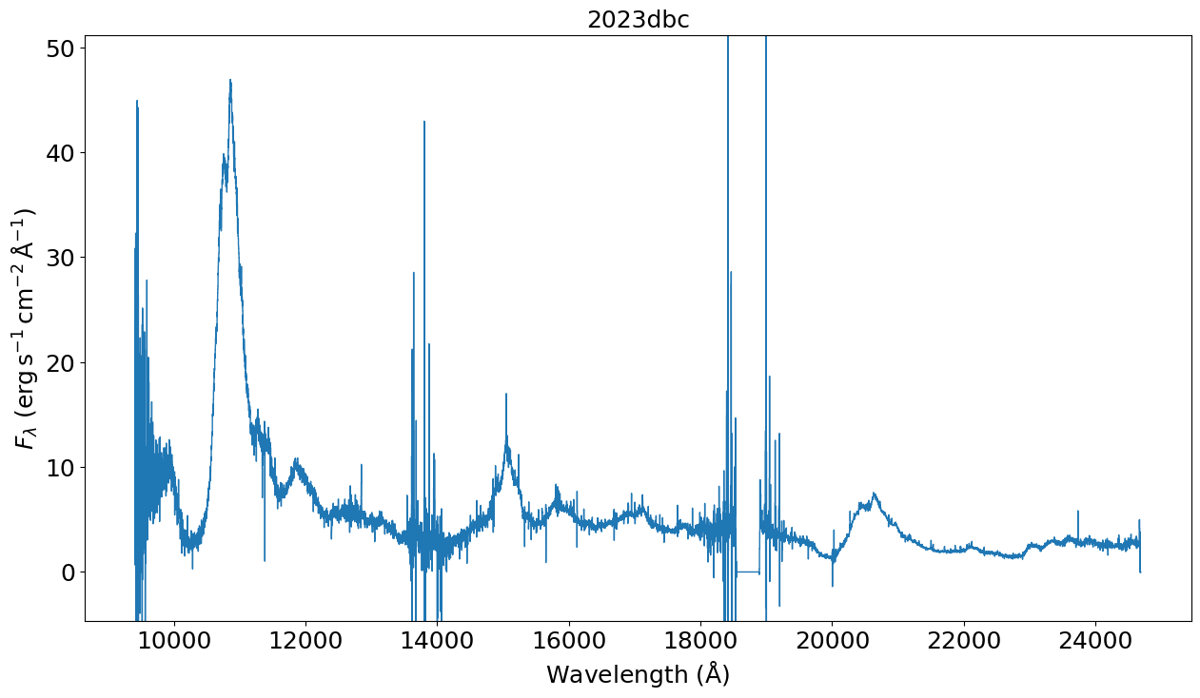
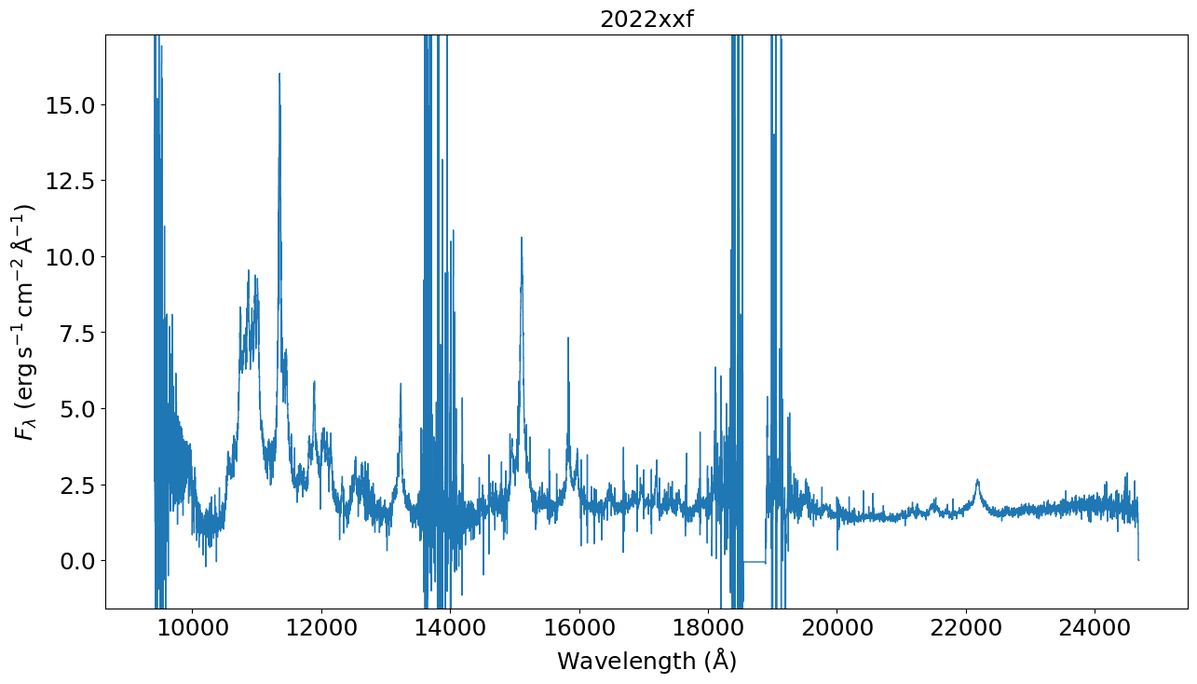
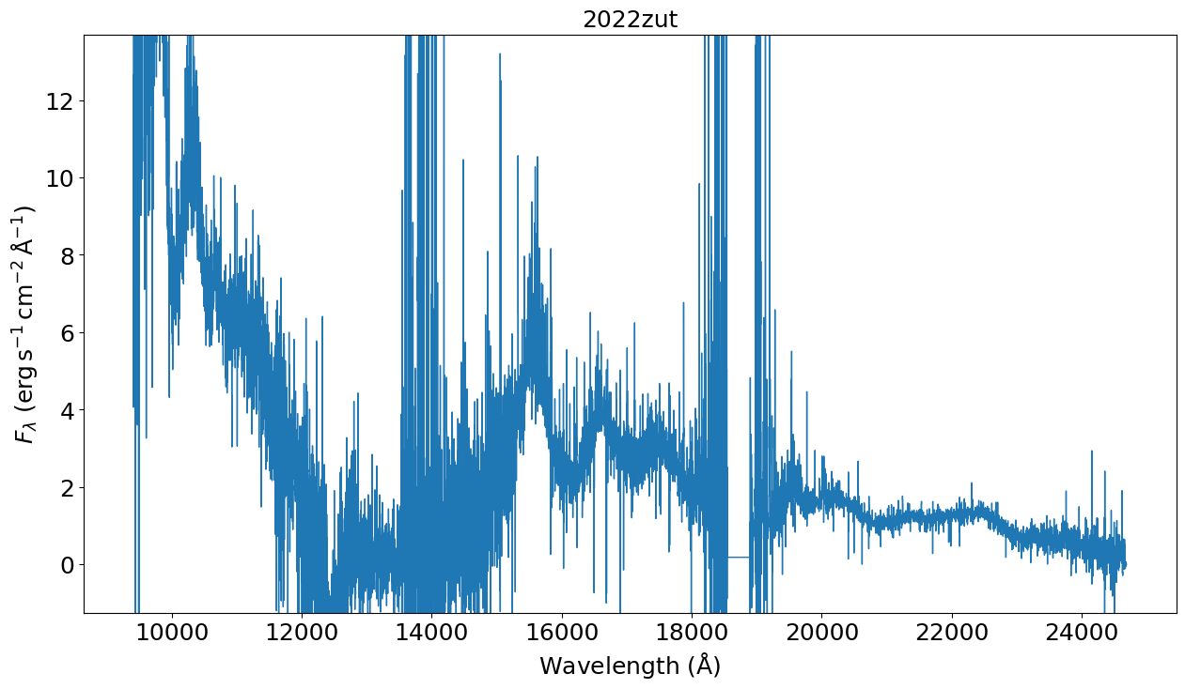
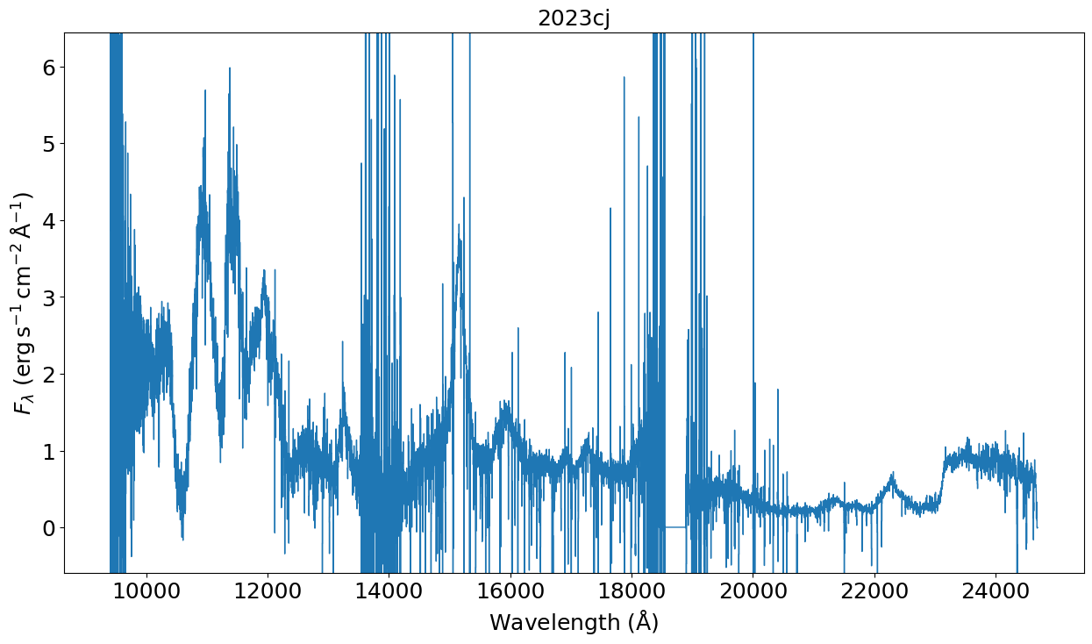
Weird interacting
Ic BL
Nearby SNe Ic
with CO
Late-time SN Ia
+150 d

Slide 17
Papers published and in preparation
Davis+ 2023; SN 2022ann: a Type Icn supernova from a dwarf galaxy that reveals helium in its circumstellar environment, published
See Kyle’s talk on Thursday!
Yadavalli+ 2023: SN 2022oqm coming to the arxiv soon
See Karthik’s talk on Thursday!
Tinyanont+ in prep; survey description and data release 1

Slide 18
Conclusion
KITS obtained 217 spectra of 113 unique SNe so far
Aims to observe all SNe with z < 0.01 or brighter than r = 17
Uniform data reduction with pypeit
Data release 1 of 2022A observations coming out soon
Let us know if you are working on SN 2022something to see if we can provide NIR spectra now
Contact samaporn@narit.or.th, foley@ucsc.edu

Slide 19
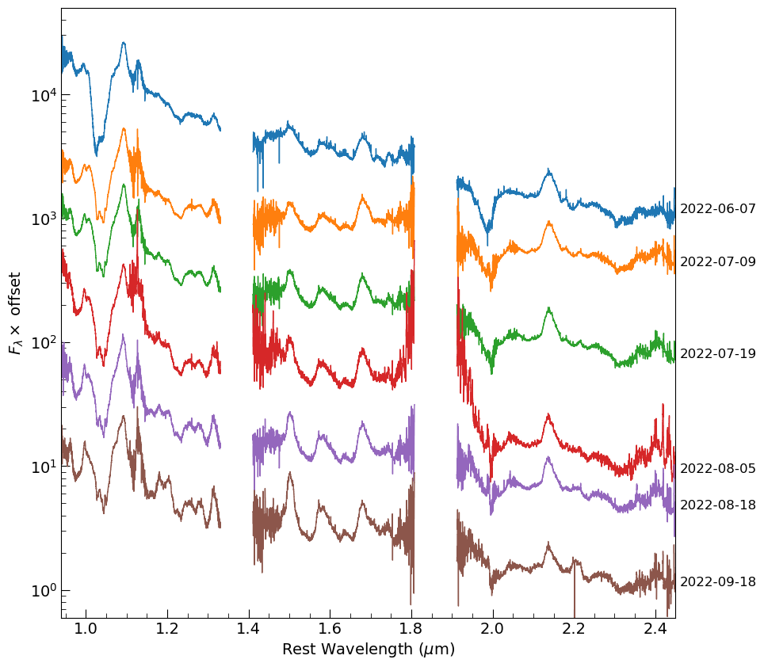
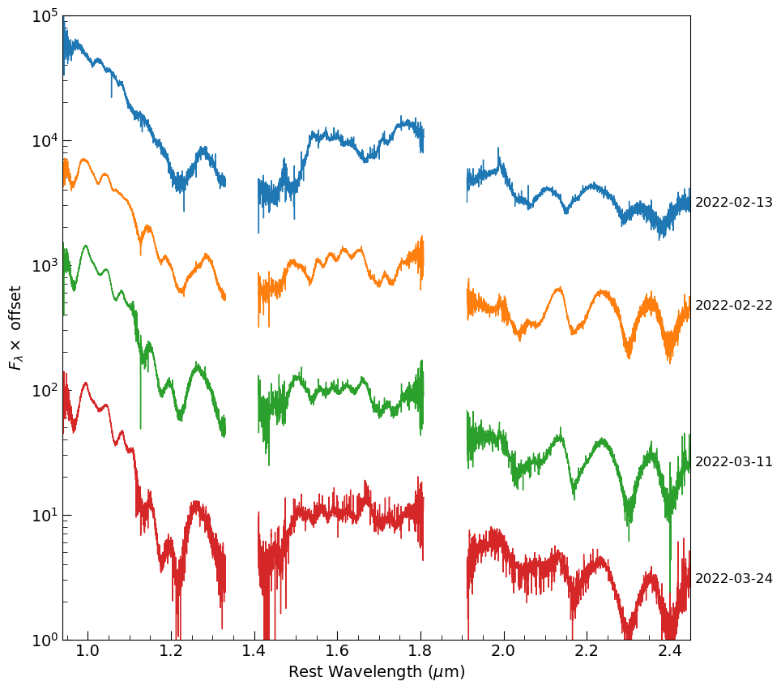
SN 2022jli (Ibc)
SN 2022fw (Ia)

Slide 20
Objects included in DR1
2021biy | LRN | 2022erq | SN Ia-CSM | 2022jli | SN Ic
2022abq | SN II | 2022erw | SN Ia | 2022jo | SN II
2022afc | SN Ib | 2022esa | SN Ia-CSM | 2022joj | SN Ia
2022ann | SN Icn | 2022ewj | SN II | 2022kla | SN Ia
2022baw | SN Ia | 2022exc | SN Ia | 2022lxg | SN II
2022bck | SN Ib | 2022eyj | SN Ia | 2022mji | SN II
2022bdu | SN Ic | 2022eyw | SN Iax | 2022mm | SN II
2022bdw | TDE | 2022fcc | SN Ia | 2022mxv | SN II
2022bse | SN II | 2022frl | SN Ib-pec | 2022mya | SN Ib
2022crr | SN Ic-BL | 2022frn | SN Ia | 2022nag | SN Ia
2022crv | SN Ib | 2022fw | SN Ia | 2022ngb | SN IIb
2022cvr | SN Ia | 2022hrs | SN Ia | 2022ojo | SN II
2022dbl | TDE | 2022hsu | SN IIn | 2022oqm | SN Ic-pec
2022dml | SN II | 2022ihx | SN Ibn | 2022osg | SN Ia
2022dsb | TDE | 2022iid | SN II | 2022ovq | SN Ia
2022dtv | SN Ia | 2022ilv | SN Ia-SC

Slide 21
2022A ToO observations
2022jzc (MOSFIRE)
2022mji, 2022hrs, and 2022oqm

