Slide 1
A search for millimeter-wave transient sources in the galactic plane with SPT-3G
Yujie Wan, UIUC
06/22/2023

Slide 2
Outline
Background
Galactic plane survey
Preliminary results
Future plans
Mm-wave transient survey with SPT
Previous results of SPT transient survey
Motivation for galactic plane survey
Observing strategy
False color galactic plane image
Individual maps
Average map
Difference maps
First results
Data analysis
Building faster pipeline
Notes:
haha

Slide 3
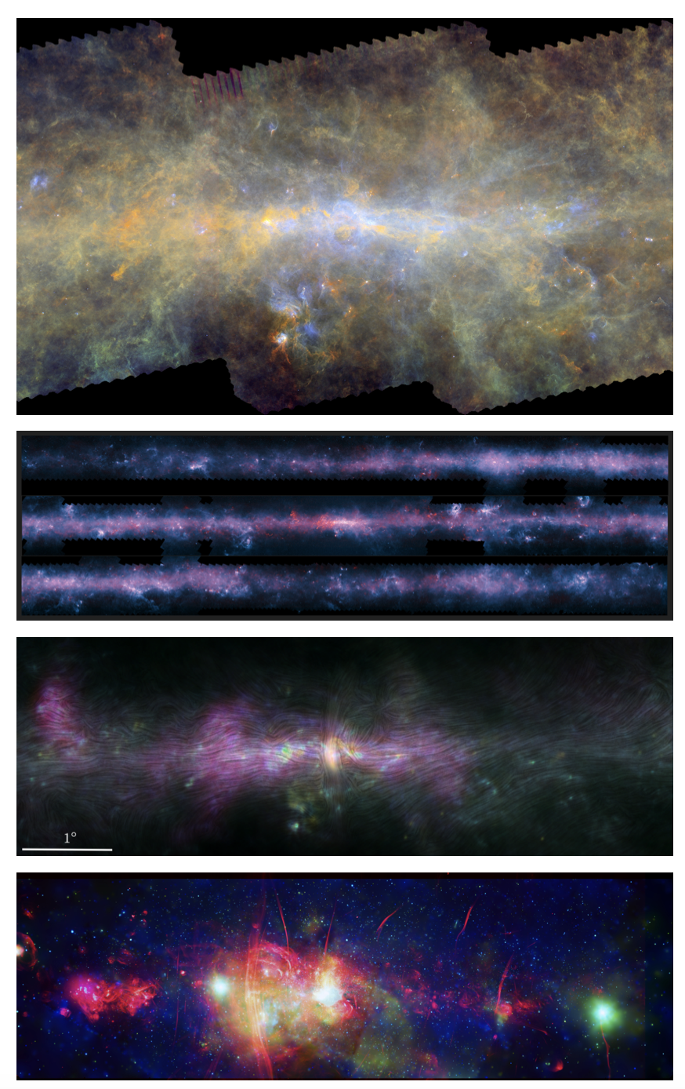
What have been done
Hi-GAL, the Herschel infrared Galactic Plane Survey: 70, 160, 250, 350 and 500 um in T over ~12 deg²; photometric maps and compact source catalogues. (Malinari, et al. 2016)
APEX/LABOCA ATLASGAL observed 400 deg² at 870um from 2017-2010 (Schuller + 2009, Contreras + 2013, Csengeri + 2014)
ACTpol observed 32 deg² in T and P in 2019 (Guan + 2021)
MeerKAT observed 6.5 deg² at 1.3GHz (Heywood + 2022)
These were all static continuum surveys
Not time-domain

Slide 4
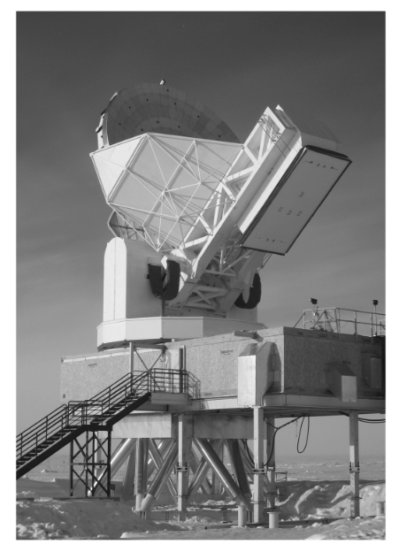
Mm-wave transient search with SPT
South Pole Telescope (SPT) is a 10 meter diameter, wide field telescope located at Amundsen-Scott South Pole Station in Antarctica.
Observing bands: 95GHz, 150GHz, and 220GHz.
Angular resolution: ~ 1’
Observing Strategy: repeated observations of the same patch of sky for multiple years.
Carlstrom, et al. 2011

Slide 5
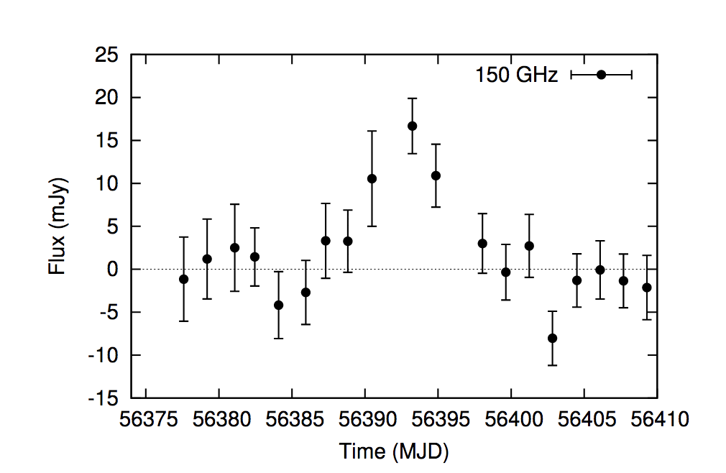
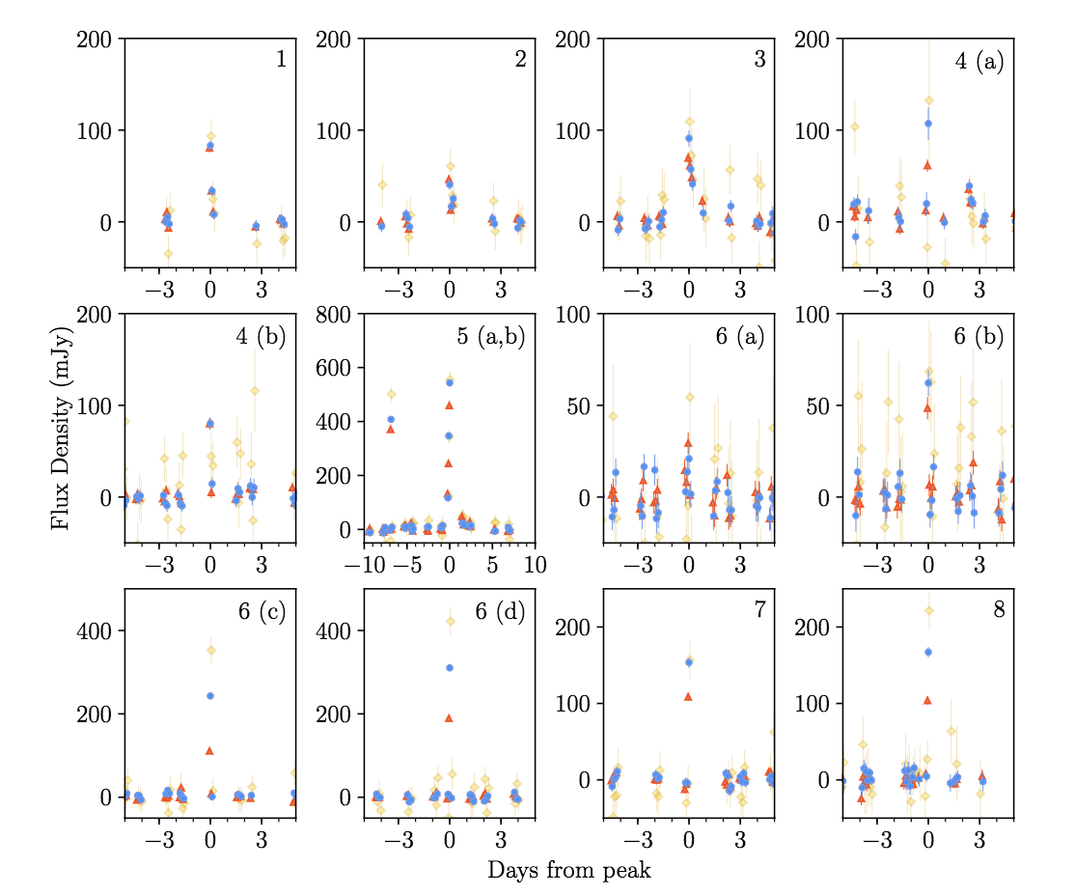
Previous Results of SPT transient surveys
SPT-3G 1-year 1500 square degrees transient survey
SPTPol 1-year 100 square degrees transient survey
Whitehorn et al., 2016
Guns et al., 2021

Slide 6
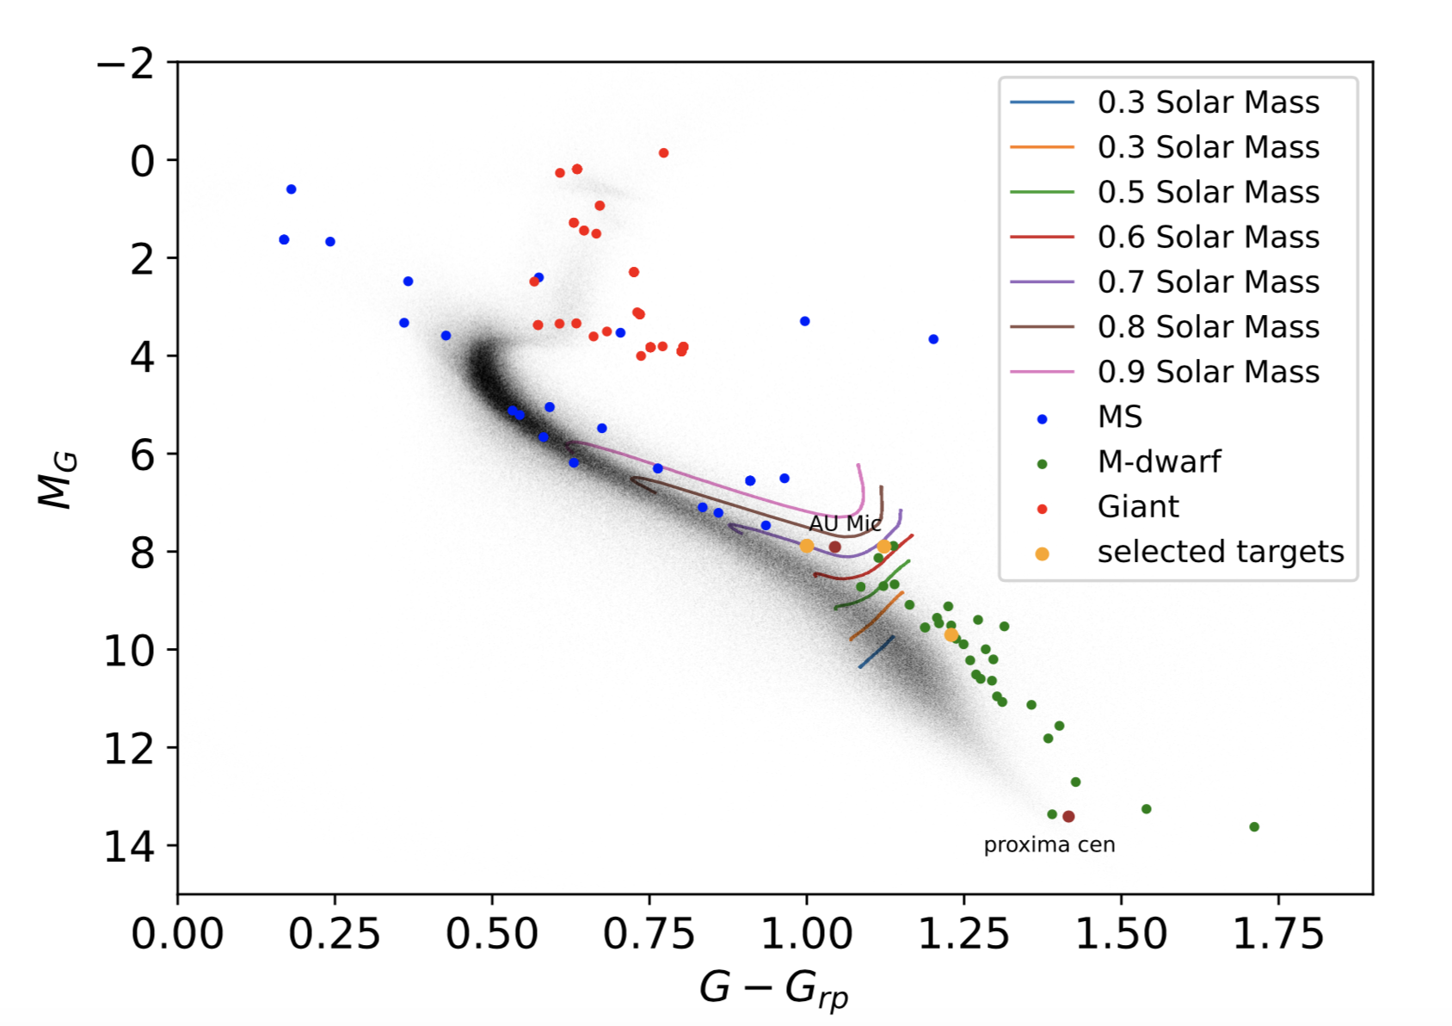
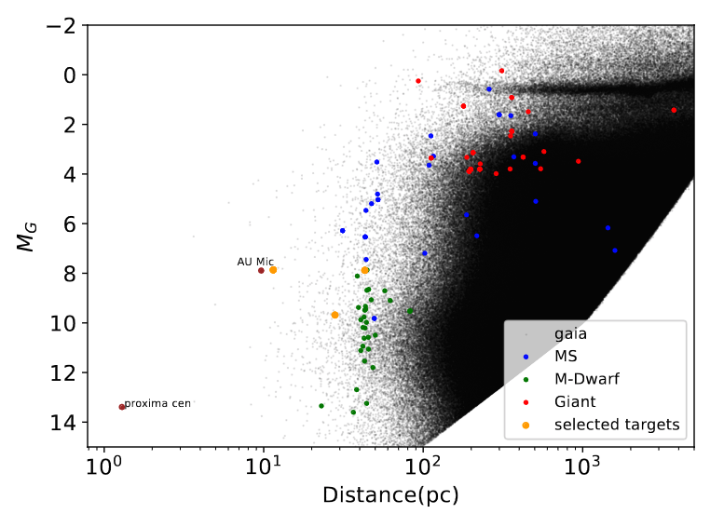
Stellar flares
The majority of mm-wave transient events are flares from nearby stars.
Q: Why are they flaring? What is the nature of the stars?

Slide 7
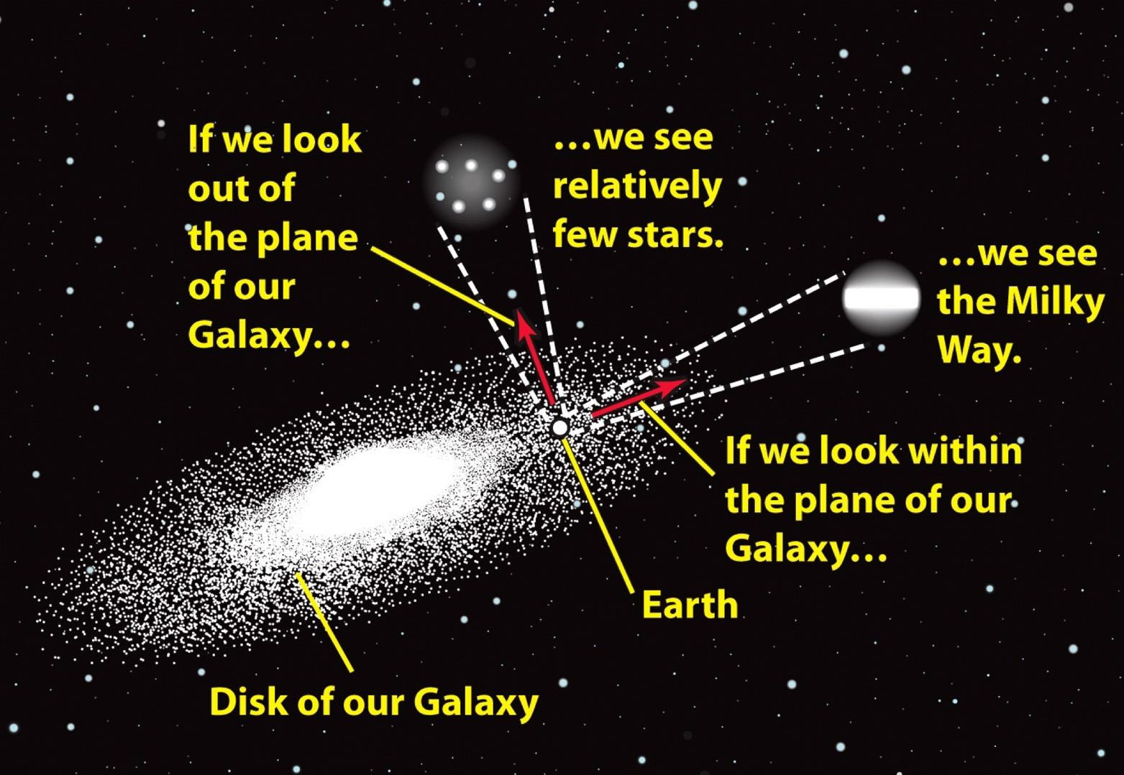
Motivation for the galactic plane transient survey

Slide 8
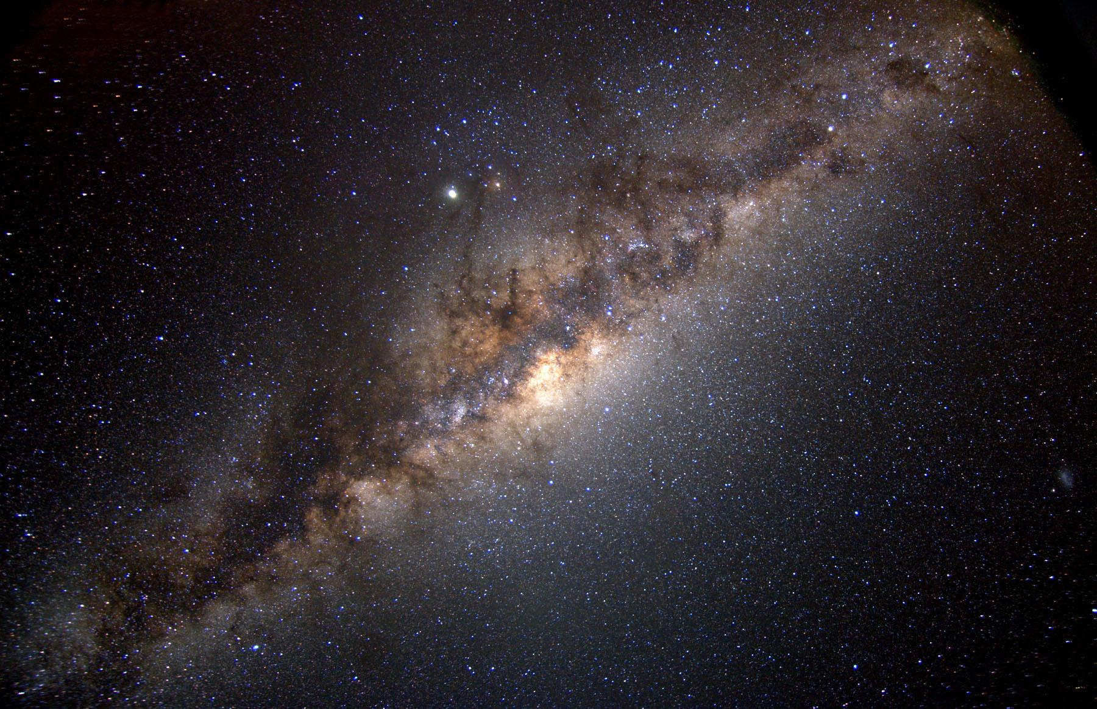
Science Cases
Sgr A*
Stellar Flares
X-ray binaries
Classical Novae
Planetary Nebulae
Magnetars
There is a seperate Sgr A* survey measuring its variability.
Based on previous detection rate, we are expecting to detection a few flaring stars.
The survey will cover a number of known X-ray binaries that are bright in radio.

Slide 9
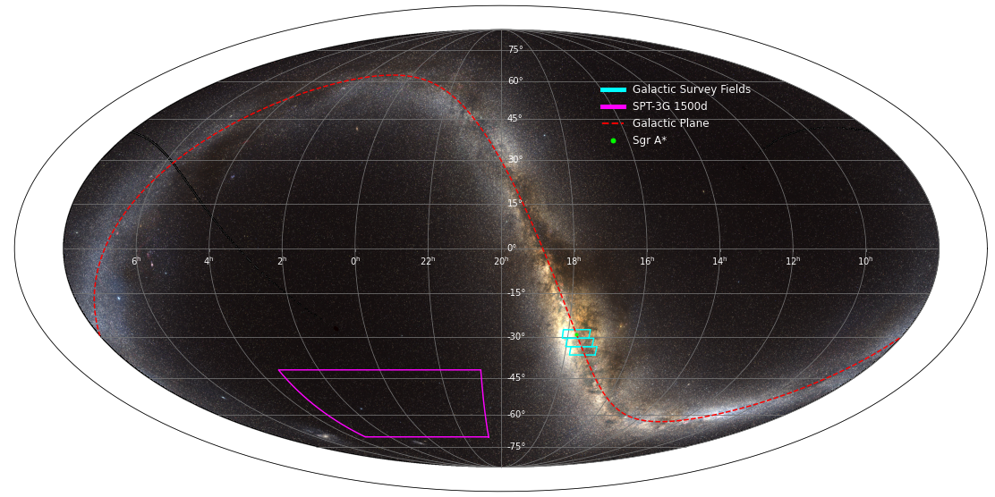
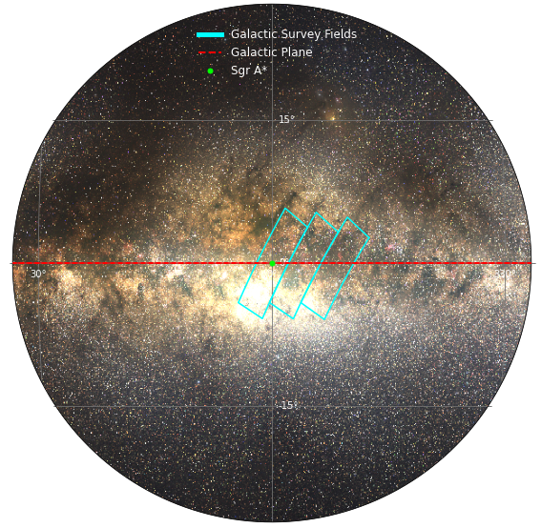
The galactic plane transient survey
Location: The galactic plane
Time: February 13th 2023- March 21st 2023

Slide 10
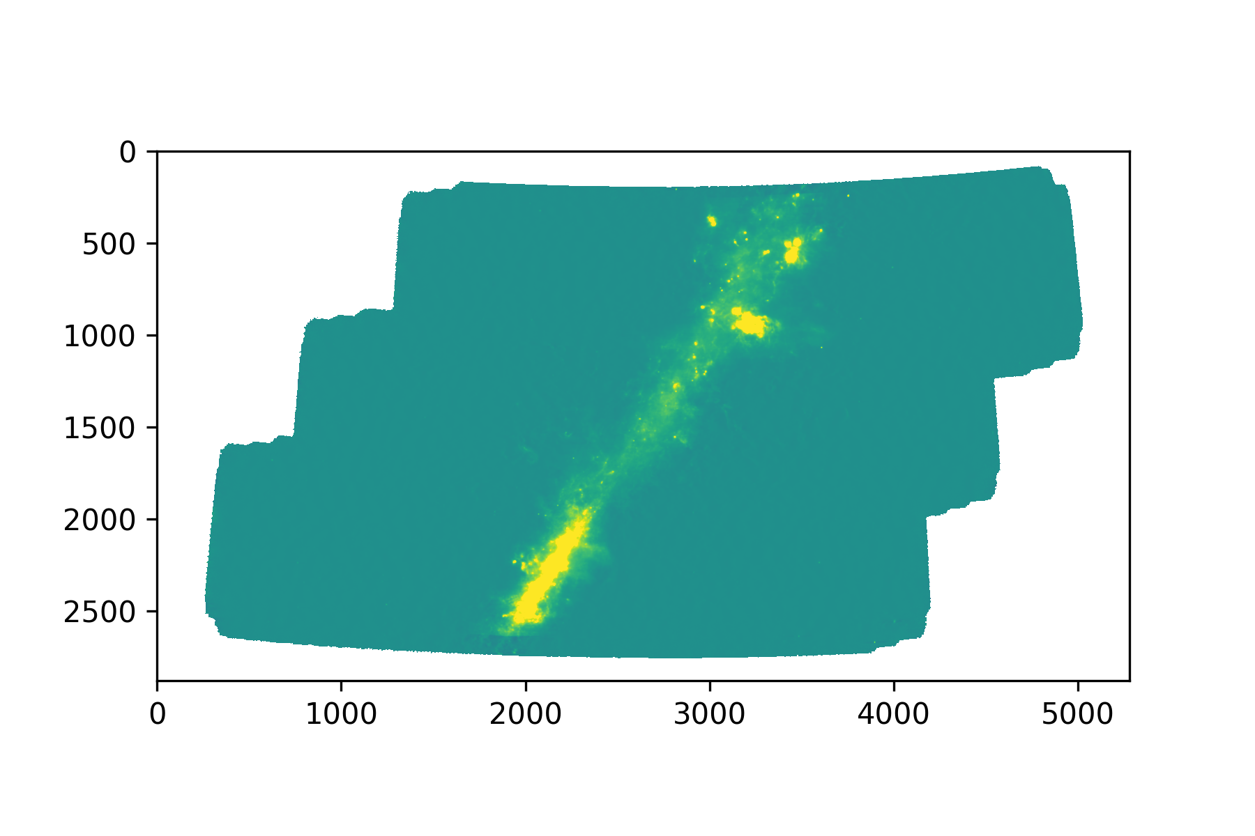
The galactic plane transient survey
~10 deg
125.6 deg²
300 observations
5.6, 6.8, 23uK-arcmin at 95,150, 220GHz
~16 deg

Slide 11
The galactic plane transient survey
~10 deg
125.6 deg²
300 observations
5.6, 6.8, 23uK-arcmin at 95,150, 220GHz
~16 deg

Slide 12
~10 deg
125.6 deg²
5.6, 6.8, 23uK-arcmin at 95,150, 220GHz
300 observations
~16 deg

Slide 13
The galactic plane transient survey

Slide 14
Workflow for transient detection
Time ordered data
Mapmaking pipeline
Individual maps
Combine all individual maps together
Average map
Subtract individual maps by average maps
Difference Maps
Transient detection pipeline
Lightcurve for transient events

Slide 15
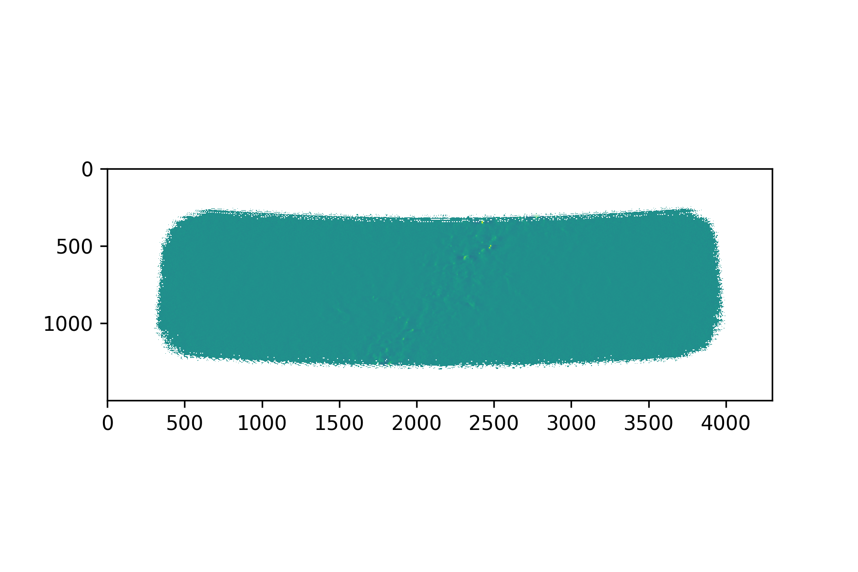
Making individual map for each observation
Example of an individual map for one single observation

Slide 16
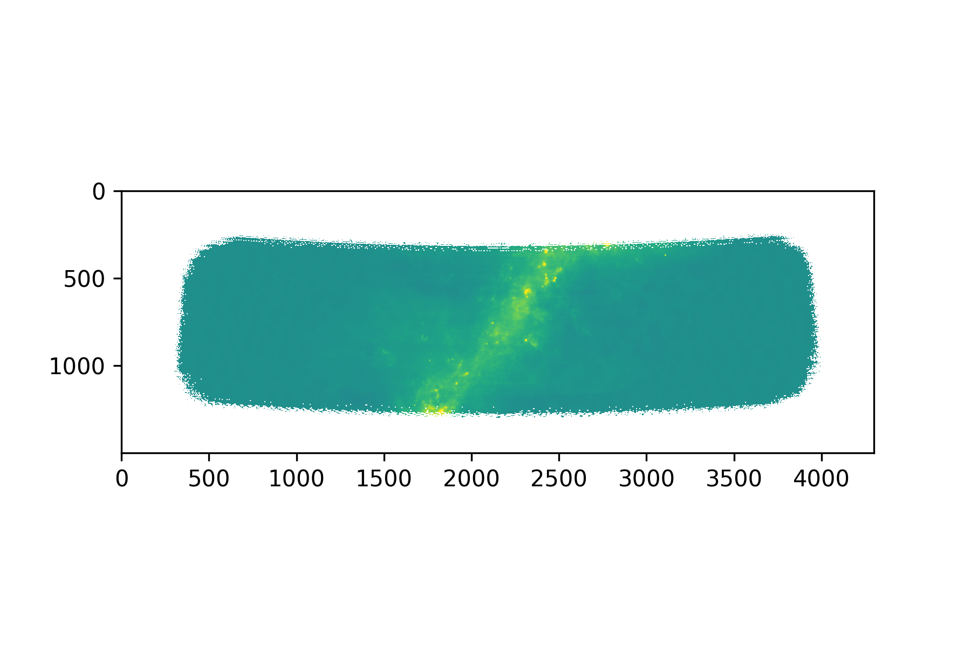
Making the coadd map
The is the coadd map for one subfield by adding all the individuals maps together

Slide 17
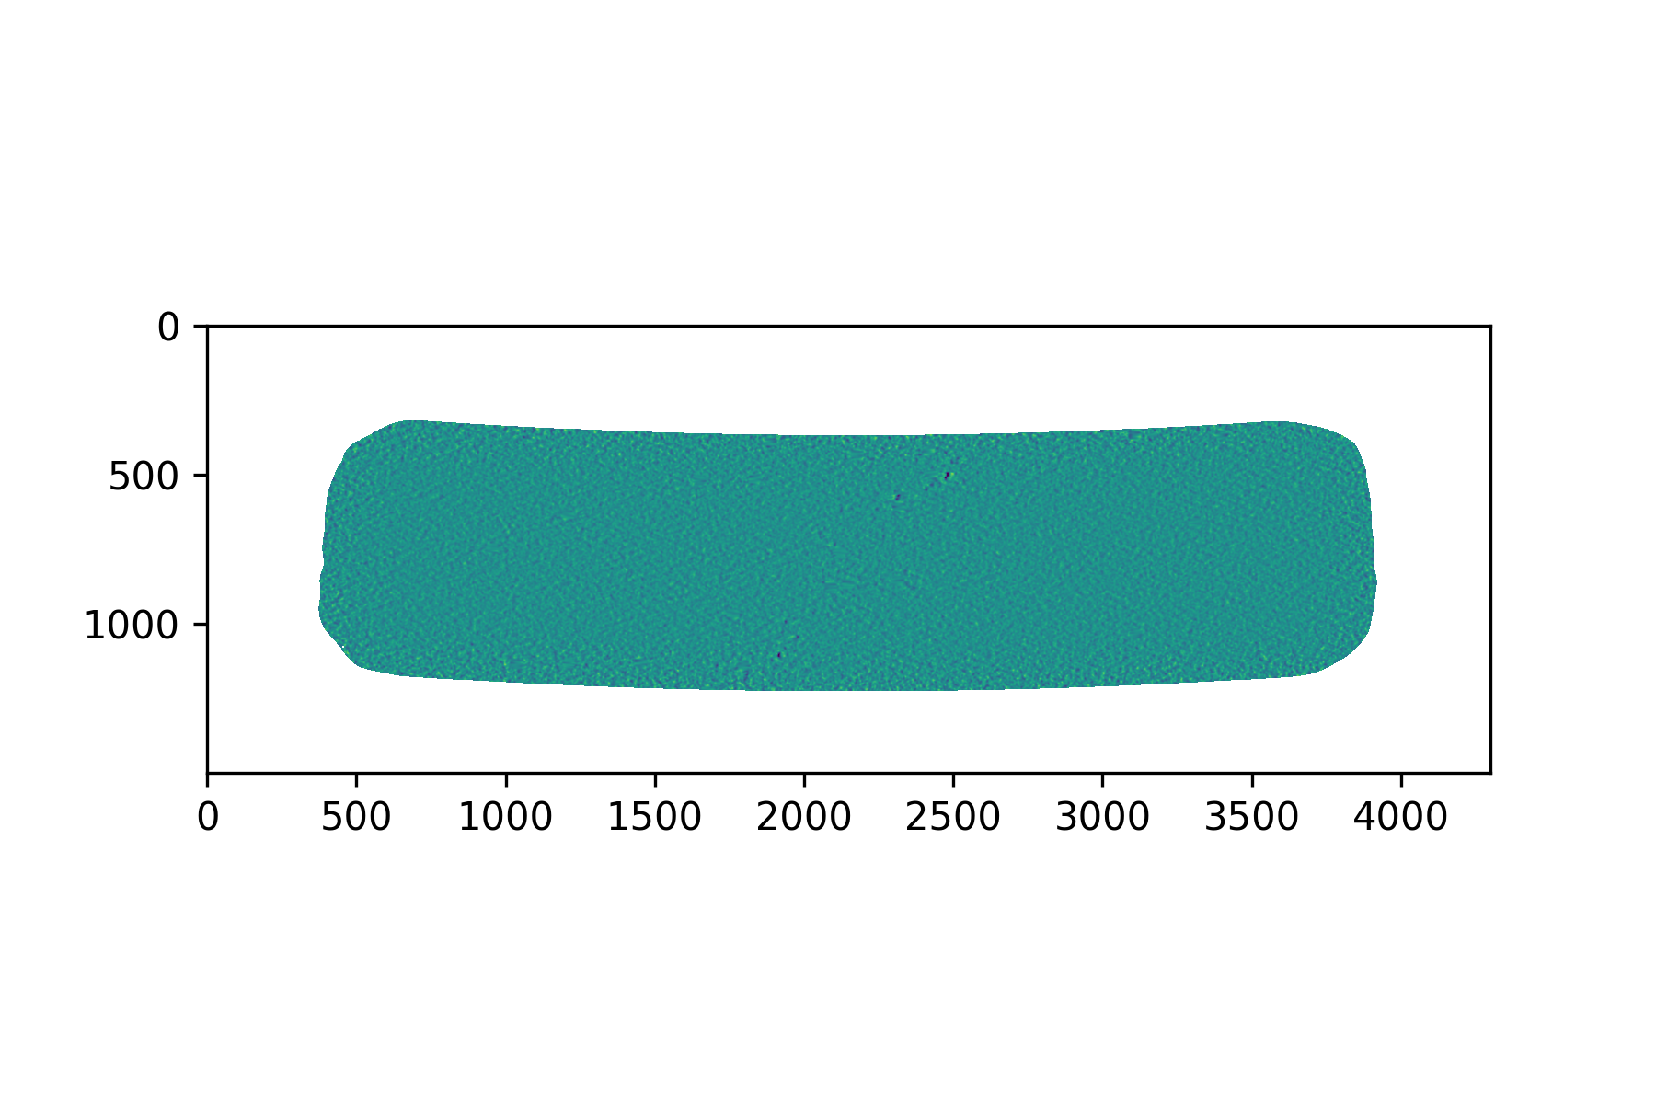
Making difference maps
Example of a difference map by subtracting the individual map by the average map

Slide 18
First result
Static point source
Possible variable source
Reference map (average map)
Difference map
Difference map

Slide 19
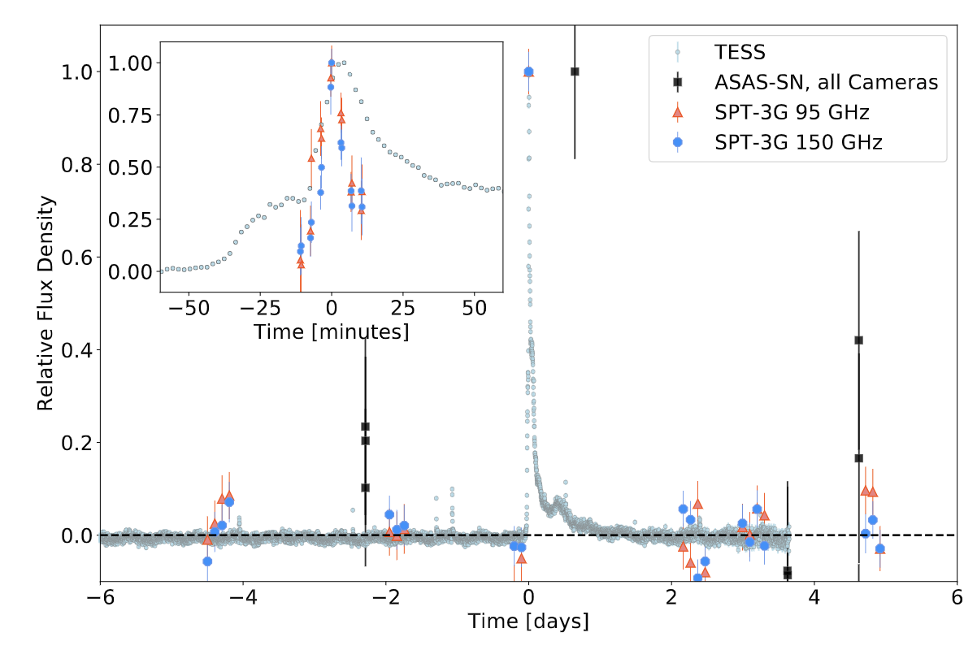
Building a new faster pipeline
The existing transient pipeline detects at hour-scale time resolution.
We want to build a new transient pipeline which works at individual scan level instead of the entire two-hour observation level.
Guns et al., 2021

Slide 20
Summary
SPT is uniquely great for transient surveys.
SPT observed the galactic plane this spring for a month.
First results from the galactic plane survey, possible variable source
Future plans, continuing data analysis; building new faster pipeline

Slide 21
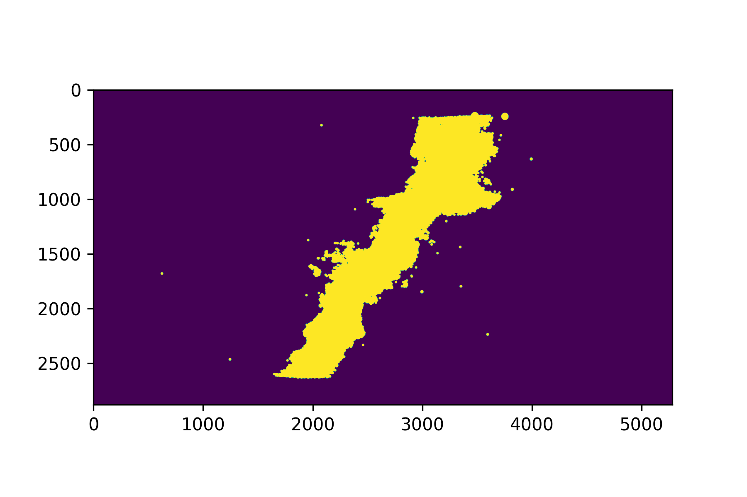
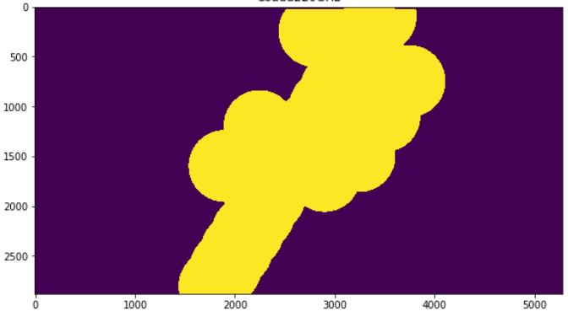
Back up

Slide 22
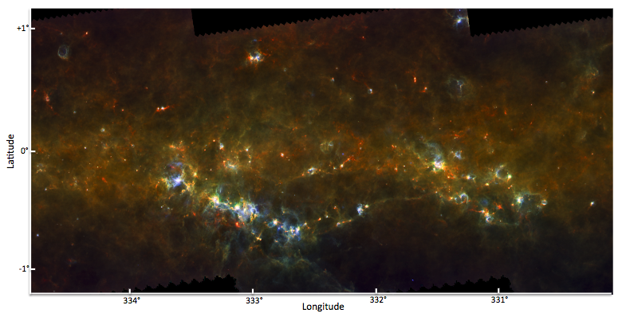
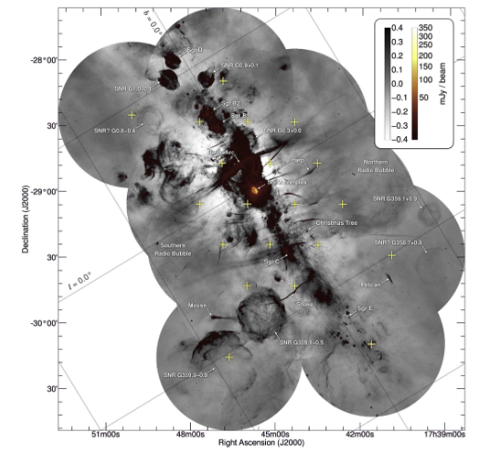
What have been done
Hi-GAL, the Herschel infrared Galactic Plane Survey: 70, 160, 250, 350 and 500 um in T over ~12 deg²; photometric maps and compact source catalogues. (Malinari, et al. 2016)
MeerKAT: observes in 1.28GHz covering 6.5 deg² (Heywood, et al, 2022)
These were all static continuum surveys
Not time-domain

Slide 23
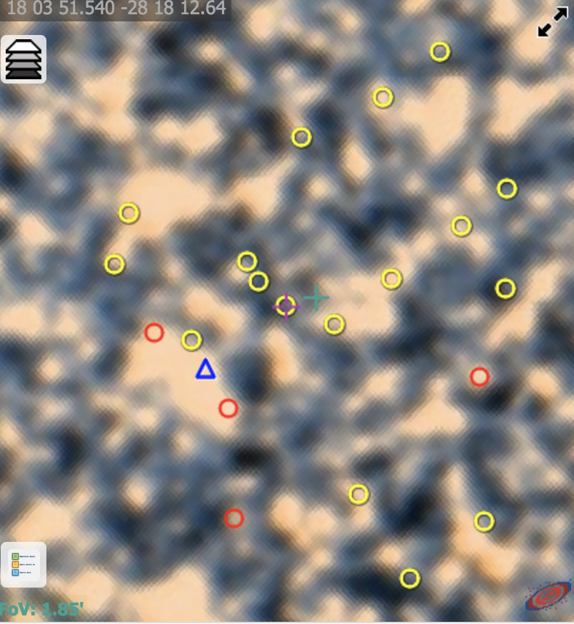
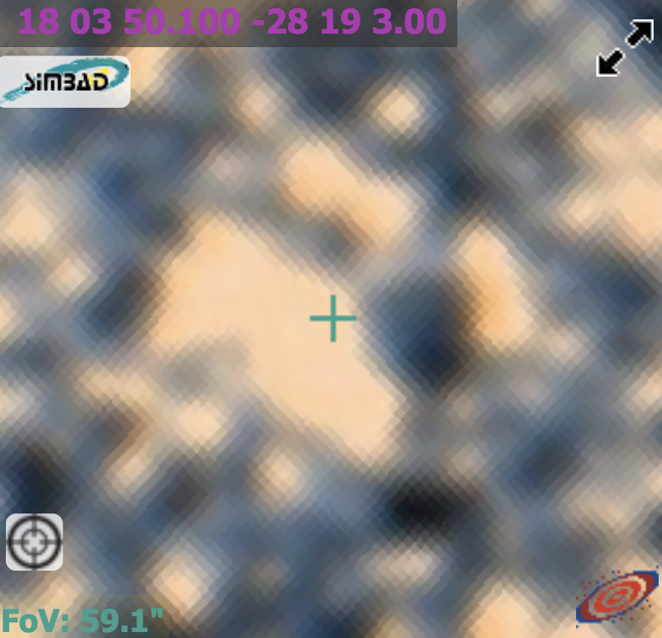
Possible counterpart

