Slide 1
Hydrogen-Rich luminous supernovae (LSNe-II): Looking into the unexplored regime of ccSNe distribution.
Subhash Bose
The Ohio State University
The Transient and Variable Universe conf. | University of Illinois | June 22nd, 2023

Slide 2
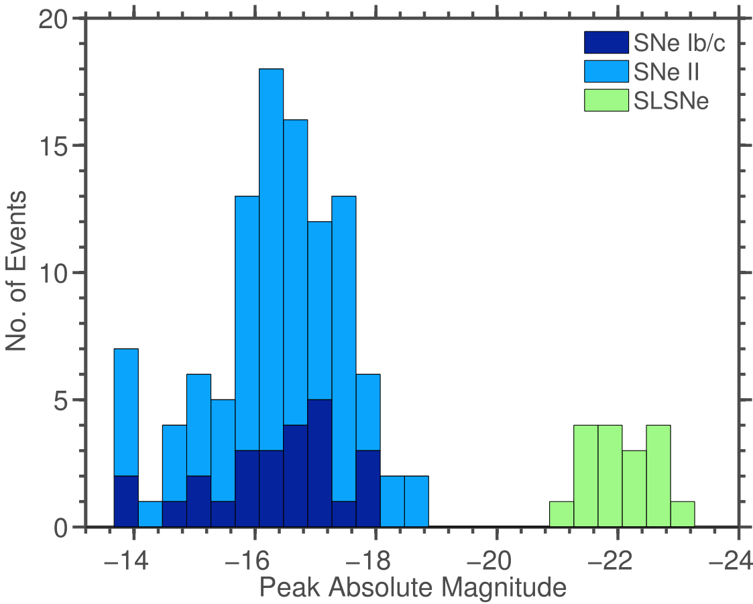
SNe luminosity distribution
Majority of our understanding are based on normal types of SNe.
We don’t have a complete picture of SNe luminosity distribution
We are now finding new types of objects which does not fit in standard models.
Arcavi et al. 2016
Normal SNe
Luminous
SLSNe
GAP?
${10}^{41}$ ${10}^{43}$ ${10}^{44}$ ${10}^{45}$
$(erg s^{−1})$
Superluminous SNe (SLNe)
Intermediate luminous SNe (LSNe; )
Fast blue optical transients (FBOTs) – e.g., 2018cow

Slide 3
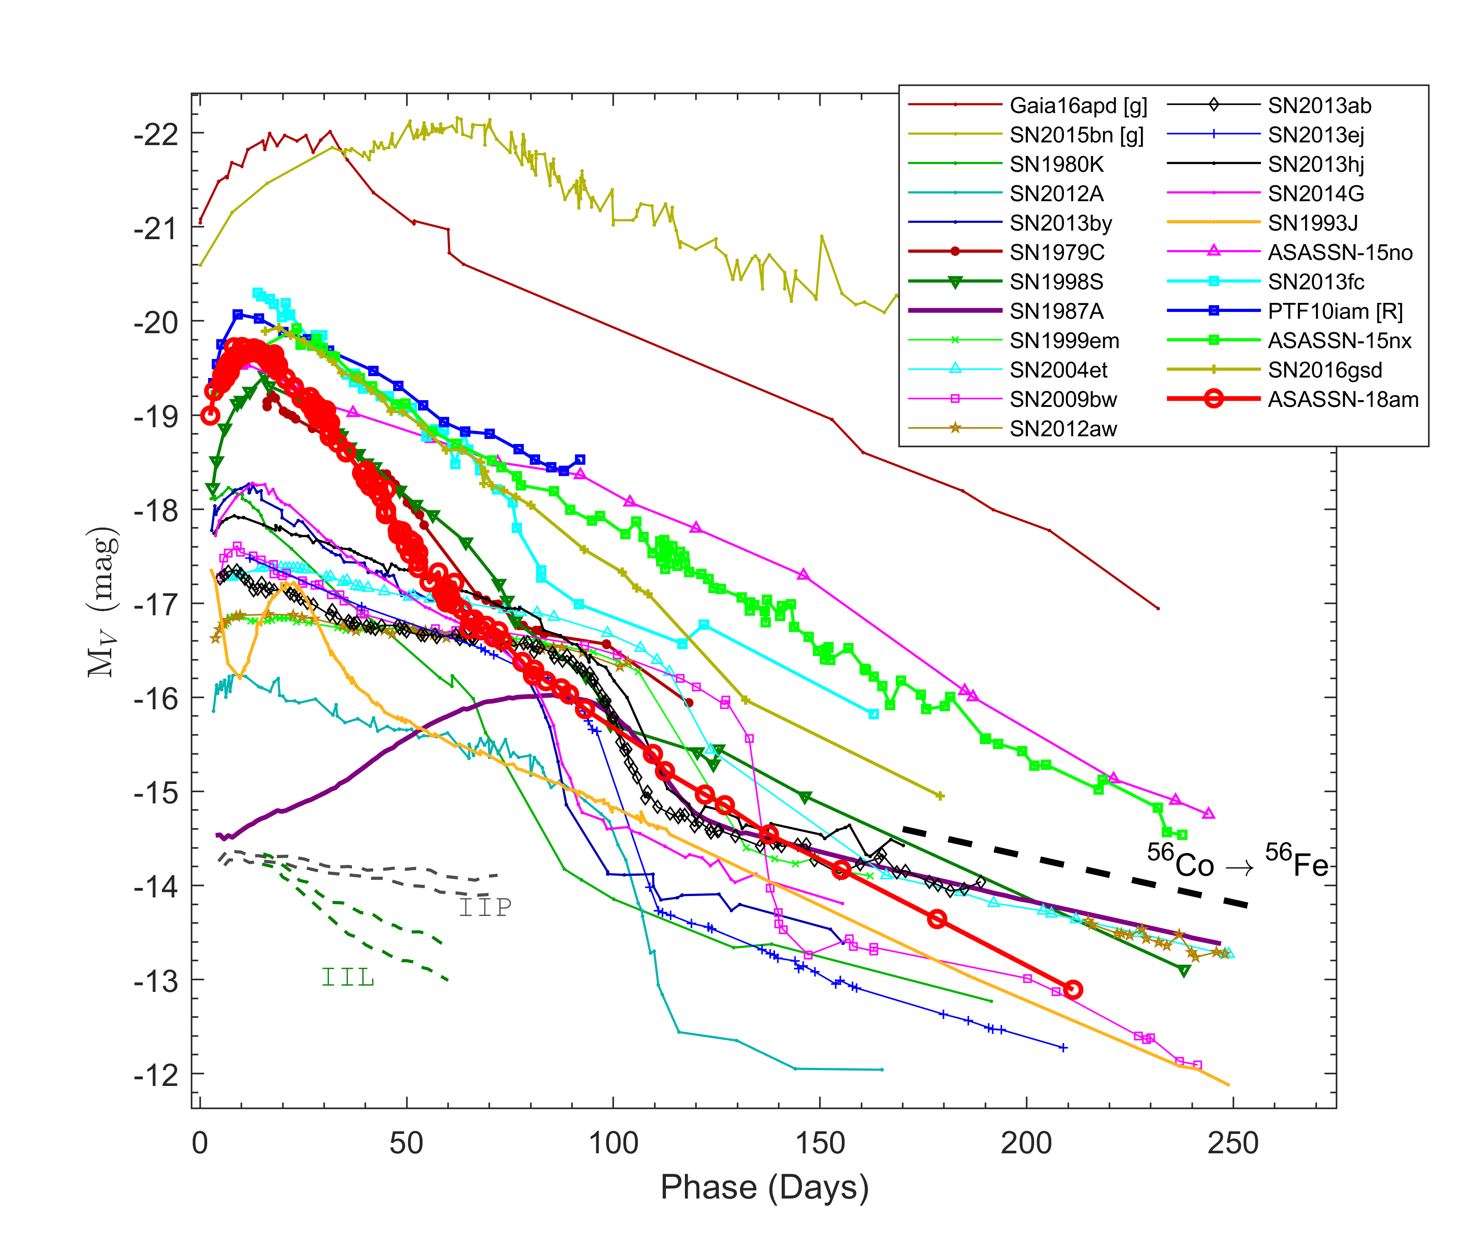
Hydrogen rich luminous SNe
Intermediate luminosity between ccSNe and SLSNe
No narrow emission lines or prominent interaction signatures
Mv ~ -20 mag
We designate these as
LSNe (Bose et al. 2021)
A continuity between ccSNe and SLSNe?
or
A distinct subclass?
: Unknown
SLSNe
LSNe
Normal SNe
Bose et al. 2021

Slide 4
Hydrogen rich luminous SNe
These are rarer (discovery rate) than SLSNe-I
Candidates we identified SN 2013fc (Kangas et al. 2016) PTF10iam (Arcavi et al. 2016) ASASSN-15nx (Bose et al. 2018) SN 2016gsd (Reynolds et al. 2020) ASASSN-18am (Bose et al. 2021)
Are these actually so rare?
Normal SNe
Luminous
SLSNe
GAP?
Arcavi et al. 2016
Arcavi et al. 2016

Slide 5
Light curves
No significant breaks or transitions in LCs
Short rise times
Fast decline -
For V-band:
~ 6 – 3 mag/100d

Slide 6
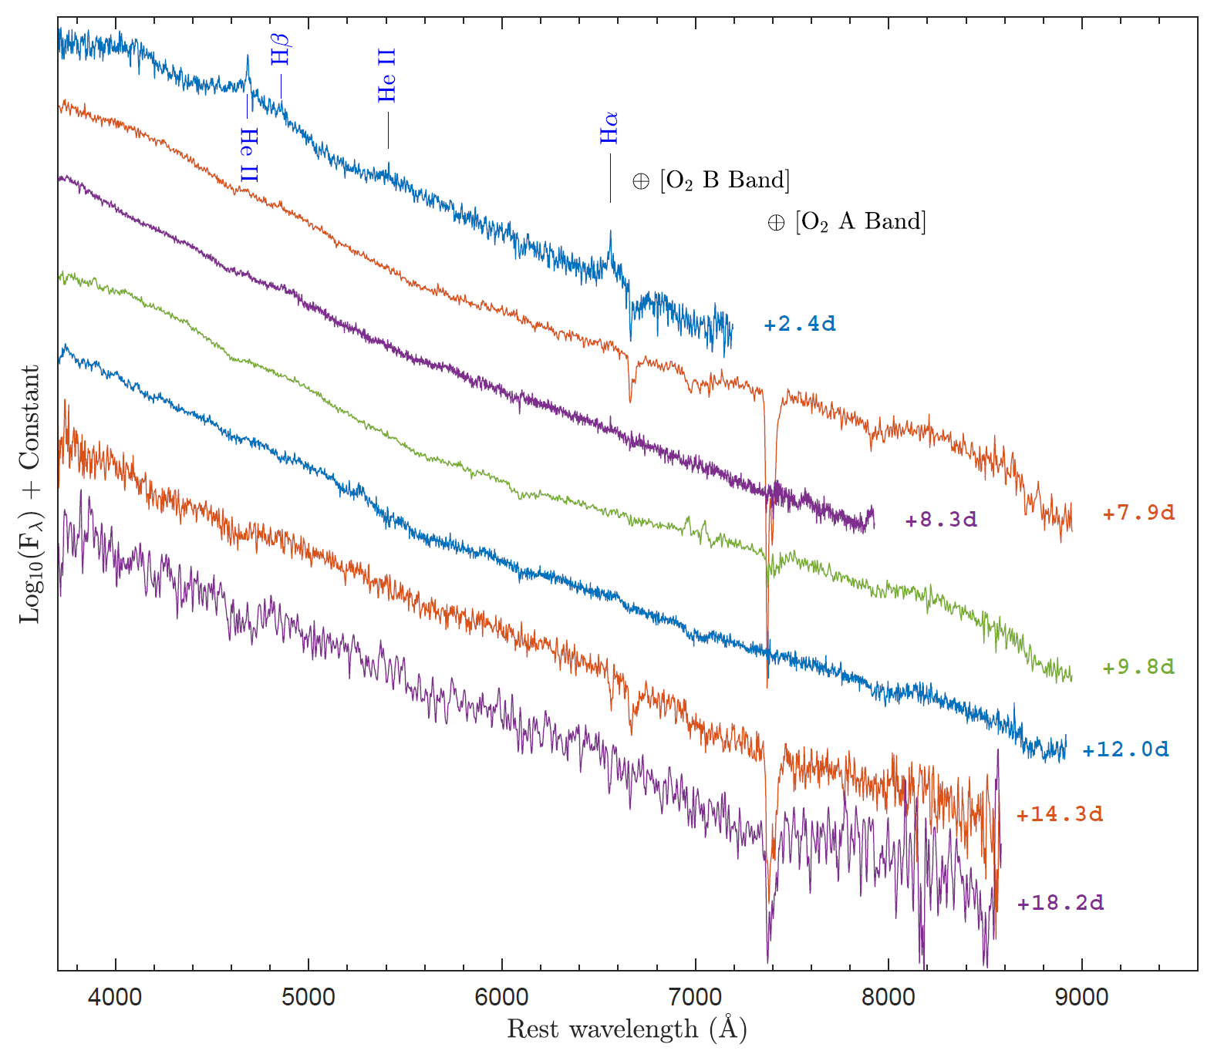
ASASSN-18am : Spectra
Flash Ionization
$\dot{M}=2×{10}^{−4} M_{⊙}/yr$
Blue featureless continuum until 20d

Slide 7
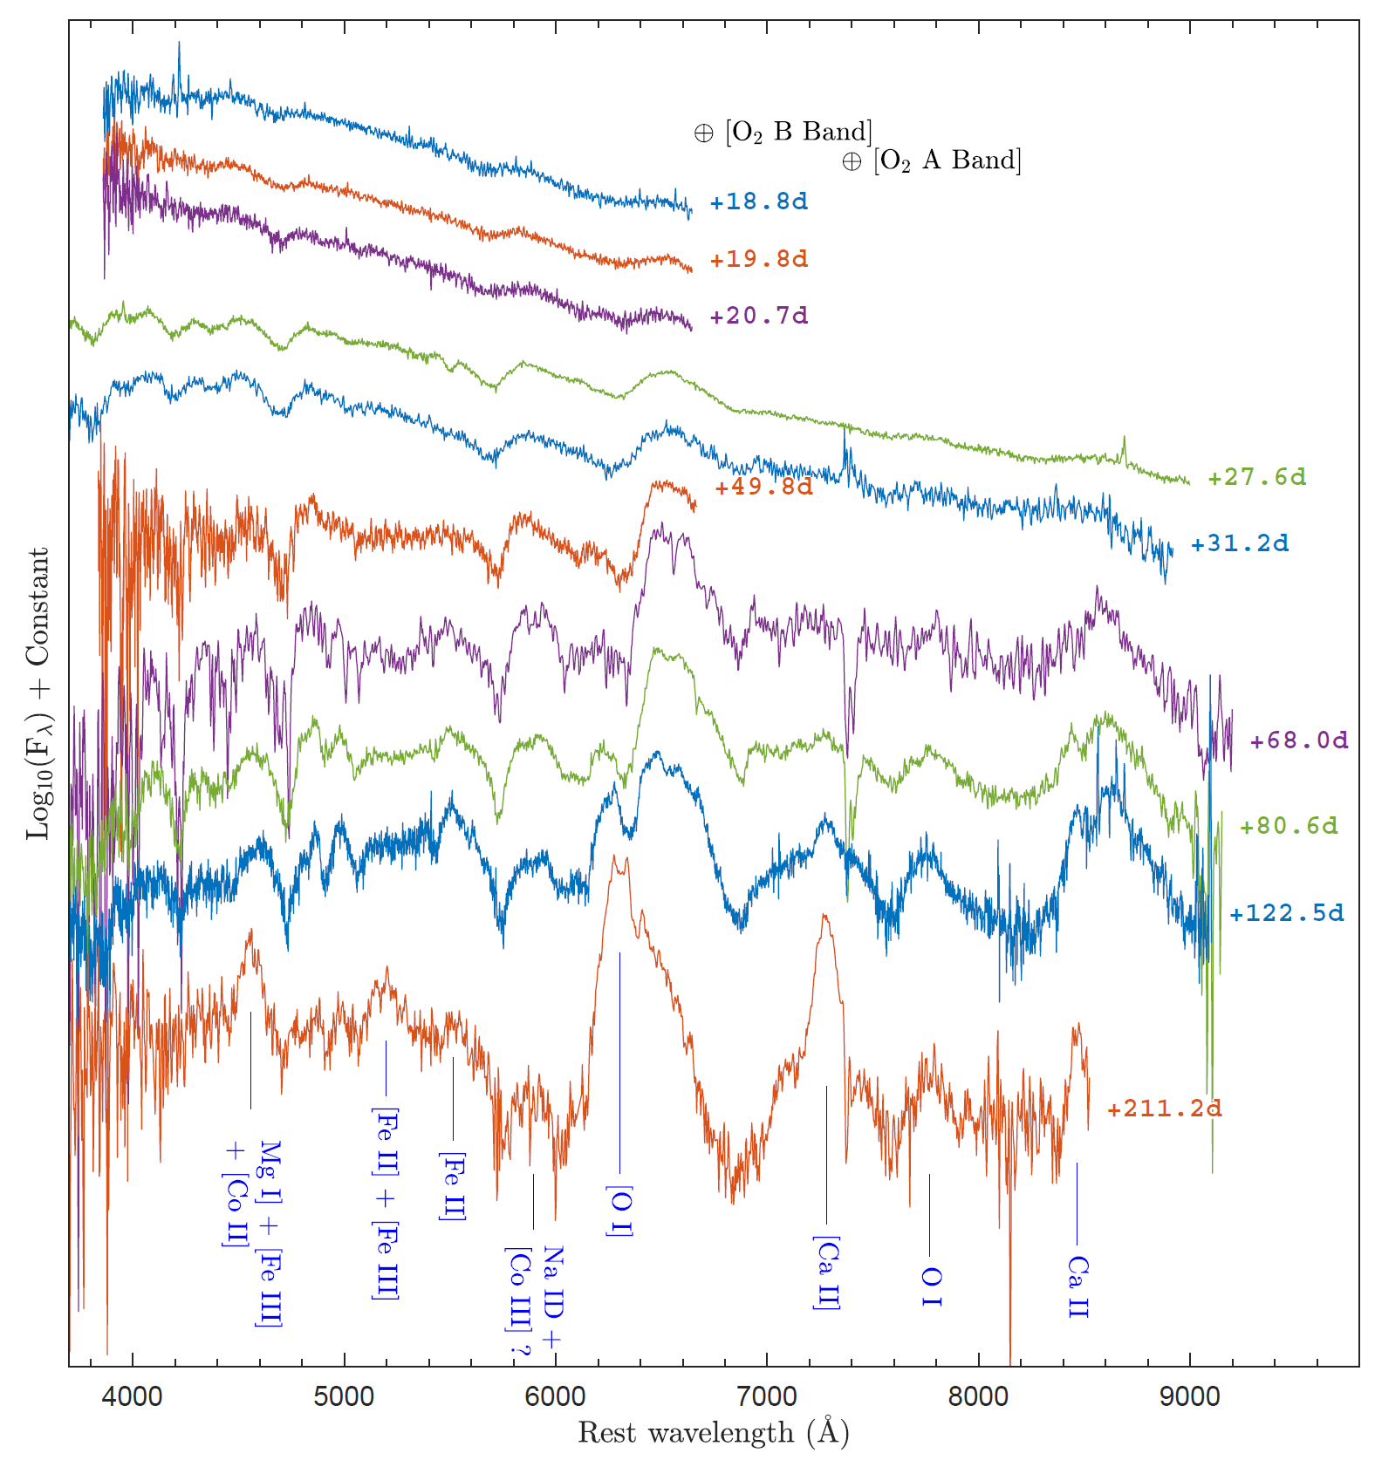
ASASSN-18am : Spectra
Line profiles develop after ~19 days
Earliest $Hα$ velocity $\sim 17,000 km/s$
Peculiar $Hα$ profile
Unusually strong nebular $[O I]$ line
Prominent FeII group nebular lines.

Slide 8
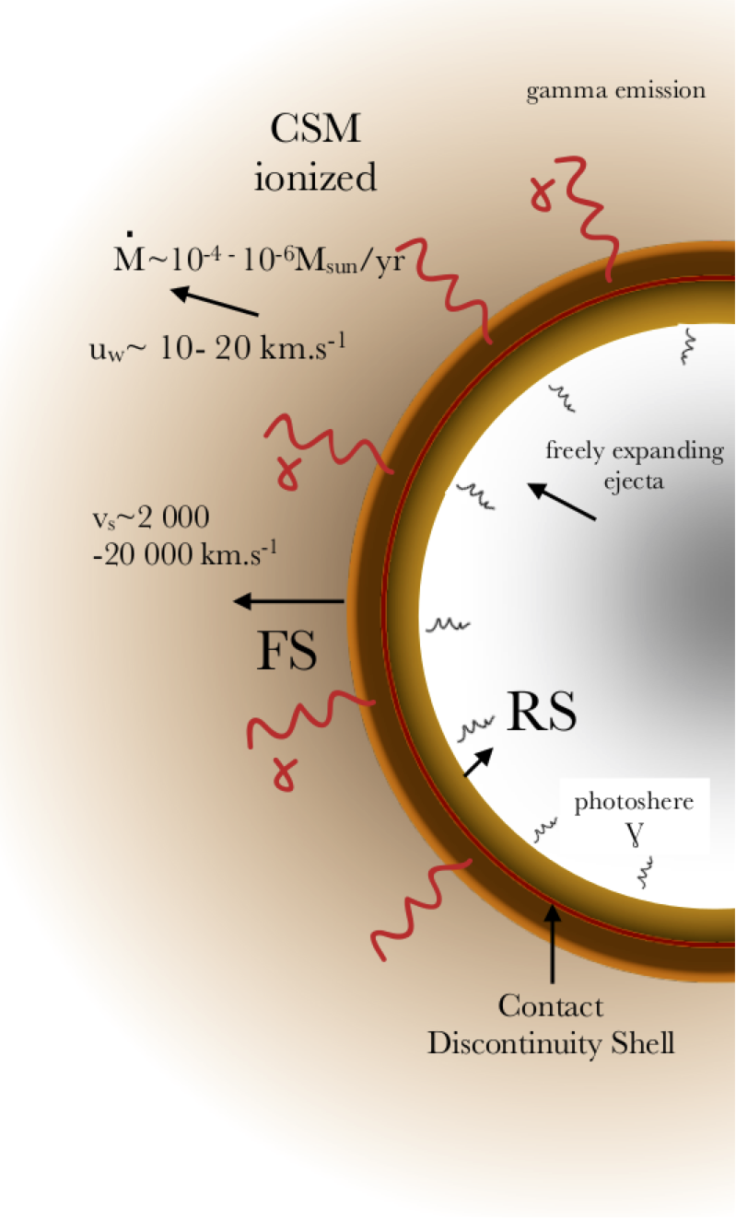
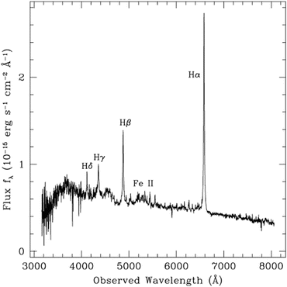
Alternate Power inputs
Circumstellar Interactions
https://www.mpi-hd.mpg.de/

Slide 9
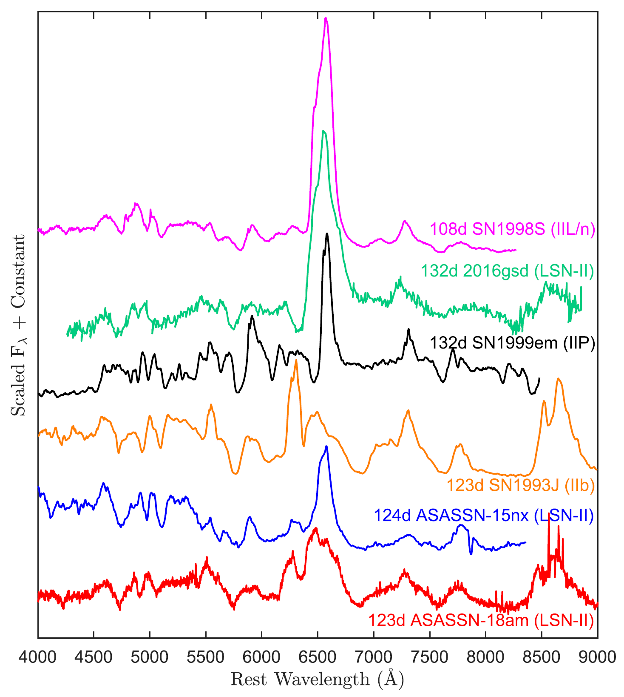
Spectra
No Interaction signatures
Weak HI lines
LSNe

Slide 10
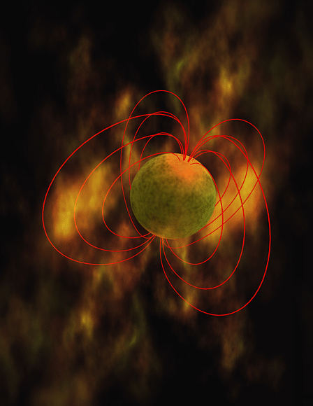
Alternate Power inputs
Circumstellar Interactions
Magnetar Spindown
$$B \sim {10}^{15} Gauss ;P \sim <10 ms$$

Slide 11
Alternate Power inputs
Circumstellar Interactions
Magnetar Spindown
Large synthesized ⁵⁶Ni mass
$${}_{}^{56}{Ni→{}_{}^{56}{Co}→{}_{}^{56}{Fe}}$$
$τ=8.8$ days; $Q=1.75 MeV$
$τ=111.3$ days; $Q=3.61 MeV$
${kin}_{pos}=0.21 MeV$
$$L\left(t\right)=M_{Ni}\left[ε_{Ni} e^{−t/τ_{Ni}} + ε_{Co}\left\{e^{−t/τ_{Co}} −e^{−t/τ_{Ni}}\right\}\right]$$
$${}_{}^{56}{Ni}⟹{}_{}^{56}{Co}+γ+ν_{e}$$
$${}_{}^{56}{Co}⟹\left\{\begin{aligned}{}_{}^{56}{Fe}+γ+ν_{e} \\ {}_{}^{56}{Fe}+e^{+}+γ+ν_{e}\end{aligned}\right.$$

Slide 12
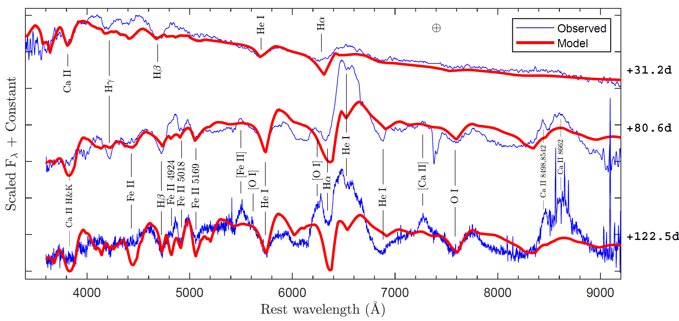
ASASSN-18am : Line ID
Presence of Helium $→$ SN IIb

Slide 13
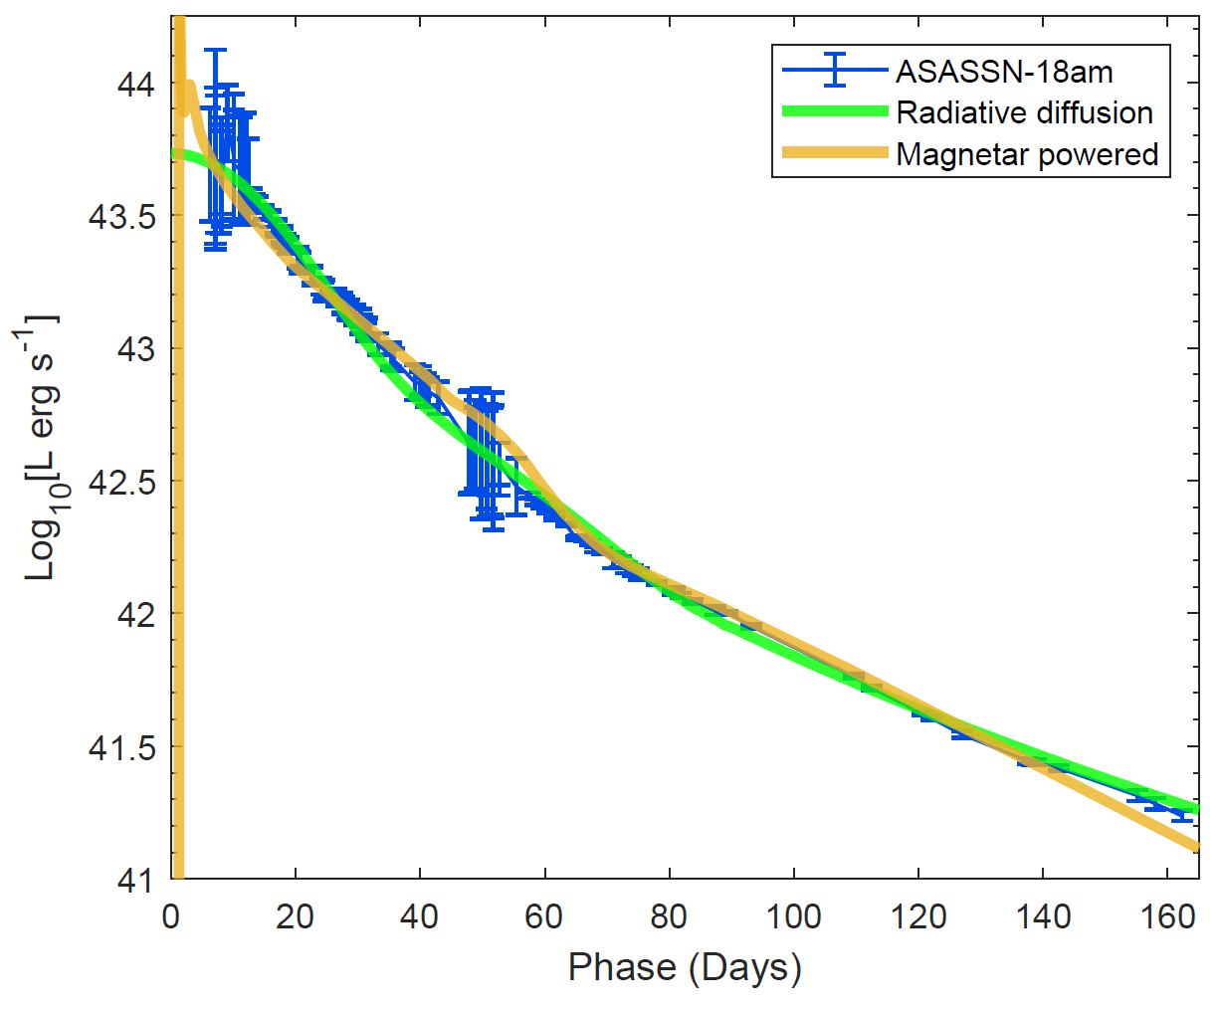
Powering Mechanisms
⁵⁶Ni powered – Radiative diffusion model
High $M_{Ni}>0.4 M_{⊙}$
$t_{0}=\sim 65 d$
Small $M_{ej}≈3−4 M_{⊙}$
$M_{Ni}>0.2 M_{⊙}$ can not be produced by neutrino driven explosion models!!
(e.g., Sukhbold et al. 2016; Ertl et al. 2020)

Slide 14
Powering Mechanisms
⁵⁶Ni powered – Radiative diffusion model
High $M_{Ni}>0.4 M_{⊙}$
$t_{0}=\sim 65 d$
Small $M_{ej}≈3−4 M_{⊙}$
Magnetar model
$B≈4×{10}^{15}$gauss
Period $≈1.2$ ms
$M_{Ni}=\sim 0.3 M_{⊙}$
$M_{ej}≈2 M_{⊙}$
$M_{Ni}>0.2 M_{⊙}$ can not be produced by neutrino driven explosion models!!
(e.g., Sukhbold et al. 2016; Ertl et al. 2020)

Slide 15
Powering Mechanisms
CSM interaction
Can a contrived interaction scenario still exist?
ASASSN-18am is the best case for probing CSM
From Flash ionized spectrum : $\dot{M}=2×{10}^{−4} M_{⊙}/yr$

Slide 16
Powering Mechanisms
CSM interaction
Can a contrived interaction scenario still exist?
ASASSN-18am is the best case for probing CSM
From FI spectrum : $\dot{M}=2×{10}^{−4} M_{⊙}/yr$
X-ray $∼5×{10}^{41}$ ergs/s only during 11 – 14 days, non detection afterwards
These are higher than RSGs for SNe IIP/L
Lower than interacting (IIn) SNe.
Above CSM is weak to explain the luminous LC of ${10}^{44}$erg/s

Slide 17
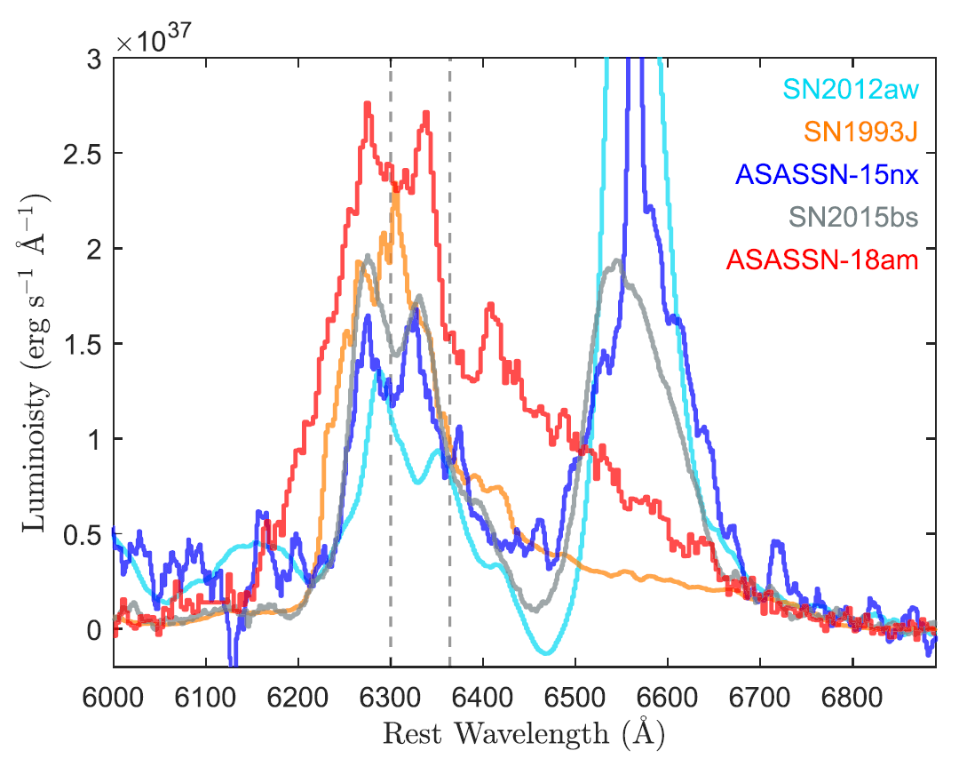
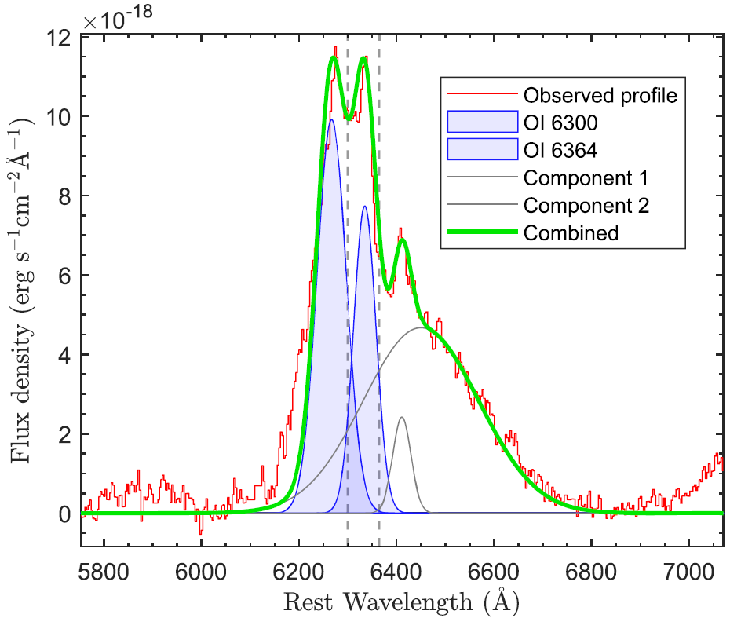
ASASSN-18am – A massive progenitor
Bose et al. 2018b
Missing high mass ($>18M_{⊙}$) SNe II progenitor is a long standing problem in SNe physics.
Oxygen core mass $M_{O}=1.7−3.1 M_{⊙}$
[OI]
10m GTC
+211d

Slide 18
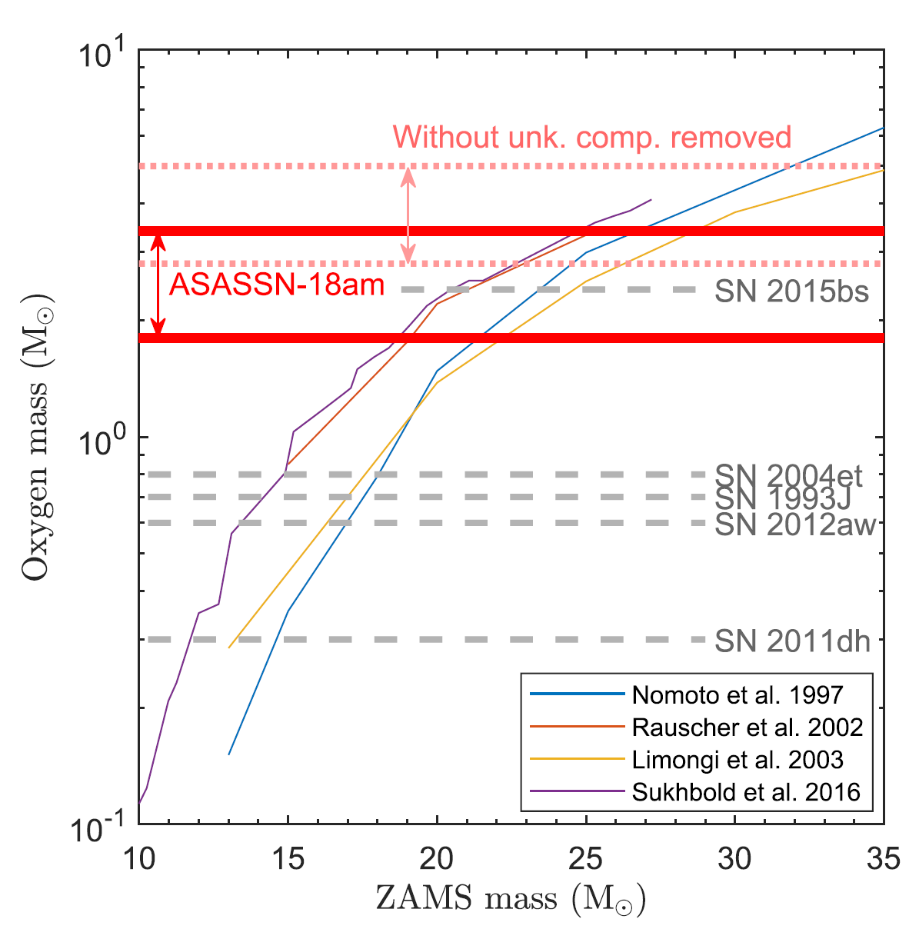
ASASSN-18am – A massive progenitor
Oxygen core mass $M_{O}=1.7−3.1 M_{⊙}$
We found one of the most massive progenitor $\sim 19−26 M_{⊙}$
A possible clue to missing high mass progenitor problem.

Slide 19
Features in common
Luminosity: About 10 times luminous than normal SNe (intrinsically)
Rare : $\sim 30/Gpc^{3}/yr$ – comparable to SLSNe ; only 5 we know
Powering source: Neutrino driven explosion + radiative diffusion models are insufficient
Light curves: Short rise-to-peak time ; followed by a Steep decline
Spectra: Weak HI lines compared to normal SNe II, but stronger than Iib
Progenitors: Possibly massive progenitor ??
Future
We need more such objects – LSST will help finding more
Need detailed multiband follow-up
Early as well as Nebular spectra are essential.
Thank You

