Slide 1
Short timescale radio variability in black hole and neutron star X-ray binary jets
Eli Pattie (Texas Tech, graduate student)
Tom Maccarone (Texas Tech)
Alex Tetarenko (Texas Tech, Einstein Fellow)

Slide 2
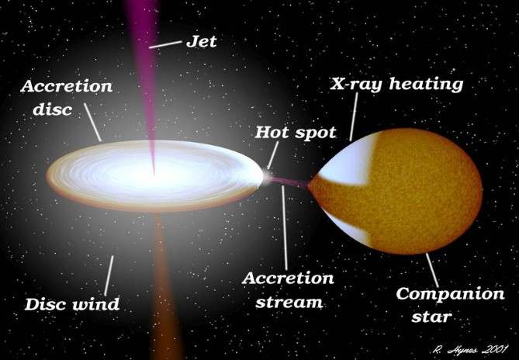
X-ray Binaries (XRBs)
Black hole (BH) or neutron star (NS) accreting matter from a companion
Accretion disk: optical/infrared
Inner accretion disk: X-rays
Jets: Sub-mm to radio
mildly or highly relativistic
Robert Hynes

Slide 3
Jets (the compact, steady kind)
Model: Blandford-Königl (1979); conical, synchrotron self-absorbed radiation
Fed by inner accretion disk, collimated and accelerated by magnetic fields
Internal shocks (Malzac 2014)
Lower frequencies target segments further from accretor (see below)
Strength of variability decreases with lower frequencies
Adapted from Chris Done

Slide 4
Jet production mechanisms

Slide 5
Jet production mechanisms
Black holes: Blandford-Znajek: Magnetic fields are dragged and twisted by BH spin
Depends on magnetic field ($∝B^{2}$) and spin ($∝α^{2}$)
Blandford-Znajek

Slide 6
Jet production mechanisms
Black holes: Blandford-Znajek: Magnetic fields are dragged and twisted by BH spin
Depends on magnetic field ($∝B^{2}$) and spin ($∝α^{2}$)
Neutron stars: produce own magnetic fields and rotate
Depends on magnetic field (10⁸⁻¹³ G) and spin (~10ms to 100s sec.) of NS
Blandford-Znajek
Neutron Star

Slide 7
Jet production mechanisms
Black holes: Blandford-Znajek: Magnetic fields are dragged and twisted by BH spin
Depends on magnetic field ($∝B^{2}$) and spin ($∝α^{2}$)
Neutron stars: produce own magnetic fields and rotate
Depends on magnetic field (10⁸⁻¹³ G) and spin (~10ms to 100s sec.) of NS
Blandford-Payne: Accretion disk rotation and magnetic field
Depends on B_{z} and B_{φ} of disk, rotation Ω, and jet launch radius R_{j}
Blandford-Payne
Blandford-Znajek
Neutron Star

Slide 8
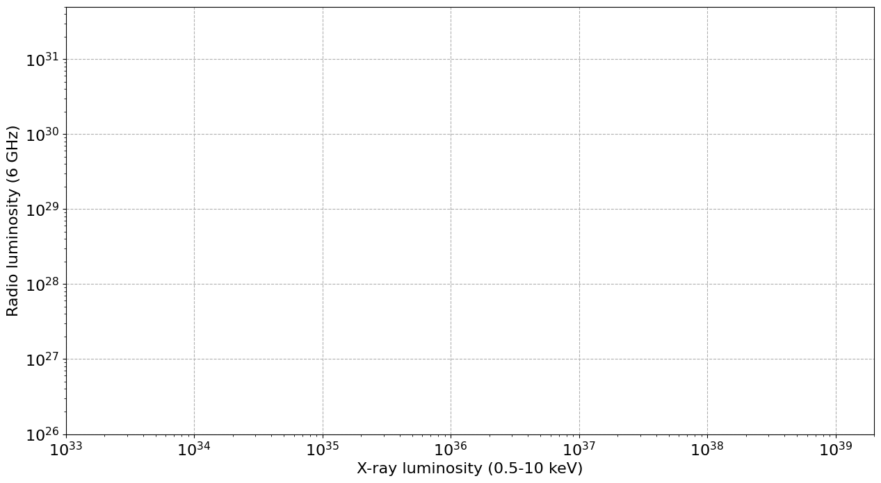
The Fundamental Plane: (L_{R}/L_{X})
Note that:
Overall, comparable L_{x}
2 BHXB tracks
Large range in L_{R} for NSXBs
NSXBs usually fainter in radio than BHXBs

Slide 9
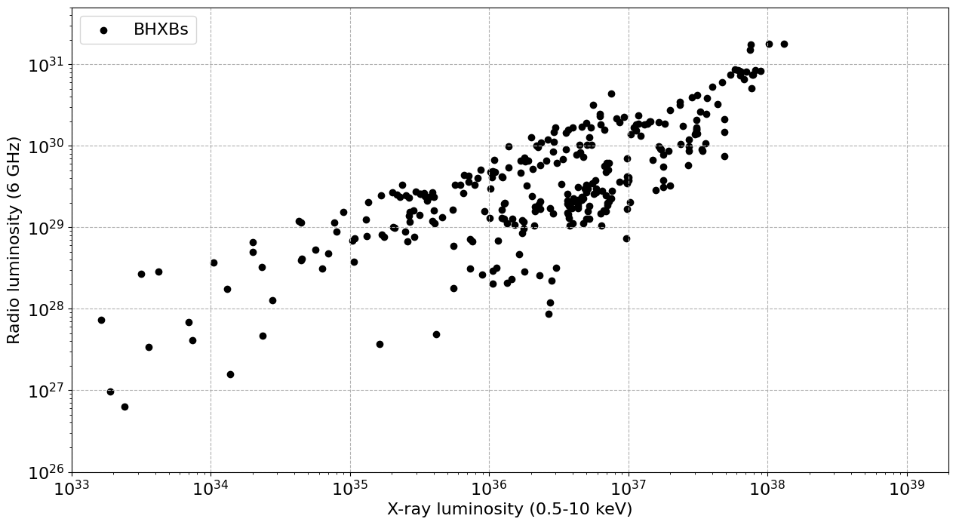
The Fundamental Plane: (L_{R}/L_{X})
Note that:
Overall, comparable L_{x}
2 BHXB tracks
Large range in L_{R} for NSXBs
NSXBs usually fainter in radio than BHXBs

Slide 10
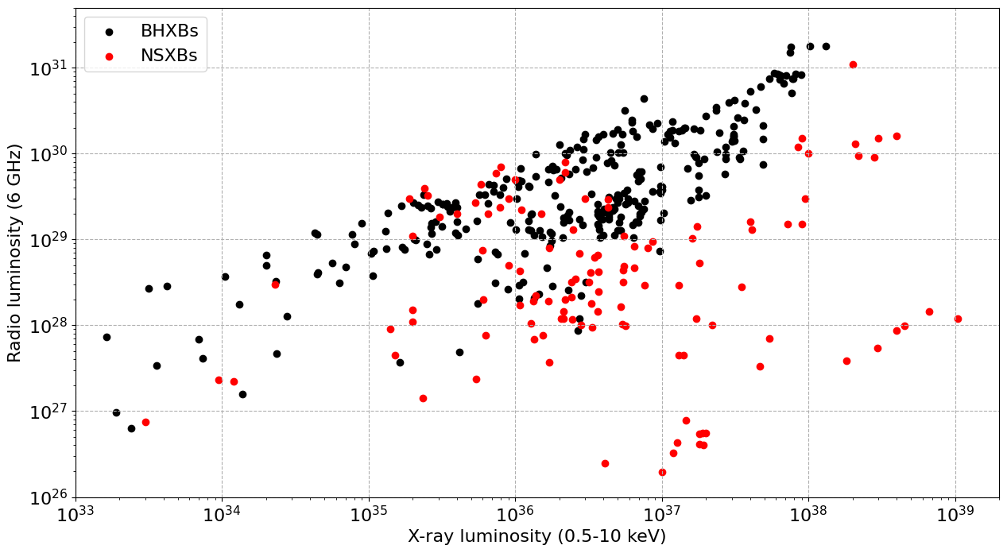
The Fundamental Plane: (L_{R}/L_{X})
Note that:
Overall, comparable L_{x}
2 BHXB tracks
Large range in L_{R} for NSXBs
NSXBs usually fainter in radio than BHXBs

Slide 11
The Fundamental Plane: (L_{R}/L_{X})
Overall, comparable L_{x}
2 BHXB tracks?
Large range in L_{R} for NSXBs
NSXBs usually fainter in radio than BHXBs
Still plenty left to explain

Slide 12
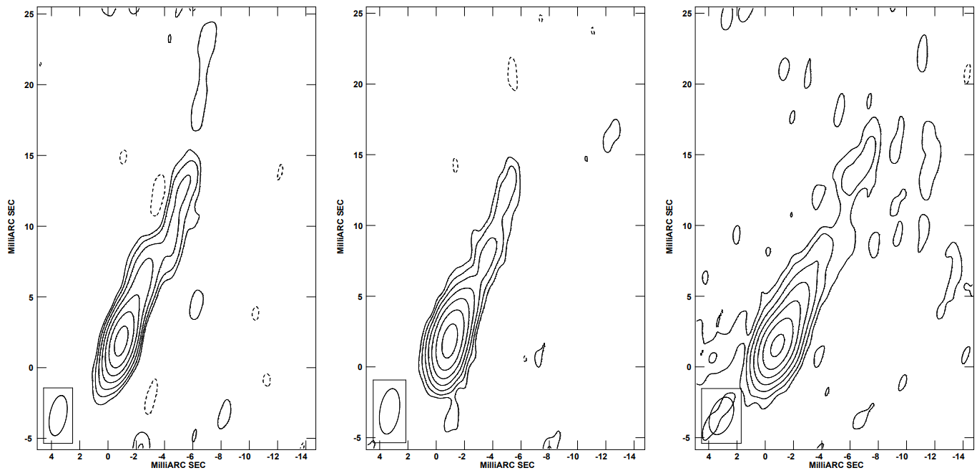
Unfortunately, jets are difficult to image
Some systems have been partially resolved with VLBI
VLBI cannot resolve transverse dimensions, nor opening angles
BHXB Cyg X-1
Stirling et al. 2001

Slide 13
Short timescale radio variability
Short timescales: probe the limit of variability behavior
Potential dependencies on jet speeds, opening angles, feeding/launching
Use indirect methods, like timing analyses
Multiwavelength timing analyses have been very successful for BHXBs before
Try comparing many XRBs to search to systematic differences
Focus on BH vs NS – how different or similar are they?

Slide 14
Outline of the (ongoing) project
Scour VLA and ALMA archives for observations of XRBs
Gather the good, usable data
Target is bright enough and observation duration is not too short
Produce light curves
Run power spectra and other time-domain analyses on light curves
Assemble power spectra and analyze
But keep in mind that different frequencies have different intrinsic variability

Slide 16
● Black holes ●
<50 GHz
50-150 GHz
>150 GHz
∎ Neutron stars ∎
<50 GHz
50-150 GHz
>150 GHz

Slide 17
● Black holes ●
<50 GHz
50-150 GHz
>150 GHz
∎ Neutron stars ∎
<50 GHz
50-150 GHz
>150 GHz
NSXB jets do show similar short timescale variability to BHXB jets, despite usually being less luminous and possibly utilizing a different jet launching mechanism

Slide 18
● Black holes ●
<50 GHz
50-150 GHz
>150 GHz
∎ Neutron stars ∎
<50 GHz
50-150 GHz
>150 GHz
NSXB jets do show similar short timescale variability to BHXB jets, despite usually being less luminous and possibly utilizing a different jet launching mechanism

Slide 19
Jet behaviors depend on accretion state
Essentially: high rate or low rate of accretion
Compact, steady jets at low accretion rate
Transient/discrete ejecta jets at high accretion rate
There are a few observations of jets that are discrete ejecta/high accretion regime

Slide 20
Jet behaviors depend on accretion state
Time increasing →
Essentially: high rate or low rate of accretion
Compact, steady jets at low accretion rate
Transient/discrete ejecta jets at high accretion rate
There are a few observations of jets that are discrete ejecta/high accretion regime
Where are these jets on the PSD?
GRS 1915+105
Fender et al. 1998

Slide 21
● Black holes ●
<50 GHz
50-150 GHz
>150 GHz
∎ Neutron stars ∎
<50 GHz
50-150 GHz
>150 GHz
Discrete ejecta

Slide 22
Known BH ejecta jets show very low levels of variability, even at high frequencies.
Jet variability depends on the accretion regime.
● Black holes ●
<50 GHz
50-150 GHz
>150 GHz
∎ Neutron stars ∎
<50 GHz
50-150 GHz
>150 GHz
Discrete ejecta

Slide 23
Known BH ejecta jets show very low levels of variability, even at high frequencies.
Jet variability depends on the accretion regime.
● Black holes ●
<50 GHz
50-150 GHz
>150 GHz
∎ Neutron stars ∎
<50 GHz
50-150 GHz
>150 GHz
Discrete ejecta

Slide 24
This NSXB
● Black holes ●
<50 GHz
50-150 GHz
>150 GHz
∎ Neutron stars ∎
<50 GHz
50-150 GHz
>150 GHz
Discrete ejecta

Slide 25
Interestingly, Sco X-1
Persistently accreting NSXB
Always accreting at a very high rate ($≳1$ L_{Edd})
Has had discrete ejecta resolved in imaging
And yet, also seems to be able to produce a compact jet?
Currently very few observations available to study, but:
Persistent highly accreting NSXB jets could have interesting properties and evolution patterns compared to typical BHXBs

Slide 26
The Future
Summary
First evidence that NSXBs have short timescale variability like BHXBs
High accretion jets have lower variability than low accretion, compact jets
Persistent high accretion NSXB jets: unclear as to the exact structure
In short, more data
Observations meant for time domain analyses
Particularly:
NSXBs: there just are not much high quality data out there right now
Further investigate the dependencies of radio emission properties on accretion regimes

Slide 27
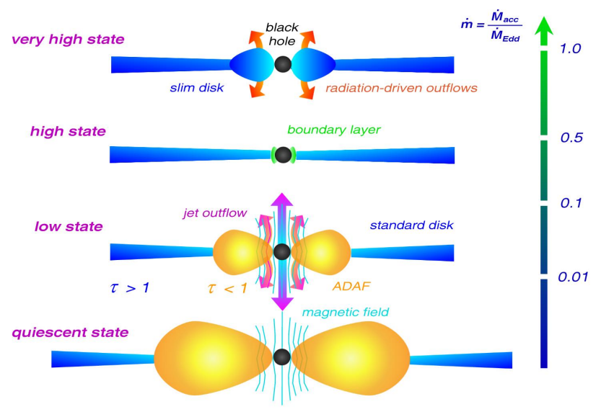
Müller 2004

