Slide 1
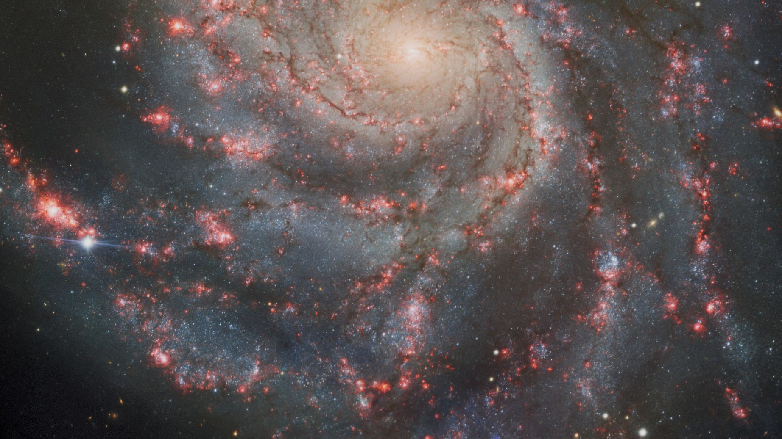
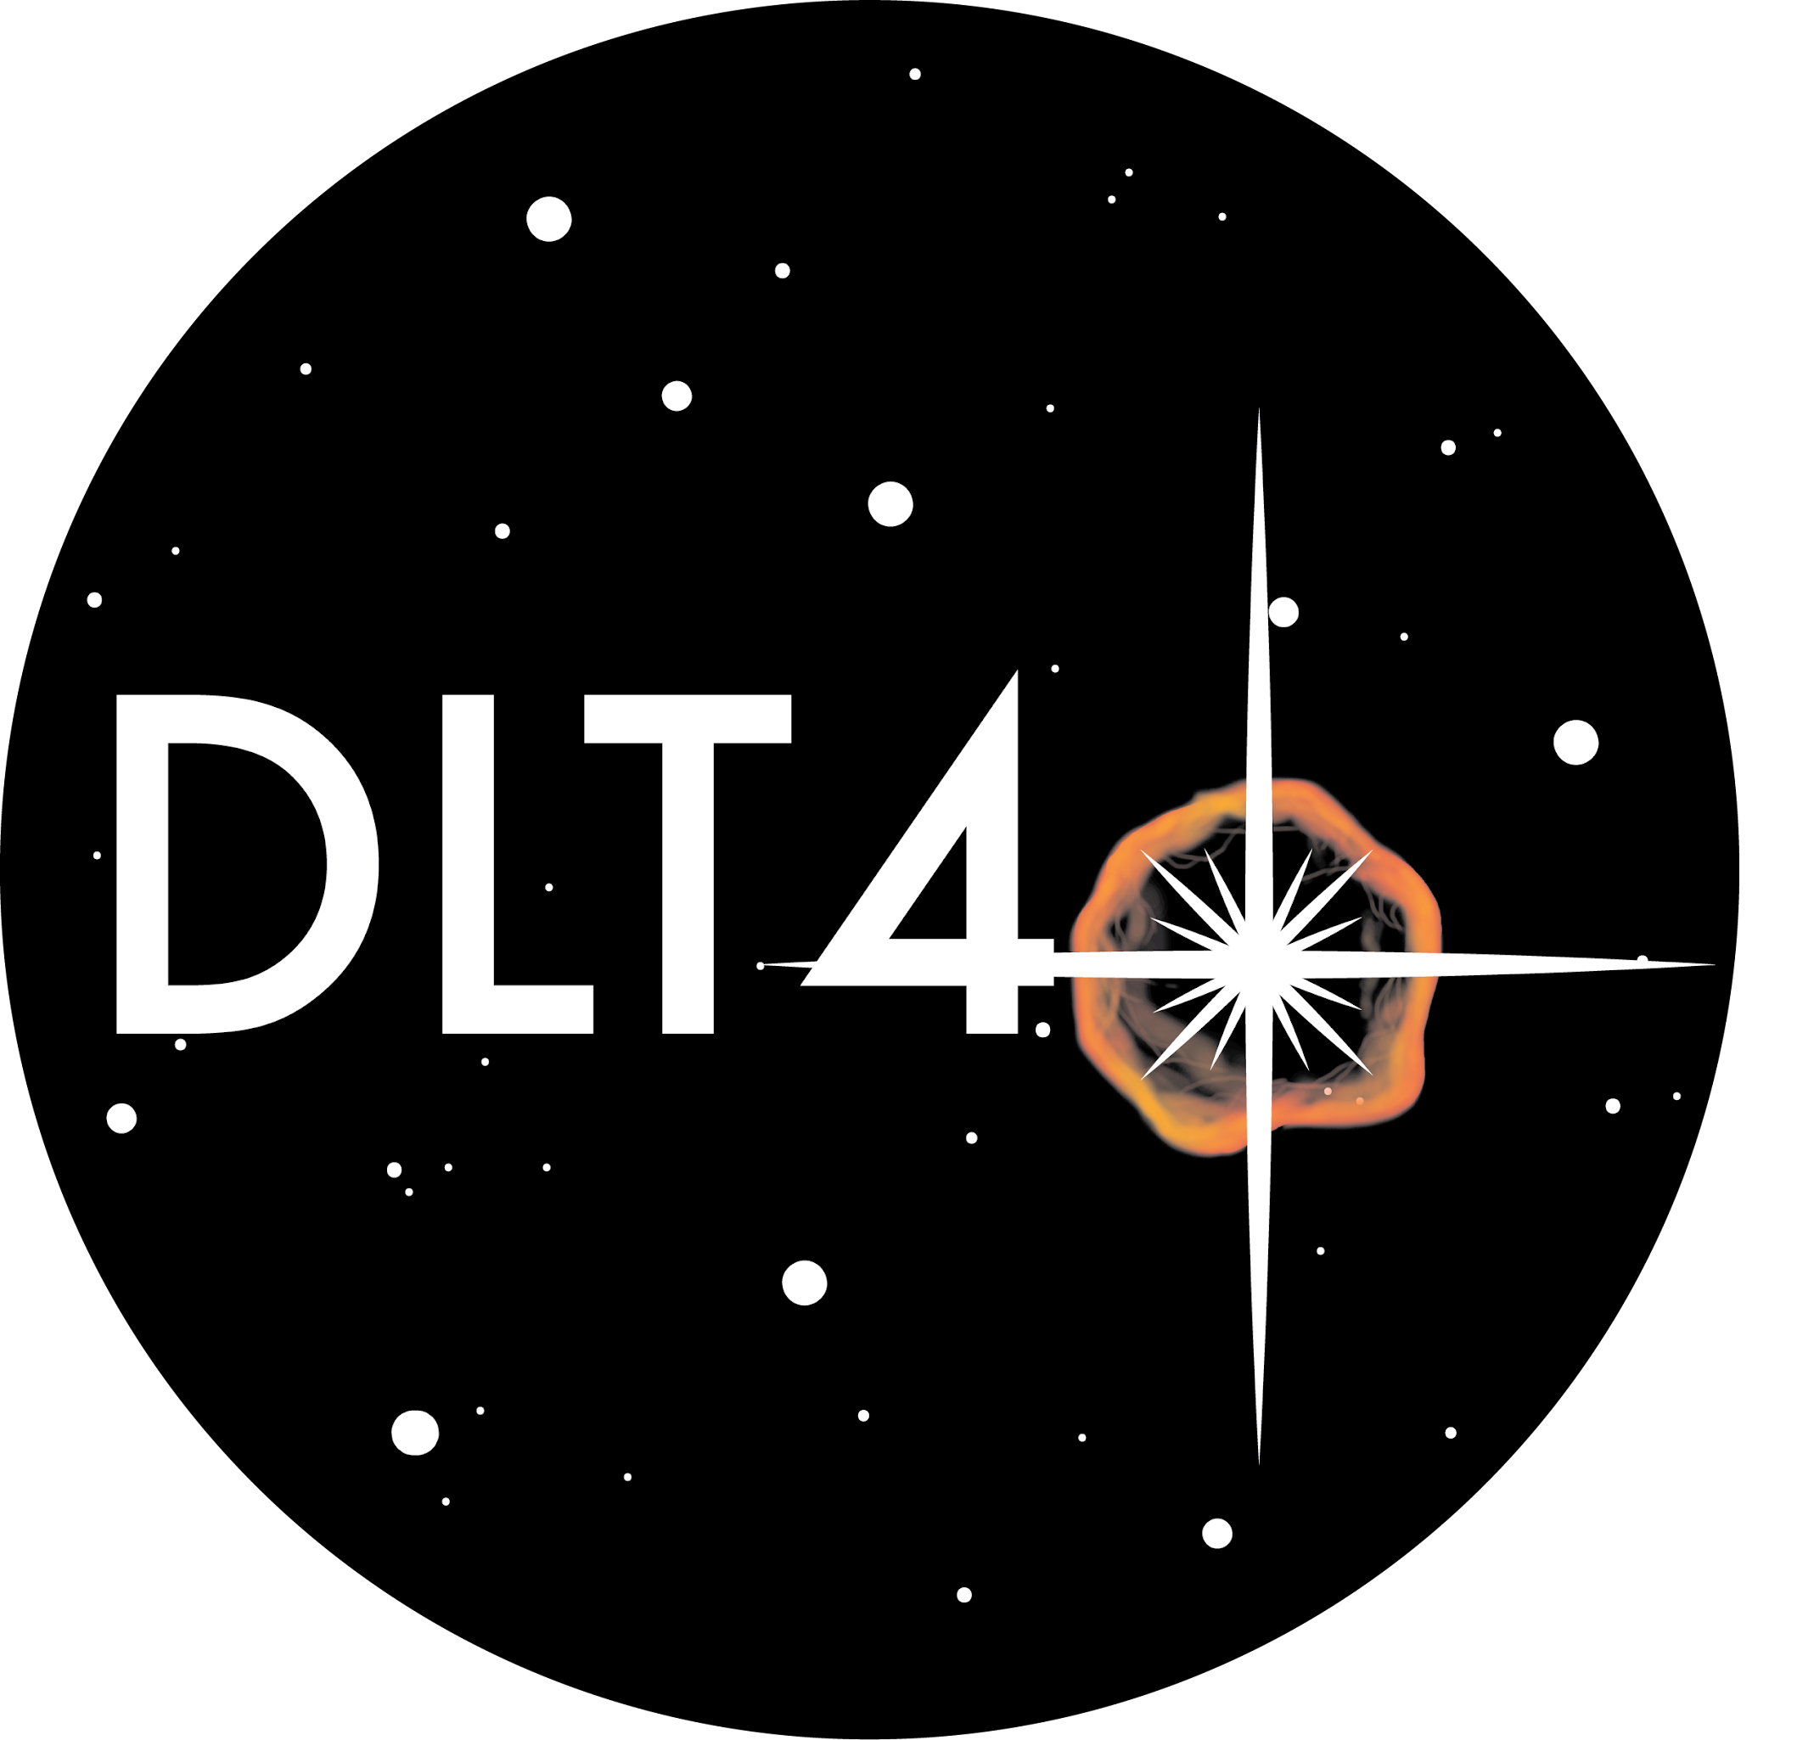
Background: International Gemini Observatory/NOIRLab/NSF/AURA
Observing the Youngest Supernovae in the Nearby Universe
Jeniveve Pearson
University of Arizona
In collaboration with: David Sand, Griffin Hosseinzadeh, K. Azalee Bostroem, Manisha Shrestha, Stefano Valenti, Yize Dong, Nicolas Meza Retamal, Emily Hoang, Darshana Mehta, Jennifer Andrews, and Daryl Janzen
The Transient and Variable Universe 2023 - June 20th 2023
jenivevepearson@arizona.edu

Slide 2
~20,000 transients are reported each year
~2,000 are spectroscopically classified as SNe
<10% of all SNe each year have both spectroscopic and photometric datasets
Notes:
These numbers are from TNS, the top contributors to this numbers are the groups you would expect Pan-STARRS, ZTF, ALeRCE, Gaia, ATLAS, ASAS-SN. Massive surveys which focus on surveying the entire sky as often as possible. These surveys have been massive contributors to the significant increase in the rate at which we detect transients, and even classify them.
Only about 10% of transients are classified as supernova and less than 10% of those classified objects have multiple epochs of photometric and spectroscopic follow-up.

Slide 3
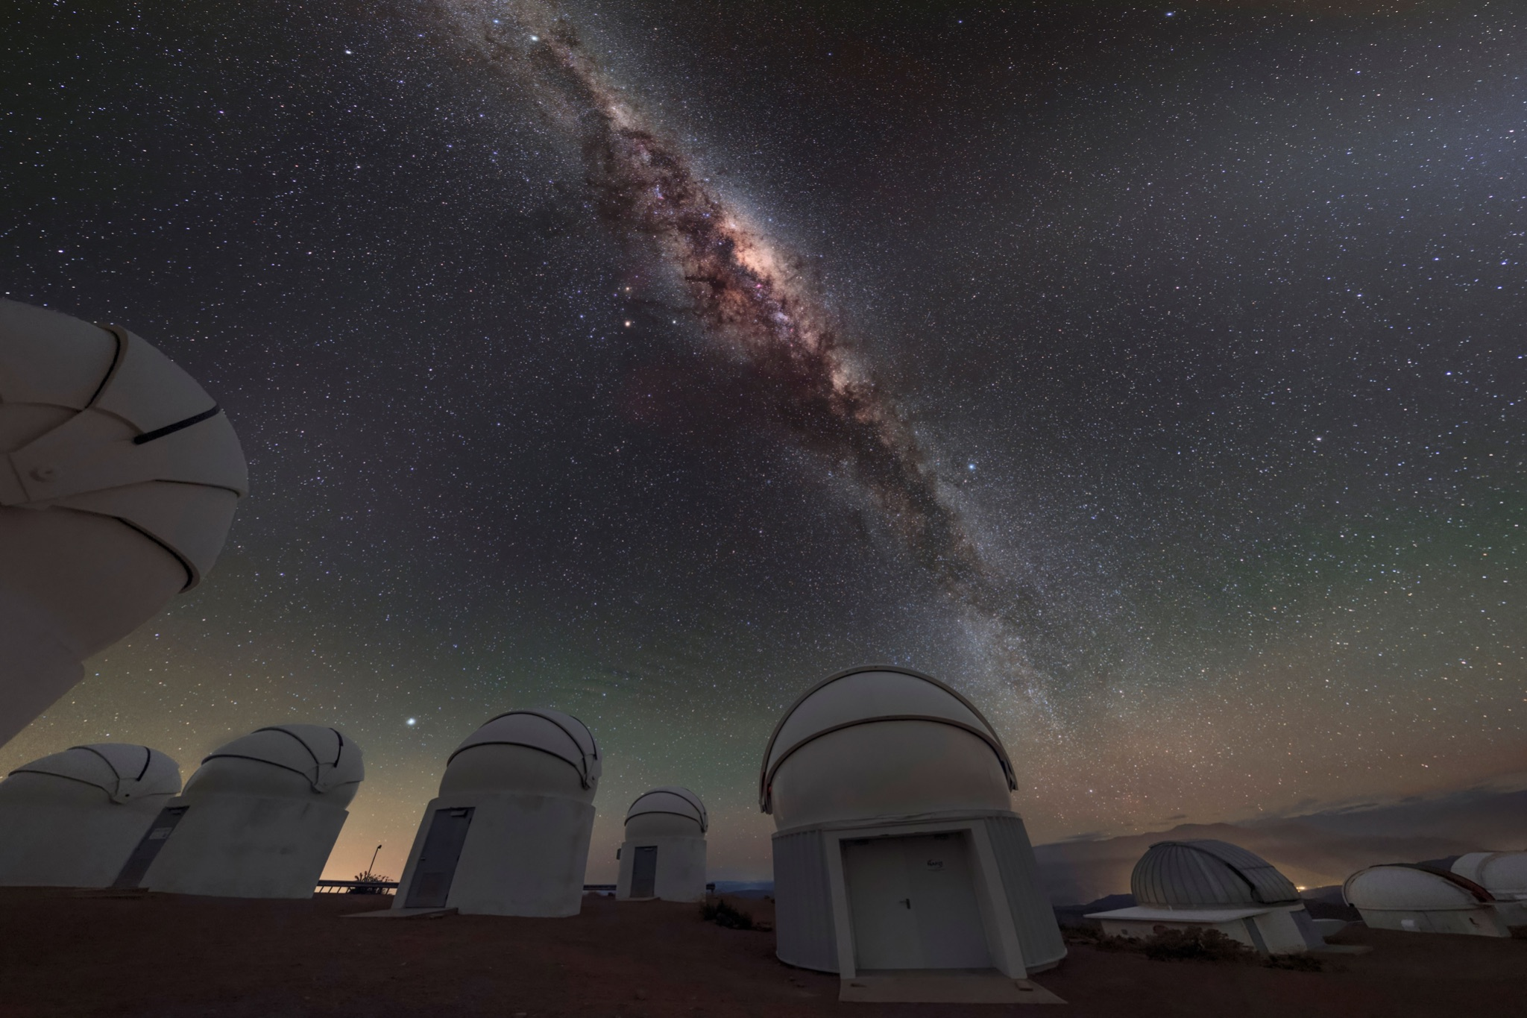
The Distance Less than 40 Mpc (DLT40) SN Survey
DLT40 is a collaboration between University of Arizona and UC Davis
Follow/discover ~10 SNe per year
Focus on complete follow-up of transient events in nearby galaxies (d<40 Mpc)
Immediate focused photometric and spectroscopic follow-up
Worldwide network of Prompt 0.4m telescopes
Chile, Canada, and Australia
2-3 images of each target field each night
Open filter calibrated to r band
New multiband photometry (UBVgri) capabilities (see Hosseinzadeh et al. 2023b and Bostroem et al. 2023a)

Slide 4
Catching Supernovae at Infancy
Discovery of SN 2022xkq
Machine learning + visual inspection
If transient near a target galaxy is reported on TNS:
Automated hourly email to all DLT40 members
Allows for rapid follow-up of transients within 40 Mpc even if they are not a DLT40 discovery
2022-10-12 06:06:23
2022-10-13 06:43:35
Image
Template
Difference
Notes:
Since 2017, of the 92 SNe that have DLT40 names, 34.7% of those were observed by DLT40 within 24 hours
DLT40 also grabs 47% within 48 hours

Slide 5
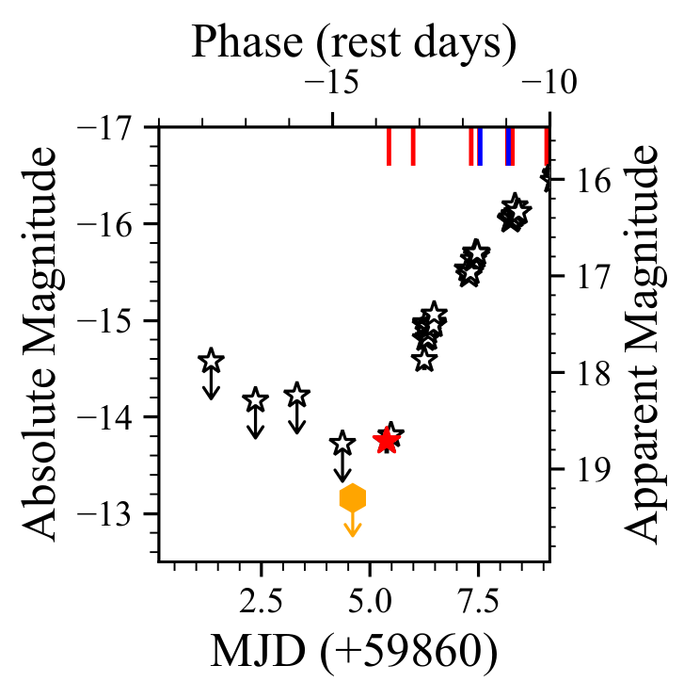
Enabling Rapid Follow-up
DLT40 observes 35% of followed supernovae within 24 hours of explosion
Immediate photometric data
Robotic telescopes allow for photometry within minutes
Rapid spectroscopic mobilization
MMT API (Shrestha et al in prep.)
Gemini
Las Cumbres Observatory
SN 2022xkq
Pearson et al. (in prep)
Notes:
Since 2017, of the 92 SNe that have DLT40 names, 34.7% of those were observed by DLT40 within 24 hours
DLT40 also grabs 47% within 48 hours

Slide 6
Why Observe Newborn Supernovae?

Slide 7
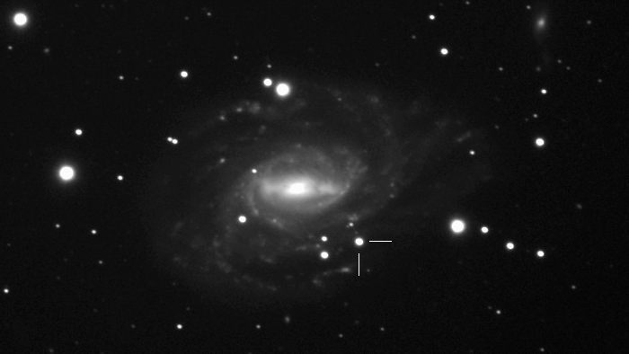
Type Ia Supernovae
DLT40 Supernovae
SN 2022xkq
Image credit: Grzegorz Duszanowicz

Slide 8
Early Spectra:
Carbon Features
Optical and near-IR Carbon features
near-IR: Visible ~weeks after explosion
Optical: fades within a few days
Carbon features trace unburnt carbon
Helps differentiate the explosion mechanism
Pearson et al. (in prep)

Slide 9
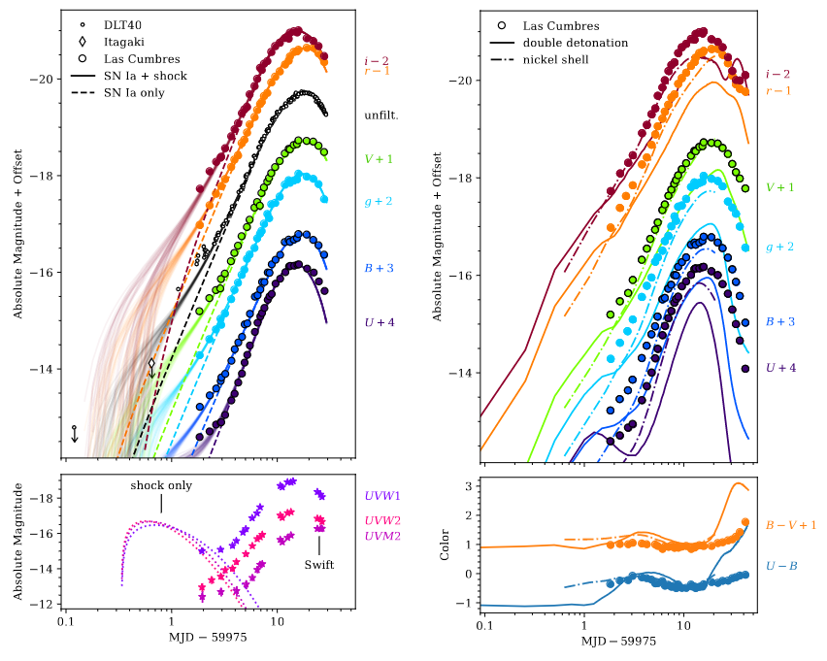
Early SN Ia Light Curves
SN 2023bee
Blue Bumps and Red Excesses
Visible in the first few days following explosion
Primarily seen in blue, but also visible in red
Companion shocking
Rising Slope
First few days of light curve can distinguish between explosion models
Hosseinzadeh et al. 2023b
Notes:
Companion shocking - supernova ejecta hits a nondegenerate companion resulting in blue excess

Slide 10
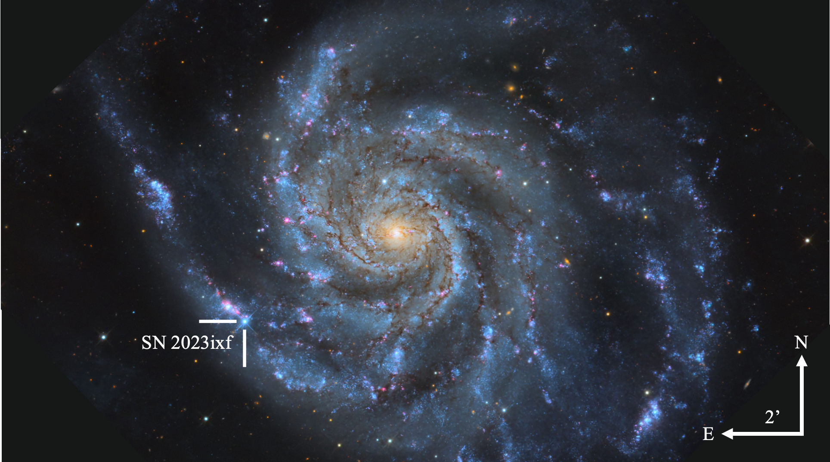
Core-collapse Supernovae
Image credit: Travis Deyoe, Mount Lemmon
SkyCenter, University of Arizona

Slide 11
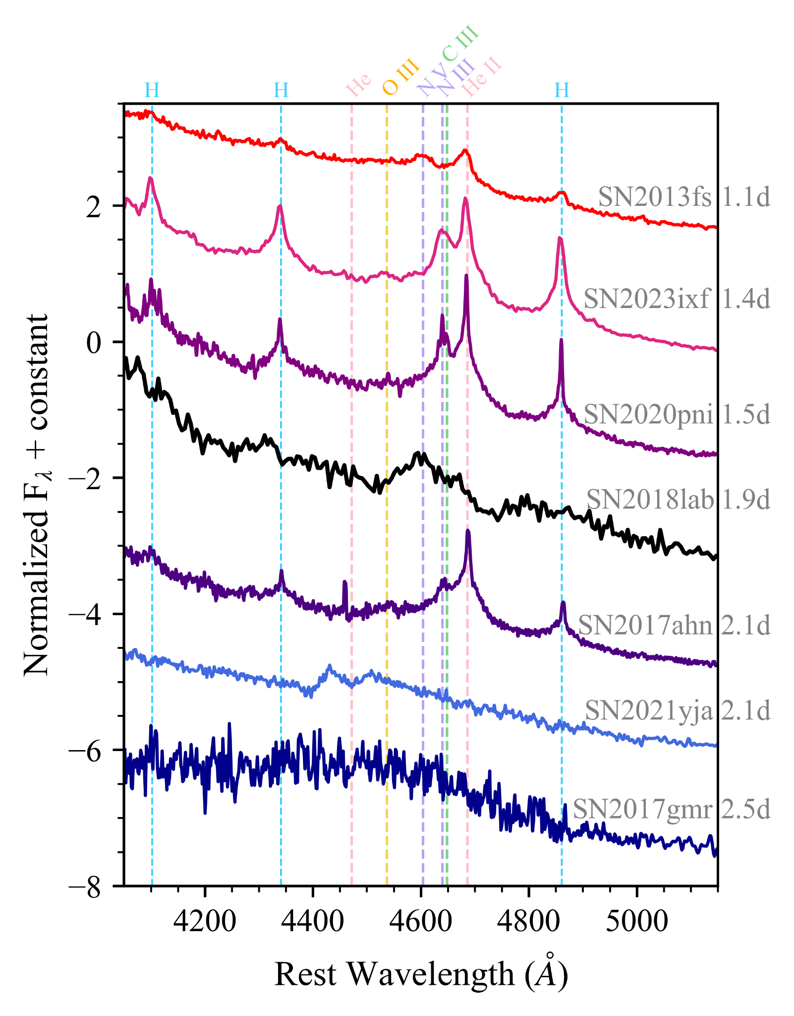
Early Spectra: Flash Features
Bostroem et al. on arxiv
≲5 days after collapse
Production:
Recombination of the CSM ionized by the shock-breakout flash
Ejecta–CSM interaction before the CSM is swept up
Morphology:
Narrow flash features:
Noncoherent scattering of thermal electrons
Broad flash features:
Bulk motions produce broad lines which blend together
Can indicate the composition, density, and velocity of the CSM surrounding the progenitor
Broader features -> lower density CSM

Slide 12
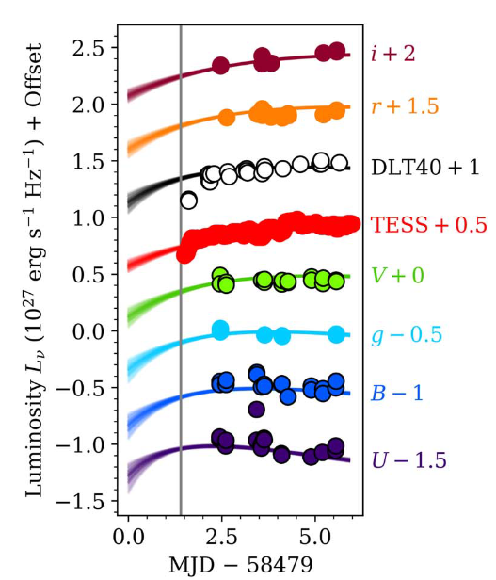
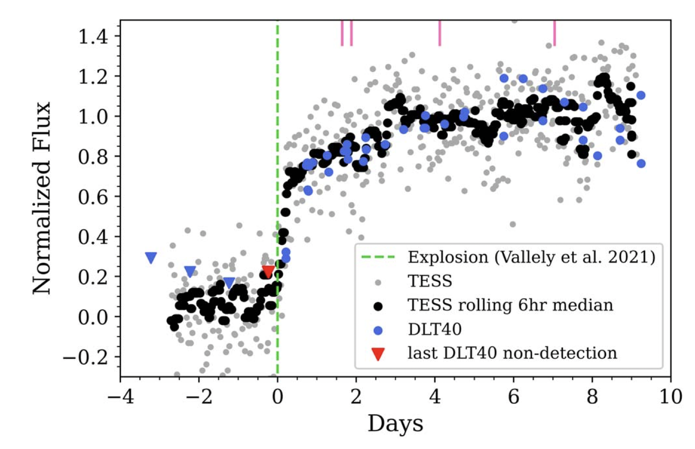
The Rising Light Curve
SN 2018lab
Fast rise and/or bump
Visible in first week
Often ≲2 days
Result of dense CSM
Shock breakout occurs within the CSM
Ejecta expands and cools faster in the gradual density gradient of CSM
Limits on the amount and extent of CSM surrounding the progenitor at collapse
Pearson et al. 2023

Slide 13
>500,000 SNe expected each year
In the LSST era:
~2,000 spectroscopically classified
A handful with complete early time datasets that aid in understanding the progenitors and explosions of SNe
That handful will be primarily observed by smaller, focused surveys like DLT40
Notes:
These numbers are from TNS, the top contributors to this numbers are the groups you would expect Pan-STARRS, ZTF, ALeRCE, Gaia, ATLAS, ASAS-SN. Massive surveys which focus on surveying the entire sky as often as possible. These surveys have been massive contributors to the significant increase in the rate at which we detect transients, and even classify them.
Only about 10% of transients are classified as supernova and less than 10% of those classified objects have multiple epochs of photometric and spectroscopic follow-up.

