Slide 1
Moments of Birth
Origins of Type Ia Supernovae informed by the infant phase
Yuan Qi (Chris) Ni
Image: Natas Vol 6 Iss 5
Notes:
Introduce SN 2018aoz importance:
In supernova studies, we often talk about the earliness of a SN, and that
usually refers to how fast we were able to detect the SN’s light from the moment when it first emerges.
In that sense, SN 2018aoz is the earliest Type Ia that has ever been detected.
I’m gonna talk about what we discovered in its earliest signals,
And how it has informed our understanding of how Type Ia SNe explode.

Slide 2
Table of Contents
Part I. Background: The Type Ia SN origin problem
Part II: Infant type Ia SNe from the KMTNet Supernova Program
Part III: Current and future avenues of progress

Slide 3
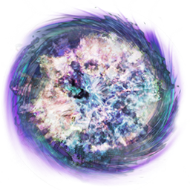
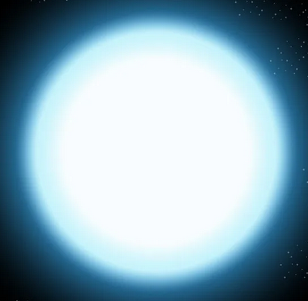
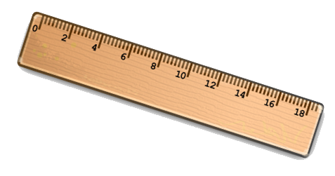
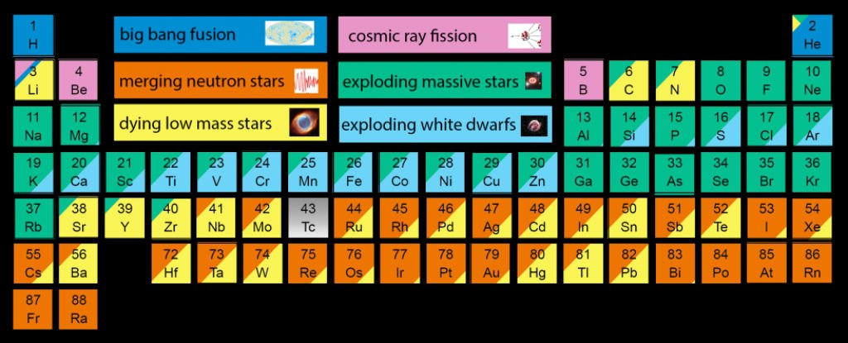
Importance of Type Ia Supernovae?
Seeding the elements
&
Measuring the Universe
Notes:
Type Ia SNe intro
Are the explosions of White Dwarf stars, one of the most important end stages of stellar evolution.
Most of the Fe-group elements in the Universe are produced by them.
They are very bright and common for a standard candle, which is essential for cosmology because you can measure long distances.
Needless to say, they are a very important class of events for astrophysics.

Slide 4
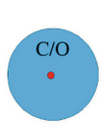
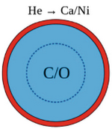
Problem: Type Ia SN origins remain uncertain
C/O WD
Companion
SN
∆M
Star
WD
SD
C/O Ignition Process
DD
Ignited by what?
Ignited where?
C/O -> Ni
Ignition Point
Ignited how?
+
+
Subsonic
Supersonic
Notes:
A C/O WD is usually what produces Type Ia SNe.
Since we wouldn’t expect a static WD to explode, we believe Type Ias must mainly come from binary systems with some mass transfer.
Despite the importance of Type Ia SNe in astrophysics, questions remain about how the explosion is triggered, and what kind of companion is involved.
Companion: either single degenerate or double degenerate.
Soft X-ray surveys for cataclysmic variables favor < 10% single degenerate.
Delay-time distribution also favors double-degenerate.
Nebular search for stripped H favours double-degenerate.
Explosion Process:
Can have density driven or He-shell detonation driven C/O ignition. Governs nucleosynthetic distribution.
Can be C/O ignited in the center or off-center. Governs observable diversity of a single event.
Can be C/O ignited by detonation or deflagration. Governs how mixed the ejecta is.

Slide 5
Double-degenerate double detonation
C/O WD
Companion
SN
∆M
WD
C/O Ignition Process
DD
Ignited by what?
Ignited where?
Ignition Point
Ignited how?
+
Supersonic
Notes:
Double-degenerate double detonation is one scenario

Slide 6
Off-center ignited delayed detonation
C/O WD
Companion
SN
∆M
Star
WD
SD
C/O Ignition Process
DD
Ignited by what?
Ignited where?
C/O -> Ni
Ignition Point
Ignited how?
+
Subsonic
Notes:
Another scenario is the off-center ignited delayed detonation double detonation is one scenario

Slide 7
And how do these relate to subtype diversity?
91T-like
(overluminous)
Peculiar
Core Normal
91bg-like
(subluminous)
Normal
Broad Line
Notes:
Then there’s the question of whether type Ia supernovae come from a single production channel or multiple,
And how that all relates to the observed diversity of different type Ia subclassifications.
There are 4 main subtypes that are classified based on light curve and spectroscopic properties.
And then peculiar events with peculiar properties that probably relate to their origin.

Slide 8
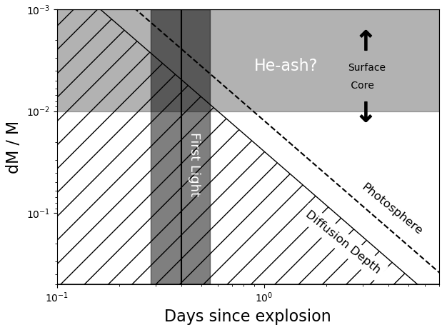
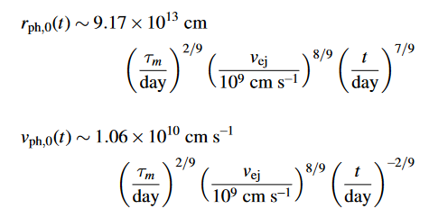
Solution: phase-tomography of the ejecta
Diffusion depth (< ΔM):
Origin of photons
Photosphere (Rph):
Shapes the spectrum
Visible layers of the ejecta at different phases
Notes:
As the supernova expands, the layers of the star’s that are visible to you, down to what’s called the diffusion depth,
goes inwards towards to core with a rather simple power-law that’s what you would expect for a white dwarf explosion.
Also, the photosphere that forms the spectrum moves inward, somewhat like the diffusion depth.
So each phase you are really scanning through a certain slice of the SN ejecta between what is optically thin and diffusion opaque.
If you go late enough to near peak, the photosphere eventually stalls at the bulk ejecta velocity and all the ejecta is diffusive.
If you go even later, then the entire ejecta eventually become optically thin by ~200 days called the nebular phase, and you see all material.

Slide 9
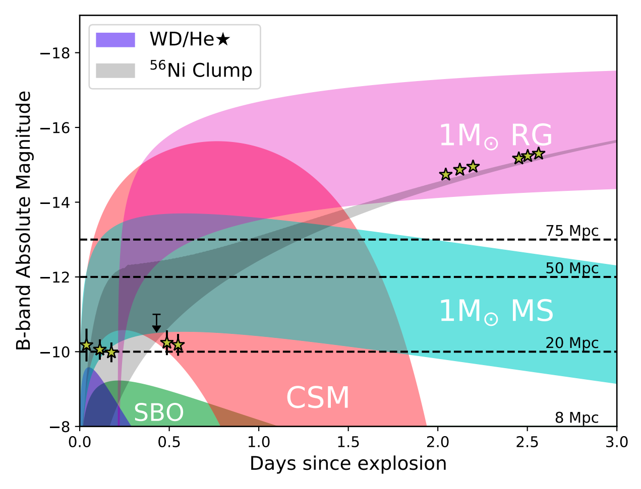
Processes visible within a few hours/days:
Various sources of thermal early excess emission:
Radioactive decay of excess Ni56
Ejecta interaction with:
Red giant companion
Main sequence star
Circumstellar disk
White Dwarf / He-star
Shock breakout
Notes:
Some clues to these questions can be found in the earliest moments right after the SN explodes.
There are several processes associated with the supernova’s birth that can produce excess emission within the first hours to days.
The emission is usually thermal because Type Ia SN ejecta starts off very dense, and most emission ends up thermalizing.
For instance, the ejecta colliding with a red giant or main sequence companion can produce bright excess emission.
If there is a double WD merger, that produces CSM and colliding with that can also leads to excess emission.
If there is a lot of extra Ni56 in the outer layers, that can lead to excess emission as well.
Other sources like ejecta collision with a WD or shock breakout from the WD surface tend to be very faint
And require deep detection limits as well as an early detection in order to observe.
There are some other processes are less detectable, like colliding with a companion WD/He-star.
There are a lot surveys today that focus of finding Type Ias as early as possible in order to catch these different processes in action.

Slide 10
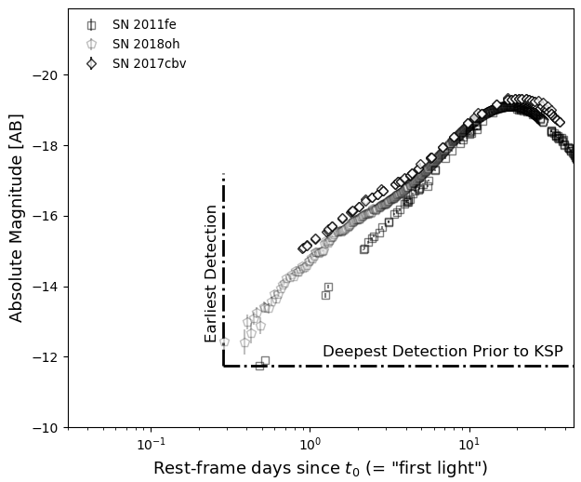
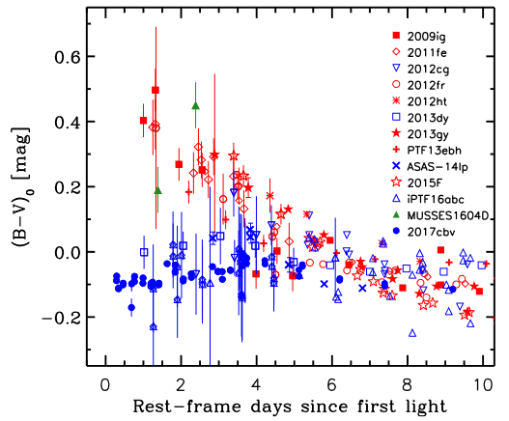
Commonly observed early light curve behaviors
Power-law:
~86% of normal events
Blue 2017cbv-like:
~14% of normal events
Peculiar
?
Unexplored
Regime
Notes:
There are now many objects observed within a few days following first light, tending to follow two kinds of behaviors.
Either they follow a simple power-law rise, which is what you expect from a smooth distribution of Ni56 in the ejecta
Or they have an early excess emission, which usually looks blue and appears in ~14% of normal events.
So clearly there is some process happening in a minority of events, maybe there is some type of interaction happening.
The majority just have power-law rise, which tells us that the Ni56 is centrally concentrated and mostly smooth,
Which is what you would expect from most models of white dwarf explosions.
And we probably don’t have puffy red giant companions present.
However, a lot of processes that have the power to distinguish the progenitor and explosion
like, signatures of He-shell double-detonation or double-degeneracy are hidden just beyond the veil, in the unexplored regime.

Slide 11
Table of Contents
Part I. Background: The Type Ia SN origin problem
Part II: Infant type Ia SNe from the KMTNet Supernova Program
Part III: Current and future avenues of progress

Slide 12
Infant SN Surveys | Characteristics
KSP | 4 sq. deg fov 21.5 mag limit 4.7 hr cadence B, V, I filters
ZTF | 2500 sq. def fov 20.5 mag limit 3 obs/night g, r filters
Kepler | 21.5 mag limit 12 hr bin cadence Single band
DLT 40 | Galaxies < 50Mpc 19 mag limit r band
KMTNet: Three 1.6-m wide-field (2°x 2°) telescopes in the Southern hemisphere, providing 24-h continuous sky coverage for search/monitoring of transients
Notes:
We are looking for SNe in this regime using the KMTNet SN program.
Cadence is high because of telescope locations, and depth is given by focusing our relatively small field of view on nearby galaxies.
KMTNet – three telescopes in the southern hemisphere, conducting a 24 hr continuous search for infant supernovae.
Compared to other surveys, the KMTNet is focused on a relatively small survey area,
But it is concentrated on 10-20 nearby galaxies within 75 Mpcs, with 22nd mag depth observations.
Now the depth is especially important because Type Ias always start off faint and rise slowly. So if you cant get sufficient depth, you are basically suffering on earliness.
The point of this kind of focused survey is, while we wont win on broad statistics, but we will win on detecting
Type Ias at their faintest and most important phases, with multiple colors and densely sampled light curves.

Slide 13
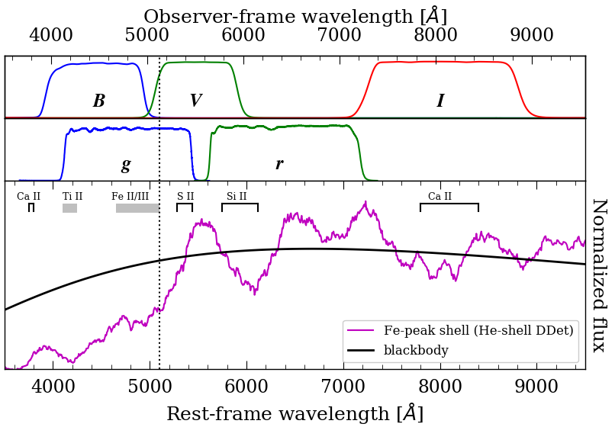
Sensitive filters to Fe-peak elements
Adapted from Ni et al. 2022
KMTNet
ZTF
Notes:
The particular filters used by the KMTNet are also well suited to studying the distribution of metals in Type Ia SN ejecta due to their sensitivity.
For instance there is a complex of Fe-group lines that land around 5000A, which would be reflected in the B and V bands.
This kind of effect may not be as prominent in say the broader ZTF g, r band system.

Slide 14
Object 1: SN 2018aoz
Host = NGC 3923
Redshift = 0.0058
Distance = 22 Mpc
Supernova = normal type Ia
Likely exploded in March 28
Then, on March 29, 2018
12 AM : Epoch of first light
1 AM : BVI detection (by KSP)
Multi-facility follow-up (April 2+)
NGC 1566
SN 2021aefx

Slide 15
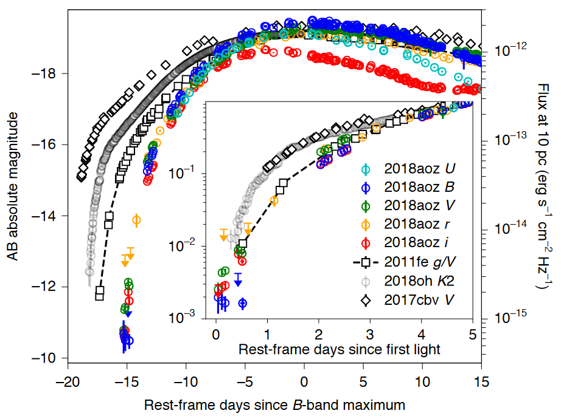
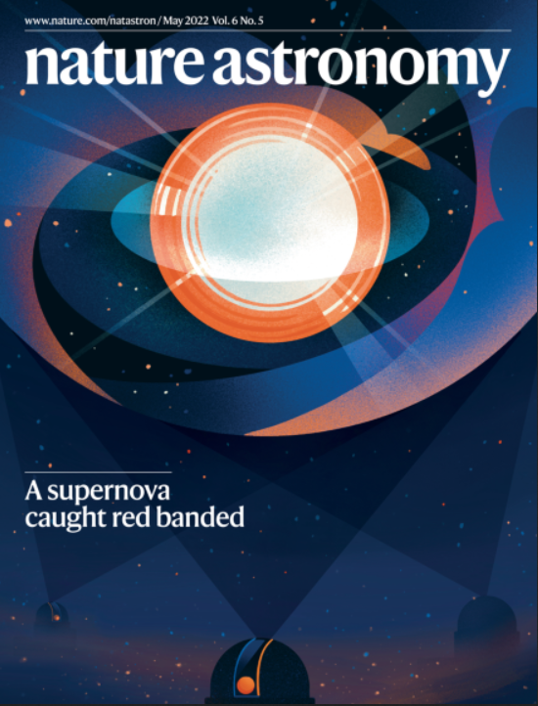
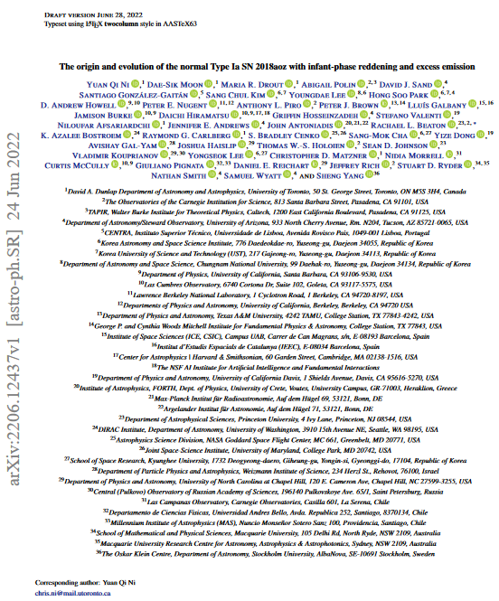
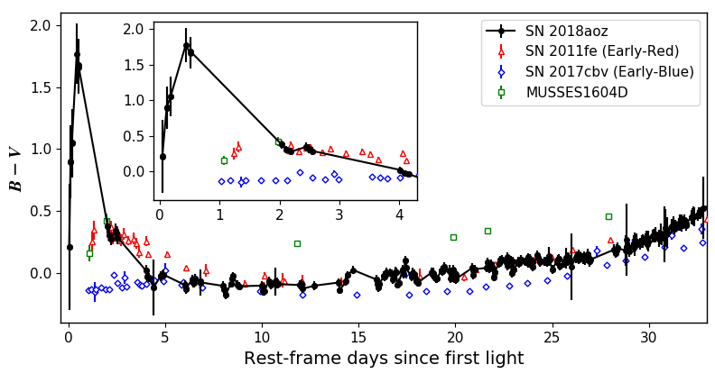
SN 2018aoz: the first Type Ia from 1hr since first light
Ni et al. (2022a)
SN 2018aoz
Ni et al. (2023a)
Notes:
SN 2018aoz, which is the earliest detection of a Type Ia SN to date. Here is the light curve of its evolution, and I’ve written two papers on it that came out this year which you can check out.
Its apparent here how early the detection is compared to some of the earliest Type Ias before it, 2018oh, 2017cbv, and 2011fe,
So we’ve got data in a faint and early regime that has never been explored before.
And you’ll notice the following. There’s an uptick in the V and I bands at the earliest phases which indicates excess emission.
And the B-band is plateaued, stalled, at ~ -10 mags for 0.5 days. This leads to color evolution like this,
With a remarkable reddening of the color, redder than anything we’ve seen in an early Type Ia to date for a brief half-day period,
Before returning to look like any normal Type Ia that we’d expect to see.

Slide 16
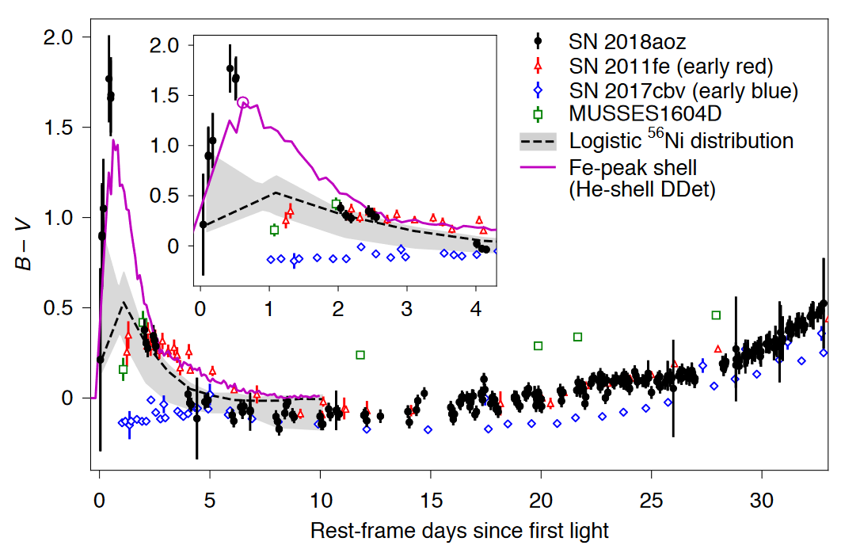
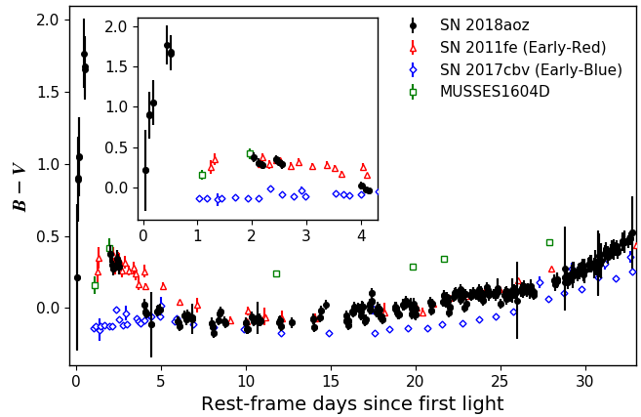
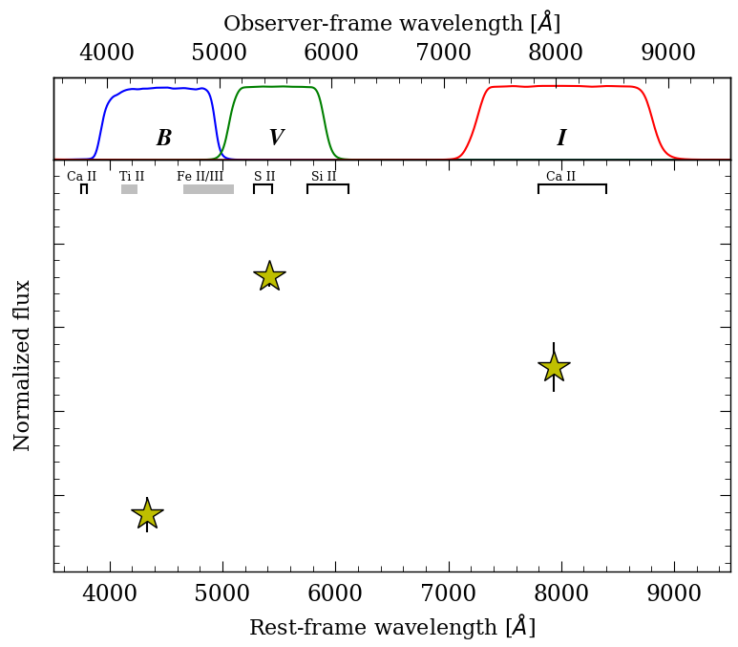
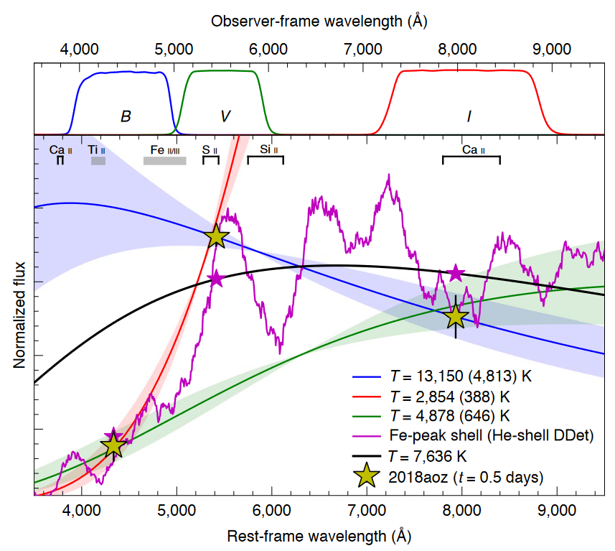
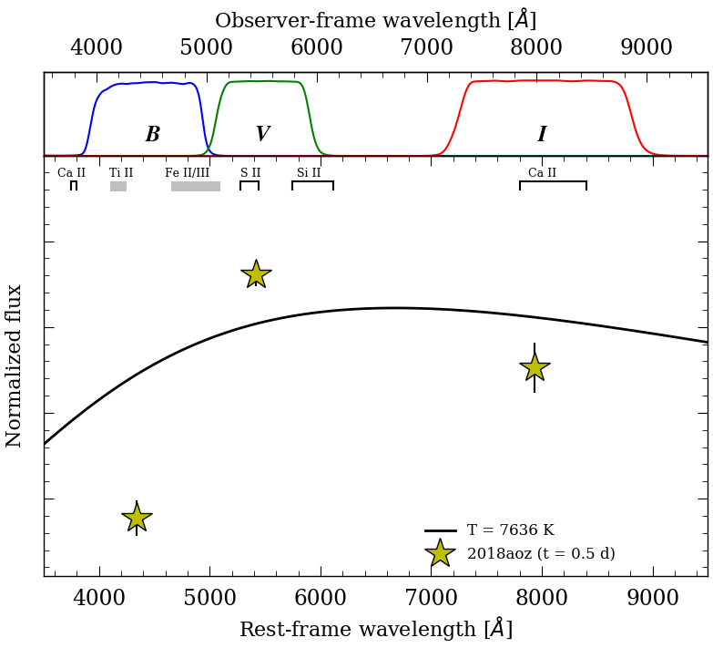
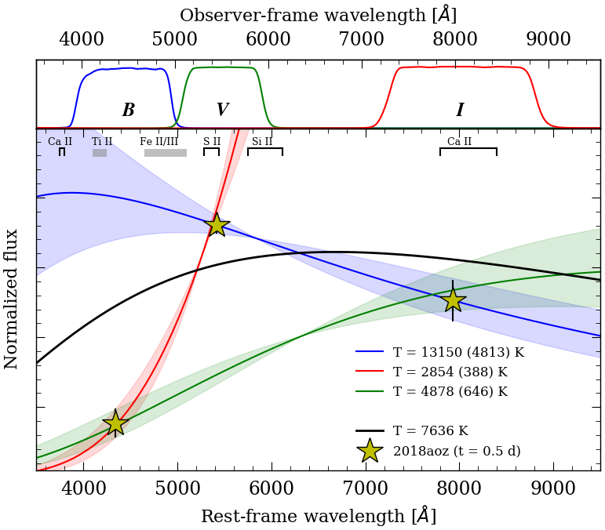
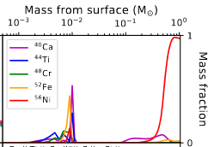
Origin of infant reddening:
SED
Origin of infant reddening: Surface Fe-peak elements
Notes:
First, we tried to understand the red color evolution.
What we did first was look at the SED at the reddest point.
Now this is a very surprising and strange SED for a Type Ia, and I’ll explain why.
As I said earlier, when you have excess emission in a Type Ia, the first thing you suspect is some kind of thermal process that
produces additional light, like collision with a companion or CSM, or extra heating from radioactive NI56.
We found that no blackbody could fit all three bands, and that’s largely because the B-band flux level is extremely low compared the to V and I bands.
In fact, if you fit two bands together, the B-band gives impossible temperatures for a Type Ia, while the V and I bands are perfectly reasonable for what you might expect in an exploding WD.
So the B-band must be selectively suppressed by spectroscopic features. In Type Ia SNe, the elements that can produce this suppression are Fe-peak elements.
Here, the magenta models show the effect of having a shell of Fe-peak elements in the outer 1% of the SN ejecta.
We find that the Fe-elements produce a spectroscopic break that just matches the red color, so that must be the origin of the reddening.
And this discrete clump is probably what they are actually distributed like, because a continuous distribution would look more like the grey curve.

Slide 17
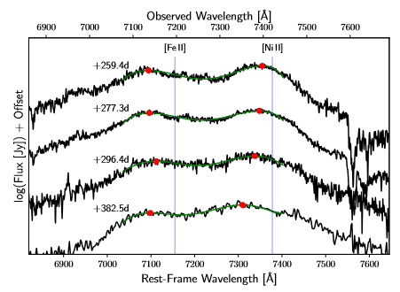
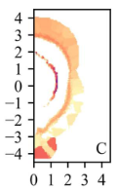
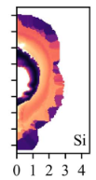
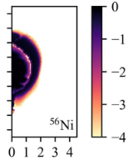
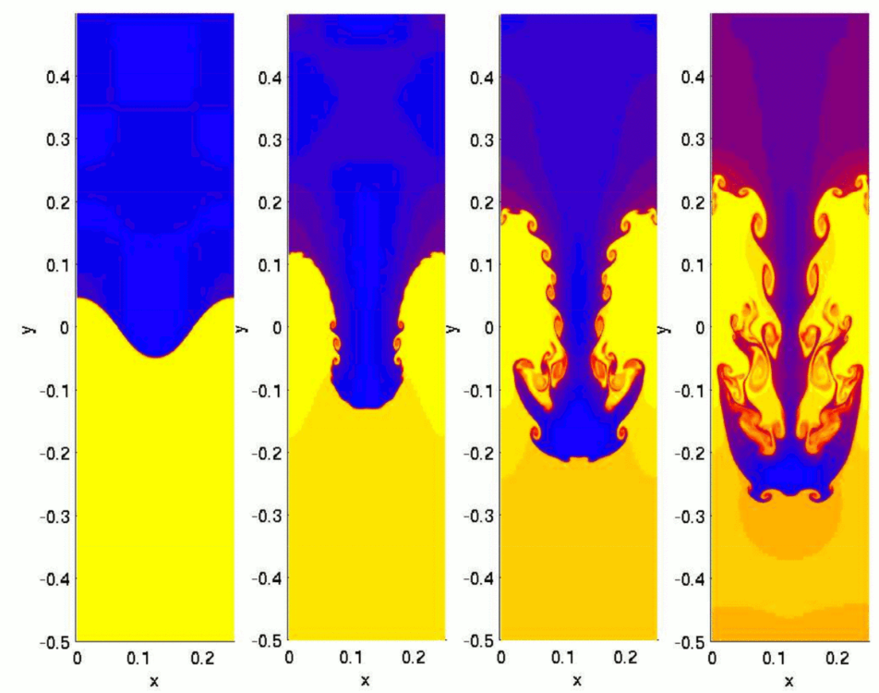
Where can surface Fe-peak elements come from?
C/O WD
Companion
∆M
SN
Boos et al. (2021)
Star
WD
SD
C/O Ignition Process
DD
Ignited by what?
Ignited where?
2
1
Subsonic instabilities
C/O -> Ni
Ignition Point
Ignited how?
+
+
Subsonic
Supersonic
Notes:
We’ve narrowed down the ignition process to two options

Slide 18
Recap: What caused infant reddening in SN 2018aoz?
1: He-shell Double-Detonation
Leads to asymmetric detonation (supersonic) of central C/O
Produces surface Fe-peak elements via burnt He-shell
2: Chandrasekhar-mass explosion
Requires asymmetric deflagration (subsonic) of central C/O
Produces surface Fe-peak elements via subsonic mixing
Notes:
So that’s about the explosion process.
What about the progenitor?

Slide 19
Object 2: SN 2021aefx
Host = NGC 1566
Redshift = 0.0053
Distance = 17 Mpc
Supernova = normal type Ia
Nov. 11, 2021
3-8 AM : Likely explosion epoch
8 AM : First detection (by DLT)
7 PM : Multi-band photometry
9 PM : Spectroscopy
NGC 1566
SN 2021aefx

Slide 20
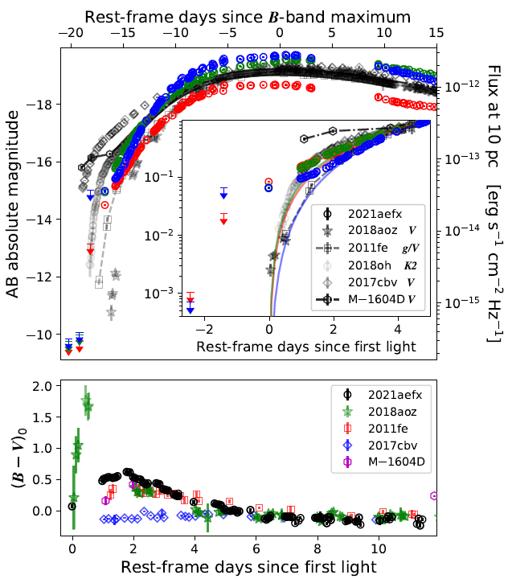
Feature 1: red excess
Kinds of early light curves
Power-law:
~86% of normal events
Blue 2017cbv-like:
~14% of normal events
Red 2018aoz-like:
Unknown…
Can be ≃ Power-law
Red MUSSES1604D-like:
Small fraction, not normal
Red 2021aefx-like?
A new kind of normal…

Slide 21
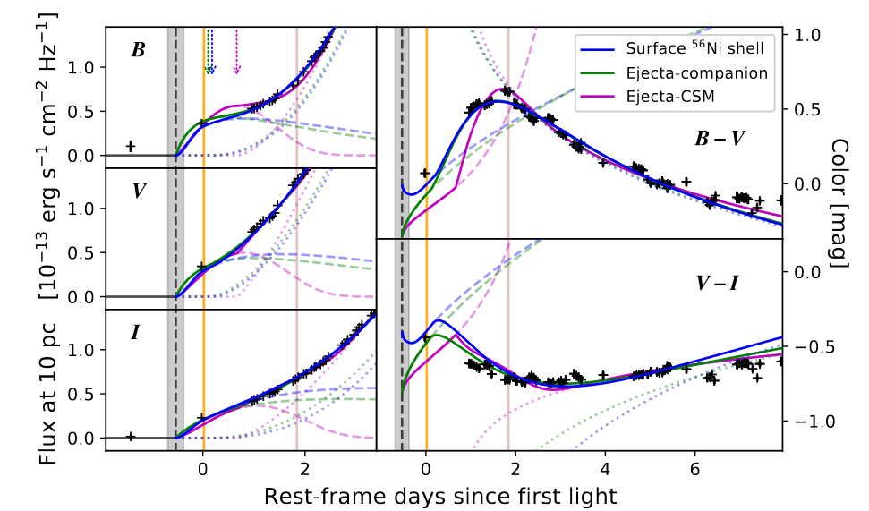
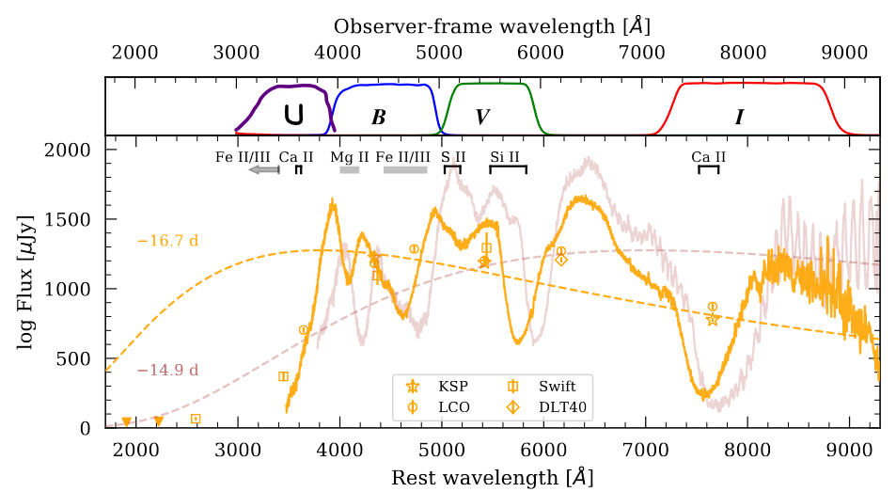
Possible origins of early excess:
Epoch of explosion
Ni56 over-density
∼ 0.007 Msol
(outer 0.5% of ejecta)
Seems quite possible
Compact CSM
∼ 0.02 Msol
<10^12 cm
Spectrum: Emission lines?
Companion
∼ 2 Msol subgiant
(NLTE: maybe bigger)
Nebulae: H/He not found
?
Possible origins of UV suppression:
Surface Ni56
Phase => outer < 0.7%
Maybe also due to Z

Slide 22
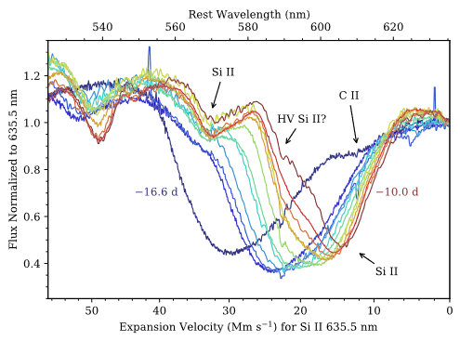
Feature 2: Very high-velocity absorption profile
Questions:
What components are in the feature?
How do the velocities evolve?
Are there other high-velocity features?
[Hosseinzadeh et al. 2022]
Notes:
Show first spectrum, percent of SNe with such features, unique aspects of it

Slide 23
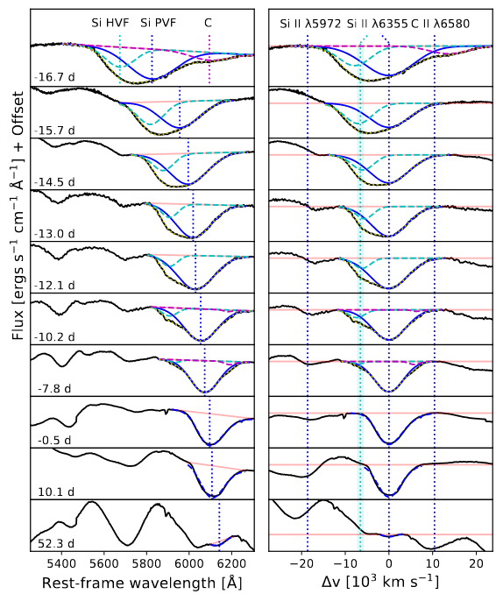
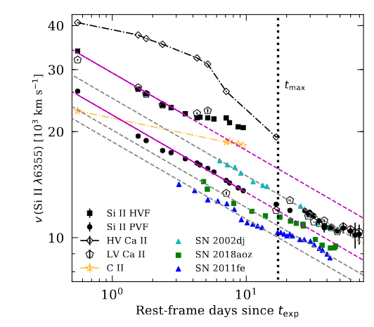
Si II
PEAK ->
Notes:
The plot shows how we identified lines.
The blue dotted lines are where you expect to find Si II 6355 at the photospheric velocity of normal type Ia Sne.
If we shift into this photospheric velocity frame, we can see there is an absorption component at constant offset to the left of the 6355 line.
You can see the component start strong, and then independently fading between -15 and -10 days.
Even farther to the left, you see photospheric velocity Si II 5972, while to the right, there appears to be photospheric velocity C.
These other blue dotted lines indicate where those two absorption features would land if they were photospheric velocity.
So, a similar such component near the Si 6355 line has been identified in other type Ia SNe before as the HVF of Si 6355.
Makes sense, because the only lines that you can expect would have to have unreasonable velocities to be it.
The origin of the HVFs are debated, overdensities in the ejecta and line opacity enhancements (swept up H) have been suggested.
So you can see in the plot that I already fitted out the velocities of these components, and they are shown in this graph.
Interestingly, the HVF in SN 2021aefx appears to trace the evolution of the PVF.
For those who don’t know, the PV evolution of Type Ia is theoretically expected and usually observed to follow a special power-law…
It’s what you expect from a homologously expanding polytropic ejecta, the photosphere starts at high velocity
Then the density drops, so the photosphere moves inward in a lagrangian sense, and the spectrum becomes dominated by lower velocity material.

Slide 24
Feature 2: Very high-velocity absorption profile
Questions:
What components are in the feature?
How do the velocities evolve?
Are there other high-velocity features?
[Hosseinzadeh et al. 2022]
Notes:
Show first spectrum, percent of SNe with such features, unique aspects of it

Slide 25
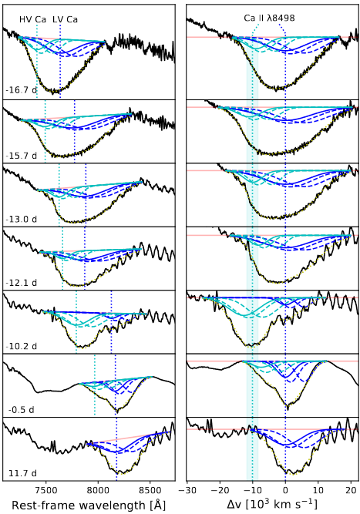
Si II
Ca II
PEAK ->
PEAK ->
Notes:
Ca very high-velocity doesn’t have to be from separate ejecta, can be line-broadening effect.

Slide 26
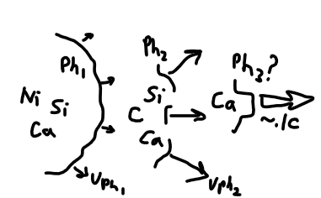
Si & Ca velocities
Components:
Normal photosphere
∼ 1.34 Msol of material
Secondary photosphere
∼ outer 14% along L.O.S.
Relativistic Ca (~0.13c)
Tertiary photosphere?
Line-specific effect?
Notes:
High-velocity of silicon is the low-velocity of calcium. Calcium has an even higher velocity.

Slide 27
Recap: What is the origin of high-velocity features?
Co-evolving HV Si and Ca components:
Following two photosphere-like velocity evolutions
=> Normal primary photosphere of Mch explosion
and aspherical secondary photosphere
Relativistic Ca
Tertiary photosphere or line effect?

Slide 28
Origin of SN 2021aefx
Near Chandrasekhar-mass explosion
High-velocity features → 2. Outer ejecta has at least one non-spherically
symmetric secondary component
Red excess emission → 3. Consistent with Ni56-enrichment in outer ejecta
(May also be from compact CSM)
(4. Double-degenerate progenitor)
Outer ejecta profile is not smooth and has 2nd order asphericities
Consistent with initially subsonic burning after off-center ignition
Off-center ignition also seen in offsets of nebular Ni58 vs Fe/Co56

Slide 29
Off-center ignited delayed detonation
C/O WD
Companion
SN
∆M
WD
C/O Ignition Process
DD
Ignited by what?
Ignited where?
C/O -> Ni
Ignition Point
Ignited how?
+
Subsonic
Notes:
Another scenario is the off-center ignited delayed detonation double detonation is one scenario

Slide 30
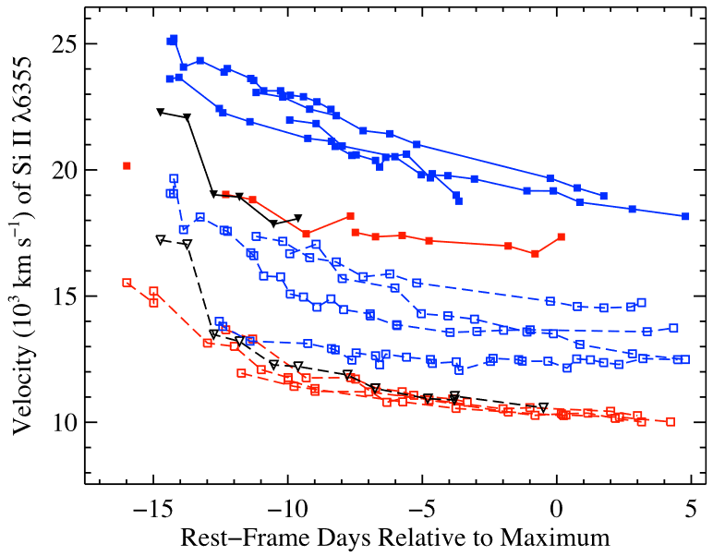
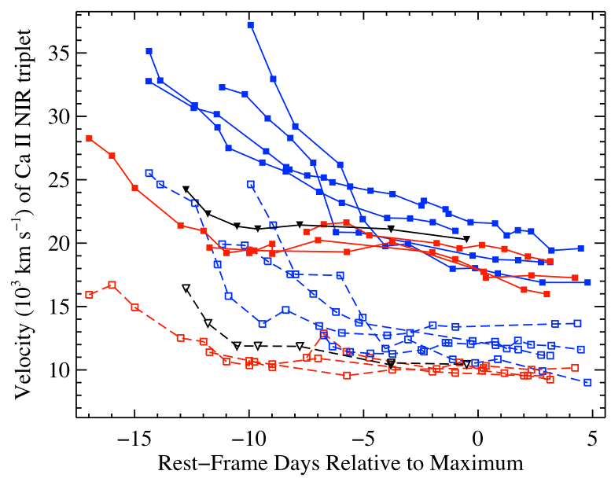
How common is co-evolving HV Si & Ca?
Si II HVF: Found in ~32% of normal events
Ca II HVF: Found in almost all normal events
At early enough phases, might Si & Ca often co-evolve?
[Silverman et al. 2015]

Slide 31
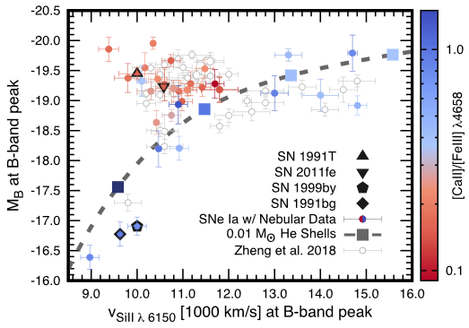
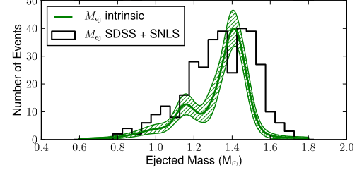
How common are Near Ch.-mass explosions?
Arnett model (L.O.S. ejecta mass):
> 50% clustered around Mch (incl. 2021aefx)
Unburnt C (Progenitor mass):
Up to 40% consistent with sub-Mch
Nebular Ca (Progenitor mass):
∼ 40% may be sub-Mch (not 2021aefx)
[Polin et al. 2021]
[Scalzo et al. 2014]

Slide 32
Conclusion: How common is a 2021aefx-like event?
The red excess is very rare (can be partly due to asphericity)
∼ 1/3 have Si & Ca HVFs (how many co-evolving?)
≳ 1/2 have near Chandrasekhar ejecta mass
Maybe up to 1/3 if red excess is a lucky viewing angle effect

Slide 33
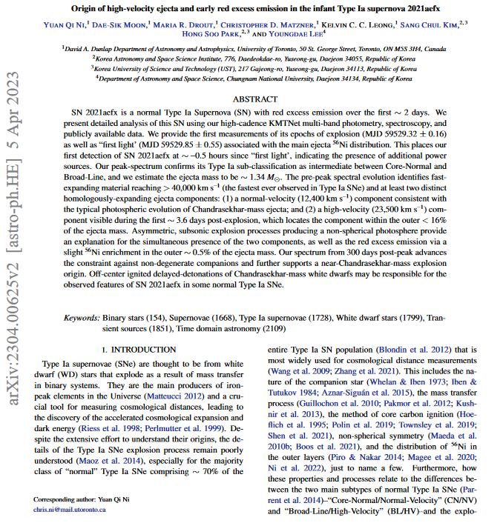
References
Ni et al. (2023b), ApJ submitted → read our paper on astroph:2304.00625
Ni et al. (2023a), ApJ, 946, 7
DerKacy et al. (2023), ApJL, 945, 2
Kwok et al. (2023 ), ApJL, 994, 3
Hosseinzadeh et al. (2022), ApJL, 933, 45
Ashall et al. (2022), ApJL, 932, 2
Ni et al. (2022), Nature Astronomy, 6, 568
Polin et al. (2021), ApJ, 906, 65
Yao et al. (2019), ApJ, 886, 152
Jiang et al. (2018), ApJ, 865, 149
Silverman et al. (2015), MNRAS, 451, 1973
Piro & Nakar (2014), ApJ, 784, 85
Scalzo et al. (2014), MNRAS, 445, 2535
Seitenzahl et al. (2013), MNRAS, 429, 1156
Hillebrandt et al. (2013), FrPhys, 8, 2
Walker et al. (2012), MNRAS, 427, 103
Maeda et al. (2010), ApJ, 712, 624
Notes:
Anticipate questions from audience list
Think of reverse questions for

Slide 34
Table of Contents
Part I. Background: The Type Ia SN origin problem
Part II: Infant type Ia SNe from the KMTNet Supernova Program
Part III: Current and future avenues of progress

Slide 35
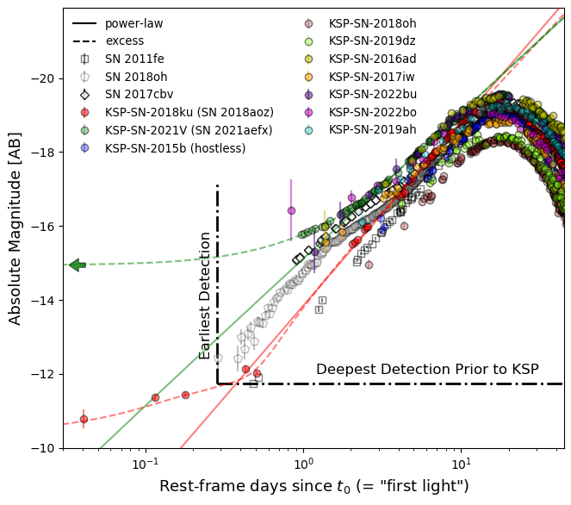
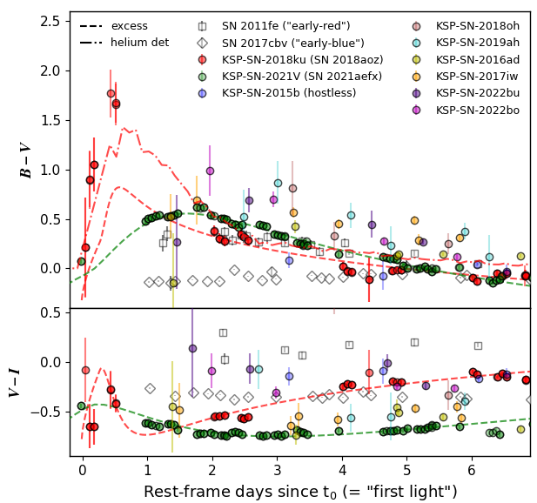
Coming soon: early multi-color statistics
+12 others
+12 others

Slide 36
Future avenues of progress:
Virgo cluster infant type Ia SNe detected by DECam
Cross-survey golden sample of multi-color high-cadence type Ia SNe
(< 0.5 day cadence)&(< 1 day multi-band cadence)&(> 3 bands)
YSE + TESS + ZTF + ATLAS + KMTNet + Literature ∼ 50 objects in all
Origin of excess emission in 91T-like events

