Slide 1
AN Asymmetric Double-Degenerate Type IA Supernova with a Surviving Companion Star
Matthew R. Siebert, Ryan J. Foley, Yossef Zenati, Georgios Dimitriadis, Grace Yang, Eva Schmidt, Kyle W. Davis, Kirsty Taggart, César Rojas-Bravo
The Transient and Variable Universe - 6/22/2023
1
Notes:
A lot of similar themes to previous Ia talks, progenitor problem, early light curve bumps, ejecta distributions from nebular phase.
I will talk about SN 2020hvf which is a peculiar type ia that likely comes from a super-mch progenitor system. Deeply related related to all of these things.

Slide 2
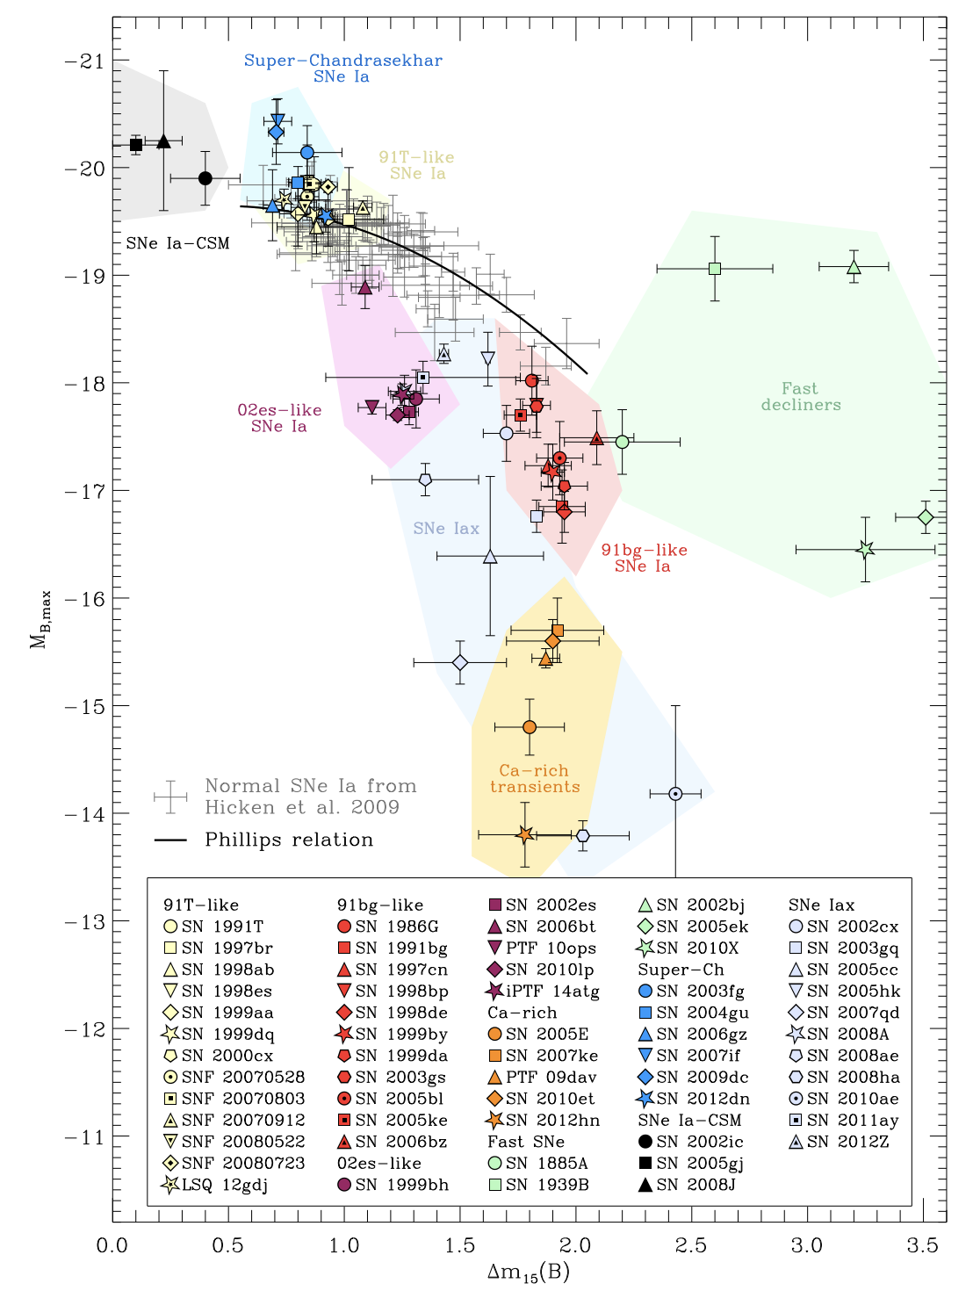
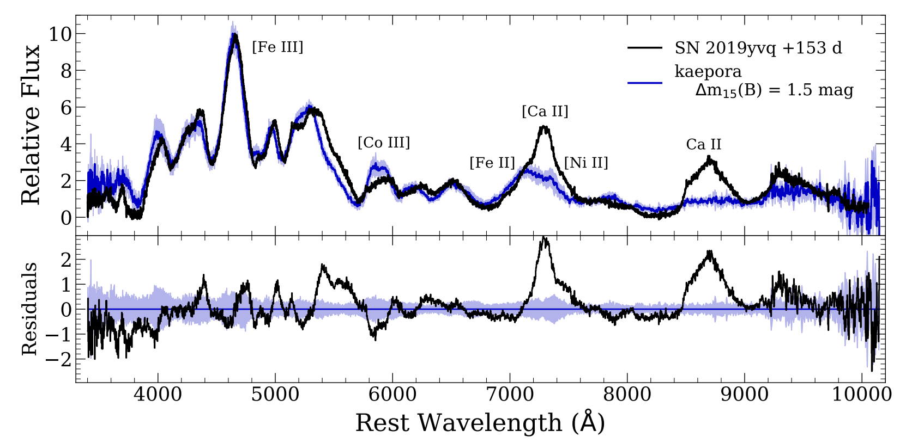
Nebular phase observations of Peculiar SNe Ia show Calcium
Siebert et al. 2020b
See also: Miller et al. 2020, Tucker et al. 2021, Burke et al. 2021
Taubenberger et al. 2017
Notes:
Nebular phase, ejecta are optically thin, can learn about bulk velocity and distribution of the ejecta. Potentially the progenitor scenario in combination of with other properties.
Presence of calcium can tell you about the ionization state, temperature, and potentially if the ejecta are stratified.
Increasingly associated with peculiar subtypes of SNe Ia. While most the large majority are normal Ias with no Ca.

Slide 3
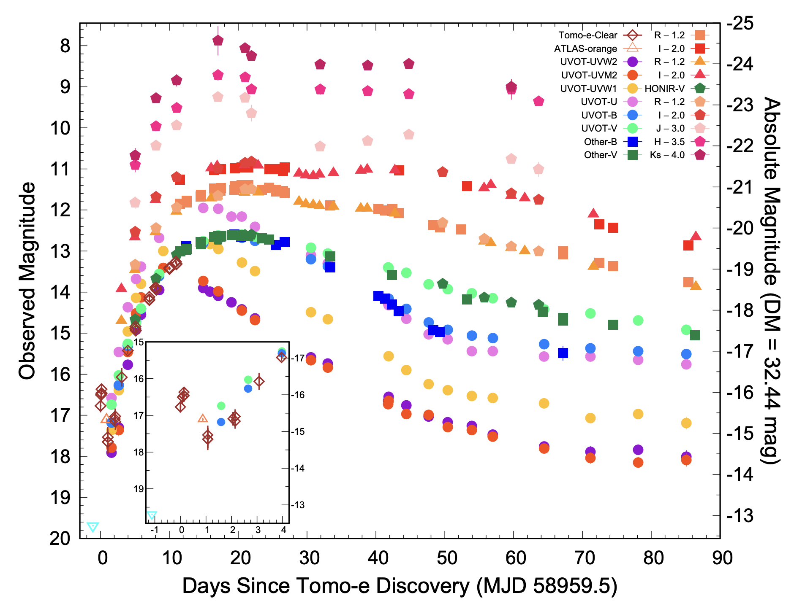
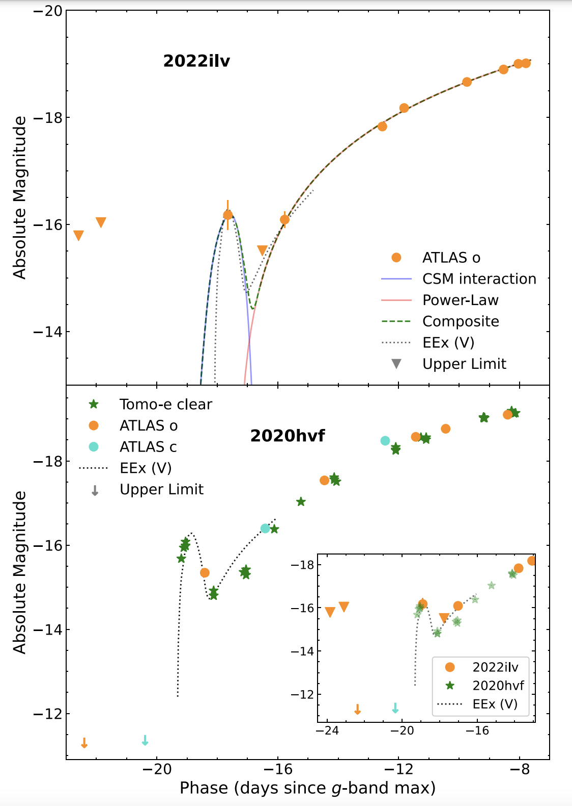
SN 2020hvf had an early light curve bump and high luminosity
M_{B} = -19.9 mag
Jiang et al. 2021
Srivastav et al. 2023
M_{ej} = 2.1M !
$$☉$$
Notes:
No formal classification for Super-Chandra type Ias
But properties suggest an ejecta mass in excess of Mch.
While a distinct subclass of SNe Ia, we still have a similar progenitor problem (SD vs DD)
This could potentially be explained with the explosion of a perhaps rapidly rotating massive white dwarf (formed by accretion) or perhaps by a DD system whose total mass is exceeds the Mch.
Other scenarios have been proposed like the core-degenerate where the excess luminosity comes from the interaction of the ejecta with the envelope of an ABG star.
These papers interpret the bump as a result of interaction with a dense carbon oxygen rich CSM

Slide 4
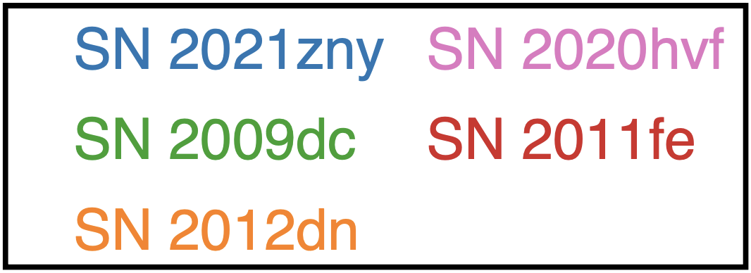
Super-M_{Ch} (or 03fg-like) SNe have unique photospheric features
Dimitriadis et al. 2023
Notes:
Early bump + strong carbon features
Similar to 2009dc but high velocity and asymmetric absorption features

Slide 5
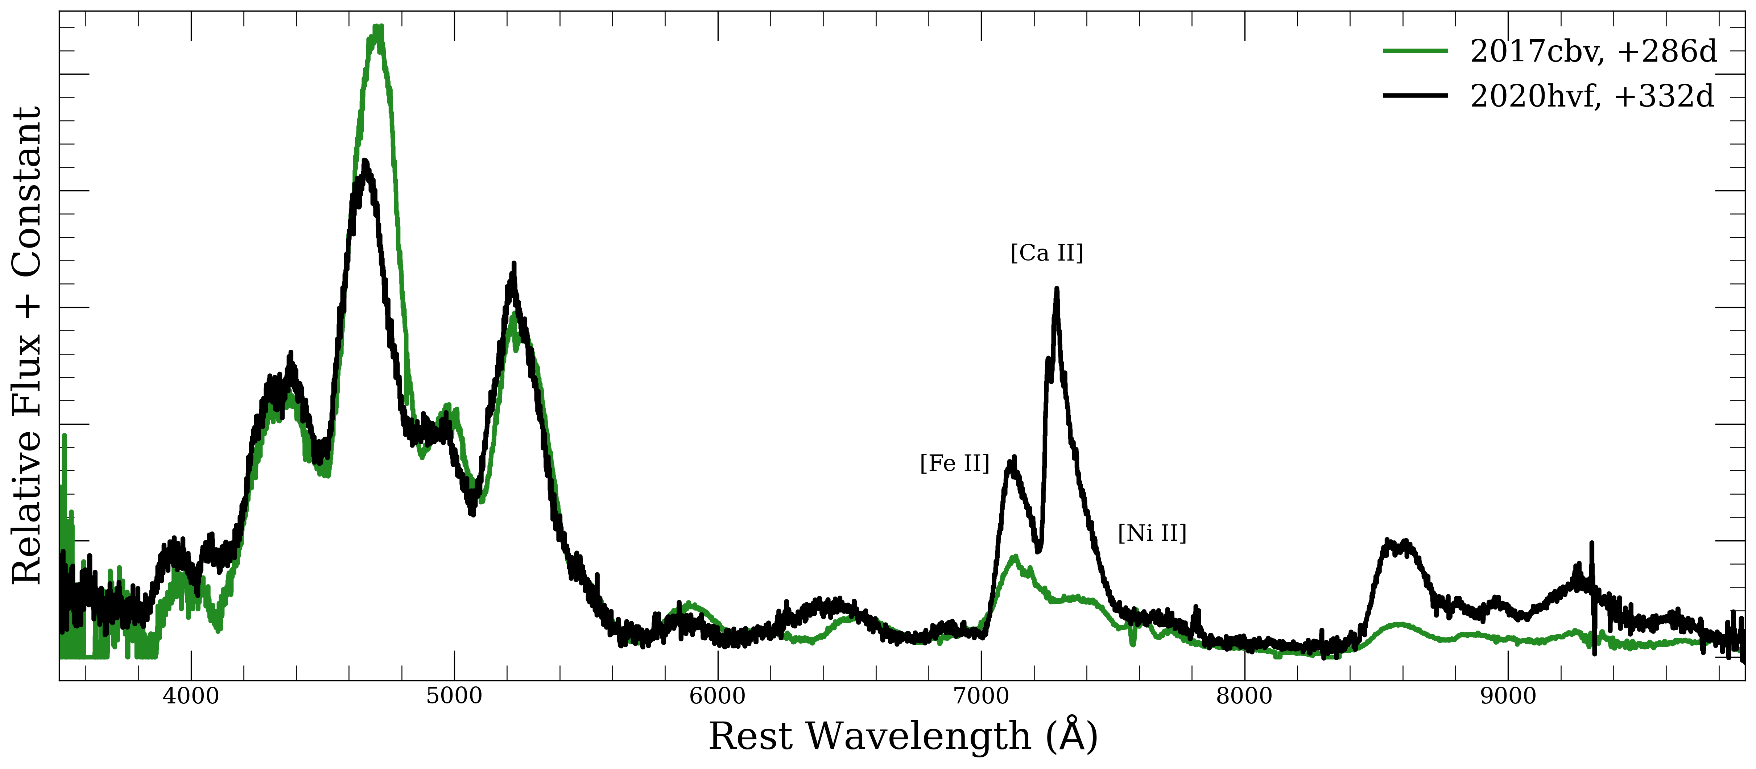
Nebular spectrum is very different from “normal”-SNe Ia
[Fe III]
Ca II
Notes:
Very different from normal SNe Ia, primarily ionization state and presence of Ca

Slide 6
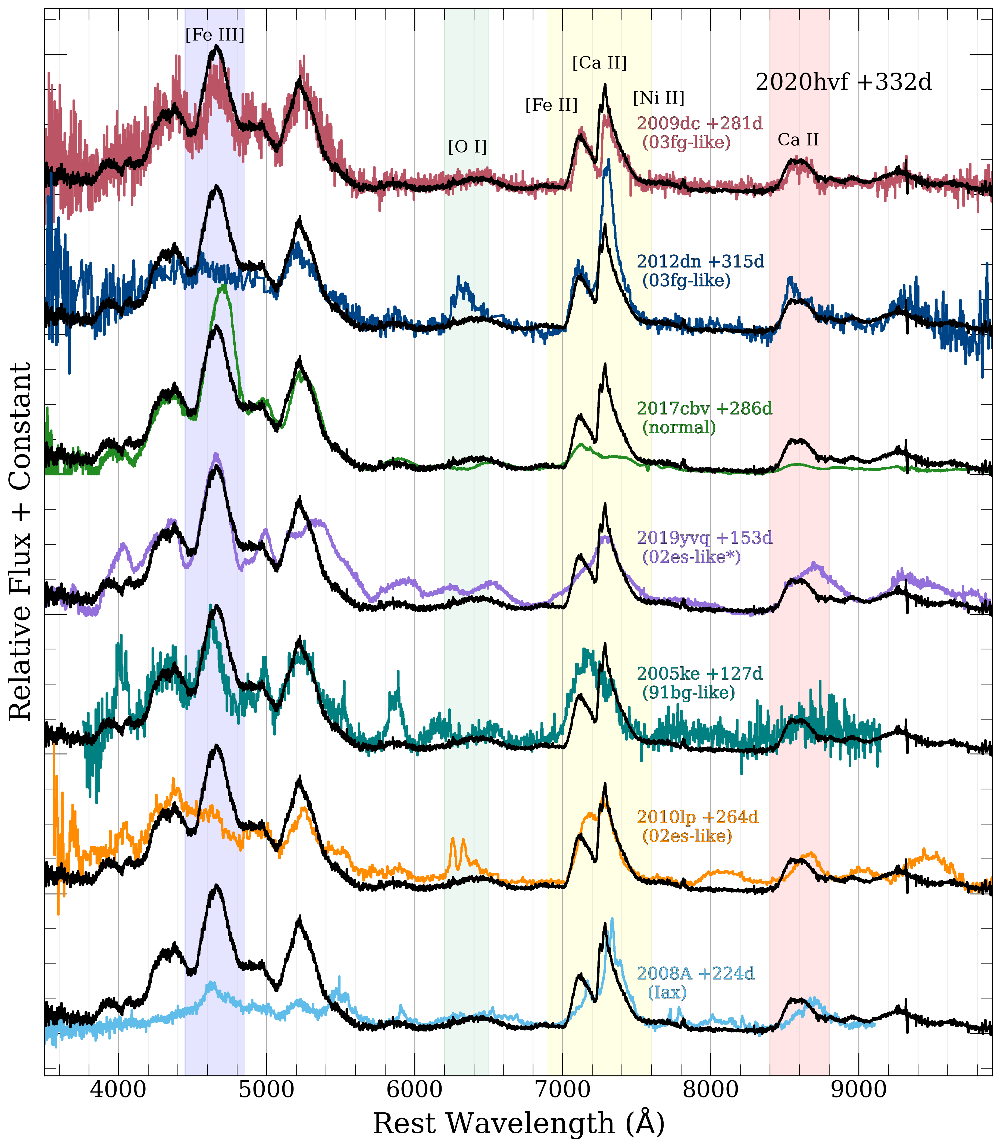
Nebular properties are most similar to Super-M_{Ch} SNe Ia
-20 mag
Early excess flux
Super-M_{Ch} (03fg-like) SNe Ia
Peculiar SN Ia with Strong [Ca II]
Low Luminosity SN Ia
02es-like with narrow [O I]
SN Iax
-17 mag
Siebert et al. 2023
Notes:
Mostly peculiar Sne Ia with low ionization state spectral features
Most similar qualitatively to 09dc
No lack of Fe III
Sometimes see broad or narrow oxygen.
Most of talk will focus on the 7300 complex which is a blend of Fe Ni and Ca

Slide 7
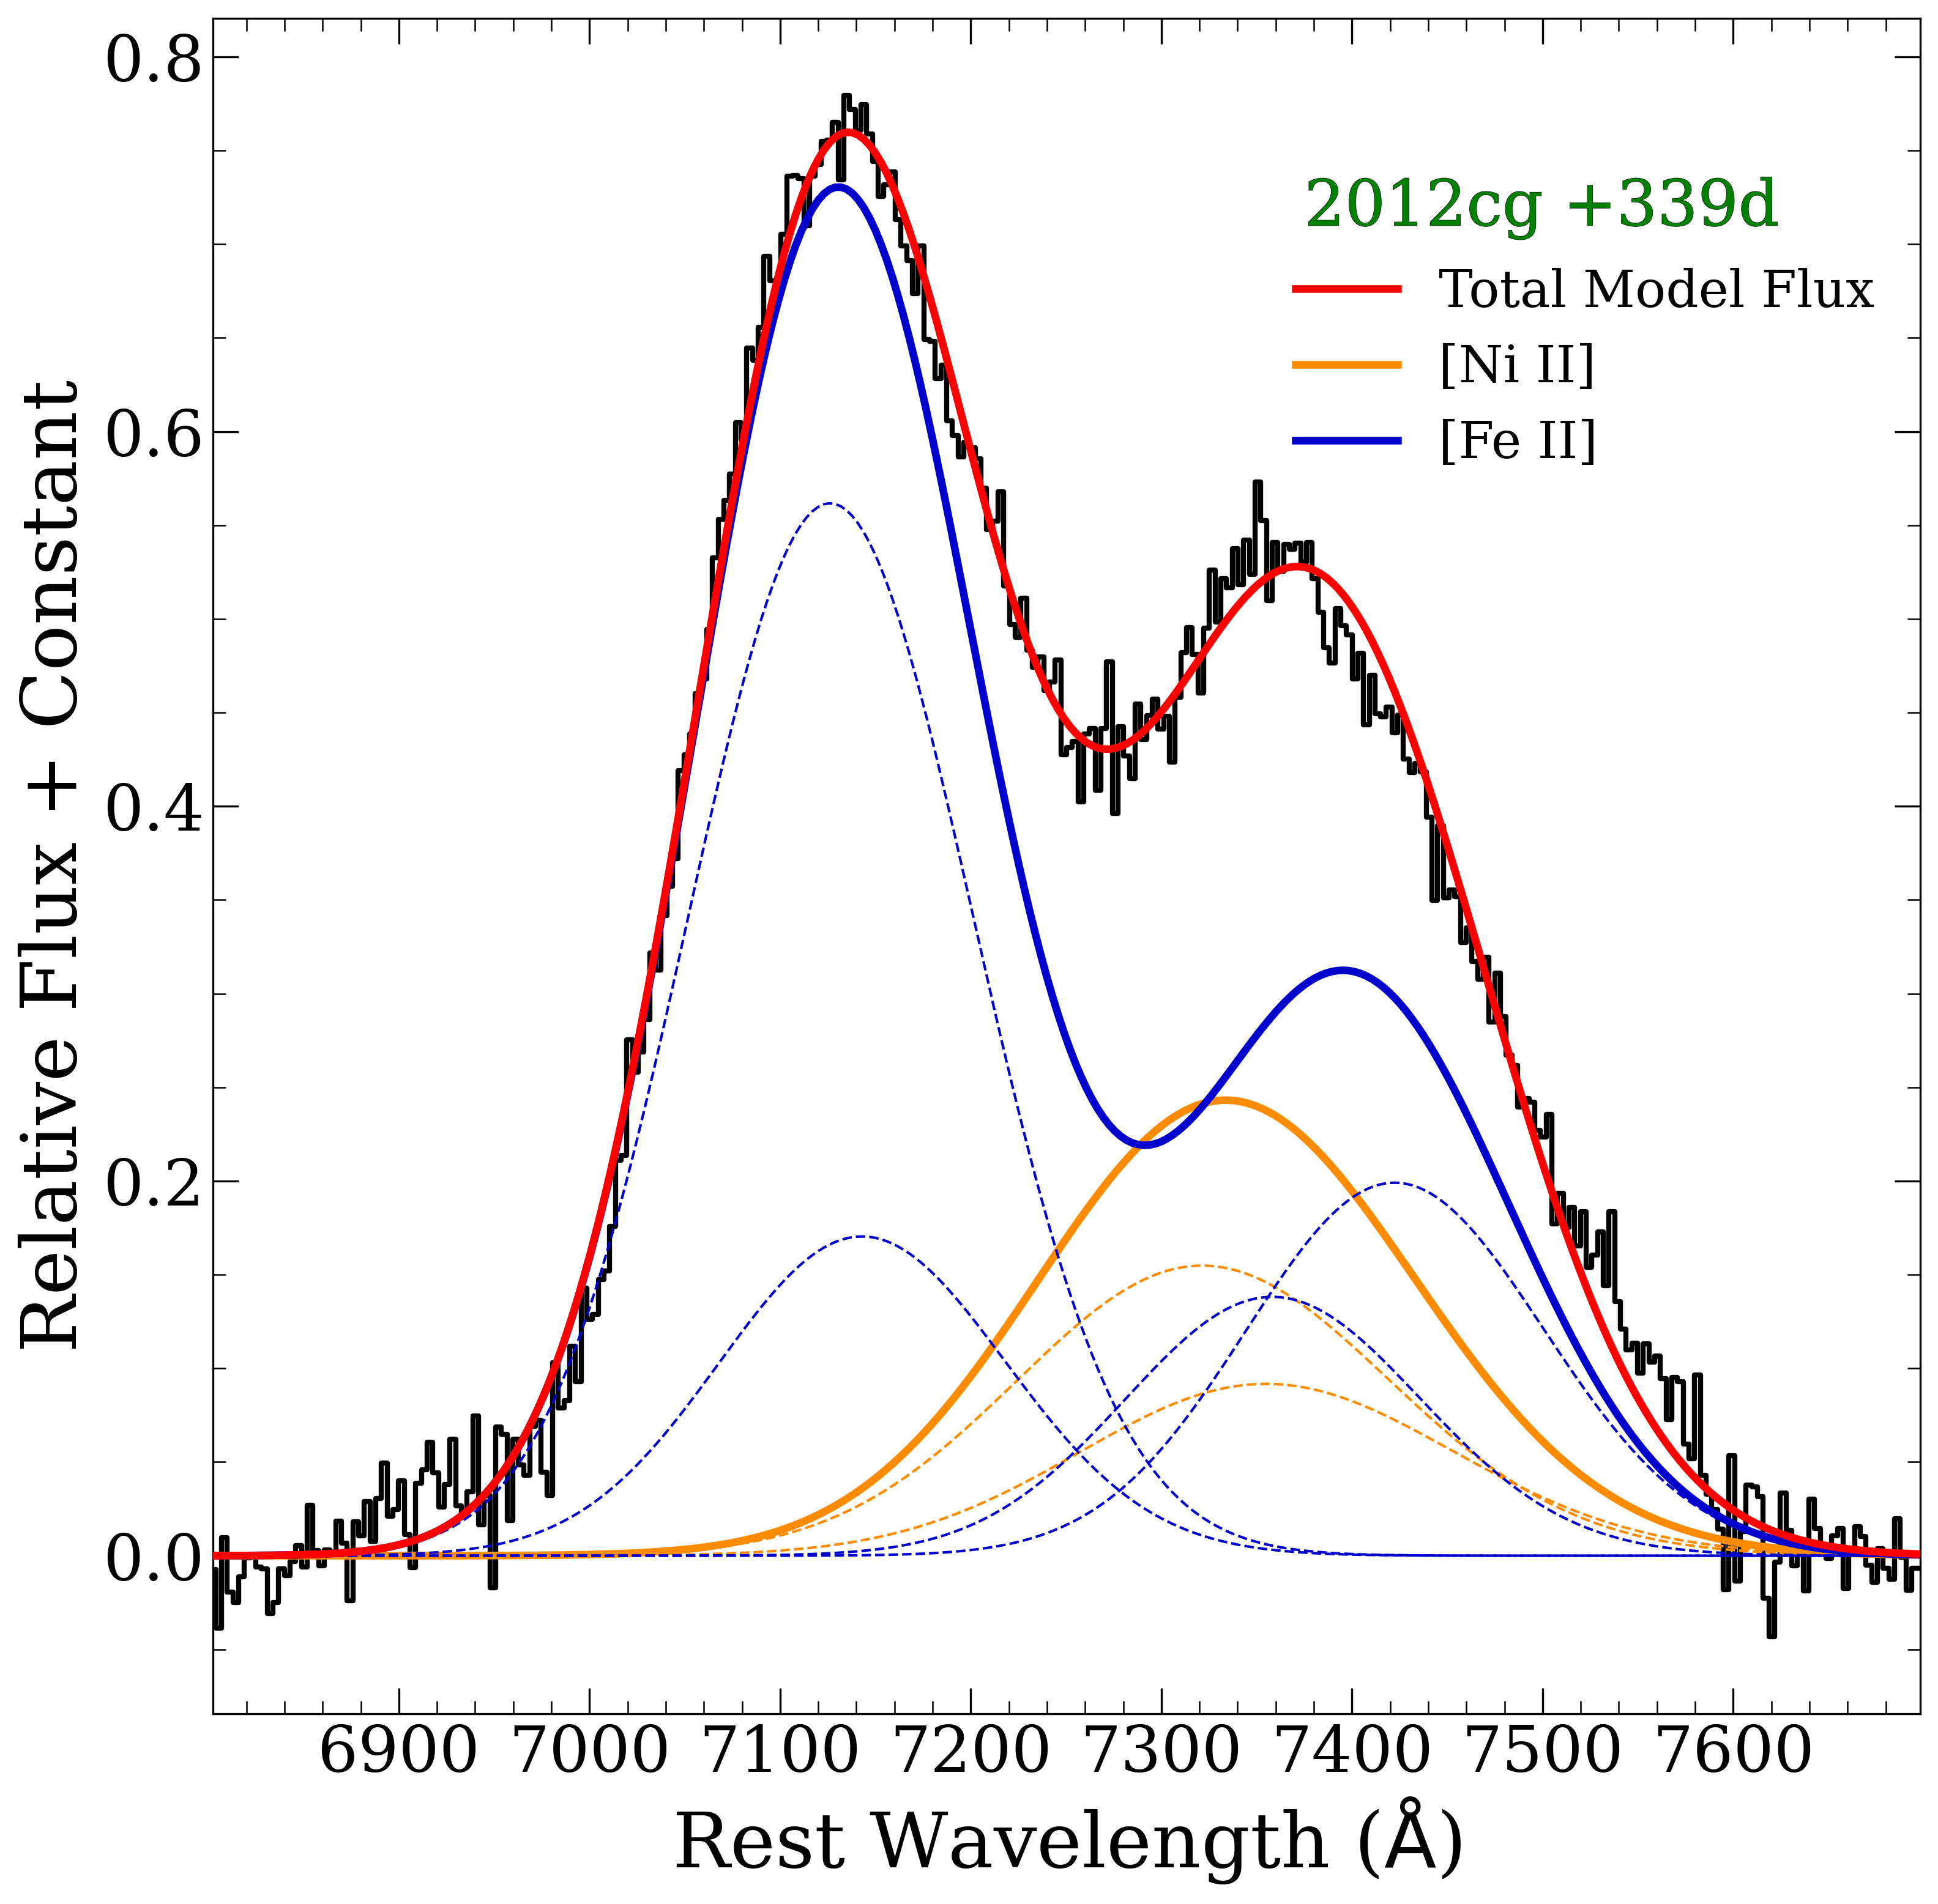
Single symmetric components are often sufficient for normal SNe Ia
Likely contribution from [Ni II] but no [Ca II]
Offset -1,200 km/s
FWHM ~7000 km/s
3 parameters per solid blue/orange line
Siebert et al. 2023
Notes:
For normal SNE Ia single symmetric components of
Typical, velocity widths and offsets on order of 1000 km/s
Walk through fit – dashed

Slide 8
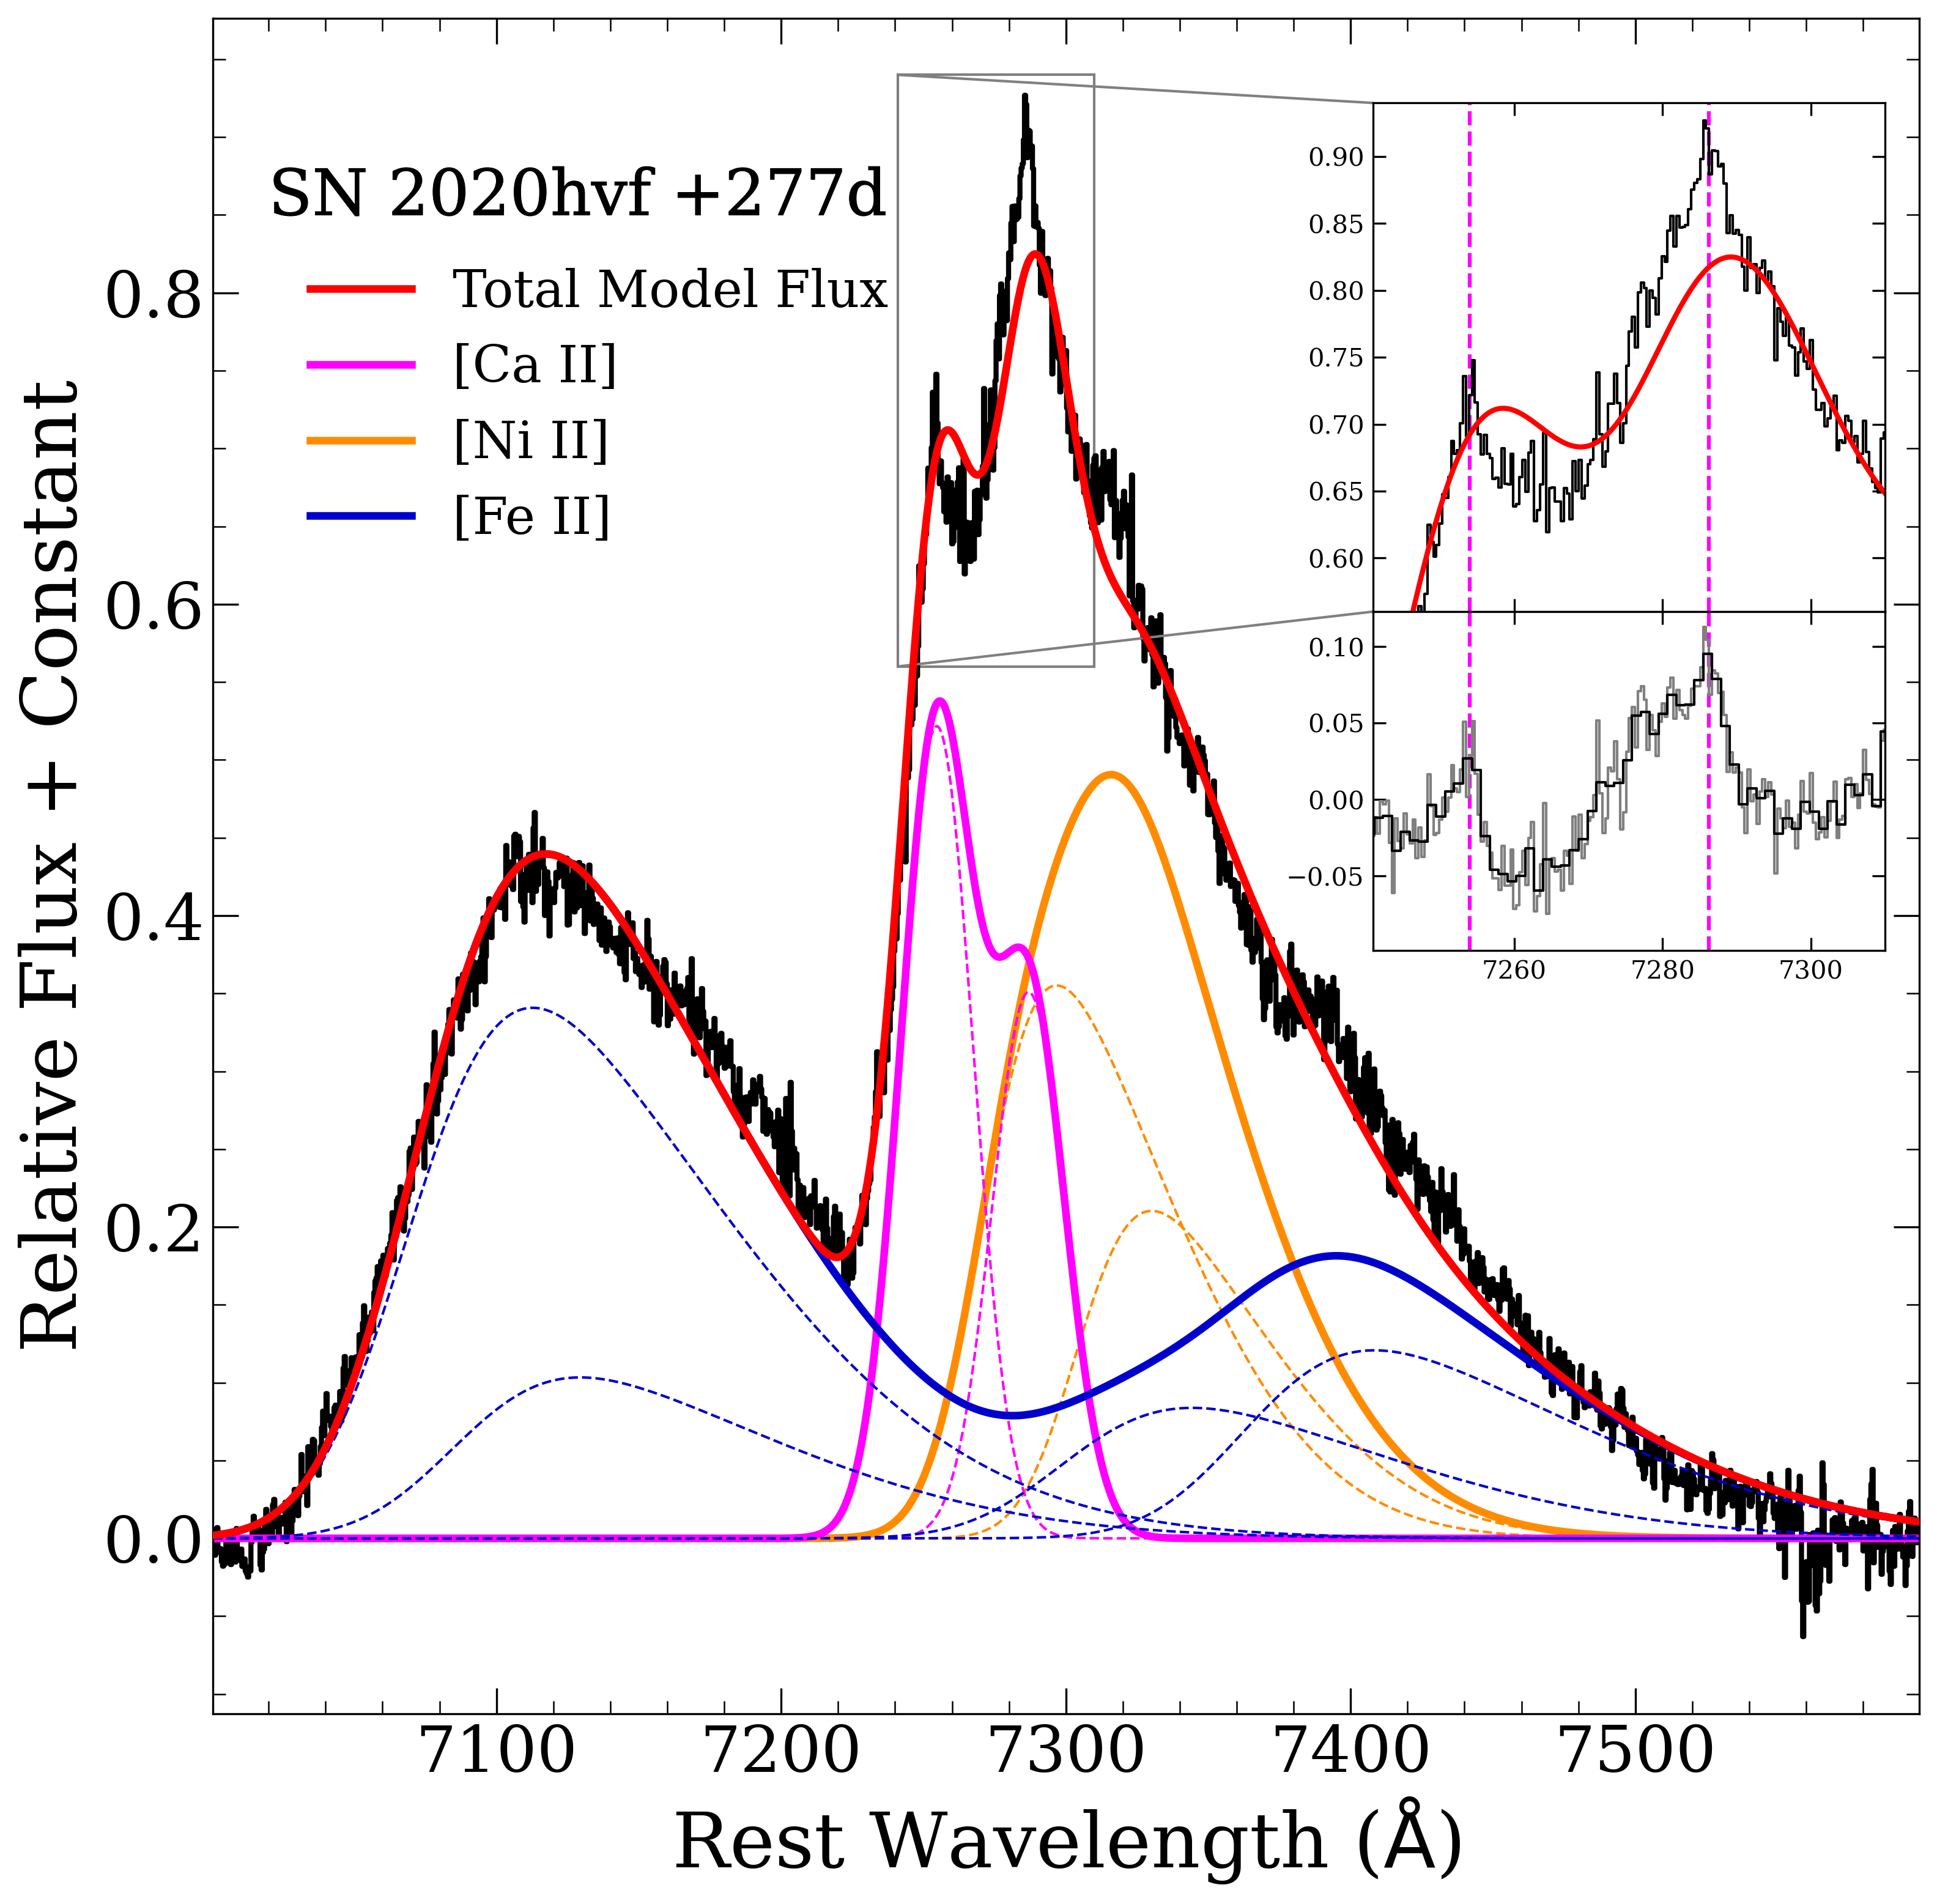
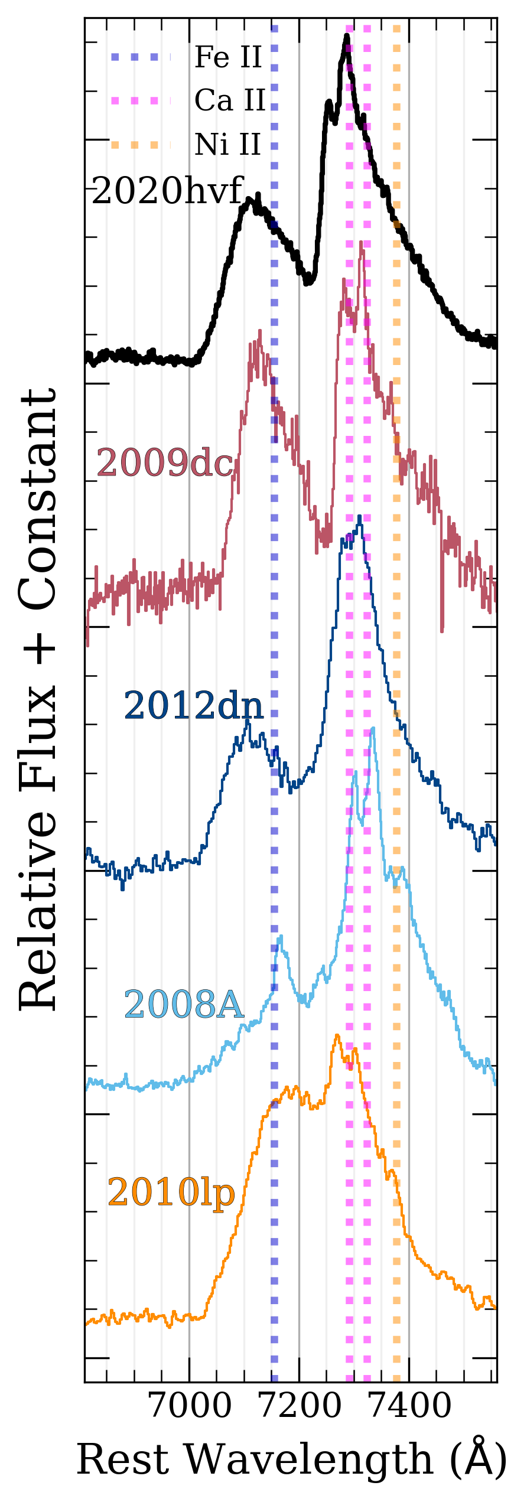
Single velocity components are insufficient
03fg-like
“Saw-Tooth”
profile
SN Iax
02es-like
Siebert et al. 2023
Notes:
Saw-tooth steep blue edge and shallow-sloped red edge seem to be a common feature of 03fg-like
Added a skewness parameter to Fe and Ni which does ok.
Single Gaussian component of Ca is not sufficient to explain triple peaked structure.
Velocity of this broad component does not match up, the red shoulder is not reproduced well
Look at residuals, there are very narrow components present

Slide 9
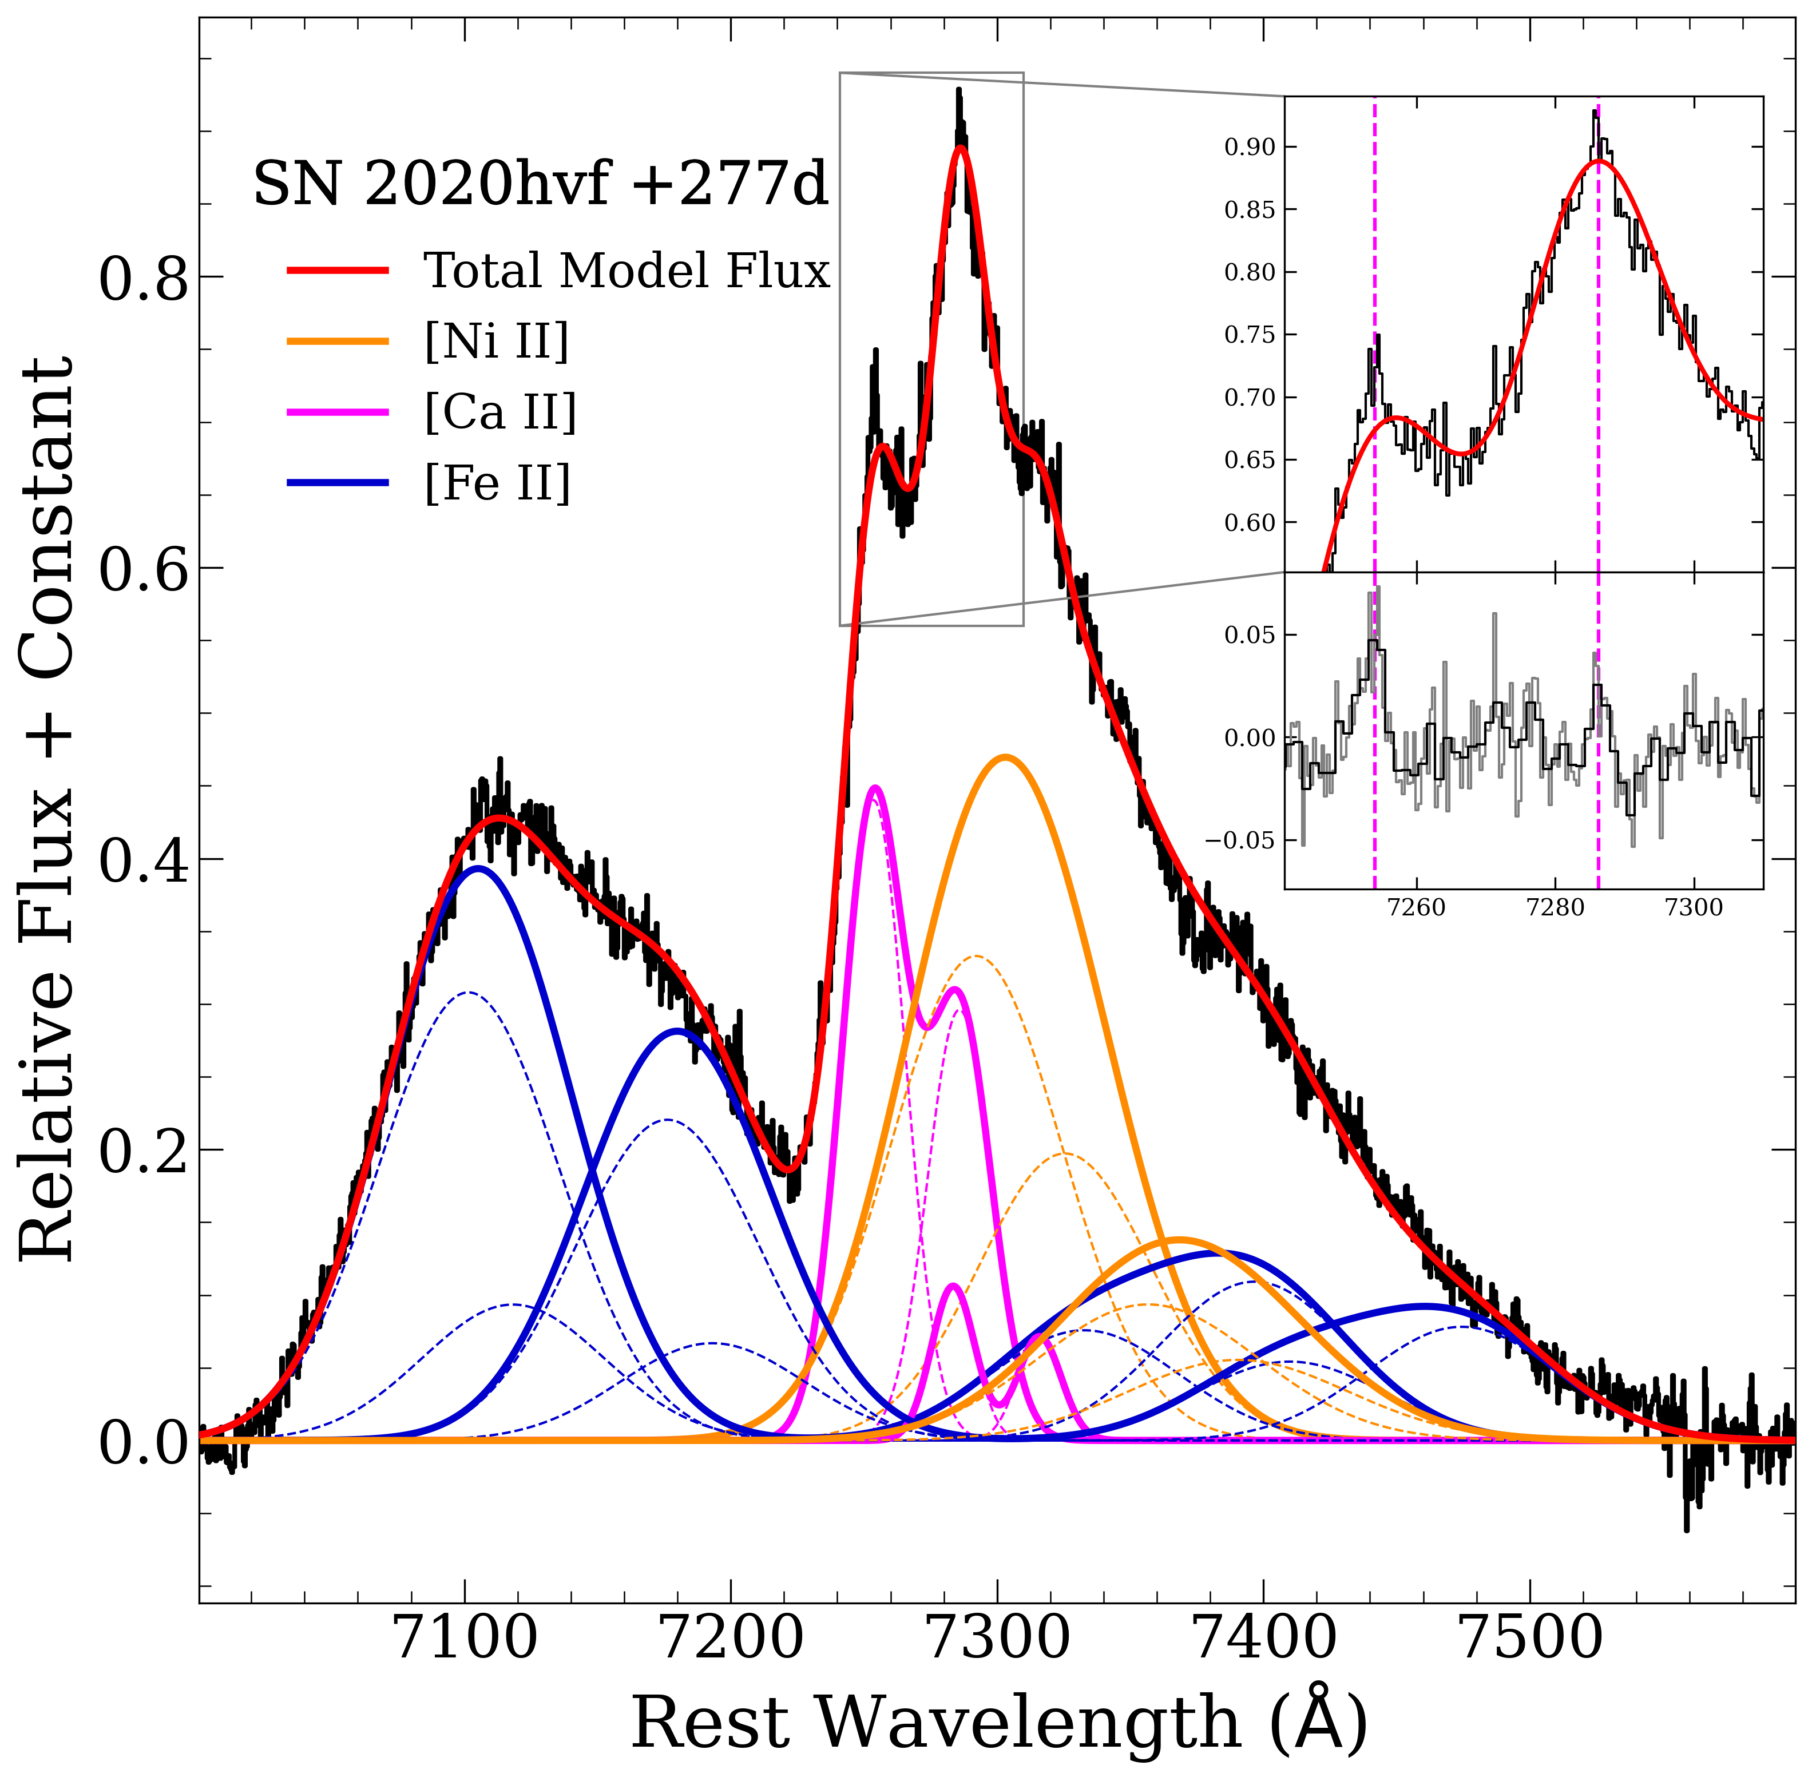
Two broad velocity components are needed to explain “triple-peak”
Siebert et al. 2023
Notes:
Primary change, added a second component of Ca

Slide 10
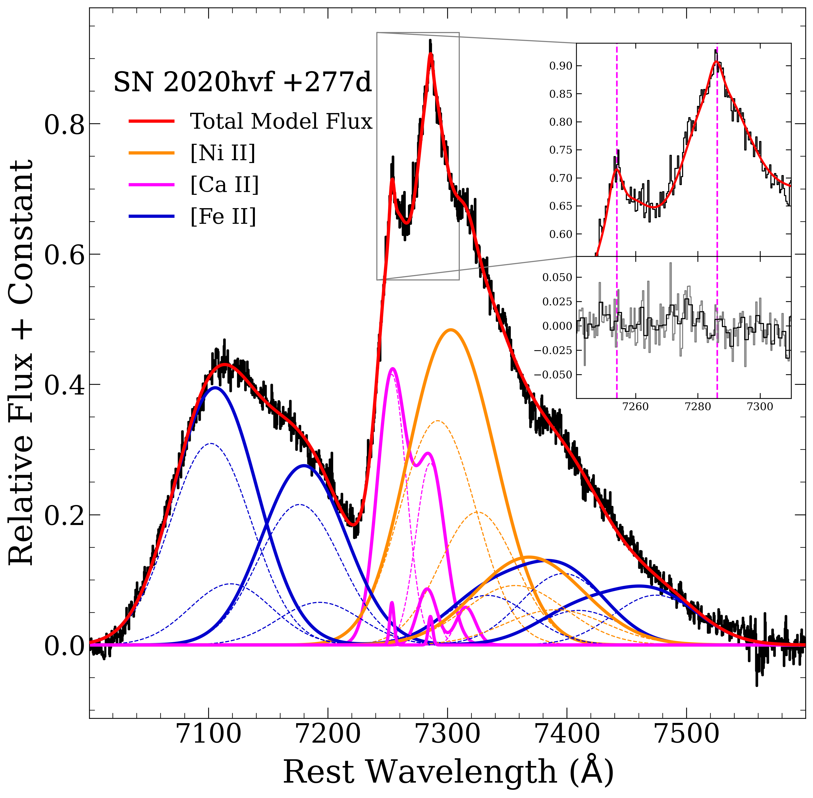
A narrow component of [Ca II] is needed to reproduce the sharp peaks
Siebert et al. 2023

Slide 11
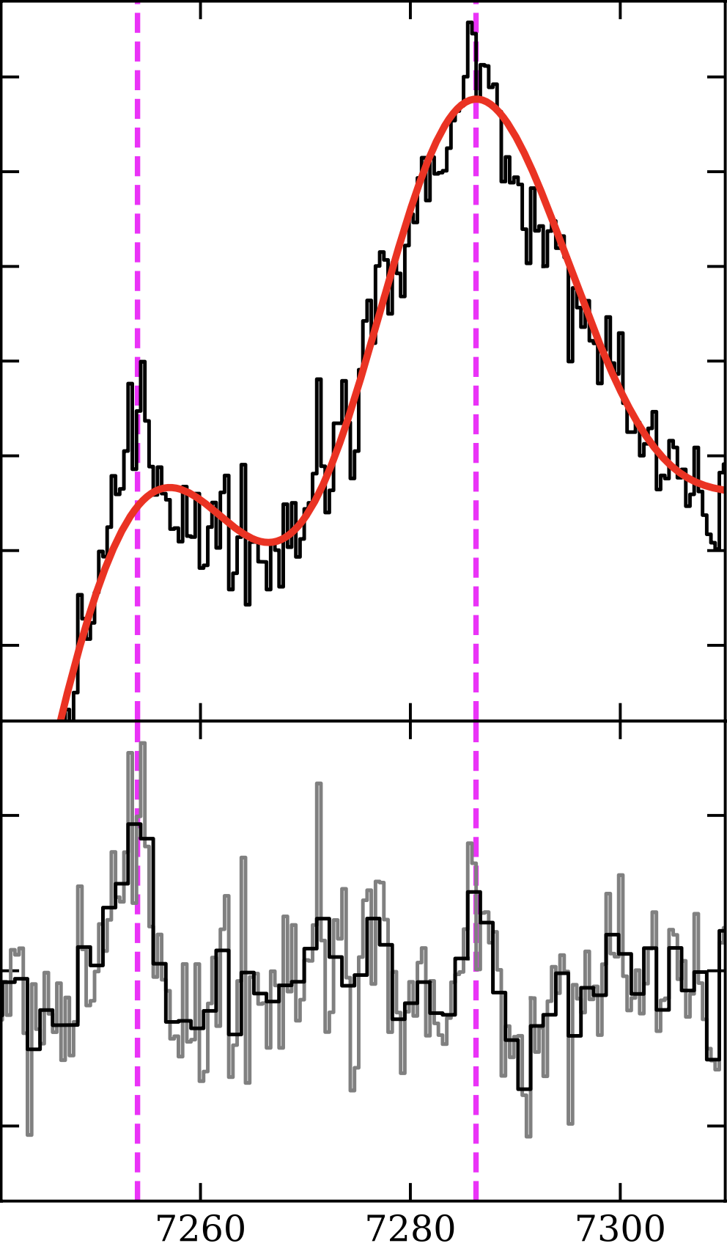
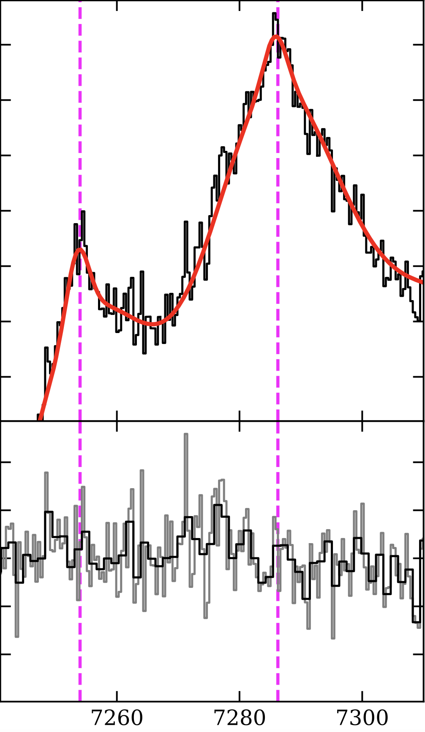
A narrow component of [Ca II] is needed to reproduce the sharp peaks
2-Component Ca
2-Component + 1 Narrow
FWHM = 180 km/s!!
Siebert et al. 2023
Notes:
Comparable ve

Slide 12
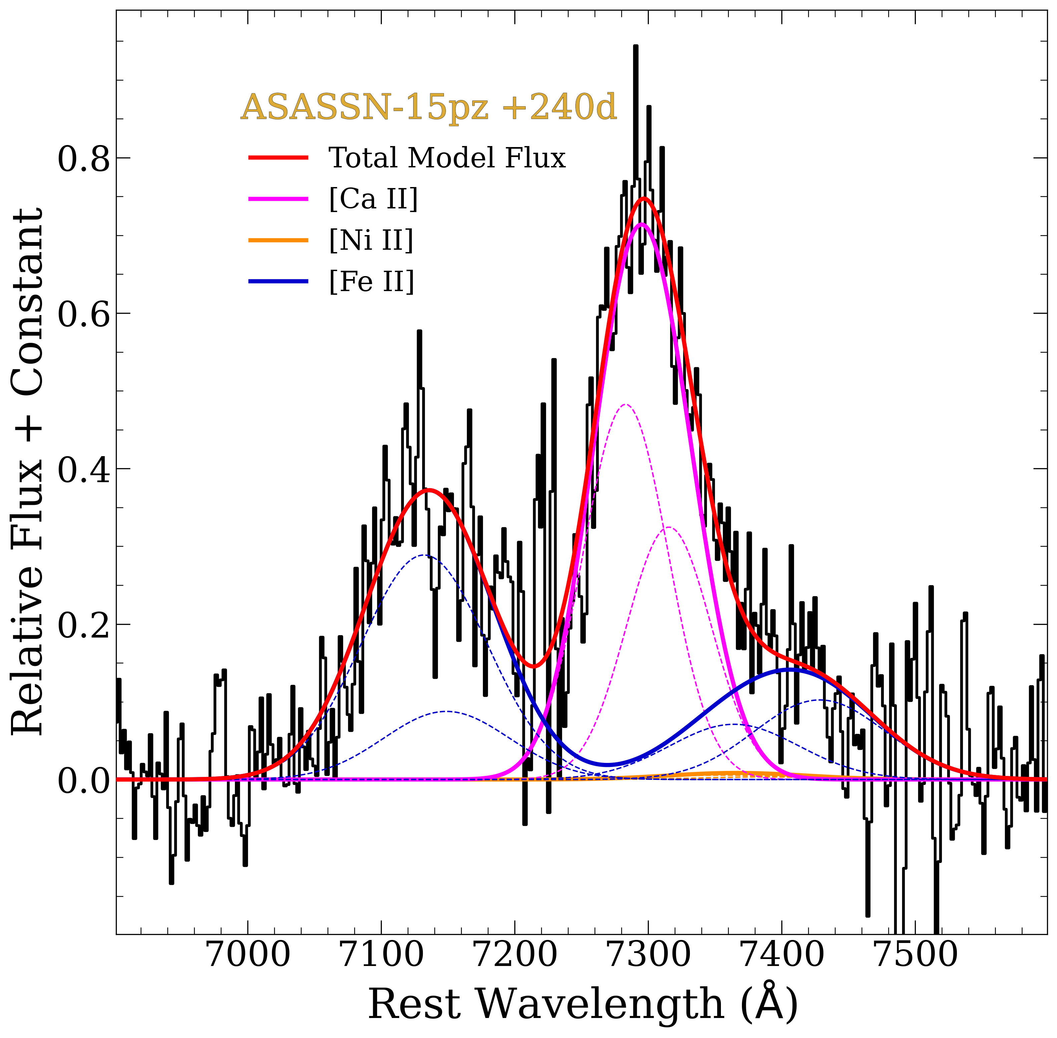
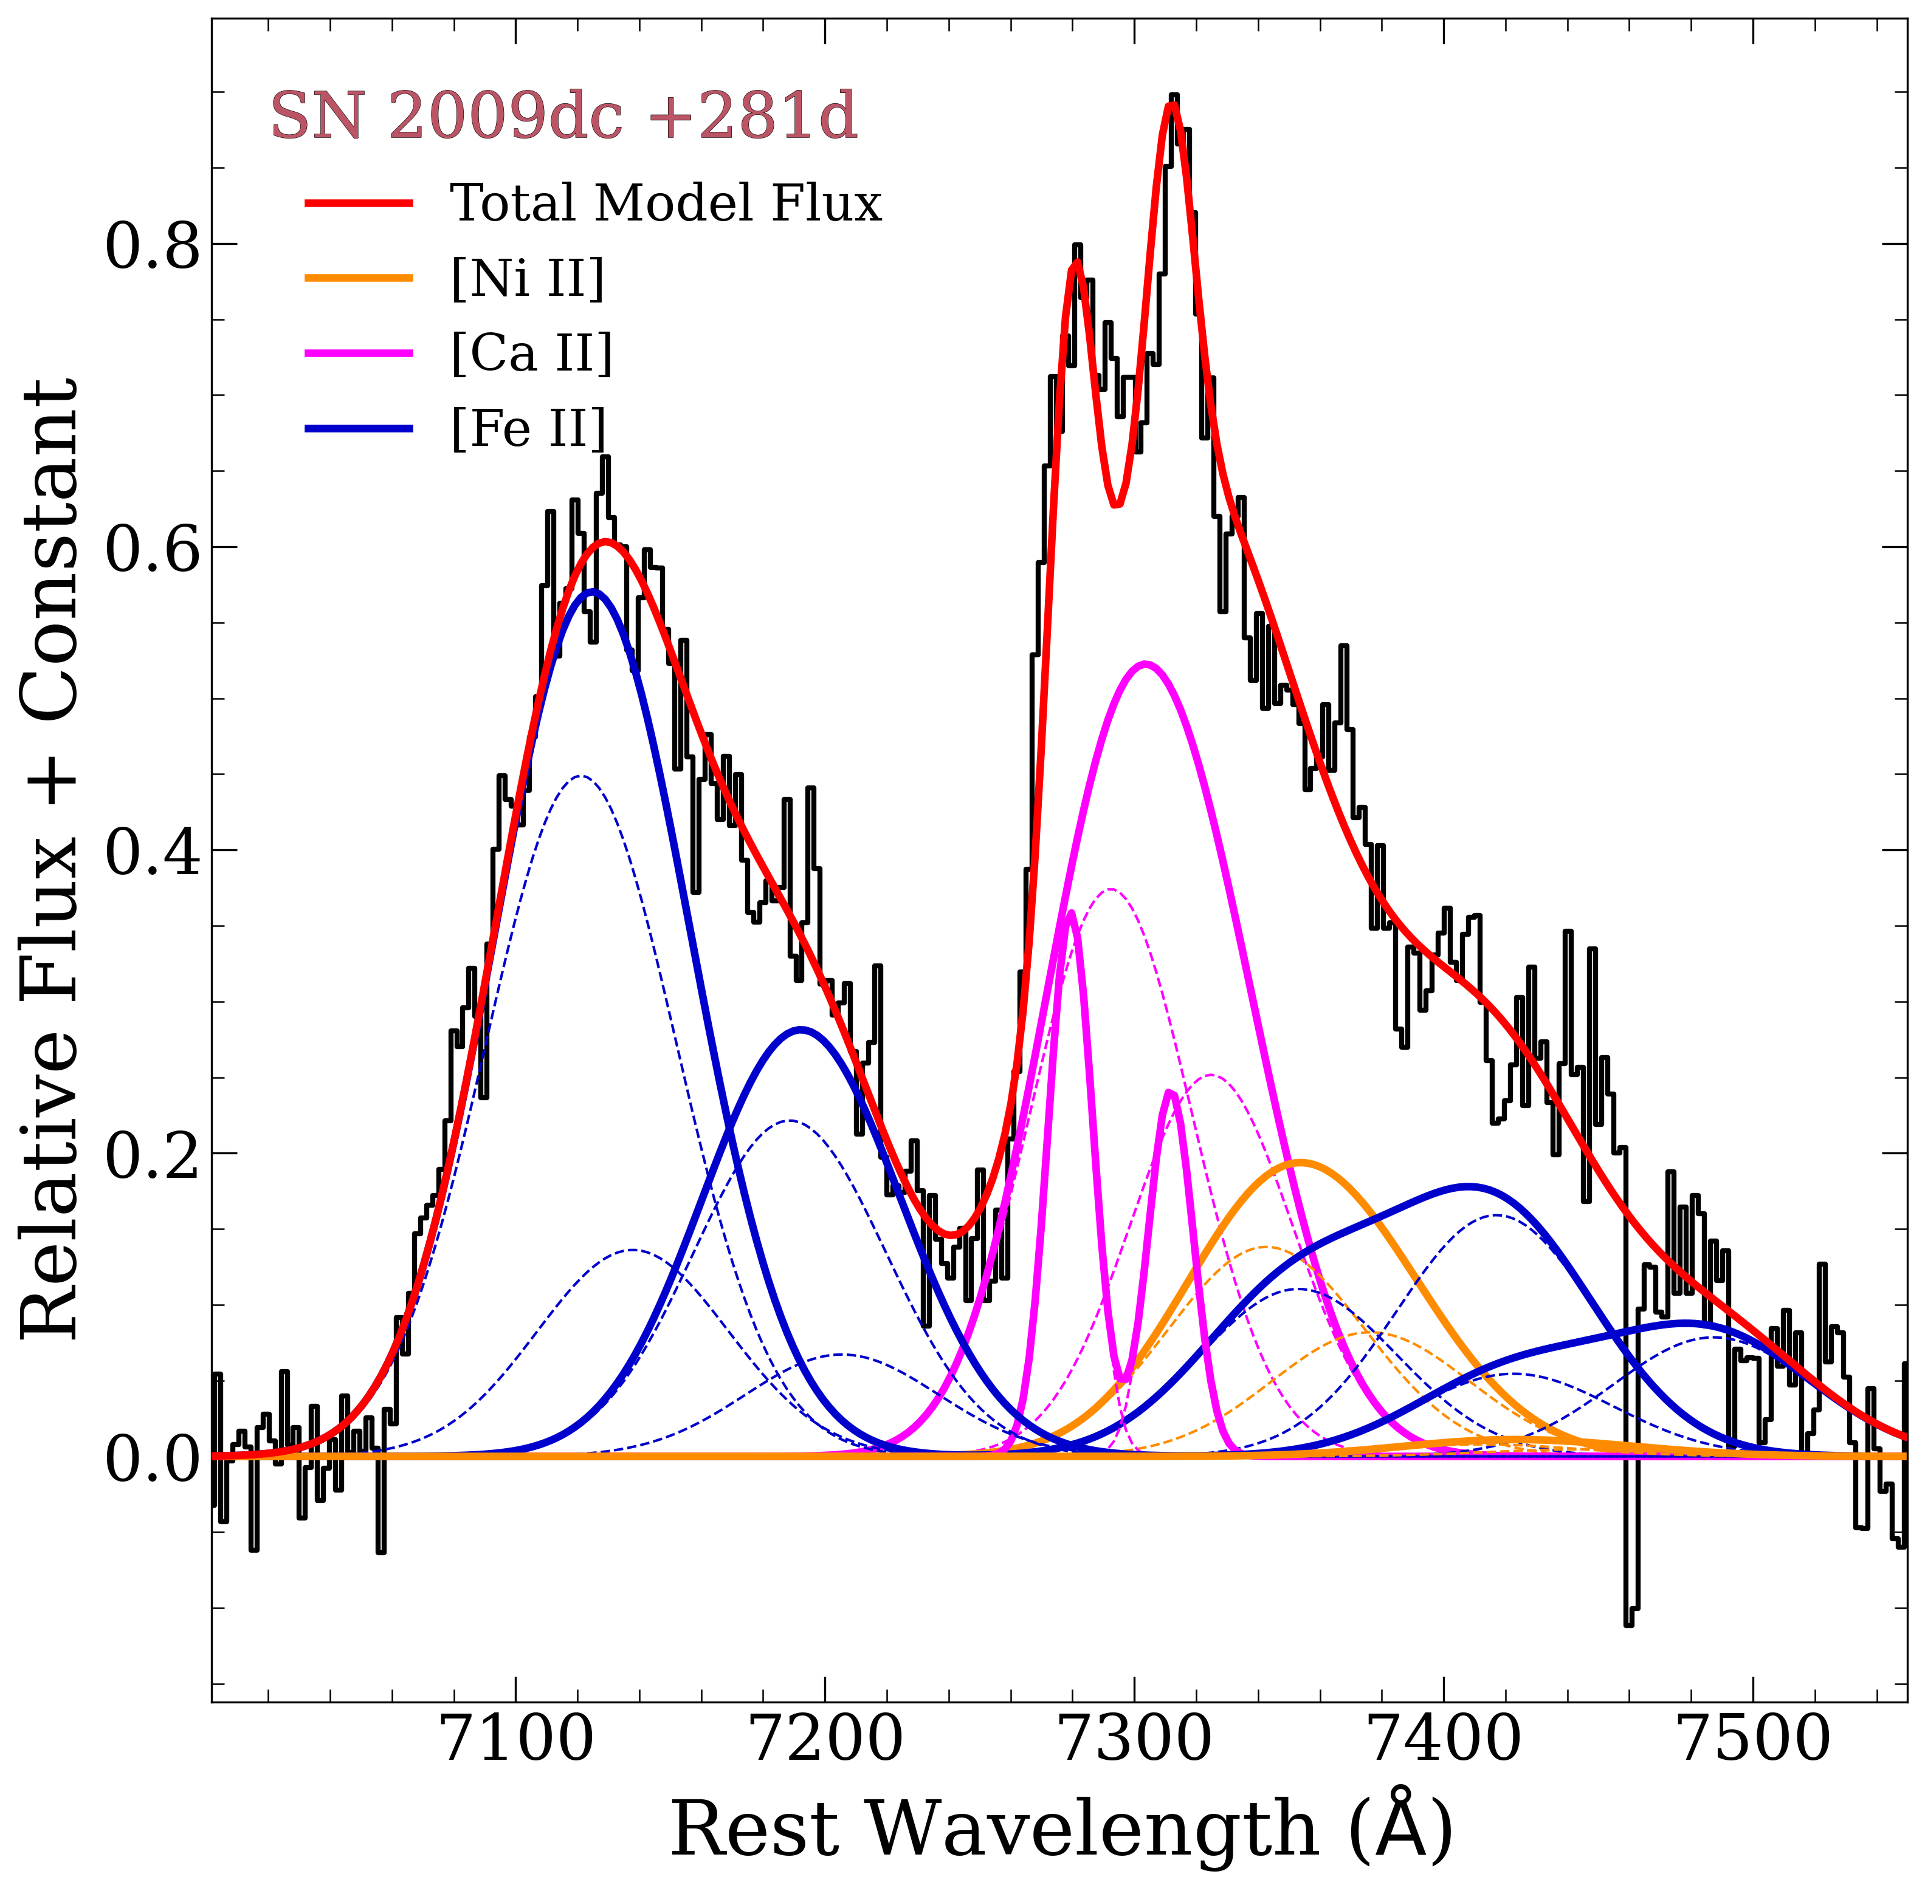
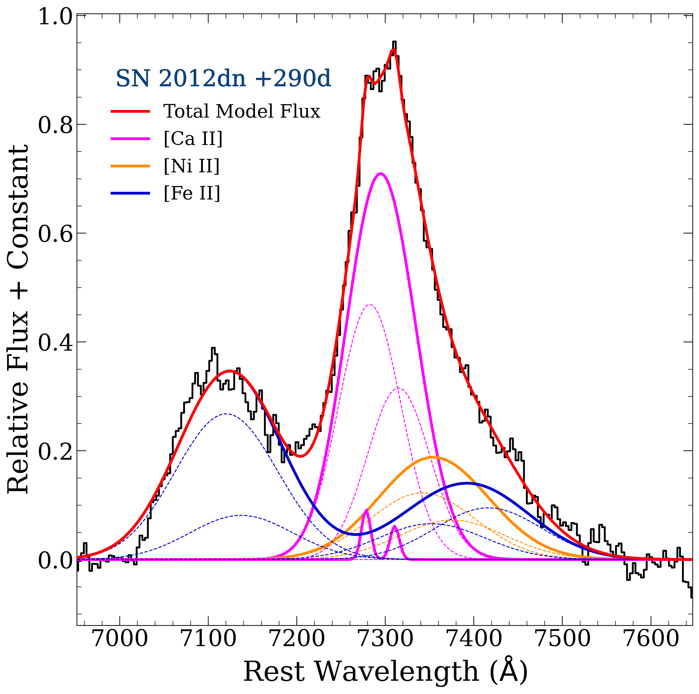
The nebular spectra of Super-M_{Ch} SNe Ia are diverse
2020hvf
2 broad Ca
1 very narrow (180 km/s)
2009dc
2 broad Fe
1 narrow Ca (700 km/s)
2012dn
1 narrow Ca (500 km/s)
ASASSN-15pz
Strong Ca
Weak Ni
Siebert et al. 2023

Slide 13
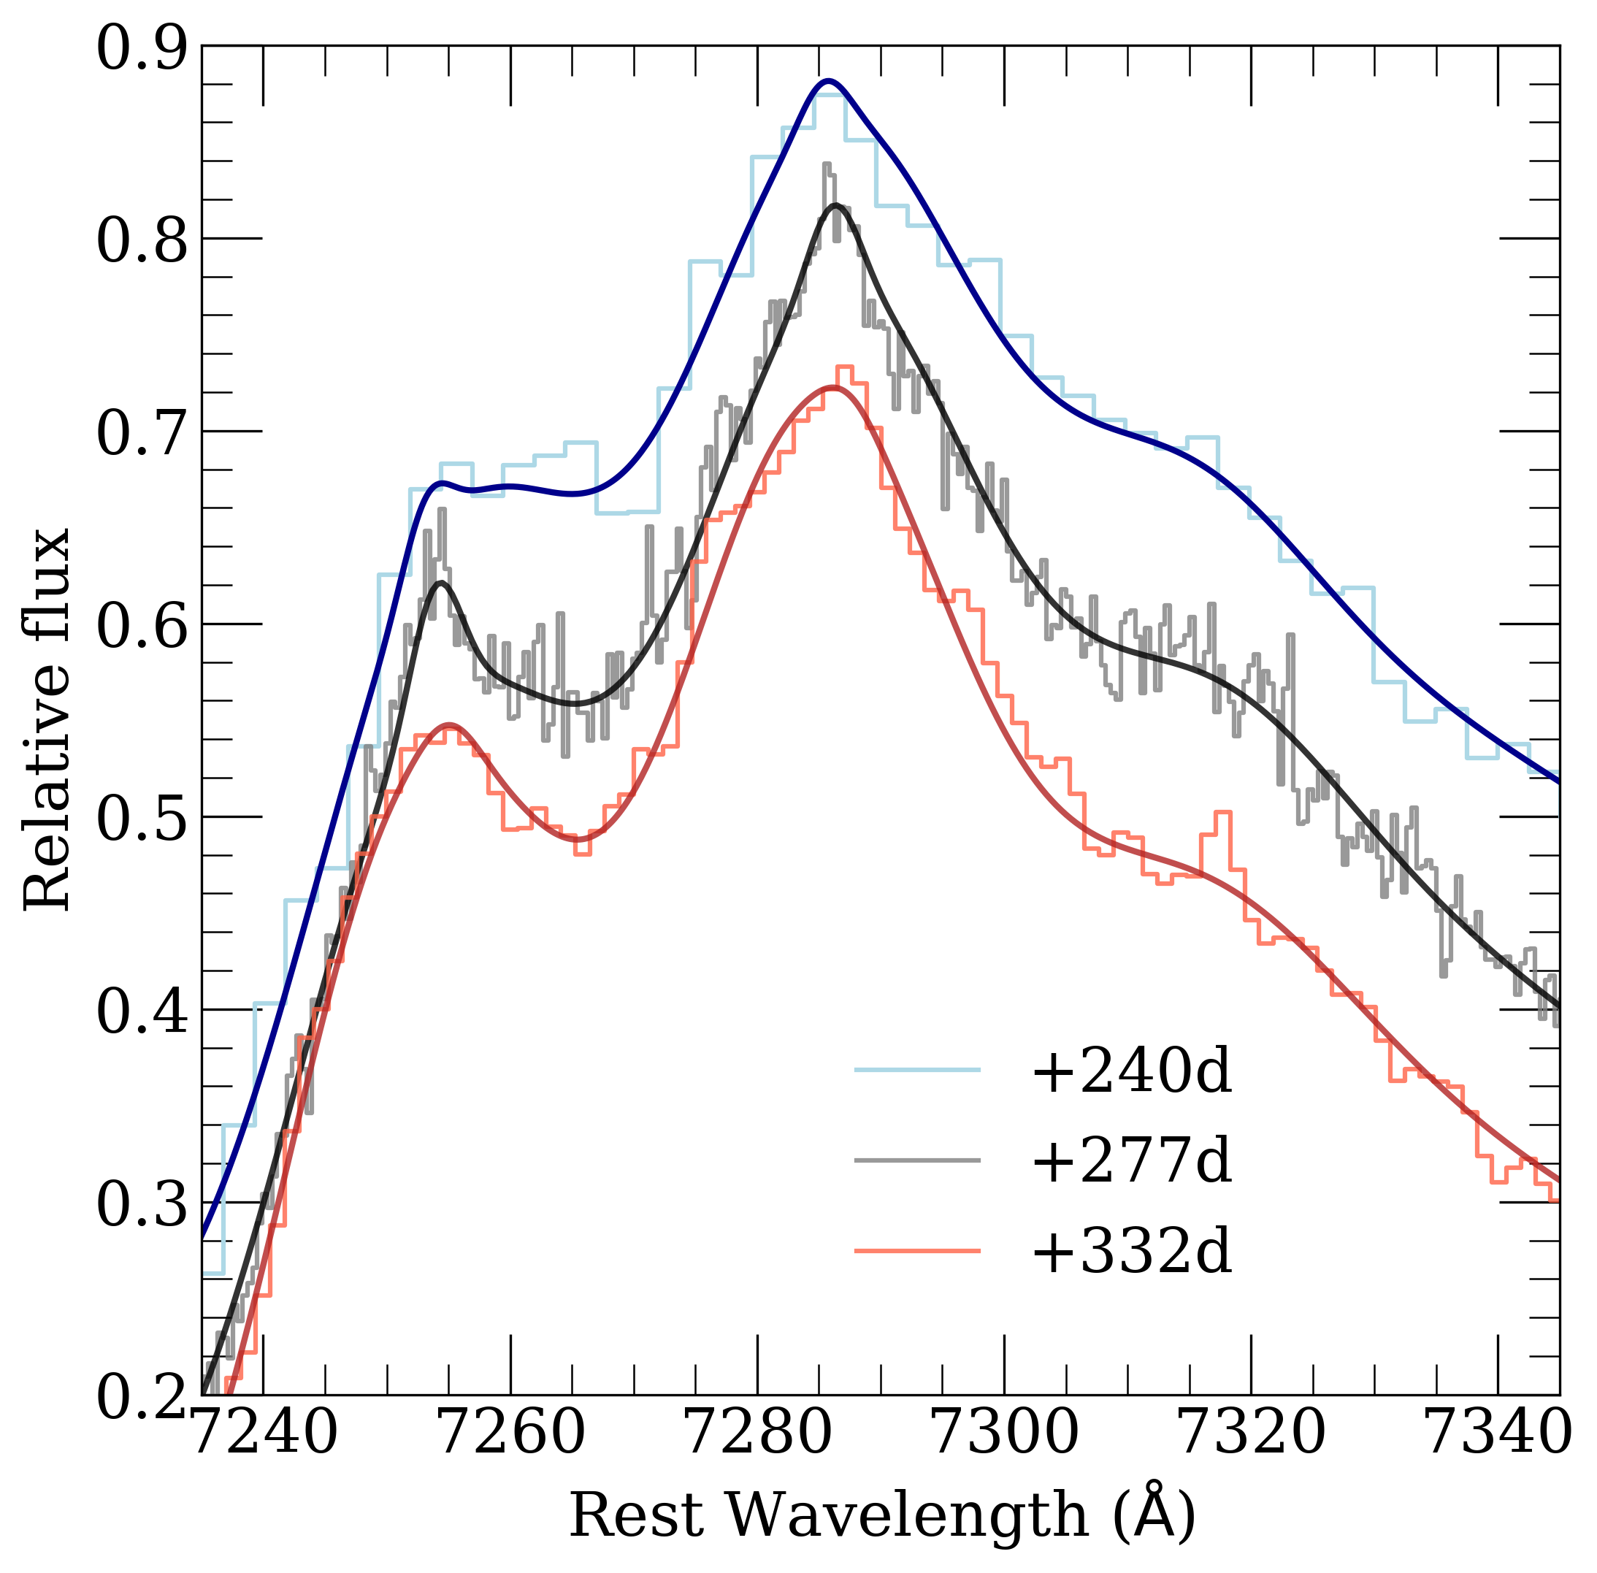
Higher resolution is important for constraining narrow features
Kast: R ~ 3,000
LRIS: R ~ 18,000
LRIS: R ~ 6000
Siebert et al. 2023

Slide 14
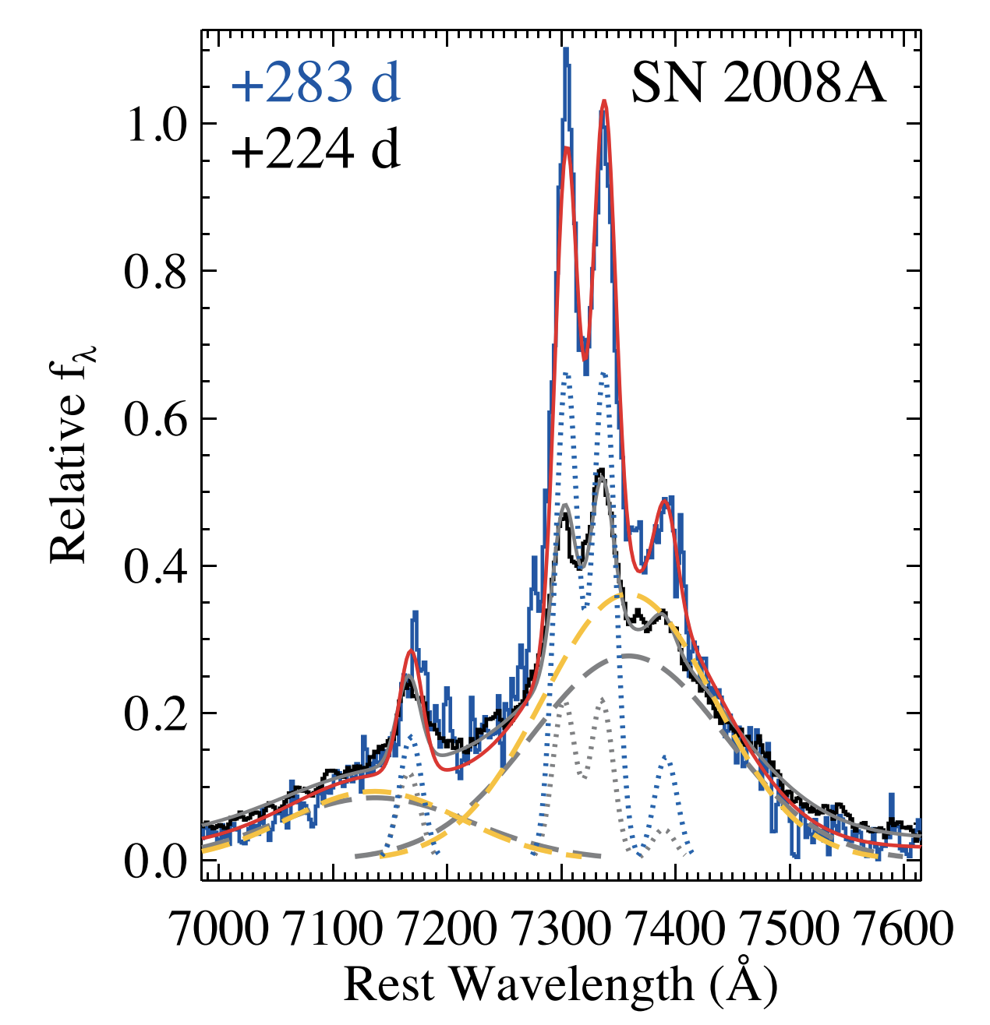
Narrow [Ca II] is not seen in SN Ia but has been observed in SNe Iax
Siebert et al. 2023
Foley et al. 2016
Notes:
Using velocity width and making some basic assumptions, we estimate the mass of the bound remnant to be 0.2Msun.
However, we don’t see narrow Fe or Ni potentially telling us something about the composition of the ejecta.
These still come from very different progenitors but both likely leave behind a bound remnant.

Slide 15
Progenitor System Takeaways
P
S
Highly asymmetric
Significant amounts of radioactive material offset by orbital velocities
High ejecta mass likely requires a DD progenitor system
Extremely low-velocity Ca offset from systemic velocity indicates a surviving companion star
Check out the paper! arXiv:2306.11788
Future observations:
High resolution spectra are needed of Super-Chandra events
JWST spectroscopy - SN 2022pul…
?
BR
Notes:
Regardless of the exact details of the fit. There is clearly a narrow component of Ca offset by -1500 km/s.

Slide 16
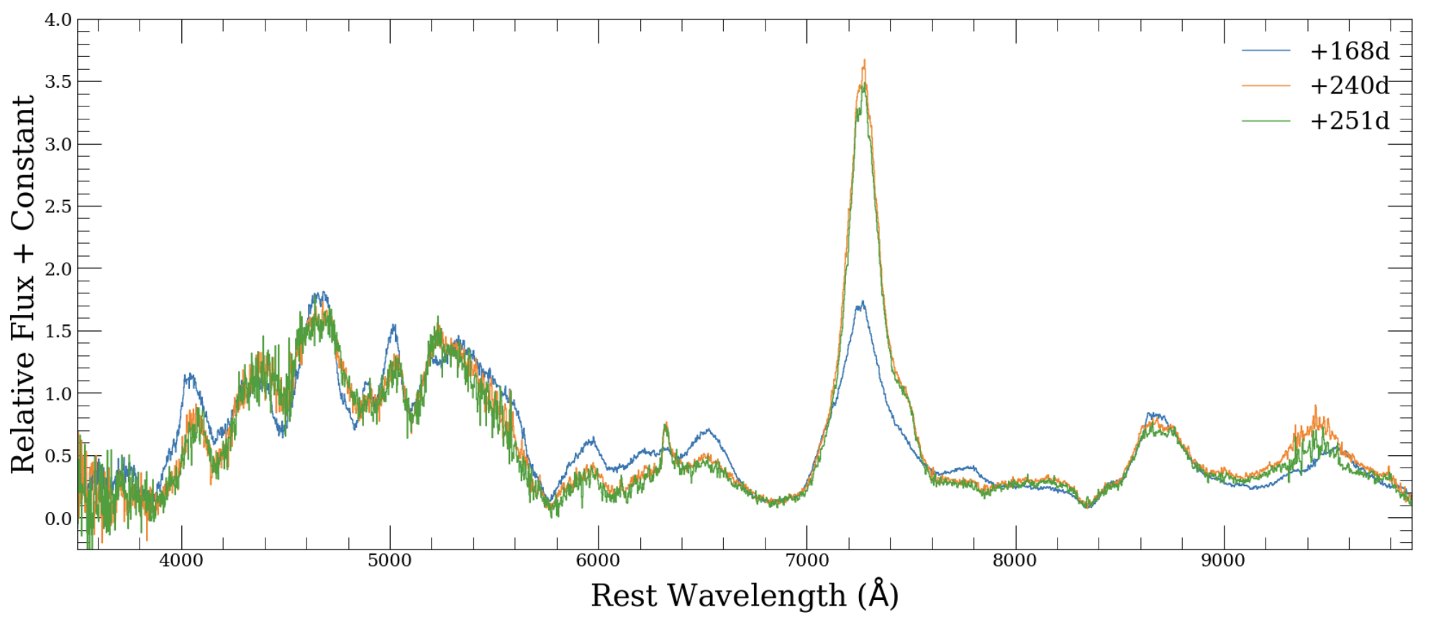
SN 2022pul is bonkers!
Narrow [Ca II] ?
[O I]
Notes:
Strongest Calcium I have seen in a SN Ia. Oxygen pops up out of nowhere

Slide 17
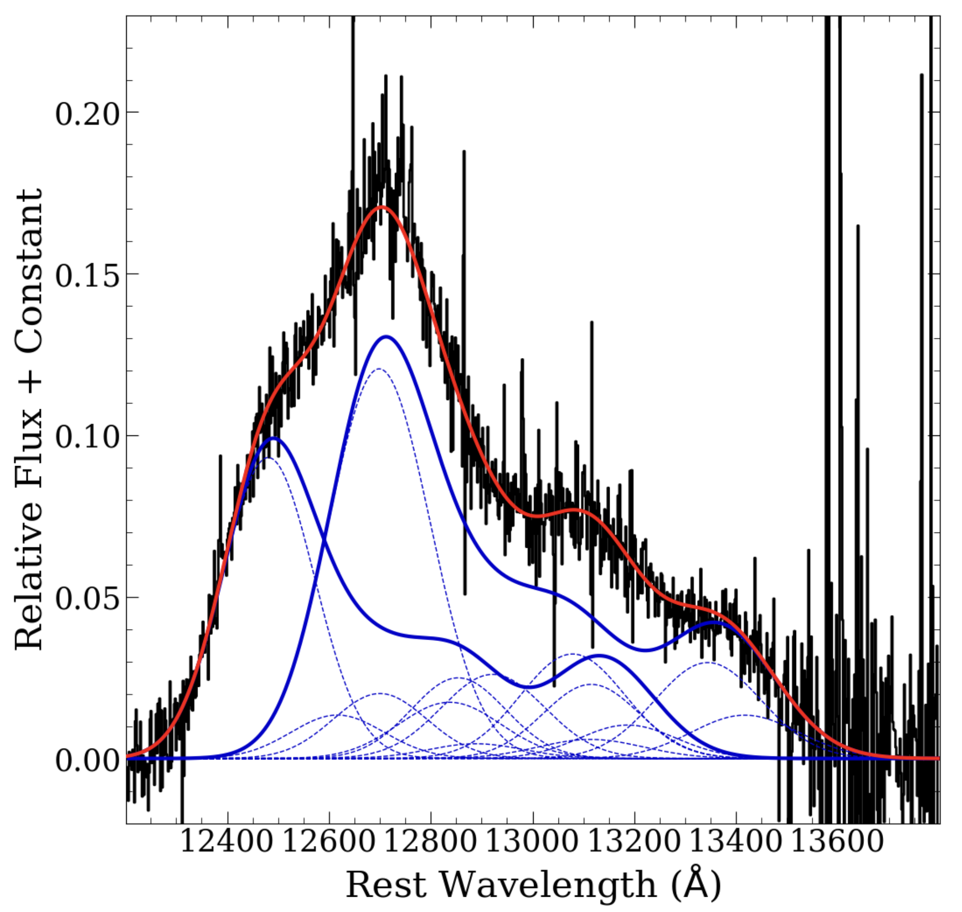
NIR nebular features require multiple Fe components
SN 2022pul – Super-M_{ch}
Normal SNe Ia
KITS!
[Fe II]
Maguire et al. 2018

Slide 18
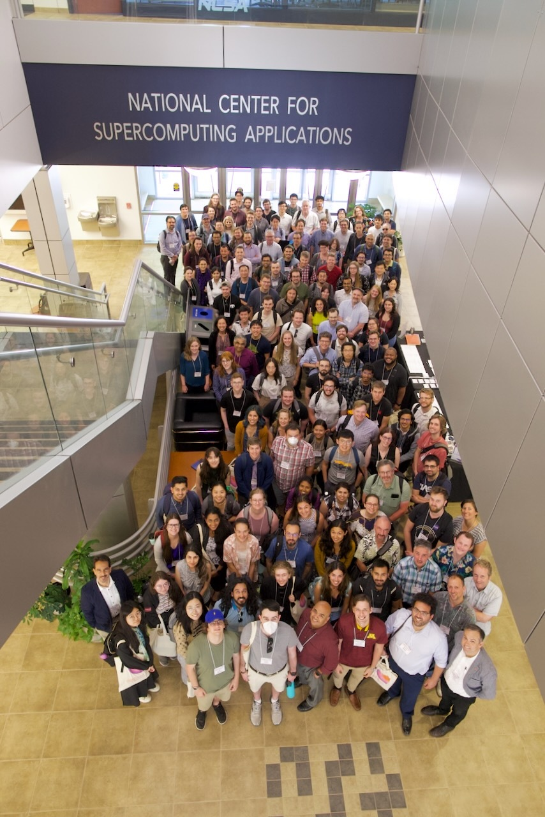
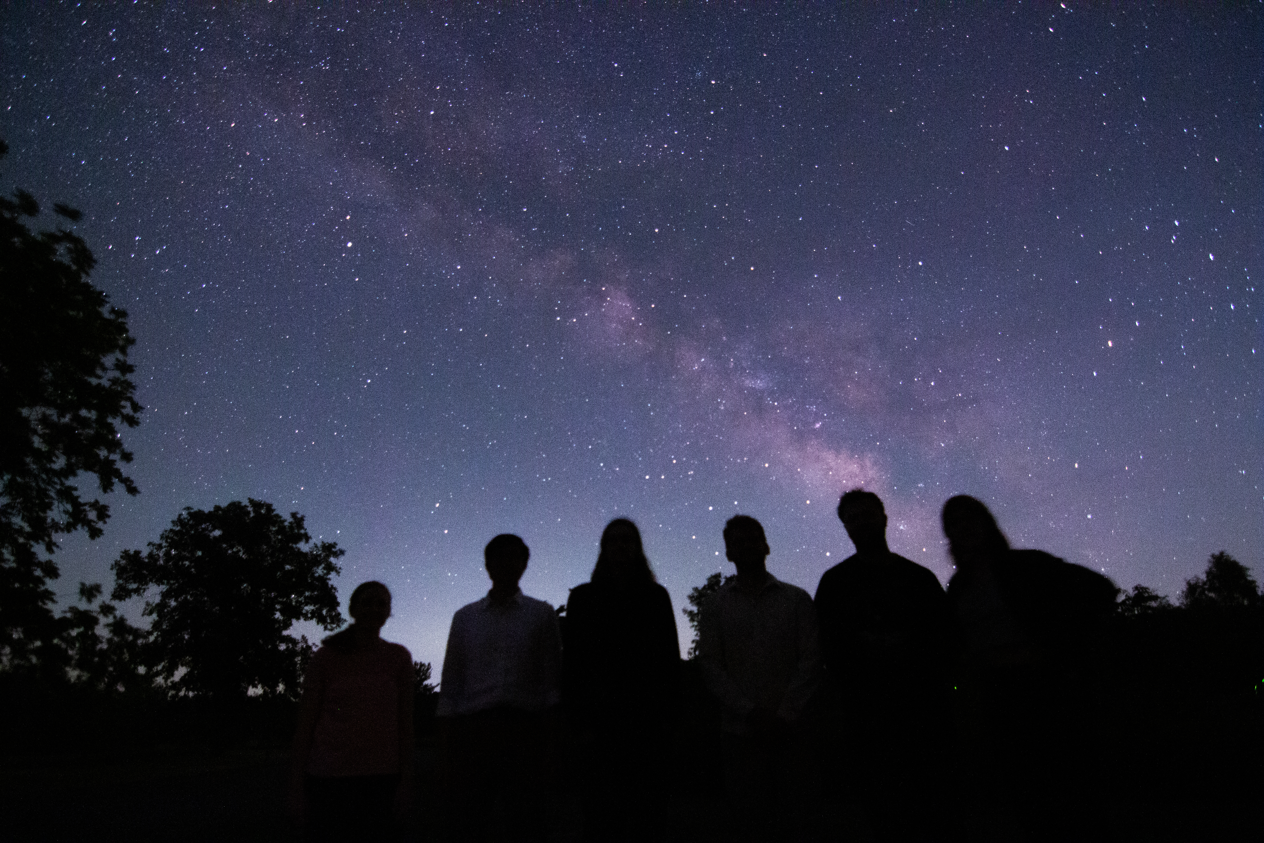
BOOM!
Image Credit: Chris Ni

