Slide 1
Crystal Ball Gazing of the TDA Landscape
S. R. Kulkarni
California Institute of Technology
Pasadena, California

Slide 2
Framework for forecasting
Nature turns out to richer in imagination than scientists.
In phenomenological subjects such as astronomy and biology discoveries are driven by technology (and rarely ideas)
So forecasting is best done by seeing where the technical gains are the largest
These gains have traditionally been via hardware (bigger telescopes, better detectors) but of late algorithms and analysis have ascended to similar levels
Confluence of advances can itself result in great advances (e.g., Gaia astrometry combined with highly multiplexed spectroscopy)

Slide 3
Stellar Astronomy: A Rebirth
Gaia astrometry was a once in a century leap in astrometry (0.1 mas, all sky)
  Volume limited samples for all classes of stars
  Galactic Dynamics with Chemical tagging
Separately this field is being driven by Confluence
  Highly multiplexed spectrographs (DESI, SDSS-V, GALAH, WEAVE, 4MOST)
  MESA! (stellar modeling at your finger tips)
  Highly cadenced light curves (ZTF, ATLAS, ASAS-SN,…)
From small samples to astrophysically complete samples

Slide 4
Transient object astronomy
This general area has many sub-fields with varying levels of maturity
  Optical TDA is most advanced and is now a mature field
  Radio FRBs is advancing rapidly and will shortly peak (mature)
  Non-FRB Radio TDA is lumbering along and will likely peak by end of decade
    slow rate of discoveries, primarily long lived transients
  X-ray TDA is flourishing with both discovery engines (SRG, and soon Einstein Probe) and an armada of follow up facilities
  NIR TDA is rising (ground based: PRIME, WINTER; space-based: WISE, EUCLID, Roman)
  UV TDA has been lagging and there are huge opportunities for growth

Slide 5
Roadmap for the talk
List upcoming facilities in this decade
List areas which are mature and very productive (“industrial”)
List sub-fields areas which are approaching maturity and very productive (“cottage industries”)
Discuss areas which will likely grow rapidly or where breakthroughs can be anticipated
In all cases by crystal ball gazing is limited to the rest of the decade.

Slide 6
A trove of new missions and facilities
SVOM (Sino-French): GRBs [2024]
Einstein Probe (China): wide-field soft X-ray transients [2024]
LSST [2025]
ULTRASAT (Israel, Germany, US): Shock breakout, UV [2026]
UVEX (US): UV Imaging & Spectroscopic Explorer [step 1; 2029]
STAR-X (US): X-ray imager with UV camera [step 1; 2029]
------------------------------------------------------------------------------------------
LSST[2025]
An explosion in Massively Multiplexed Spectrogaphs (GALAH, WEAVE, 4MOST)
MeerKAT→ SKA-1 [2027]
DSA-2000 (under development)
HAWC, HESS, IceCube

Slide 7
Industrial Programs
FRB localizations combined with DESI and photo-z catalogs will advance CGM and IGM studies
  Cottage industry: the origin of FRBs (beyond magnetars)
Supernova Cosmology (LSST)
Stellar astronomy with LSST
  LSST will be the greatest photometric engine of our times
  By year 5 of LSST stellar astronomy will be dominated by precision photometry provided by LSST

Slide 8
Well established cottage industries
The Magnetar Revolution
  Super-luminous supernovae (LSST)
  Connection between FRBs and magnetars
  ultra-long duration pulsars
Systematic studies of young supernovae
  Flash spectroscopy (ZTF, YSE, DLT40)
Pre-supernova eruptions
  LSST will have a big impact
TDEs
  Intermediate mass black holes?

Slide 9
Nascent Cottage Industries
Common envelope events
  planetary engulfment
  planetary debris disks around white dwarfs
18cow and related phenomenon
  18cow events are being detected routinely with ZTF
  Exotic behavior (brightest, long lived, short term variability)
  Magnetars or Intermediate Mass Black Holes????
Millimeter wave TDA
Lens Magic!
  Lensed supernovae
  Lensed shock breakout
  Lensed single stars at high redshift

Slide 10
On the horizon
GW Astronomy
  Without doubt the most important advance in my life
  Alas will be paced by the slow improvement in localization of GW facilities
Shock breakout (ULTRASAT)
Connection between black-black hole coalescences which take place in AGN nuclear regions and possible EM signal
Novel discoveries discovering from spectroscopy (as opposed to the traditional imaging followed by spectroscopy)
  4MOST+LSST and related programs

Slide 11
Questions that intrigue me

Slide 12
Relativistic Transients
Beppo-SAX and HETE-2 identified X-ray flashes but their population has now grown.
Is there a class of dirty fireballs? SVOM and EP to the rescue?
If not, it may well be that there are two types of GRBs: successful (jets) and not so successful (quasi spherical explosion)
Willingale & Meszaros 2017

Slide 13
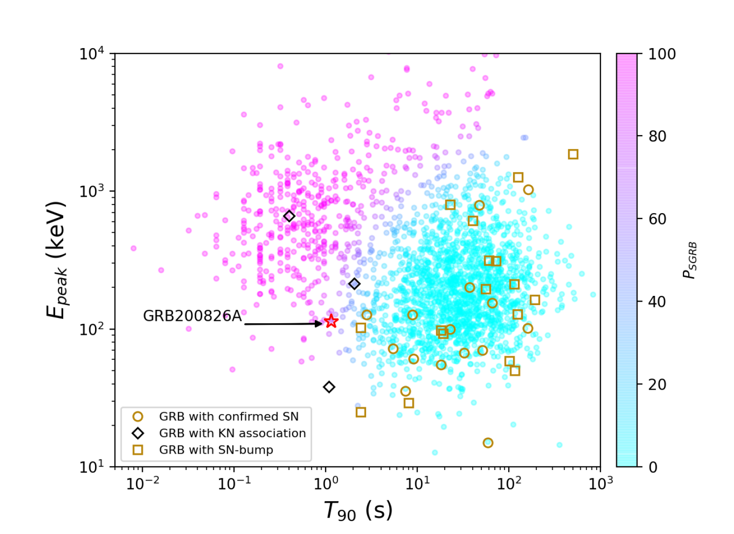
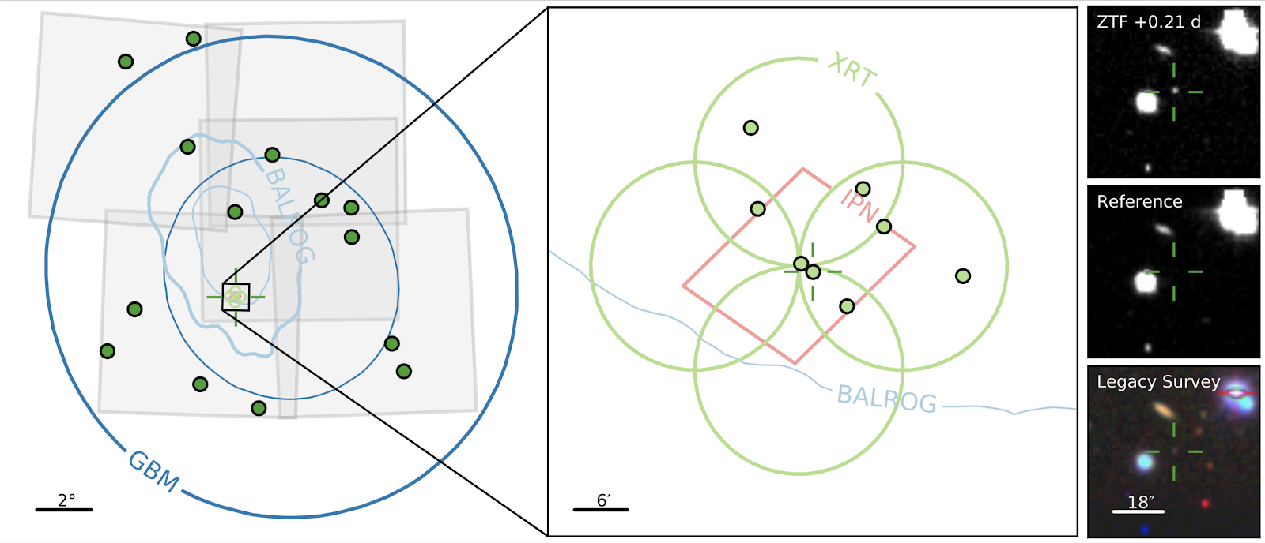
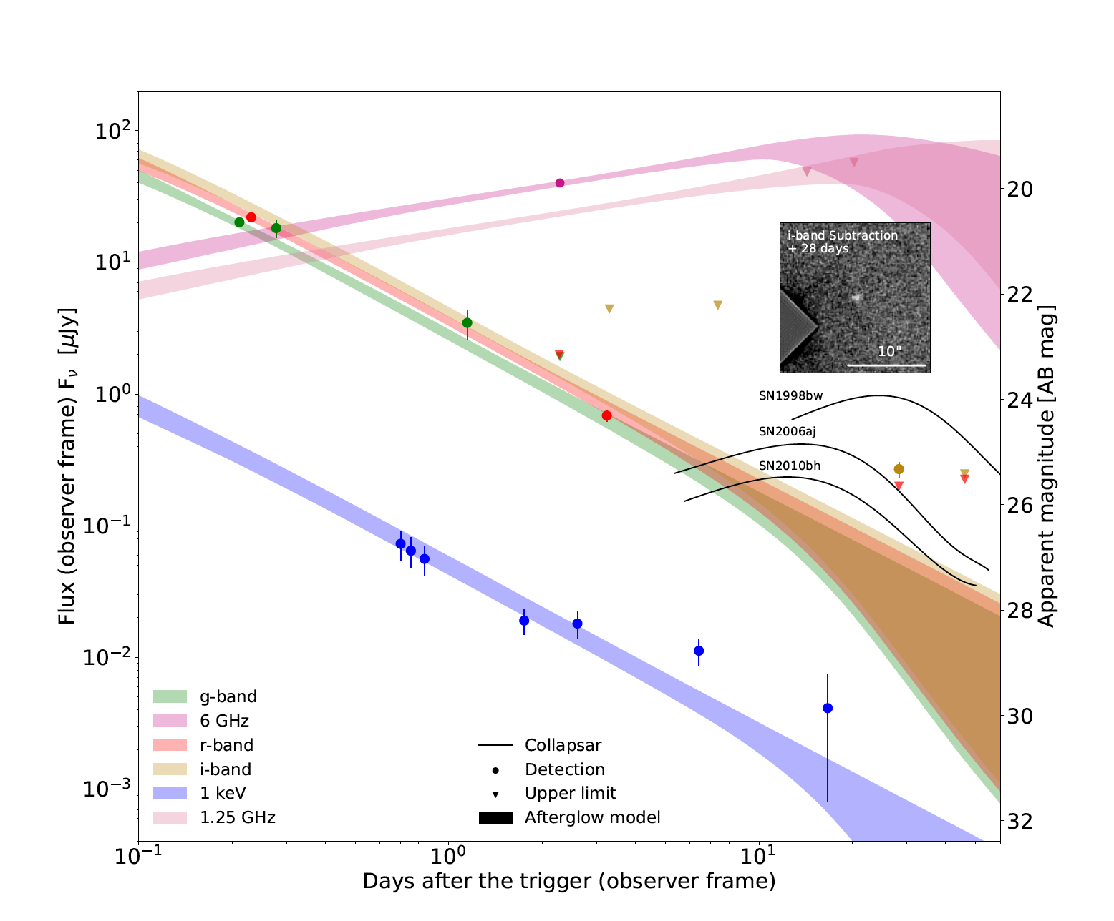
Topsy-Turvy!
GRB170817A
GRB200826A - SGRB from a collapsar
90% ~250 sq. degrees
Rest-frame T90 of 0.65 sec
i-band excess 28 days from burst
Consistent with a SN bump
Ahumada et al., Nat. Ast. 2021
Zhang et al., Nat. Ast. 2021
Notes:
With all this in mind I present you the case of GRB200826A. In blue you see the 90% error region of GBM, the ZTF tiles are shown in grey and the candidates found after the first night are in green. Thanks to IPN the region was reduced to a few square arcminutes and XRT was able to tile, observe, detect and circulate Xray objects in the field. Only one of them had a ZTF counterpart that was consistent with our filtering criteria. These are the cutouts of the ZTF source and the faint host galaxy.

Slide 14
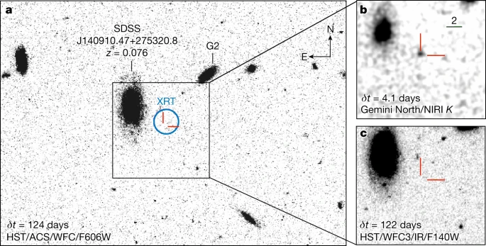
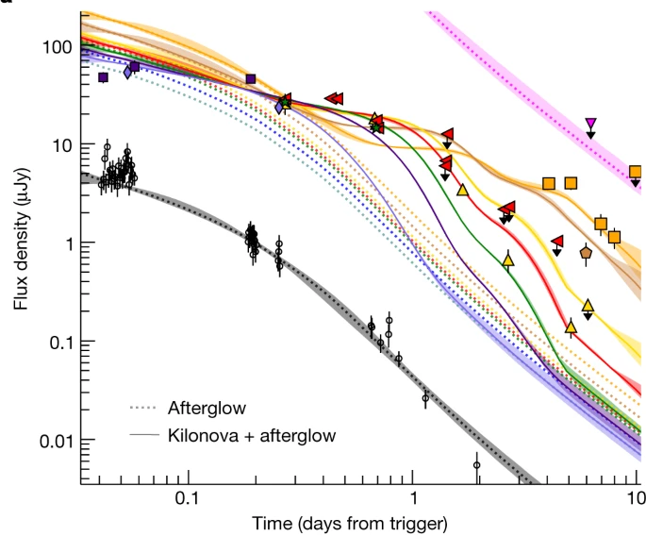
GRB170817A
GRB060614
GRB211211A
GRB211211A - LGRB from a merger
Rest-frame T90 of 65 sec
K-band excess 3 days from burst
Consistent with AT2017gfo
Rastinejad et al., Nat. 2023
Troja et al., Nature 2023
Yang et al., Nature 2023
Notes:
With all this in mind I present you the case of GRB200826A. In blue you see the 90% error region of GBM, the ZTF tiles are shown in grey and the candidates found after the first night are in green. Thanks to IPN the region was reduced to a few square arcminutes and XRT was able to tile, observe, detect and circulate Xray objects in the field. Only one of them had a ZTF counterpart that was consistent with our filtering criteria. These are the cutouts of the ZTF source and the faint host galaxy.

Slide 15
Long duration phase space

Slide 16
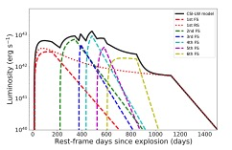
iPTF14hls and related events
M(CSM)+M(ejecta)=245 Msun
(pulsational pair instability?)
L-J Wang et al. 2022
Wang et al. 2020, Sollerman et al. 2018, Arcavi et al. 2017

Slide 17
GRB remnant: FIRST J1419+3940
Mooley et al 2022.

Slide 18
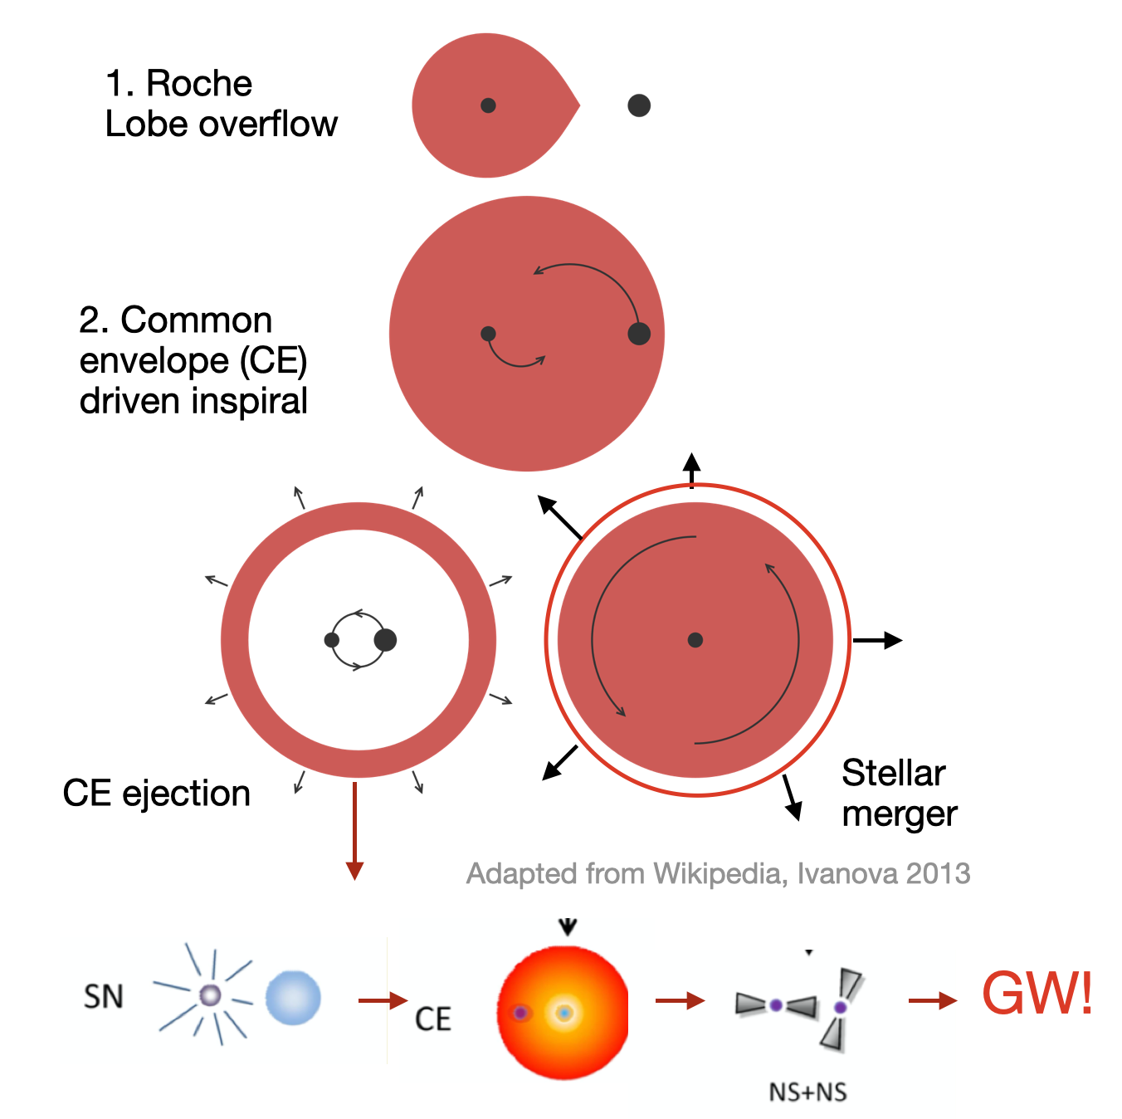
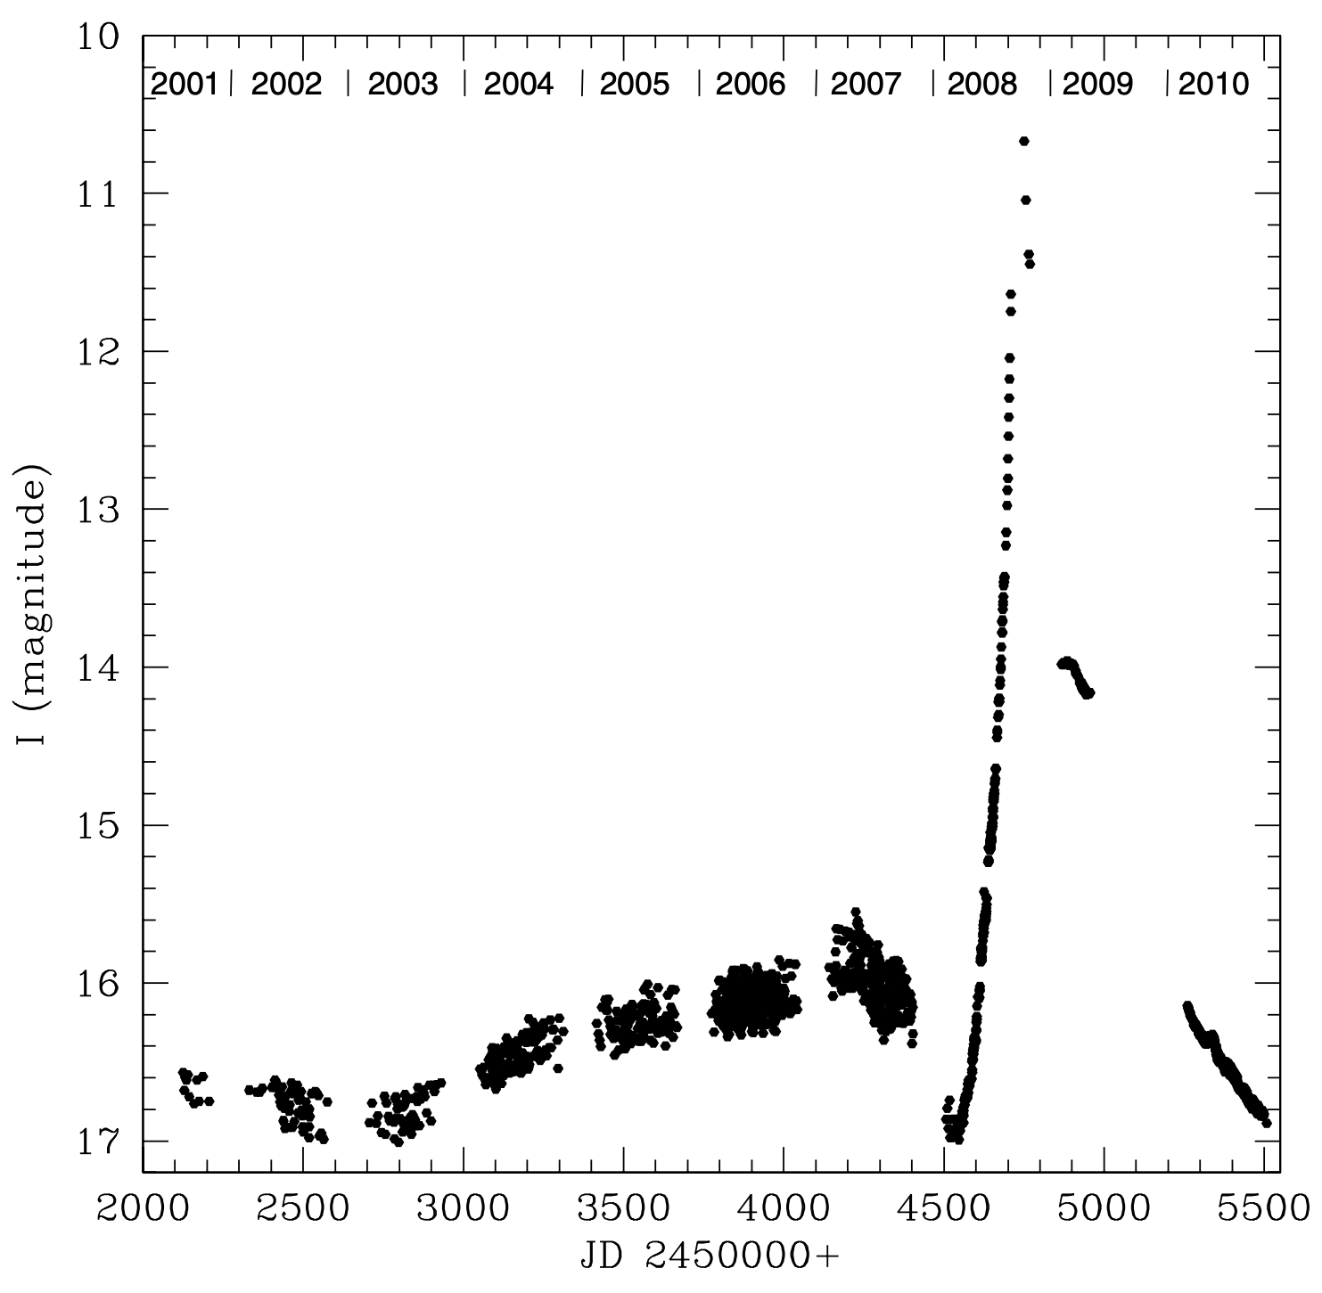
Luminous Red Novae
Probes of common envelope evolution in massive binaries
Tylenda et al. 2011
LRN!
V1309 Sco – prototypical Milky Way main-sequence merger
~Two dozen LRNe have been discovered in the last decade (Pastorello+2019, Karambelkar+2023)

Slide 19
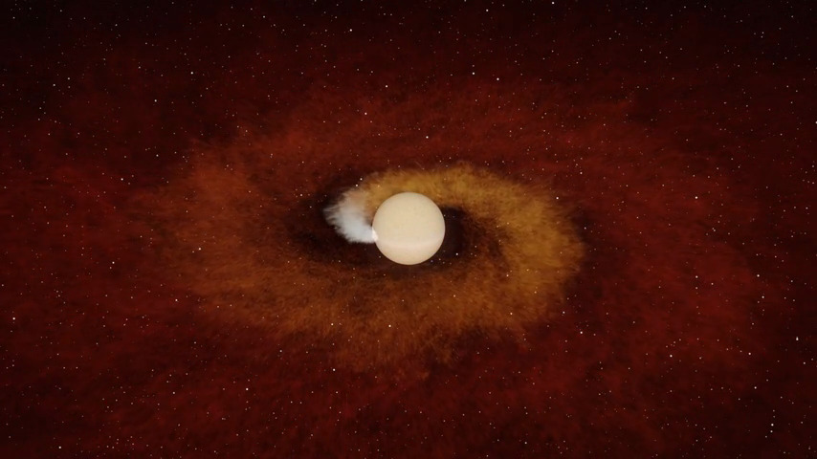
Planetary Engulfment!
K. De et al. (2023)

Slide 20
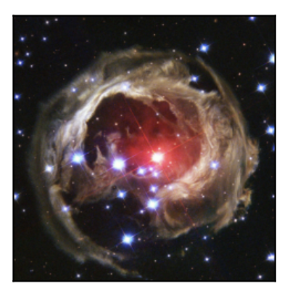
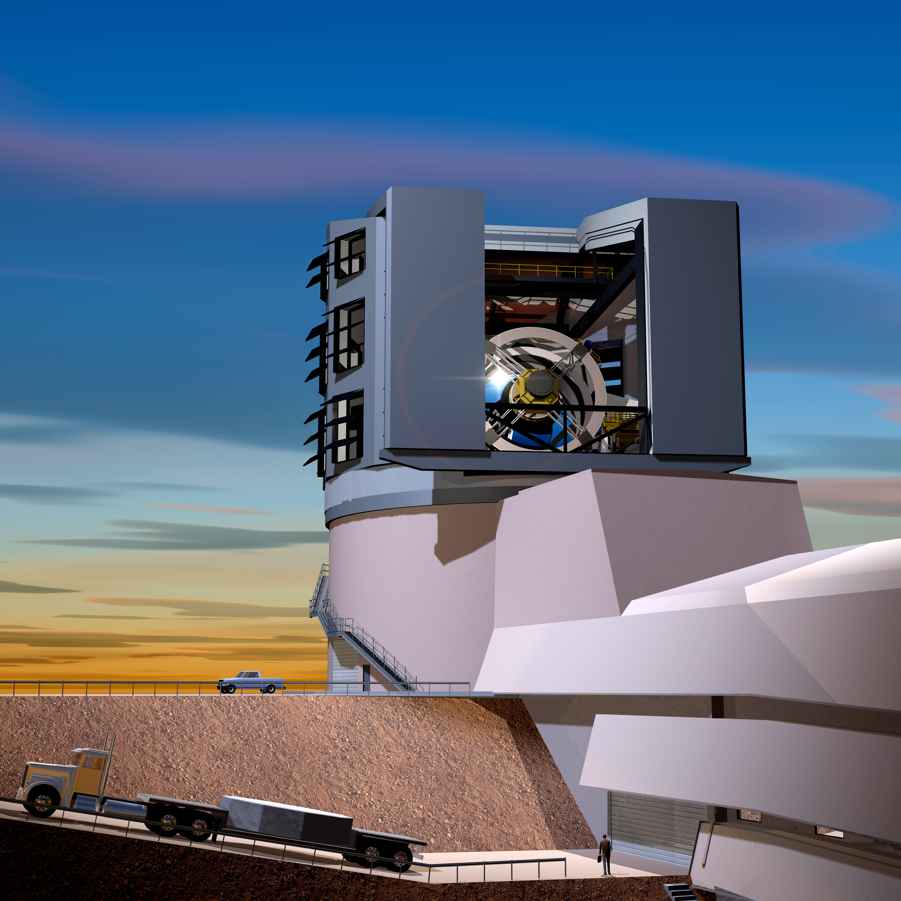

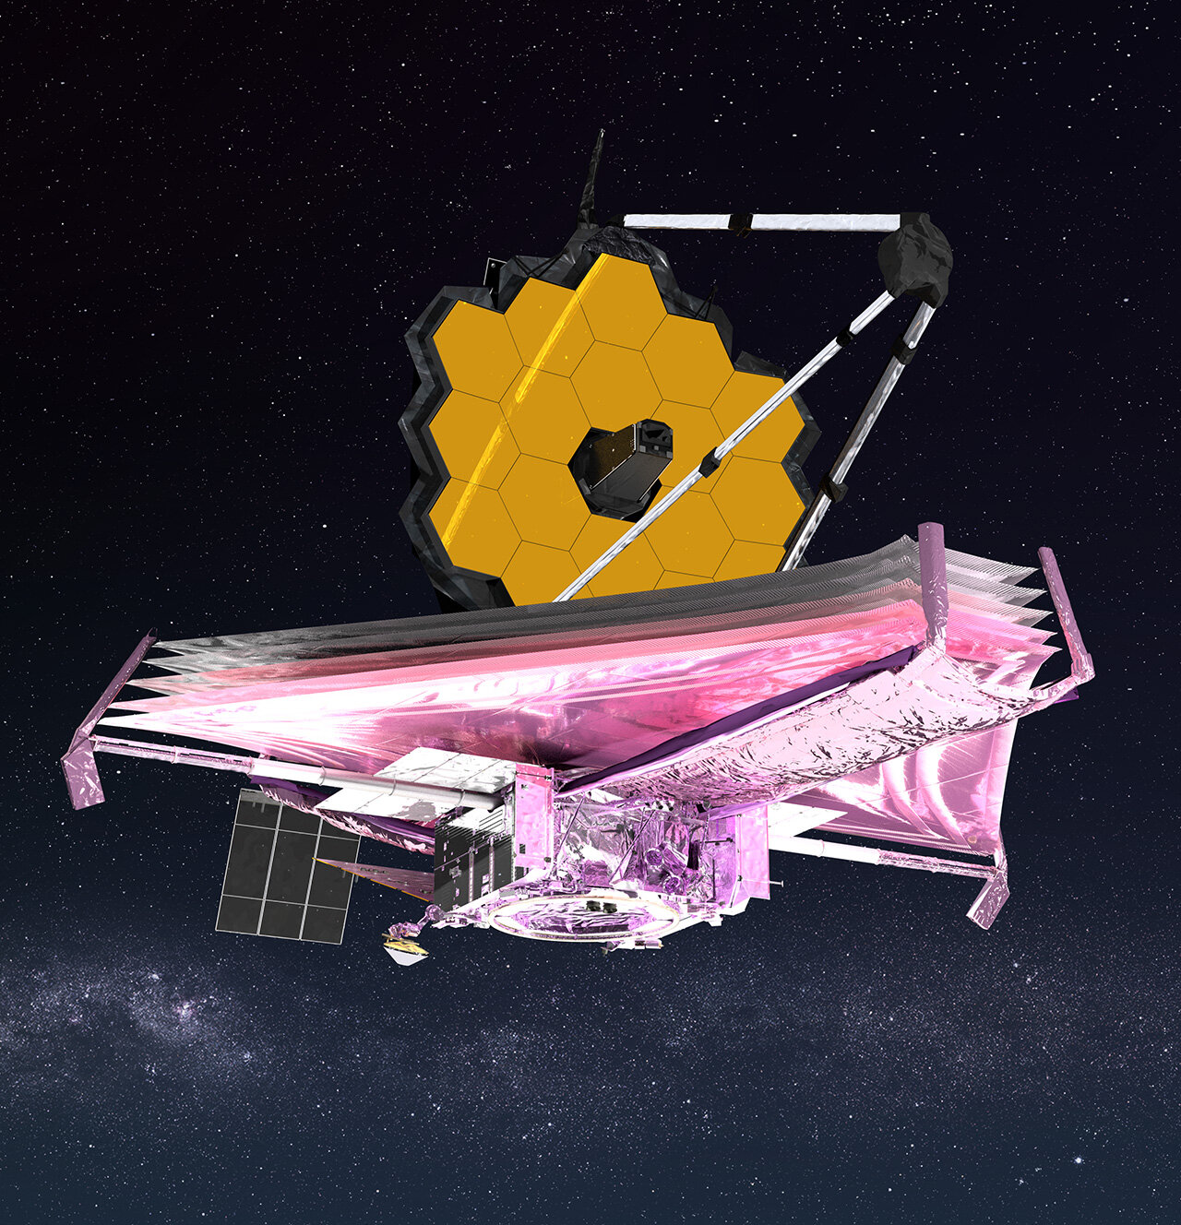
The future of CE is (IR) bright!
LSST
Lourie et al. 2022
LRN V838Mon (NASA/ESA)
NIR time domain surveys (WINTER, DREAMS) to unveil populations of
extremely dusty, IR-only LRNe (e.g., MacLeod et al. 2022, Pejcha et al. 2017)
NASA
Rubin
~500-1000 LRNe discoveries per year (Karambelkar+2023)
Discoveries of LRNe in their precursor phase
JWST
Late-time studies of LRNe now possible in the mid-IR (e.g., Cycle 2 GO, PI Karambelkar)

Slide 21
Supernovae

Slide 22
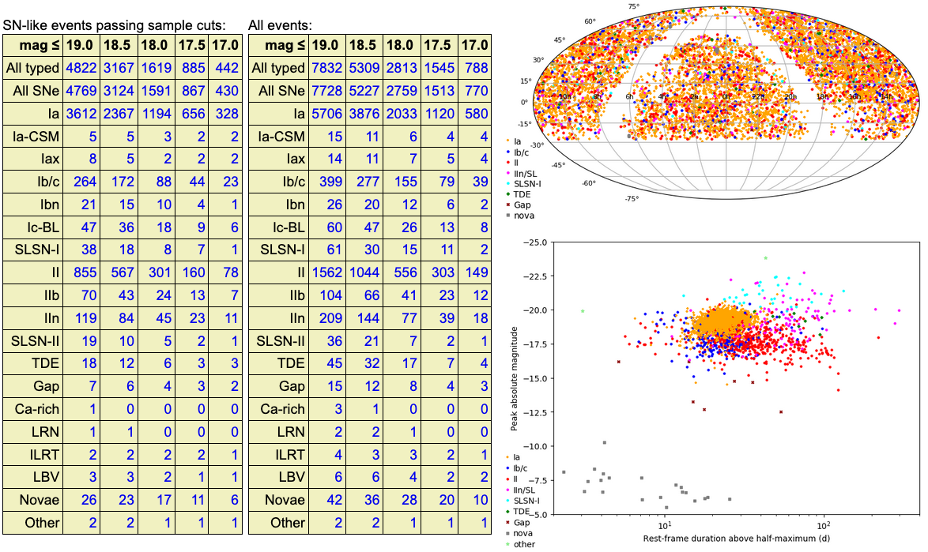
ZTF Bright Transient Survey (7728 SNe to date)

Slide 23
Basic questions still abound
How do stars with mass between say, 8 to 12 Msun explode?
  Electron capture?
  Complete destruction?
Does the Accretion induced collapse (AIC) channel work?
Do white dwarfs mergers occasionally lead neutron stars?
Do neutron stars mergers occasionally lead to a massive quasi stable neutron star?

Slide 24
The UV Frontier

Slide 25
Early FUV observations are critical but missing
Bostroem et al. 2023

Slide 26
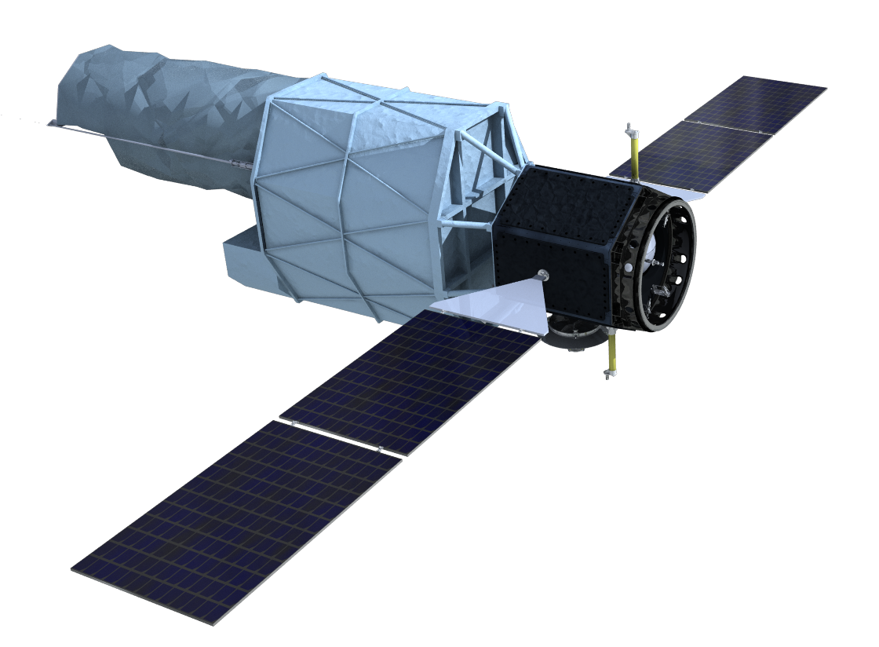

The Ultraviolet Explorer
Synoptic Two-Band All-Sky Survey
  50-100x deeper than GALEX
  Complementary to Rubin, Euclid, Roman
Time Domain Capabilities
  3 hr target-of-opportunity response time
  Multiple cadences from hours to months
Slit Spectroscopy
  Sensitive, R>1000 over broad bandpass
  1-degree long slit with multiple widths

Slide 27
The CMOS revolution and the LNSD revolution

Slide 28
CMOS revolution
There has been an exponential growth in CMOS sensors (billions of smart phones around the world)
CCDs have receded away from the main market to minor bespoke markets
CMOS sensors are following Moore’s law (not just in terms of decreased cost but also increased performance)
Future optical/UV detectors will be CMOS and not CCD

Slide 29
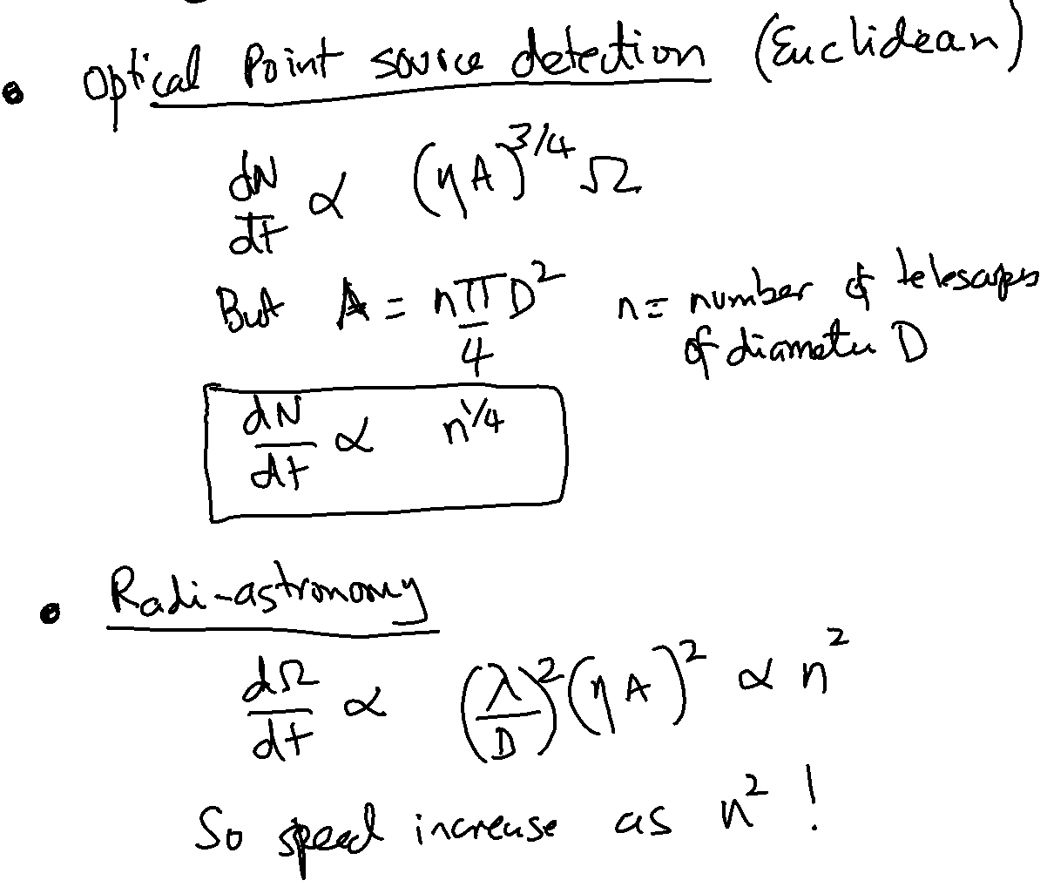
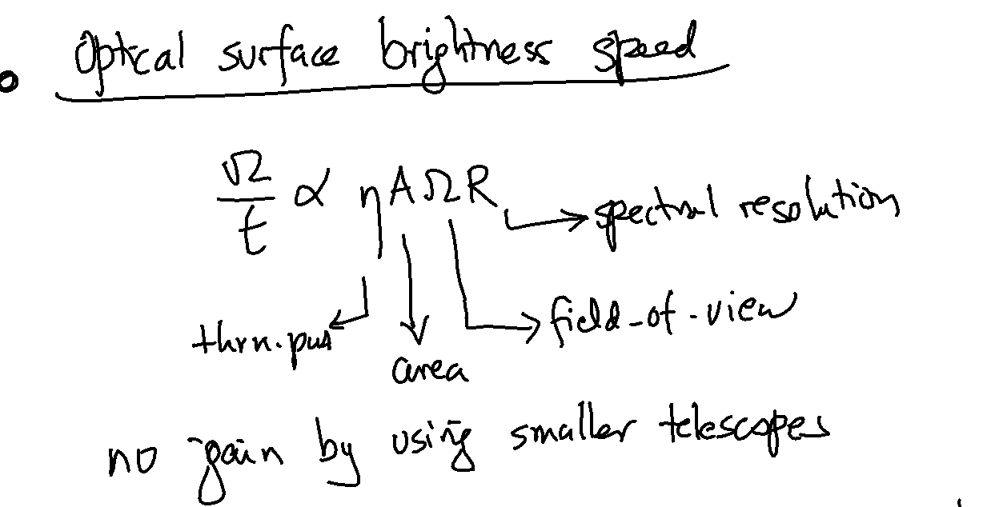
LNSD (Large N Small Diameter) Architecture

