Slide 1
General Coordinates Network NASA’s Next Generation Time-Domain and Multimessenger Alert System A service of the Astrophysics Science Division at NASA’s Goddard Space Flight Center https://gcn.nasa.gov
The Transient and Variable Universe 2023
20th June, 2023
Presenter: Dr. Eric Burns
Louisiana State University (LSU)
On Behalf of Vidushi Sharma (NASA GSFC/UMBC) and the GCN Team

Slide 2
Gamma-ray Coordinates Network

Slide 3
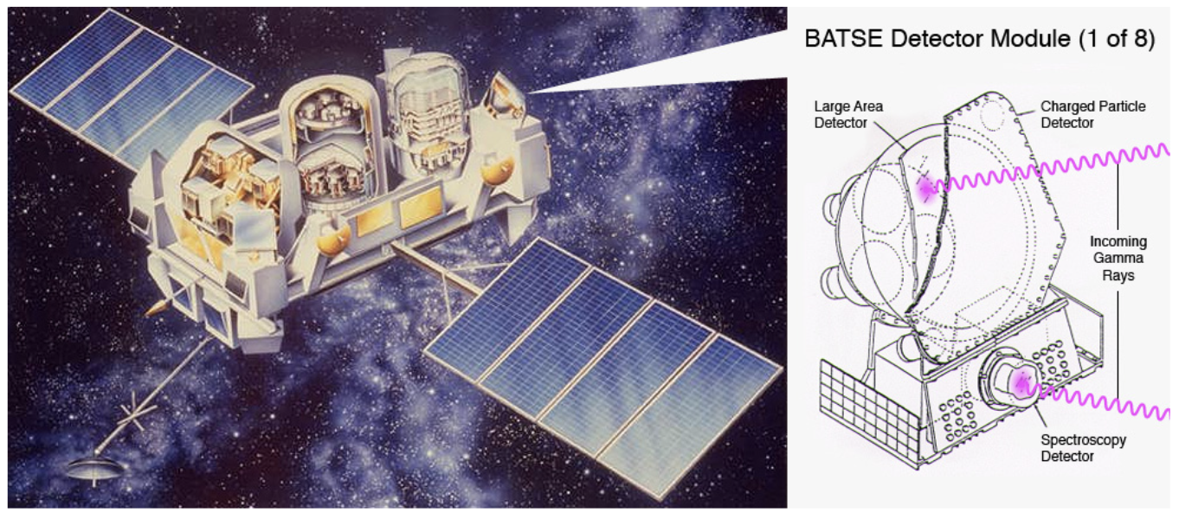
Realtime Alerts Born of Necessity
The Compton Gamma-Ray Observatory’s onboard recorder failed in 1992
The need to downlink events as they occurred created an opportunity for realtime follow-up
BAtse COordinates DIstribution NEtwork (BACODINE) was built to receive and distribute those alerts worldwide

Slide 4
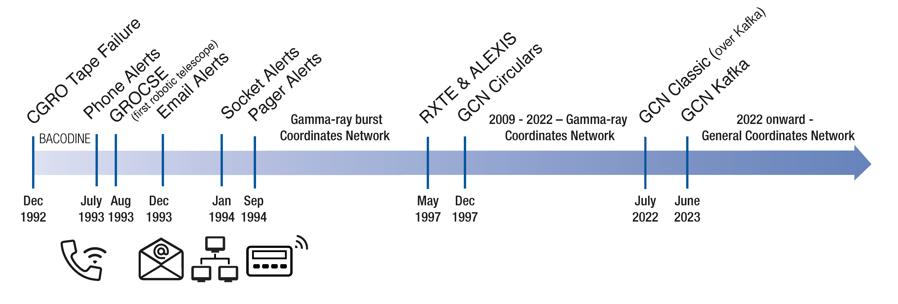
Early History of GCN
BACODINE provided new alert formats (phone, email, socket, and pager)
New instruments and transient types led to the Gamma-ray Coordinates Network

Slide 5
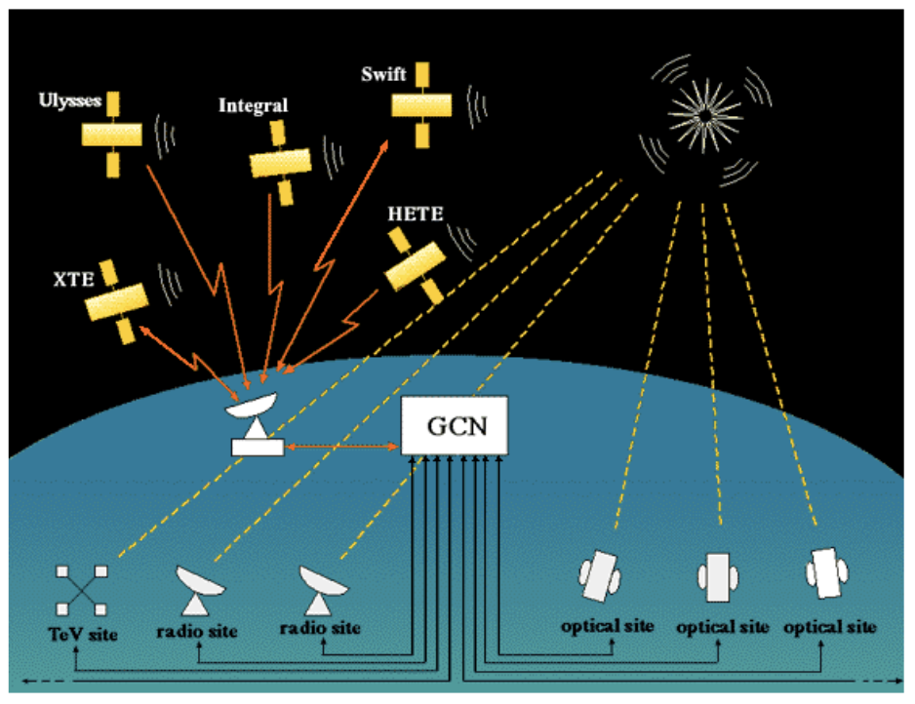
GCN Enabled Seminal Breakthroughs in Astrophysics
The GCN community enabled worldwide follow-up observations that revealed the nature of gamma-ray bursts:
Afterglows and redshifts confirmed their distant, extragalactic origin
Supernova-GRBs established massive stellar deaths as the cause of long GRBs
Afterglow and host studies established neutron star mergers as the cause of short GRBs

Slide 6
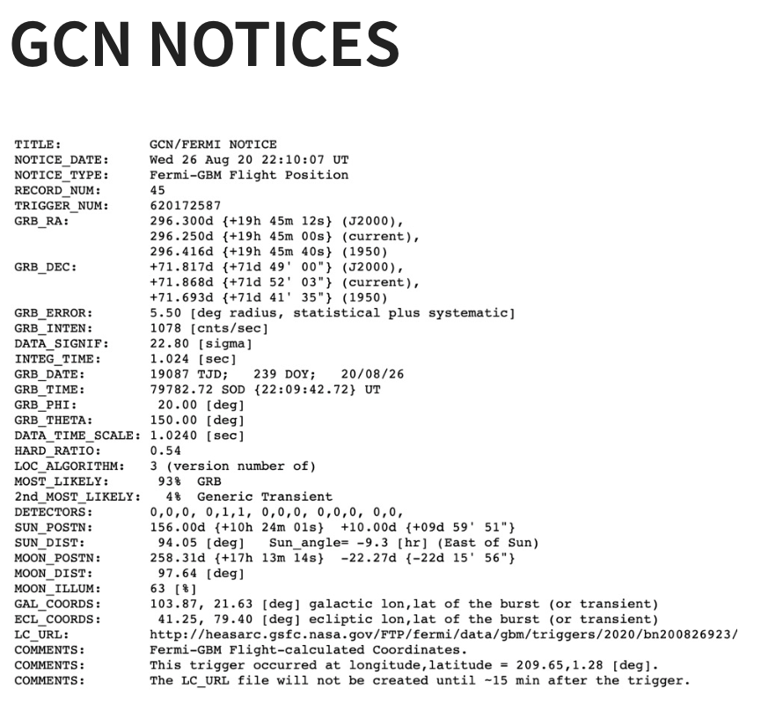
There are two kinds of GCN data products:
By and for machines
Fixed, predefined format
Schema specific to each notice type
By and for humans (some automated)
Freeform text (with established style)
Citable (but not peer-reviewed)

Slide 7
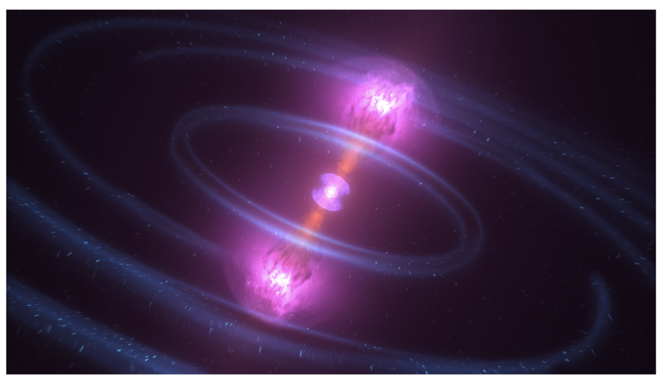
The Changing Scientific Landscape
GCN is constantly evolving to serve new transients, messengers, and observatories:
Gravitational wave events (GW150914, GW170817)
High-energy neutrinos (IC170922A)
MeV neutrinos (waiting since 1987)
Tidal disruption events (Swift J1644+57)
Magnetar giant flares (200415A)

Slide 8
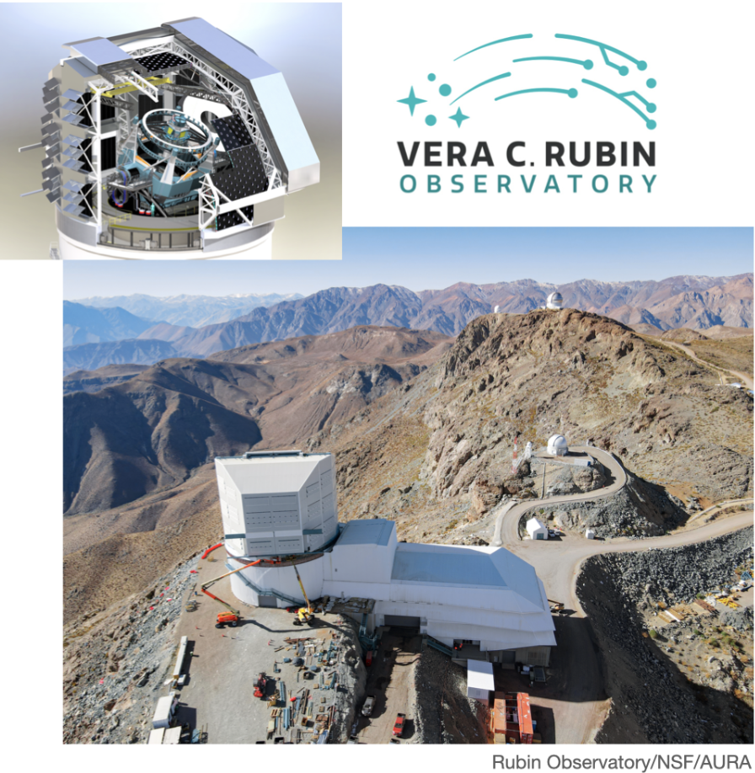
The Changing Technological Landscape
Internet standards have led to new, better ways to serialize astronomy data (VOEvent, JSON, Avro, etc.)
Encryption is necessary on the modern Internet (e.g. https)
Industry has developed general time-series databases and streaming frameworks
The Vera C. Rubin Observatory will use Apache Kafka to distribute transient alerts as its primary data product
Many other experiments are following suit: Zwicky Transient Facility, LIGO/Virgo/KAGRA

Slide 9
Introducing the new GCN

Slide 10
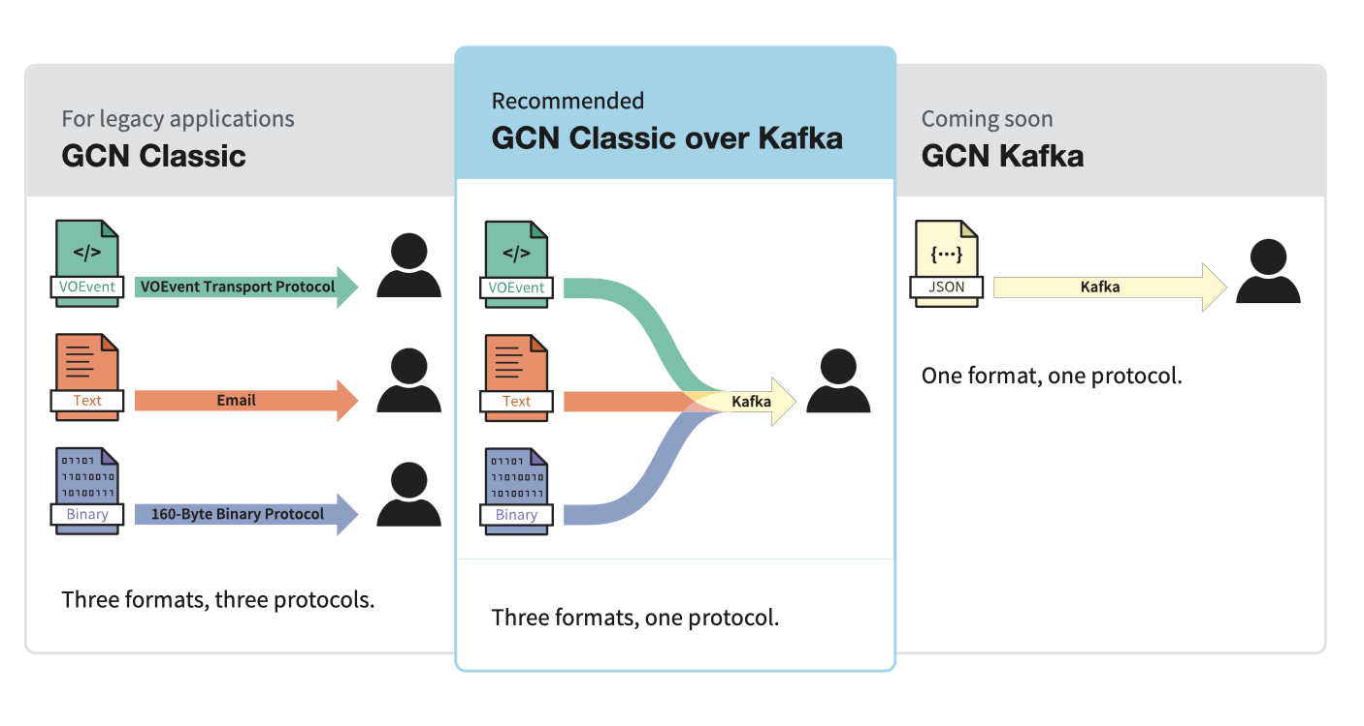
The New GCN is built on Kafka
GCN Classic provides three formats over three custom protocols
GCN Classic over Kafka provides all three formats over one standard protocol: Apache Kafka

Slide 12
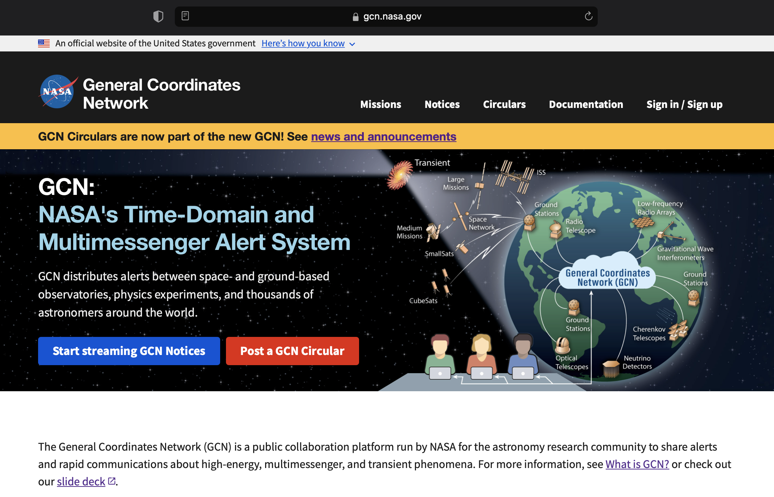
New GCN
web site
at https://gcn.nasa.gov
Updated look and feel
More accessible, based on US Web Design System
Single sign on with:
email and password
Google
Facebook
LaunchPad (for NASA employees and affiliates)

Slide 13
The New GCN Circulars

Slide 14
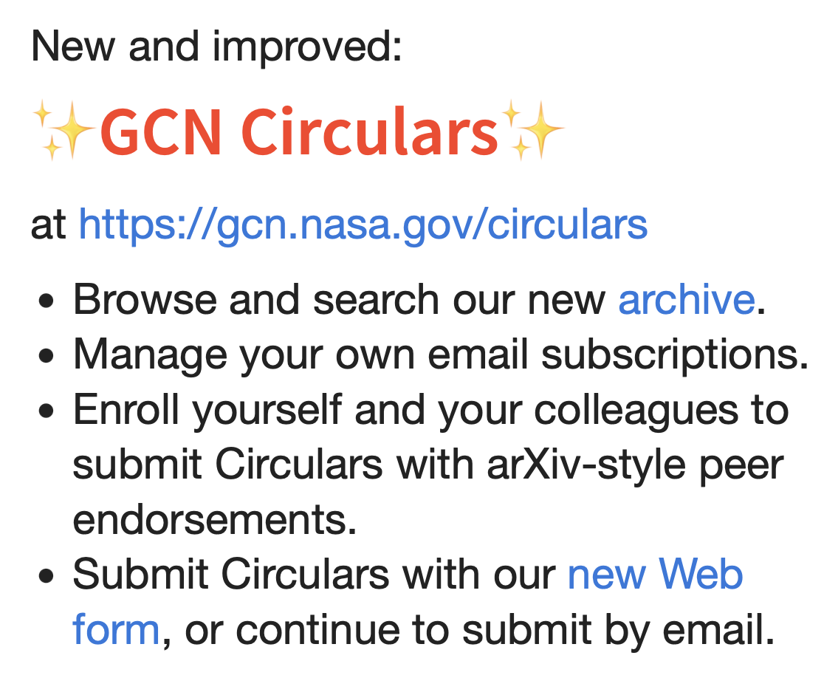
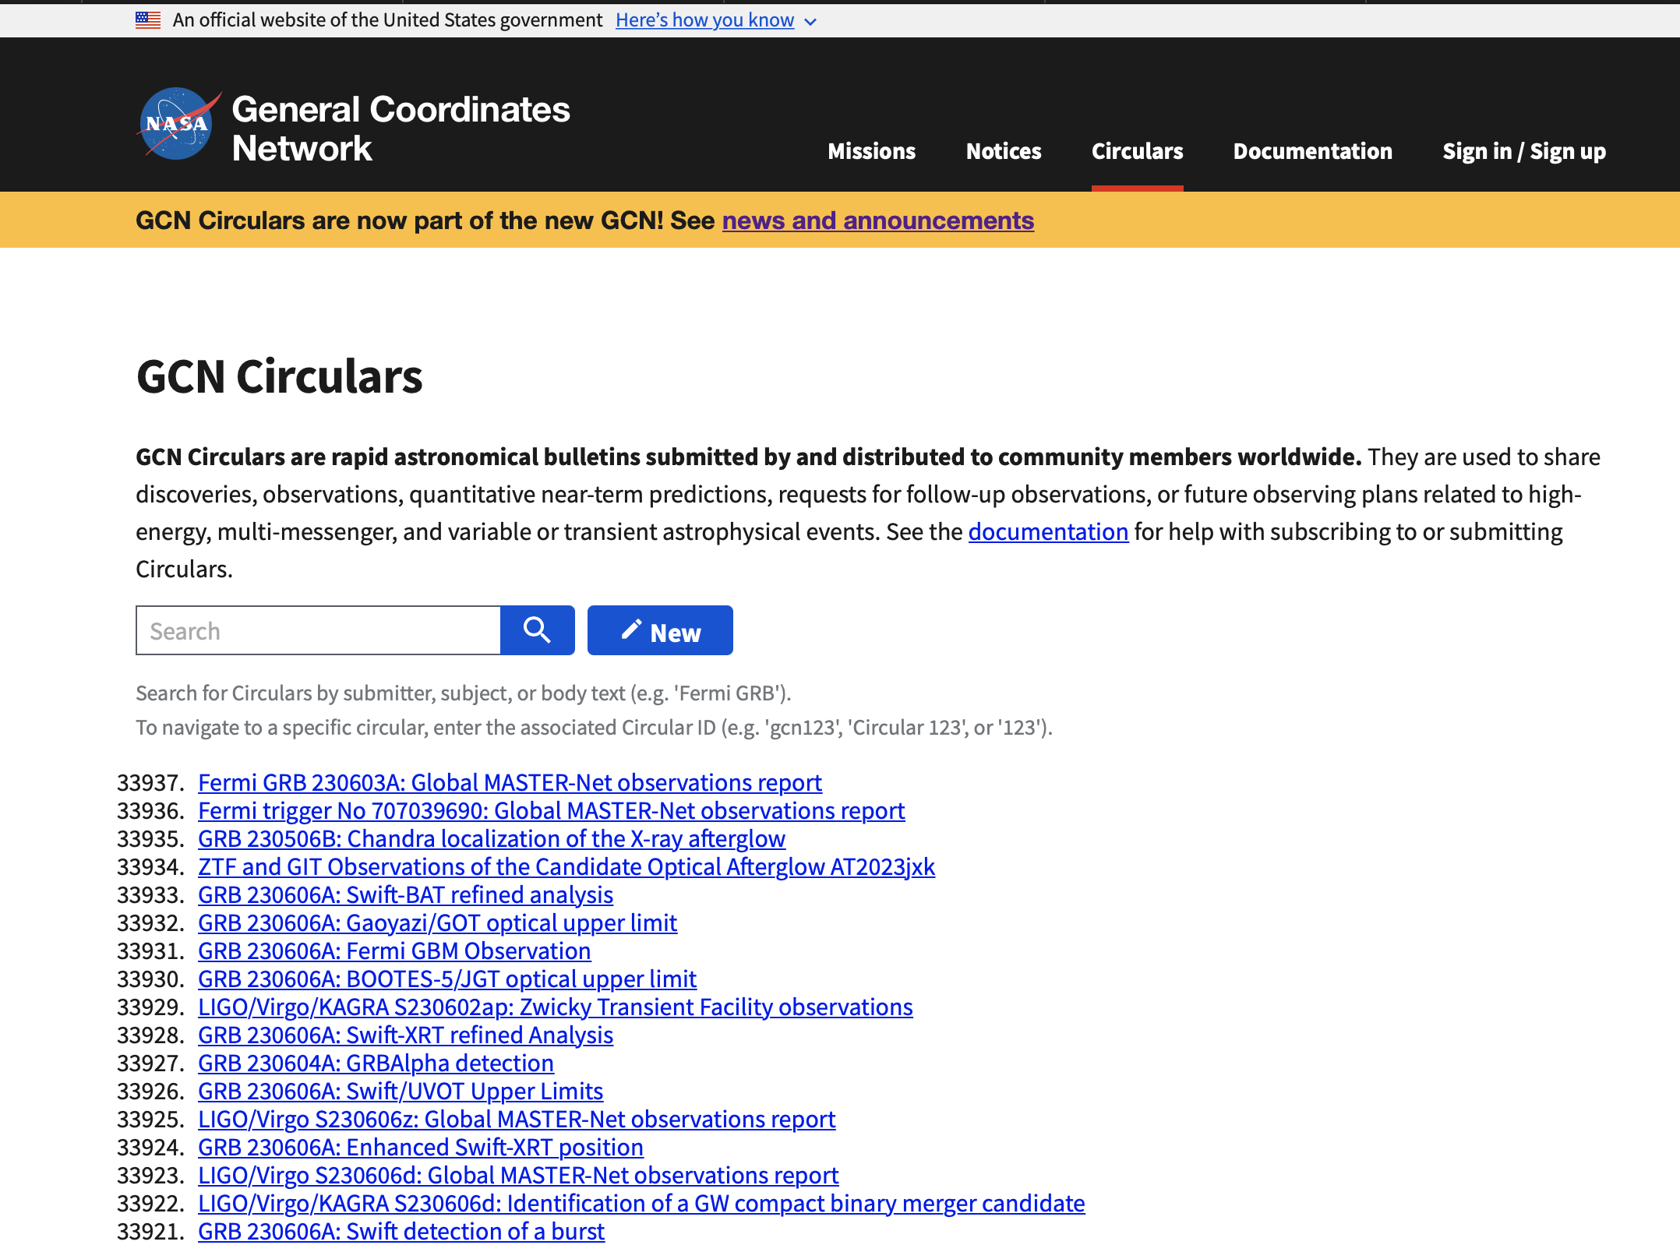

Slide 15
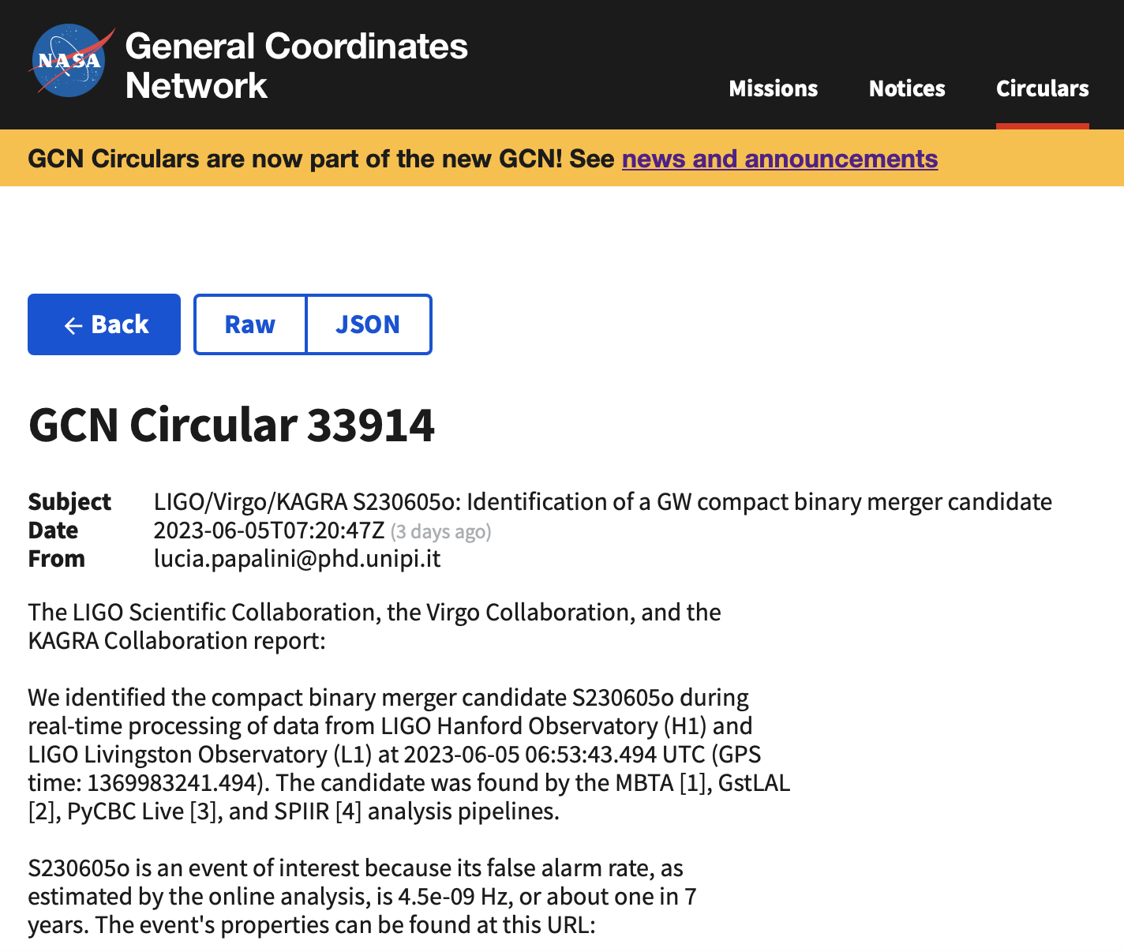
Improvements to Circulars
The new GCN Circulars are:
Self service: Manage your own subscriptions and settings.
More inclusive: It's easy to join the community and submit a GCN Circular.
Fast: Email notifications are distributed in parallel to all users within seconds.
Robust: Circulars run on highly available, distributed cloud services.
Sustainable: GCN Circulars are robustly funded by NASA and are part of the open source GCN project

Slide 17
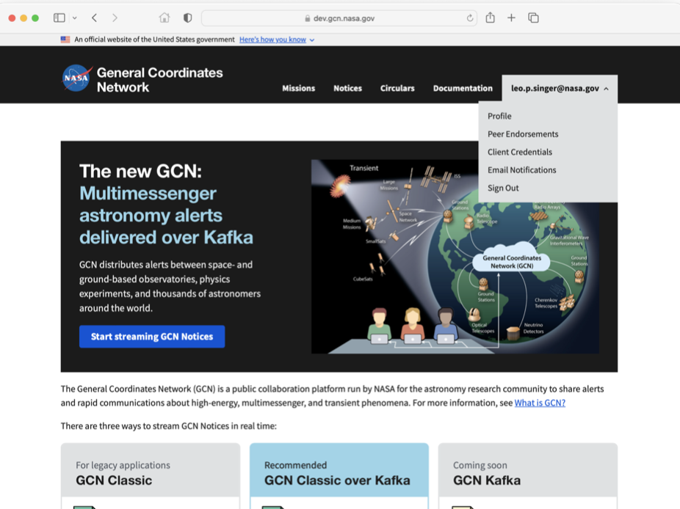
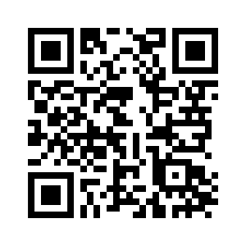
Tutorial on Receiving and Submitting GCN Circulars
Launch quick start
Go to https://gcn.nasa.gov and
See Presentation: https://nasa-gcn.github.io/gcn-presentation/

Slide 18
What’s next for GCN?

Slide 19
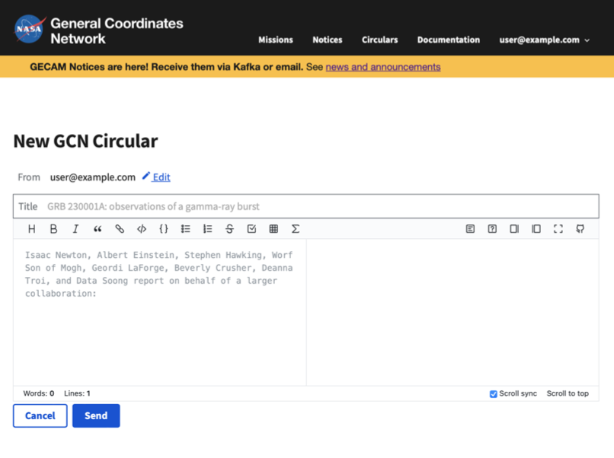
Coming soon to
GCN Circulars
We're planning lots of enhancements soon to make GCN Circulars even better:
Receive Circulars over Kafka
Real-time integration with SAO/NASA Astrophysics Data Service (ADS)
Link multiple emails with your account
Link your ORCID to your account
DOIs and BiBTeX entries for all Circulars
Browse Circulars by event
Embed tables, coordinates, images, and styled text in Circulars with “Astro Flavored Markdown”

Slide 20
More enhancements are coming to GCN:
New alert types and alerts from new missions and facilities
Unified schema and alert format for GCN Kafka
Integrated, searchable database of Notices and Circulars (GCN Viewer)
Interoperability with other transient Kafka brokers (e.g. SCiMMA)

Slide 21
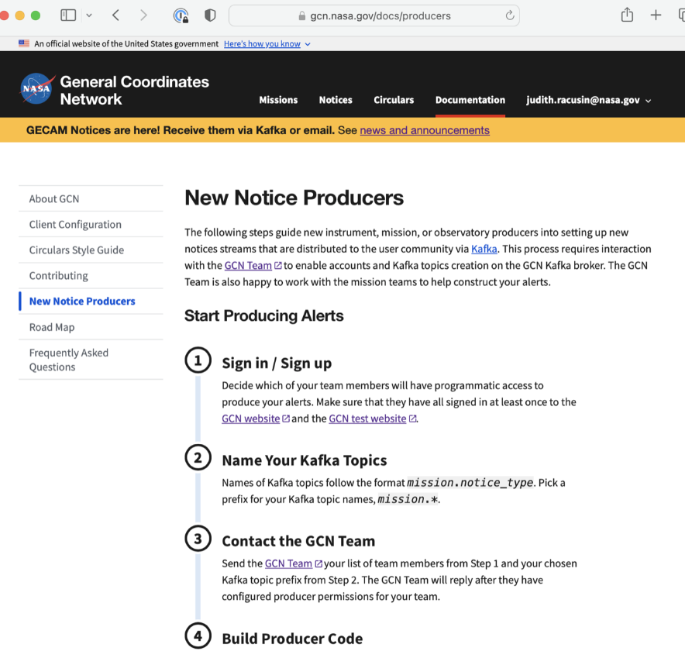
Create new Notice types
All new notice topics will only be distributed by GCN Kafka
See step-by-step instructions
Preferred notice format is JSON
Unified JSON schema in development: IceCube, GlowBug, Swift/Guano are our first producers

Slide 22
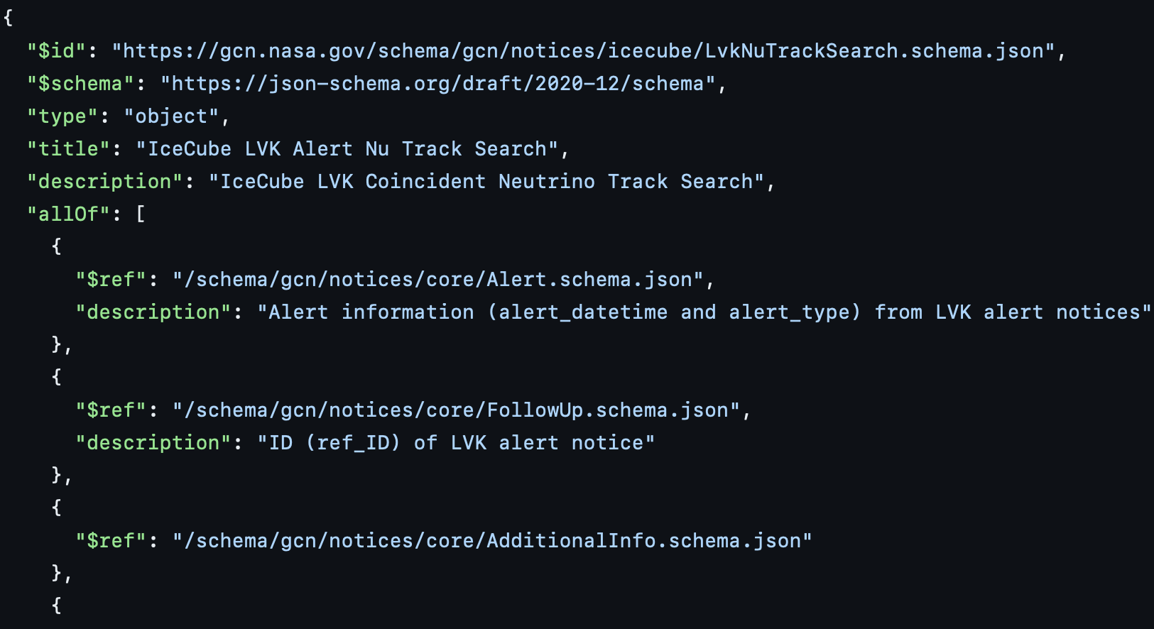
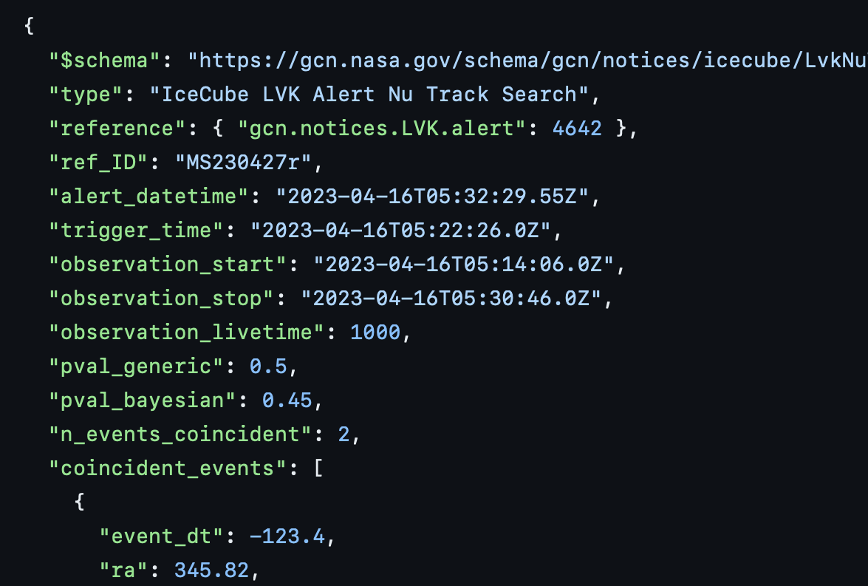
Unified schema and alert format for GCN Kafka
JSON schema with common core fields
Instrument/mission/observatory specific fields where needed
https://github.com/nasa-gcn/gcn-schema
Schema Browser and Schema design documentation coming soon
JSON example of IceCube schema:

Slide 23
Thanks for listening!
Web site: https://gcn.nasa.gov
This presentation: https://nasa-gcn.github.io/gcn-presentation/

Slide 24
Schema Browser
(In Development)
A step in the process for setting up New Notice Producers.
Browse the schema definitions for notices distributed by GCN Kafka

Slide 25
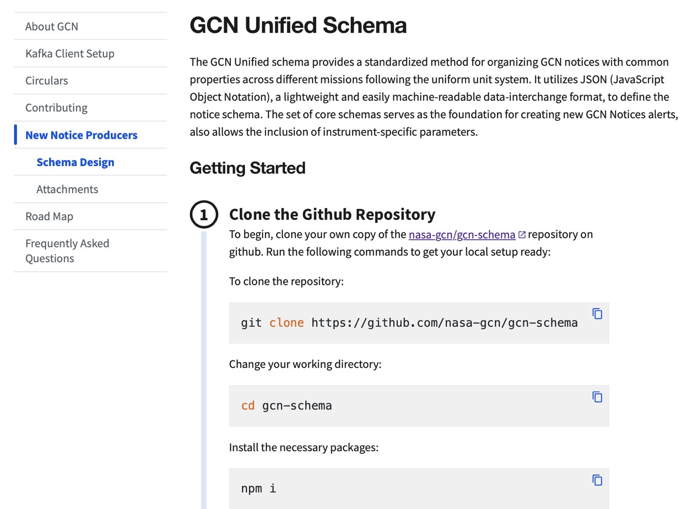
Schema Design
(In Development)
Steps for designing the mission specific schema
IceCube, Glowbug, Swift/Guano have already joined the suit

