Slide 1
TURBO: Total-coverage Ultra-fast Response to Binary-mergers Observatory
Daniel Warshofsky
University of Minnesota

Slide 2
University of Crete
Kostas Tassis
John Antoniadis
Vassilis Charmandaris
New Mexico Tech
Van Romero
University of Texas
J. Craig Wheeler
University of Minnesota
Patrick Kelly (PI)
Terry Jones (Co-PI)
Michael Coughlin (Co-PI)
Ben Mack
Daniel Warshofsky
Mandeep Gill
Matthew Tran
Robert Strausbaugh
Sam Benscoter
Sophia Benz-Narveson
Sudhanva Mohan
Thomas Proctor
Vuk Mandic
Claudia Scarlata
Bob Gehrz
Lucy Fortson
Notes:
Wide field image of andromeda by TURBO from the St.Paul site

Slide 3
GW170817
Arcavi +17
But only one confirmed optical counterpart detection of more than one hundred gravitational wave detections (Abbot+20).
AT 2017gfo the optical counterpart of GW 170817, was discovered eleven hours after LIGO detection. Origin of early blue component not well constrained by observations — either due to radioactive decay or shock-heated debris
Notes:
AT 2017gfo/DLT17ck/SSS17a counterpart name
Gw170817 final 90% localization area less than 40 deg^2
Peak in g,r ~17 mag
Early time kilo nova not well constrained
But only one (or two) counterpart detections of more than one hundred gravitational wave detections (Abbot+20).
Optical counterpart of GW 170817 discovered eleven hours after LIGO detection. Origin of early blue component not well constrained by observations — either due to radioactive decay or shock-heated debris

Slide 4
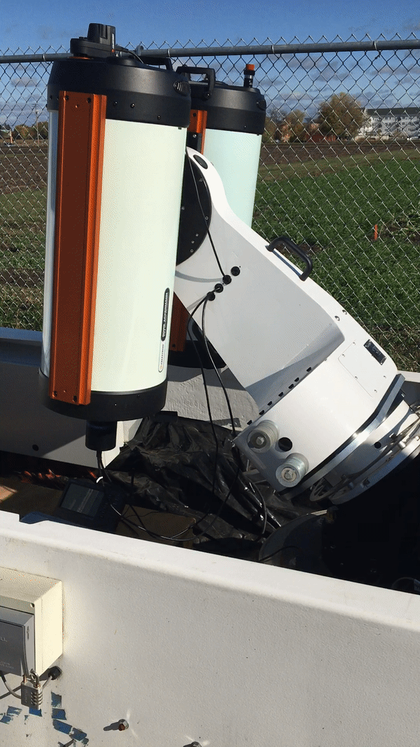
Current surveys are not sensitive to prompt emission
TURBO will image over a large area on sky (112 deg2) in 2 seconds
Funded by the NSF MRI program
~2 second slew time!!
Notes:
Currently only the TURBO prototype in St.Paul. The full array is not build yet
Slew in 2 seconds and settle to take stable image
Turbo will be a telescope array consisting of 16 mount split evenly between two site (New Mexico and Crete)
2 sites give coverage of most of the northern sky at all times
Each mount will have two 11’ celestron Rowe-Ackermann Schmidt Astrograph (RASA) telescopes with (ZWO CAMERAS)
The combination provides a 2.2x3.3 deg^2 field of view with a 1.25 arcsec/pix plate scale for each RASA.
When offset this yields ~14 deg^2 field of view for each mount or 112 deg^2 per site.
The mounts are Planewave L-350’s which have slew speeds up to 50 deg/s allowing pointing to anywhere on the sky in under ~5 seconds
At dark sites we expect to achieve a limiting magnitude of 20 with a 30 second exposure
A 1000 deg^2 area can be covered in 10 pointing by one site
5 seconds for the first pointing, subsequent pointings will be nearby so slew time is negligible
30 seconds per pointing for a depth of 20 mag
5+(30*10)=305 seconds ~ 5 minutes

Slide 5
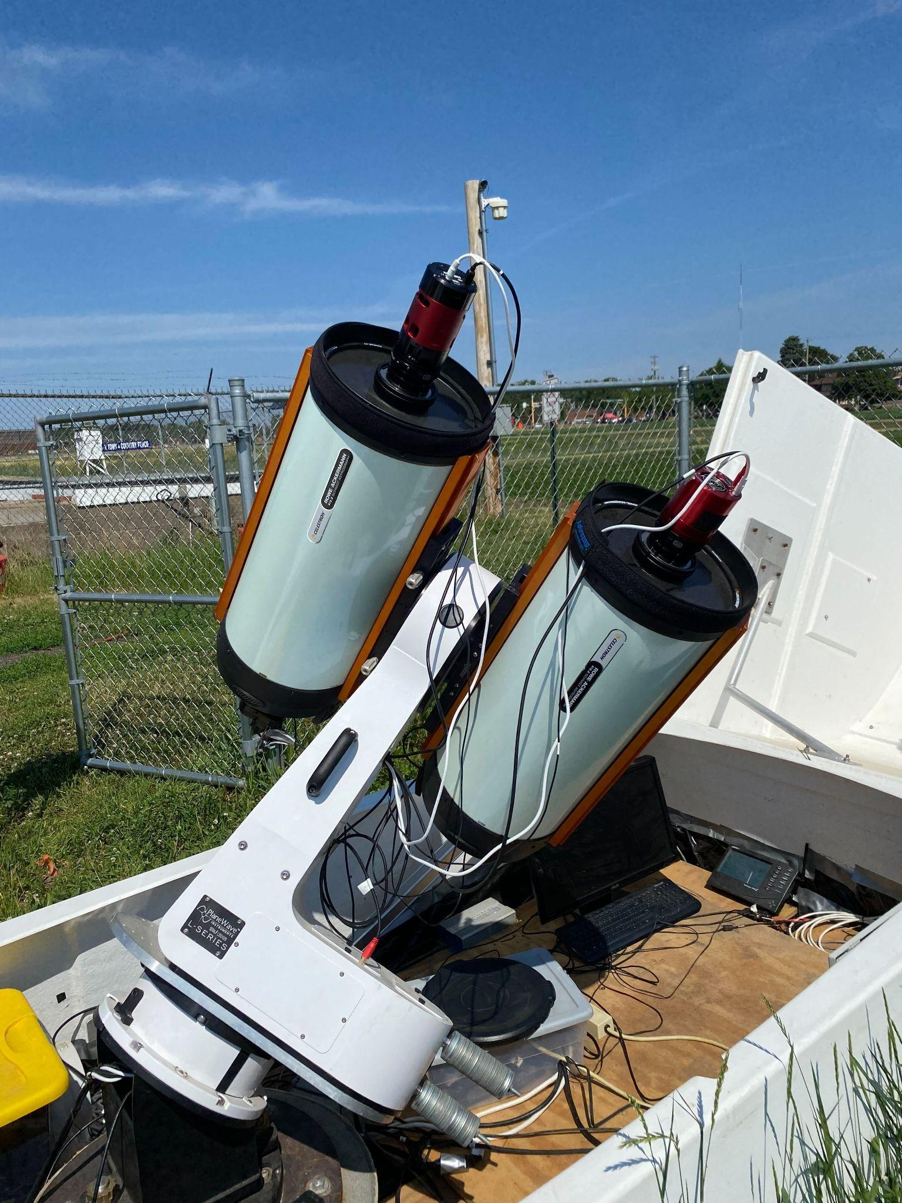
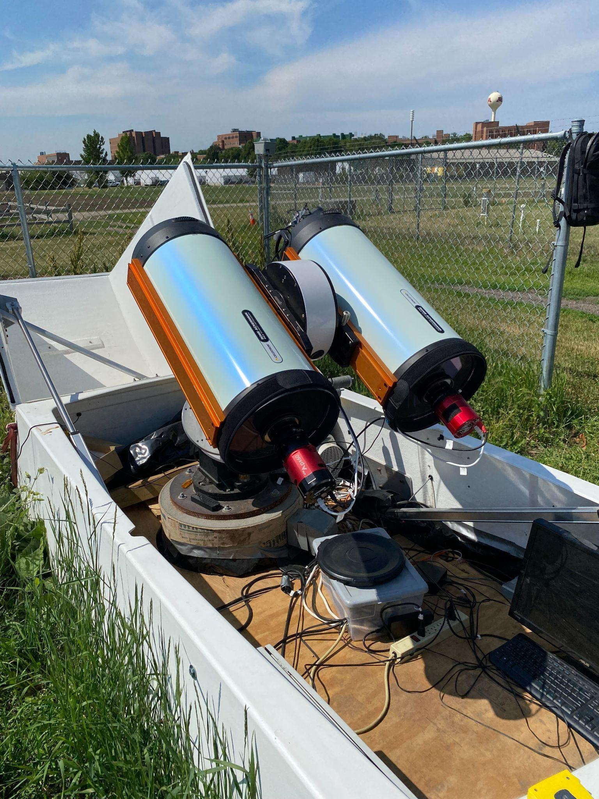
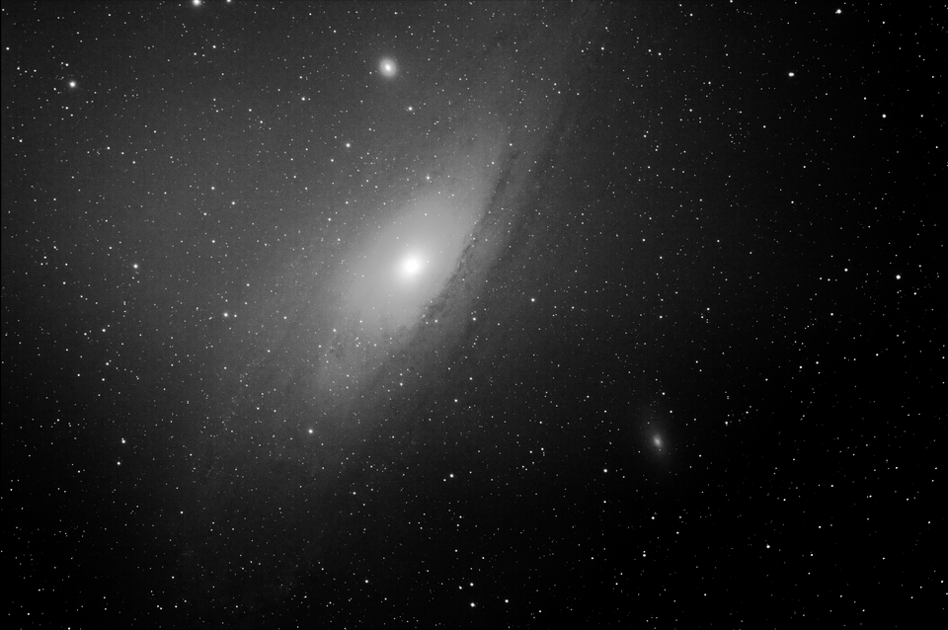
7 deg² field of view per telescope
8 mounts per site
112 deg² field of view for each site
Notes:
2 11’ telescopes per mout

Slide 6
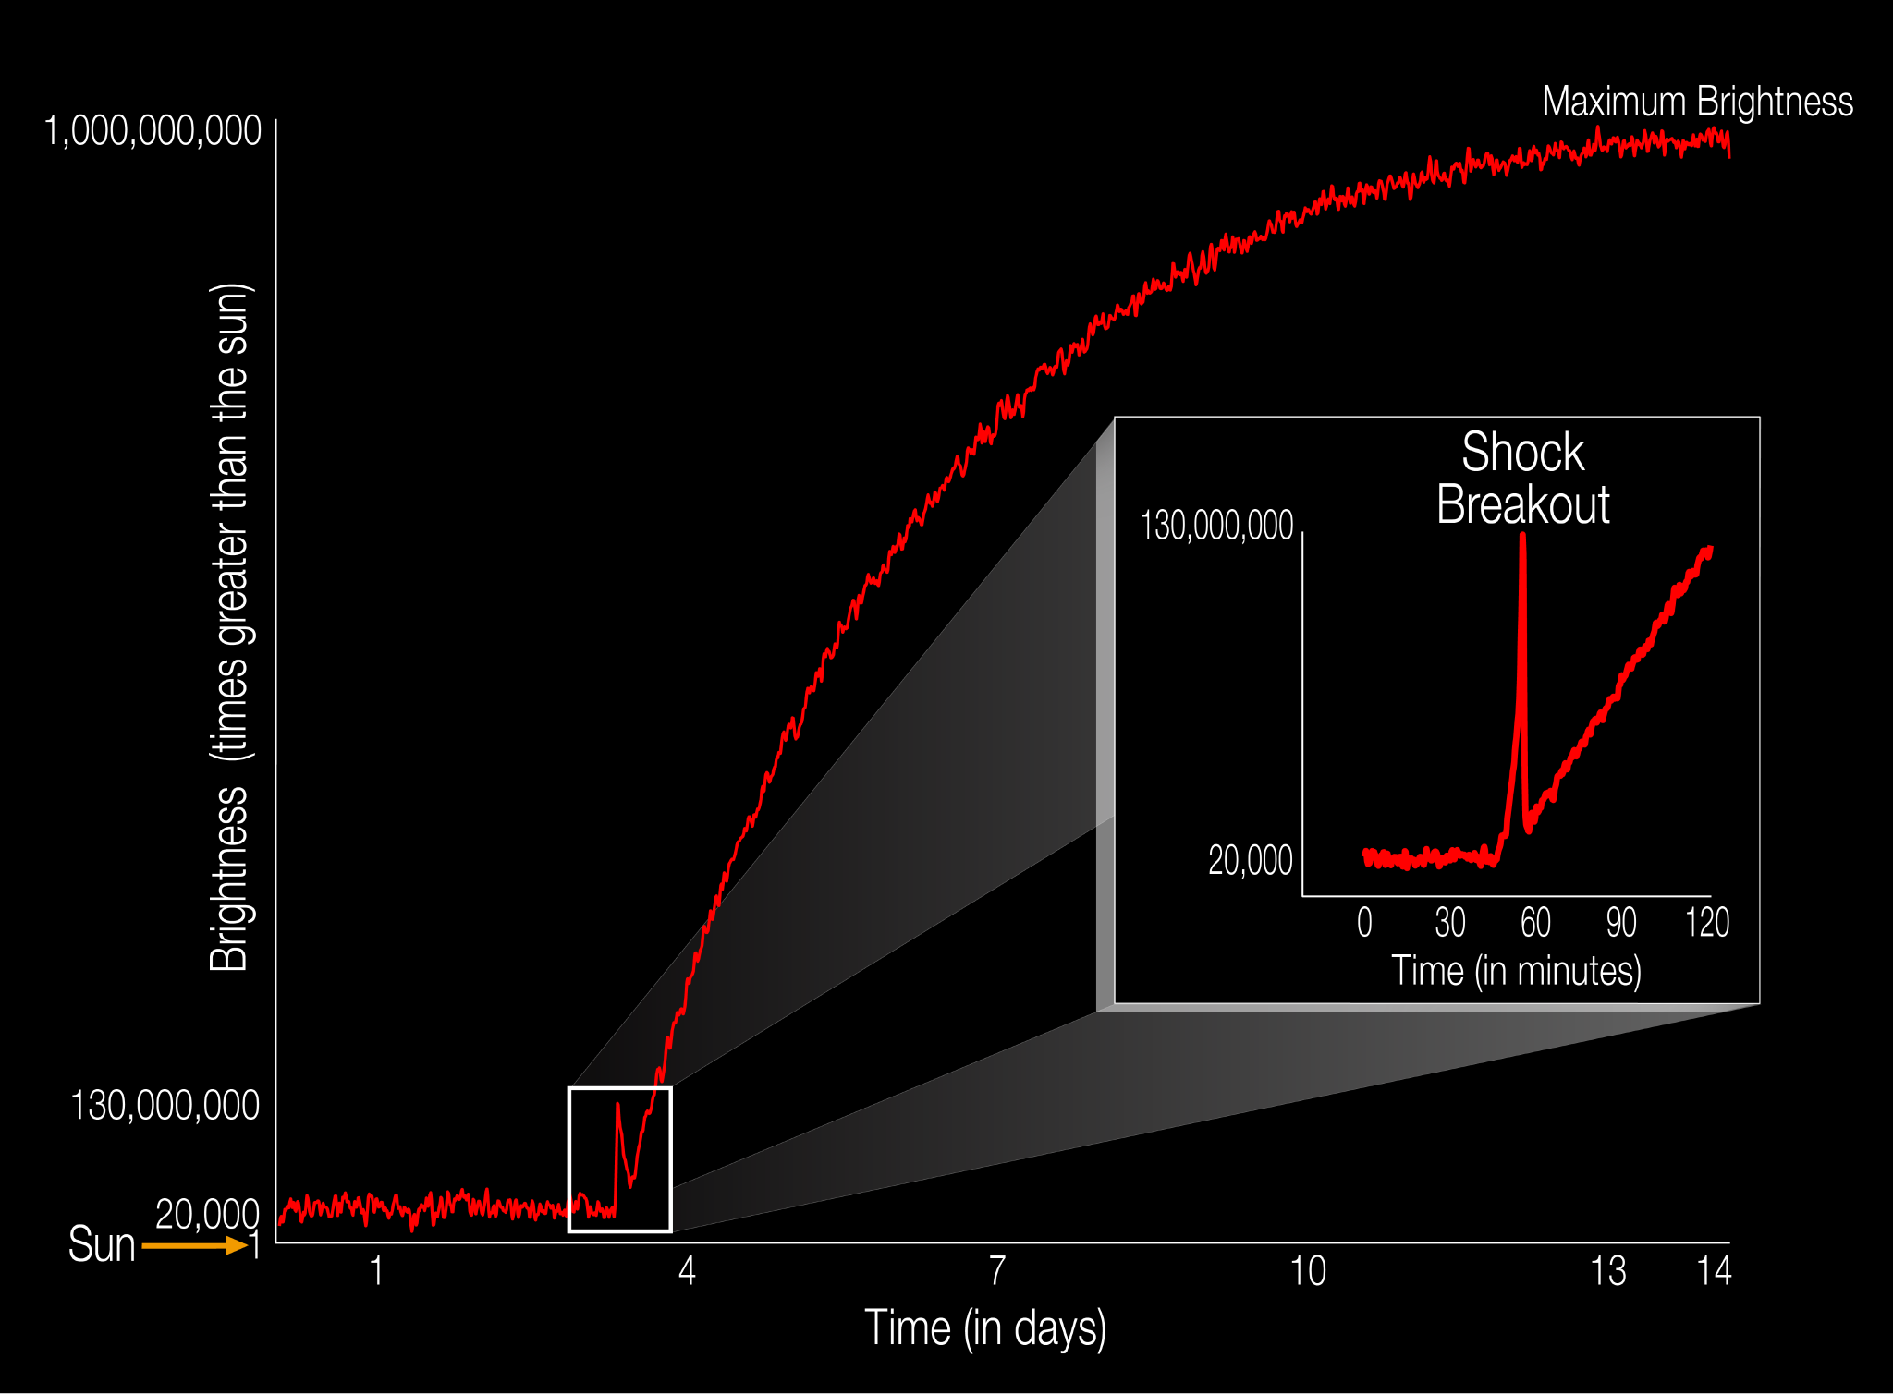
Very Early Light Curves of SNe
Very early SNe light curves contain uniquely constraining information about the progenitor (e.g Nakar & Sari 2010)
SNe have been difficult to discover within minutes or hours of explosion
Shock break out happen on time scales of about 10 minutes
Garnavich+16
Notes:
No radioactivity in early time.
Early time emissions contain constraining information about progenitor.
Shock break out happen on time scales of the light travel time across a supergiant star

Slide 7
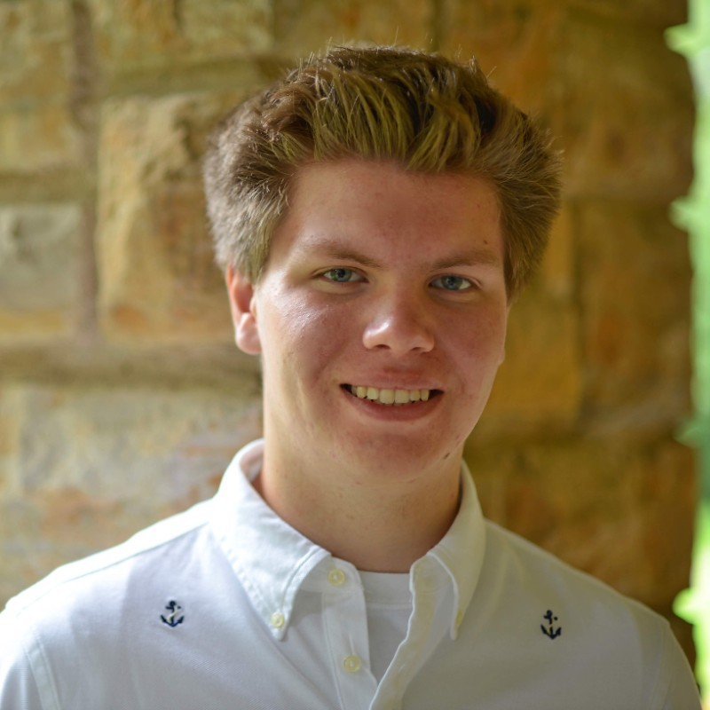
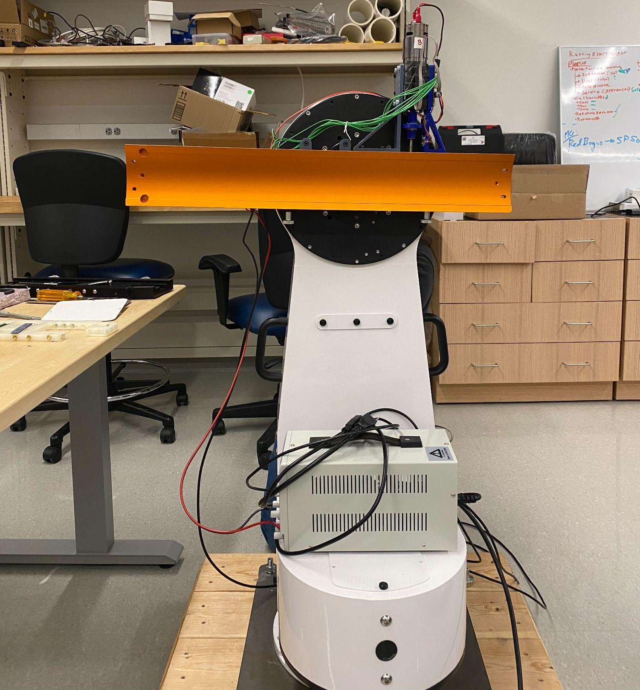
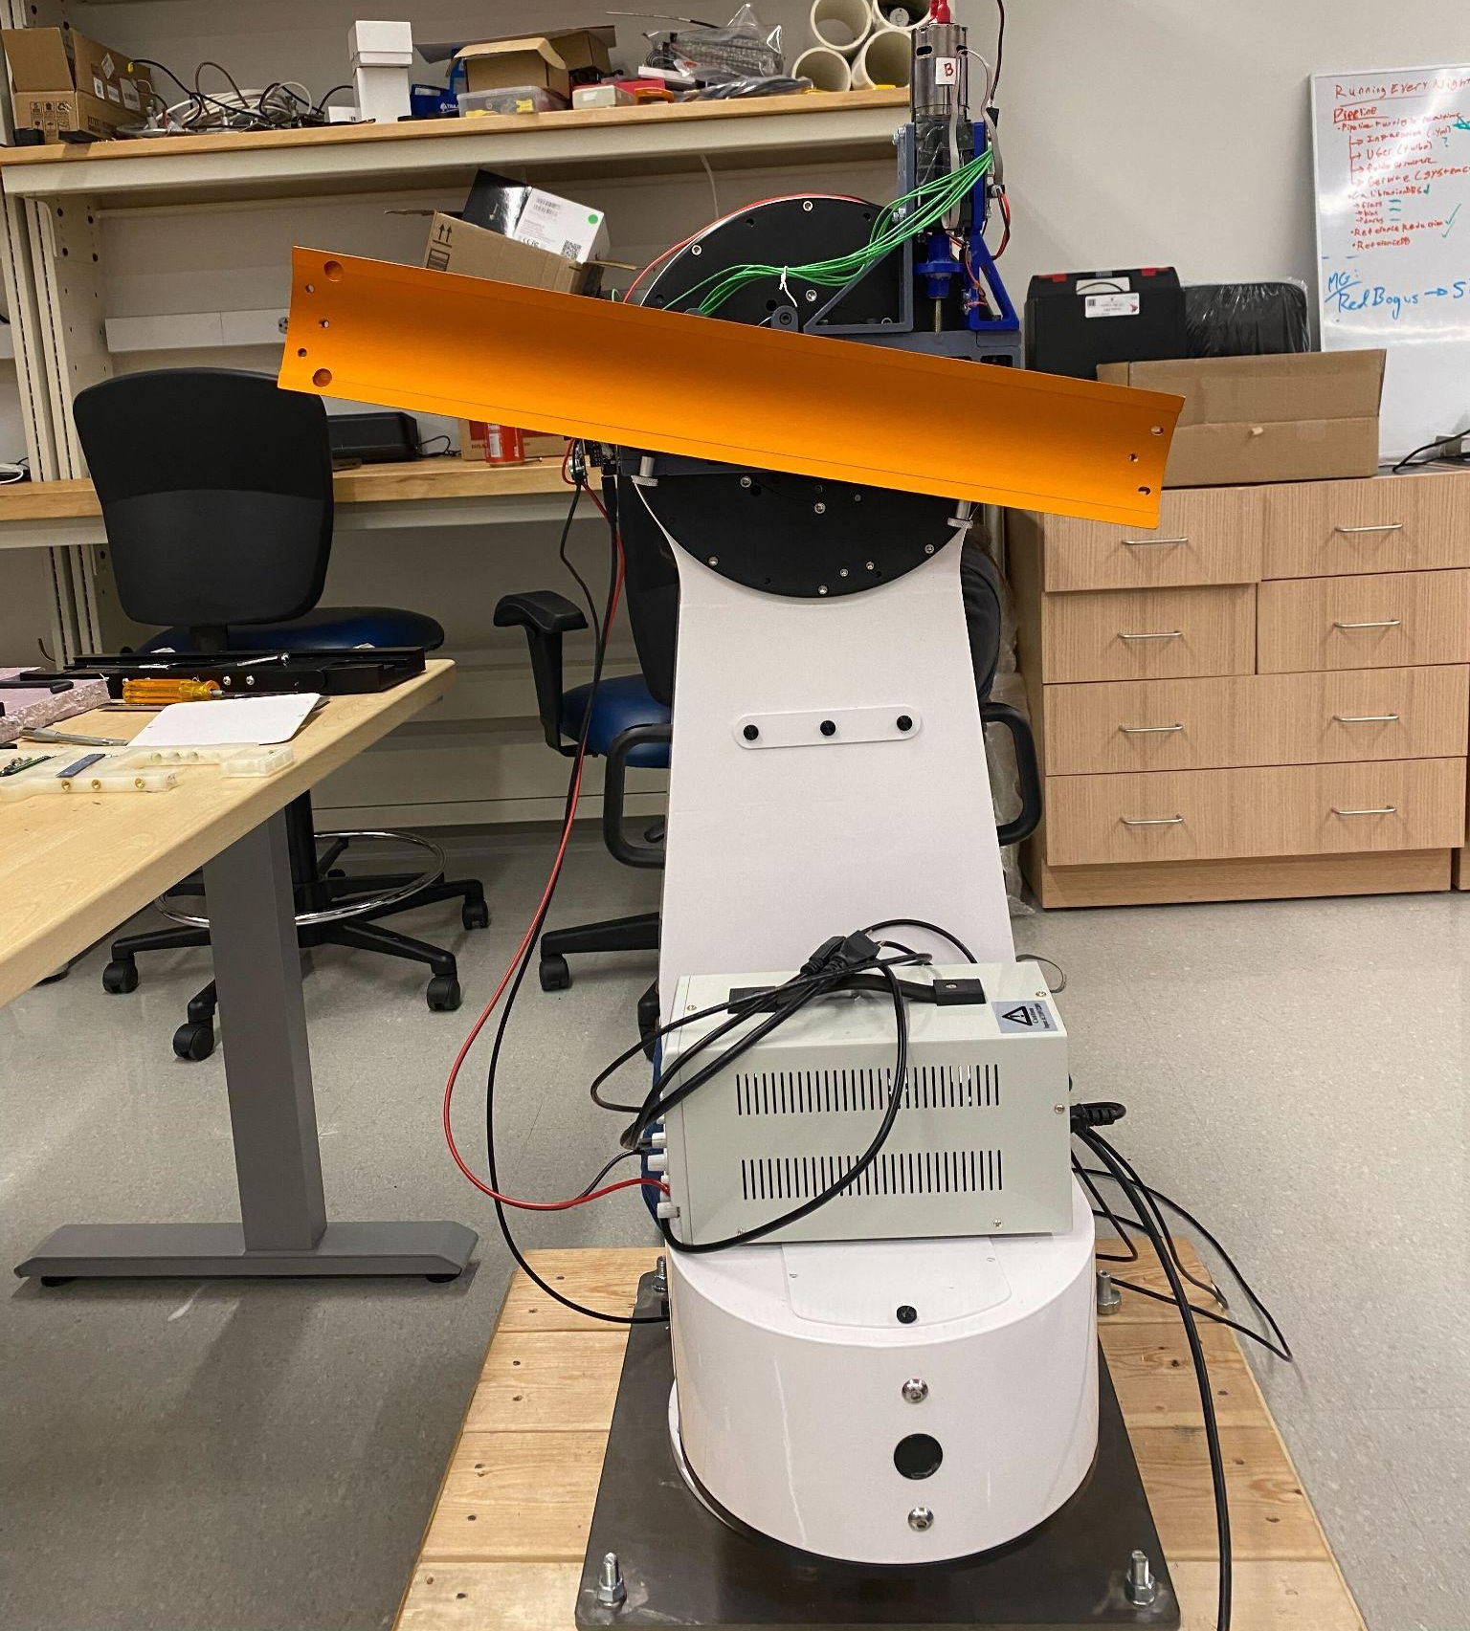
Offset Mechanism
Sam Benscoter
Will be able to copoint or offset telescopes on each mount by up to 5 deg
Notes:
Ben-sk-oh-ter
Copoint for depth, offset for field of view

Slide 8
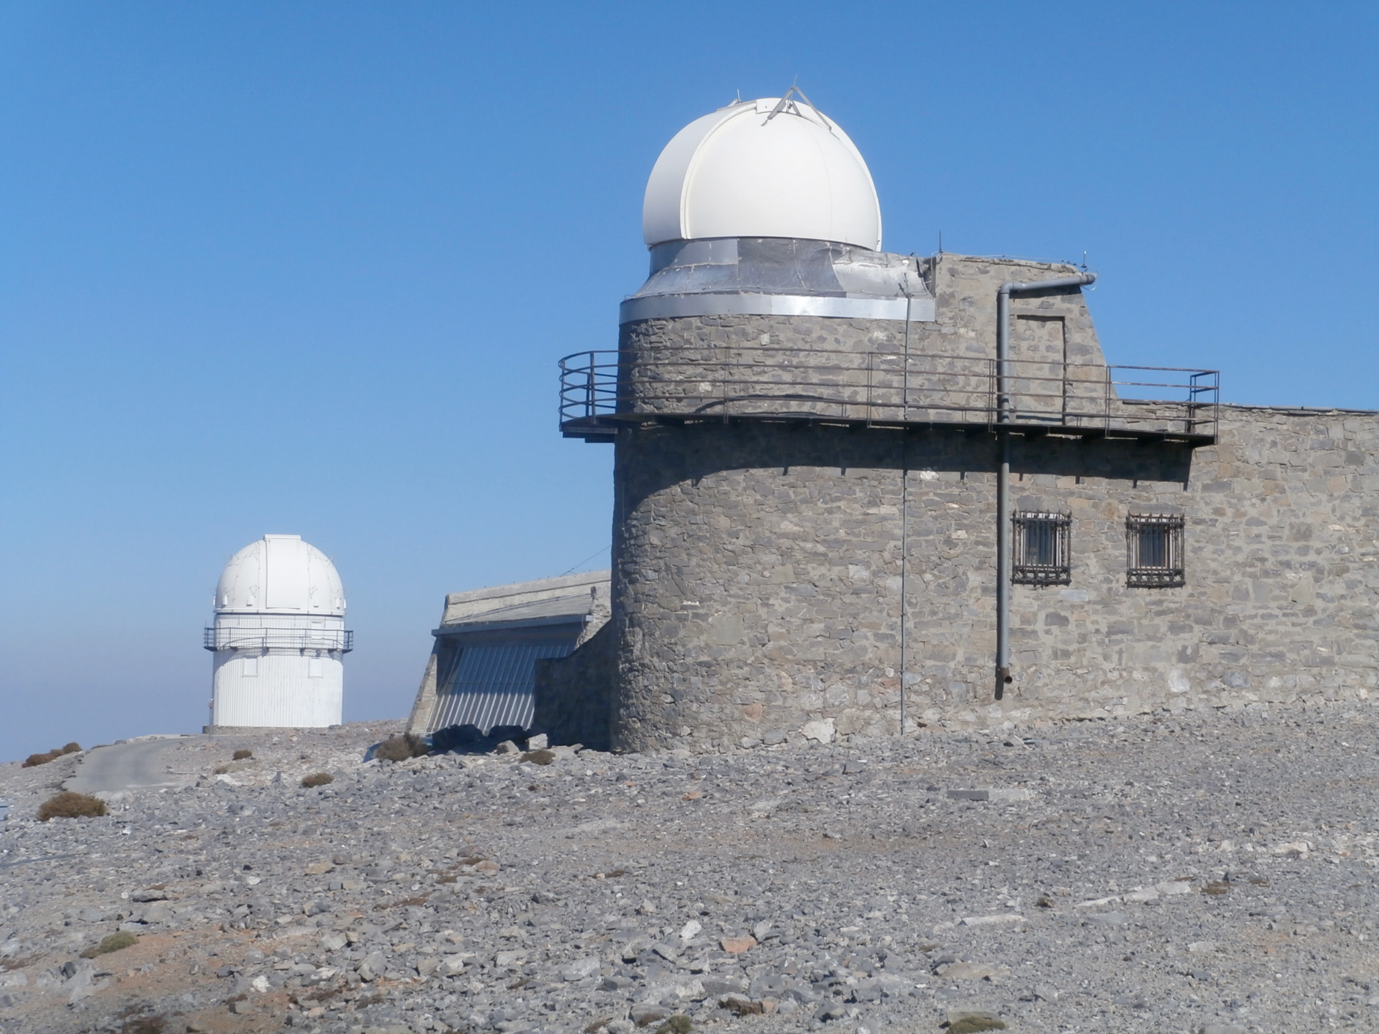
Skinakas Observatory University of Crete / FORTH
Planning to finish construction in 2023
Notes:
Turbo will be a telescope array consisting of 16 mount split evenly between two site (New Mexico and Crete)
2 sites give coverage of most of the northern sky at all times
Each mount will have two 11’ celestron Rowe-Ackermann Schmidt Astrograph (RASA) telescopes with ASI6200MM Pro:lisa
The combination provides a 2.2x3.3 deg^2 field of view with a 1.25 arcsec/pix plate scale for each RASA.
When offset this yields ~14 deg^2 field of view for each mount or 112 deg^2 per site.
The mounts are Planewave L-350’s which have slew speeds up to 50 deg/s allowing pointing to anywhere on the sky in under ~5 seconds
At dark sites we expect to achieve a limiting magnitude of 20 with a 30 second exposure
A 1000 deg^2 area can be covered in 10 pointing by one site
5 seconds for the first pointing, subsequent pointings will be nearby so slew time is negligible
30 seconds per pointing for a depth of 20 mag
5+(30*10)=305 seconds ~ 5 minutes

Slide 9
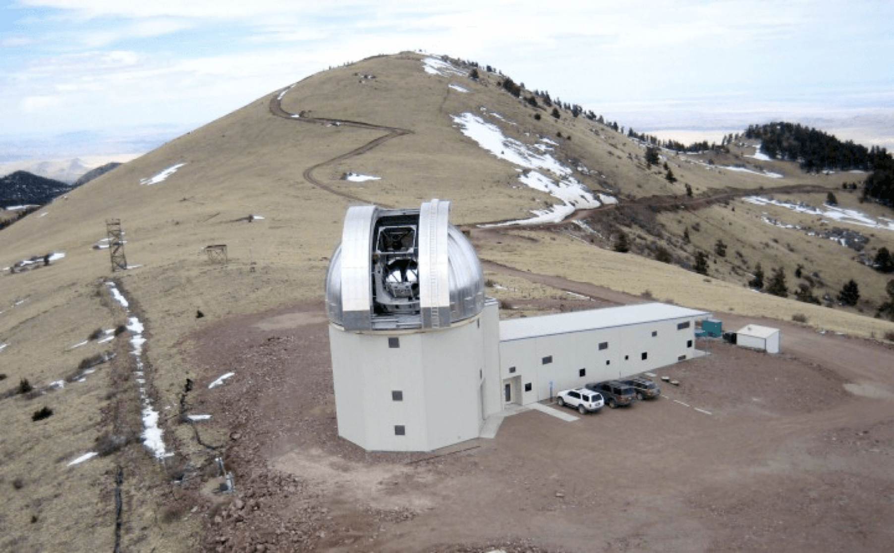
Magdalena Ridge Observatory near Socorro, NM
Planning to finish construction in 2023
Notes:
Turbo will be a telescope array consisting of 16 mount split evenly between two site (New Mexico and Crete)
2 sites give coverage of most of the northern sky at all times
Each mount will have two 11’ celestron Rowe-Ackermann Schmidt Astrograph (RASA) telescopes with ASI6200MM Pro:lisa
The combination provides a 2.2x3.3 deg^2 field of view with a 1.25 arcsec/pix plate scale for each RASA.
When offset this yields ~14 deg^2 field of view for each mount or 112 deg^2 per site.
The mounts are Planewave L-350’s which have slew speeds up to 50 deg/s allowing pointing to anywhere on the sky in under ~5 seconds
At dark sites we expect to achieve a limiting magnitude of 20 with a 30 second exposure
A 1000 deg^2 area can be covered in 10 pointing by one site
5 seconds for the first pointing, subsequent pointings will be nearby so slew time is negligible
30 seconds per pointing for a depth of 20 mag
5+(30*10)=305 seconds ~ 5 minutes

Slide 10
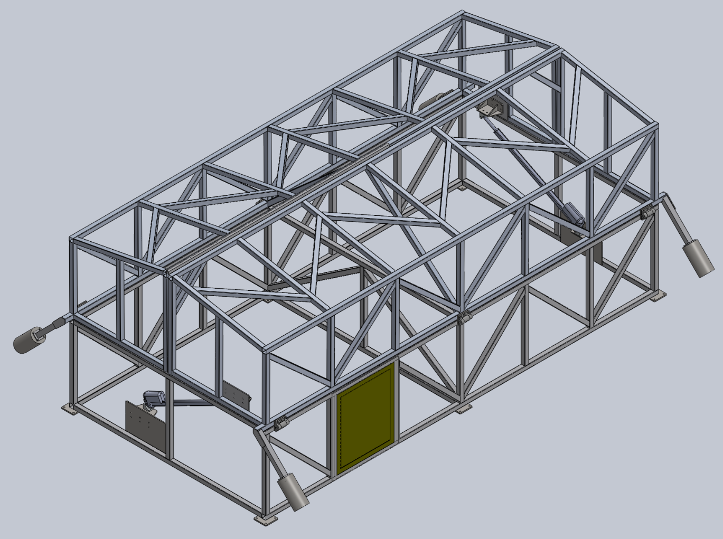
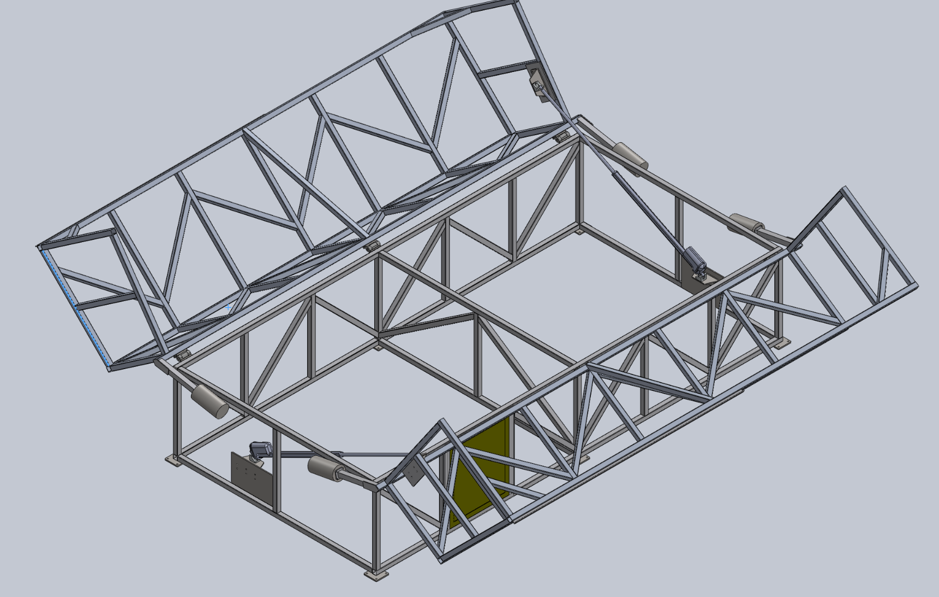
Clamshell Enclosures
Notes:
Use enclosure as a windshield
Linear actuators power it (4 of them)
8x 16 feet

Slide 11
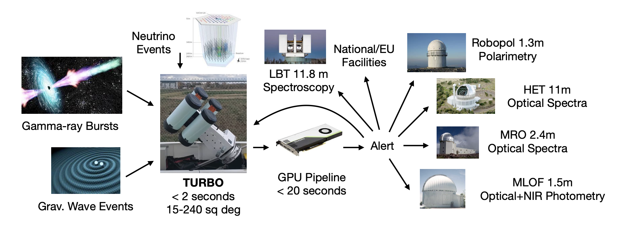
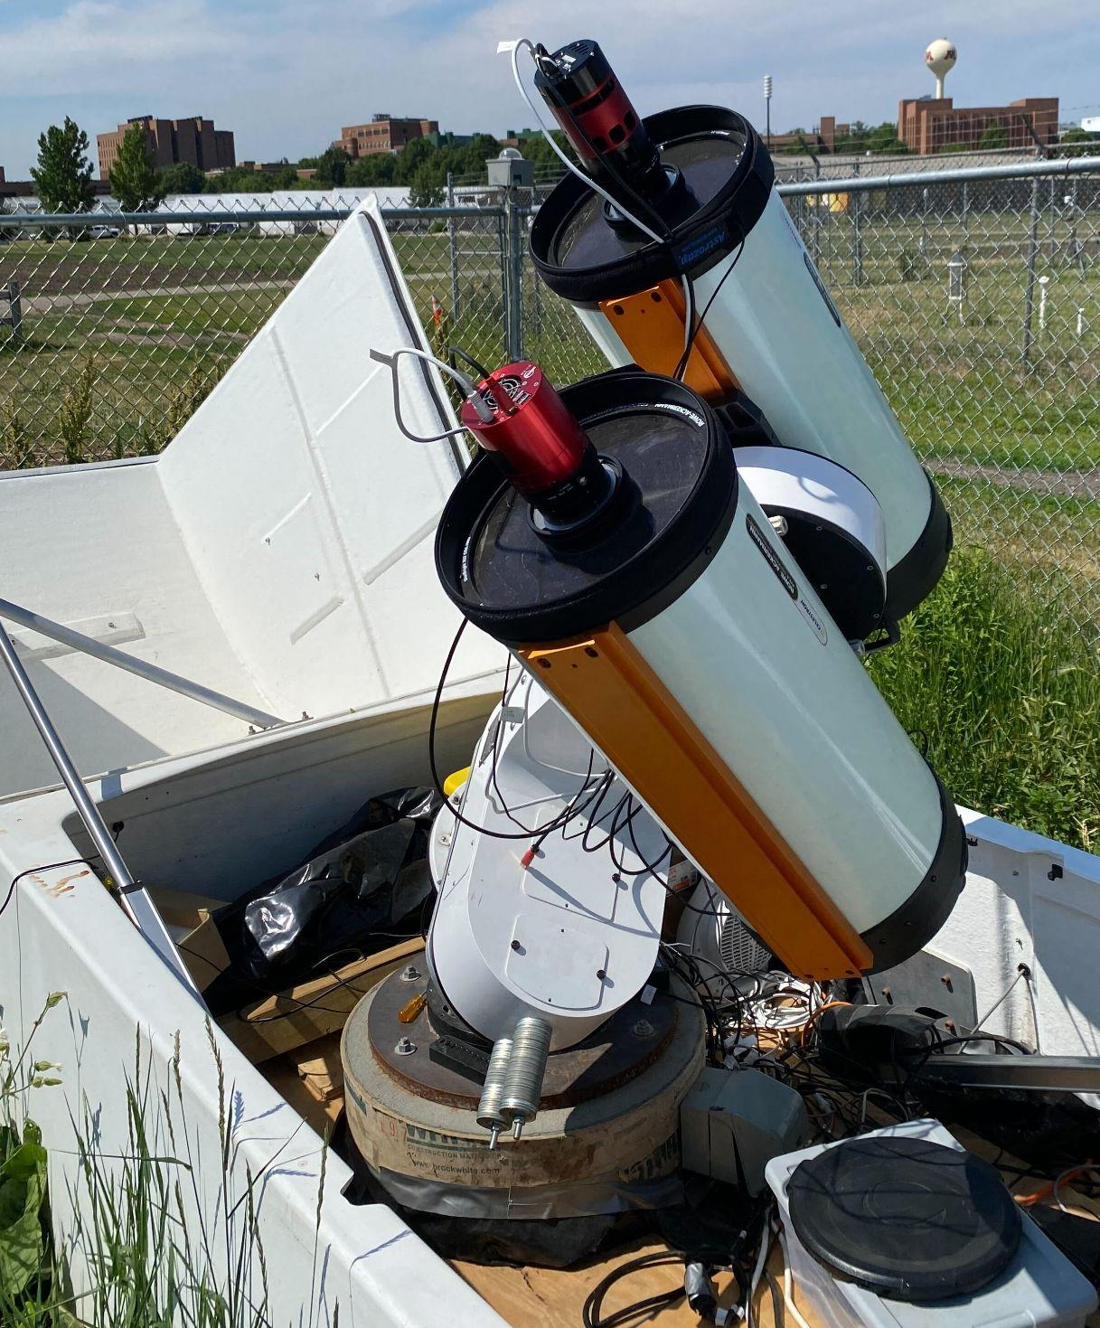
Matthew
Tran
7-112 deg²
⅔ of alerts will be pubic during commissioning
Notes:
122Mb per image. 2 GB per exposure per site.
Image subtraction under 4 seconds using GPU
⅔ of alerts will be public during commisioning
GW170817 peak magnitude 17 in g and r. Localization area less than full array area, wouldn't even have to offset!! Nomainaly discover it in 1 minute

Slide 12
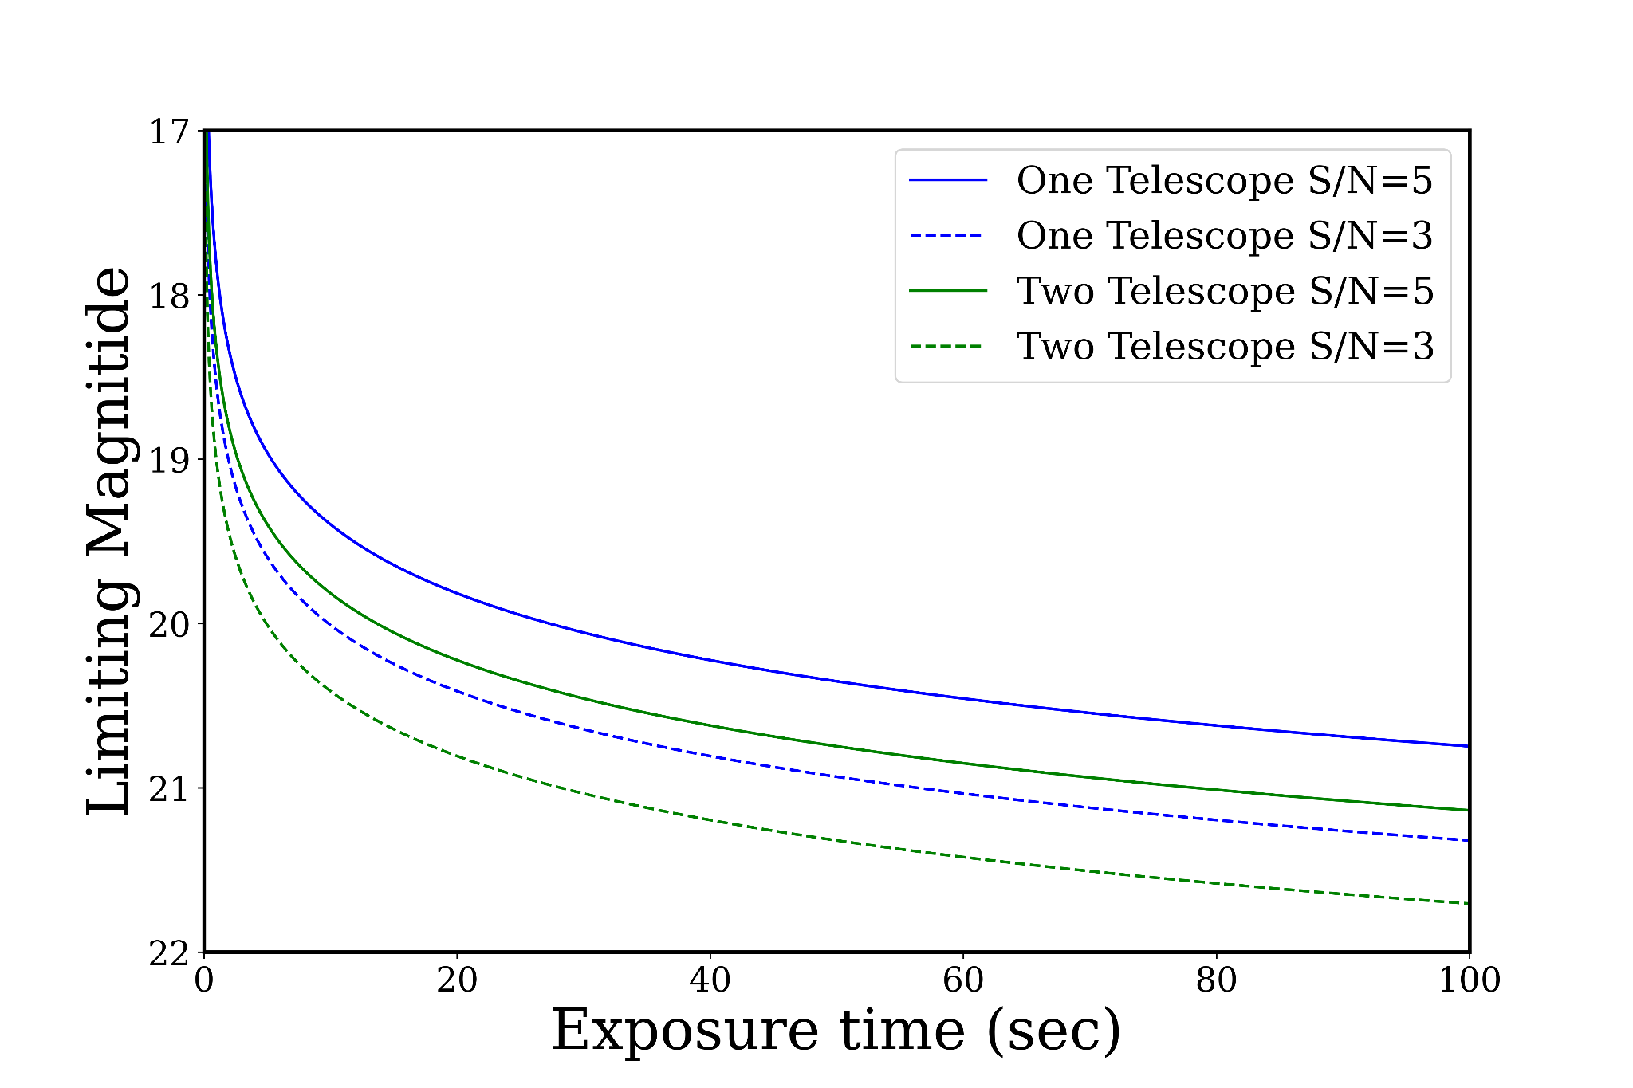
High Cadence Supernova Search
Image nearby (up to 45 Mpc) SN host galaxies every few minutes
Sites are separated by ~130 deg longitude increasing temporal coverage
8 independent mounts allow for many targets at high cadence
We expect TURBO to find 4-6 SNe at the time of their first light each year
Notes:
LIGO, Fermi and other instruments produce lots of alerts but not enough to take all the available observation time of TURBO
While waiting for alerts (or updating reference image catalog) TURBO will be conducting a supernova search survey
TURBO’s 8 independent pointings per site allow for a high cadence survey of multiple supernova host galaxies
With a depth of 20 mag TURBO can observe 100 targets at a 6 minute cadence
Based on the the Asiago SN catalog, if looking at galaxies within 45 Mpc with at least two SNe in 2021 we would have expected TURBO to find 4-6 SNe at the time of their first light

Slide 13
GRB Follow Up With Prototype in St.Paul
GRB | Limiting Mag. g | Limiting Mag. r | Exp time | Limits from other facilities
GRB 221120A | 16.0 | 15.4 | 150s | 24.1 in r O'Connor et al. (GCN 32957)
GRB 230201B | 17.9 | 17.8 | 900s | 16.7 in clear Lipunov, V et al. (GCN 33249)
GRB 230314A | 18.3 | 18.7 | 1800s | 13.9 in clear Lipunov, V et al. (GCN 33476)
Notes:
Proof of concept, Just for testing
There are more alerts than just LIGO!
The current Prototype in St.Paul has not respond to any LIGO events yet, but has responded to 3 of gamma ray bursts alerts from FERMI.
The site in St.Paul is not a dark site so limiting magnitudes are lower than expected at the final sites
Reference images were not available at the time of observations. After about two weeks any optical counterpart would fade out of TURBO’s detection capabilities in St.Paul so the field can be followed up used as a reference since there would be no GRB counterpart remaining. This was done for GRB 230201B

Slide 14
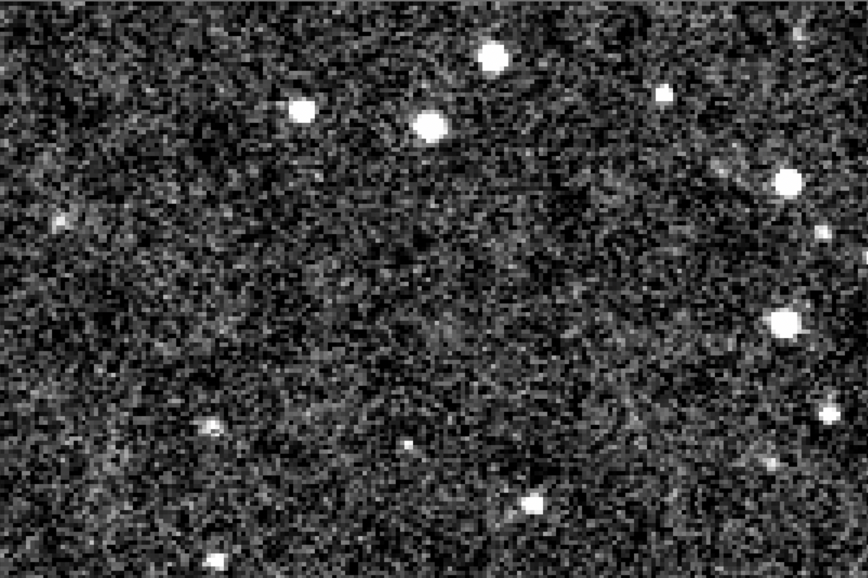
Images processed in ~10 seconds
Notes:
Proof of concept, just image cut out. GPU pipeline
GRB 230201B, g 17.6 r 16.7.
No reference images were available at the time of observation
New data was collected ~2 weeks later, after any afterglow would have faded to be undetectable by TURBO to act as reference images
During analysis this transient was found in the field and serves as a proof of concept for TURBO’s transient detection capabilities

Slide 15
Conclusions
TURBO’s wide field of view and fast slew speeds allow:
Full coverage of entire gravitational-wave localization area
Discovery of supernovae in nearby galaxies within seconds or minutes of explosion
GPU enabled pipeline will enable near real time alerts
⅔ of alerts will be public during commissioning
Construction is starting this summer and expected to finish in 2023

Slide 16
Questions?

Slide 17
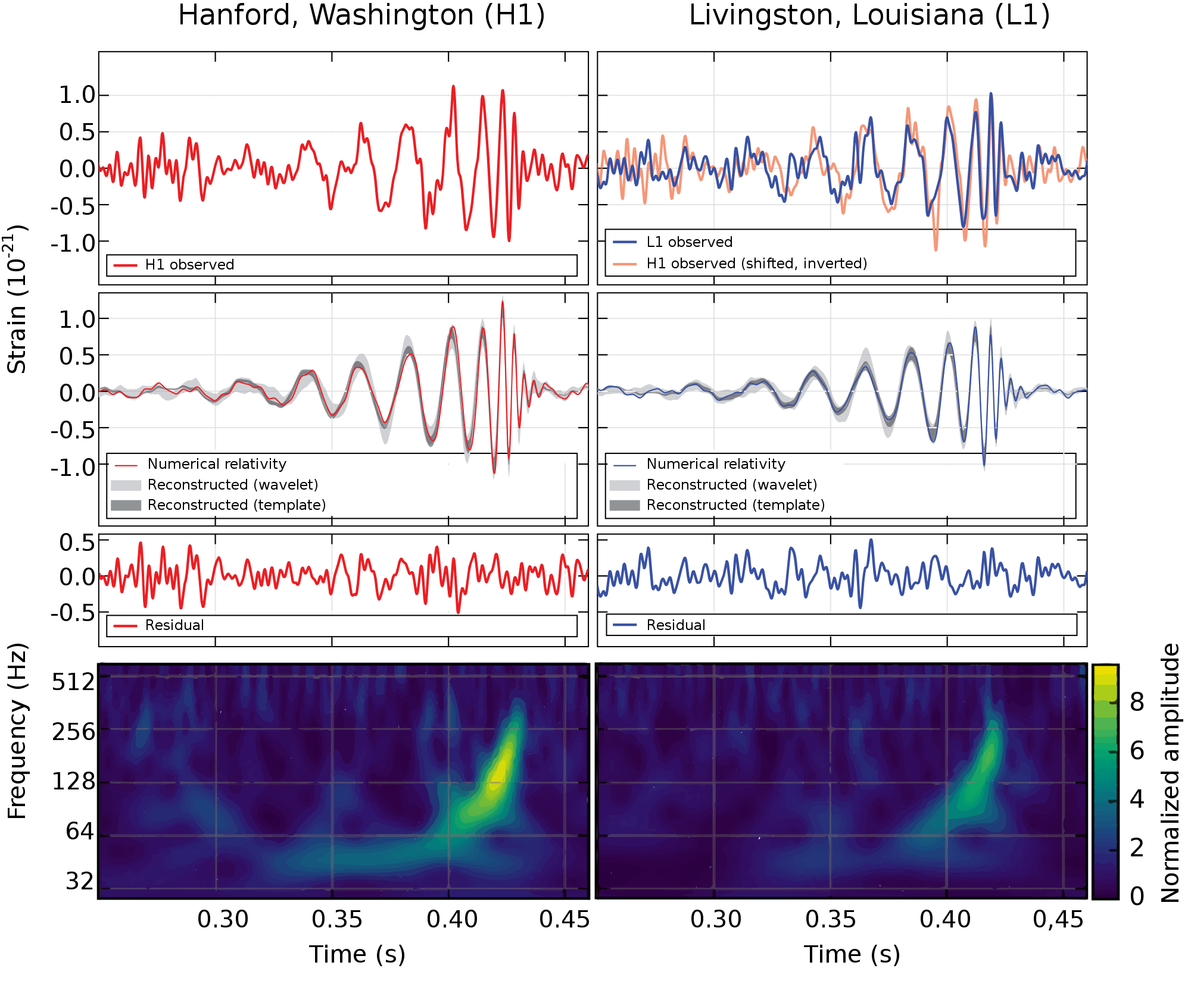
Finding The Transients
Diff image
It is not enough to just image the area where a transient is, you need to find it!
TURBO will use a difference imaging data reduction pipeline to find transients
Each Turbo image has a size of ~ 122 MB so at a 30 second cadence for each of the 16 cameras per site ~2 GB of images need to be processed every 30 seconds to produce real time results.
The speed required necessitates at GPU enabled pipeline
We use a slightly modified version of the SFFT* python package to compute difference images using a Nvidia RTX 4090 GPU in ~4 seconds per image. Multiple GPUs will be used in parallel to reach desired speeds
* https://github.com/thomasvrussell/sfft
Notes:
it is not enough to just image the area where a transient is, you need to find it!
TURBO will use a difference imaging data reduction pipeline to find transients
Each Turbo image has a size of ~ 122 MB so at a 30 second cadence for each of the 16 cameras per site ~2 GB of images need to be processed every 30 seconds to produce real time results.
The speed required necessitates at GPU enabled pipeline
We use a slightly modified version of the SFFT* python package to compute difference images using a Nvidia RTX 4090 GPU in ~4 seconds per image. Multiple GPUs will be used in parallel to reach desired speeds

Slide 18
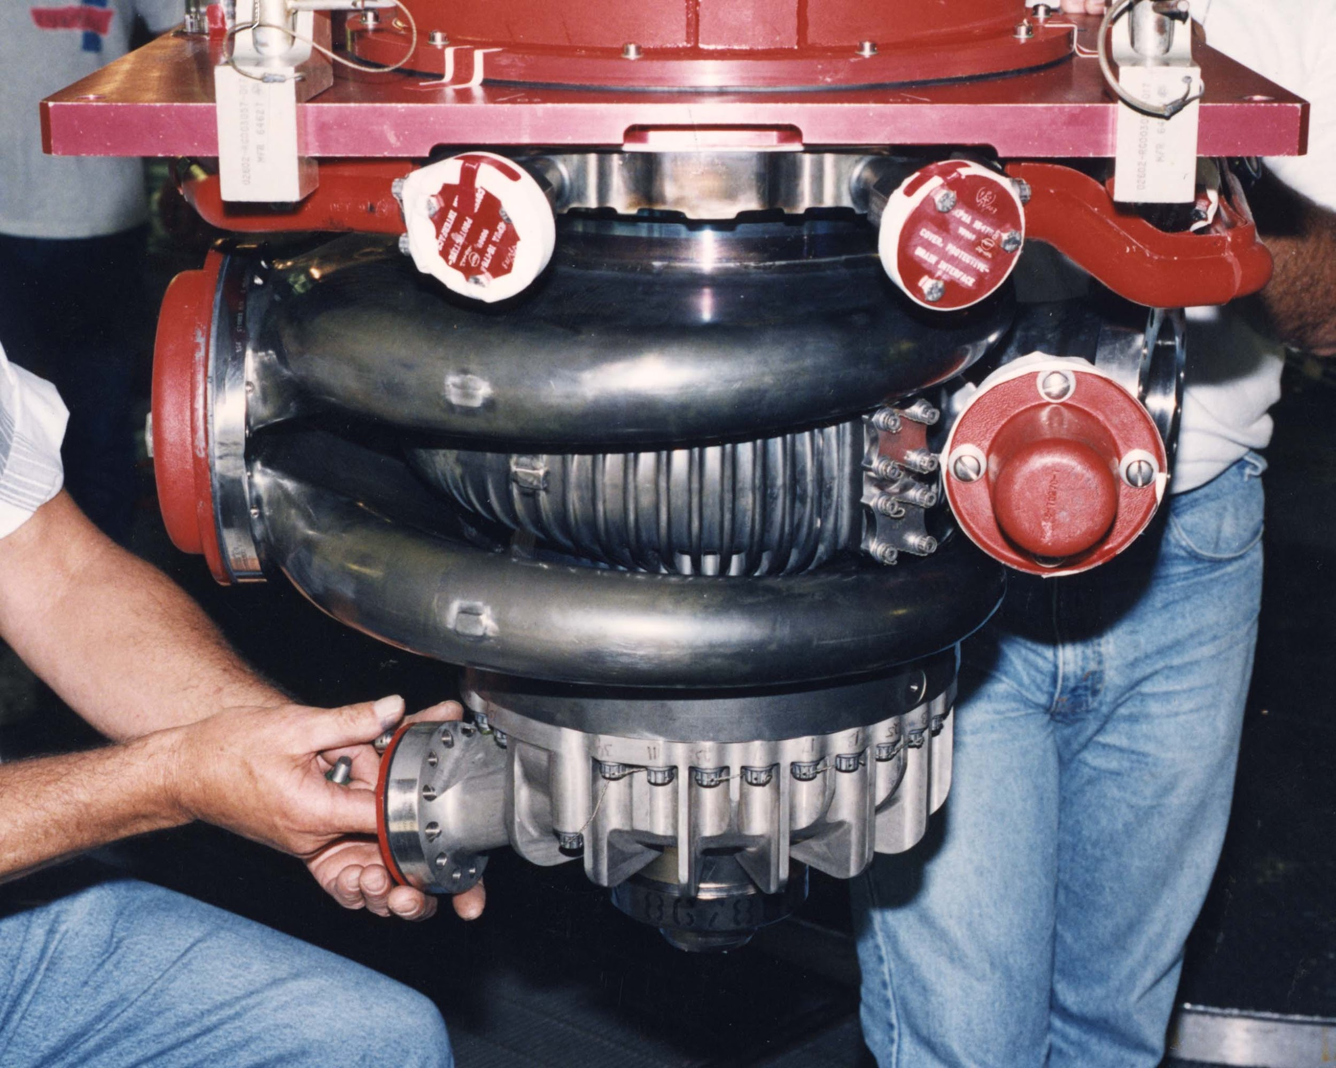
What is TURBO cont.
The mounts are Planewave L-350’s which have slew speeds up to 50 deg/s allowing pointing to anywhere on the sky in under ~5 seconds
At dark sites we expect to achieve a limiting magnitude of 20 with a 30 second exposure
A 1000 deg^2 area can be covered in 10 pointing by one site
5 seconds for the first pointing, subsequent pointings will be nearby so slew time is negligible
30 seconds per pointing for a depth of 20 mag
5+(30*10)=305 seconds ~ 5 minutes
Ultra-fast :check!

Slide 19
What is TURBO?
Turbo will be a telescope array consisting of 16 mount split evenly between two site (New Mexico and Crete)
Each mount will have two 11’ celestron Rowe-Ackermann Schmidt Astrograph (RASA) telescopes with (ZWO CAMERAS)
The combination provides a 2.2x3.3 deg^2 field of view with a 1.25 arcsec/pix plate scale for each RASA.
When offset this yields ~14 deg^2 field of view for each mount or 112 deg^2 per site.
Total coverage: check!
TURBO prototype in St.Paul MN

Slide 20
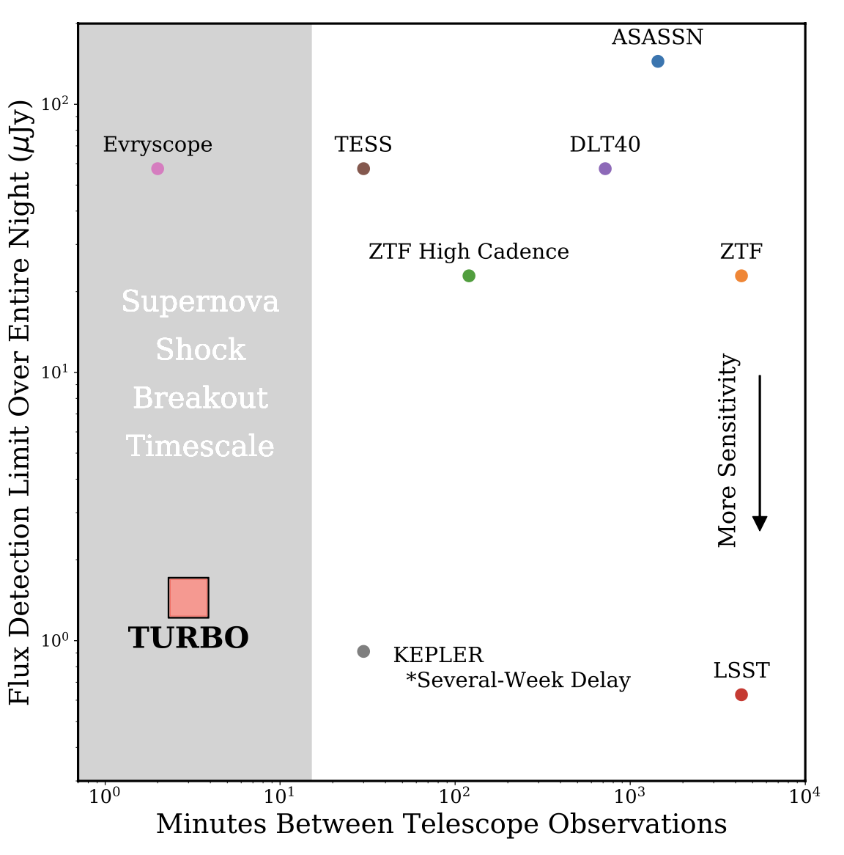

Slide 21
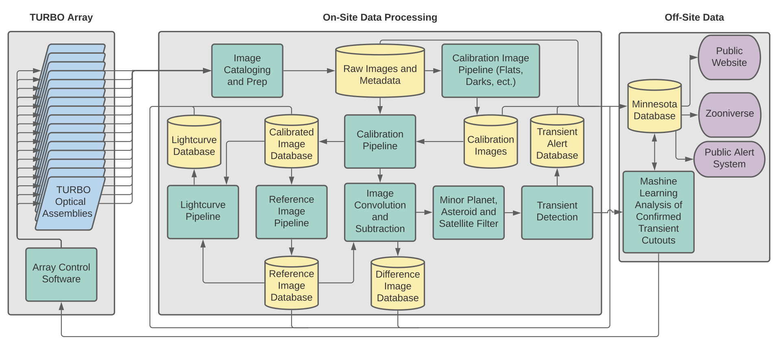

Slide 22
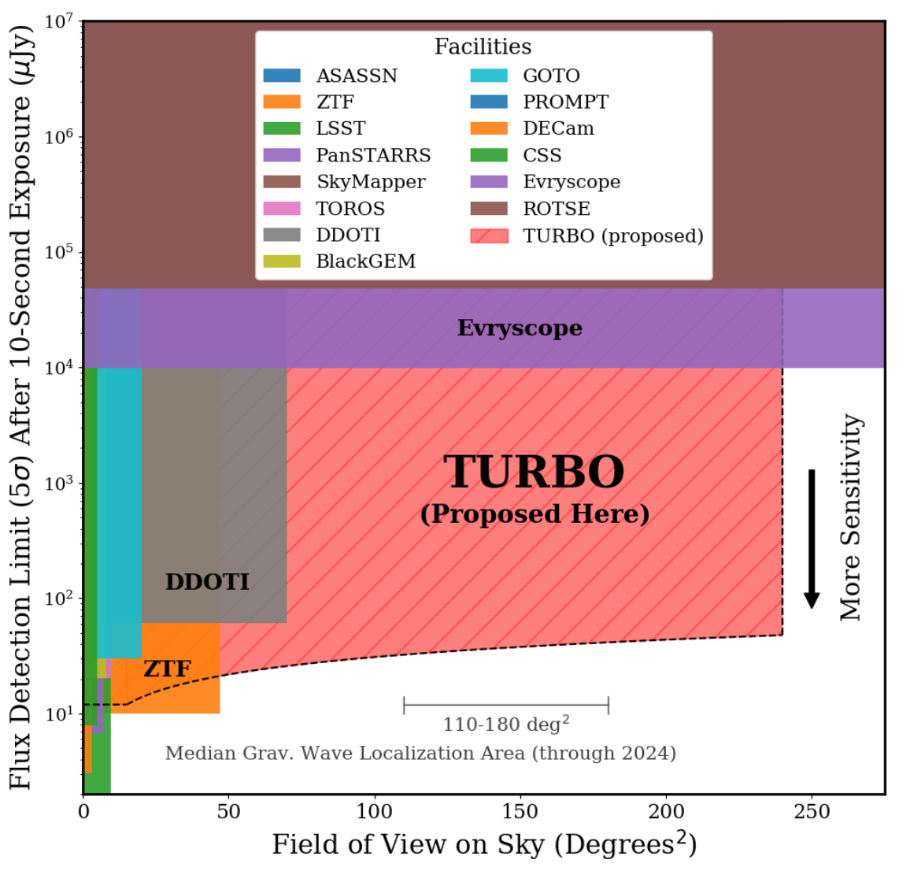

Slide 23
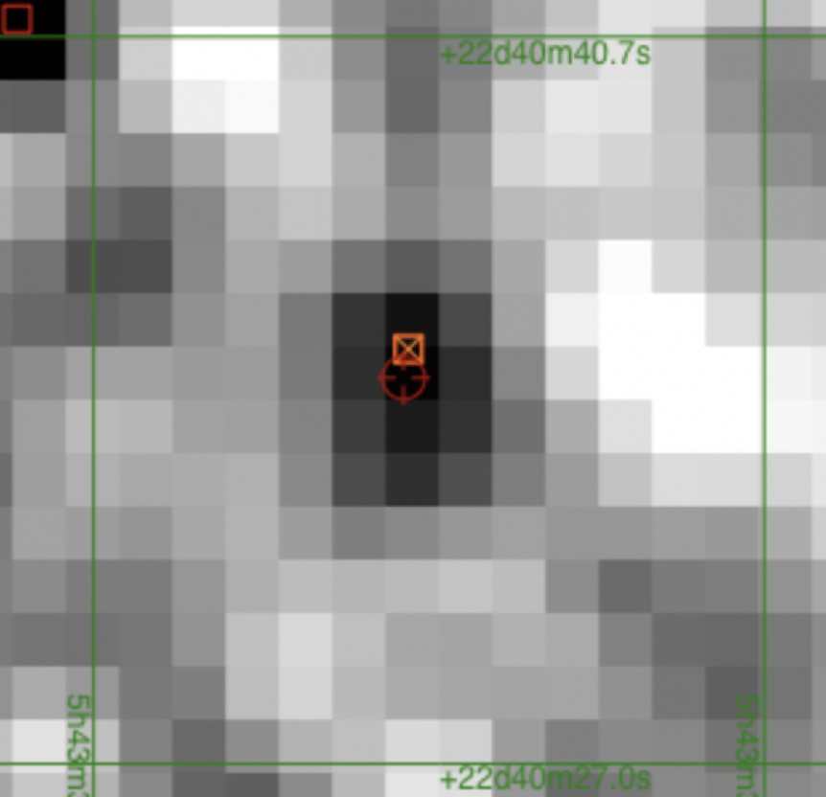
WISEA J054335.82+224034.5
r mag 16.7
g mag 17.6

Slide 24
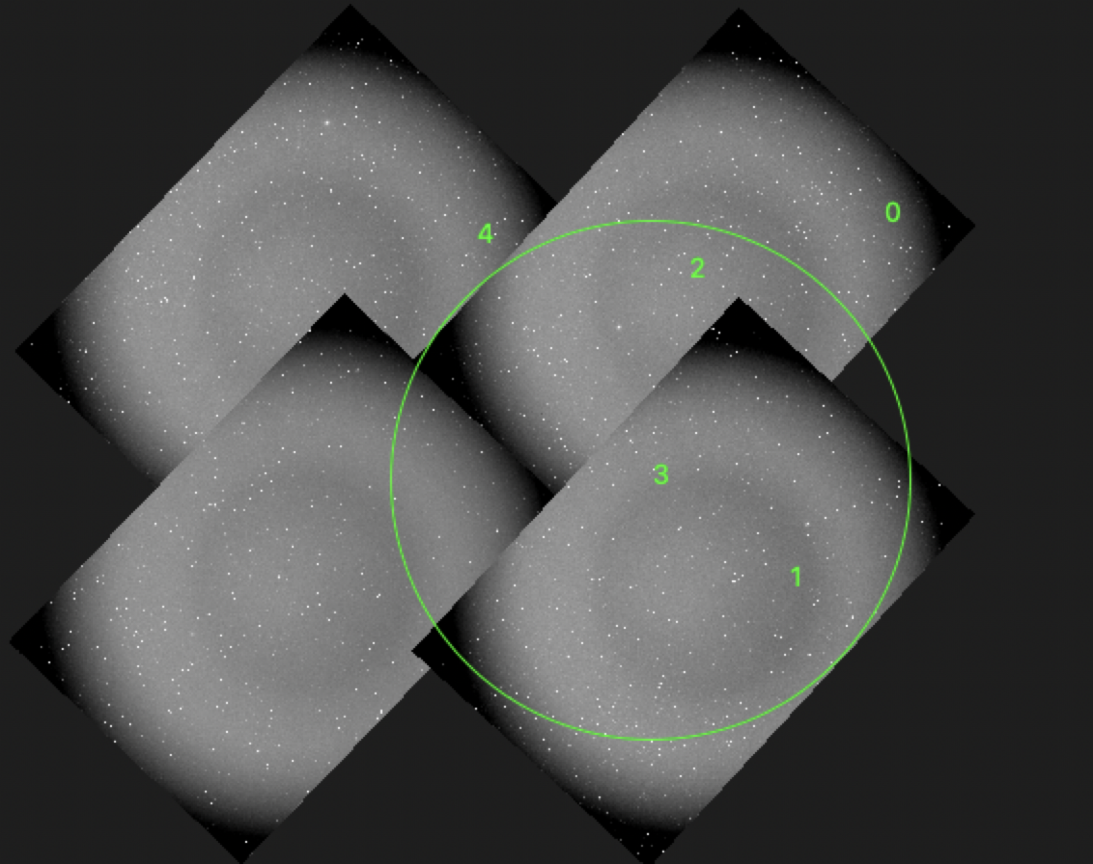

Slide 25
