Slide 1
GRBs, SFR, and the ISM (with Gavin Lamb, Nial Tanvir & Miti Patel)
Andrew Blain
University of Leicester
June 2023, NCSA

Slide 2
Motivation
Long gamma-ray bursts (GRBs)
High-energy transient: 90% of γ-ray luminosity lasts >2s
Associated supernova (SN) core collapse/massive stars
SN involve a jet, interacts with envelope and environment to produce non-thermal photons from radio-to-GeV γ
Jet opening angle up to ~10 degrees
Afterglow fades over ~days
GRB/SN rate expected to follow high-mass star-formation rate (SFR)
Obscuration is a factor in selection
On-axis, a single event can be recognized at z>>10
Yet host galaxy properties seem to be involved

Slide 3
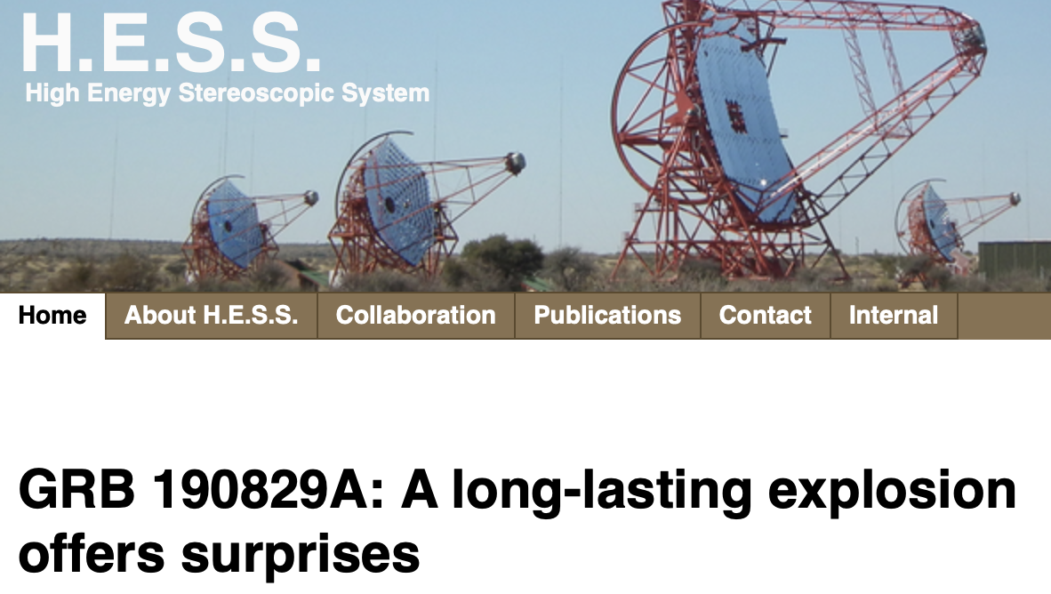
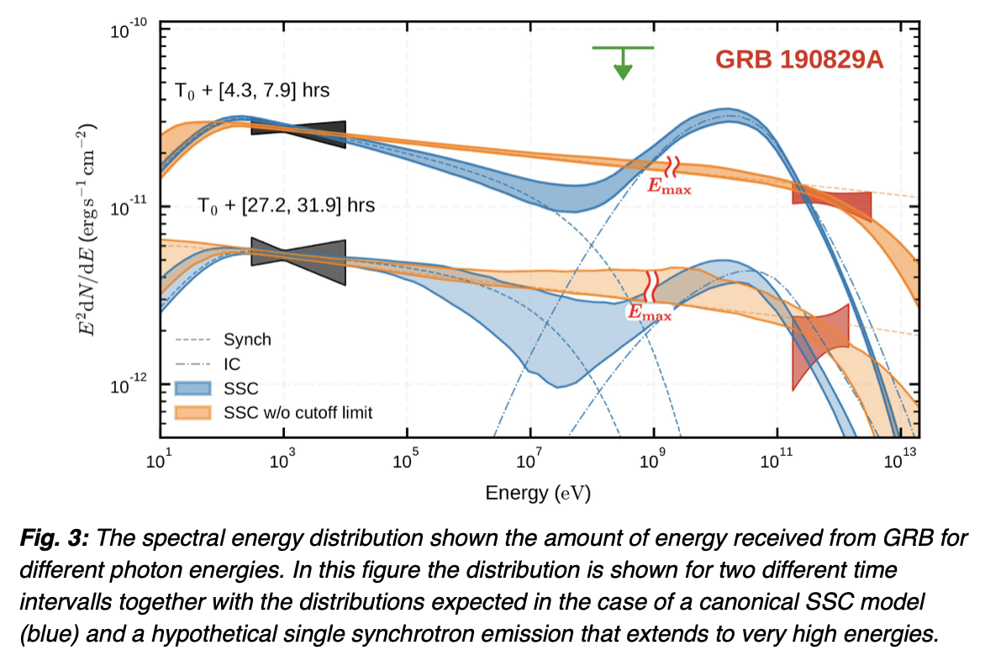
GRBs trace forming stars directly, not bulk properties of their host galaxies
Consistency check with galaxy luminosity functions
Yet: TeV γ-ray photons claimed to be preferentially from ‘dusty` hosts
TeV emission challenges jet models.

Slide 4
Why would `dusty’ `star-forming’ galaxies produce more TeV emission?
The local environment of the GRB shouldn’t affect the SN core collapse process
Further the SN progenitor dominates its immediate environment
Burst timescales are hours, so size scales 100 AU
However, wider ISM environment of a starburst galaxy is not like the Milky Way
Supernova remnants can’t break out of the disk
“Frustrated” as “cosmic-ray factories”
Only well-studied (and indeed studiable) case is M82

Slide 5
GRB jet conditions
The most remarkable signal – 0.1% of rest-mass energy of a star’s core, on second timescales. Probably asymmetric.
Launch of jet from ~1-10km region
Also short GRBs where compact objects inspiral and merge, definitely on a ~ 10km scale.
Gravitational-wave signals
Energy density? 10²⁸⁻³⁰ Jm⁻³
C.f. 10²¹ Jm⁻³ in ”mc²” energy for water

Slide 6
Jet properties
Emission is explained by internal shocks in the jet, and slowing to reduce beaming
Evolution in time and in frequency of synchroton emission
But, this has trouble with TeV-PeV energies
Hence, could involve (and probe) the ISM
Massive stars in rich ISM regions, long GRBs occur there
ISM responds on few second timescales, micro-pc scales

Slide 7
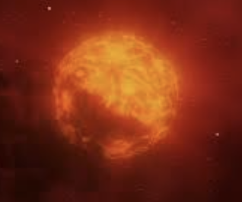
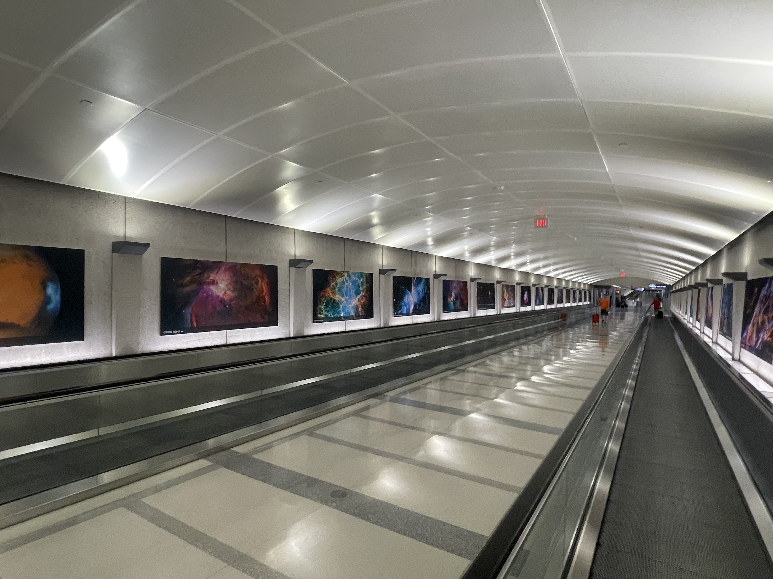
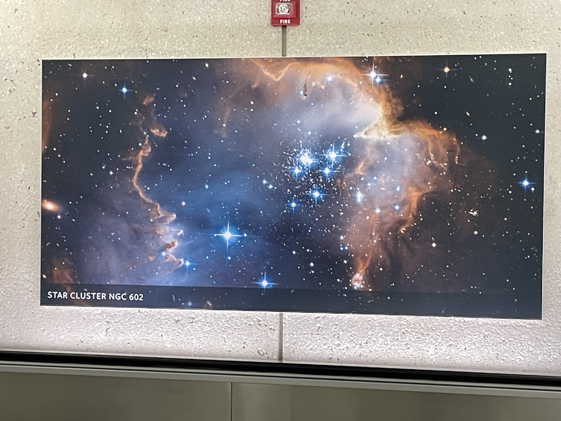
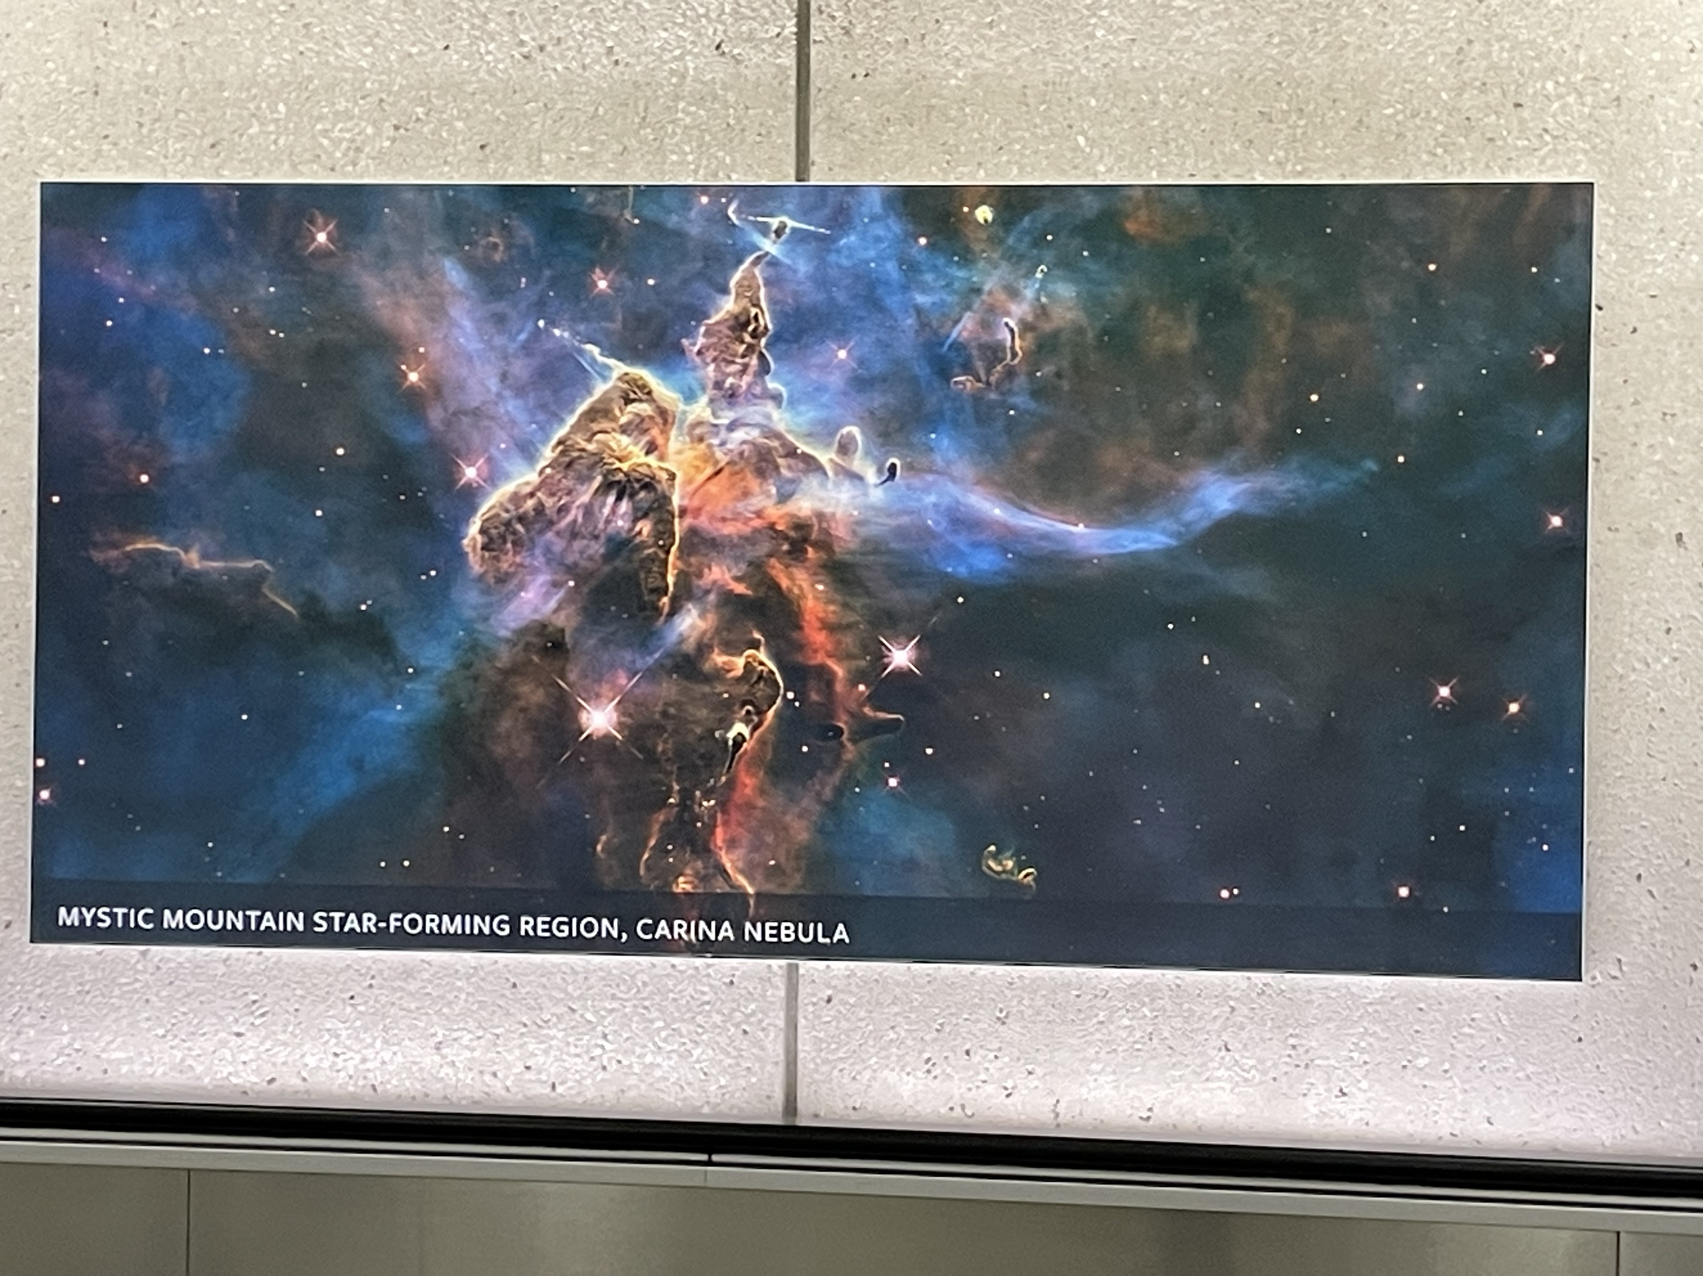
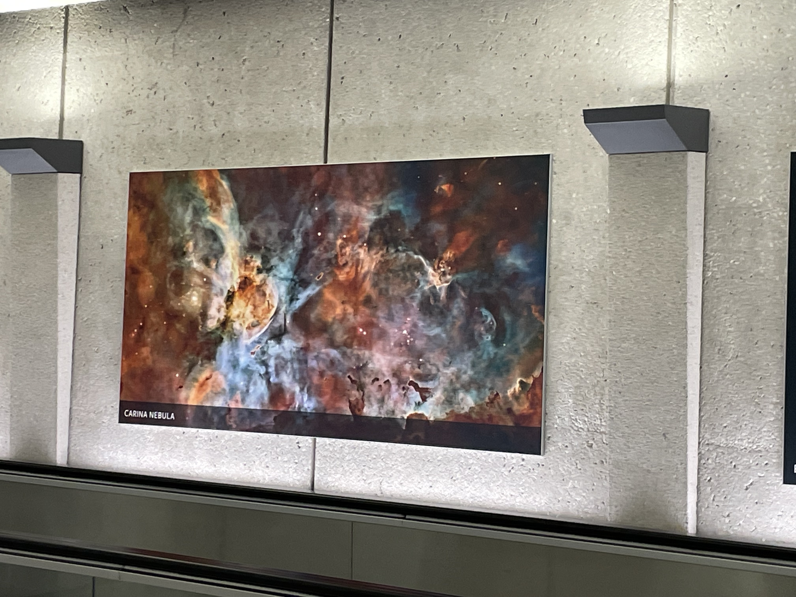
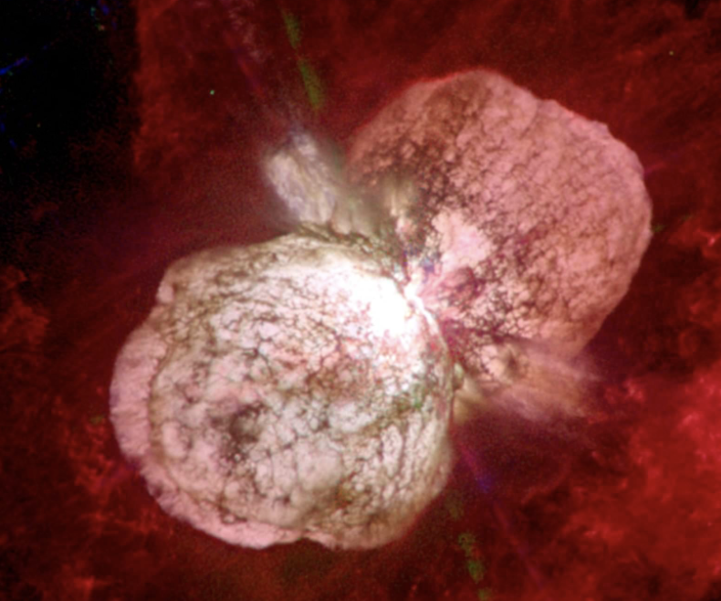
Conditions in ISM
Dulles Metro saved some search time.

Slide 8
Cartoon of light passage

Slide 9
Cartoon of light passage

Slide 10
Cartoon of light passage

Slide 11
Cartoon of light passage

Slide 12
Cartoon of light passage

Slide 13
Cartoon of light passage

Slide 14
Cartoon of light passage

Slide 15
Along the blasted track
~100s / 10¹⁰m
Photons lead accelerated/entrained debris
The innocent ISM
Total ionization
Nuclear dissociation?
Flowing near c
The innocent ISM

Slide 16
Gamma “Puck” completely ionizes ISM
Through any density, passage of 10-100s of prompt emission makes a very-ionized “tunnel”
Extremely hot, bulk flowing: expands sideways
Jet opening angle matters
Optical properties affected by electron density
Lowered in the very-hot, lower-density tunnel – raised in the higher-density “pushed” shroud. This gradient will deflect subsequent photons inwards, along the channel.
“Drinking straw”, or “Optical fiber” as a picture
Unusual case - radio refraction and scintillation from plasma is usually diverging, in an optical sense, yet this is converging.

Slide 17
Along the blasted track
Electron density
Along track
The opening angle/profile is
Unclear, but assuming it’s a “beam”:
~100s / 10¹⁰m
Structure through the ISM determines electron density
~100s / 10¹⁰m
Look down the barrel:
Radial electron density
is grey scale
The innocent ISM

Slide 18
Effects might be?
“Focussing” of X-ray to radio afterglow signal
Can influence the statistics of visible GRBs?
Can affect inferred luminosities
Can affect inferred variability
Absorption and variability could read out the conditions in the ISM as it’s been “exploded” by the passage of the prompt GRB emission, then affects the afterglow’s passage
Also scattering of signal: light echoes, direct emission from the excited ISM

Slide 19
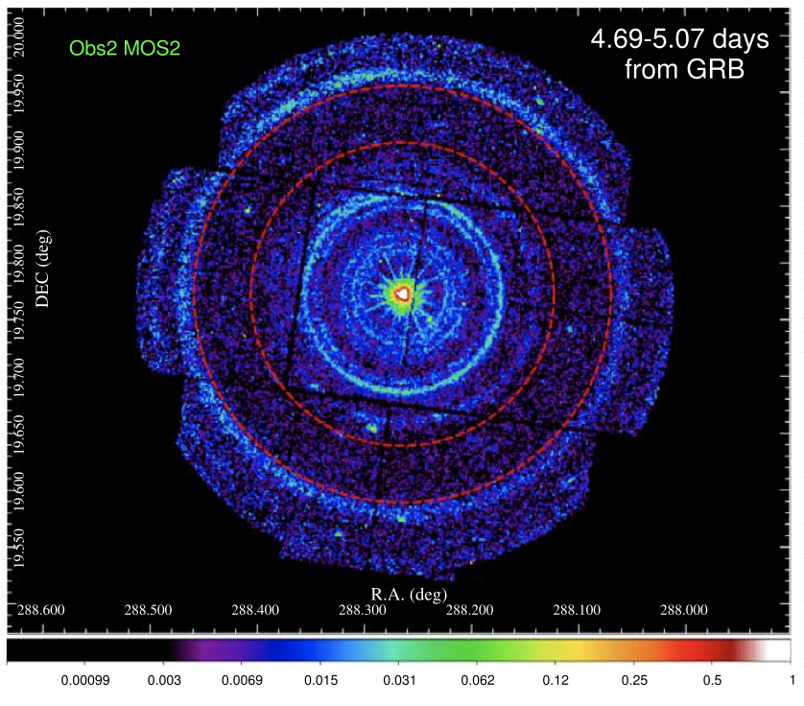
Some ISM information locally
“BOAT” GRB X-ray echoes from Milky Way ISM
221009A
Uniform rings
Coherent sheets
Separate rings
Discrete sheets
Time delay
Video can be made

Slide 20
GRB emission scatters from blasted ISM
Multiple photon interactions
Photon density exceeds interaction scale
Electron energy distribution in the ISM can already include relativistic component
Supernova remnants (SNRs)
General cosmic ray distribution
Both enhanced in star-forming, dusty galaxies.
This photon-electron interaction regime seems not to be well studied – odd circumstance
Sunyaev-Zeldovich etc, relativistic corrections

Slide 21
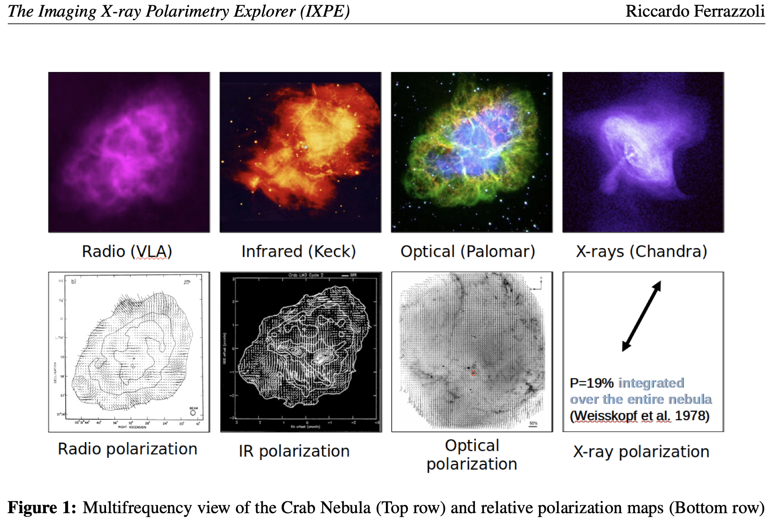
Circle round to star formation: SN Remnants (SNRs)
Generate relativistic electrons that produce radio synchrotron emission, escaping into wider host ISM
Cosmic ray source
Furiously roiling scattering/complex/ turbulent photon-proton-electron soup is largely retained within
Crab is nearest youngest local example.
3 cases in 30 Doradus region
34 cases in M82

Slide 22
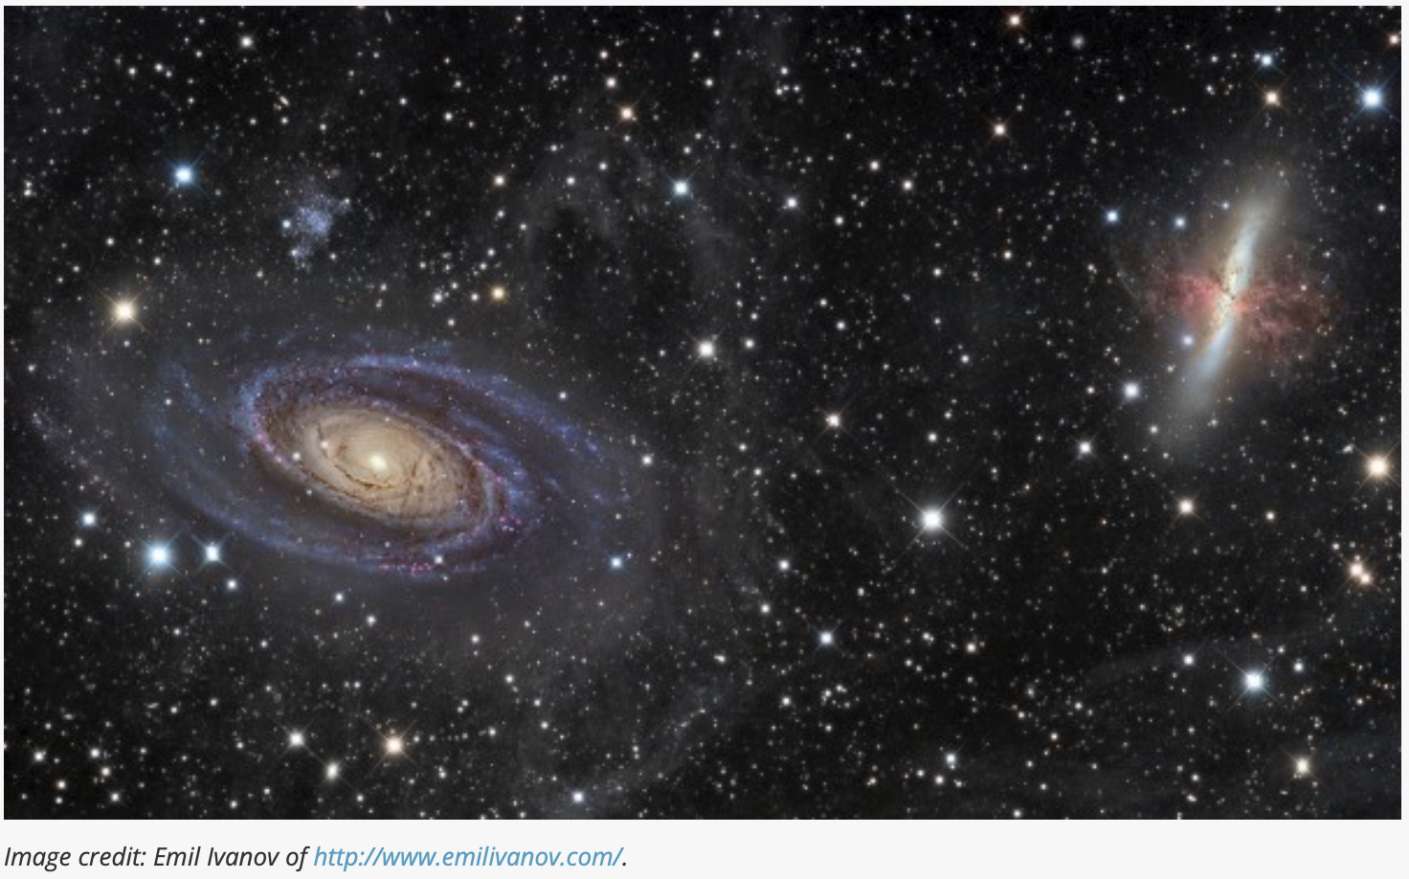
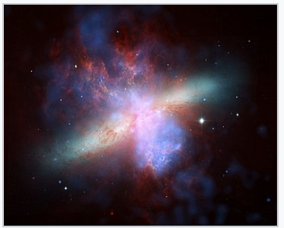
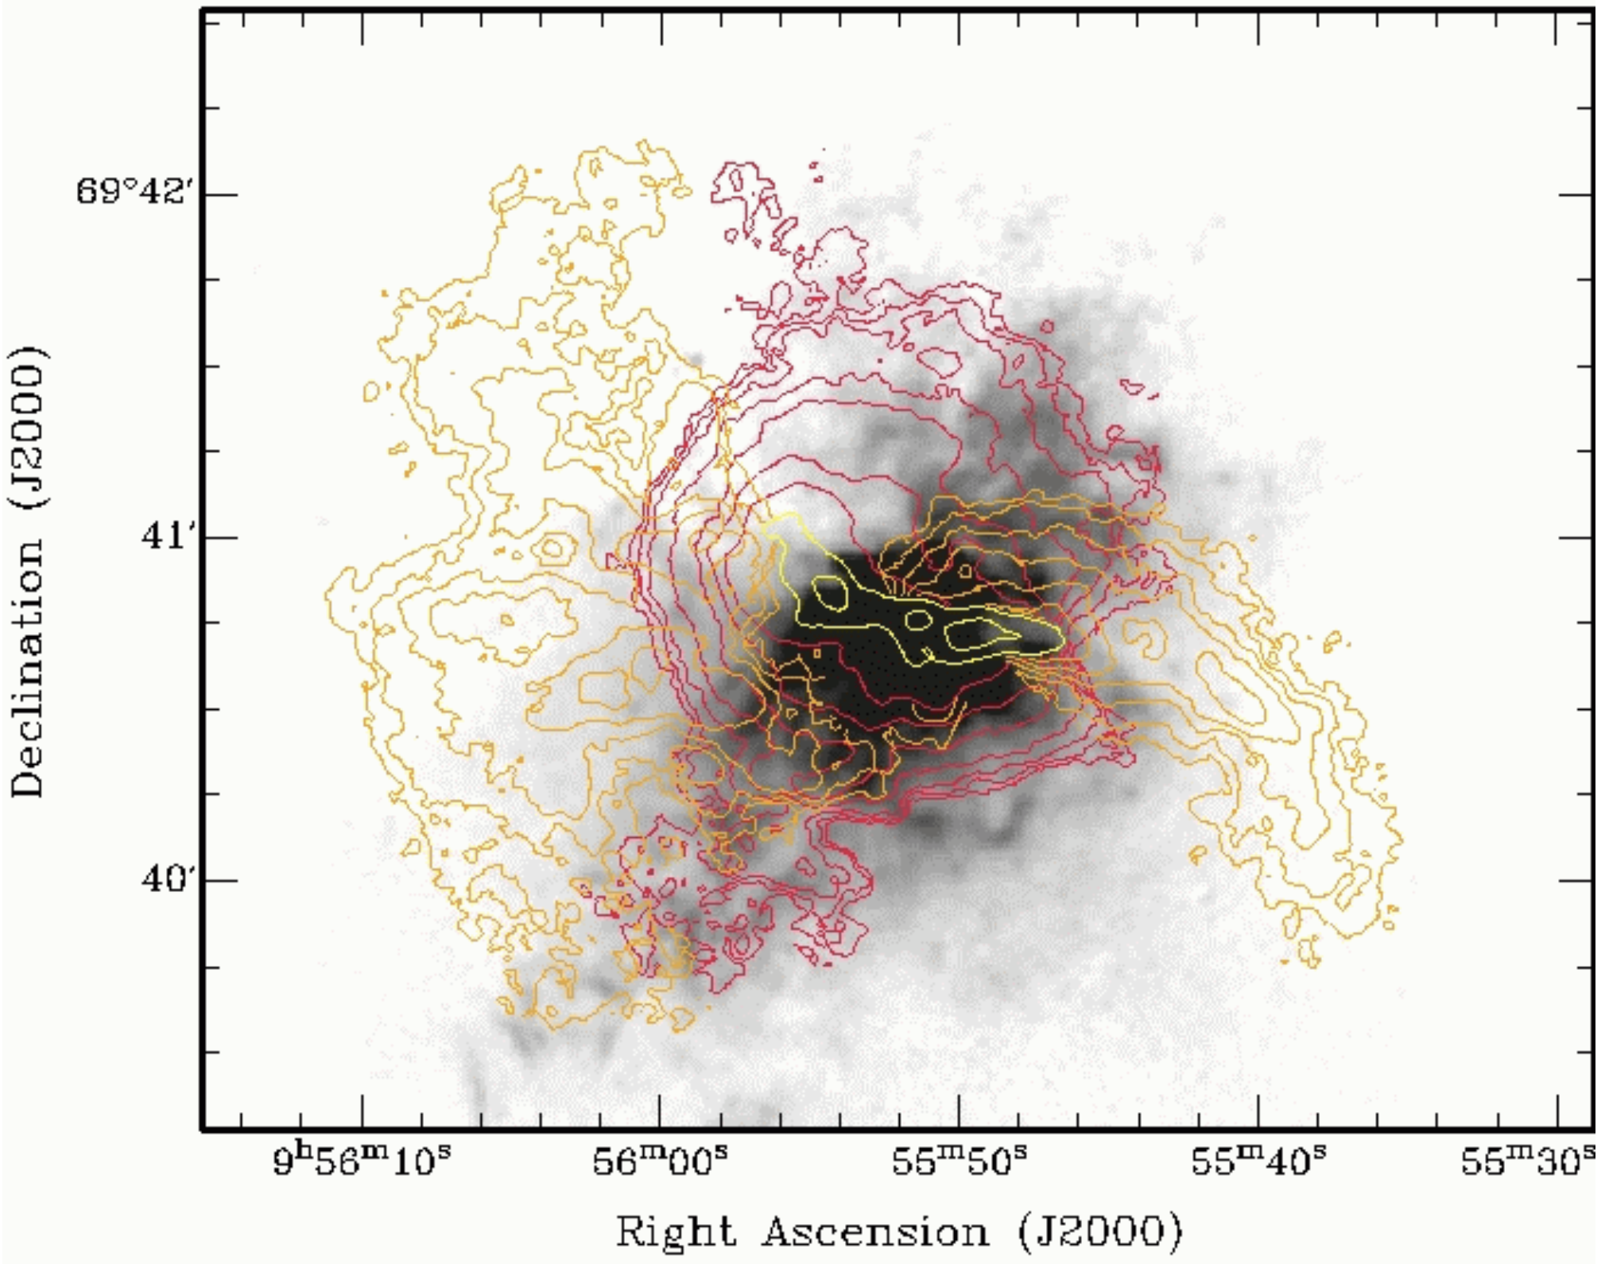
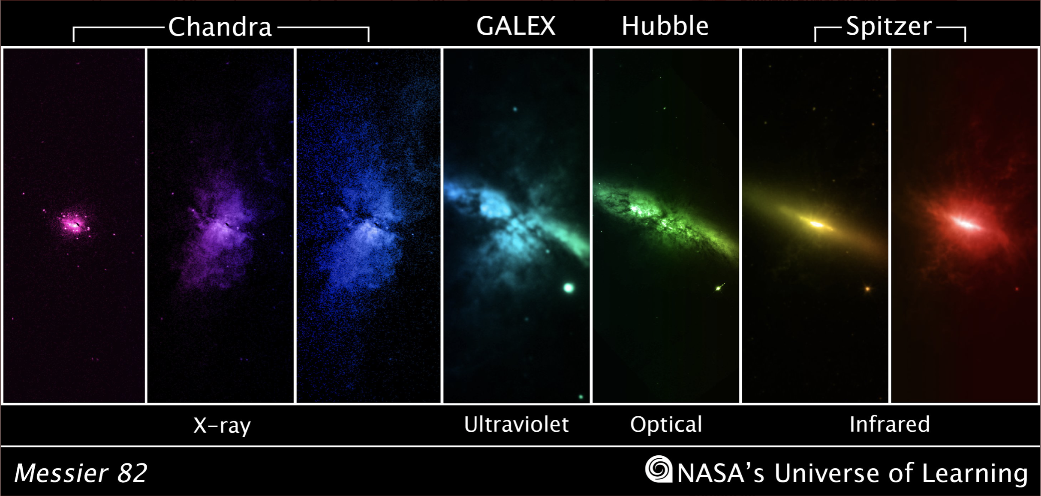
M82 – 3Mpc away - only 3 x 10¹⁰ L☉
Walter, Weiβ &
Scoville (2002)

Slide 23
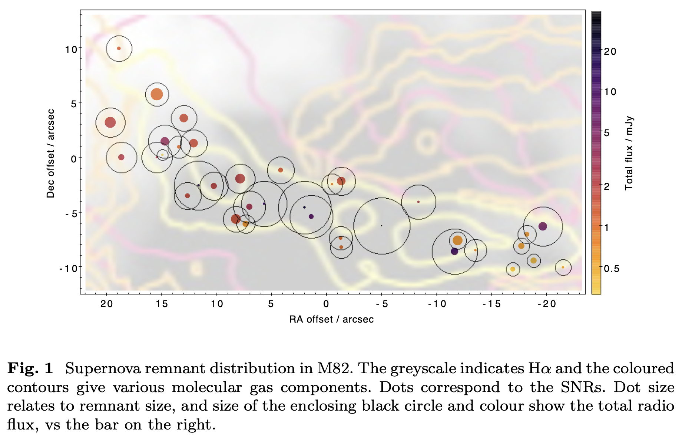
M82: SFR 10M☉yr⁻¹, 34 radio SNRs
A SNR “swarm”
VLBI confirms non-thermal SNRs
Note: M82 is 1000x less luminous than “DSFGs”

Slide 24
A GRB dragon in the star-forming region
In M82, has about a 0.5% chance of crossing a SNR
II Zw 40 / 30 Dor have similar SNR/SFR ratio
If 1000x more SNRs present in region, modulated perhaps by ambient T_{dust} that responds to radiation intensity, then
More like 60%.
Could be more if packed closer for covering/filling factors
What does the roiling relativistic mess of a compressed SNR do to the passing photons?

Slide 25
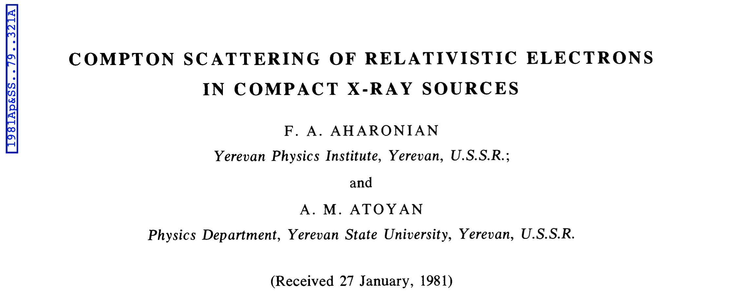
Thankfully…
Isotropic electron distribution
Collimated photon beam
Pole-on “hockey puck” of emission 100-s/AU thick travels for ~yr through SNR

Slide 26
Energy transfer to photons
Energies and angles of deflection work out
You need an X-ray source, or can’t reach TeV, or have small deflections – GRBs work, but ambient radiation field would not.
Subtle geometry and inhomogeneity in remnant matters… WHICH…

Slide 27
Which?....
… is a good thing
As the signature of the TeV GRB could provide information about the ISM
AND the dusty, star-forming ISM, which is tough to investigate even in the best optical/IR spectra, once the opacity reaches ~1
Can find out about both the GRB and its host galaxy. SNRs are otherwise invisible at z>0.001

Slide 28
Summary
Can potentially infer conditions in the ISM in dense regions out to high redshift, and on small scales by exploiting the time domain.
Direct SNR dissection with VLBI only works for M82 – even Arp220 is ~100x farther away.
Could affect inferred GRB population properties
Scintillation could add to the variability that’s intrinsic to the GRB jet?

