Slide 1
Radio Counterparts of Binary Neutron Star Mergers from Present to Future
Avery Eddins
Department of Physics and Astronomy
Texas Tech University
The Transient and Variable Universe
June 20th, 2023

Slide 2
Overview
Motivation: GW170817 and current VLA radio studies
ngVLA long baseline simulations
First results
The ngVLA, SKA, and GW detectors
Co-authors: Alessandra Corsi, Vsevolod Nedora, Eric Murphy, David Radice, Viviana Rosero, Davide Lazzati

Slide 3
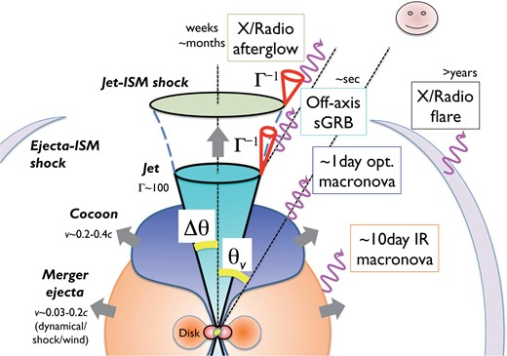
GW170817 and its Ejecta
Two main components: structured jet and merger ejecta
Structured jet:
Fast core + cocoon
Synchrotron radiation from shocked ISM
Delayed afterglow for off-axis observers as casual cones widen
Merger ejecta/kilonova: currently searching for kilonova afterglow
Diagram of GW170817’s emission (Ioka & Nakamura 2018)
(Metzger 2017), (Metzger 2019)

Slide 4
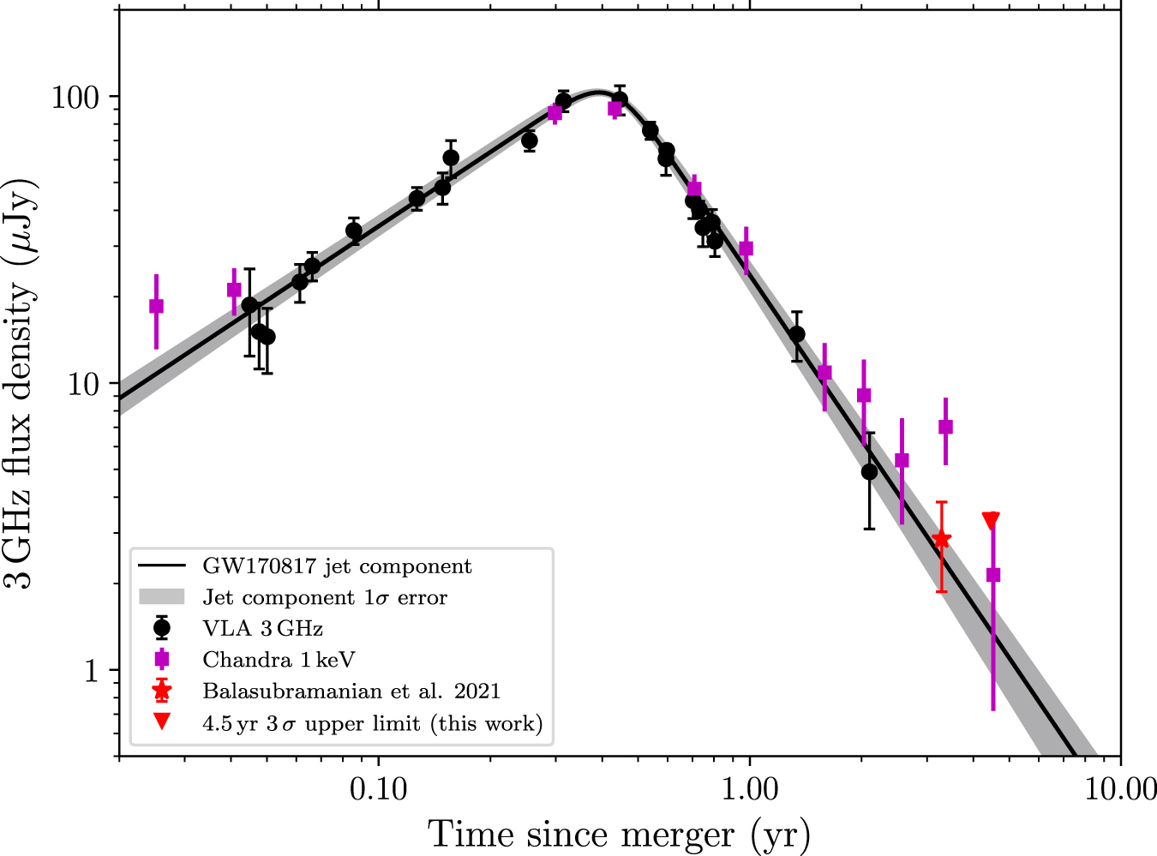
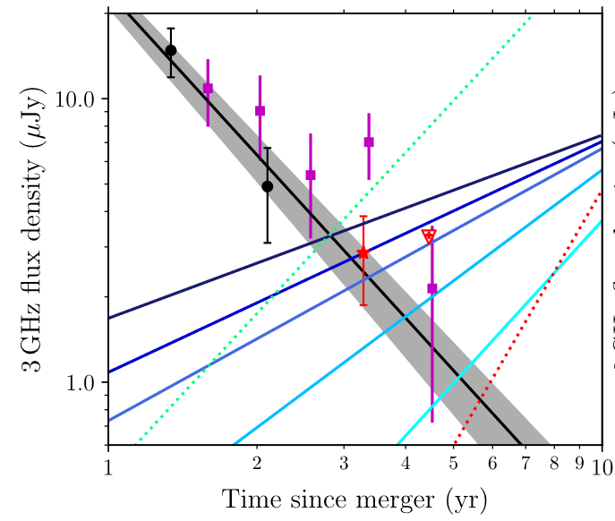
Current VLA Searches: GW170817
Light curve at left zoomed in with predictions of a kilonova afterglow light curve overlaid
Looking for GW170817’s late-time KN radio flares
Predicted by models
X-ray excess potentially detected, maybe radio too?
Their presence has implications for mass ratio and EOS
GW170817 3 GHz light curve showing the evolution of the jet component of the emission
(Nakar & Piran 2011), (Troja et al. 2020)
Figures from Balasubramanian, A., Corsi, A., Mooley, K. P., et al. 2022, ApJ, 938, 12

Slide 5
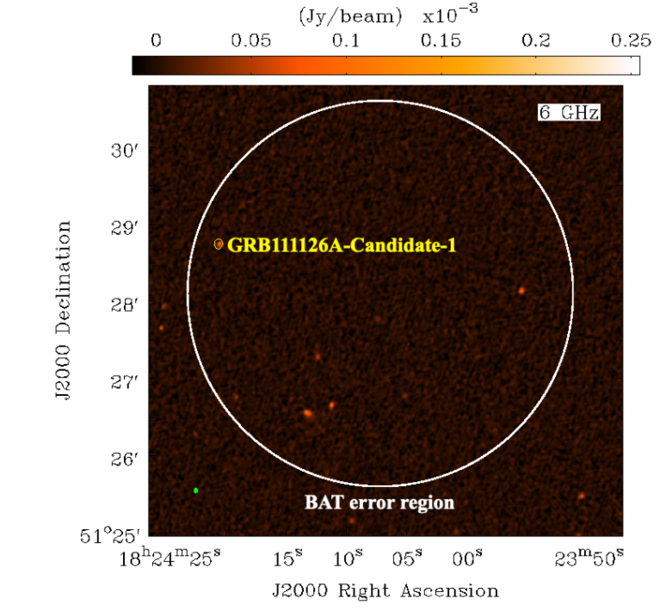
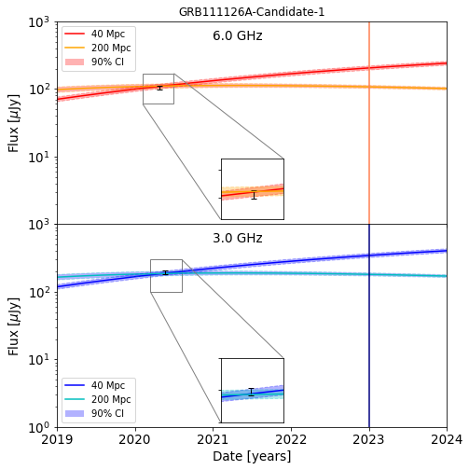
Current VLA Searches: Short GRB Survey
Searches for missed BNSes
Observe GRBs without x-ray or radio afterglow
Check morphology, spectral information
Need more observations to verify predicted light curves
How will the ngVLA’s long baselines (best) see the various components of BNS mergers?
Predicted light curves calculated for BNS candidate
VLA field containing the candidate radio source
Figures from Eddins, A., Lee, K.-H., Corsi, A., et al. 2023, ApJ, 948, 125

Slide 6
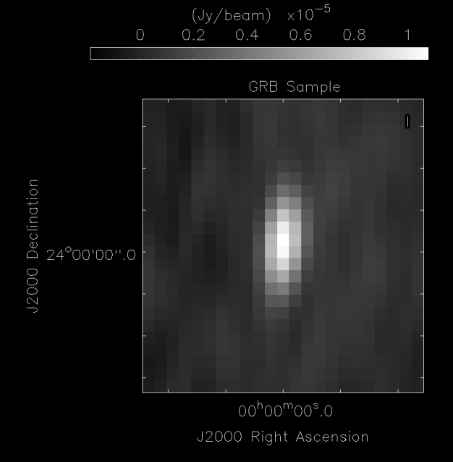
ngVLA Simulations: Jet Results
The jet image used in simulating the ngVLA’s observations (see Nedora et al. 2023)
Simulated four-hour observation of the jet image at 2.4 GHz with the main array and LBA

Slide 7
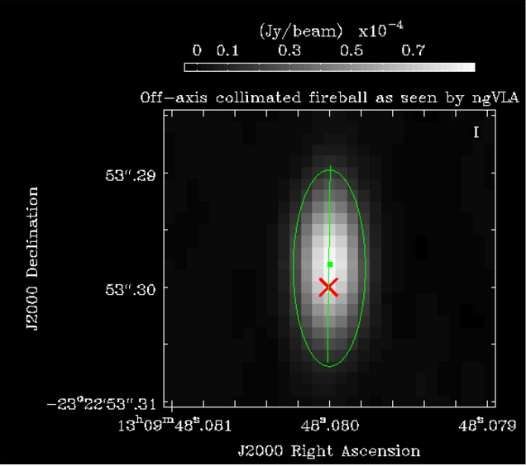
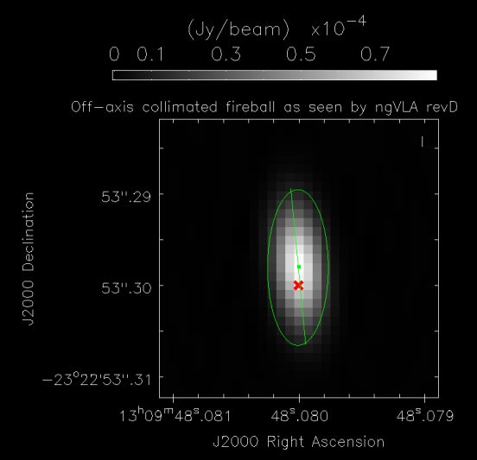
ngVLA Simulation Details
$σ_{NA} \sim \frac{σ_{simple}}{\sqrt{{n_{ch} n}_{pol}{ n}_{baselines}{ n}_{integrations}}}$
Natural weighting
CASA’s simobserve and sm toolkit
simobserve: generate the observation
sm toolkit: add noise
Tested with revD config files on the data from Corsi et al. 2018
Verified to produce the same results within error
↓
Uniform weighting
$${RMS}_{exp}\sim 2.9σ_{NA}$$
Jet at day 150 from Corsi et al. 2018 (revB)
Jet at day 150 from own script (revD)

Slide 8
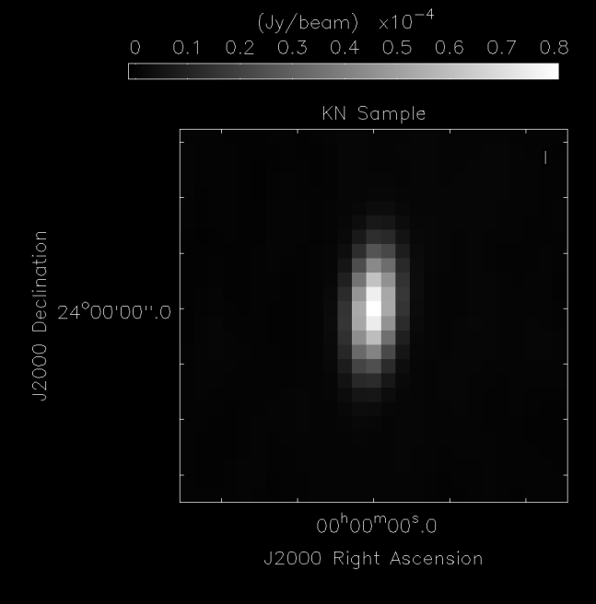
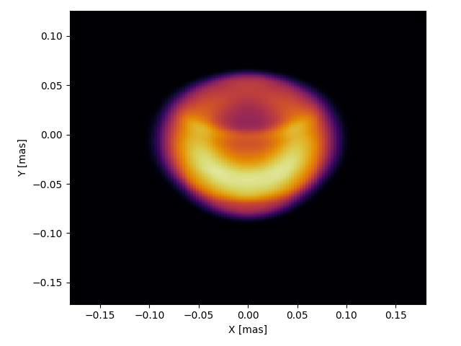
Results: Kilonova at Peak
The kilonova image used in simulating the ngVLA’s observations (see Nedora et al. 2023)
Simulated four-hour observation of the kilonova at z = .001 at 27 GHz with the main array and LBA (~.1 mas major axis FWHM)

Slide 9
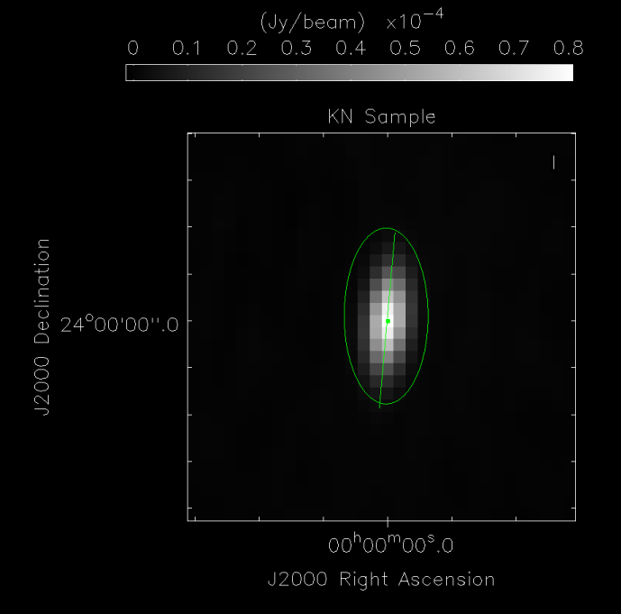
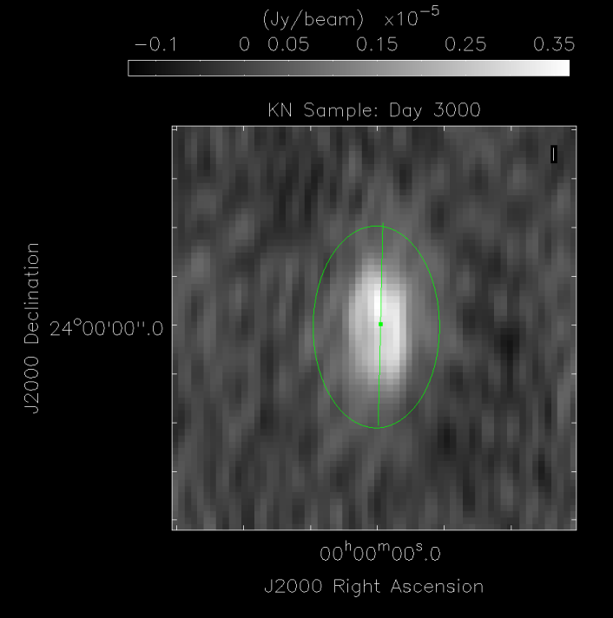
Results: Kilonova After Peak
Kilonova image from previous slide at day 29 (~.1 mas major axis FWHM)
The same kilonova as at left but at day 3000 (viewing angle of 45°, SNR ~ 14, ~2 mas major axis FWHM)
Notes:
Cannot claim centroid motion. Explain the ellipse encompasses the whole source rather than being the size of the source.

Slide 10
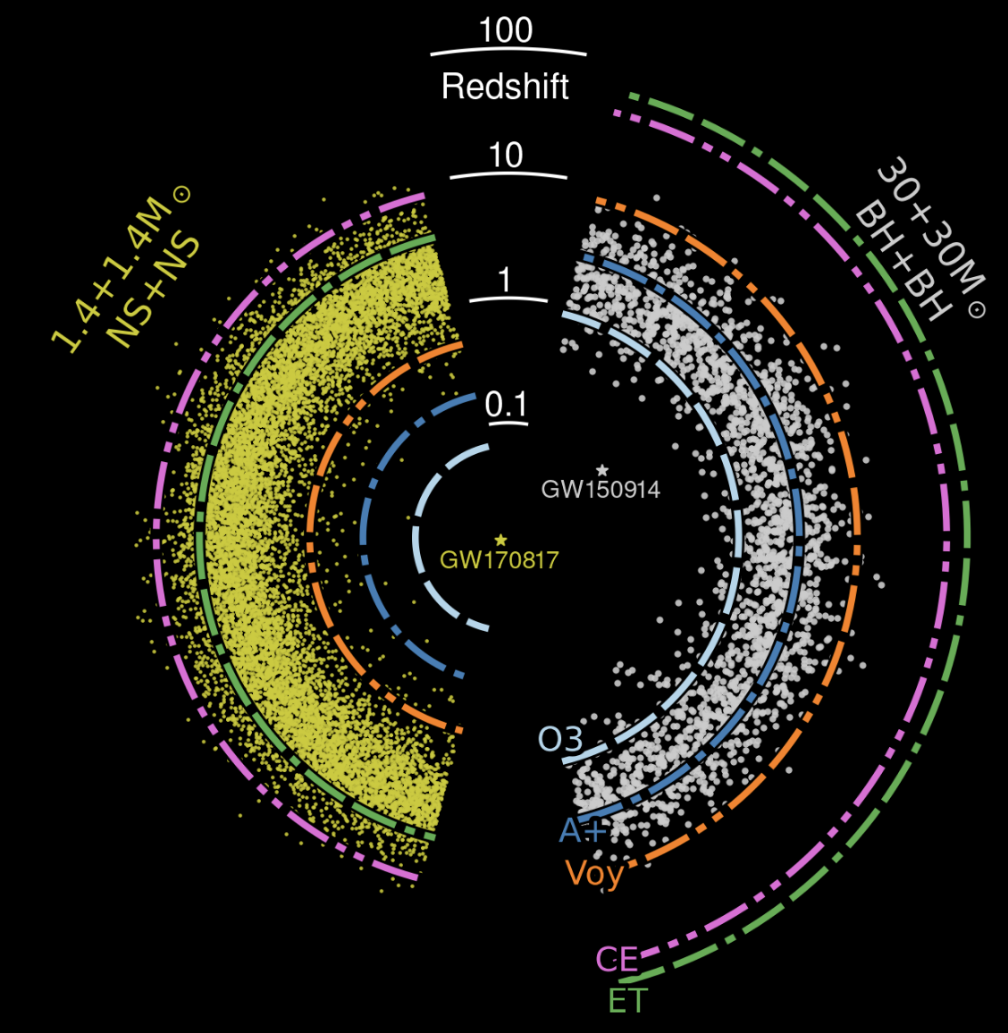
Synergy with SKA and GW detectors
GW detector horizons will soon grow beyond what the VLA can see
Most of the BNS/BBH population will be enclosed in the CE/ET horizon
How many BNSes will be resolved by the ngVLA in the 3G era?
SKA and ngVLA play different roles in GW follow-up:
SKA: Ideal for larger redshift (z ~ 1-2) triggers
ngVLA:
Ideal for lower redshift, potentially off-axis triggers
Frequency coverage → find spectral indices
BNS, BBH population and distance compared to various GW detector horizons (Evans et al. 2021)

Slide 11
Conclusion
The ngVLA will enhance current BNS studies and enable new ones
Current degeneracies will be determined through increased resolution
Will continue to study how the ngVLA will see BNS emission
Study combined jet + KN emission
Develop public guide
The ngVLA and SKA will uniquely complement current and 3G GW detectors

Slide 12
References
Ioka, K., & Nakamura, T. 2018, PTEP, 2018, 043E02
Metzger, B. D. 2017, arXiv e-prints, arXiv:1710.05931
Metzger, B. D. 2019, Living Reviews in Relativity, 23, 1
Nakar, E., & Piran, T. 2011, Nature, 7367, 82-84
Troja, E., van Eerten, H., Zhang, B., et al. 2020, MNRAS , 498, 5643
Balasubramanian, A., Corsi, A., Mooley, K. P., et al. 2022, ApJ, 938, 12
Eddins, A., Lee, K.-H., Corsi, A., et al. 2023, ApJ, 948, 125
Nedora, V., Dietrich, T., Shibata, M., et al. 2023, MNRAS, 520, 2727
Corsi, A., Frail, D. A., Lazzati, D., et al. 2018, arXiv e-prints, arXiv:1810.07544
Evans, M., Adhikari, R. X., Afle, C., et al. 2021, arXiv e-prints, arXiv:2109.09882

