Slide 1
A Transient UV Source at the Location of AT2018cow Years Post-Explosion
Yuyang Chen
PhD student, University of Toronto
Co-supervisors: Maria Drout and Bryan Gaensler
Collaborators: Tony Piro, Charlie Kilpatrick, Ryan Foley, César Rojas-Bravo, Mark Magee

Slide 2
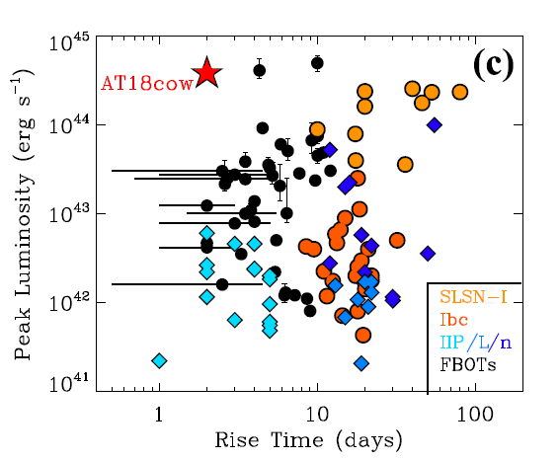
AT2018cow: Fast Blue Optical Transients (FBOTs)
Margutti et al. (2019)
Superluminous
Fast

Slide 3
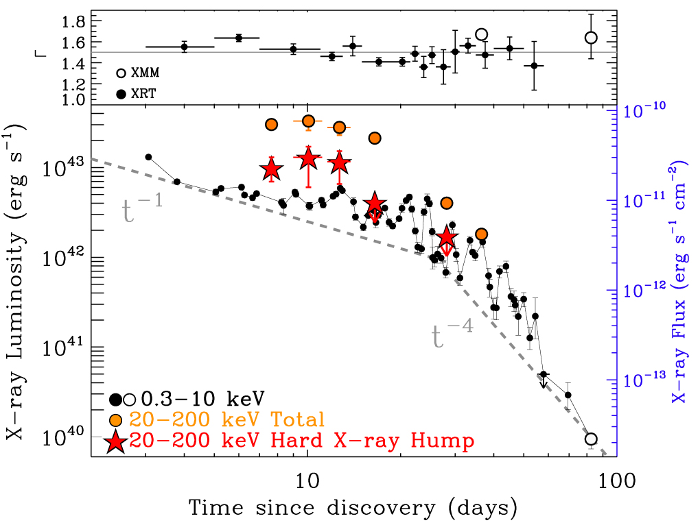
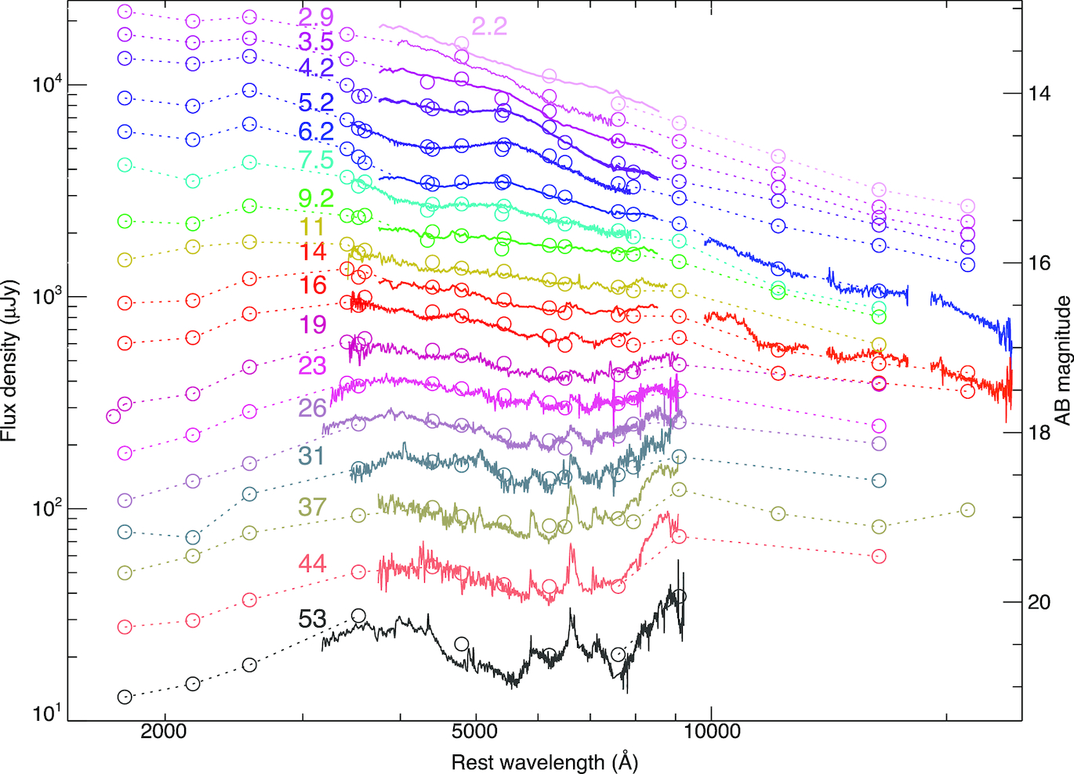
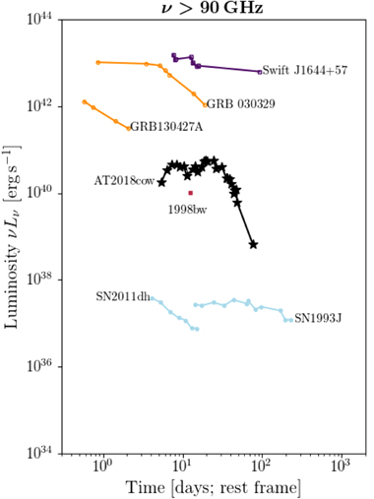
Array of Peculiar Properties
Margutti et al. (2019)
Bright
(Soft/Hard)
X-ray
Perley et al. (2019)
SN Ic-BL
Ho et al. (2019)
Narrower
H/He lines
Bright
(mm)
Radio

Slide 4
AT2018cow is still the most extensively studied of its class (luminous FBOTs).
The exact progenitor and explosion mechanism are still unclear.
(Currently) Preferred Explanations:
Ejecta-CSM Interaction
Radio + IR emission
Emission lines
Asymmetry
Central Engine
Mildly-relativistic outflow
X-ray emission and QPO

Slide 5
Late-Time HST Observations of AT2018cow (t~2-4 years)
2020 (t=703d) Program 15974 (PI Levan)
2021 (t=1119d) Program 16179 (PI Filippenko)
2022 (t=1453d) Program 16925 (PI Chen)

Slide 6
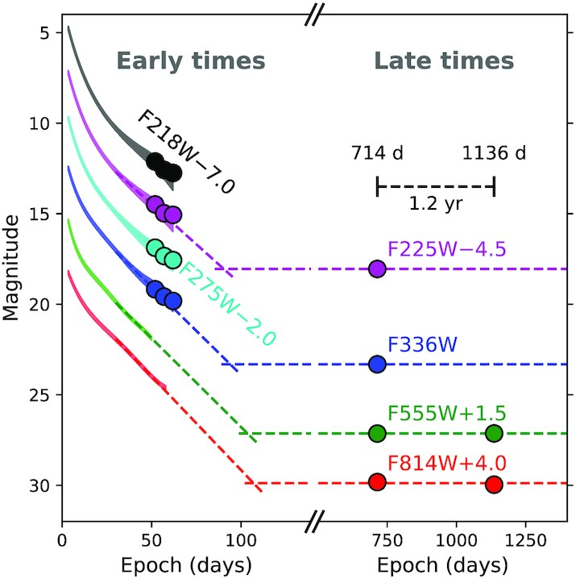
Sun et al. (2022): discovery of a hot and luminous source
2020 (t=703d) Program 15974 (PI Levan)
2021 (t=1119d) Program 16179 (PI Filippenko)
2022 (t=1453d) Program 16925 (PI Chen)

Slide 7
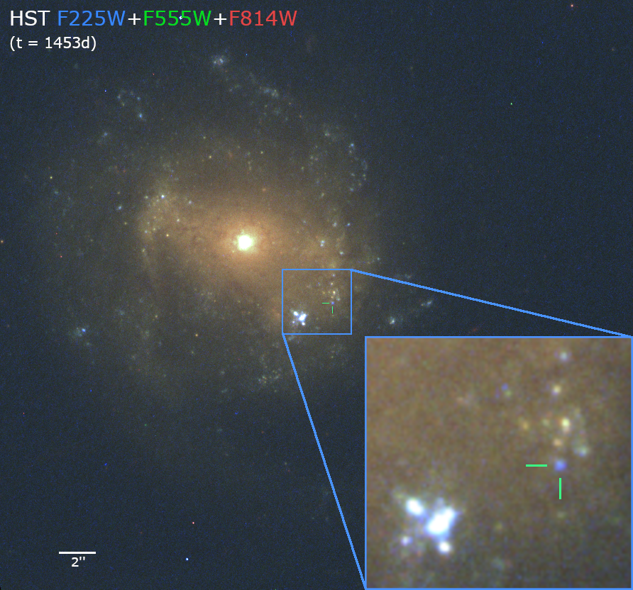
HST Observations of the Underlying Source
2020 (t=703d) Program 15974 (PI Levan)
2021 (t=1119d) Program 16179 (PI Filippenko)
2022 (t=1453d) Program 16925 (PI Chen)

Slide 8
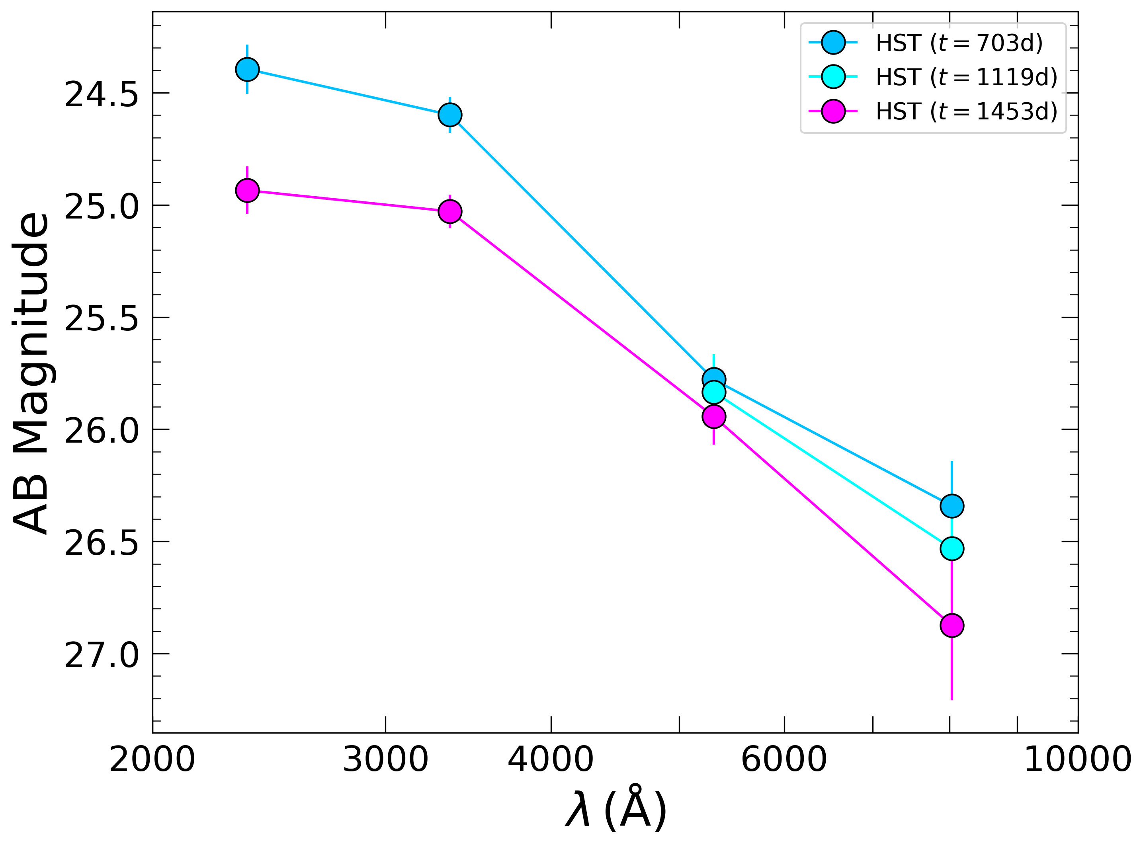
A UV-Bright Transient(?) Underlying Source
2020 (t=703d) Program 15974 (PI Levan)
2021 (t=1119d) Program 16179 (PI Filippenko)
2022 (t=1453d) Program 16925 (PI Chen)
$$Δm∼0.4−0.5 mag$$

Slide 9
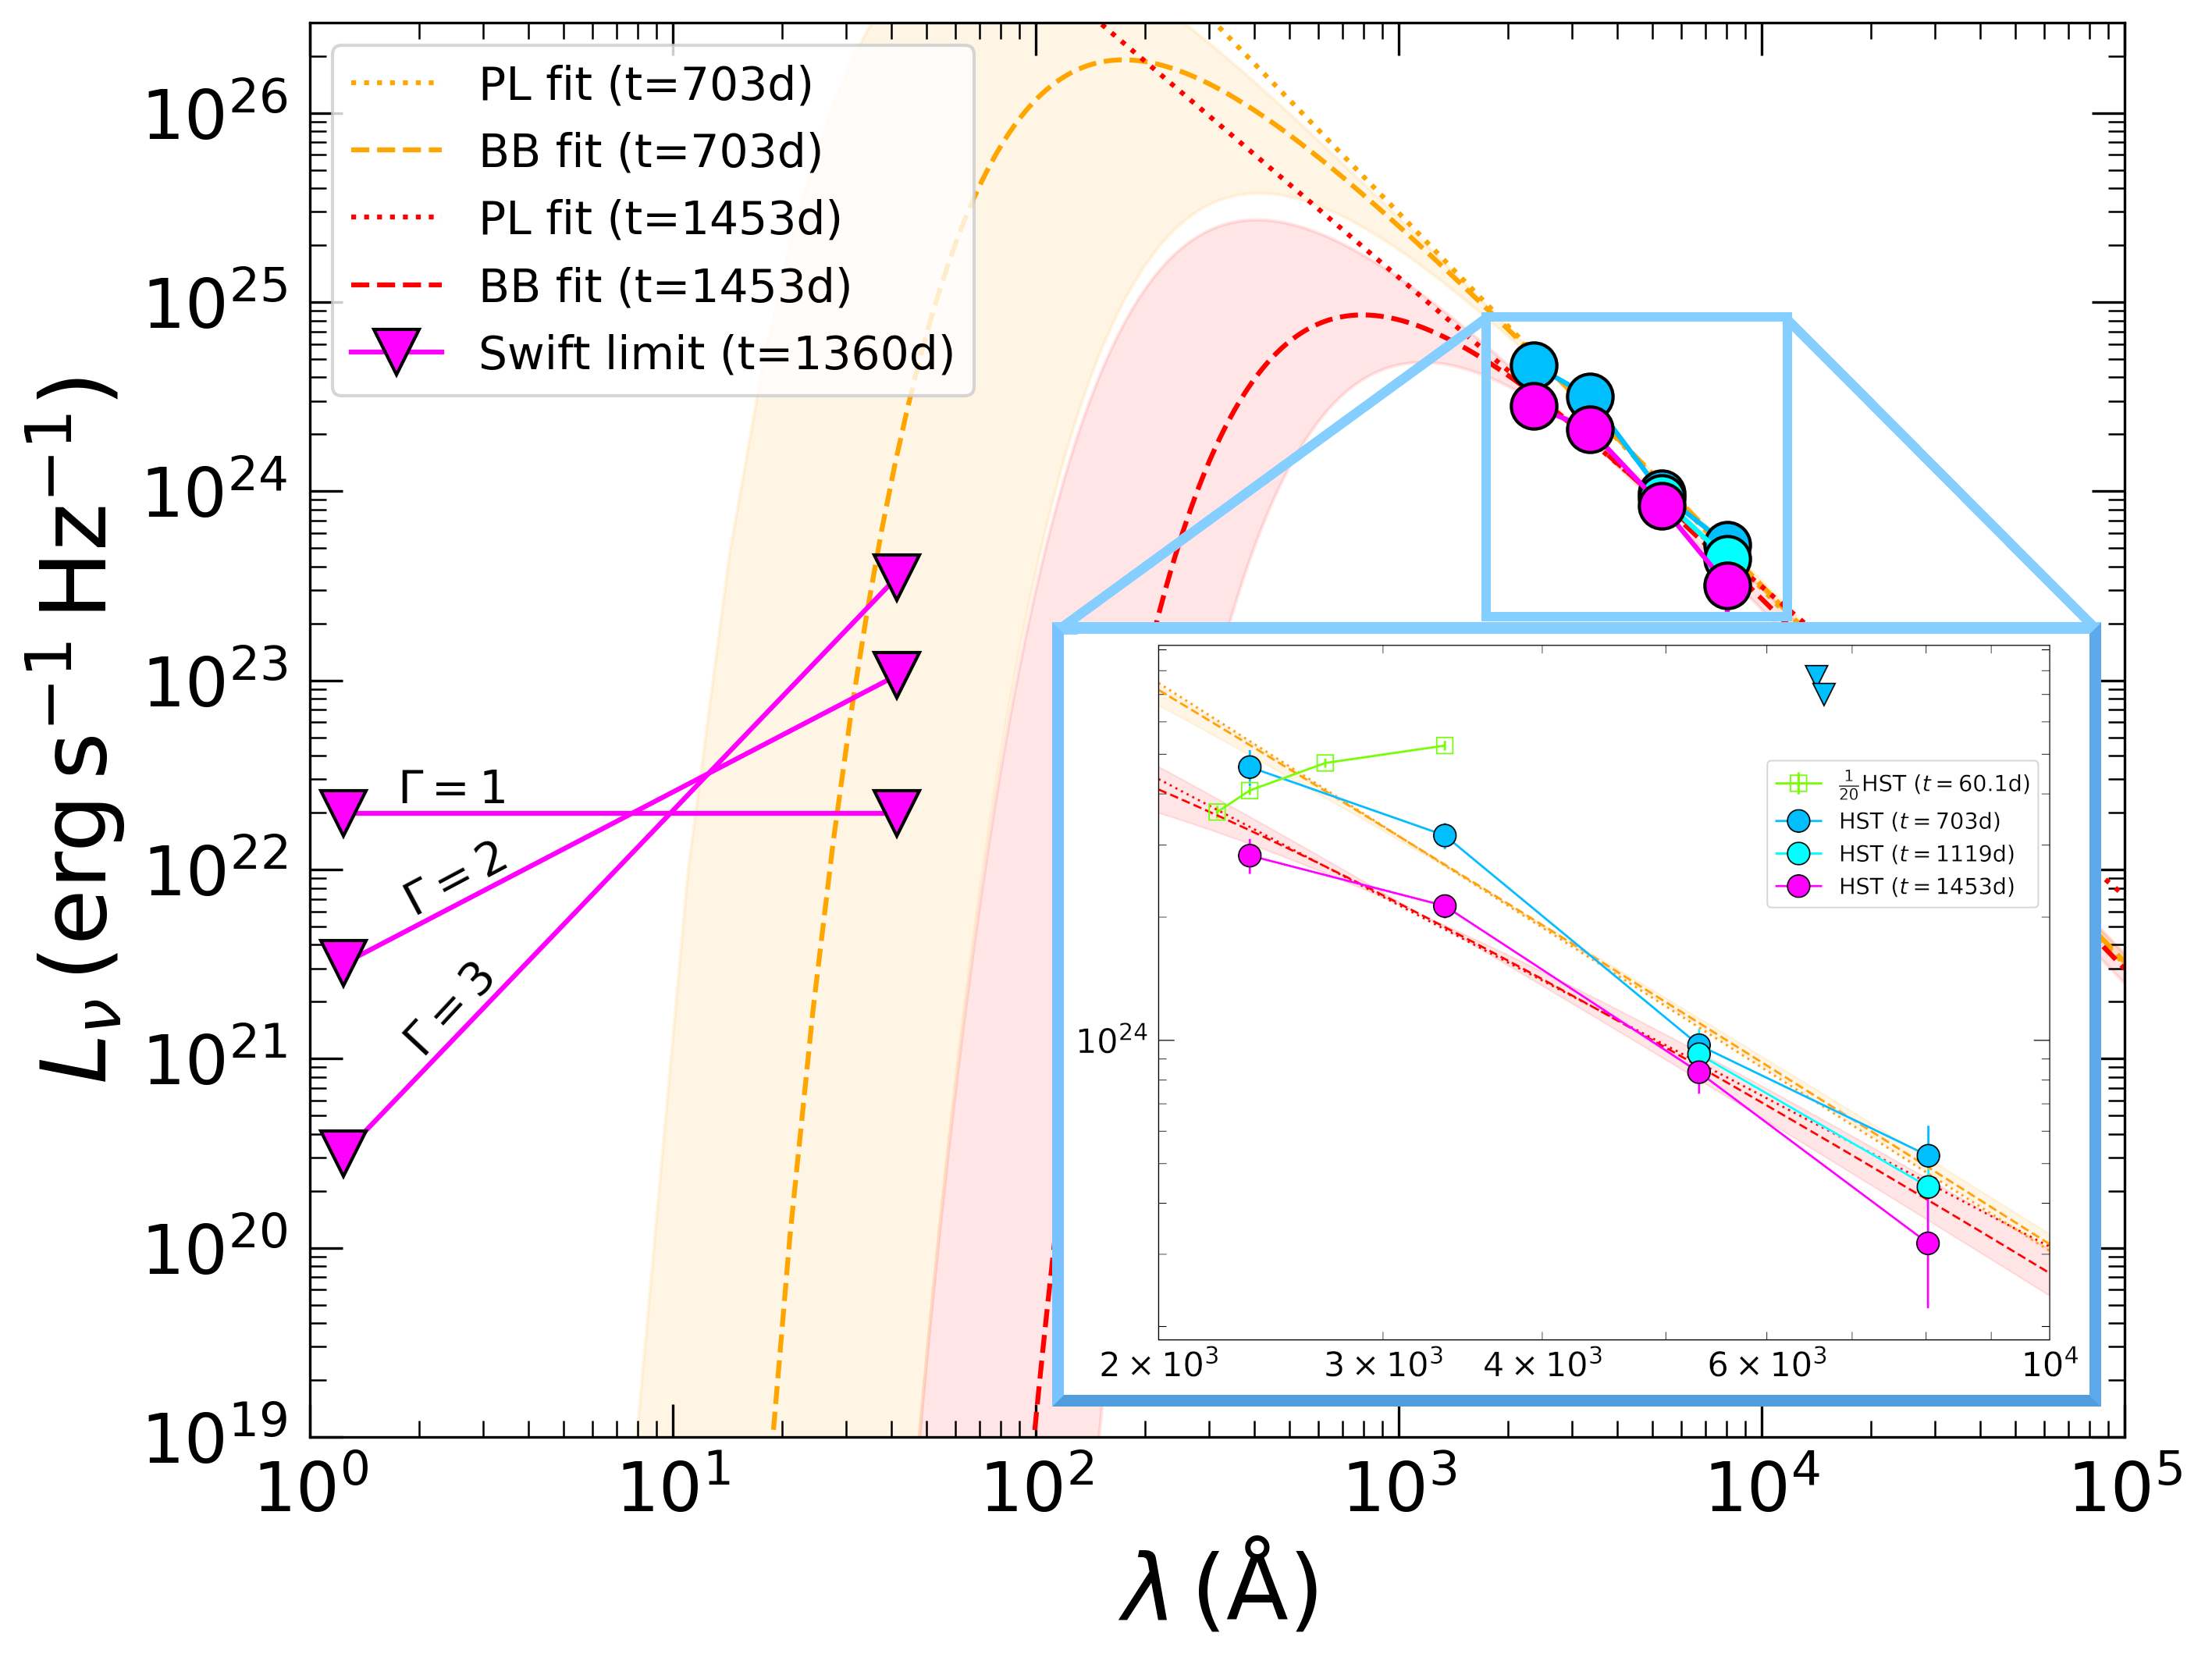
Basic Properties
Power Law (PL):
$$α\left(t=703d\right)∼1.99$$
$$α\left(t=1453d\right)∼1.64$$

Slide 10
Basic Properties
Blackbody (BB):
$$T(t=703d)>{10}^{5} K$$
$$R(t=703d) \sim 15 R_{⊙}$$
$$L\left(t=703d\right)>{10}^{42} erg/s$$
$$T\left(t=1453d\right)∼{10}^{4.8} K$$
$$R\left(t=1453d\right)∼30 R_{⊙}$$
$$L\left(t=1453d\right)∼{10}^{40.7} erg/s$$
Minimum Luminosity:
$L_{UVO,min}∼\left(1.2−1.7\right)×{10}^{39} erg/s$

Slide 11
What might explain the underlying source?
 Stellar Contribution (& some transient component)
 Ejecta-CSM Interaction
● Magnetar Spin Down
❍ Remnant Accretion Disk

Slide 12
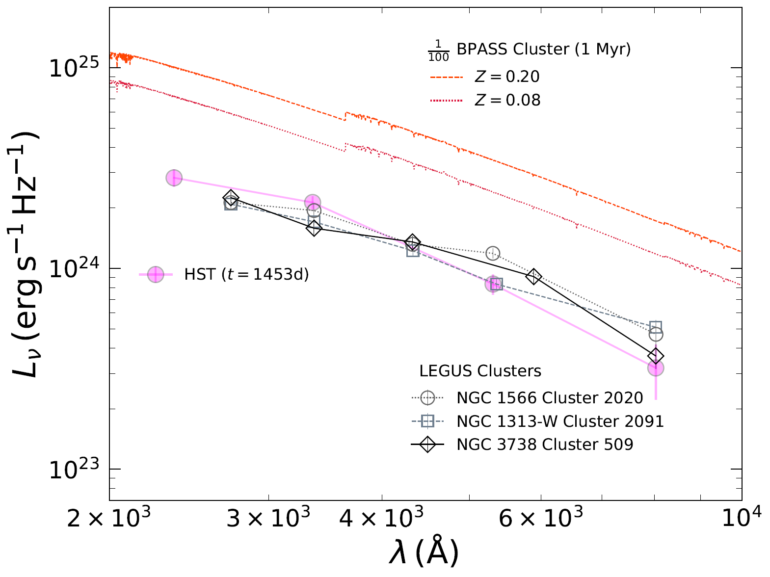
Stellar Contribution (star cluster)
Young (~1 Myr) + low mass (~${10}^{3}M_{⊙}$)
cluster emission at t=1453d
absurdly blue transient at t=703d?

Slide 13
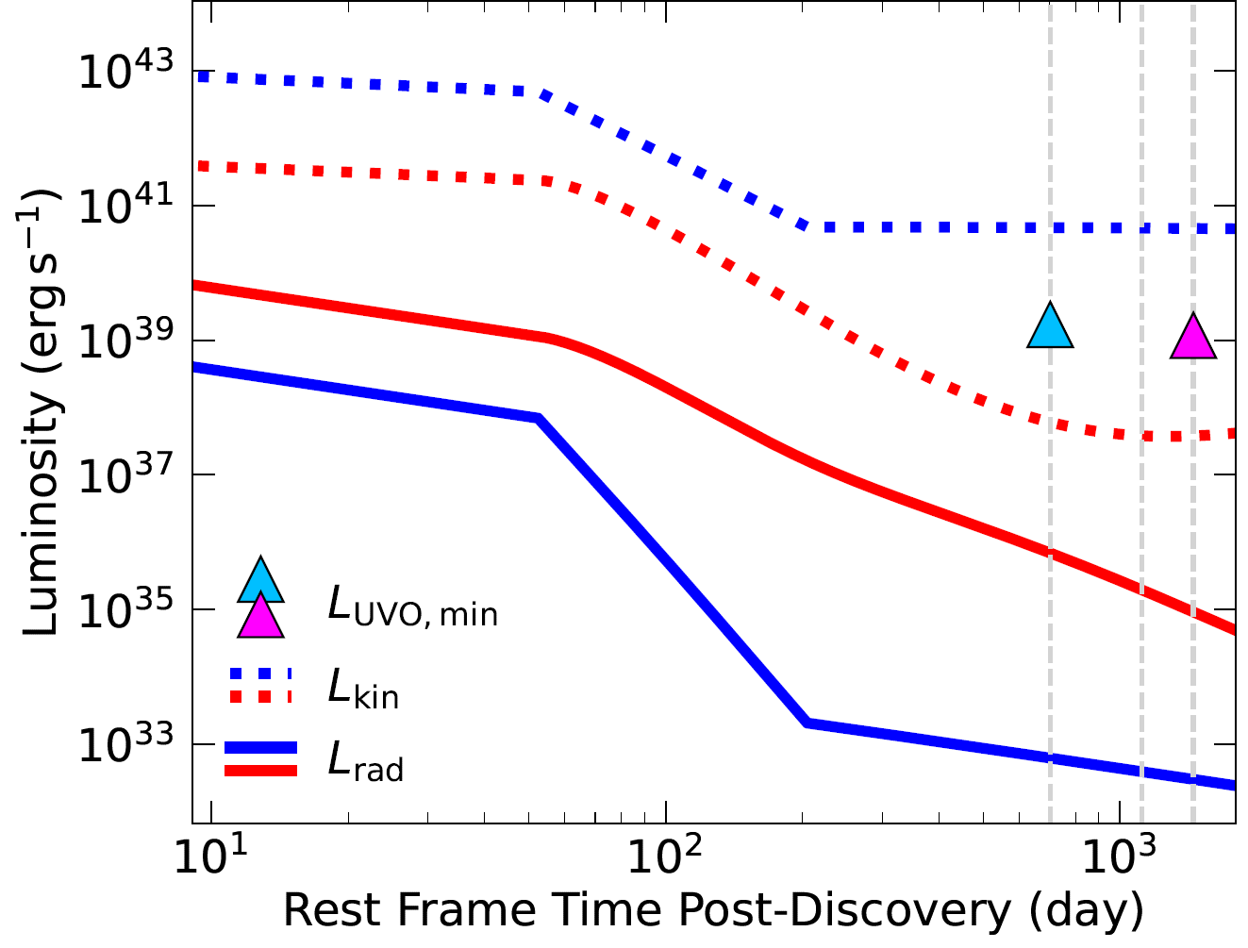
Ejecta-CSM Interaction
Fast ejecta
($M_{ej}=0.5{ M}_{⊙}, E=3×{10}^{51} erg$)
+
CSM known from radio emission
Advance shock radius
Calculate densities and speeds
Derive temperatures and timescales
Radiated luminosity too low!

Slide 14
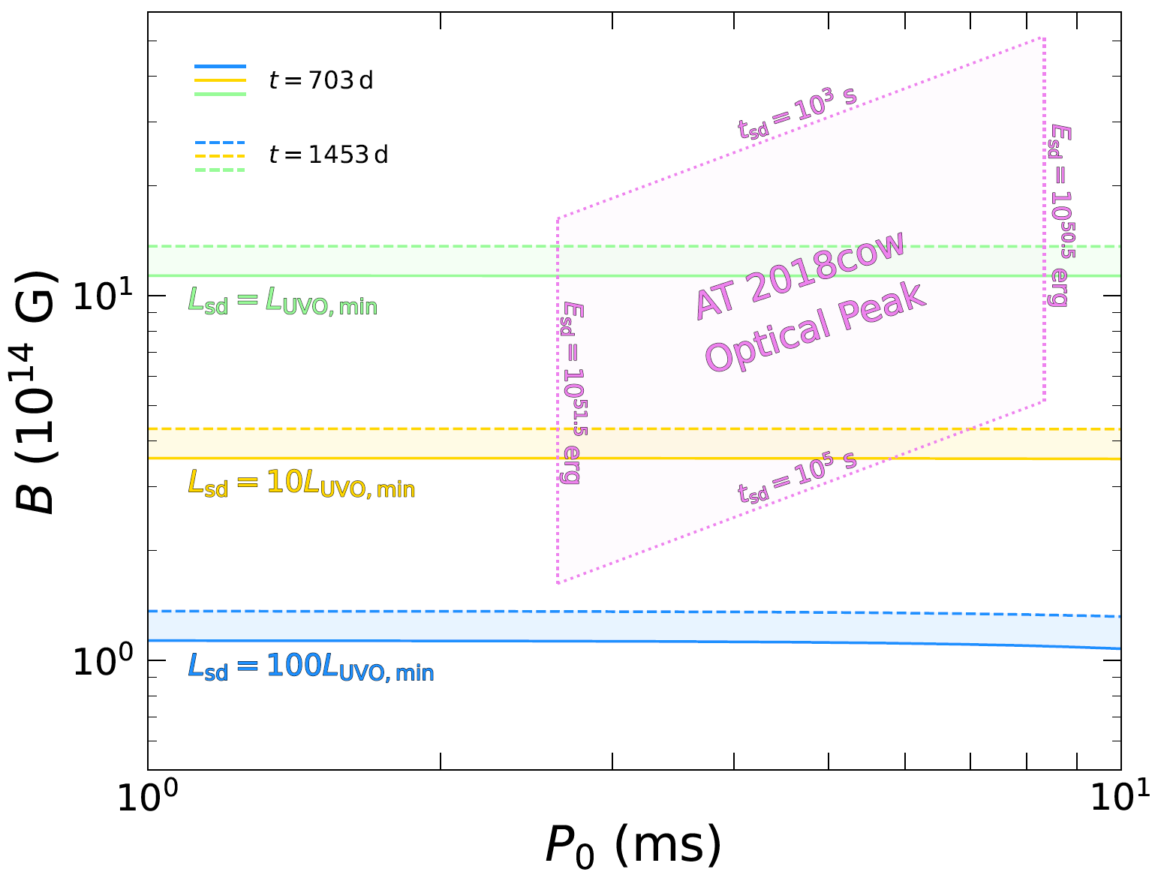
Magnetar Spin Down
Magnetars with strong magnetic fields ($B∼{10}^{15}$) can only power the minimum luminosity!

Slide 15
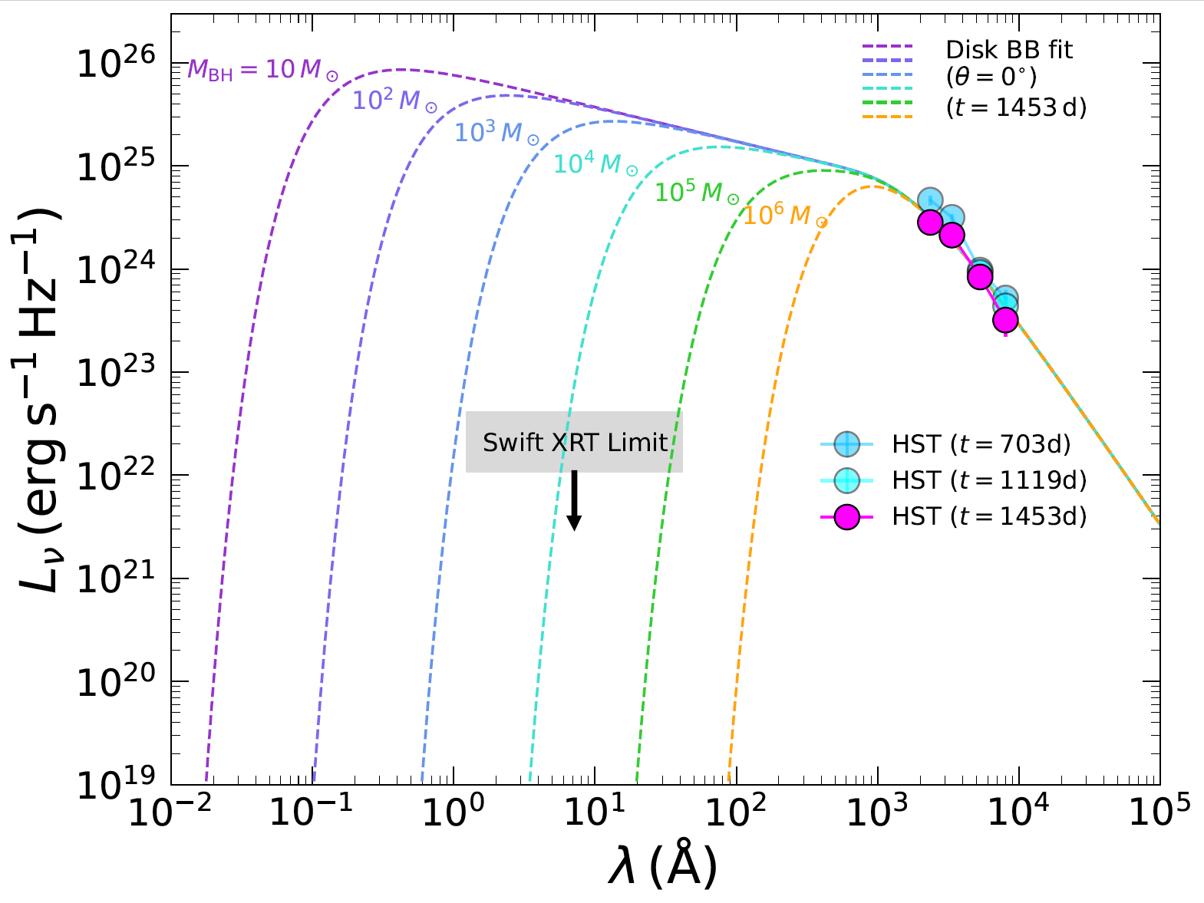
Remnant Accretion Disk (Small & Hot!)
Assume standard accretion disk
geometrically thin
optically thick
Multi-temperature disk blackbody
fit to t=1453d
outer edge only
central mass degenerate

Slide 16
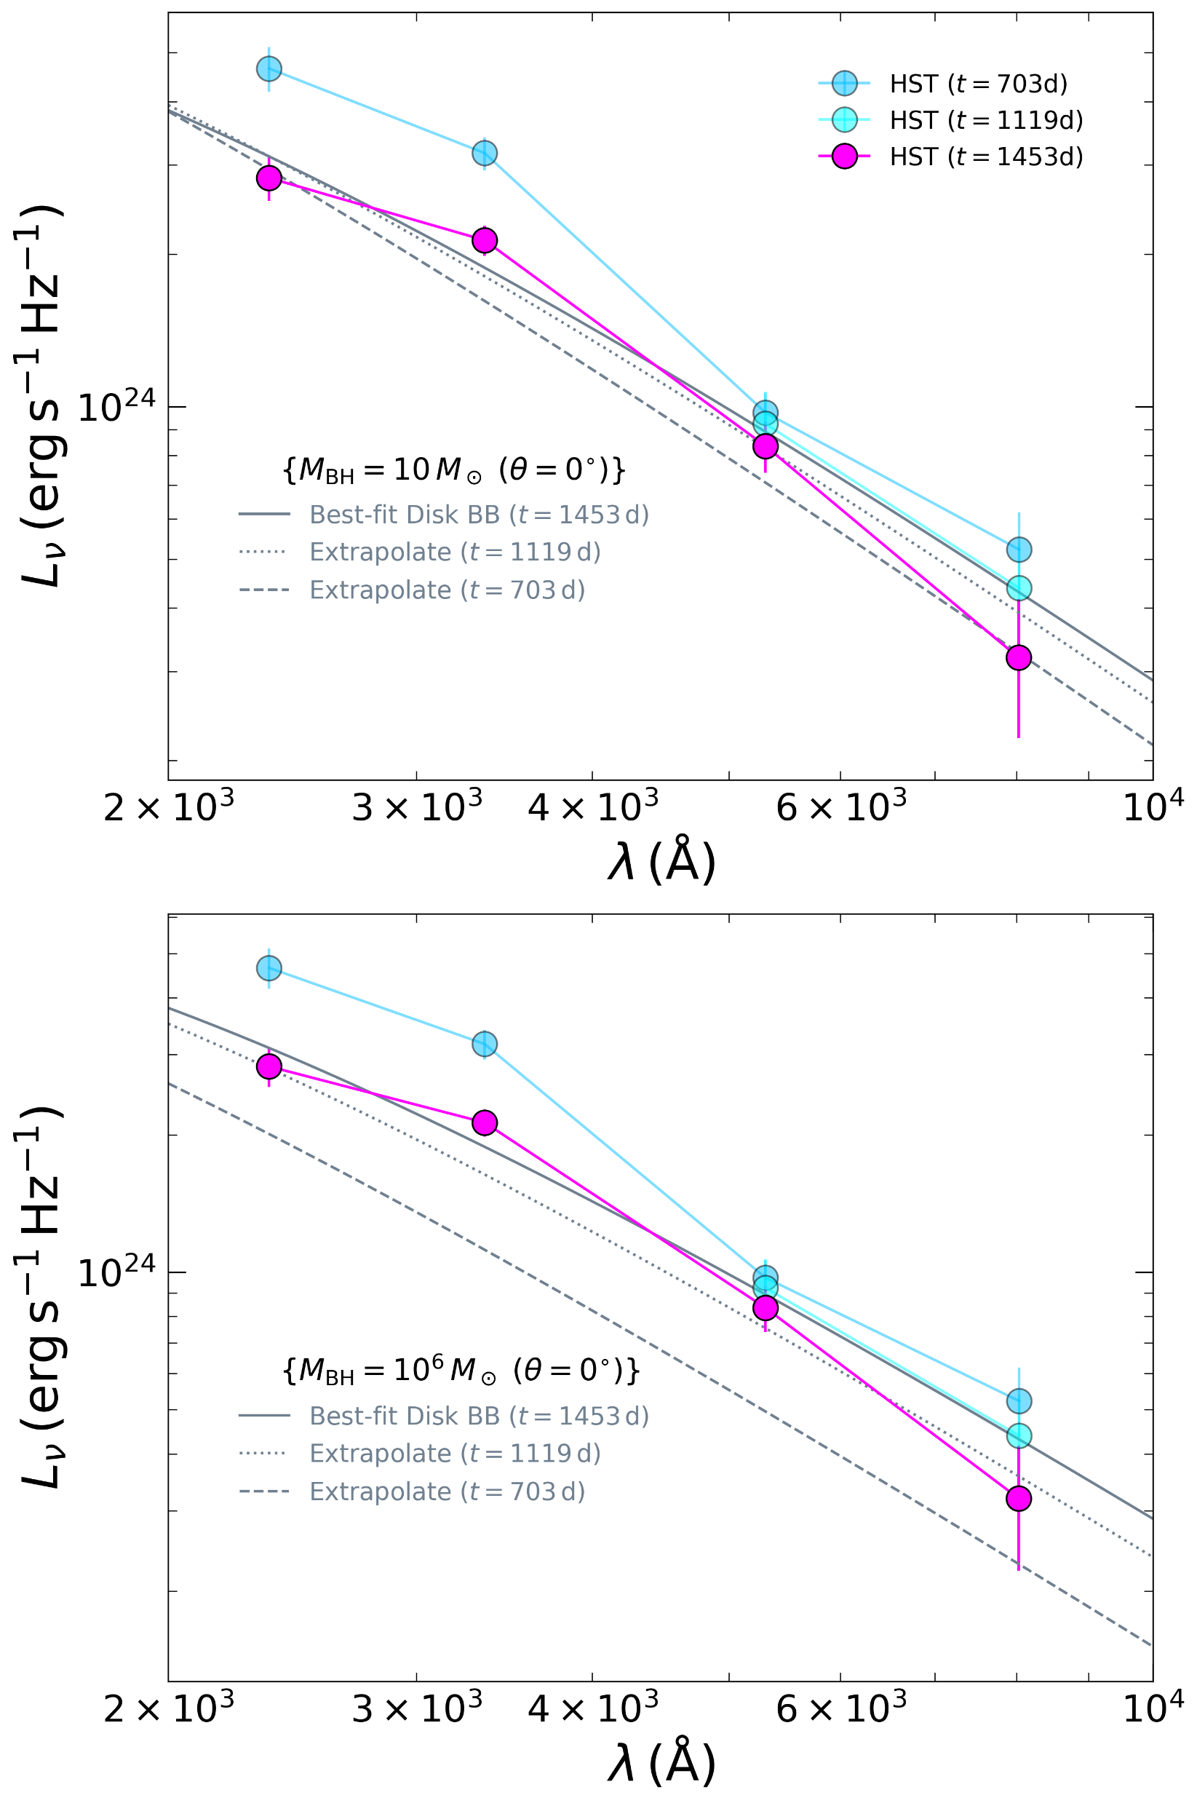
Predicted disk evolution:
$R_{out}∝t^{2/3}$
$\dot{M}∝t^{−4/3}$
Extrapolate best-fit values at t=1453d to earlier epochs
(assuming fixed $θ$)
Disk is predicted to be fainter at earlier epochs

Slide 17
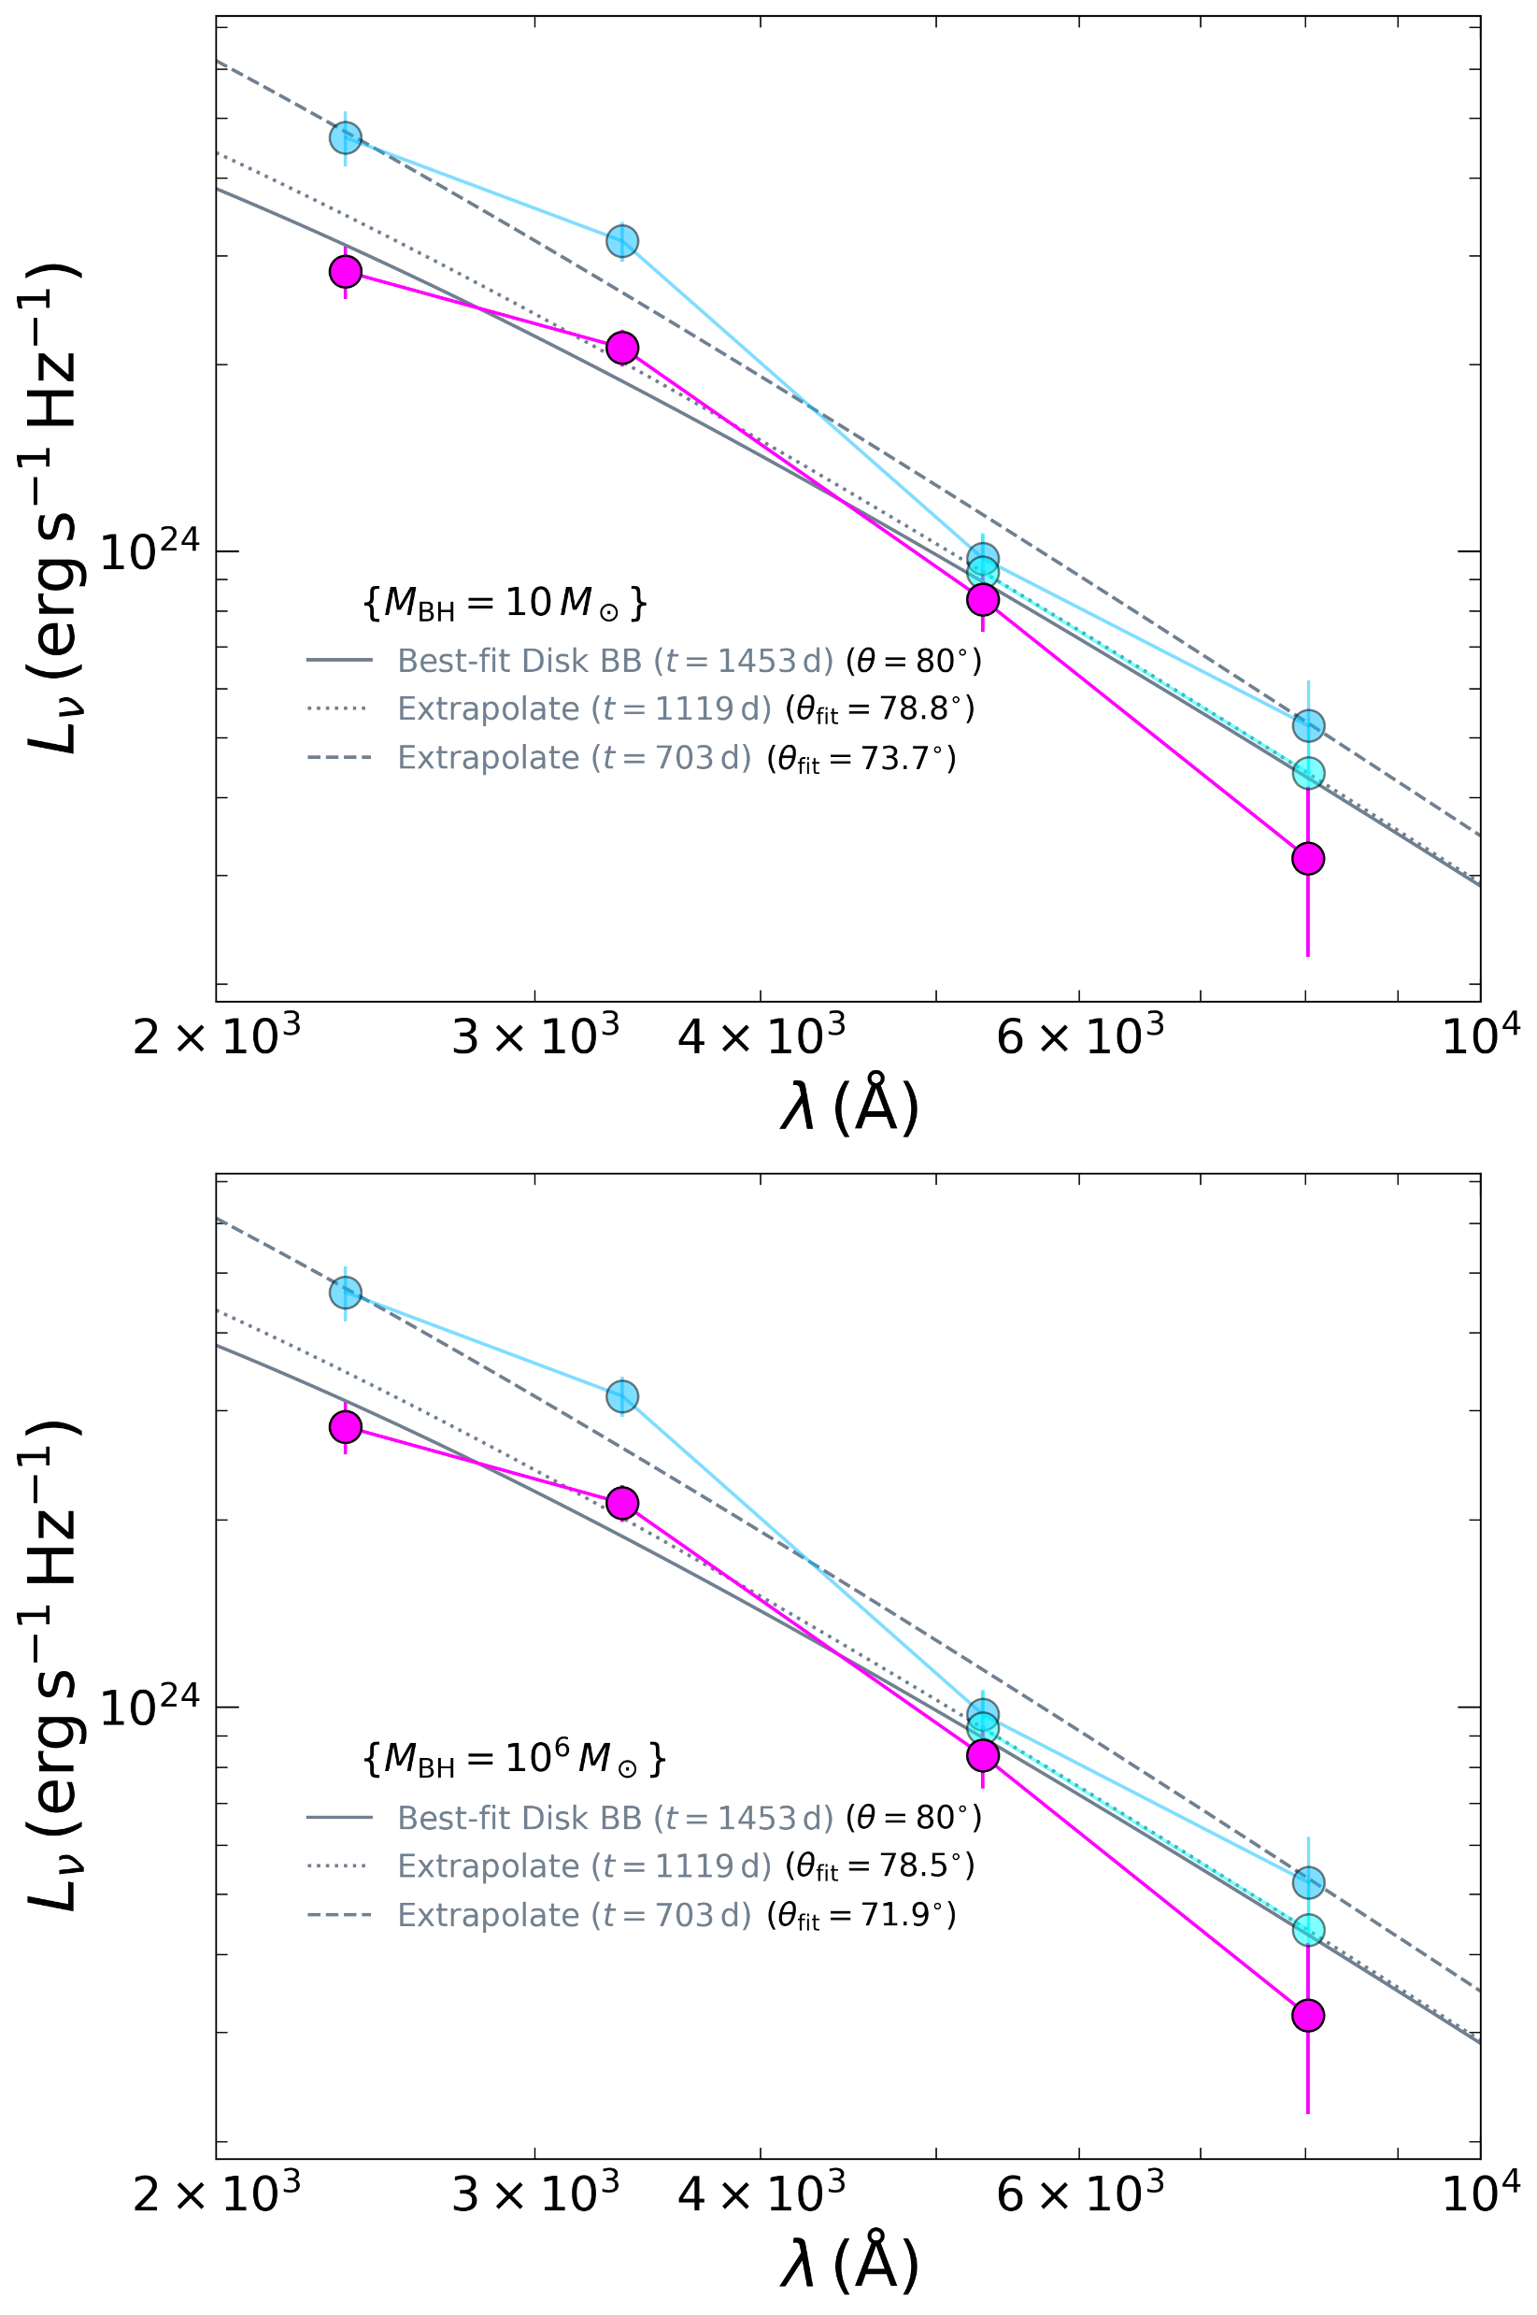
Predicted disk evolution:
$R_{out}∝t^{2/3}$
$\dot{M}∝t^{−4/3}$
Extrapolate best-fit values at t=1453d to earlier epochs
(free parameter $θ$)
Disk must be highly-inclined and precessing to match color and brightness evolution

Slide 18
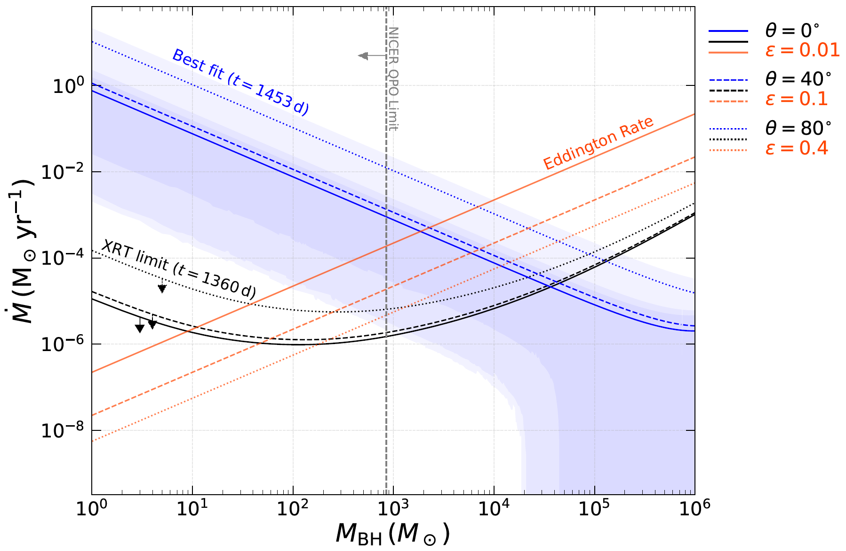
Accretion Rate vs. Central Black Hole Mass
Stellar-mass BH:
Super-Eddington
Lack X-ray?
(Model breaks)
IMBH:
Sub-Eddington
Consistent emission
QPO limit?
TDE feasible?

Slide 19
What might explain the underlying source?
Stellar Contribution (& some transient component)
Young and low mass cluster + absurdly blue transient.
Ejecta-CSM Interaction
Known CSM from radio emission do not produce enough power.
Magnetar Spin Down
Stronger magnetic fields do not produce enough power
Slightly more preferred?
Remnant Accretion Disk
Highly-inclined precessing disk (assuming standard disk) can explain color and brightness evolution.
Both high and low central masses face distinct challenges.
Significant implications on the progenitor and explosion mechanism of AT2018cow!

Slide 20
References
Ho, A. Y. Q., Phinney, E. S., Ravi, V., et al. 2019, ApJ, 1642 871, 73, doi: 10.3847/1538-4357/aaf473
Margutti, R., Metzger, B. D., Chornock, R., et al. 2019, 1714 ApJ, 872, 18, doi: 10.3847/1538-4357/aafa01
Perley, D. A., Mazzali, P. A., Yan, L., et al. 2019, MNRAS, 1755 484, 1031, doi: 10.1093/mnras/sty3420
Sun, N.-C., Maund, J. R., Crowther, P. A., & Liu, L.-D. 1805 2022, MNRAS, 512, L66, doi: 10.1093/mnrasl/slac023

