Slide 1
Compressing Supernova Light Curves with Informative Latent Features
Kaylee de Soto
Supervisor: Dr. Ashley Villar
June 21, 2023

Slide 2
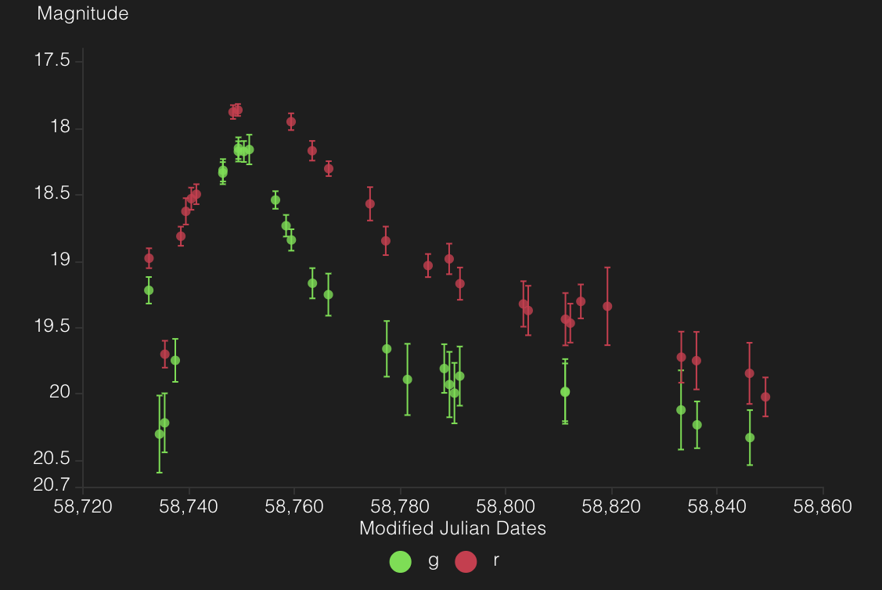
The goal: to classify supernovae using their photometric data
Source: ALeRCE

Slide 3
What features do we train these classifiers on?
User-defined parametrization
Often have physical or observational significance
Examples: maximum amplitude, model fit parameters

Slide 4
What features do we train these classifiers on?
Latent features
User-defined parametrization
Determined by a neural network to be the most “informative” features
Linear or non-linear combination of input values
Often have physical or observational significance
Examples: maximum amplitude, model fit parameters

Slide 5
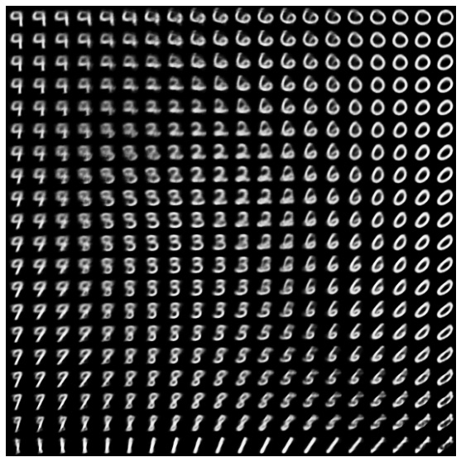
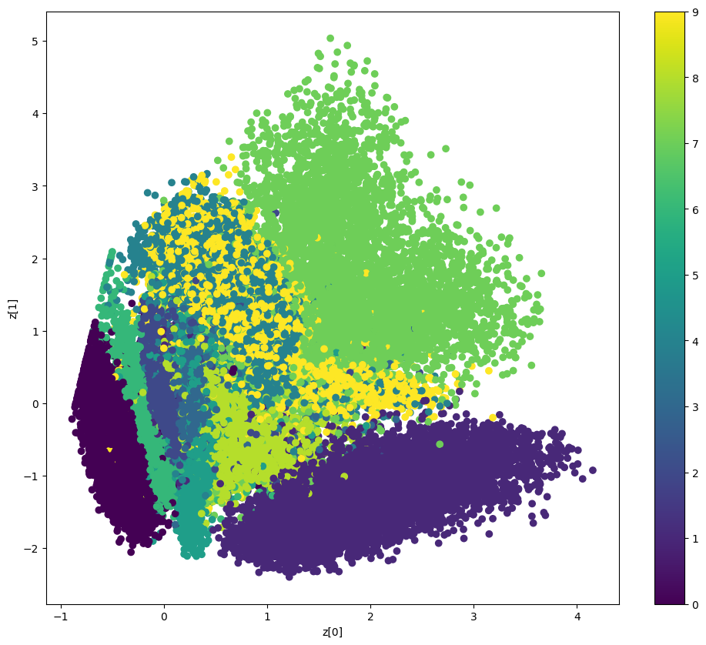
What features do we train these classifiers on?
Latent features
Determined by a neural network to be the most “informative” features
Linear or non-linear combination of input values
Source: Keras

Slide 6
Letting a neural network decide the best latent space:
Reduces the dimensionality of our problem
Prevents human bias in isolating informative features
Creates an optimal set of features non-linearly from our data
Requires less computational overhead

Slide 7
SuperVRAENN+
Supernova Variational Recurrent Autoencoder Neural Network

Slide 8
Network trained on two-band ZTF data
Extra points added to end of light curves to match sequence length
Imbalanced dataset:
  75% SNe Ia
  1.4% SLSNe-I

Slide 9
Network trained on two-band ZTF data
Gaussian processes used to interpolate data for both bands per timestamp
  Non-stationary, Sigmoid/Matern hybrid kernel

Slide 10
SuperVRAENN+ is designed to be:
Completely redshift invariant

Slide 11
SuperVRAENN+ is designed to be:
Completely redshift invariant → shifting all input light curves

Slide 12
SuperVRAENN+ is designed to be:
Completely redshift invariant → shifting all input light curves
Effective for rarer supernovae

Slide 13
SuperVRAENN+ is designed to be:
Completely redshift invariant → shifting all input light curves
Effective for rarer supernovae → oversampling

Slide 14
SuperVRAENN+ is designed to be:
Completely redshift invariant → shifting all input light curves
Effective for rarer supernovae → oversampling
Effective at classifying partial light curves

Slide 15
SuperVRAENN+ is designed to be:
Completely redshift invariant → shifting all input light curves
Effective for rarer supernovae → oversampling
Effective at classifying partial light curves → partial training samples

Slide 16
An autoencoder can encode entire light curves into N values (latent space)
Decodings
Inputs
N(encoded) = 10
Predicted fluxes returned for each input phase, without errors
Gaussian processes are used to interpolate fluxes + errors in all bands at each phase
…
…
…
…
…
…
…
N(hidden) = 100

Slide 17
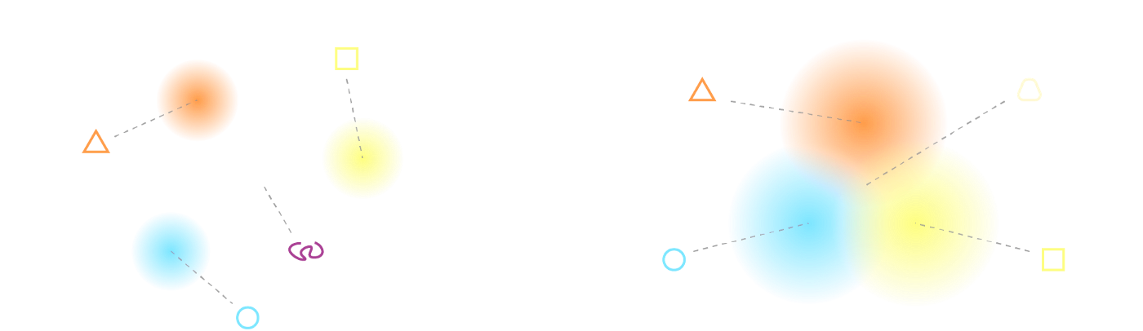
AUTO-ENCODERS LACK REGULARIZATION
Without regularization
With regularization
Source: https://towardsdatascience.com/
LATENT SPACE IS UNPREDICTABLE; WILL INCORRECTLY DECODE TYPE-AMBIGUOUS SUPERNOVAE

Slide 18
Encoded means
…
…
…
…
…
…
…
Encoded variances

Slide 19
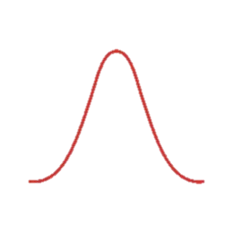
Encoded means
Sample from latent space Gaussian
Variational autoencoders optimize probability distributions in the latent space
…
…
…
…
…
…
…
Encoded variances

Slide 20
Network Overview
Dense (x3)
1 x 64
Dense
1 x 2
Dense
1 x 64
Dense
1 x 6
Dense (x3)
1 x 64
Dense
1 x 2
Input
300 x 4
Dense
1 x 64
GRU
1 x 64
Lambda
1 x 6
…
Dense
1 x 6
Dense (x3)
1 x 64
Dense
1 x 64
Dense
1 x 2
Input2
300 x 1

Slide 21
Loss term is a tradeoff between accurately reconstructing light curves and keeping latent distributions close to unit Gaussians
$$loss=mean\left[ loss_{match}\left(f_{pred}, f_{true}\right)+loss_{KL}(μ, σ^{2})\right]$$

Slide 22
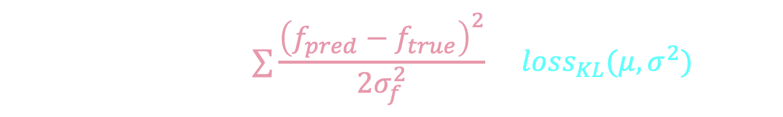
Loss term is a tradeoff between accurately reconstructing light curves and keeping latent distributions close to unit Gaussians
$$loss=mean\left[∑\frac{{\left(f_{pred}−f_{true}\right)}^{2}}{2σ_{f}^{2}}+loss_{KL}(μ, σ^{2})\right]$$

Slide 23
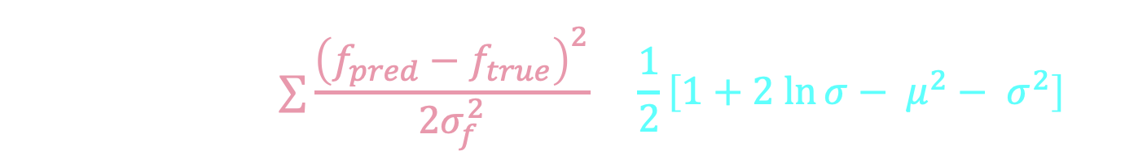
Loss term is a tradeoff between accurately reconstructing light curves and keeping latent distributions close to unit Gaussians
$$loss=mean\left[∑\frac{{\left(f_{pred}−f_{true}\right)}^{2}}{2σ_{f}^{2}}+\frac{1}{2}\left[1+2 ln{σ}− μ^{2}− σ^{2}\right]\right]$$

Slide 24
Loss is a tradeoff between two sources
KL Loss
Reconstruction Loss
Increases as latent space takes on more informative structure
Decreases as decoded light curves better match input light curves

Slide 25
Preliminary Decoding Results

Slide 26
Latent space continuous and close to origin, but there is clustering of different SN types

Slide 27
Additional loss terms can improve latent space interpretability
Similarity Loss (distance-preserving)
Spectroscopic Label Loss

Slide 28
Summary
Variational autoencoders are effective for reducing the dimensionality of supernova light curves
Careful choice of pre-processing and loss terms can improve interpretability and generality of latent space
Supernova encodings can be used for classification, simulations, and spectroscopic prioritization

