Slide 1
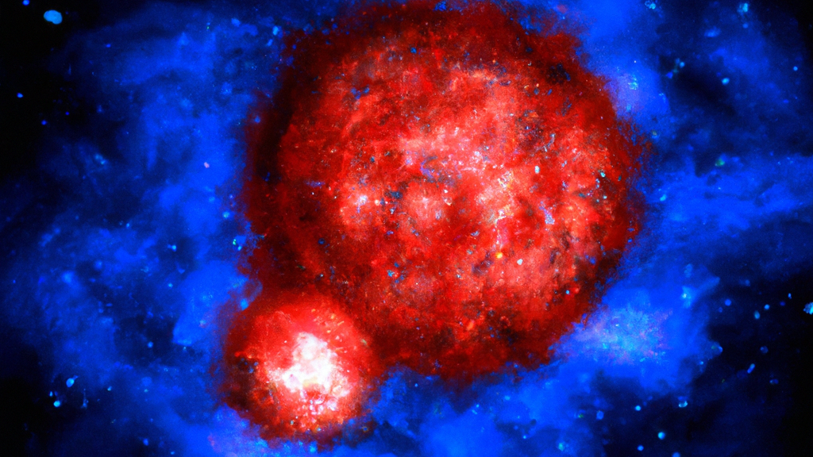
Luminous Red Novae : Probes of Common Envelope Evolution in massive binaries
Viraj Karambelkar, Caltech
The Transient and Variable Universe
June 21, 2023

Slide 2
For your
consideration, yet another nova
Nova
Supernova
Macronova
Kilonova
Hypernova
Micronova
Red nova
Luminous Red Nova

Slide 3
“If you want to study fun binary systems, you just cannot escape common envelope.”
- Shri Kulkarni, 06/21/2023

Slide 4
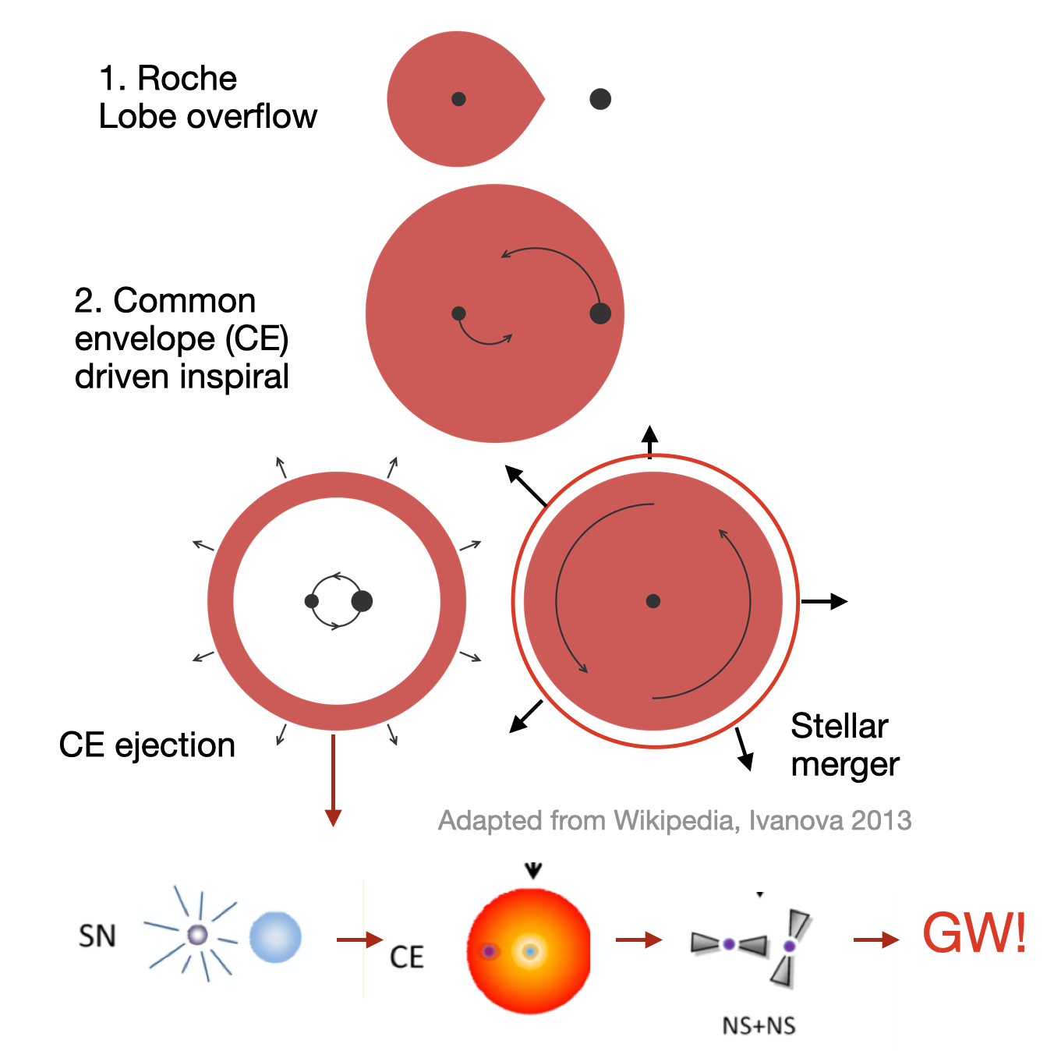
Kilonova!!

Slide 5
Common envelope evolution An important, but poorly understood step in the formation of compact binaries
Kilonova!!

Slide 6
Common envelope evolution An important, but poorly understood step in the formation of compact binaries
Powers a transient,
termed as
Luminous Red Nova
Kilonova!!

Slide 7
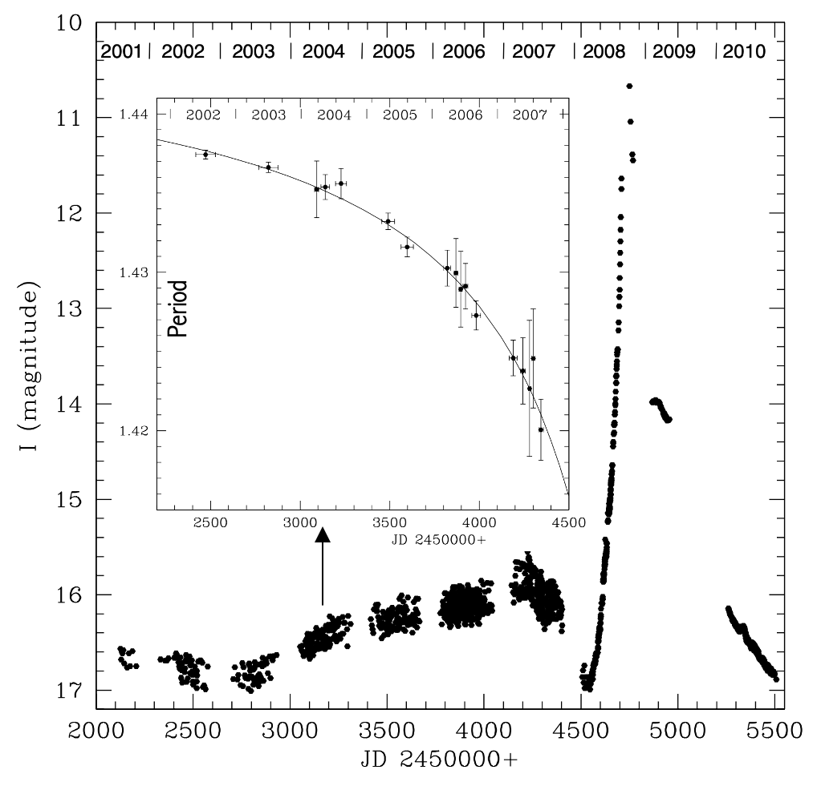
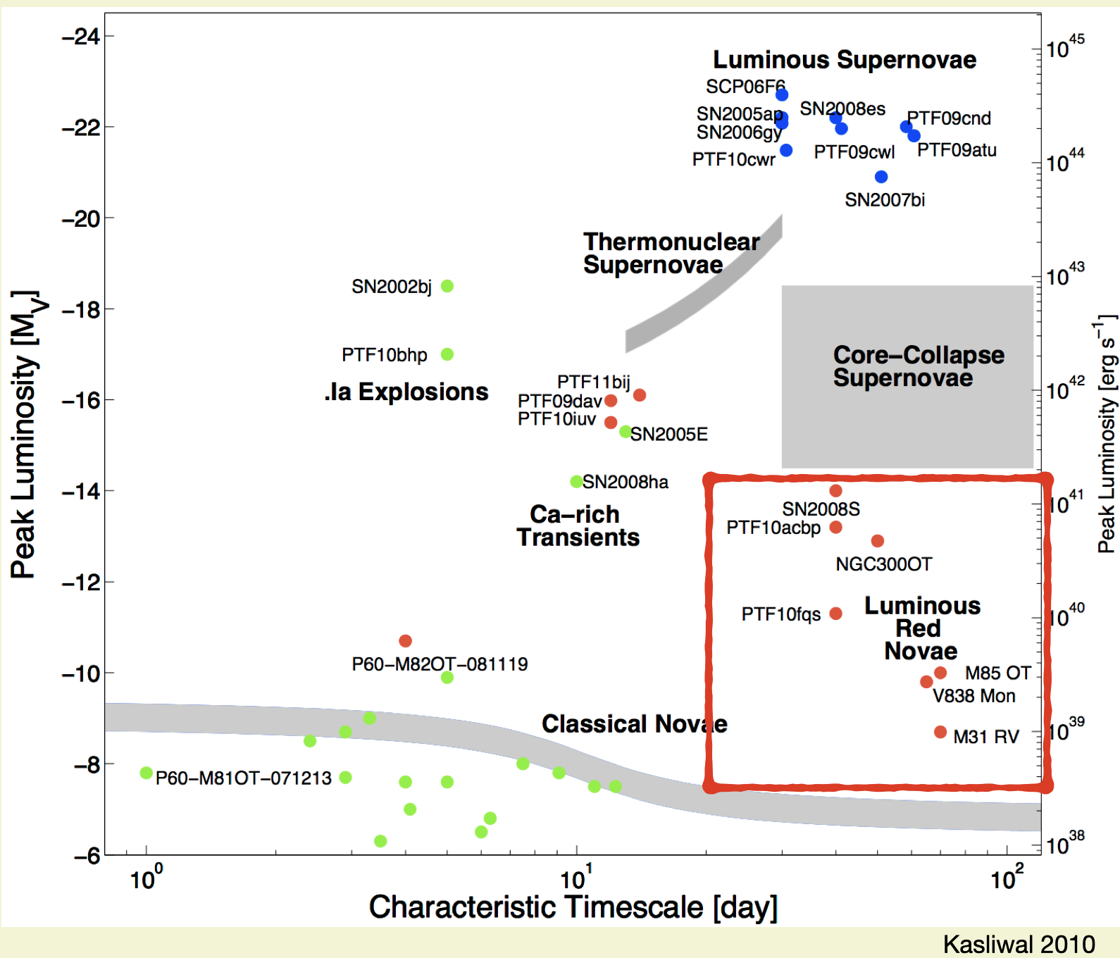
Luminous Red Novae
Tylenda+2011
Kasliwal+2010
LRNe have low intrinsic luminosities, making them observationally rare.

Slide 8
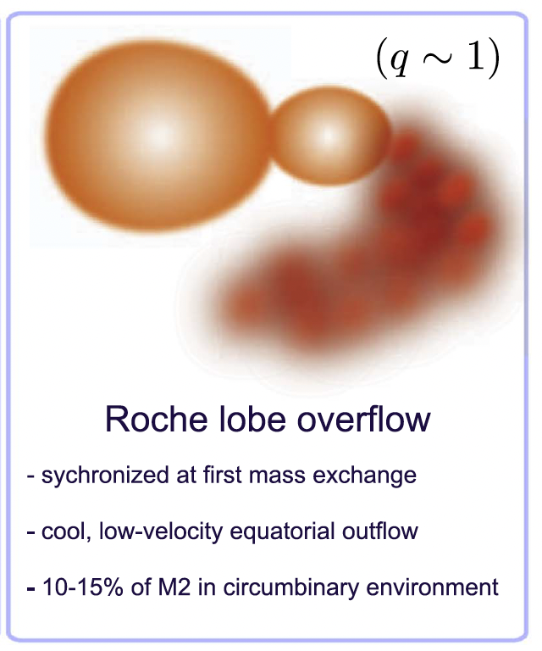
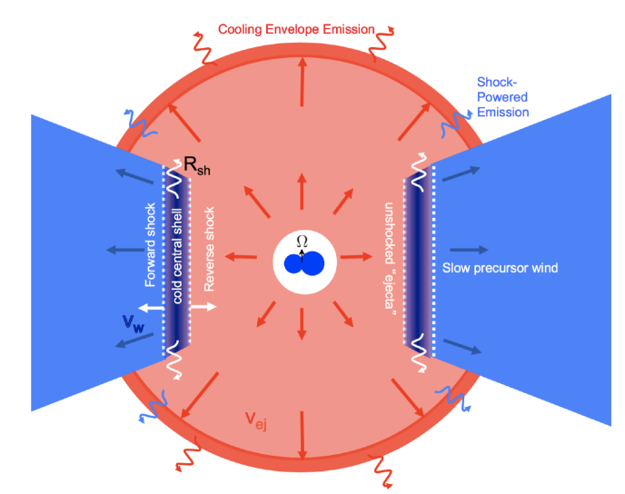
Blagorodnova, Karambelkar et al. 2020
MacLeod et al. 2017
Metzger et al. 2017

Slide 9
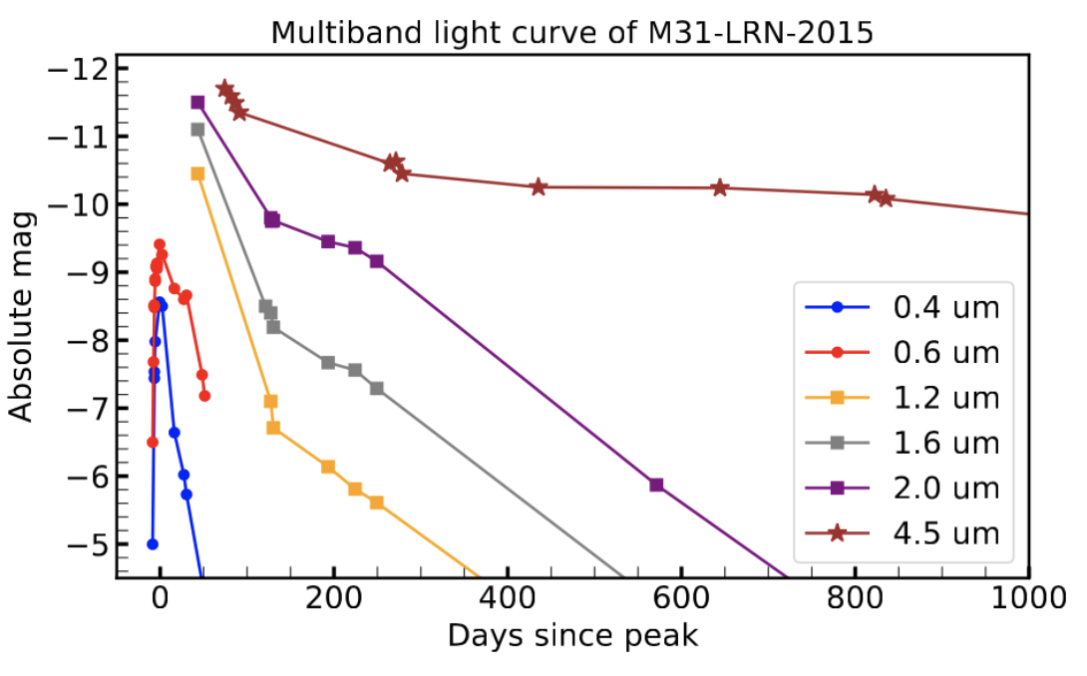
Blagorodnova, Karambelkar et al. 2020
MacLeod et al. 2017
Metzger et al. 2017

Slide 10
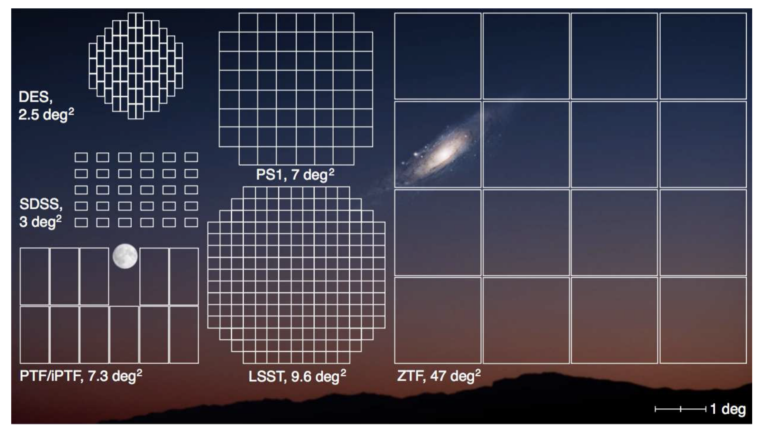
The Zwicky Transient Facility An industrial-scale transient discovery machine at Palomar, ideal to search for LRNe
ZTF has been surveying the entire northern sky at 2-3 day cadence since June 2018

Slide 11
Census of the Local Universe
Spectroscopically classify all ZTF transients associated with nearby galaxies < (~150 Mpc)
Overall spectroscopic completeness ~80 %
Volume-limited survey ideal to construct systematic samples of interesting transients

Slide 12
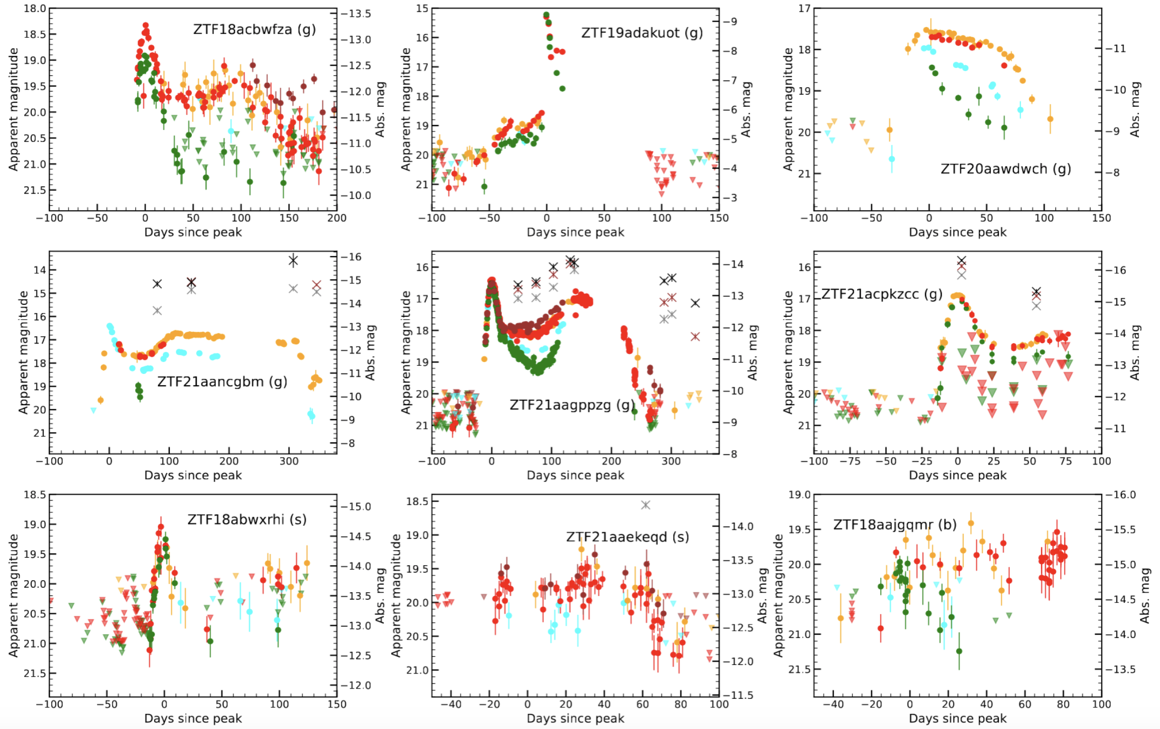
First systematic sample of LRNe
Largest sample of LRNe in literature from a single survey
Optical-NIR lightcurves
Multi-epoch optical, NIR spectra
Karambelkar et al. 2023

Slide 13
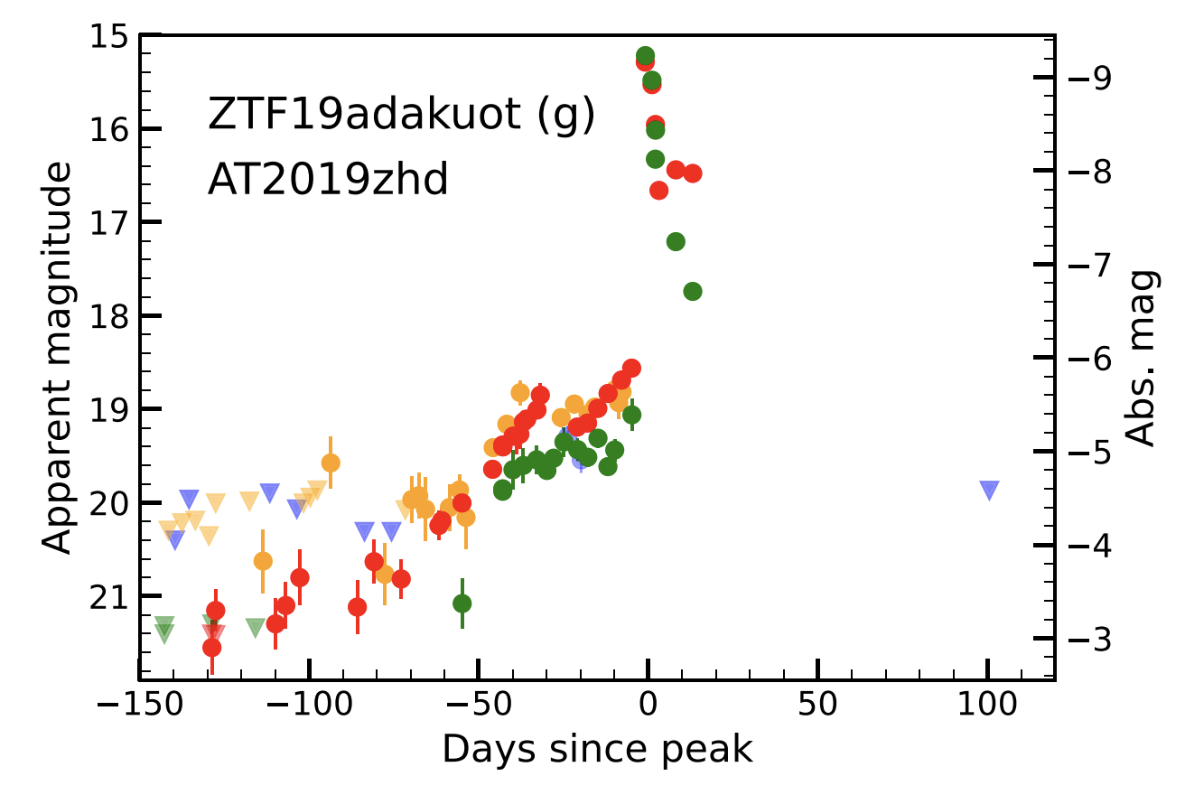
AT 2019zhd
L2 mass loss ? > 0.01 Msun
required

Slide 14
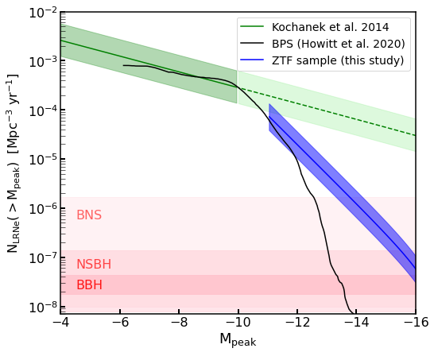
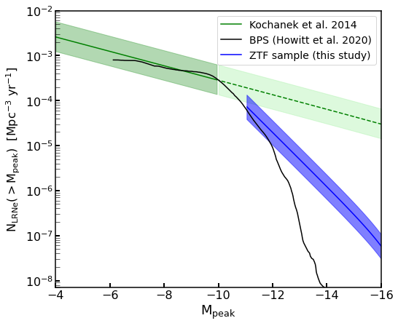
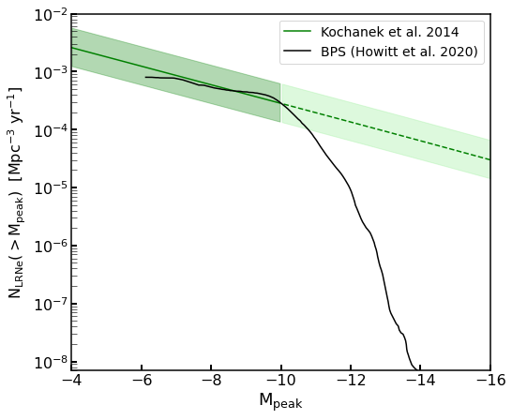
Volumetric rate of LRNe How common is common-envelope?
Previously, the LRN rate was determined from only 3 low-luminosity mergers in the Milky Way discovered by amateur astronomers
The ZTF systematic sample shows that at higher luminosities, the luminosity function falls much more steeply than at lower luminosities.
Discrepancies between BPS and observed rate can be used to pin-point CE parameters
Rates of the most luminous LRNe are consistent with them being progenitors of merging double compact object systems
Karambelkar et al. 2023

Slide 15
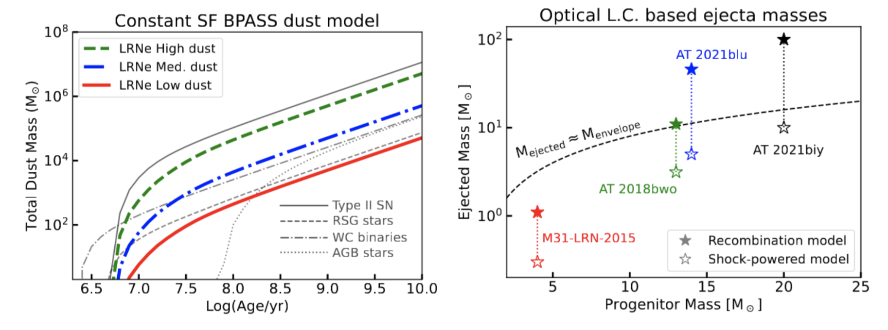
Late time observations of LRNe – with JWST!
Are LRNe cosmic dust factories?
JWST Cycle 2 GO (PI: Karambelkar)

Slide 16
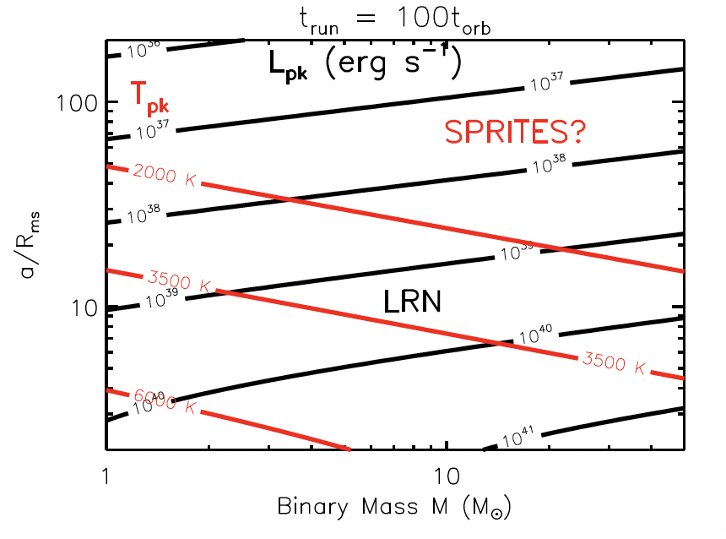
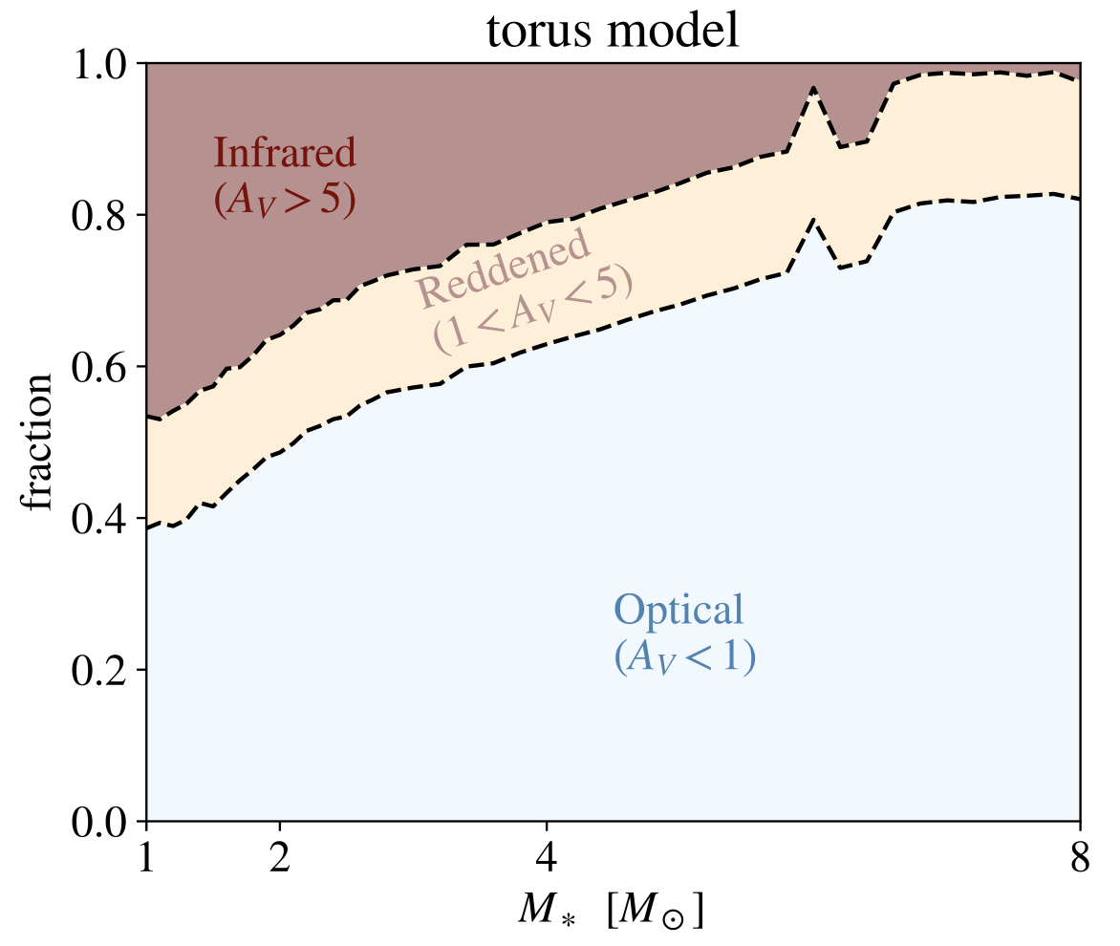
Are we missing some LRNe? Optical searches are biased against finding the dustiest LRNe
Metzger & Pejcha 2017
MacLeod et al. 2022
Depending on the progenitor binary properties, some LRNe can be completely obscured by dust

Slide 17
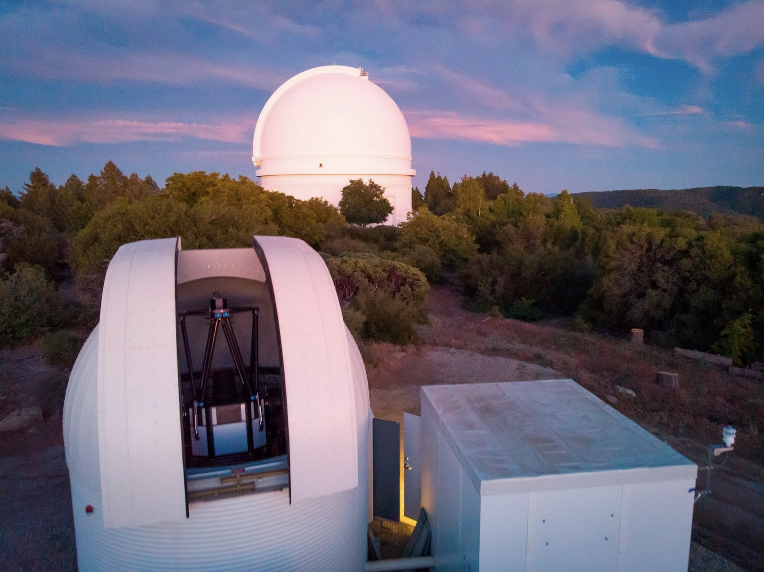
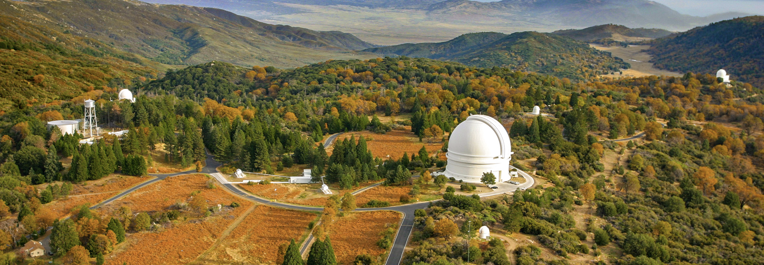
WINTER is coming here! A NIR time-domain survey at Palomar, ideal to discover the dustiest LRNe
WINTER will conduct a time-domain survey of nearby galaxies to search
for dusty LRNe that are being missed by optical surveys
1 m telescope, 1 sq. deg. FOV
Y, J, Hs bands
Camera commissioned last week (talk by Danielle Frostig yesterday)!

Slide 18
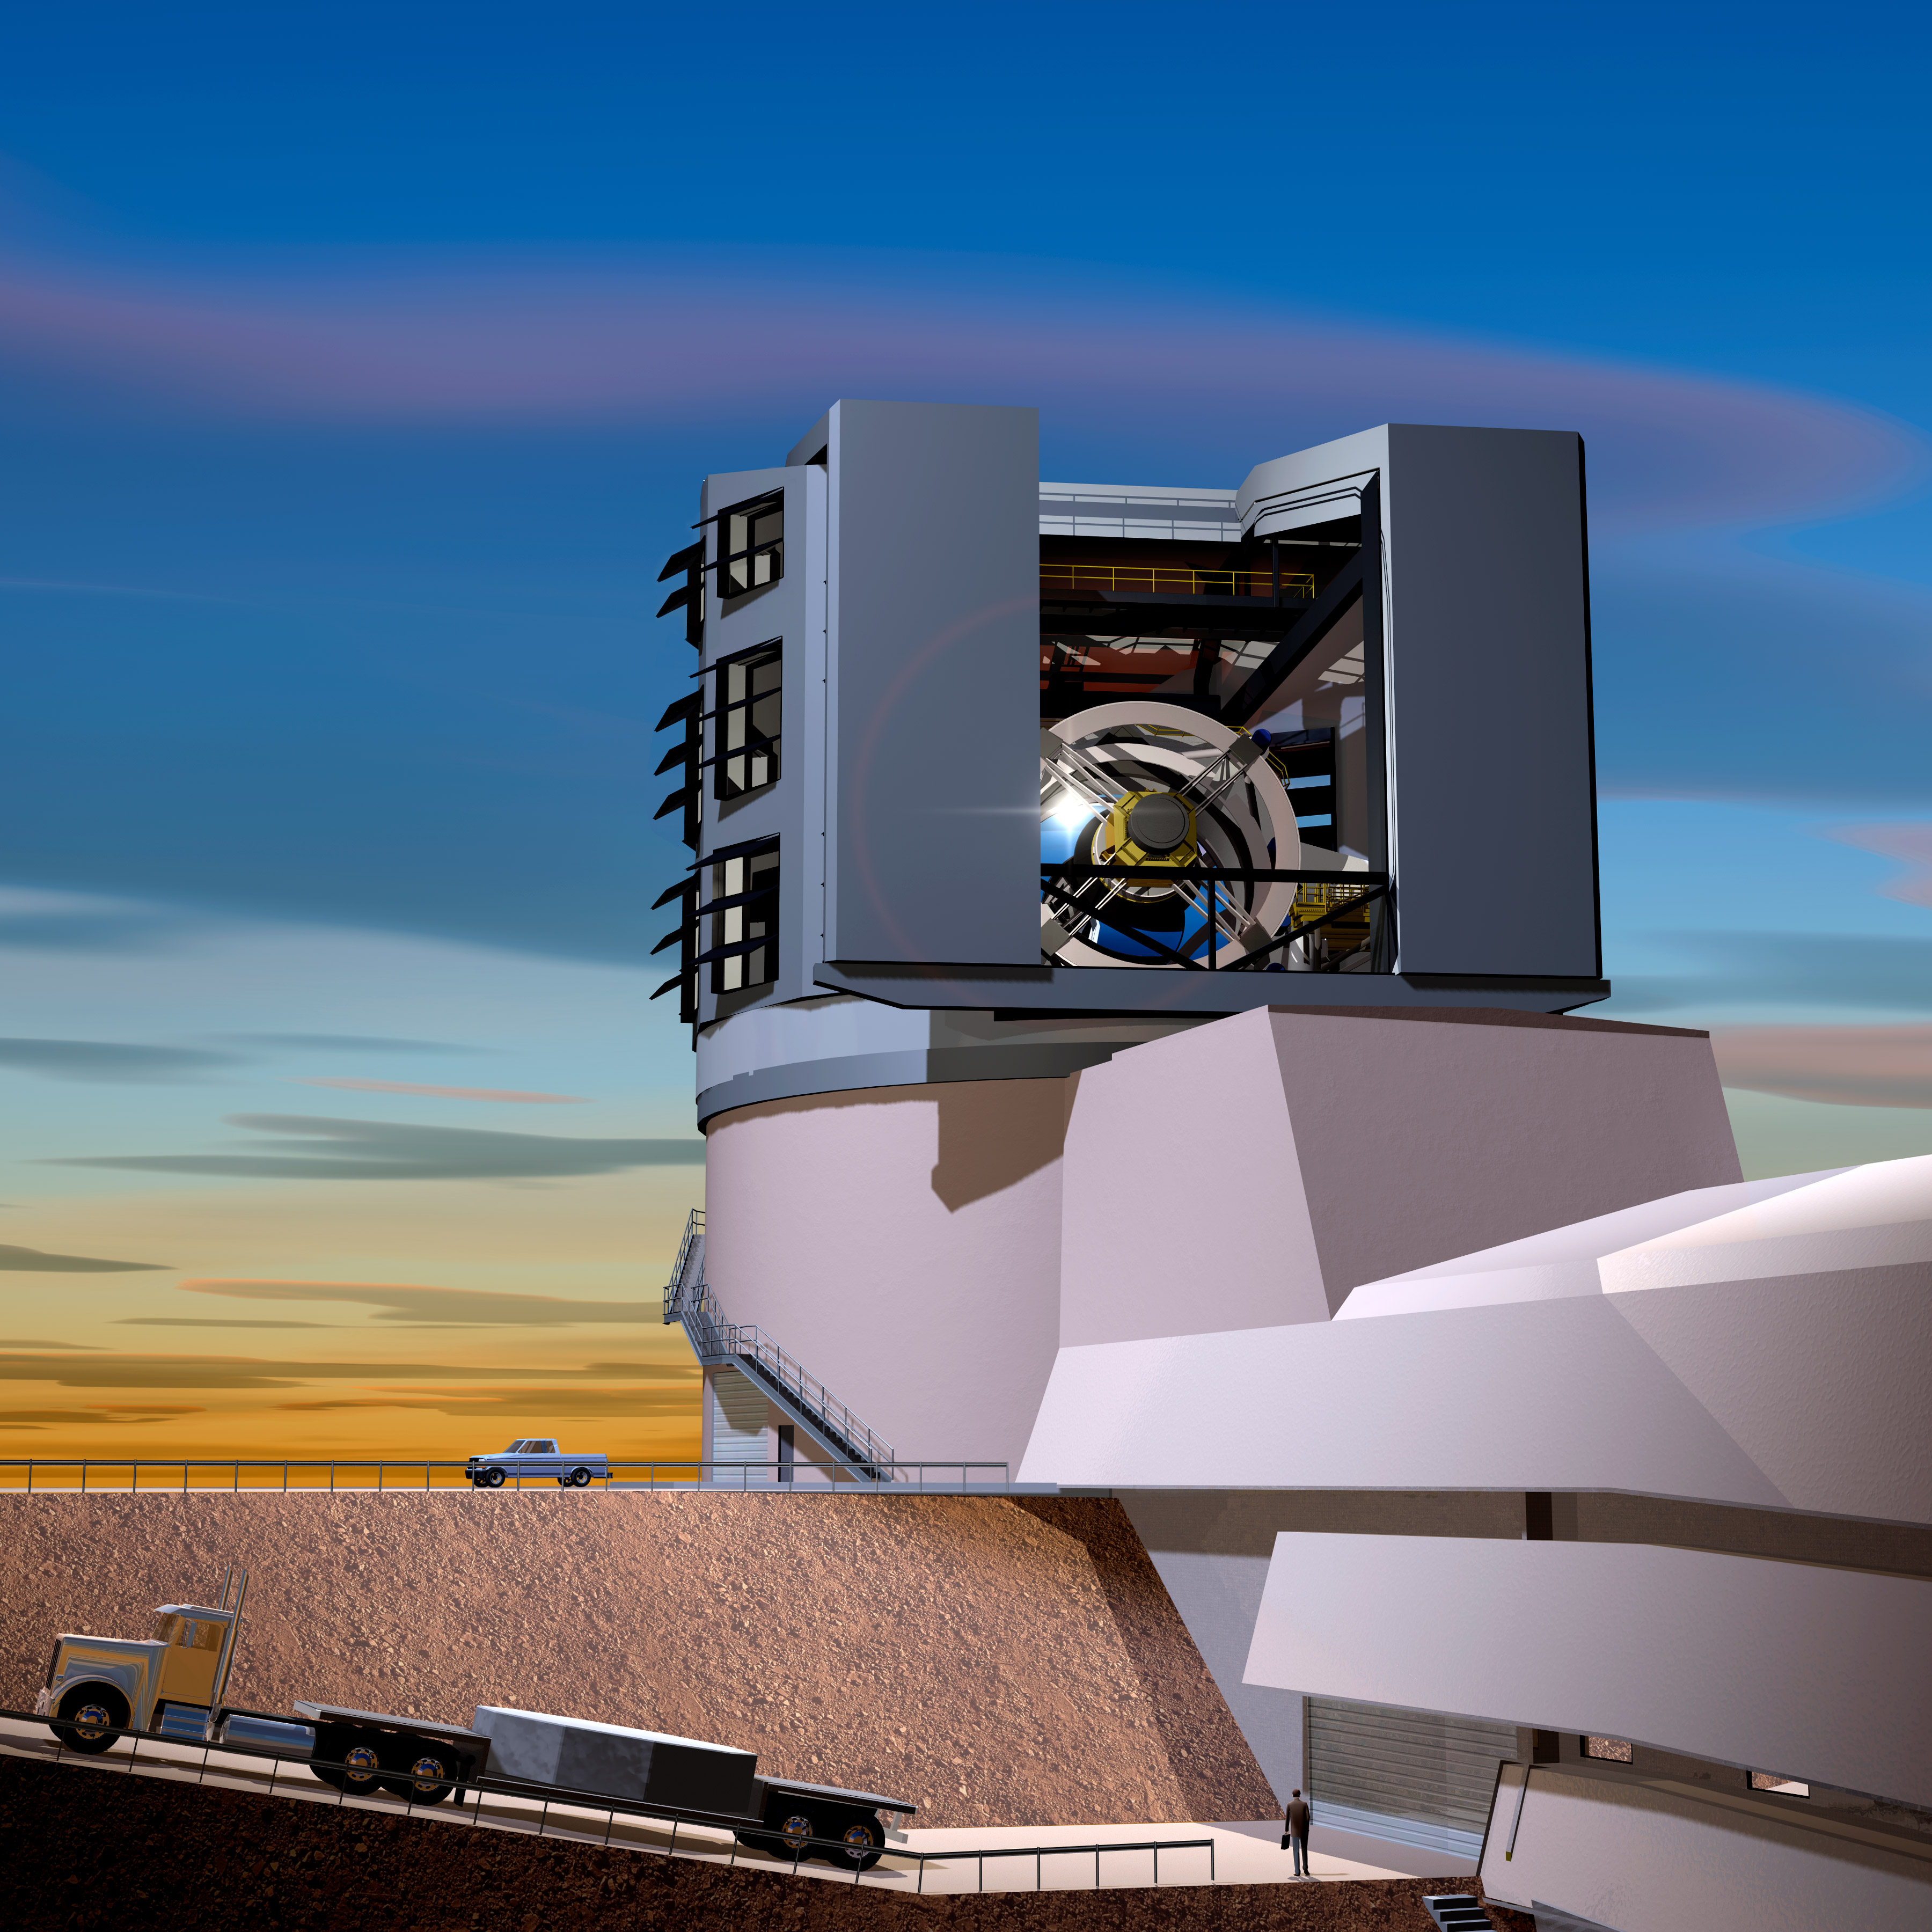
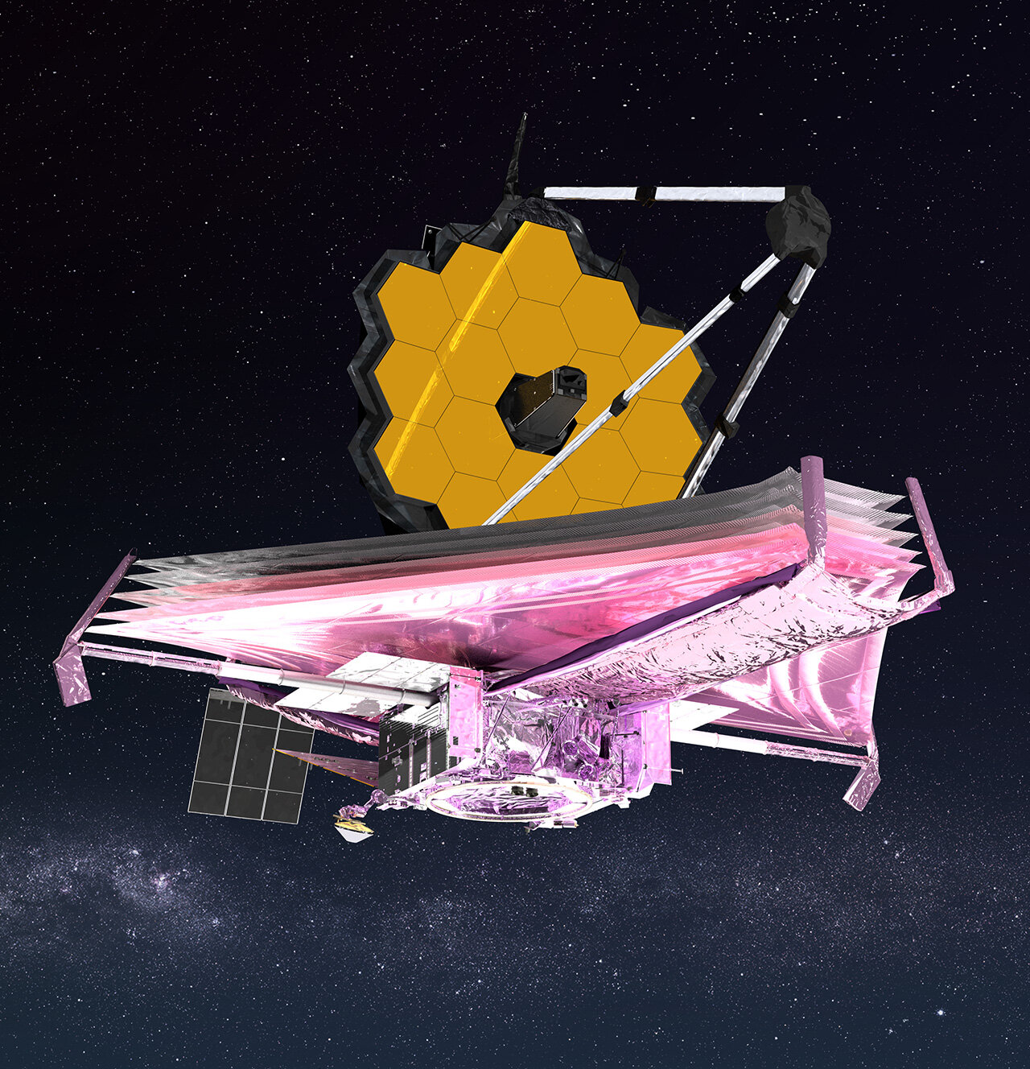
The future of CE is (IR) bright!
Lourie et al. 2022
LSST
LRN V838Mon (NASA/ESA)
NIR time domain surveys (WINTER, DREAMS) to unveil populations of
extremely dusty, IR-only LRNe
NASA
Rubin
~500-1000 LRNe discoveries per year
Discoveries of LRNe in their precursor phase
Continued studies from optical time-domain surveys (ZTF, ATLAS, PanSTARRS, GOTO, MeerLICHT, <your survey!!>)
JWST
Late-time studies of LRNe now possible in the mid-IR

Slide 19
Thank you!

Slide 20
Extra

Slide 21
Spectroscopic properties of LRNe
Blagorodnova, Karambelkar et al. 2020

Slide 22
Karambelkar et al. 2023

Slide 23
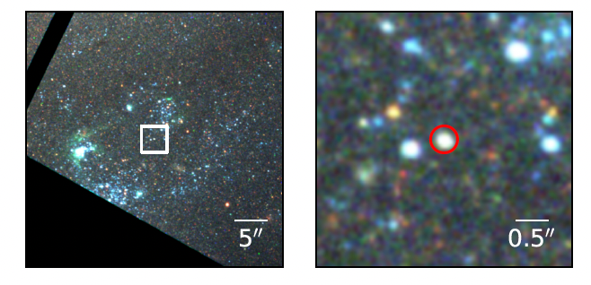
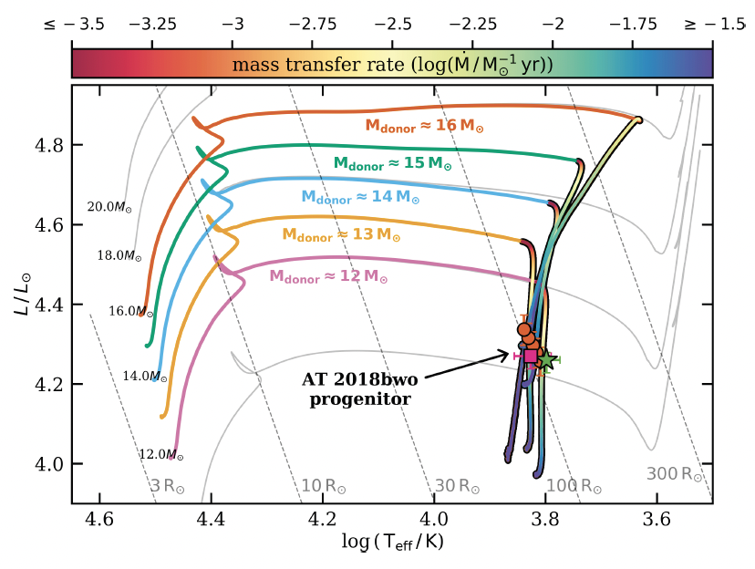
Progenitors of LRNe Archival HST imaging analysis
Blagorodnova, et al. 2021

Slide 24
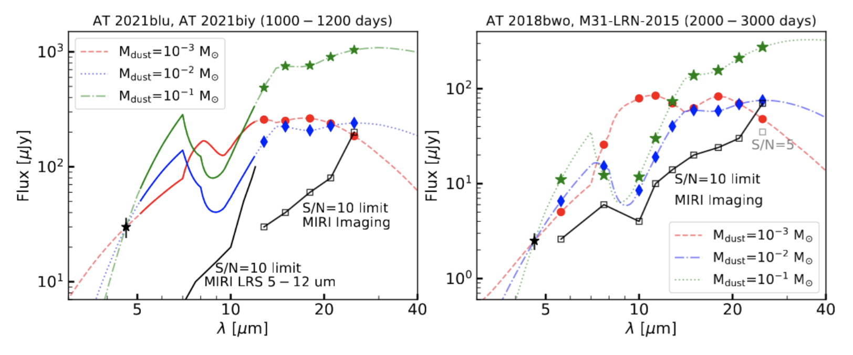
Late time observations of LRNe – with JWST! Mid-IR observations of 4 LRNe to measure dust masses
JWST Cycle 2 GO Proposal (PI: Karambelkar)

Slide 25
Mid-IR dust modeling

