Slide 1
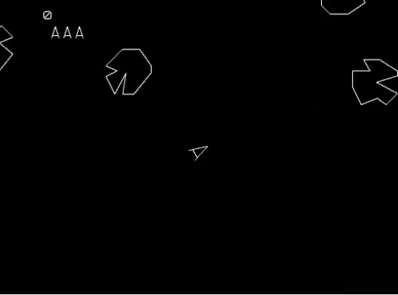
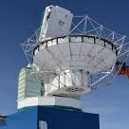
Asteroid Measurements at Millimeter Wavelengths with the South Pole Telescope
June 21, 2023
Paul Chichura
pchichura@uchicago.edu
University of Chicago
South Pole Telescope

Slide 2

Overview
Why observe asteroids at mm wavelengths?
Why use CMB surveys to do it?
What’s been seen so far with SPT?

Slide 3
Overview
Why observe asteroids at mm wavelengths?
Why use CMB surveys to do it?
What’s been seen so far with SPT?

Slide 4
High Level Motivation
Sizes, shapes, and compositions of asteroids are products of our solar system’s evolution.

Slide 5




How to Observe an Asteroid
Send and receive reflected radar signals
Visible solar light gets reflected
Absorbed light heats the asteroid, get thermal radiation, primarily in IR
Thermal radiation happens at lots of wavelengths, including mm+
  surfaces are more transparent to longer wavelengths (mm, cm, etc.)

Slide 6
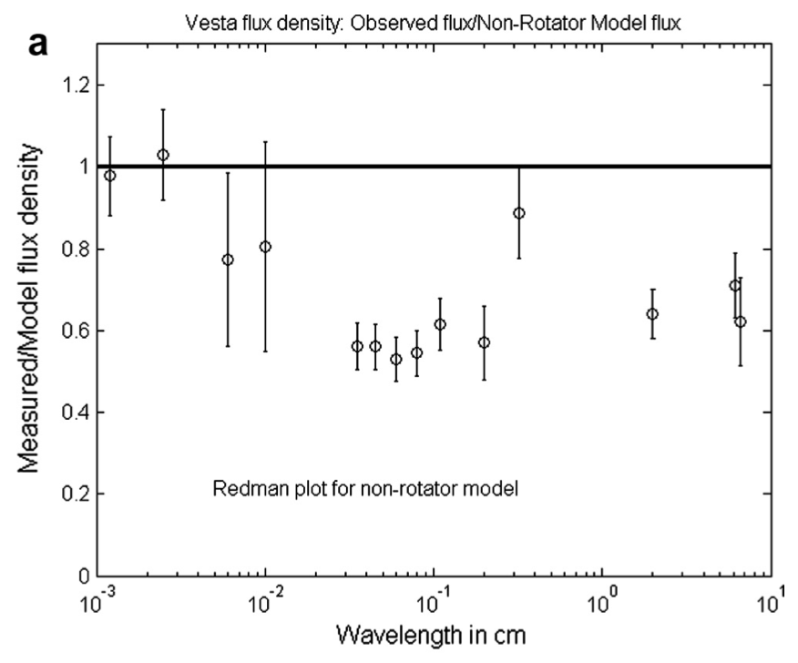
Millimeter/Centimeter Observations
Long-wavelength thermal radiation originates below surface
Historical observations found objects dimmer than expected
  Bright as expected at IR
  Less bright at mm+
Learn about surface properties!
  cooler subsurface?
  surface particle scattering?
mm+ observations historically lacking
Observations of (4) Vesta
Keihm et al. 2013, summarizing results of Redman et al. 1992

Slide 7
Overview
Why observe asteroids at mm wavelengths?
Why use CMB surveys to do it?
What’s been seen so far with SPT?

Slide 8
Overview
Why observe asteroids at mm wavelengths?
Why use CMB surveys to do it?
What’s been seen so far with SPT?

Slide 9
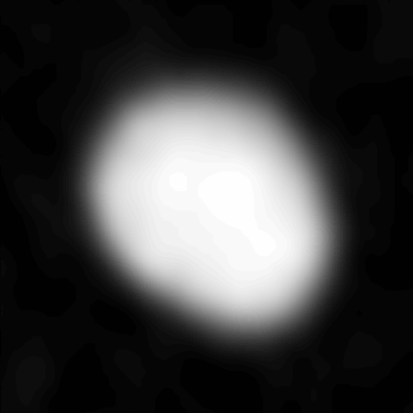
Targeted Observations
Usually, we see asteroids by looking at them!
Some examples in ~mm:
  ESA’s Rosetta spacecraft flybys of (21) Lutetia, (2867) Šteins
  ALMA measured (3) Juno, (16) Psyche, etc.
This requires money and time!
ALMA’s mm images of (3) Juno
https://public.nrao.edu/news/lbc-juno/

Slide 10
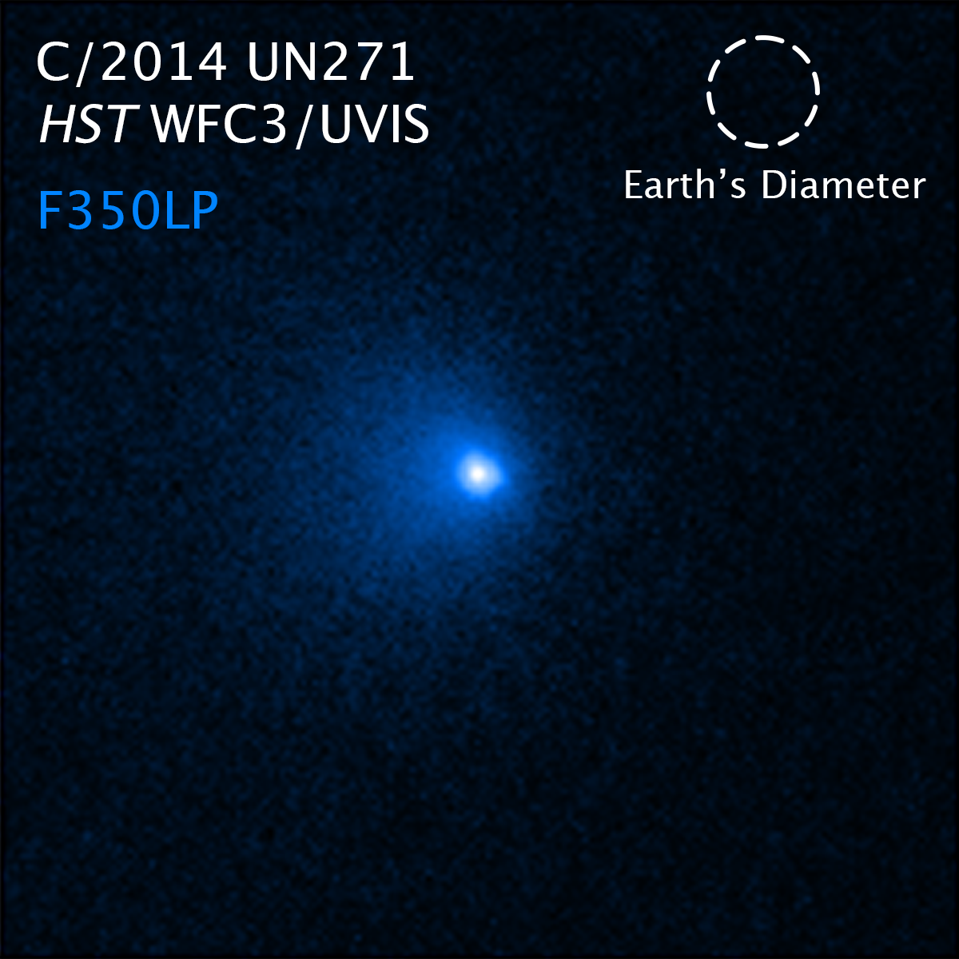
Surveys
Repeated observations of the same region of the sky
  Ex: WISE/NEOWISE all-sky IR survey
  Ex: Dark Energy Survey
Lower opportunity costs, the data already exists!
CMB experiments do the same, just at mm wavelengths
Hubble image of C/2014 UN217, found by DES
https://hubblesite.org/contents/news-releases/2022/news-2022-020

Slide 11
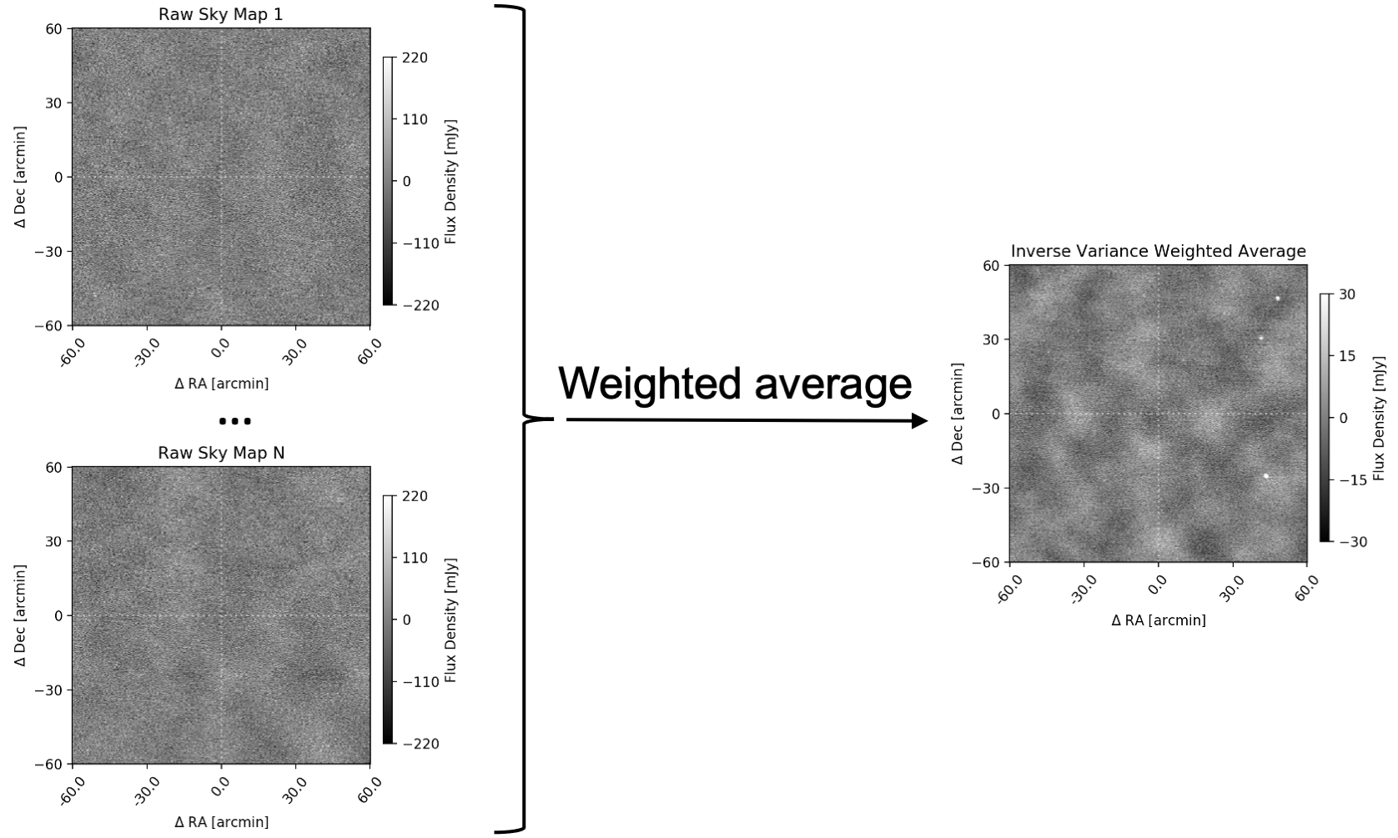
What do our observations look like?
One observation is just one snapshot of the sky in mm
Contains:
  CMB signal
  lots of noise
  static point sources (stars, etc.)
  transient objects (flares, AGN, etc.)
  moving objects (planets, asteroids)
Need a novel approach to make out the asteroids
Example Observation

Slide 12
How to Observe
figure out static signal (point sources, CMB) by averaging region

Slide 13
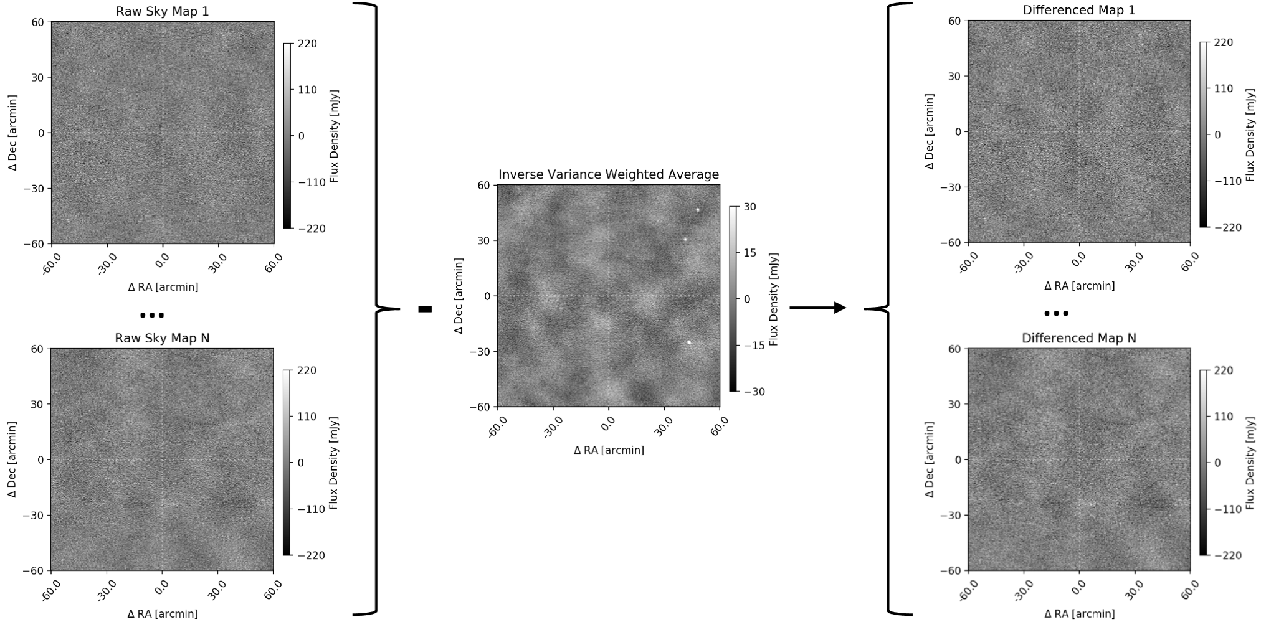
How to Observe
subtract off the average to leave moving/transient sources + noise

Slide 14
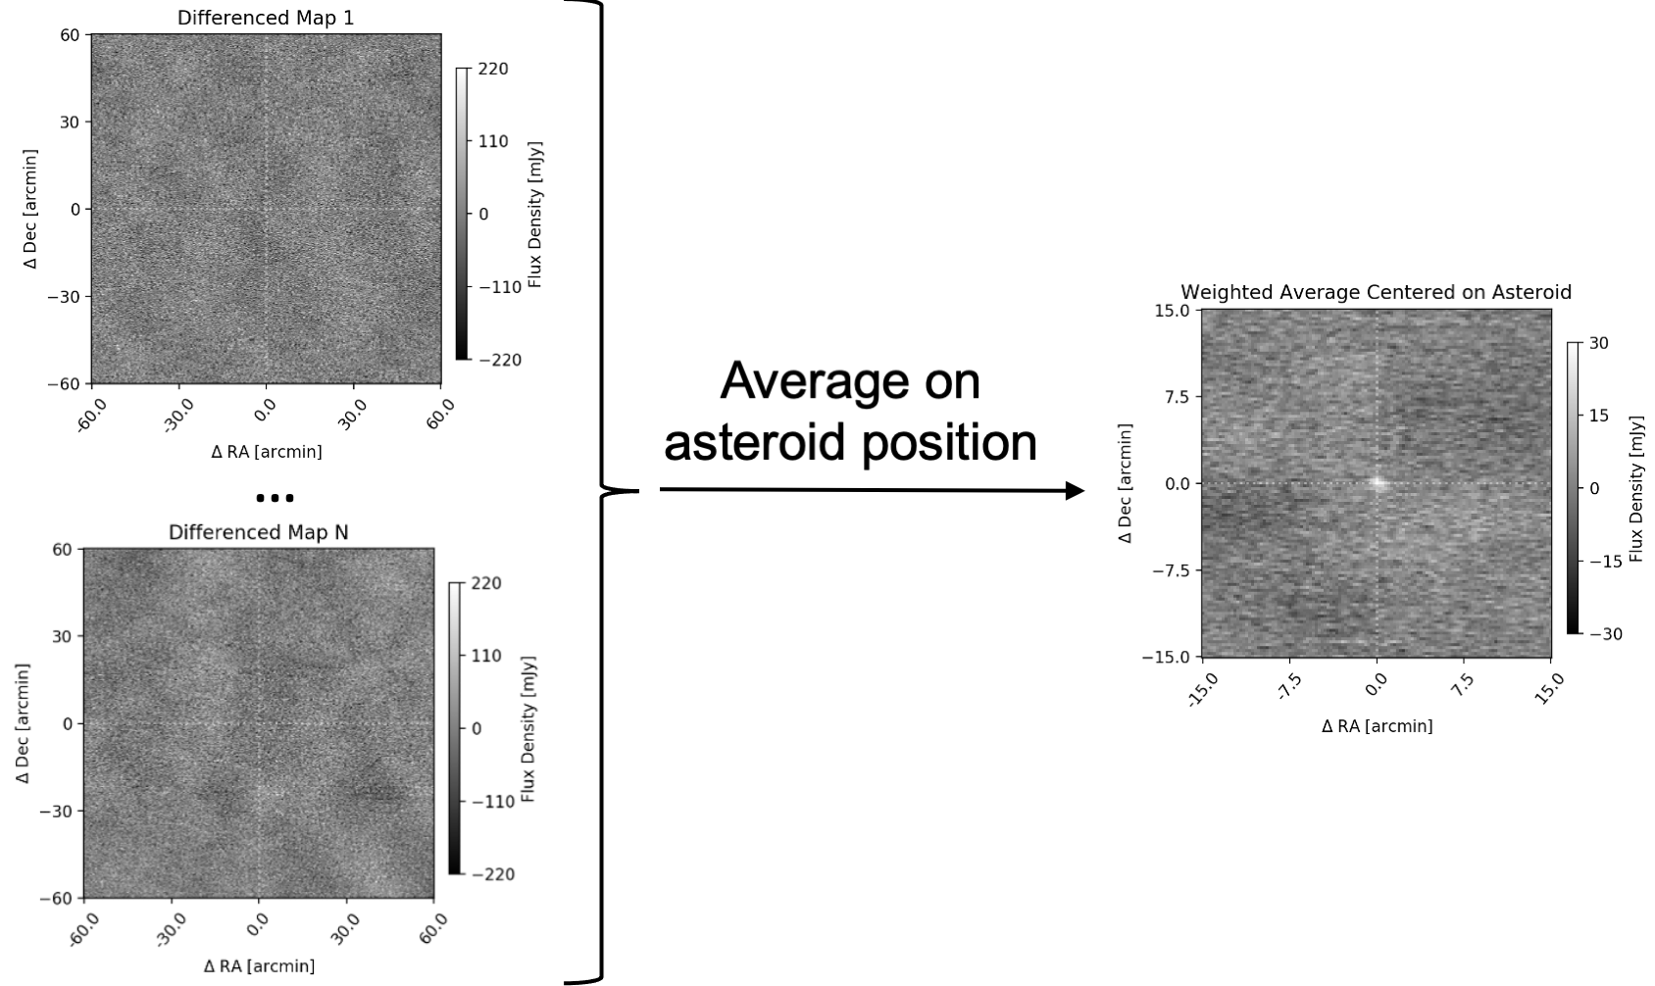
How to Observe
pick an asteroid and average on known position to reduce noise

Slide 15
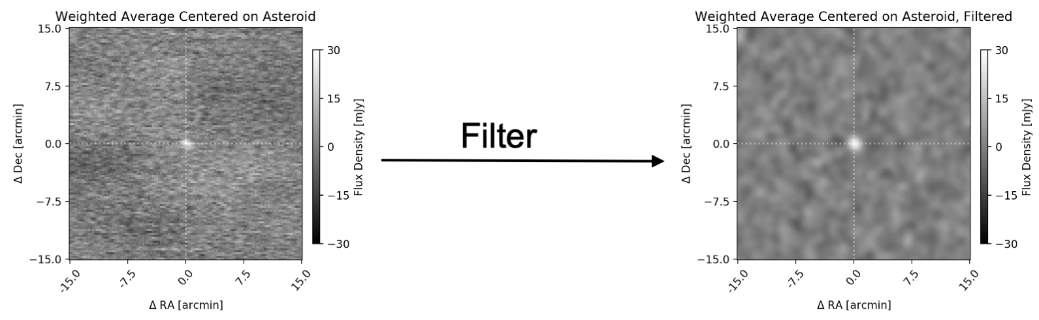
How to Observe
filter to maximize signal-to-noise (S/N) for point sources

Slide 16
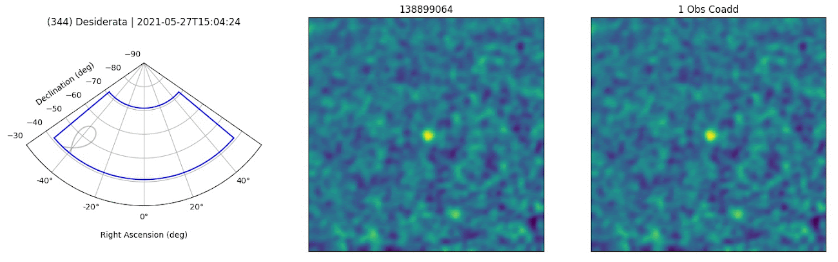
How to Observe
Example of a bright asteroid, (344) Desiderata
Trajectory
Individual Observation
Rolling Average
Allen Foster, Case Western Reserve University, SPT

Slide 17
Overview
Why observe asteroids at mm wavelengths?
Why use CMB surveys to do it?
What’s been seen so far with SPT?

Slide 18
Overview
Why observe asteroids at mm wavelengths?
Why use CMB surveys to do it?
What’s been seen so far with SPT?

Slide 19
South Pole Telescope (SPT)
10m telescope observing at mm and submm wavelengths
SPT observed with 3 different cameras (colored boxes)
Typically avoid foregrounds (Planck dust map shows galactic plane)
Most asteroids near ecliptic plane (dashed line)

Slide 20
Asteroids in Select SPT Fields
Handful of bright asteroids pass through SPT fields near ecliptic

Slide 21
SPT Asteroid Trajectories
Typically observe objects for ~month(s)
Parallactic motion helps put asteroids in field

Slide 22
SPT Asteroids
SPTpol observed at 2 wavelengths:
  2mm: asteroids bright enough to detect
  3.2mm: Asteroids dimmer
We can quantify how much dimmer

Slide 23
SPT Asteroid Takeaways
What did we learn about these asteroids?
(324) Bamberga and (13) Egeria
  measurements roughly agree with model
  potentially similar temperature as surface and low surface scattering
(22) Kalliope:
  M-type asteroid, surface consisting of silicates and iron
  ~64% as bright as expected at 2.0mm
  <46% as bright as expected at 3.2mm
  potentially due to highly scattering surface

Slide 24
SPT Asteroids
Expect to observe ~34
(2) Pallas and (344) Desiderata are bright
Some frequent visitors
NASA’s Lucy mission will study (617) Patroclus

Slide 25
Overview
Why observe asteroids at mm wavelengths?
  Tells us about surface composition
Why use CMB surveys to do it?
  It’s free data! No opportunity cost to measure
What’s been seen so far with SPT?
  3 MBA details published by SPT (Chichura et al. 2022)

Slide 26
Thank You For Listening!
Questions?

Slide 27
Backup Slides

Slide 28
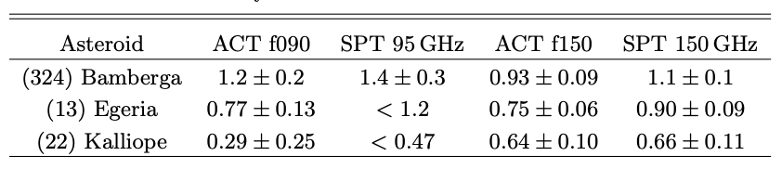
Atacama Cosmology Telescope (ACT)
arXiv pre-print recently posted, 160 asteroid observations, in rough agreement with SPT on their observations
Orlowski-Scherer et al. 2023, in prep

Slide 29
CMB-S4 Deep Survey
thousands of objects present, ~18 objects with S/N>10
NEO!

Slide 30
CMB-S4 Wide Survey
~2.9k objects with S/N>1, ~611 objects with S/N>10

Slide 31
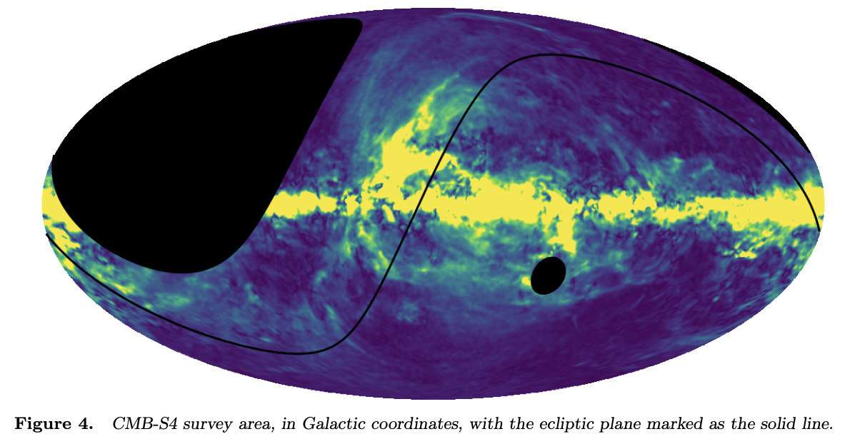
CMB-S4 Wide Survey
wide survey covers entire ecliptic plane (black line)
pick an asteroid, and CMB-S4 will probably see it
(fig 4 of CMB-S4 project plan)

