Slide 1
The Millimeter Transient Sky: CMB surveys as astrophysical transient detectors
Emily Biermann
University of Pittsburgh
Advised by Arthur Kosowsky
act.princeton.edu
Notes:
Today I am going to be talking about searching for astrophysical transient events using ACT millimeter wavelength data. This brand new topic of research in astrophysics as CMB searches have only recently acquired the resolution necessary to pick up these events, opening the transient sky to a never before seen frequency band.

Slide 2
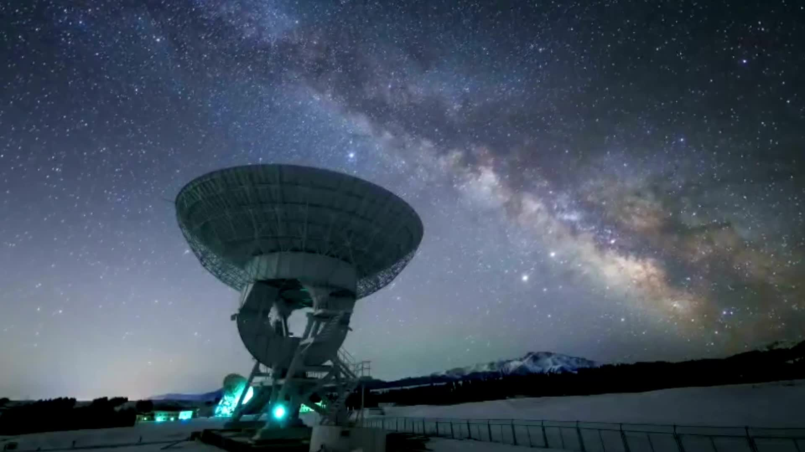
Decadal Survey on Astronomy and Astrophysics 2020
“It is essential that CMB-S4 produce transient alerts, as well as calibrated maps in all bands and on all angular scales that are openly usable and accessible on as rapid a cadence as practical”
Notes:
Priority work within the astronomy community!
Wait! I’ve never hear of this before! Why is this so important? What’s CMB-S4? Why do we need it to produce rapid alerts?

Slide 3
In this talk…
The millimeter transient sky
The State of the Field
ACT Blind Transient Search
Future Studies

Slide 4
In this talk…
The millimeter transient sky
The State of the Field
ACT Blind Transient Search
Future Studies

Slide 5
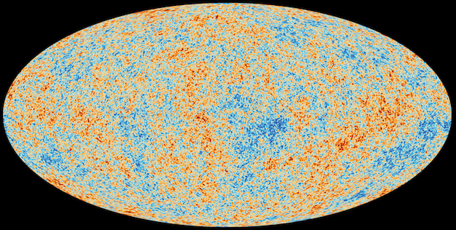
ESA/Planck Collaboration
Notes:
Think of microwave we think of CMB. Very static thing we use to study the origins of the universe, not stars

Slide 6
Millimeter Transient Events
Eftekhari et al., 2022
Notes:
Normalized flux density models of simulated events at 100GHz
High energy, relativistic → bright peak, shorter duration
Lower energy, nonrelativistic (Sne) → lower peak, longer duration

Slide 7
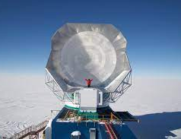
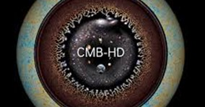
Current and Future CMB Surveys
Past/Current Surveys
ACT
SPT
Near Future
Simons Observatory
Looking ahead
CMB-S4
CMB-HD
Notes:
CMB surveys- wide field of view, good for detecting millimeter transients

Slide 8
Millimeter Transients
Short Gamma Ray Bursts
Produced from neutron star mergers
Fast Blue Optical Transients
We don’t know what these are but they have been observed in mm
NSMs with a Stable Magnetar Remnant
Magnetar transfers energy to surrounding merger ejecta
Ejecta reaches relativistic speeds, emission peaks in microwave and radio
Tidal Disruption Events
gamma-ray/X-ray transient Sw J1644 +57 → evidence of jets from TDEs
Long Gamma Ray Bursts
Massive star collapses into black hole
Fireball model, jets interact with medium producing forward and reverse shocks
Unbiased probe of reverse shock
Synchrotron emission peaks in millimeter in early times
Emission peaks in early times
See Eftekhari et al., 2022 and references therein

Slide 9
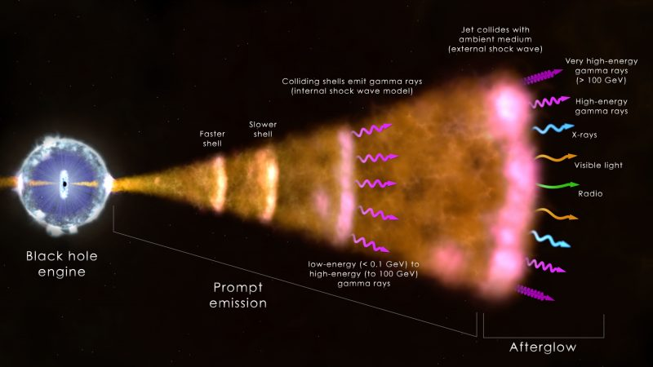
Gamma Ray Bursts
Hunting for orphan afterglows in CMB surveys
earthsky.org
Notes:
Synchrotron radiation created from magnetic fields interacting with surrounding medium
Orphan afterglow

Slide 10
GRB Reverse Shock
GRB 221009A radio observations
Predicted to peak in millimeter just 30 minutes post burst!
Use CMB instruments to identify RS in GRBs, prompt rapid follow-up
Bright et al., 2023
Notes:
Afterglow peaks in the microwave
Synchrotron spectrum of a relativistic shock with a power-law electron distribution

Slide 11
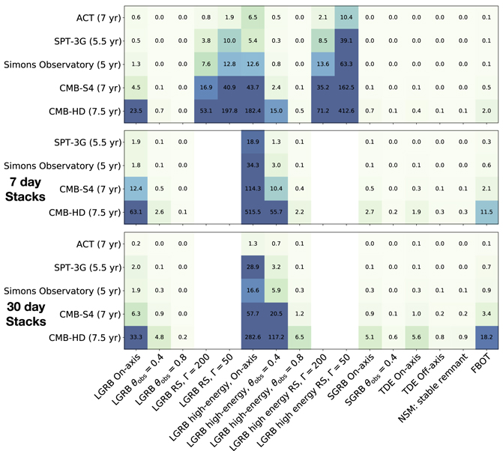
Observation Predictions
Eftekhari et al., 2022
Simulated synchrotron transients
Will see many extragalactic transient events
We have to know how to look for and identify them!
Notes:
- CMB surveys cover large sky area, can see many transients

Slide 12
In this talk…
The millimeter transient sky
The State of the Field
ACT Blind Transient Search
Future Studies

Slide 13
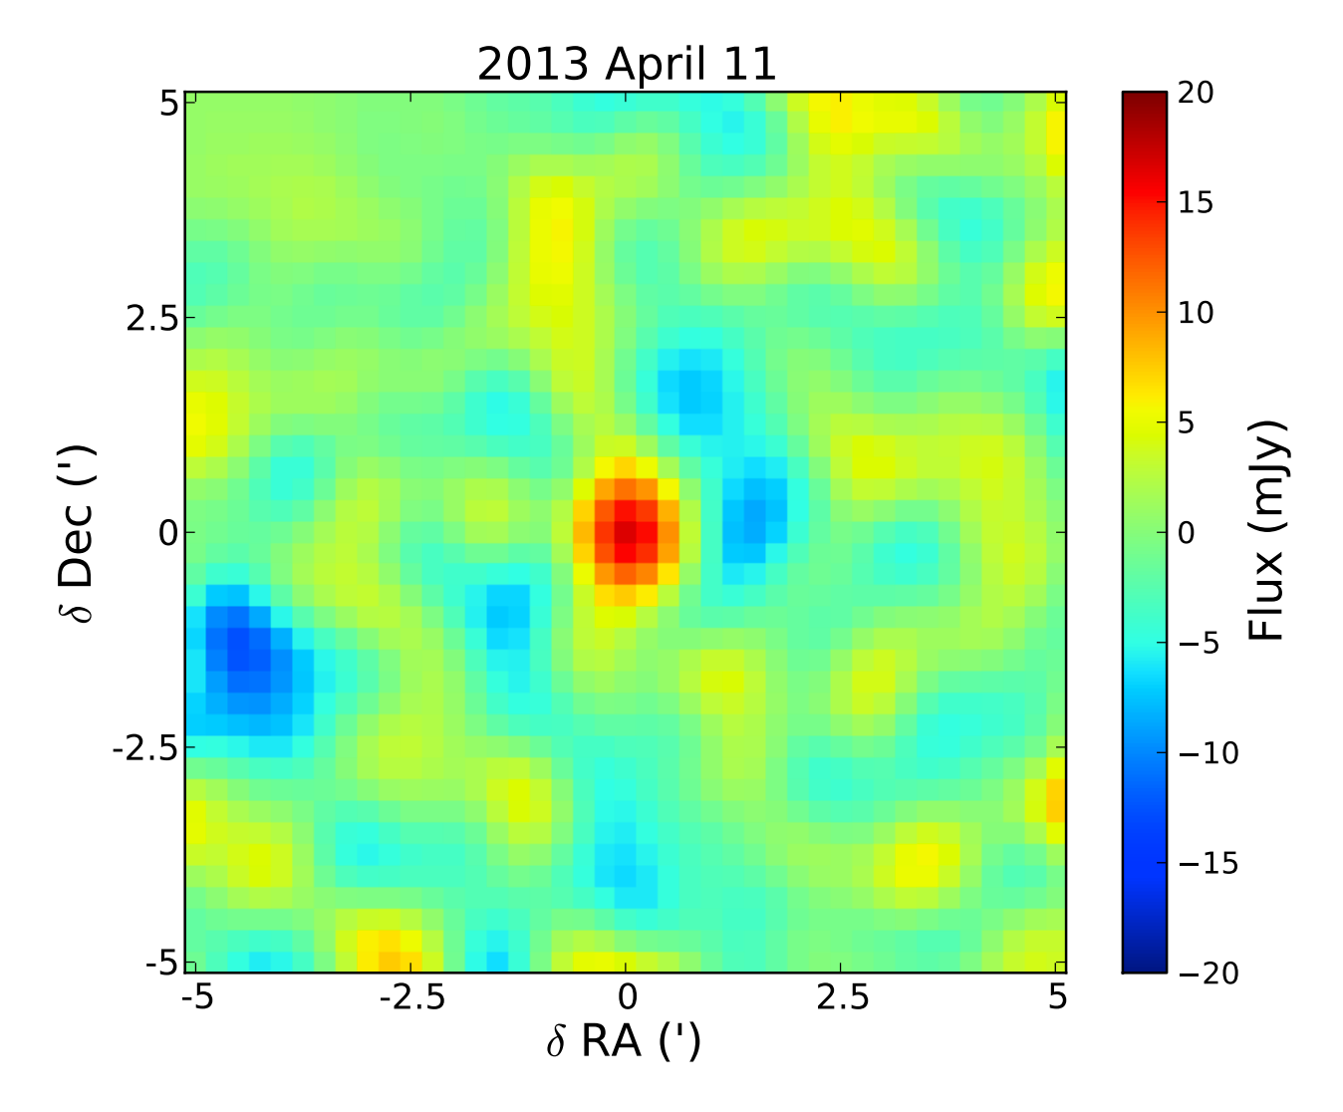
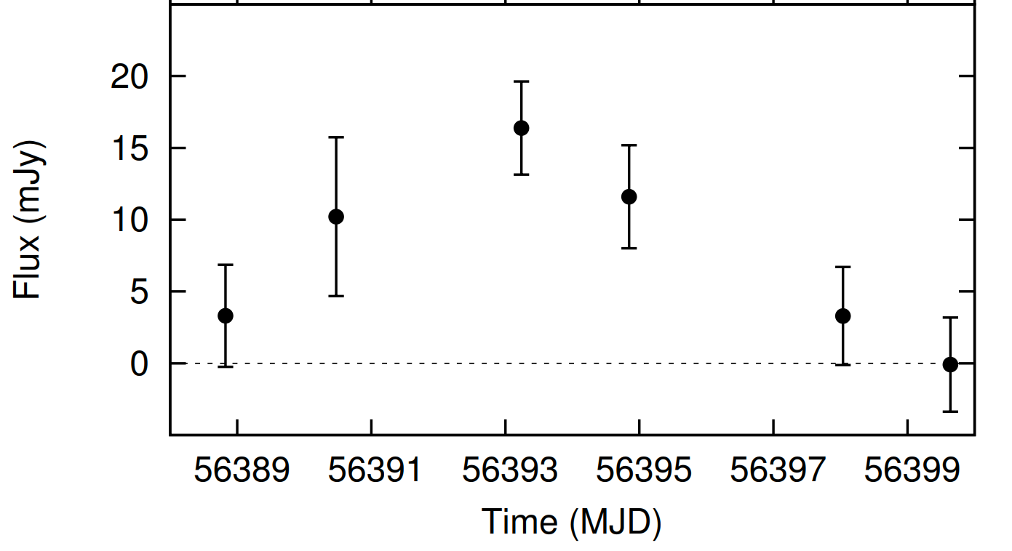
SPTpol: Whitehorn et al., 2016
One possible transient event
Broadly consistent with GRB orphan afterglow
Whitehorn, N., Natoli, T., Ade, P. A. R., et al. 2016
Notes:
- Only a blind search could detect orphan afterglow (α > 1.5, self-absorbed synchrotron emission)

Slide 14
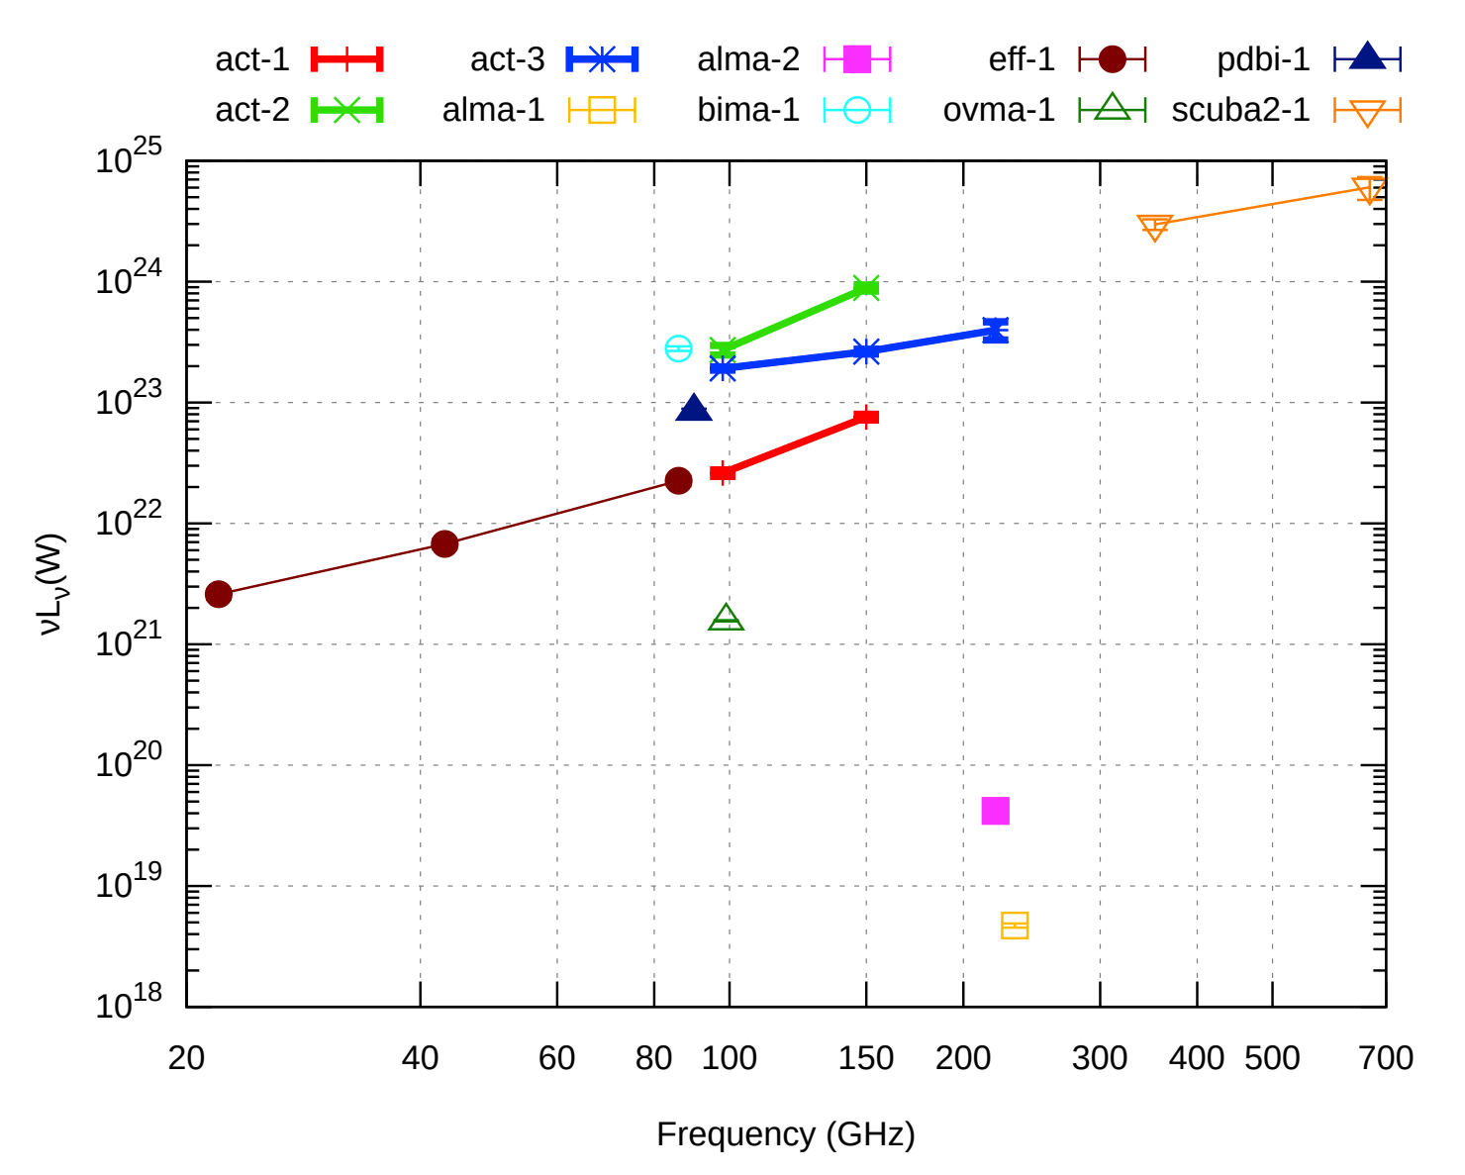
ACT: Naess et al., 2020a
Serendipitous discovery of three bright transients
3-day maps for Planet 9 search
All have stellar counterparts with active coronas
May be caused by magnetic recombination
Naess, S., Battaglia, N., Richard Bond, J., et al. 2021a

Slide 15
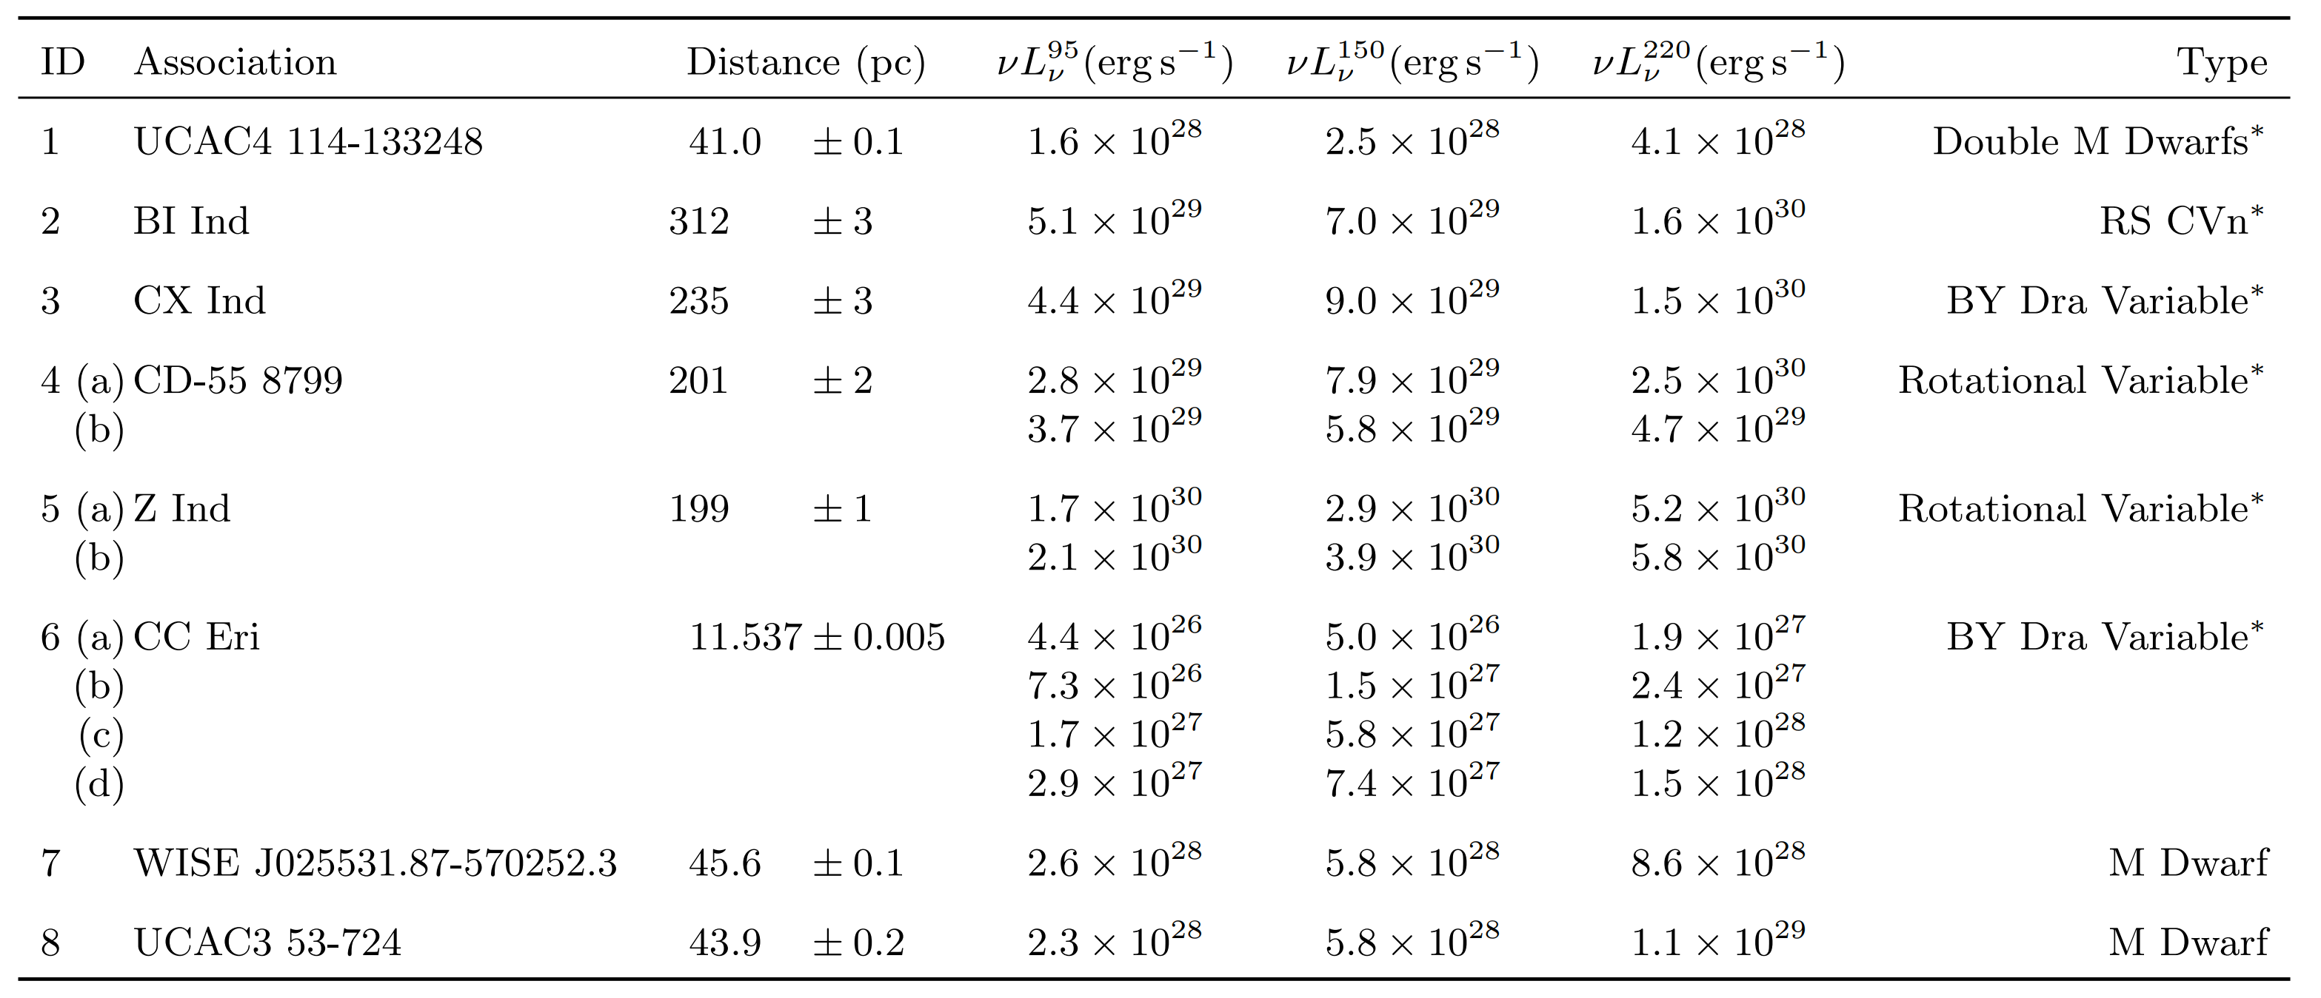
SPT-3G: Guns et al., 2021
Blind search yielded 13 galactic events at 8 locations
~min – hour duration
Guns, S., Foster, A., Daley, C., et al. 2021
Notes:
Flat Spectra ➔ Synchrotron Emission
Lack of polarization ➔ optically thick or inhomogenous emission region
X-ray emitters except for M dwarfs

Slide 16
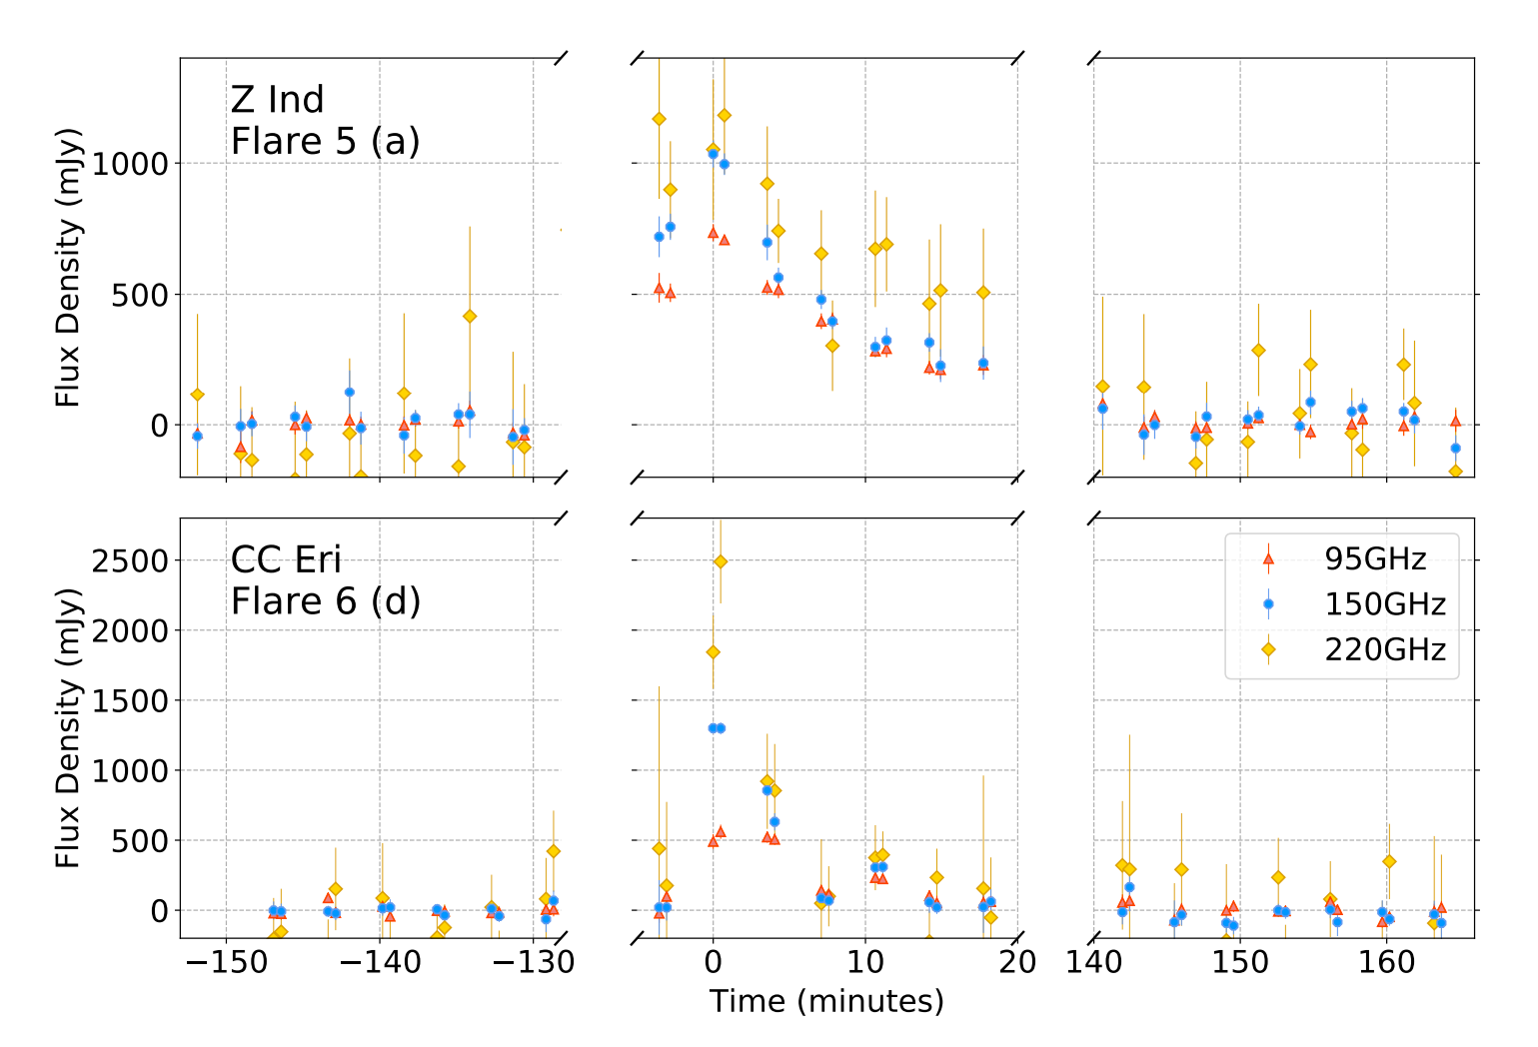
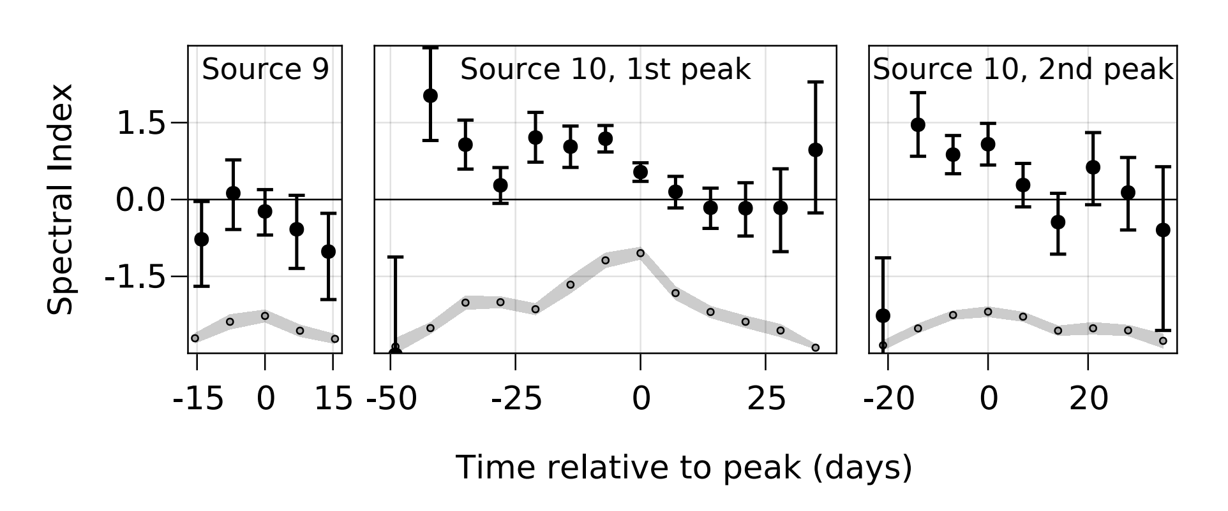
SPT-3G: Guns et al., 2021
2 Possible Extragalactic Events
Longer duration (~weeks)
No obvious counterparts
Spectrum evolves
Consistent with newly formed jet

Slide 17
ACT Targeted Search Carlos Hervías-Caimapo et al., 2023
Check out Carlos’ talk tomorrow!

Slide 18
ACT Systematic Search Li, Biermann, et al., 2023
Check out Yaqiong’s talk this afternoon!

Slide 19
In this talk…
The millimeter transient sky
The State of the Field
ACT Blind Transient Search
Future Studies

Slide 20
Atacama Cosmology Telescope
ACT (2008-2022) was a 6 meter millimeter telescope covering 3 frequency bands across three arrays with arcminute-scale angular resolution
Surveyed 40% of the sky with roughly a weekly cadence
Allows us to conduct the largest systematic transient search in this band to date
act.princeton.edu
Notes:
The Atacama Cosmology Telescope, located in Chile is perhaps better known for doing work in well, cosmology.
We survey 40% of the sky, 3 frequency bands across three arrays with arcminute-scale resolution.
amazing work with Cosmology which was discussed earlier this week,
but it also allows us to conduct the largest systematic transient search in the microwave to date
1,500 vs 17,000, about order of magnitude

Slide 21
ACT DR5 Maps [1]
Data from 2008-2018
3 square deg cutouts
0.5 arcmin resolution
depths of 8/8/30 µK-arcmin at f090/f150/f220 in this region
Naess 2020 et al
Notes:
So if you are a cosmologist, and you think of ACT or Planck data, you probably think of something like this.
Beautiful maps taken from ten or more years of data, incredible high depth measurements of CMB
Frequency range of 90-220 GHz.
But what if we could see the microwave in a new way?

Slide 22
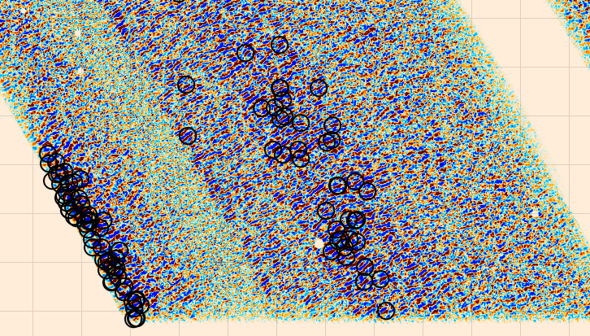
3-Day Maps
s17-19
Split data into 3-day mean subtracted, matched filtered maps
1 arcmin resolution
Find sources with SNR >5
Apply geometric data cuts
Naess 2020b et al
Notes:
So if you are a cosmologist, and you think of ACT or Planck data, you probably think of something like this.
Beautiful maps taken from ten or more years of data, incredible high depth measurements of CMB
Frequency range of 90-220 GHz.
But what if we could see the microwave in a new way?

Slide 23
Analysis
Initial detection
Array/Frequency
Require sources appear in at least 2 frequency/array combination
Geometric cuts
Characterization
Search for known counterparts
Find pixels with SNR>5 in three day maps
Edges, clustered sources, zero variance contours
Light Curves
Verify transients by inspecting light curve
Notes:
Note: found 8 events coincident with asteroids

Slide 24
Li, Biermann, et al., 2023
Notes:
Talk about rising vs falling spectra, light curves look pretty good for ones we are unsure about but still might be a glitch, sparse cadence

Slide 25
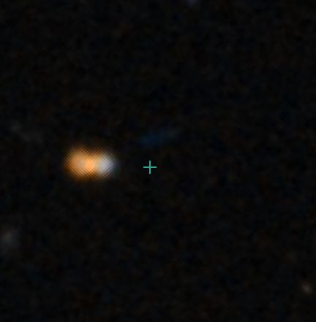
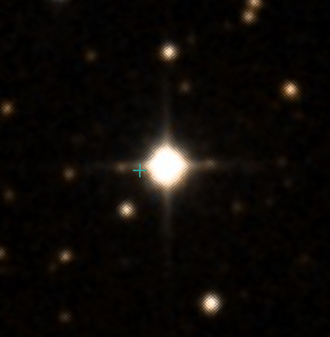
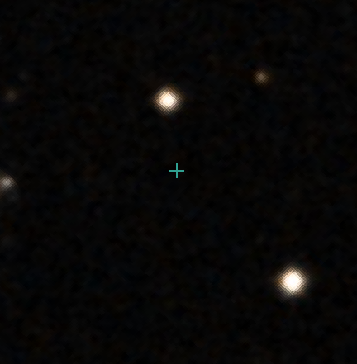
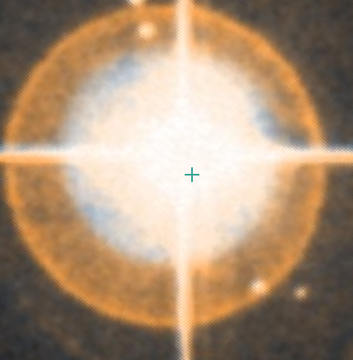
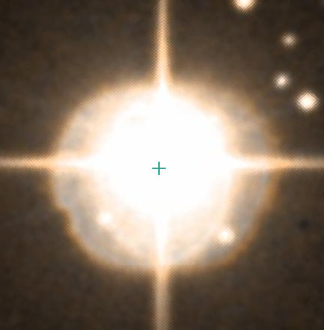
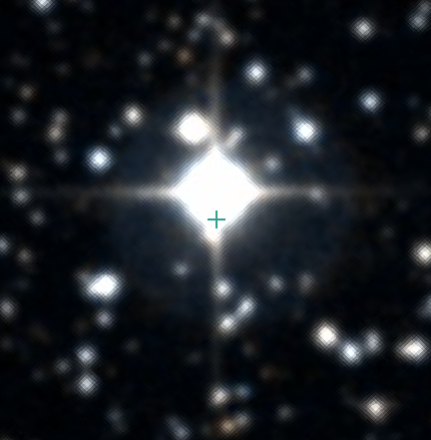
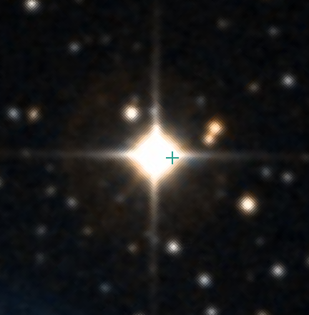
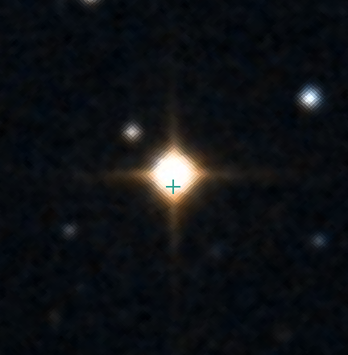
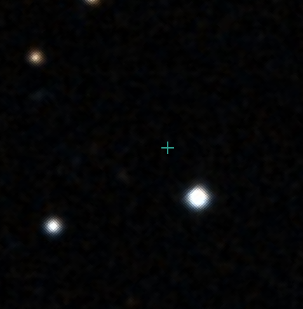
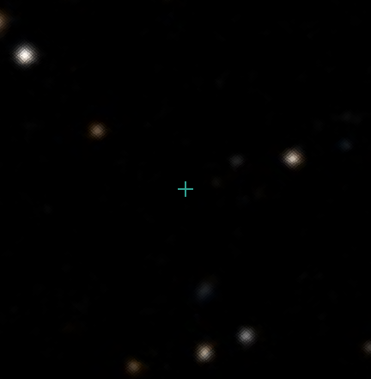
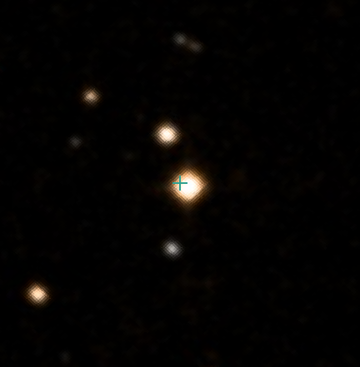
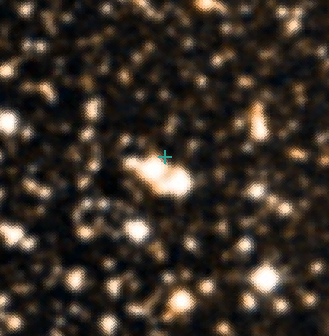
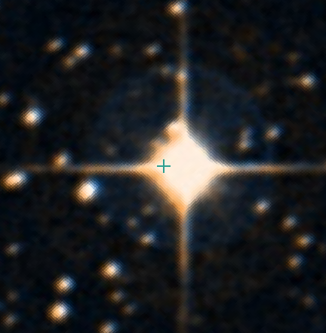
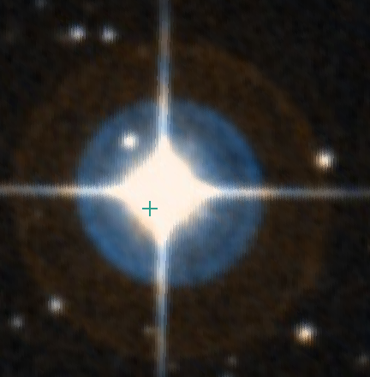
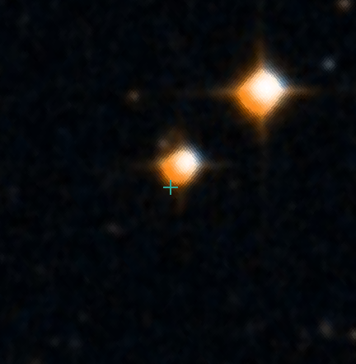
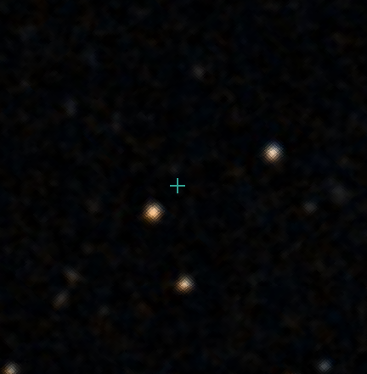
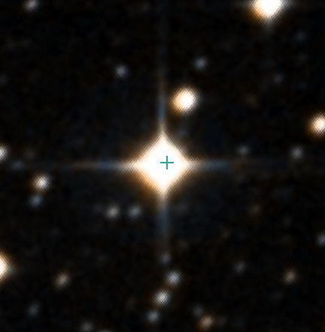
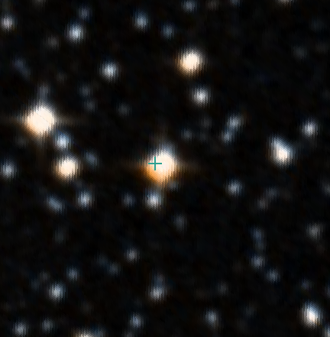
Possible Counterparts
Eclipsing Binary
RSCVn
RSCVn
Spec. Binary
Rotating Variable
M-Star
7
1
13
12a/b
4a/b
N3
15
8
9
10
14
6
N2
11
3
2
5a/b
N1
K-Star
Eruptive M-Star
RSCVn
Rotating Variable
Image Credits: Digital Sky Survey

Slide 26
In this talk…
The millimeter transient sky
The State of the Field
ACT Blind Transient Search
Future Studies

Slide 27
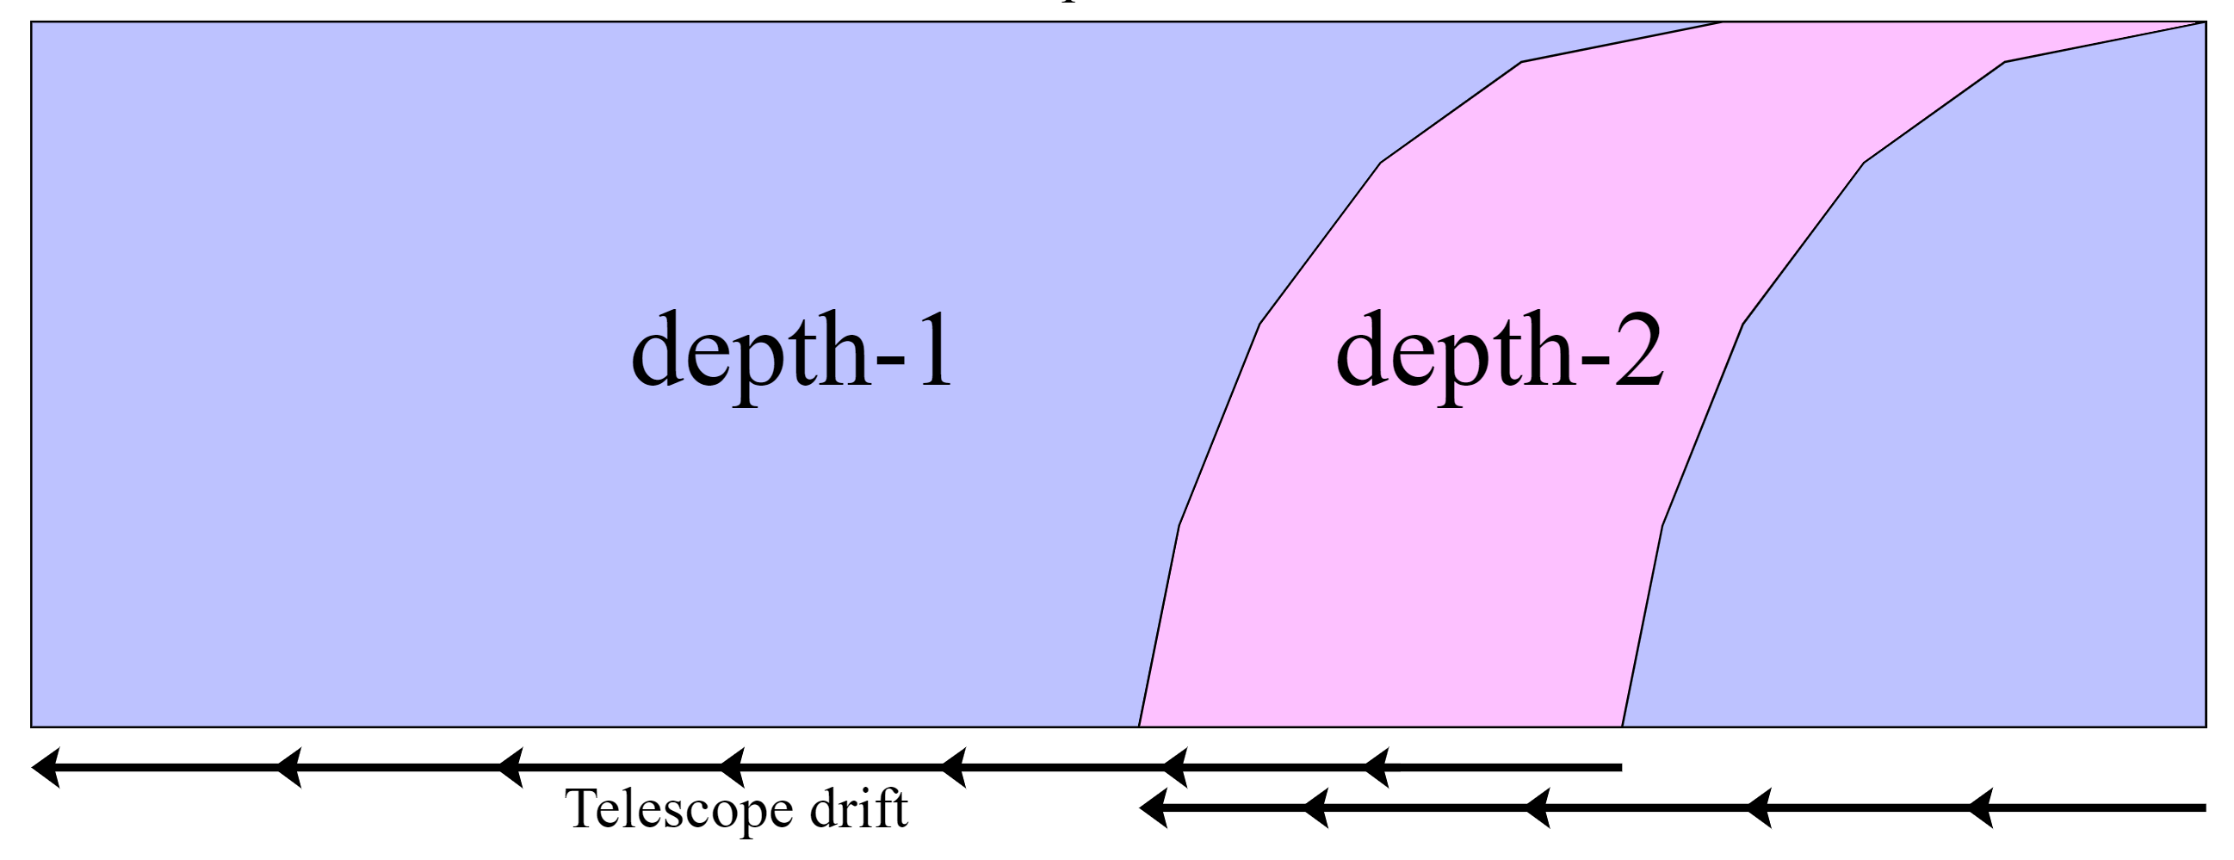
Depth-1 Maps
Single Scan maps
Maximum cadence and precise event timing
Ideal for transient detection!

Slide 28
Live Alerts and Follow-up
Goal is to create live transient alerts for SO using depth-1 maps
Transients may be followed up in radio or optical
Use ACT data to create SO transient pipeline
Filtering and counterparts in real time

Slide 29
Transients in ACT Data
Blind searches of millimeter transients have recently become possible
ACT search yields 14 galactic transient events coincident with flaring stars
More data is available to search within depth-1 maps
Necessary to build pipelines for real-time detection
Emily Biermann
University of Pittsburgh
emily.biermann.@pitt.edu

Slide 30
Bonus Slides

Slide 31
GRB Spectra
Early Times
Late Times
Sari et al., 1998
Notes:
Afterglow peaks in the microwave
Synchrotron spectrum of a relativistic shock with a power-law electron distribution

Slide 32
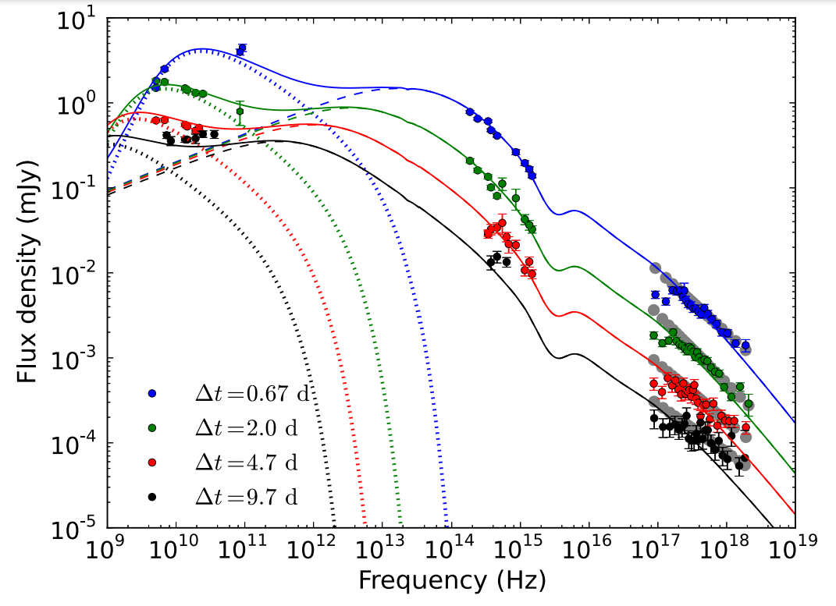
GRB Spectra
GRB 130427A Multiwavelength Observations
Millimeter, Optical, XRay
Models RS (dot), FS (dash)
RS peak in mm, moves to radio overtime
Laskar et al., 2018
Notes:
Afterglow peaks in the microwave
Synchrotron spectrum of a relativistic shock with a power-law electron distribution

Slide 33
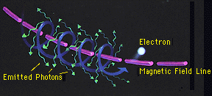
Synchrotron Millimeter Transients
Nasa.gov
Particles radiate when accelerated by magnetic field
Emits across the spectrum but high flux in radio
See Rybicki and Lightman, 2004

Slide 34
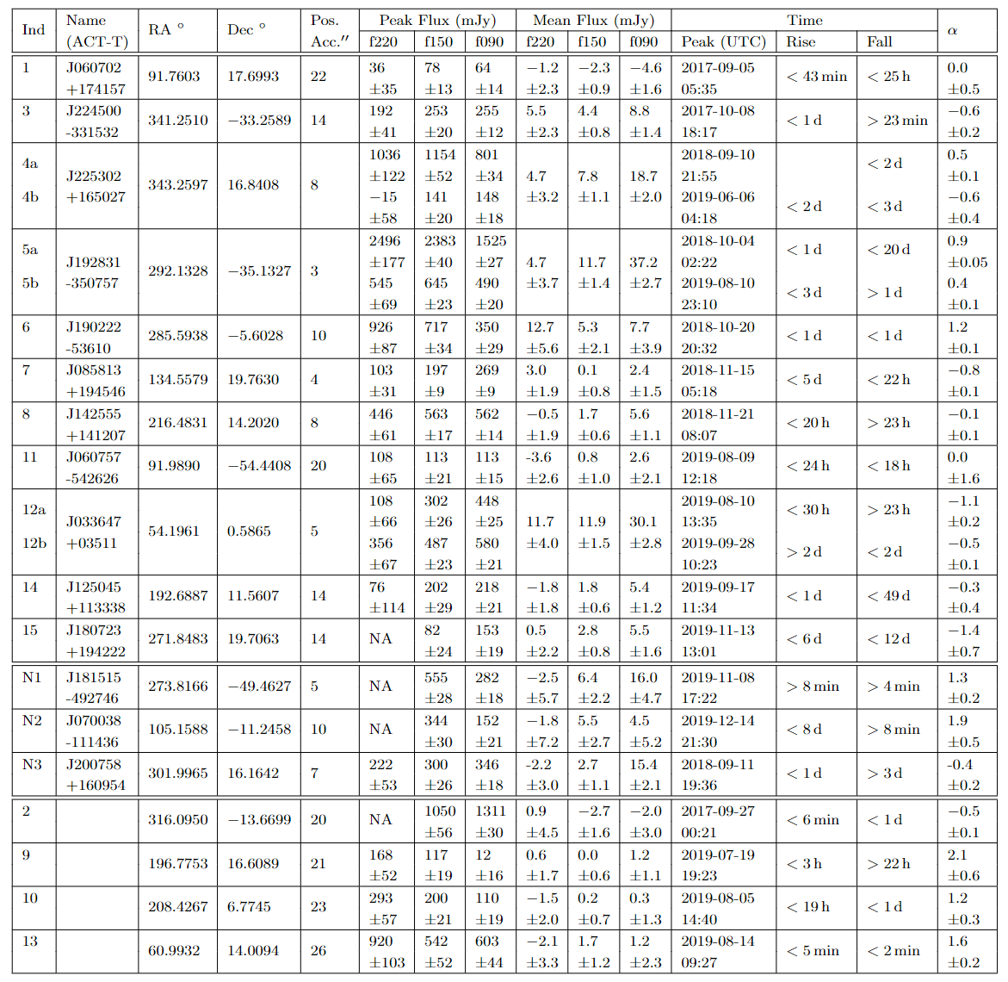
PRELIMINARY

Slide 35
Falling/Flat Spectra
High Poper Motion Binary
RSCVn
7
M-Star
12a/b
9
13
8
Gaia Star
Eclipsing Binary
14
1
10
RSCVn
2
4a/b
N2
5a/b
3
Spec. Binary
K-Star
N3
Young Stellar Object
Rotating Variable
Eruptive M-Star
6
High Proper Motion M-star
11
Rotating Variable
N1
15
RSCVn
Rising Spectra

