Slide 1



SN 2022oqm: An Exceptionally Bright Multipeaked Calcium-rich Transient
S. Karthik Yadavalli

Slide 2
Photometry
Initially classified as a Ic
Early-time excess
Multiple Peaks
Notes:
Classified as Ic

Slide 3
Ic-like Photospheric Spectra
Notes:
Define photospheric phase of supernova
Point out that Ic’s and Iax’s have very different progenitors, so it’s weird that it’s similar to both
Got like 8 spectra on this object from my program on HET

Slide 4
Later Spectra Show Calcium-Rich Status
Notes:
Ca is the next best coolant—could imply not much Oxygen
Understand the physics of this, from this paper: https://iopscience.iop.org/article/10.3847/1538-4357/abcccc/pdf

Slide 5
Later Spectra Show Calcium-Rich Status
This is a CaRT
Notes:
Ca is the next best coolant—could imply not much Oxygen
Understand the physics of this, from this paper: https://iopscience.iop.org/article/10.3847/1538-4357/abcccc/pdf

Slide 6
Photometric Comparison to Other Transients

Slide 7
2022oqm is Among the Brightest CaRTs Seen
Das et al. 2022
De et al. 2020
Notes:
Among the brightest, definitely the brightest CaRT-ic, except for 19bkc, which was also weird
Check if bkc is a radioacritve peak

Slide 8
Photometric Modeling

Slide 9
Shock + Double Radioactive Decay

Slide 10


Shock + Double Radioactive Decay Model
$$M_{Ni}≈0.1$$
Guillochon et al, 2018

Slide 11
Three Peaks are Well-Captured

Slide 12
Spectroscopic Modeling

Slide 13

Tardis Can Fit Spectra
Most line features are captured
Kerzendorf & Sim 2014

Slide 14
Abundance Profile: Double Peaked in Iron Group Elements
Notes:
Double peaked Fe-peak and Calcium abundance
Consistent with Mosfit suggestions

Slide 15
So, What Exploded?

Slide 16
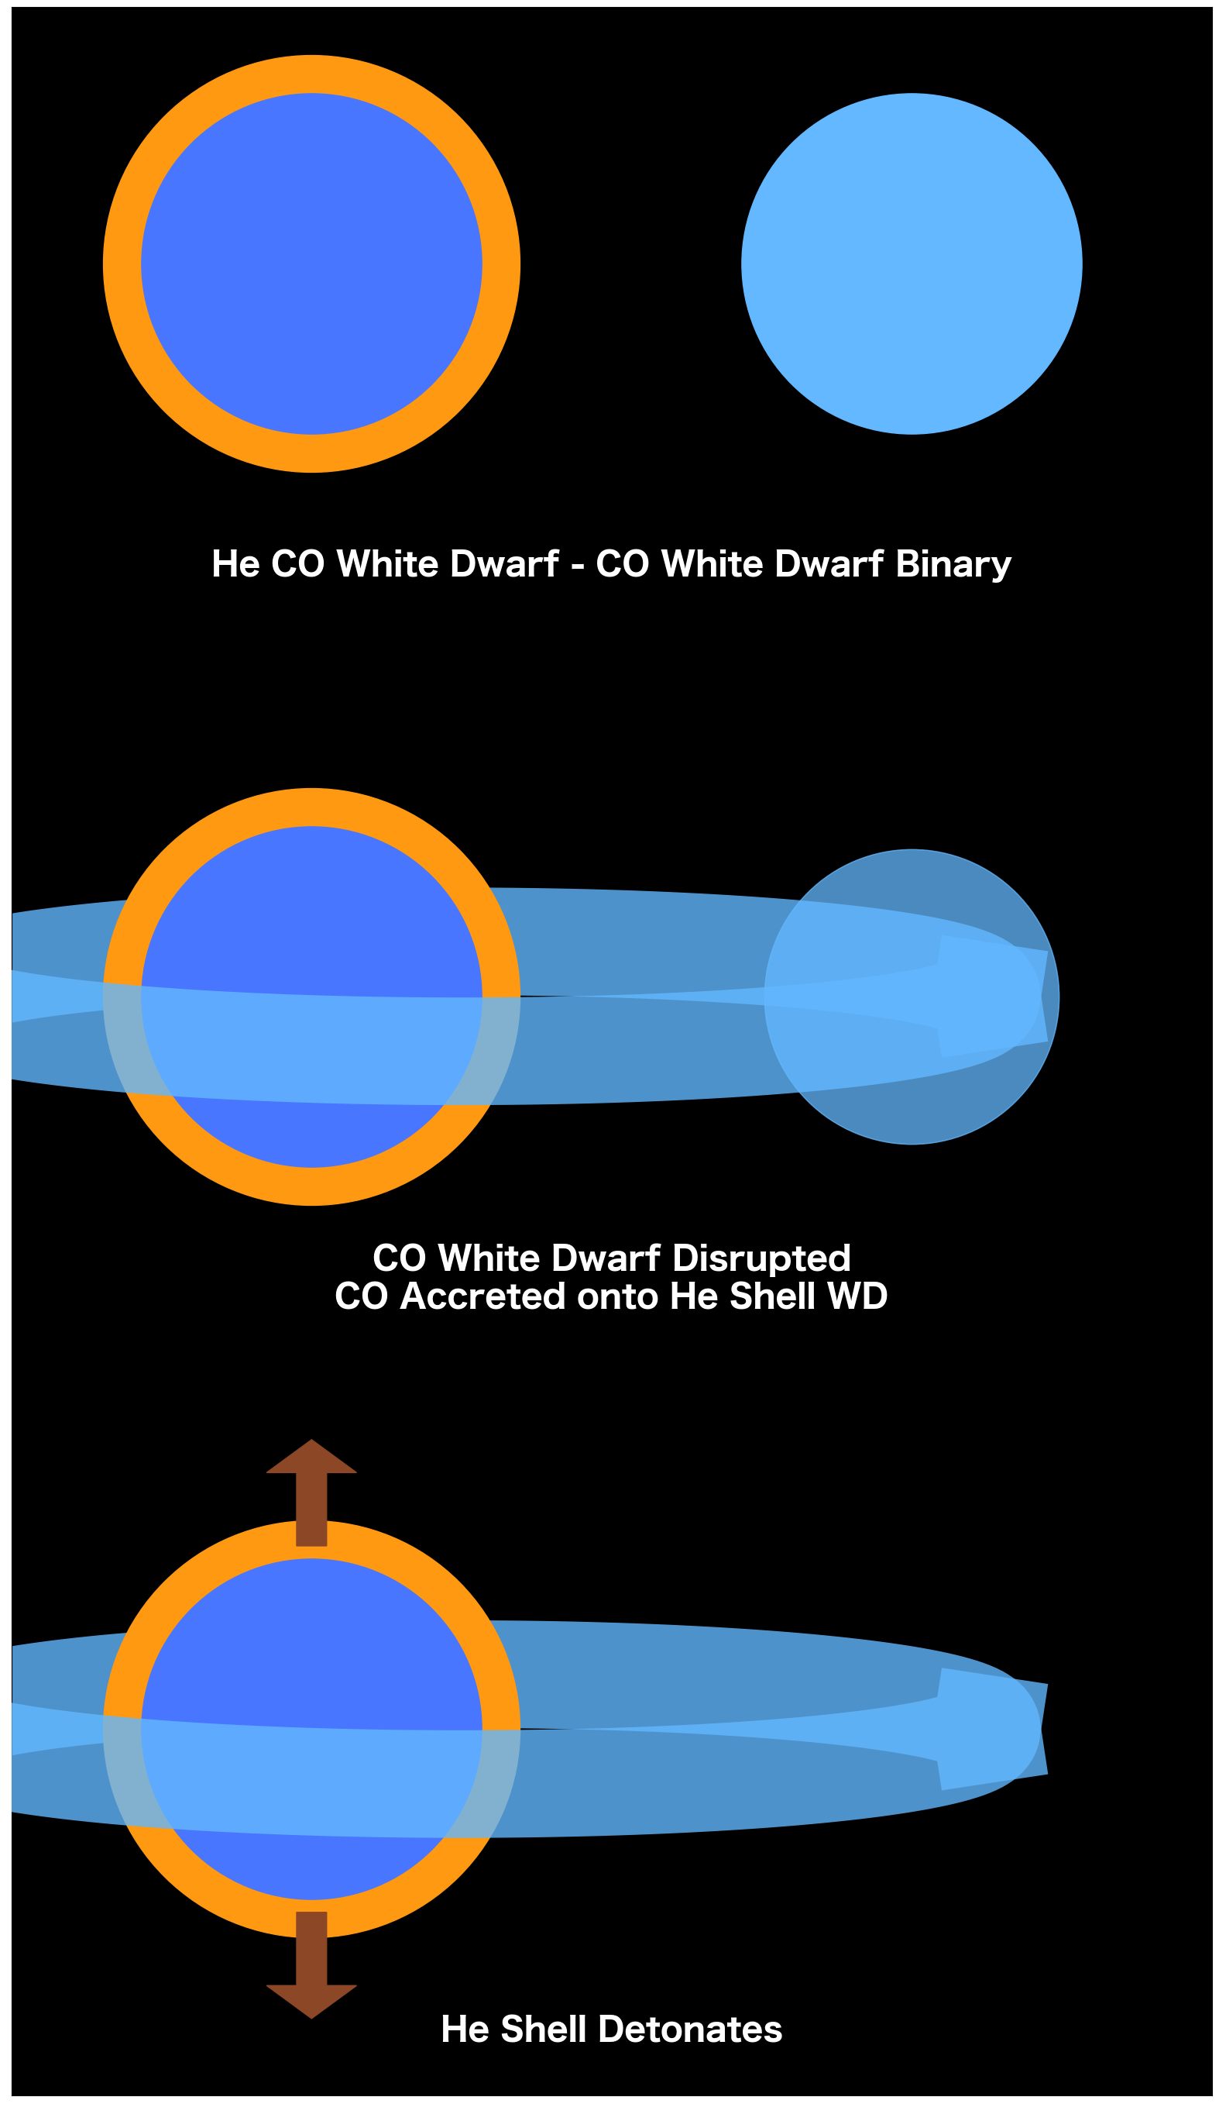
2022oqm Can Be Interpreted as a HeCO-CO WD Binary
CO White Dwarf Disrupted by HeCO Hybrid White Dwarf
Zenati et al 2023
Notes:
Mention what a HeCO hybrid is

Slide 17
2022oqm Can Be Interpreted as a HeCO-CO WD Binary
Asymmetric mass ratio
  q < 0.55
Notes:
Mention what a HeCO hybrid is

Slide 18
But This Space is Not Well Studied
2022oqm is still so bright!
Double Radioactive Decay is a toy model
Need detailed simulations to fully explore the phase space-especially for regions with more asymmetric WD mass ratios
Notes:
Mention what a HeCO hybrid is

Slide 19
Conclusions
Among the brightest CaRTs detected
  About as bright as usual SNe-Ic
  -> Misclassified Population?
Triple Peaked
  Mixing of Nickel
Double-peaked Iron group elements
Read the paper (will be out soon, email me)!
Thanks!!
Notes:
Mention what a HeCO hybrid is

Slide 20
Questions?
Thanks!

Slide 21
Backup Slides

Slide 22

So What Can Produce This Much Nickel?
Core Collapse of High Mass Stars
M > 8 $M_{\text{⊙}}$
Notes:
Make this about physical classiciation of SNE

Slide 23
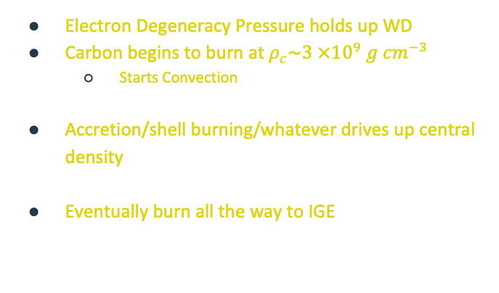
So What Can Produce This Much Nickel?
Thermonuclear Detonation of White Dwarfs
Electron Degeneracy Pressure holds up WD
Carbon begins to burn at $ρ_{c}\sim 3 ×{10}^{9} g {cm}^{−3}$
  Starts Convection
Accretion/shell burning/whatever drives up central density
Eventually burn all the way to IGE
Degenerate Carbon
Burning
Notes:
Make this about physical classiciation of SNE

Slide 24
Magnetar Model (This Doesn’t Work..)

Slide 25
EXtrabol

Slide 26
Three Peaks

Slide 27
Color Evolution Comparisons
r-i color shows more similarity to CaRTs, but also to SNe-Ibc
Notes:
This is a backup slide

Slide 28
Extended, Star-forming Host Galaxy
Initially classified as a Ic
Offset (19.9 kpc) from center of galaxy
Notes:
Talk about YSE, part of a larger collaboration

Slide 29
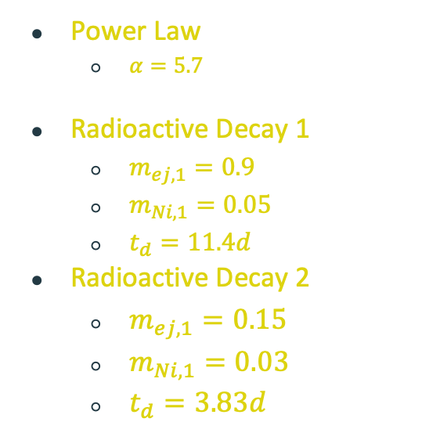
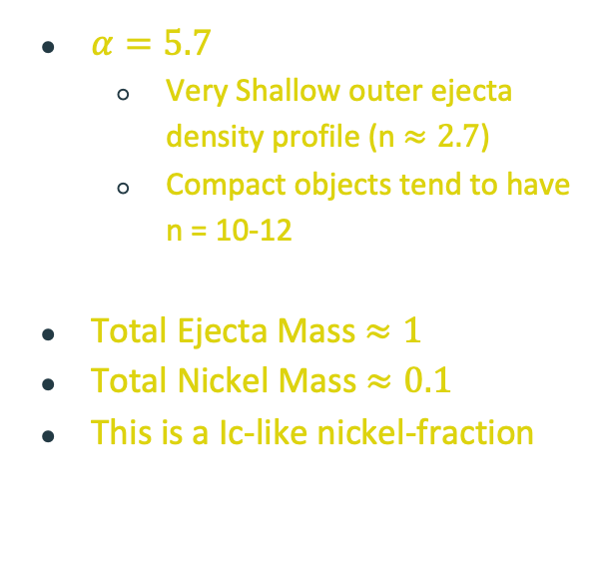
The Parameters Are (Somewhat) Reasonable
Power Law
  $α=5.7$
Radioactive Decay 1
  $m_{ej,1}=0.9$
  $m_{Ni,1}=0.05$
  $t_{d}=11.4d$
Radioactive Decay 2
  $m_{ej,1}=0.15$
  $m_{Ni,1}=0.03$
  $t_{d}=3.83d$
$α=5.7$
  Very Shallow outer ejecta density profile (n $≈2.7$)
  Compact objects tend to have n = 10-12
Total Ejecta Mass $≈1$
Total Nickel Mass $≈0.1$
This is a Ic-like nickel-fraction

Slide 30
The Modular Open Source Fitter for Transients
Guillochon et al, 2018
Notes:
Combine Blackbody SED and photometry into one box, and don’t go into too much detail

Slide 31
The ‘Default’ Arnett Model Already Exists in MOSFiT
Notes:
Combine Blackbody SED and photometry into one box, and don’t go into too much detail

Slide 32
The Light Curve Has 3 Peaks

Slide 33
Shock Emission with Radioactive Decay

Slide 34
Shock Emission with Radioactive Decay Model Schema

Slide 35
Shock Emission with Double Radioactive Decay
Finds peak 3
Finds diffusion time
Doesn’t distinguish peaks 2+3
Doesn’t fully capture shock emission

Slide 36
Double Radioactive Decay (A Toy Model)

Slide 37
Double Radioactive Decay Model Schema

Slide 38
Double Radioactive Decay (A Toy Model) Captures Peaks 2 and 3

Slide 39
Shock + Double Radioactive Decay

Slide 40
Shock + Double Radioactive Decay Model Schema
Notes:
Mention We tried a bunch of different shock emission models
Exponential
Power law-exponential
With diffusion too
For whatever reason, no diffusion works best
Implies there’s very little material beyond the csm to reprocess the photons emitted by the csm

Slide 41
So What Can Produce This Much Nickel?
Core Collapse of High Mass Stars
Hydrogen Envelope
Hydrogen, Helium Fusion
Helium Fusion
Carbon, Oxygen Fusion
Magnesium, Neon, Oxygen Fusion
Silicon, Sulfur Fusion
Iron Ash
Notes:
Make this about physical classiciation of SNE

Slide 42
Velocity Gradient
Notes:
Backup slide

Slide 45
Was it a normal SN-Ic (i.e. Core Collapse)?
Location in Host
  Too far
Fitting to Photometry
  Ejecta Mass too small
Spectra
  Density Profile Mismatch
Notes:
Too far offset in host galaxy
Ejecta mass is inconsistent
Doesn’t quite match to a Ic density profile

Slide 46
Was it a normal SN-Ic (i.e. Core Collapse)?
Location in Host
  Too far
Fitting to Photometry
  Ejecta Mass too small
Spectra
  Density Profile Mismatch
NO!!
Notes:
Too far offset in host galaxy
Ejecta mass is inconsistent
Doesn’t quite match to a Ic density profile

Slide 47
Shock + Double Radioactive Decay Model Schema
Guillochon et al, 2018
Notes:
Mention We tried a bunch of different shock emission models
Exponential
Power law-exponential
With diffusion too
For whatever reason, no diffusion works best
Implies there’s very little material beyond the csm to reprocess the photons emitted by the csm

Slide 48
Shock + Double Radioactive Decay

Slide 49
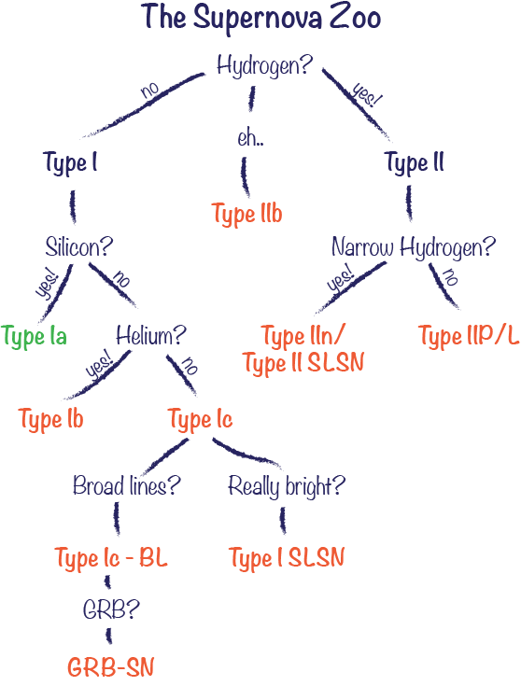
What Could The Progenitor Be?
Calcium-Rich Transient

Slide 50
Needed to Use a Novel Density Profile: Exponential

Slide 51
Was it a SN-Iax?
Velocity-somewhat consistent
Ejecta Mass too large
Notes:
Ejecta mass for Iax is 0.5 ish
Ours is larger

