Slide 1
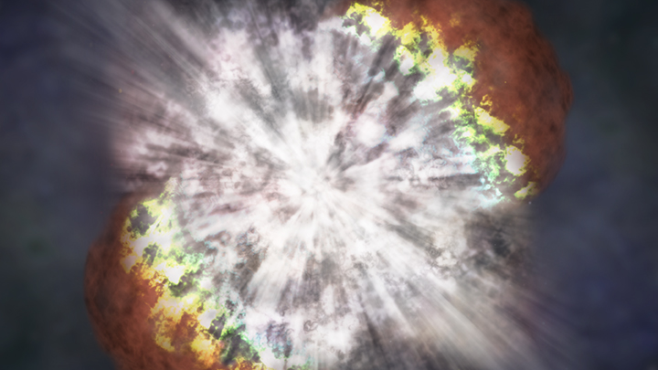
Shock Breakout in Dense Circumstellar Material
Annastasia Haynie
Advisor: Anthony Piro
University of Southern California and Carnegie Observatories
6/21/2023
Image: NASA

Slide 2
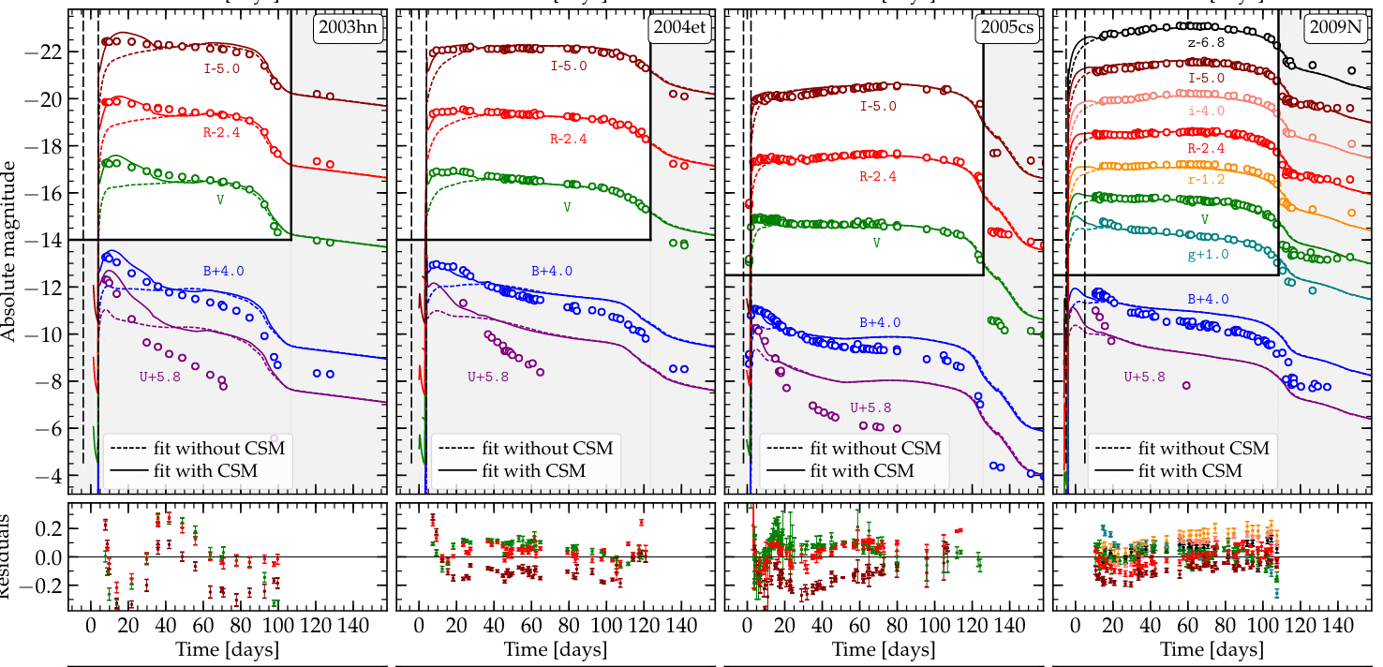
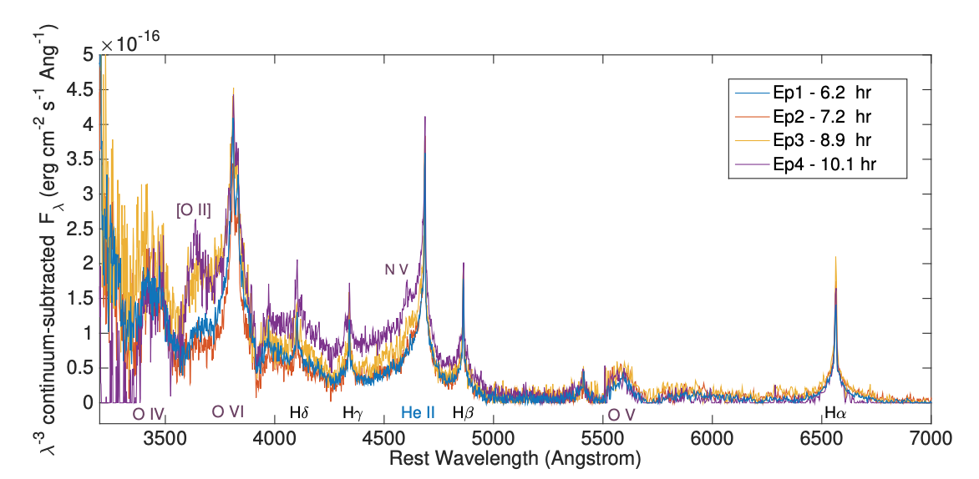
Massive Stars and Extended Material
Morozova + 2018
Yaron + 2017
+ Luc Dessart, Takashi Moriya, Sung-Chul Yoon, Jim Fuller, Ben Margalit, Keiichi Maeda, Nathan Smith, Roger Chevalier, Christopher Irwin, and many more
Notes:
It is becoming increasingly clear that we must include interaction with CSM to most core collapse supernova modeling to be able to explain the shock cooling emission over the first ~20-30 days of the light curve, which you can see here in this partial figure from Morozova 2018 where 4 CCSNe are fit to models with (solid line) and without csm (dashed line)
Because the shock cooling emission is proportional to the initial radius of the star, bare models are unable to recreate the early excess in the light curve
Similarly, we see evidence of CSM in early time spectra, such as this figure from Yaron 2017 which shows spectra from within 2 days of explosion in the ccsn iPTF13dqy – the strong oxygen lines early on are signatures of flash ionization from the sn shock interacting with a surrounding dense csm
The groups involved in these works, among many others in the field including but not limited to Luc Dessart, Takashi Moriya, Sung-Chul Yoon, Jim Fuller, Patrick Vallely, Ben Margalit, Keiichi Maeda, Nathan Smith, Roger Chevalier, Christopher Irwin, and more have dedicated significant work to understanding the impacts and origins of this circumstellar material and what it means for the final stages of massive star evolution.
I have been motivated by their work, as well as some exciting observations and upcoming high cadence surveys to explore other ways we may probe CSM around massive stars, specifically via observations of the shock breakout signal

Slide 3

Expected Properties of Shock Breakout
PS1-13arp
Gezari + 2015
See Waxman & Katz 2017 review and references therein:
Stellar Surface
$$τ_{sbo}≈\frac{c}{v_{s}}$$
$$t_{sbo}≈\frac{R_{∗}}{c}$$
$$T_{sbo}≈{10}^{5}K$$
Goldberg + 2022: 3D modeling pushes SBO to ~3-6hr timescale
Core
Shock
Notes:
As has been mentioned, shock breakout is the very initial flash of radiation in a supernova explosion because this is the moment where the shockwave from collapse reaches a sufficiently low optical depth such that radiation can diffuse out in front of the shockwave and break out of the star
As explored in the Shock Breakout Theory review paper by Waxman and Katz, this optical depth threshold for sbo defines where the diffusion time becomes shorter than the shock travel time, and happens at tau ~ c/v ~30
For a typical, bare red supergiant, the
radiation escapes roughly in the light crossing time of the star → short lived (~1hr)
Characteristic temp that peaks in UV
All of this makes it a really interesting signal to study because of how it is probing the very surface of the progenitor, but it’s both extremely short lived and peaks in the UV, making it dim for optical/ground-based surveys, so it’s very difficult to capture most of the time
However, this event Ps1-13arp (discovery paper Gezari et al 2015) shows a clear UV excess at early times
We can see the obvious UV flash, much brighter than the more optical bands, but doesn’t look like how we expect because it lasts too long, motivated to find out what could be causing this? Recent work from Jared Goldberg shows that explosion asymmetry can extend the shock breakout signal by a few hours, however, the signal in this case is on the order of a day,

Slide 4

Framework
A steady state wind (Chevalier & Irwin 2011)
  $R_{w}$
  $ρ_{w}=\frac{D}{r^{2}}=\frac{\dot{M}}{4πv_{w}r^{2}}$
Considerations
  Compactness
  Timescale
Notes:
We begin by adopting the steady-state wind framework provided in C&I 2011, which parameterizes the CSM by it’s radius of extent, and mass loading factor, D, which encompasses the information of the density structure, giving it a nice 1/r2 profile.
In this framework, there are two main considerations we need to think about, the first being the size or compactness of the wind. This is determined by the diffusion radius defined by Chevalier and Irwin, as the radius where shock breakout would happen if the wind was infinitely large. For winds that are larger than this radius, we call those extended and sbo occurs near the diffusion radius
For winds that are smaller than Rd, we call those compact and sbo is going to occur very near the surface of the wind, so we generally approximate the radius of sbo as the wind radius – for the kinds of winds/events I’m discussing here, we’re always in the compact regime

Slide 5
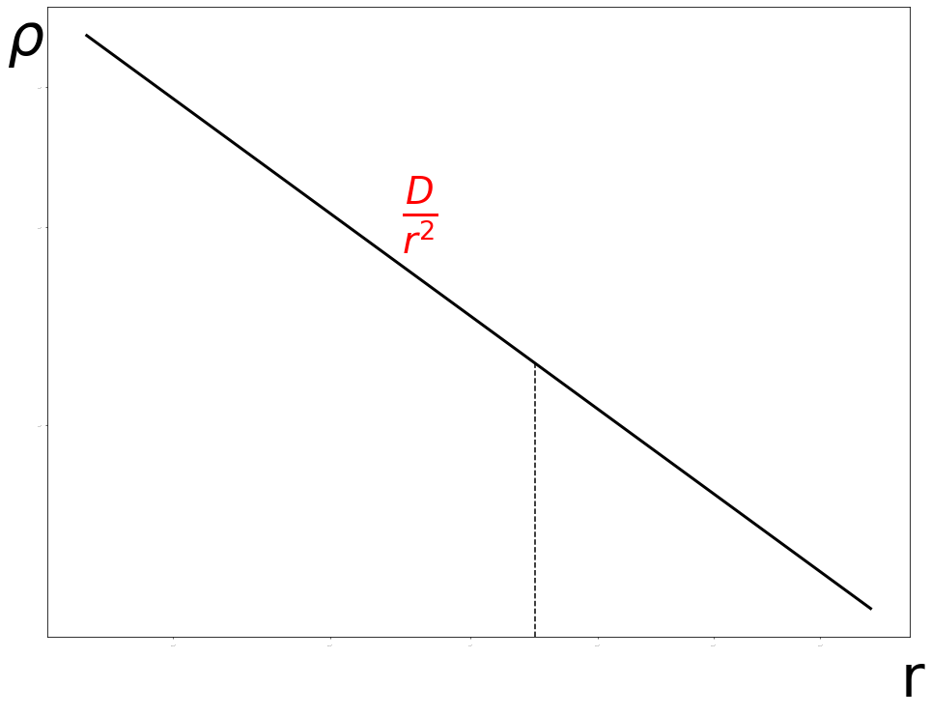
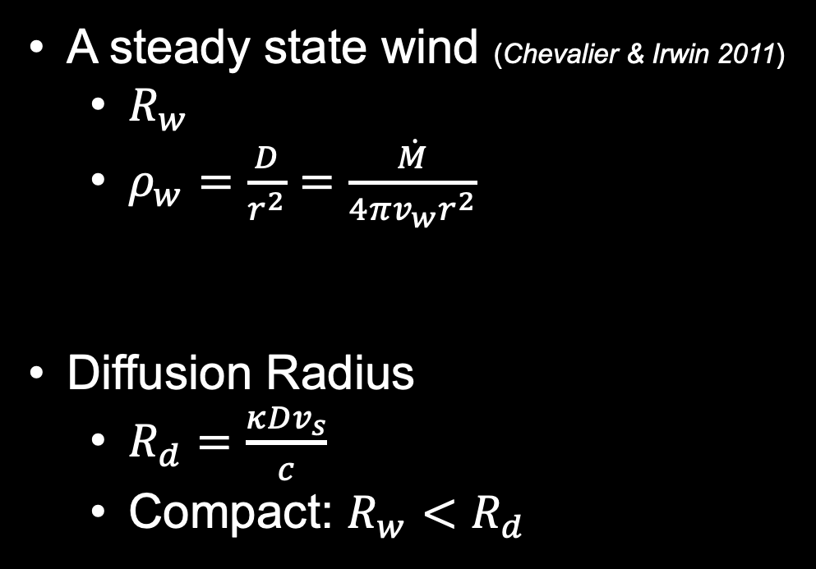

Framework: Compactness
A steady state wind (Chevalier & Irwin 2011)
  $R_{w}$
  $ρ_{w}=\frac{D}{r^{2}}=\frac{\dot{M}}{4πv_{w}r^{2}}$
Diffusion Radius
  $R_{d}=\frac{κDv_{s}}{c}$
  Compact: $R_{w}<R_{d}$
Compact
Extended
$$R_{d}$$
Notes:
We begin by adopting the steady-state wind framework provided in C&I 2011, which parameterizes the CSM by it’s radius of extent, and mass loading factor, D, which encompasses the information of the density structure, giving it a nice 1/r2 profile.
In this framework, there are two main considerations we need to think about, the first being the size or compactness of the wind. This is determined by the diffusion radius defined by Chevalier and Irwin, as the radius where shock breakout would happen if the wind was infinitely large. For winds that are larger than this radius, we call those extended and sbo occurs near the diffusion radius
For winds that are smaller than Rd, we call those compact and sbo is going to occur very near the surface of the wind, so we generally approximate the radius of sbo as the wind radius – for the kinds of winds/events I’m discussing here, we’re always in the compact regime

Slide 6
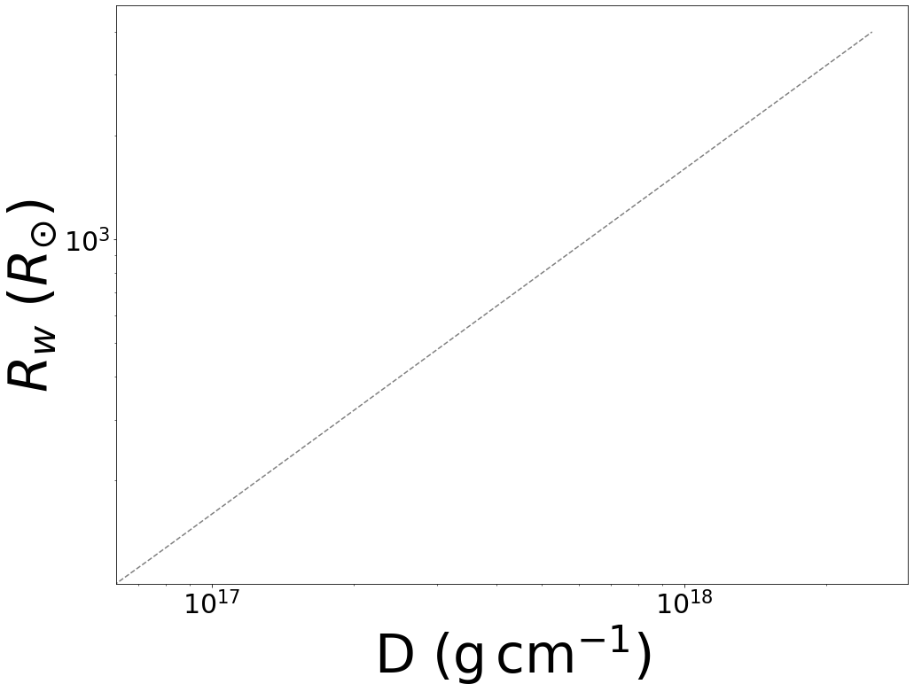

Framework: Timescale
Diffusion vs. Light Travel
Light Travel Dominance:
  $t_{lt}≈\frac{R_{sbo}}{c}$
  $R_{w}<κD{\left(\frac{v_{s}}{c}\right)}^{2}$
Diffusion
Light Travel
Notes:
The second consideration we need to explore is the timescale for the photons to reach the observer and whether that is dominated by the diffusion time or the light travel time, because this will set scaling for the rise time for the light curve.
In the case of light travel dominance (longer of the two processes) the rise time is set by the light travel time which is roughly the the sbo radius/c
For the compact case, this is roughly the wind radius over c, and compared to the diffusion time for the compact case, which we’ll get to shortly, this requires the radius of the star to be smaller than ( ), which divides our parameter space like this.
For the numerical studies that I’ve worked on, I worked mainly in the diffusion dominant regime, but as we’ll see later on, it’s likely important to continue expanding well into the light travel dominant regime

Slide 7
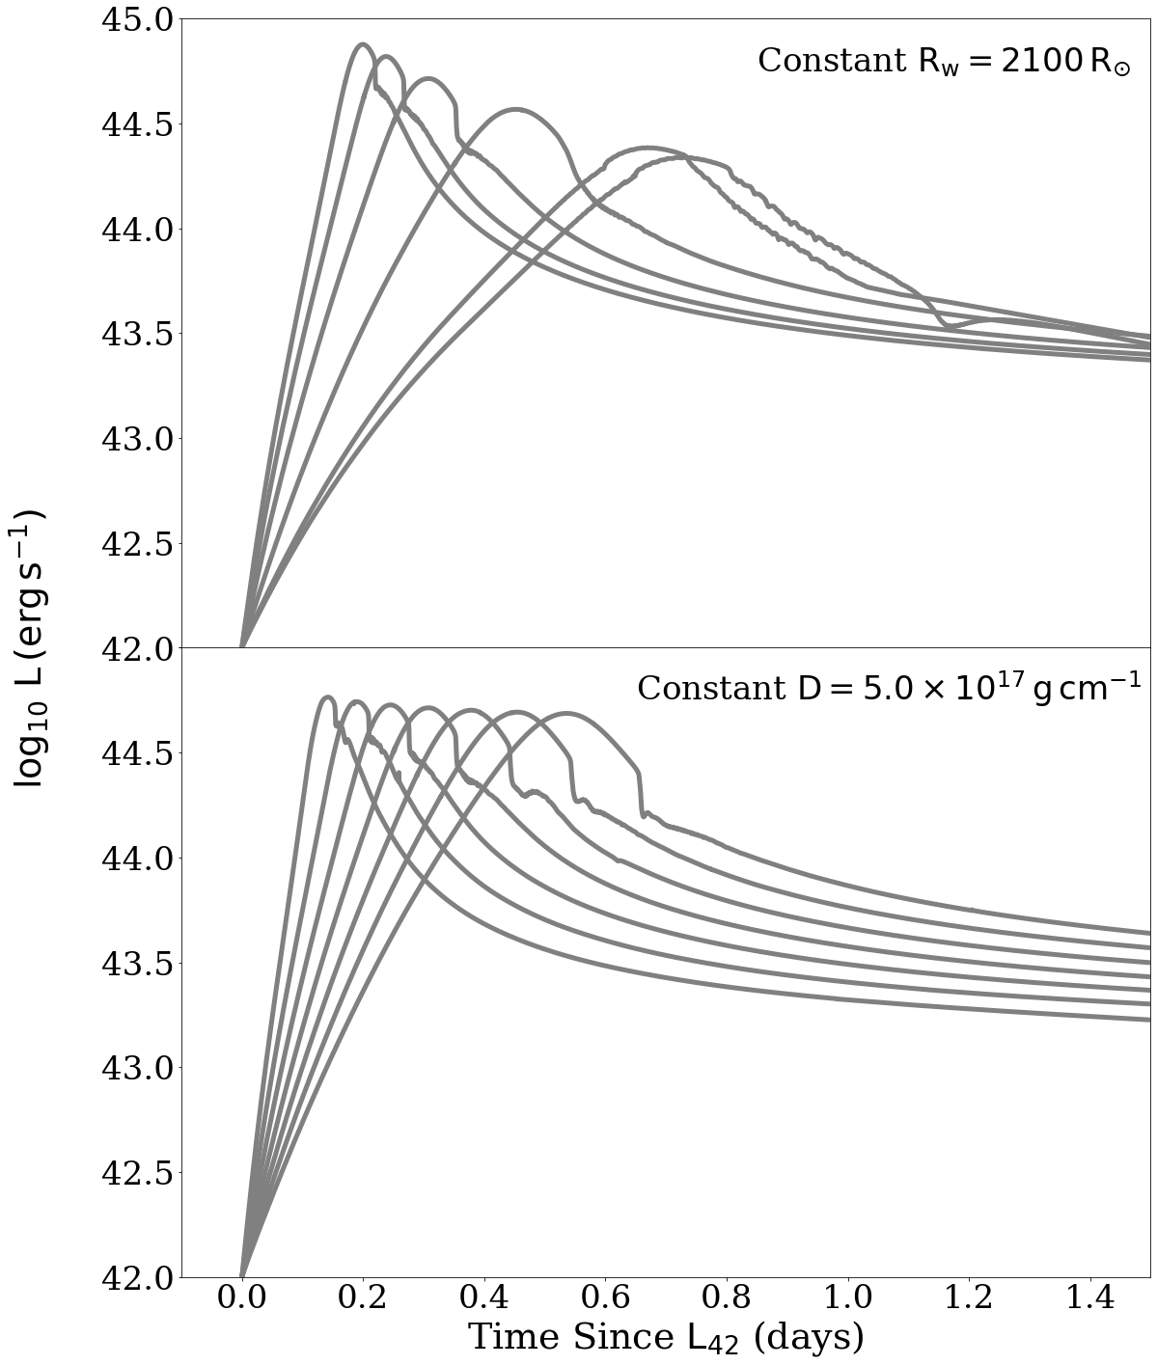

Impact of CSM
D
Haynie & Piro 2021
$$t_{rise}≈\frac{R_{w}^{2}c}{κDv_{s}^{2}}$$
$$L_{sbo}≈4πDv_{s}^{3}$$
Numerical modeling with SNEC (Morozova + 2015)
R
Haynie & Piro 2021
Notes:
Applying the conditions of sbo to our compact, diffusion dominated model we find that the rise time should go as
Meaning that for progenitors with a larger radius they will rise more slowly and with larger D or larger opacity, meaning more material to diffuse through is present, they will rise more quickly,
I like this result because it’s slightly counterintuitive that a dense wind will have a shorter rise time, but in reality this is because the sbo optical depth threshold is not met until much closer to the edge of the wind so there is only a very short distance to cross to get all the way out of the csm
We also see that luminosity does not have any strong dependence on the radius, only on D, while the velocity of the shock may depend weakly on the radius
We tested these analytic scalings against more detailed numerical models done in the 1D hydrorad code SNEC and find very nice agreement with our analytic arguments. The top panel here shows a subset of the LCs in our grid with the same initial radius and D increases to the left. We see these models get brighter and rise more quickly as D increases as we expect. Similarly the bottom panel shows a subset of LCs with a constant D and R increases towards the right. The models chance only very minorly in peak luminosity while the rise time increases as the radius increases.

Slide 8

Fitting PS1-13arp
$$R_{w}≈1900R_{⨀}$$
$$D≈{10}^{17}g {cm}^{−1}$$
$$M_{w}≈0.08M_{⨀}$$
Haynie & Piro 2021
Haynie & Piro 2021
Notes:
Now that we’re happy with the results of our numerical models, we can try to fit the PS1-13arp data and try to understand why kind of CSM is necessary to reproduce this early, extended UV flash
Properties of best fit model : Rw = 1900Rsun, D = 1.0e17 g/cm giving us a total wind mass of ~0.08Msun
Finding a well fitting csm model for this data is really exciting because of the implications it has for further characterizing and understanding CSM in the future and it’s good to understand how this model fits into our larger grid as well as other events observed

Slide 9
Numerical Grid compared to SCE events
Large amount of parameter space to explore
Some degeneracy along lines of equal CSM mass
Haynie & Piro 2021
Notes:
Here is how our best fit model, indicated by the star compares to the suite of numerical models we tested, all of which are in the compact regime and all but one fall into the diffusion dominant regime and the color of each circle represent the goodness of fit to the 13arp data
We see an interesting degeneracy along lines of equal mass showing that the light curve is sensitive to the overall mass of the wind, which has also been seen in other work
And speaking of other work, how unique is the wind on 13arp anyway? While it’s unusual to observe the sbo signal, we know that csm has been inferred in other works using SCE data, some of which is shown here

Slide 10
Numerical Grid compared to SCE events
Large amount of parameter space to explore
Some degeneracy along lines of equal CSM mass
CSM inferred from SCE tends to be more dense and more confined
Haynie & Piro 2021
Notes:
Black crosses represent the CSM parameters inferred for SNe~II fit in Morozova 2018 – they aren’t so different than the 13arp wind that they can’t live on the same parameter space plot, but seem to at least be a little different
Many of the events in morozova 2018 have smaller R and larger D, both of which, if we remember the scaling from a few slides ago, would cause an even shorter sbo rise time meaning that even with csm distorting the sbo signal, they are still probably pretty fast and hard to see. Are these totally different types of events? Probably not, but tell us that the mass loss history between this population and 13arp is sort of different, where the Morozova events probably got more violent closer to CC than 13arp did or had higher mass loss rates creating denser winds.
As new high cadence surveys come online and we start to observe this early sbo signal more and more often, it will be great to have this sort of apparatus ready to apply to the data and continue fleshing out our understanding on csm and how it tells us about the very final stages of stellar evolution

Slide 11
CSM in 2023ixf
Quick rise and bright peak make this event a great candidate for CSM interaction
Seems to lay outside of the parameter space I have already explored and more modeling is necessary to understand its CSM
PRELIMINARY
Notes:
Other events I’ve begun exploring to understand their CSM properties include 2018fif which was primarily studied through SCE and inferred to be a typical RSG with a small amount of CSM necessary to explain the UV excess at early The broader properties of this CSM, however, are not well explored and I hope to find a nice fit to the SWIFT data shown here.
Similarly, I’ve looked into SN PTF 09uj, which has CSM properties explored in the extended wind regime, while I suspect a more accurate analysis may utilize the compact wind regime.
This is now a general call for SBO+CSM events, if there is something that you’re excited about and would like me to take a whack at modeling it, please please let me know!

Slide 12
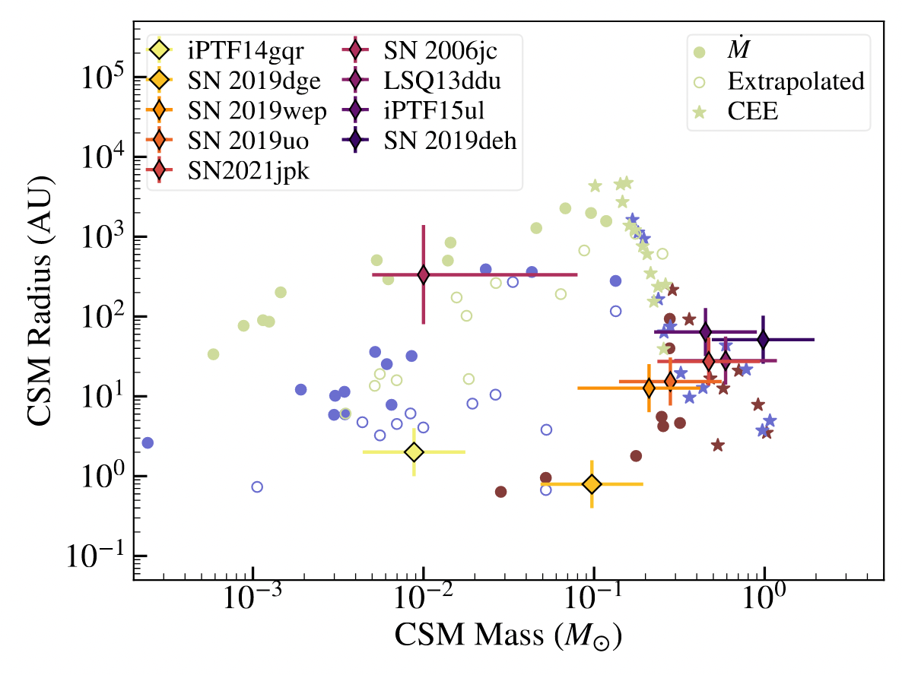
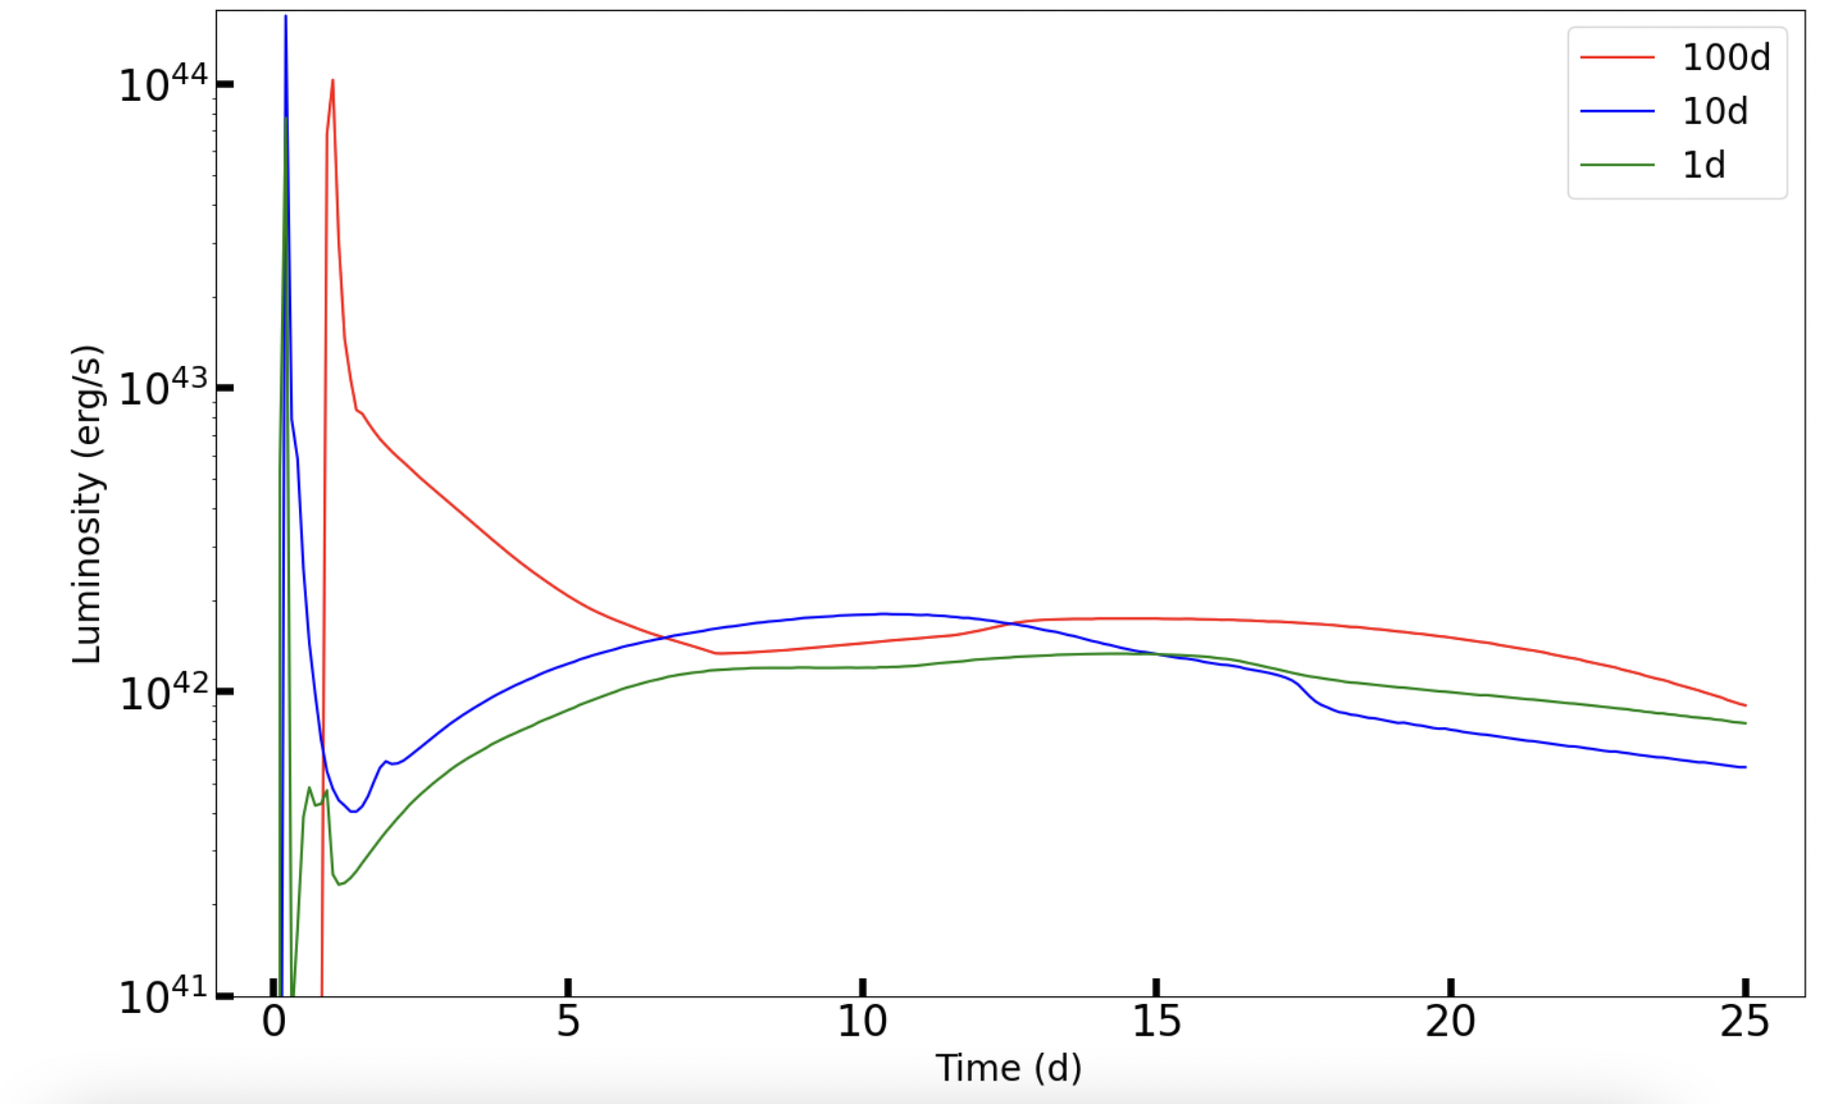
SESN and CSM
Wu and Fuller 2022
PRELIMINARY
Notes:
In the time since this paper was published in 2021, I have also become interested in stripped envelope supernovae, and you can look for a paper from me on the progenitors of these events soon, but I am delighted to be working with Samantha Wu and Jim Fuller on the marriage of these two projects by exploring the overall light curve properties of SESN interacting with dense CSM, utilizing the models from their 2022 paper exploring extreme mass loss during binary evolution.
This project is very much still in the exploratory phases and I’m excited to see where it takes us as we continue to understand the origin and impacts of CSM
Again here is an open call for any other CSM events/impacts that you’re thinking about! Please let me know!

Slide 13
Summary and Future Work
Observations of the shock breakout luminosity and rise time can constrain properties of the circumstellar material (Haynie & Piro 2021, ApJ, 910, 128)
There is still a large parameter space to explore, especially with respect to stars stripped via binary interaction
More detailed treatment of thermalization, wind density profiles, and modeling in the extended wind and light-travel dominant regimes are necessary to better characterize SBO observables

Slide 14

A Caveat on Thermalization
We consider our models to be roughly thermalized at the SBO depth on the condition that: (Rybicki & Lightman 1986, Hansen & Kawaler 1994, Waxman & Katz 2017)
$τ_{eff}≈κ_{eff} ρ \left(R_{w}−R_{SBO}\right)≈0.24 D_{17}^{1/{16}}v_{9}^{{−37}/{16}}R_{14}^{−1/8}≥1$
Region above SBO depth is not necessarily thermalized, therefore (see Sapir & Waxman 2017) ${ T}_{therm}≈1.2{ T}_{BB}$
Could result in an up to ~10% decrease in estimate of $R_{w}$
Notes:
Since the observed UV and optical photometric bands are on the Rayleigh-Jeans side of the spectrum, we expect a scaling of Lν ∝ R 2 wν 2T, which would result in an up to ∼ 10% decrease in the measured R

Slide 15
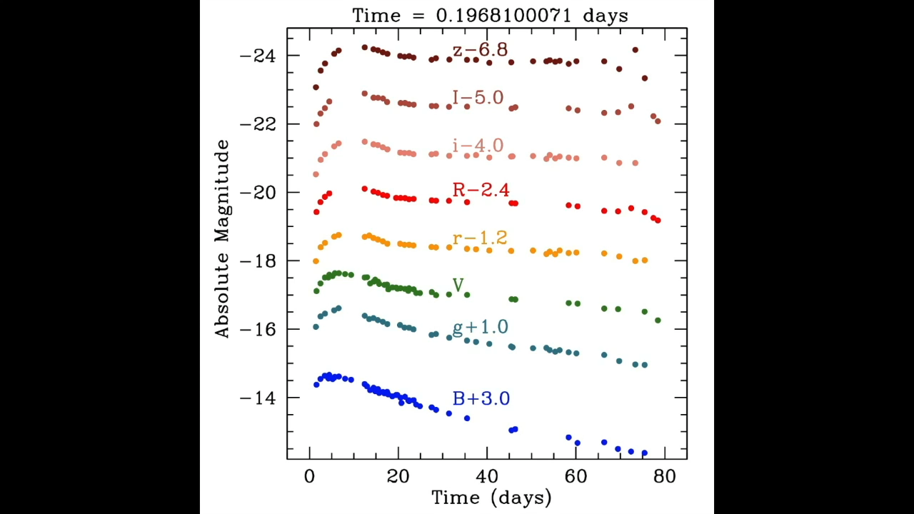
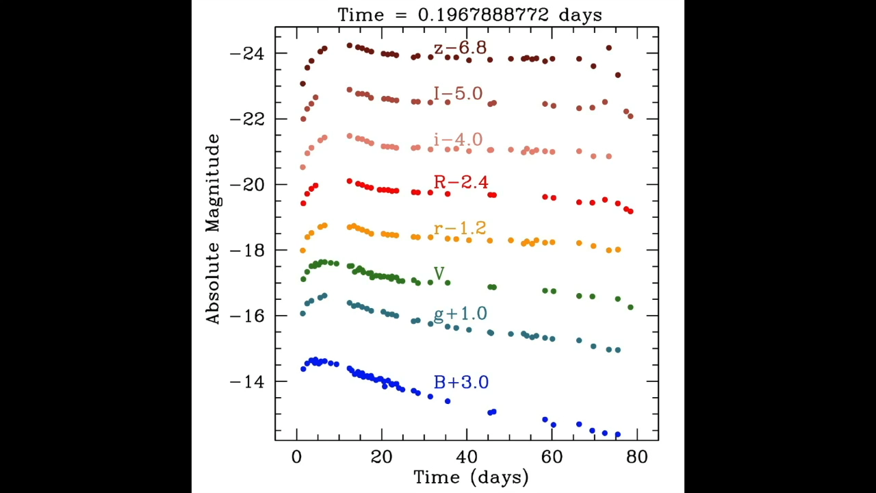
RSG vs RSG+CSM
SN 2013fs
Courtesy of Anthony Piro
With CSM
Without CSM
Notes:
Where diffusion time ~ adiabatic cooling time

Slide 16

Derivation of SBO threshold
$$t_{d}<t_{s}$$
$$t_{d}=\frac{τl}{c} t_{s}=\frac{l}{v_{s}}$$
$$τ<\frac{c}{v_{s}}≈30$$

Slide 17


Extended Wind and Light Travel Regimes
$$R_{w}<κD{\left(\frac{v_{s}}{c}\right)}^{2}$$
$$t_{rise}≈\frac{R_{w}}{c}$$
$$L_{sbo}≈\frac{4πv_{s}c^{2}R_{w}}{κ}$$
$$R_{w}>\frac{κDv_{s}}{c}$$
$$t_{rise}≈\frac{κD}{c}$$
$$L_{sbo}≈4πDv_{s}^{3}$$

Slide 18
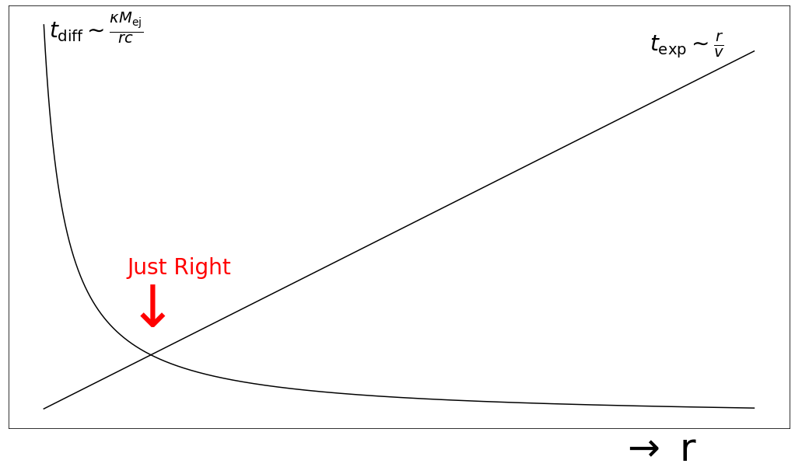
Derivation of Rise Time
Notes:
Where diffusion time ~ adiabatic cooling time

Slide 19

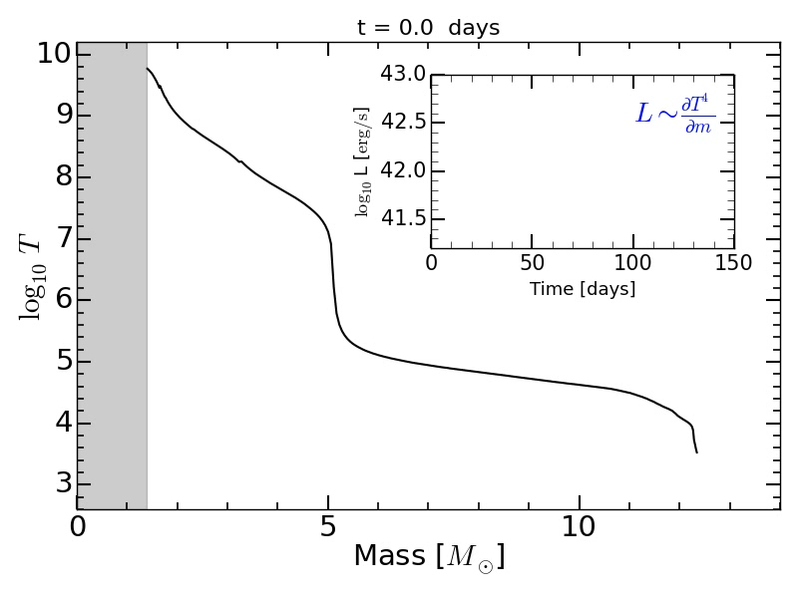
Supernova Explosion Code
stellarcollapse.org/SNEC.html
Open-source 1-D hydrodynamic radiative transfer code
Developers:
  Viktoriya Morozova
  Anthony Piro
Notes:
Motivated to study this phenomena, we prepared to do numerical modeling with SNEC- the open source code developed by () and it is a one dimensional code that solves hydrodynamic and radiative transport equations to model stars through shock breakout out and beyond and produce light curves
I feed snec hydrodynamic and compositional profiles of stellar models and then set off the explosion as you can see in the video here we insert a certain amount of heat and see the shock pass through the mass of the star and then the photosphere start being deeper and deeper in so we are observing deeper in and that’s the luminosity that we’re seeing above
I’m happy to explain this more if there are questions, but otherwise I will save time and move on!

