Slide 1
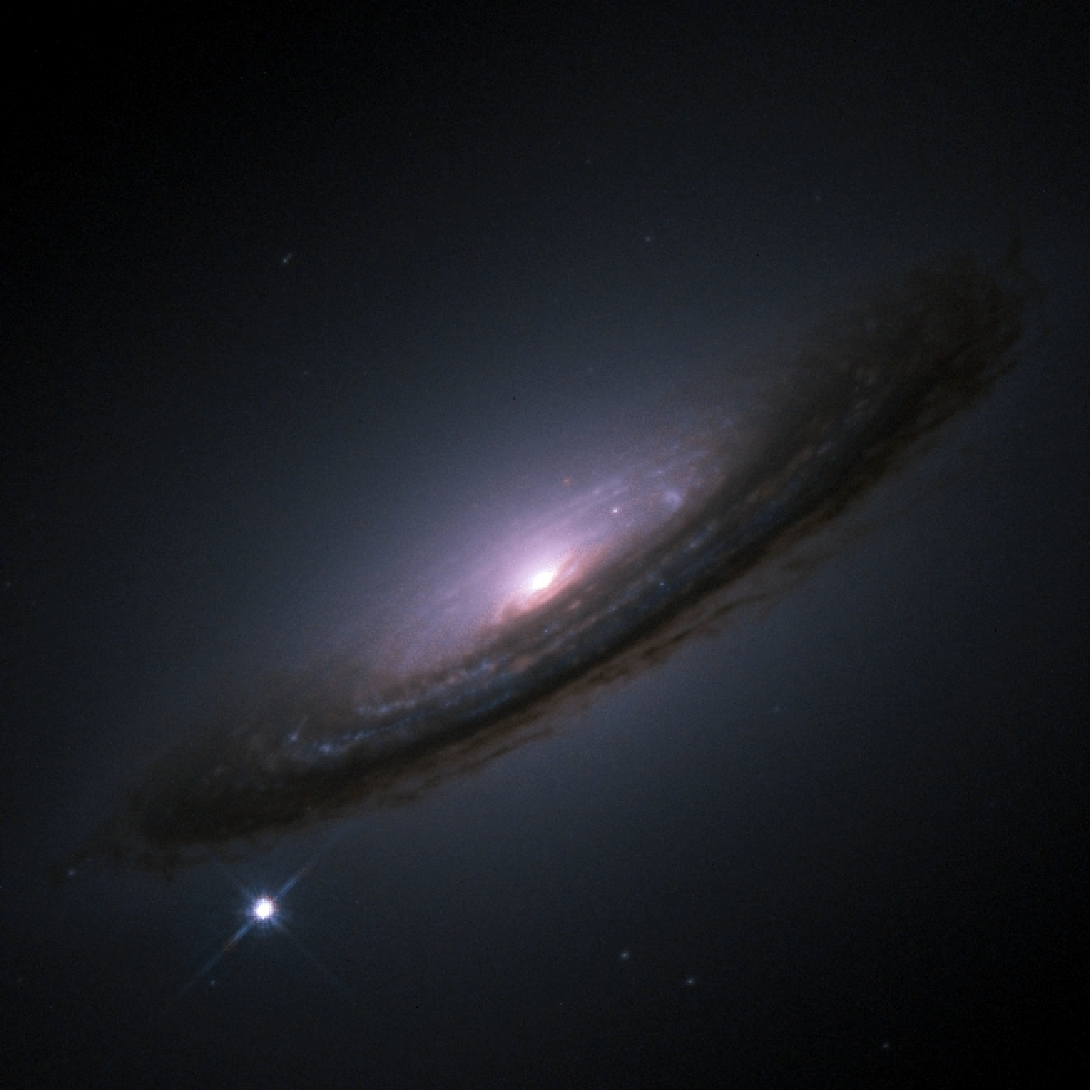
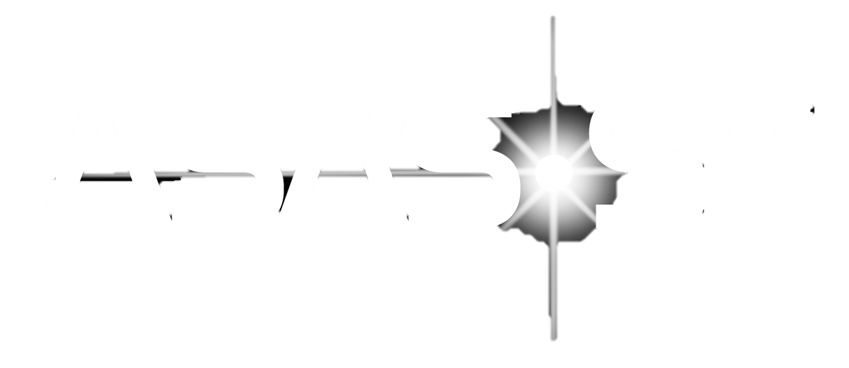


The Local Type Ia SNe Rate and Luminosity Function in .
Dhvanil Desai,
Chris Kochanek, Ben Shappee, et al.
The Transient and Variable Universe
June 22, 2023 – Urbana, Illinois

Slide 2
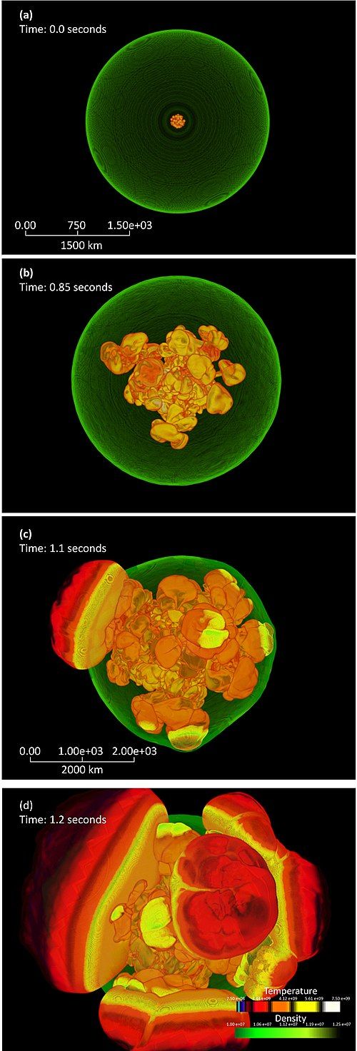
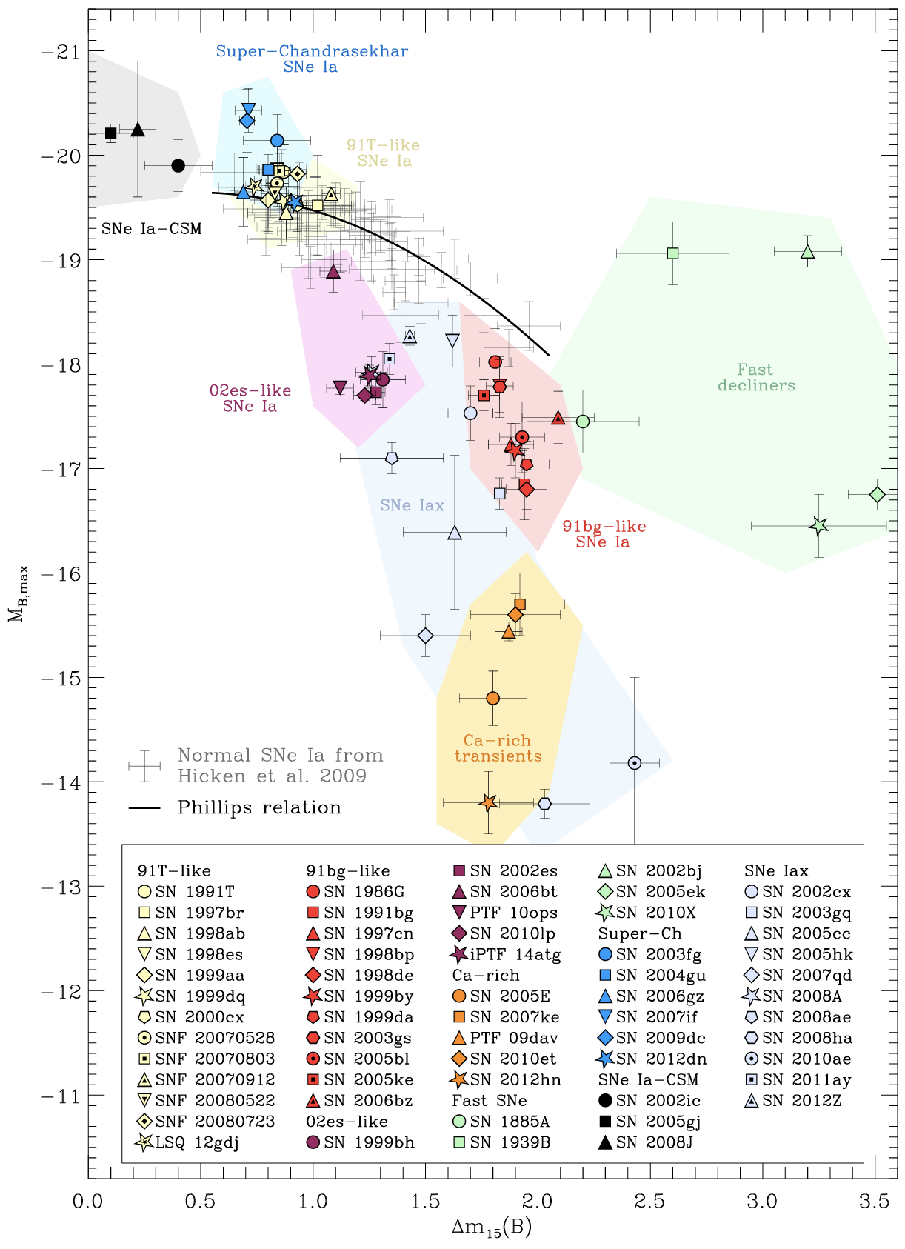
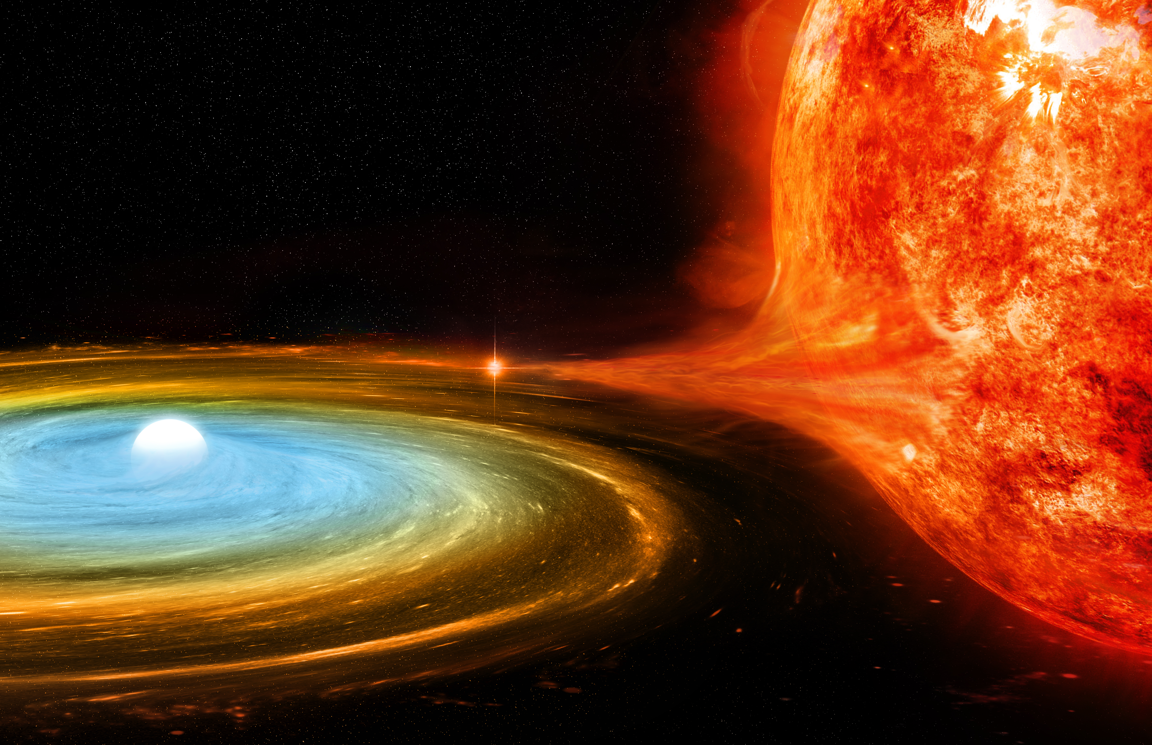
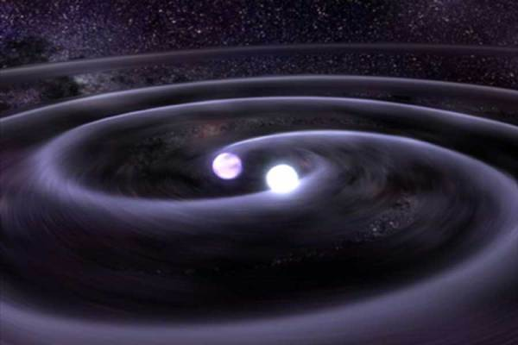
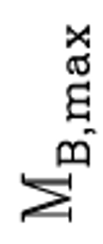
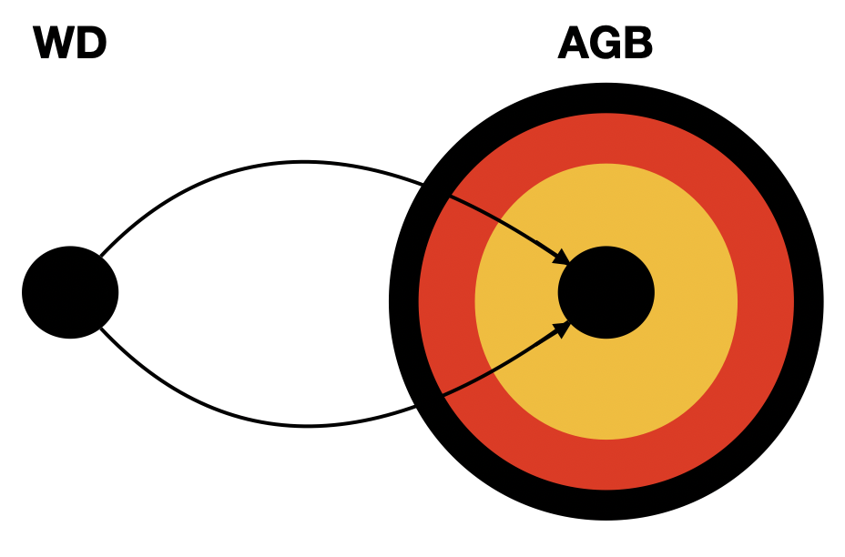
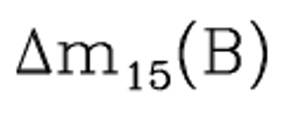
Taubenberger (2017)
Non-deg.
companion
WD
WD
WD
and more…
Notes:
Diversity in Type Ia Sne. Different explosion mechanisms and progenitor scenarios invoked. Zeroth order thing: how many are there, get rates!
Mark Phillips in 1993 showed a relationship between the absolute magnitude and the width of the light curves for Type Ia SNe. The more luminous Sne tend to have broader light curves and vice versa. This allowed Type Ia Sne to be standardizable as distance calibrators and extremely useful in cosmological studies. Since then, there have been many new discoveries and this plot has drastically expanded into…
Something like this! This plot shows the same axes but now including all the subtypes and extreme cases of thermonuclear explosions that have been observed so far. We see the fainter subclass of 91-bg like Sne, the more luminous 91T-like Sne that follow the Phillips relations but are spectroscopically distinct, the most luminous subclass of Ia-CSM SNe being characteristically luminous due to their interaction with the circumstellar medium. In any case, it is likely that these different subtypes of Type Ia Sne originate from different progenitor systems and explosion mechanisms.
The two most common progenitor scenarios are the Single Degenerate and the Double Degenerate. In the SD scenario, the WD accretes mass from a non-degenerate companion and explodes after reaching critical mass. The delay times of this progenitor system span a wide range of possibilities from short to long delay times after a burst of star formation. On the other hand, the DD scenario involves binary WDs and the delay times for this are much longer, on order of Gyrs. Therefore, to probe the delay times and to shed light on the physical origins of Type Ia Sne and the extreme cases, understanding the intrinsic rates of their occurrence is crucial!
With the utility of Sne Ia in galactic chemical evolution studies, cosmological studies, and SN progenitor studies, it is crucial to measure their rates and do so precisely.

Slide 3






Local SNe Ia Rates
Cappellaro+ 1999
Li+ 2011
Frohmaier+ 2019
Perley+ 2020
Desai+ 2023
Dilday+ 2010
Notes:
Since 1930s, rate efforts ongoing. Cappellaro and evans visual search, galaxy targeted, SDSS larger sample out to a higher redshift, LOSS galaxy targeted, PTF not targeted, good handling of systematics, ZTF first estimate of rate using their sample, completeness corrections can be improved. Now what we do!

Slide 4

Ingredients for a Rate
Observed SNe
Completeness
Corrections
Volumetric Rate
Notes:
How do we cook up rates? lLooks simple, but the middle one is the hardest. I’ll go through each of these one by one. Point out the highlight scheme at the bottom of the page in next few slides.

Slide 5
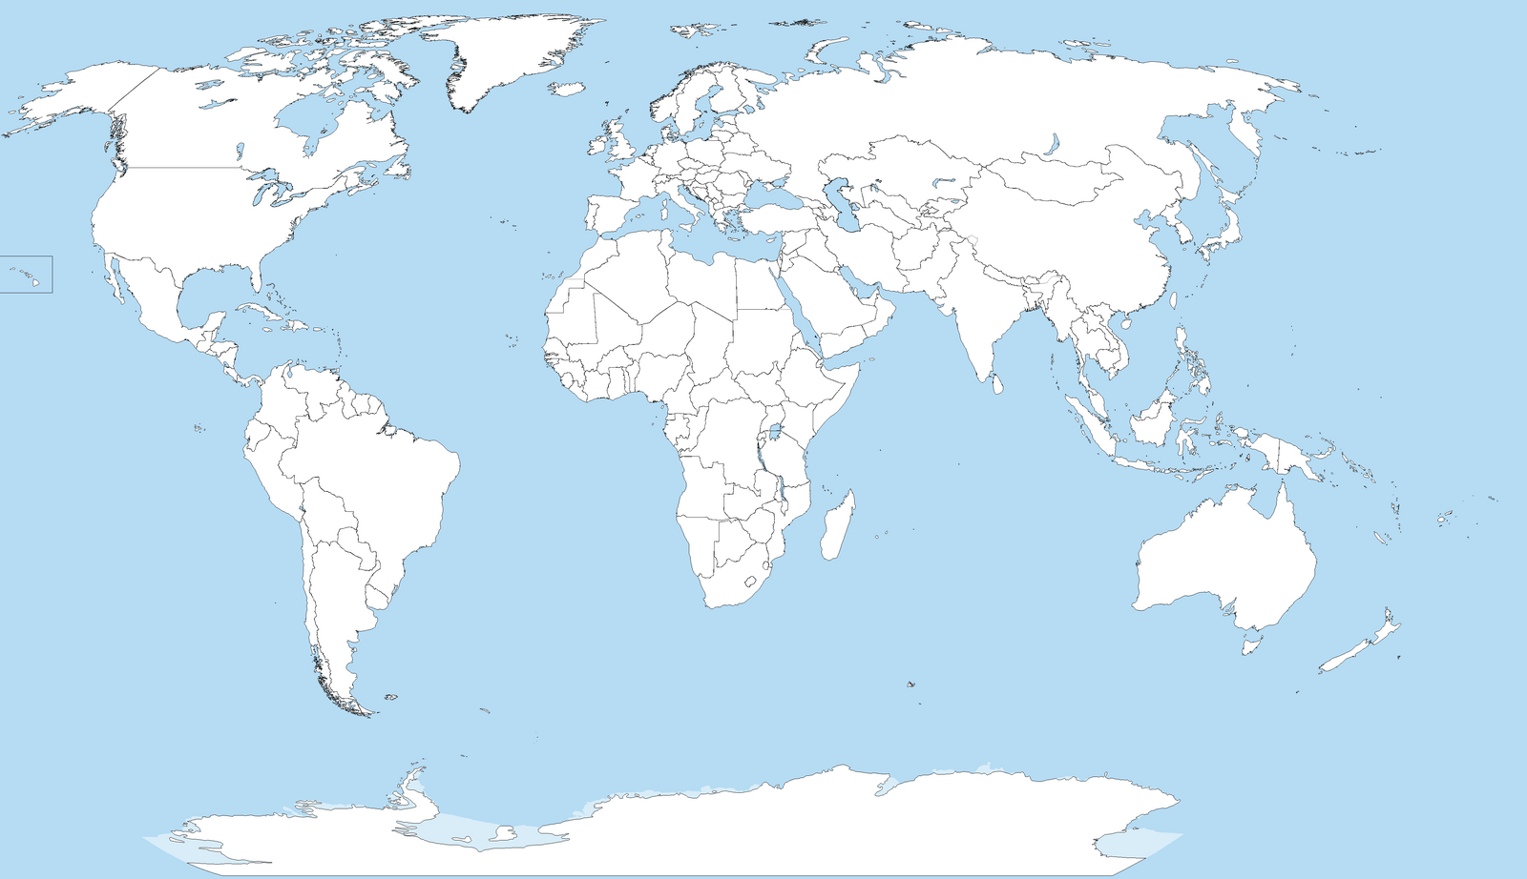

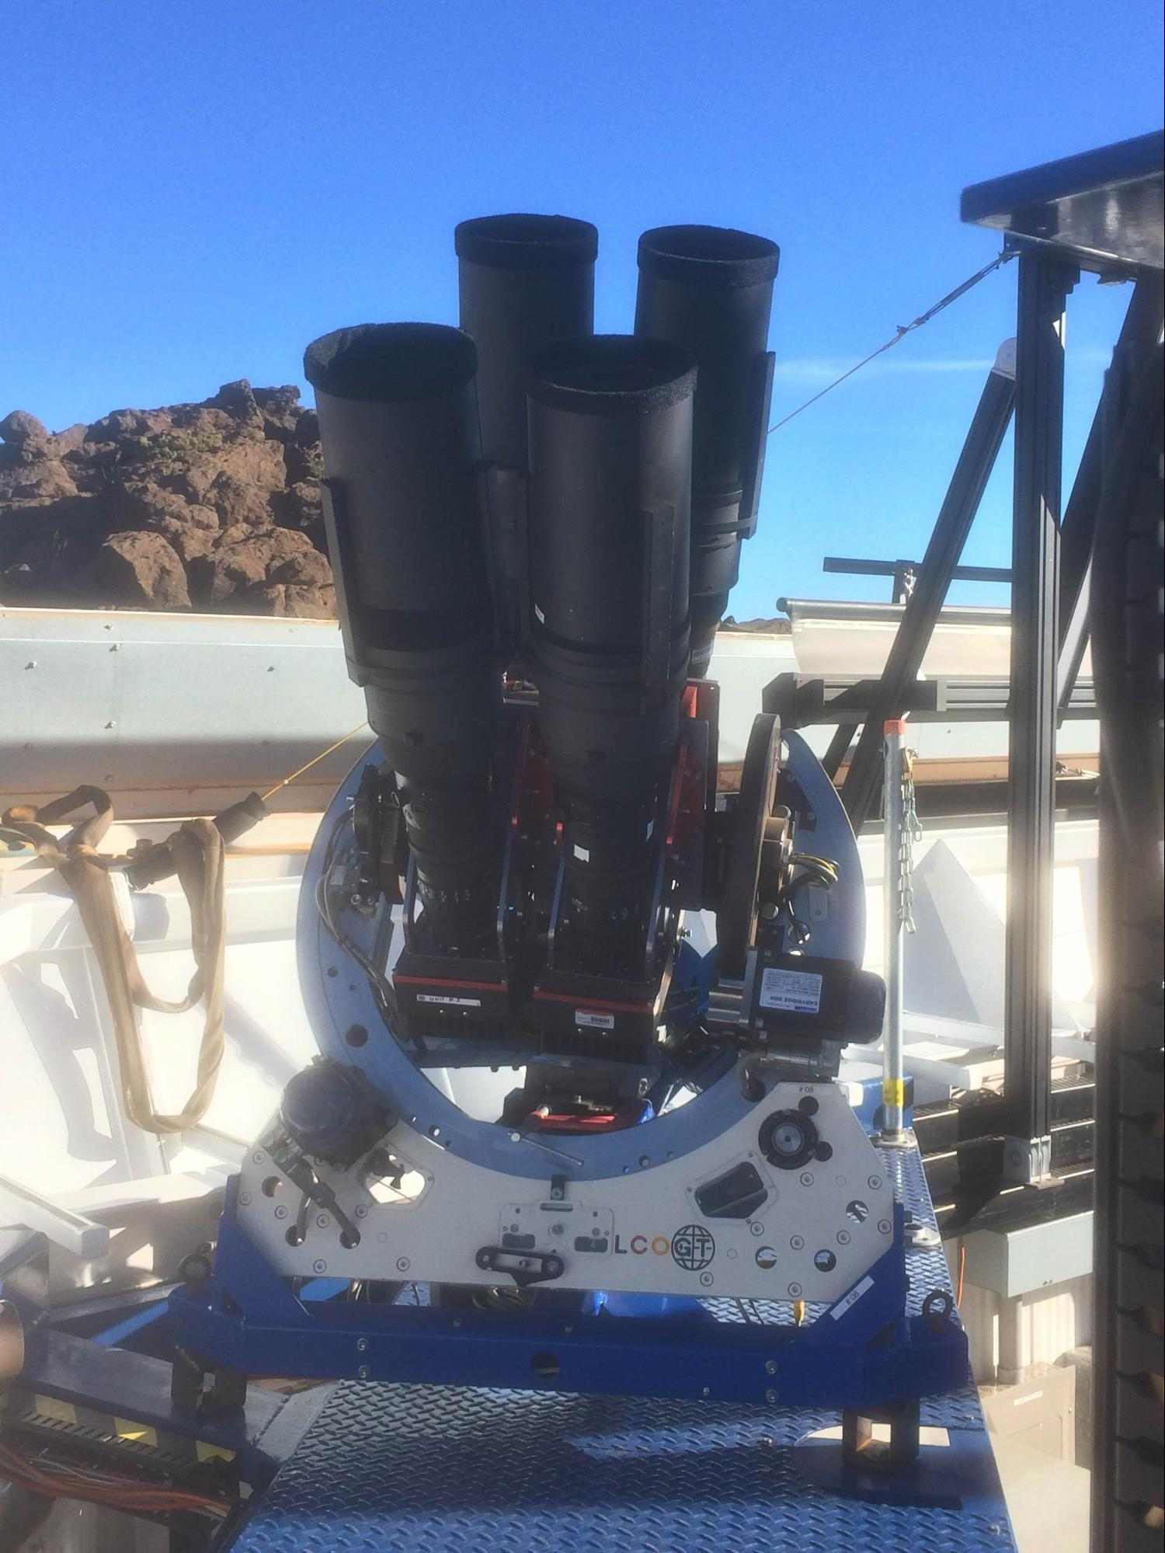





2013-2017
2017 +
V-band $<17$mag
g-band $<18$mag
Notes:
What is ASASSN? Many of you have probably used asassn light curves. But fundamental goal was to get systematic rates and after a decade we have finally obtain the rates carefully.

Slide 6
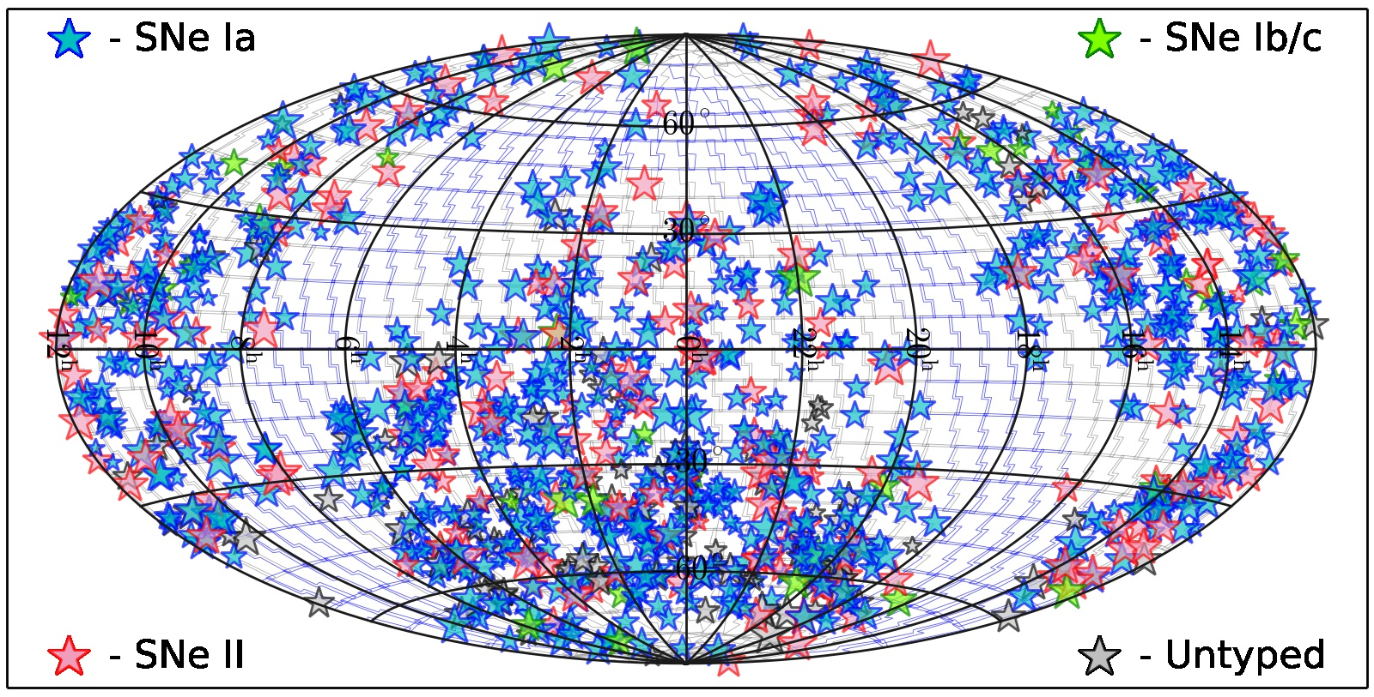
Notes:
Distribution of Sne on sky, most are Ias, so let’s get rates for them first.

Slide 7
All-sky
Nearly spectroscopically complete
Large sample
Notes:
Why its good for rates (all-sky, high spectroscopic completeness 97% gives reliable classifications, large time-baseline 4yr so large sample)

Slide 8
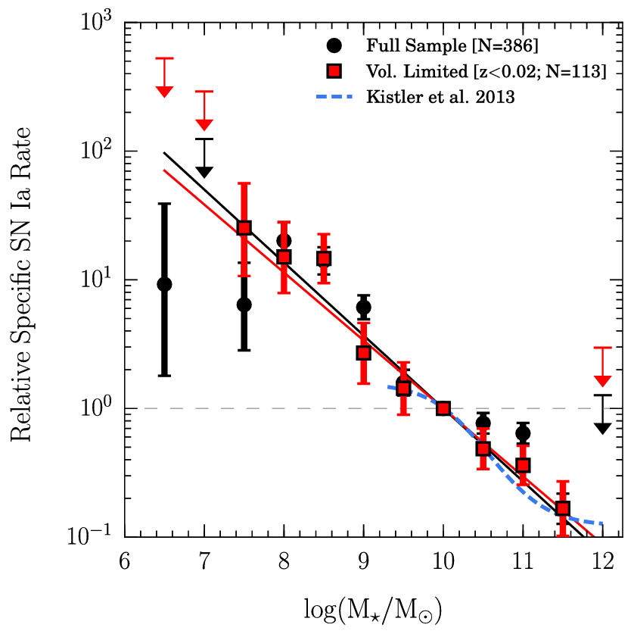
Rate rises towards
lower masses
Brown et al. (2019)
Notes:
The first statistical study of rates from ASAS-SN was done by Brown et al. in 2019. They computed the relative specific rate of Type Ia Sne as a function of host galaxy stellar mass. Expanding on previous studies, they showed that the relative specific rate keeps rising for even lower mass galaxies down to stellar mass of 10^7 Msun. This has been done, but It’s all relative, my work is getting the y-axis. The next step is to get the volumetric rate.

Slide 9
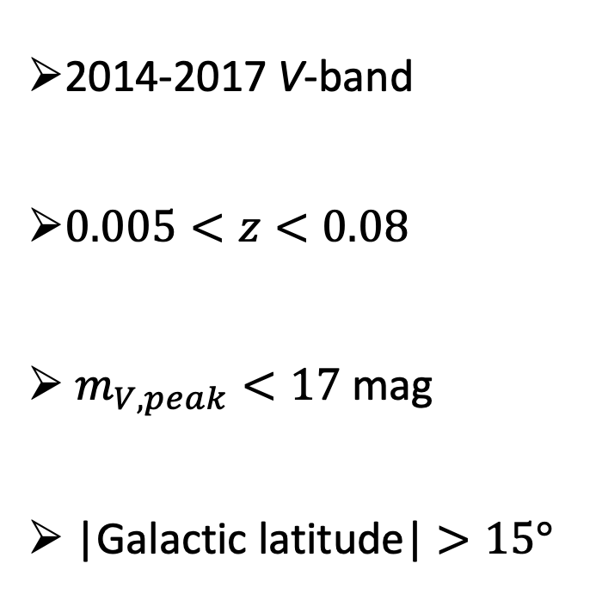
ASAS-SN Sample of SNe Ia
2014-2017 V-band
$0.005<z<0.08$
$m_{V,peak}<17$ mag
|Galactic latitude| $>15°$
Notes:
We consider Sne that were discovered by ASASSN or independently recovered in ASASSN. And after making some quality cuts, we end up with about 400 Sne Ia in our final sample. Most at low-z and faint.
Move on to the next ingredient.

Slide 10
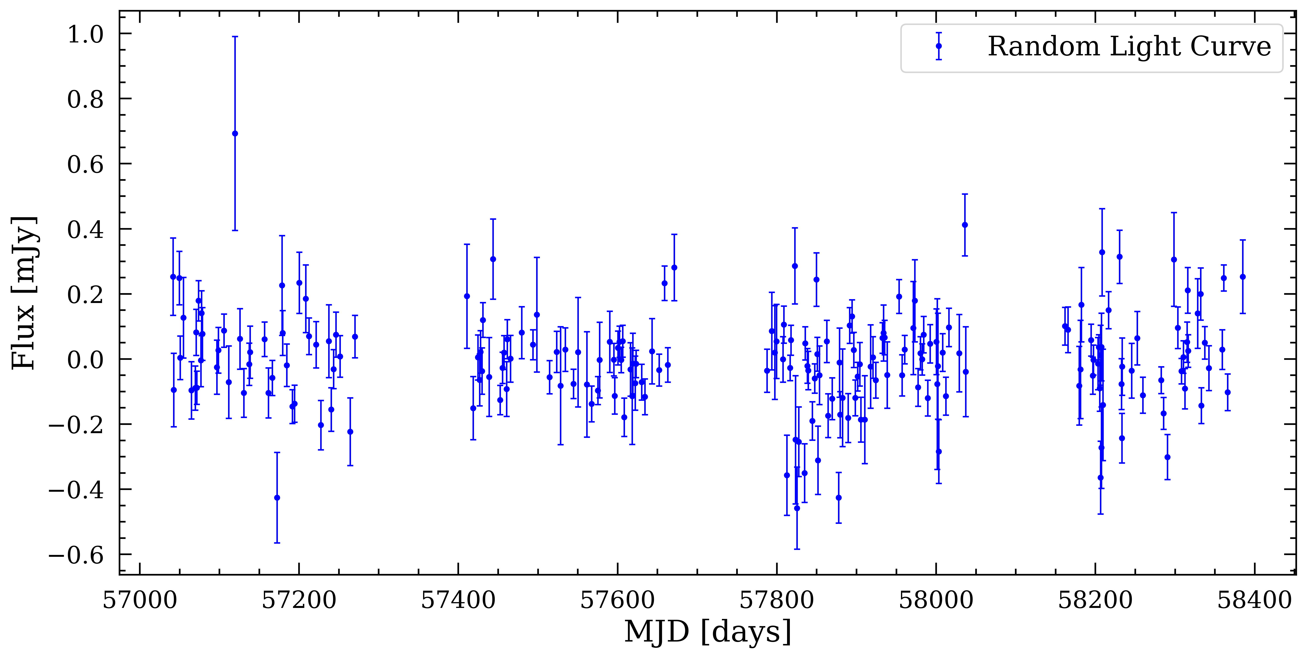
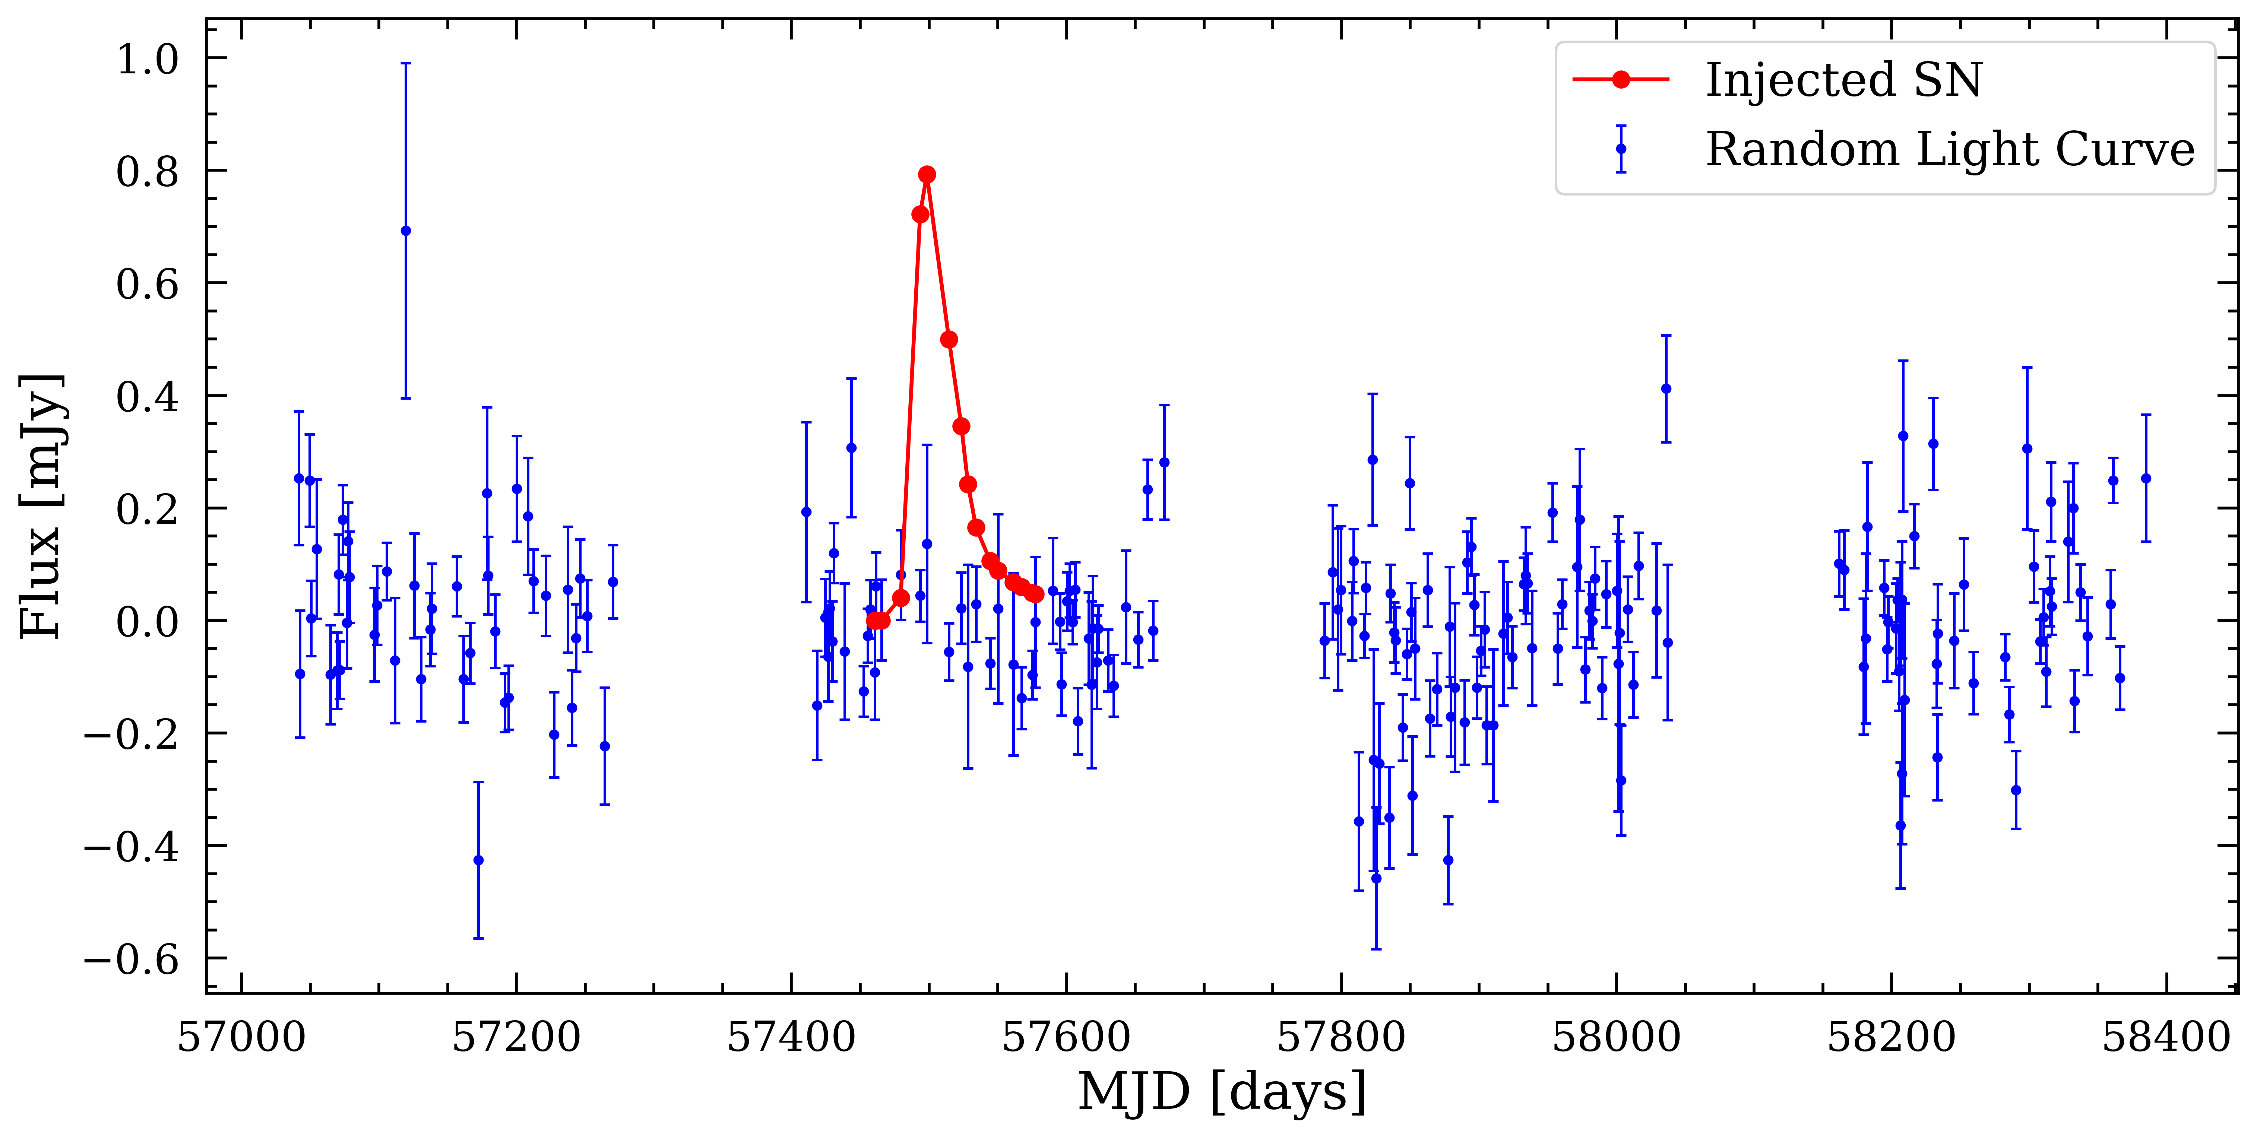
Detected ?
Notes:
Take a random light curve -- imagine there was a SN somewhere -- would we be able to detect it? -- Explain Injection recovery
After getting a clean sample, the next step is to estimate the completeness of the survey. We do this by implementing Injection recovery of Sne Ia on ASASSN light curves. We select random coordinates on sky, get the asassn light curves, and inject fake Sne at a random time with a random redshift and peak magnitude and ask if it would be detected given the signal to noise of the light curve and the gaps in the data.

Slide 11
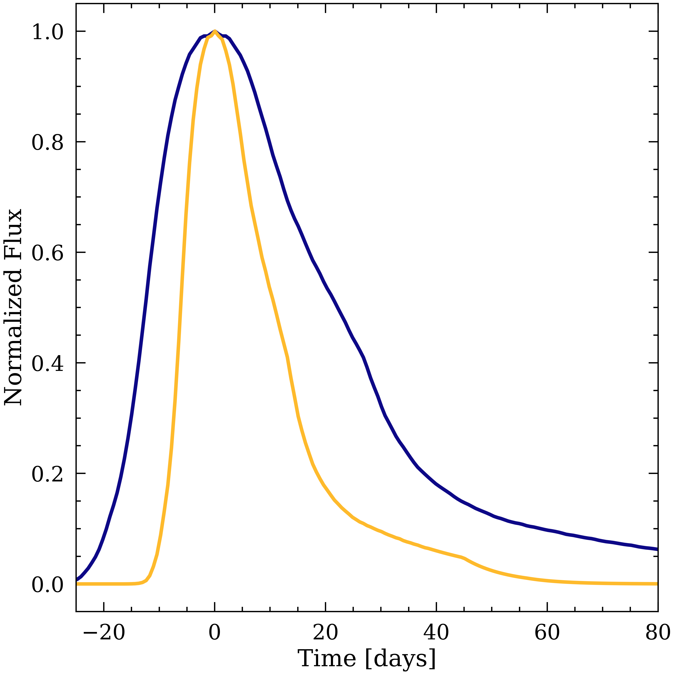
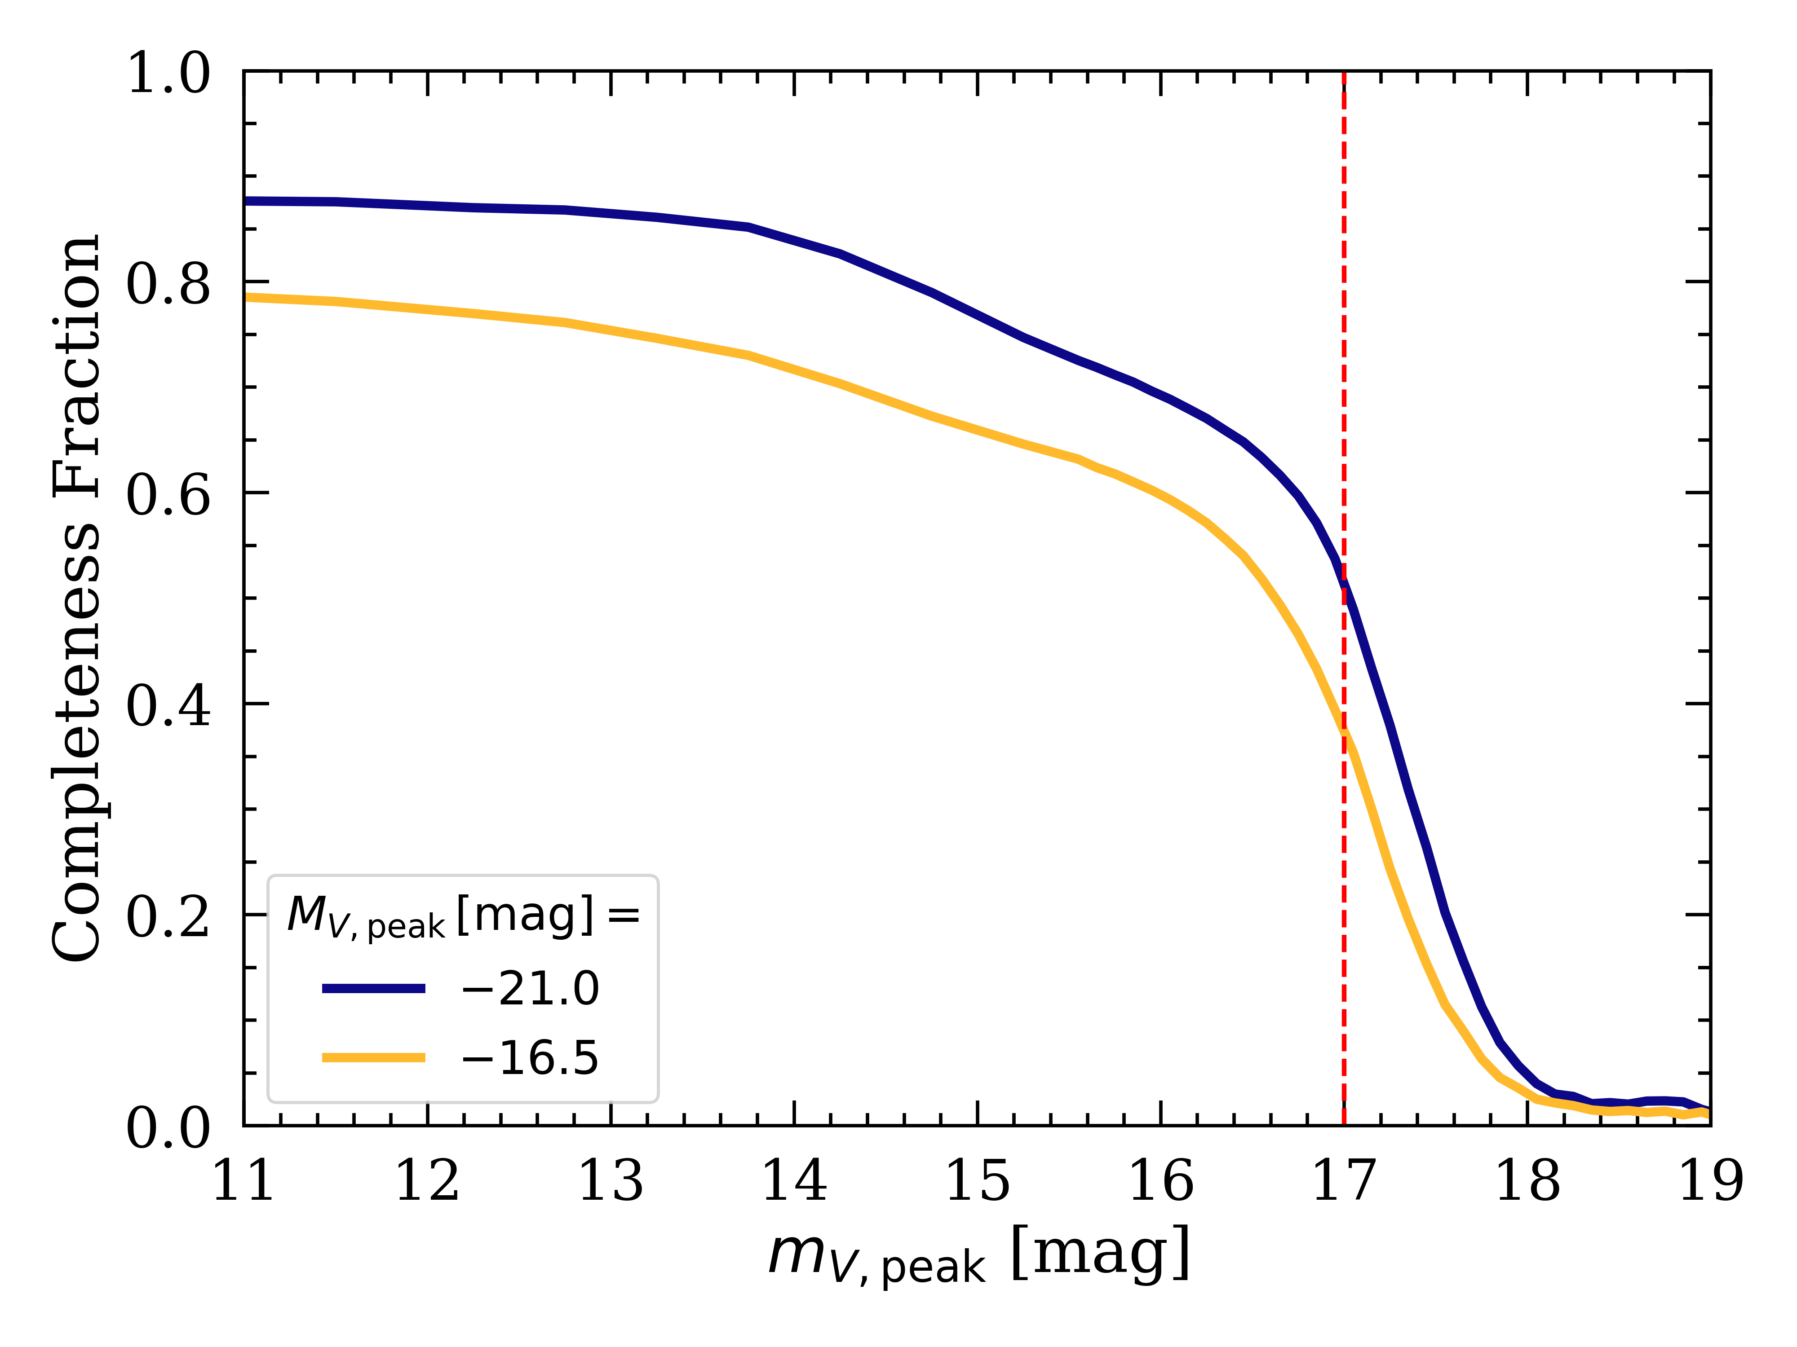
1 / Weight for a SN
Sum of Weights
Rate =
Volume x Time
Notes:
Y-axis det/all -- Function of apparent but also absolute is important -- Lum-width relation – say SN at a given set of magnitudes – get weight – finally get rate
This injection recovery simulation leads to the completeness corves as a function of BOTH apparent and absolute magnitude.
Previous works have only assumed an average completeness for all absolute magnitudes. However, we see that there is a ~10% difference between the most luminous and the least luminous Sne.
Completess leads to weights and these weights for each observed SN can be summed up and divided by volume and time to obtain a rate.
What’s different in my work and what’s better

Slide 12
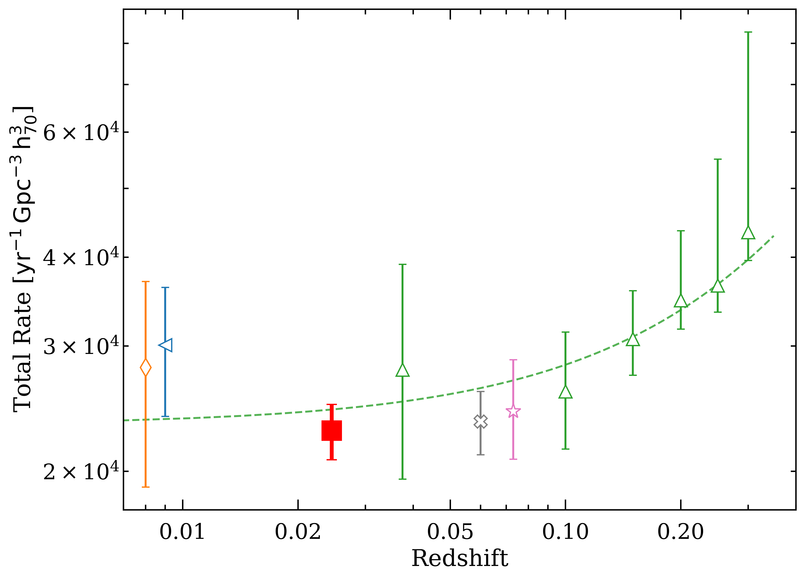
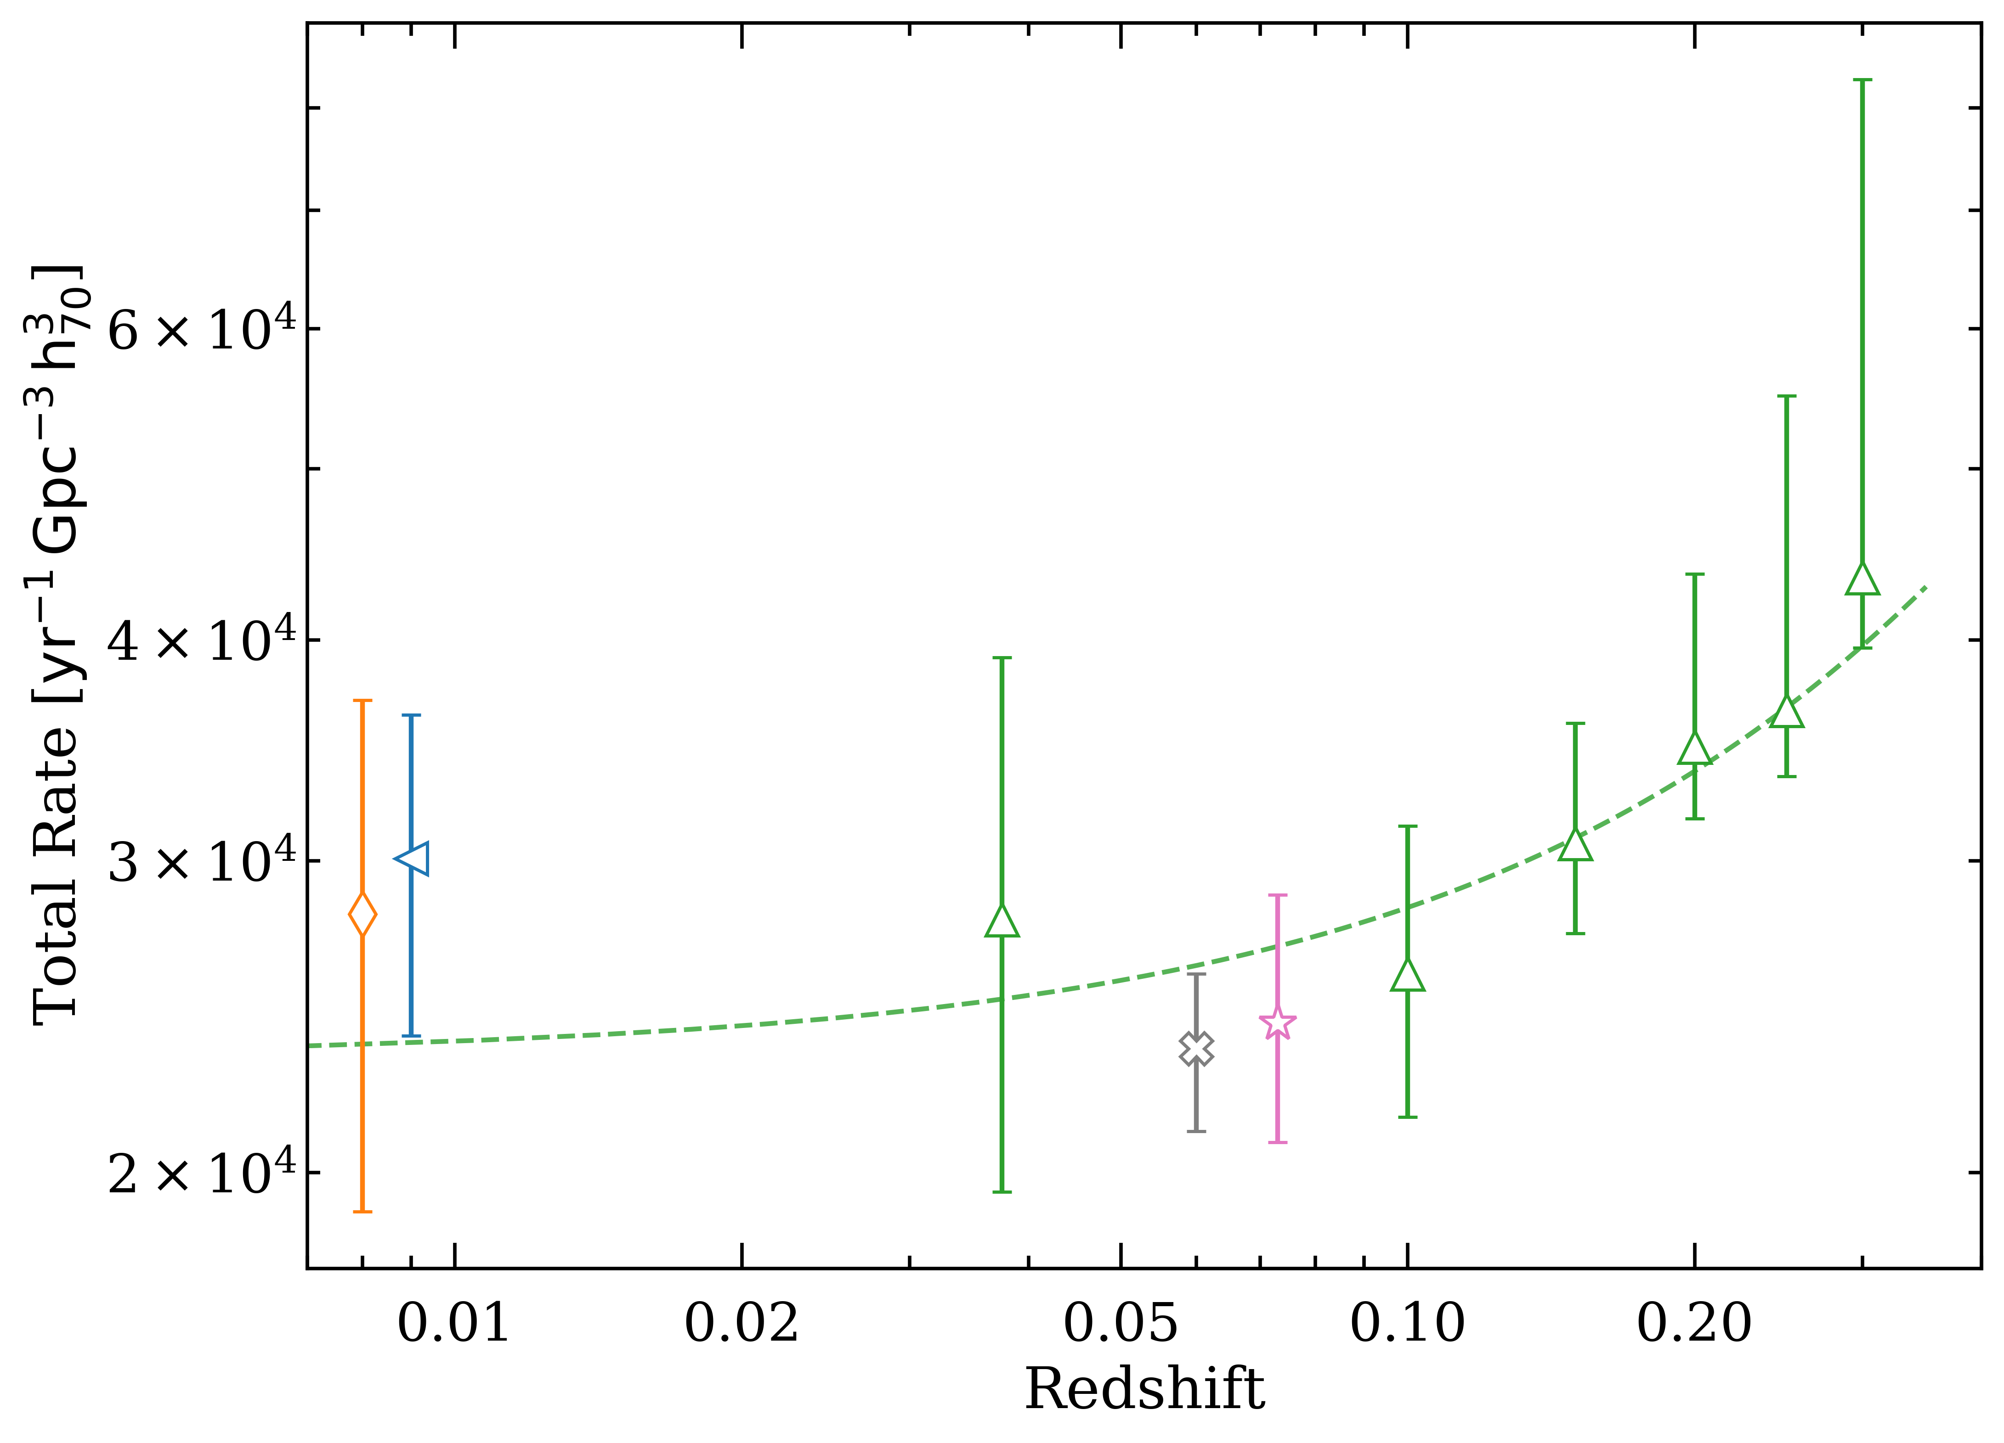






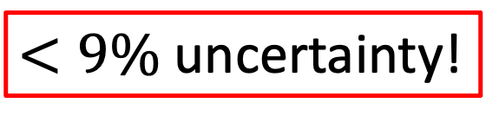
$<9\%$uncertainty!
Notes:
The rate as a function of redshift can also help constrain the DTD. Dilday did a fit using SDSS data and Perret using SNLS data. My errorbars much better (SMALLEST), pinning down the zeropoint!!!
Even with only 4 years of ASAS-SN data, we obtain the best results. ASAS-SN was made for this.
Our rate agrees well with the other rates at low redhisfts but we have the lowest statistical and systematic uncertainties.

Slide 13
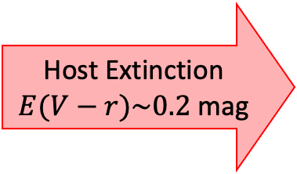
Host Extinction
$E(V−r)\sim 0.2$ mag
R-band
r-band
V-band
Notes:
Talk about LOSS (galaxy targeted they get more less lum ones) -- ZTF extend to more luminous end – LFs in different bands -- Shift is a way to estimate extinction -- take the offset out and that gives average extinction.

Slide 14
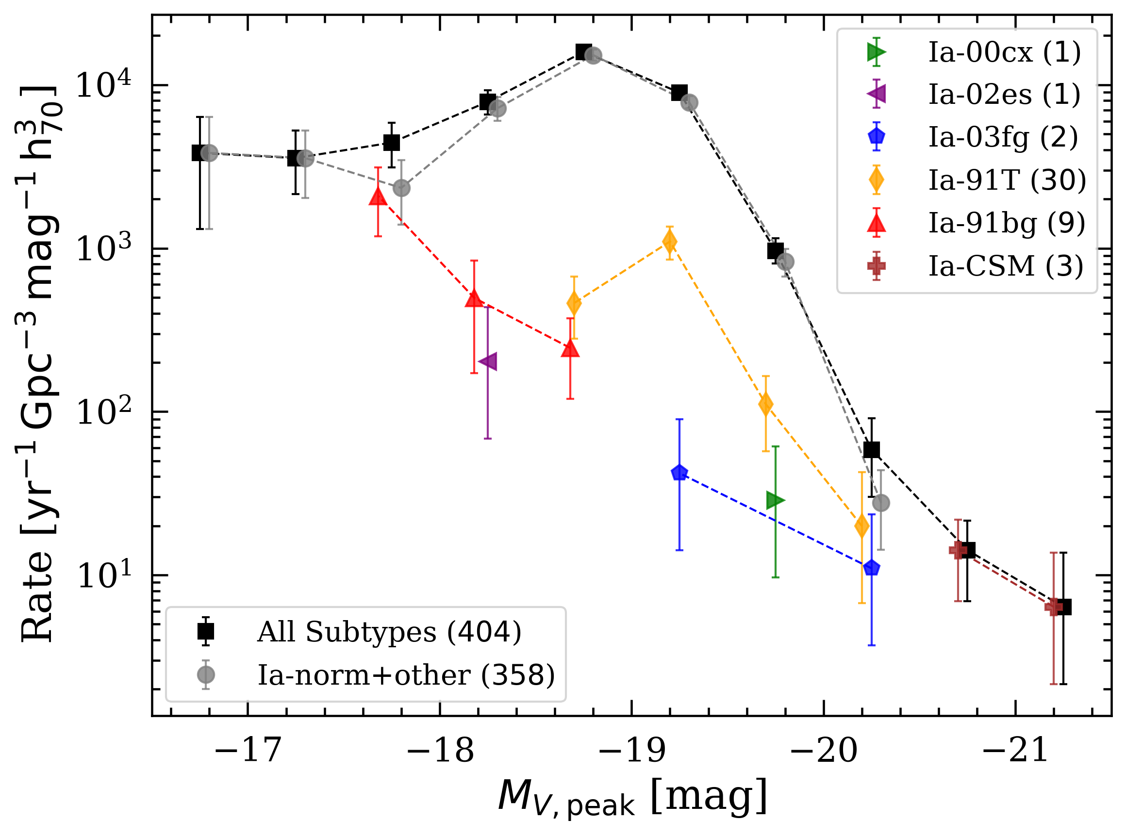
Notes:
Finally, for the first time!!! – Loss fractions of sub-types but no LFs – go back and look at the Taubenberger plot – WONDERFUL FIRST STEP IN THE DIRECTION OF UNDERSTANDING THE DIVERSITY IN IA SNE

Slide 15

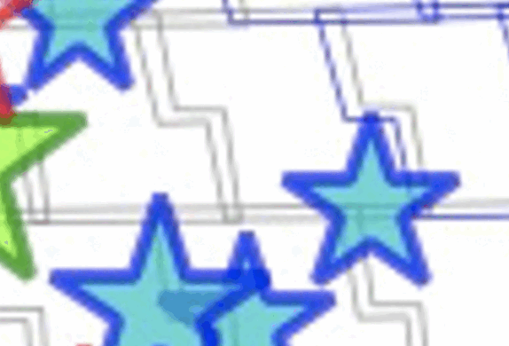
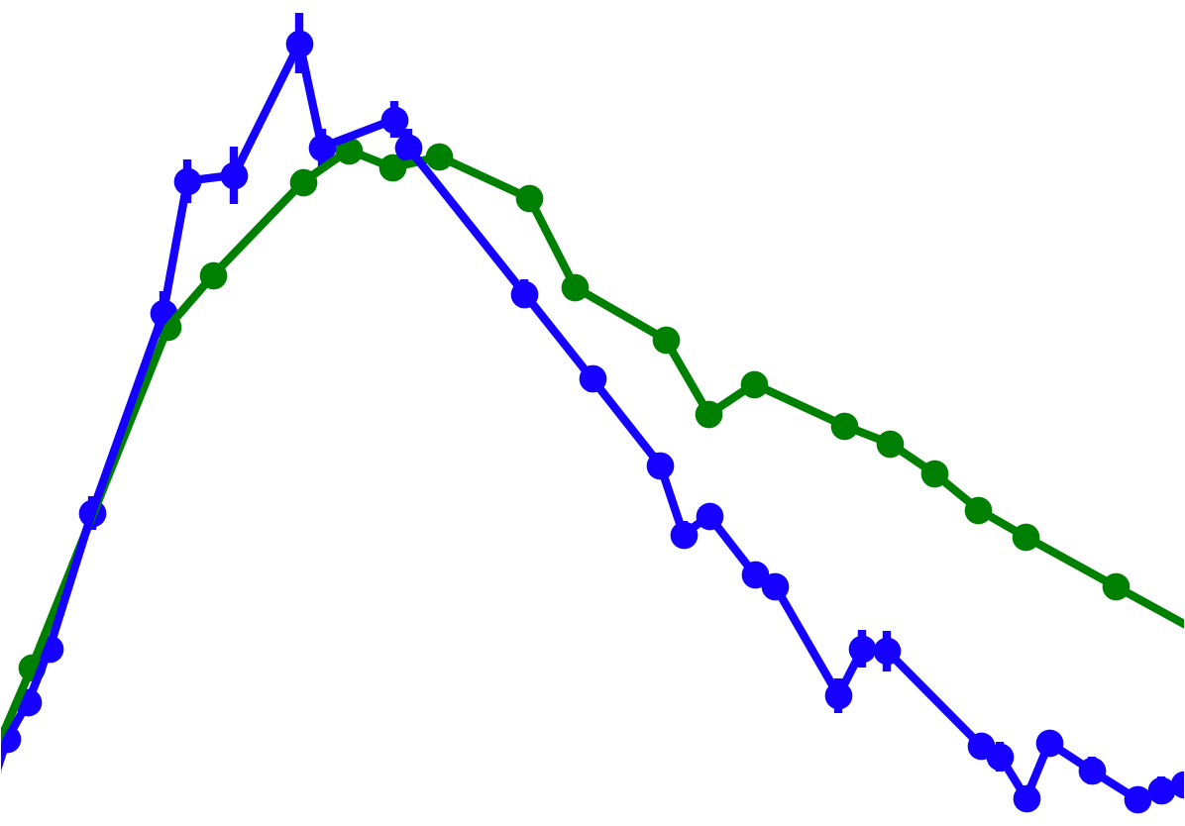
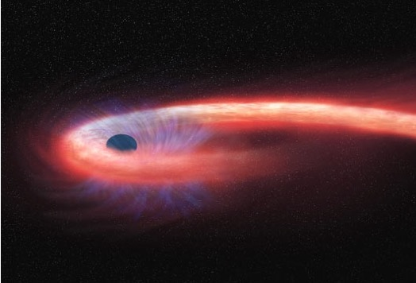

So… what’s next?
ASAS-SN g-band Rates
Host-Galaxy Extinction
Other Transients’ Rates
Notes:
G-band – larger sample – more dimensionality -- Extinction using multi-band light curves – other transients, TDEs, CCSNe, etc

Slide 16

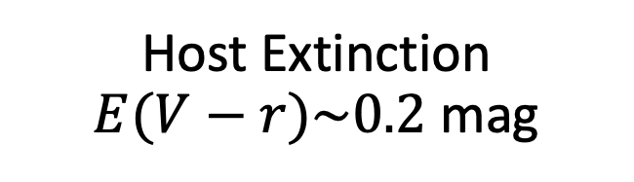
Summary
arXiv:2306.11100
Most precise rates with improved corrections!
Host Extinction $E(V−r)\sim 0.2$ mag
Sub-type LFs for the first time!

Slide 17
Backup Slides

