Slide 1

SN 2022ann a type Icn supernova from a dwarf galaxy that reveals helium in its circumstellar environment
Image: Cas A (SN IIb),
NASA/JPL-Caltech
see Davis et al. 2023
arxiv:2211.05134
Kyle Davis
The Transient & Variable Universe 2023

Slide 2
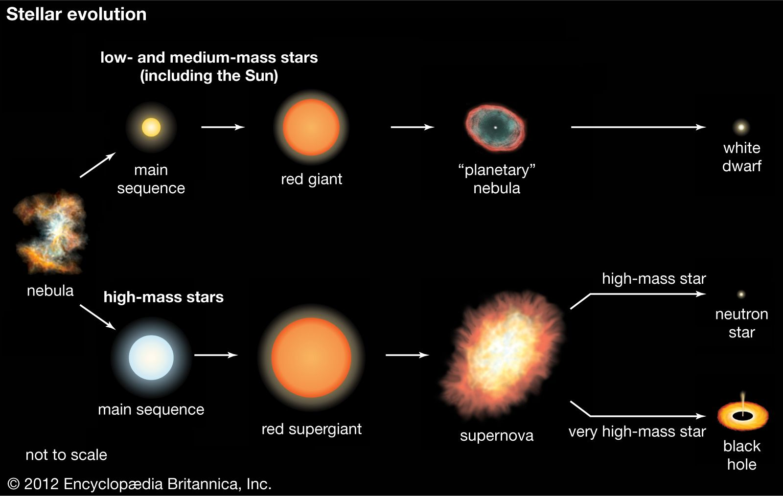
Supernovae!
Notes:
Top-level, textbook diagram of stellar evolution where your mass is your date
Things are very simple in this paradigm where if youre more than about 8 solar masses youll evolve through the MS and RSG phases until you fuse to iron and explode as a core collapse supernovae
Leave behind a neutron star, or a black hole depending on mass

Slide 3
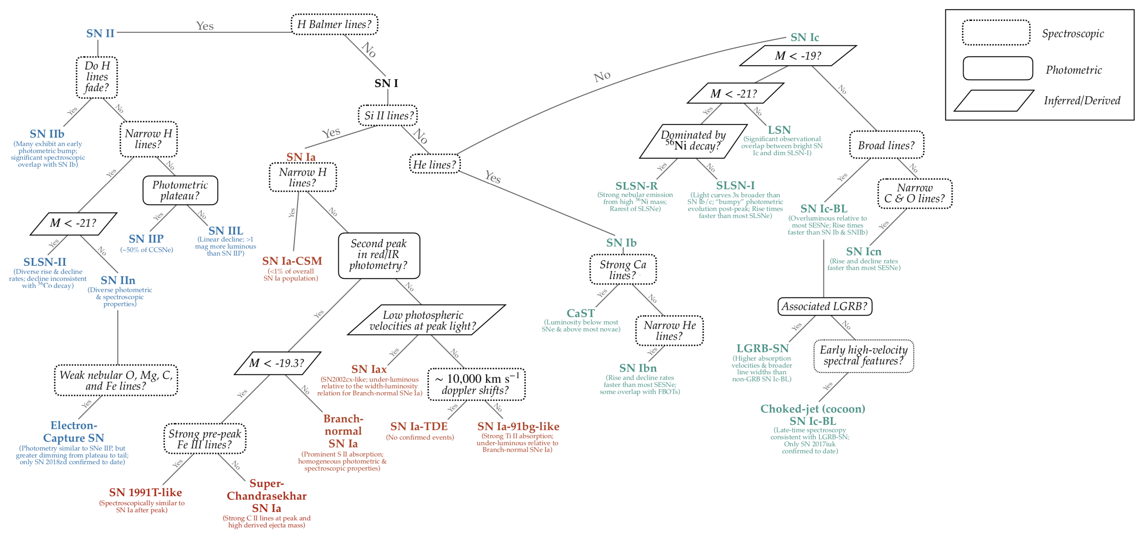

New Stellar Endpoints
Gagliano 2023
Notes:
Despite the very simple picture of stellar evolution, there is a ton of diversity in Sne
With technological advances of time domain sky surveys, we are discovering new types of SNe almost every year, a trend that will only increase as Rubin and LSST come online
Each type of SN indicates a different endpoint of stellar evolution, which we don’t have good explanations for yet

Slide 4
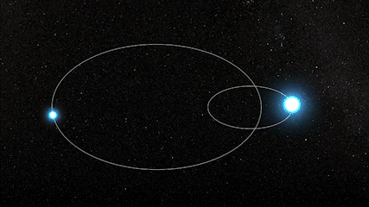
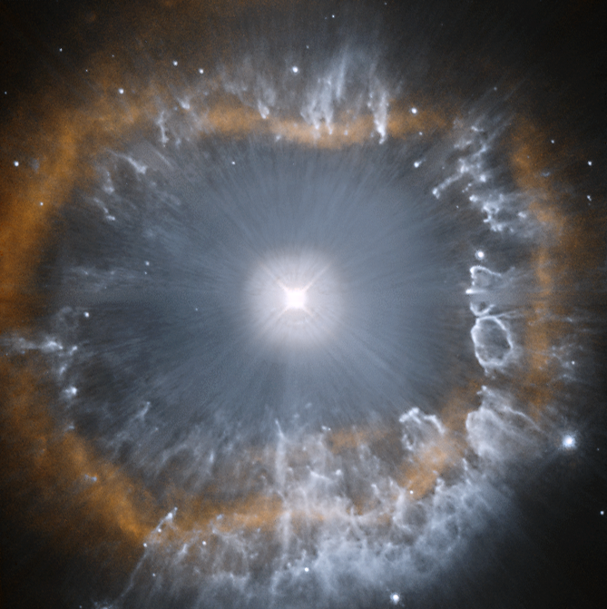
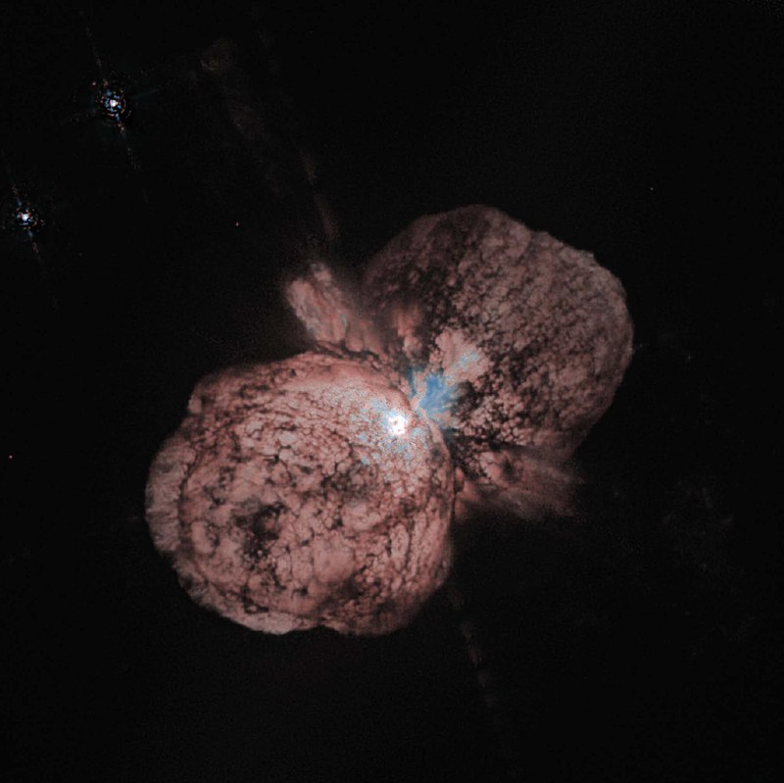
Mass Loss
Single star: wind-like? eruptive? episodic?
Binary? Get really messy really quick
Notes:
One main driver of this diversity at least on the core collapse side is stellar mass loss
Stars can lose up to tens of solar masses through these channels, which will obviously manifest itself in the eventual supernova.
We’ve observed starts losing mass through a variety of mechanisms, such as driving winds, undergoing epochs of explosive mass loss, or binary stripping
However, while we know that extreme mass loss occurs in galactic massive stars and binaries, the connection to the extragalactic supernovae we observe is still unclear
All the different flavors of single and binary mass loss are numerous and many are intrinsically messy processes, so we should expect a heterogenous set of resulting supernovae

Slide 5
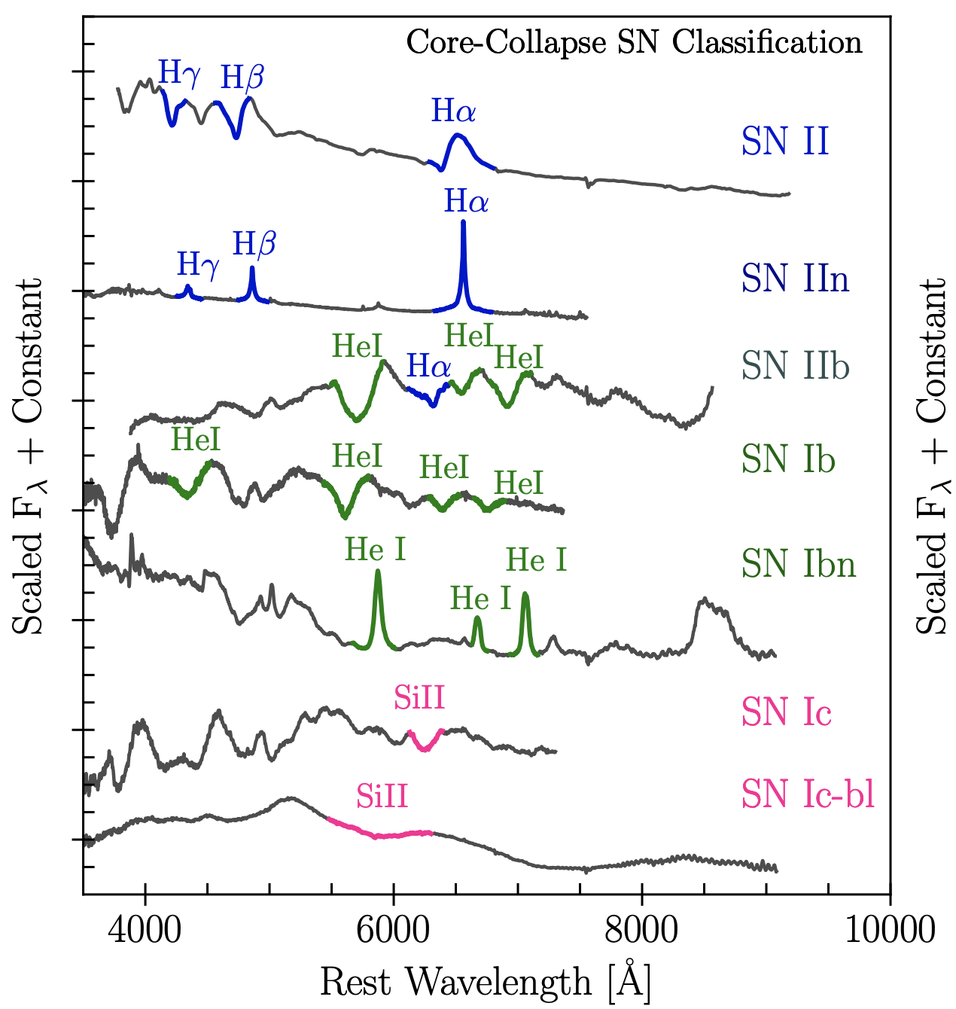
Mass Loss
Stars that lose their entire H envelopes explode as SNe Ib
Stars that also lose their He envelopes explode as SNe Ic
Increasing envelope-stripping
No H or He
No H or He
Modjaz+ 2019
Notes:
Given my advisor wont pay me to sit and wait 10000 years for a galactic WR to explode, we’re left with no choice but to figure out these channels of stellar evolution from observations off extragalactic supernovae
I will be talking about SESNe, which are particularly drastic cases of mass loss in which the progenitor has been stripped of its entire H (in the case of Ib) or also the He shell (in the case of Ic)
I also want to draw your attention to type IIn and Ibn supernovae, which as many of you know, are characterized by narrow emission lines arising from interaction with circumstellar material
This means that the stripped stellar material remains nearby when the star explodes
As of 2019 there was no type Ic analog

Slide 6
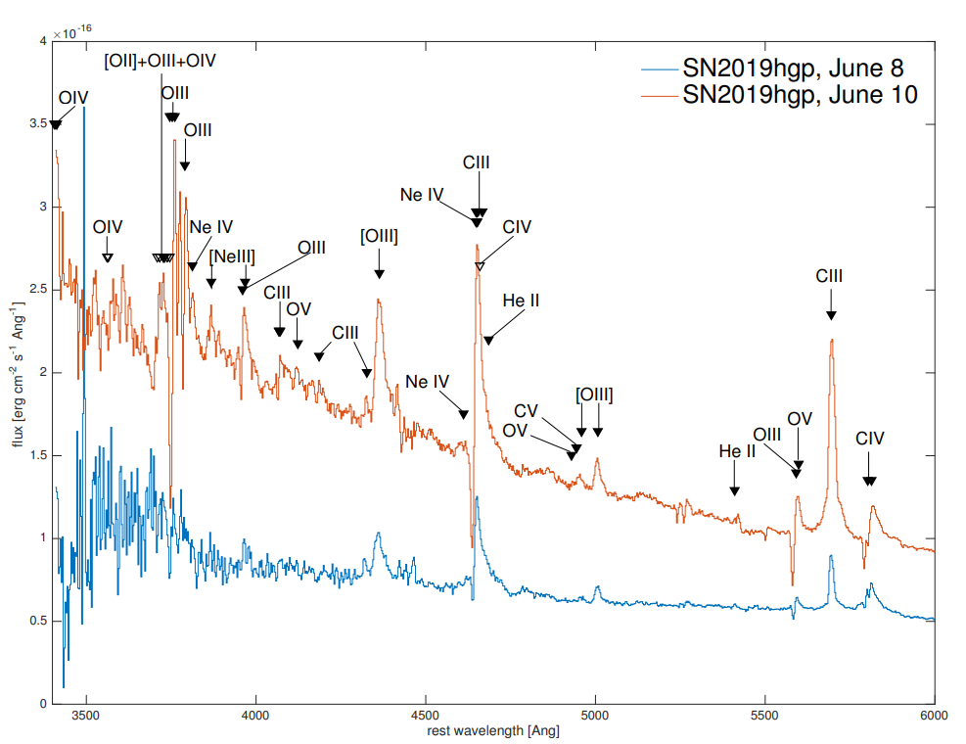
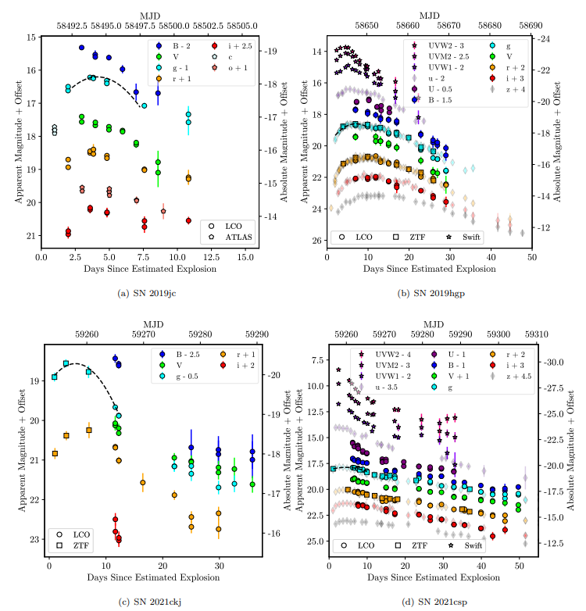
Type Icn Supernovae
Gal-Yam+ 2022
Pellegrino+ 2022
Only 5 known SNe Icn; ~0.01% of all CCSNe
Notes:
This is no longer true since the discovery and classification of SN 2019hgp which showed narrow and highly ionized lines with no H or He such as shown on the left
The sample is currently at 5, 4 of which are compiled in the smaple paper by craig Pellegrino and what wer’re finding is a heterogeneous and fast-evolving population roughly consistent with other interacting supernovae
Super rare

Slide 7
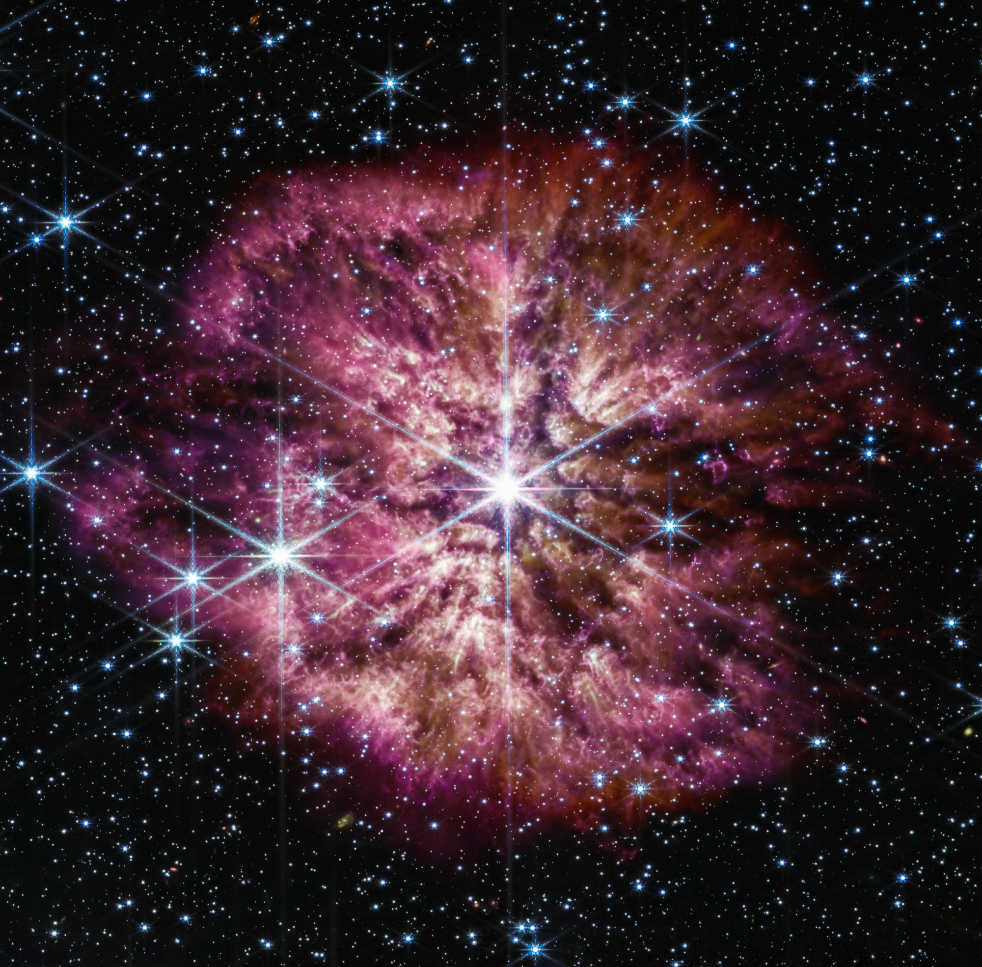

“Interacting” SN IIn, Ibn, Icn
Unshocked CSM
Dense CSM shed from stellar envelope
100s-1,000s km/s
Explosion shock wave propagating through CSM
10,000s km/s
Star undergoing heavy mass loss
Core collapse SN
Notes:
This is the basic premise and single progenitor scenario for interacting supernova
You start off with some star undergoing heavy mass loss, shrouding itself in a dense cocoon of circumstellar material, or CSM. Note here the CSM outflow from the star is roughly the escape velocity of the star
Then when the star explodes, it sends an energetic shock wave that propagates through the CSM at 10,000s km/s and heats it up
The key here is that the SN ejecta and CSM velocities are an order of magnitude apart
The csm properties are reflective of the progenitor properites

Slide 8
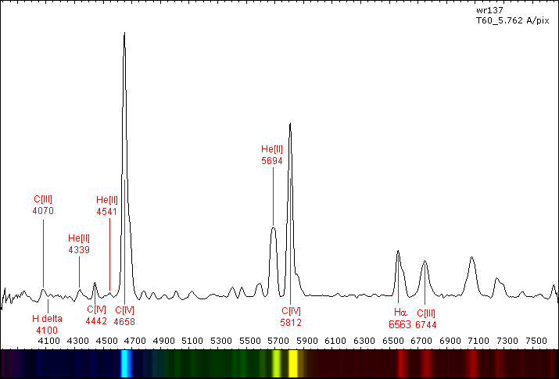
SNe Icn: Explosion of a Wolf-Rayet star?
Gal-Yam+ 2022
~30 to 70/80 M☉
WR 137, Wikipedia

Slide 9
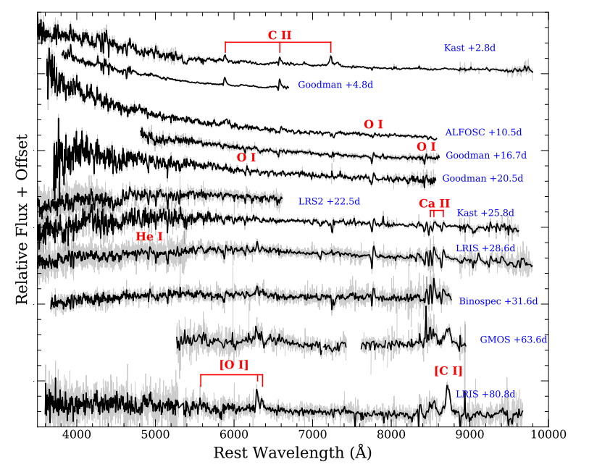
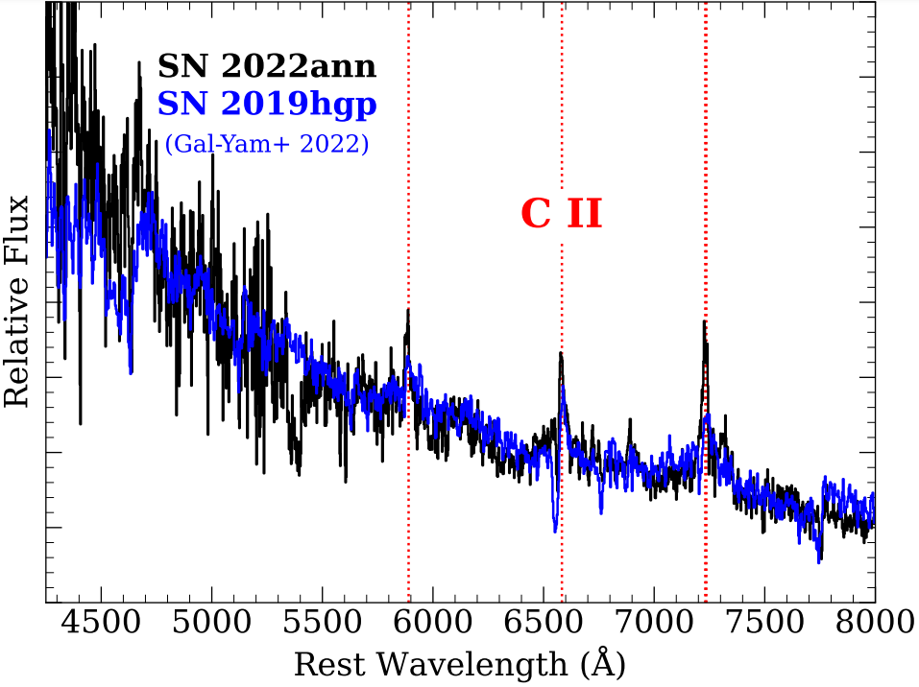
SN 2022ann
Davis+ 2023
Notes:
It’s here that I will introduce 2022ann, which exploded in February 2022.
It is the most recent Type Icn as of two days ago when 2023emq was demoted to a type Ibn
As you can see in the spectral time series on the right, it shows narrow lines of C and O throughout its entire evolution, while also showing no H and very little He (ill touch on this in a bit)
In this talk, I’m going to go through some of the unique observed properties in 2022ann that have pointed us in the direction of a binary progenitor

Slide 10
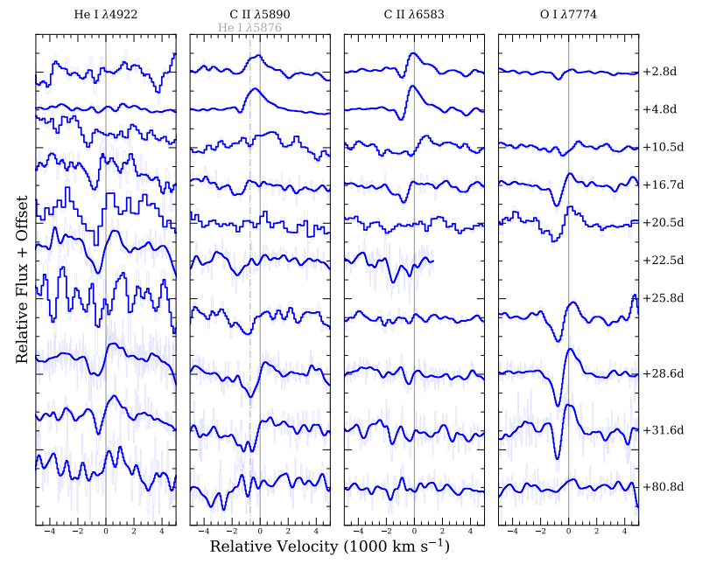
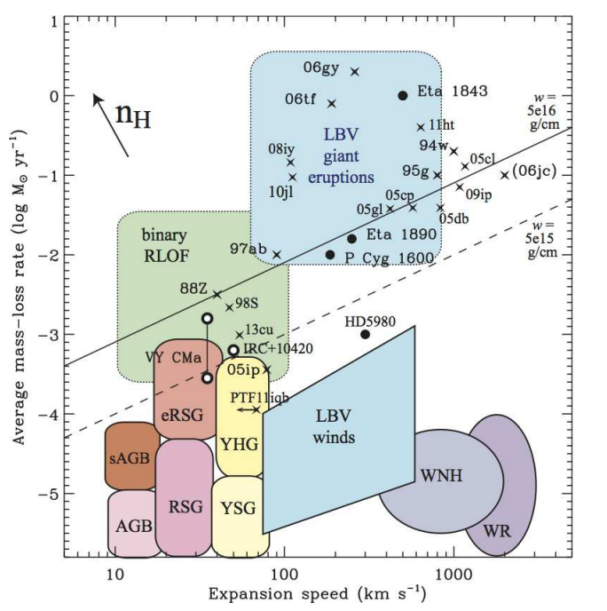
SN 2022ann Progenitor: Line Velocities
Davis+ 2023
Smith 2016
Notes:
In the plot on the left I show the line velocities for several CSM lines
This is the first way we noticed SN 2022ann is unique relative to the other SNe Icn. All SNe Icn in the Pellegrino sample show P-Cygni absorption velocities of 1000-2000 km/s, which are consistent with massive WR winds
However, SN 2022ann shows 800 km/s which is too low for typical single WRs, and is inconsistent with any stripped stars shown on the diagram
If you think about the line velocities in terms of the escape velocity of the star, this implies we either have a puffed up, or lower mass progenitor

Slide 11
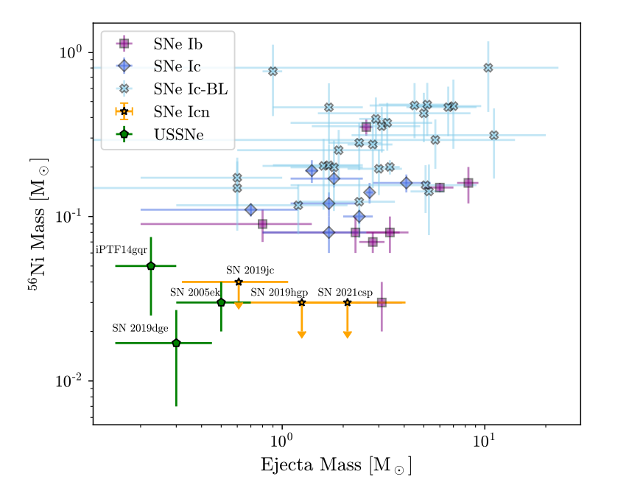
SN 2022ann Progenitor: Light Curve Modeling
MOSFiT; Guillochon+ 2018
CSM model; Chatzopolous+12, Villar+17, Jiang+20
Light curve modeling estimates only 5M☉ of SN ejecta interacting with 1M☉ of CSM, as well as >0.04M☉ of radioactive Ni!
SN 2022ann
Davis+ 2023
Notes:
Our next clue into the progenitor is the light curve
To estimate the CSM and ejecta properties, we then model the light curve with MOSFiT
We find, like other SNe Icn, the mass is too low for a WR star
, I don’t show it here, but we also find the CSM density profile parameter “s” to be inconsistent with either a pure steady wind, or constant density shell

Slide 12
SN 2022ann Progenitor: Host Galaxy
pre-explosion
pre-explosion
Davis+ 2023
Notes:
The third clue is the host galaxy
This is the first time im showing an image of the supernova!

Slide 13
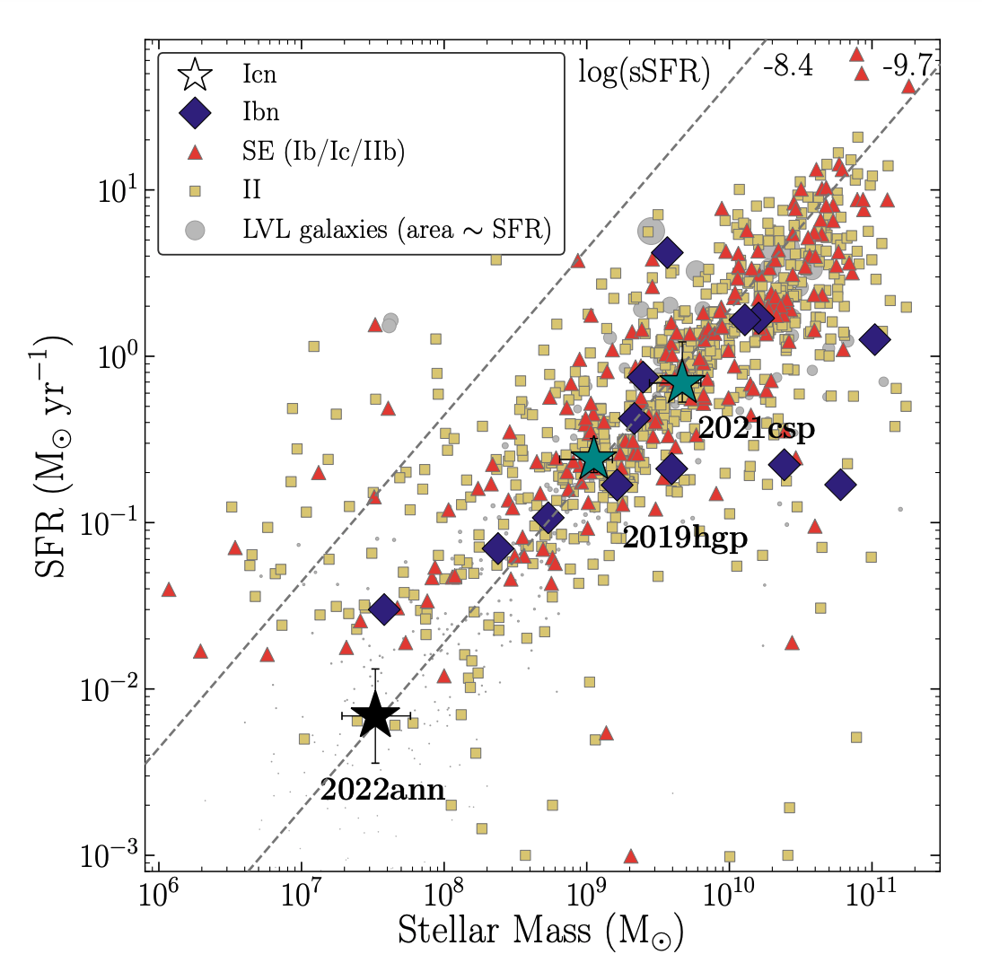
SN 2022ann Progenitor: Host Galaxy
Davis+ 2023
Notes:
2022ann has extremely low stellar mass and SFR among CCSN host galaxies
Use LePHARE to model a declining starburst

Slide 14
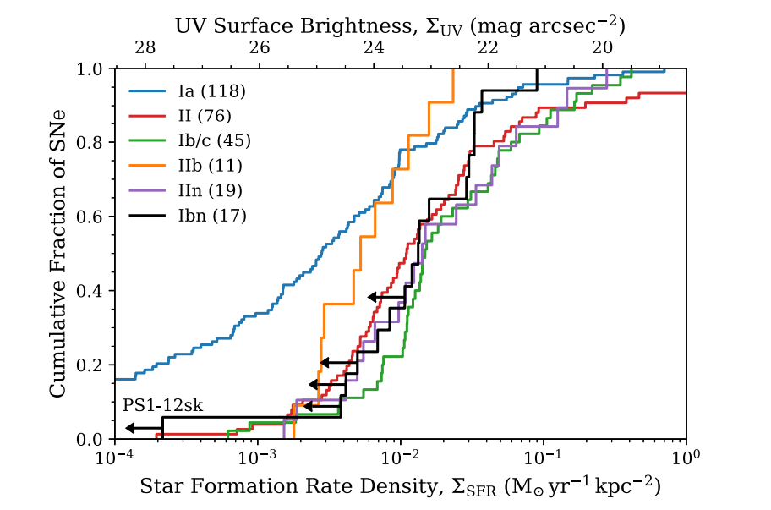
SN Ibn/Icn Massive Progenitor Problem
Hosseinzadeh+ 2019
Pellegrino+ 2022
SN 2022ann
Notes:
Reproduces trend that In the past few years, people have begun to doubt WR as Ibn/Icn progenitors
On the left I show the host galaxy properties of Type Ibn SNe from Hosseinzadeh 2019, which shows that some SNe Ibn explode in host galaxy environments that are nearly devoid of star formation, which is inconsistent with massive progenitors
On the right I show again the ejecta mass of SNe Icn measured from light curve modeling, which finds that they are unilaterally inconsistent with massive WRs

Slide 15
SN Icn Host Galaxies
Taggart+ in prep.
incl. Davis
Notes:
Kirsty helped a lot with the host galaxy analysis, and is taking the next step to do local environment analysis of SNe Ibn/Icn ☺

Slide 16
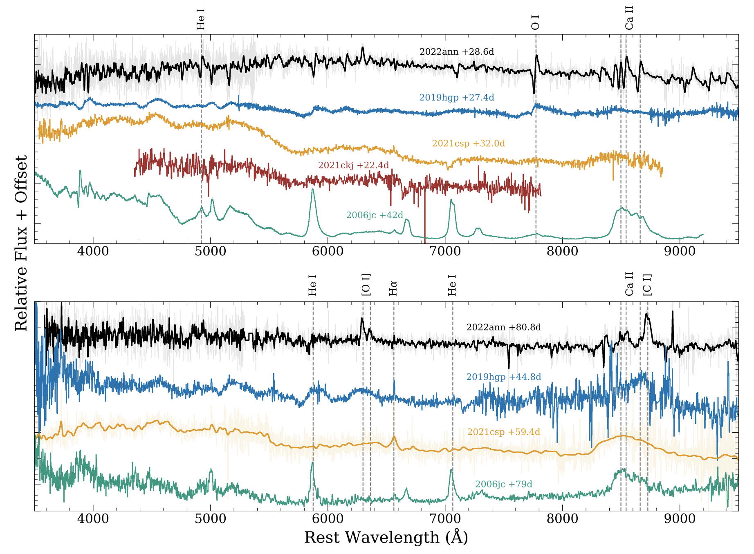
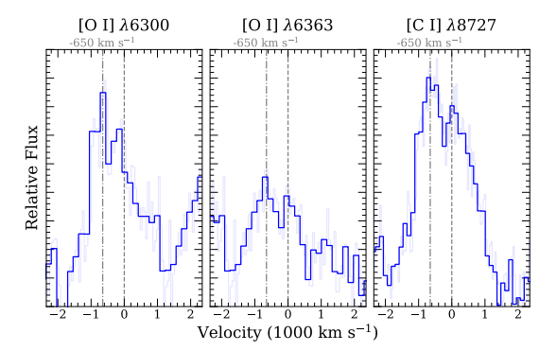
Heterogeneity Implies Binary Origin?
SNe Icn late-time spectral diversity and asymmetry
Davis+ 2023

Slide 17
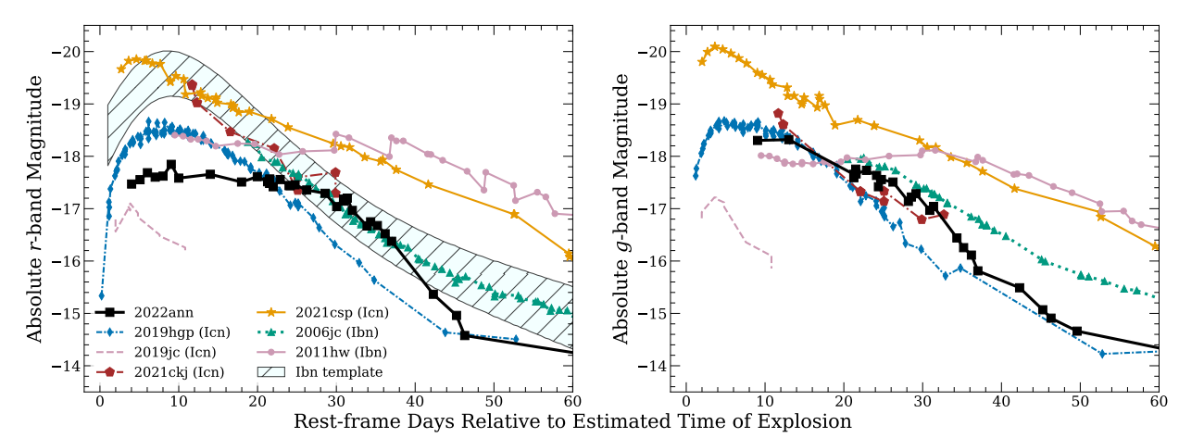
Heterogeneity Implies Binary Origin?
Davis+ 2023
Notes:
Photometry probably a better probe of CSM differences than spectroscopy
Overall, we find 22ann inconsistent with a single massive progenitor, and believe a binary is likely necessary

Slide 18
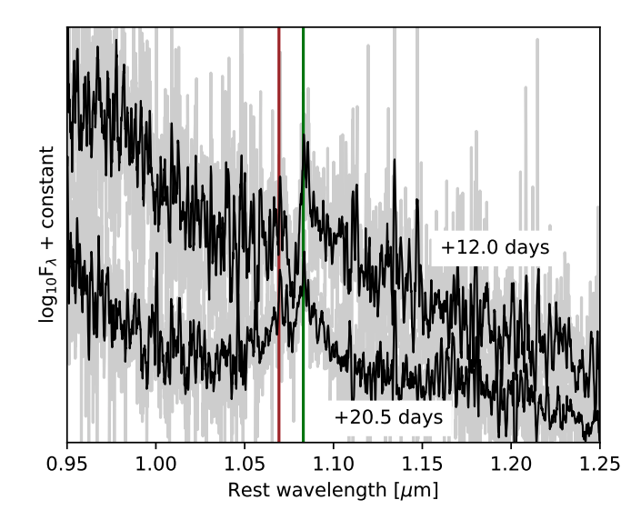
SNe Icn in the IR: Finding Helium
SN 2021csp; Fraser+ 2021
Davis+ 2023

Slide 19
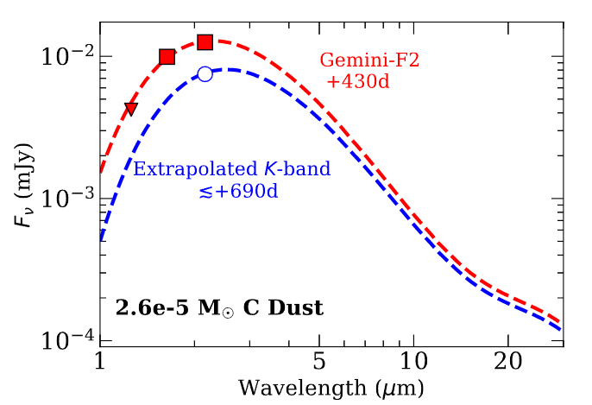
SNe Icn in the IR: Ideal dust producers?
Preliminary
Preliminary
Rich in C and O
Bright in the IR over a year later! Dust!!!
Notes:
Over a year later, we find that 2022ann is still bright in the infrared!
Prolonged IR emission is an indication of dust, solid grains based on primarily C and O!
This is the first detection of a SN Icn in this phase space (late-time, red wavelengths).
Type IIn are dusty, Icn could be the ideal dust production for supernovae
To probe cooler dust, we really need JWST, so it would be great if a 2022ann DDT proposal was approved

Slide 20
Conclusion
We present SN 2022ann, the fifth-discovered SN Icn
Its spectra are dominated by low velocity C and O, with little H and He. Extreme case of mass loss.
The emission line velocities, modeled ejecta+CSM mass, and host galaxy environment are inconsistent with the explosion of a massive WR-like star, and suggest a binary origin
IR observations of SNe Icn are critical to revealing He and searching for dust

Slide 21

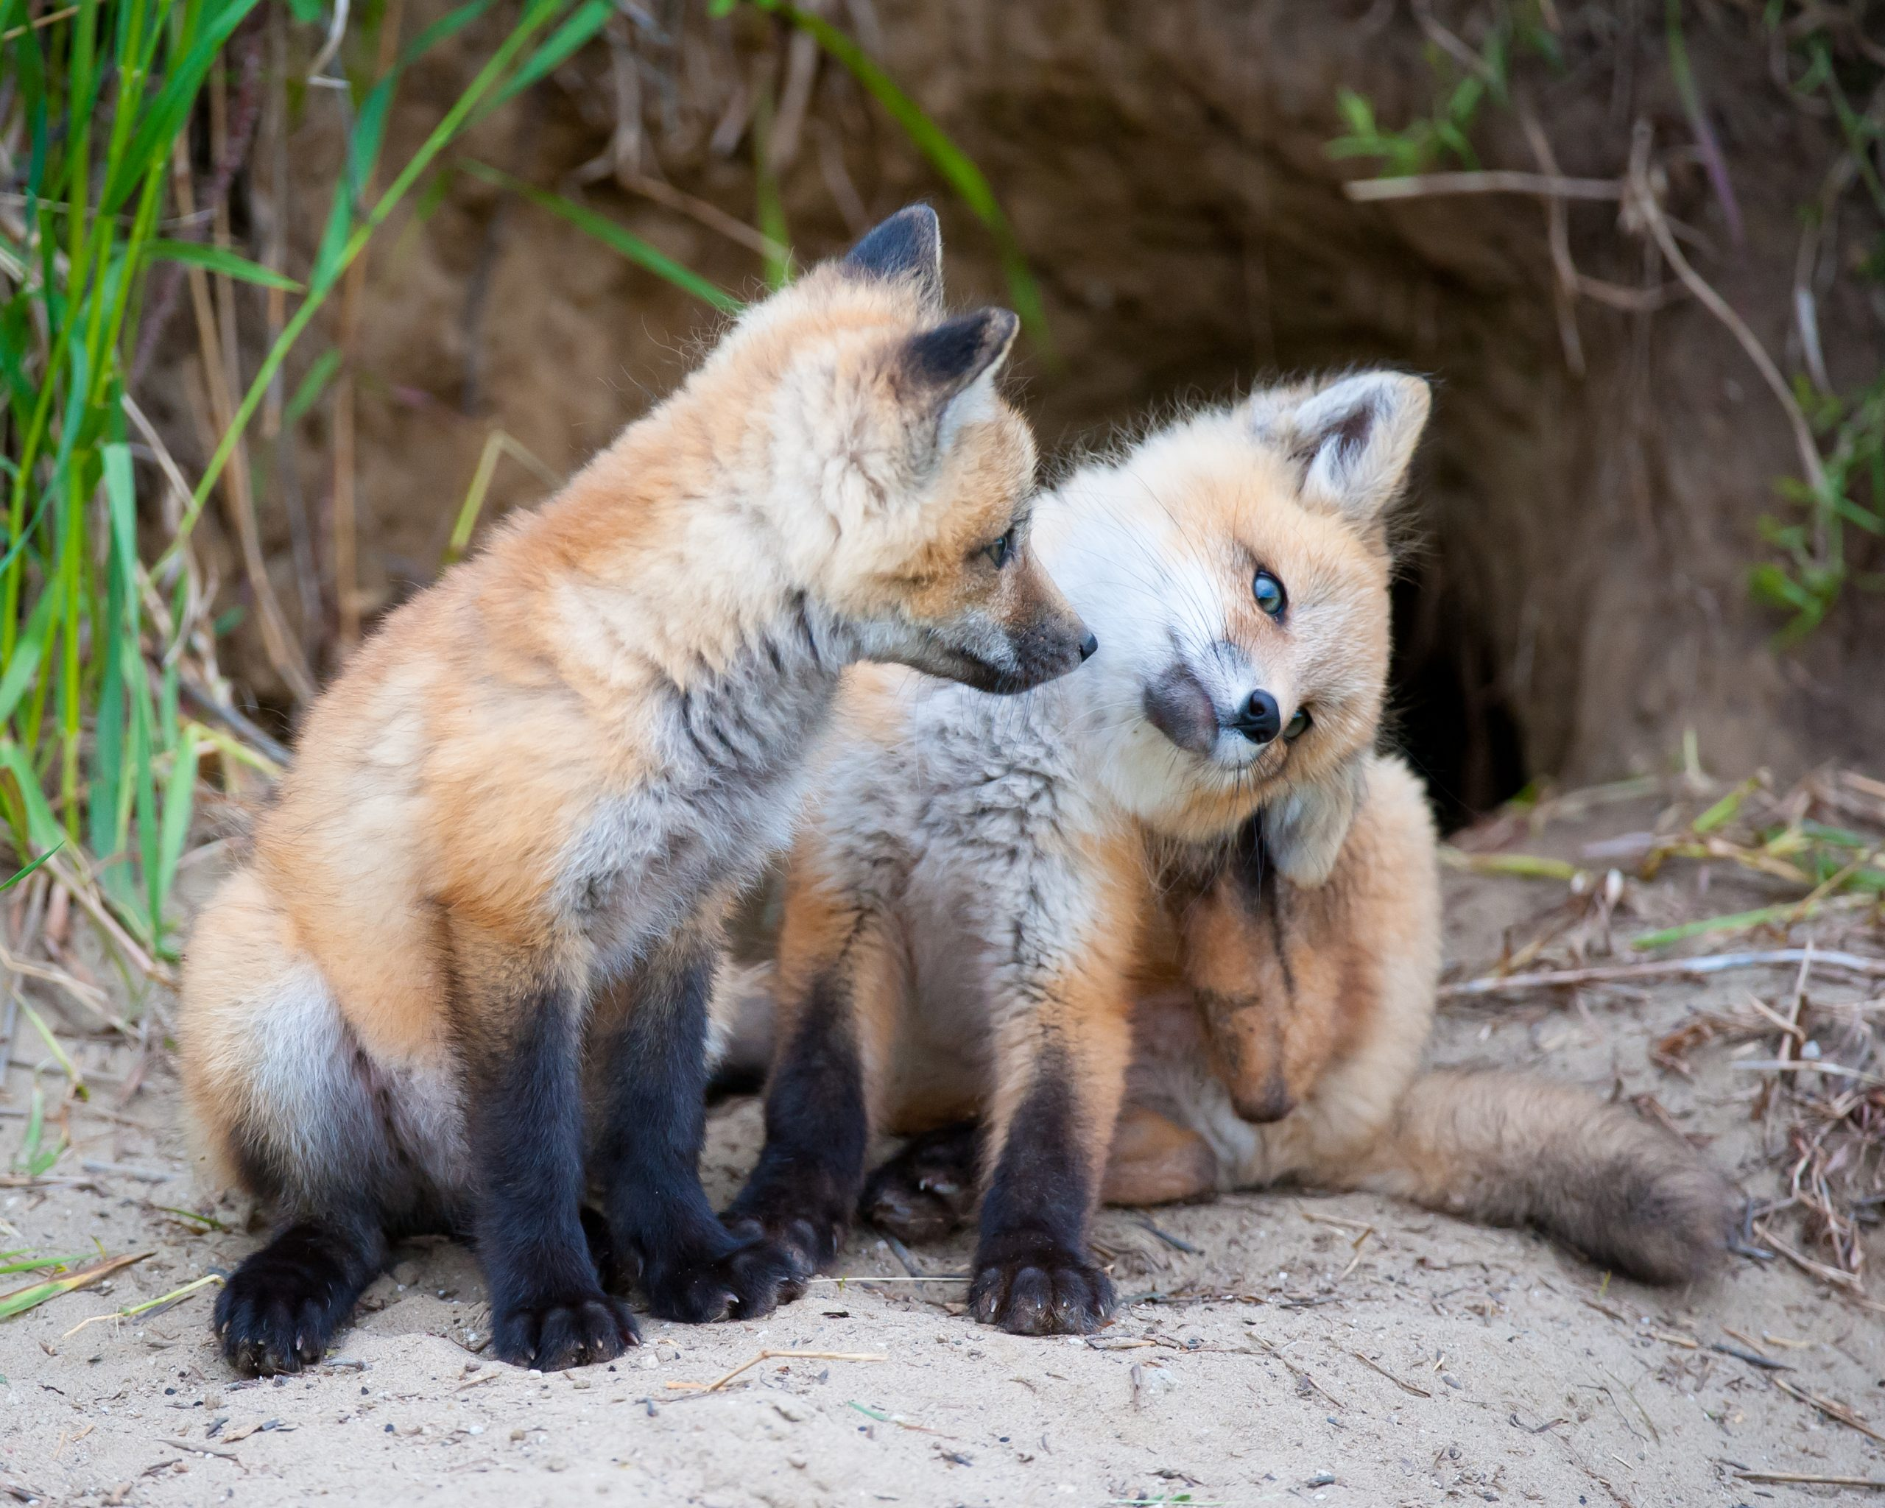
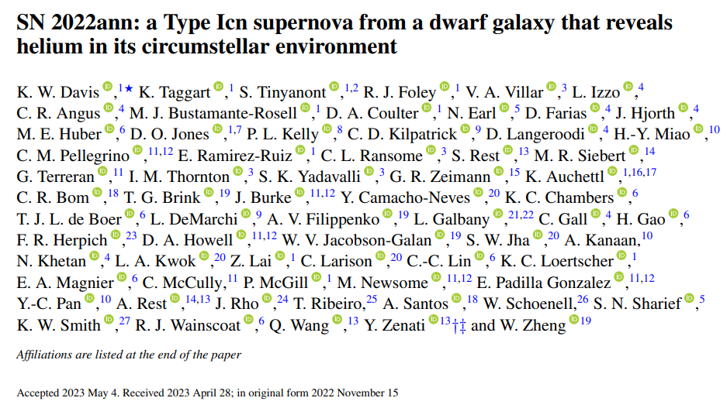



Thanks!
and more!

Slide 22
Future Work
Host galaxy environments (Taggart+ in prep!)
Probing dust formation/destruction with JWST
Multi-wavelength(Discussed IR, but also UV and X-ray will be very informative)
Connecting SNe Icn to regular SN Ic and SN Ic-BL (gamma ray sources?)

Slide 23
Helium in SNe Icn
NIR Spectrum?
2019hgp ❌
2019jc ❌
2021ckj ❌
2021csp ✅
2022ann ✅
High S/N Early Spectrum
2019hgp ✅
2019jc ❌
2021ckj ❌
2021csp ✅
2022ann ❌
Spectrum at +1 month?
2019hgp ✅
2019jc ❌
2021ckj ❌
2021csp ✅
2022ann ✅
CONFIRMED He?
2019hgp ❔
2019jc ❌
2021ckj ❌
2021csp ✅
2022ann ✅
Maybe there’s always helium, but it’s just hard to see!

Slide 24
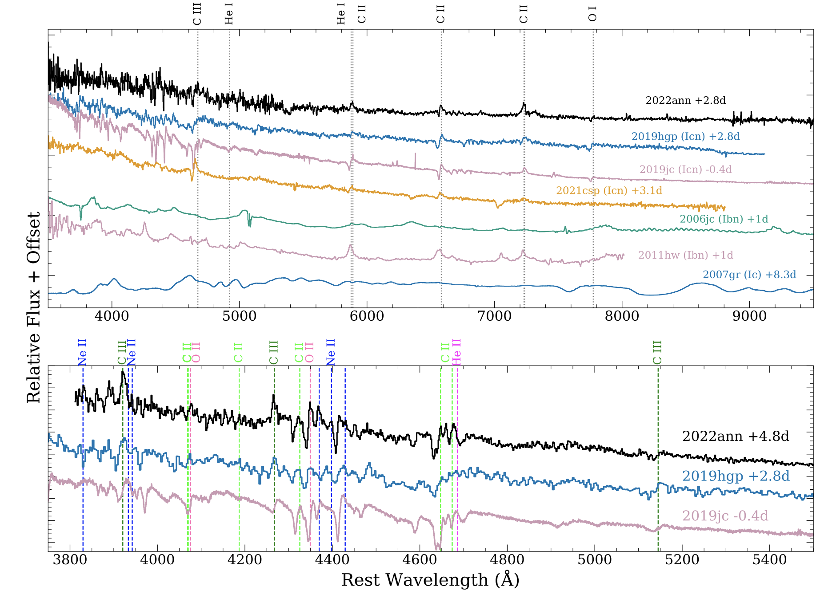
Binary Progenitors?
SNe Icn spectra remarkably similar at early times!
Davis+ 2023

Slide 25
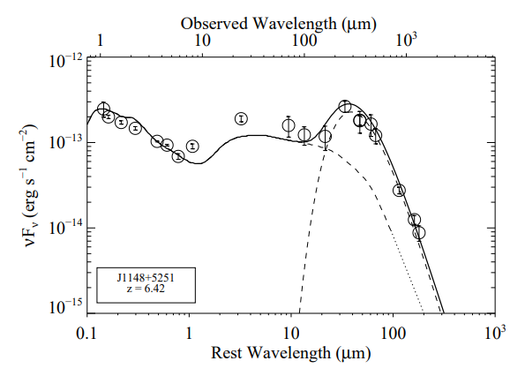
“Dust Budget Crisis"
What could have produced all this dust in <1 Gyr? CCSNe?
Leipski & Meisenheimer 2012

Slide 26
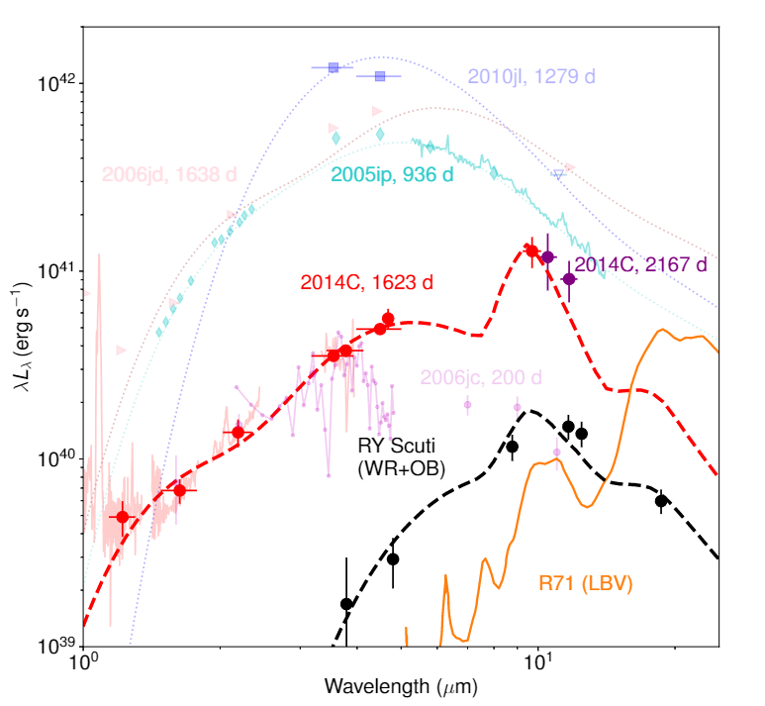
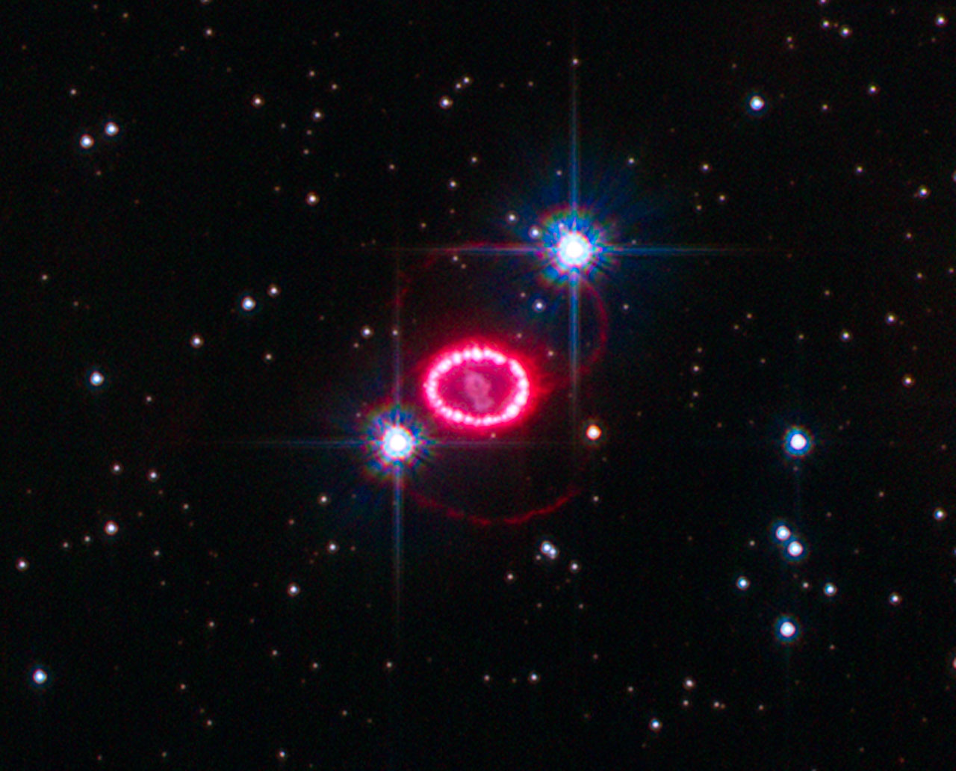
Supernova Dust
Notes:
Form after CO formation equally depletes C and O (like Doug said) and cools environment
Dust can either be pre-existing in CSM or newly formed in ejecta
SNe Ibn and SN IIn known to be particularly dusty, but still produce way less dust than supernova models predict, and not enough to solve dust budget
2022ann could be the ideal dust factory

Slide 27
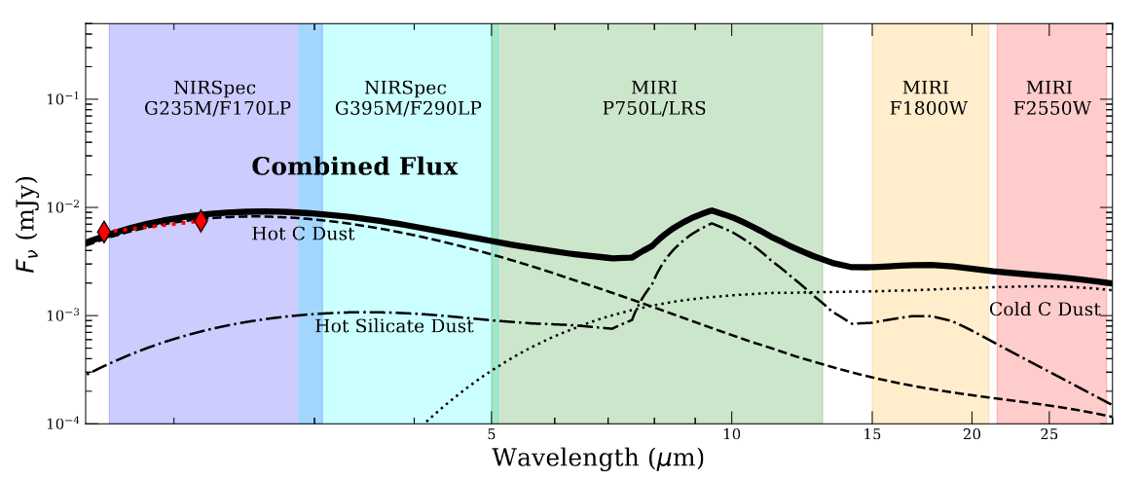
We need JWST!
Davis+ in prep.
Please don’t steal this!

Slide 28
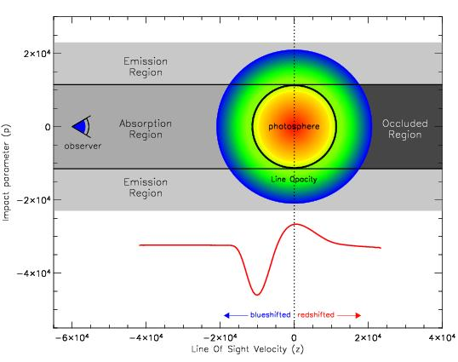
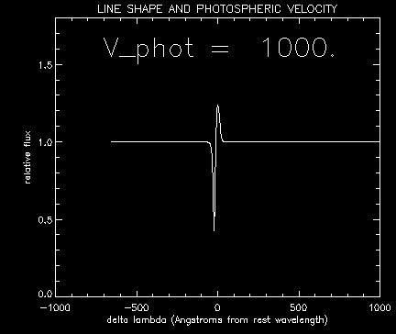
Supplemental

Slide 29
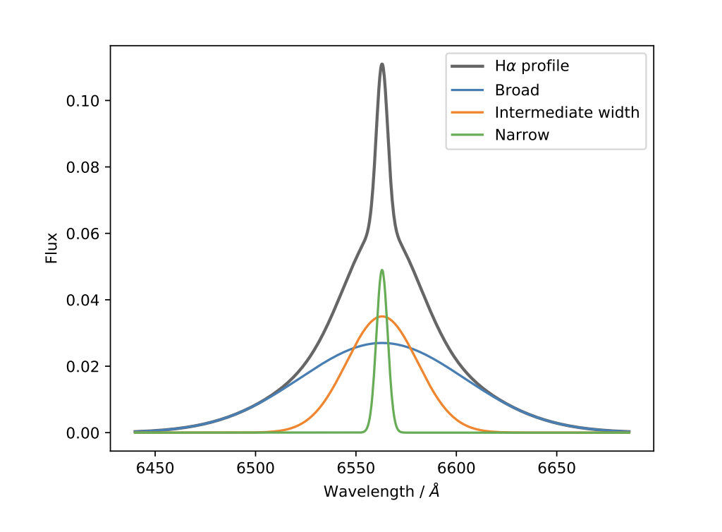
Supplemental
Ransome+ 2021

