Slide 1
Exploring type IIn supernovae using MOSFiT
Conor Ransome, The Pennsylvania State University

Slide 2
Type IIn supernovae
Uncommon class of SN characterized by persistent narrow line components in the spectrum, most obvious in the H Balmer lines.

Slide 3
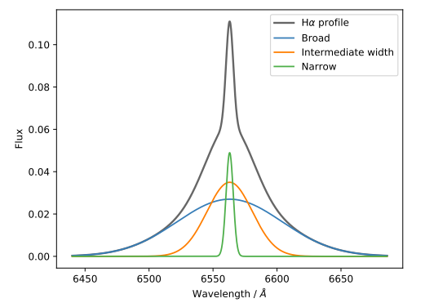
Type IIn supernovae
Uncommon class of SN characterized by persistent narrow line components in the spectrum, most obvious in the H Balmer lines.
Consistent with interaction with a slow, dense circumstellar medium (CSM).

Slide 4
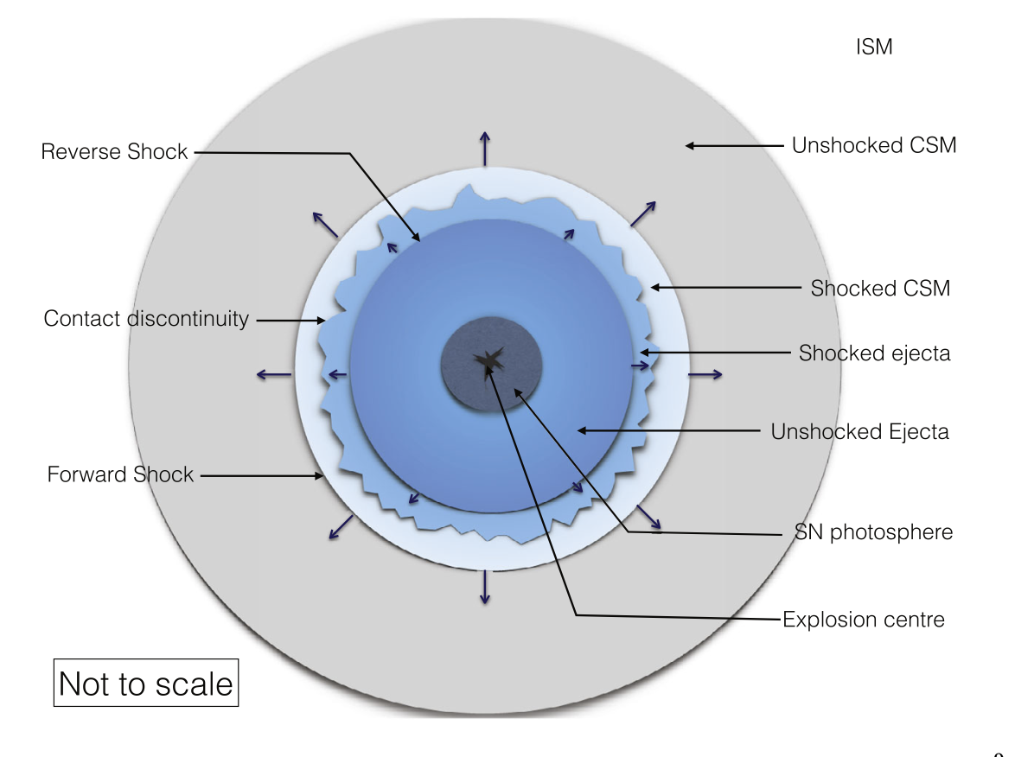
Type IIn supernovae
Uncommon class of SN characterized by persistent narrow line components in the spectrum, most obvious in the H Balmer lines.
Consistent with interaction with a slow, dense circumstellar medium (CSM).
Highly heterogenous, but generally:
Bright
Long lasting
Chandra 2018

Slide 5
Type IIn supernovae

Slide 6
Type IIn diversity
The diversity may manifest in a variety of ways e.g.

Slide 7
Type IIn diversity
The diversity may manifest in a variety of ways e.g.
Long lasting SNeIIn, e.g. SN2005ip where prolonged CSM interaction powers the lightcurve for several years. (Fox+2020).

Slide 8
Type IIn diversity
The diversity may manifest in a variety of ways e.g.
Long lasting SNeIIn, e.g. SN2005ip where prolonged CSM interaction powers the lightcurve for several years. (Fox+2020).
Superluminous SNe IIn, e.g. SN2006gy, the most luminous supernova at the time of discovery (Smith+2007).

Slide 9
Type IIn diversity
The diversity may manifest in a variety of ways e.g.
Long lasting SNeIIn, e.g. SN2005ip where prolonged CSM interaction powers the lightcurve for several years. (Fox+2020).
Superluminous SNe IIn, e.g. SN2006gy, the most luminous supernova at the time of discovery (Smith+2007).
Subluminous SNe IIn, e.g. SN2008S which peaked at M ~ -15 (Adams+16)

Slide 10
Type IIn diversity
The diversity may manifest in a variety of ways e.g.
Long lasting SNeIIn, e.g. SN2005ip where prolonged CSM interaction powers the lightcurve for several years (Fox+2020).
Superluminous SNe IIn, e.g. SN2006gy, the most luminous supernova at the time of discovery (Smith+2007).
Subluminous SNe IIn, e.g. SN2008S which peaked at M ~ -15 (Adams+16)
Not actually a SN… also known as SN impostors, non-terminal outbursts masquerading as an impostor. Sometimes precede a full SN! (e.g. SN2009ip, Mauerhan+2012)

Slide 11
Type IIn progenitors

Slide 12
Type IIn progenitors
The progenitor system may drive some of this diversity
The CSM was produced by the progenitor system

Slide 13
Type IIn progenitors
The progenitor system may drive some of this diversity
The CSM was produced by the progenitor system
What are the progenitors?

Slide 14
Type IIn progenitors
The progenitor system may drive some of this diversity
The CSM was produced by the progenitor system
What are the progenitors?
Massive stars (perhaps over 50 msol)? SN2005gl may have an LBV progenitor based on pre-explosion data (Gal-Yam+2007, 2009)
Less massive stars (down to ~8 msol)? Some SNeIIn e.g. SN2018zd are more consistent with a progenitor at the lower end of the core-collapse mass range (Hiramatsu+2021). Some SNeIIn have thermonuclear origins e.g. SN2002ic (Wang+2004).

Slide 15
Type IIn progenitors
The progenitor system may drive some of this diversity
The CSM was produced by the progenitor system
What are the progenitors?
Massive stars (perhaps over 50 msol)? SN2005gl may have an LBV progenitor based on pre-explosion data. (Gal-Yam+ 2007, 2009)
Less massive stars (down to ~8 msol)? Some SNeIIn e.g. SN2018zd are more consistent with a progenitor at the lower end of the core-collapse mass range (Hiramatsu+2021). Some SNeIIn have thermonuclear origins e.g. SN2002ic (Wang+2004).
Environmental studies haven’t cleared things up (Habergham+14, Ransome+22).

Slide 16
Type IIn progenitors
The progenitor system may drive some of this diversity
The CSM was produced by the progenitor system
How do the different progenitors produce CSM?

Slide 17
Type IIn progenitors
The progenitor system may drive some of this diversity
The CSM was produced by the progenitor system
How do the different progenitor paths produce CSM?
Dense massive winds, e.g. in super-AGB stars (Hiramatsu+2021)
Eruptive mass loss, e.g. LBV great eruptions (e.g. Smith 2017 + others)
Outbursts and dense winds in RSG progenitors (e.g. Li and Morozova 2022)
Binary interactions (e.g. Wu and Fuller 2022)

Slide 18
Type IIn progenitors
SNeIIn represent an opportunity to delve into the late life of massive stars.
Constraining progenitor properties is one way to get a handle on this late-time evolution.

Slide 19
Type IIn progenitors
SNeIIn represent an opportunity to delve into the late life of massive stars.
We use lightcurve fits to infer SN properties which may be used to explore progenitor properties.

Slide 20
MOSFiT
We use the Modular Open-Source Fitter for Transients (MOSFiT) to fit SNIIn lightcurves. (Guillochon+17)

Slide 21
MOSFiT
We use the Modular Open-Source Fitter for Transients (MOSFiT) to fit SNIIn lightcurves.
MOSFiT fits photometric data to user defined models and estimates SN parameters.

Slide 22
MOSFiT
We use the Modular Open-Source Fitter for Transients (MOSFiT) to fit SNIIn lightcurves.
MOSFiT fits photometric data to user defined models and estimates SN parameters.
In this work, we use the CSM interaction models, which are included in MOSFiT.
CSM model from Chatzopoulos 2012, Villar+2017 and Jiang+2020

Slide 23
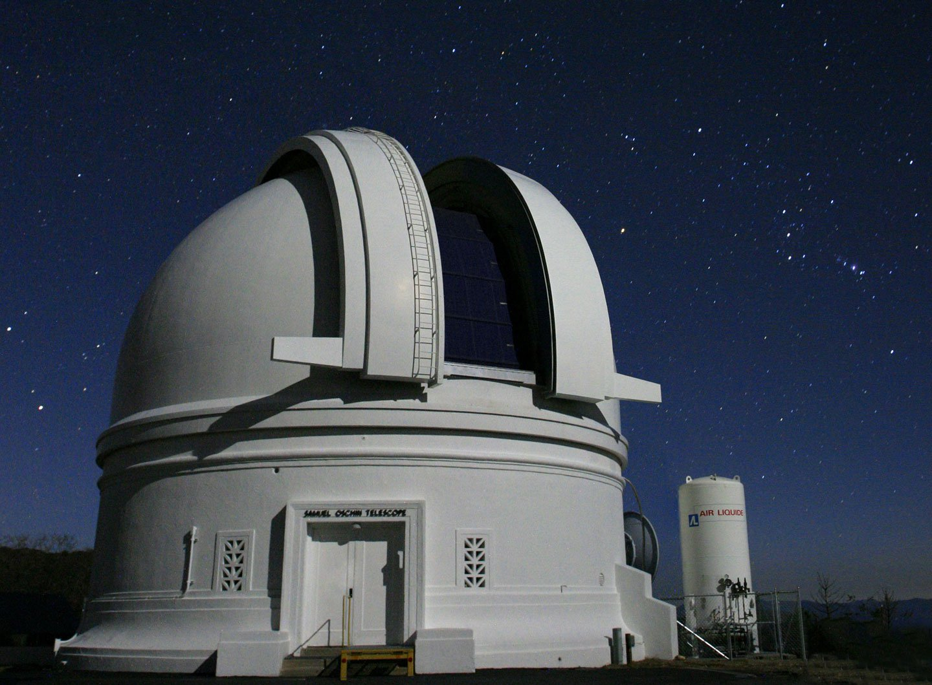
Data Selection
In this talk, 51 SNeIIn from the Zwicky Transient Facility Bright Transient Survey (ZTF BTS, Perley+20) are presented.

Slide 24
Data Selection
In this talk, 51 SNeIIn from the Zwicky Transient Facility Bright Transient Survey (ZTF BTS, Perley+20) are presented.
We select transients that have good photometric coverage (at least 50 days of followup), in at least the ZTF g and r filters.

Slide 25
Data Selection
In this talk, 51 SNeIIn from the Zwicky Transient Facility Bright Transient Survey (ZTF BTS, Perley+20) are presented.
We select transients that have good photometric coverage (at least 50 days of followup), in at least the ZTF g and r filters.
The transients should also have spectral data spanning ~a week post explosion to discount flash ionization masquerading as SNIIn features. (c.f. 23ixf). Around half of the full BTS sample did not meet our selection requirements.

Slide 26
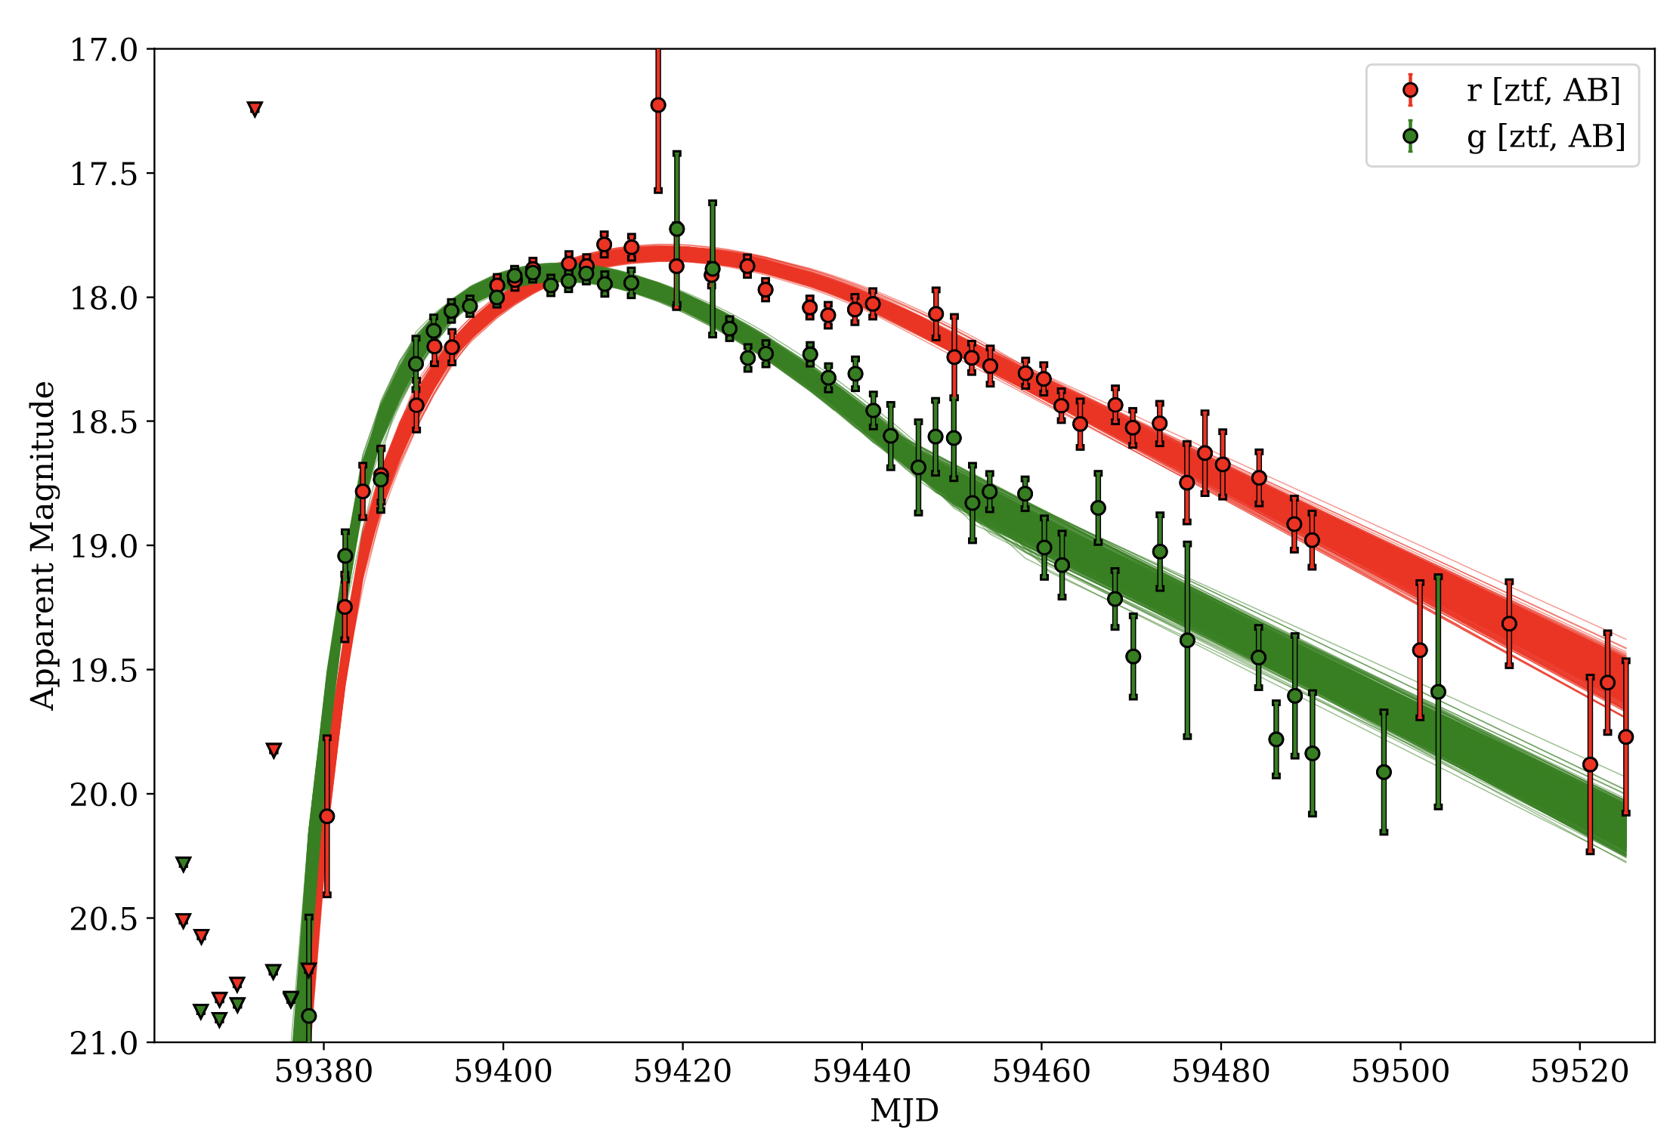
Lightcurve fits

Slide 27
SN parameters from MOSFiT

Slide 28
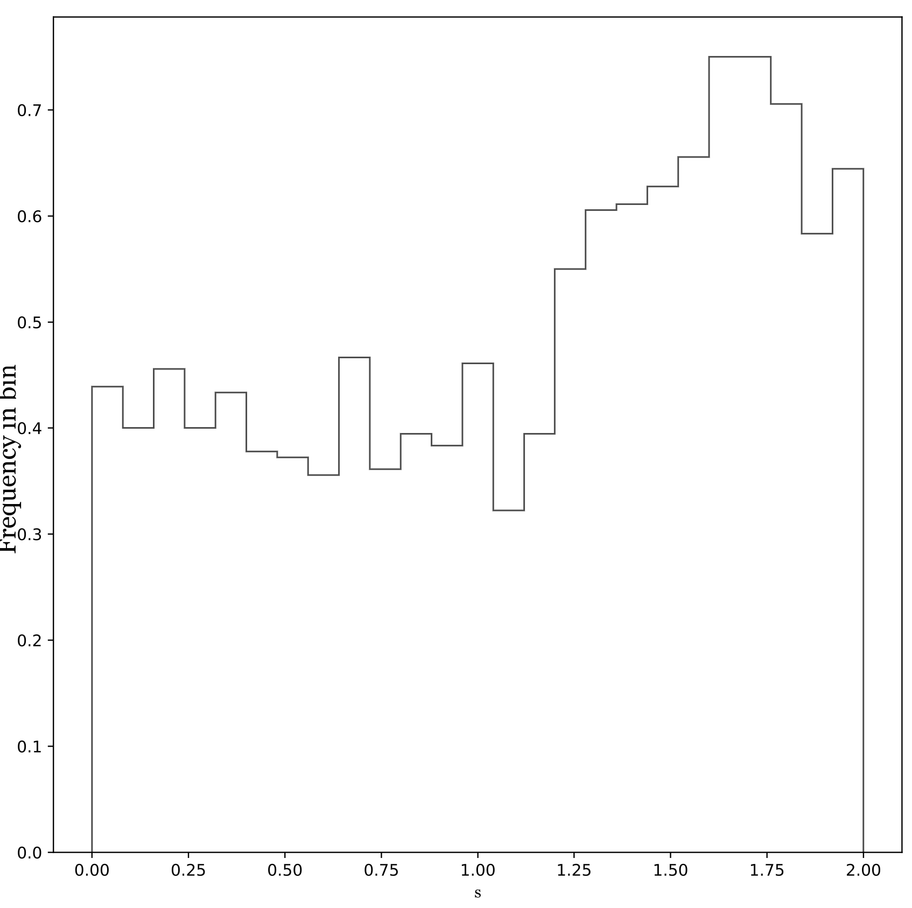
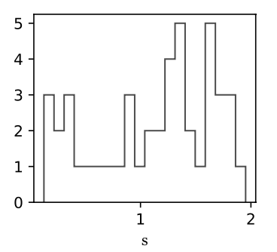
Selected parameters
$$ρ ∝r^{−s}$$
Shell like CSM, consistent with eruptive mass loss
Wind-like CSM, consistent with steady mass loss

Slide 29
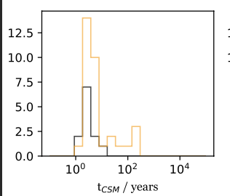
Selected parameters
$$ρ ∝r^{−s}$$
Shell like CSM, consistent with eruptive mass loss
Wind-like CSM, consistent with steady mass loss

Slide 30
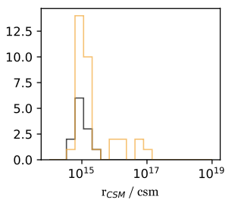
Selected parameters
$$ρ ∝r^{−s}$$
Shell like CSM, consistent with eruptive mass loss
Wind-like CSM, consistent with steady mass loss

Slide 31
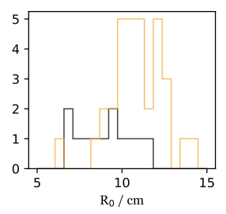
Selected parameters
$$ρ ∝r^{−s}$$
AU
Shell like CSM, consistent with eruptive mass loss
Wind-like CSM, consistent with steady mass loss

Slide 32
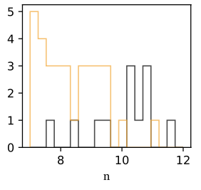
Selected parameters
$$ρ ∝r^{−s}$$
Shallower gradient.
Steeper gradient
Shell like CSM, consistent with eruptive mass loss
Wind-like CSM, consistent with steady mass loss

Slide 33
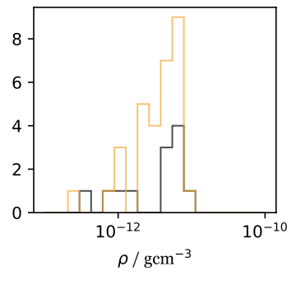
Selected parameters
$$ρ ∝r^{−s}$$
Shell like CSM, consistent with eruptive mass loss
Wind-like CSM, consistent with steady mass loss

Slide 34
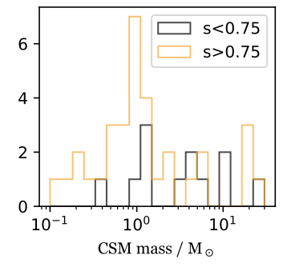
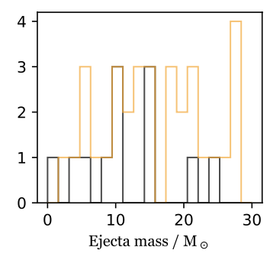
Selected parameters
$$ρ ∝r^{−s}$$
Shell like CSM, consistent with eruptive mass loss
Wind-like CSM, consistent with steady mass loss

Slide 35
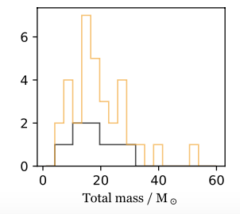
Selected parameters
$$ρ ∝r^{−s}$$
Shell like CSM, consistent with eruptive mass loss
Wind-like CSM, consistent with steady mass loss

Slide 36
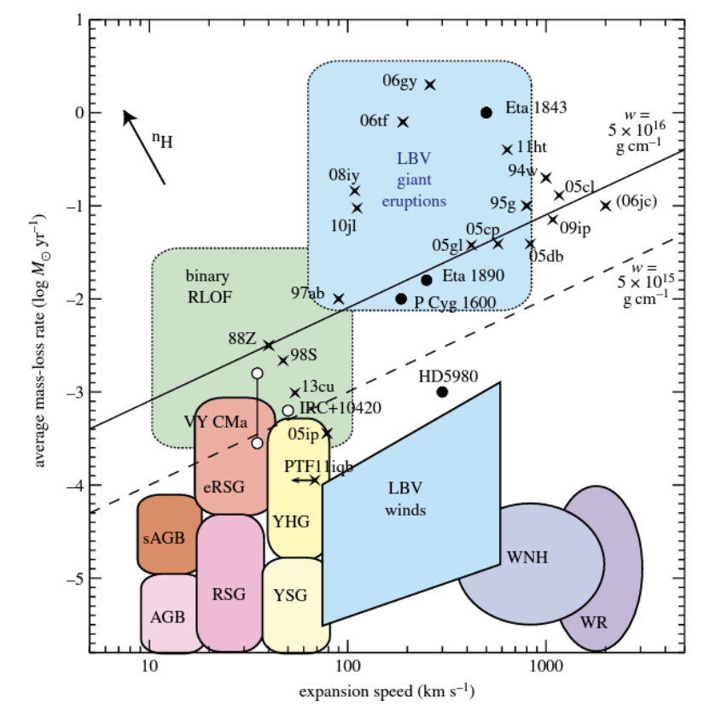
Comparisons
Smith 2017

Slide 37
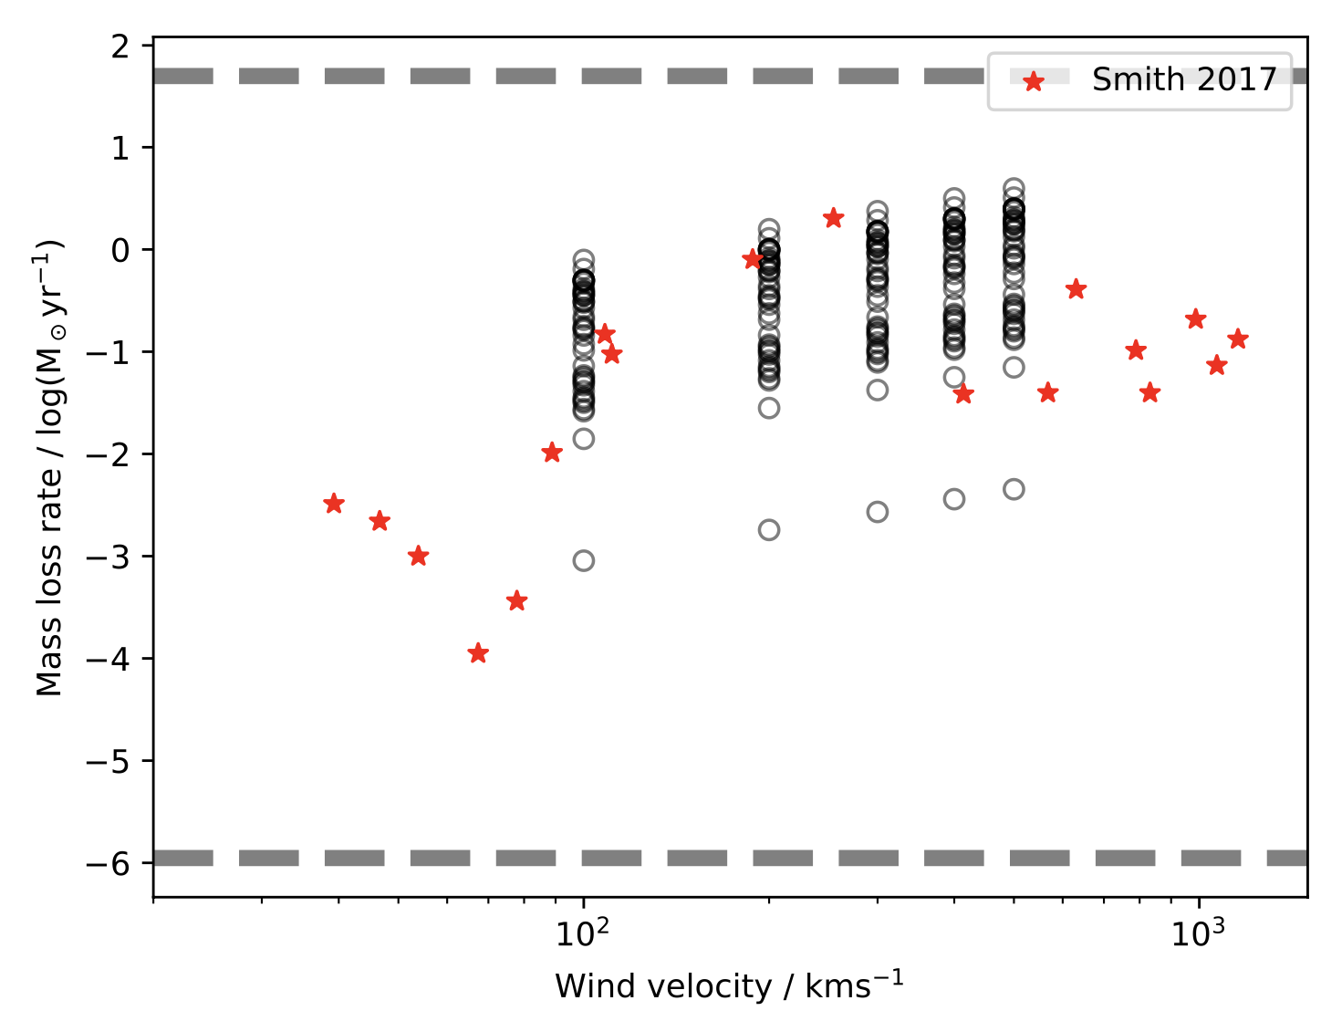
Comparisons
Smith 2017

Slide 38
Comparisons
Our SNe IIn have mass loss rates which are consistent with the typical mass loss rates of SN IIn progenitors, in both observations and modelling (Smith 2017, Yaron+2017)
The mass loss histories are not consistent with purely eruptive, or purely steady wind modes
The total masses (approximate to progenitor masses -1.4 msol) are consistent with a range of possible progenitor paths.

Slide 39
Comparisons
The total masses span from the very lowest core-collapse progenitor masses ~8 msol to massive progenitors >30msol.
Progenitor channels (which are broadly consistent with the mass loss rates we find) include:
Super-AGB stars which lose mass via massive winds, core collapse then occurs via electron capture -> electron capture SNe, e.g. SN2018zd (Hiramatsu+2021).
`Normal’ progenitors such as red supergiant, for example SN2005cl (Li&Morozova 2022)
Luminous blue variables, either low luminosity/mass LBVs or higher mass ‘classical’ LBVs which lose mass via dramatic eruptive mass loss. (Smith 2014, 2017)

Slide 40
Conclusions and summary
MOSFiT fits of 51 SNIIn lightcurves.
Parameters calculated from lightcurve fits show that our sample of ZTF BTS SNeIIn are consistent with observed SNeIIn and SNIIn models.
There is no clear correlation or clustering in these parameters.
The CSM density profiles suggest non-steady mass loss in the years preceding the SN explosion.
Our results are consistent with a continuum of progenitors, perhaps ranging from the very lowest mass core collapse progenitors, super-AGB stars, to massive, LBV-like progenitors.

Slide 41
Conclusions and summary
MOSFiT fits of 51 SNIIn lightcurves.
Parameters calculated from lightcurve fits show that our sample of ZTF BTS SNeIIn are consistent with observed SNeIIn and SNIIn models.
There is no clear correlation or clustering in these parameters.
The CSM density profiles suggest non-steady mass loss in the years preceding the SN explosion.
Our results are consistent with a continuum of progenitors, perhaps ranging from the very lowest mass core collapse progenitors, super-AGB stars, to massive, LBV-like progenitors.
FUTURE WORK – extend to more SNeIIn from PTF, PanSTARRS and other archival objects.

