Slide 1
Long duration transients (LDTs) with SPT-3G
Kedar A Phadke (UIUC) on behalf of the SPT-3G collaboration
The Transient and Variable Universe
June 2023
Photo Credit: Aman Chokshi

Slide 2
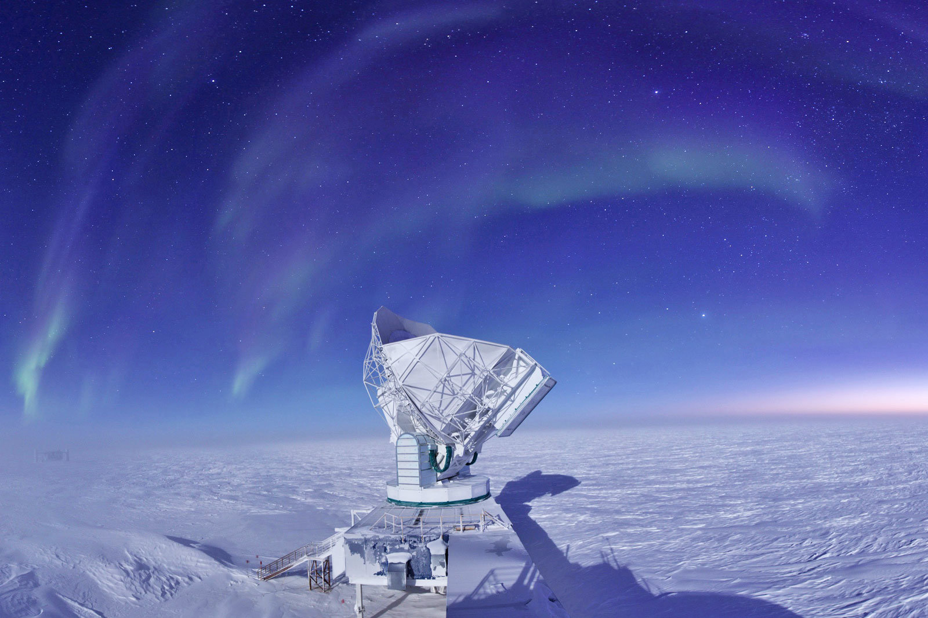
The South Pole Telescope (SPT)
10 m off-axis sub/mm telescope
Now with 3rd Generation camera installed (SPT-3G)
Observes at 1.4 mm (220GHz), 2 mm(150 GHz), 3 mm (95 GHz)+ polarization
Photo Credit: Jason Gallichio

Slide 3
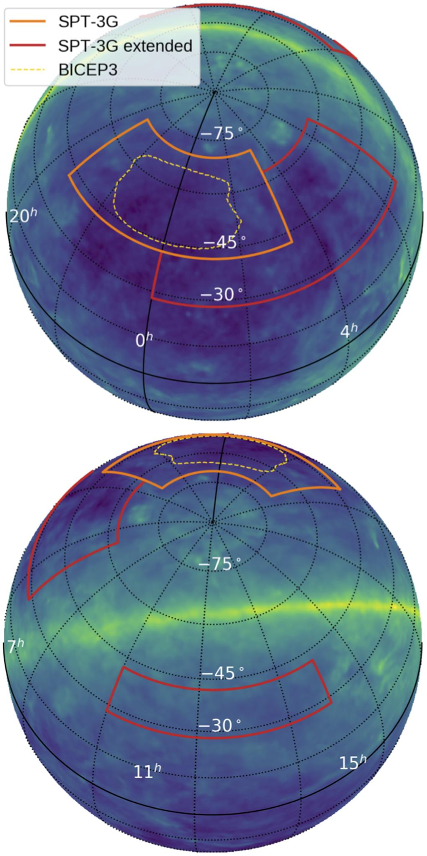
The SPT-3G field
1500 deg² main survey during austral winters; 2019-current
~1.2’ beam size at 150 GHz
20h 40m0s to 3h 20m0s R.A., and −42° to −70° declination
Divided into 4 subfields centered on declinations −44.75°, −52.25°, −59.75°, and −67.25°
Single field observations take about 2 hours
Re-observation cadence for a source varies from 2-20 hours
Figure 6 from Sobrin et al. 2022

Slide 4
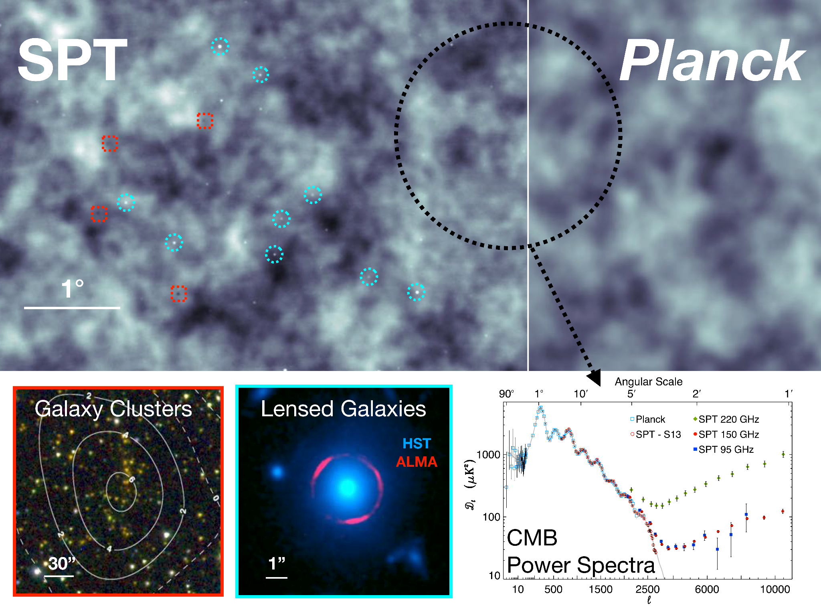
https://astro.fnal.gov/science/cmbr/spt-3g/
Notes:
An illustration of the power of SPT to measure the large- and small-scale features in the mm-wave sky and the science reach of these observations. Top: A composite SPTpol–Planck map of 30 deg2 of the Southern sky. The SPTpol data is both several times deeper and higher angular resolution than the Planck data, but only over a fraction (∼1%) of the sky. The large-scale CMB features are measured with high fidelity in both experiments, with many more clusters (red-dash squares) and point sources (blue-dash circles) visibly identifiable in the SPT data. Bottom Left: An optical-infrared image of galaxy cluster SPT-CL J0459-4947 with SPT-SZ significance contours over-plotted (Bleem et al., 2015). This cluster is the highest-redshift spectroscopically-confirmed SPT cluster with a measured X-ray redshift of z = 1.70 ± 0.02 (Khullar et al., 2018). Bottom Middle: HST/ALMA view of the SPT-discovered strongly lensed DSFG SPT-S J053816-5030.8 at z = 2.78 (Vieira et al., 2010, 2013). Bottom Right: CMB temperature power spectra from SPT-SZ and Planck (George et al., 2015). SPT extends the multipole range of the Planck data, providing new constraints on primary CMB anisotropy and making groundbreaking measurements of secondary anisotropy.

Slide 5
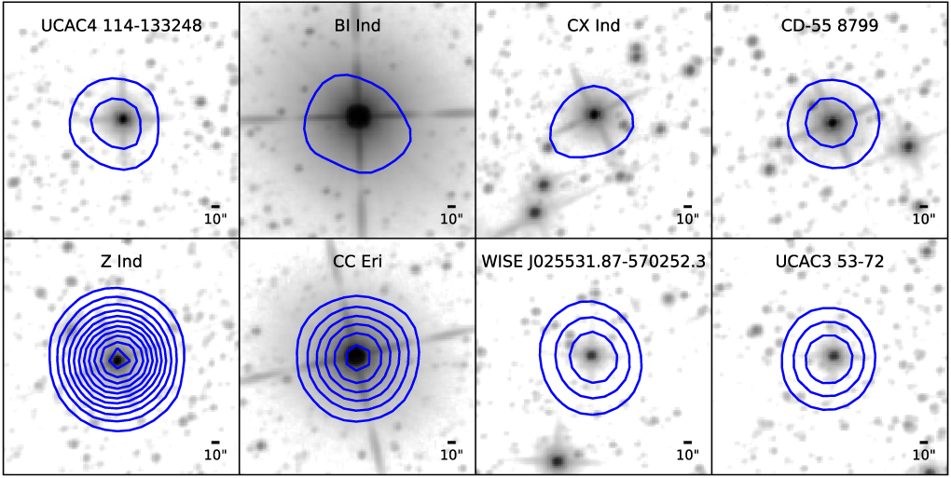
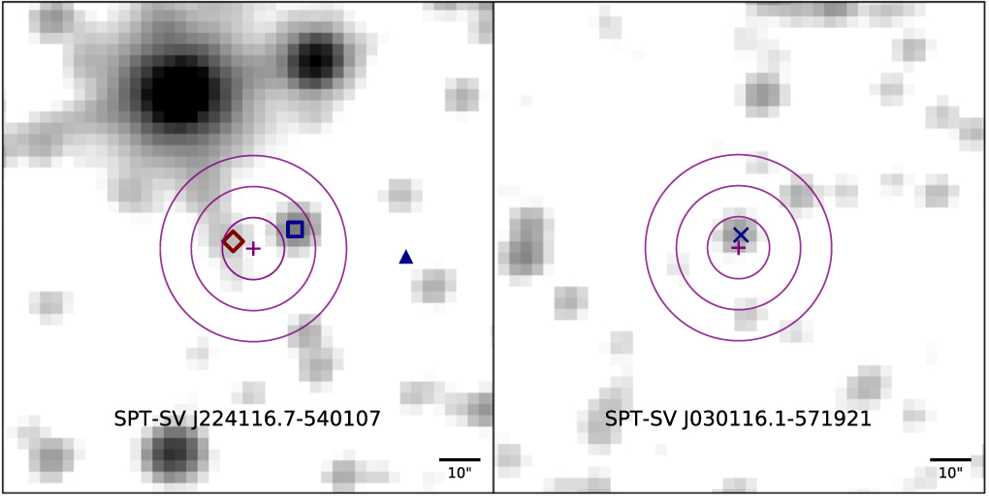
The first SPT-3G transient survey
Short duration flares associated with stars (more on this by C. Tandoi in the afternoon)
Long duration transients
X-ray
WISE band 1 background images
10 transients objects > 10𝜎 identified with SPT-3G; 13 short-flares associated with 8 stars; 2 LDTs were identified to be of extragalactic origin
Figures 2 , 6 and 7 from Guns et al. 2021

Slide 6
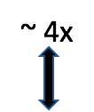
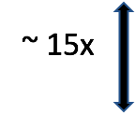
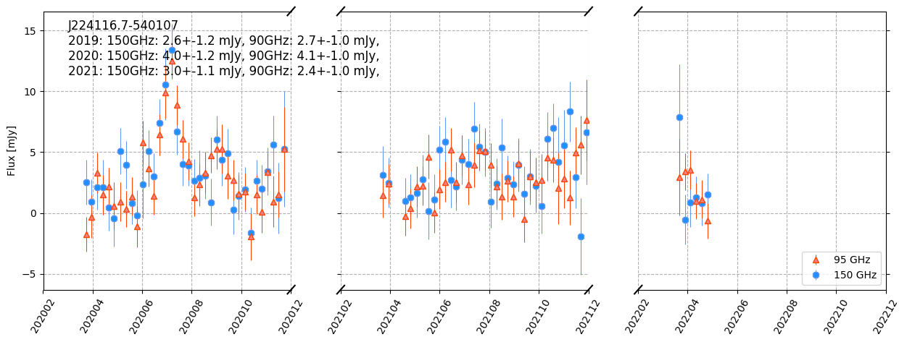
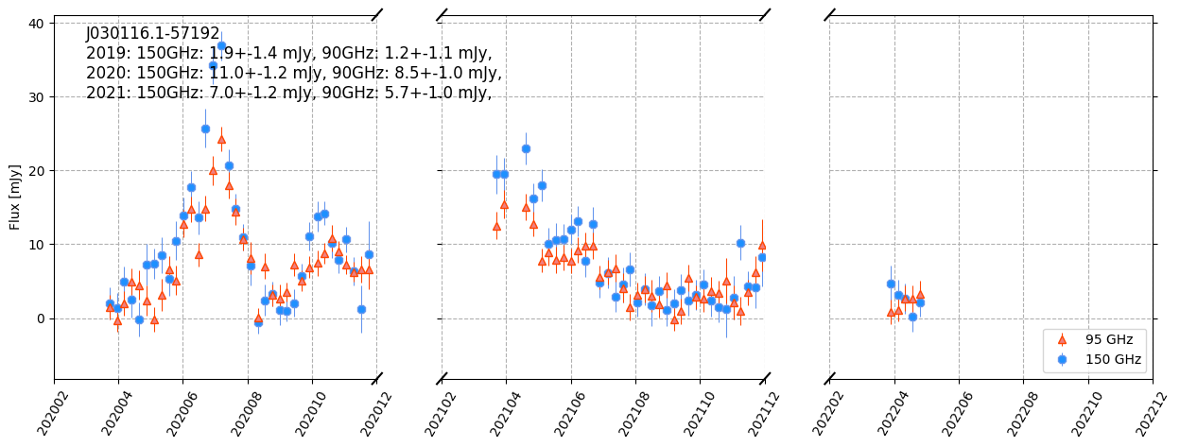
Figures 8 and 9 from Guns et al. 2021
Source 9
Source 10
Credit: Allen Foster, CWU

Slide 7
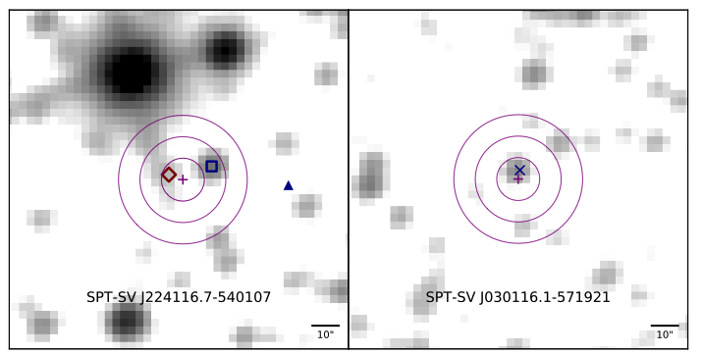
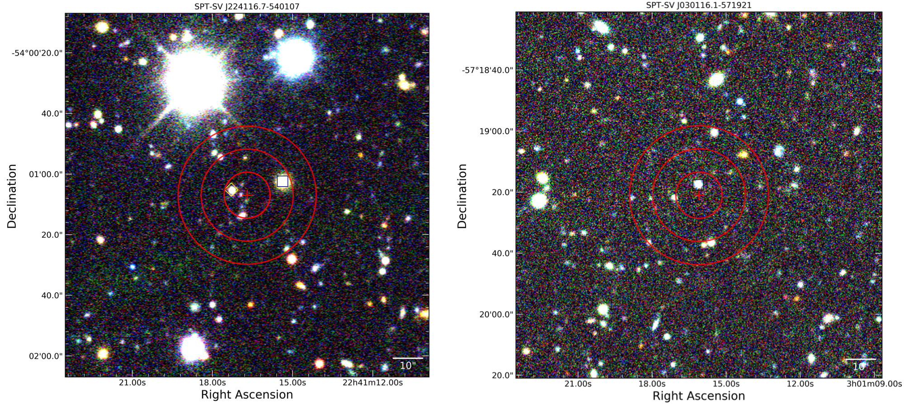
X-ray
Source 9
Source 10

Slide 8
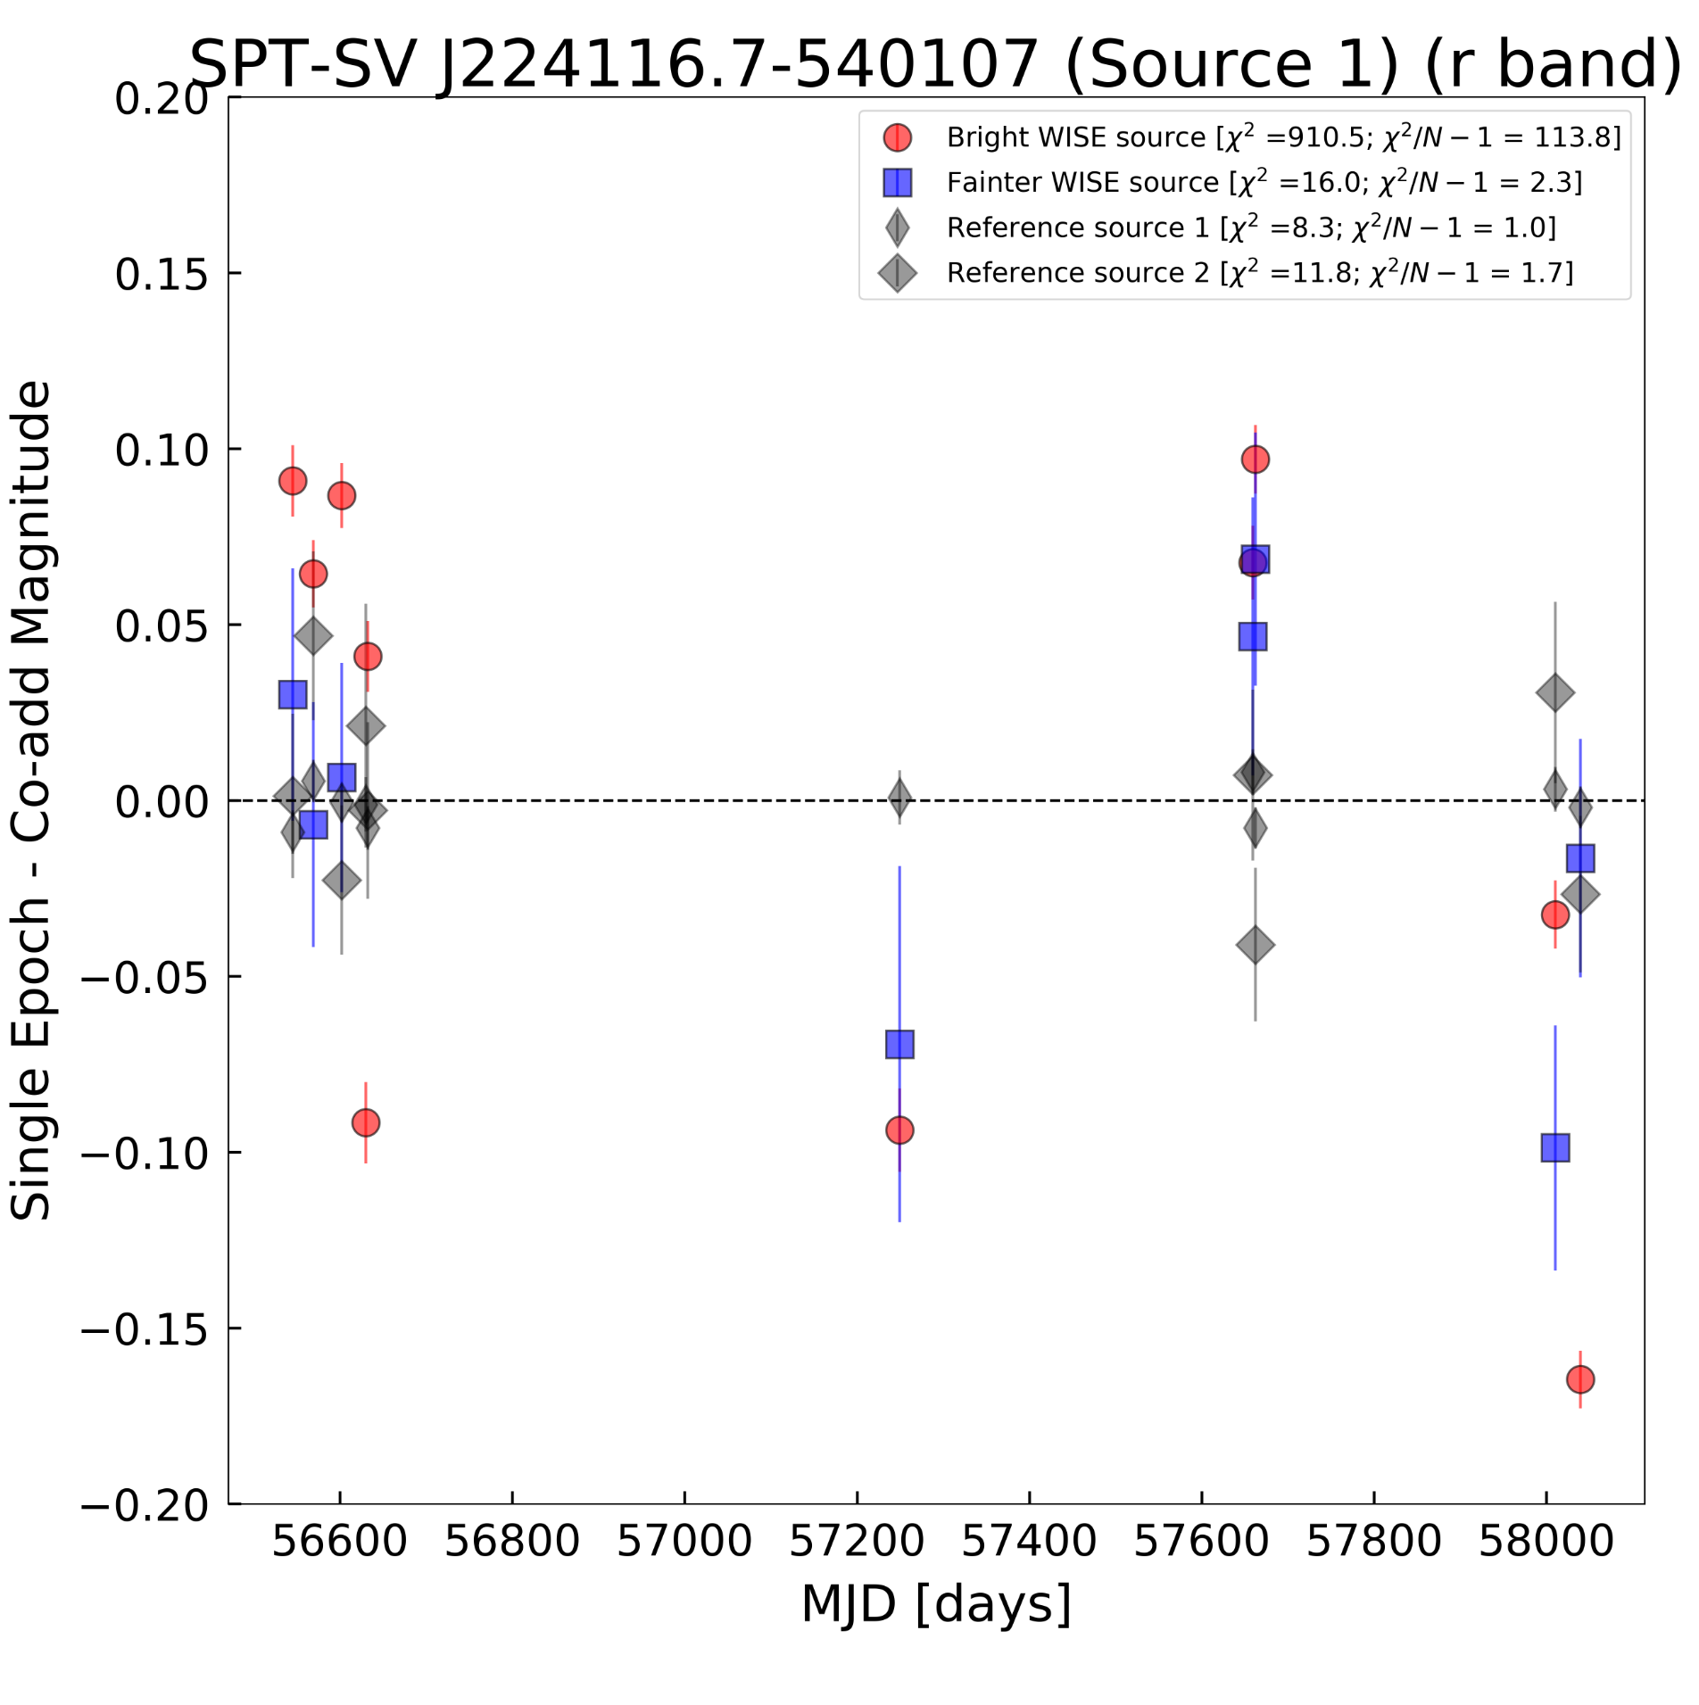
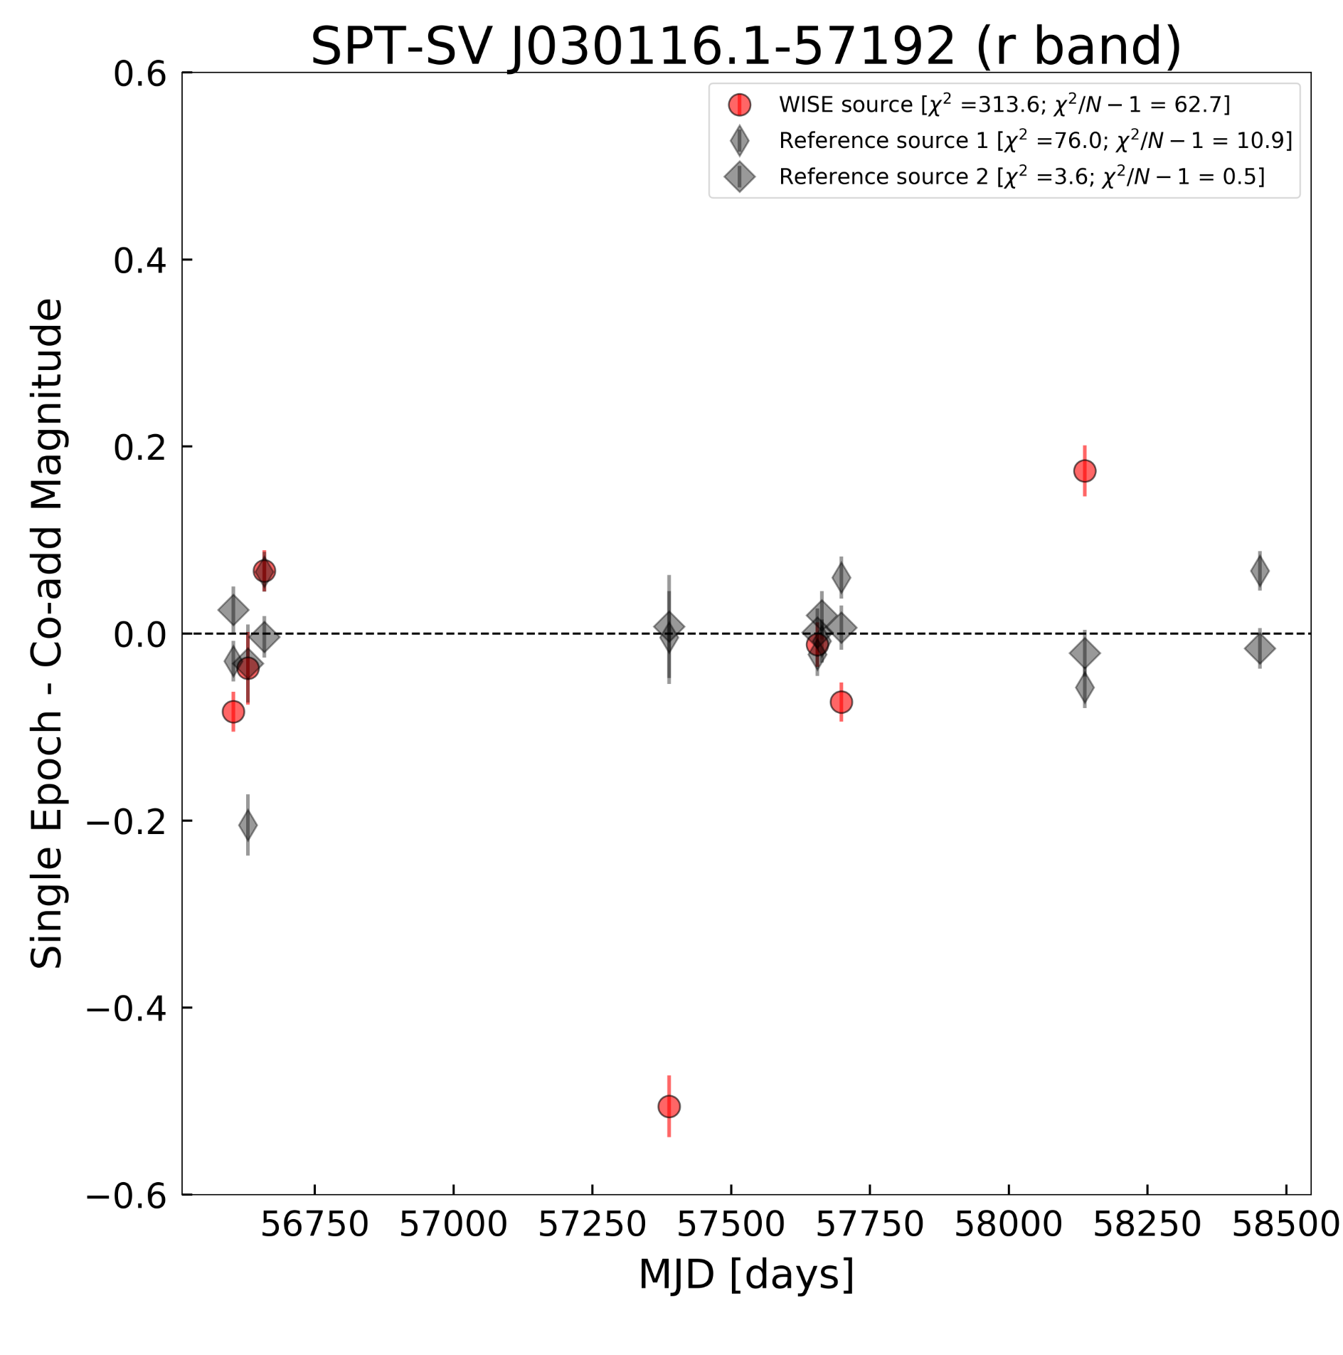
Optical variability in DES r band
9

Slide 9
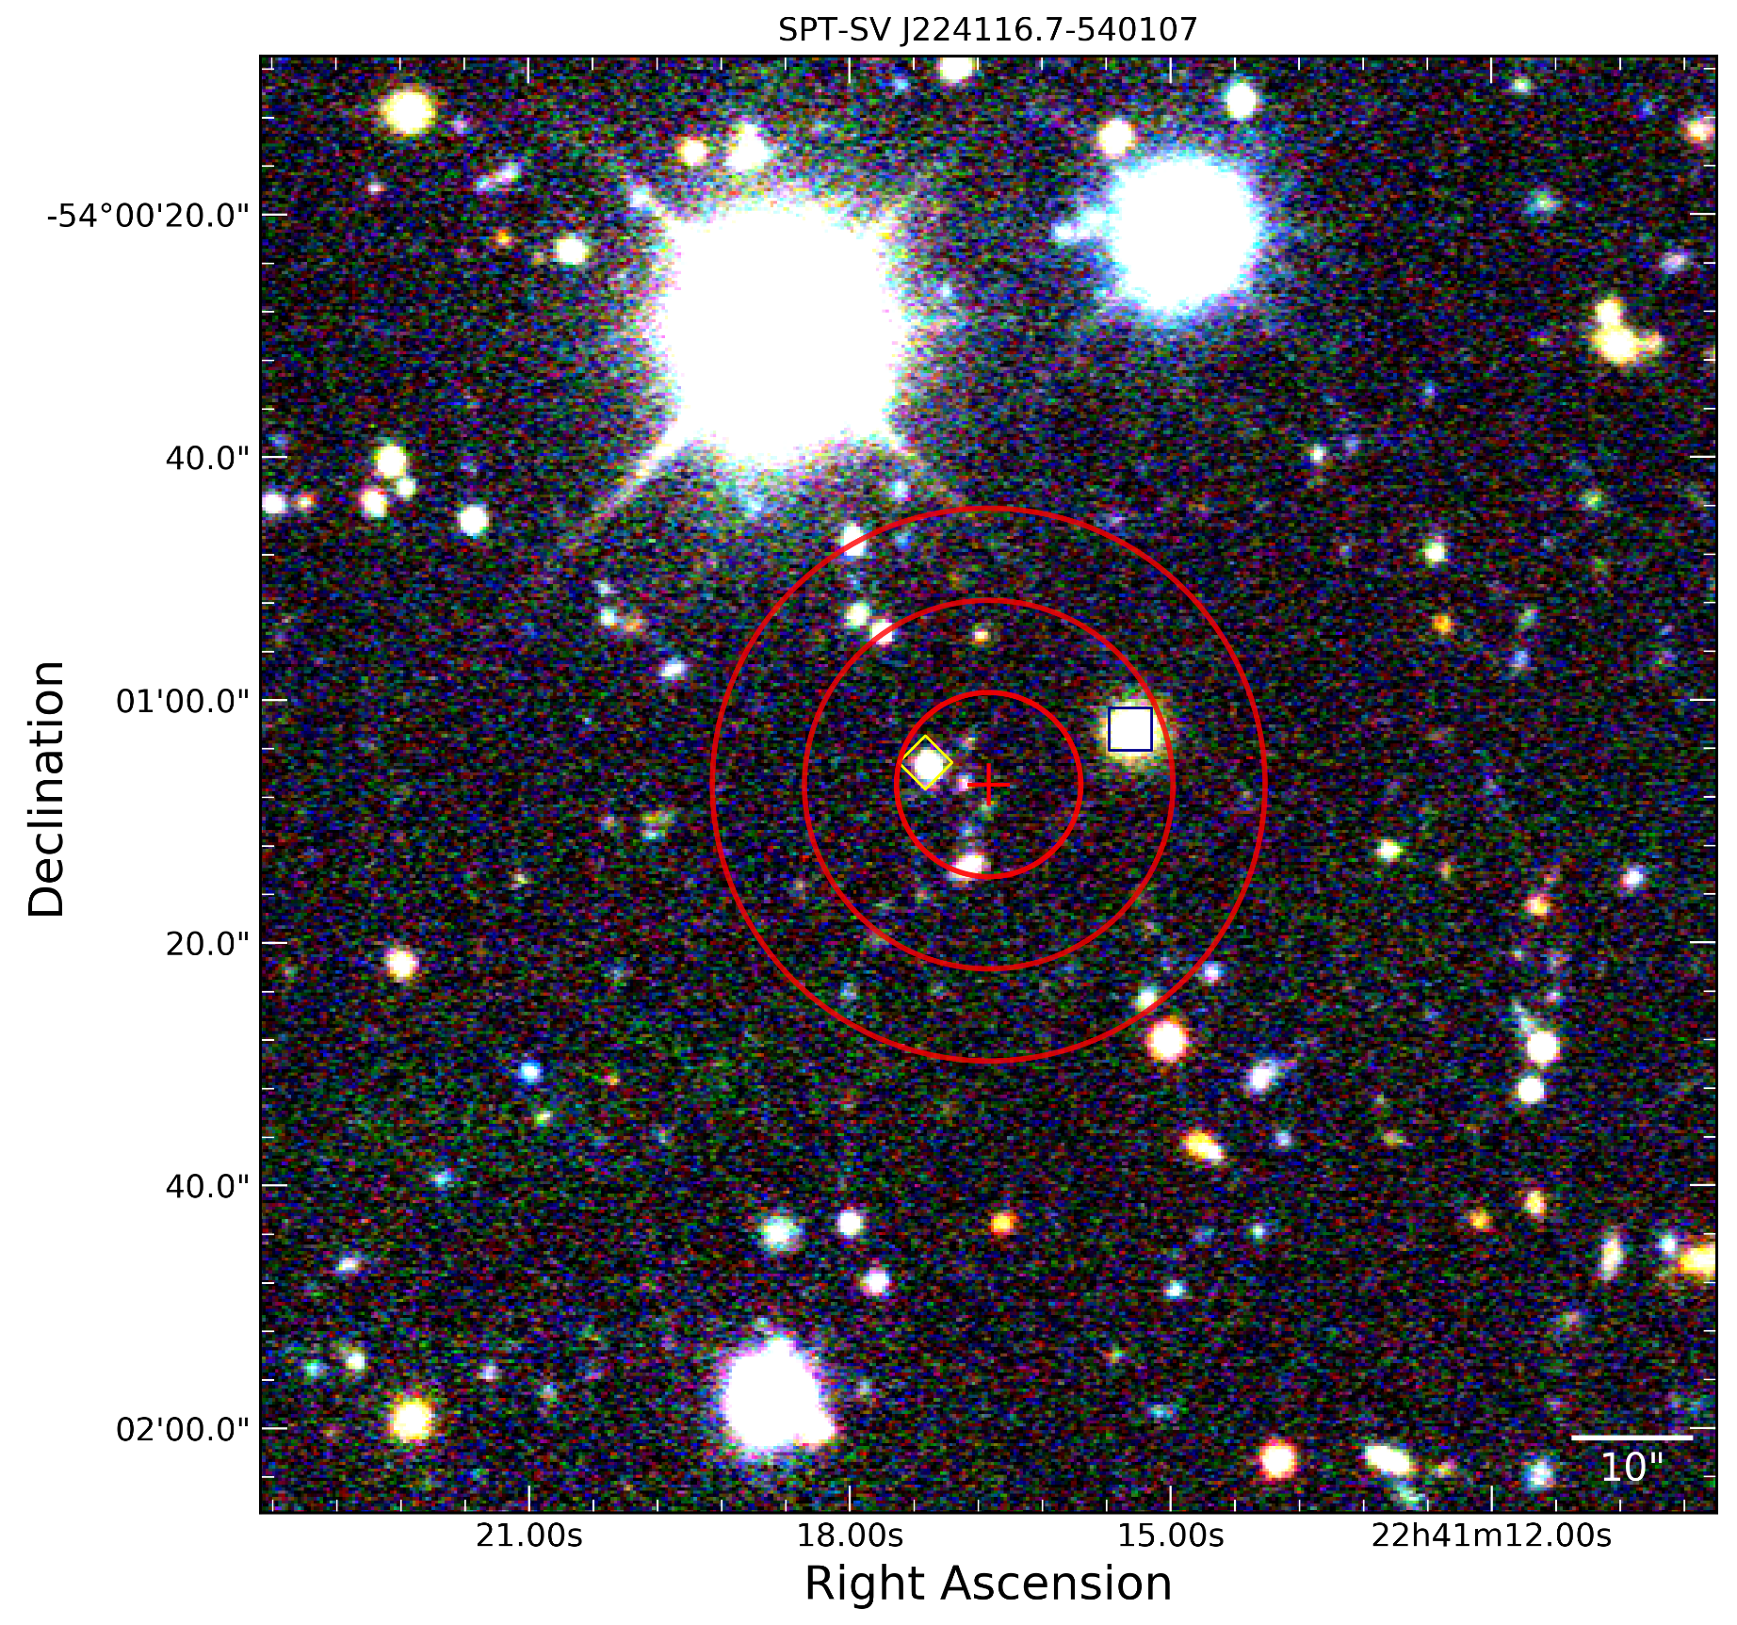
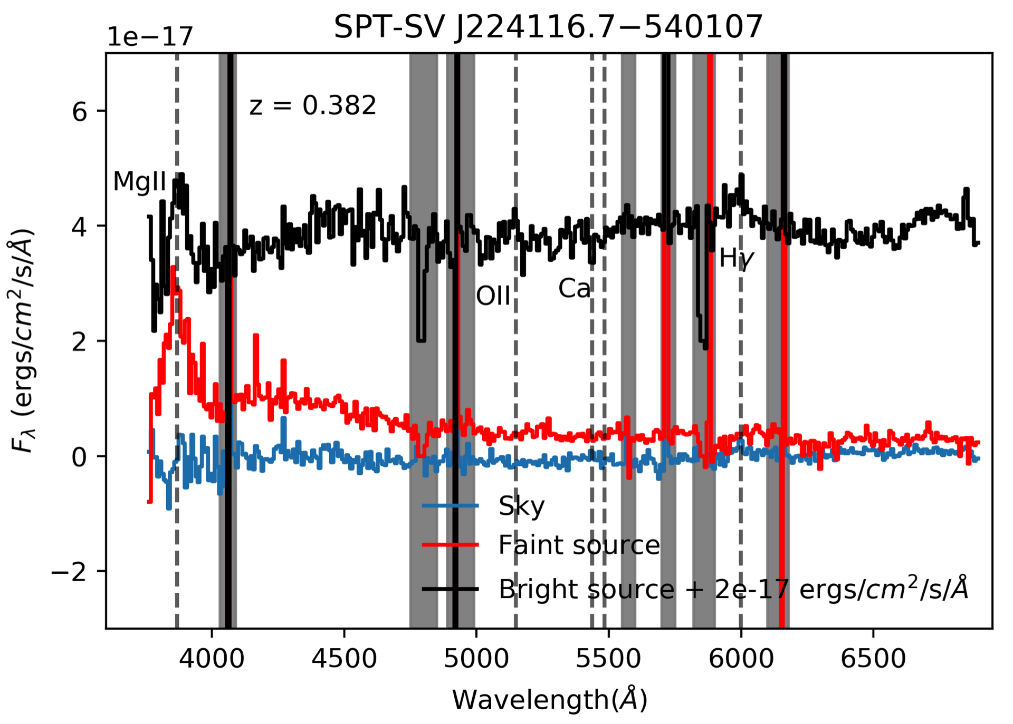
“Source 9” (SPT-SV J224116.7−540107): 2 possible WISE associations, 1 X-ray source associated with the bright WISE source
GMOS-S
Confirmed redshift and broad MgII, Hγ line for the bright source.Fainter source has a detection of a broad line possibly at same redshift.
Photo-z ~ 0.37 (bright), 0.64 (faint)

Slide 10
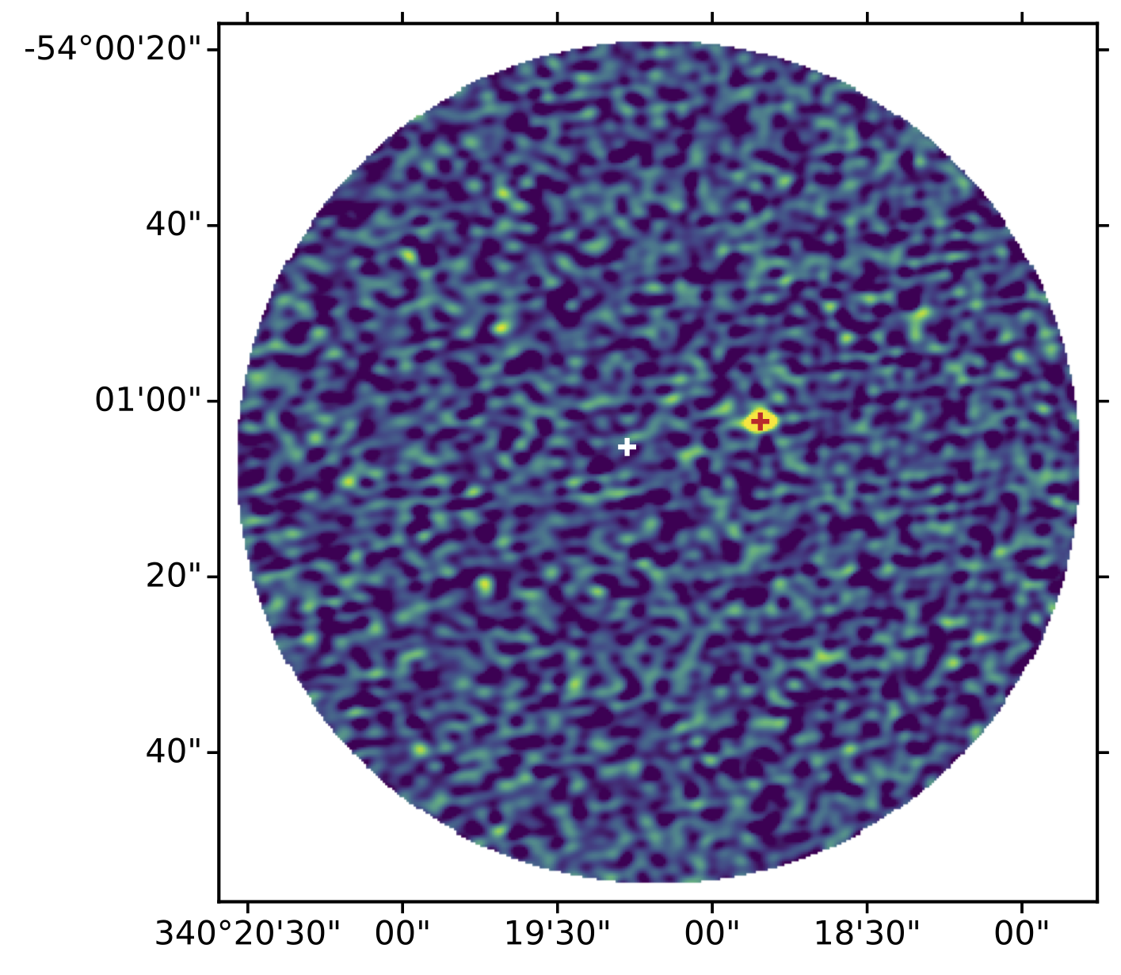
“Source 9” (SPT-SV J224116.7−540107): 2 possible WISE associations, 1 X-ray source associated with the bright WISE source with ALMA
ALMA Band 3

Slide 11
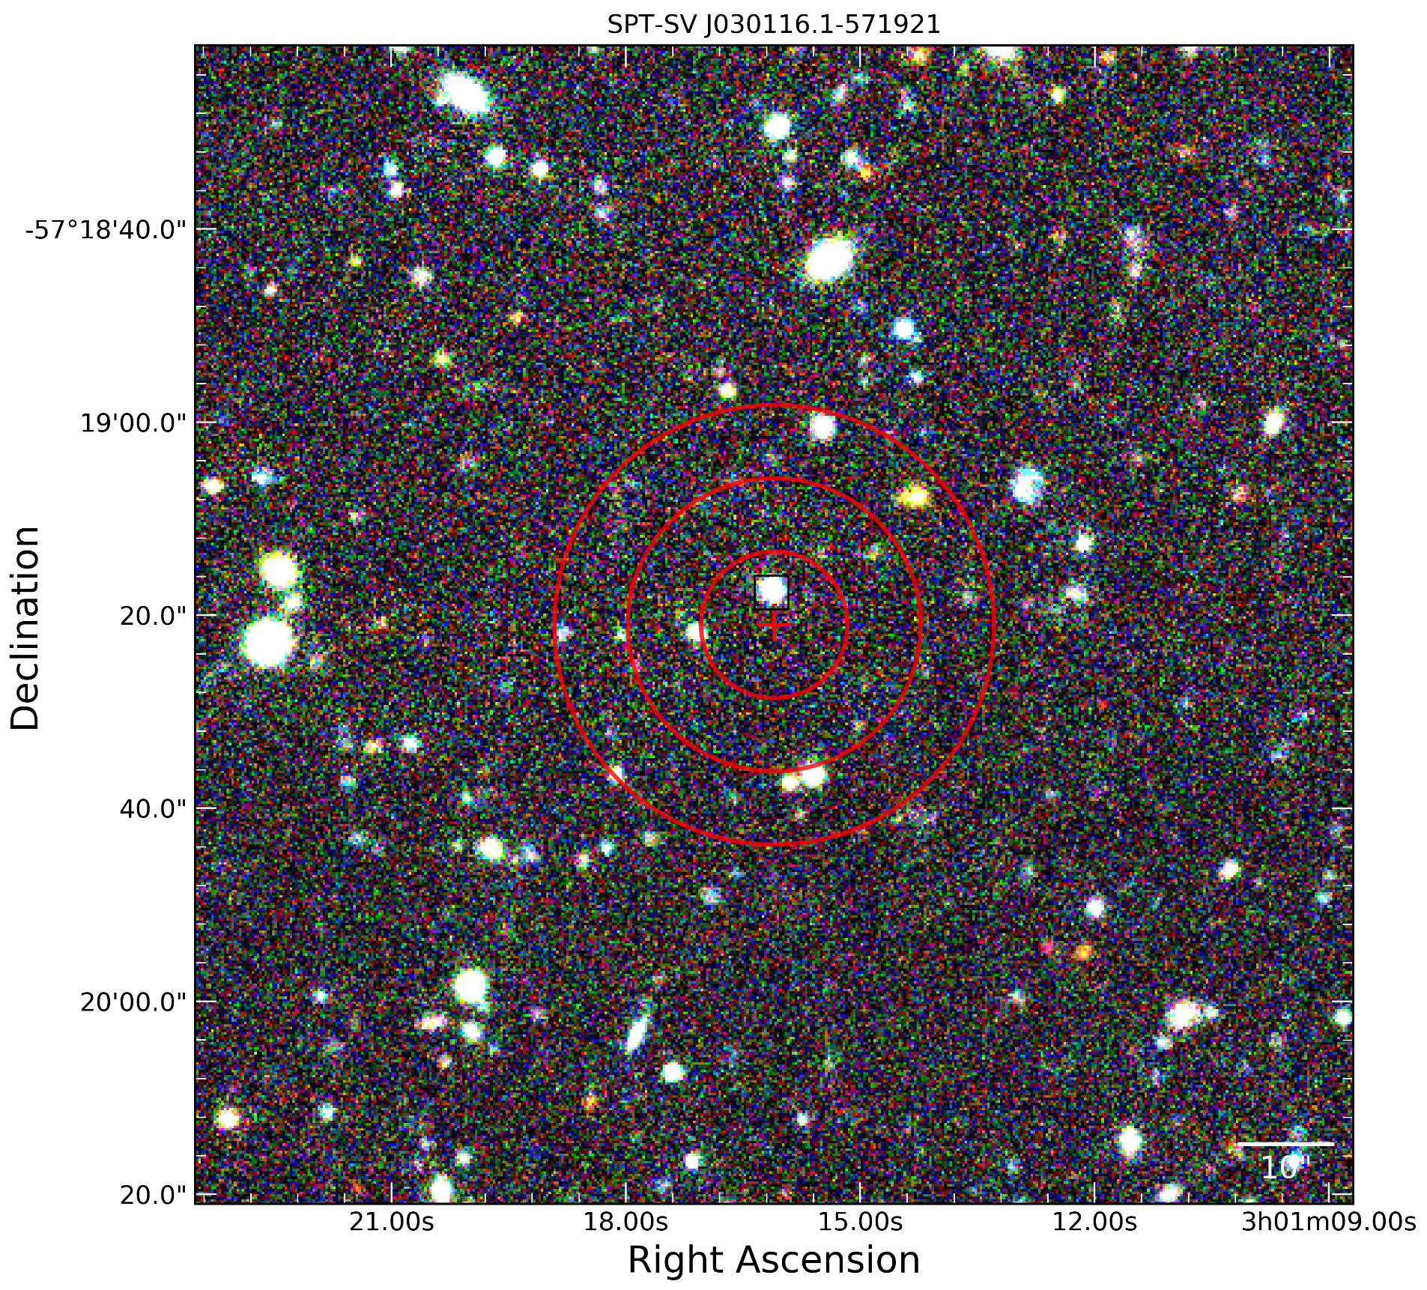
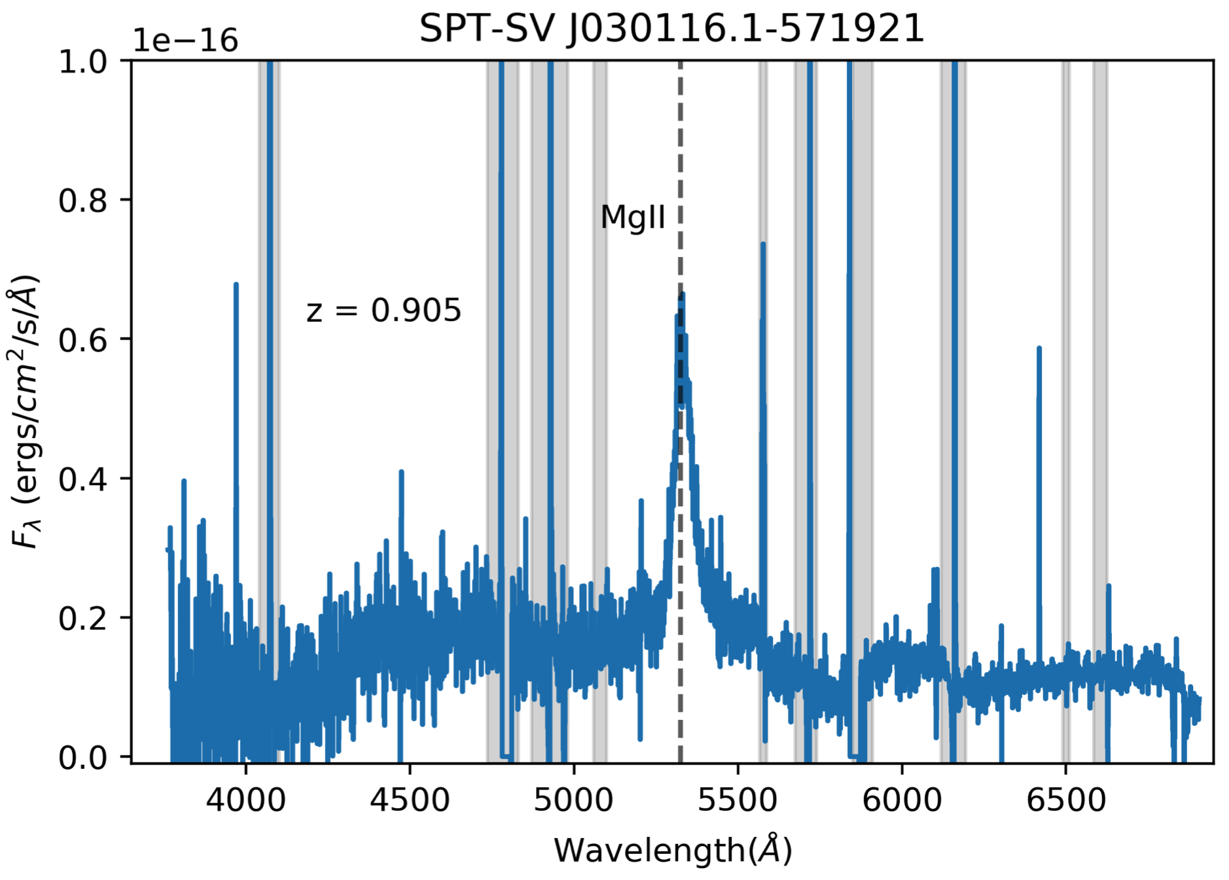
“Source 10” (SPT-SV J030116.1−57192/ WISEA J030116.15-571917.7)
Photo-z ~ 0.97
Gemini spectra centered on the WISE source
GMOS-S
Broad MgII line consistent with the photo-z and AGN hypothesis

Slide 12
Summary of LDTs follow-up
Flaring factors of 4 or 15 is rare compared to bright (>50 mJy) AGN in the SPT field.
Most evidence still points to likely faint AGN flaring
Could also be TDE in an AGN but no reported TDEs/flares found in optical (ASAS-SN) or other surveys.

Slide 13
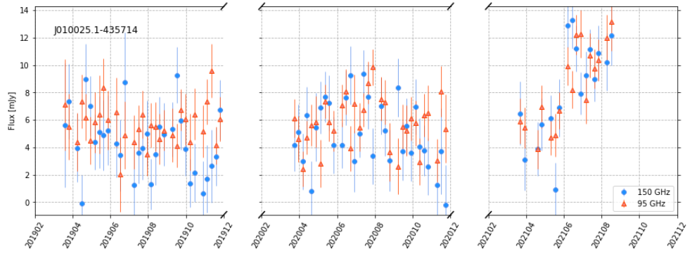
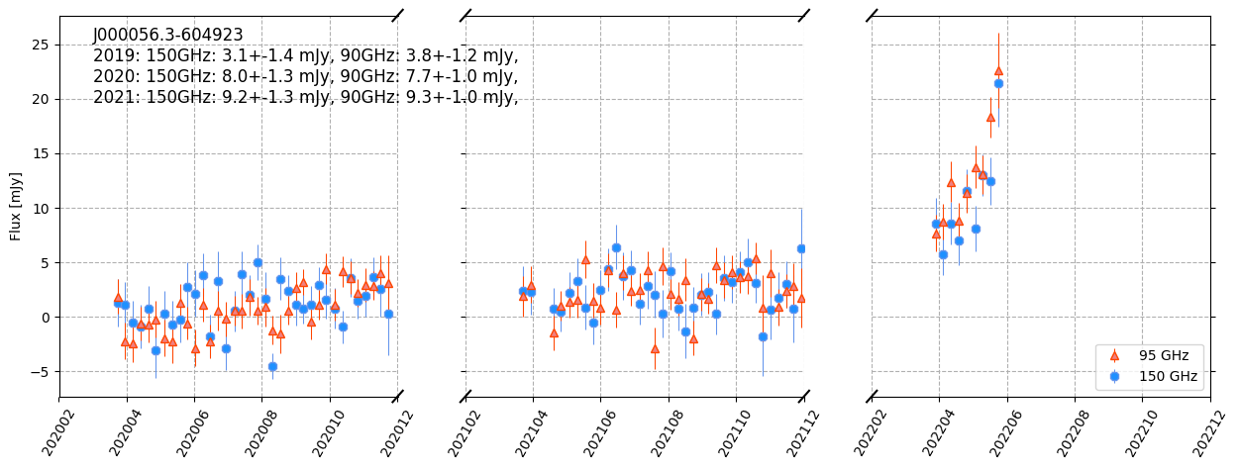
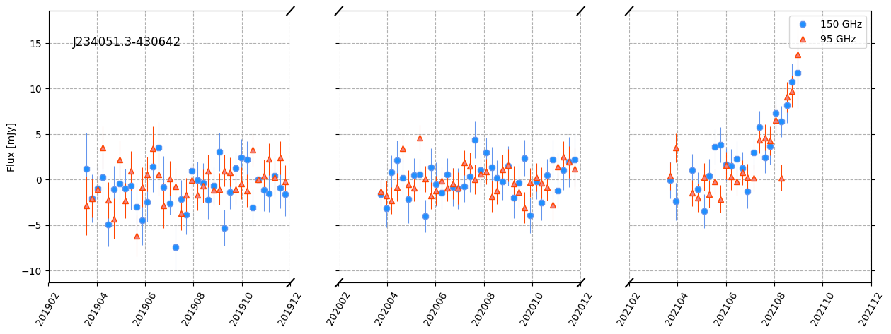
ATel alerts after the first survey paper
https://pole.uchicago.edu/public/data/transients/

Slide 15
J234049.9-430641
2019
2020
2021

Slide 16
Summary of ATels
3 ATels published after the first year survey paper.
SPT-SV J000056.3-604923 known X-ray and RACS source followed up with Swift XRT ToO (~2500s x2) but did not detect anything while the source is still rising in mm-wavelengths.
SPT-SV J234051.3-430642 possibly associated with a WISE source. No other follow-up published.
SPT-SV J010025.1-435714 associated with known X-ray and RACS source, most probably AGN flare.
We’ll keep alerting the community on rare long duration mm-wave flares.

Slide 17
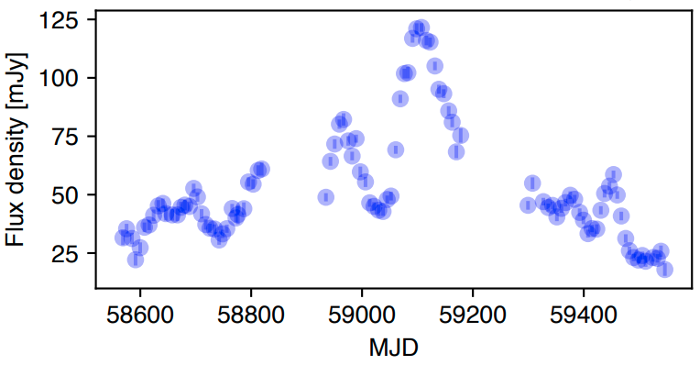
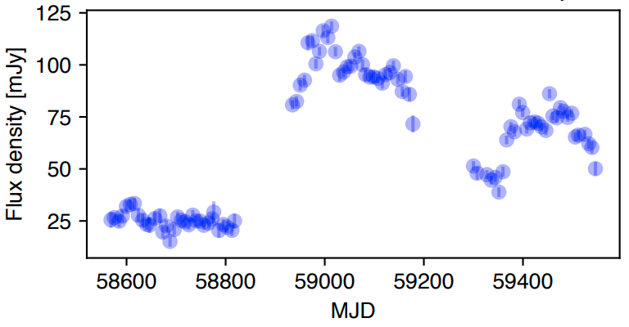
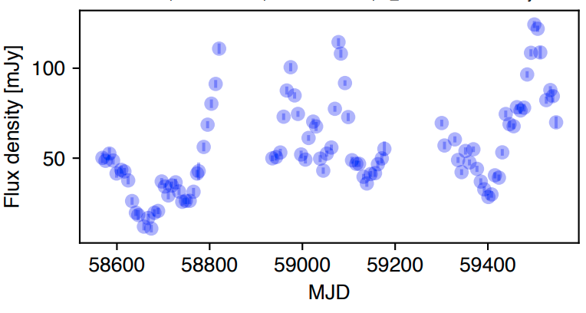
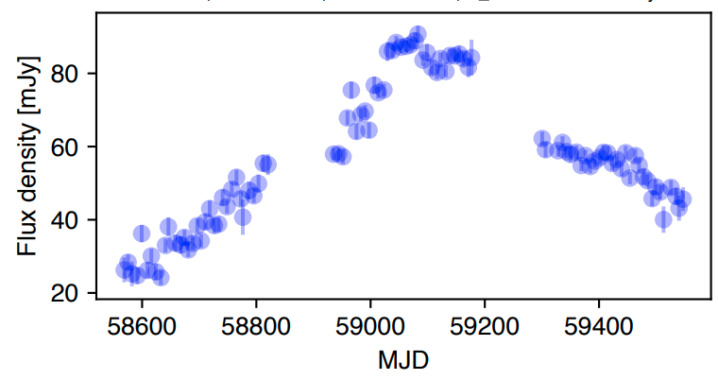
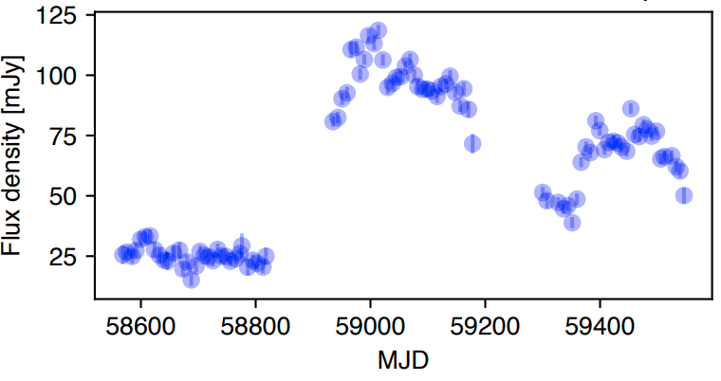
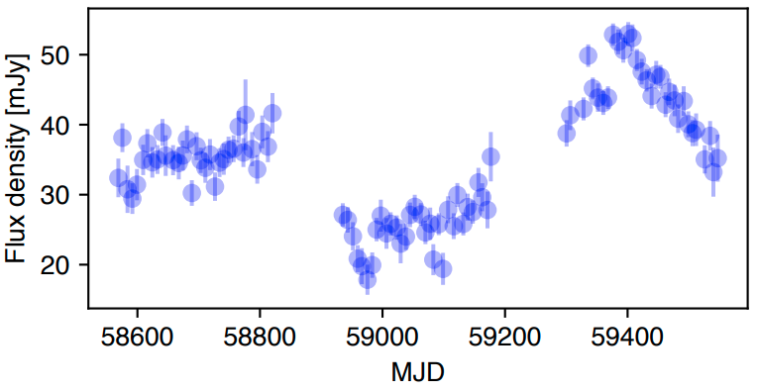
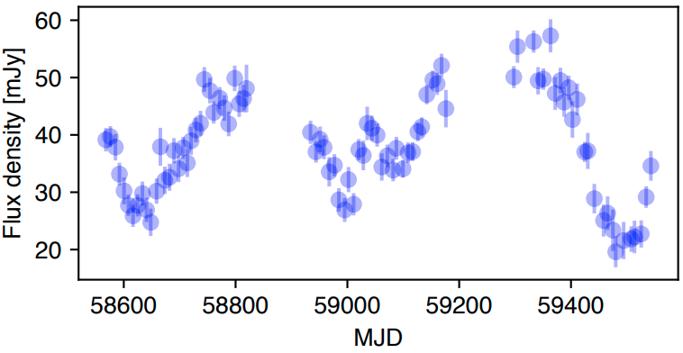
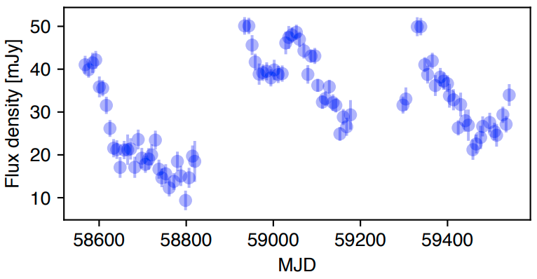
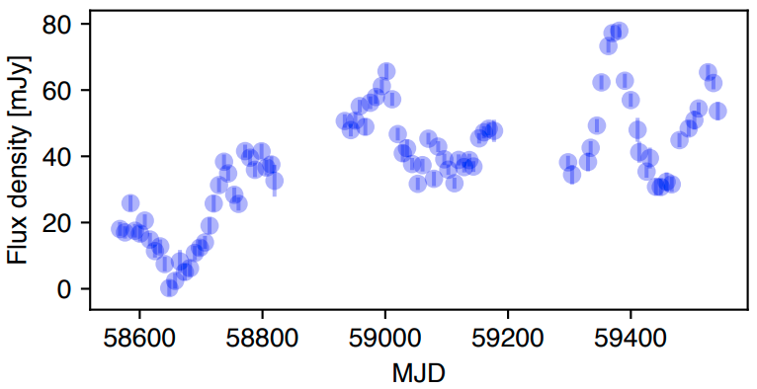
Point source light curves at 150 GHz

Slide 18
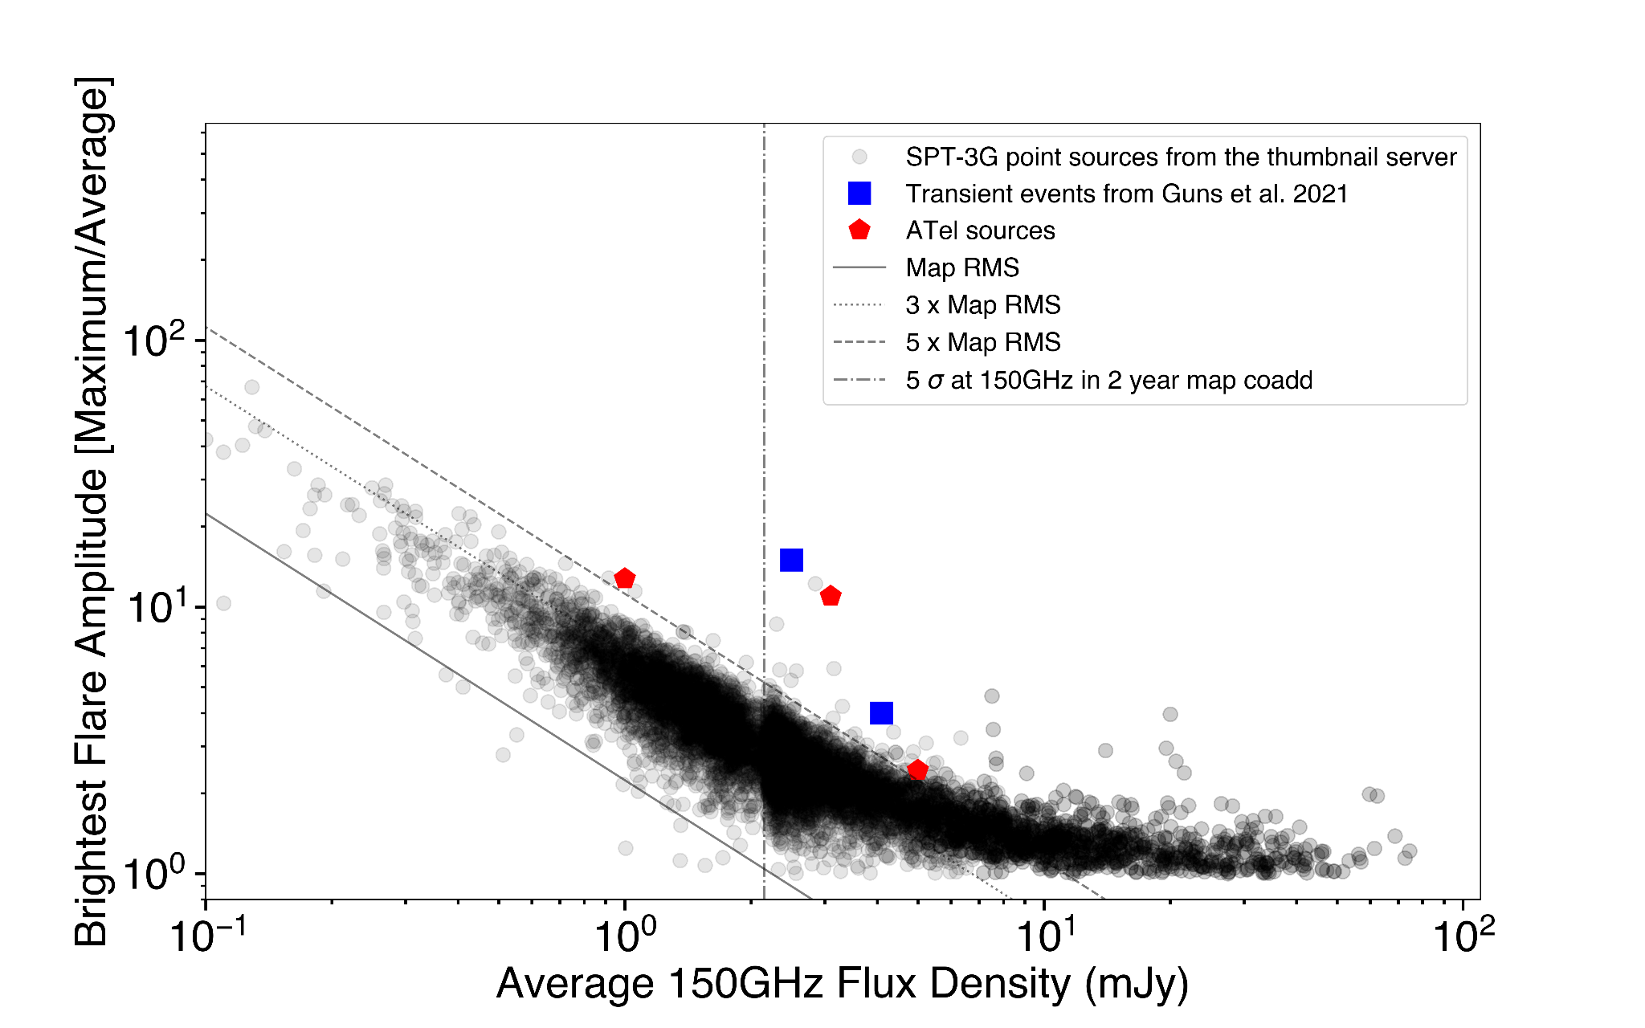
Preliminary long duration (weekly avg.) flare amplitude of 3G sources

Slide 19
Summary and future plans
The two LDTs discovered in Guns et al. 2021 most likely AGN flaring.
Three ATels published after the first year survey paper.
Archival analysis of all point sources being conducted to estimate “normal” mm-wave behaviour of AGN in the SPT-3G field.
Look out for public alerts at: https://pole.uchicago.edu/public/data/transients/
Questions?
PS: Most light curves shown are made by Allen Foster

