Slide 1
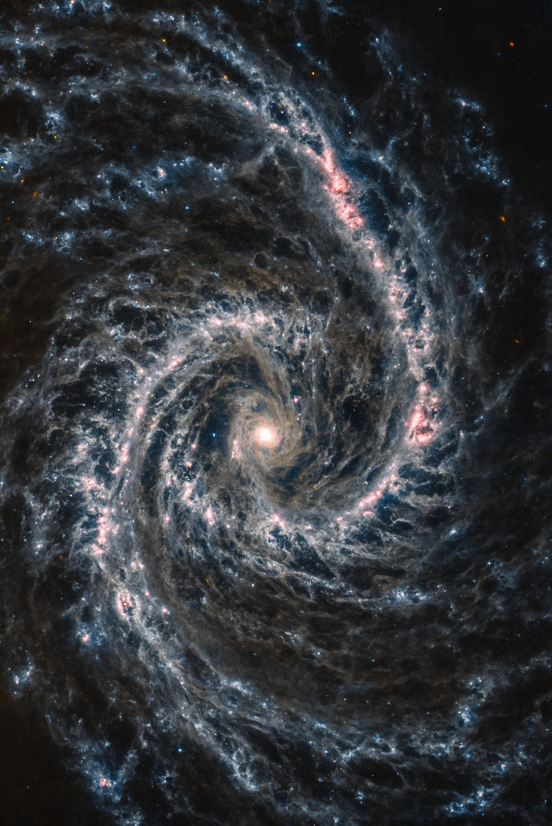
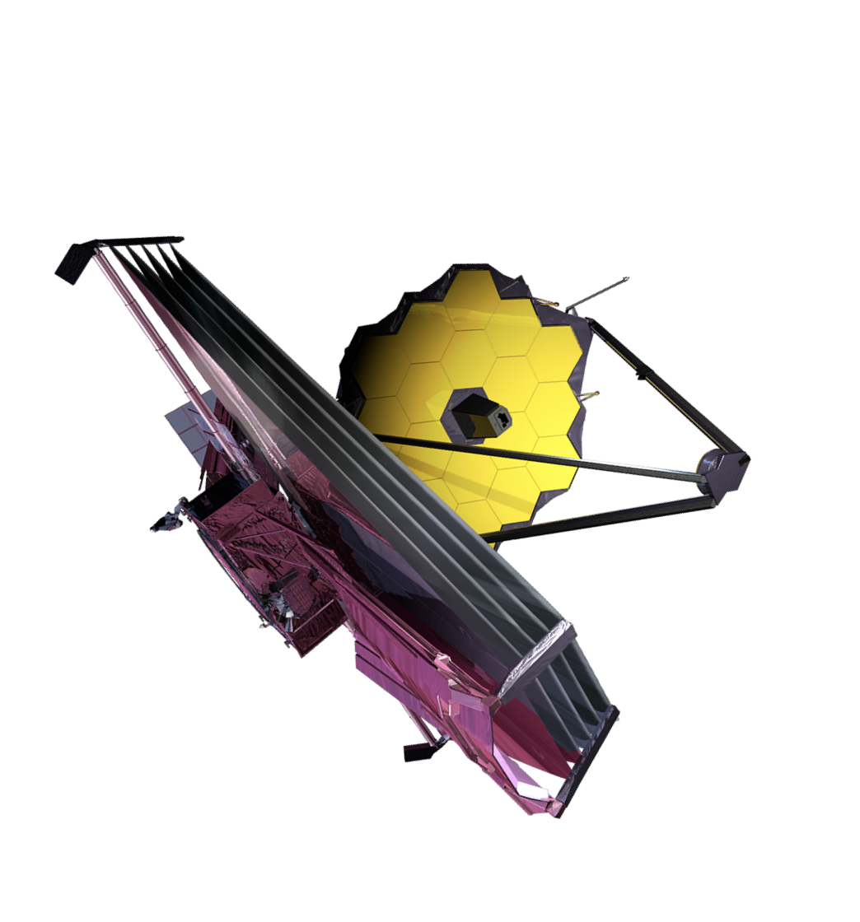
Infrared Evolution of
Type Ia Supernovae
Lindsey Kwok
NASA FINESST Fellow – Rutgers University
UIUC Conference – June 20, 2023
SN 2021aefx
JWST/MIRI image of host galaxy NGC 1566
data via JWST GO 2107 (PI: Janice Lee), processing by Judy Schmidt

Slide 2
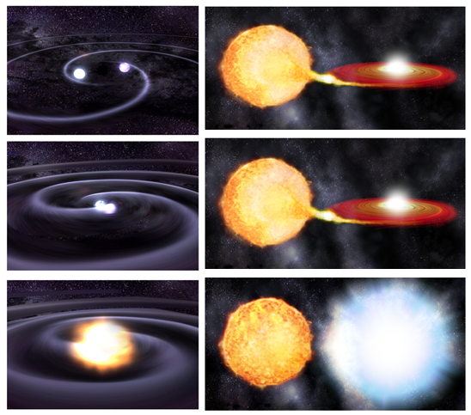
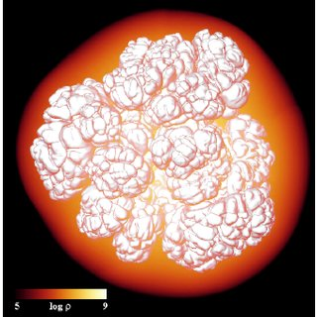
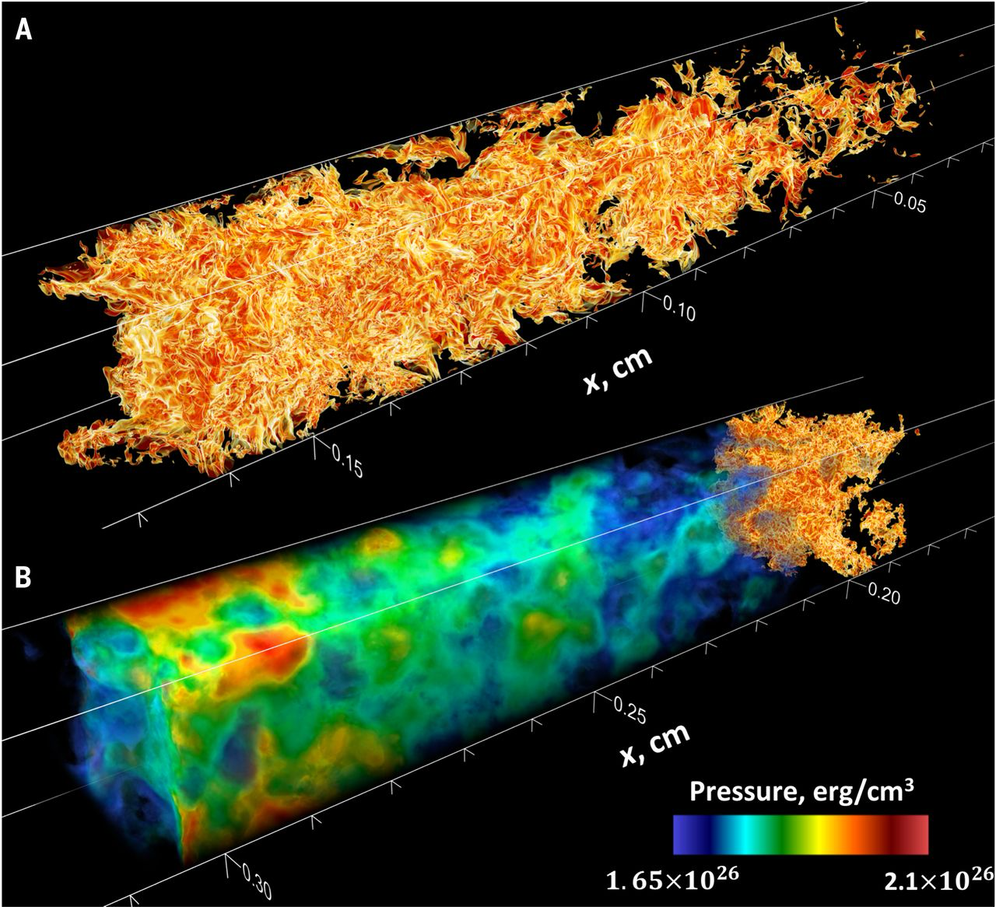
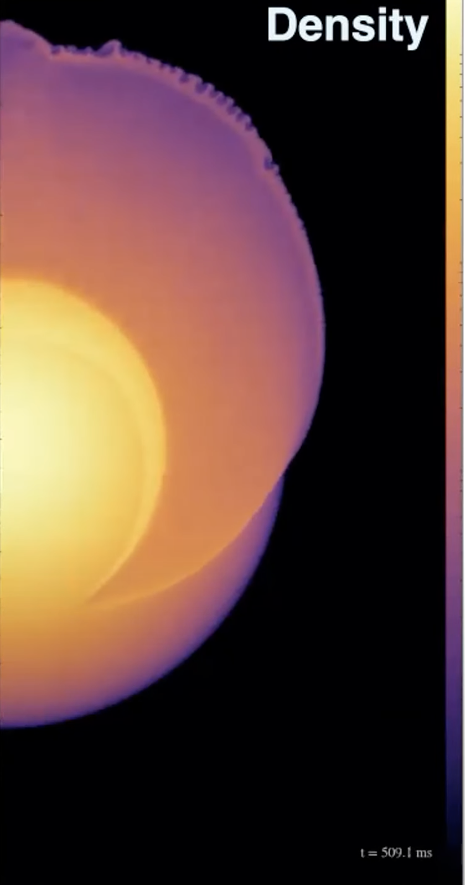
Type Ia Supernovae
thermonuclear explosions of white dwarfs
?
?
progenitor system
explosion mechanism

Slide 3
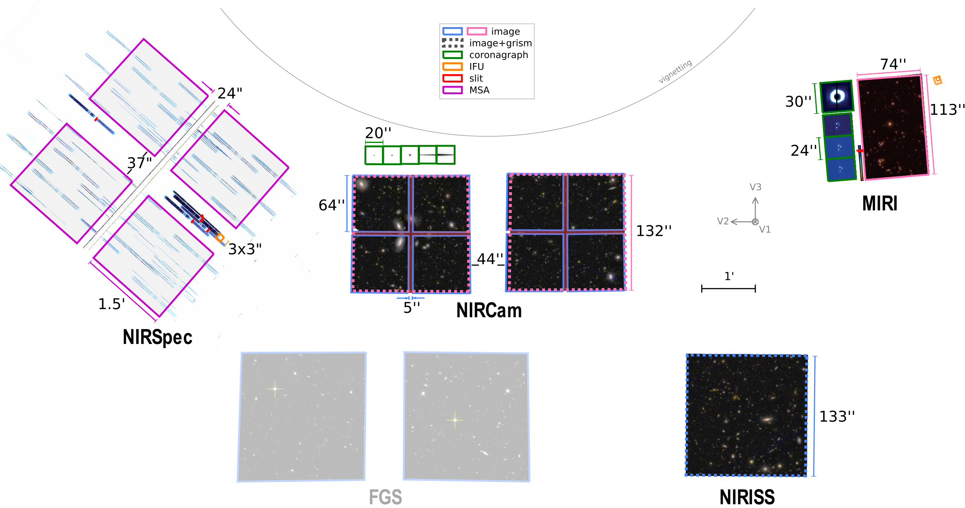


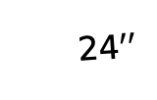
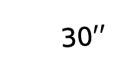
JWST GO 2072 Program
9 white-dwarf supernovae over 3 years
NIR & MIR spectra, 2 observations each
74$′′$
PI: Saurabh W. Jha
60 hours JWST time
30$′′$
113$′′$
24$′′$
MIRI
NIRSpec
Low Resolution: 5—14 µm
Medium Resolution: 5—28 µm
Prism: 0.6–5 µm Gratings: 1.7–5 µm
Notes:
I led the observational aspects of the proposal
Involved in all aspects of the program
Christmas launch
Fortunate to be in graduate school at exactly the perfect time for JWST
Using NIRSpec and MIRI instruments to get infrared spectra of a sample of white dwarf supernovae

Slide 4
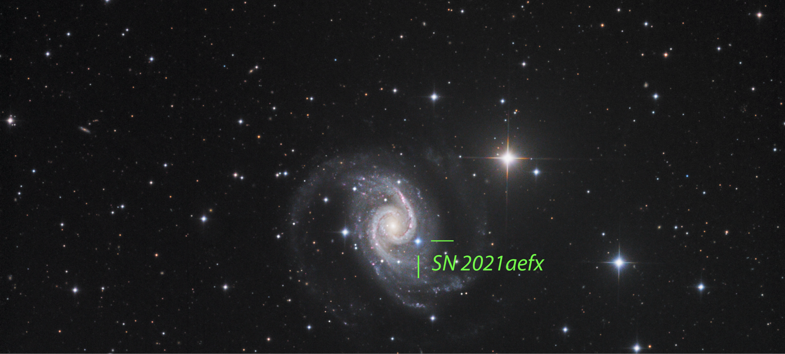
host-galaxy NGC 1566
Normal, nearby SN Ia
(18 Mpc)
Discovered early by DLT40 survey
Observed extensively from the ground
Optical
image by Dan Crowson
https://www.flickr.com/photos/dcrowson/51717006130/

Slide 5
JWST MIR
Optical
JWST/MIRI image of host galaxy NGC 1566
data via JWST GO 2107 (PI: Janice Lee), processing by Judy Schmidt
image by Dan Crowson
https://www.flickr.com/photos/dcrowson/51717006130/

Slide 6
SN 2021aefx: Optical + NIR + MIR
Kwok et al. 2023
Co
Fe
Ni
Fe
Ar
Co
Ar
Ni
Ni
Fe
Fe, Ni
Ni
Fe, Co
Ni
Co
Ca, Fe
Fe
Fe
Fe
Fe
Fe
Co
Fe
Ni, Fe
Blondin et al. 2023
unobserved region before JWST

Slide 7
SN 2022aaiq: Optical + NIR + MIR
Normal, nearby (~30 Mpc) SN Ia in an elliptical host galaxy
(preliminary)
Ca, Fe
Co
Ni
Co
Fe
Ni
Ar
Ni
Co
Fe
Co
Fe, Ni
Co
Fe
Ni, Fe
Fe
Fe
Ar
Fe?
Fe
Fe
Ni
Co
Fe
Ni
Fe?
Co
unobserved region before JWST

Slide 8
SN2022aaiq MRS Spectrum
[Ni III]
[Co III]
[Co II]
[Ni IV]
[Fe II]?
[Ni III]
[Co III]
[Ar III]
[Co II] + [Co IV]
[Fe III]?
[Ar II]
[Ni II]
[Fe II]
[Fe II]?
[Co II]
[S III]?
[Co II]
unobserved region before JWST

Slide 9
Infrared Spectral Evolution
MIR spectra are very similar over time
Line velocities are roughly constant
SN 2022aaiq
JWST/NIRSpec
JWST/MIRI
+125d
HET
Keck
SALT
SN 2021aefx
+255d
+323d
SALT
+372d
JWST/MIRI/MRS spectrum of SN 2021aefx from JWST GO 2114 (PI: Ashall)
+418d

Slide 10
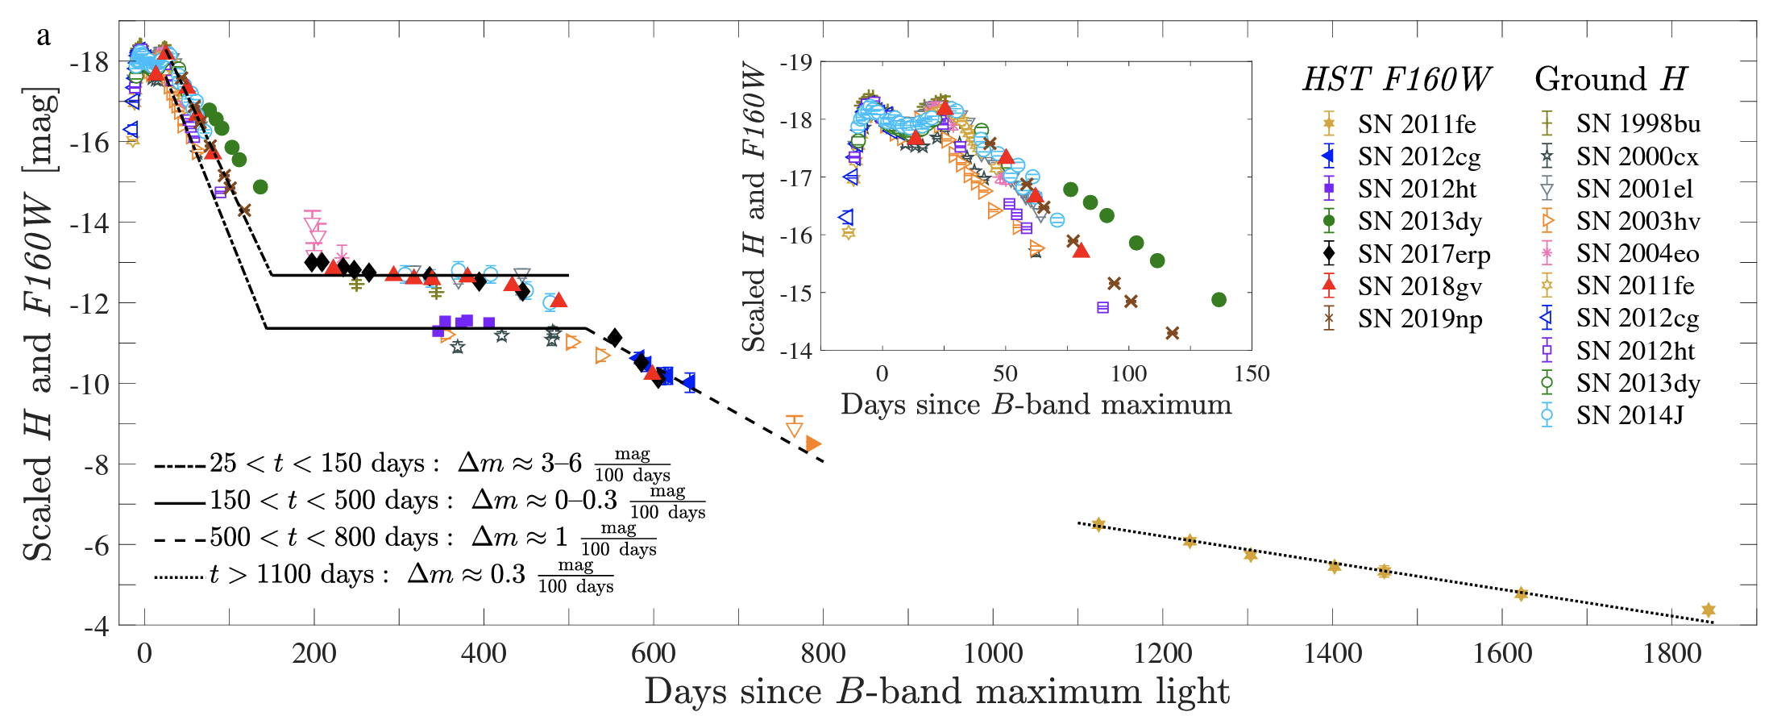
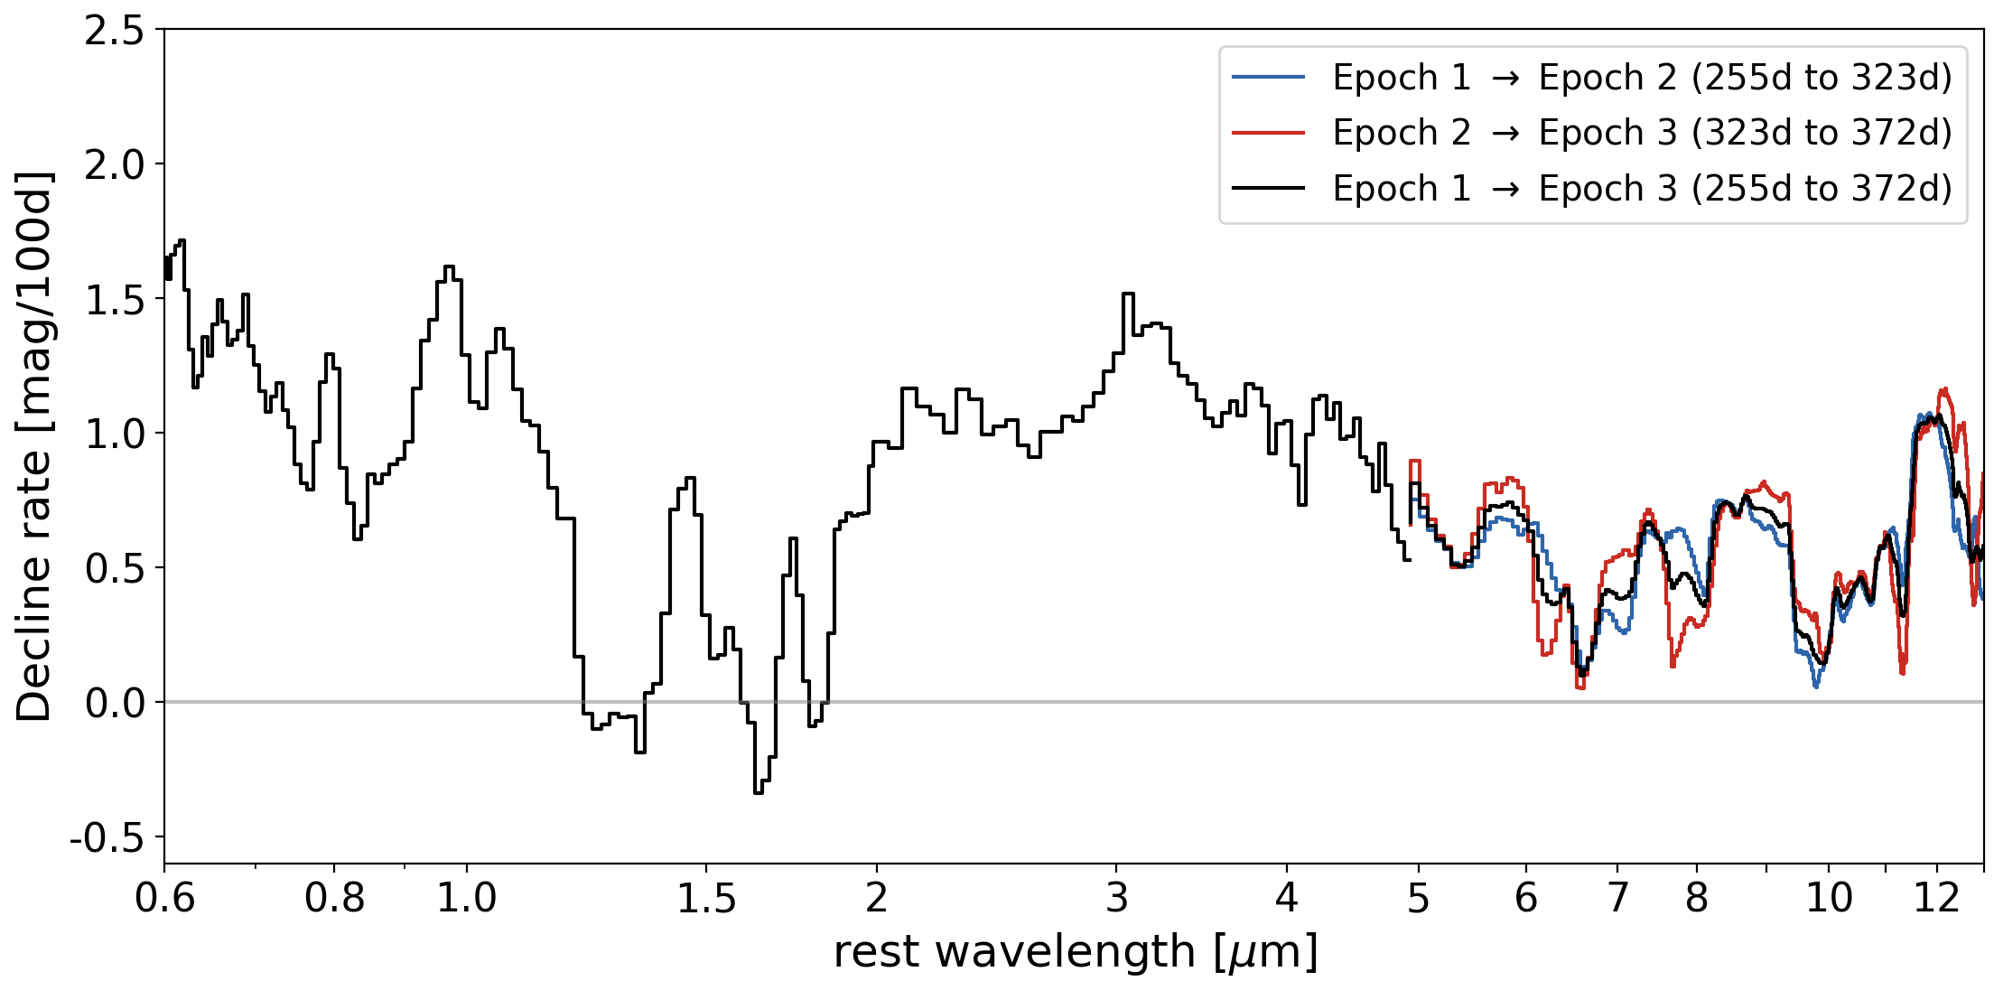
Infrared Decline Rates
Graur et al. 2020
SN 2021aefx
NIR plateau
(Graur et al. 2020)
Ca IV
Fe III
Co III
Ar III
Ni IV
Co II
Ni III
Ni III
Co II
Fe II
Co II
Fe II
Ar II
Fe II
Ni II
Fe II
Fe II

Slide 11
Argon: detonation involved
Kwok et al. 2023
Flat-topped [Ar III] line profile
→ thick shell of emission
Ar & Ca lines broader than Fe, Co, Ni
→ IMEs extend to larger
radii than IGEs
→ stratified ejecta
→ signature of some type
of detonation
IMEs (Si, Ar)
lower density
high density
IGEs
(Fe, Co, Ni)
nucleosynthesis

Slide 12
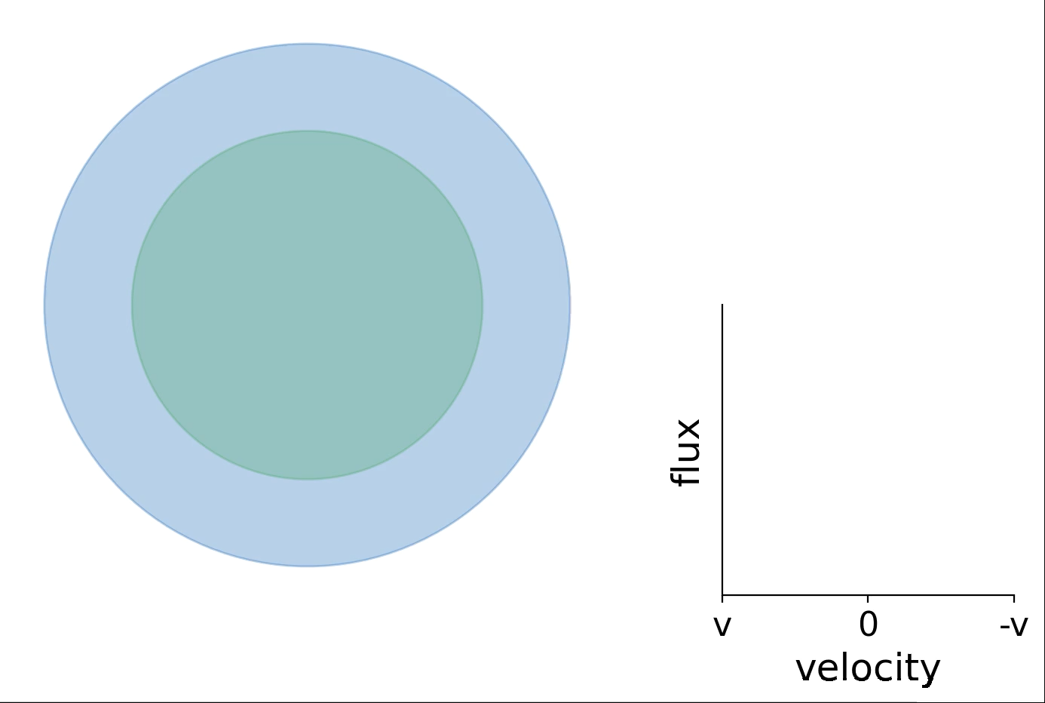

Ejecta Geometry from Emission Line Profiles
v
0
-v
-
Graphics by Lindsey Kwok

Slide 13
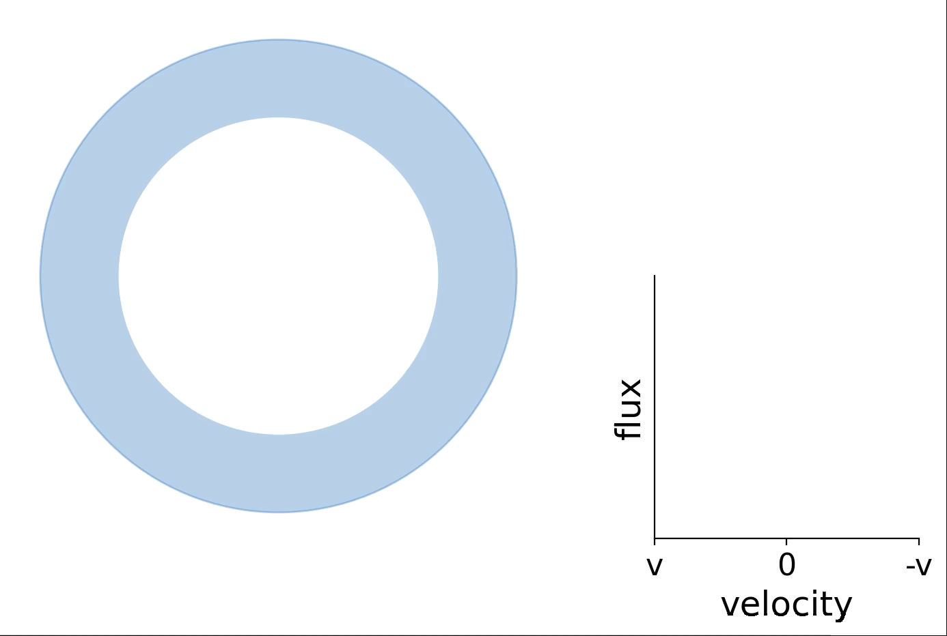
Ejecta Geometry from Emission Line Profiles
v
0
-v
-
Graphics by Lindsey Kwok

Slide 14
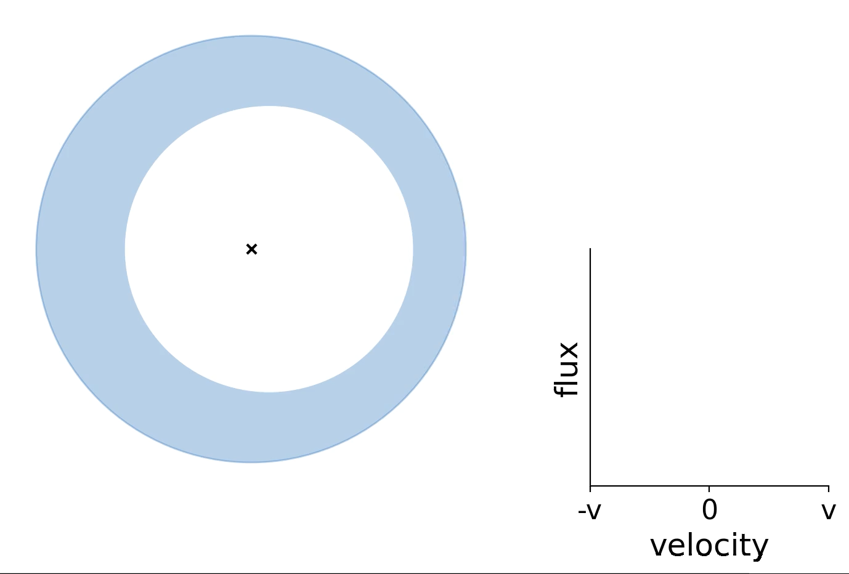
Ejecta Geometry from Emission Line Profiles
v
0
-v
Graphics by Lindsey Kwok

Slide 15
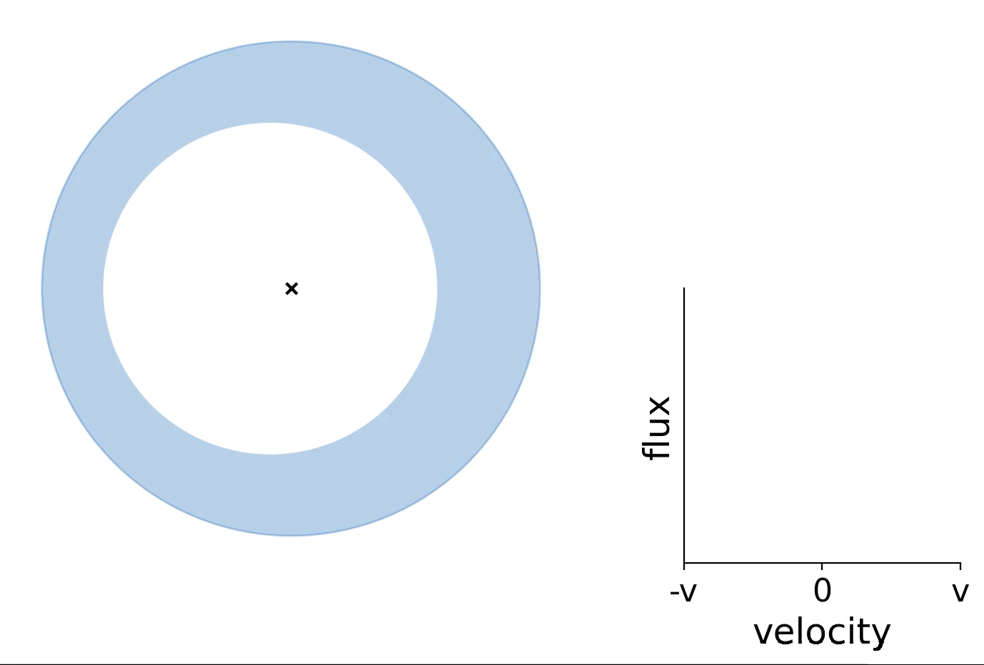
Ejecta Geometry from Emission Line Profiles
v
0
-v
Graphics by Lindsey Kwok

Slide 16
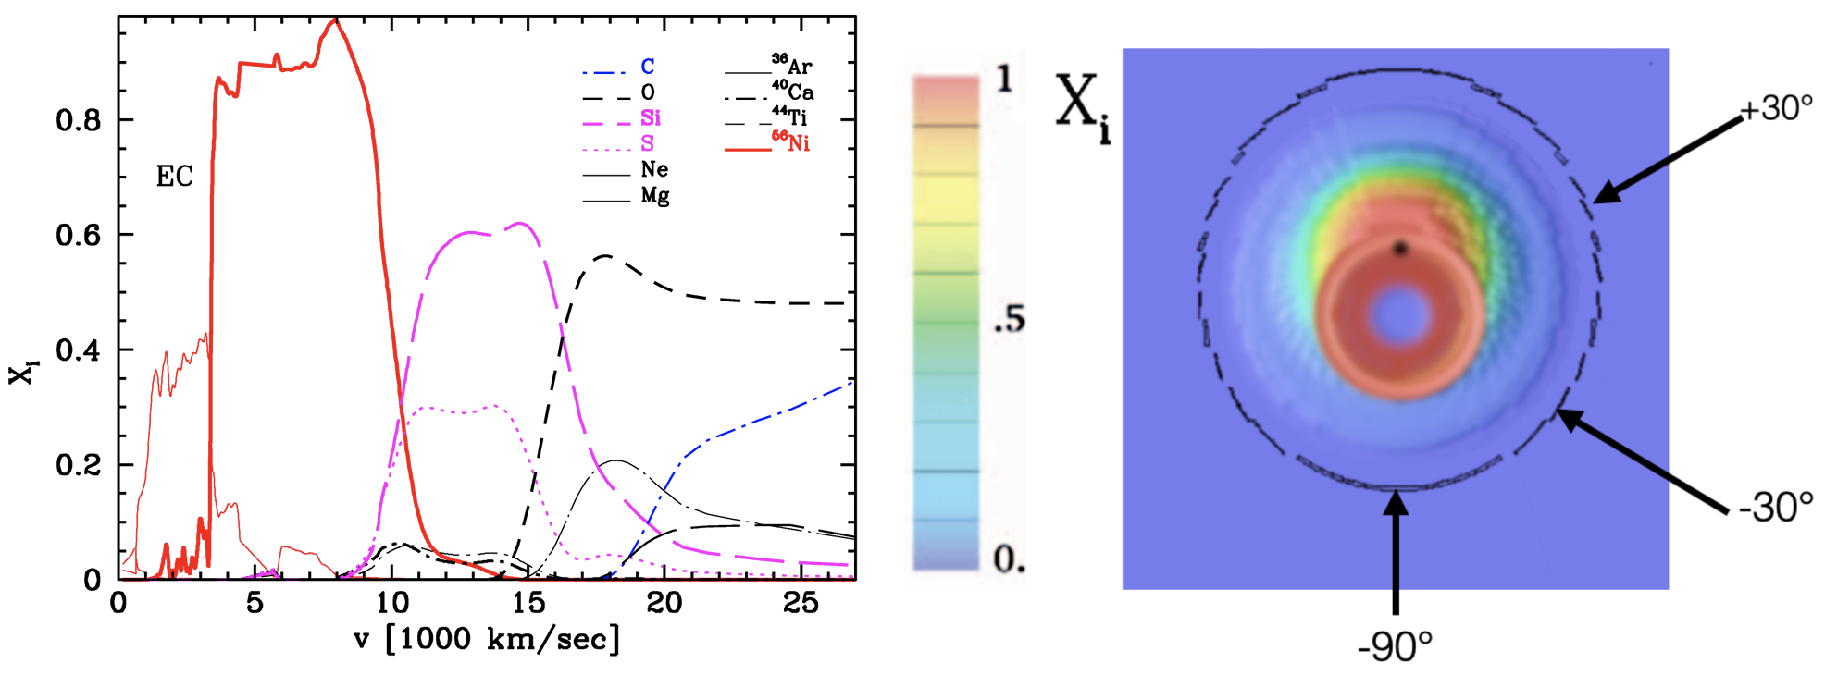
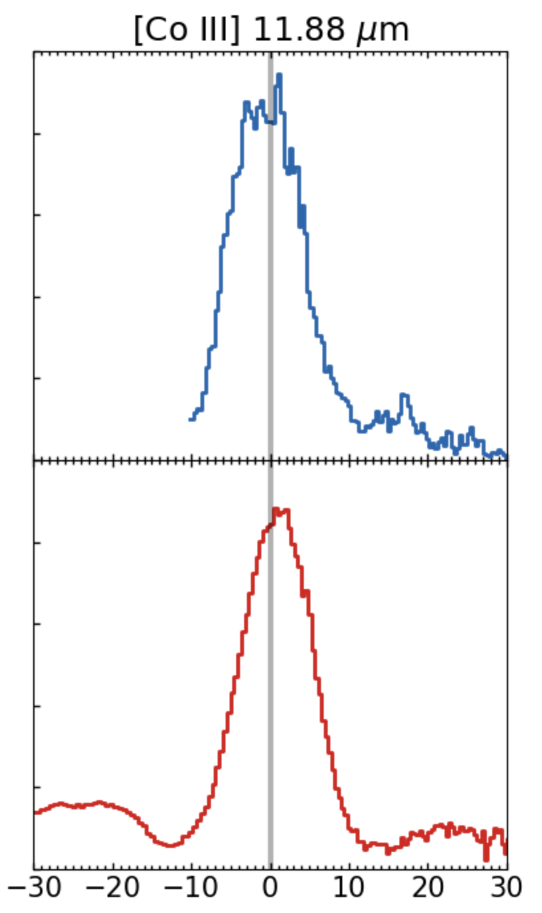
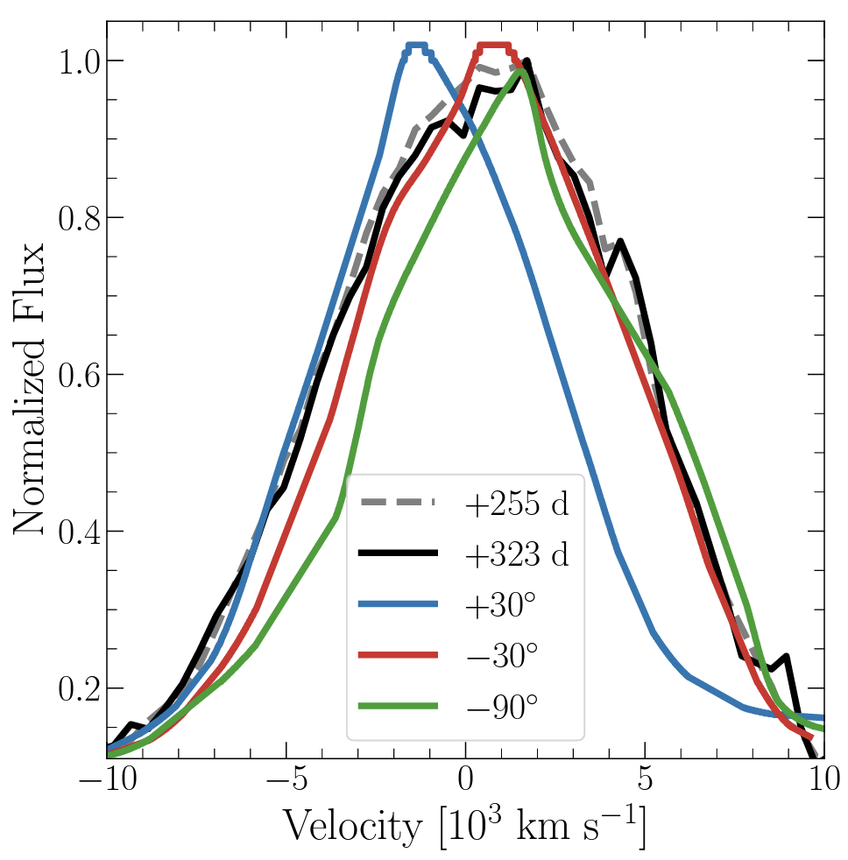
Ejecta Asymmetries
22aaiq
Sloped flat-topped profiles:
→ slopes in consistent directions
→ off-center explosion
→ 21aefx & 22aaiq consistent
with different viewing angles
SN 2021aefx
SN 2022aaiq
21aefx
DerKacy et al. 2023

Slide 17
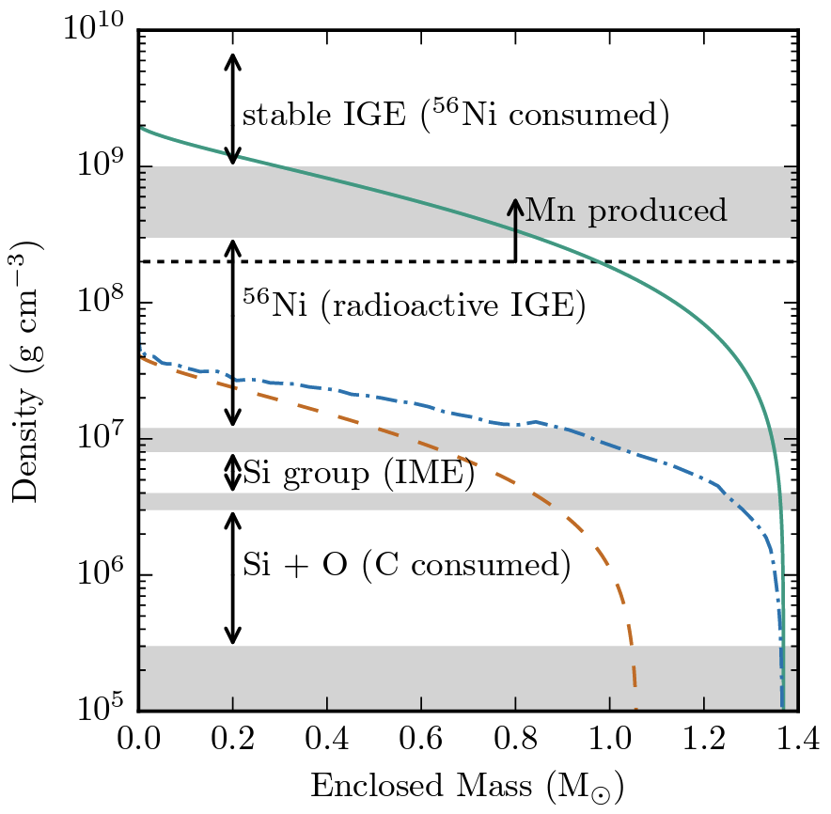
Nickel: high-mass progenitor
Many strong stable ⁵⁸Ni lines → requires high-density burning
High-mass white dwarf
Kwok et al. 2023
Seitenzahl & Townsley 2017

Slide 18
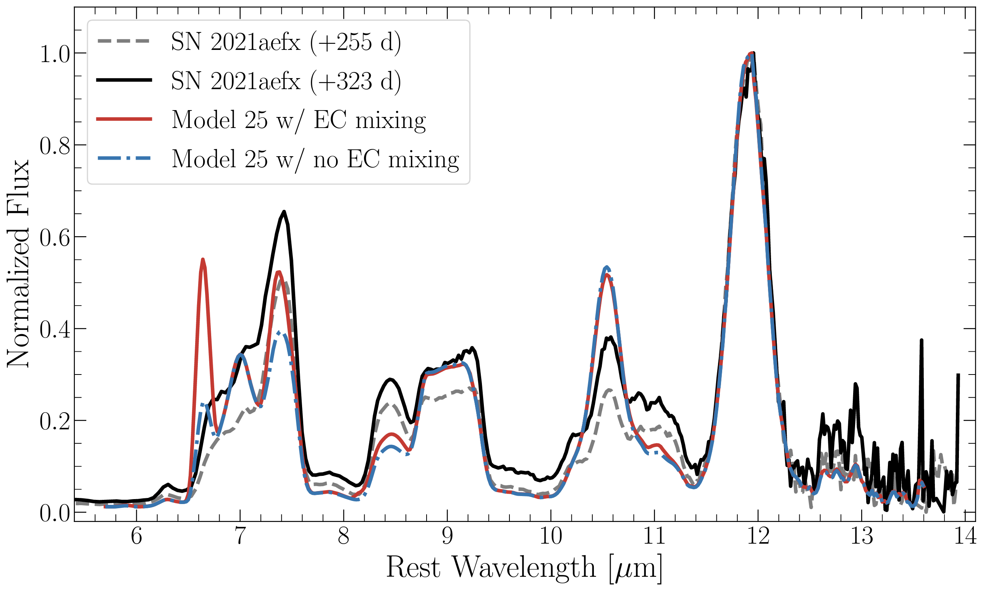
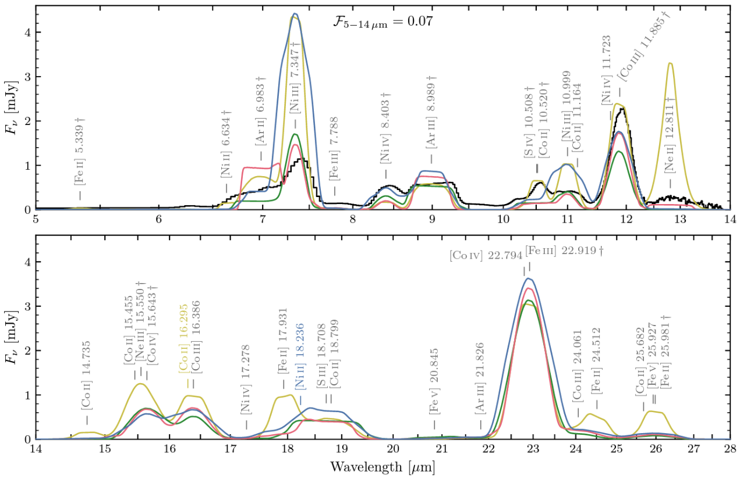
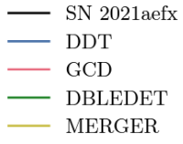
Models of 21aefx
DerKacy et al. 2023:
Off-center delayed-detonation of
>1.2 M☉ WD at -30° viewing angle
Blondin et al. 2023:
Pros and cons for each model, sensitive to ionization. Sub-M_{Ch} not ruled out.

Slide 19
SN 2021aefx & SN 2022aaiq
off-center, stratified, high-density ejecta
progenitor system
explosion mechanism
?
DDT?
DoubleDet?
GCDet?
Merger?
(probably?)
high mass C/O WD

Slide 20
Upcoming JWST Observations
exploding white dwarfs:
much more than just normal SN Ia!
JWST GO 2072 (PI: Jha)
6 more WD SN (2 epochs each)
Build sample of normal SN Ia
  SN 2021aefx (LRS; spiral host)
  SN 2022aaiq (MRS; elliptical host)
Peculiar objects
  SN 2022pul – “Super-Chandra”!
JWST GO 2114 (PI: Ashall)
SN 2022xkq – 91bg-like!

Slide 21
JWST has opened a new window to understanding SN Ia astrophysics.
SN 2021aefx
JWST/MIRI image of host galaxy NGC 1566
data via JWST GO 2107 (PI: Janice Lee), processing by Judy Schmidt

Slide 22
Progenitor Systems
Single-degenerate:
Others:
non-degenerate
C/O WD
He shell
non-degenerate
?
C/O WD
C/O
WD
C/O WD
He WD
non-degenerate
Double-degenerate:
etc.
C/O WD
AGB
C/O WD
C/O WD
non-degenerate

Slide 23


Explosion Mechanisms
M_{Ch} Detonation
M_{Ch} Delayed detonation
too much Ni
(too bright)
No IMEs
Deflagration to Detonation Transition (DDT)
M_{Ch} Deflagration
Double detonation
not enough Ni
(too dim)
detonation of helium shell → detonation of C/O core
etc.

Slide 24
MIR Spectrum
Prominent, isolated Ni, Co, & intermediate-mass element Ar emission lines
JWST vs. Spitzer:
huge improvement in SNR!

Slide 25
MIR Spectral Evolution

Slide 26
Off-center delayed-detonation explosion of >1.2 M☉ WD at
-30° viewing angle
DerKacy, Ashall, Hoeflich et al. 2023
[Co III] 12 µm

Slide 27
Blondin et al. 2023

Slide 28
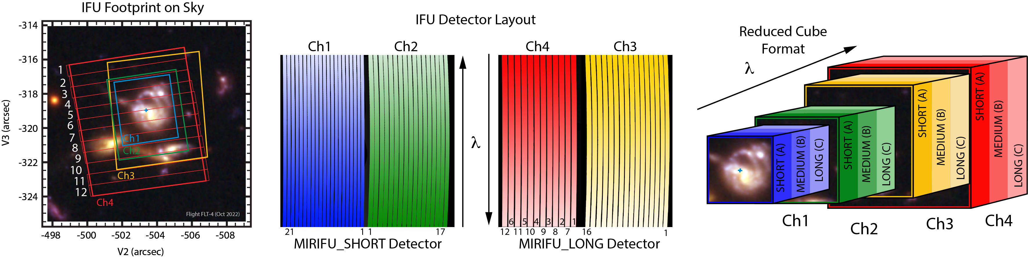
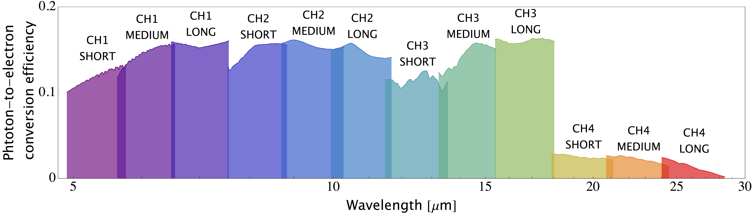
MIRI Medium Resolution Spectrograph

