Slide 1
Connecting Type Ia Populations with
Deep-Learning Accelerated Abundance Tomography
Jack O'Brien
Notes:
Good afternoon everyone
I'm Jack O'Brien and I'm a 5th year graduate student at Michigan State University working with Wolfgang Kerzendorf and the TARDIS collaboration trying to disentangle to progenitors of Type Ia supernovae
Today I'm going to discuss how we can use a technique known as "abundance tomography" to help narrow down the progenitor systems of Type Ia and potentially other thermonuclear supernovae.

Slide 2
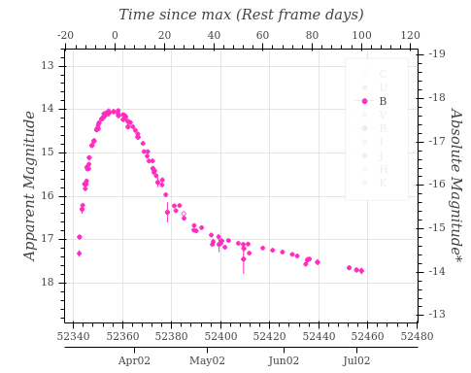
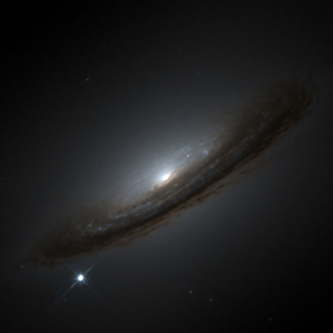
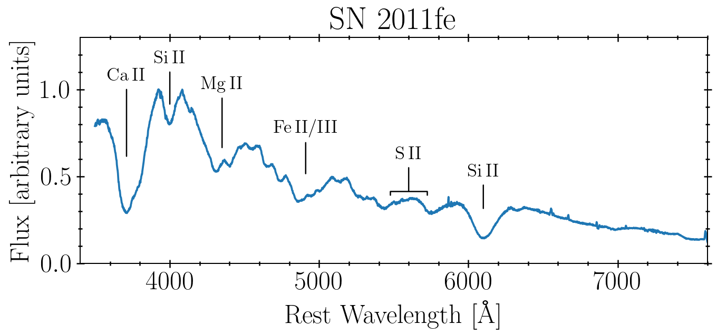
What are Type Ia Supernovae?
Thermonuclear explosion of Carbon-Oxygen White Dwarf
Results from interaction with a binary companion
M_{B,Max}
Δm₁₅(B)
Tool for Cosmic Distance Measurement
Brightness-dimming rate relation
5-sigma H0 tension
Vital to Chemical Enrichment of the Universe
Iron-peak elements and some intermediate mass elements

Slide 3
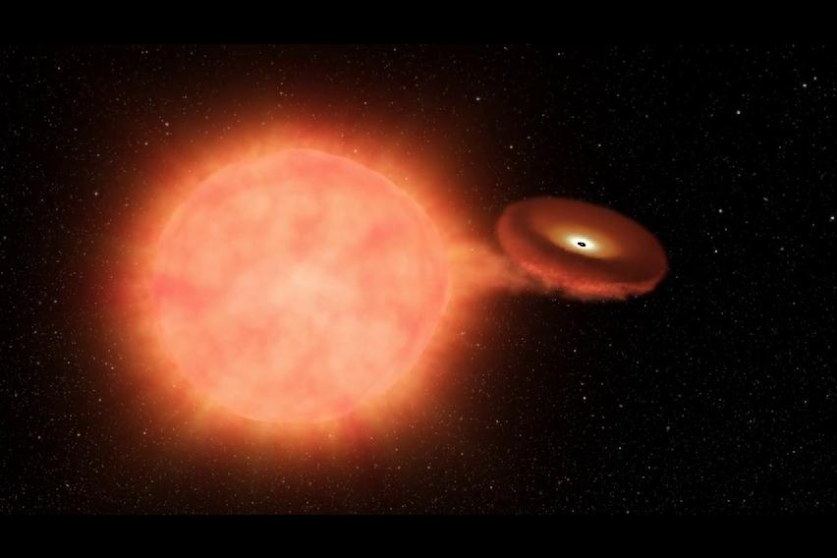
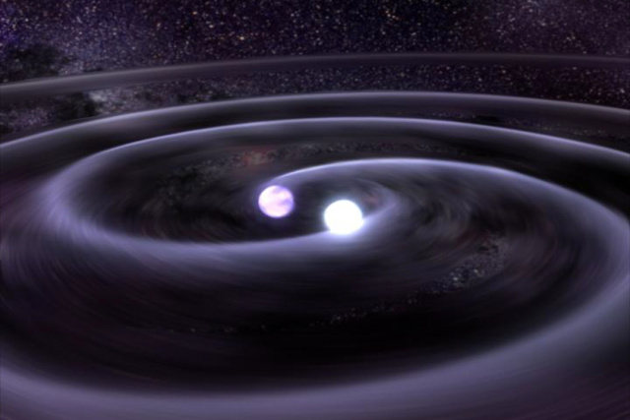
What are Type Ia Supernovae?
The Progenitor Problem
How can we make a white dwarf explode?
Density and temperature high enough for ignition
Many competing scenarios
Ignition sources
Accretion or violent merger?
Progenitor mass
Near M_{ch} or sub M_{ch}?
Can be probed through flame propagation
Notes:
<Click>
Type Ia supernovae are generally thought to be driven by the explosion of carbon-oxygen white dwarfs.
<Click>
White dwarfs are very stable systems, so generally some external mechanism needs to be present to drive the temperature and density high enough to generate a thermonuclear explosion.
<Click>
A few competing scenarios to explain these systems have emerged over the years
<Click> <Click>
For example, ignition of the primary white dwarf is generally believed to result from an interaction with a binary companion
Either through a violent merger or through accretion of material from the secondary onto the primary
In the case of accretion, there are multiple proposed pathways to get ignition
<Click> <Click>
Such as mass transfer causing the WD to approach the Chandrasekhar mass resulting in central ignition
Accretion models have also been proposed that involve explosions of lower-mass WDs through a variety of potential mechanisms
<Click>
We use use the speed of flame propagation as a method of probing these scenarios as they make different predictions

Slide 4
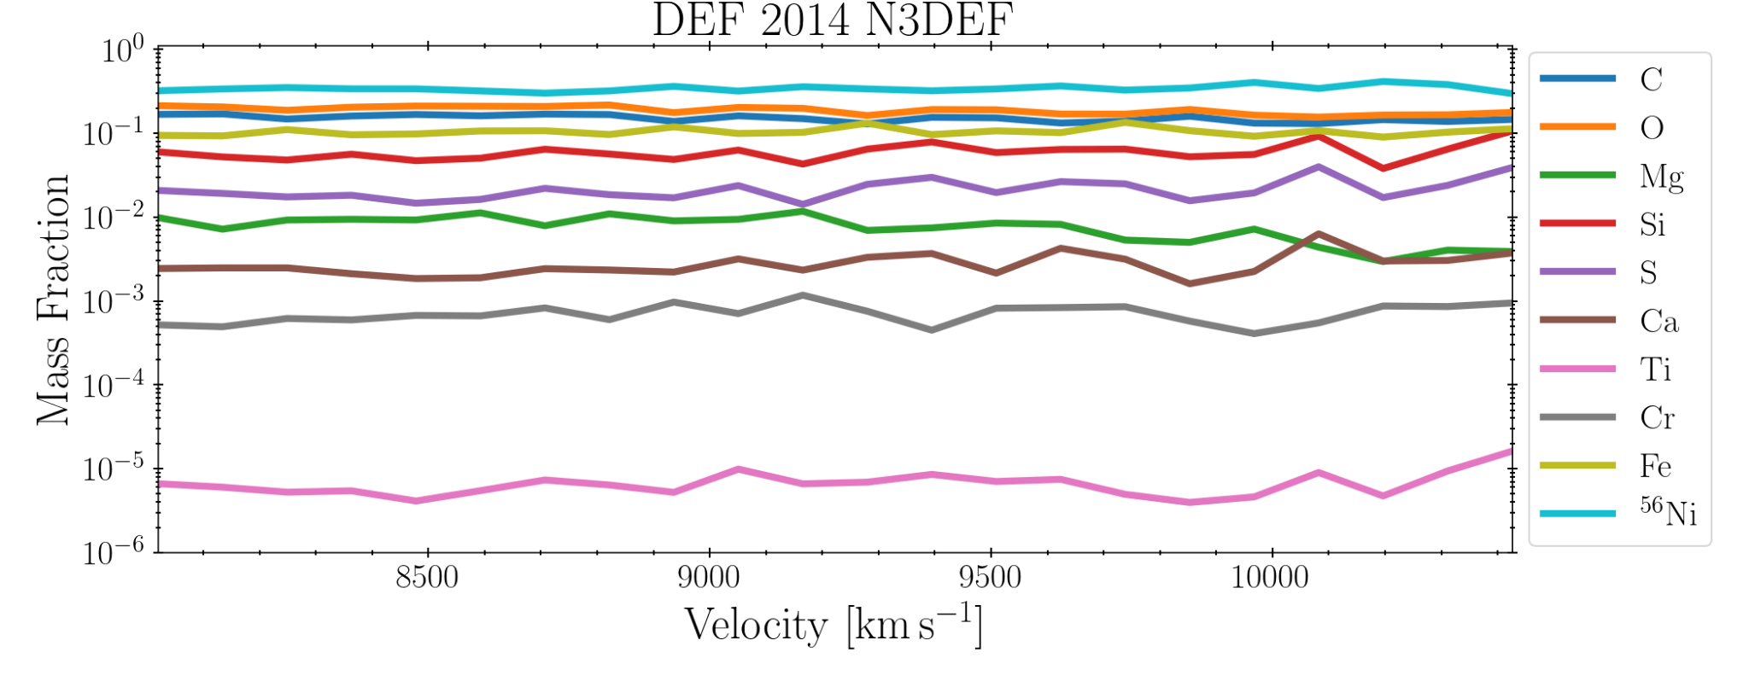
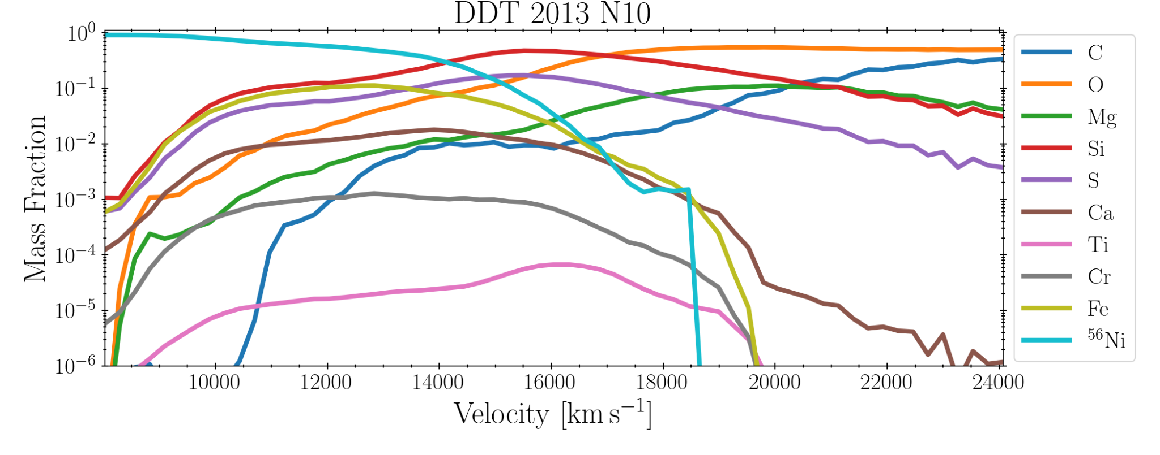
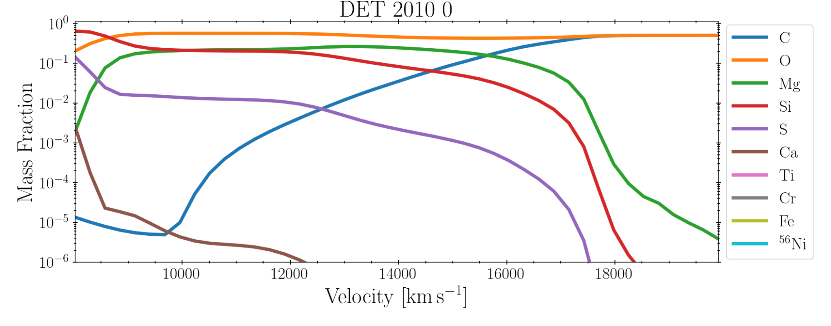
Large Diversity of Progenitor Models
Mass Fraction
Pure Deflagrations
Subsonic turbulent burning front causes materials from different depths to mix
Material mixed at all depths
Pure Detonations
Supersonic nuclear burning wave
Shock front too fast for mixing
Detonation Deflagration Transition
Subsonic turbulent burning front -> supersonic detonation
Mixing closer to the center
Mass Coordinate
Mass Fraction
Mass Coordinate
Mass Fraction
Mass Coordinate

Slide 5
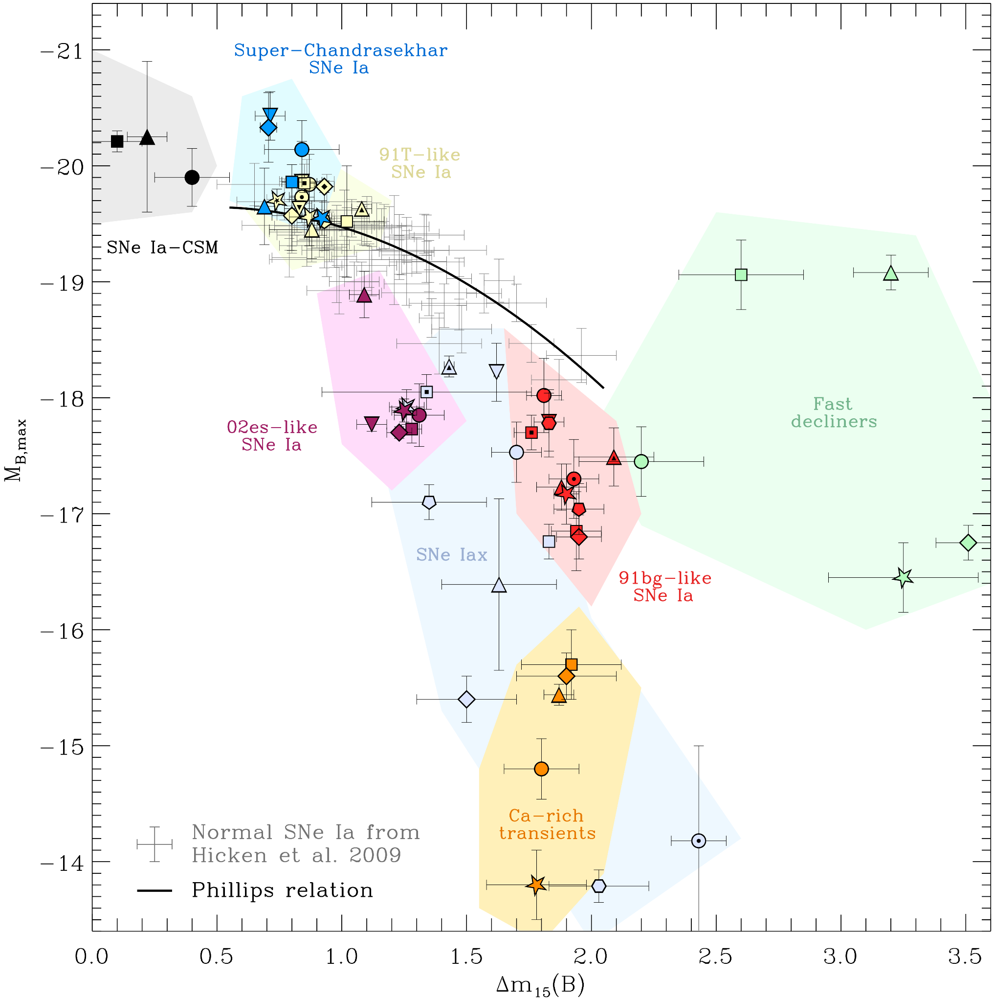
Large Diversity of Type Ia
What are their progenitors?
Do they have the same progenitor with different parameters or are they distinct scenarios?
What physics determines their observational properties?
Taubenberger 2017
Notes:
<First Click: Show Taubenberger plot>
The plot I’ve shown here is taken from a 2017 paper by Stefan Taubenberger that demonstrates the wide diversity of thermonuclear supernovae.
The axes correspond to the parameters of the Phillips relation, an important relationship between the peak brightness and decay rate of the light curve of a Type Ia supernova. The Phillips relation is a critical component of our ability to use Type Ia supernovae as cosmic distance indicators.
On the y-axis, we have the peak brightness of the supernova in magnitudes
On the x-axis is a quantity called delta-M-15, which refers to the change in brightness of the supernova 15-days after peak brightness
The black line shows the phillips relation, used to standardize Type Ia supernovae for cosmic distance measurements.
It should be noted that this relation is purely empirical
As you can see, most of what we consider to be a “typical” Type Ia fall along this relationship, but there are mean objects with similar spectral properties that do not.
The most well known category of thermonuclear transients outside of Ias are the subluminous Iax
What is unknown is if these objects represent distinct progenitor systems, or if they are a sort of transitional objects between different progenitors
And of course, the progenitors of all of these systems themselves are not fully understood
Though all of these systems are expected to originate from the thermonuclear explosion of a white dwarf which begs the question:

Slide 6
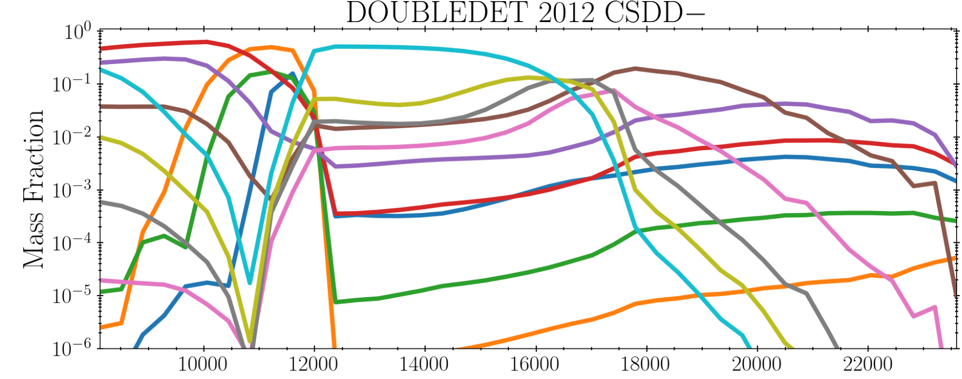
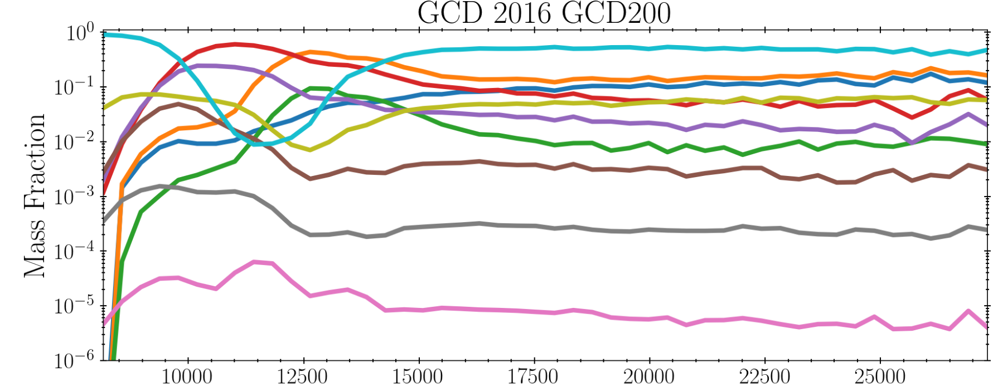
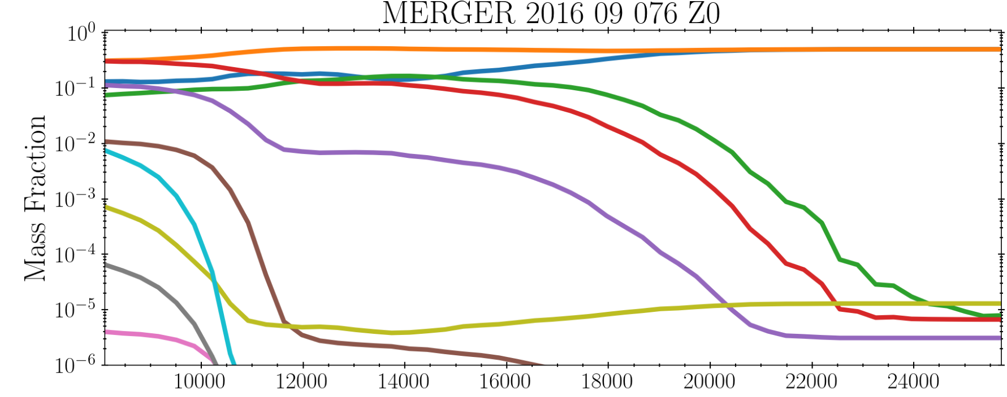
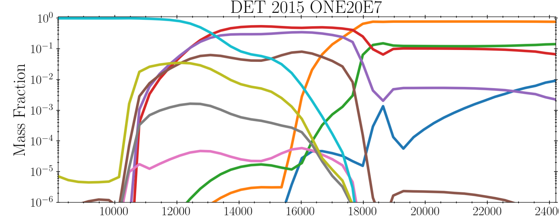
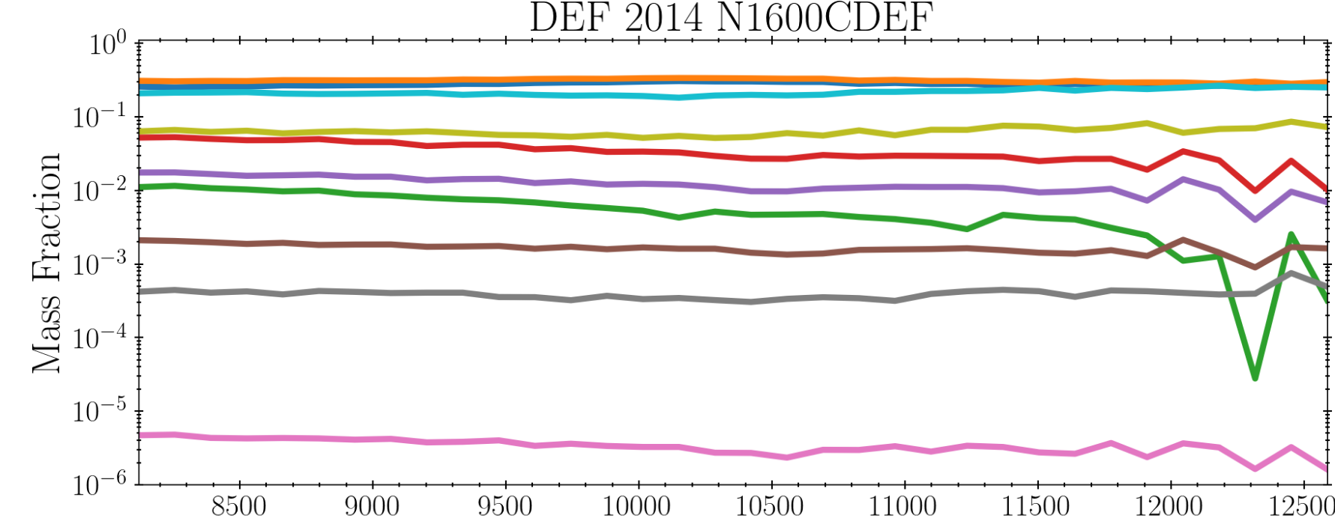
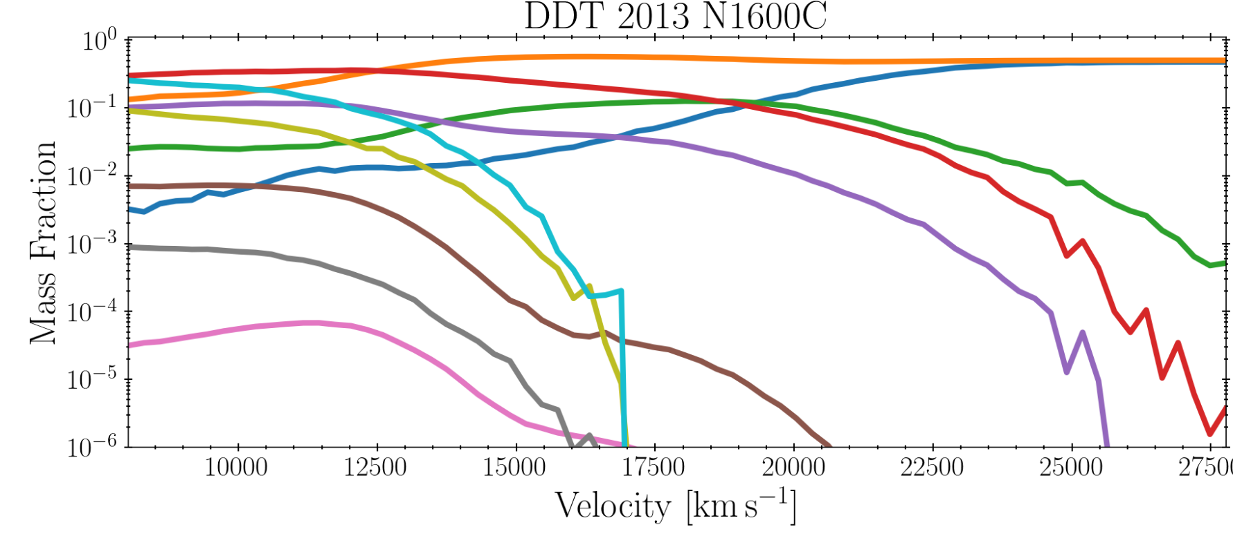
Theory
Observation
Double Detonation
2003fg-likes
1991T-likes
Gravitationally Confined Disruption
?
Normal Ias
Merger
02es-likes
1991bg-likes
Pure Detonation
Type Iaxs
Pure Deflagration
Delayed Detonation

Slide 7
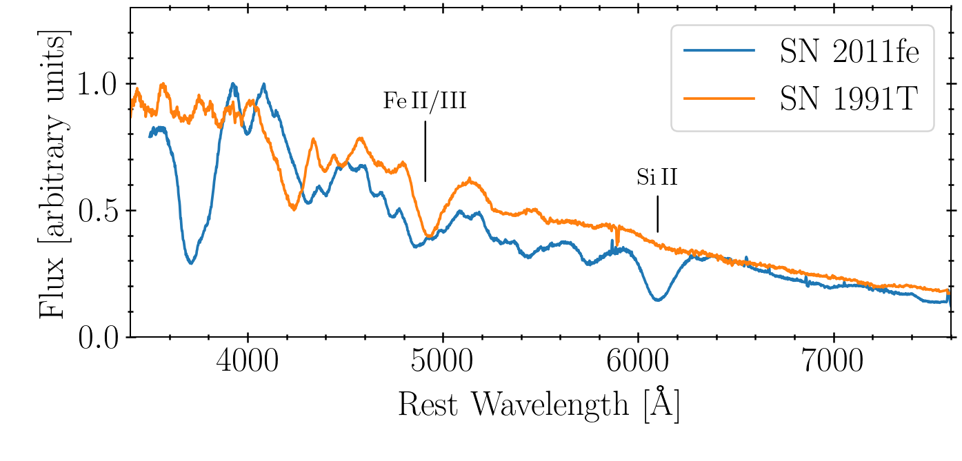
SN 1991T-like Thermonuclear Supernovae
Selected a sample of 36 normal and 5 91T-like supernovae
Objects from WISeREP with available photospheric phase spectra
Are these distinct progenitors?
Why are they brighter?
Why do they lack features of silicon and other intermediate mass elements?

Slide 8
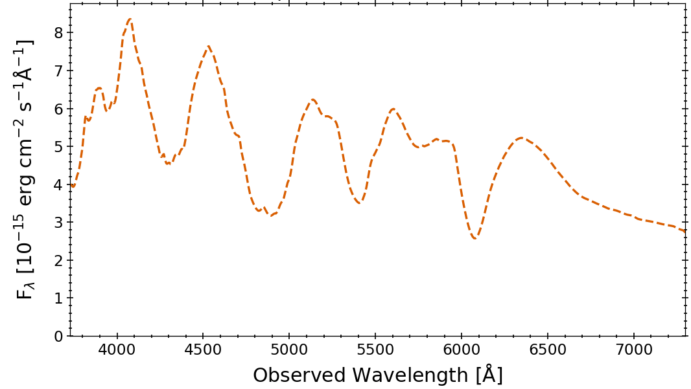
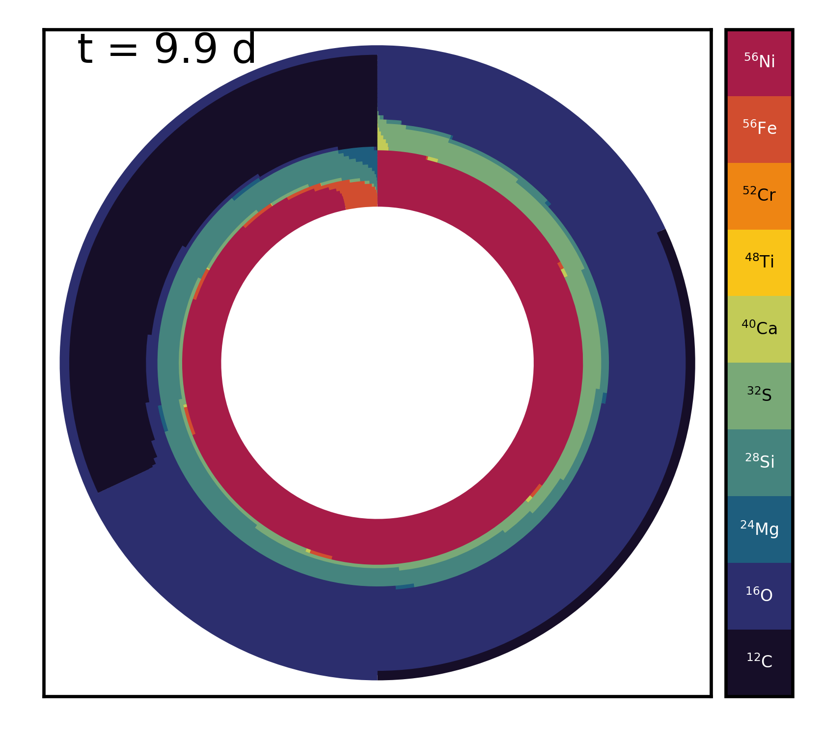
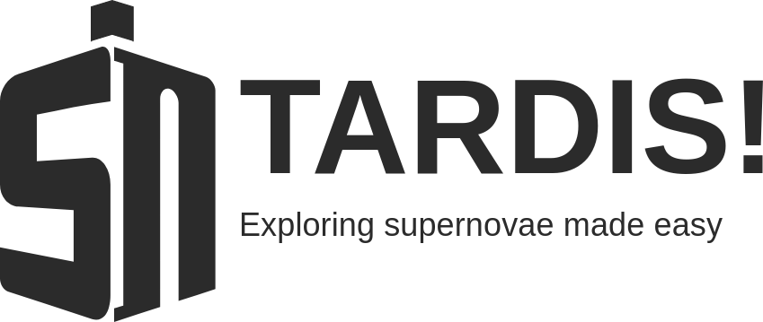
Ejecta Model and Synthetic Observables
Photospheric phase outer ejecta
1D Multi-Zone Radiative Transfer
𝛉 = (C, Si, ⁵⁶Ni, …, T_{inner}, t_{exp}, …)
Ejecta
Model evaluation with TARDIS-SN
Models fit with Nested Sampling
Dalek Physics-Informed Probabilistic Generative Deep-Learning Emulator Accelerates Evaluation
Optically thick central region

Slide 9
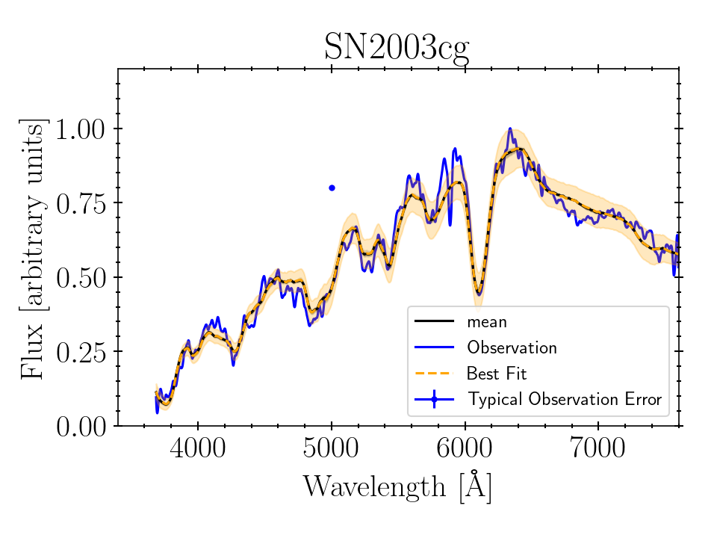
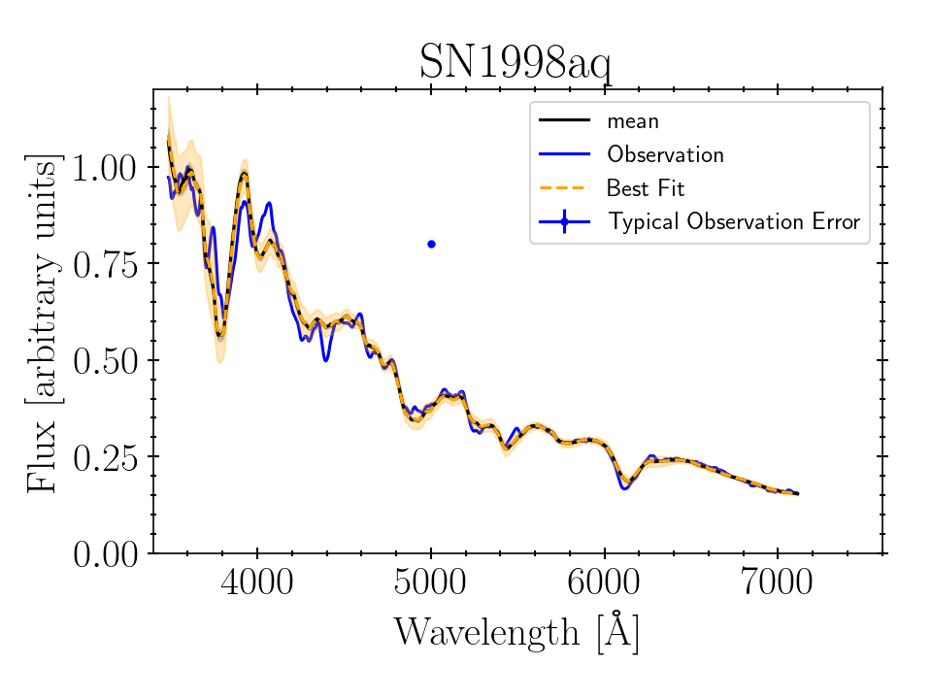
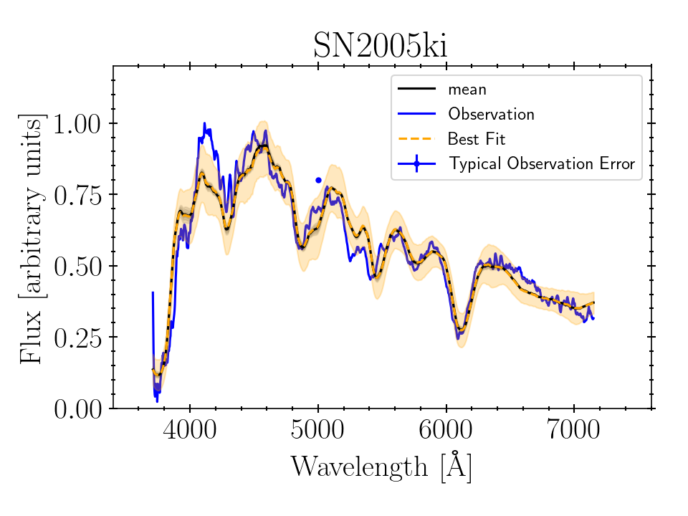
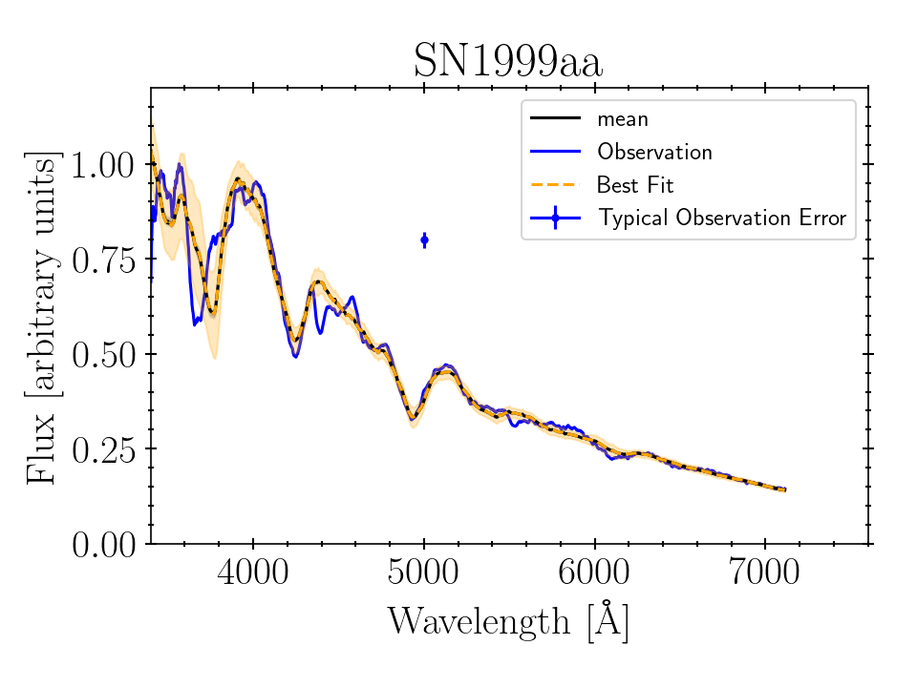
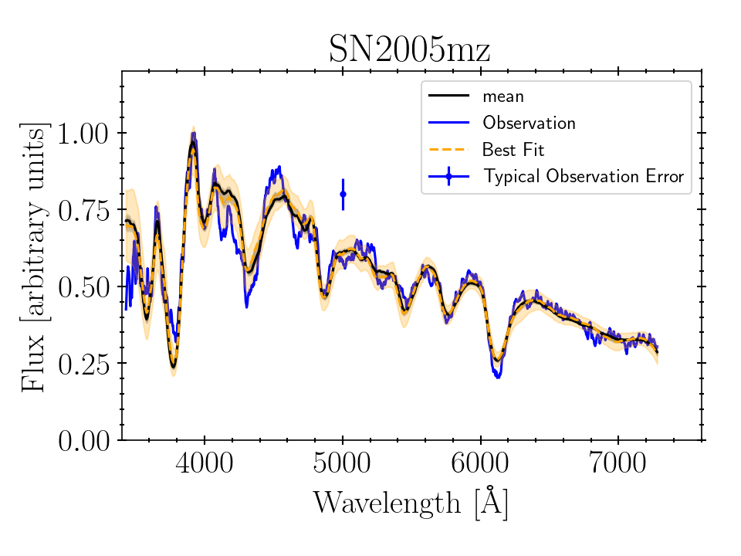
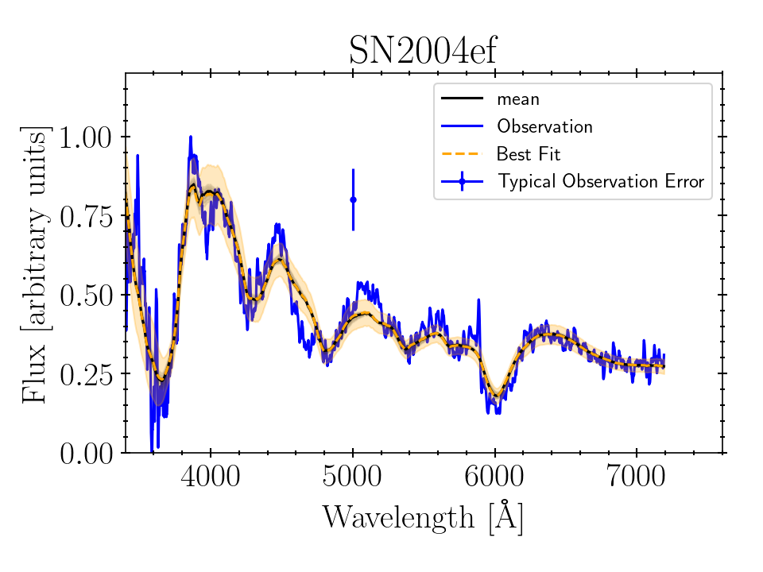
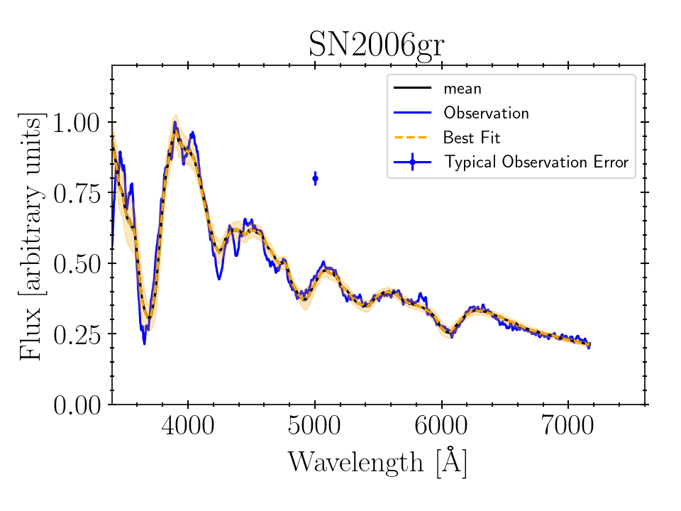
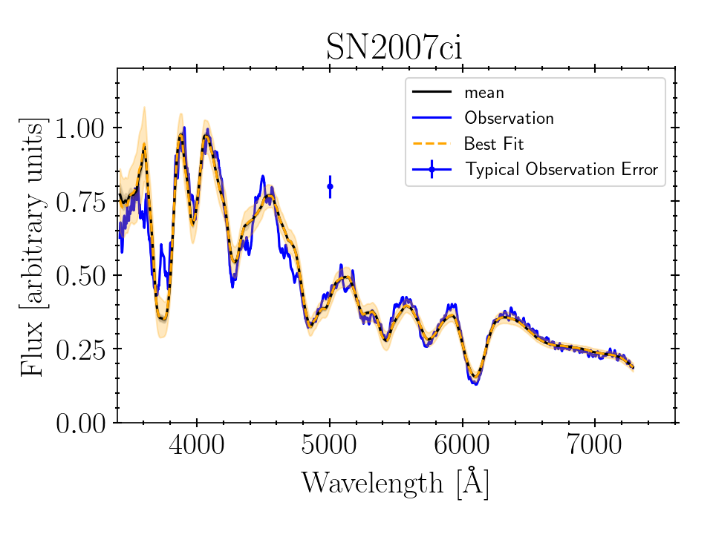
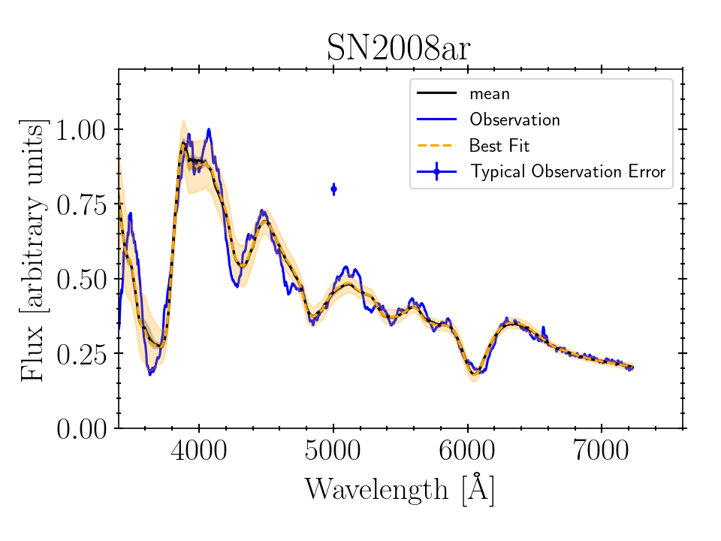
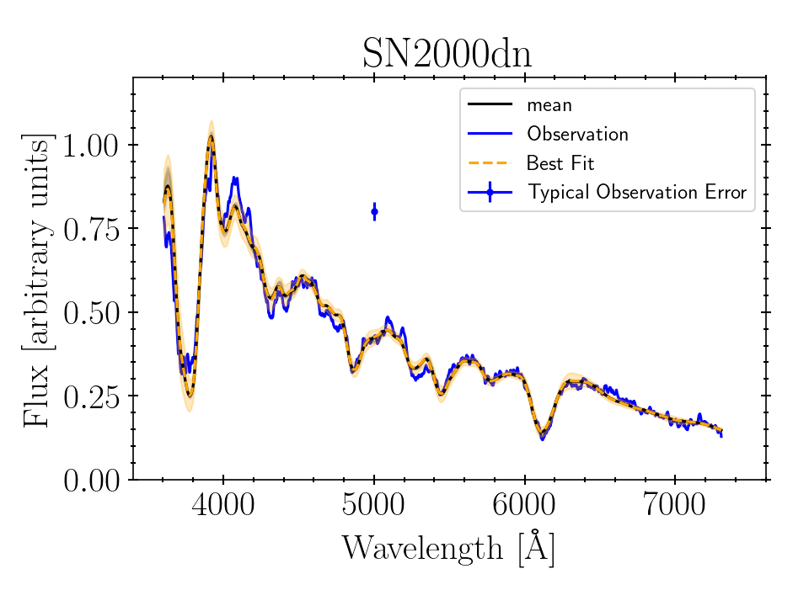
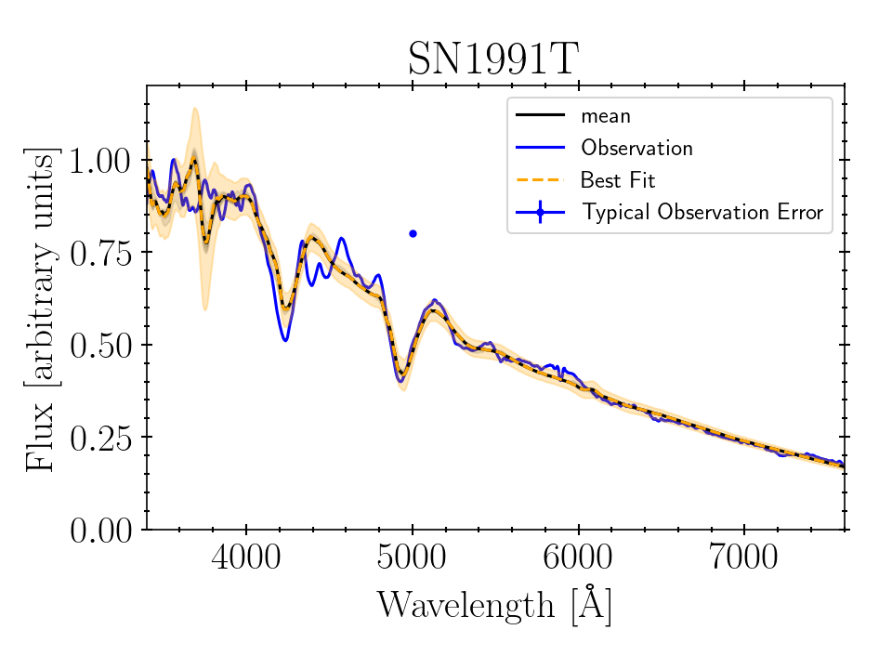
Bulk Modeling Dozens of Supernovae
For the first time we can accurately and rapidly reconstruct large numbers of spectra at a time!
Notes:
And many of them have already come through.
We're modeling approximately 50 different Type Ia and Type Ia-like supernovae in the photospheric phase currently in order to see if we can better distinguish differences between populations of Type Ia
And narrow down their progenitor systems.
Then the step after this is to begin expanding the parameter space through the inclusion of spectral time series models to better constrain these models up to high depths.

Slide 10
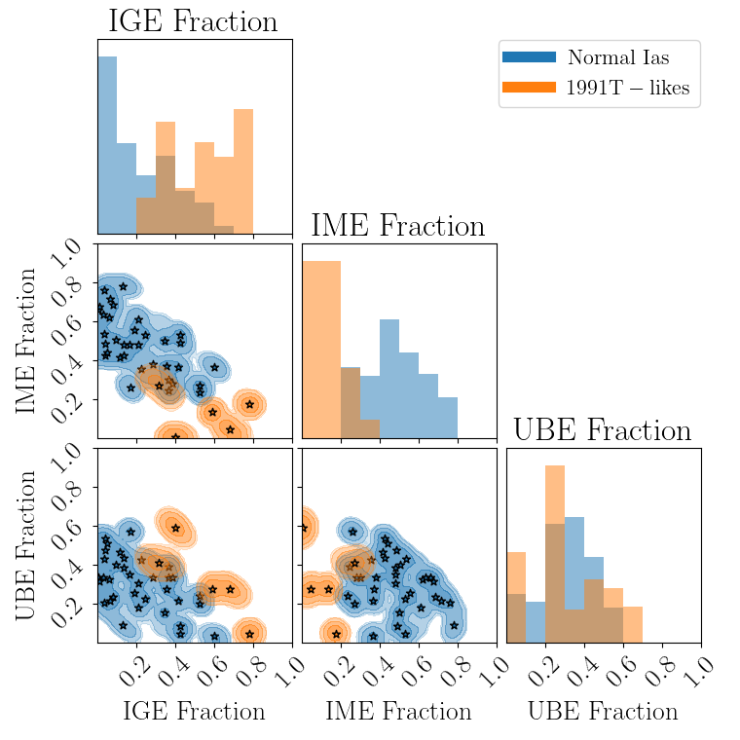
Results:
91T-likes have less overall intermediate mass elements in their outer ejecta
Major contributing factor to shallow silicon features
Evidence of overlap between 91T-like and Normal Ias
Hints towards a common progenitor system
O'Brien et al. 2023

Slide 11
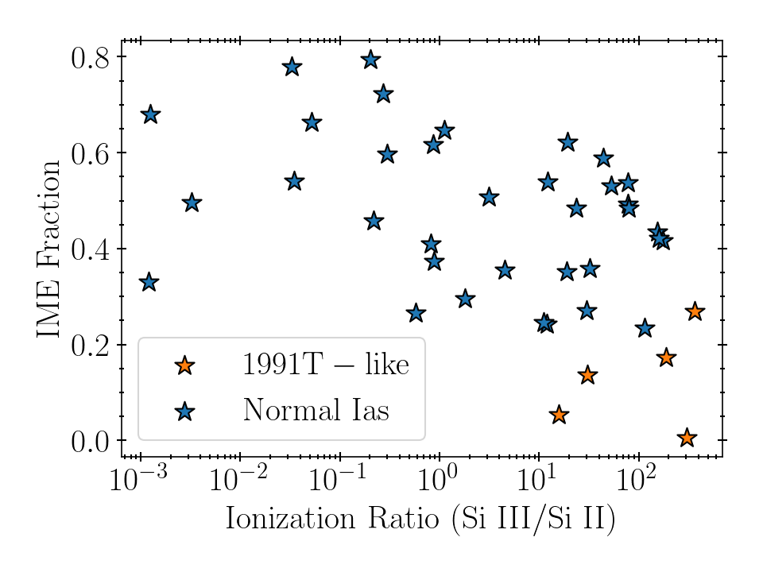
Results:
Shallow Silicon features come from multiple physical mechanisms
Mass fraction of intermediate mass elements
Ionization state of the plasma
O'Brien et al. 2023

Slide 12
Closing Remarks
Conclusions
Full-spectrum inference reveals more information than light-curves or individual spectral features alone
Unique observational properties of 1991T-like supernovae have multiple degenerate underlying causes
Normal Ia population smoothly transitions into the 1991T-like population
Rapid spectral inference from physics is now possible on a wide variety of transients
Future Work
Directly connect inference results to progenitor systems
Paper coming soon!
Investigating Type Iax/02cx-like supernovae
Apply inference over spectral time-series
Generalize Ejecta Models with more powerful Generative Deep-Learning Models

Slide 13
Thank you for Listening!
O'Brien et al. 2023
Connect with Me

Slide 14
Previous Study on SN2002bo Rules out Deflagration
O'Brien et al. 2021

Slide 15
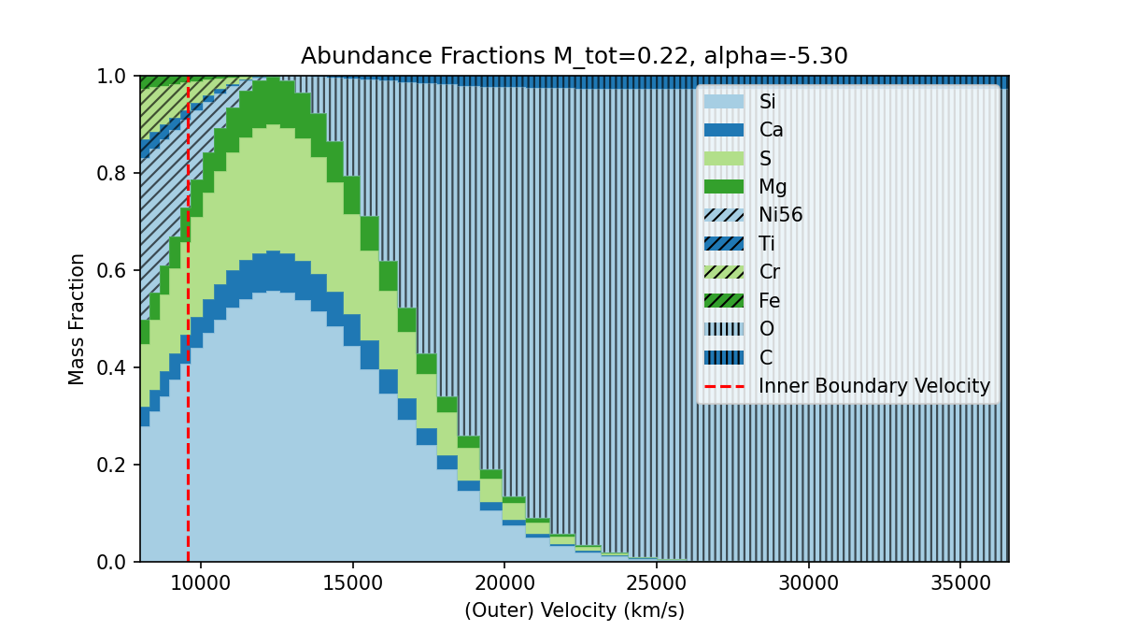
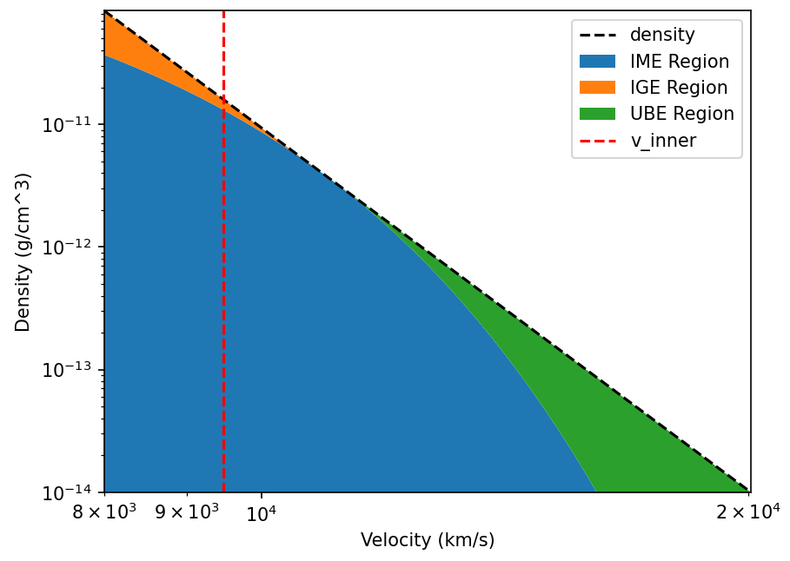
Multi-Zone Models with Few Parameters
Intermediate Mass Elements
Iron-Group Elements
width
Unburned Elements
Centroid
O'Brien et al. 2022 (in prep)
Notes:
So to tackle both of these tasks, I've come up with a new parameterization for our ejecta that allows us to model a simplified multi-zone system without increasing the total number of model parameters
This figure demonstrates an example abundance profile produced by our model
<click>
Masses of intermediate mass elements (such as silicon, Calcium, sulfur, and magnesium) are sampled and placed in a gaussian "bubble" of material in the ejecta to represent the transition from complete nuclear burning, to nuclear burning, to the unburned outer ejecta.
<Click>
We similarly sample a set of masses for the contributions of iron group elements to place below this bubble
<click>
And we do the same for the unburned carbon and oxygen on the outside.
<click>
Given the total masses of these three categories of elements, as well as our density profile parameter, we are able to solve for a width of our gaussian bubble
<click>
As well as it's centroid

Slide 16
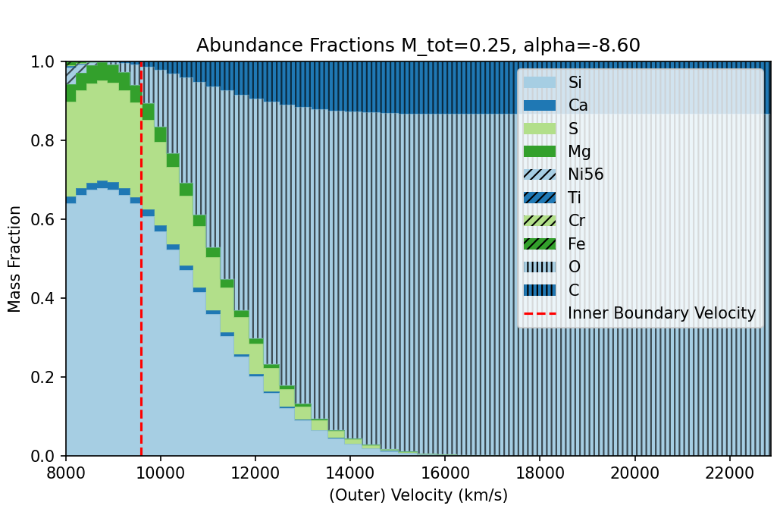
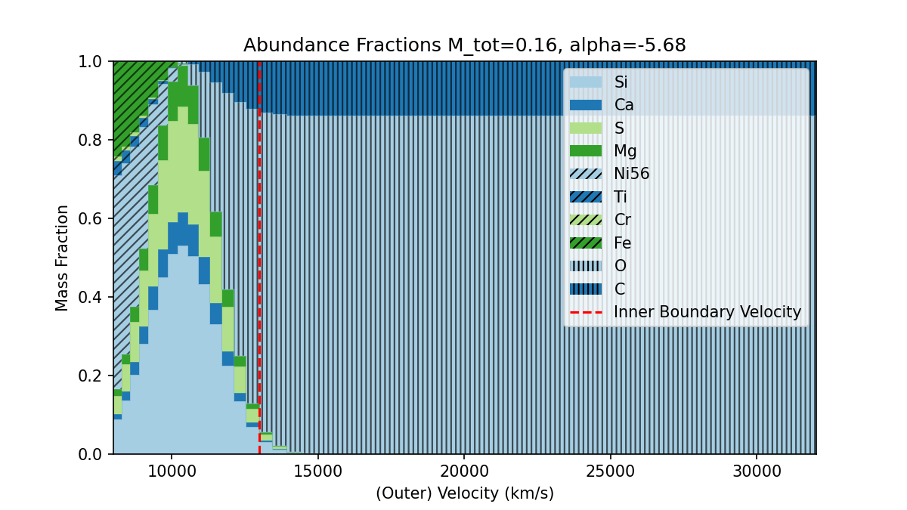
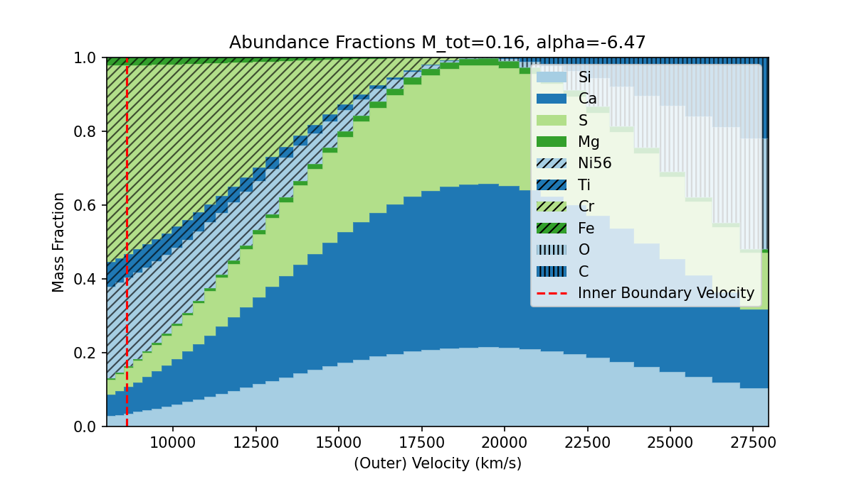
Multi-Zone Models with Few Parameters
Advantages
Probe mixing in the ejecta in detail
Explore changes in ionization states at various line velocities
Probe differences in nuclear burning efficiency
Better constrain progenitor mass and nucleosynthetic yields
Multi-epoch spectral synthesis only adds 2 parameters per epoch!
New Emulator
Higher complexity of this model makes emulation difficult
Probabilistic Dalek which understands its own uncertainty allows us to capture this error in our likelihood
Notes:
<Click>
Here are a few realizations of randomly sampled profiles from this space
<Click>
Our new parameterization has a few advantages that allow us to directly model more complex dynamics within the ejecta as well as search for distinguishing features between type Ia subgroups
<click>
<click>
For example, now that we can alter the relative abundances of material with depth, we are better able to accurate reconstruct the line velocities corresponding the individual ionization states from changing temperatures within the ejecta
<click>
<click>
We can also look at how quickly nuclear burning falls off by investigating the widths of the central bubble, which has been proposed to be a distinguishing factor between 91T-likes, 1999aa-likes, and normal Ias
<click>
And even more exciting, since we assume homoglous expansion for type Ias, the intrinsic abundance profile should not significantly change between epochs. Since we know the time-lag between observations, we only need additional parameters for the inner boundary photosphere temperature and velocity for each additional spectrum in the time series rather than an entire 10
<Click>
<click>
This new model does come with some drawbacks though. Due to the way the inner boundary velocity is independently sampled, some regions of the parameter space change the resulting spectrum extremely rapidly as well as suddenly unconstrain certain parameters (for example, abundance fractions of iron group elements when the inner boundary is above the centroid of the bubble)
<click>
So working with researchers Patrick Van Der Smagt and Nutan Chen at the Volkswagen Group Machine Learning lab, we trained a probabilistic emulator ensemble that is able to predict the accuracy of emulation for a given set of parameter inputs. These uncertainties can be fed directly into our likelihood function by simply adding them in quadrature to our observational and intrinsic uncertainties.

Slide 17
How Important is NLTE?
Shen et al. 2021
Notes:
Are these approximations reasonable?
A 2021 paper investigated the impact of the inclusion of NLTE effects in radiative transfer models
While the inclusion of NLTE effects have significant impacts on the late-time spectra, it was found that for pre-maximum spectra the differences are negligible
Our systematic uncertainty in comparing to our observed spectra and the model simplifications to lower our parameterization are going to to dominant sources of error in our fitting

