Slide 1
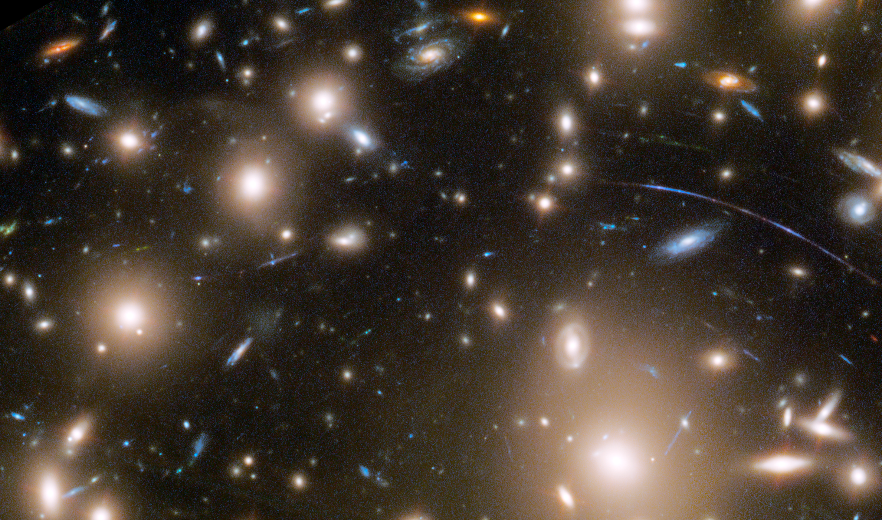
Shock cooling of a red-supergiant supernova at redshift 3 in lensed images
Minnesota Institute for Astrophysics
Wenlei Chen
June 20, 2023

Slide 2
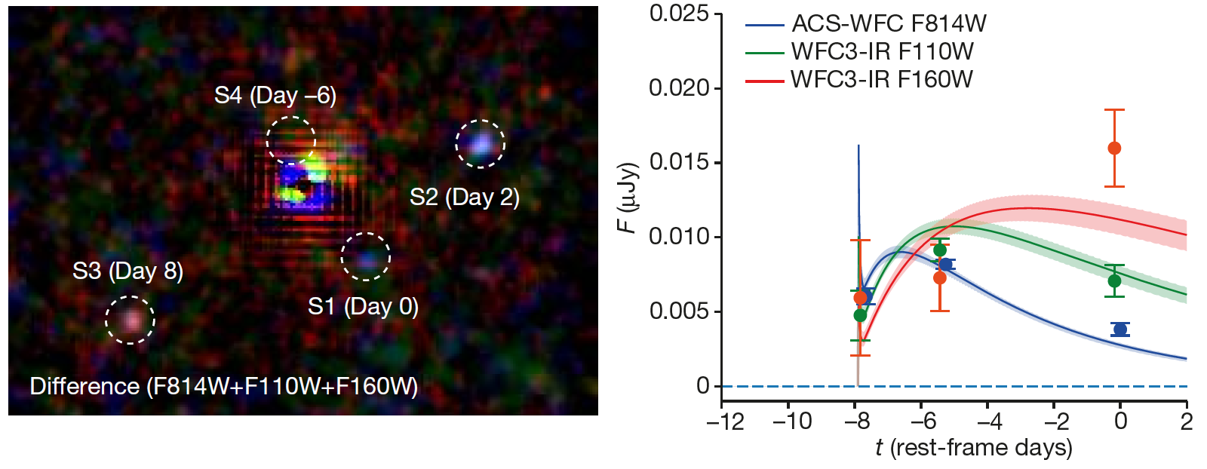
We discover a multiply imaged supernova behind a massive galaxy cluster from the HST imaging.
Individual exposures simultaneously capture three gravitationally lensed and magnified images of a supernova at redshift ~3.
The time delayed images show the early phases of the supernova, indicating a red supergiant progenitor with ~500 solar radii.
Wenlei Chen, Patrick L. Kelly, Masamune Oguri, Thomas J. Broadhurst, Jose M. Diego, Najmeh Emami, Alexei V. Filippenko, Tommaso L. Treu & Adi Zitrin, Nature 2022

Slide 3
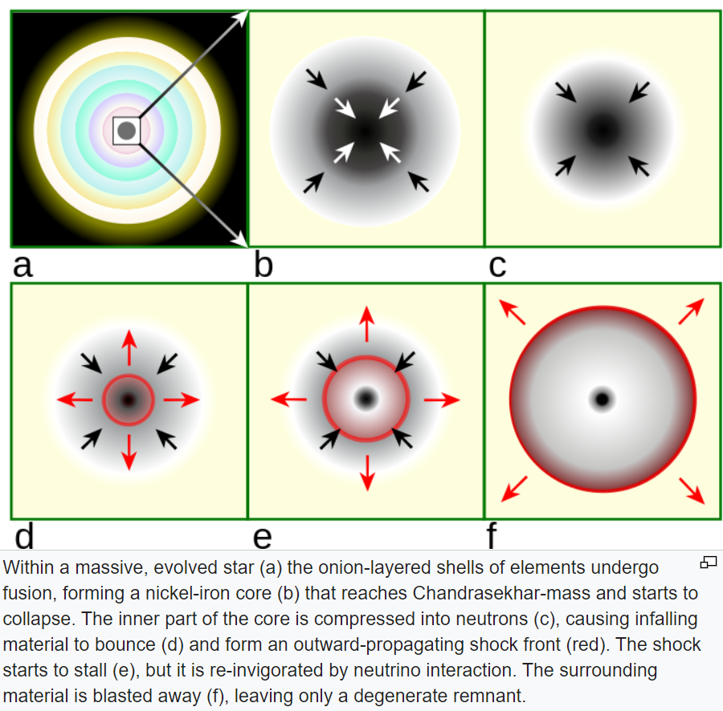
Early Light Curves of Core-collapse SNe
Shock breakout (a few minutes – 1 day)
Cooling of shocked materials (a few days)
Shock breakout occurs when the shock becomes sufficiently close to the surface that the optical depth is smaller than the ratio of the speed of light to the shock velocity.
$$τ<\frac{v}{c}$$
by R.J. Hall

Slide 4
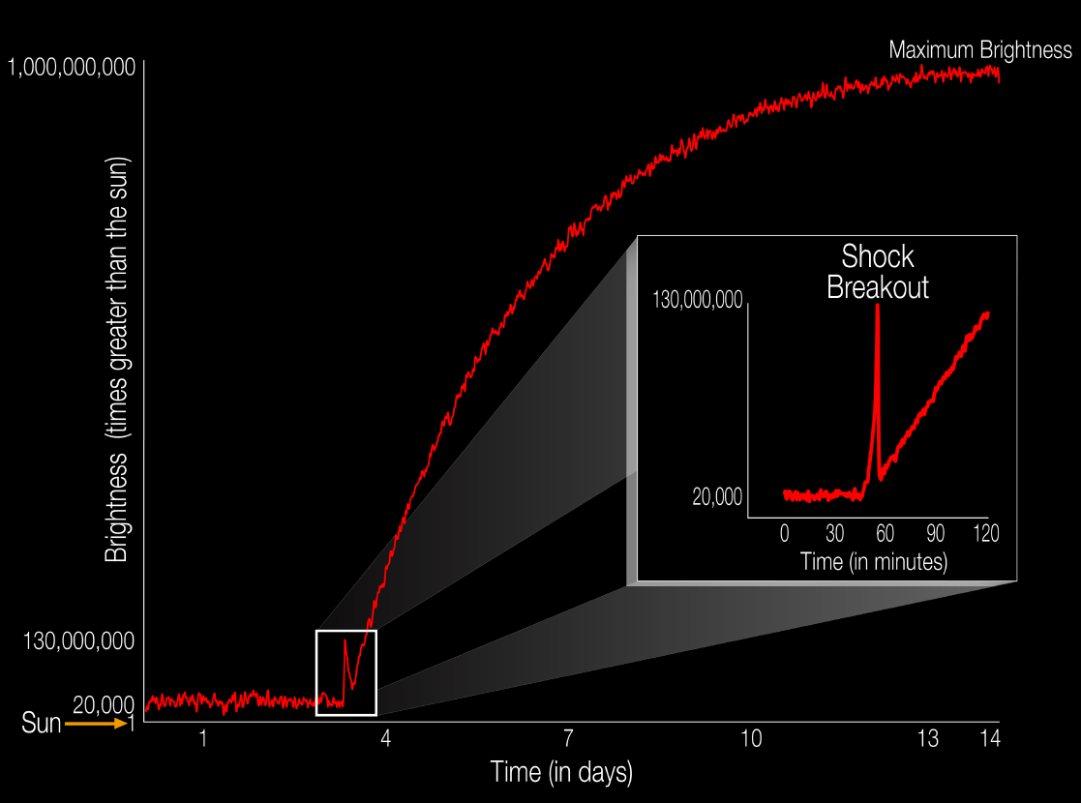
Early Light Curves of Core-collapse SNe
Shock breakout (a few minutes – 1 day)
Cooling of shocked materials (a few days)
KSN 2011d
-- Envelope of massive star
-- Circumstellar material (CSM)
Garnavich+ 16
Rubin & Gal-Yam 17

Slide 5
Early Light Curves of Core-collapse SNe
Observations of this shock-cooling phase provide a powerful tool for inferring the progenitor’s pre-explosion radius as well as constraining the mass of circumstellar material surrounding the progenitor.
There are a dozen examples of the SNe well-observed early light curve in the nearby universe. However, at high-redshift universe, we lack an ability to study the properties of individual massive stars and their explosions.

Slide 6
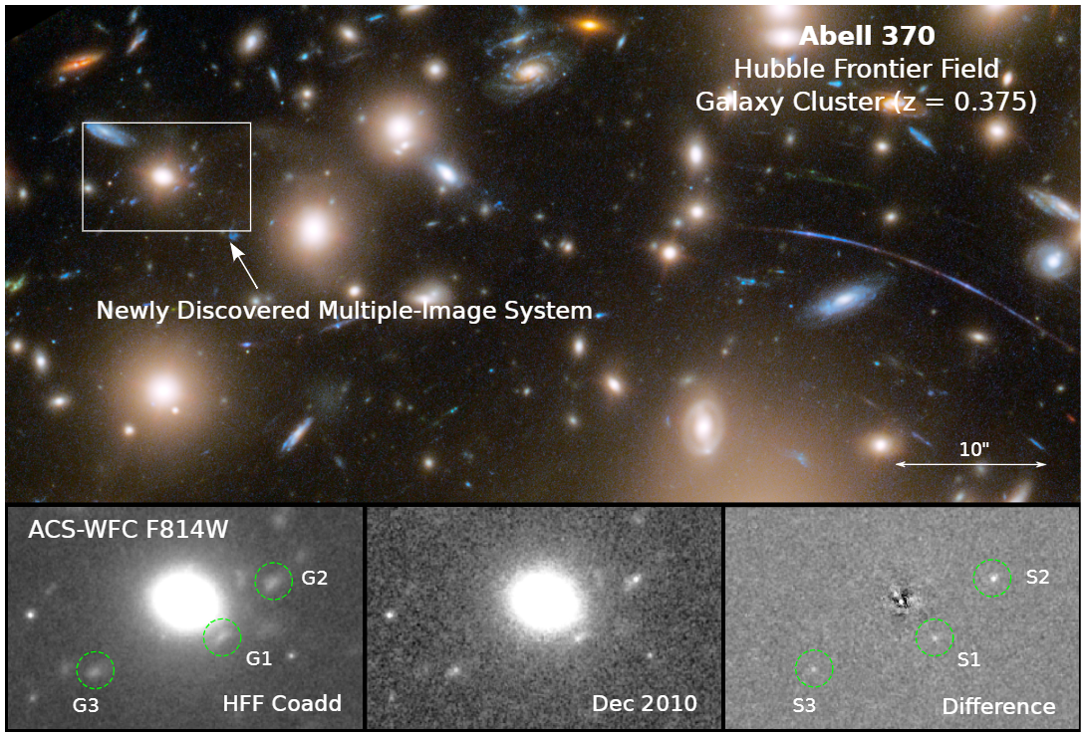
A multiply imaged SN at z~3

Slide 7
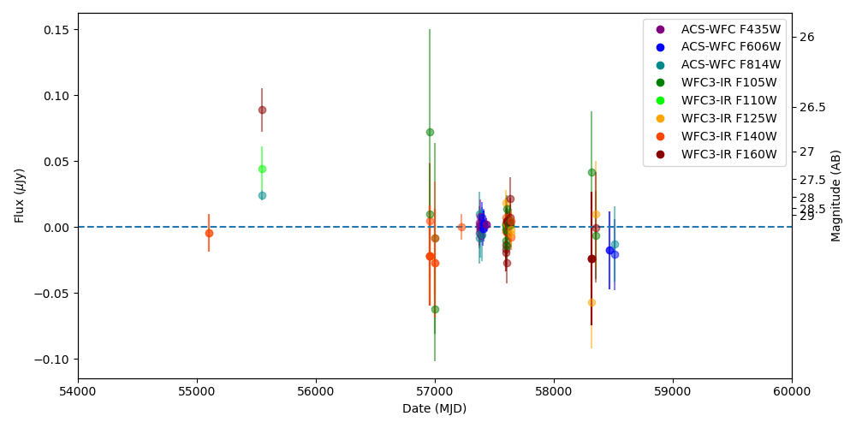
A multiply imaged SN at z~3

Slide 8
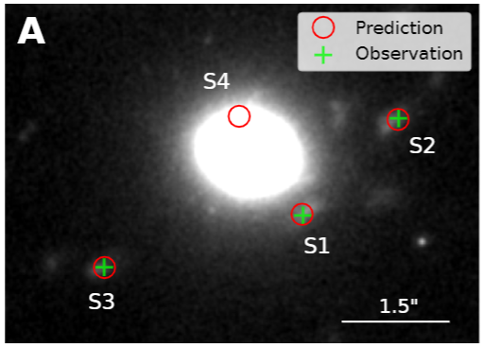
Modeling the gravitational lens (GLAFIC)

Slide 9
Time delayed images
The SN was observed by the HST through ACS-WFC F814W, WFC3-IR F110W, and WFC3-IR F160W filters.
Significant color difference: Effective blackbody temperatures of S1, S2, and S3 are 5.5E4 K, 2.0E4 K, and 1.1E4 K, respectively.

Slide 10
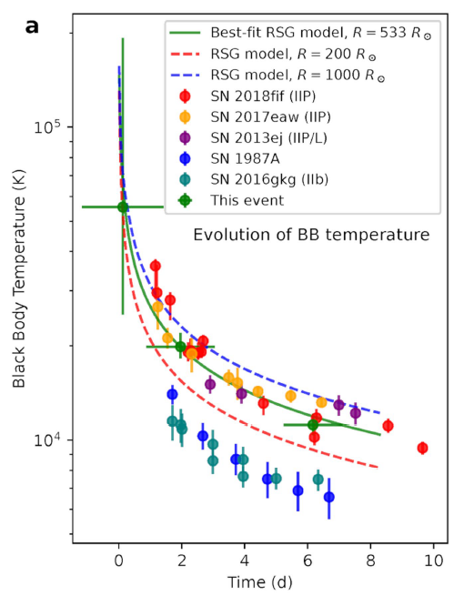
Time delayed images
The SN was observed by the HST through ACS-WFC F814W, WFC3-IR F110W, and WFC3-IR F160W filters.
Significant color difference: Effective blackbody temperatures of S1, S2, and S3 are 5.5E4 K, 2.0E4 K, and 1.1E4 K, respectively.

Slide 11
Rate of multiple imaged CCSNe
GLAFIC V4
HST Imaging
DM mass
Magnification
0.03˚×0.03˚

Slide 12
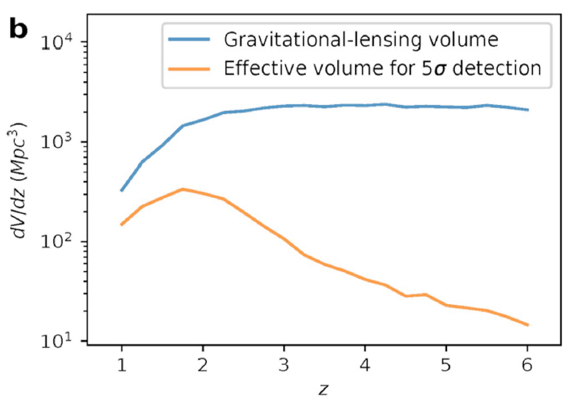
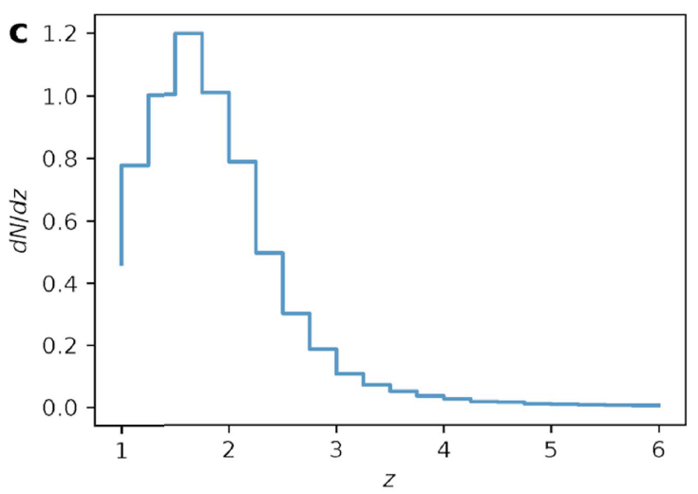
Rate of Multiply Imaged CCSNe
In the past decades, there are two examples of multiply imaged CCSNe found in the Hubble Frontier Fields. (This one and the SN Refsdal)
Our simulation based on the cosmic star-formation history from Madau & Dickinson 2014 and a Salpeter initial mass function ($k_{CC}=0.0068{M_{⊙}}^{−1}$) shows that we should expect 1.7 strongly lensed CCSNe in the existing observations of the HFF cluster fields.

Slide 13
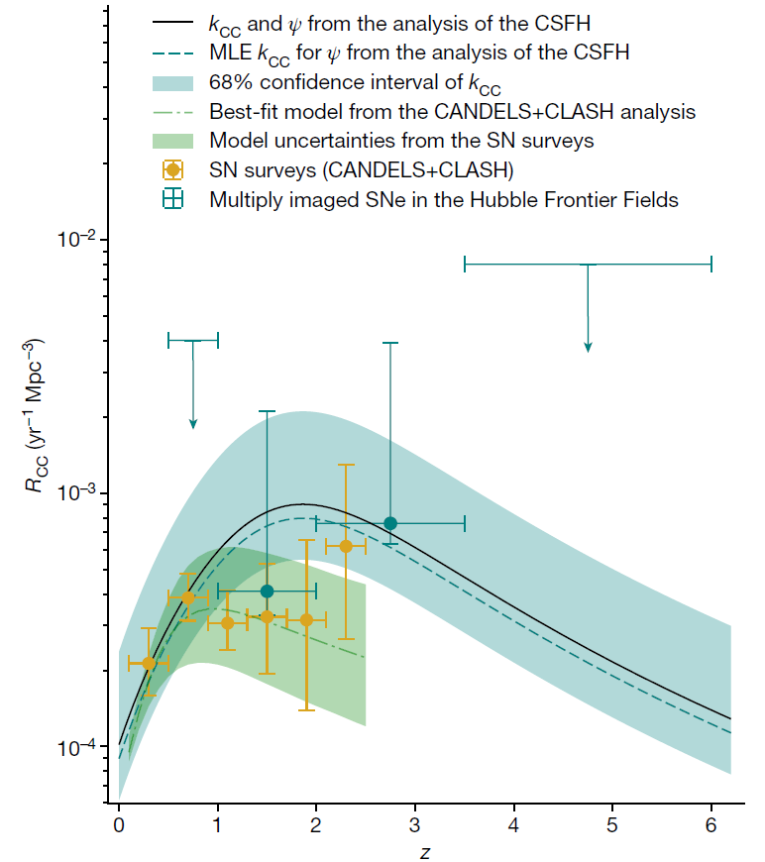
Inferring the Cosmic Star-Formation History from the Observation of Multiply Imaged CCSNe
If we use the number of multiply imaged CCSNe found in the Hubble Frontier Fields to constrain $k_{CC}$ based on the cosmic star-formation history from Madau & Dickinson 2014, we find $k_{CC}={0.0087}_{−0.0046}^{+0.0071}{M_{⊙}}^{−1}$ and a MLE value of $k_{CC}=0.0060{M_{⊙}}^{−1}$.
This is consistent with the theoretical expectation for a Salpeter initial mass function and the approximate assumption that stars with initial masses between $8M_{⊙}$ and $40M_{⊙}$ successfully explode.
If we use the inferred volumetric CCSN rates from previous CCSN surveys and adopt the same extinction prior to predict the expected number of strongly lensed SNe in archival observations of the HFF cluster fields, we find a probability of only P = 0.026 of discovering at least two strongly lensed CCSNe.
More examples in the future would improve the constraints.

Slide 15
Backup slides

Slide 16
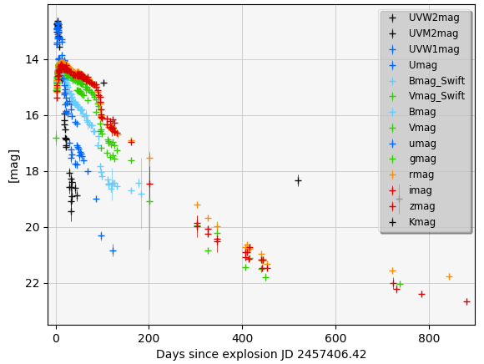
Type IIP supernova ASASSN-16at

Slide 17
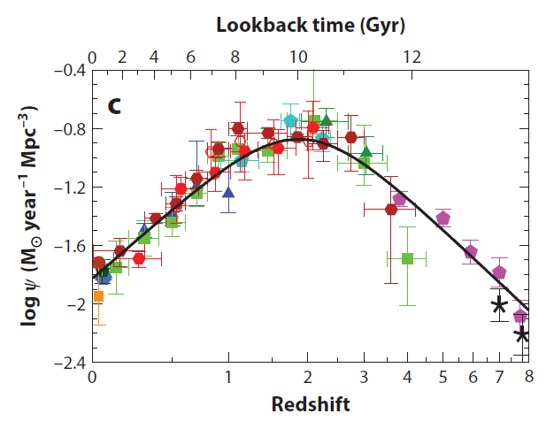
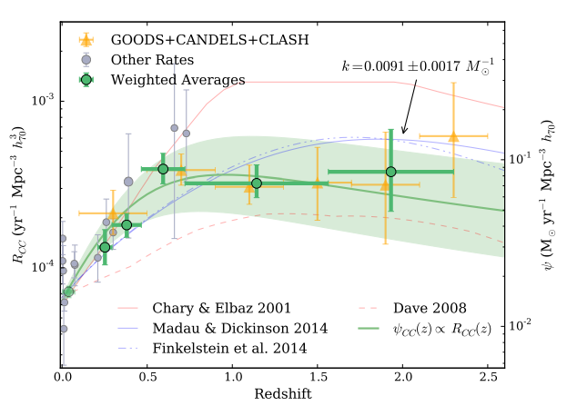
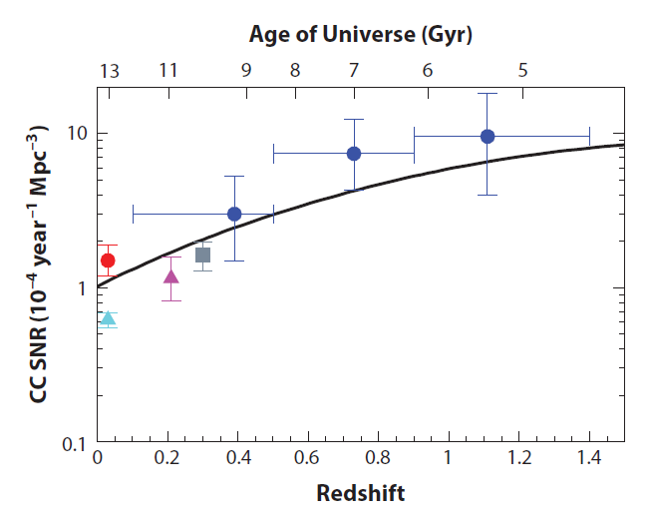
Cosmic CCSN Rate and Star-Formation Rate
Strolger+2015
Madau & Dickinson 2014

Slide 18
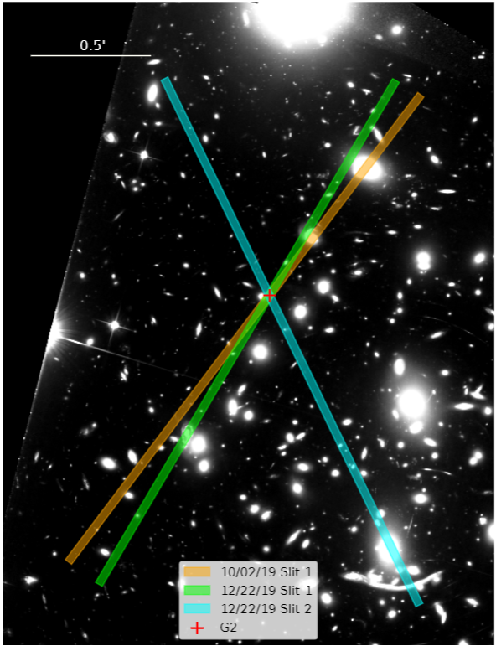
MMT Blue-Channel Spectrograph

Slide 19
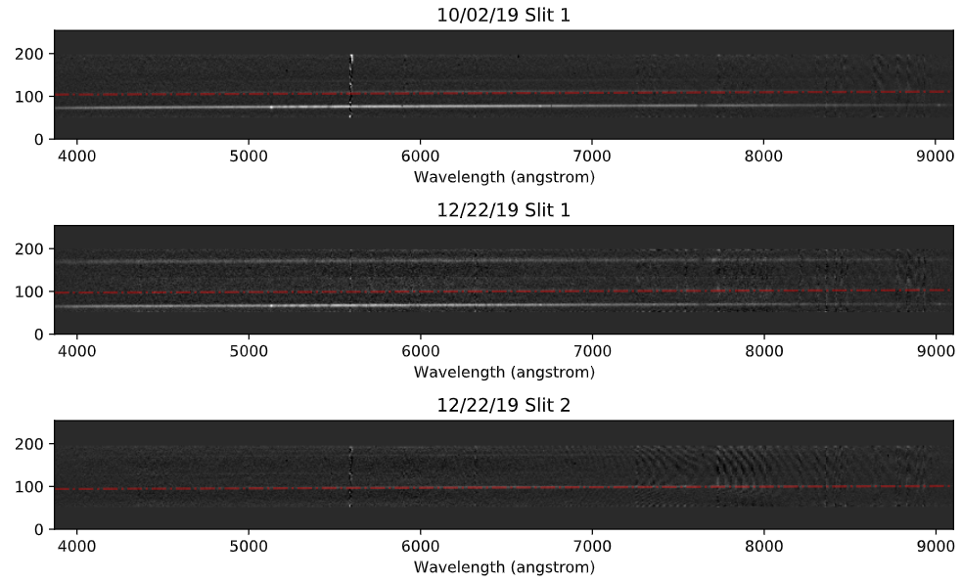
MMT Blue-Channel Spectrograph

Slide 20
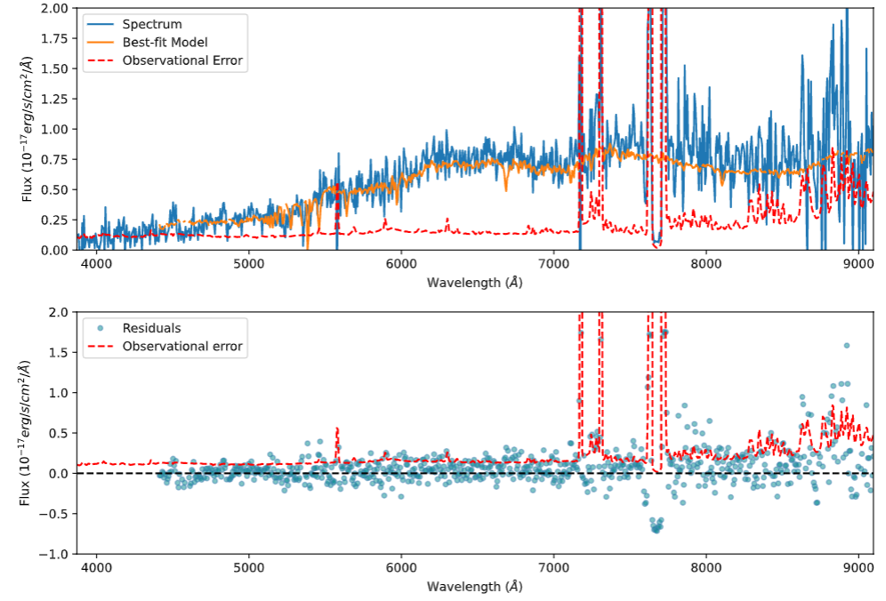
MMT Blue-Channel Spectrograph

Slide 21
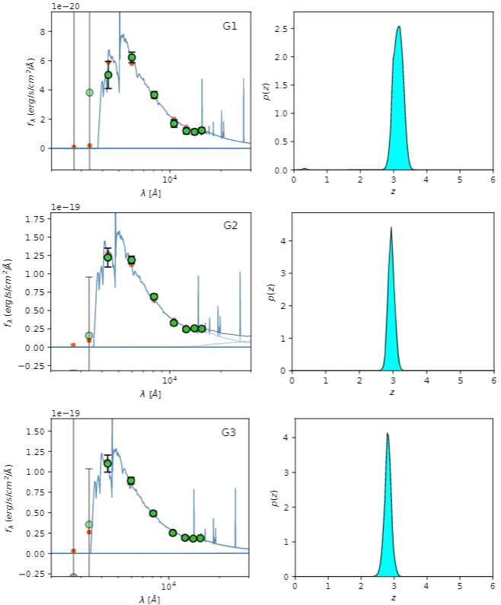
Photometric redshift

Slide 22
Fitting models of the early SN light curve
Shocked massive envelope with negligible CSM: Sapir & Waxman 2017 model with a planar-phase correction by Morag et al.; (M20-RSG & M20-BSG)
Shocked thin and dense CSM shell with low mass (typically between 0.001 and 0.1 solar mass): Piro et al. 2021 (P21) and Margalit 2021 (M21)
Free parameters from both light-curve models and lens models.
M20-RSG is the best-fit model, using the parameter ranges determined prior to the test.
By relaxing the upper bound of CSM shell mass to 1 $M_{⊙}$, P21 is as good as M20-RSG model fitting into the light curve.

Slide 23
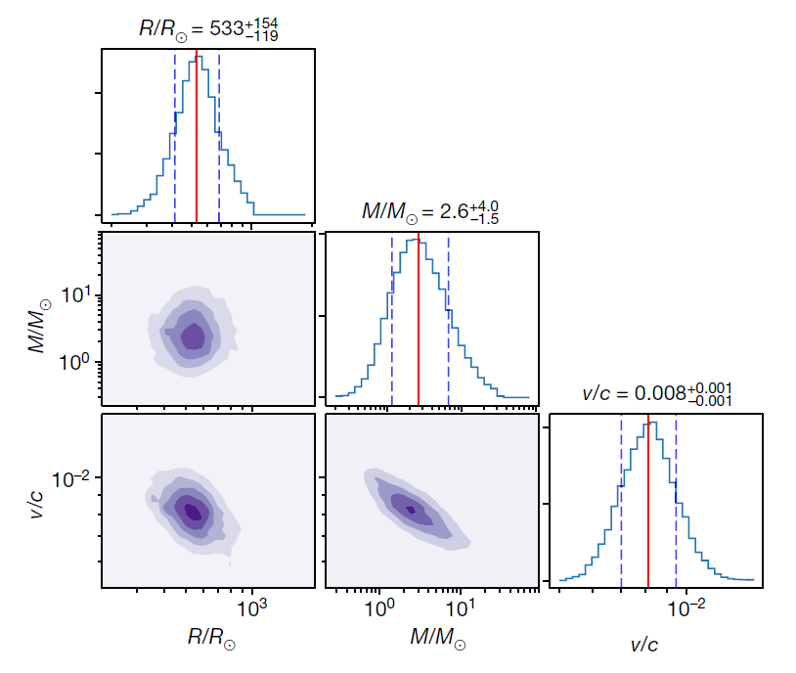
Constraints on progenitor’s pre-explosion properties
From M20-RSG, we constrain the radius of the progenitor red-supergiant star to be ${533}_{−119}^{+154}R_{⊙}.$
From P21, the initial radius of the CSM is constrained to be ${481}_{−118}^{+157}R_{⊙}$. The maximum-likelihood mass of CSM shell is peaked at the upper bound at 1 $M_{⊙}$.
A ~ 500 $R_{⊙}$ CSM shell with mass of 1 $M_{⊙}$ is unlikely.

Slide 24
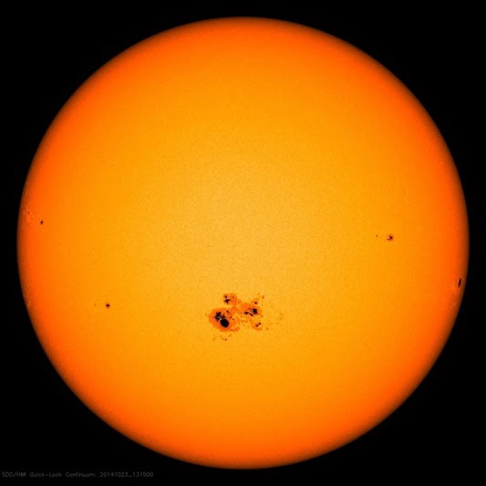
Color difference from microlensing?
The colors of multiple images of a single source can become different if the caustic of a microlens, such as a back hole or a compact object in the foreground lens, intersects the photosphere.
We find the microlensing optical depth of 0.01, 0.013, and 0.006 for S1, S2, and S3, respectively.
It is unlikely that the color difference is from microlensing.
Microlensing Optical Depth:

Slide 25
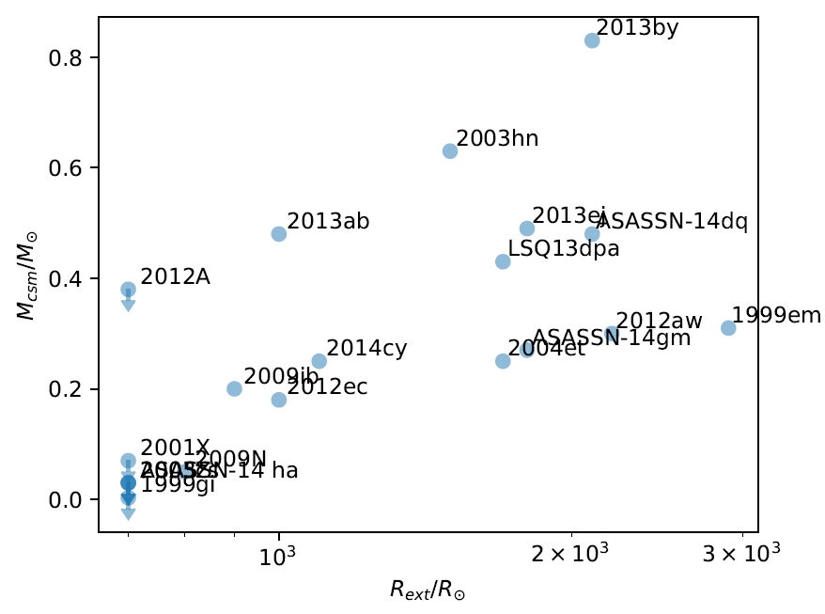
Constraints on progenitor’s pre-explosion properties
The CSM shell need to be initially optical thick, hence the shock breakout can occur at large radius.
Higher mass of the CSM shell indicates larger radius of the shell.
A ~ 500 $R_{⊙}$ CSM shell with mass of 1 $M_{⊙}$ is uncommon (has not been seen in the nearby Universe).
Plotted using results from Morozova+ 2018

Slide 26
Constraints on progenitor’s pre-explosion properties
This event
The CSM shell need to be initially optical thick, hence the shock breakout can occur at large radius.
Higher mass of the CSM shell indicates larger radius of the shell.
A ~ 500 $R_{⊙}$ CSM shell with mass of 1 $M_{⊙}$ is uncommon (has not been seen in the nearby Universe).
Plotted using results from Morozova+ 2018

Slide 27
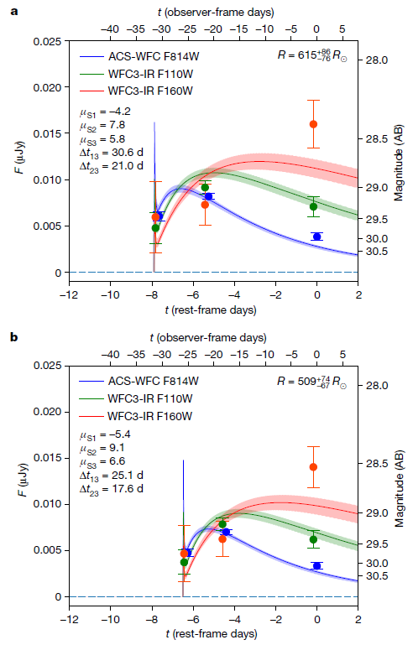
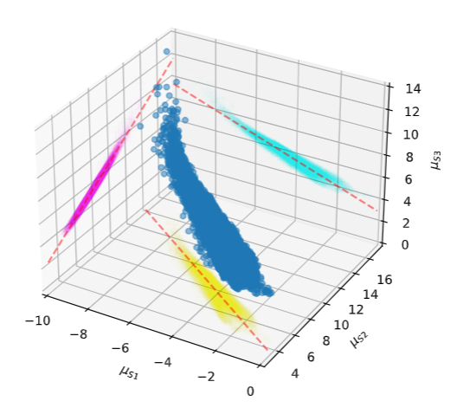
Dependence on Lensing Models
Two examples of the reconstructed light curve of the SN with fixed time delays and magnifications.
Parameters from gravitational-lensing models are highly covariant.

Slide 28
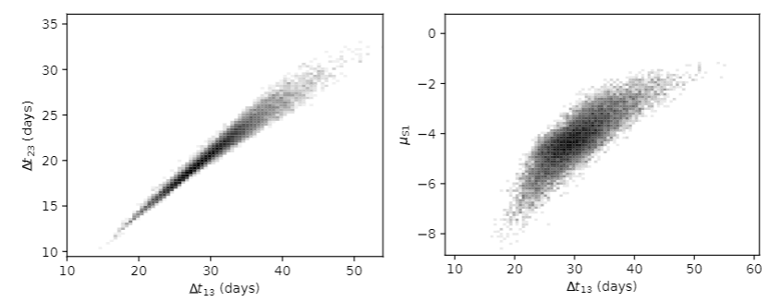
Covariant of gravitational lensing parameters

Slide 29
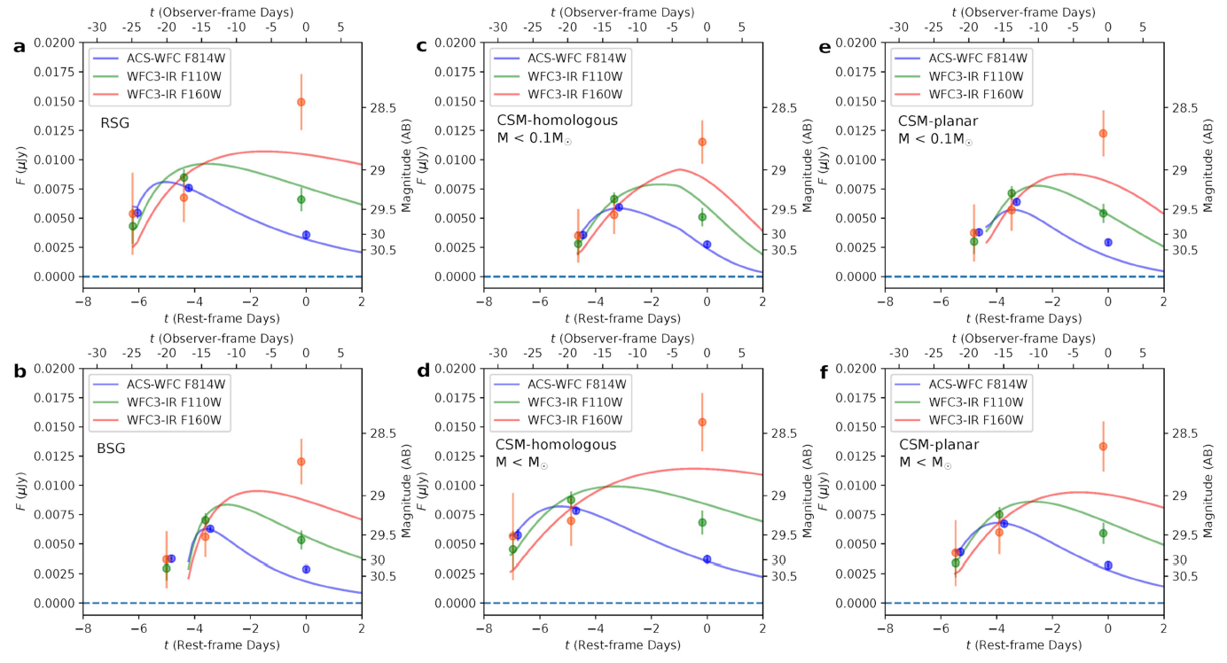

Slide 30
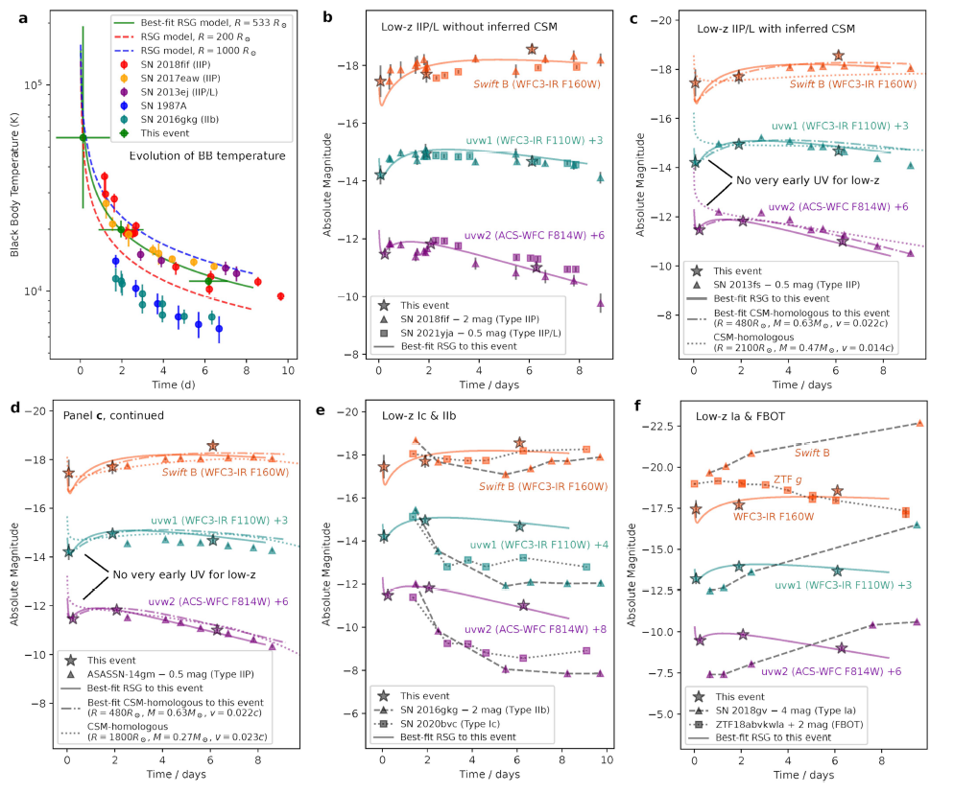

Slide 31
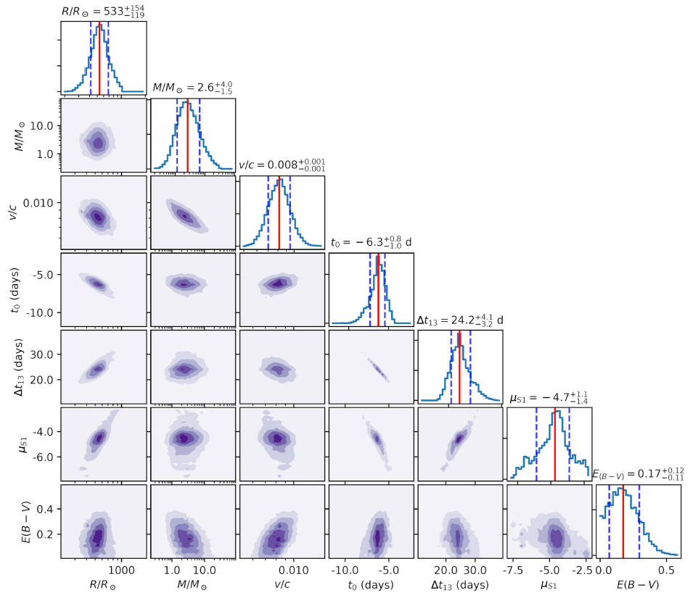
M20-RSG corner plot

Slide 32
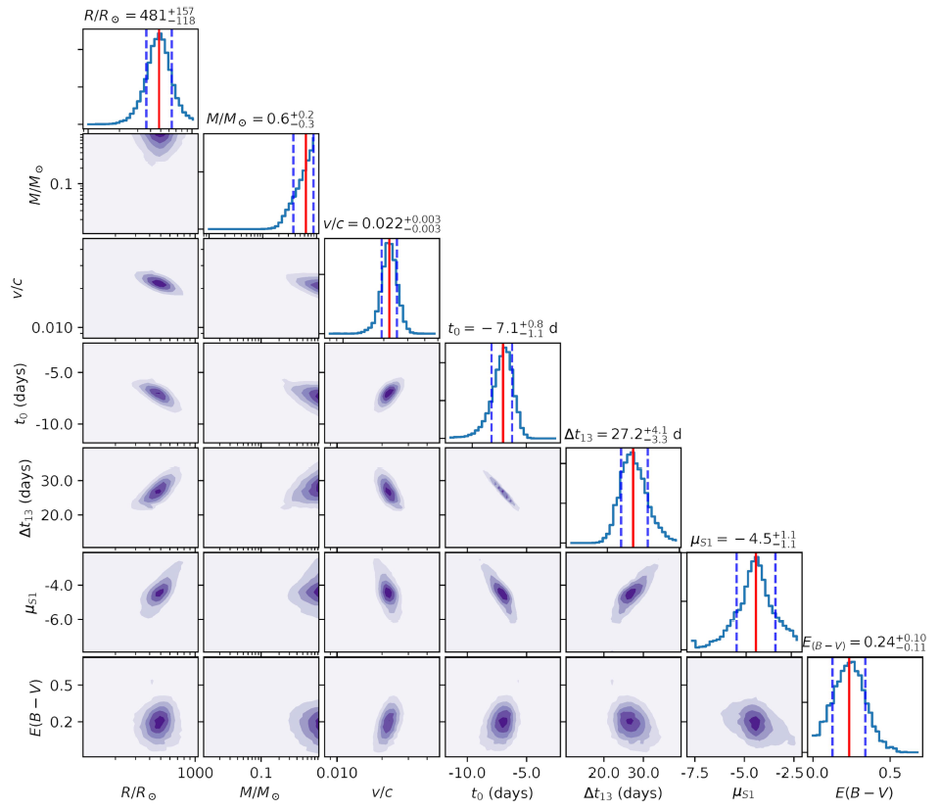
P21 corner plot

Slide 33
