Slide 1
A Confidence-Aware Approach for Truth Discovery on Long-Tail Data
Qi Li¹, Yaliang Li¹, Jing Gao¹, Lu Su¹, Bo Zhao²,
Murat Demirbas¹, Wei Fan³, and Jiawei Han⁴
¹SUNY Buffalo, Buffalo, NY, USA
²LinkedIn, San Francisco, CA, USA
³Baidu Research Big Data Lab, China
⁴University of Illinois, Urbana, IL, USA

Slide 2
Which of these square numbers also happens to be the sum of two smaller square numbers?
16
25
36
49
https://www.youtube.com/watch?v=BbX44YSsQ2I

Slide 3
Which of these square numbers also happens to be the sum of two smaller square numbers?
16
25
36
49
https://www.youtube.com/watch?v=BbX44YSsQ2I

Slide 4
Problem Description
Our task is to aggregate the information from different sources for the same entities by considering source reliability degrees.
Truth Discovery

Slide 5
Truth Discovery
Principle
Infer both truth and source reliability from the data
A source is reliable if it provides many pieces of true information
A piece of information is likely to be true if it is provided by many reliable sources

Slide 6
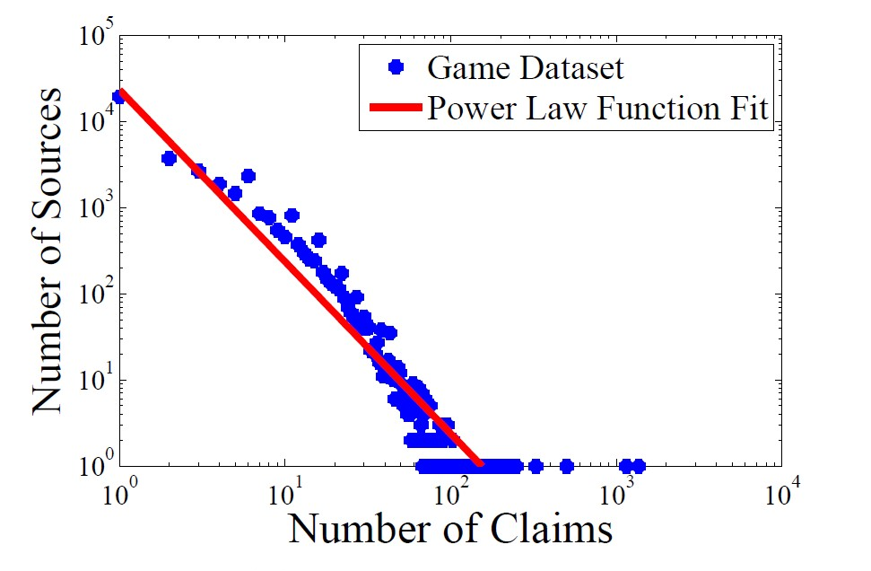
Long-Tail Phenomenon

Slide 7
Existing Work
Existing methods
Tackle different challenges in truth discovery
Source correlations, source costs, streaming data, ……
Limitation when most sources make a few claims
Sources weights are proportional to the accuracy of the sources
When the number of claims from a source is quite small, the estimation of the accuracy is unreliable.

Slide 8
Overview of Our Work
A confidence-aware approach
not only estimates source reliability
but also considers the confidence interval of the estimation

Slide 9
Aggregation
Assume that each source has a weight $w_{s}$
To aggregate the various information, weighted combination is adopted:
$$x_{n}^{∗}= \frac{\sum_{s∈S_{n}}{w_{s}∙x_{n}^{s} }}{\sum_{s∈S_{n}}{w_{s} }}$$

Slide 10
Model the Error Distribution
Assume that sources are independent
$\text{Error} \text{made} \text{by} \text{source} s: ε_{s}∼N\left(0, σ_{s}^{2}\right)$
Since $ε_{combine}=\frac{\sum_{s∈S}{w_{s}ε_{s}}}{\sum_{s∈S}{w_{s}}}$, we have
$$ε_{combine}∼N\left(0,\frac{\sum_{s∈S}{w_{s}^{2}σ_{s}^{2}}}{{\left(\sum_{s∈S}{w_{s}}\right)}^{2}}\right)$$
Without loss of generality, we constrain $\sum_{s∈S}{w_{s}}=1$

Slide 11
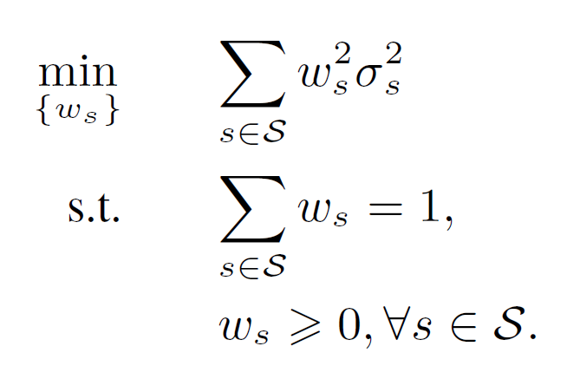
Minimize the Variance of Errors
Goal:
want the variance of $ε_{combine}$to be as small as possible
Optimization

Slide 12
How to Estimate Variance
We can estimate the variance of each source using similar formulation for sample variance:
$$\hat{σ_{s}^{2}}=\frac{1}{\left|N_{s}\right|}\sum_{n∈N_{s}}{{\left(x_{n}^{s}−x_{n}^{∗(0)}\right)}^{2}}$$
where $x_{n}^{∗(0)}$ is the initial truth.

Slide 13
Estimate CI of Variance
The estimation is not accurate with small number of samples.
Find a range of values that can act as good estimates.
Calculate confidence interval based on
$\frac{\left|N_{s}\right|\hat{σ_{s}^{2}} }{σ_{s}^{2}}∼χ^{2}\left(\left|N_{s}\right|\right)$

Slide 14
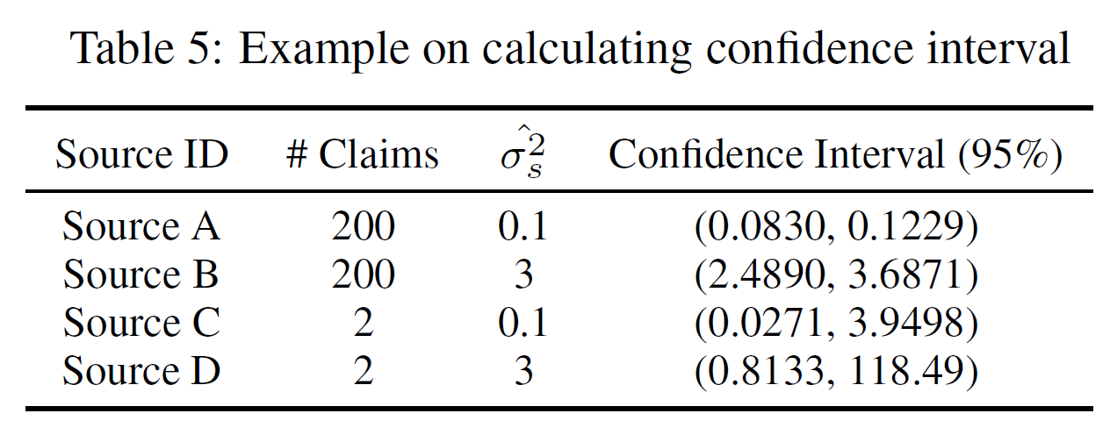
Example
Example on calculating confidence interval

Slide 15
Example
Example on calculating confidence interval

Slide 16
Example
Example on calculating confidence interval

Slide 17
How to estimate variance
Consider the possibly worst scenario of $σ_{s}^{2}$
Use the upper bound of the 95% confidence interval of $σ_{s}^{2}$
$$u_{s}^{2}=\frac{\sum_{n∈N_{s}}{{\left(x_{n}^{s}−x_{n}^{∗\left(0\right)}\right)}^{2}}}{χ_{\left(0.05, \left|N_{s}\right|\right)}^{2}}$$

Slide 18
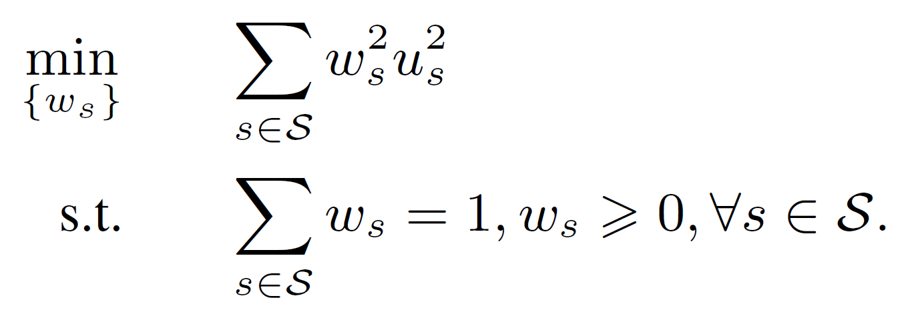
CATD
Closed-form solution:
$$w_{s}∝ \frac{1}{u_{s}^{2}}= \frac{χ_{\left(0.05, \left|N_{s}\right|\right)}^{2}}{\sum_{n∈N_{s}}{{\left(x_{n}^{s}−x_{n}^{∗\left(0\right)}\right)}^{2}}}$$

Slide 19
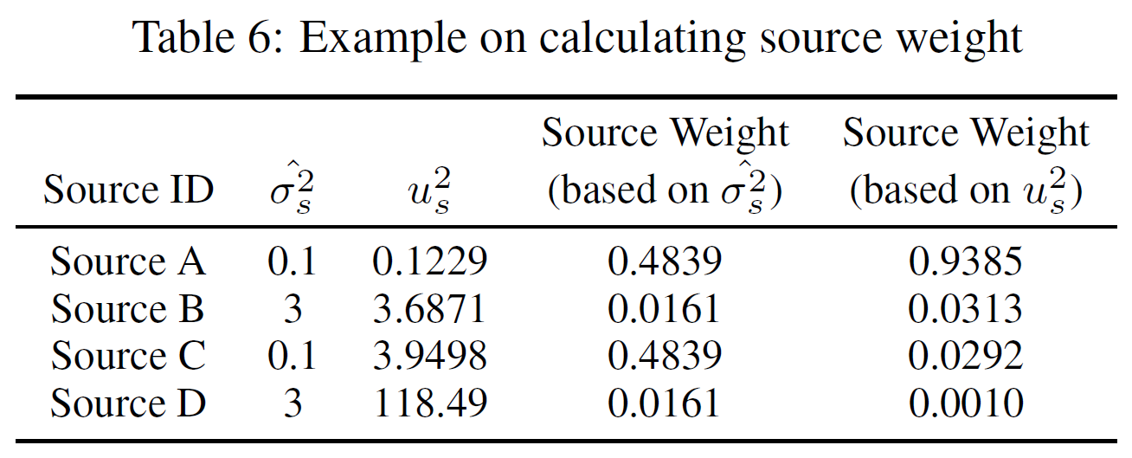
Example
Example on calculating source weight

Slide 20
Example
Example on calculating source weight

Slide 21
Example
Example on calculating source weight

Slide 22
Performance on Game Data
Question level | Majority Voting | CATD
1 | 0.0297 | 0.0132
2 | 0.0305 | 0.0271
3 | 0.0414 | 0.0276
4 | 0.0507 | 0.0290
5 | 0.0672 | 0.0435
6 | 0.1101 | 0.0596
7 | 0.1016 | 0.0481
8 | 0.3043 | 0.1304
9 | 0.3737 | 0.1414
10 | 0.5227 | 0.2045

Slide 23
Performance on Game Data
Comparison on Game dataset

Slide 24
Summary
Truth Discovery on long-tail data
Most sources only provide very few claims and only a few sources makes plenty of claims.
By adopting effective estimators based on the confidence interval, CATD appropriately estimates source reliability for sources with different levels of participation.

Slide 25
Thank You!

