Slide 1
Resolving Conflicts in Heterogeneous Data by Truth Discovery and Source Reliability Estimation
Qi Li¹, Yaliang Li¹, Jing Gao¹, Bo Zhao², Wei Fan³, Jiawei Han⁴
¹SUNY Buffalo; ²Microsoft Research;
³Huawei Noah’s Ark Lab; ⁴University of Illinois

Slide 2
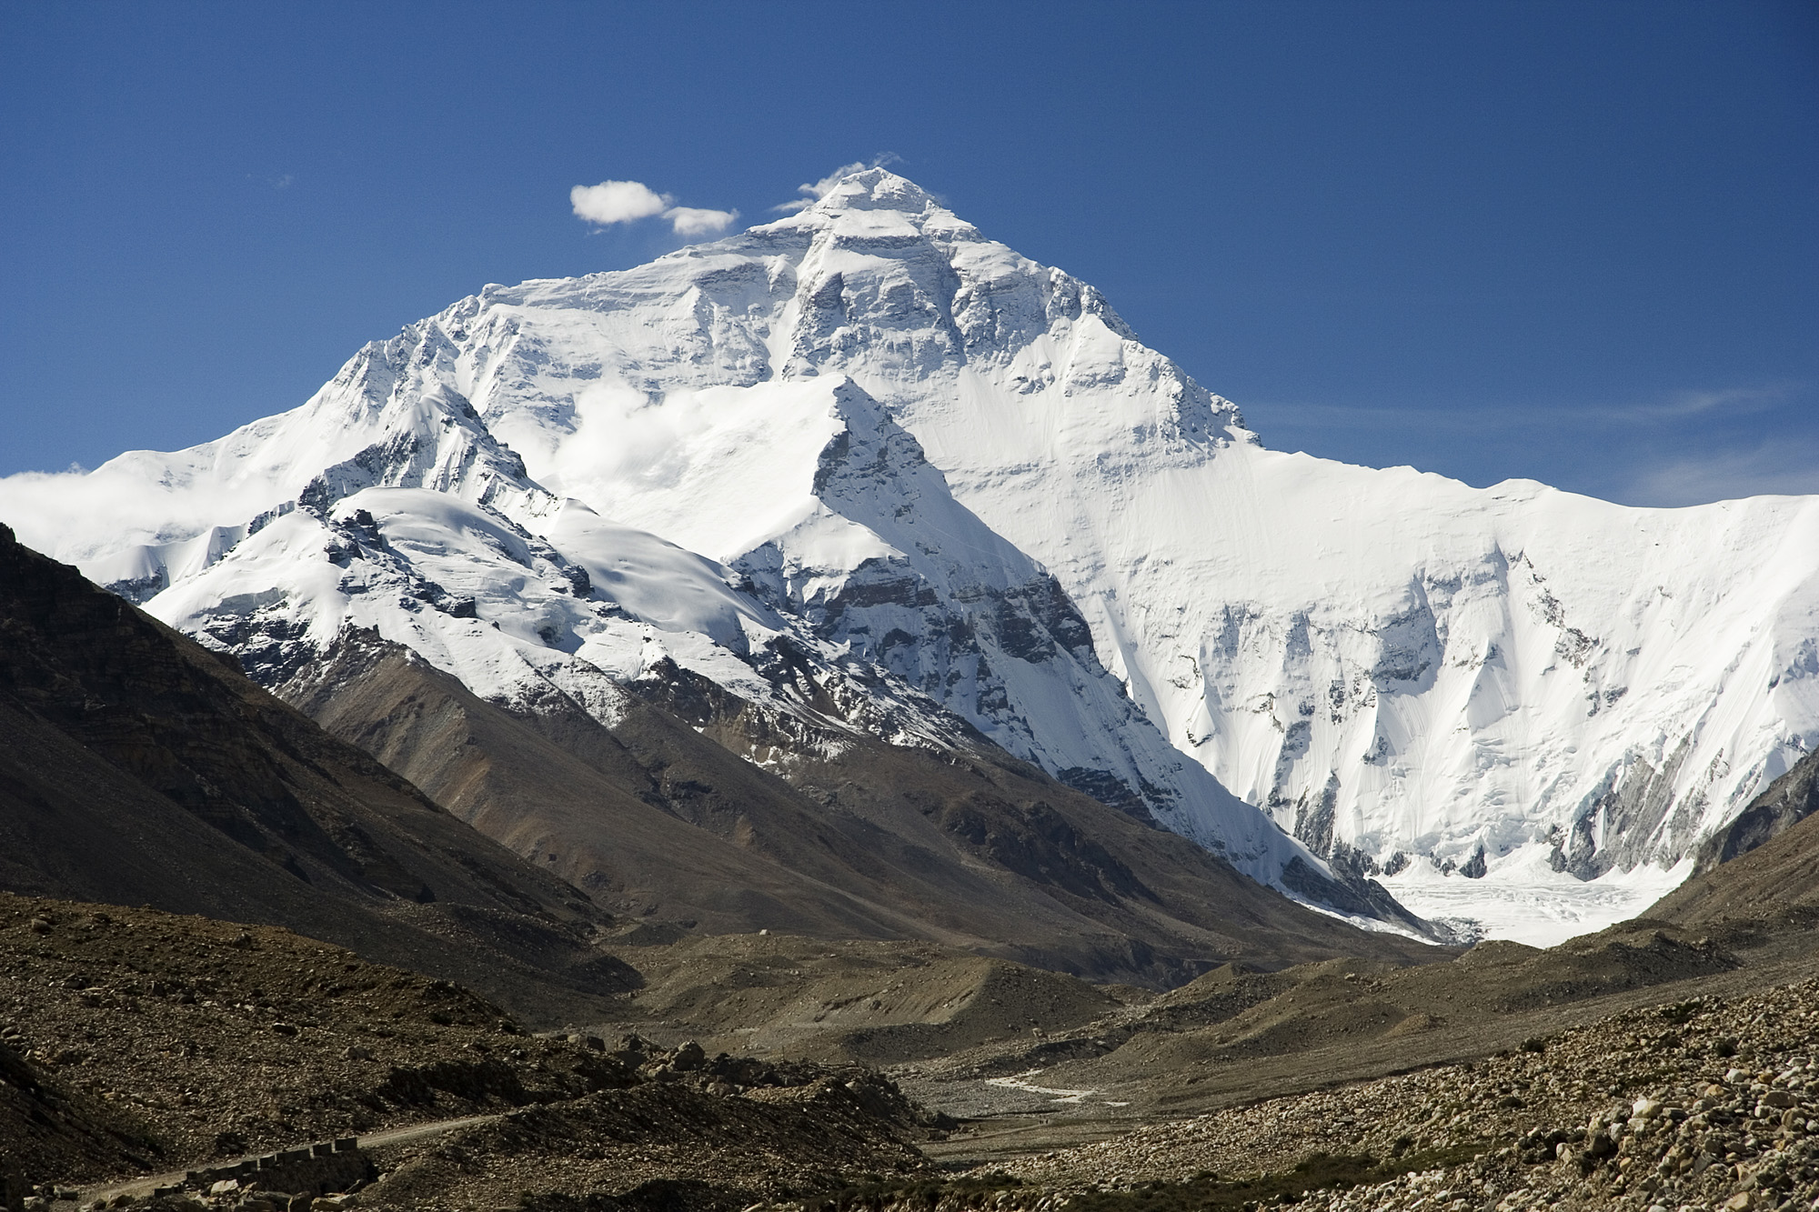
What Is The Height Of Mount Everest?

Slide 4
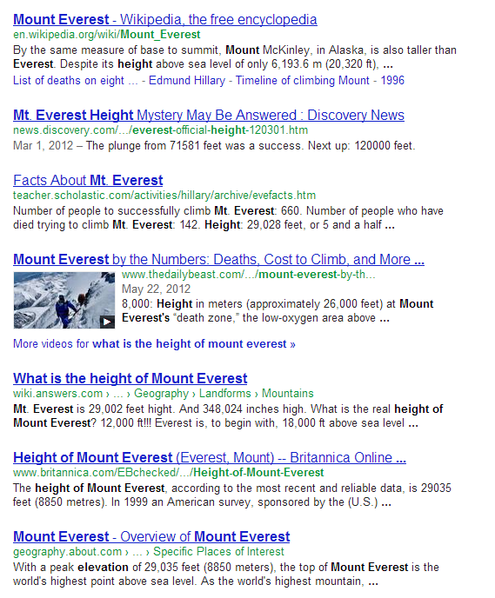

Slide 6
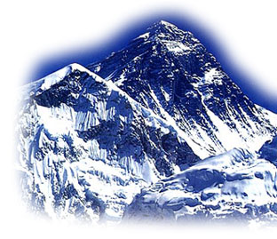
Object
Integration
Source 1
Source 2
Source 3
Source 4
Source 5

Slide 7
A Straightforward Solution
Voting/Averaging
Take the value that is claimed by majority of the sources
Or compute the mean of all the claims
Limitation
Ignore source reliability
Source reliability
Is crucial for finding the true fact but unknown

Slide 8
Truth Discovery
Principle
Infer both truth and source reliability from the data
A source is reliable if it provides many pieces of true information
A piece of information is likely to be true if it is provided by many reliable sources

Slide 9
Existing Work on Truth Discovery
Existing methods
Tackle different challenges in truth discovery
Source correlations, source costs, streaming data, ……
Limitation when handling data of various types
Apply on one type only: Not enough information to estimate source reliability accurately
Apply on all types but treat them the same way: Each data type’s characteristics are not taken into account

Slide 10
Overview of Our Work
A framework for discovering truth from data of various types
Integrate all the data of various types in truth and source reliability estimation
Take unique characteristics of data type into consideration

Slide 11
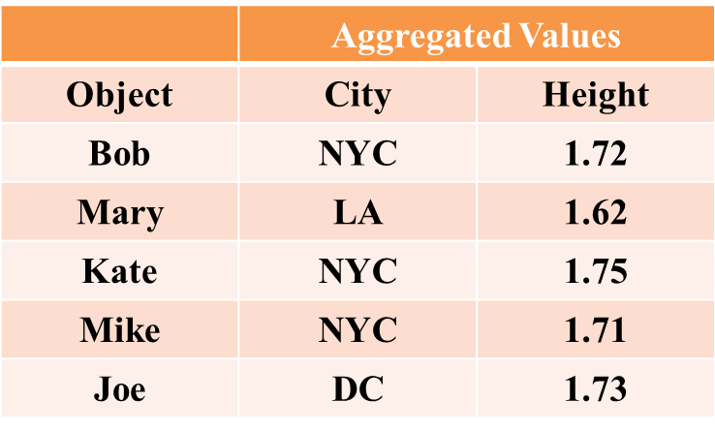
Problem Setting
 | Source $1$ |  | Source 2 |  | Source 3
Object | City | Height | City | Height | City | Height
Bob | NYC | 1.72 | NYC | 1.70 | NYC | 1.90
Mary | LA | 1.62 | LA | 1.61 | LA | 1.85
Kate | NYC | 1.74 | NYC | 1.72 | LA | 1.65
Mike | NYC | 1.72 | LA | 1.70 | DC | 1.85
Joe | DC | 1.72 | NYC | 1.71 | NYC | 1.85

Slide 12
Problem Formulation
Input
Multi-source Observations: $\{𝒳^{\left(1\right)},𝒳^{\left(2\right)},…, 𝒳^{\left(K\right)}\}$ where${ 𝒳}^{\left(k\right)}$is the collection of the observations made on all the objects by the k-th source.
Output
Truths: $𝒳^{\left(∗\right)}$
Source weights: $𝒲=\left\{w_{1},w_{2},…,w_{K}\right\}$ where $w_{k}$ is the reliability degree of the k-th source. The higher, the more reliable.

Slide 13
Further Notation
$v_{im}^{(k)}$: the observation of the m-th property for the i-th object made by the k-th source
$v_{im}^{(∗)}$: the truth of the m-th property for the i-th object

Slide 14
CRH Framework
$$\begin{matrix}\min_{𝒳^{\left(∗\right)}\text{, }𝒲} & f(𝒳^{\left(∗\right)}\text{, }𝒲\text{)=}\sum_{k=1}^{K}{w_{k}\sum_{i=1}^{N}{\sum_{m=1}^{M}{d_{m}\left(v_{im}^{(∗)},v_{im}^{(k)}\right)}}} \\ & s.t. δ\left(𝒲\right)=1, 𝒲≥0.\end{matrix}$$
Basic idea
Truths should be close to the observations from reliable sources
Minimize the overall weighted distance to the truths in which reliable sources have high weights

Slide 15
Functions
Loss function
$d_{m}$: loss on the data type of the m-th property
Output a high score when the observation deviates from the truth
Output a low score when the observation is close to the truth
Constraint function
The objective function may go to $−∞$ without constraints
Regularize the weight distribution

Slide 16
Iterative Procedure
Run the following until convergence
Truth computation
Minimize the weighted distance between the truth and the sources’ observations
$$v_{im}^{\left(∗\right)} ←\arg{\min_{v}{\sum_{k=1}^{K}{w_{k}⋅d_{m}\left(v,v_{im}^{\left(k\right)}\right)}}}$$
Source reliability estimation
Assign a weight to each source based on the difference between the truths and the observations made by the source
$$𝒲 ←\arg{\min_{𝒲}{f(𝒳^{\left(∗\right)}\text{, }𝒲\text{)}}}$$

Slide 17
Truth Computation
Categorical data type
$$d_{m}\left(v_{im}^{\left(∗\right)},v_{im}^{\left(k\right)}\right)=\left\{\begin{matrix}\begin{matrix}1 \\ 0\end{matrix} & \begin{matrix}if{ v}_{im}^{\left(k\right)}≠v_{im}^{\left(∗\right)} \\ otherwise\end{matrix}\end{matrix}\right.$$
$v_{im}^{(∗)}←$ weighted vote

Slide 18
Truth Computation
Continuous data type
$$d_{m}\left(v_{im}^{\left(∗\right)},v_{im}^{\left(k\right)}\right)=\left|v_{im}^{\left(∗\right)}−v_{im}^{\left(k\right)}\right|$$
$v_{im}^{(∗)}←$ weighted median

Slide 19
Source Weight Assignment
$$δ\left(𝒲\right)=\sum_{k=1}^{K}{exp⁡(−w_{k})}=1$$
$$w_{k}=−\log\left(\frac{\sum_{i=1}^{N}{\sum_{m=1}^{M}{d_{m}\left(v_{im}^{\left(∗\right)},v_{im}^{\left(k\right)}\right)}}}{\sum_{k^{′}=1}^{K}{\sum_{i=1}^{N}{\sum_{m=1}^{M}{d_{m}\left(v_{im}^{\left(∗\right)},v_{im}^{\left(k^{′}\right)}\right)}}}}\right)$$

Slide 20
 | $$𝒳^{(1)}$$ |  | $$𝒳^{(2)}$$ |  | $$𝒳^{(3)}$$
Object | City | Height | City | Height | City | Height
Bob | NYC | 1.72 | NYC | 1.70 | NYC | 1.90
Mary | LA | 1.62 | LA | 1.61 | LA | 1.85
Kate | NYC | 1.74 | NYC | 1.72 | LA | 1.65
Mike | NYC | 1.72 | LA | 1.70 | DC | 1.85
Joe | DC | 1.72 | NYC | 1.71 | NYC | 1.85
Input

Slide 21
 | $$𝒳^{(1)}$$ |  | $$𝒳^{(2)}$$ |  | $$𝒳^{(3)}$$
Object | City | Height | City | Height | City | Height
Bob | NYC | 1.72 | NYC | 1.70 | NYC | 1.90
Mary | LA | 1.62 | LA | 1.61 | LA | 1.85
Kate | NYC | 1.74 | NYC | 1.72 | LA | 1.65
Mike | NYC | 1.72 | LA | 1.70 | DC | 1.85
Joe | DC | 1.72 | NYC | 1.71 | NYC | 1.85
Input
 | Initialization
Object | City | Height
Bob | NYC | 1.77
Mary | LA | 1.69
Kate | NYC | 1.70
Mike | DC | 1.76
Joe | NYC | 1.76
Initialize by Voting or Averaging
Truth

Slide 22
 | $$𝒳^{(1)}$$ |  | $$𝒳^{(2)}$$ |  | $$𝒳^{(3)}$$
Object | City | Height | City | Height | City | Height
Bob | NYC | 1.72 | NYC | 1.70 | NYC | 1.90
Mary | LA | 1.62 | LA | 1.61 | LA | 1.85
Kate | NYC | 1.74 | NYC | 1.72 | LA | 1.65
Mike | NYC | 1.72 | LA | 1.70 | DC | 1.85
Joe | DC | 1.72 | NYC | 1.71 | NYC | 1.85
Input
 | Initialization
Object | City | Height
Bob | NYC | 1.77
Mary | LA | 1.69
Kate | NYC | 1.70
Mike | DC | 1.76
Joe | NYC | 1.76
Initialize by Voting or Averaging
Truth
Weight | Iteration 1
Source 1 | 0.2789
Source 2 | 0.2521
Source 3 | 0.1318
$$w_{k}=−\log\left(\frac{\sum_{i=1}^{N}{\sum_{m=1}^{M}{d_{m}\left(v_{im}^{\left(∗\right)},v_{im}^{\left(k\right)}\right)}}}{\sum_{k^{′}=1}^{K}{\sum_{i=1}^{N}{\sum_{m=1}^{M}{d_{m}\left(v_{im}^{\left(∗\right)},v_{im}^{\left(k^{′}\right)}\right)}}}}\right)$$
Source
Weight

Slide 23
 | $$𝒳^{(1)}$$ |  | $$𝒳^{(2)}$$ |  | $$𝒳^{(3)}$$
Object | City | Height | City | Height | City | Height
Bob | NYC | 1.72 | NYC | 1.70 | NYC | 1.90
Mary | LA | 1.62 | LA | 1.61 | LA | 1.85
Kate | NYC | 1.74 | NYC | 1.72 | LA | 1.65
Mike | NYC | 1.72 | LA | 1.70 | DC | 1.85
Joe | DC | 1.72 | NYC | 1.71 | NYC | 1.85
Input
 | Initialization |  | Iteration 1
Object | City | Height | City | Height
Bob | NYC | 1.77 | NYC | 1.72
Mary | LA | 1.69 | LA | 1.62
Kate | NYC | 1.70 | NYC | 1.72
Mike | DC | 1.76 | NYC | 1.72
Joe | NYC | 1.76 | NYC | 1.72
$$v_{im}^{∗}←\text{weighted} \text{voting}$$
$$\text{or} \text{weighted} \text{median}$$
Truth
Weight | Iteration 1
Source 1 | 0.2789
Source 2 | 0.2521
Source 3 | 0.1318
$$w_{k}=−\log\left(\frac{\sum_{i=1}^{N}{\sum_{m=1}^{M}{d_{m}\left(v_{im}^{\left(∗\right)},v_{im}^{\left(k\right)}\right)}}}{\sum_{k^{′}=1}^{K}{\sum_{i=1}^{N}{\sum_{m=1}^{M}{d_{m}\left(v_{im}^{\left(∗\right)},v_{im}^{\left(k^{′}\right)}\right)}}}}\right)$$
Source
Weight

Slide 24
 | $$𝒳^{(1)}$$ |  | $$𝒳^{(2)}$$ |  | $$𝒳^{(3)}$$
Object | City | Height | City | Height | City | Height
Bob | NYC | 1.72 | NYC | 1.70 | NYC | 1.90
Mary | LA | 1.62 | LA | 1.61 | LA | 1.85
Kate | NYC | 1.74 | NYC | 1.72 | LA | 1.65
Mike | NYC | 1.72 | LA | 1.70 | DC | 1.85
Joe | DC | 1.72 | NYC | 1.71 | NYC | 1.85
Input
 | Initialization |  | Iteration 1
Object | City | Height | City | Height
Bob | NYC | 1.77 | NYC | 1.72
Mary | LA | 1.69 | LA | 1.62
Kate | NYC | 1.70 | NYC | 1.72
Mike | DC | 1.76 | NYC | 1.72
Joe | NYC | 1.76 | NYC | 1.72
$$v_{im}^{∗}←\text{weighted} \text{voting}$$
$$\text{or} \text{weighted} \text{median}$$
Truth
Weight | Iteration 1 | Iteration 2
Source 1 | 0.2789 | 0.5552
Source 2 | 0.2521 | 0.4539
Source 3 | 0.1318 | 0.0149
Source
Weight

Slide 25
 | $$𝒳^{(1)}$$ |  | $$𝒳^{(2)}$$ |  | $$𝒳^{(3)}$$
Object | City | Height | City | Height | City | Height
Bob | NYC | 1.72 | NYC | 1.70 | NYC | 1.90
Mary | LA | 1.62 | LA | 1.61 | LA | 1.85
Kate | NYC | 1.74 | NYC | 1.72 | LA | 1.65
Mike | NYC | 1.72 | LA | 1.70 | DC | 1.85
Joe | DC | 1.72 | NYC | 1.71 | NYC | 1.85
Input
 | Initialization |  | Iteration 1 |  | Iteration 2
Object | City | Height | City | Height | City | Height
Bob | NYC | 1.77 | NYC | 1.72 | NYC | 1.72
Mary | LA | 1.69 | LA | 1.62 | LA | 1.62
Kate | NYC | 1.70 | NYC | 1.72 | NYC | 1.74
Mike | DC | 1.76 | NYC | 1.72 | NYC | 1.72
Joe | NYC | 1.76 | NYC | 1.72 | DC | 1.72
Truth
Weight | Iteration 1 | Iteration 2
Source 1 | 0.2789 | 0.5552
Source 2 | 0.2521 | 0.4539
Source 3 | 0.1318 | 0.0149
Source
Weight

Slide 26
 | $$𝒳^{(1)}$$ |  | $$𝒳^{(2)}$$ |  | $$𝒳^{(3)}$$
Object | City | Height | City | Height | City | Height
Bob | NYC | 1.72 | NYC | 1.70 | NYC | 1.90
Mary | LA | 1.62 | LA | 1.61 | LA | 1.85
Kate | NYC | 1.74 | NYC | 1.72 | LA | 1.65
Mike | NYC | 1.72 | LA | 1.70 | DC | 1.85
Joe | DC | 1.72 | NYC | 1.71 | NYC | 1.85
Input
 | Initialization |  | Iteration 1 |  | Iteration 2 |  | Iteration 3 |  | Iteration 4
Object | City | Height | City | Height | City | Height | City | Height | City | Height
Bob | NYC | 1.77 | NYC | 1.72 | NYC | 1.72 | NYC | 1.72 | NYC | 1.72
Mary | LA | 1.69 | LA | 1.62 | LA | 1.62 | LA | 1.62 | LA | 1.62
Kate | NYC | 1.70 | NYC | 1.72 | NYC | 1.74 | NYC | 1.74 | NYC | 1.74
Mike | DC | 1.76 | NYC | 1.72 | NYC | 1.72 | NYC | 1.72 | NYC | 1.72
Joe | NYC | 1.76 | NYC | 1.72 | DC | 1.72 | DC | 1.72 | DC | 1.72
Truth
Weight | Iteration 1 | Iteration 2 | Iteration 3 | Iteration 4
Source 1 | 0.2789 | 0.5552 | 0.6734 | 0.6734
Source 2 | 0.2521 | 0.4539 | 0.4077 | 0.4077
Source 3 | 0.1318 | 0.0149 | 0.0141 | 0.0141
Source
Weight

Slide 27
Experiment Evaluation
Performance Measure
Error rate: for categorical data type
Mean normalized absolute distance (MNAD): for continuous data type
The lower the better for both

Slide 28
Data Sets
Weather Forecast Data
We crawled temperature and weather condition from various platforms for 20 cities over a month
Stock Data and Flight Data
Different properties about stocks crawled from various websites
Departure and arrival time and gate information crawled from various websites
Available at http://lunadong.com/fusionDataSets.htm
UCI Adult and Bank Data
We simulate multiple conflicting sources by injecting different levels of noise on original data

Slide 29
Baseline Methods
Applied to one type only
Categorical data only: Voting
Continuous data only: Mean, Median, GTM
Applied to multiple types
Investment, PooledInvestment, 2-Estimates, 3-Estimates, TruthFinder, AccuSim

Slide 30
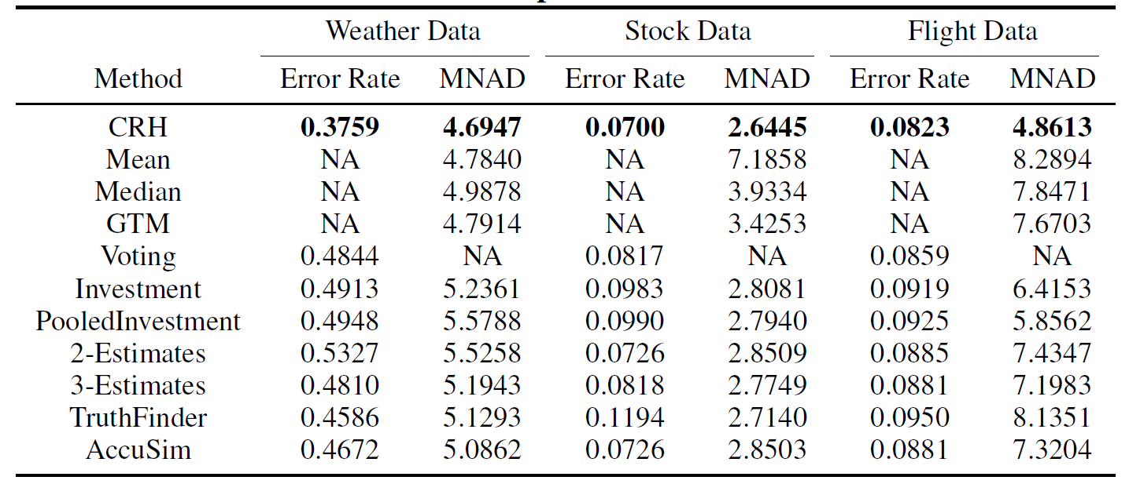
Performance Comparison

Slide 31
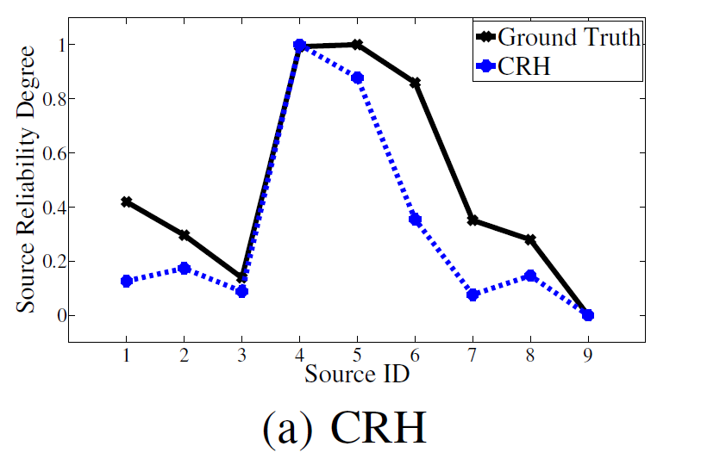
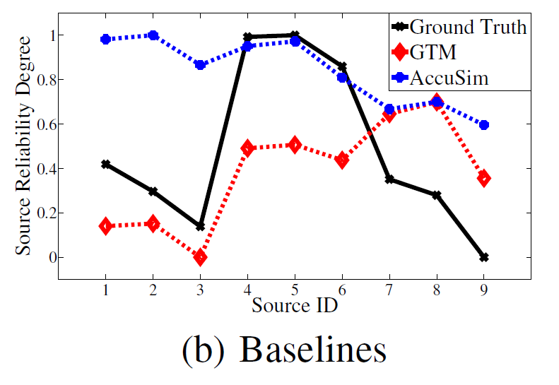
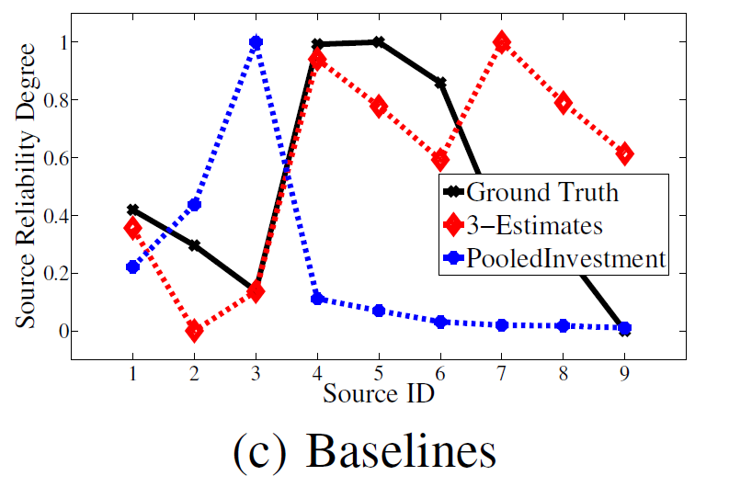
CRH derives better estimates of source reliability by effectively characterizing different data types in a joint model

Slide 32
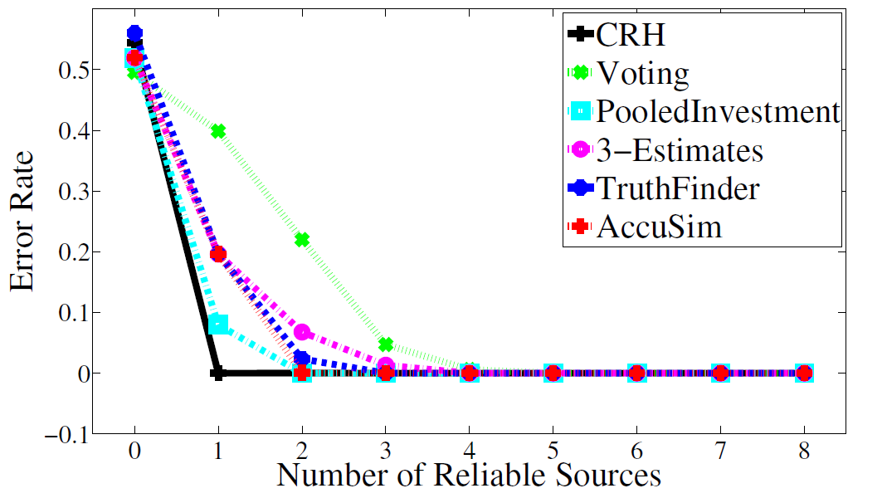
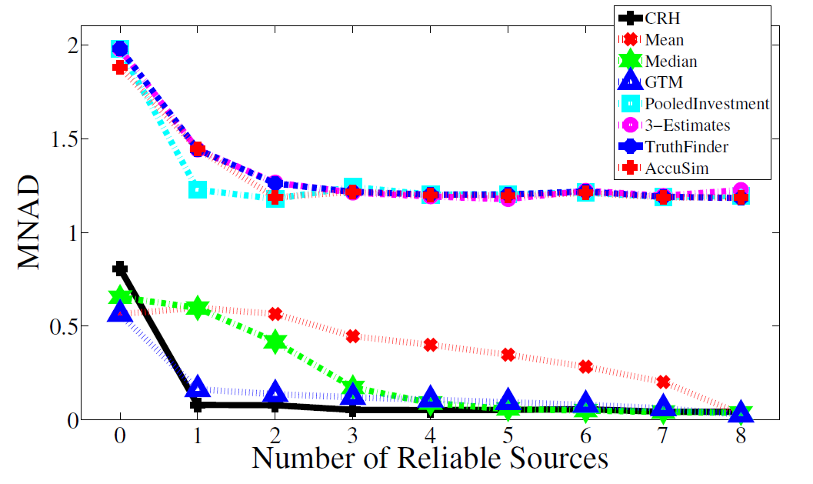
Varying Number of Reliable Sources
Categorical
data
Continuous data
Continuous
data

Slide 33
Summary
Truth Discovery on Heterogeneous Data
Provide a nice way to combine data of various types when deriving source weights and truths
Present several common loss functions and effective solutions under this framework
Unique characteristics of each data type are considered, and all types contribute to source reliability estimation together
This joint inference improves source reliability estimation and leads to better truth discovery on heterogeneous data
Slides, code and datasets available
http://www.cse.buffalo.edu/~jing

Slide 34
Thank You!

