Slide 1
R primer

Slide 2
What is < R >
It is a programing language and environment
for statistical computing and graphics (!)
It is similar to S (called these days S-Plus; not to be confused with SAS; SPSS)
a script from S can more or less spin in R, after a few alteration
It provides a wide variety of statistical and graphical techniques
linear and nonlinear modelling
statistical tests
time series analysis
classification
clustering
and other goodies

Slide 3
What is < R >
I like acronyms, especially when they are used as substitute for a word!
What does < R > mean?
Most likely, it is a play of words on < S-Plus >, its bigger brother
some say it instead acknowledge the founders of R
Ross Ihaka and Robert Gentleman (University of Auckland, New Zealand)

Slide 4
R is very much a vehicle for newly developing methods of interactive data analysis
It has developed rapidly and has been extended by a large collection of packages

Slide 5
All of it functionalities are nested in packages
either part of the < core >
or developed by various individuals (such as the R luminescence package)
However, most programs written in R are essentially ephemeral,
written for a single piece of data analysis
hence, if the code says version 1.0, and has not been updated in the past two years, chances are its developer has moved on!

Slide 6
user may only interact in the < console >, and < script >, to a certain degree

Slide 7
Script window
I strongly encourage you to place your coded lines in the < script > window
it is possible to execute a line of code directly in the < console > window
the console window is a very busy place
this is where you execute individual lines of codes
the textual output is also presented here
with the script window, you may only place lines of codes
along with comments
it is easily preserved and saved for future sessions
you can easily replicate what you previously did
the console window is therefor less cluttered

Slide 8
R console window
x <- rnorm(50)
y <- rnorm(x)
Generate two pseudo-random normal vectors of x- and y-coordinates
plot(x, y)
a scatter plot
A graphics window will appear automatically
ls()
See which R objects are now in the R workspace
rm(x, y)
Remove objects no longer needed
always a good idea to pick up after yourself!

Slide 9
help is (probably) on the way
Yes, there is a manual for the luminescence package: about 300 pages
You must know the coded speak of R, however, to properly understand the manual!
within the R console window:
help(MyFunctionName)
?MyFunctionName
with the mouse, you can browse your way to the MyFunctionName, from the luminescence package

Slide 10
case sensitive
< A > and < a > will refer to different variables
recall and correction of previous commands
vertical arrow keys on the keyboard can be used to scroll forward and backward through a < command history >, within the < console > window
as you type in the < console > window, possible words (existing variable names, function, …) will be suggested to you
hashtag, #, is a codename indicating that a < comment > follows, to its right
always a good idea to insert comments, to explain what you are doing
it is for you, also. For next week, to recall why you did that!

Slide 11
Executing commands from or diverting output to a file
source(“myCommands.R")
If myCommands is stored in an external file, in the < working directory >
you can directly < source > a script from the < script > window
sink(“myOutput.lis")
will divert all subsequent output from the < console > to an external file, myOutput.lis
sink()
will restore output to the console window

Slide 12
Excel versus R
Excel operates with cells, located in a spreadsheet
only one value (i.e. a single number) can be inserted in a cell
mathematical operations are performed on one cell at a time
R operates with vectors and matrices
a vector is a single entity consisting of an ordered collection of elements
e.g. the natural shine down curve
a matrix is a container for 2 or more vectors, of same length
all dose with Lx/Tx ratio
mathematical operations are performed on vector(s)
calculate the Lx/Tx ratios, from a set of Lx and Tx
Excel can emulate a vector, by defining an < array >, but still remains a one for one number operator

Slide 13
number (Excel) versus vector (R)
handling one number at a time is conceptually easier to comprehend
performing a math operation on vectors is immensely faster!

Slide 14
assignment statement
x <- c(10, 5, 3, 6, 21)
This is an < assignment statement > using the function c() (concatenating)
which in this context can take an arbitrary number of vector arguments and whose value is a vector got by concatenating its arguments end to end.
<-
assignment operator
it ‘points’ to the object receiving the value of the expression
In most contexts the ‘=’ operator can be used as an alternative

Slide 15
Vector arithmetic: addition
in R, console window
x <- seq(from = 1, to = 10, by = 2) # generate a sequence of number
[1] 1 3 5 7 9
z <- x + 2
[1] 3 5 7 9 11
y <- seq(from = 2, to = 10, by = 2)
[1] 2 4 6 8 10
z <- x + y
[1] 3 7 11 15 19

Slide 16
Vector arithmetic: multiplication
x <- rep(x = 2, time = 5) # replicate a number
[1] 2 2 2 2 2
z <- x * 2
[1] 4 4 4 4 4
y <- seq(from = 2, to = 10, by = 2)
[1] 2 4 6 8 10
z <- x * y
[1] 4 8 12 16 20

Slide 18
analyst
you may ride the bike on your own
but remember to read the instruct manual
111 pages, for the latest version 4.57 (2018)

Slide 19
Analyst, version 4.57 (November 2018)
for the latest version
http://users.aber.ac.uk/ggd/
it used to be here. There are other software update on their website
https://www.nutech.dtu.dk/english/products-and-services/radiation-instruments/tl_osl_reader/software

Slide 20
excel

Slide 21
honorable mention
compilation of various data analytical software
http://ancienttl.org/software.htm
including the latest entry: LDAC
nested within Excel (relies on VBA)
will not calculate the De,
but basically does everything else that comes after that

Slide 22
R

Slide 23
where to get it
https://cran.r-project.org/
for the latest R (version 3.6.1, July 5 2019)
https://www.rstudio.com/products/rstudio/download/
for the latest Rstudio (version 1.2.1335, April 8 2019)
https://cran.r-project.org/web/packages/Luminescence/index.html
for the latest R Luminescence package (v. 0.9.3, July 31 2019)
https://cran.r-project.org/web/packages/Luminescence/news/news.html
documents what was changed

Slide 25
Basic keywords in R
number
vector
list
matrix
array
data.frame
object
in Rstudio
data
values

Slide 26
error code
the luminescence package is not automatically loaded into memory, when you open R
> BINfile <- read_BIN2R(file)
Error in read_BIN2R(file) : could not find function "read_BIN2R“
Instead, we have to explicitly load the package first so that R can actually find the function. The common way to do this is by using the function library(), which only requires the name of the package to be loaded.
> library(Luminescence)

Slide 27
workspace
it is your work environment, in R
it contains
scripts, currently open
an R workspace can be saved and loaded from the file menu
and any time you close the console, R will ask you if you want to save the workspace

Slide 28
file path (working directory)
When you think about it, very little tools are found in R
Almost everything is provided in the form of packages
You need to tell R where to find your data, the functions
library(Luminescence)
this will load the luminescence package in active memory
for the data, a simple way is to put your data in the < working directory >
there always is a default working directory
it can be changed

Slide 29
file path (working directory)
in RStudio
if you want to permanently change the default working directory
find your shortcut for Rstudio (from your Windows menu of software/apps)
change the "Start in" field to your preferred folder
during your active session, you can still change (temporarily) the active working directory

Slide 30
how to bring data into R
bin/binx/xsyg
read_BIN2R()
read_XSYG2R()
option: fastForward = TRUE
txt file
File/Import Dataset (RStudio)
copy/paste
read.table("clipboard")
file.choose()
choose.files()

Slide 31
objects in the luminescence packages
Risoe.BINfileData
the BIN/BINx file, transposed into R
RLum.Analysis
a way to uniformize the source data (BIN/BINx/XSYG) into a common format that the luminescence package can more easily decipher
RLum.Data.Curve
this is the data structure that contains the actual luminescence signal and time (or temperature, for TL) data
RLum.Results
the name says it!

Slide 32
your raw bin file, on the computer (YourFile.binx)
converted to Risoe.BINfileData
converted to RLum.Analysis
or
read_BIN2R(YourFile, fastForward = TRUE)
will bypass Risoe.BINfileData object and directly provide you with RLum.Analysis object

Slide 33
bin/binx and XSYG
read_BIN2R()
read_XSYG2R()
remember to convert into a RLum.Analysis class object
before using any of the luminescence package analytical tools

Slide 34
accessing information
$
[]
[[]]
get_RLum()

Slide 35
creating a subset
a bin file typically records OSL and TL measurements, together
bin <- read_BIN2R(MyFileName)
say, you would like to only see the OSL curves
bin_OSL <- subset(bin, LTYPE == "OSL")
or only OSL records from POSITION 3
bin_OSL_3 <- subset(bin, POSITION == 3 & LTYPE == "OSL")
POSITION, LTYPE, …
these are the keywords used by the BINX file to record the metadata information for each record

Slide 36
creating a subset
subset is more easily performed on the Risoe.BINfileData object
it is organized by recorded number (just like the bin file, when you open it in Analyst
RLum.Analysis object
the data (OSL, TL, IRSL, …) are grouped by POSITION number

Slide 37
creating a subset
bin <- read_BIN2R(MyFileName)
rlum <- Risoe.BINfileData2RLum.Analysis(bin)
to extract all IRSL curves
bin_IRSL <- lapply(rlum, function(x) subset(x, LTYPE == "IRSL"))
or only the IRSL curve for position 3
bin_IRSL <- lapply(rlum, function(x) subset(x, LTYPE == "IRSL"))[[2]]
the measured aliquots occupied odd positions numbers in the Risoe
the RLum.Analysis object with merely list them as 1, 2, 3, …, for the explicitly purpose of grouping them. The POSITION number is still present, deeply nested with the Rlum.Analysis OBJECT structure. Thus, not easily accessible from the outside.
awkward, if you ask me!

Slide 38
creating a subset
extract fifth CW-OSL curve of the third aliquot
cw_curve <- get_RLum(subset(rlum[[3]], LTYPE == "OSL"))[[5]]
again, [[3]] does not explicitly refers to < position > 3
rather, it points to the 3rd entry in the < rlum > Rlum.Analysis OBJECT
rlum is an object that groups together OSL, IRSL, TL, … records, performed on the same position
the [[3]] will point to that order, inside the < rlum > list.
awkward, if you ask me!

Slide 39
creating a subset
easier to extract records from a Risoe.BINfileData
then convert to RLum.Analysis
bin <- read_BIN2R(MyFileName)
bin_OSL <- subset(bin, LTYPE == "OSL")
rlum_OSL <- Risoe.BINfileData2RLum.Analysis(bin_OSL)

Slide 40
Combining .BIN(X) files
yes, it is possible with the Luminescence package
my advise to you: it is easier to combine with Analyst. But if you insist
get multiple files names
Myfiles <- list.files(path = ".", pattern = ".binx")
choose.files()
combine into a single object
rlums <- lapply(Myfiles, function(file) read_BIN2R(file, fastForward = TRUE))
rlum <- unlist(rlums)
well, at least this is how the Germans wrote it. I do not have a proper example to show. From what I have seen, my advise, again, is to combine via Analyst

Slide 41
function: how to pass data to it
in programming, you use functions to incorporate sets of instructions that you want to use repeatedly or that, because of their complexity, are better self-contained in a sub program and called when needed.
A function is a piece of code written to carry out a specified task; it can or can not accept arguments or parameters and it can or can not return one or more values.

Slide 42
function: how to pass data to it
in R
function (arglist) {body}
where the code in between the curly braces {} is the body of the function
Note that by using built-in functions (such as those found in the Luminescence package), the only thing you need to worry about is how to effectively communicate the correct input arguments (arglist) and manage the return value(s), if there are any.

Slide 43
function: how to pass data to it
read_BIN2R
Import Risø BIN/BINX-files into R
Usage
read_BIN2R(file, show.raw.values = FALSE, position = NULL, n.records = NULL, zero_data.rm = TRUE, duplicated.rm = FALSE, fastForward = FALSE, show.record.number = FALSE, txtProgressBar = TRUE, forced.VersionNumber = NULL, ignore.RECTYPE = FALSE, pattern = NULL, verbose = TRUE, ...)
the (arglist), the argument list, is everything that lies between the ()

Slide 44
function: how to pass data to it
read_BIN2R(file, show.raw.values = FALSE, position = NULL, n.records = NULL, zero_data.rm = TRUE, duplicated.rm = FALSE, fastForward = FALSE, show.record.number = FALSE, txtProgressBar = TRUE, forced.VersionNumber = NULL, ignore.RECTYPE = FALSE, pattern = NULL, verbose = TRUE, ...)
when passing data to a function (e.g. read_BIN2R)
they will be tied to each of these arguments, starting from the 1st on the list, and working its way down the list
for example
read_BIN2R(myFileName)
myFileName is implicitly given to the 1st available argument on the list, < file >

Slide 45
function: how to pass data to it
for example
read_BIN2R(myFileName)
myFileName is implicitly given to the 1st available argument on the list, < file >
read_BIN2R(file = “myFileName”)
myFileName is explicitly given to the < file > argument

Slide 46
function: how to pass data to it
read_BIN2R(file, show.raw.values = FALSE, position = NULL, n.records = NULL, zero_data.rm = TRUE, duplicated.rm = FALSE, fastForward = FALSE, show.record.number = FALSE, txtProgressBar = TRUE, forced.VersionNumber = NULL, ignore.RECTYPE = FALSE, pattern = NULL, verbose = TRUE, ...)
read_BIN2R(myFileName, fastForward = TRUE)
myFileName is passed to the 1st available argument
TRUE is explicitly passed to fastForward

Slide 47
function: how to pass data to it
read_BIN2R(file, show.raw.values = FALSE, position = NULL, n.records = NULL, zero_data.rm = TRUE, duplicated.rm = FALSE, fastForward = FALSE, show.record.number = FALSE, txtProgressBar = TRUE, forced.VersionNumber = NULL, ignore.RECTYPE = FALSE, pattern = NULL, verbose = TRUE, ...)
not all arguments need to be specified when calling a function
here, only < file > needs to be specified
all other arguments in the list have a predefined value, =
...
further arguments that will be passed to another function
here, this other function is Risoe.BINfileData2RLum.Analysis

Slide 48
error code
be prepared to use an abundant supply of patience.
handling errors in R is an art
it requires a lot of skill
for R provides little help, up front
best solution: take a step back, to a place where it worked. And advance slowly, one step at a time, toward where you want to go
Office Space (1999)

Slide 49
error code
there is a lot of resources on the internet
such as Reddit
you may also directly reach out to someone else
IMPORTANT: please, provide that person with a detail explanation of the problem (scripts, variables, binx). If we can recreate your error, then it is easier to be of concrete help
Office Space (1999)

Slide 50
error code: luminescence package
R is very unfriendly, when it encounters an error
it will stop, providing an error message
in most cases, it is unhelpful, in figuring out the cause
various functions in the luminescence package have < integrity checks >
it verifies that you are providing data that makes senses
if it fails the integrity checks, the function returns a message
it helps a lot to read, once more, the description of the function, to make sense of the message
these < integrity checks > do not verify each and every possible scenario of abuse that YOU might think of!

Slide 52
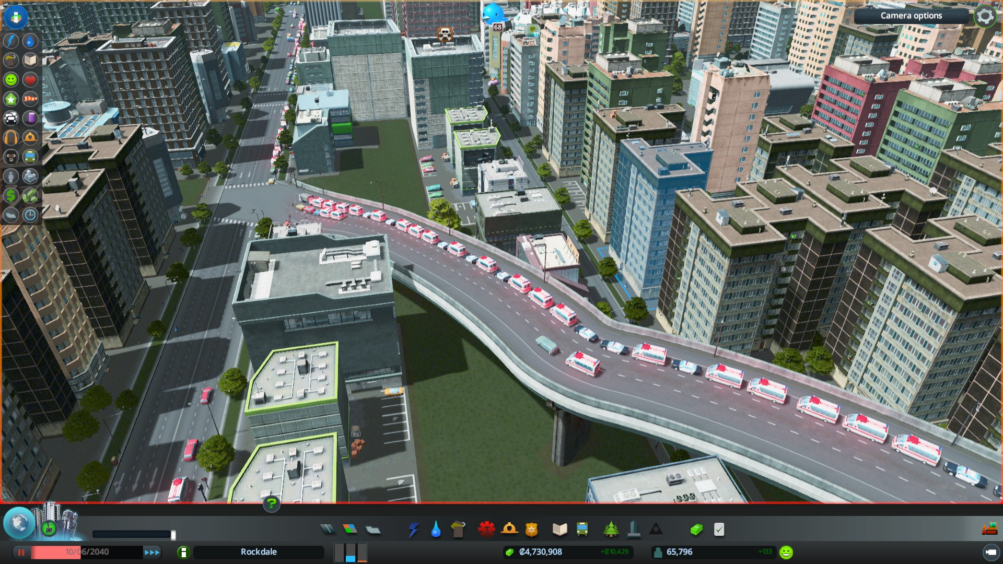

Slide 53
